Slide 1
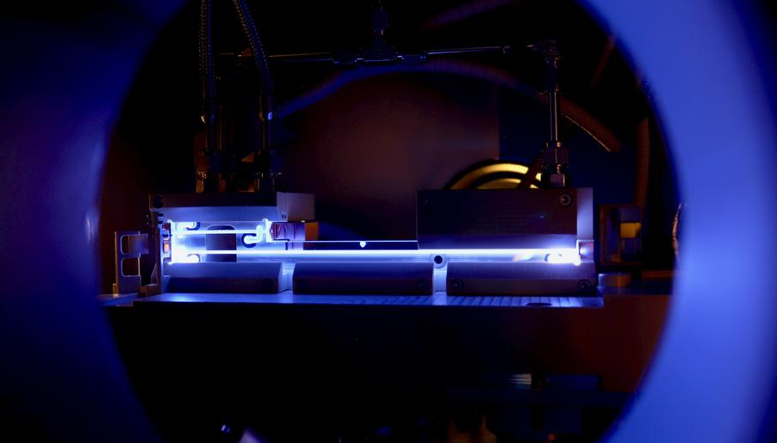
R&D Roadmap of the European Particle Physics Strategy
Update on Plasma Accelerator R&D
ALEGRO Workshop 2024
For the whole Plasma Accelerators team:
Instituto Superior Técnico
Lisbon | Portugal
19th March 2024
Wim Leemans | Accelerator Division | DESY
Rajeev Pattathil | STFC UKRI | RAL
wim.leemans@desy.de
rajeev.pattathil@stfc.ac.uk

Slide 2
Progress towards a pre-CDR ‘HALHF 2.0’ is gathering pace
WP1.1: Overall Collider Concepts (R. D’Arcy, C.A. Lindstrøm, B. Foster)
Recent progress:
  Collaboration
    Monthly meeting of scientists (plasma, RF, detector/physics, positrons, etc.) meet monthly to discuss themes, including other collider concepts (e.g. proton-driven)
  Optimisation
    Community engagement has made progress in answering some questions (RF, plasma parameters, etc.) but posed some more (flat beams)
  Upgrades
    Upgrade paths for polarised positrons, higher energies (380 GeV, 1 TeV), multiple IPs, & γ–γ collisions
  Towards a pre-CDR
    ‘Experts meeting’ at Erice, Sicily from Oct 3-8 (funded by INFN) to solidify the pre-CDR design
Reference: Lindstrøm, D'Arcy, Foster, arXiv:2312.04975 (2024)

Slide 3
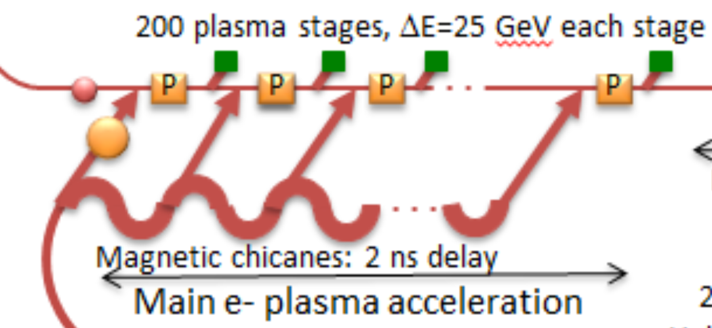
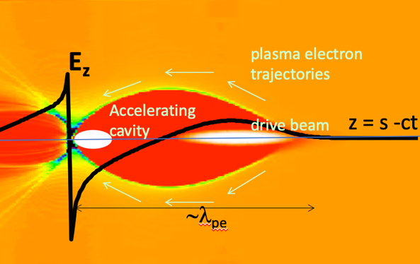
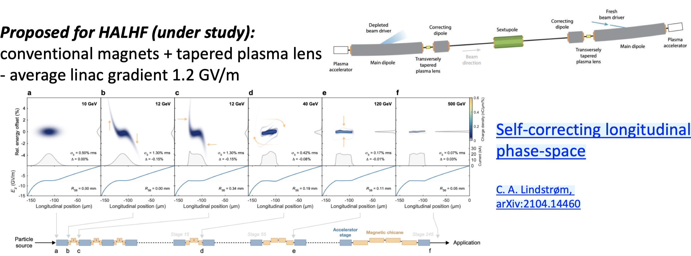
Progress towards a pre-CDR ‘HALHF 2.0’ is gathering pace
WP1.2: Beam-driven electron linacs (Erik Adli, Carl Lindstrøm)
  Simulations to underpin HALHF design
  Develop single stage and interstage models with all the relevant physics needed
  Tolerance checks/self-correction concepts
Single-stage physics
Drive beam generation and distribution
Carl Lindstrøm’s ERC grant : Staging of Plasma Accelerators for Realizing Timely Applications

Slide 4
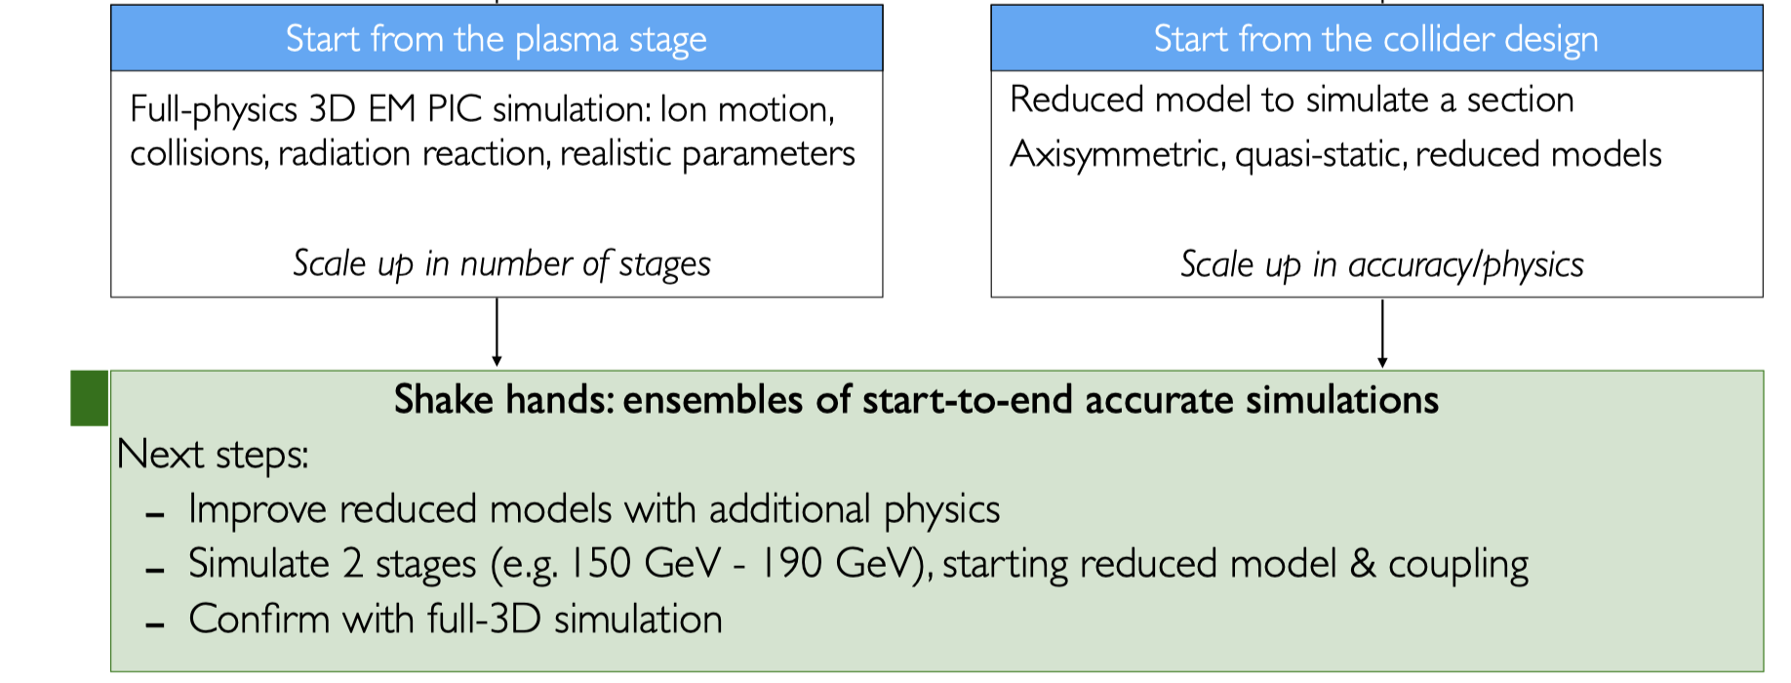
Feasibility studies for future upgrades
  WP 1.3: Laser-driven electron linacs (Jorge Viera, Maxence Thévenet, Brigitte Cros, Zulfikar Najmudin)
  Looking out for fundamental show-stoppers
  Improving reduced models with additional physics
  Simulate 2 stages, starting with reduced model & coupling and conﬁrm with full-3D simulation
  Could underpin future plasma-based collider designs/upgrades to HALHF
  Experimental verification via 2.4 and in-kind contributions at LPA facilities
Common topics:
Pre- and post-driver plasma modeling
Multi-time and length scales
Radiation and mass transport
Ionization and MHD
Heat management
Dedicated funding source yet to be identified

Slide 5
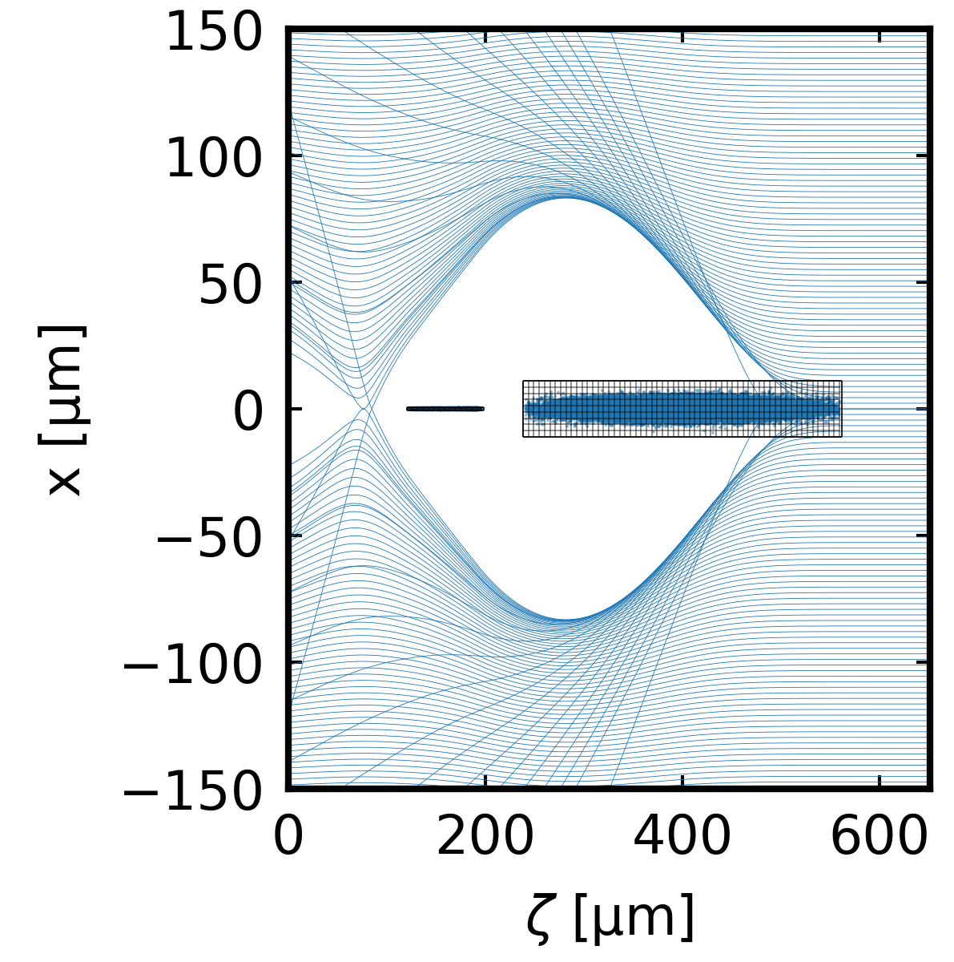
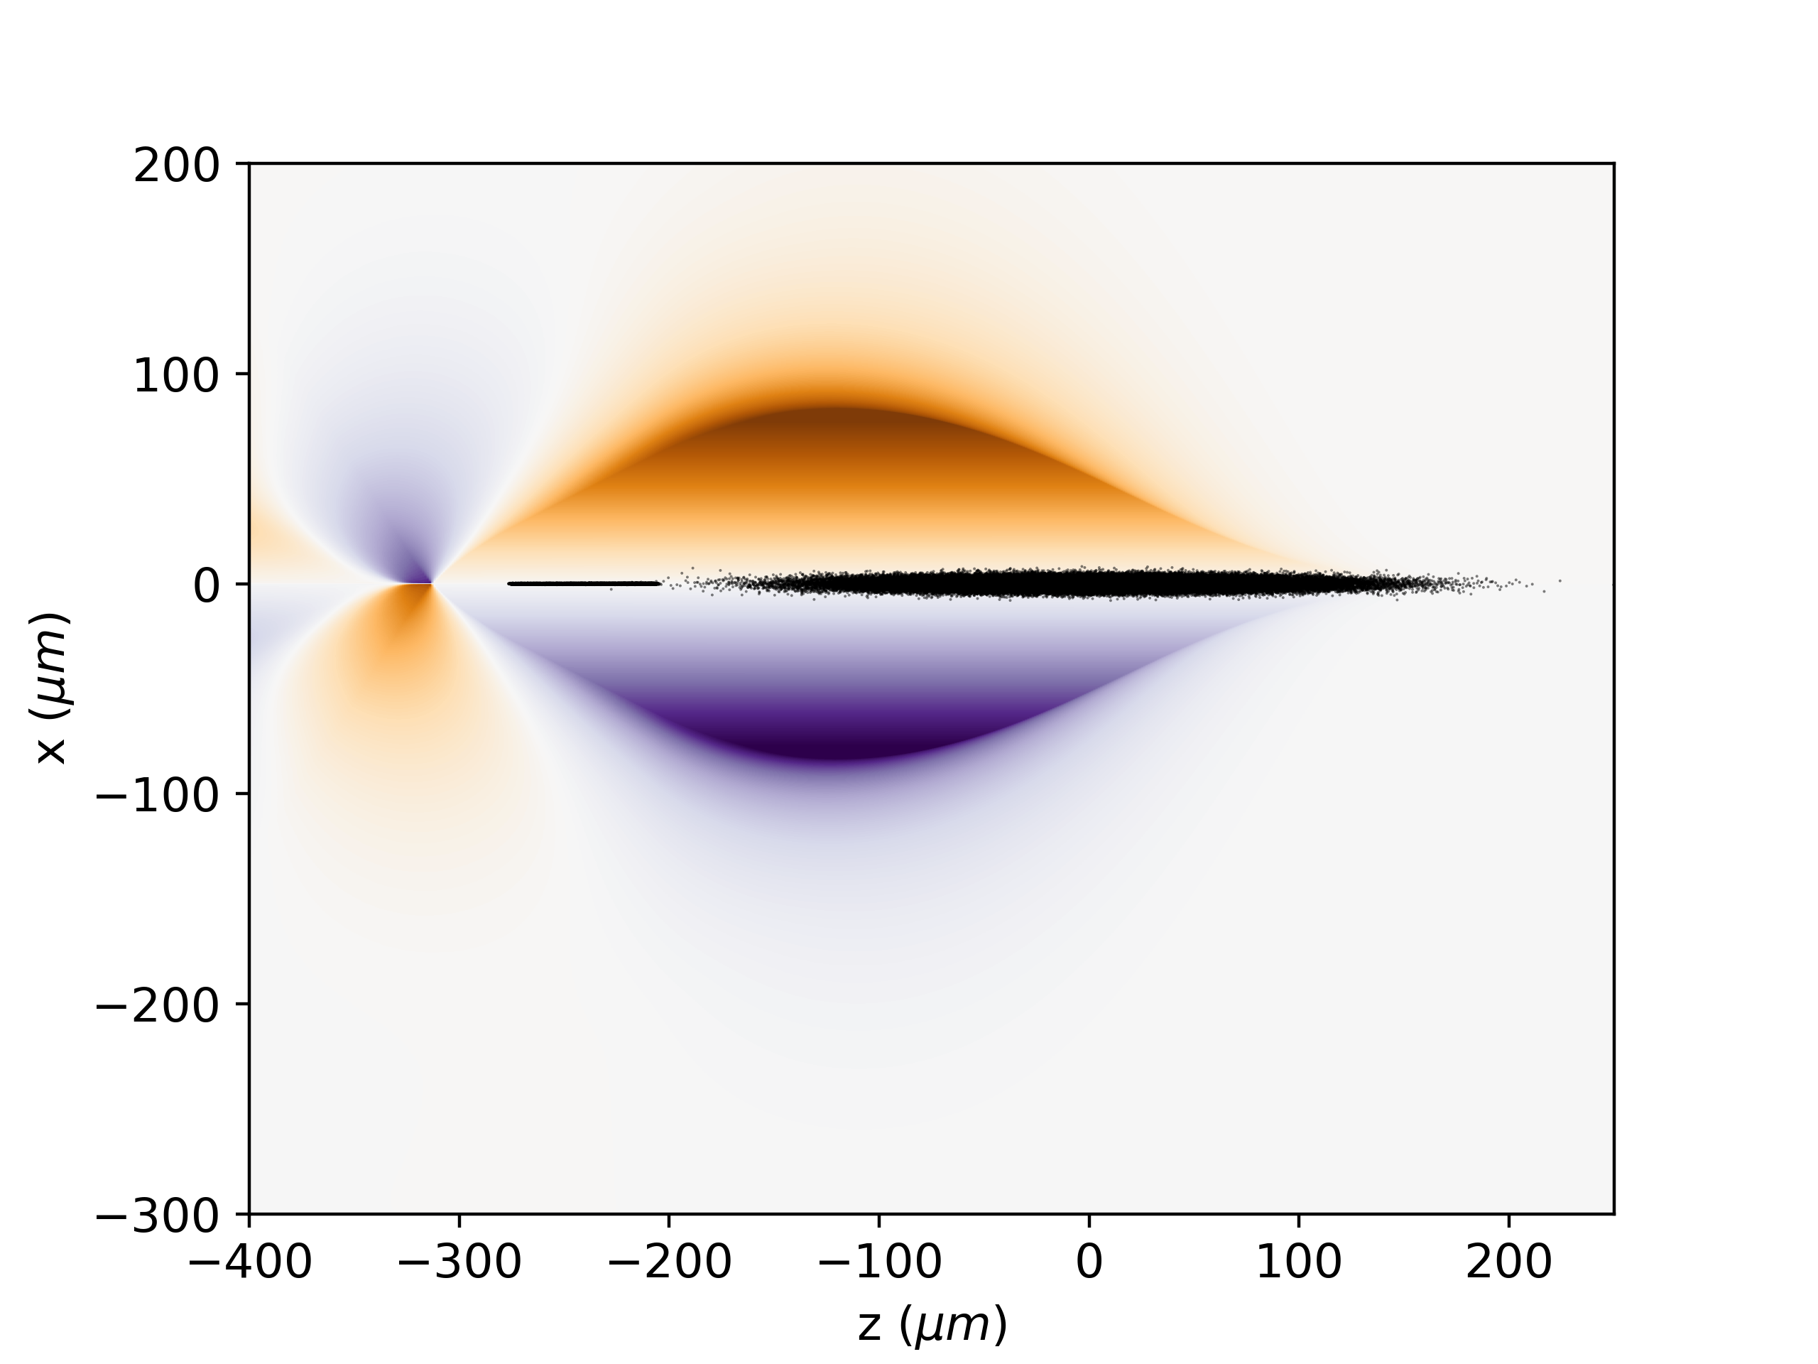
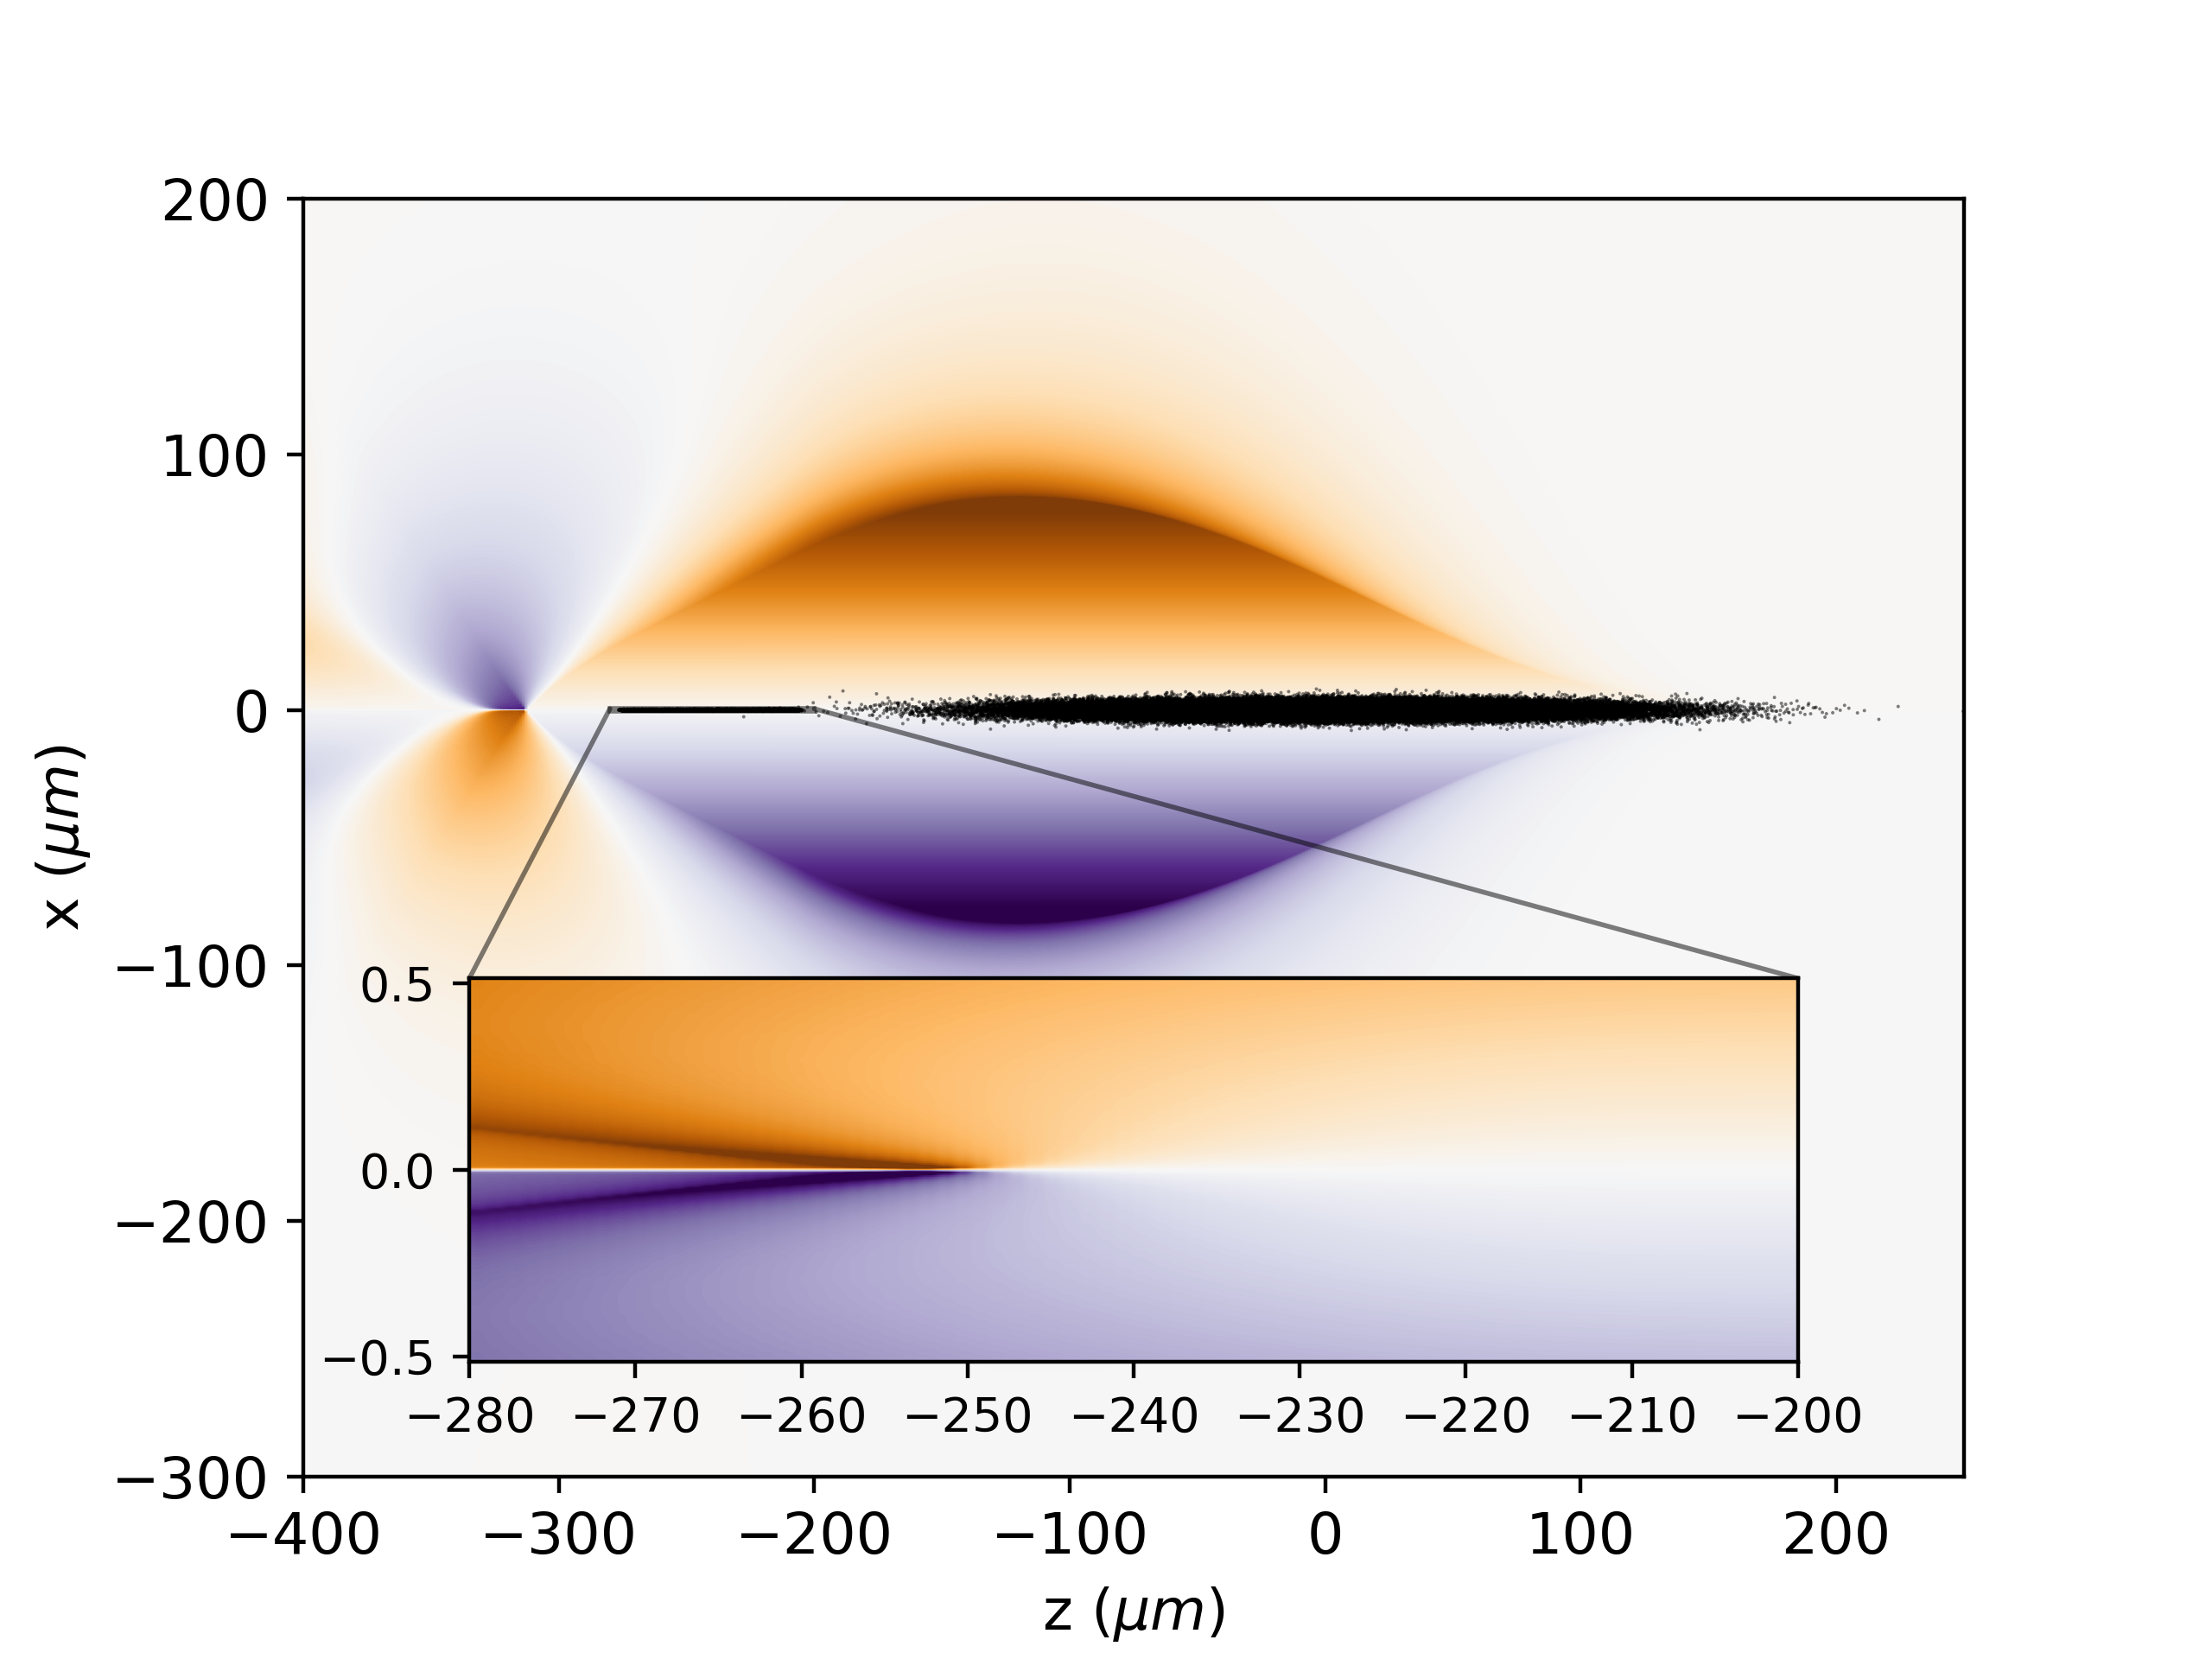
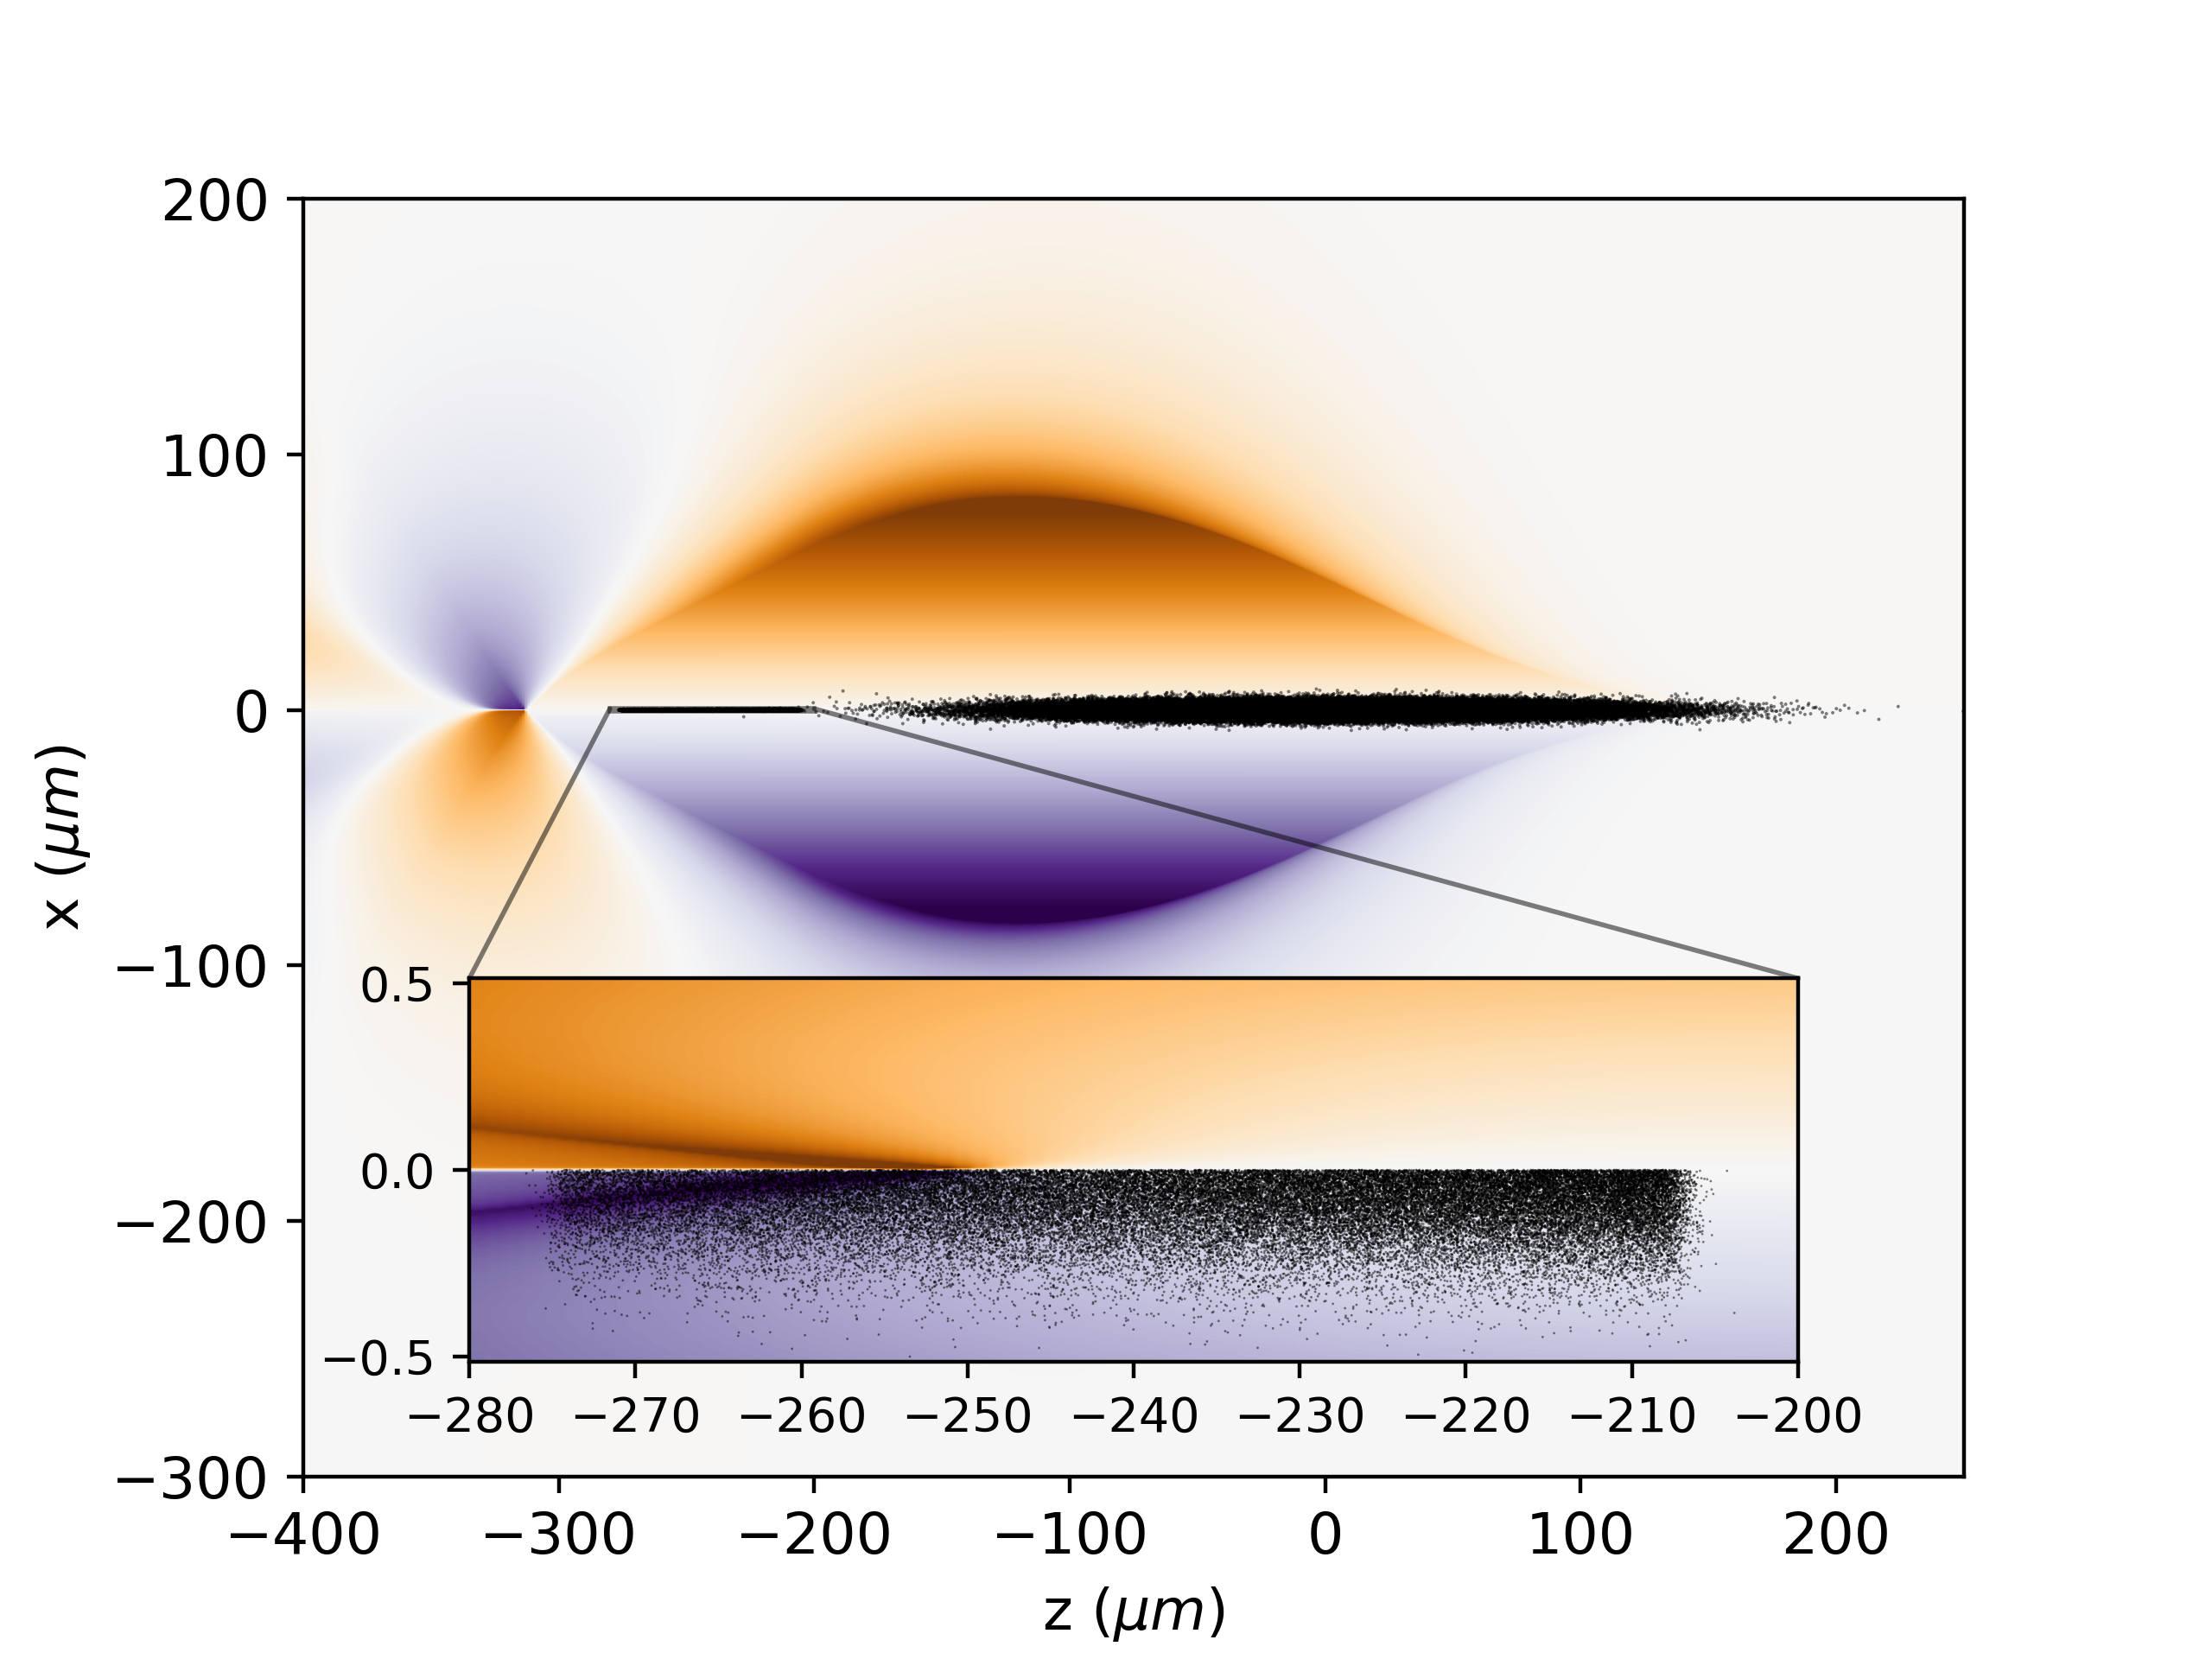
100 nm-emittance beams can now be simulated with open-source codes
  WP 1.3: Laser-driven electron linacs (Jorge Viera, Maxence Thévenet, Brigitte Cros, Zulfikar Najmudin)
Adaptive grid
in Wake-T [1]
Adaptive grid method in Wake-T allows for fully converged simulations of beams with nanometer-scale emittance including ion motion, on a laptop [1].
Mesh refinement in HiPACE++ makes such simulations in 3D (very) affordable.
Optimization with Optimas [3] (see S. Diederichs’ presentation).
OSIRIS now running on GPU: 1D/2D/3D Cartesian, tile-based dynamic load-balancing, many features already compatible [4].
Mesh refinement in HiPACE++ [2]
 | Single GPU [ns / push] | Single CPU [ns / push] | Single-proc speedup
2D | 0.085 | 60 | 700
3D | 0.14 | 90 | 640
OSIRIS performance on GPU
[1] https://github.com/AngelFP/Wake-T , manuscript in preparation
[2] https://github.com/Hi-PACE/hipace, manuscript in preparation
[3] A. Ferran Pousa et al., PRAB 26, 084601 (2023), https://github.com/optimas-org/optimas
[4] R. Lee et al., in preparation.

Slide 6
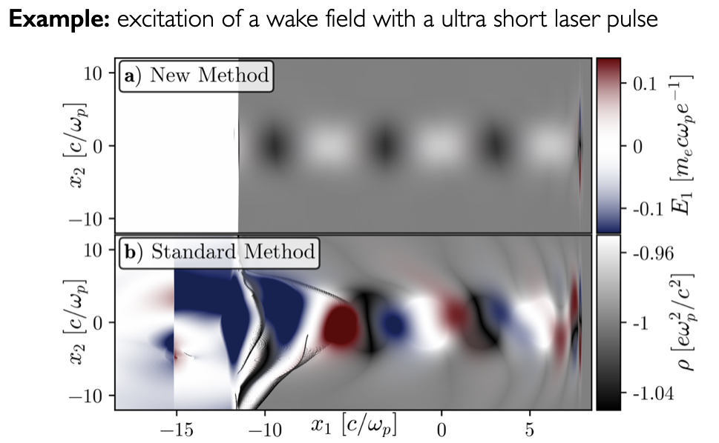
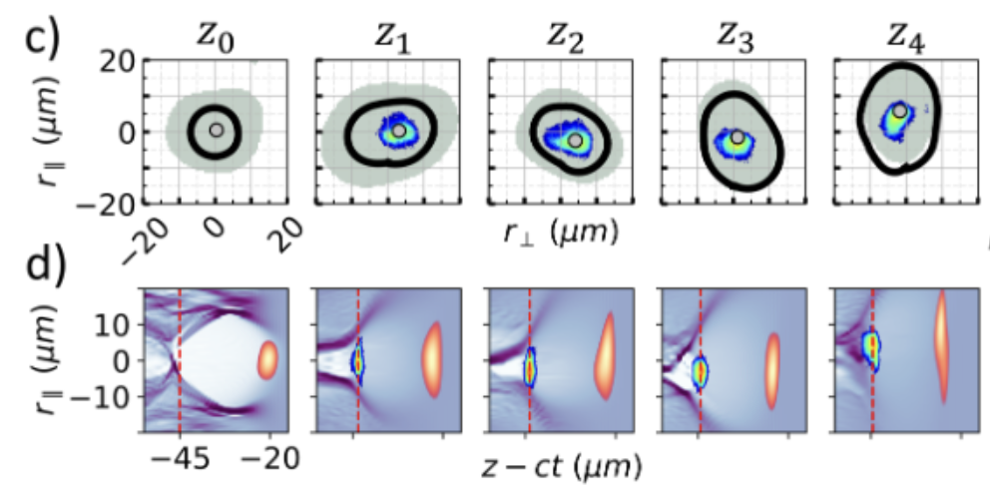
Asymmetric laser energy distributions have strong impact on LWFA
  WP 1.3: Laser-driven electron linacs (Jorge Viera, Maxence Thévenet, Brigitte Cros, Zulfikar Najmudin)
Exact laser-injection algorithm in OSIRIS: beyond paraxial and envelope approximations, arbitrary profiles, can reconstruct laser profile from measurements (see R. Almeida’s poster) [1].
PIC simulations with laser profiles reconstructed from experimental measurements:
  Novel GSA-MD algorithm [2,3] from fluence measurements.
  General implementation in open-source library LASY [4].
Combination of envelope model+PML+B-TIS3 in the Smilei code for quick and accurate long distance simulations, boosted frame implementation (in progress).
Wakefield driven by a single-cycle laser pulse [1]
Coupling of laser energy into accelerator stages and optimizing targetry to simplify electron beam transfer between stages.
Strongly driven laser stages may provide higher acceleration better beam preservation.
Bubble border
Laser transverse shape
Asymmetric Laser Pulse
[1] R. Almeida et al., in preparation
[2] I. Moulanier et al., Phys. Plasmas 30, 053109 (2023); I. Moulanier et al., J. Opt. Soc. Am. B 40(9), 2450-2461 (2023).
[3] submitted to the EAAC23 Proceedings.
[4] https://github.com/LASY-org/lasy
Electron Beam
Laser reconstructed from fluence measurements through GSA-MD algorithm [2]

Slide 7
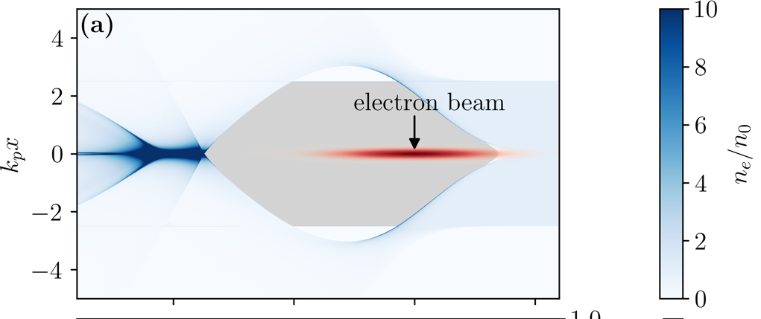
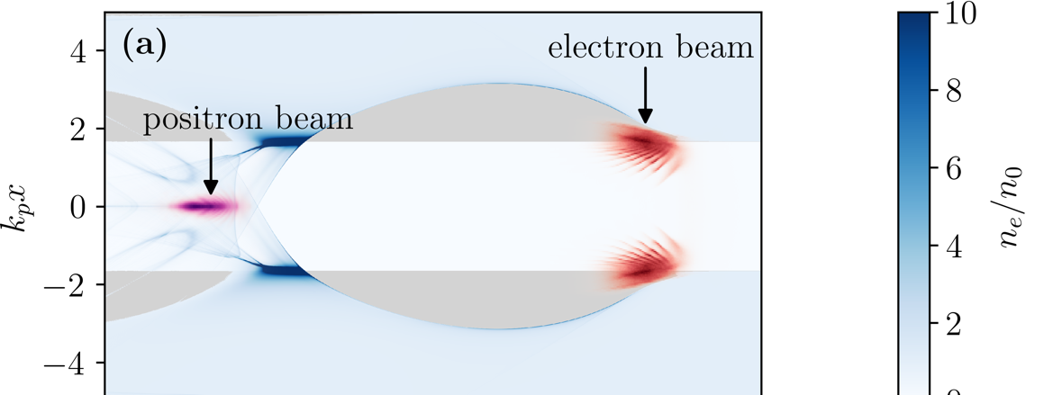
Plasma-based acceleration of positrons: significant progress
A titanic task, but with new exciting and promising results
  WP 1.4: Positron acceleration (Gianluca Sarri, Severin Diederichs)
NUMERICAL / THEORETICAL WORK
- GPU-capable PIC codes with mesh refinement allow modeling of positron acceleration with collider-relevant parameters.
- Several acceleration schemes numerically identified, such as hollow plasma channels¹ and finite plasma columns².
- Temperature effects shown to enable emittance preservation of collider-relevant positron beams³.
a)
Courtesy of T. Silva and J. Vieira
b)
c)
EXPERIMENTAL WORK
To date, only SLAC can study positron acceleration⁴
Promising results in the generation of high-quality
laser-driven positron beams have been obtained⁵
[1] Phys. Rev. Lett. 127, 104801 (2021)
[2] Phys. Rev. Accel. Beams 23, 121301 (2020)
[3] Phys. Plasmas 30, 073104 (2023)
[4] ArXiv:2304.01700 (2023)
[5] Sci. Rep. 10.1038/s41598-024-56281-1 (2024)

Slide 8
Plasma-based acceleration of positrons: lots of work still to do!
Specific investment in both experimental and numerical work is urgently required
  WP 1.4: Positron acceleration (Gianluca Sarri, Severin Diederichs)
NUMERICAL / THEORETICAL WORK
Extensive and programmatic simulation work needed to optimize plasma-based positron acceleration schemes and to study tolerances/stability etc. etc.
Development of new schemes still needs work.
EXPERIMENTAL WORK
Programmatic and extensive experimental work needed to validate acceleration models and study real-life effects.
Develop and operate a range of dedicated positron sources that can enable both laser- and beam-driven studies and study their efficiency, sustainability, tolerances, stability…
Dedicated laboratories being designed (e.g. EuPRAXIA, EPAC, DESY…) but funding required for their realization and operation.
Form well-funded consortia able to bring together laser, plasma, and accelerator physicists.
Priorities remain unchanged but, without funding, further progress will be limited!

Slide 9
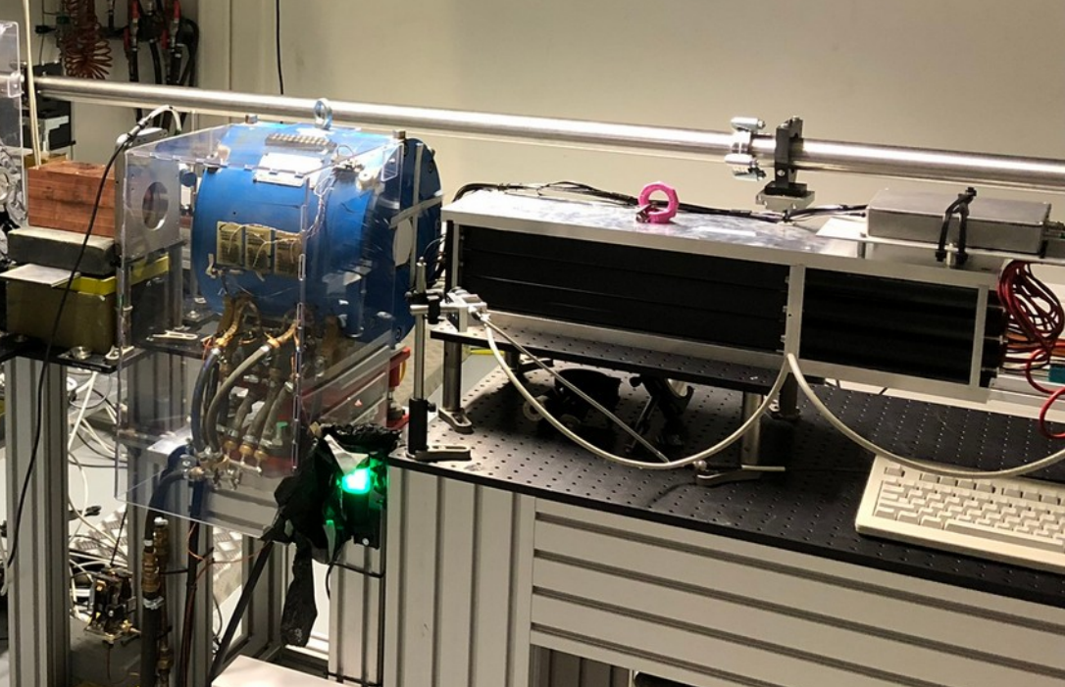
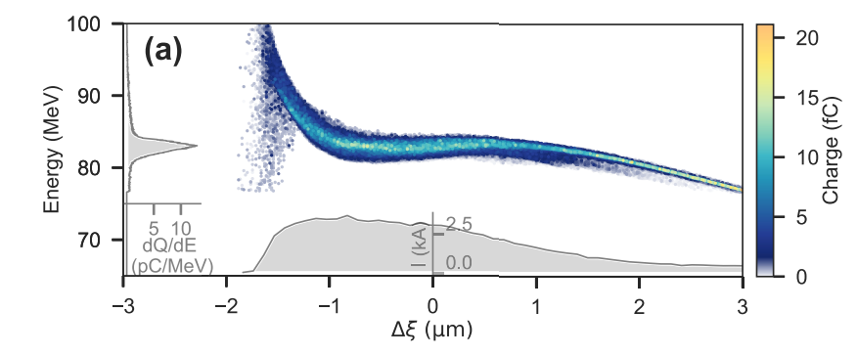
Tools and concepts being developed for studies of spin-polarisation preservation in plasmas
WP 1.5 coordinated by Kristjan Põder (DESY)
LEAP project at DESY
  Commissioned 100-MeV level electron polarimeter with unpolarised beams
  Developed high-fidelity polarised injection scheme [1]
Spin tracking recently integrated into HiPACE++
  Large 3D plasma-booster spin-preservation studies
Started first HALHF stage polarisation preservation simulations
Funding needed (min. 2 postdocs)
90% pol. beam
[1] S. Bohlen et al., Phys. Rev. R 5, 033205 (2023)
Notes:
Top right: picture of custom-built electron polarimeter in 28M Bond lab.
Top right Graph: preliminary analysis of the measured beam polarization. The beam was unpolarized, so the result should be 0.
Bottom right: comparison of spin depolarisation in FBPIC and HiPACE++, showing excellent agreement.
Bottom middle: Plot from Ref [1], showing the phase-space of a high-quality, highly polarised (>90%) electron beam from an LPA.

Slide 10
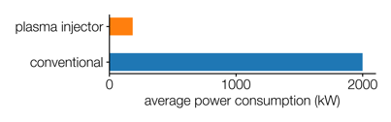
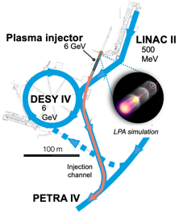
Sustainability must be at the centre of all designs – a dedicated session tomorrow
WP 1.7 coordinated by Denise Voelker (DESY) & Marlene Turner (CERN)
Development of guidelines that allow comparison of the environmental impact of the proposed HALHF and ILC Higgs-factory design.
  Community outreach to gather reliable data from similar previous projects and synergistic efforts (e.g. CLIC efforts, iFAST,...).
Application of the developed guidelines for the environmental impact comparison of the HALHF and ILC Higgs-factory proposal.
A facility-wide energy consumption assessment for electron, proton and laser drivers.
Communicate, share and spread analysis results. Establish platforms that enable networking, exchanges and cooperation between accelerator physics, other scientific areas and industry.
Identify highest impact R&D that would allow to reduce the environmental footprint of future accelerators.
250-350 kW (estimate)

Slide 11
WP2.1:High-repetition rate laser-driven plasma module (coordination)
WP 2.1 coordinated by Leo Gizzi, Andi Maier and Paul Mason
Joint workshop to develop concepts and carry out research focusing on inter-stage technology.
Coordinated effort on high-rep rate laser-driven LPA is a core activity of current EuPRAXIA Preparatory Phase
An EuPRAXIA_PP Workshop will take place on 22-27 September 2024 in Elba, Italy
We plan to propose a three-day meeting on High Rep Rate LPA Satellite Meeting at the EuPRAXIA Workshop
Progress on high-rep rate lasers
High average power beam trasport and optics
Gas targets for 100 Hz operation and beyond
Control system and active stabilization
Machine learning optimisation techniques
High rep-rate data handling
Radioprotection at high rep-rate
…
Proposal will be sent shortly to the EuPRAXIA_PP Workshop Scientific Programme Committee
Currently relying on ancillary funds (for R&D towards plasma-based light sources)
Notes:
This WP coordinates all the efforts on high-rep rate laser-driven plasma accelerators (eg. lasers, plasma targets and facility integration). This would also involve strong partnerships with industries, in order to improve the TRL of laser-based solutions.

Slide 12
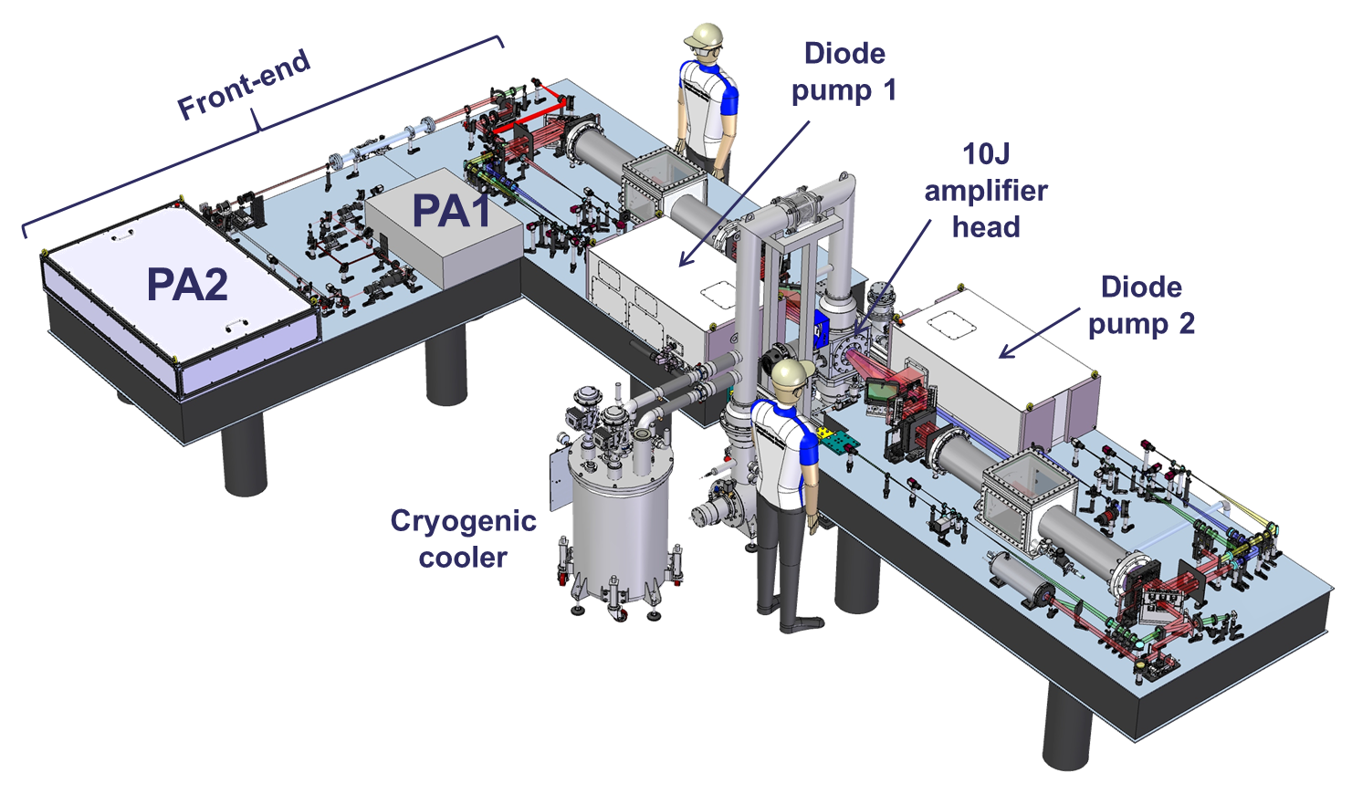
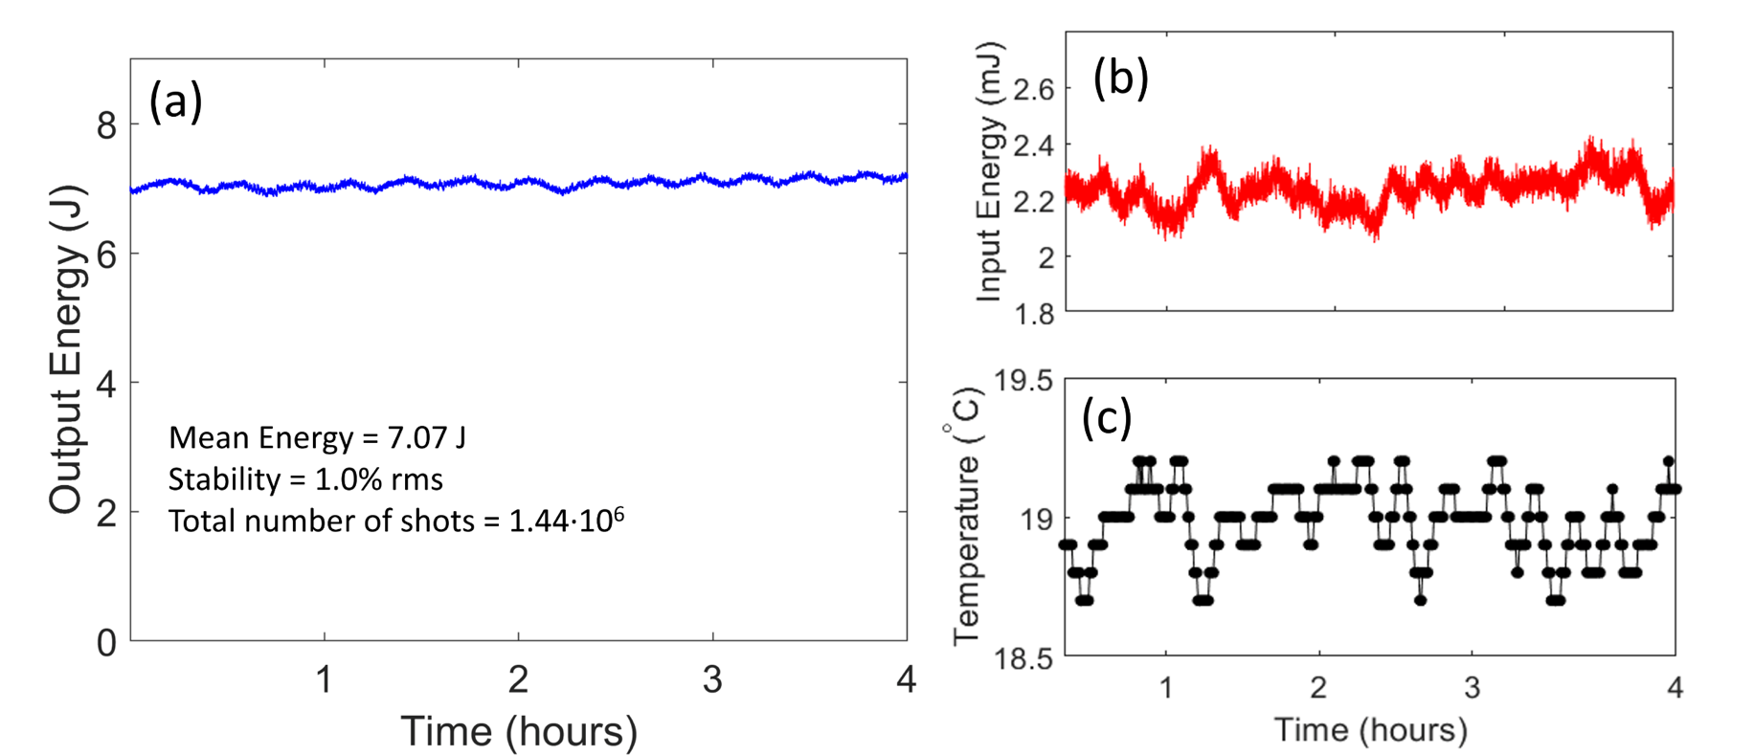

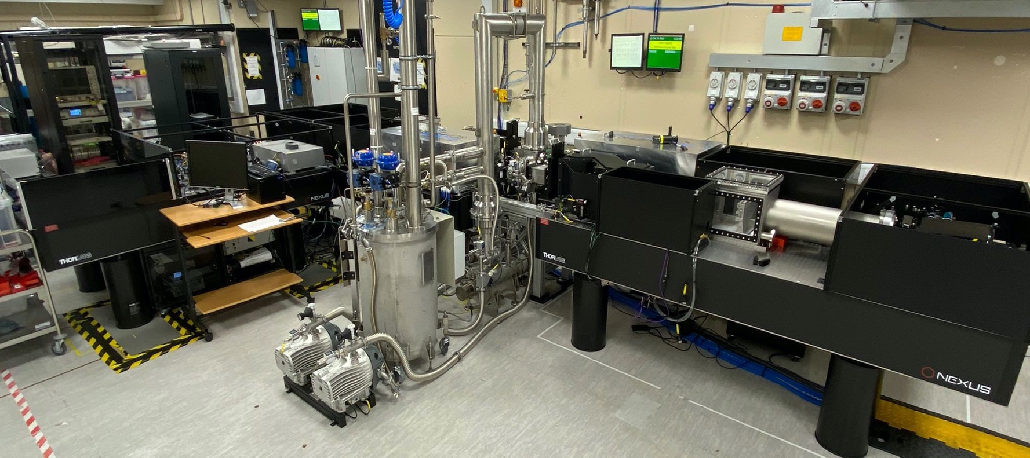

WP2.2: High-Repetition Rate Laser Driver Developments (100 Hz → 1 kHz) – Progress Update
WP 2.2 coordinated by Andi Maier, Paul Mason and Leo Gizzi
Long-term stable operation of high-energy 10 J, 100 Hz (1 kW) DPSS pump laser demonstrated at CLF#
  Multi-slab Yb:YAG gas cooled amplifier (DiPOLE-S)
  Energy stability 1 % rms @ 100 Hz
    45 mins (300 kshots) @ 10 J
    4 hours (1.4 Mshots) @ 7 J – no user intervention
Oscillation artefact linked to lab temperature instability
#M. De Vido et al., „Demonstration of stable, long-term operation of a nanosecond pulsed DPSSL at 10 J, 100 Hz“, submitted to Optics Express (2024)

Slide 13
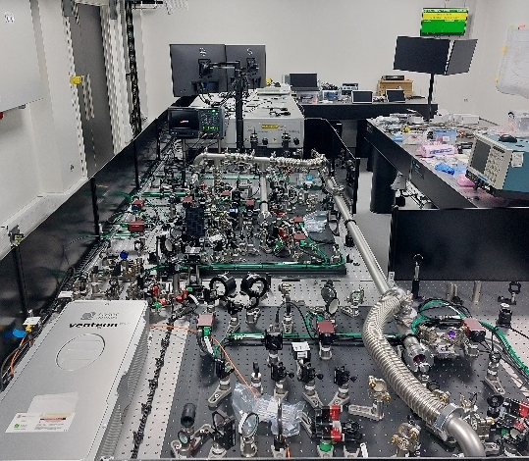
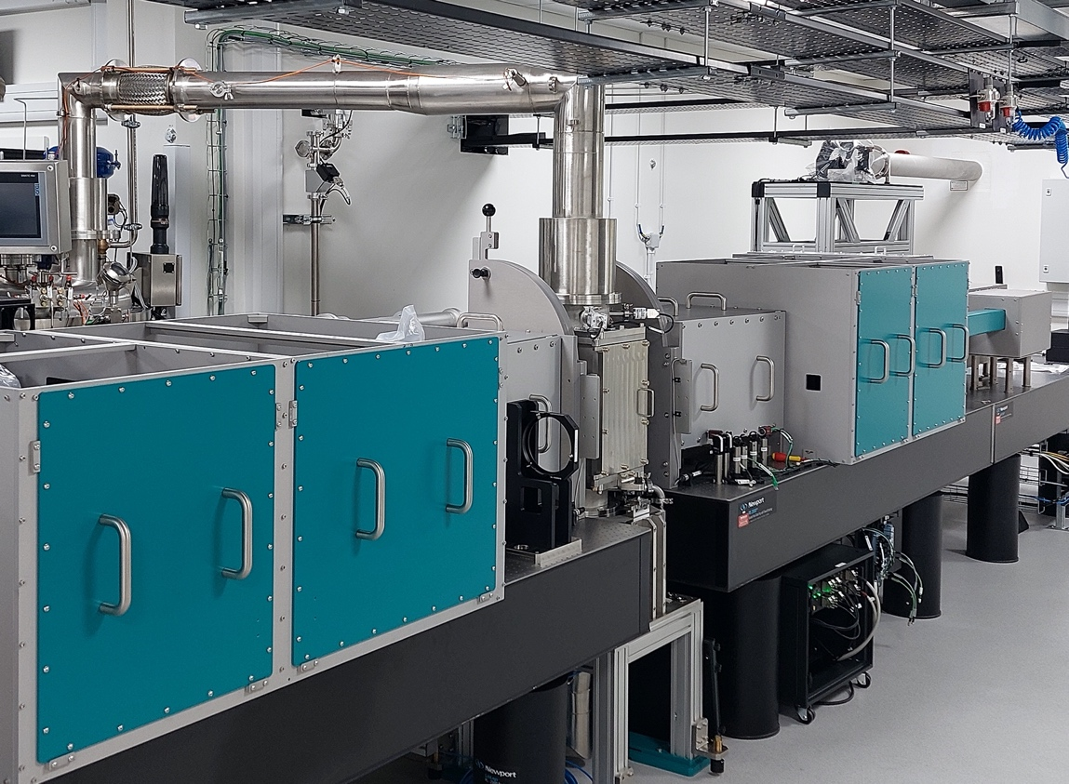
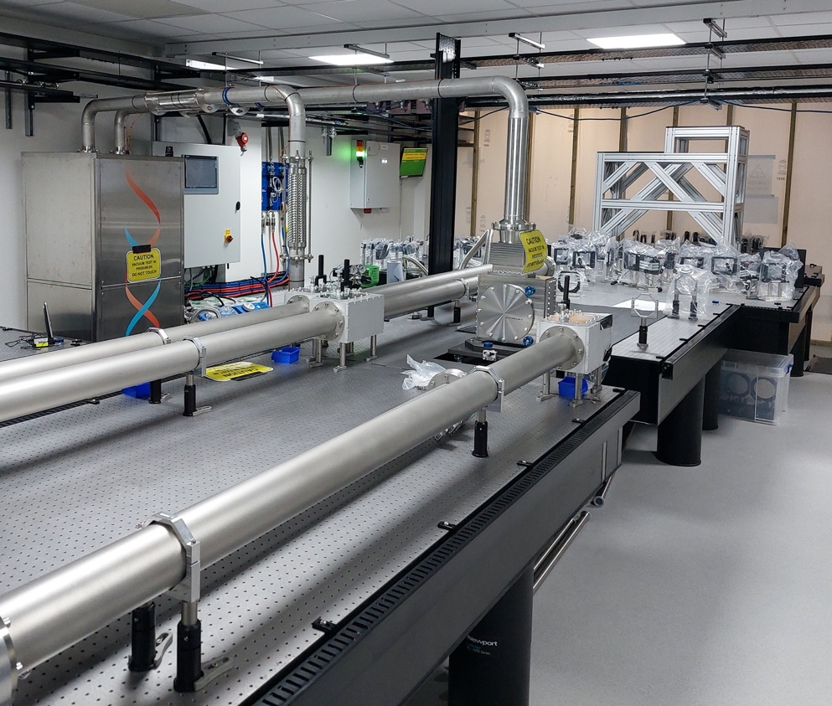
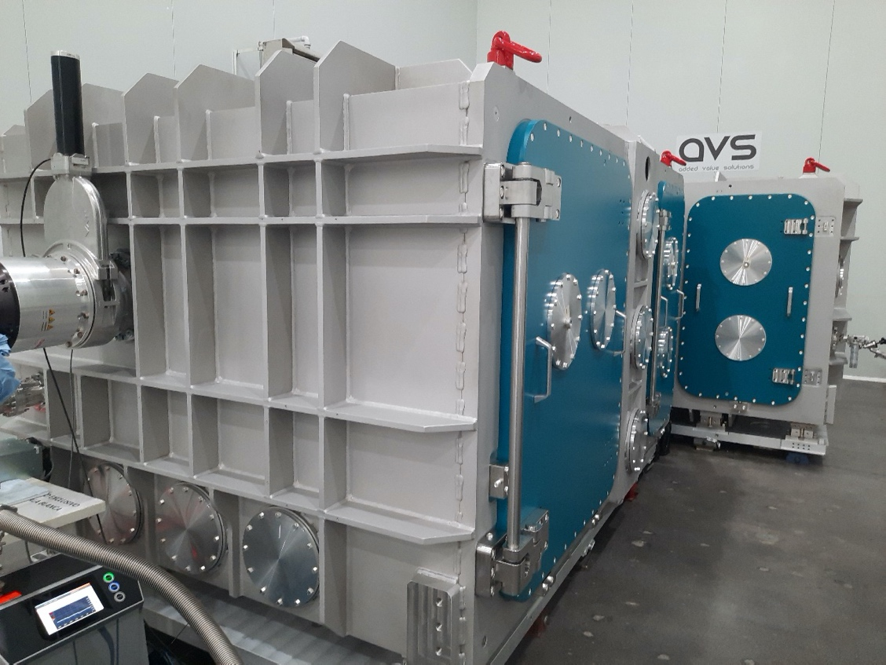
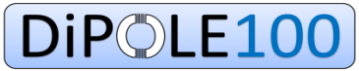
WP2.2: High-Repetition Rate Laser Driver Developments (100 Hz → 1 kHz) – Progress Update
WP 2.2 coordinated by Andi Maier, Paul Mason and Leo Gizzi
Performance of high-energy Ti:Sa amplifiers
  PW-class (30 fs, 30J, 300W) laser @ 10 Hz commissioning underway at the Extreme Photonics Application Centre (EPAC)
  Laser damage testing of multi-layer dielectric gratings in progress
Joule-class OPCPA Front-end
DiPOLE 100J, 10Hz pump cryo-amplifier
Ti:Sa high-energy amplifier
Compressor chamber

Slide 14
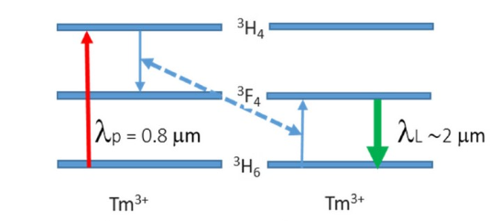
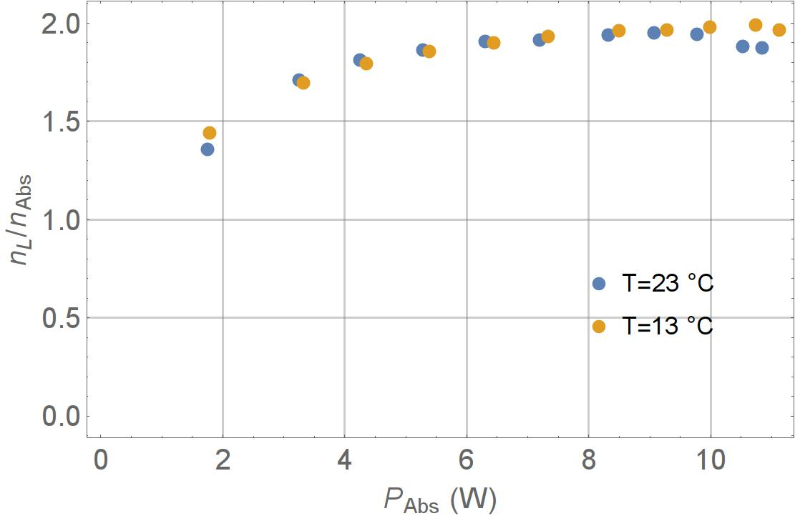
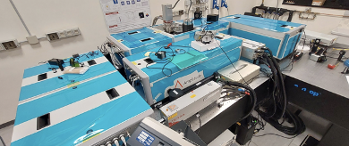
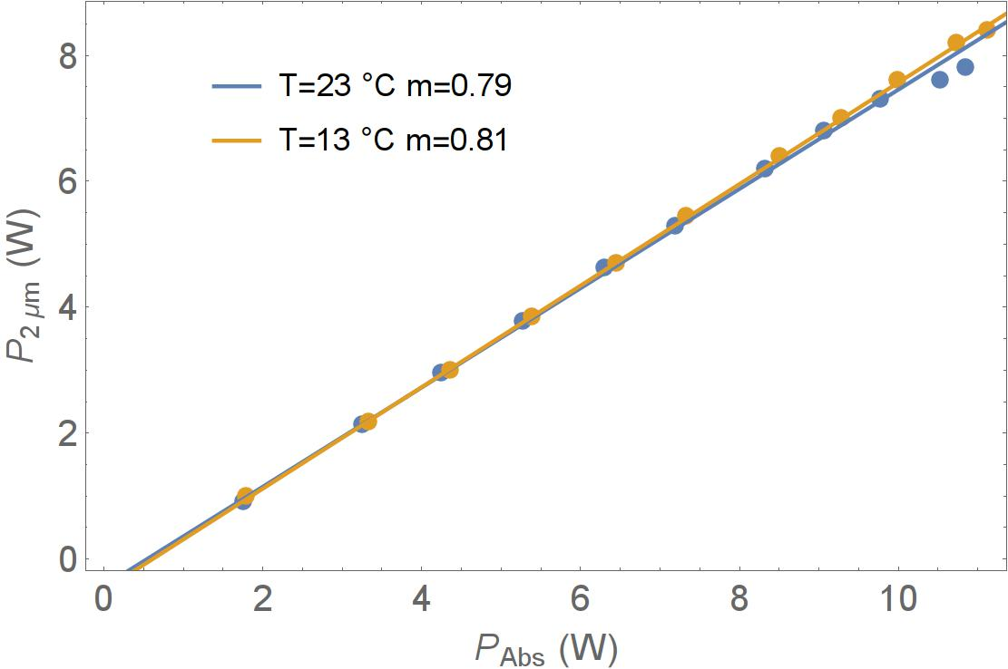
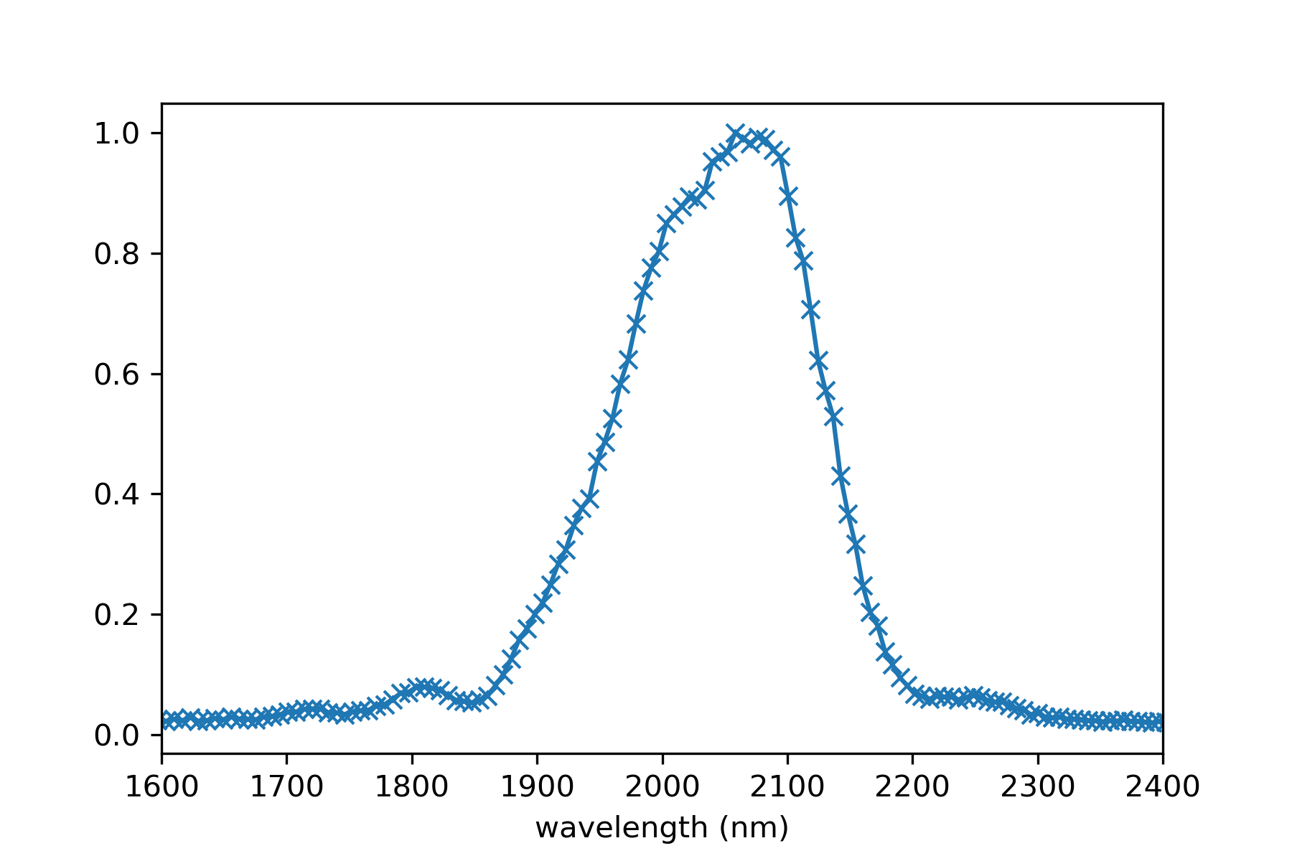

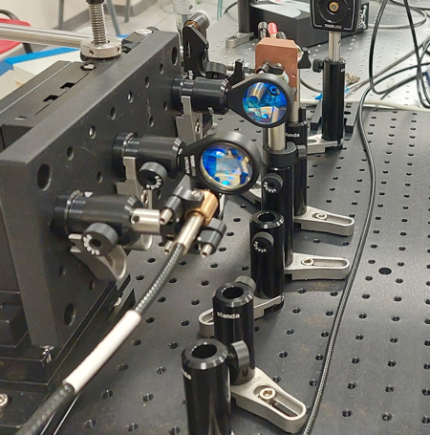

WP2.2: High-Repetition Rate Laser Driver Developments (100 Hz → 1 kHz) – Progress Update
WP 2.2 coordinated by Andi Maier, Paul Mason and Leo Gizzi
Next generation laser drivers
  Commercial, mJ, kHz, 30 fs, 2 µm front end (Ti:Sa pumped OPA) operational
  Efficient, room temperature, direct diode pumping of Tm:Lu₂O₃ (2 µm) at 796 nm demonstrated
  kHz 2 µm test bed for material characterization set-up
Front-end
Efficient 2-for-1 cross-relaxation QE ~ 2 demonstrated
Spectrum
λ_{c}= 2025 nm
Δλ_{FWHM} = 182 nm
τ_{FTL} = 33 fs
Oscillator test bed
Slope efficiency ≈ 75%

Slide 15
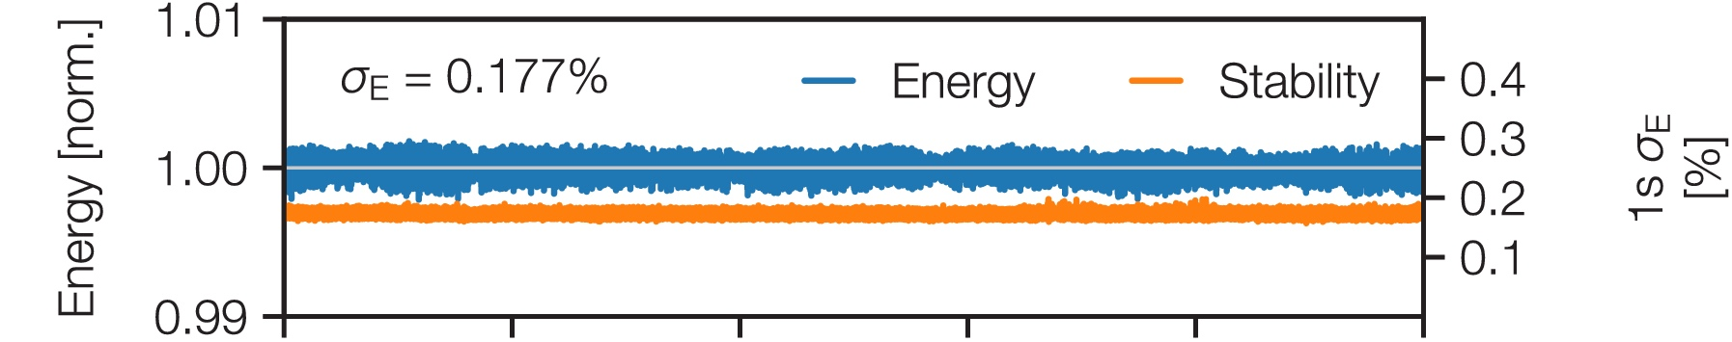
WP2.2: High-Repetition Rate Laser Driver Developments (100 Hz → 1 kHz) – Progress Update
WP 2.2 coordinated by Andi Maier, Paul Mason and Leo Gizzi
KALDERA LPA drive laser development at DESY
  Long-term stable frontend demonstrated
  Frontend auto-tuning using machine learning
  Concept published on multi-layer based compressor that could support kW-average power
  Approaching 0.5 J at 100 Hz
  Will be used for LPA injector development for PETRA IV
50 hours
C. Werle et al., Out-of-plane multilayer-dielectric-grating compressor for ultrafast Ti:sapphire pulses, Opt. Express 31, 37437 (2023)
T. Eichner et al., “Evolutionary optimization and long-term stabilization of a white-light seeded two-stage OPCPA seed laser”, Opt. Express 31, 36915 (2023)

Slide 16
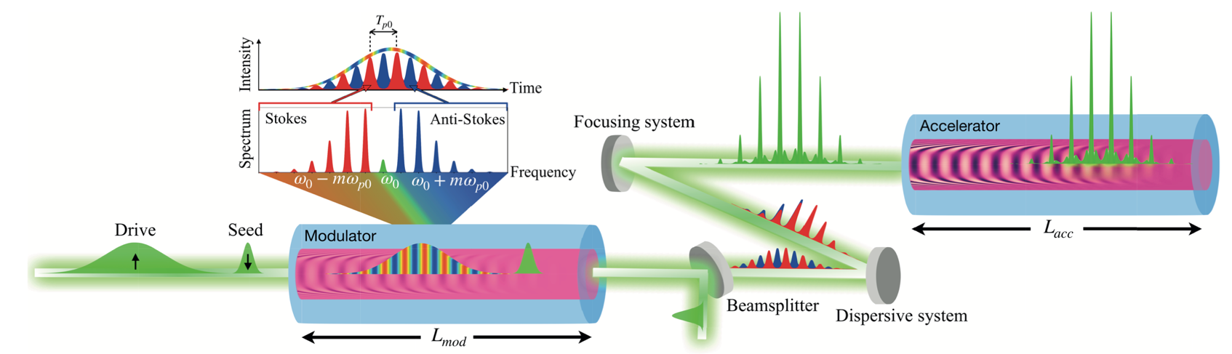
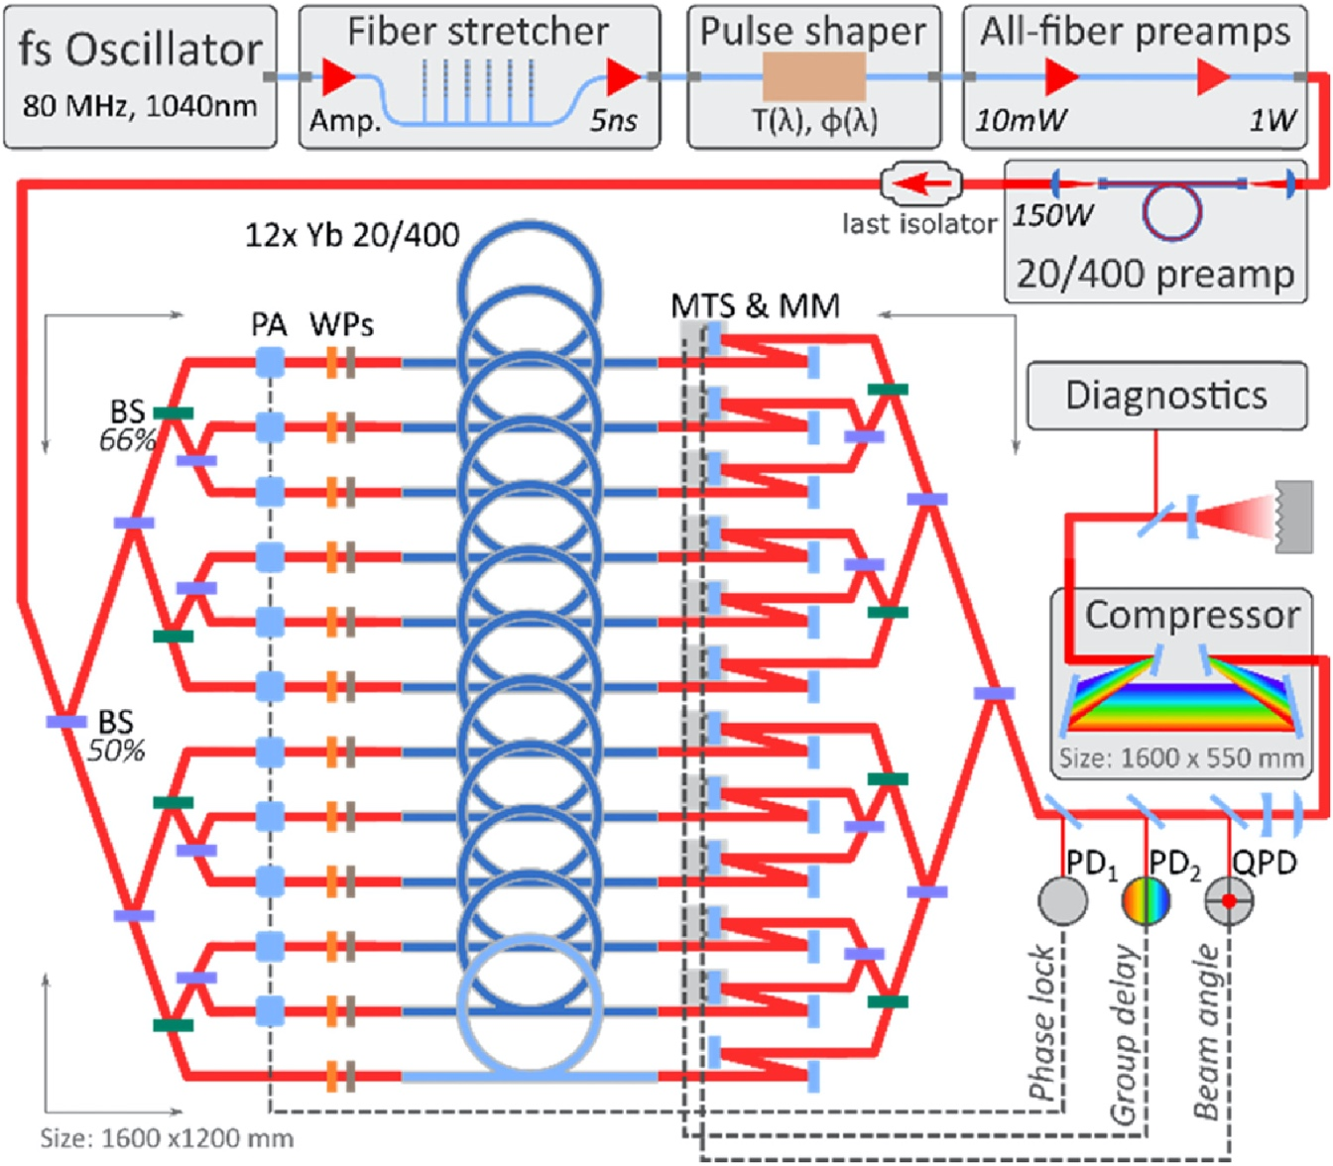



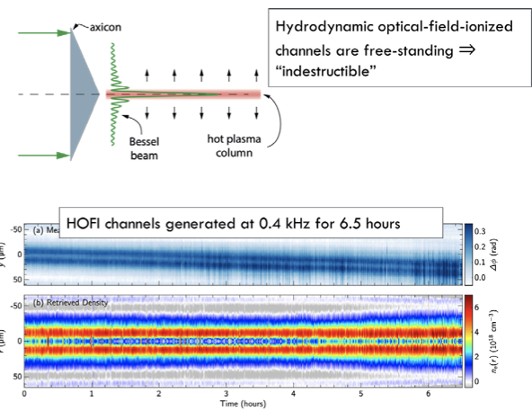


R&D on sustainable high rep-rate LWFA architectures
  In conjunction with WP 2.3: Plasma source technology (Simon Hooker, Brigitte Cros)
Multi-pulse LWFA with long pulses with HOFI channels offer a lot of promise
Direct CPA- fiber sources could also be an option for multi-kHz laser drivers
Solutions for heat load management in plasma sources and multi-time and length scale modeling aimed at pre- and post-driver interactions required
Phys. Rev. Lett. 131, 245001 (2023)

Slide 17
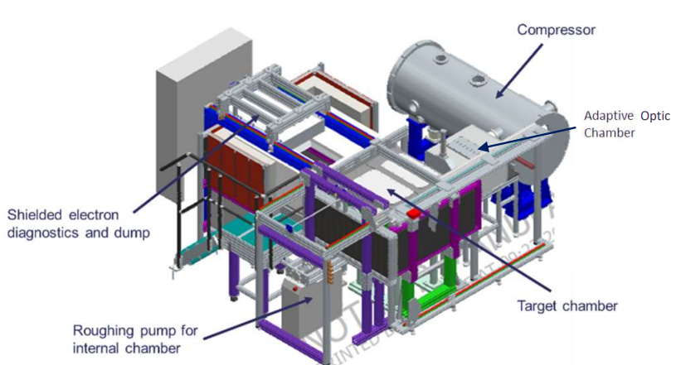

Experimental LPA facility developments
WP 2.4: Experimental LPA Facility Developments: (Dan Symes, Andreas Döpp)
Beamline being installed in Gemini TA2 for prototyping aspects of EPAC delivery
500 mJ, 5 Hz laser to drive 100 MeV LWFA
Implementing active stabilization systems
Developing robust control code for routine machine learning optimization of LWFA performance
Testing new diagnostics – e.g. ASTeC dielectric streaker for bunch duration measurement
Testing operation of LWFA-driven x-ray CT beamline
Use test beamline to de-risk operations on EPAC (10 Hz) and other future user facilities
Staging Experiment under setup in Gemini TA3
Currently, relying on ancillary funds (individual facility funds)
Dedicated funds required for coordination and alignment

Slide 18
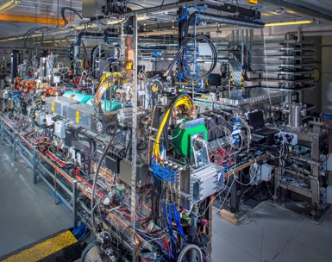
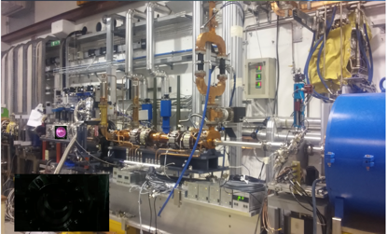
Strategies of existing PWFA facilities align with pre-CDR work
WP3.1: Electron-beam-driven experiments (Richard D’Arcy, Jonathan Wood)
CLARA is an ultrabright, electron beam test facility under development at STFC Daresbury Laboratory
  H3beams proposal (CLARA beams injected into a 100 TW-driven wake) at an advanced stage of funding review
FLASHForward at DESY explores high-efficiency, high-average-power PWFAs
Frascati (INFN) explores PWFA based light sources and applications (EuPRAXIA)
CLARA beamline
Contributing to
Electron beam-driven PWFA/Plasma photocathode
Plasma source development/plasma-based beam diagnostics
External injection LPA, Trojan Horse, …
INFN PWFA chamber

Slide 19
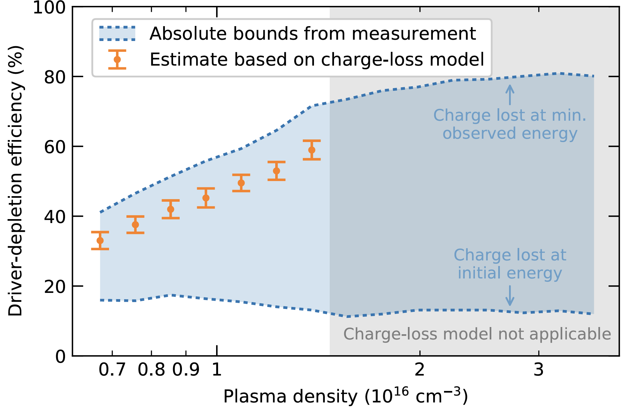
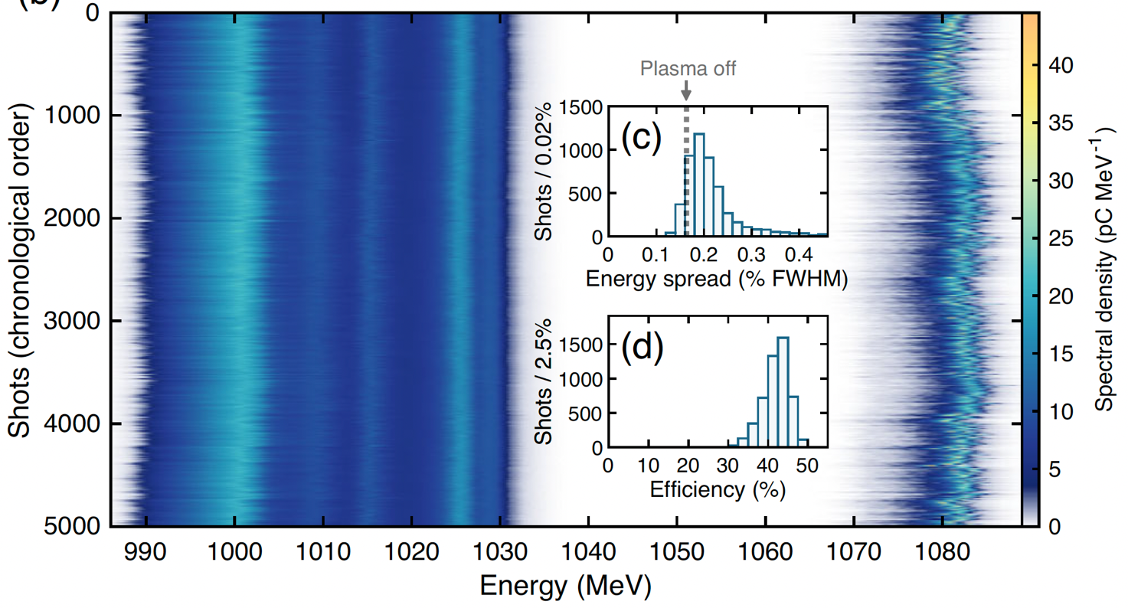
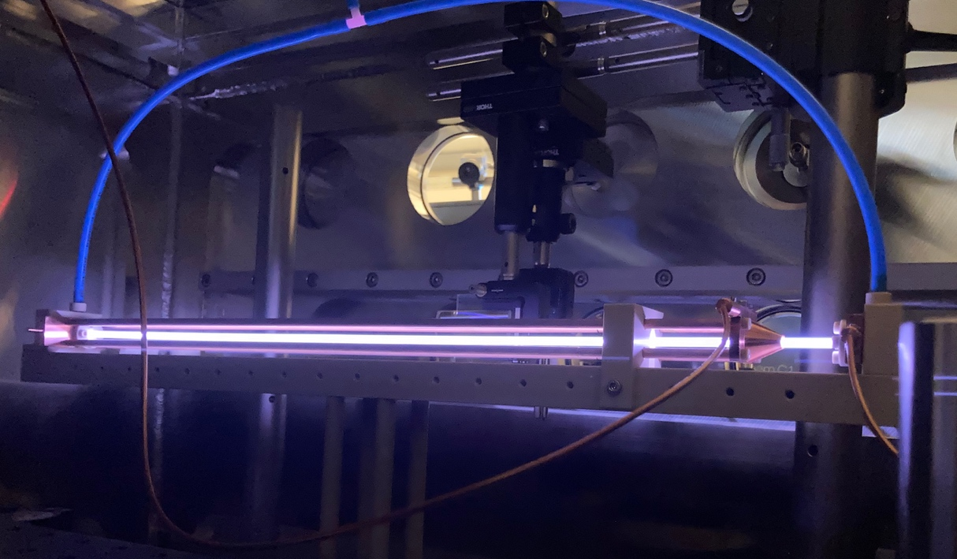
Progress towards collider-relevant efficiencies at FLASHForward
WP3.1: Electron-beam-driven experiments (Richard D’Arcy, Jonathan Wood)
55 % depletion efficiency
(F. Peña et al., arXiv:2305.09581 (2023))
42 % extraction efficiency
(Lindstrøm et al., PRL 126 (2021))
Record efficiencies shown seprately at FLASHForward
  55 % x 42% ~ 20 %
  Competitive with CLIC
Next step: Combine these two results to reach >10 %
  Requires larger energy gain than in Lindstrøm et al. PRL
Plasma-source development to enable longer acceleration lengths
  195 mm demonstrated
  500 mm to come…
>200 MeV energy gain (charge-preserved) in 195 mm
New 500 mm cell for >0.5 GeV energy gain

Slide 20
AWAKE has a well-defined program
WP3.2: Proton-beam-driven experiments (Edda Gschwendtner, Patric Mugli)
CERN Management requested an External Review on the Scientific and Technical Challenges of AWAKE Run 2, 5 February 2024
… The Committee commends the AWAKE team for their spectacular achievements to date… AWAKE is a unique experiment, with capabilities and opportunities that cannot be reproduced in a practically reasonable time anywhere else in the world… The work is very synergistic with CERN’s plans to ramp-up efforts on FCCee… definitely contribute to the success of any future CERN project involving electron accelerators.
➔ The committee strongly endorses AWAKE’s plan for future run.

Slide 21
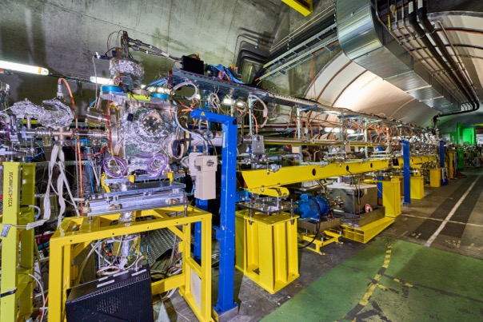



AWAKE Measurement Milestones in 2023 Achieved
WP3.2: Proton-beam-driven experiments (Edda Gschwendtner, Patric Mugli)
10 m Rb vapour source with a density step in AWAKE in 2023/2024
AWAKE Run 2023/24: Stabilization: New 10 m long rubidium vapour source with a density step
density step allows to maintain a large amplitude of the wakefields.
Clear effects of the density step seen in 2023 Run!
Complete the Stabilization experiment in 2024!
10m Discharge Plasma Source: Unique opportunity during May 2023 Proton Run
Successfully installed, commissioned and operated a 10m long discharge prototype plasma source during the May 2023 Run
➔ Physics papers on current filamentation instability, ion motion, …

Slide 22
Strong Field QED with lasers and laser-generated beams
4.1 Early particle physics with advanced accelerators (Matt Zepf, Brian Foster, Stuart Mangles, Marija Vranic)
Laser-electron beam scattering was highlighted for SFQED in the previous report
Proof-of-concept experiments are underway in several facilities.
Direct Laser Acceleration being explored to provide multi-GeV electrons at “moderate intensities” (a0~10)
These beams are high-charge (>100 nC), and can be used directly or for synchrotron radiation generation.
We can generate and accelerate positrons as well!
M. Vranic et al, Phys. Rev. Lett 113, 134801 (2014)
https://dx.doi.org/10.1103/PhysRevLett.113.134801
R. Babjak et al, Phys. Rev. Lett. accepted (2024)
https://journals.aps.org/prl/accepted/8107bYa8Q8f1298f29da633030887fdaeb5e969dd

Slide 23
Strong Field QED with lasers and laser-generated beams
4.1 Early particle physics with advanced accelerators (Matt Zepf, Brian Foster, Stuart Mangles, Marija Vranic)
  Non-linear QED using plasma mirrors: EPAC, CALA, ELI, DESY,…
  Fixed target experiments – AWAKE
Beam-Beam collisions can also get us to SFQED regime
It is possible to obtain electron-electron collisions with high luminosity, because QED effects help against diluting the beam (talk by T. Grismayer on Friday).
Spin polarization is getting interest in SF theory&sim studies
Can we generate polarized beams and cascades? Under what conditions the polarization is generated and transmitted in QED-dominated regime?
V. Yakimenko et al, Phys. Rev. Lett. 122, 190404 (2019)
https://dx.doi.org/10.1103/PhysRevLett.122.190404
Q. Qian et al, Phys. Plasmas 30, 103107 (2023)
https://doi.org/10.1063/5.0165788

Slide 24

HALHF Workshop on 4-5th April, 2024
How to continue and push HALHF – prospective funding sources: ERC, STFC/Oxford
Start-to-end simulations: high fidelity, full physics modeling
  Include non-linear QED effects in extreme regime
Need a plan for staging demonstrator:
  “Staged approach”:
    What does a multi-stage demonstrator look like?
    Are there current facilities that can be used without major (>1M€) investment needed?
Develop base line parameters for drive linac and collaborate with drive linac experts
Work out parameters for ILC-like positron source using spent e⁻-beam
Detector concept development needs to continue
Produce a “pre-CDR” in the next few months – a coherent machine based on HALHF scheme in which all conventional and PWFA parts are identified and believably implementable,
“Erice” expert meeting to draft “pre-CDR” 03.-08.10.2024 (tbc) limited to ~30 experts
Collaboration meeting end of 2024 / early 2025 to “sign off” pre-CDR and launch ”funded” R&D phase.

Slide 25
Thanks!
To the Plasma Accelerators Team for all the progress towards input for the
European Particle Physics Strategy R&D Roadmap
Contacts:
Wim Leemans | Accelerator Division | DESY
Rajeev Pattathil | STFC UKRI | RAL
wim.leemans@desy.de
rajeev.pattathil@stfc.ac.uk

