Slide 1
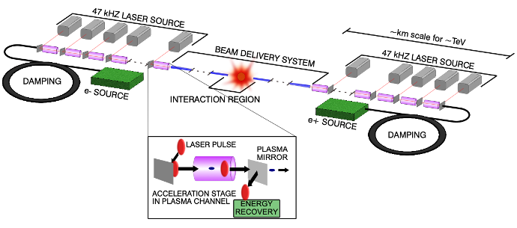
US perspective on plasma based accelerators and future colliders
DRIVER
2024
Cameron G.R. Geddes, Director
Accelerator Technology & Applied Physics Division
Lawrence Berkeley National Laboratory

Slide 2
Outline
Introduction to US planning
  Snowmass community study highlights
P5 decadal plan (panel member)
  High level recommendations
  Accelerator and Collider plan
  Wakefield accelerator highlights
Personal perspectives (not P5 content)
  Wakefield accelerator next steps

Slide 3
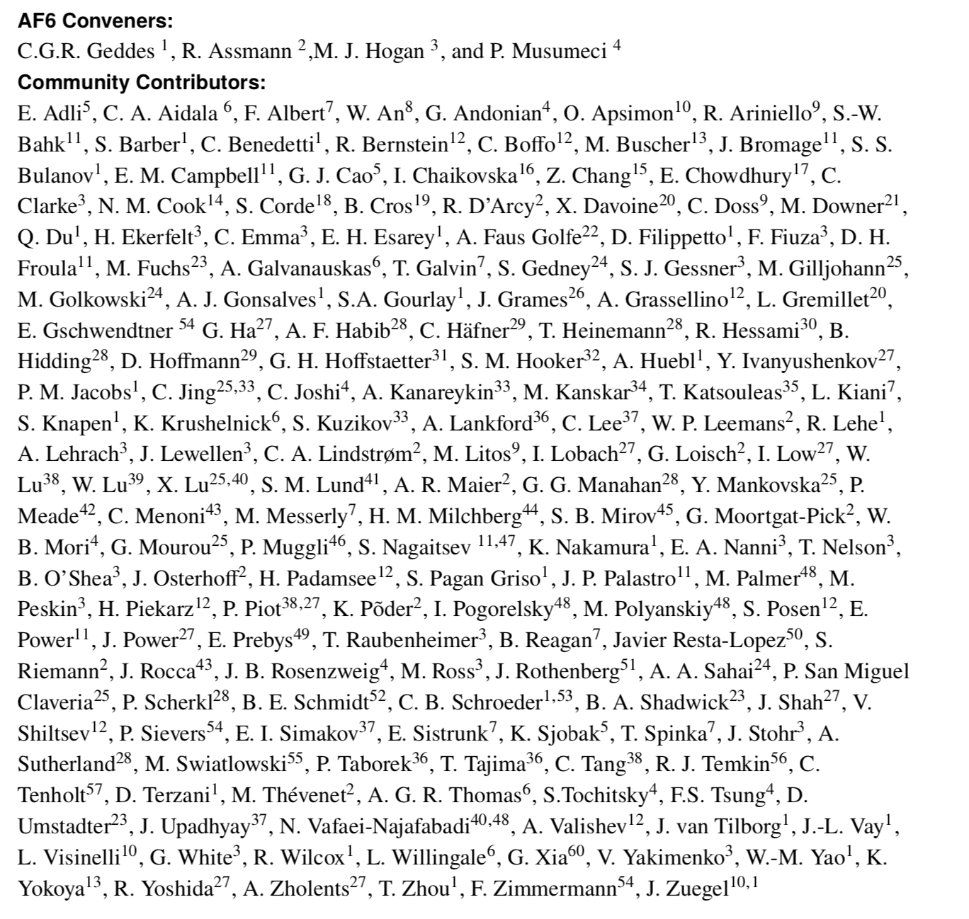
Thank You to the AF6 & Advanced Accelerator Community
Report of the Accelerator Frontier Topical Group 6 on Advanced Accelerator Concepts for Snowmass 2021
https://arxiv.org/abs/2208.13279
Includes citations for this talk
Also: novel RF, other concepts
(not the focus of this talk)
Thanks for coordination and work with the Implementation Task Force and AF4 collider Groups, the overall AF, EF, TF, CoF, CmF, and the overlapping European Strategy for Particle Physics Roadmap group.
3

Slide 4
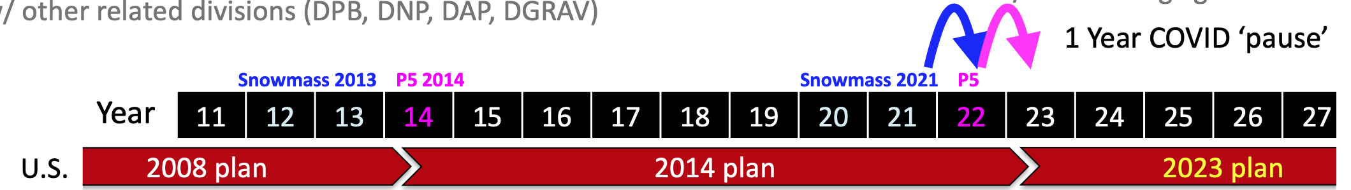
Strategic Planning Process for U.S. Particle Physics
  Particle physics is the largest driver of U.S. investment in advanced accelerators
    Light sources, other DOE nearer term ideas often based from stewardship of collider technology
    NSF programs are broadly based
  DOE and NSF programs in particle physics are guided by decadal planning
    Snowmass community science study defined important questions, promising opportunities
    2-year discussion across the field developed and provided community input / interest on opportunities
    Particle physics Project Prioritization Panel “P5” formulates a 10-year plan and 20 year vision within funding constraints. Subpanel of High Energy Physics Advisory Panel, advising DOE & NSF.
    Parallel: International benchmarking panel
    Parallel: National Academies studies define overall scientific vision-Elementary Particle Physics
    Related to: planning for other U.S. science areas such as nuclear physics, fusion and plasmas; international planning including the European Strategy for Particle Physics, Japan, others
4

Slide 5
Snowmass Advanced Accelerator Selected Highlights
  Advanced accelerators in beam and laser driven structures/plasmas offer potential for compact, energy efficient future e-e+/γγ colliders to the 15 TeV range with few TeV/km geometric gradients
  AF6 key recommendations …vigorous research on advanced accelerators as part of General Accel. R&D
    A targeted R&D program addressing high energy advanced accelerator-based colliders
    Recognize near-term applications as essential & providing leverage to colliders-strengthen connections
    Enhanced driver R&D to develop efficient, high repetition rate high average power… technology
    Upgrade beam test facilities, continue strong role in workforce, recruiting including high repetition rate facility kBELLA, positrons at FACET-II, integrated SWFA at AWA
    Pursue 10’s GeV collider demonstration study develop physics experiments at intermediate energy
    A DOE-HEP sponsored workshop should update and formalize the U.S. Advanced accelerator strategy

Slide 6
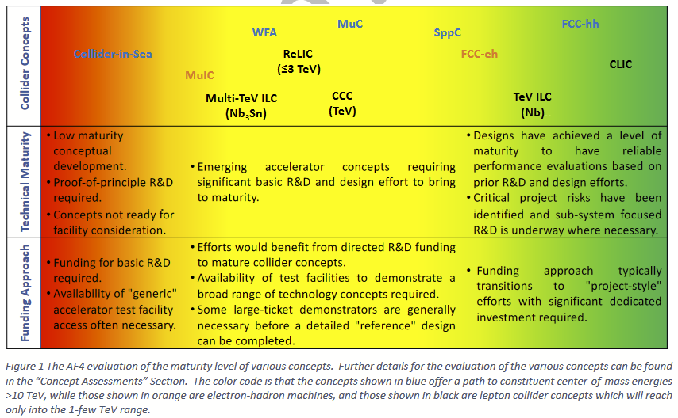
Snowmass Accelerator Frontier
  AF4: No 10 TeV lepton collider at ‘green’ maturity level needed for informed comparison, decision
    Advanced accelerators ranked less mature
  Implementation task force compared collider properties and potential costs
    Wakefield collider: limited documentation, next steps include integrated self consistent parameter sets with tradeoffs to advance evaluation of collider options. For future technologies, cost est. likely conservative.
    Muon collider: substantial documentation
  Accelerator Frontier summary:
AF4 status summary
  ‘… discovery machines such as O(10 TeV c.m.e.) muon colliders have rapidly gained significant momentum… R&D is in progress on other concepts such as wakefield based e +e − or γγ systems which may present additional future options... reduce the dimensions and thus potentially reduce the costs and power consumption of future high energy physics machines’
6

Slide 7
Strong Snowmass Energy & Theory Frontier Interest in 10+ TeV
  Higher energy scale than emphasized in the last Snowmass driven by evolving data
  Leptons offer clean collisions and strong physics potential
    Motivates R&D to reduce cost and energy consumption and provide viable options at 10+ TeV
    Similar physics is anticipated to be accessible with muons or e+e-
    γγ colliders likely access significant portion of physics, analysis less complete
    Muon collider emphasis: included detailed EF analysis driven by renewed muon collider effort and presence, spanning accelerator, energy, instrumentation (detection) and theory frontiers
    e+e- collider forum: identified potential for similar signatures, potential LC benefit via AAC methods but not analyzed in detail – stronger engagement on colliders with energy/theory frontiers needed
  Challenging energy scale emphasizes
    Leverage of nearer term applications
    R&D on new technologies including carbon efficiency
    Integrated design and analysis of collider options
7

Slide 8
Outline
Introduction to US planning
  Snowmass community study highlights
P5 decadal plan (panel member)
  High level recommendations
  Accelerator and Collider plan
  Wakefield accelerator content
Personal perspectives (not P5 content)
  Wakefield accelerator next steps

Slide 9
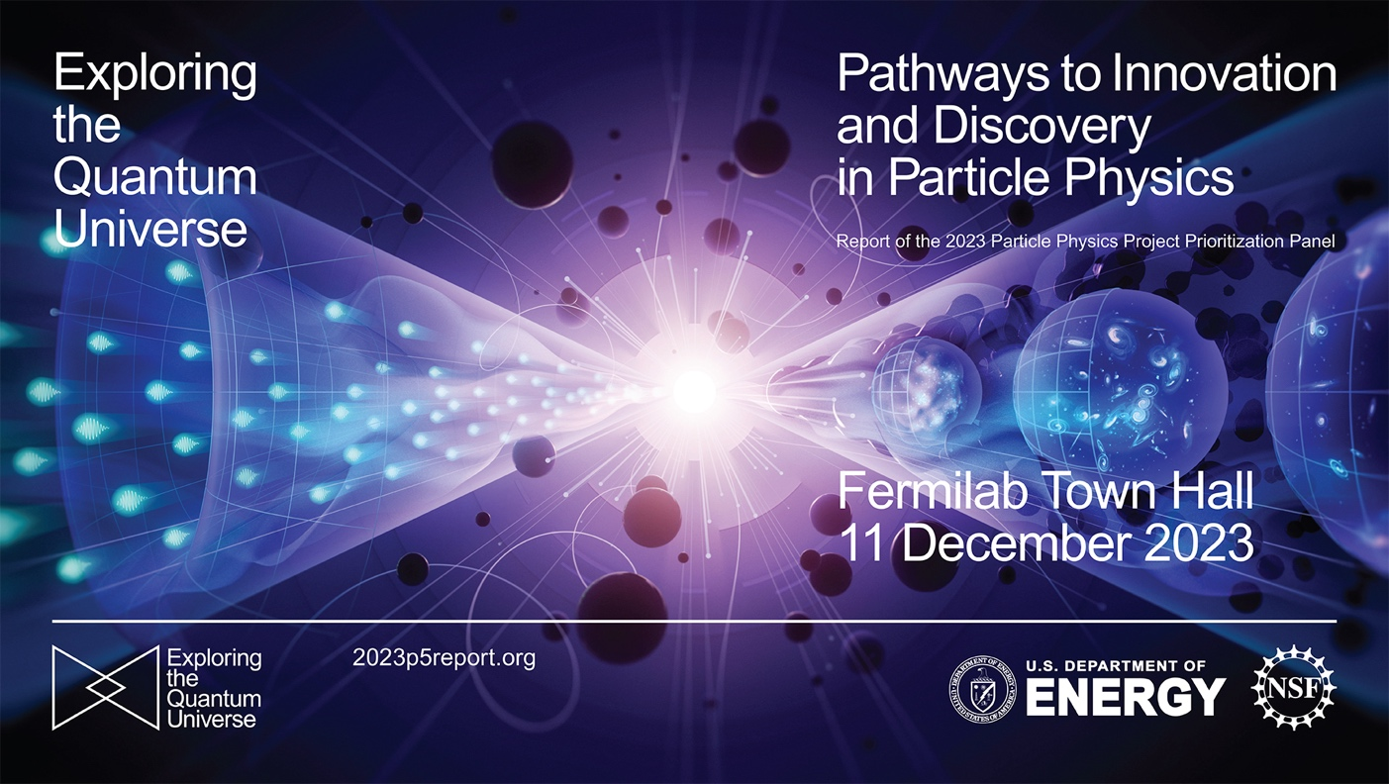
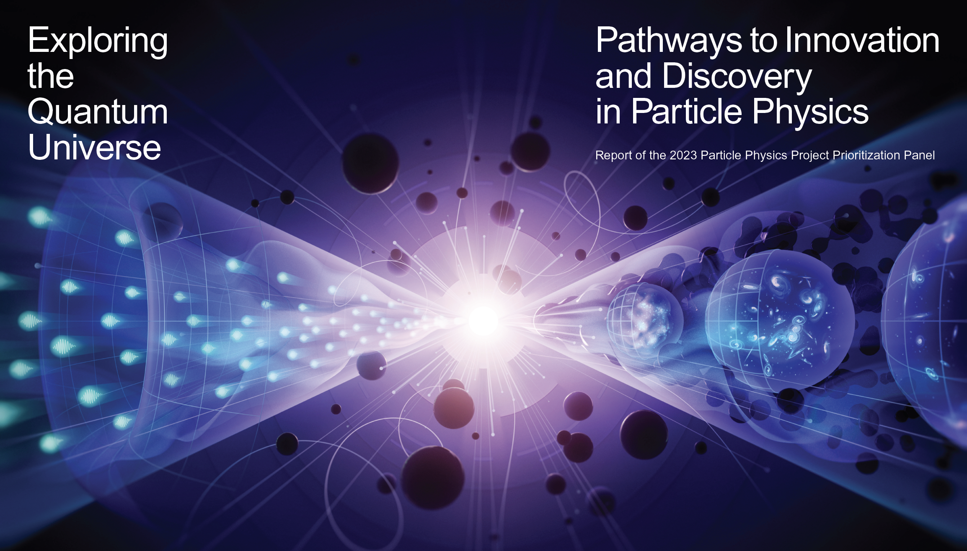
P5 Report Context
2023p5report.org
With content credit to P5 members

Slide 10
Full P5 presentations…
HEPAP Presentation in DC, December 7-8
Draft report presented to HEPAP for discussion and open community feedback
Unanimous support of the report by HEPAP vote
FNAL Town Hall, December 11
and others
Today is NOT a full presentation of the P5 report
Focus on accelerator and collider items relevant to wakefield accelerators
Recommendations/highlights shown are a subset
and do not represent priority

Slide 11
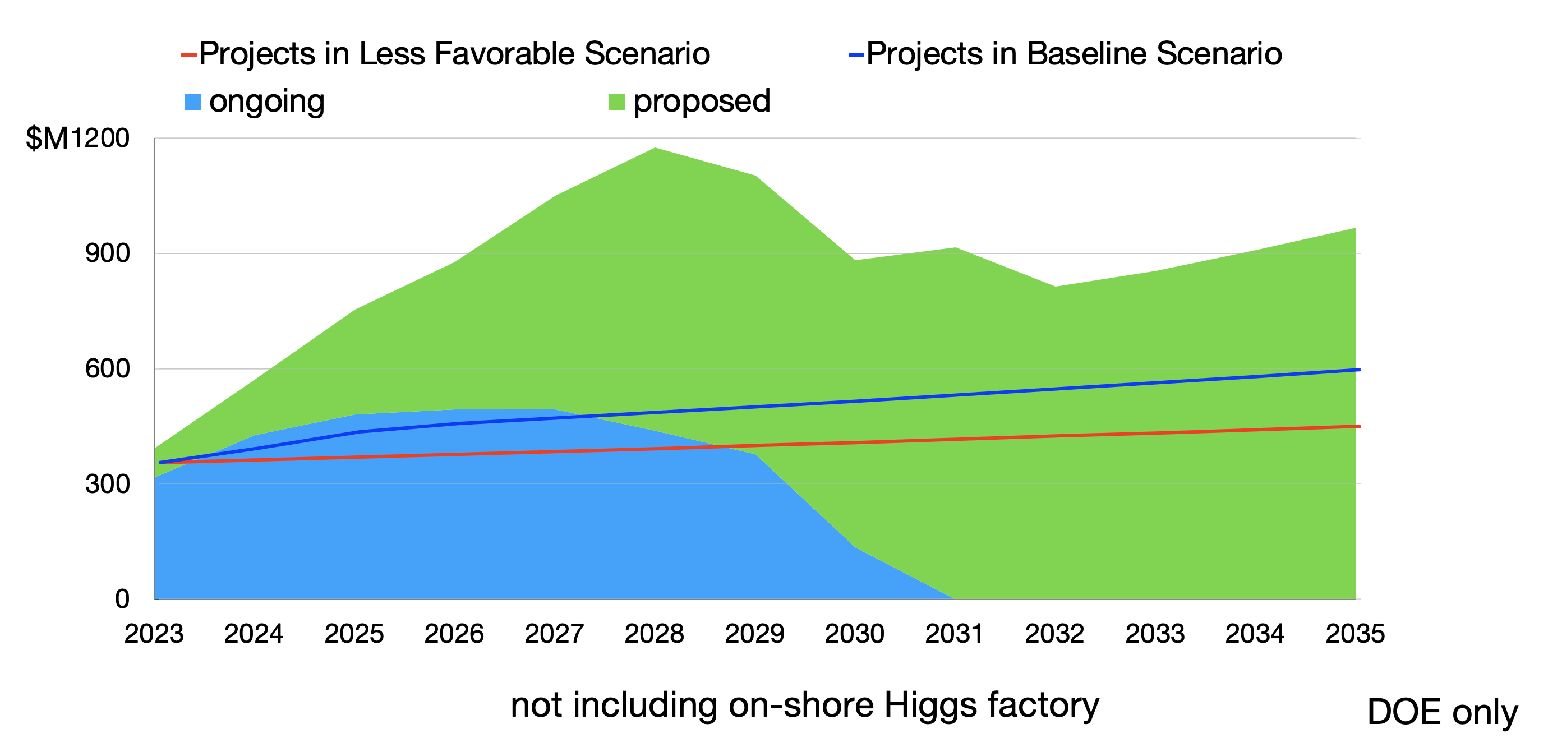
Budget Scenarios and Projects
Proposed projects exceeded scenarios

Slide 12
Recommendation 2
Rank-Ordered
CMB-S4, which looks back at the earliest moments of the universe to probe physics at the highest energy scales. It is critical to install telescopes at and observe from both the South Pole and Chile sites to achieve the science goals (section 4.2).
Re-envisioned second phase of DUNE with an early implementation of an enhanced 2.1 MW beam—ACE-MIRT—a third far detector, and an upgraded near-detector complex as the definitive long-baseline neutrino oscillation experiment of its kind (section 3.1).
An off-shore Higgs factory, realized in collaboration with international partners, in order to reveal the secrets of the Higgs boson. The current designs of FCC-ee and ILC meet our scientific requirements. The US should actively engage in feasibility and design studies. Once a specific project is deemed feasible and well-defined (see also Recommendation 6), the US should aim for a contribution at funding levels commensurate to that of the US involvement in the LHC and HL-LHC, while maintaining a healthy US on-shore program in particle physics (section 3.2).
An ultimate Generation 3 (G3) dark matter direct detection experiment reaching the neutrino fog, in coordination with international partners and preferably sited in the US (section 4.1).
IceCube-Gen2 for study of neutrino properties using non-beam neutrinos complementary to DUNE and for indirect detection of dark matter covering higher mass ranges using neutrinos as a tool (section 4.1).

Slide 13
Recommendation 4
Support a comprehensive effort to develop the resources—theoretical, computational, and technological—essential to our 20-year vision for the field. This includes an aggressive R&D program that, while technologically challenging, could yield revolutionary accelerator designs that chart a realistic path to a 10 TeV pCM collider.
Investing in the future of the field to fulfill this vision requires the following:

Slide 14
Recommendation 4
Not Rank-Ordered
Support vigorous R&D toward a cost-effective 10 TeV pCM collider based on proton, muon, or possible wakefield technologies, including an evaluation of options for US siting of such a machine, with a goal of being ready to build major test facilities and demonstrator facilities within the next 10 years (sections 3.2, 5.1, 6.5, and Recommendation 6).
Enhance research in theory to propel innovation, maximize scientific impact of investments in experiments, and expand our understanding of the universe (section 6.1).
Expand the General Accelerator R&D (GARD) program within HEP, including stewardship (section 6.4).
Invest in R&D in instrumentation to develop innovative scientific tools (section 6.3).
Conduct R&D efforts to define and enable new projects in the next decade, including detectors for an e⁺e– Higgs factory and 10 TeV pCM collider, Spec-S5, DUNE FD4, Mu2e-II, Advanced Muon Facility, and line intensity mapping (sections 3.1, 3.2, 4.2, 5.1, 5.2, and 6.3).
Support key cyberinfrastructure components such as shared software tools and a sustained R&D effort in computing, to fully exploit emerging technologies for projects. Prioritize computing and novel data analysis techniques for maximizing science across the entire field (section 6.7).
Develop plans for improving the Fermilab accelerator complex that are consistent with the long-term vision of this report, including neutrinos, flavor, and a 10 TeV pCM collider (section 6.6).
We recommend specific budget levels for enhanced support of these efforts and their justifications as Area Recommendations in section 6.

Slide 15
Recommendation 6
Convene a targeted panel with broad membership across particle physics later this decade that makes decisions on the US accelerator-based program at the time when major decisions concerning an off-shore Higgs factory are expected, and/or significant adjustments within the accelerator-based R&D portfolio are likely to be needed. A plan for the Fermilab accelerator complex consistent with the long-term vision in this report should also be reviewed.
The panel would consider the following:
The level and nature of US contribution in a specific Higgs factory including an evaluation of the associated schedule, budget, and risks once crucial information becomes available.
Mid- and large-scale test and demonstrator facilities in the accelerator and collider R&D portfolios.
A plan for the evolution of the Fermilab accelerator complex consistent with the longterm vision in this report, which may commence construction in the event of a more favorable budget situation.

Slide 16
Area Recommendations
Collider R&D
Targeted collider R&D is required to translate advancements in detector and accelerator technology into the experimental facilities that shape our understanding of the universe. …
Targeted R&D investments are crucial for developing comprehensive designs with cost models, guiding technology advancements and collider pathways, establishing advanced performance benchmarks for detectors and accelerators, and training the next generation of experts.
This increased investment complements general detector and accelerator R&D (Section 6.3, 6.4), which focuses on developing the necessary infrastructure and technologies. This synergistic approach is essential for positioning the US as a leader in projects outlined in our 20-year vision. This includes robust participation in an off-shore Higgs factory and a pivotal role in shaping the path towards a future 10 TeV pCM machine, potentially on US soil.

Slide 17
Collider R&D: Higgs Factory
Collider R&D (accelerator portion)
The decisions related to construction of an off-shore Higgs factory are anticipated to be made later this decade. The current designs of both FCC-ee and the ILC satisfy our scientific requirements. To secure a prominent role in a future Higgs factory project, the US should actively engage in feasibility and design studies (Recommendation 2c). Engagement with FCC-ee specifically should include design and modeling to advance the feasibility study, as well as R&D on superconducting radio frequency cavities designed for the ring and superconducting magnets designed for the interaction region. These efforts benefit from synergies in workforce development through participation in SuperKEKB and the Electron-Ion Collider.
Maintaining engagement with ILC accelerators through the ILC Technology Network can include design updates and cryomodule construction. These will support significant US contributions to potential projects. A global framework for future collider development, such as the ILC International Development Team as implemented by ICFA for the ILC, is relevant for all future colliders.
… (parallel detector effort not shown here for space)…
Major international decisions on the route to a Higgs factory are anticipated later this decade. Supported by ICFA, the Japanese HEP community remains committed to hosting the ILC in Japan as a global project. The FCC-ee feasibility study is scheduled for completion by 2025, followed by an update by the European Strategy Group and a decision by the CERN Council. Once a specific project is deemed feasible and well-defined, the US should focus efforts towards that technology. A separate panel should determine the level and nature of US contribution while maintaining a healthy US on-shore program in particle physics (recommendation 6). In the scenario where a global consensus to move forward with the Higgs factory is not reached, the next P5 should reevaluate.

Slide 18
Collider R&D: 10 pCM collider
Collider R&D
Parallel to the R&D for a Higgs factory, the US should pursue a 10 TeV pCM collider.
End-to-end designs are needed well before a decision can be made on a project in order to understand potential performance parameters and costs. These will guide research priorities and technology development as well as demonstrator facilities. Such early designs will also play a critical role in creating and sustaining the expertise to design such machines. Progress on these end-to-end designs should be evaluated (Recommendation 6).
The 10 TeV pCM energy scale and potential performance benefits motivate muon collider development, as well as ongoing work to advance proton and possible advanced wakefield accelerator paths (section 6.4.1). The US should pursue a leading role in the muon collider design effort, in concert with the International Muon Collider Collaboration (IMCC). This includes R&D on relevant technologies and preparations for a demonstrator facility. Delivery of a baseline design later this decade is also a crucial milestone. Development of technologies under accelerator R&D (Section 6.4) are essential to this effort, including superconducting magnets at higher field crucial to both future proton (FCC-hh) and muon colliders, and high temperature superconductors suitable for high field and temperature. Similarly, progress in advanced wakefield accelerators motivates efforts to develop a self-consistent design to understand feasibility and costs. Each of these research areas will benefit from international engagement to enable timely progress.
Targeted detector R&D for 10 TeV pCM machines is needed to address challenges specific to these high energy machines, such as ultrafast timing, radiation hardness, and high rate capabilities. In particular, detector R&D for a muon collider is needed to address challenges related to the unstable nature of muons. Beam-induced backgrounds due to the in-flight muon decays from the beam line can potentially inhibit the ability of the detectors to successfully reconstruct collision products. While many aspects of detector design and optimization are common to all future collider detectors, this unique feature requires dedicated study and R&D.

Slide 19
Area Recommendations
General Accelerator R&D
Area recommendation: Increase annual funding to the General Accelerator R&D program by $10M in 2023 dollars to ensure US leadership in key areas.
Broad generic R&D with a long term focus is critical to extending the reach of accelerators to meet future physics needs. Technical breakthroughs are required to enable accelerators to meet the field’s science drivers, to push costs lower than estimates based on current technology, and to reduce environmental impact. There are exciting opportunities in the development of (i) new high average power, efficient drivers (RF, lasers, and electron beams), (ii) accelerating structures that can sustain high average power and gradient (metallic, plasma and dielectric), (iii) high temperature superconducting magnets, and (iv) computing, instrumentation and controls. Normal conducting radio frequency (RF), superconducting RF, superconducting magnets, targets, and advanced acceleration concepts are essential to develop the next generation of accelerators for particle physics. The normal conducting RF program should incorporate innovative concepts such as cryogenic cool copper and distributed coupling. Accelerator and beam physics research is also critical, including large-scale computation as machines become more complex. Superconducting high field magnet R&D is essential to future proton (FCC-hh) and muon collider options; timely execution of magnet R&D would leverage expertise becoming available with the completion of the HL-LHC Accelerator Upgrade Project.

Slide 20
Area Notes - Wakefields
Wakefield concepts for a collider are in the early stages of development. A critical next step is the delivery of an end-to-end design concept, including cost scales, with self-consistent parameters throughout. This will provide an important yardstick against which to measure progress with this emerging technology path.
Use of the existing test facilities should be maximized. […] Key acceleration and beam requirements of a stage for a future collider based on wakefield technology, including energy gain with high brightness beams at high efficiency, can be developed using FACET-II at SLAC, BELLA at LBNL, AWA at ANL, ATF at BNL, ZEUS at University of Michigan (NSF), and other facilities. In addition to demonstrating a single self-contained stage, some of these facilities, particularly BELLA and potentially ZEUS, can demonstrate the next step toward a plasma wakefield collider, operation with two linked stages.

Slide 21
Test Facilities
General Accelerator R&D
Area recommendation: Support generic accelerator R&D with the construction of small scale test facilities. Initiate construction of larger test facilities based on project review, and informed by the collider R&D program.
Test facilities are ever more important to develop the advanced technology for future machines (Recommendation 4a, 4c). The need is magnified by the small number of training opportunities on operating machines and the significant timescales and technical demands of the next colliders. Use of the existing test facilities should be maximized.
Future test facilities would typically be mid-scale projects. Technical and scientific plans should be developed for test facility projects that could be launched within the next 5–10 years.
These could include the second stage cool copper test, which could develop high gradient normal conducting RF technology.
Advanced accelerator test facilities can explore technology and concepts that could significantly reduce cost and risks associated with a 10 TeV pCM collider. An upgrade for FACET-II e⁺ is uniquely positioned to enable study of positron acceleration in high gradient plasmas. New kW-class efficient lasers, and use of their kilohertz repetition rate for active feedback at kBELLA, will advance stage performance and enable beam tests. An AWA upgrade would support GeV advanced structures.
These, together with muon collider development, will advance the technology and feed into a future demonstrator facility to make possible a 10 TeV pCM collider (see Sec. 6.5). Many of these projects may be ready for scientific, technical, and cost reviews within the context of the HEP program toward the middle to end of this decade (Recommendation 6).

Slide 22
Outline
Introduction to US planning
  Snowmass community study highlights
P5 decadal plan (panel member)
  High level recommendations
  Accelerator and Collider plan
  Wakefield accelerator content
Personal perspectives (not P5 content)
  Wakefield accelerator next steps

Slide 23
Takeaway Messages
  Interest shifted from the TeV range to emphasize 10+ TeV/parton energies, after a Higgs factory
  Strong progress assessing wakefield limits and demonstrating technologies continues motivation
    Experimental results: 10 GeV class beams, beam loading & efficiency, plasma recovery, staging, high transformer ratio, positrons, and FEL-lasing demonstrating high beam quality
    Concepts addressing: ion motion, synchrotron radiation, scattering, hosing and e+ accel.
    Collider conceptual parameter sets developed based on component simulations and models
    Strengthening R&D and test facilities while leveraging near term applications are important.
  Snowmass science study engaged across the particle physics community and informs the P5 plan
    Advanced accelerators offer potential for compact, energy efficient future e-e+/gg colliders
    Viewed as longer term than other options, less engagement
    Emphasis on the need for designs with documented self-consistent parameter sets and identified technology gaps to guide and assess R&D
    Engagement with broad accelerator and particle physics communities is needed to advance design & consideration as a collider option
23

Slide 24
Towards a Wakefield Collider
  Research progress under GARD is demonstrating fundamental techniques, potential
  Collider studies are critical to define path to address 10 TeV pCM
    Starting with end-to-end design concept with cost scales, self consistent parameters
    Integration of detector and physics signatures – muon example – synergy with C3, others
    Unique interaction point modeling and physics at high energy
    10 TeV class is the motive: Near term applications and series of collider steps likely
  Test facilities demonstrate key technical elements, often below final collider specification
    Energy gain, high brightness & efficiency FACET-II, AWA, BELLA, ZEUS, ATF… (& staging)
    Additional proposed: kBELLA rate and active feedback for precision alignment
    FACET-II upgrade for positrons; AWA for GeV structures
  Demonstrators could integrate substantial parts of collider approaching design level
    Multi-stage at significant repetition rate, potentially two arms
24

Slide 25
Collider Planning
  Move towards integrated design, starting with self consistent parameter sets, cost ranges (muon collider success in the last decade)
    Integrating: injection, staging, efficiency, cooling alignment and jitter effects and tolerances, matching/coupling between many stages, BDS and Final focus
    Engaging: the detector, high energy physics and conventional collider communities, & internationally
    Frame a common wakefield collider concept with techniques offering technical risk mitigation
    Synchronize R&D across labs, identify challenges and address jointly
    Engage particle and detector physicists – there are unique issues with WFA detectors e.g. short bunches. Discussing parameters so they have to something to work with is essential.
    Key to motivating and directing development
  Discussion started 2024: Review concepts, identify gaps, collider community input…
    Next: broaden and formalize collaboration and integrate with international efforts
  Engage strongly in non-AAC meetings and workshops: IPAC, LCWS, IMCC, C3, APS April…
    Engage with muon collider, ILC, CLIC, C3 and other collider communities; facility upgrades, injectors…
  Leverage near term applications to advance collider path and reduce cost and risk; cross agency
25

Slide 26
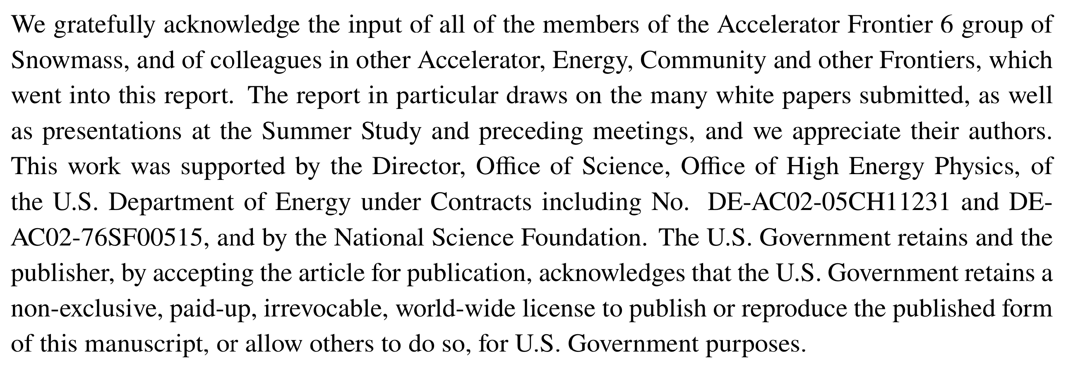
Snowmass Acknowledgement
26

Slide 27
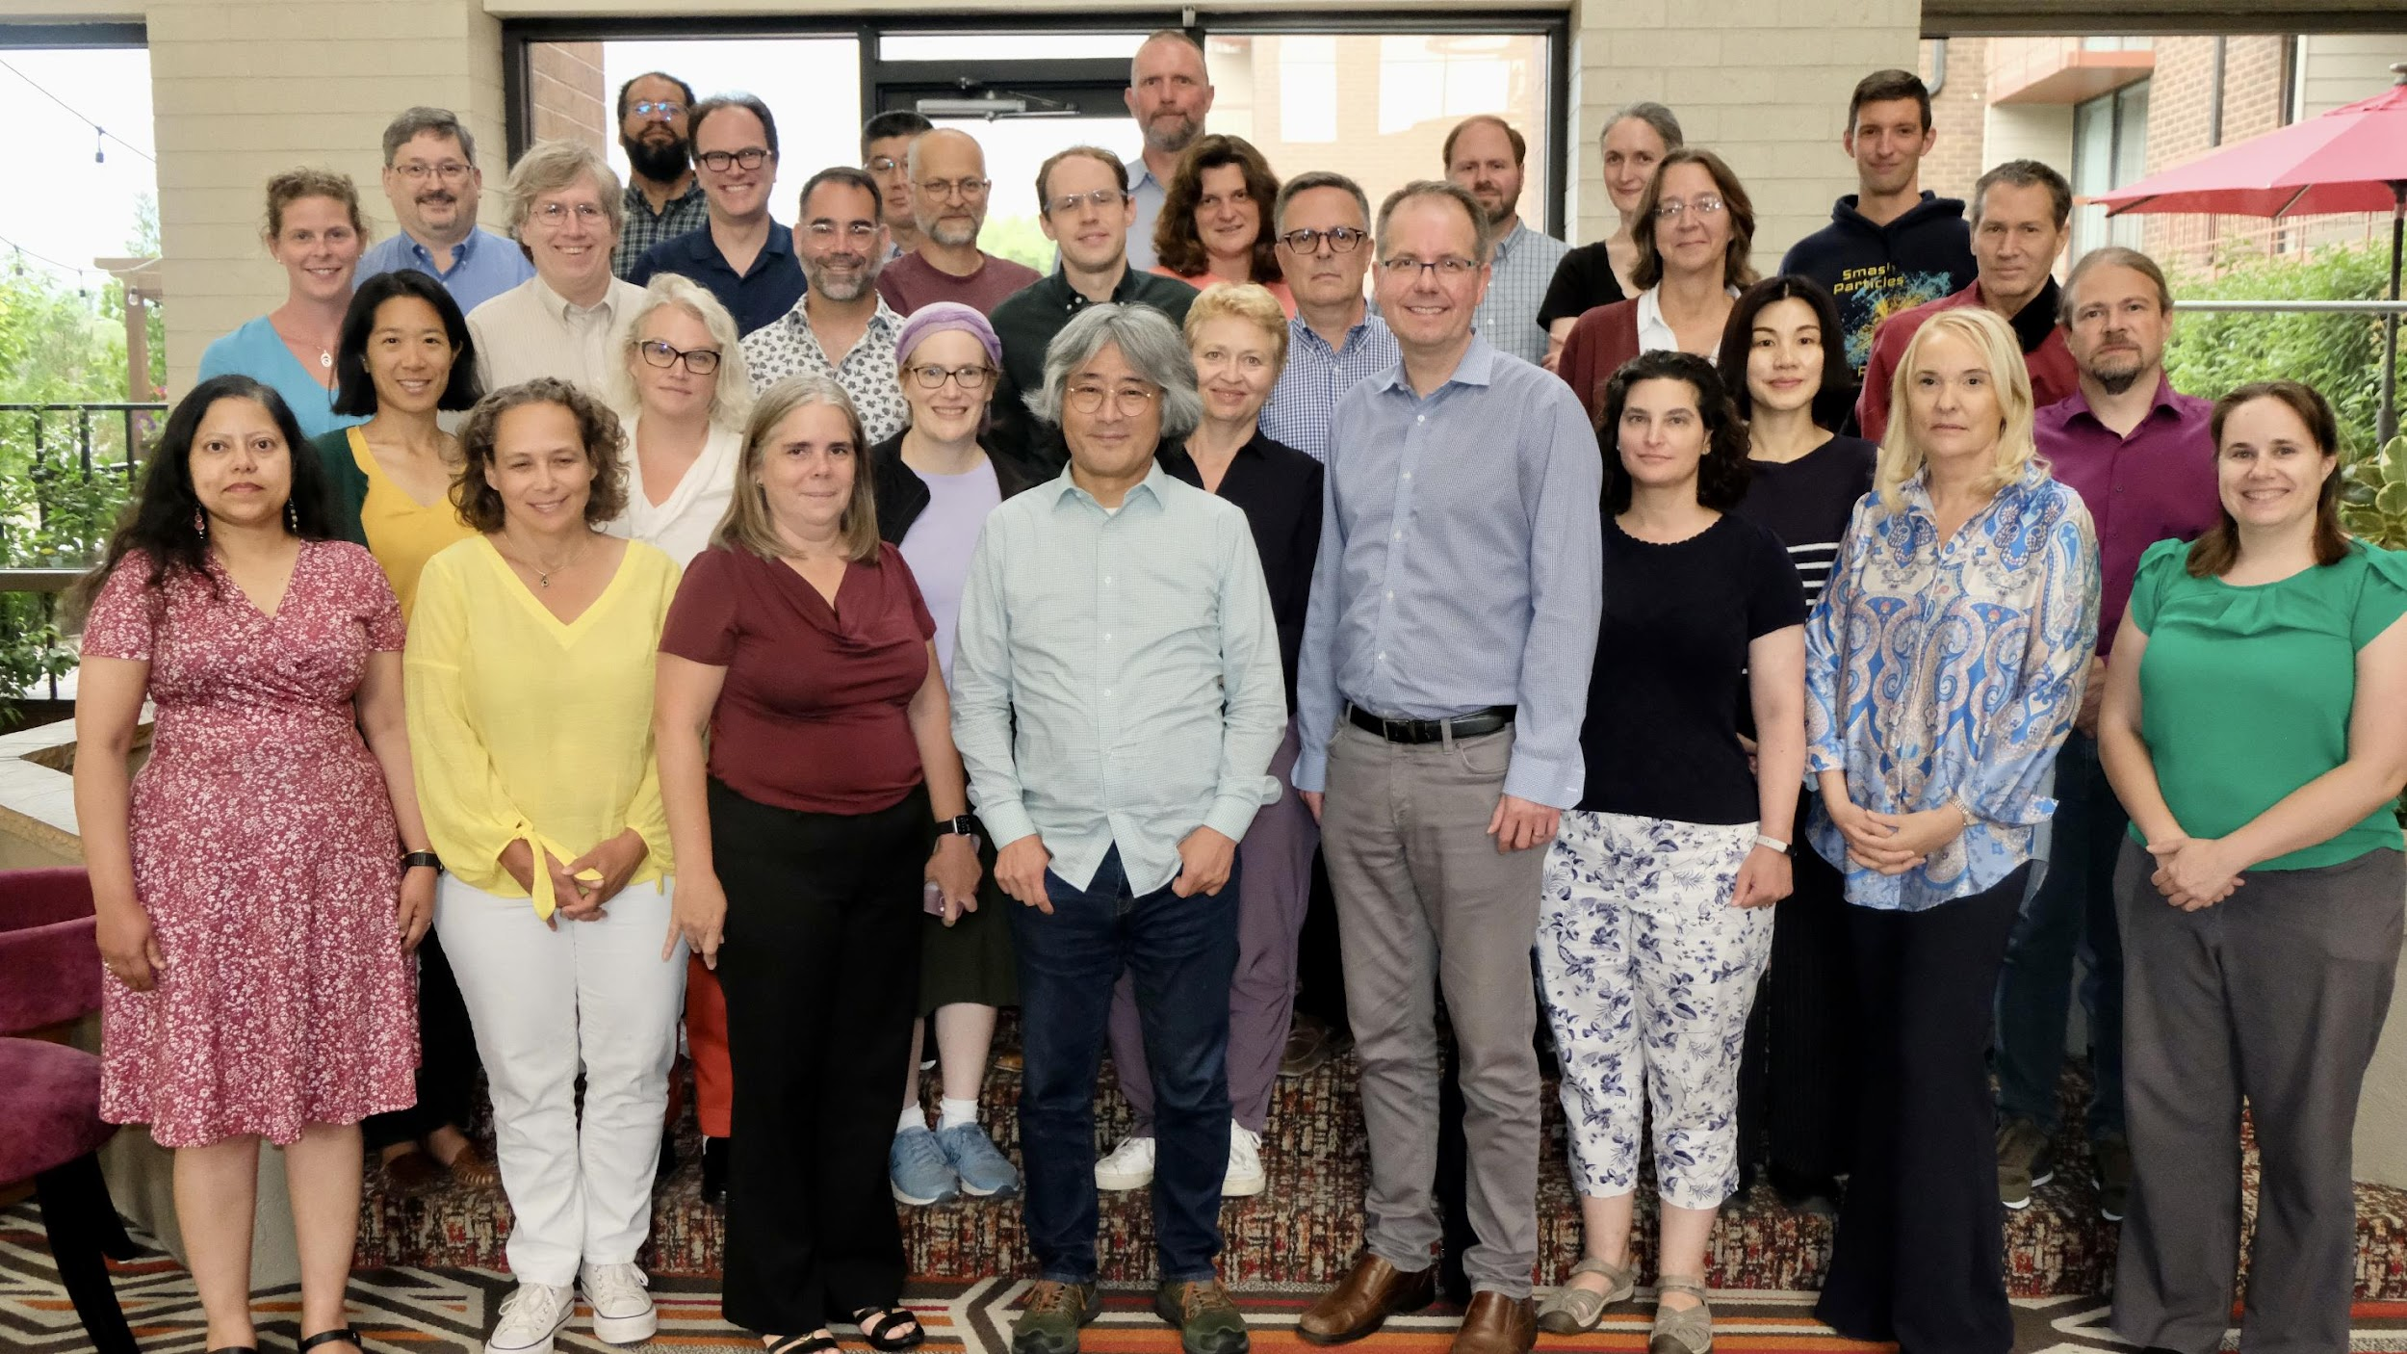
P5 Panel

Slide 28
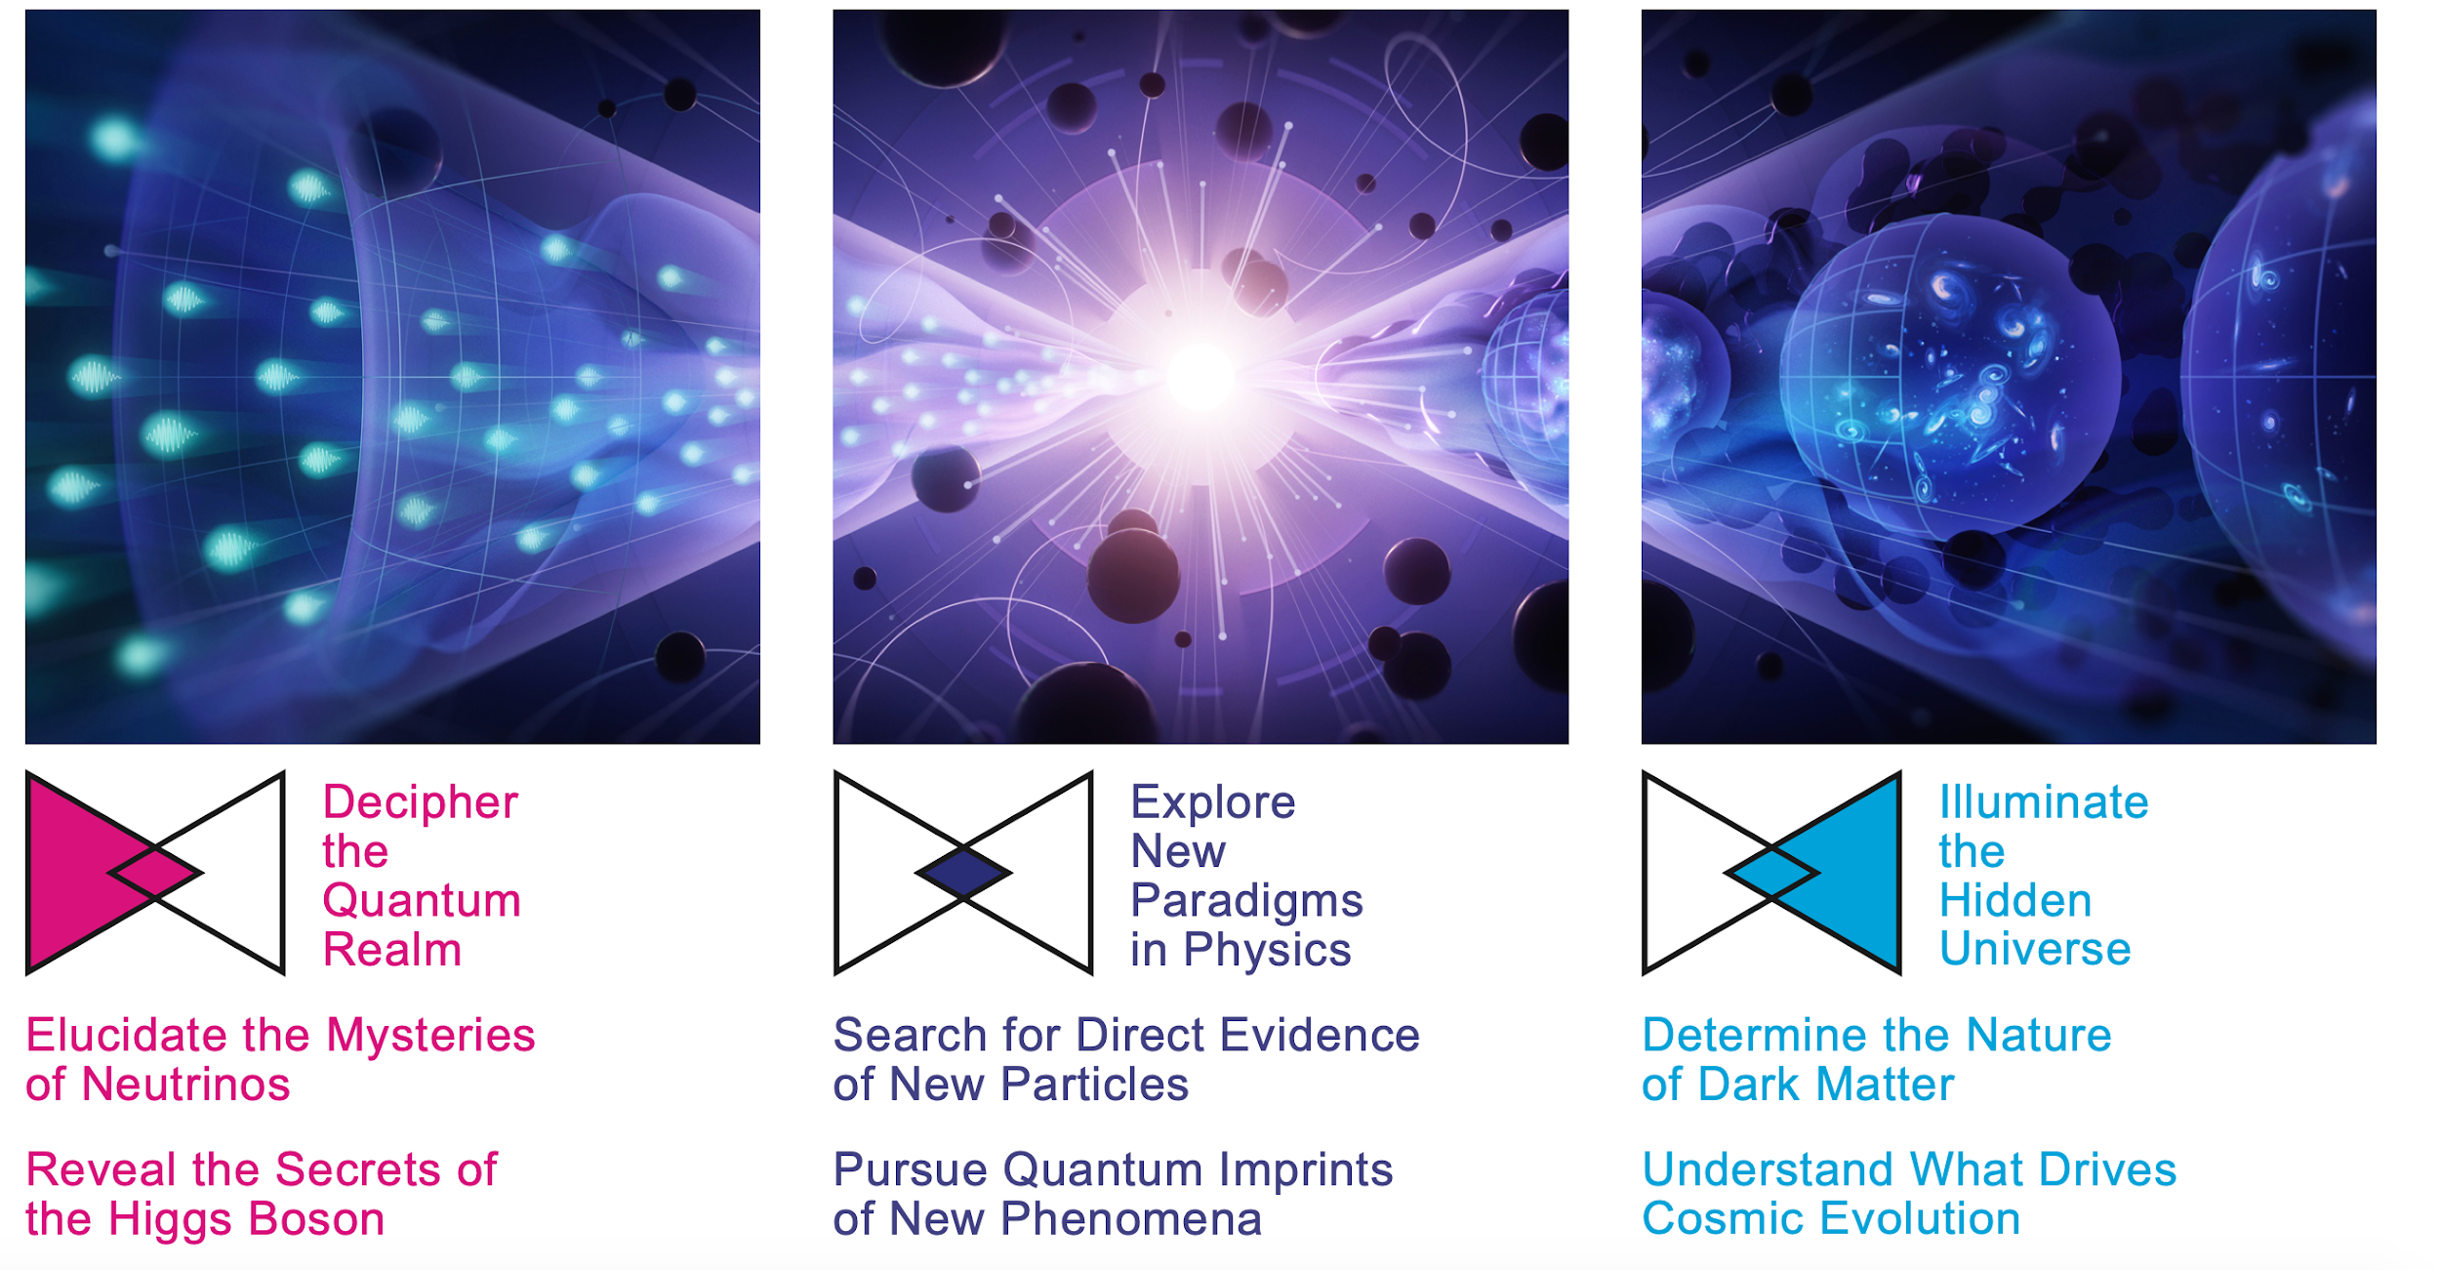

Slide 29
Backup material
29

Slide 30
Recommendation 1
Not Rank-Ordered
As the highest priority independent of the budget scenarios, complete construction projects and support operations of ongoing experiments and research to enable maximum science. We reaffirm the previous P5 recommendations on major initiatives:
HL-LHC (including ATLAS and CMS detectors, as well as Accelerator Upgrade Project) to start addressing why the Higgs boson condensed in the universe (reveal the secrets of the Higgs boson, section 3.2), to search for direct evidence for new particles (section 5.1), to pursue quantum imprints of new phenomena (section 5.2), and to determine the nature of dark matter (section 4.1).
The first phase of DUNE and PIP-II to determine the mass ordering among neutrinos, a fundamental property and a crucial input to cosmology and nuclear science (elucidate the mysteries of neutrinos, section 3.1).
The Vera C. Rubin Observatory to carry out the LSST, and the LSST Dark Energy Science Collaboration, to understand what drives cosmic evolution (section 4.2).

Slide 31
Recommendation 3
Not Rank-Ordered
Create an improved balance between small-, medium-, and large-scale projects to open new scientific opportunities and maximize their results, enhance workforce development, promote creativity, and compete on the world stage.
In order to achieve this balance across all project sizes we recommend the following:
Implement a new small-project portfolio at DOE, Advancing Science and Technology through Agile Experiments (ASTAE), across science themes in particle physics with a competitive program and recurring funding opportunity announcements. This program should start with the construction of experiments from the Dark Matter New Initiatives (DMNI) by DOE-HEP (section 6.2).
Continue Mid-Scale Research Infrastructure (MSRI) and Major Research Instrumentation (MRI) programs as a critical component of the NSF research and project portfolio.
Support DESI-II for cosmic evolution, LHCb upgrade II and Belle II upgrade for quantum imprints, and US contributions to the global CTA Observatory for dark matter (sections 4.2, 5.2, and 4.1).
The Belle II recommendation includes contributions towards the SuperKEKB accelerator.

Slide 32
Recommendation 5
Invest in initiatives aimed at developing the workforce, broadening engagement, and supporting ethical conduct in the field. This commitment nurtures an advanced technological workforce not only for particle physics, but for the nation as a whole.

Slide 33
Recommendation 5
Not Rank-Ordered
The following workforce initiatives are detailed in section 7:
All projects, workshops, conferences, and collaborations must incorporate ethics agreements that detail expectations for professional conduct and establish mechanisms for transparent reporting, response, and training. These mechanisms should be supported by laboratory and funding agency infrastructure. The efficacy and coverage of this infrastructure should be reviewed by a HEPAP subpanel.
Funding agencies should continue to support programs that broaden engagement in particle physics, including strategic academic partnership programs, traineeship programs, and programs in support of dependent care and accessibility. A systematic review of these programs should be used to identify and remove barriers.
Comprehensive work-climate studies should be conducted with the support of funding agencies. Large collaborations and national laboratories should consistently undertake such studies so that issues can be identified, addressed, and monitored. Professional associations should spearhead field-wide work-climate investigations to ensure that the unique experiences of individuals engaged in smaller collaborations and university settings are effectively captured.
Funding agencies should strategically increase support for research scientists, research hardware and software engineers, technicians, and other professionals at universities.
A plan for dissemination of scientific results to the public should be included in the proposed operations and research budgets of experiments. The funding agencies should include funding for the dissemination of results to the public in operation and research budgets.

Slide 34
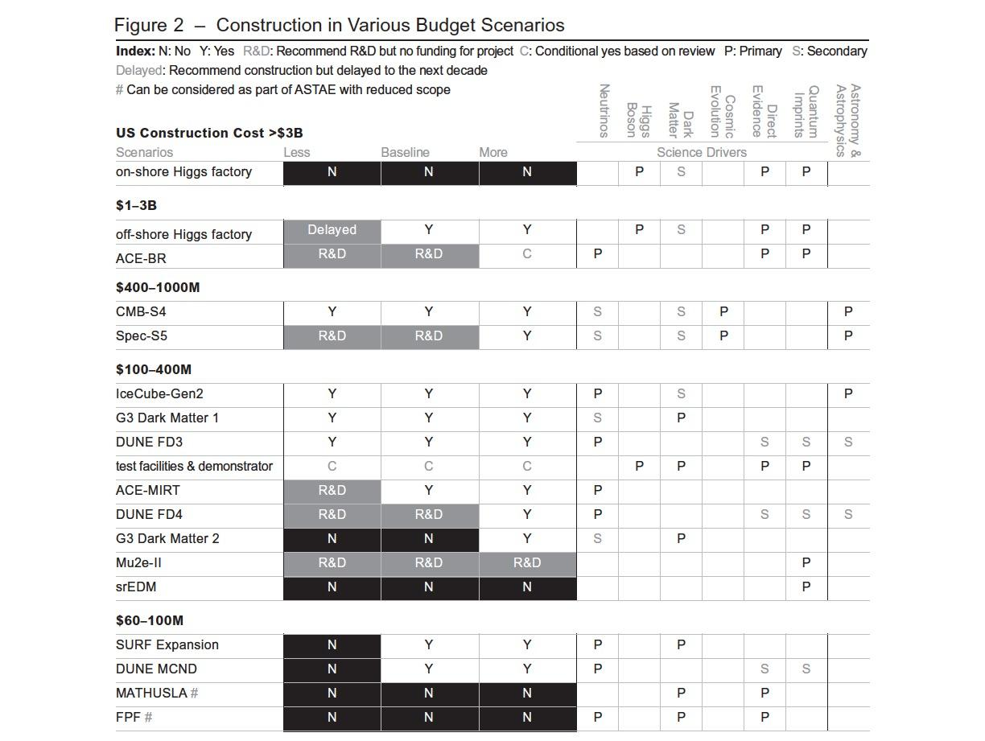
Difficult
Choices
A: Can be considered as part of ASTAE with reduced scope
A
A
A
A
A
A

Slide 35
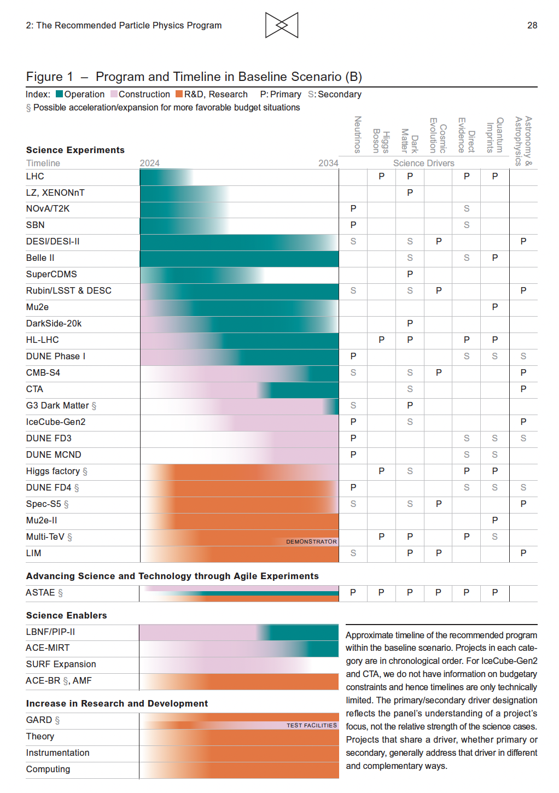

Slide 36
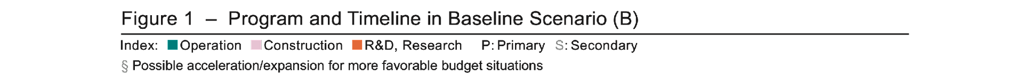

Slide 37
Prioritization Principles
Overall program should
  enable US leadership in core areas of particle physics
  leverage unique US facilities and capabilities
  engage with core national initiatives to develop key technologies,
  develop a skilled workforce for the future that draws on US talent
  realize effective engagement, partnership, and leadership in international endeavors
We also considered the uncertainties in the costs, risks, and schedule as part of our prioritization exercise. The prioritized project portfolios were chosen to fit within a few percent of the budget scenarios and to ensure a reasonable outlook for continuation into the second decade, even though that is beyond the purview of this panel.
      Balance of program in terms of
      Size and time scale of projects
      Inside or outside the US
      Project vs research
      Current vs future investment

Slide 38
Acknowledgements
We thank members of the cost subcommittee for their timely and hard work, in particular its chair, Jay Marx. We also thank all the national laboratories that made their staff available for this important task. We thank people at funding agencies for providing us all necessary information and support throughout the process. We thank our peer reviewers for giving us constructive feedback under a tight deadline. We thank Lawrence Berkeley National Laboratory, Fermilab, Argonne National Laboratory, Brookhaven National Laboratory, SLAC National Laboratory, Virginia Tech University, and University of Texas Austin for hosting the town halls. We thank James Dawson and Marty Hanna for professional editing. We thank Michael Branigan, Brad Nagle, Olena Shmahalo and Abigail Malate for providing beautiful graphics and layout. We thank the Yale Physics Department for supporting the development of the website. We thank Kerri Fomby, Jody Crisp, and Taylor Pitchford at ORISE and Stephany Tone at LBNL for logistical support. We thank our families for supporting us during this year-long process. And most importantly, we thank APS/DPF for organizing the Snowmass Community Study, and all members of our community for their bold and creative vision as well as their input to the process.

Slide 39


Pathways to Innovation and Discovery in Particle Physics
Report of the Particle Physics Project Prioritization Panel 2023
https://www.usparticlephysics.org/2023-p5-report/

