Slide 1

Intro Sustainability for lange scale Research Infrastructures
ALEGRO Workshop 2024
Denise Völker, Head of Sustainability at DESY
20th March 2024

Slide 2
Basics

Slide 3
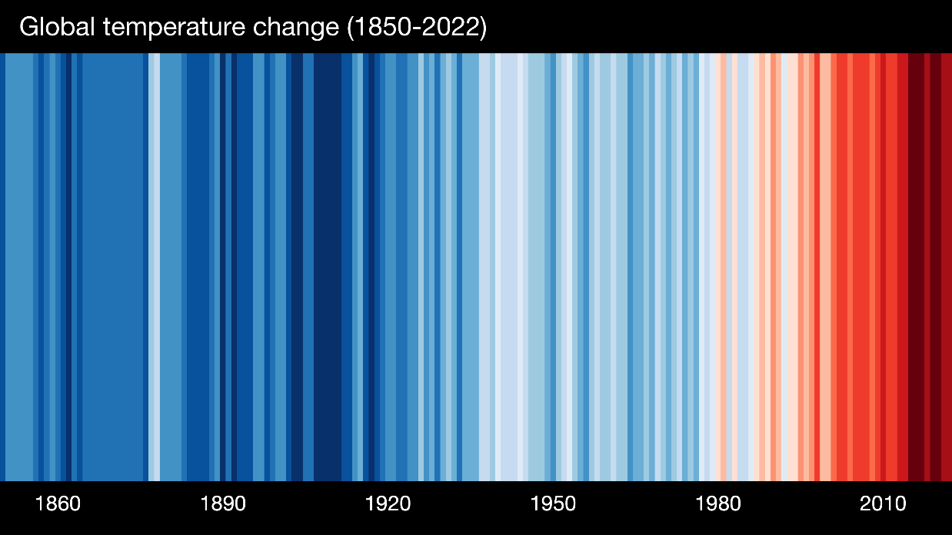
Climate Change
Temperature rise
| Source: https://showyourstripes.info
Scientific facts: Research Centers as scientific institutions have to act accordingly!
Notes:
3

Slide 4
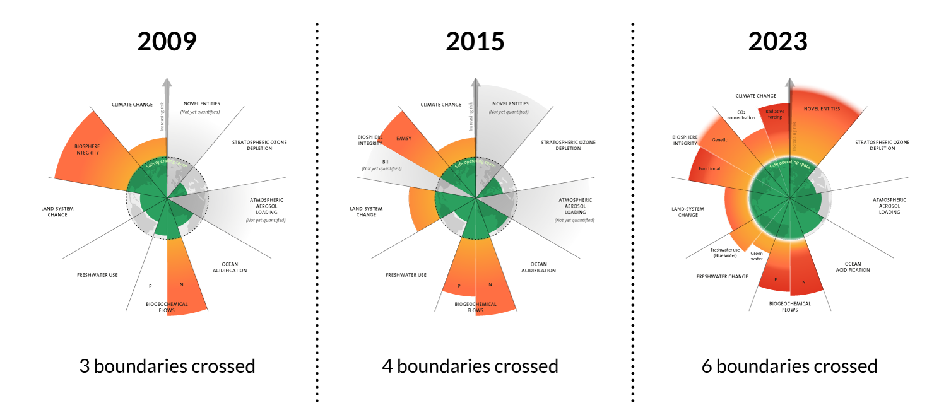
Planetary Boundaries
The Challenges
| Source: The evolution of the planetary boundaries framework. Azote for Stockholm Resilience Centre, Stockholm University. Based on Richardson et al. 2023, Steffen et al. 2015, and Rockström et al. 2009

Slide 5
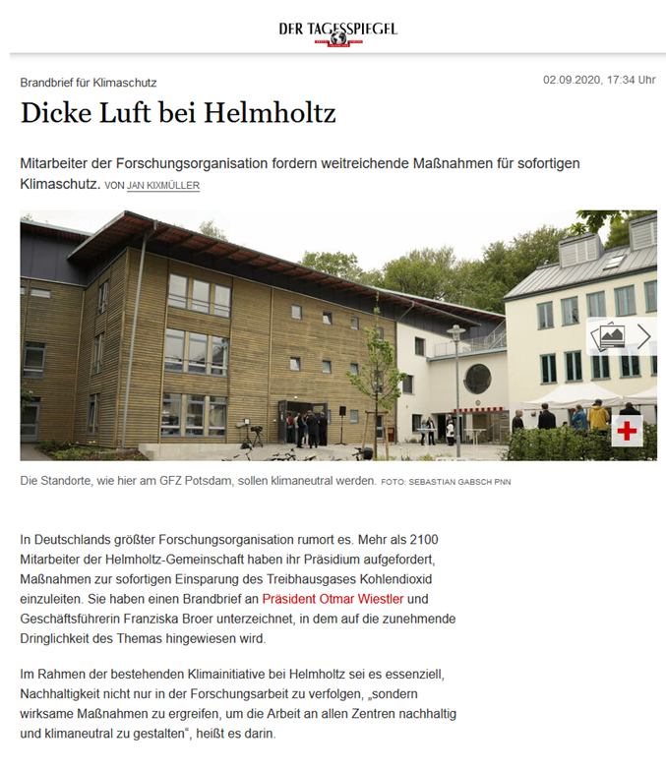
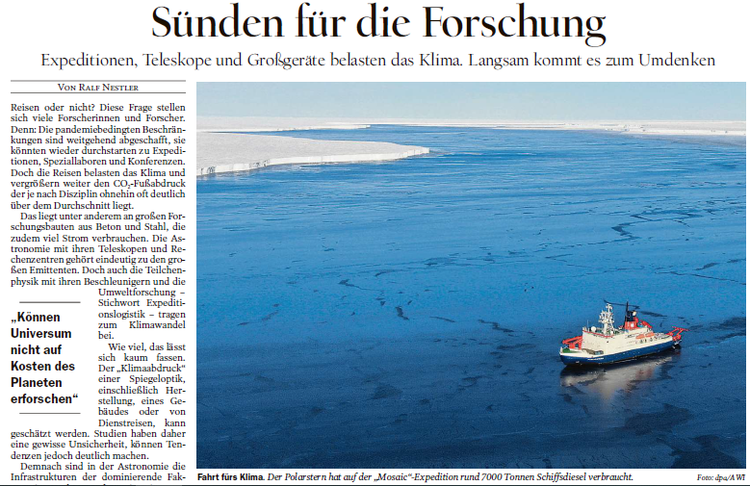
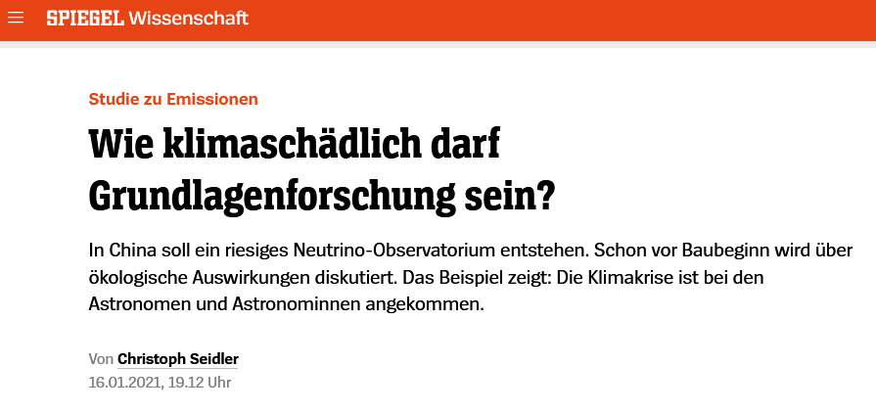
Public Perception
Securing social and political legitimacy
Trouble‘s brewing @ Helmholtz
Sins for research
How climate-damaging is basic research allowed to be?
Notes:
5

Slide 6

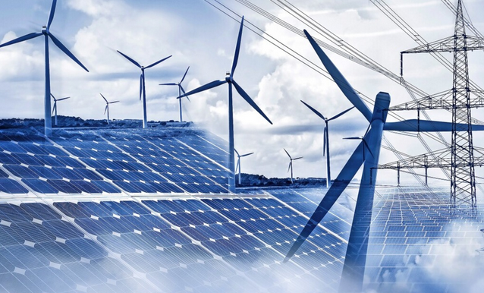
What are we looking at?
What and How
Sustainable Research Centers
Research for Sustainability = What
Sustainable Research = How
| e.g. Contribution UN Sustainable Development Goals
| e.g. Usage of eco-power
Notes:
6

Slide 7


Sustainability at Research Organizations (Germany)
Broad approach
Infrastructure
Reuse of infrastructure
Energy saving technologies
New building concepts and materials
Science
culture of scientific integrity to ensure good scientific practice
reflection of societal responsibility in the research process
Supporting processes
Procurement
Cooperation in campus security, safety, environmental protection and mobility
Staff
Sustainable career development
Keep knowledge on campus and attract best talents
Corporate Governance
Transparent to employees and stakeholders
Documentation of processes and decisions
Boost socio-economic impact
(education, employment, technology transfer)

Slide 8

Impact Degree
Possibly decades of research needed
Including Effort
Fast, needs investment
Easy, cheap, many volunteers
Measures not specific for research centers
(e.g. Travel, Catering, Mobility ….)
Measures with the infrastructure
(e.g. Remote access, renewable energy, waste heat, PV ….)
Measures at the infrastructures
(e.g. energy recovery; high temperatures, substitutes for certain gases, Plasma, Data management ….)

Slide 9
Focus Infrastructure
Footprinting / LCAs
efficient technologies
research infrastructure system efficiency
water consumption
Design for Sustainability
office/lab energy consumption
waste management & recycling
energy procurement
heating & waste heat recycling
grid energy consumption
use of materials and resources

Slide 10
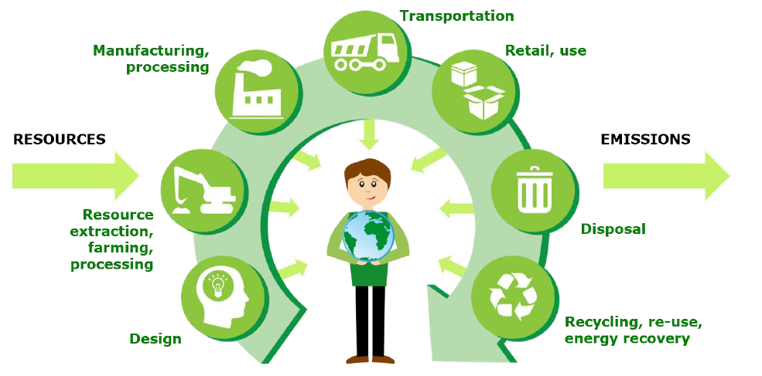
Life Cycle
It starts with the DESIGN
“LCA is a tool for the analysis of the environmental burden of products at all stages in their life cycle”
+ Social
+ Governance
I Source: European Commission, Joint Research Centre, Cristobal-Garcia, J., Pant, R., Reale, F., et al., Life cycle assessment for the impact assessment of policies, Publications Office, 2017, https://data.europa.eu/doi/10.2788/318544

Slide 11
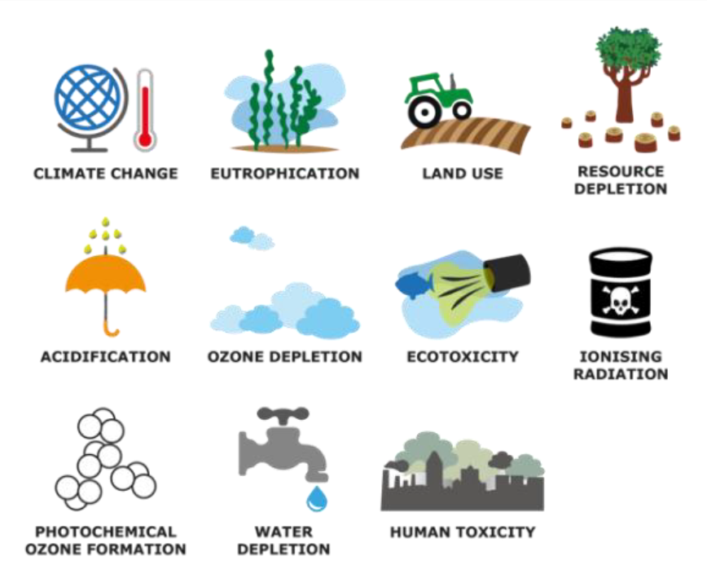
What is being looked at?
Not only Greenhouse Gases
I Source: European Commission, Joint Research Centre, Cristobal-Garcia, J., Pant, R., Reale, F., et al., Life cycle assessment for the impact assessment of policies, Publications Office, 2017, https://data.europa.eu/doi/10.2788/318544

Slide 12
What is being looked at?
Not only Greenhouse Gases
    Indicator Unit
    Climate Change Potential (Global Warming) GWP kg CO₂ eq.
    Eutrophication Potential (Over-fertilization) EP kg P eq./kg N eq.
    Photochemical Ozone Depletion Potential (Summersmog) POCP kg Ethene eq.
    Ozone Depletion Potential (Ozone hole) ODP kg CFC-11 eq.
    Acidification Potential land and ocean (Acid rain) AP kg SO₂ eq.
    Human toxicity HTP kg 1,4-DCB eq.
    Ecotoxicity FAETP / MAETP / TETP kg 1,4-DCB eq.
    Abiotic Resource Depletion (Resource scarcity) ADP kg Cu eq.
    Water scarcity m³ world eq.
    Land use m²a
    …… …….

Slide 13
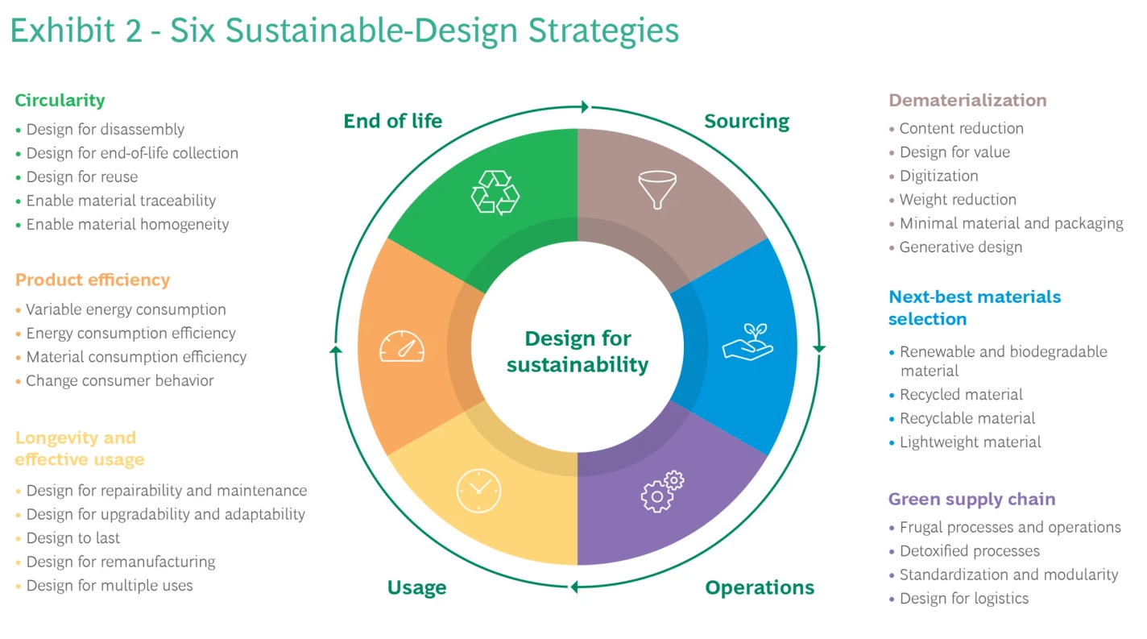
Design for Sustainability
General Approach
I Source: Boston Consulting Group. Six Strategies for Designing Sustainable Products; https://www.bcg.com/publications/2023/six-strategies-to-lead-product-sustainability-design

Slide 14
Projects examples

Slide 15
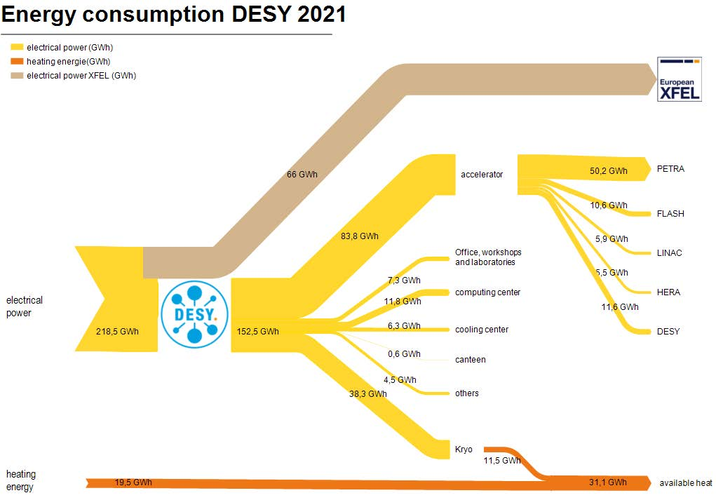
Energy consumption at DESY 2021

Slide 16
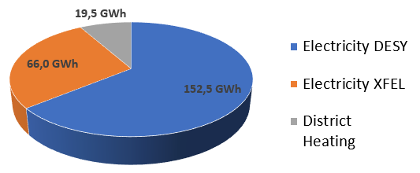
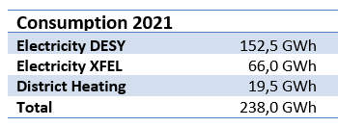
Energy consumption at DESY 2021
DESY campus in Hamburg
In 2021 this is in total as much energy consumption as 14.000 households¹ (but: households use most energy for heating and DESY uses mainly electrical energy)
Comparison only in electrical energy:
  Only DESY 49.000 households²
  DESY + XFEL ca. 70.000 households²
¹ source: Energy consumption of private households: 16.433 kWh; ca. 70% for room heating; https://www.destatis.de/DE/Presse/Pressemitteilungen/2018/10/PD18_378_85.html ; average household has ca. 2 persons: http://www.bpb.de/nachschlagen/zahlen-und-fakten/soziale-situation-in-deutschland/61587/haushalte-nach-zahl-der-personen
² source: Only electricity, no other energies. Electricity consumptions depends on size of household. Average household of ca. 2 persons uses 3.106 KWh (https://www.destatis.de/DE/Themen/Gesellschaft-Umwelt/Umwelt/UGR/private-haushalte/Tabellen/stromverbrauch-haushalte.html)

Slide 17
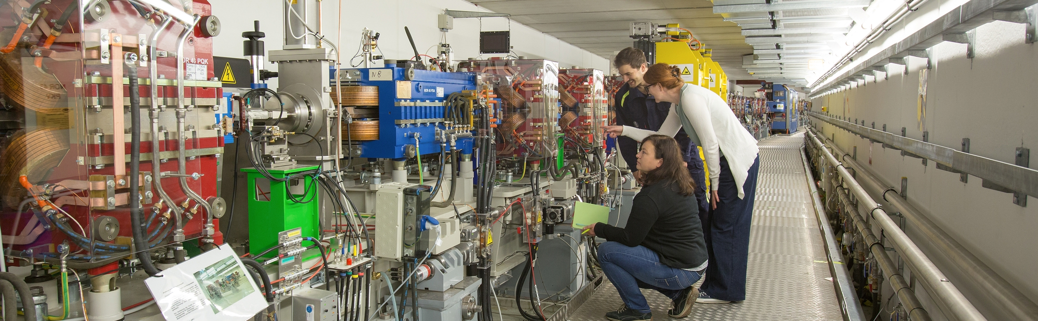
Climate Protection at DESY
Focus CO₂
DESY has 3 big CO2 emission sources (and many little ones)
  Electrical power: from 2023 on 100 % Renewable – 40.000 tons CO₂ less per year (55.000 tons with XFEL) (compared to 2019)
  Business trips: 1/3 less travel in total - short trips only by train - flights we can´t avoid to be compensated - CO₂ savings between 4.000-6.000 tons
  Heating: currently comes from a coal plant nearby - already use waste heat from the cryogenic hall (>10 GWh/y) – next project: usage of unused waste heat of ca. 12 GWh/y – possible CO₂ savings of about 4.000 tons (compared to 2019)

Slide 18
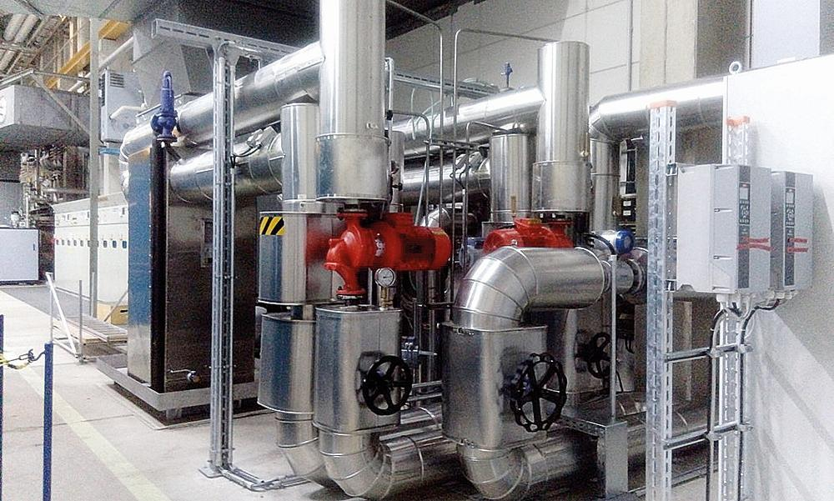
Waste Heat Usage 1
Cryogenic Plant - in use since 2017
Since 2017 use of waste heat from cryogenics
Cooling of helium down to 2 Kelvin for the operation of the superconducting accelerators
Waste heat with a temperature of 70 °C
More than 10 GWh each year
→ More than 1/3 of the required heat @ DESY
Notes:
Seit 2017 Nutzung der Abwärme aus der Kryogenik
Kühlung von Helium auf 2 Kelvin für den Betrieb der supraleitenden Beschleuniger
Dabei entsteht Abwärme mit einer Temperatur von 70 °C
Jährlich stehen so mehr als 10 GWh zur Verfügung
Mehr als ein Drittel der benötigten Wärme bei DESY

Slide 19
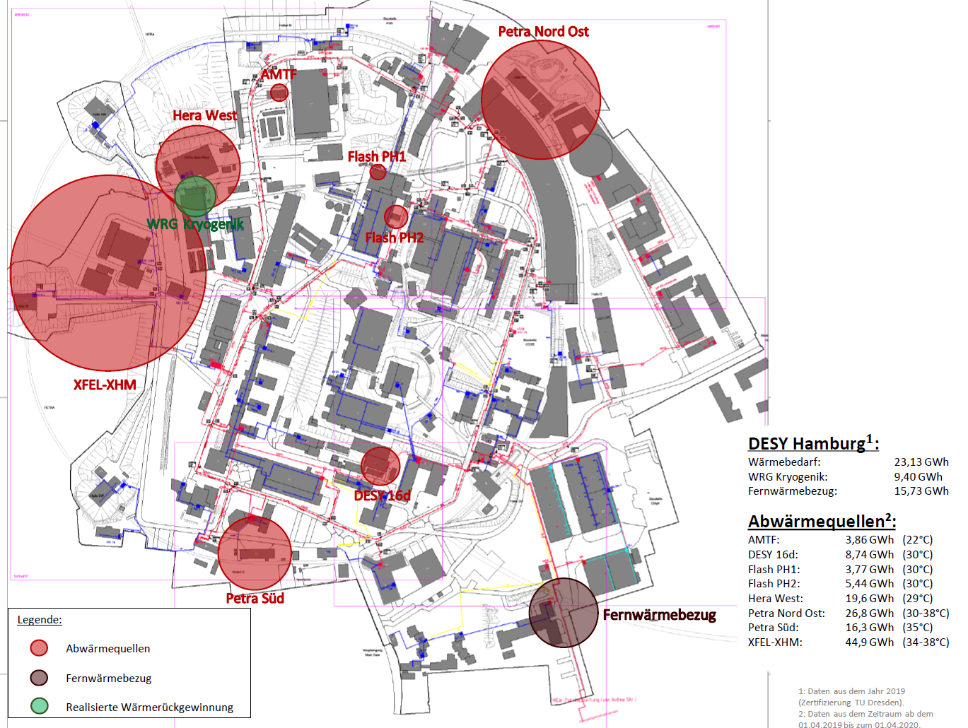
Waste Heat Usage 2
Unused Potential at DESY Campus in Hamburg
Waste heat from accelerators not yet in use
Project with University of applied science in Hamburg (HAW) to identify potential
→ Result: 129 GWh/y of waste heat available at a temperature level of 30°C - 40°C
Can cover all of DESYs heat demand
(12 GWh/y )
→ usable in existing and new buildings
Possible CO₂ savings at DESY campus of about 4.000 tons/y

Slide 20
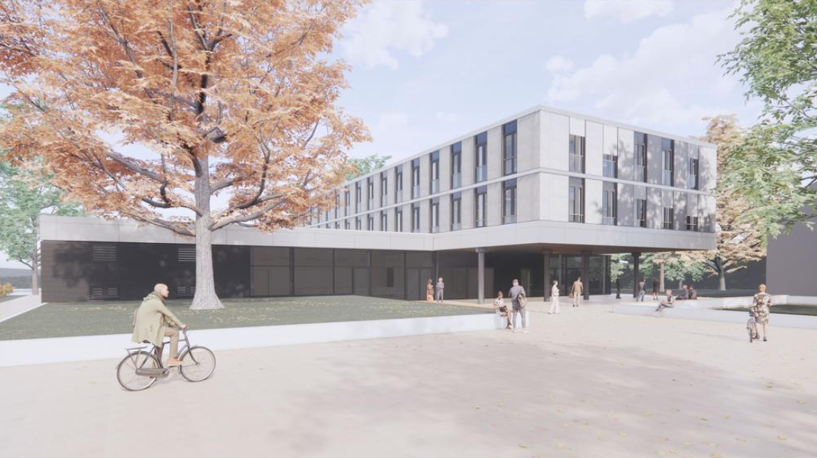
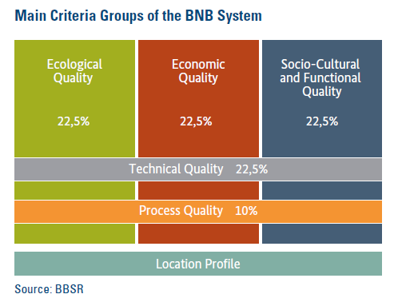
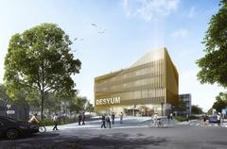
Civil Construction
Assessment System for Sustainable Building (BNB)
I CTA-SDMC Zeuthen
I DESYUM

Slide 21
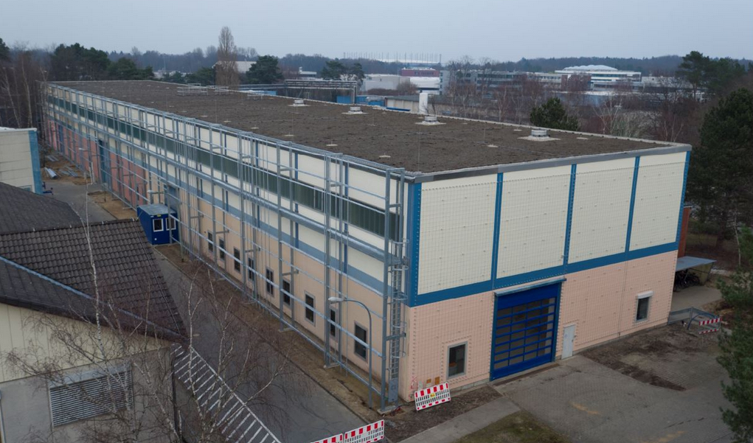
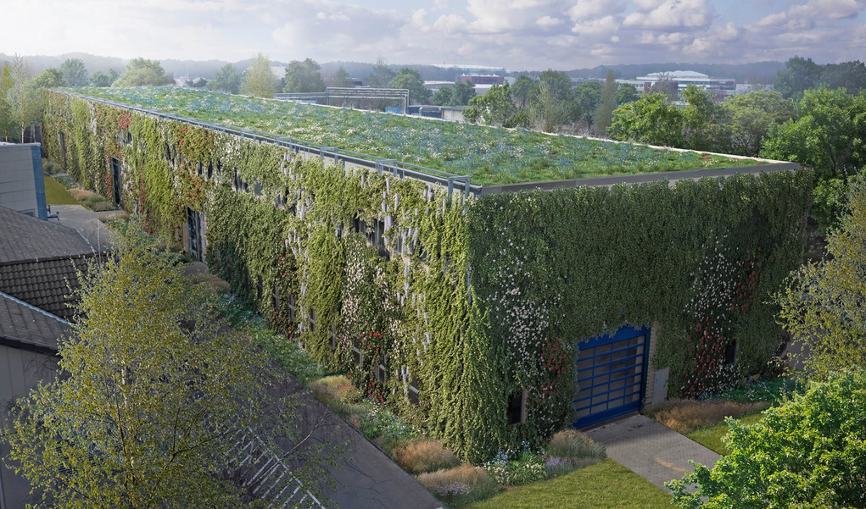
Sustainability at DESY
Green DESY
Building 36 – Total area of greening 4,570 m² = half a hectare (roof and 3 walls)
Bird's eye view at the beginning and in a few years
Draft: L+ Landschaftsarchitekten
Visualization: luminousfields
Benefits:
more efficient rainwater management through retention by increasing water seepage and evaporation opportunities
Healthy microclimate
Reduction of the heat island effect (cooling down of the city heat in summer)
Air pollution control / Respirable dust absorption
Breeding and foraging habitats for birds and insects
Contribution to biodiversity

Slide 22
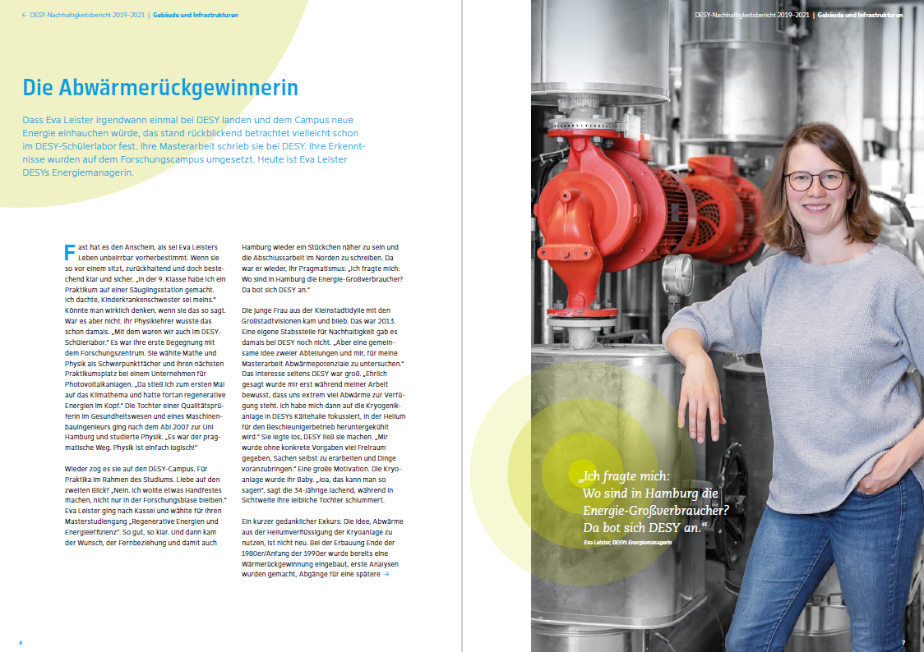
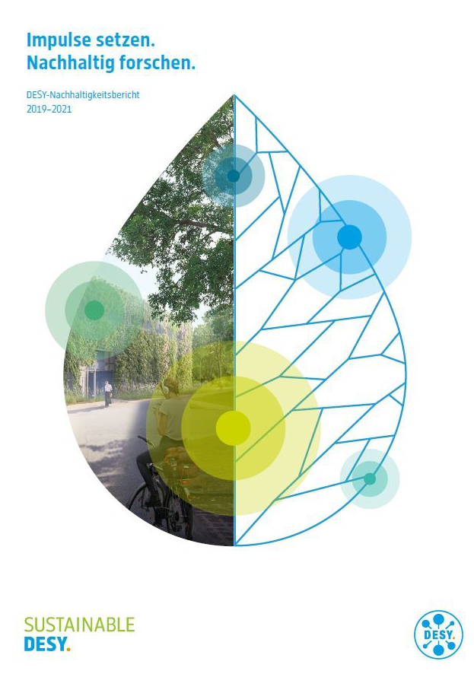
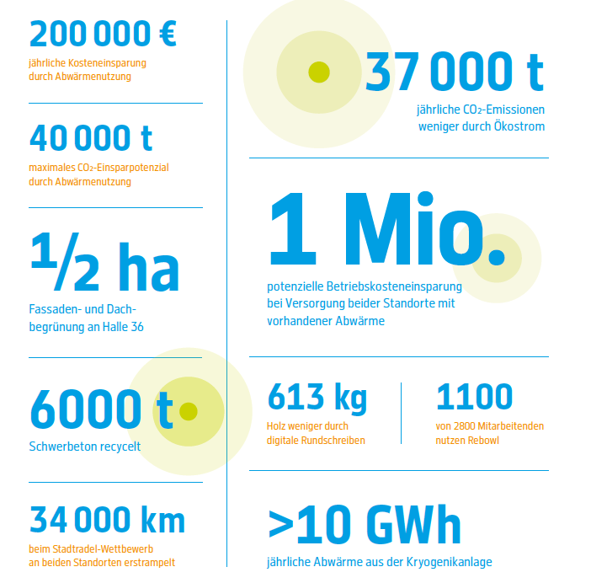
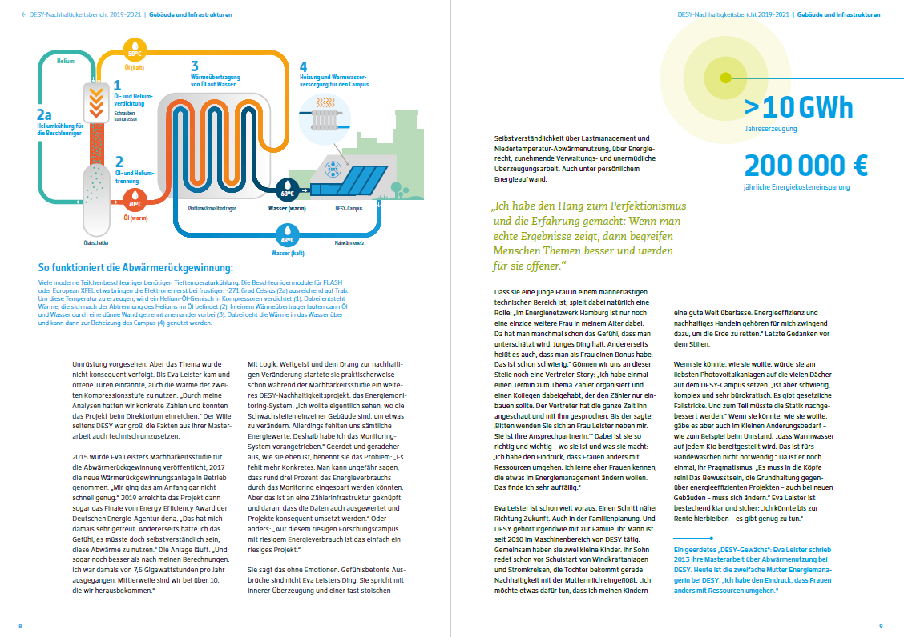
DESY Sustainability Report
2019-2021
https://nachhaltigkeit.desy.de/sustainability_report/index_eng.html

Slide 23
Lets get closer to the accelerator

Slide 24

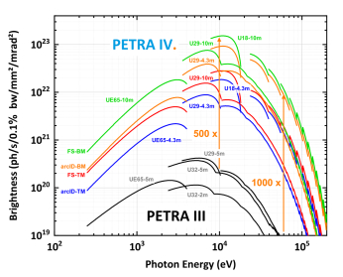
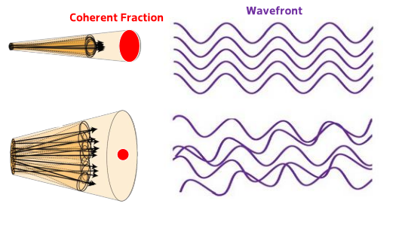
Upgrade PETRA III : PETRA IV.
What is the benefit of the upgrade?
Photon source size –ideal imaging capabilities
Comparison of the beam emittance for PETRA III (left) and PETRA IV (right)
 | PETRA III | PETRA IV
Horizontal | 1300 pm rad | 20 pm rad
Vertical | 10 pm rad | 5 pm rad
Spectral brightness of PETRA IV (H6BA lattice) compared to PETRA III ^{[1]}
Brilliance increase by
➔500 x (hard X-rays)
➔1000 x (high-energy X-rays)
PETRA IV. brilliance at 100 keV
higher than for 10 keV at PETRA III today!!
Coherence of the emitted light for PETRA III (bottom) and PETRA IV. (upper figure)
[1] C.G. Schroer et all Eur. Phys. J. Plus 137, 1312 (2022)

Slide 25
Permanent Magnets - Energy Consumption
Very good
Increasing use of PM in new lattices
PMs run without electricity
Hugh power savings
ESRF: before upgrade 16.9 GWh / year
after upgrade 8.5 GWh / year
PSI: SLS 6.4 GWh / year
SLS2.0 2.6 GWh / year
HZB: BESSY II 5.1 GWh / year
BESSY III < 1.3 GWh / year
DESY calcutaled Energy savings with the current design:
about 2.87 GWh/year
(calculated with 6500 h operation time per year; without cooling and heating)
I
J.Chavanne, Permanent accelerator magnets for light sources, 5th ESSRI Workshop 2019, https://indico.psi.ch/event/6754/contributions/18013/
I
M.Seidel, Technologies for Sustainable Accelerators, First iFAST annual meeting, 2022, https://indico.cern.ch/event/1138690/contributions/4782721/
I
J.Völker, Overview permanent magnets at accelerator facilities, iFAST REE workshop 2023, https://indico.desy.de/event/35655/timetable/#20230206.detailed

Slide 26
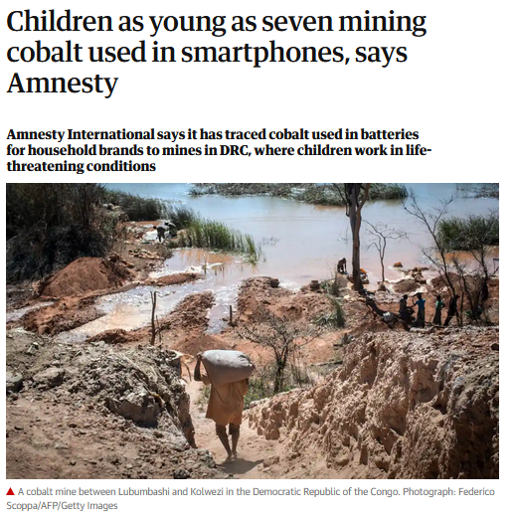
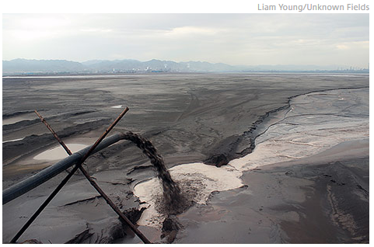
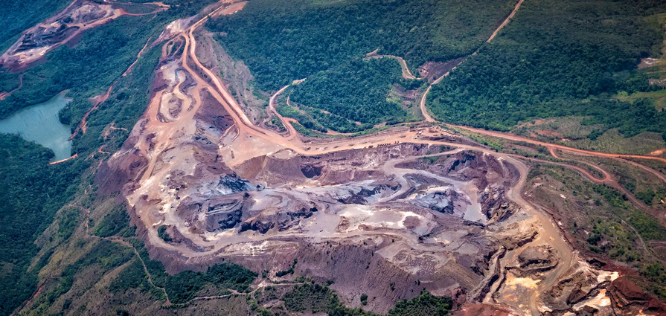
I UK Guardian: article on shocking working conditions in cobalt mining, cobalt is also to be used in PM
Rare Earth Elements - Current situation
Very bad
Rare earths (REE) are mined and processed under destructive social and environmental conditions
No alternative sources or certified mining and processing available
So far no sufficient progress on recycling of old PM
https://indico.desy.de/e/ree
I ORF, 2015, Auf der dunklen Seite des Fortschritts: https://orf.at/v2/stories/2272650/2272651/
I Spektrum, 2020, Politik bedroht unberührte Amazonasgebiete, https://www.spektrum.de/news/politik-bedroht-unberuehrte-amazonasgebiete/1754314

Slide 27
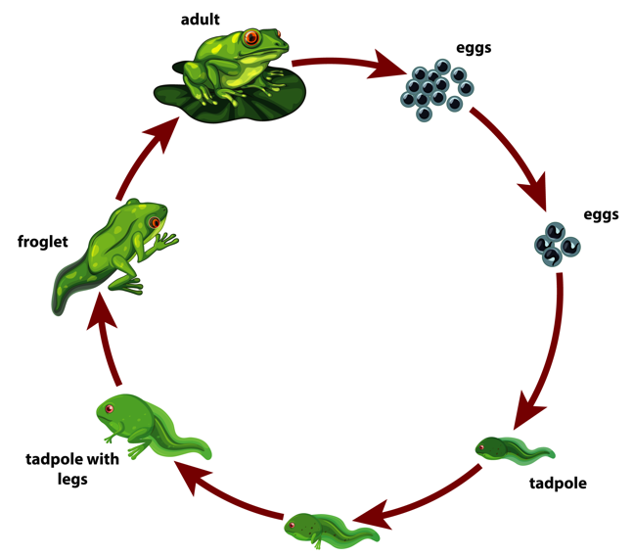

What to do?
Small steps have value
Implement life cycle management already in planning phase of new Ris
Find best practice for recycling of these materials
Support development of certification system for mining and processing of critical materials
I Image by brgfx on Freepik
I Image by juicy_fish on Freepik
Upstream Supply Chain
Downstream Supply Chain
Exploration, Mining and Comminution
Processing
Flotation, Roasting, Leaching, Precipitation (optional)
Intermediary Trade
(optional)
Separation
Ion exchange, Solvent extraction
Refining / Reduction
Calcination, Electrolysis
Semi-Fabrication & Conversion
Manufac-turing
Retail / Wholesale
(Re-)Use / Recycling
(optional)
I from M.Erdmann: https://indico.desy.de/event/35655/contributions/137541/

Slide 28
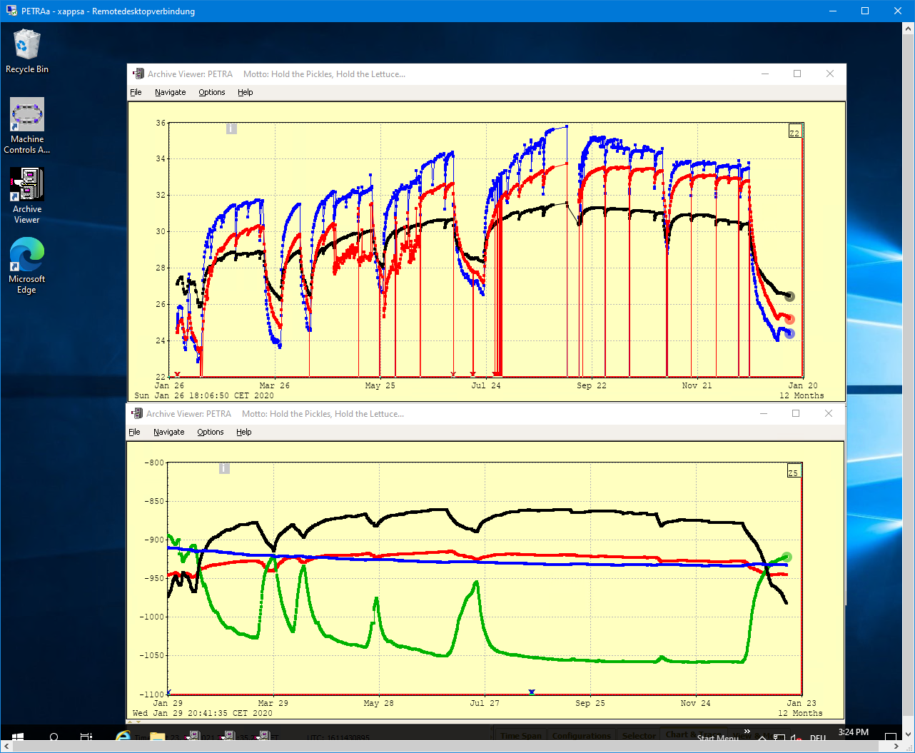
Tunnel Temperature PETRA III
Heated and unheated Sections
Tunnel Climatization today:
Air (25º C) blown in every 300/600 m
Cooling water inlet: 25º C
Temperature over one year
Temperature difference between
positions up to 5°C
Operating schedule of PETRA clearly visible
Summer and winter time visible
Black curve, 26º – 31º C: Concrete floor, OR59, air temperature regulated (30º C)
Red curve, 23º – 34º C: Concrete floor, SOR87, air temperature unregulated
Blue curve, 23º – 36º C: Air temperature, SOR85, air temperature unregulated
|Source:Temp.Calc.Kickoff| PETRA IV WP 1.12 - Michael Bieler

Slide 29
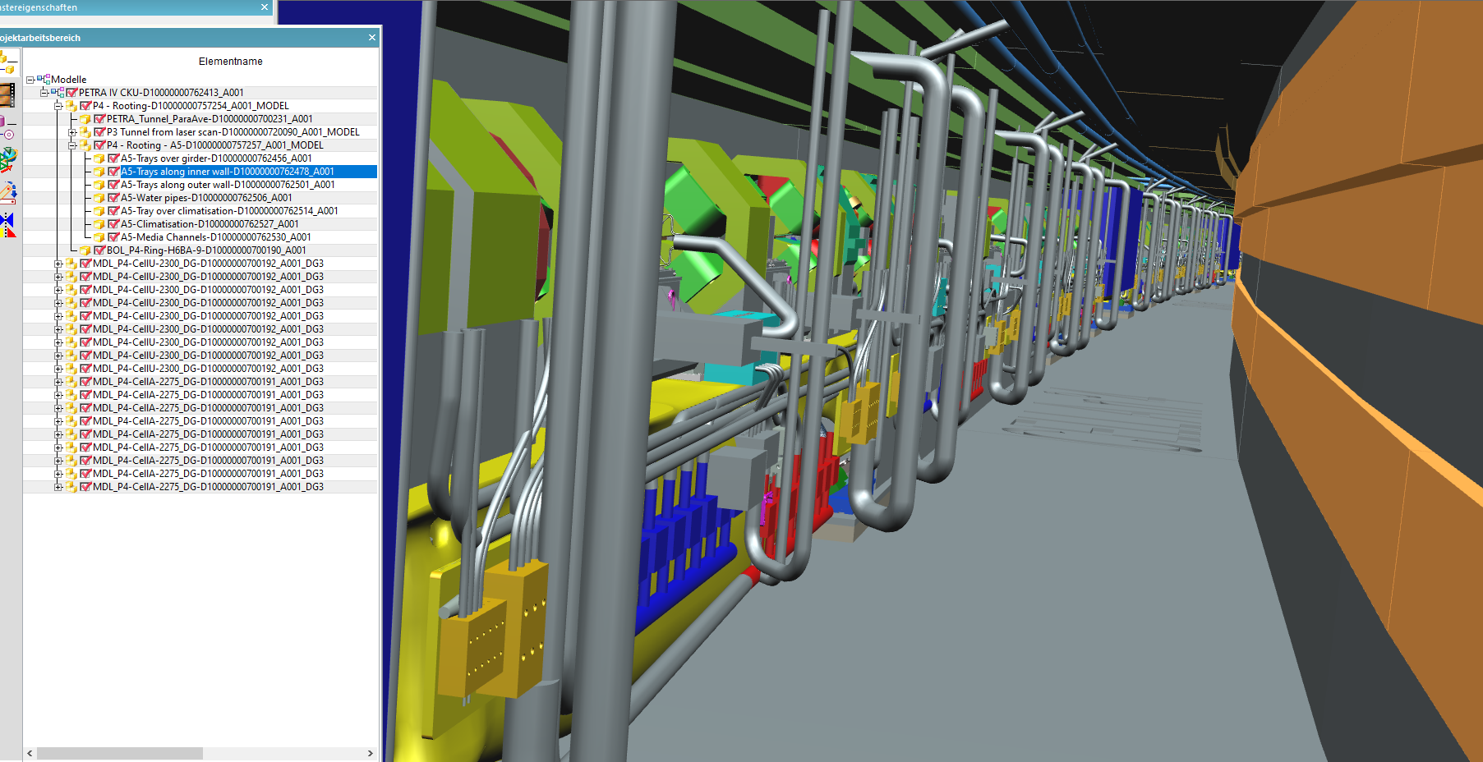
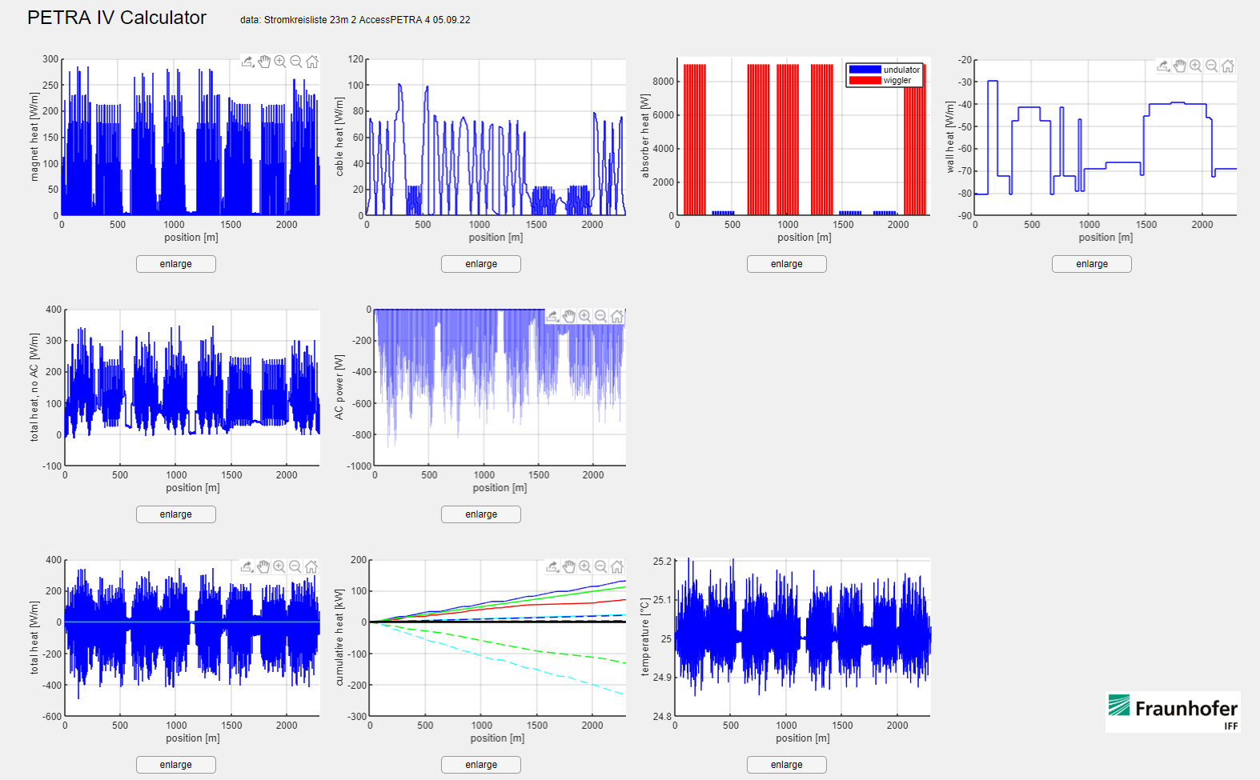
3D calculation of tunnel air and heat flowa
Cooperation with Fraunhofer Magdeburg for CFD-simulation (fluid dynamic)
Digital Twin of the tunnel in CAD (not yet completed)
Single parts can be selected and hidden
It can be rotated etc.
A list with all consumer of electricity with their heat input
(called Stromkreisliste)
Including the cooling capacity and the position
of air conditioners
Fluid dynamical simulations:
  Heat distribution also for corners and hidden places
  Optimization for cooling and heating (in shutdowns)
  Optimization of cabeling
(Cedric Kula TAC)
screenshot of the app
and first test results
(R. Zimmermann)

Slide 30
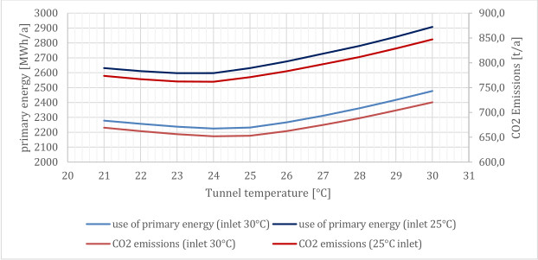
CO2 emissions for different tunnel temperatures
PETRA IV requires very stable temperature
Including shutdowns, when we have to heat for a constant temperature.
Optimal temperature in the tunnel are:
Water: 30°C
Air: 25°C
Primary energy consumption and CO₂ emission for different tunnel temperatures and cooling water inlet temperatures with reference PETRA IV operation
(T. Warnecke „Report on thermal parameters of PETRA IV”)

Slide 31
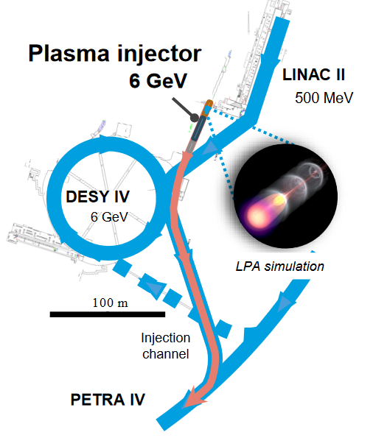
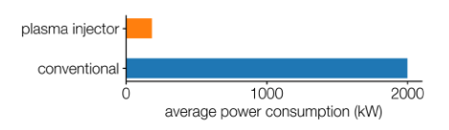
Accelerator R&D
Plasma based injector PETRA IV

Slide 32

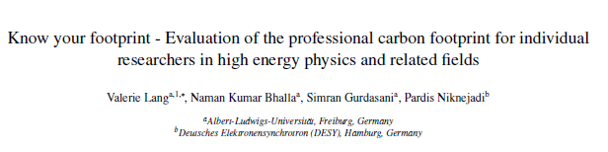
Sustainable Design
International exchange on Sustainable Accelerators
ESSRI conference
Energy for Sustainable Science at Research Infrastructures (ESSRI) 25./27. Sept. 2024 in Madrid
Program includes: energy management, latest efficiency ideas and critical materials
https://agenda.ciemat.es/event/4431/
Know your footprint Campaign
Developed by the young High Energy Physicists (yHEP)
Paper: https://arxiv.org/abs/2403.03308
Calculator: https://limesurvey.web.cern.ch/863499?lang=en

Slide 33
Thank you

Slide 34
Denise Völker
D6 - Nachhaltigkeit
E-Mail: denise.voelker@desy.de
Telefon: +49 (0)40 - 8998 4414

