Slide 1
Sustainability in future Colliders
R. Losito, ATS-DO
20 March 2024,
ALEGRO Workshop 2024, Lisbon

Slide 2
Outline
Where are we heading to: UN Sustainable goals
What parameters are important for a Collider?
  Energy
  CO₂
  Use of Land
  Responsible procurement…
Can we compare different colliders based on sustainability?
Conclusions

Slide 3
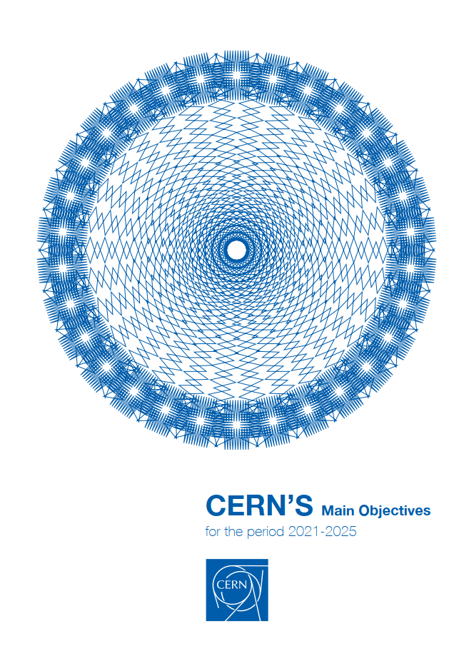
Management Objectives 2021-2025
Commitment to SDGs
‘One of the Management’s top objectives for the next five-year period is to increase CERN’s impact on society, thereby boosting the Organization’s visibility and consolidating the support of governments and the general public’.
‘Across all these areas of activity, CERN will continue to ensure that their impact also contributes to advancing the Sustainable Development Goals (SDG), adopted by all United Nations Member States in 2015. Collaboration with CERN’s Member and Associate Member States, with international organisations and other partners will be enhanced to identify and pursue further synergies in support of the SDGs, building on CERN values, competencies and technologies’.

Slide 4


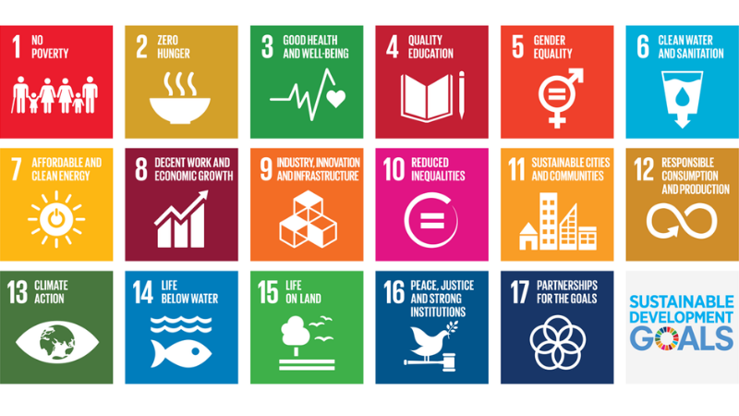
Sustainable Development Goals
The basics
On 25 September 2015, the United Nations General Assembly unanimously adopted Resolution 70/1, Transforming our World: the 2030 Agenda for Sustainable Development, laying out 17 Sustainable Development Goals, aimed at mobilising global efforts to end poverty, foster peace, safeguard the rights and dignity of all people, and protect the planet.
The Goals are inter-related and all countries have agreed to try to meet all of them by 2030.
The Goals serve to coordinate actions by UN agencies, non-governmental groups, businesses and any other entities working on a specific Goal.
Yearly meetings are organised to present the actions undertaken and the progress made.
Each Goal is broken down into defined and specific targets (169 in total) that propose concrete paths to reach each Goal; the targets are all complementary strategies to fulfil their respective Goal.
Each target has then its own indicators, which are the variables that can be measured and assessed to report on the progress made.

Slide 5
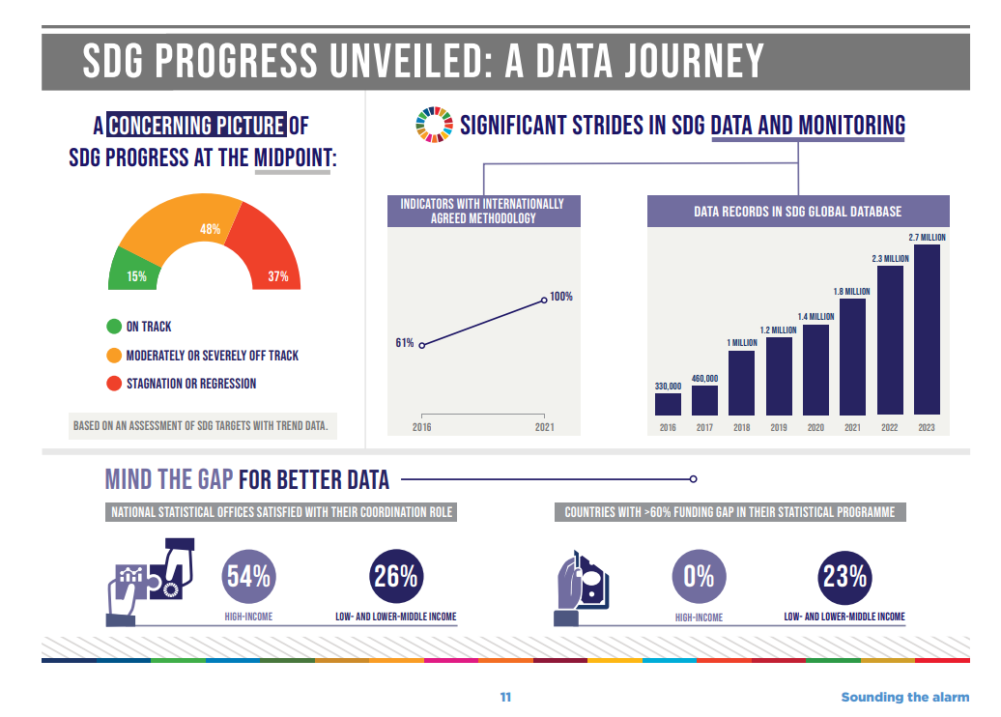
UN Report on SDGs 2023
https://unstats.un.org/sdgs/report/2023/The-Sustainable-Development-Goals-Report-2023.pdf

Slide 6
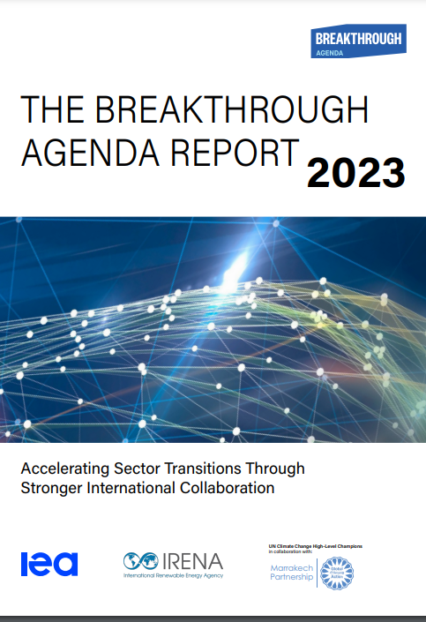
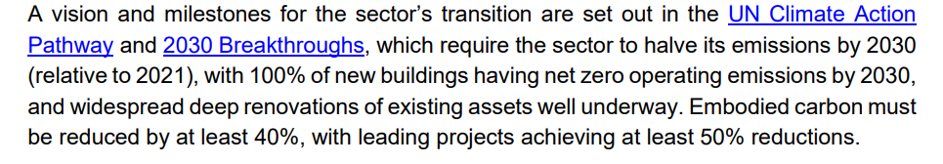
Buildings sector
Breakthrough Agenda report 2023

Slide 7

In order to control you need to measure…
CERN publishes since 2017 environmental reports based on the GRI (Global Reporting Initiative) standards
It includes detailed information about Energy and water supply and effluents management, direct and indirect CO₂ emissions, radiological impact (emissions and waste), conventional waste, Noise.
Measuring allows to establish objectives and allocate funds…

Slide 8
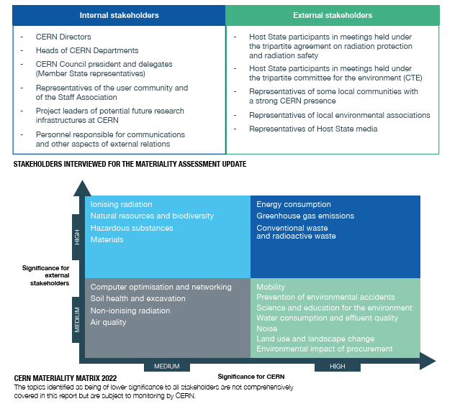

Slide 9
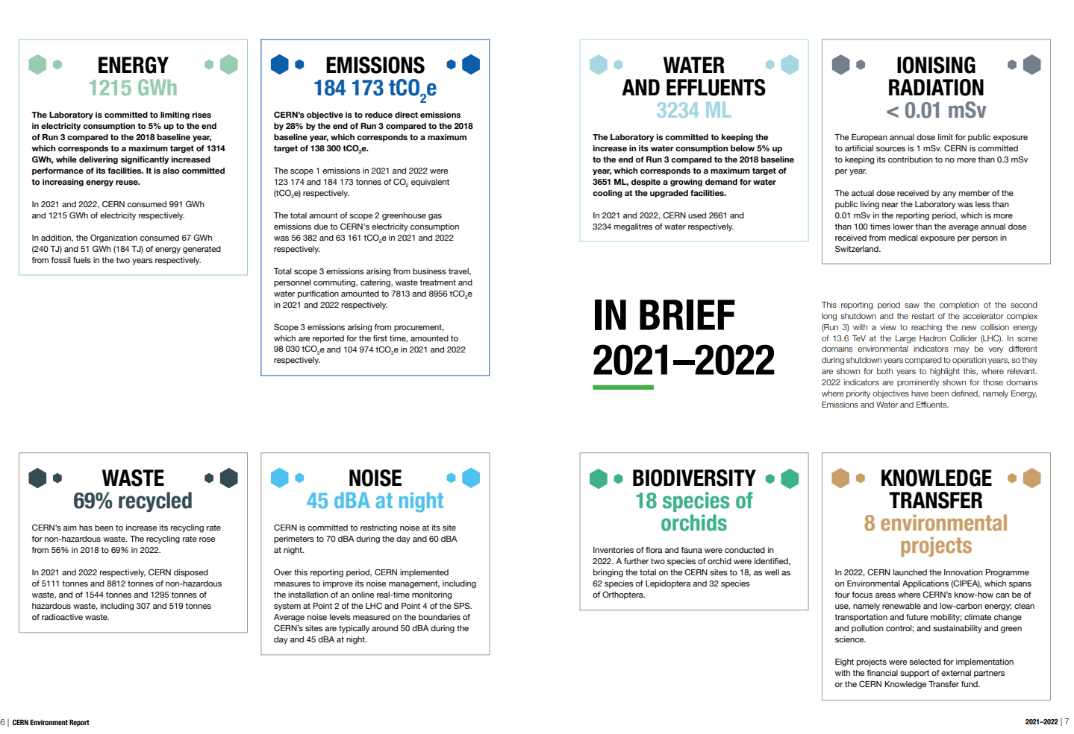

Slide 10
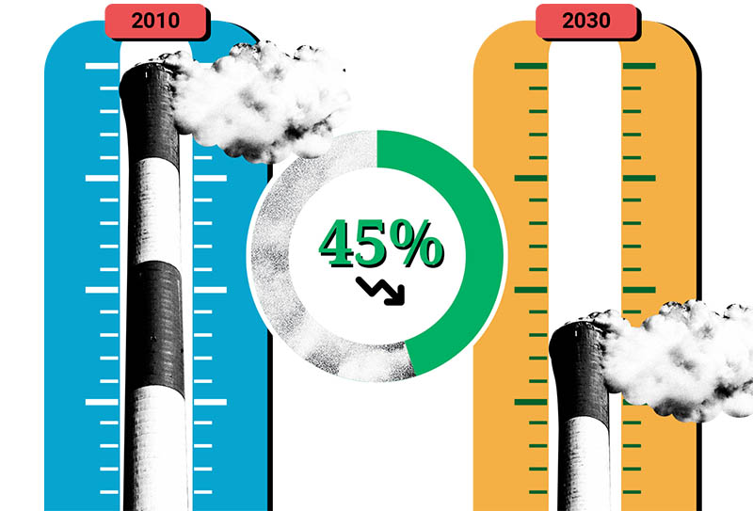
UN Climate Roadmap (Paris Agreements)

Slide 11

UN Climate Roadmap (Paris Agreements)
By 2050, we are required to become Net-Zero
  Reduce as much as possible emission
  Absorb/Compensate what remains

Slide 12
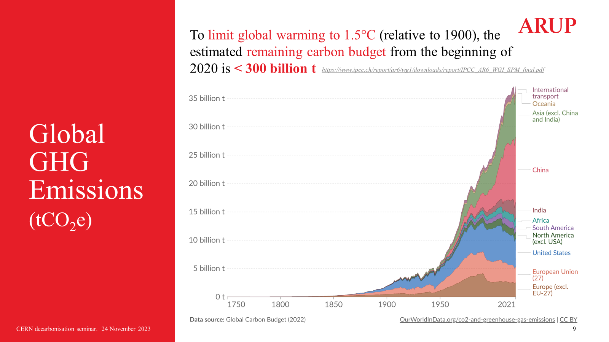
ARUP Seminar: https://indico.cern.ch/event/1334547/

Slide 13
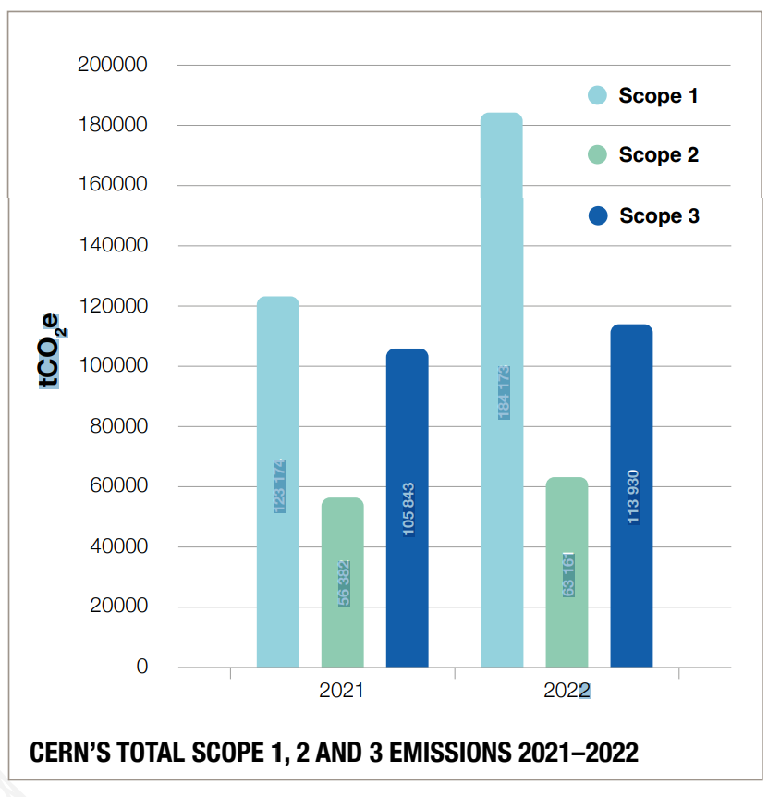
Where are the main drivers of CO2 emissions?
Environment Report 21-22
Contribution n. 1: LHC experiments
  FCC Detectors will not use those gases
  Other projects as well
  WP dedicated in the Detector R&D Roadmap
Contribution n 2:
  Raw materials
  Services (transport etc…)
Publishing Scope 3 emissions is a step forward towards its optimization, but requires a real cultural change.
  Our suppliers are often not ready, need to work with them to ensure transition at affordable cost…

Slide 14
Scope 1
Detectors and cooling circuits
CANNOT use GHG gases

Slide 15
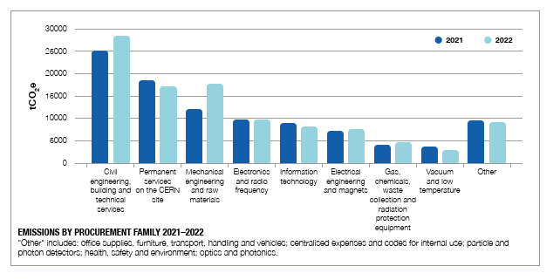
SCOPE 3 emissions detail by class

Slide 16
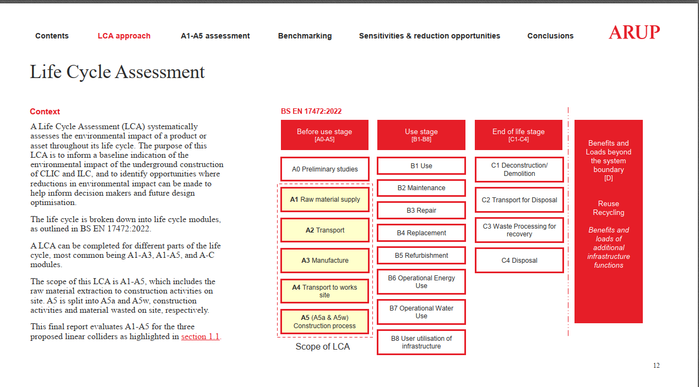
rrfr

Slide 17
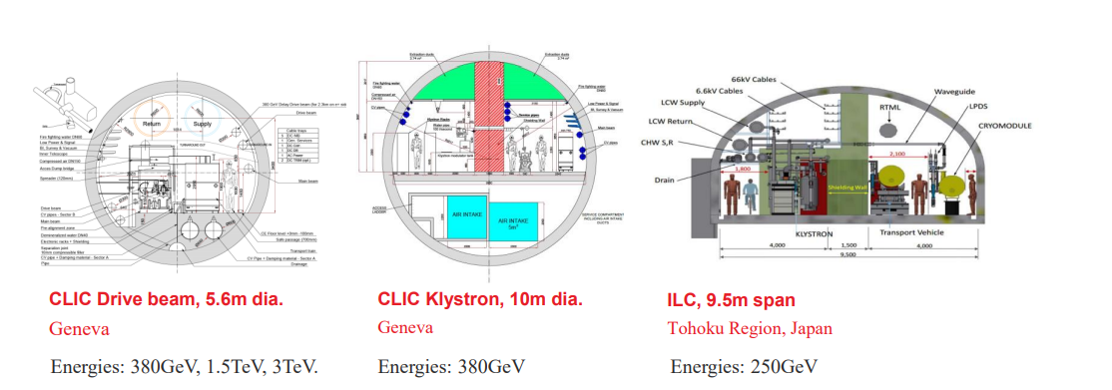
LifeCycle Assessment: CLIC & ILC

Slide 18
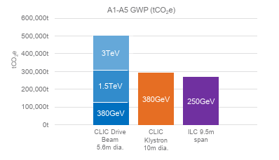
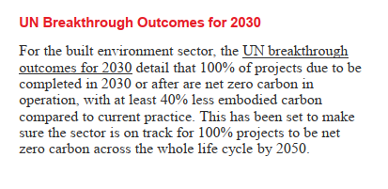
LifeCycle Assessment: CLIC & ILC
https://climatechampions.unfccc.int/system/breakthroughs/
We need to consider how to get to net zero carbon operation and 40% less impacting construction for our future projects….

Slide 19

Concrete
We will need concrete for any new project
Production of concrete is inherently producing CO₂
From Limestone (CaCO₃), through calcination (heating at 1450°C):
CaCO₃ → CaO + CO₂
For all projects, already today (and even more in 2050) the impact of construction of new accelerators will overcome the impact of their operation because of concrete!

Slide 20
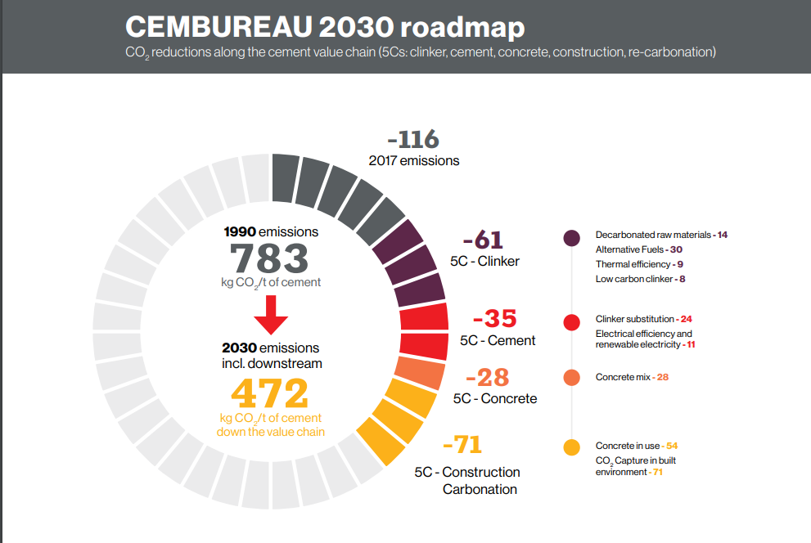
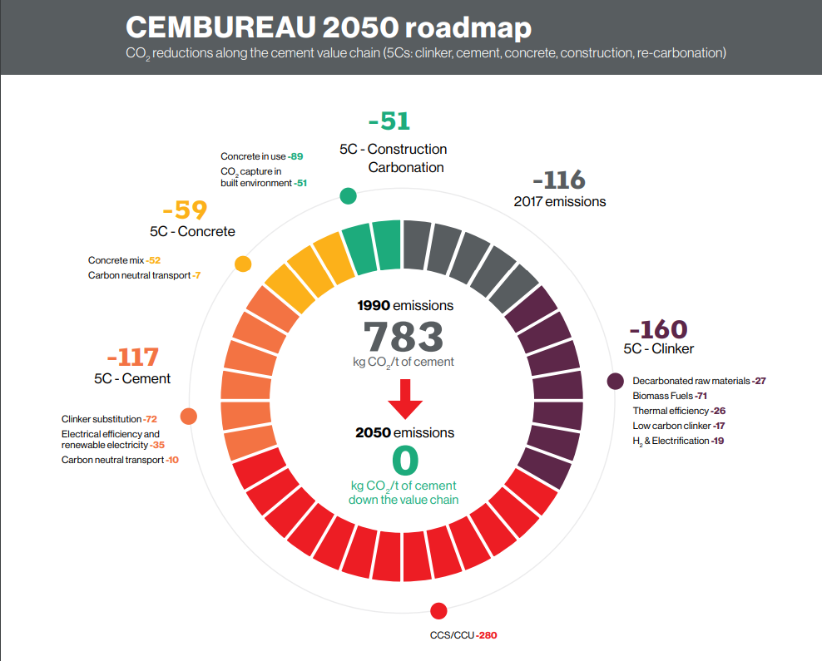
Concrete: is there hope?
The cement Industry in Europe is trying to move towards a more sustainable future.
In 2024 a new plant in Norway will start producing cement with low CO2 emissions
We don’t know which quantities they can produce, how much it will cost, and how fast competitors will react.
6 more plants in Europe are on the way to be completed.
By 2030, we might have a decent probability to purchasing low CO2 cement
  At what price?

Slide 21
Context for future projects: Energy
(SDG7: Affordable and Clean Energy)

Slide 22
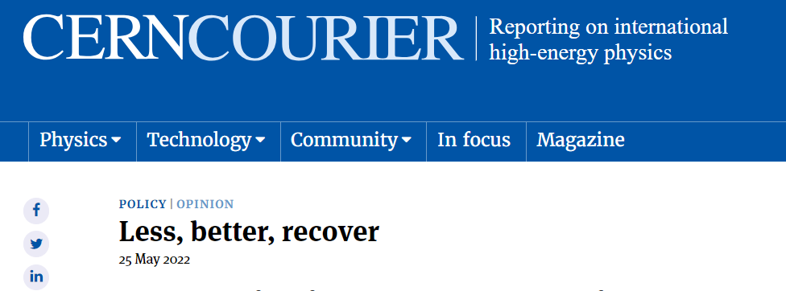

LESS
BETTER
RECOVER

Slide 23
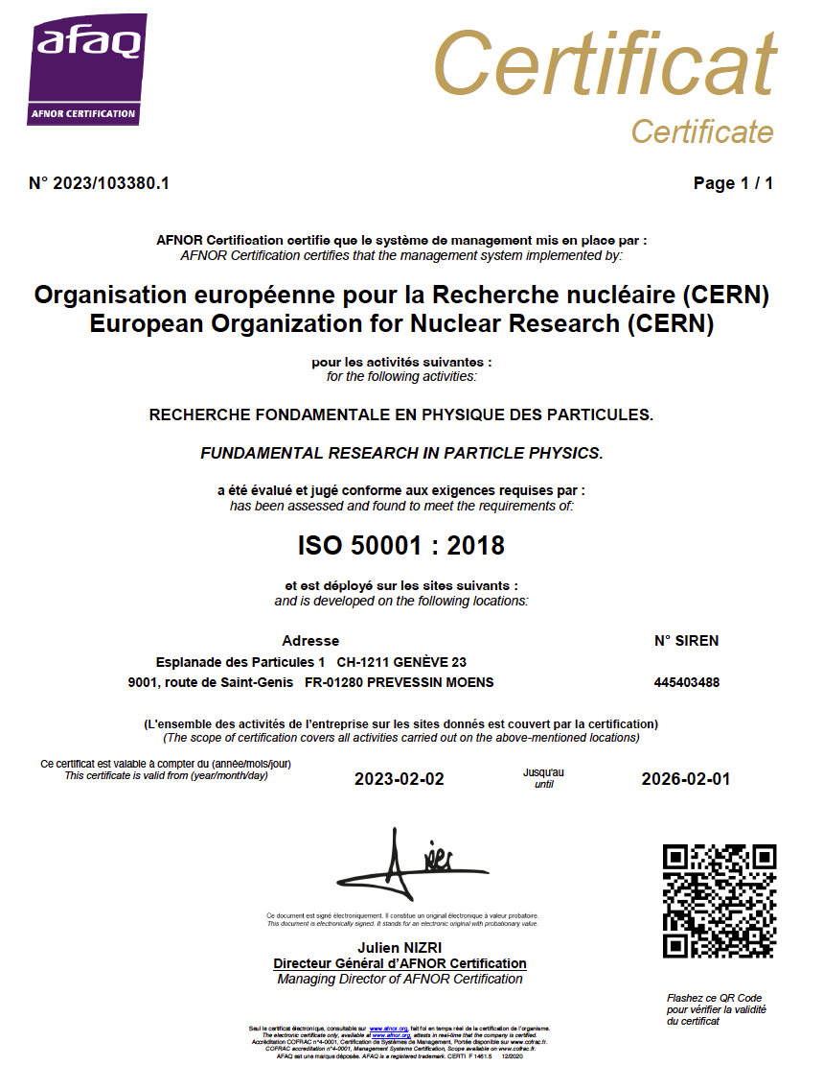
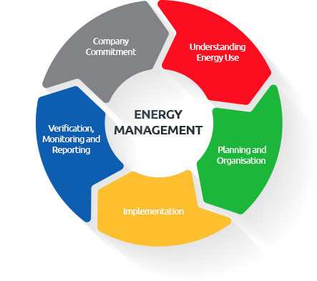
BETTER: ISO 50001 certification
CERN is the first Laboratory ISO 50001 certified.
Certification implies the establishment of improvement goals, and of continuous monitoring.
The process is not limited to the experts on the field: the line and top management have to be continuously informed of the status of the KPIs and take action.
The Energy Management Panel (standard and Enlarged) are the bodies used to manage and control Electricity Consumption.

Slide 24

Area needed to generate 1.3 TWh/y (no contingency, no distribution, no storage…)

Slide 25
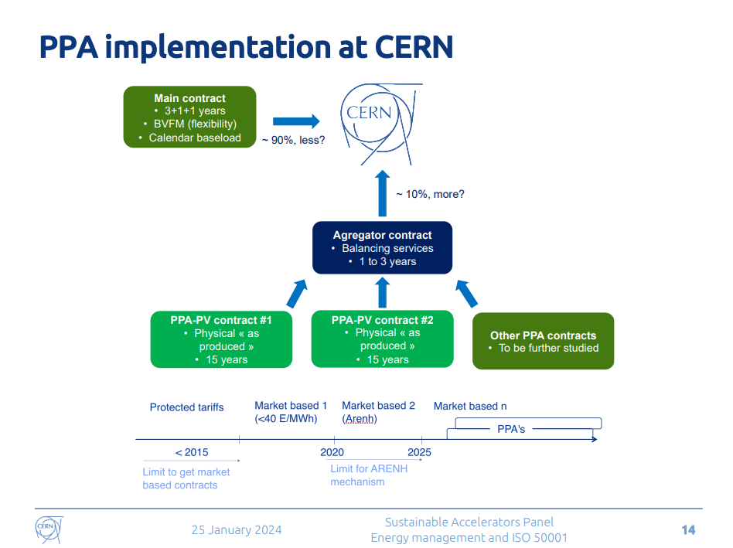
Electricity in FRANCE for CERN
The management of PPA contracts will be complex
The mix of sources (Solar, Wind Onshore and offshore, Nuclear) shall have to be carefully considered to ensure our constant baselod is affordable and cost effective
Also, we will have to assure the flexibility we have now, or reconsider the lifecycle of the accelerators (e.g. day/night, summer/winter…)
We will most probably need storage onsite, need to hope in breakthroughs, or help/invest in R&D
Courtesy of N. Bellegarde

Slide 26
ISO 50001 Action plan
 | Energy saved
Cooling and ventilation consolidation projects | 6 GWh/year
75 consolidation projects for buildings | 10 GWh/year
Science Gateway | 200+ MWh/year
Optimisation of Cryo operations mode | 25 GWh/year
Heat recovery projects
Meyrin and Prévessin | 30+GWh/year
Ferney-Voltaire | 20 GWh/year (for the neighbors)

Slide 27
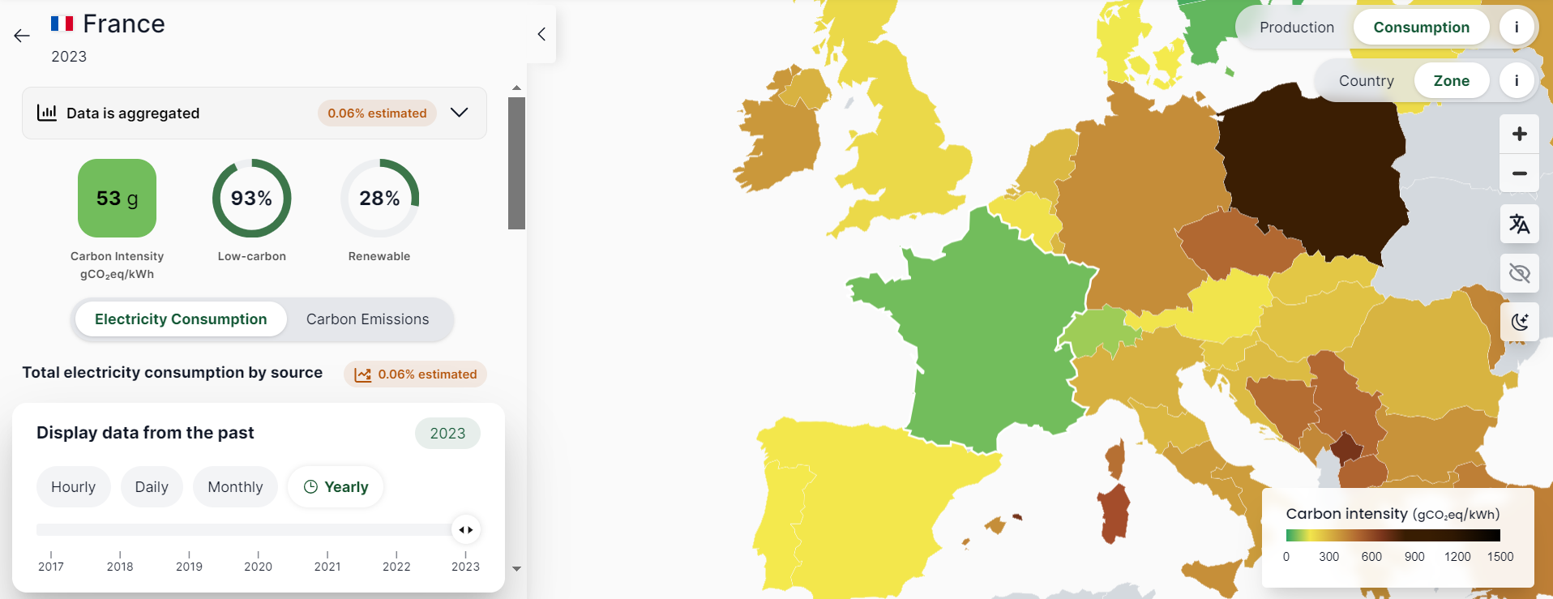
Electricity in FRANCE Today

Slide 28
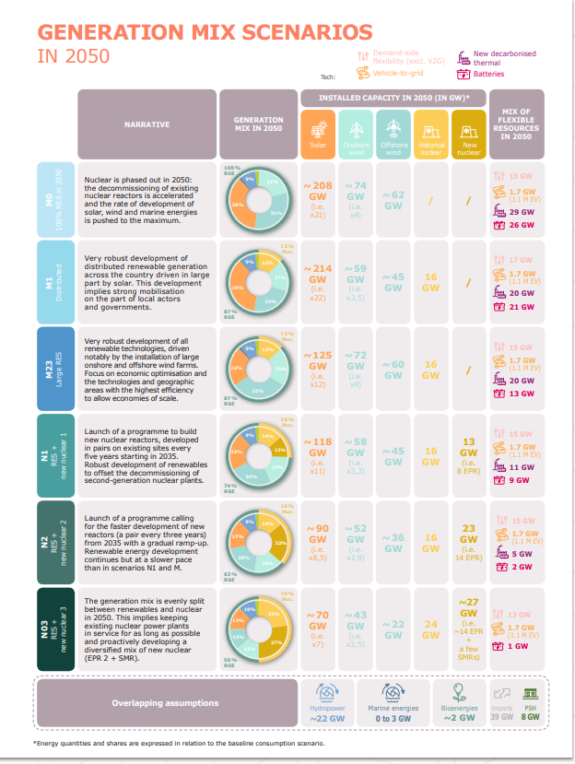
Electricity in FRANCE in 2050
Several Scenarios possible, including or not Nuclear.
Source: RTE
Which option will become reality is not only a political choice:
Technology breakthroughs are necessary to use renewables
  Increase efficiency of sources
  Development of environmentally-friendly energy storage technologies
…but also political…
  Acceptance from local communities to have sources in their backyard
  Simplification of authorisation procedures with reduction of time needed to implement new plants
  Doing all that in respect of the environment…
  The rate of installation of new renewable plants needs to increase dramatically wrt today…
Net-zero Impact in 2050: ~15÷25 gCO₂eq/kWh
  ~30÷50 kT CO₂/year for a 2 TWH/year class of collider: small but not zero
  Important to optimize the design, develop technologies such as High Efficiency Klystrons, HTS for magnets, A15 for SCRF…

Slide 29
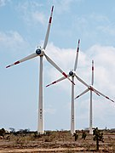
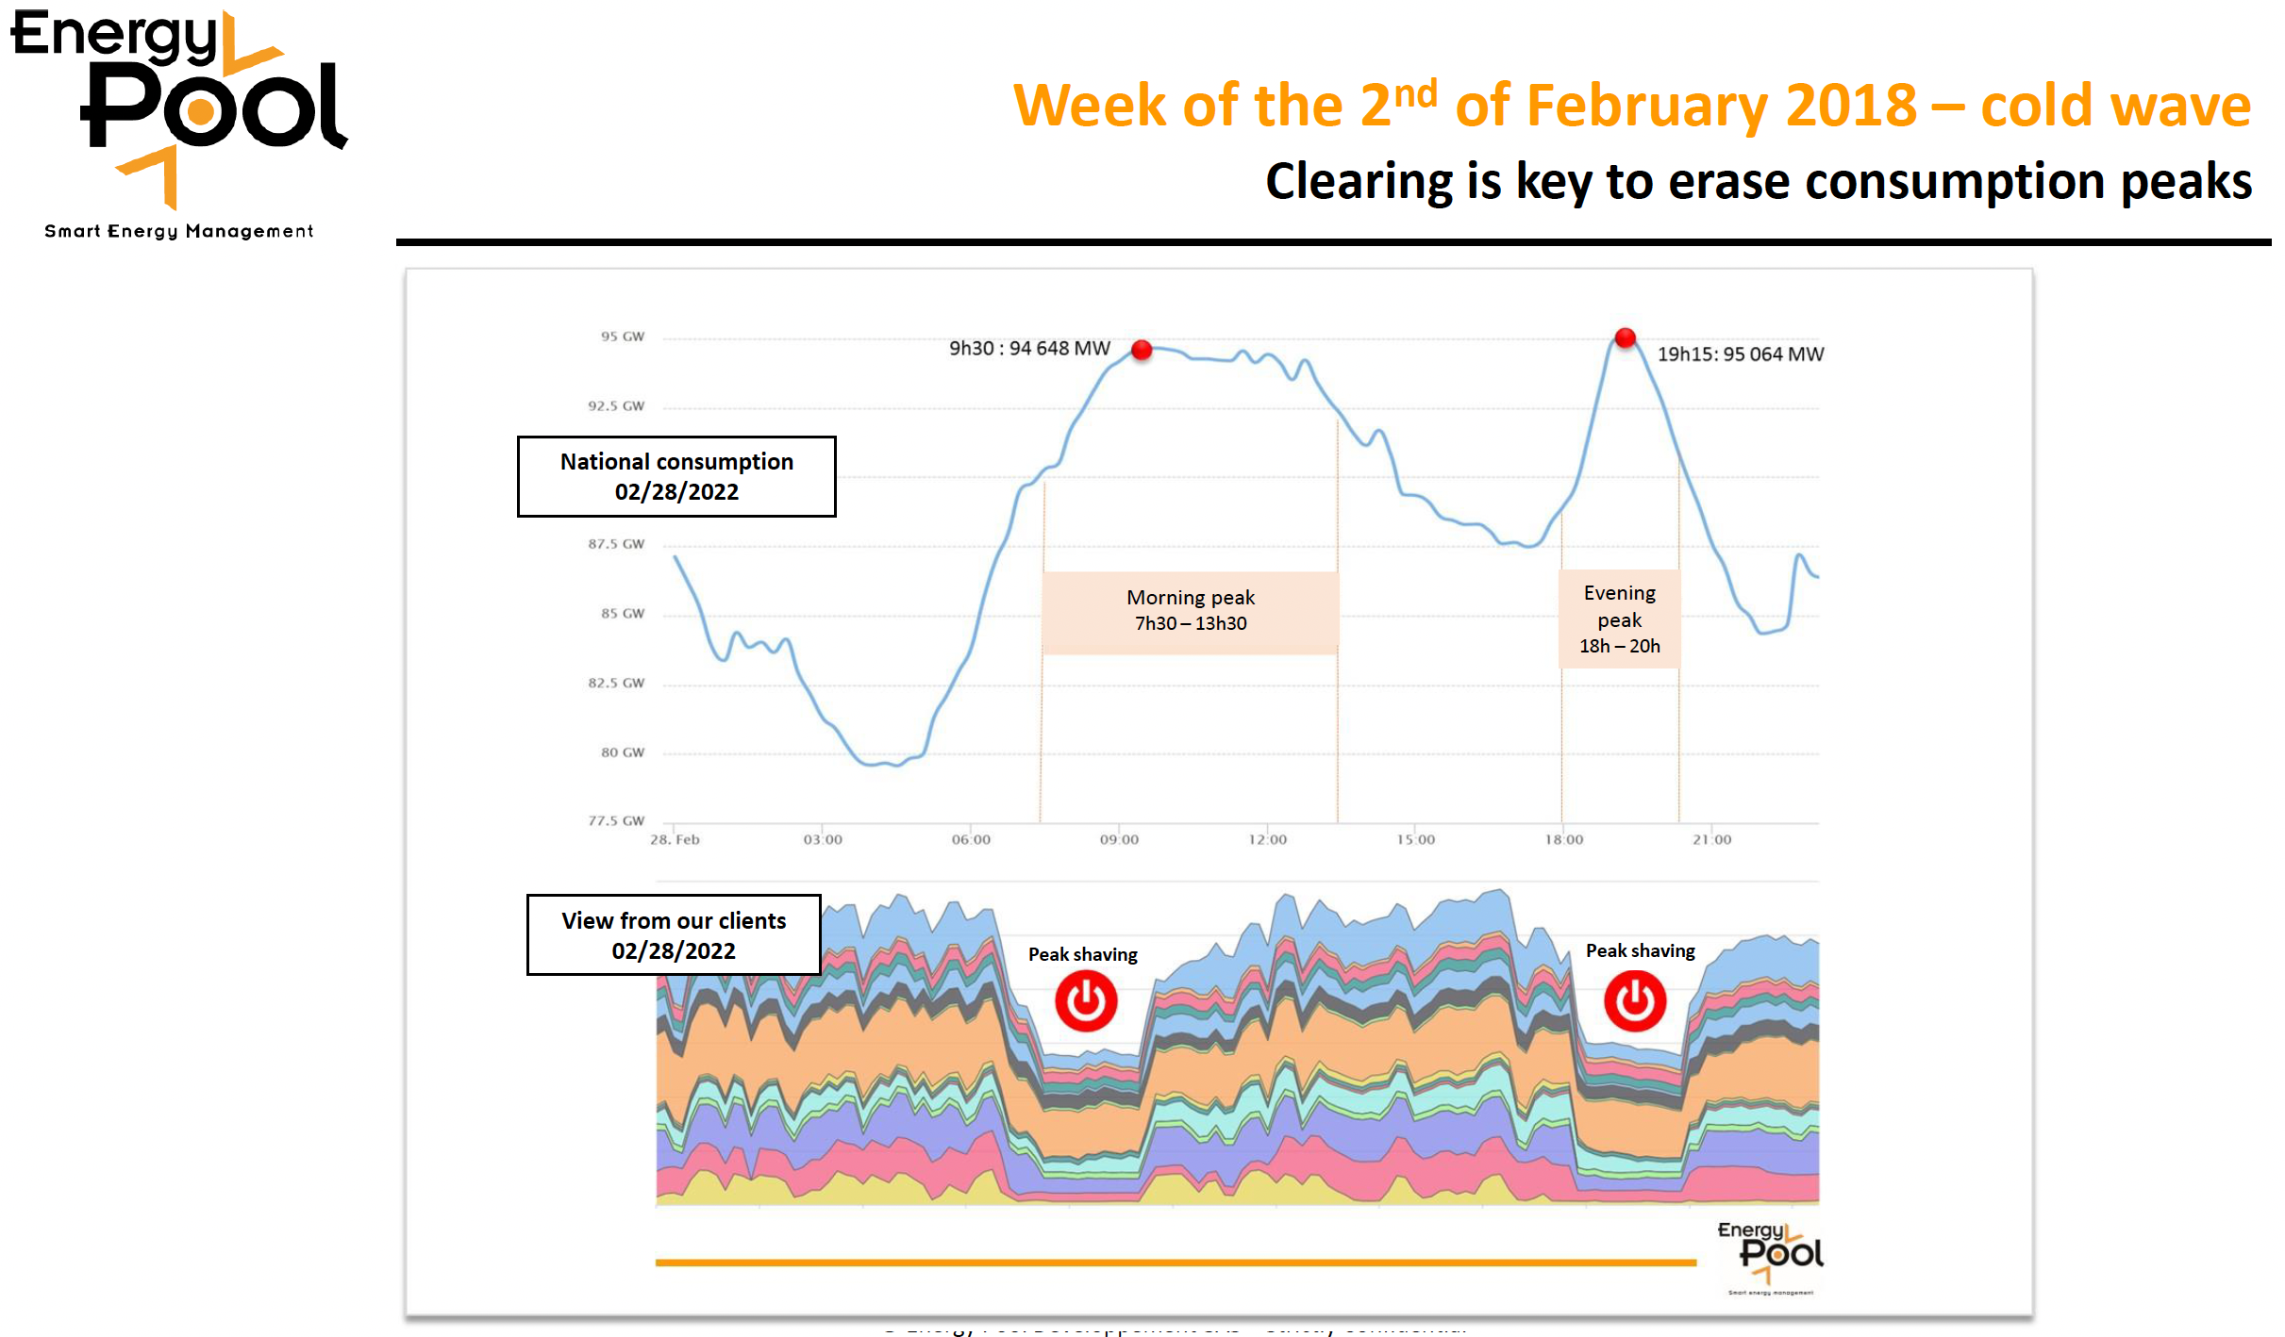
Running on renewables and when electricity is cheap
Two studies in 2017:
Supply the annual electricity demand of the CLIC-380 by installing local wind and PV generators (this could be e.g. achieved by 330 MW-peak PV and 220 MW-peak wind generators) at a cost of slightly more than 10% of the CLIC 380 GeV cost.
  Study done for 200 MW, in reality only ~110 MW are needed
Self-sufficiency during all times can not be reached but 54% of the time CLIC could run independently from public electricity supply with the portfolio simulated.
Can one run an accelerator as CLIC in a mode where one turn “on” and “off” depending prices (fluctuating with weather, demand, availability etc) ?
Specify transition times (relatively fast for a LC) and the annual luminosity goal
Significant savings – but the largest saving is the obvious one, not running in the winter.
Flexibility to adjust the power demand is expected to become increasingly important and in demand by energy companies.
More information (link)
Victor Gleim CC-BY-SA-4.0
(Regenerative) Power availability varies
Linear accelerators have no stored beam -> ideal for flexible operation
Study by Fraunhofer institute considered running
on renewables and participating in demand side flexibility
Courtesy S. Stapnes
C. Gaunand, B. Remenyi: Introduction to Demand Side Flexibility
ESSRI Workshop 2022 https://indico.esrf.fr/event/2/contributions/94/

Slide 30

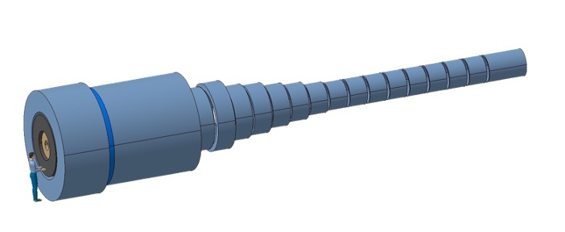
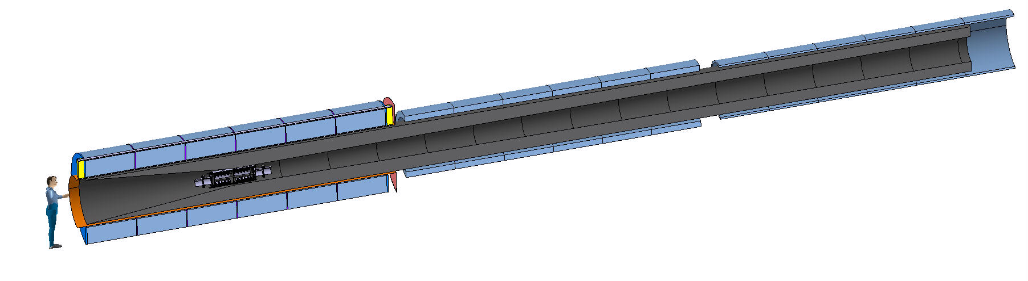
Technology: HTS
Target & Capture Solenoids for the Muon Collider
E_{M} = 2.9 GJ
T_{op} = 4.2 K
M_{coils} = 200 tons
M_{shield} = 300 tons
P = 12 MW
EM = 1 GJ
Top = 10…20 K
Mcoils = 110 tons
Mshield = 196 tons
P = 1 MW
US-MAP
Proposal
(<2016)
IMCC
Proposal
(2023)

Slide 31
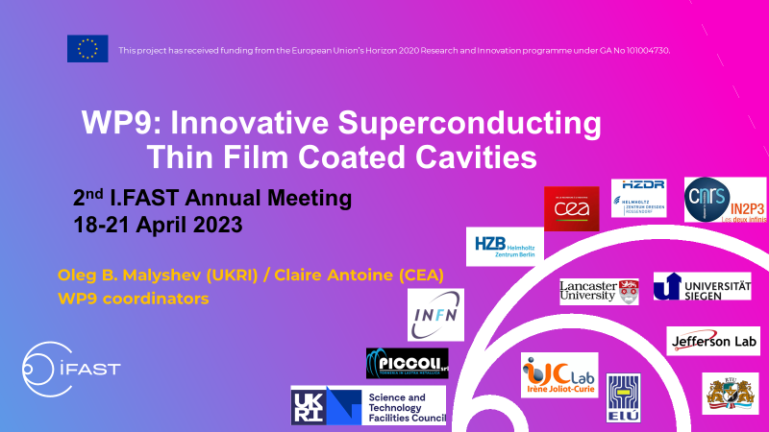
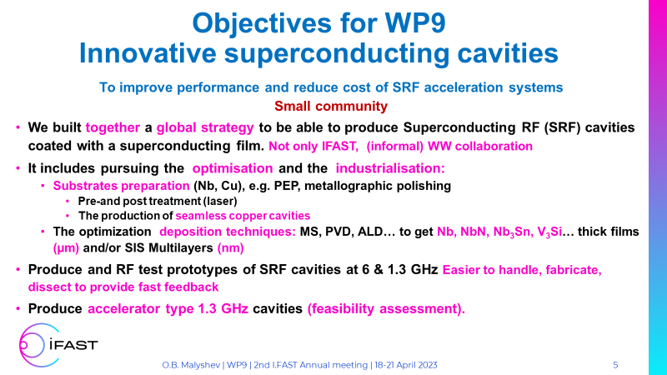
Superconductivity: RF

Slide 32
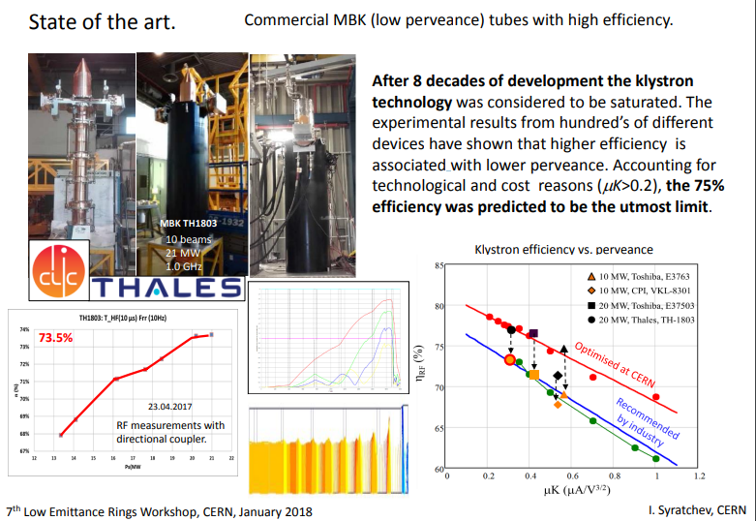
High Efficiency Klystrons
(I. Syratchev)

Slide 33
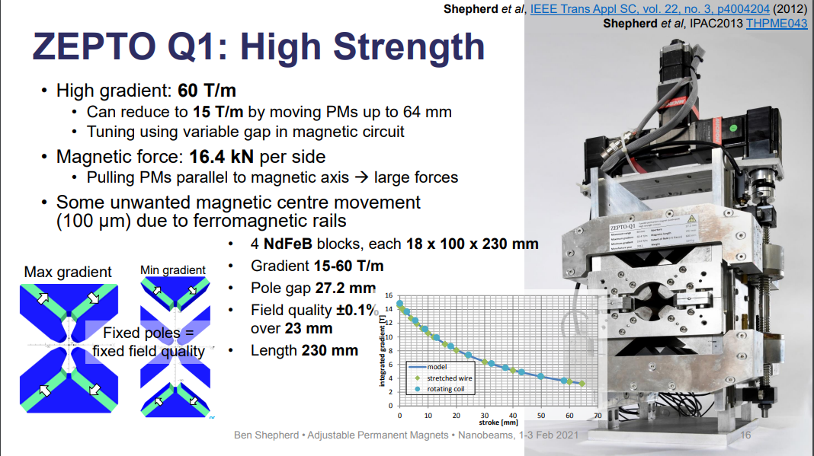
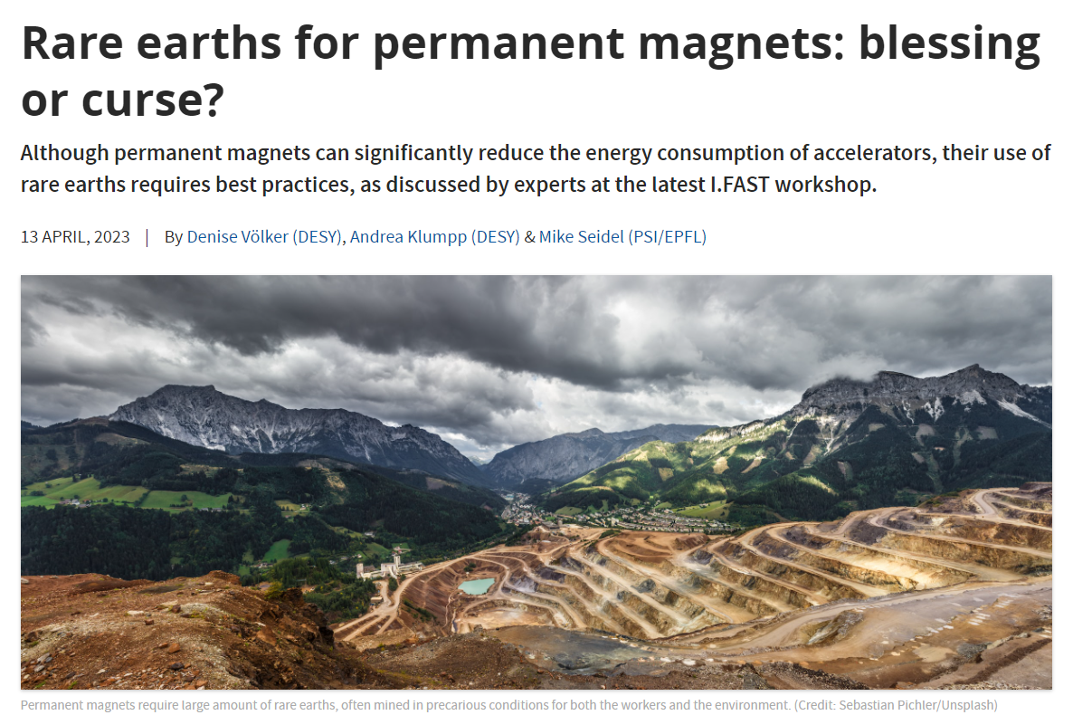
Permanent Magnets

Slide 34
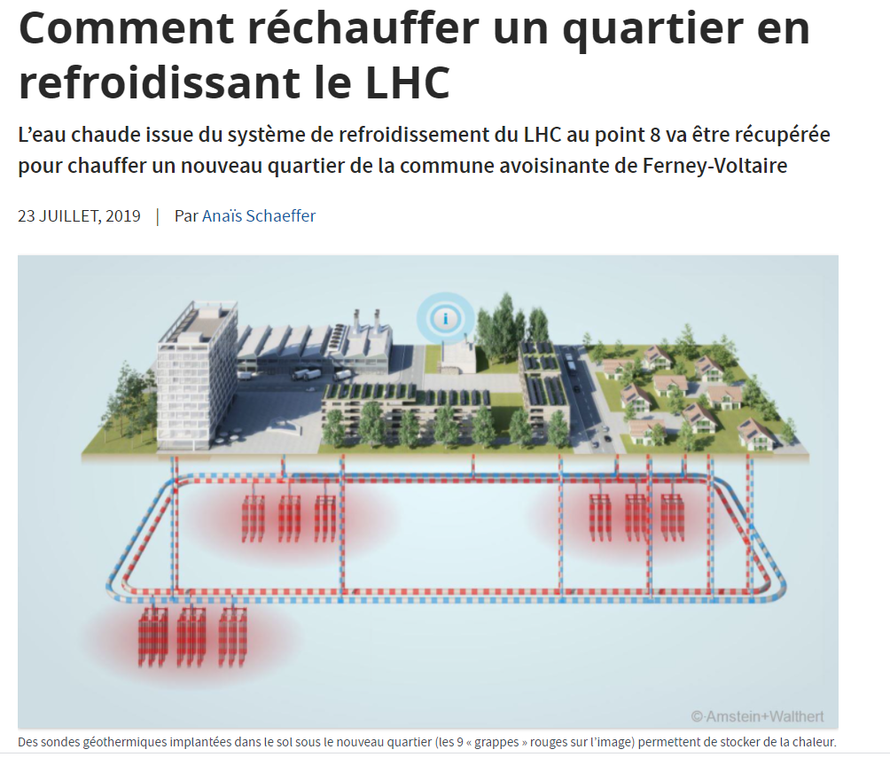
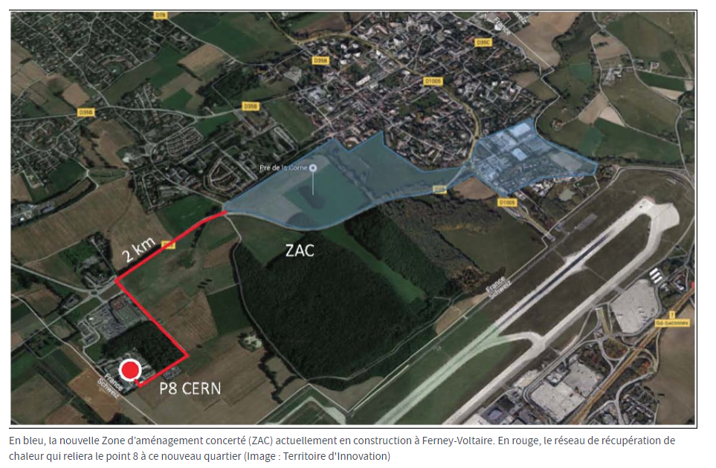
RECOVER

Slide 35
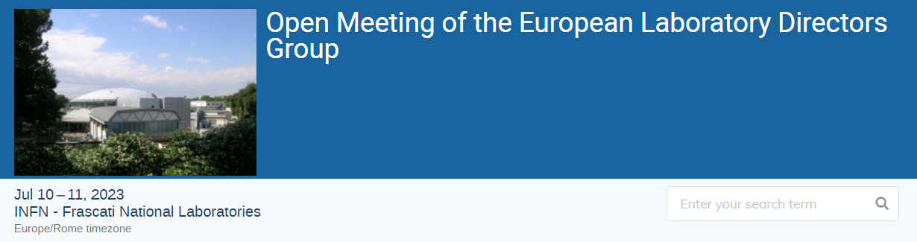
Establishing a Working Group on “Sustainability Assessment of Accelerators”
We have been commissioned by LDG Chair to draft a charge for a new working group that will develop guidelines and a minimum set of key indicators pertaining to the methodology and scope of the reporting of sustainability aspects for future HEP projects
This group will effectively define to all new infrastructure proposals what they should quantify and report upon so that fair comparisons can be made between these proposals
Having clear and common indicators will ensure that projects are not accused of cherry picking only their most favourable sustainability numbers
J. Clarcke (STFC), B. Heinemann (DESY & U. Freiburg), M. Seidl (PSI)

Slide 36
Can we compare different colliders based on sustainability?
A sustainable accelerator needs to minimize its impact on the Environment and on the available resources, while maximizing the value returned to society
Need to compare not only what is consumed, but also what is produced!
  Scientific case
  Training of people
  Innovation potential
While it is “easy” to evaluate the resources consumed, evaluating the advantages looks more subjective…
Therefore, scientific approaches are developed to assess the socio-economic impact of Scientific Projects:

Slide 37
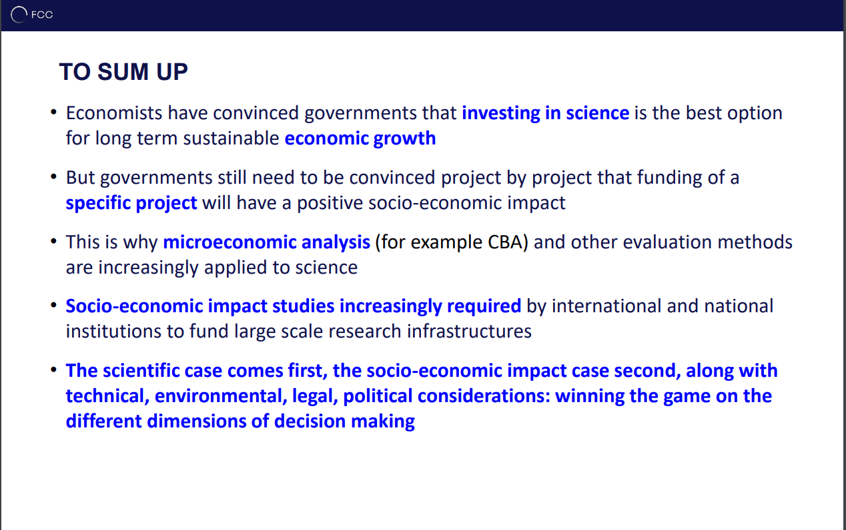
M. Florio, G. Catalano, FCC week 2022:

Slide 38
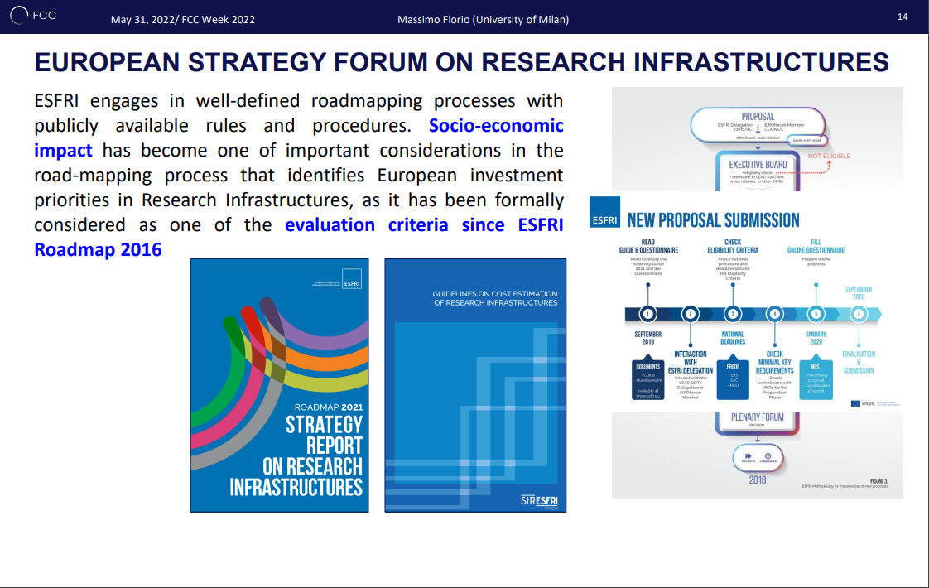
M. Florio, G. Catalano, FCC week 2022:

Slide 39
CONCLUSIONS
Building and operating a CO₂-free Accelerator is not easy
Assumptions to get to “net-zero” in 2050 imply large uncertainties, since several technologies will need to be developed at paces that we don’t see today
Large Laboratories need to undergo a profound change of culture:
  Less, better, Recover
Training to Lifecycle assessment must become common practice
A large contribution to the CO2 footprint across the lifetime of a new collider will come from its construction:
  Mainly from Concrete: CO2 free production are starting to appear, but costs will probably be much higher…
Socioeconomic Impact assessment will be a must (and is anyway required by ESFRI…)

