Slide 1
Multistage LWFA based on curved plasma channels
Boyuan Li
Shanghai Jiao Tong University, China
Wednesday, 20 March, Lisbon
ALEGRO Workshop 2024

Slide 2
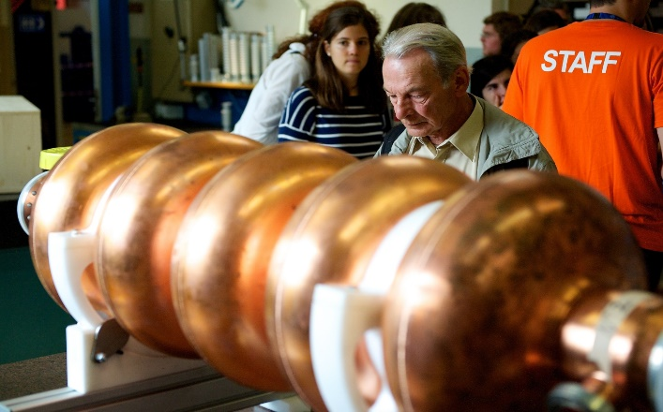
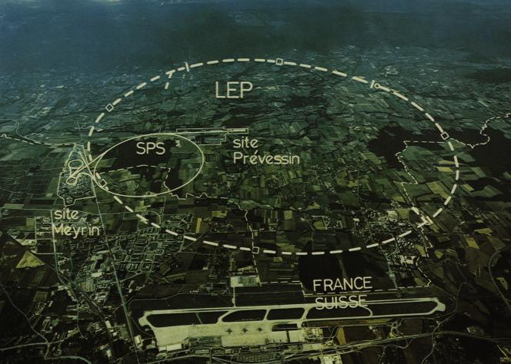
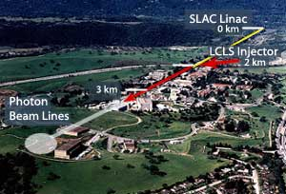
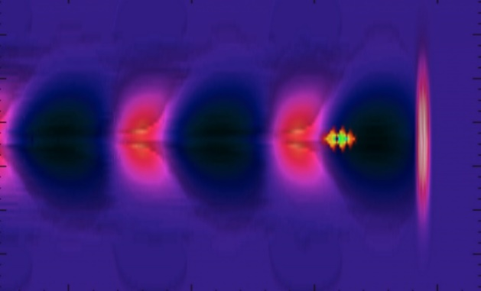
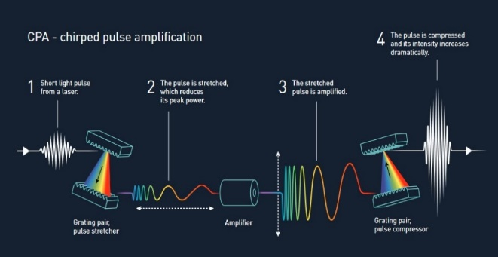
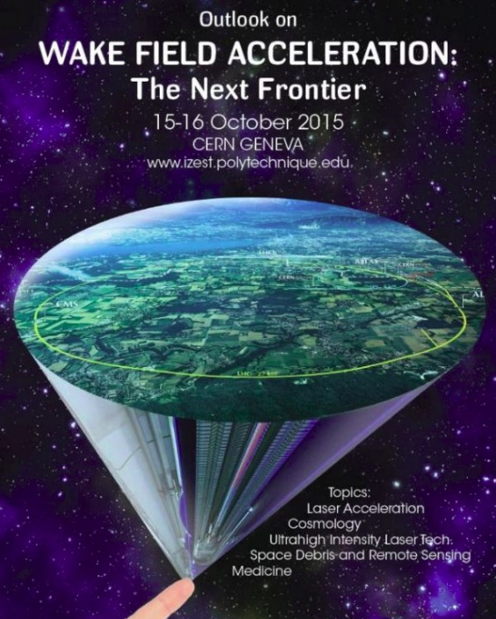

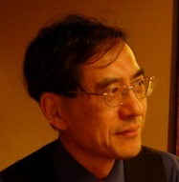
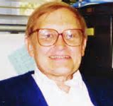
Background
Traditional Accelerator
Colliders
FEL
1MV/cm
Kilometer-scale accelerator
1GV/cm
Meter-scale accelerator
CPA Laser
Great Change to Accelerators
Laser wakefield acceleration

Slide 3
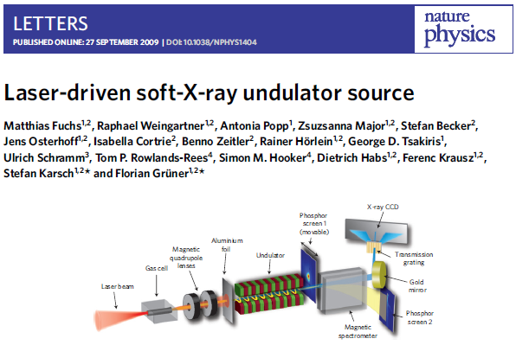

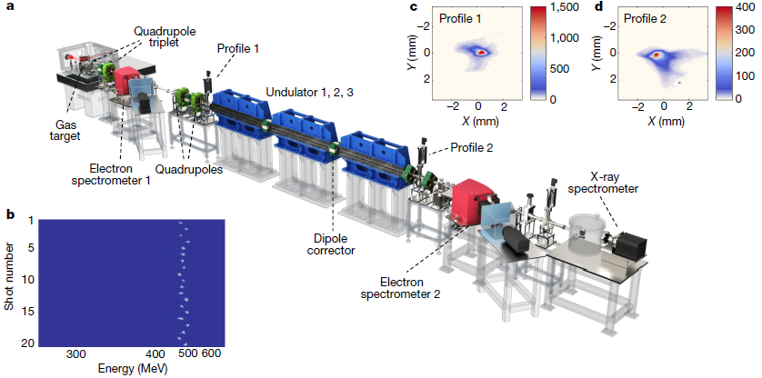
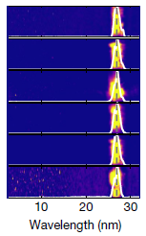
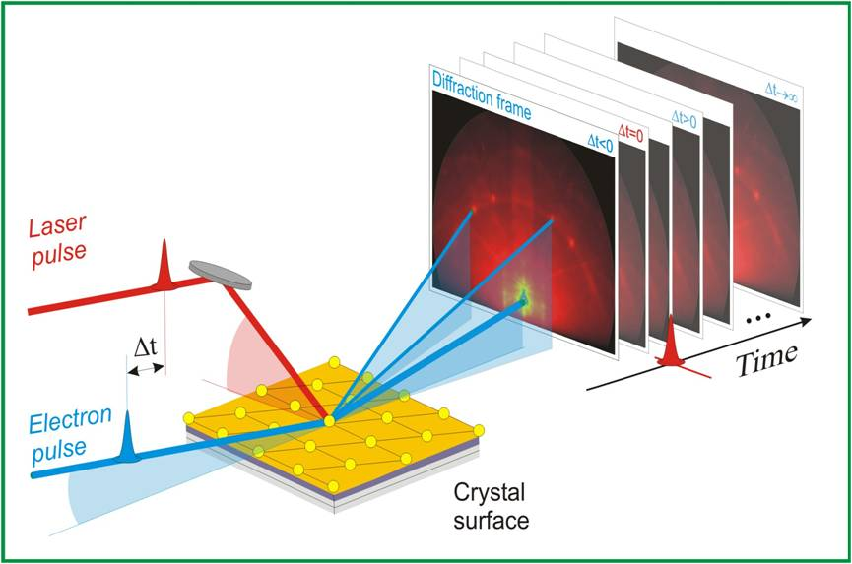
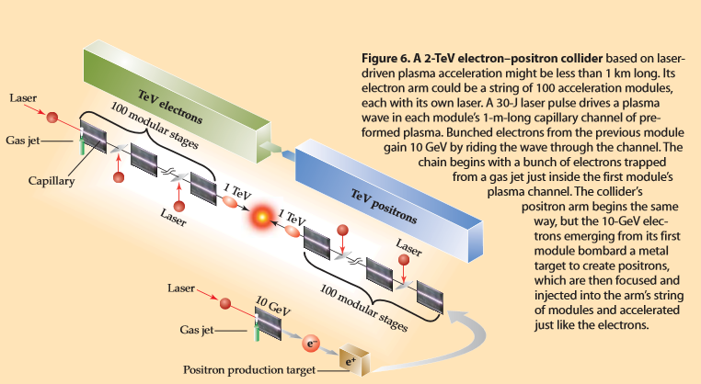
LWFA potential applications
Betatron Radiation Source
LWFA based FEL
Nature 595, 516-520 (2021)
Ultrafast Electron Diffraction
TeV e⁺ e⁻ Collider
PRST-AB 19, 021302 (2016)
Nature Photonics 11, 293-296 (2017)
Physics Today, March, 44, 2009

Slide 4

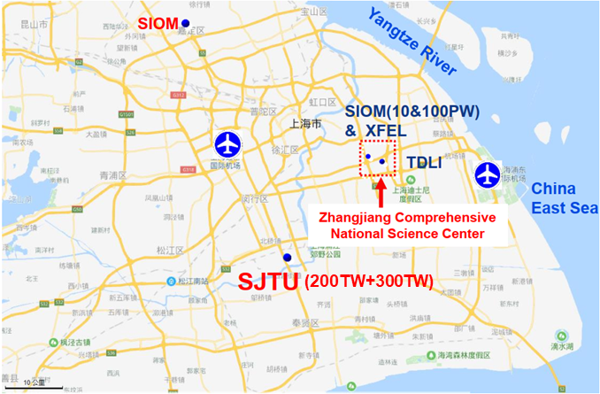
LWFA studies at SJTU
SJTU-Group (2007~)
Leader: Prof. J. Zhang
Lasers:
200TW, 10Hz, 25fs (2012~2022)
200+300TW, 1Hz, 25fs (2023~)
20mJ, kHz, 35fs laser
100TW, 2.2μm, 100fs MIR laser
Topics:
1. Electron injection in Wakefield:
  Phys. Rev. Lett. 114, 084801 (2015); NJP 20, 063031 (2018); Phys. Rev. Lett. 121, 104801 (2018); …
2. Radiation in Wakefield:
  LSA 5, e16015 (2016); Sci. Rep. 6, 29101 (2016); Nat. Photon. 11, 514 (2017); …
3. Multistage LWFA:
  Phys. Rev. Lett. 120, 154801 (2018);
  Materials 16, 3278 (2023); HPLSE 11, e58 (2023); Phys. Rev. Lett. 130, 215001 (2023).

Slide 5
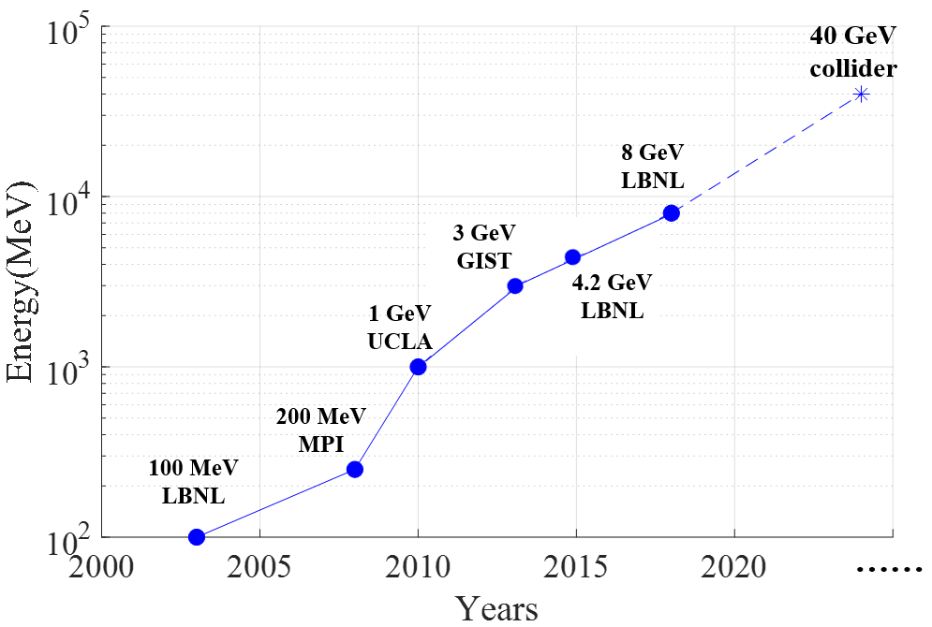
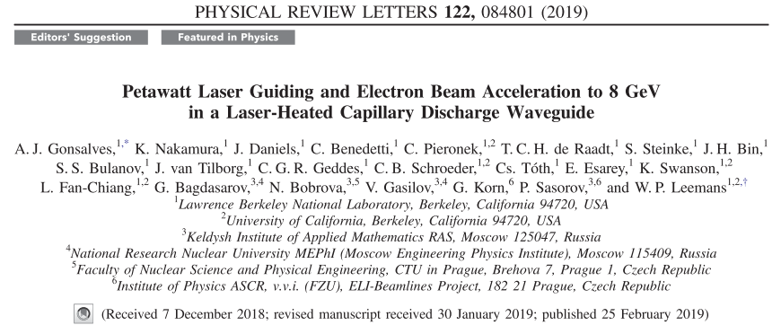
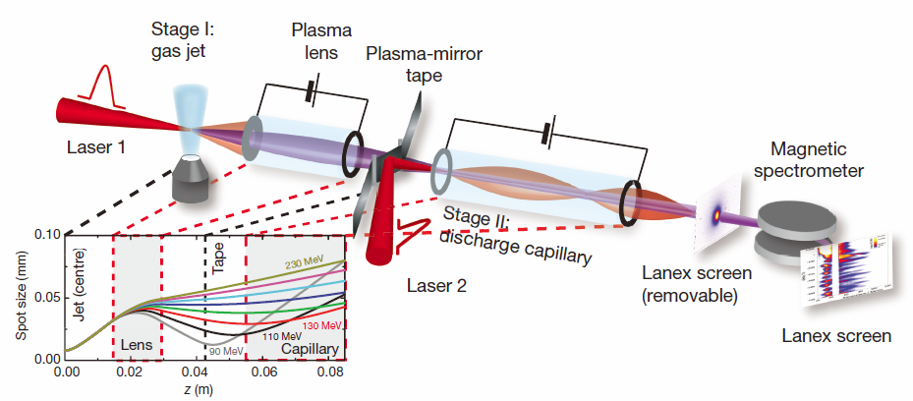
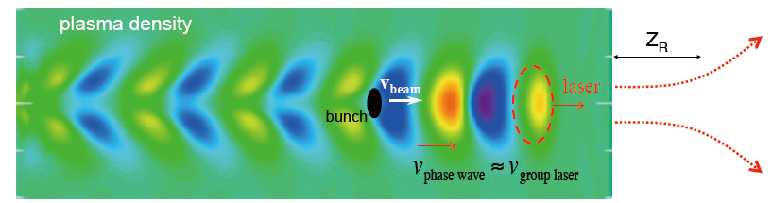



Motivation for multistage LWFA
?
The “3D” limitation:
Diffraction：$L_{diffraction}$ $\sim r_{0}^{2}λ^{−1}$
Dephasing：$L_{dephasing}$ $\sim n_{e}^{−\frac{3}{2}}λ^{−2}a_{0}^{\frac{1}{2}}$
Depletion：${ L}_{depletion}$ $\sim n_{e}^{−1}λ^{−2}τ$
First proof of staged LWFA, Nature 530, 190 (2016)

Slide 6
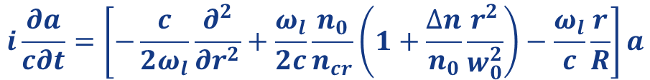

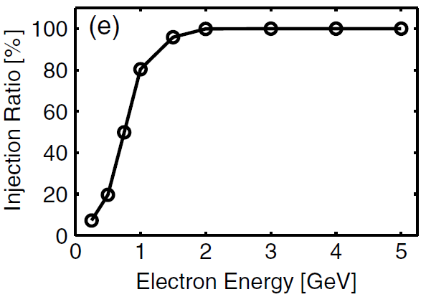
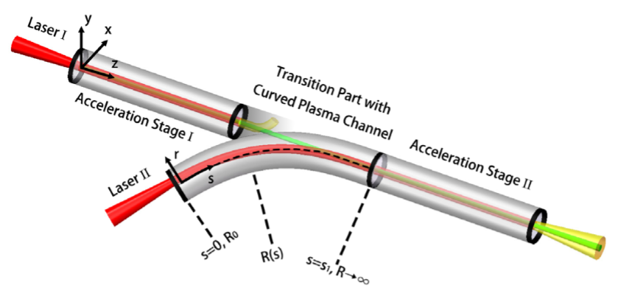
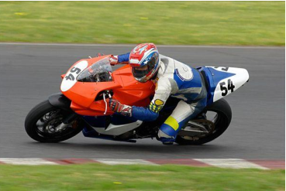
Multistage LWFA by curved plasma channels
1. Electrons always move in straight plasma channel avoiding transverse dispersion.
2. Driver laser is guided by a curved plasma channel to the following straight channel.
Channel term
Curved term
Prof. M. Chen
The staging efficiency approaches to
100% for electron energy higher than 2 GeV in Stage I.
J. Luo, et al. PRL, 120, 154801 (2018)

Slide 7
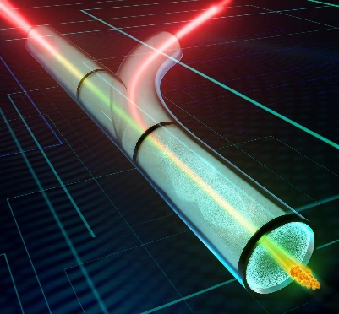
Implementation steps
Step I
Stage I: 2GeV electrons in a straight channel
done
Step II
Stage II: stable guidance of relativistic
laser in curved channel
done
Step III
Coupling: injecting electrons from Stage I to Stage II and accelerating them in relay

Slide 8
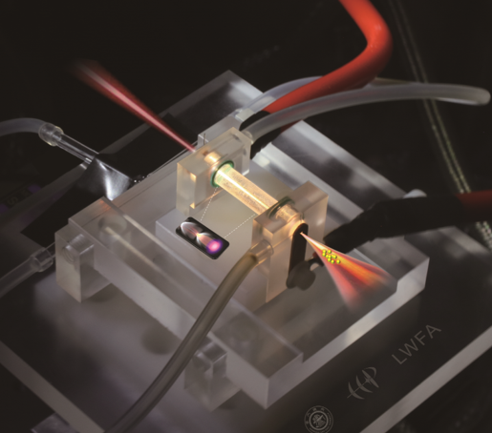
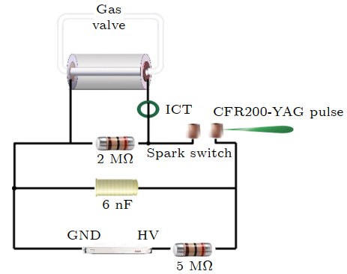
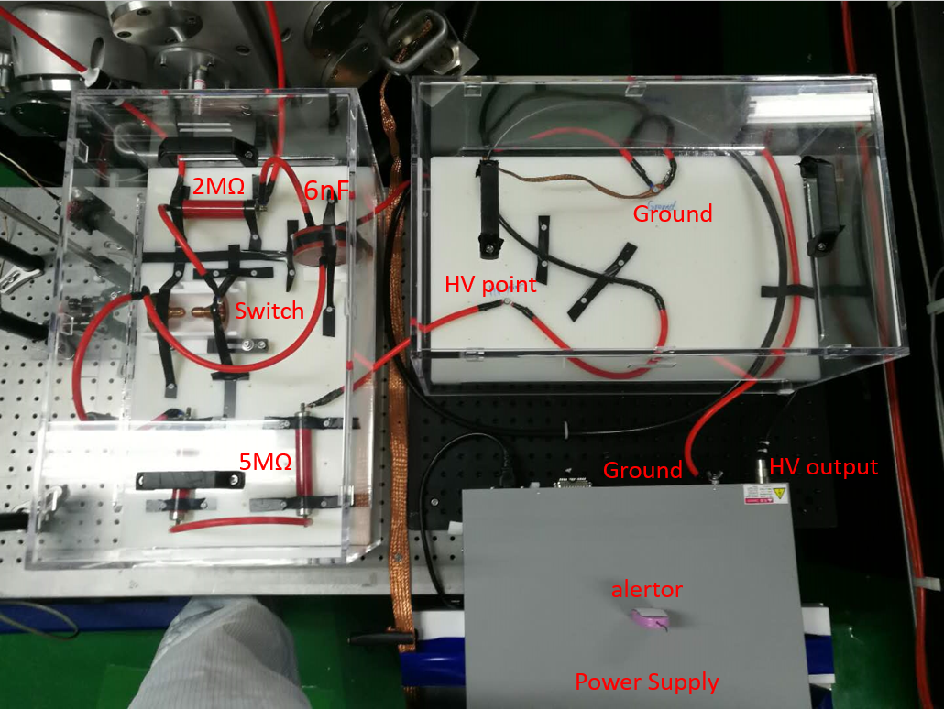
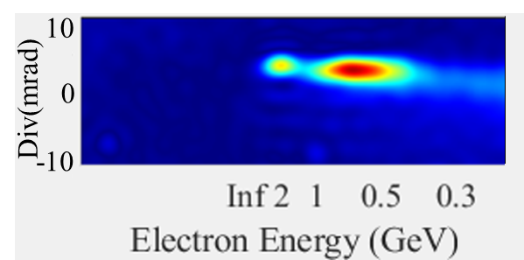
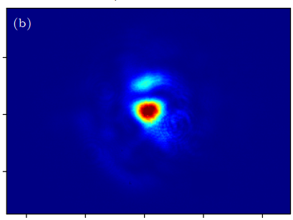
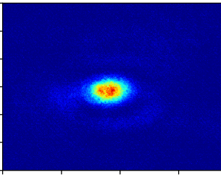
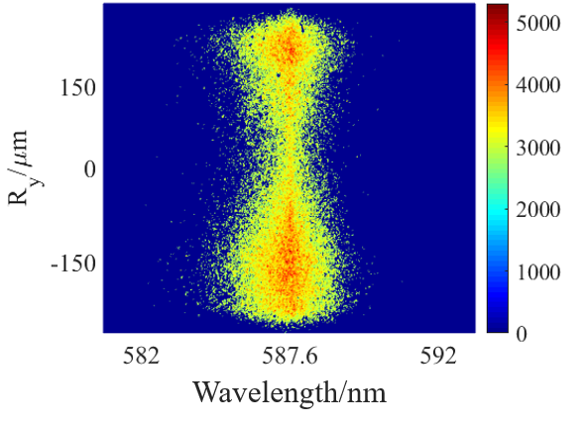
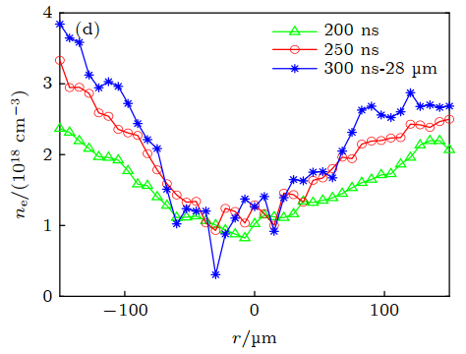
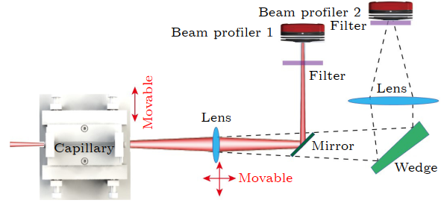
GeV electrons in straight channel
Straight plasma channel
High-voltage discharge in gas-filled capillary for plasma channel formation
3cm-Capillary
Stark broadening
parabolic plasma profile
Laser guidance and 2GeV electron beam
X.Z. Zhu, et al. Acta Phys. Sin. 71, 095202 (2022)

Slide 9
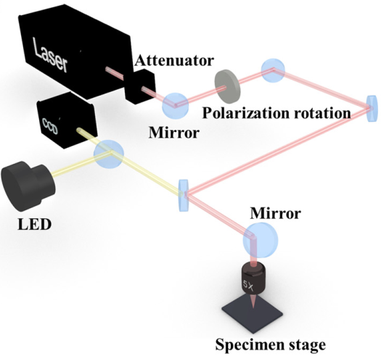
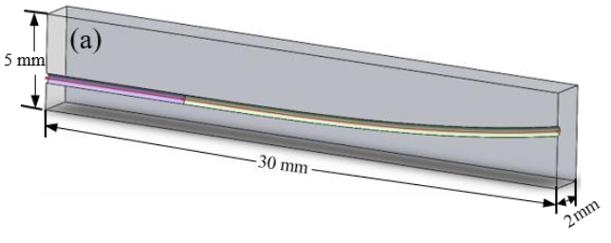
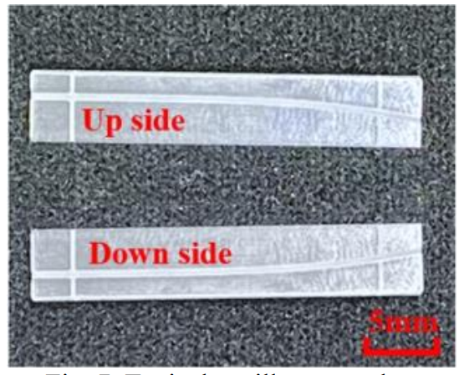
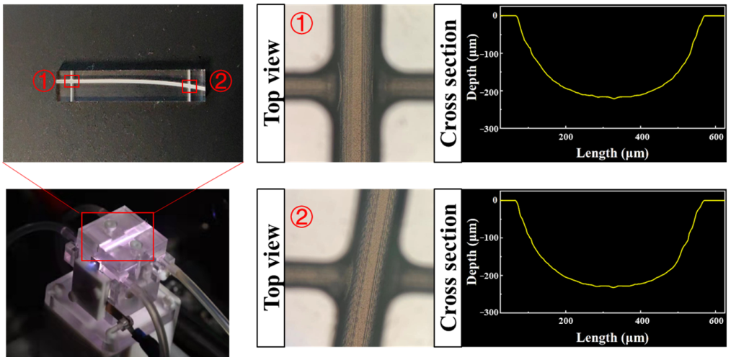
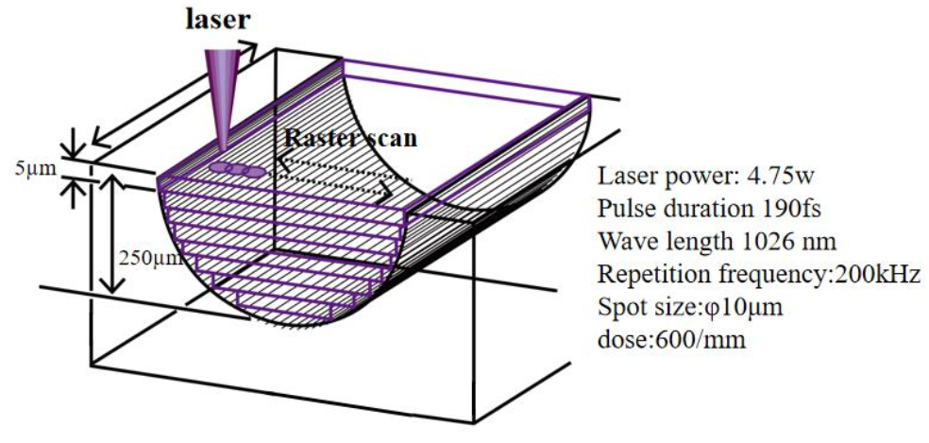
Processing curved capillary
A half circle of curved capillary is etched by MHz laser on the surface of sapphire substrate. Curved capillary is formed by assembling two etched substrates.
H.Y. Deng, et al. Materials 16, 3278 (2023)

Slide 10
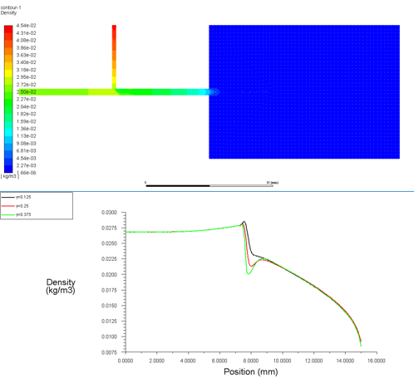
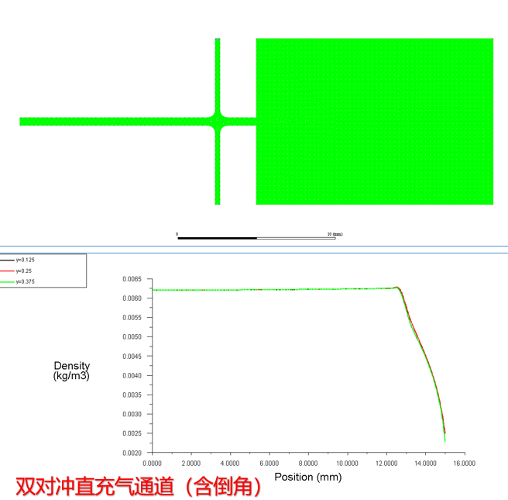
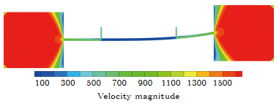
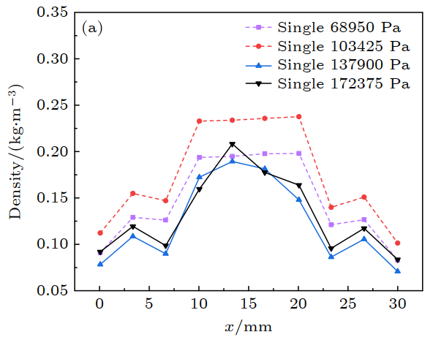
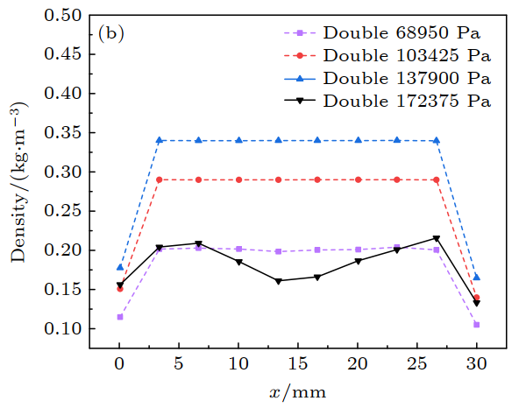
Gas filling design
Axially uniform density profile can be obtained with two-sides gas filling.
Fluid dynamics simulations
One-side filling
Two-sides filling
Y.Q. Zhao, et al. Acta Phys. Sin. 72, 184701 (2023)

Slide 11
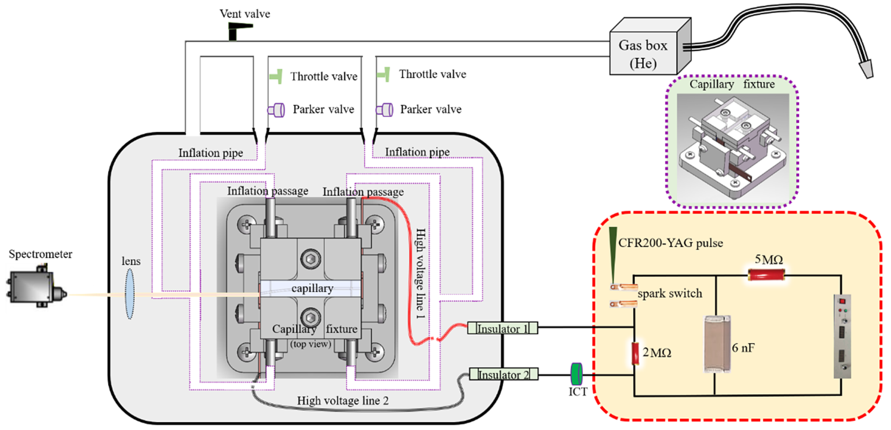
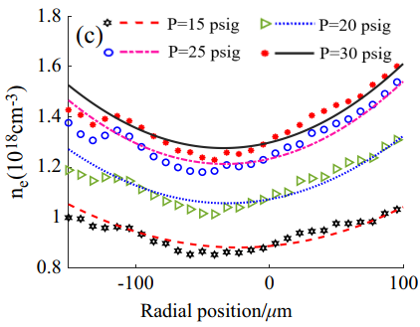
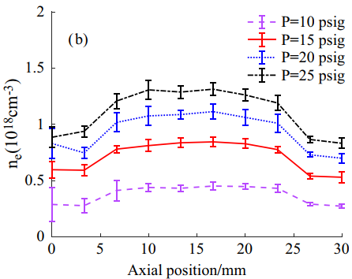
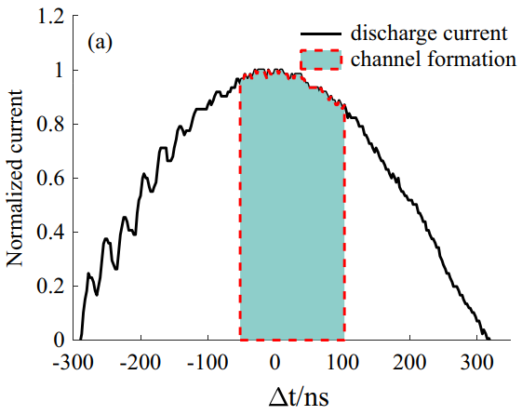
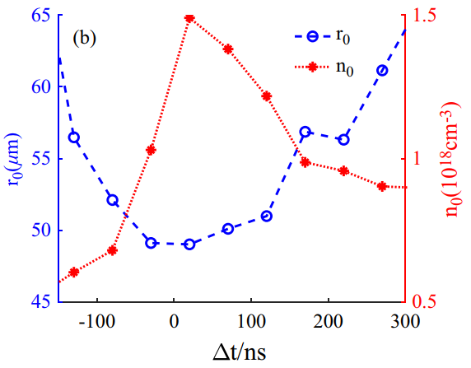
Curved plasma channels
Curved plasma channels are created with axially uniform and transversely parabolic density profile by high-voltage discharge in gas-filled curved capillary.
Stable plasma channel can be detected around the peak of discharge current.
J.L. Li, et al. HPLSE 11, e58 (2023)

Slide 12
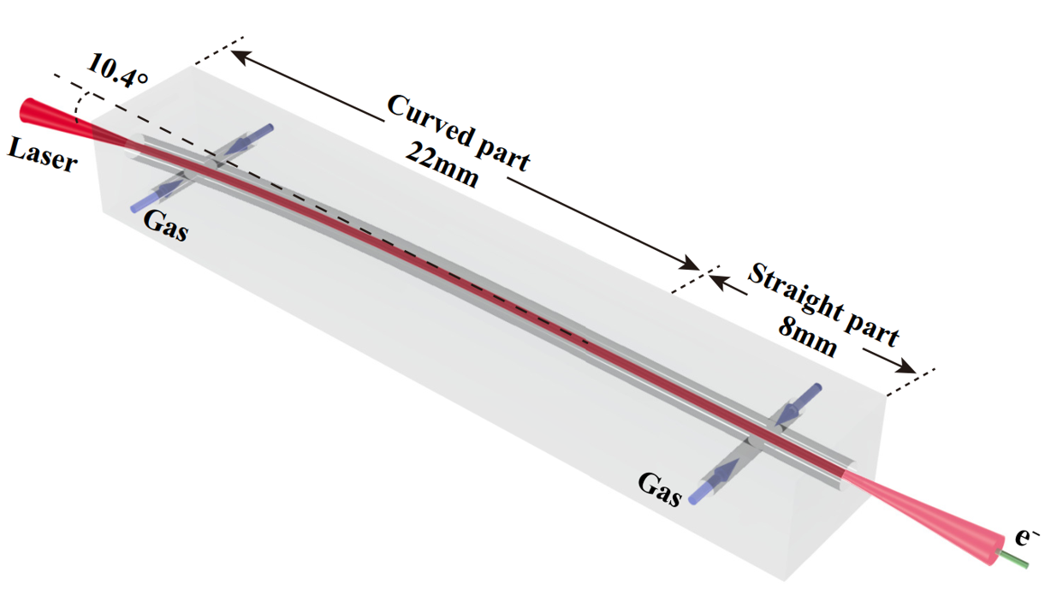
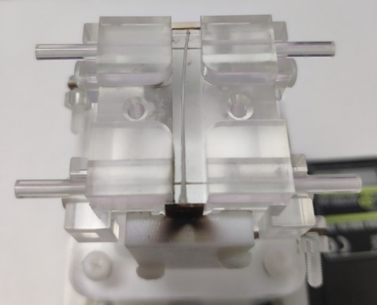

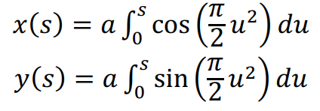


Stable laser guidance in curved plasma channel
Curved capillary with gradually increased curvature
X.Z. Zhu, et al. Phys. Rev. Lett. 130, 215001 (2023)

Slide 13







Stable laser guidance in curved plasma channel
r_{os}
E~10 mJ; λ=800 nm; τ=30 fs；w₀=33μm (FWHM)
Laser spot at (a) capillary entrance, (b) capillary exit for r_{os}=20μm, (c) capillary exit for r_{os}=90μm.
Laser beam can be well guided from curved to straight plasma channels with suitable off-axis distance.

Slide 14



Stable laser guidance in curved plasma channel
E ~ 3J; λ=800 nm; τ=30 fs；w₀=33μm (FWHM)
Gas: 99.5% He+0.5 N₂
Stage II: the second drive laser is stably guided by a curved plasma channel to the following straight channel.
For relativistic laser, we can get the most stable electron acceleration with optimal off-axis incidence. (monoenergetic and minimal energy spread)
Simulation results show that transverse oscillations of laser beam centroid can be avoided under appropriate off-axis incidence and electron injection in the curved part can be avoided using pure helium gas.

Slide 15






Next works
200TW, 10Hz, 25fs (2012~2022)
Single laser beam
200TW+300TW, 1Hz, 25fs (2023~)
Two laser beams
Angle:90~180°
300TW
200TW
Laser Room
Angle:0~90°
update
Target Processing
Control Center
Supercomputer

Slide 16
Summary
To realize multistage LWFA based on curved plasma channels, we have done the following works:
Getting 2GeV electron beams in the straight plasma channel with centimeter-scale capillary.
Demonstrating stable laser guidance and electron acceleration from the curved to straight plasma channels using appropriate off-axis incidence.
Updating our 200TW single-laser system to 200TW+300TW two-lasers system for the next coupling experiment of multistage LWFA.
Hopefully, we can complete the coupling experiment in 2024.

Slide 17
Thank you！

