Slide 1

Experience with Wakefield Acceleration at SwissFEL
Evan Ericson :: Paul Scherrer Institute, EPFL
ALEGRO workshop, March 19-22 2024, Lisbon, Portugal

Slide 2



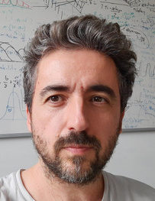
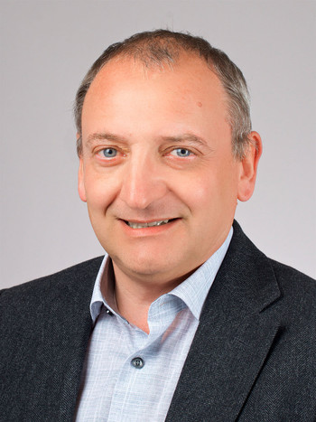

Acknowledgements
Rasmus
Ischebeck
Paolo
Craievich
Fabio
Marcellini
Sven
Reiche
Eduard
Prat
Mike
Seidel
Diagnostics
RF
Beam Dynamics
Large Research Facilities
This project has received funding from the European Union’s Horizon Europe research and innovation programme under grant agreement No. 101079773

Slide 3
Overview
SwissFEL
EuPRAXIA
Passive structures
SwissFEL passive dielectric structure
  Single Bunch Experiment & Simulations
  Two Bunch Experiment

Slide 4
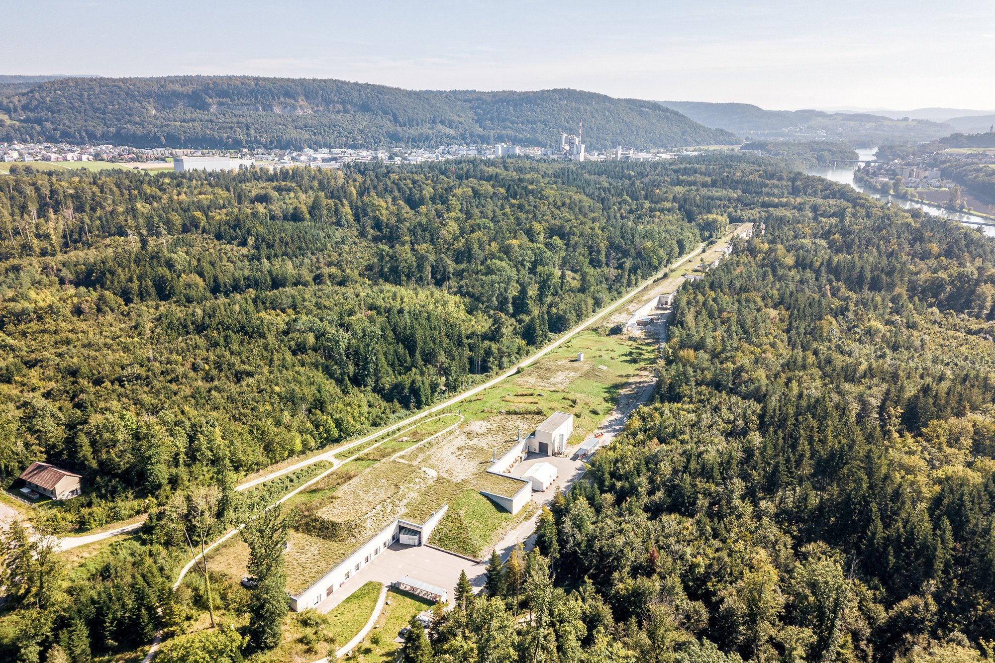
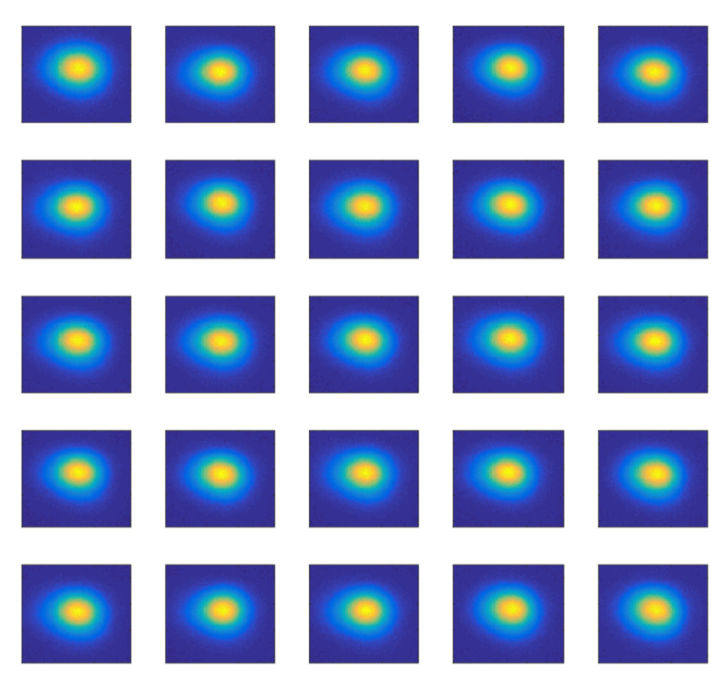
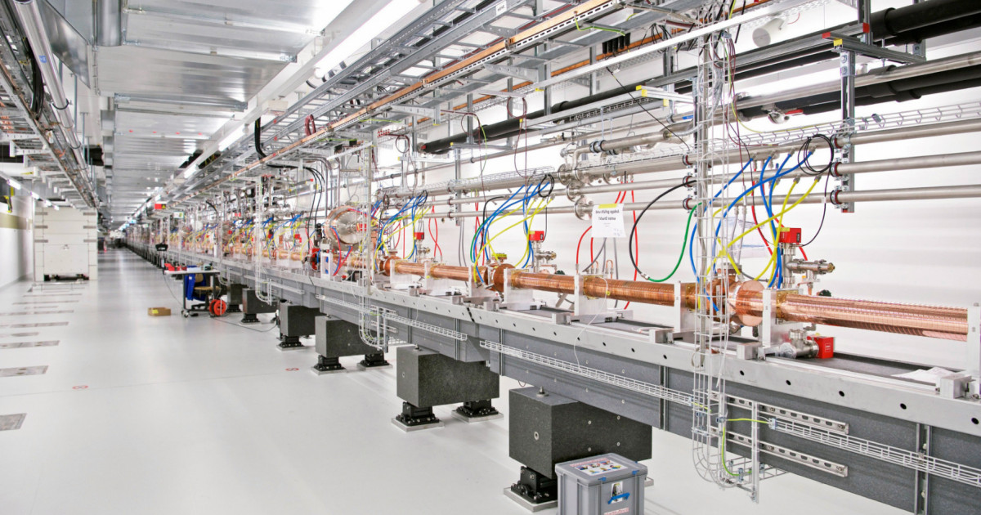
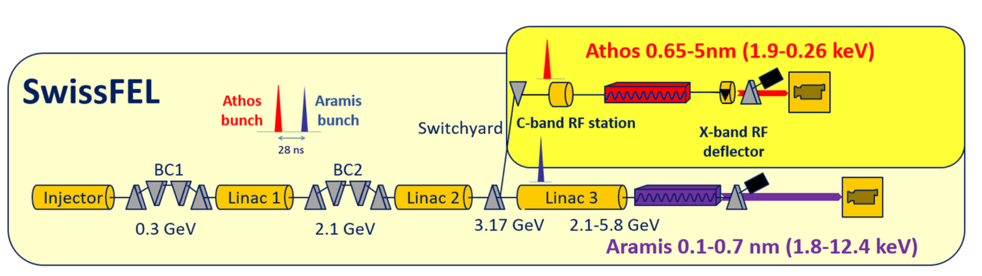
SwissFEL
Parameter | Value
Length | 740 m
LINAC frequency | 5.7 GHz (C-band)
Repetition rate | 100 Hz
Energy | up to 6.1 GeV
Bunch charge | 10 – 200 pC
Trajectory jitter | < 10% of beam size
Relative energy jitter | ~10⁻⁴
Arrival time jitter | < 10 fs
Slice emittance | 200 nm (for 200 pC)
Bunch length | < 1 fs – 50 fs
Courtesy: Eduard Prat

Slide 5
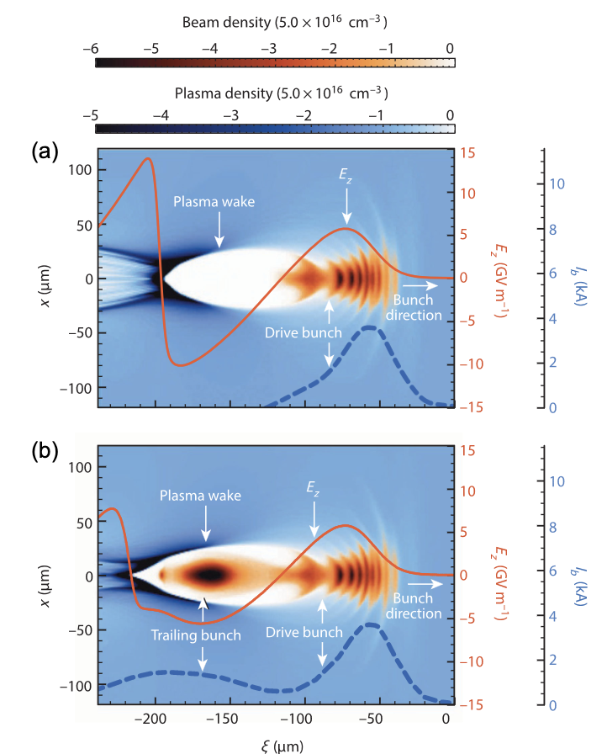
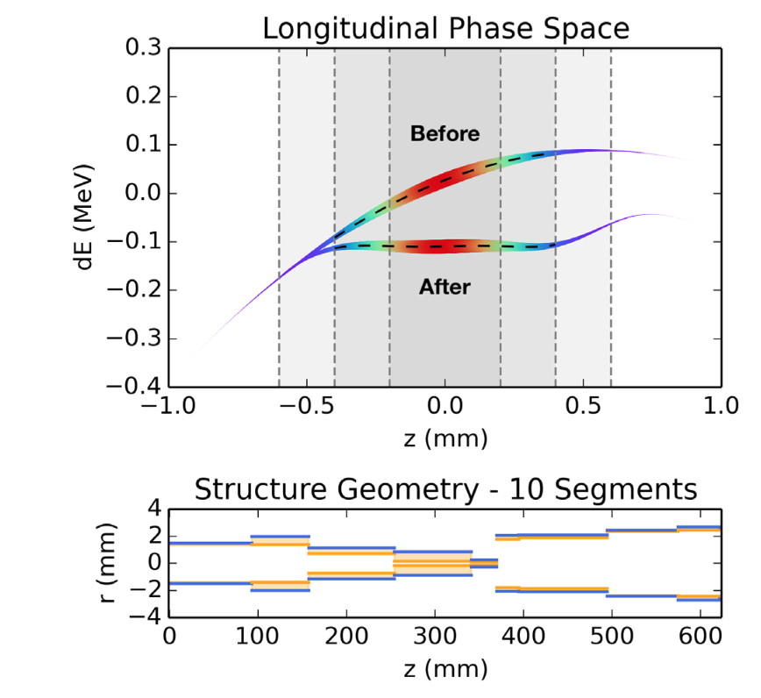
EuPRAXIA
Goal: reproduce SwissFEL performance using a plasma accelerator
Challenge: produce beams with low energy spread
Small wavelength of plasma wake leads to large difference in acceleration of particles within a bunch with a finite length
One possible solution is the use of wakefield structures
Longitudinal phase space synthesis with tailored 3D-printable dielectric-lined waveguides, Mayet, et al.
Positron acceleration in plasma wakefields, Cao, et al.

Slide 6
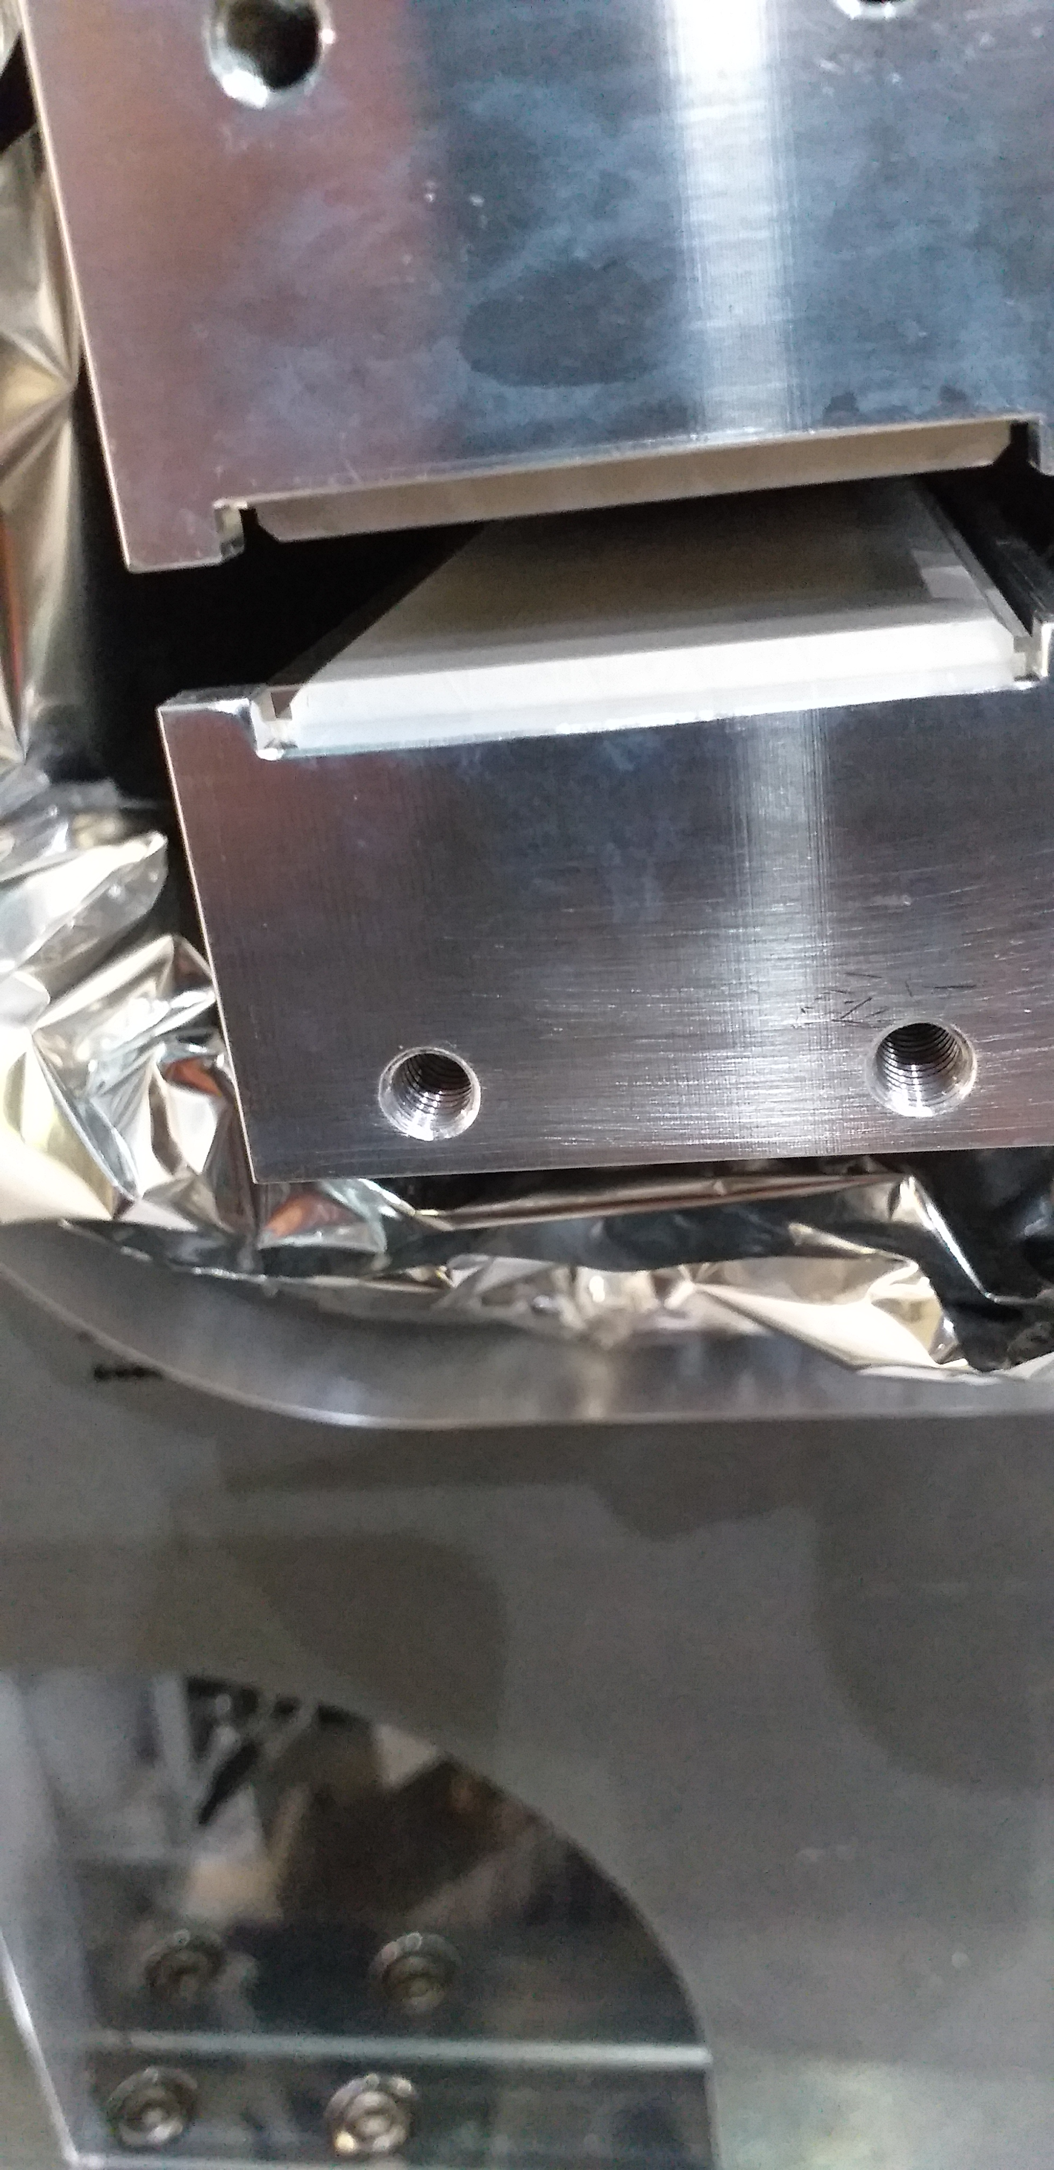
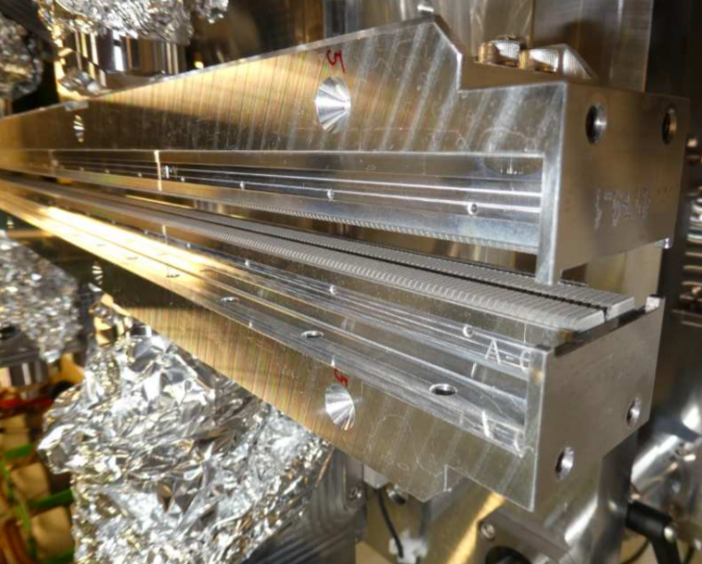
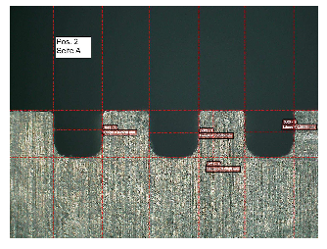
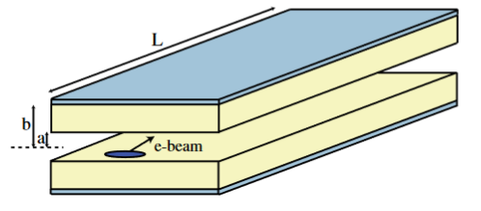
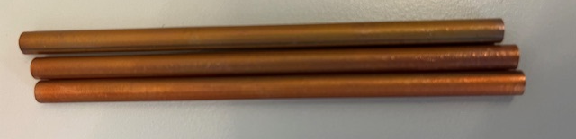
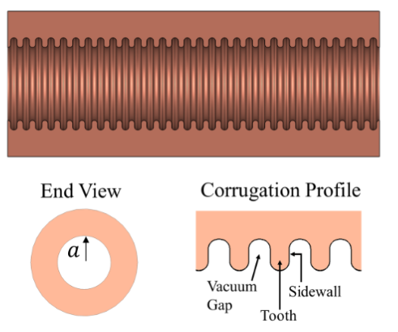
Wakefield structures
Dielectric
Metallic
Flat
Dielectric Wakefield Acceleration of a Relativistic Electron Beam in a Slab-Symmetric Dielectric Lined Waveguide, Andonian, et al.
Round
Design of a cylindrical corrugated waveguide
for a collinear wakefield accelerator, Siy, et al.

Slide 7
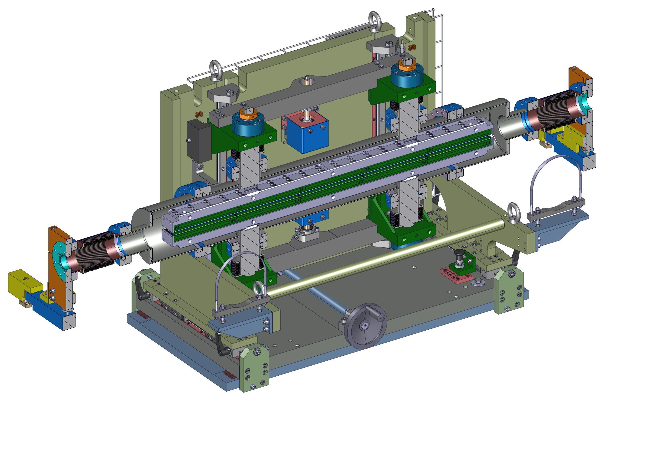
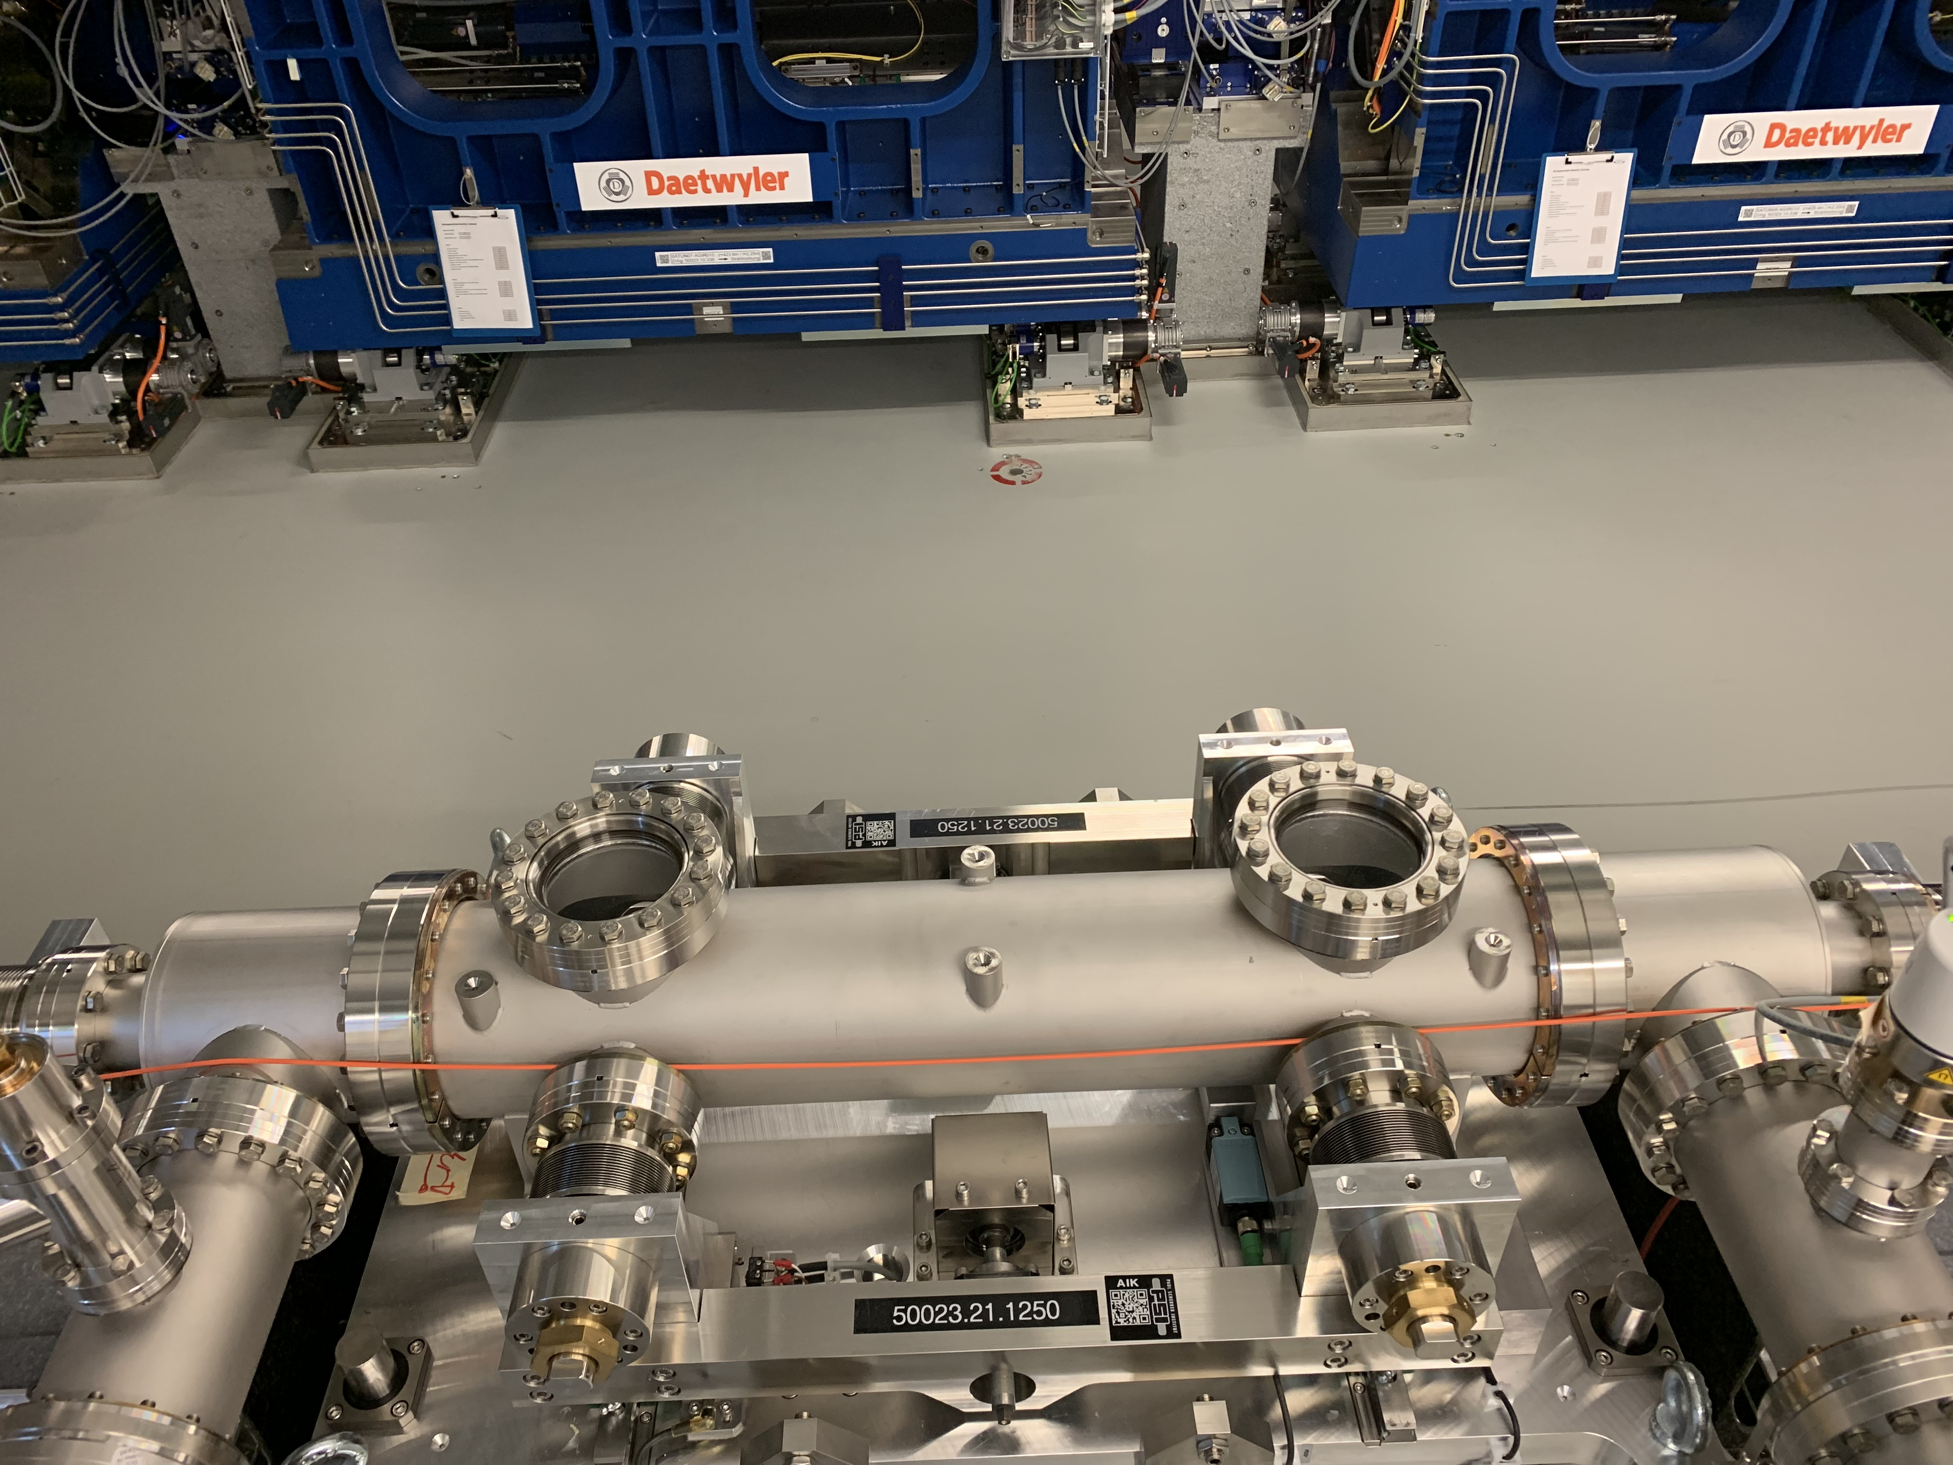
SwissFEL
Flat slab dielectric passive structure with adjustable gap
Routinely used to make ultrashort pulses, adjust FEL bandwidth
Courtesy: P. Heimgartner

Slide 8
Passive structure – single bunch experiment
Dielectric induces wakefields that act on the beam
Gap controls strength of the effect
Reduces correlated energy spread
Centroid energy changes
E
E
vacuum
tail
dielectric
positioner
Beam (into page)
head
t
t
Floor

Slide 9
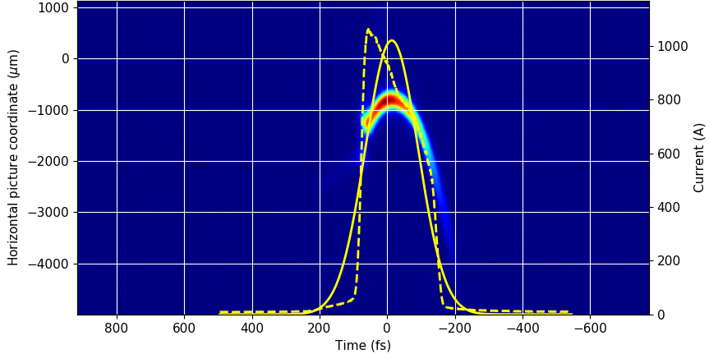
Passive structure – single bunch experiment
screen
C-band Transverse deflecting structure
Passive dielectric structure
dipole
Measurement procedure:
Passive structure gap is fully opened to limit its effect
TDS is used to get the longitudinal phase space of the beam sent into passive structure
TDS is turned off
Passive structure gap is gradually closed
Dipole & screen measure energy of beam coming out of the passive structure
Process is repeated for multiple bunch lengths (76 fs, 38 fs, 16 fs)

Slide 10
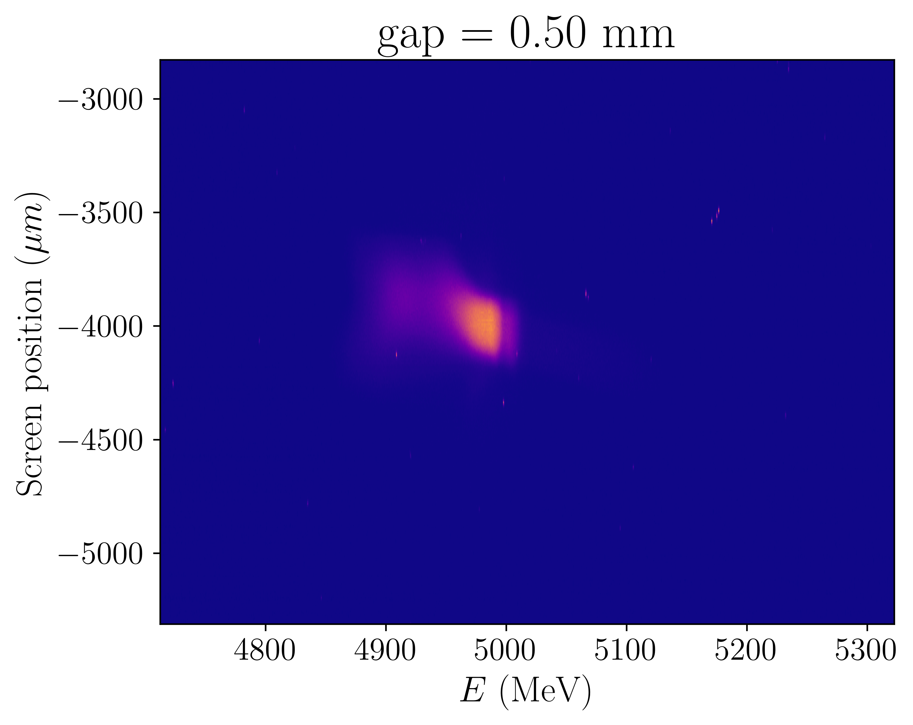
Passive structure – single bunch experiment
screen
C-band Transverse deflecting structure
Passive dielectric structure
dipole
Measurement procedure:
Passive structure gap is fully opened to limit its effect
TDS is used to get the longitudinal phase space of the beam sent into passive structure
TDS is turned off
Passive structure gap is gradually closed
Dipole & screen measure energy of beam coming out of the passive structure
Process is repeated for multiple bunch lengths (76 fs, 38 fs, 16 fs)

Slide 11
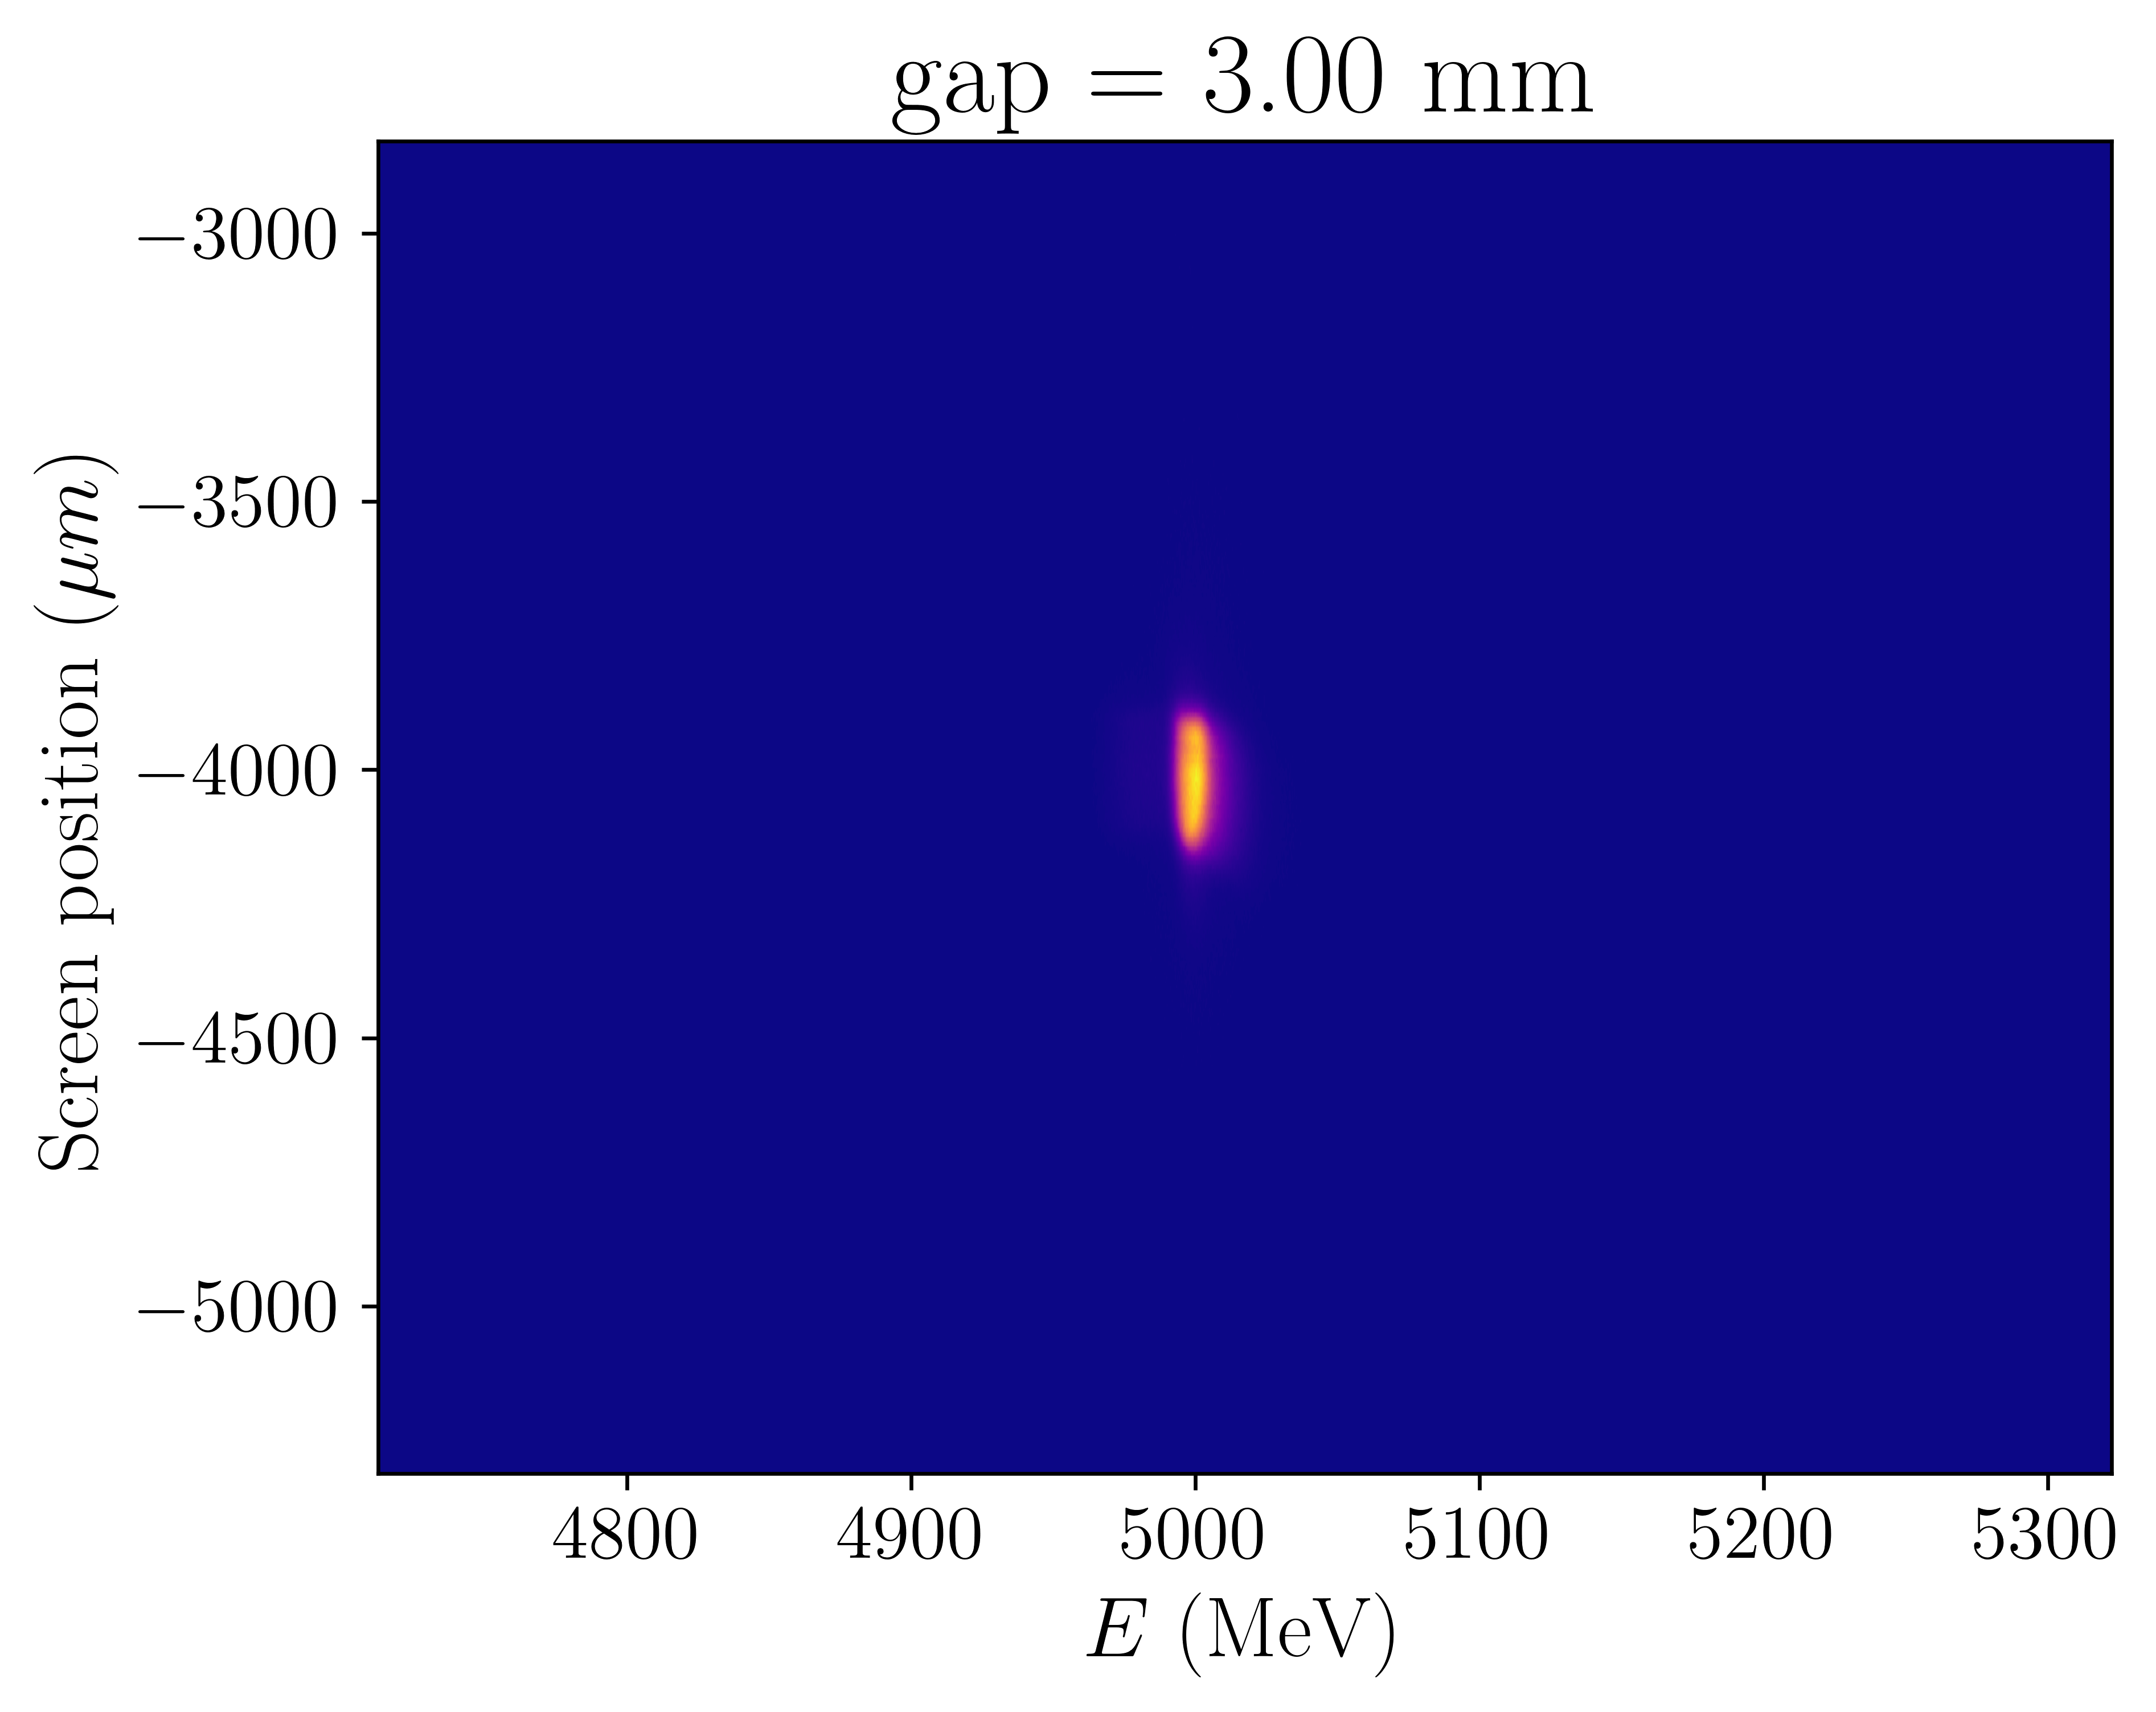

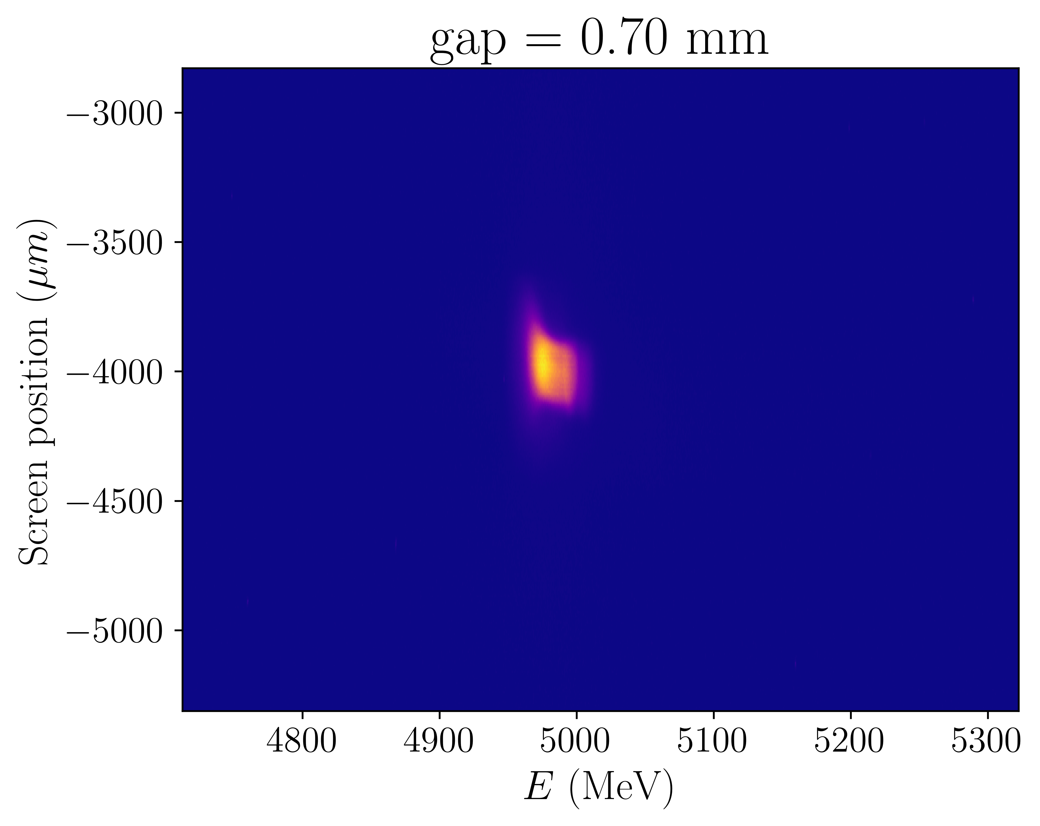
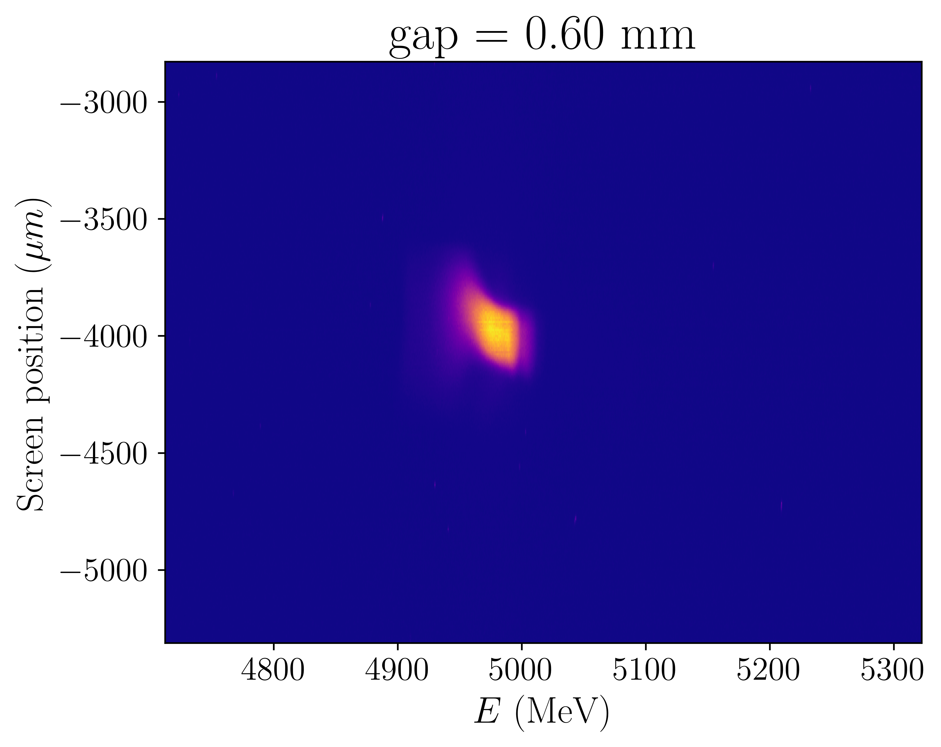
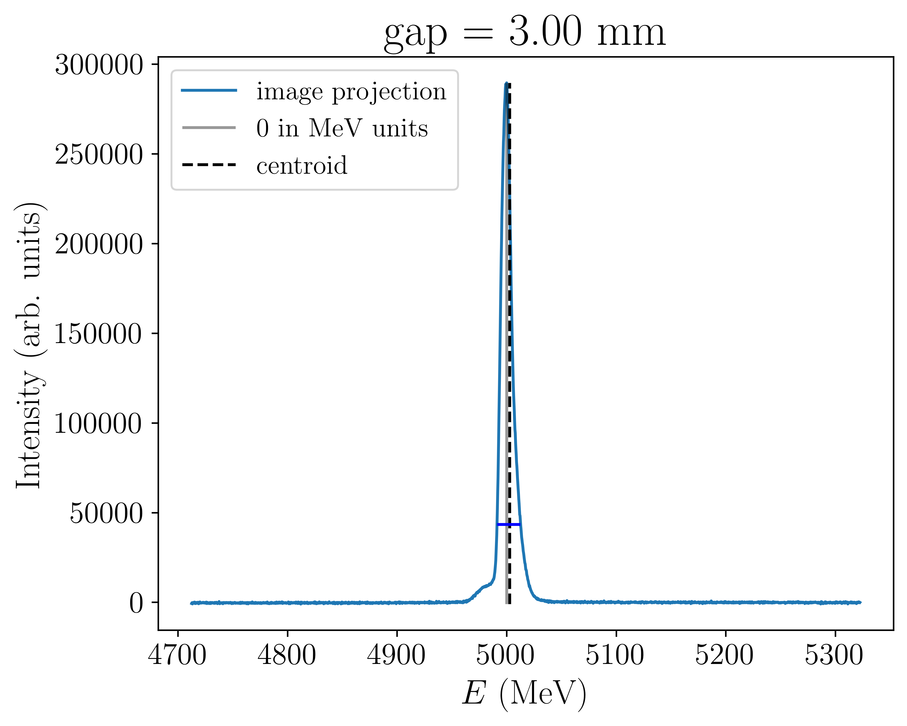
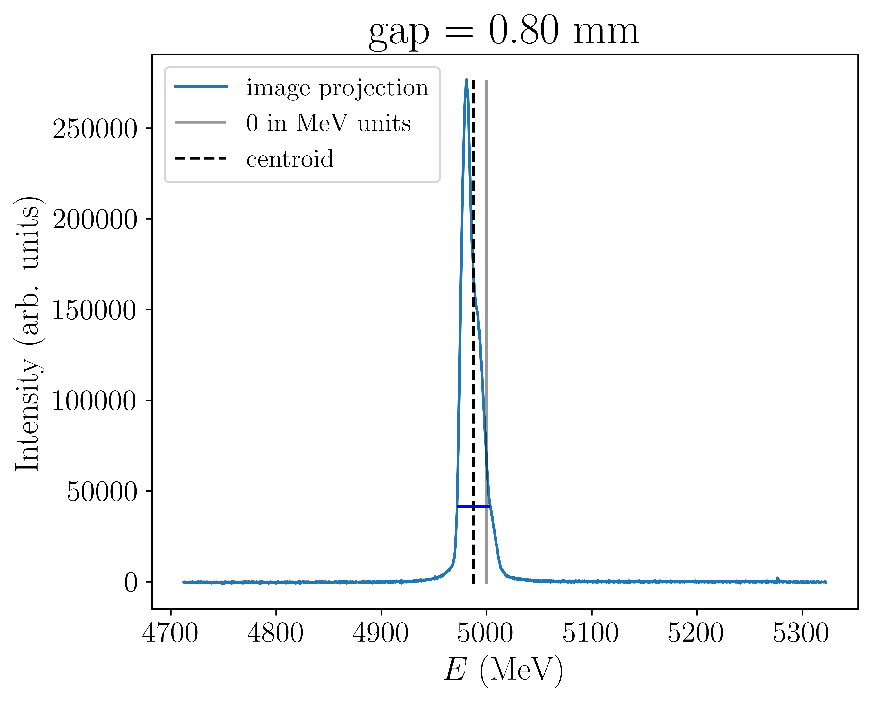
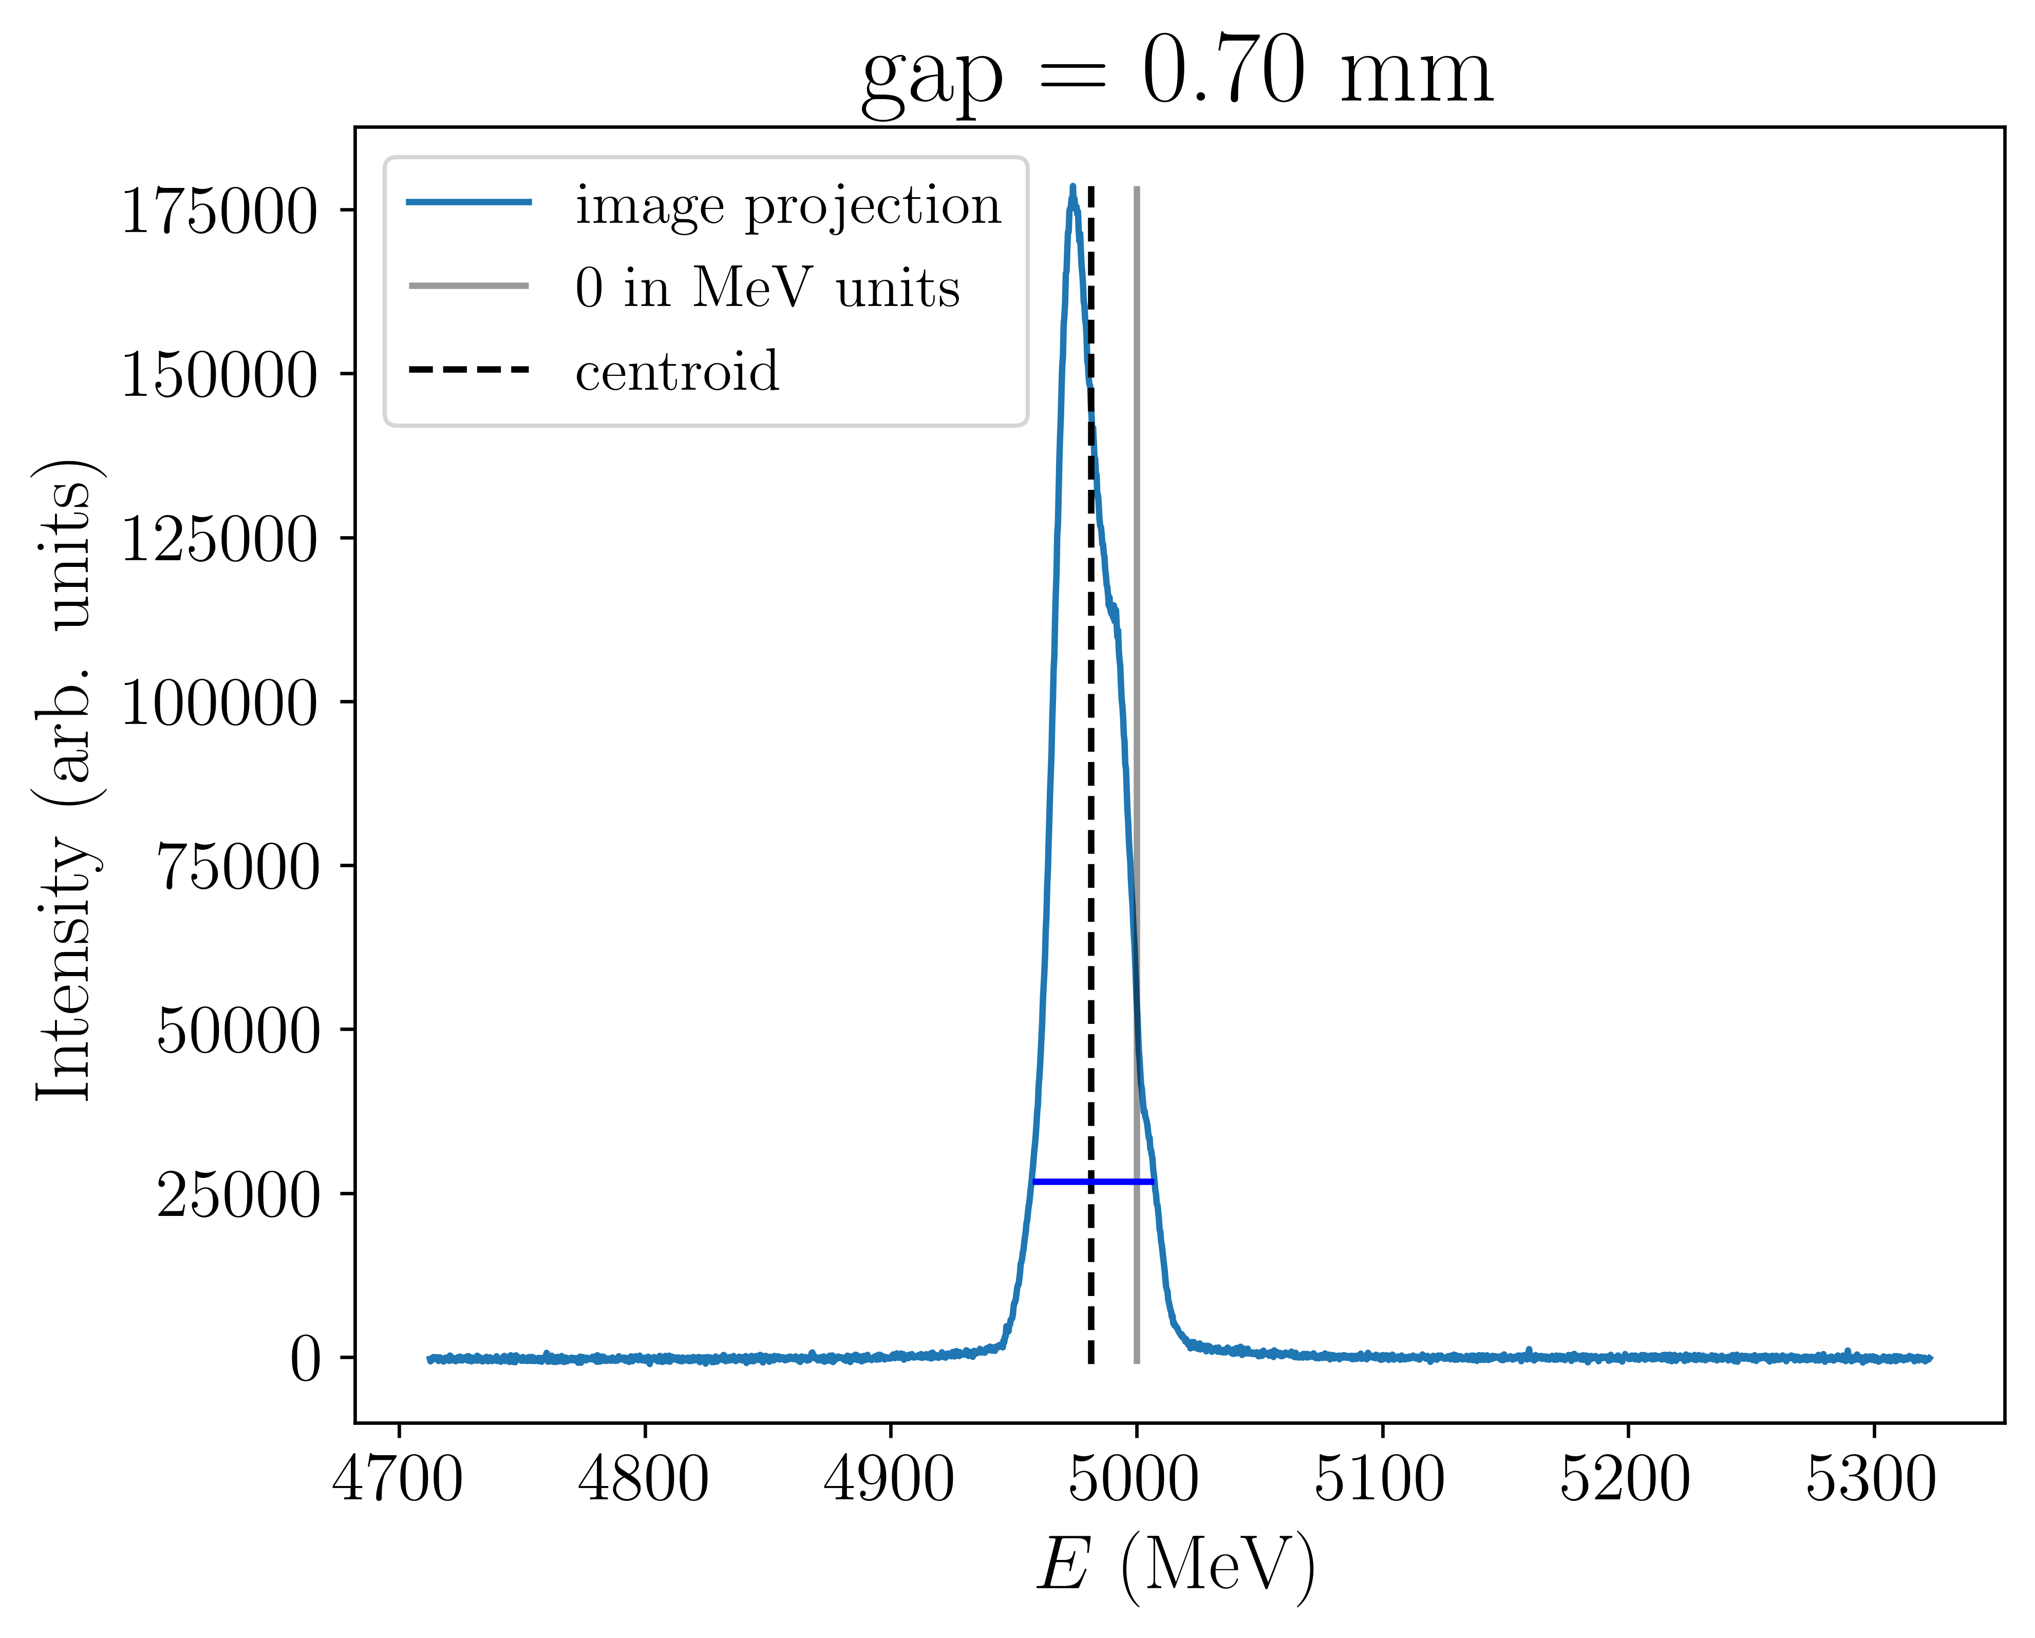
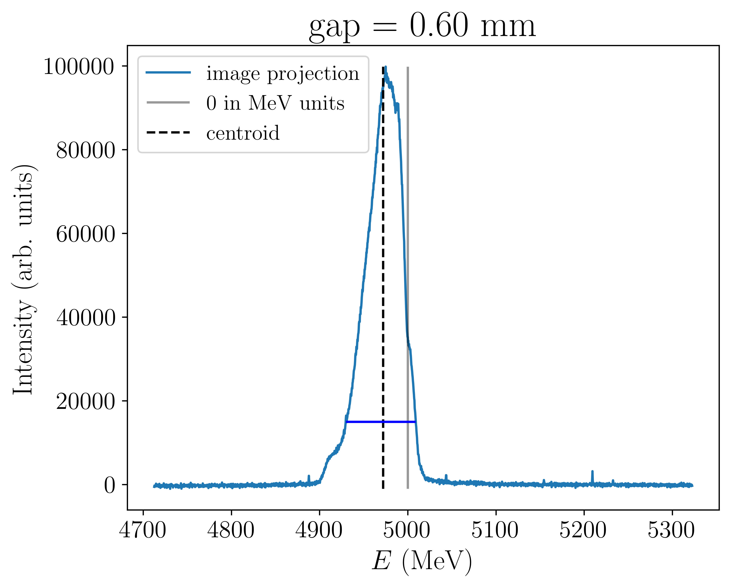
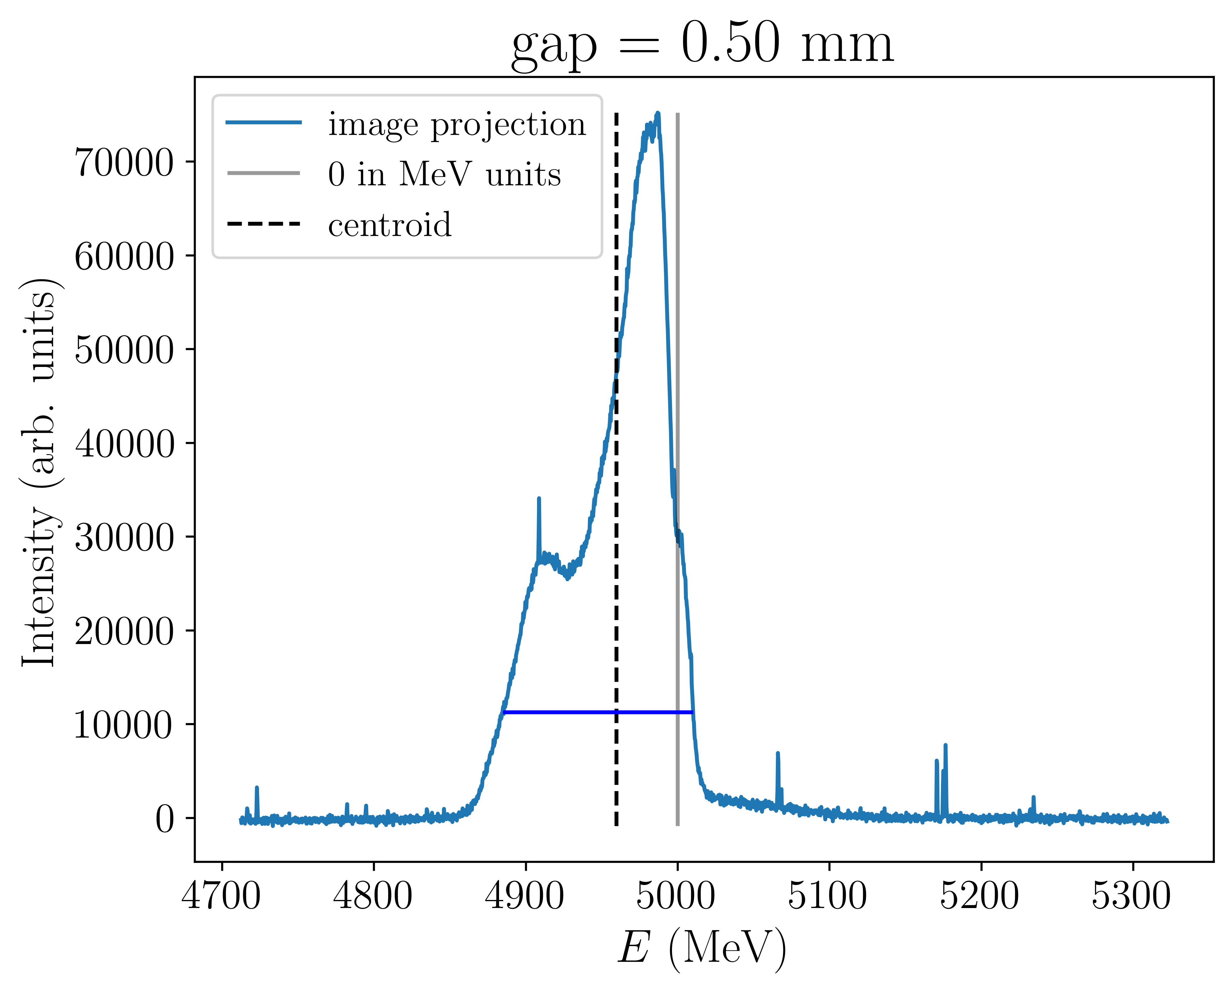
Passive structure – single bunch experiment
  How does the dechirping effect depend on structure gap?

Slide 12
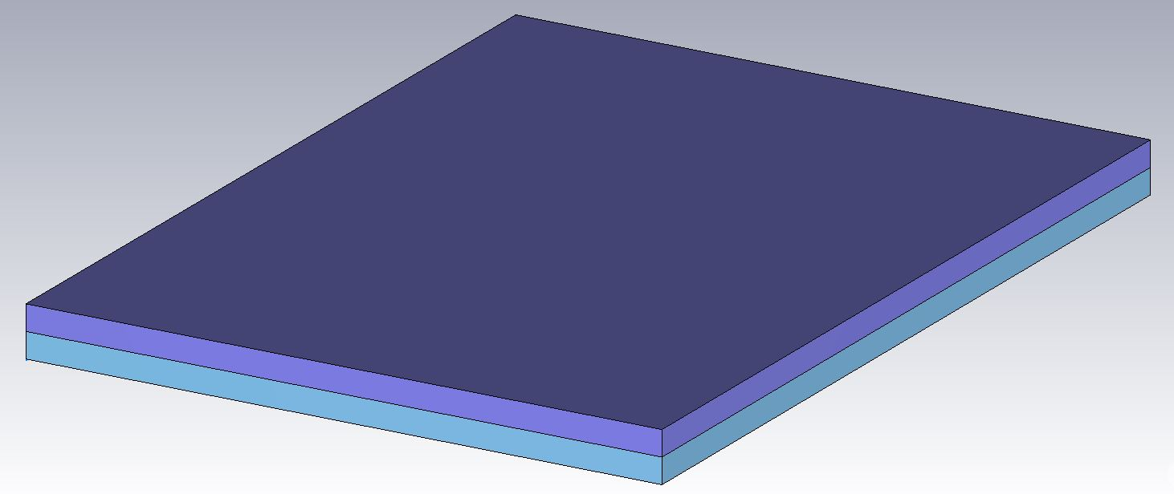
Passive structure – simulations
Began simulations using CST
Parameter | Value
half-gap, a | 0.25 mm – 1.5 mm
Dielectric thickness, d | 0.4 mm
Length, L | 1 m
Width, w | 15 mm
Alumina Permittivity, ε_{r} | ~10
w
beam
L
d
a

Slide 13
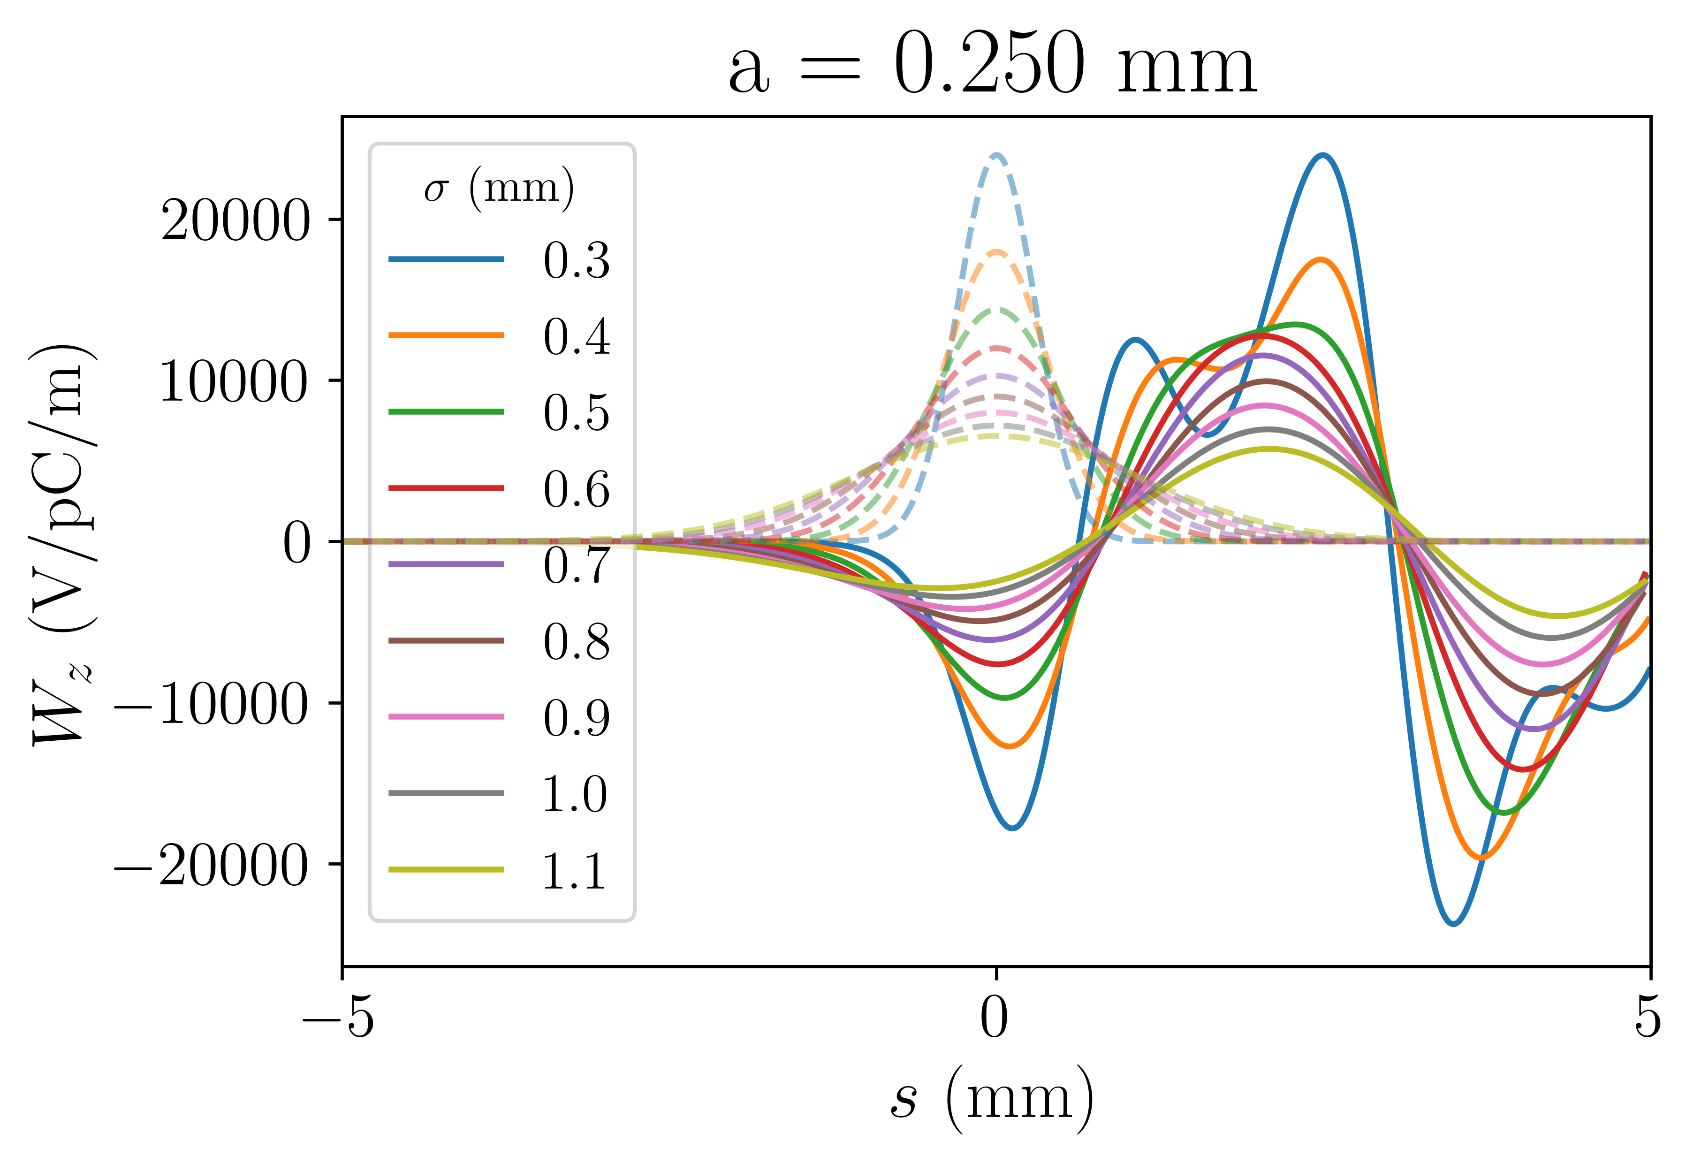
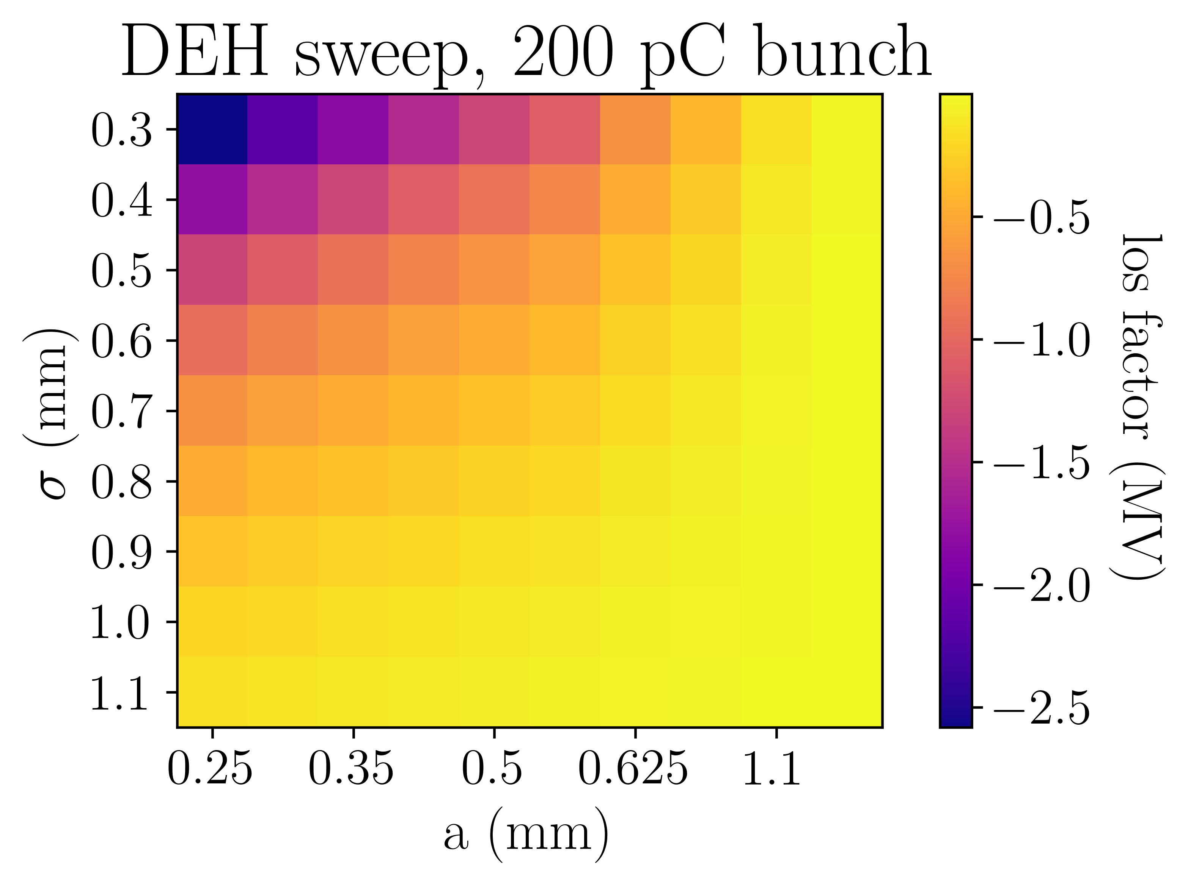
Passive structure – simulations
Possible to simulate
Difficult to simulate
Easy
to simulate
128 GB RAM PC limited to simulating σ = 0.3 mm bunches
To simulate SwissFEL bunches, σ = 4.8 μm, we used ECHO

Slide 14
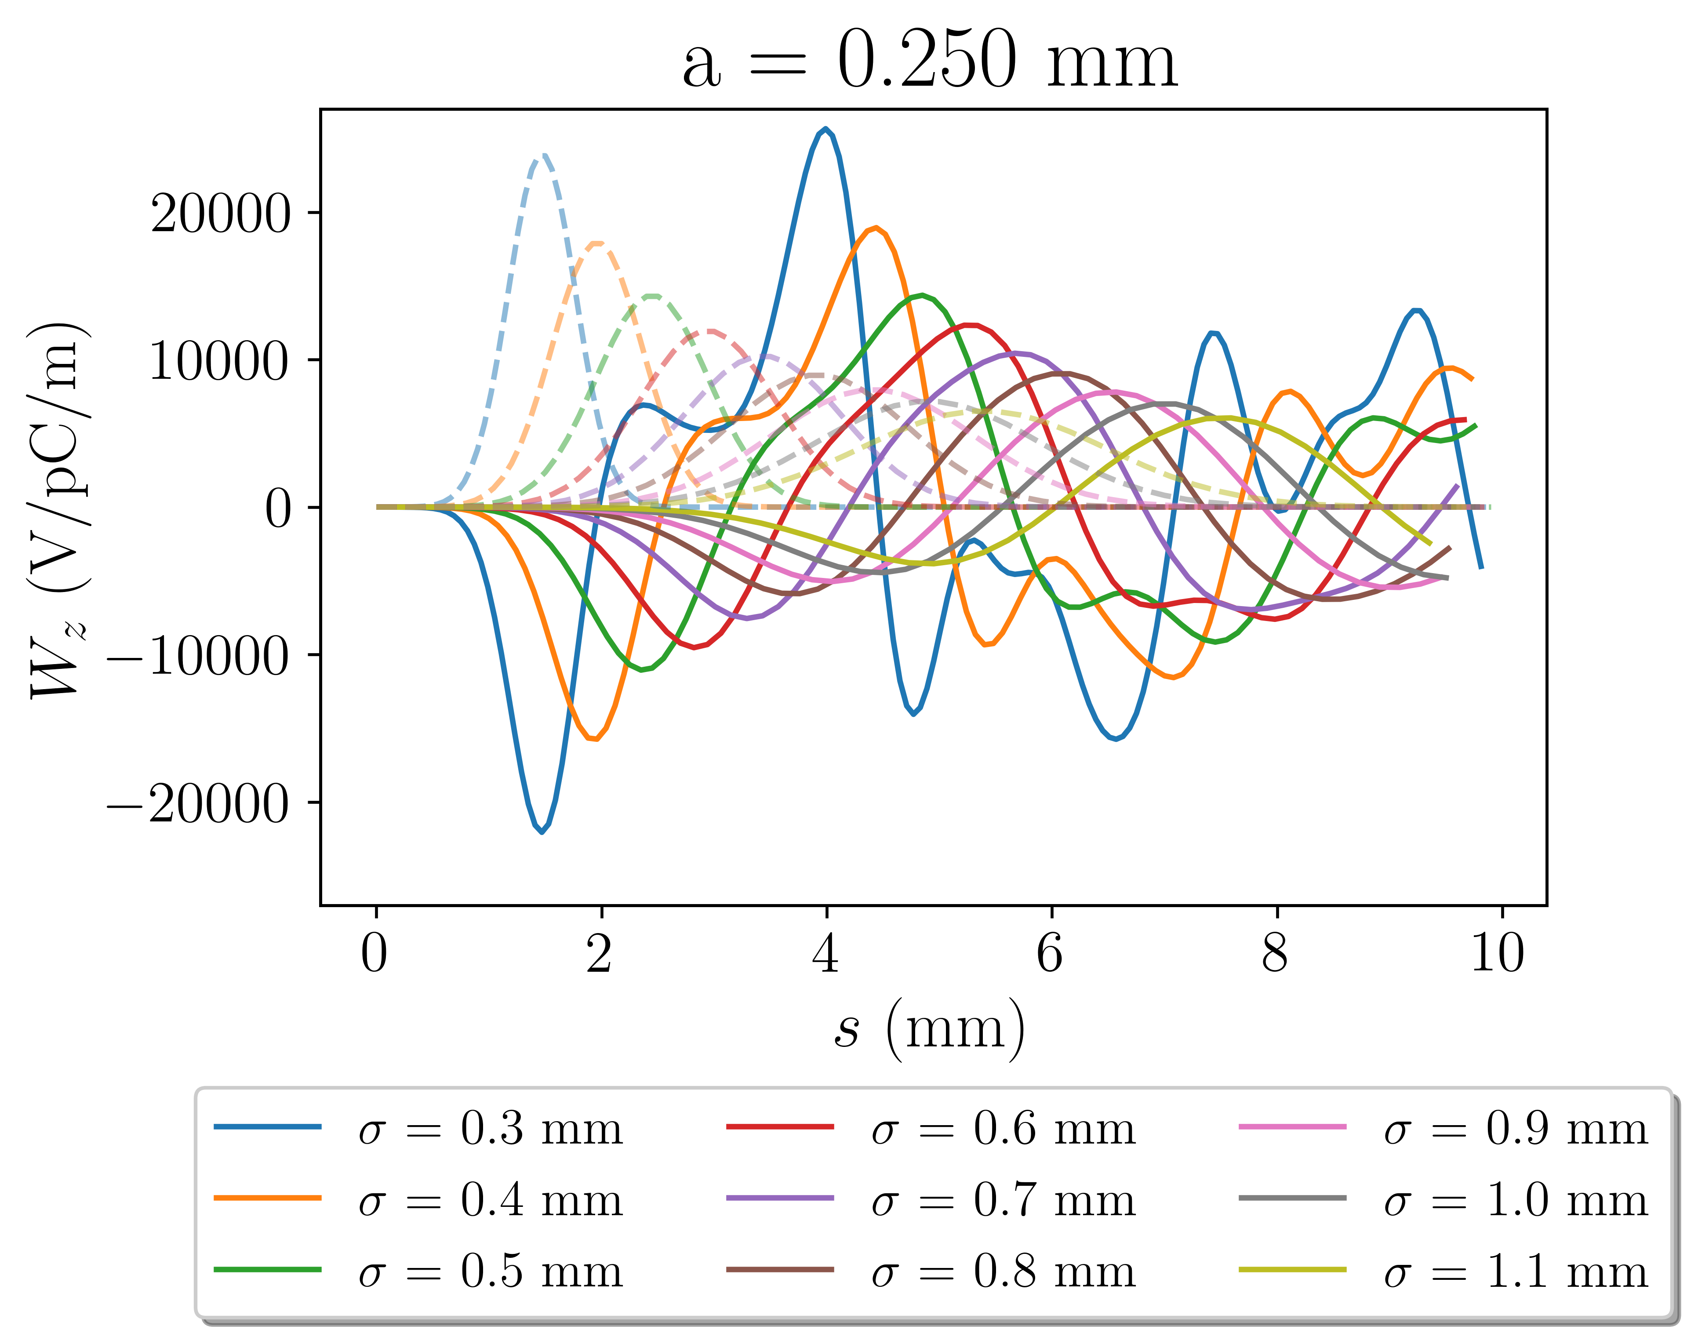
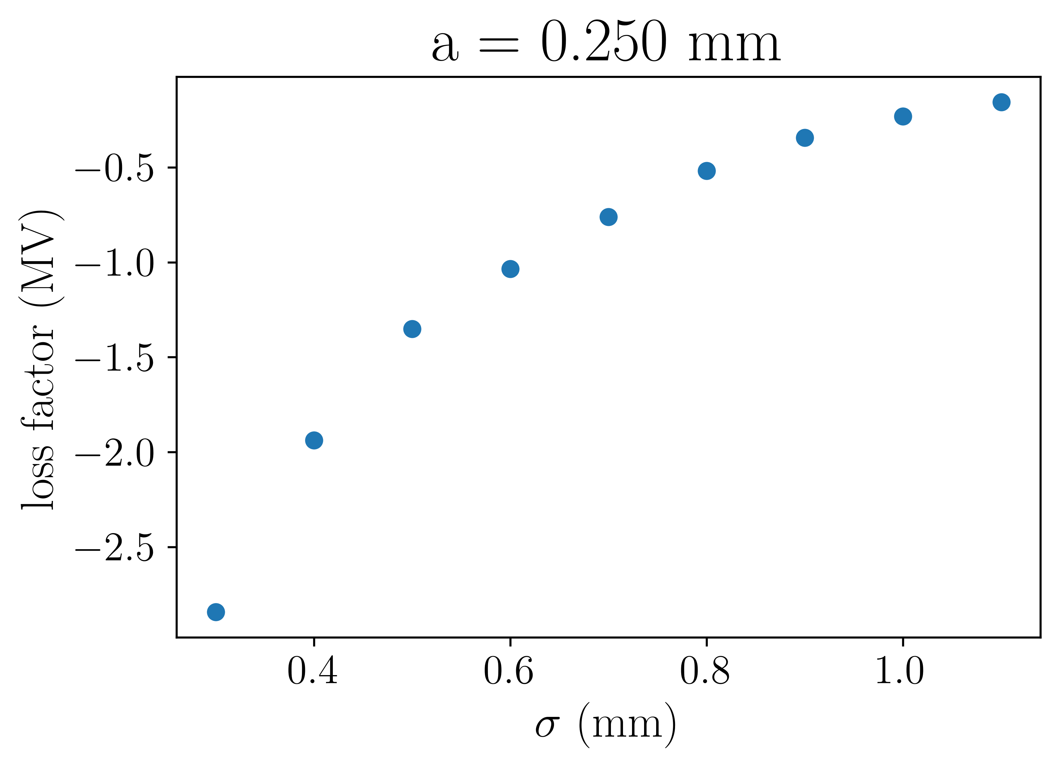
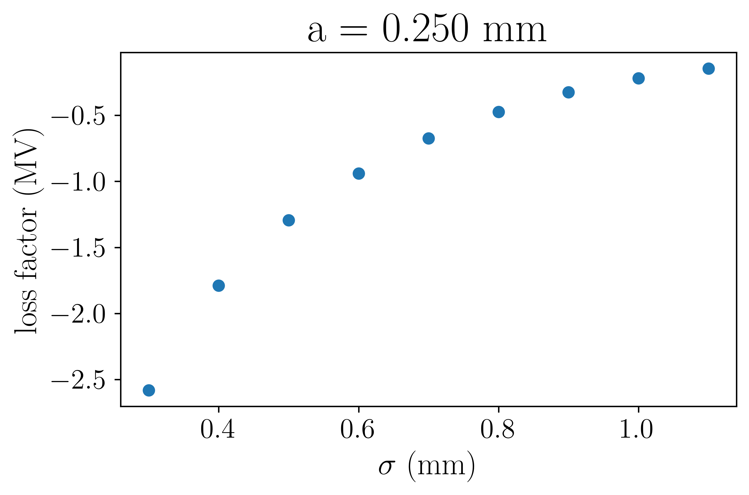
Passive structure – simulations
ECHO
CST
Wake potentials are slightly different between codes but the loss factors are similar

Slide 15
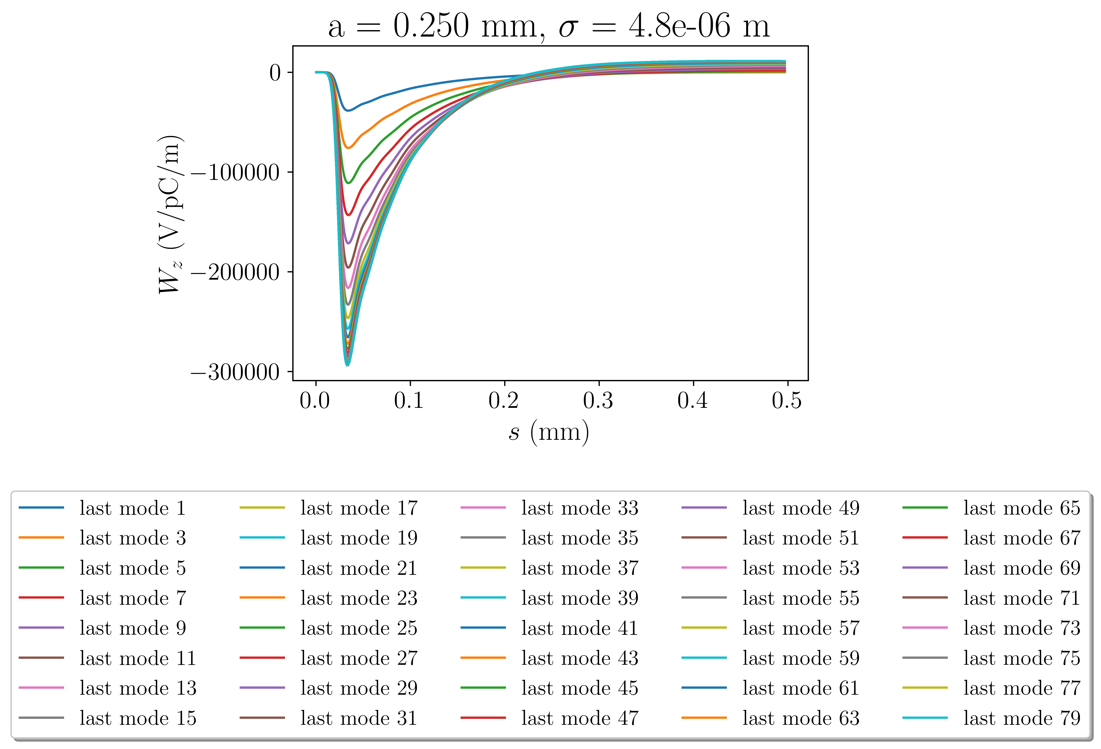
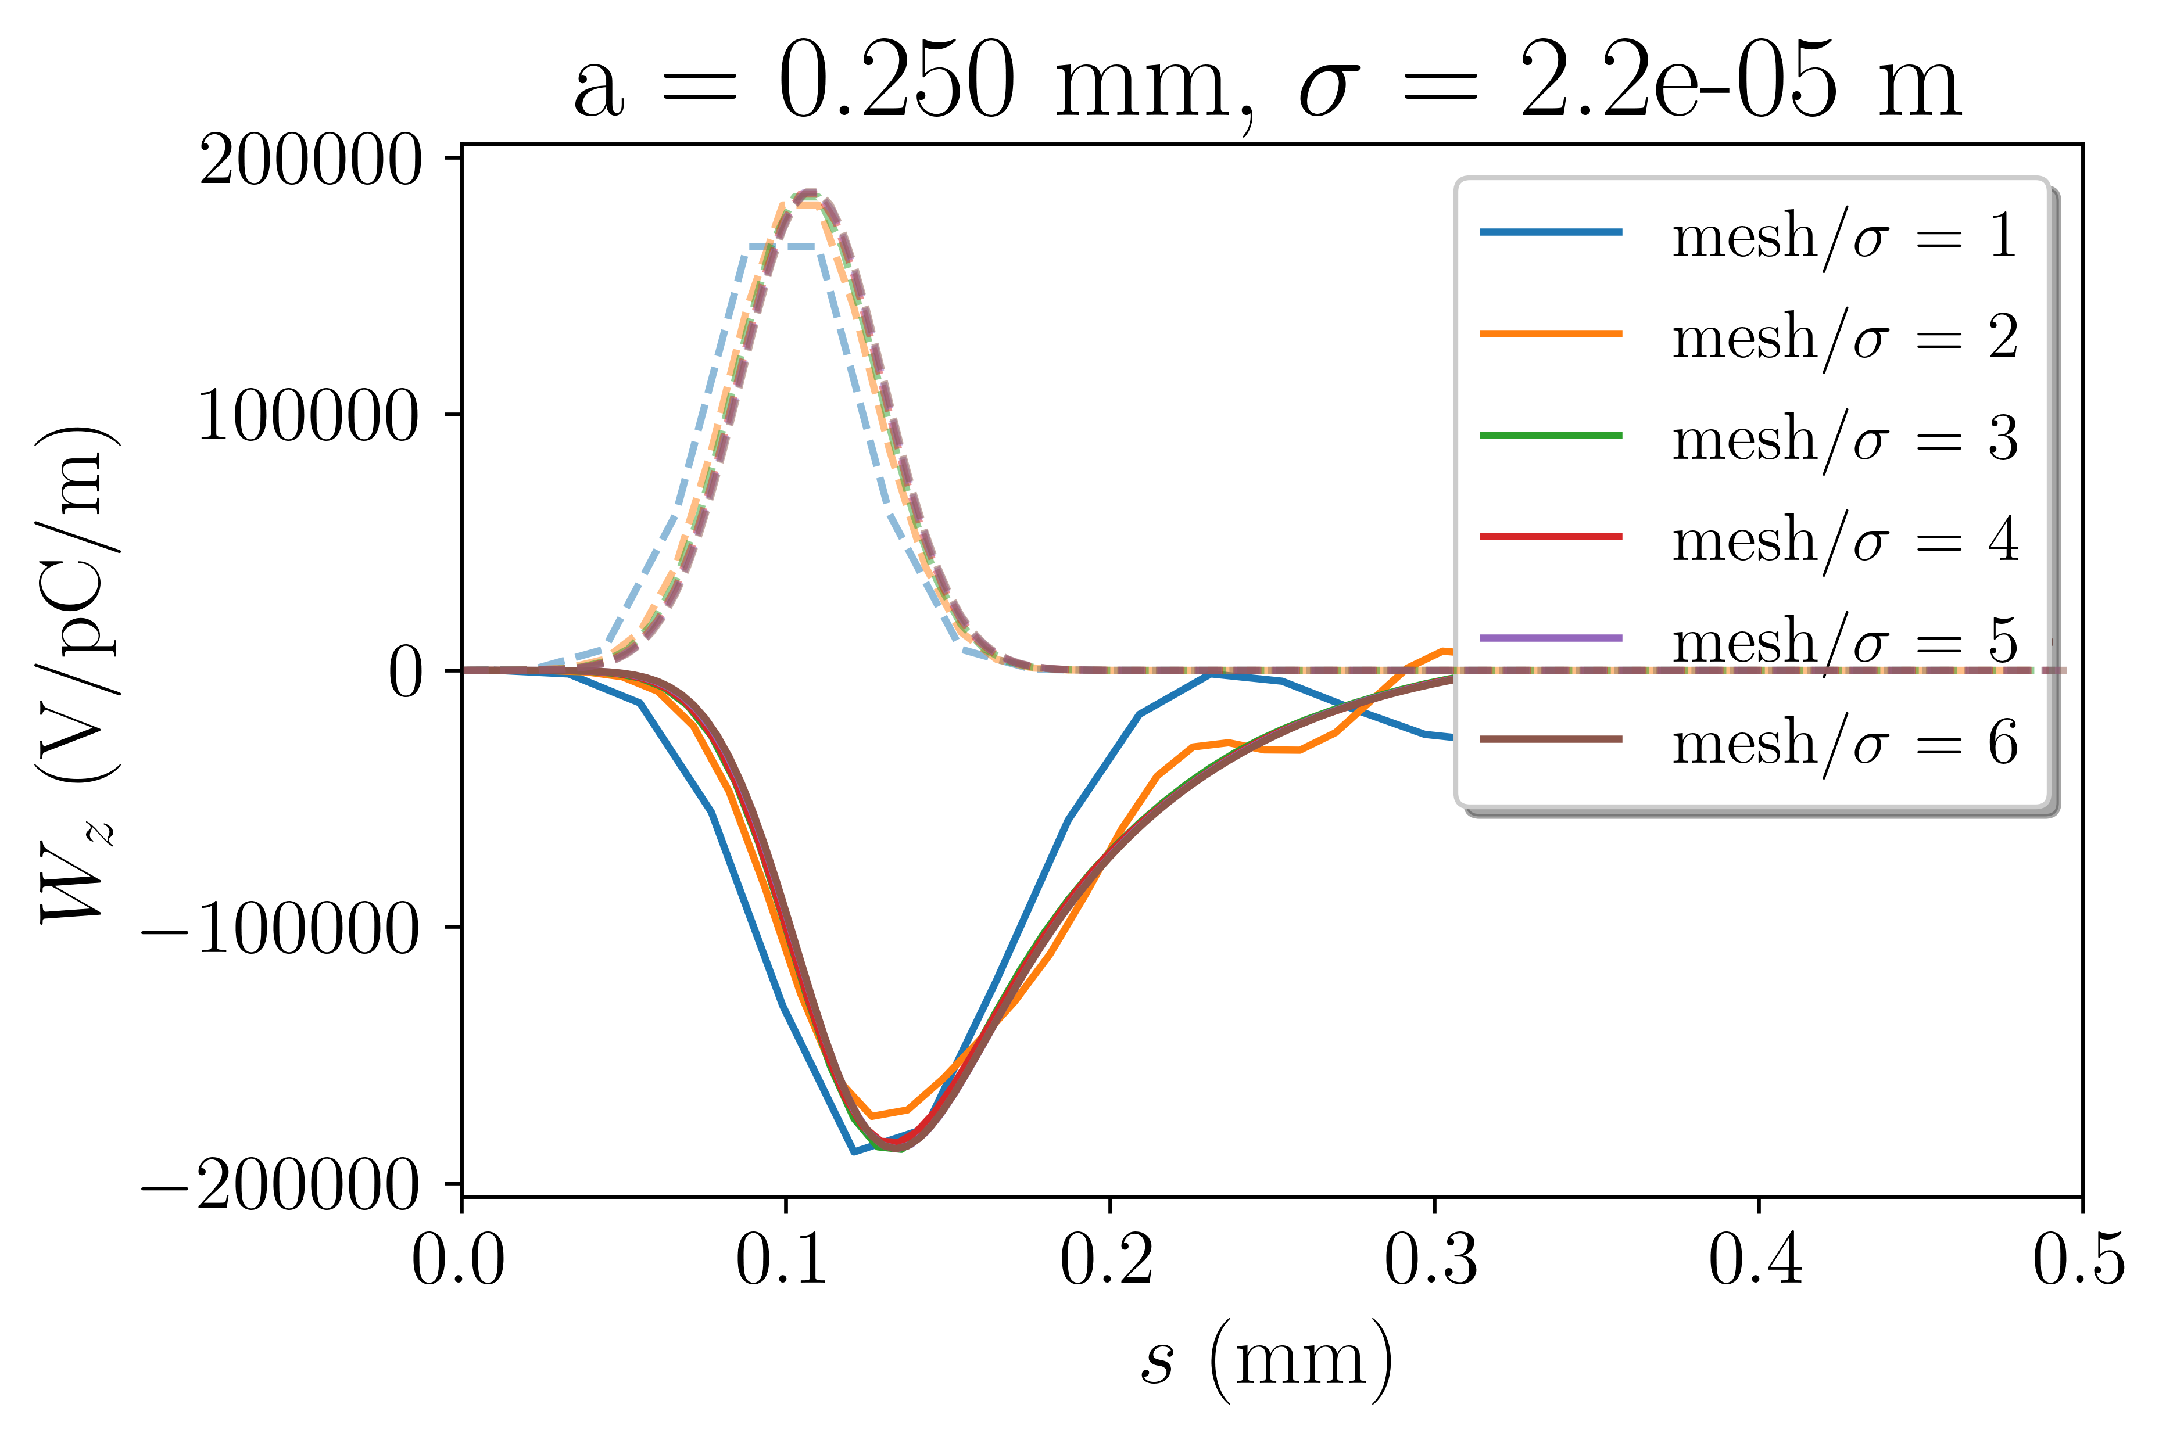
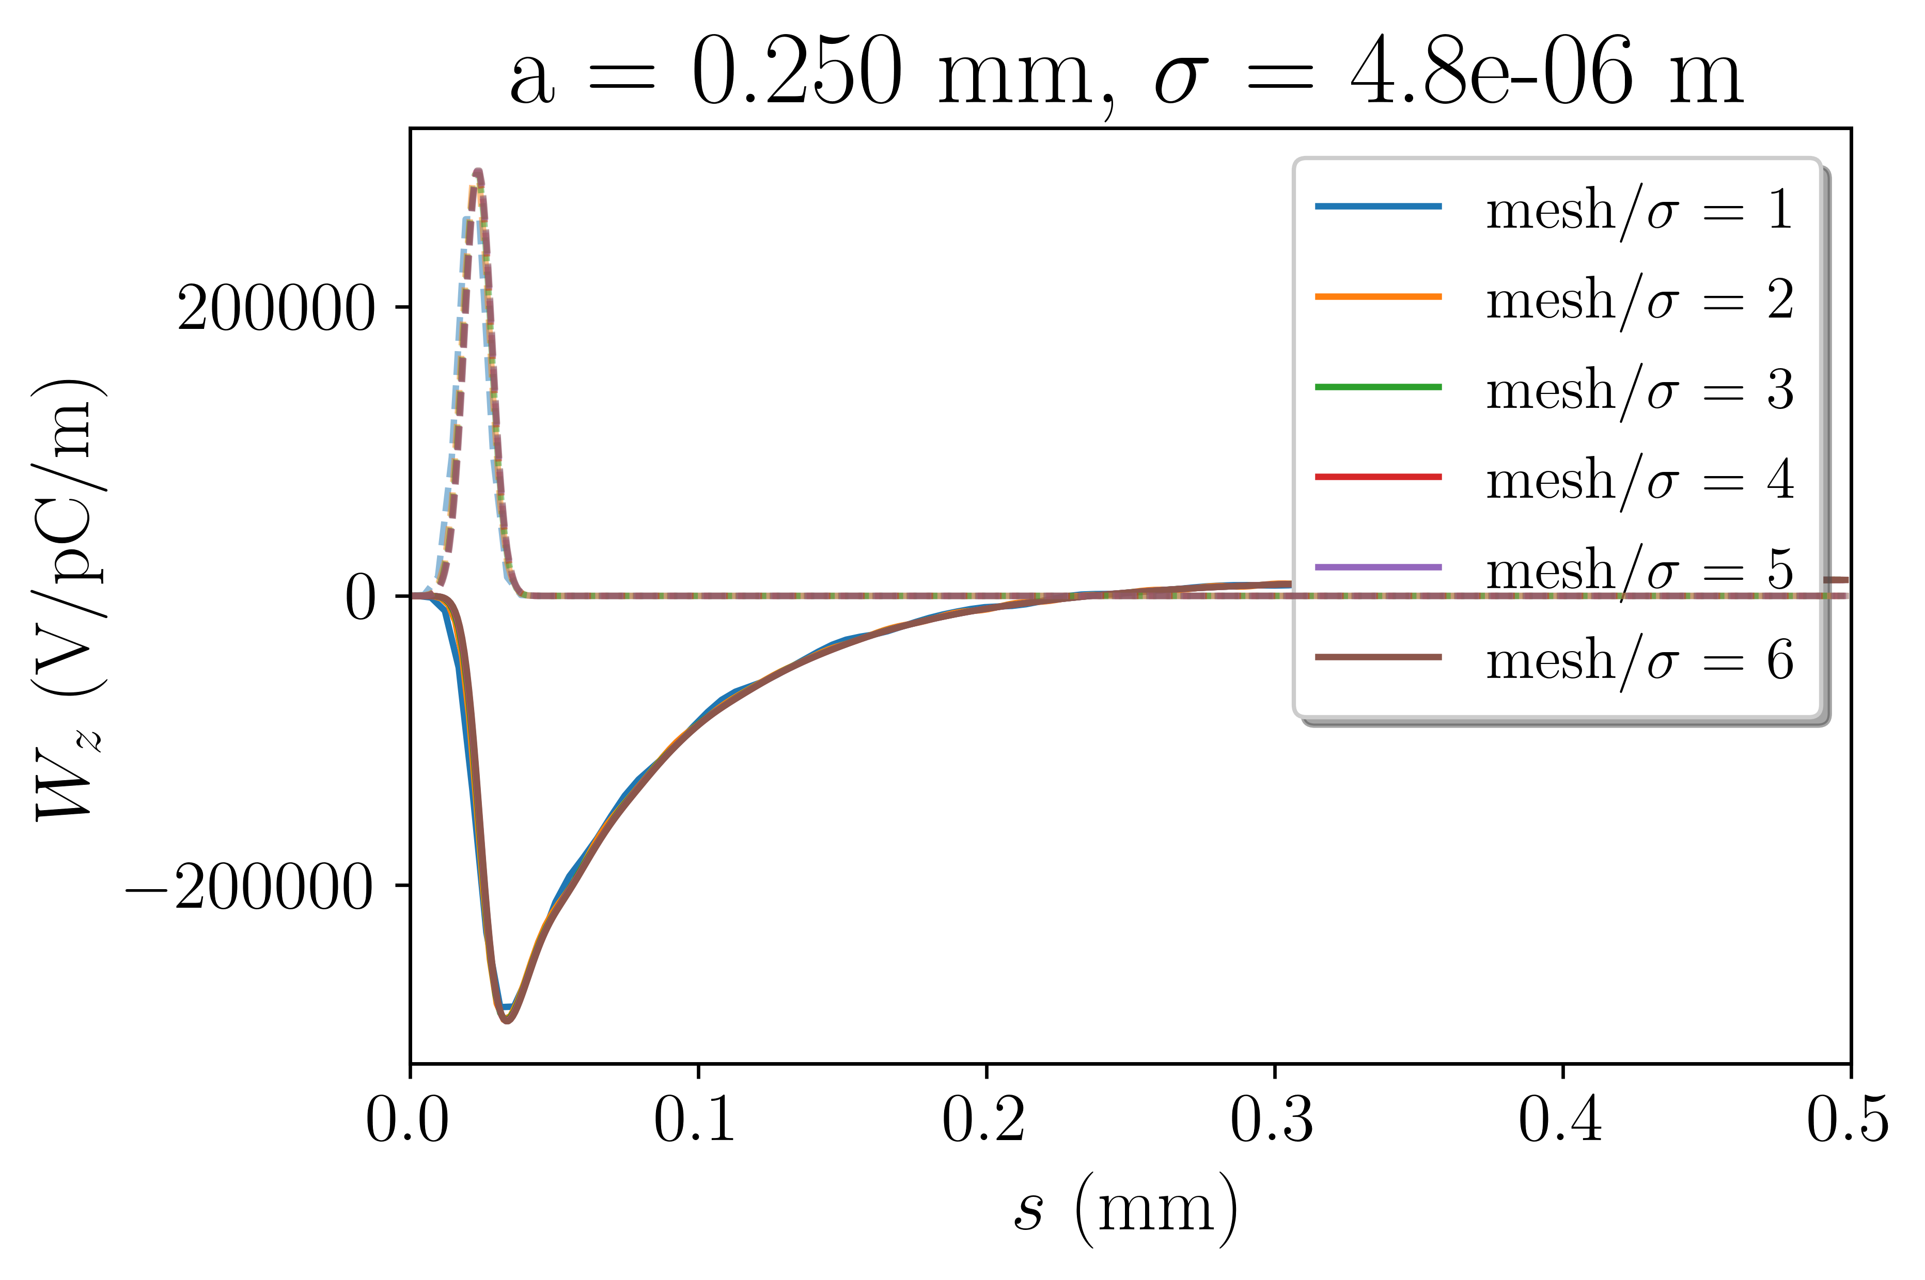
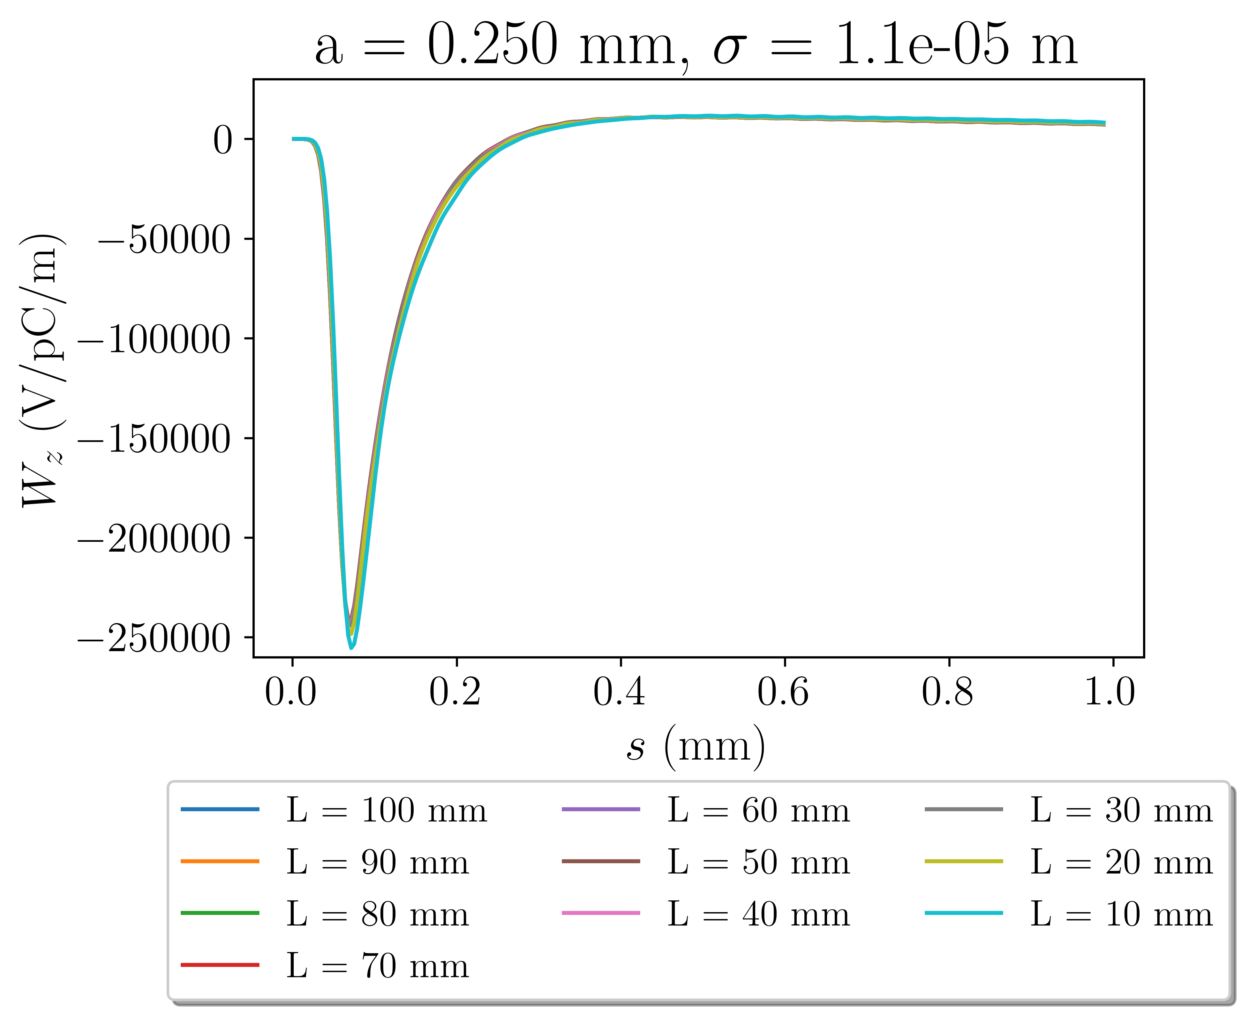
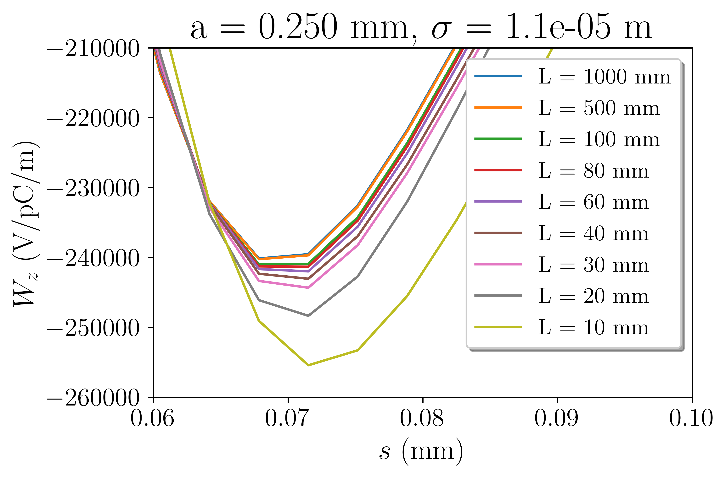
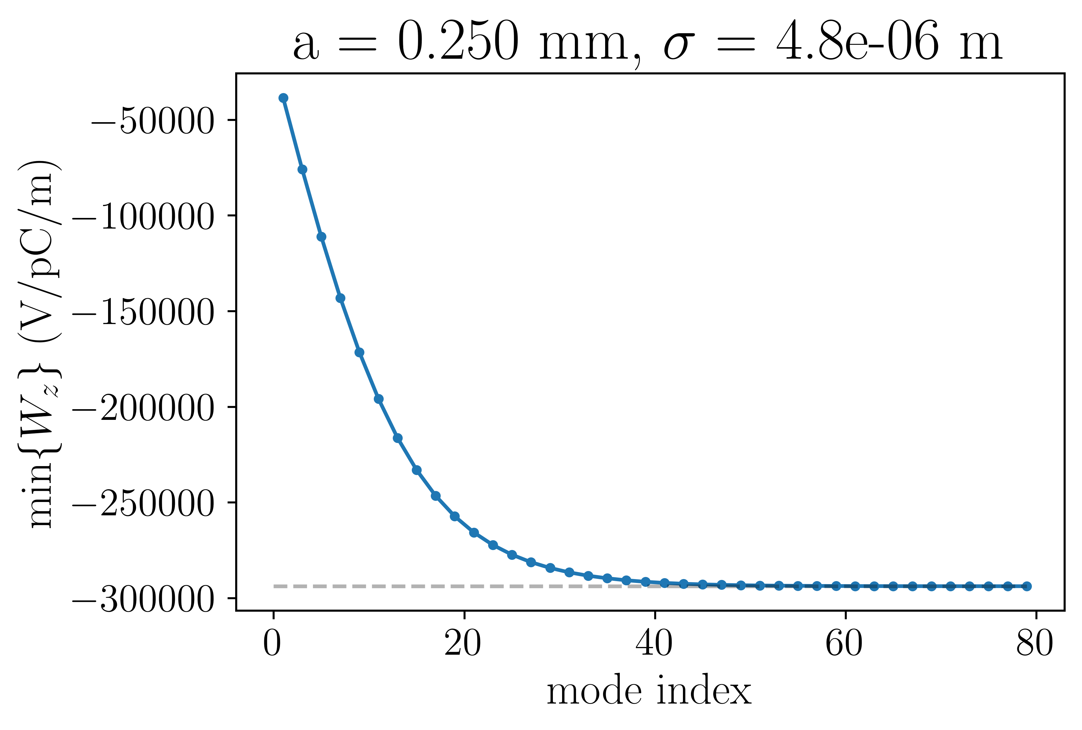
Passive structure – simulations
Structure length/Bunch length ~= 1,000,000
Mesh convergence
Convergence of modal
wake potentials
Structure length convergence

Slide 16
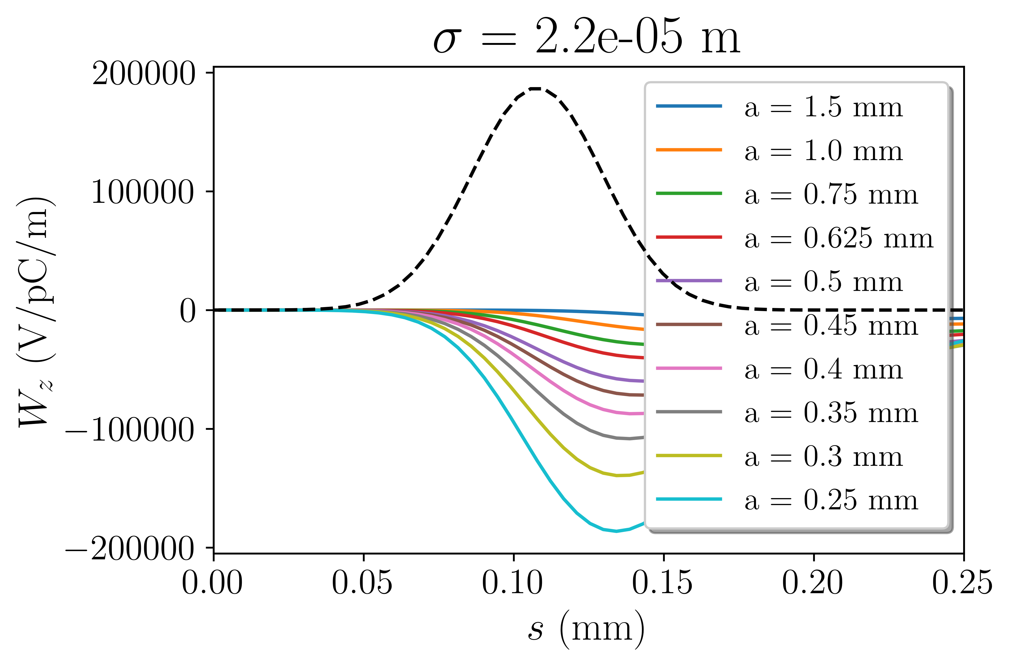
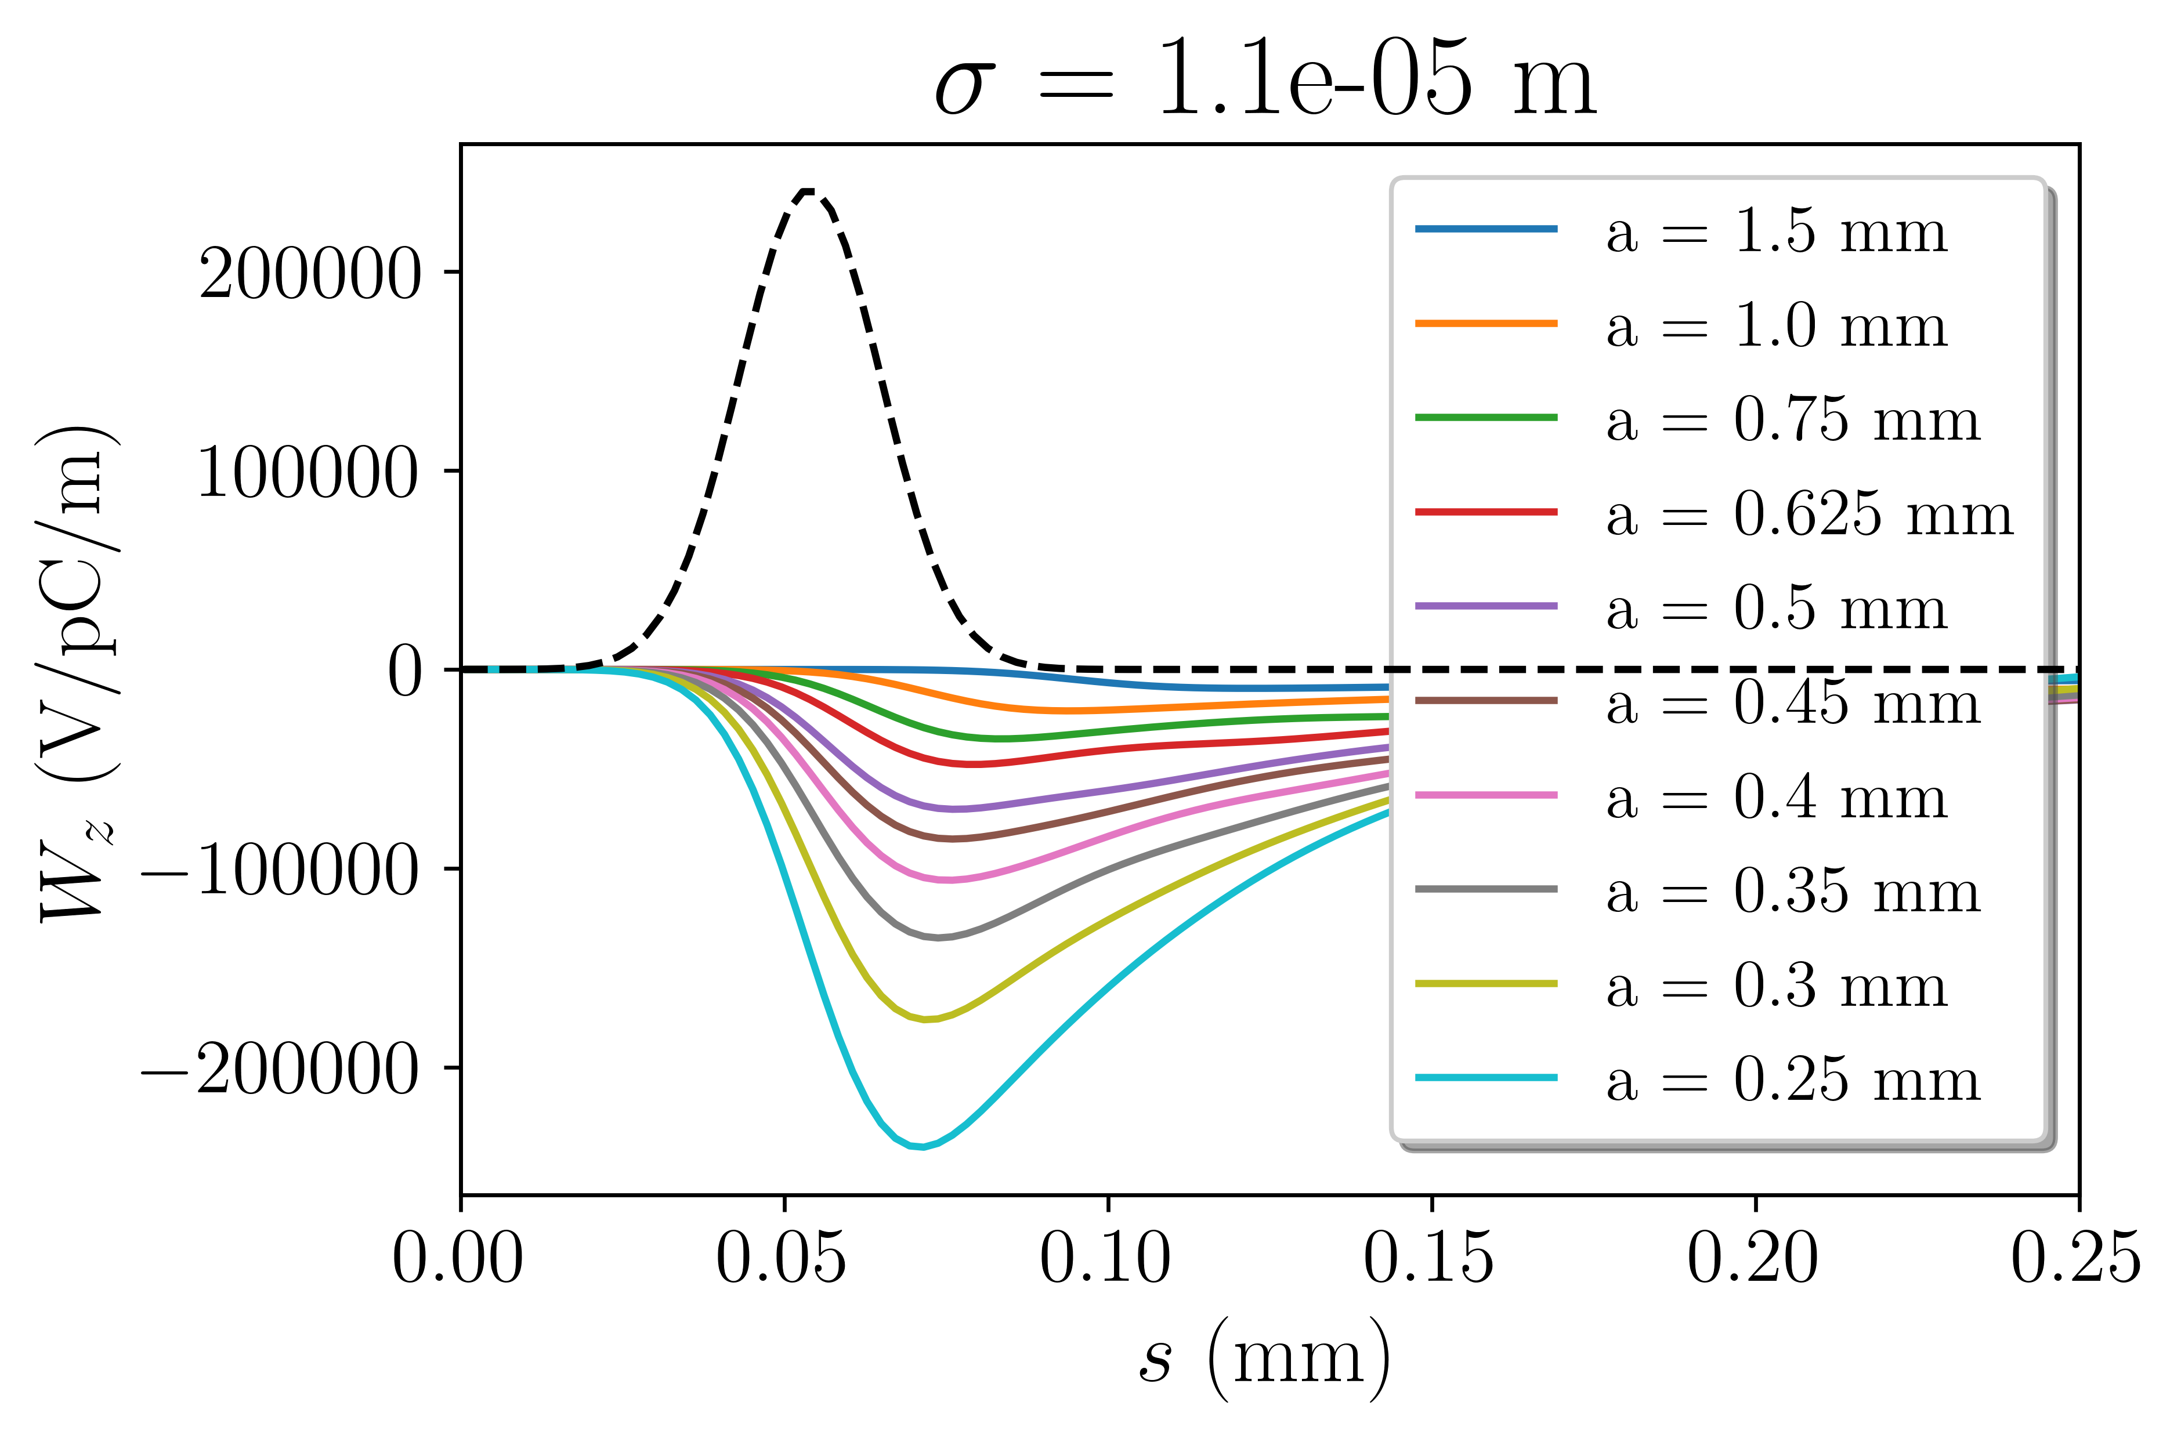
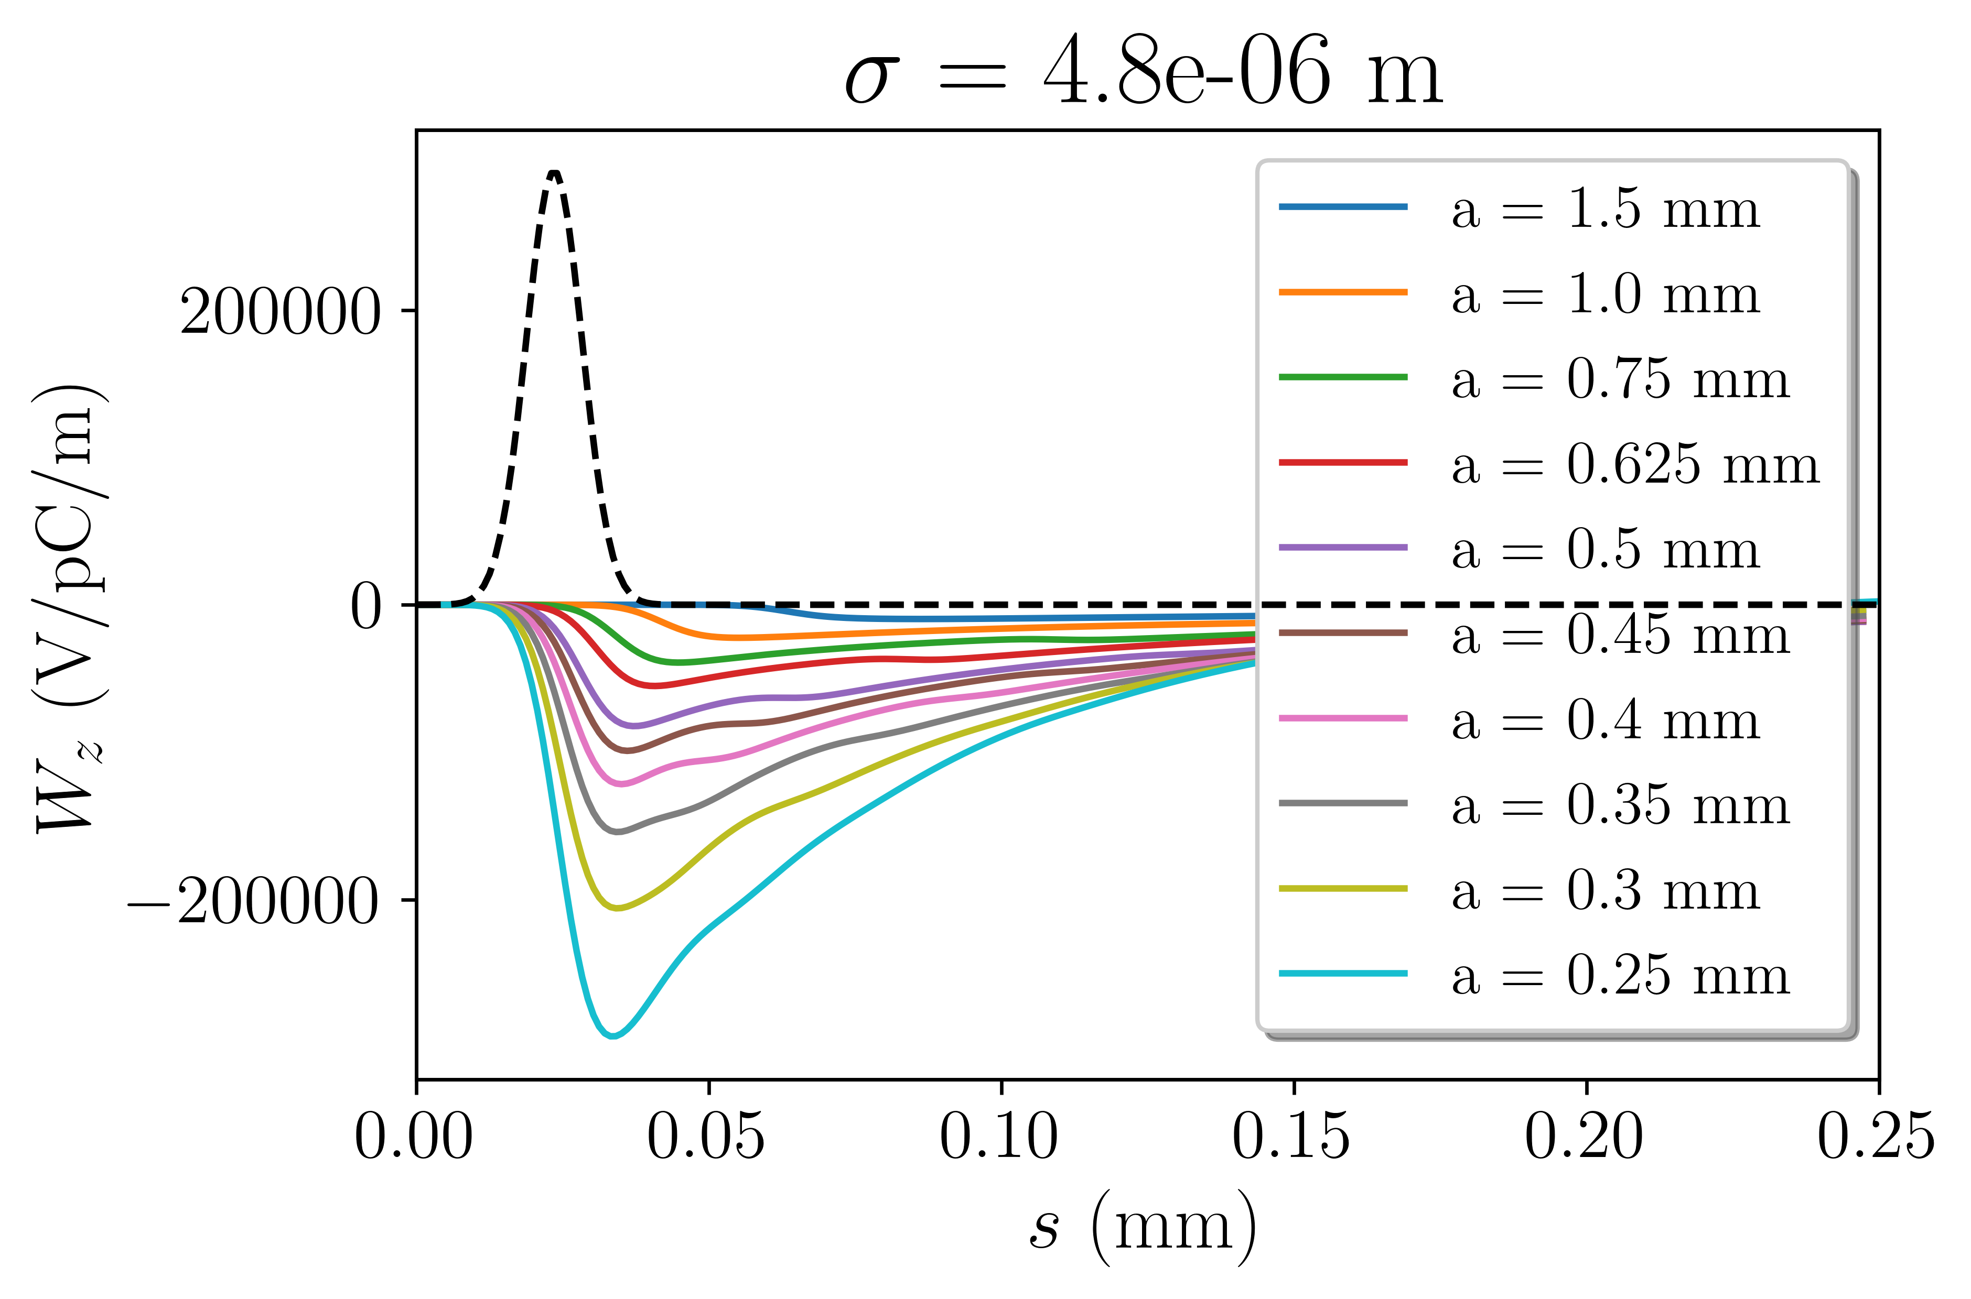
Passive structure – simulations
Performed gap sweeps for 3 gaussian current distributions (gap = 2a)
Wake potential amplitude grows for small gap and short bunches

Slide 17
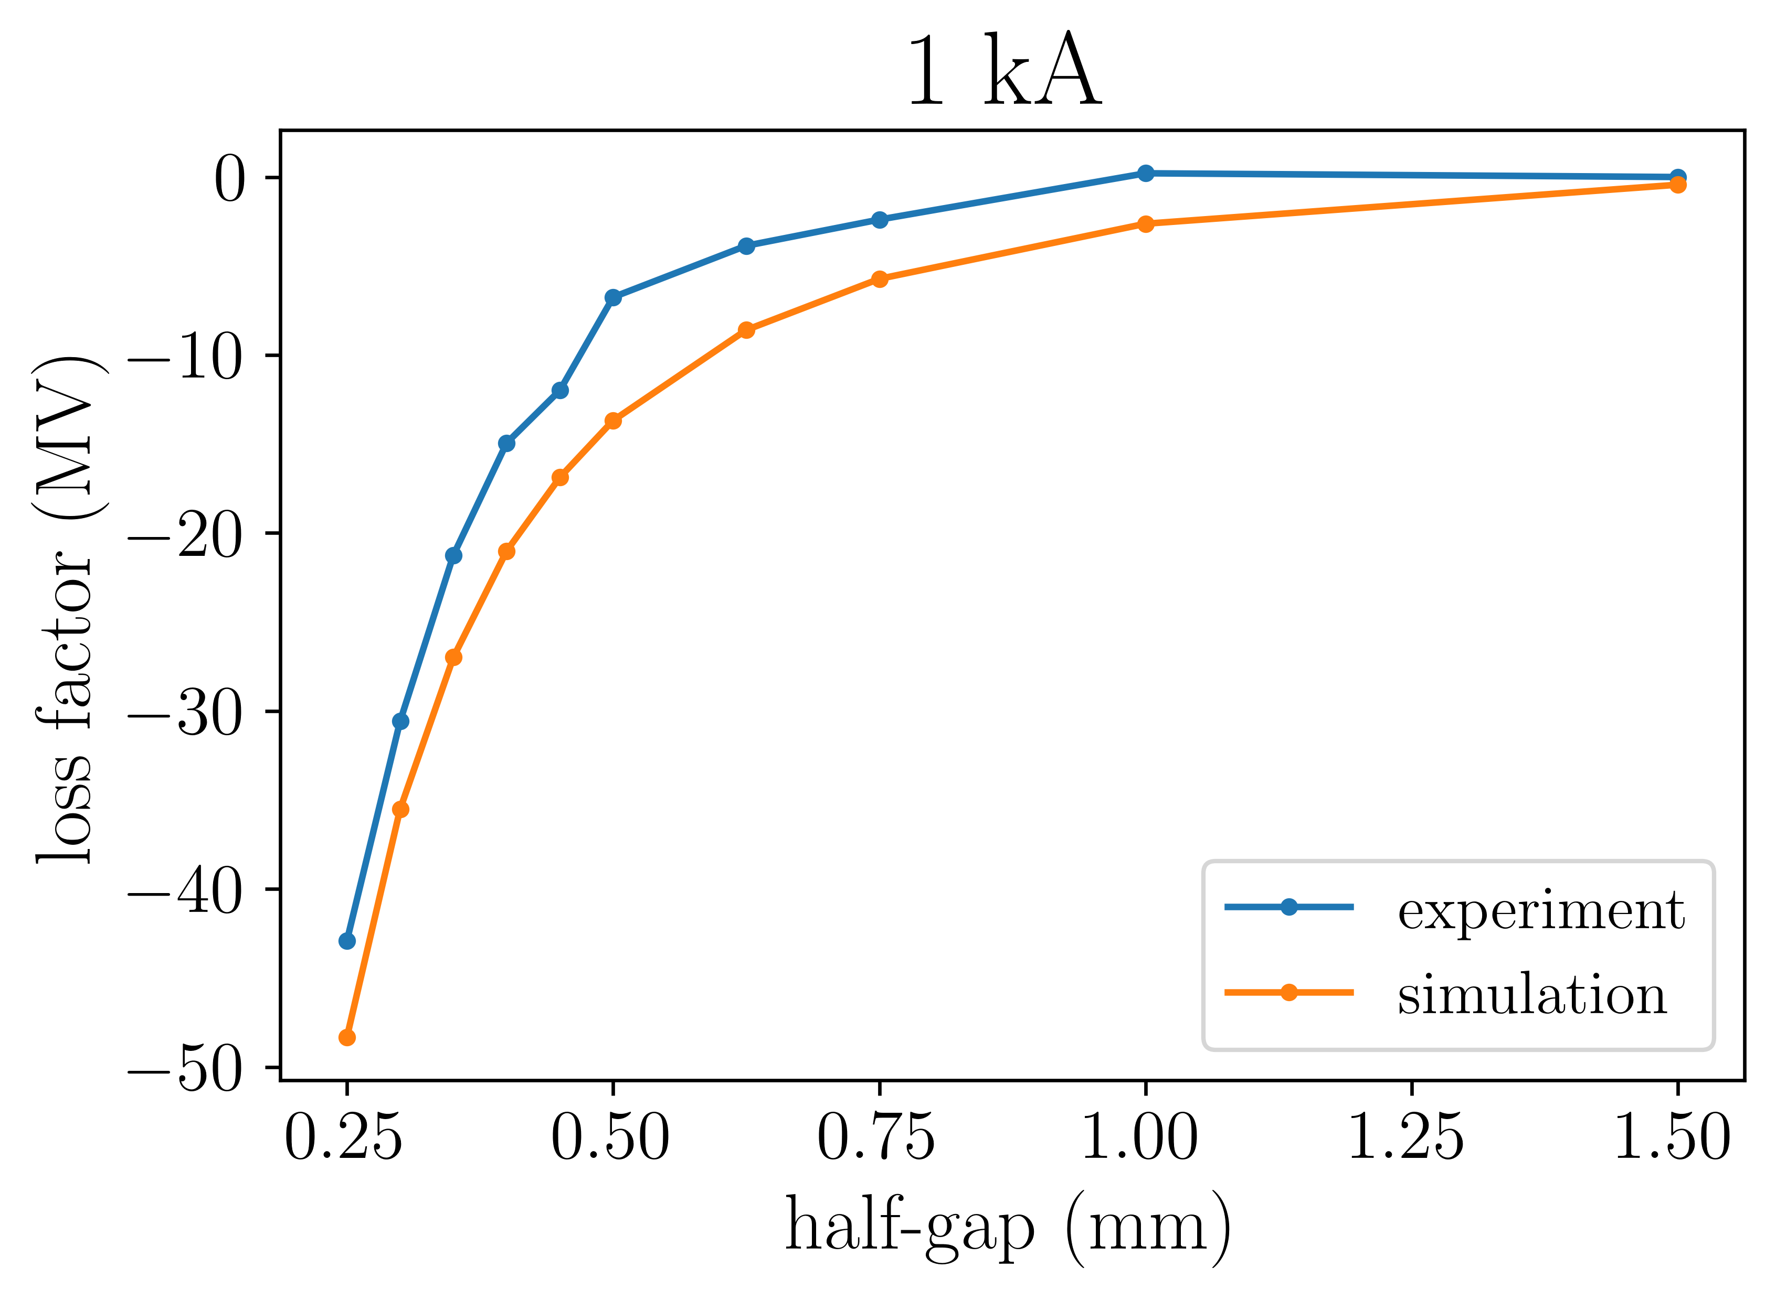
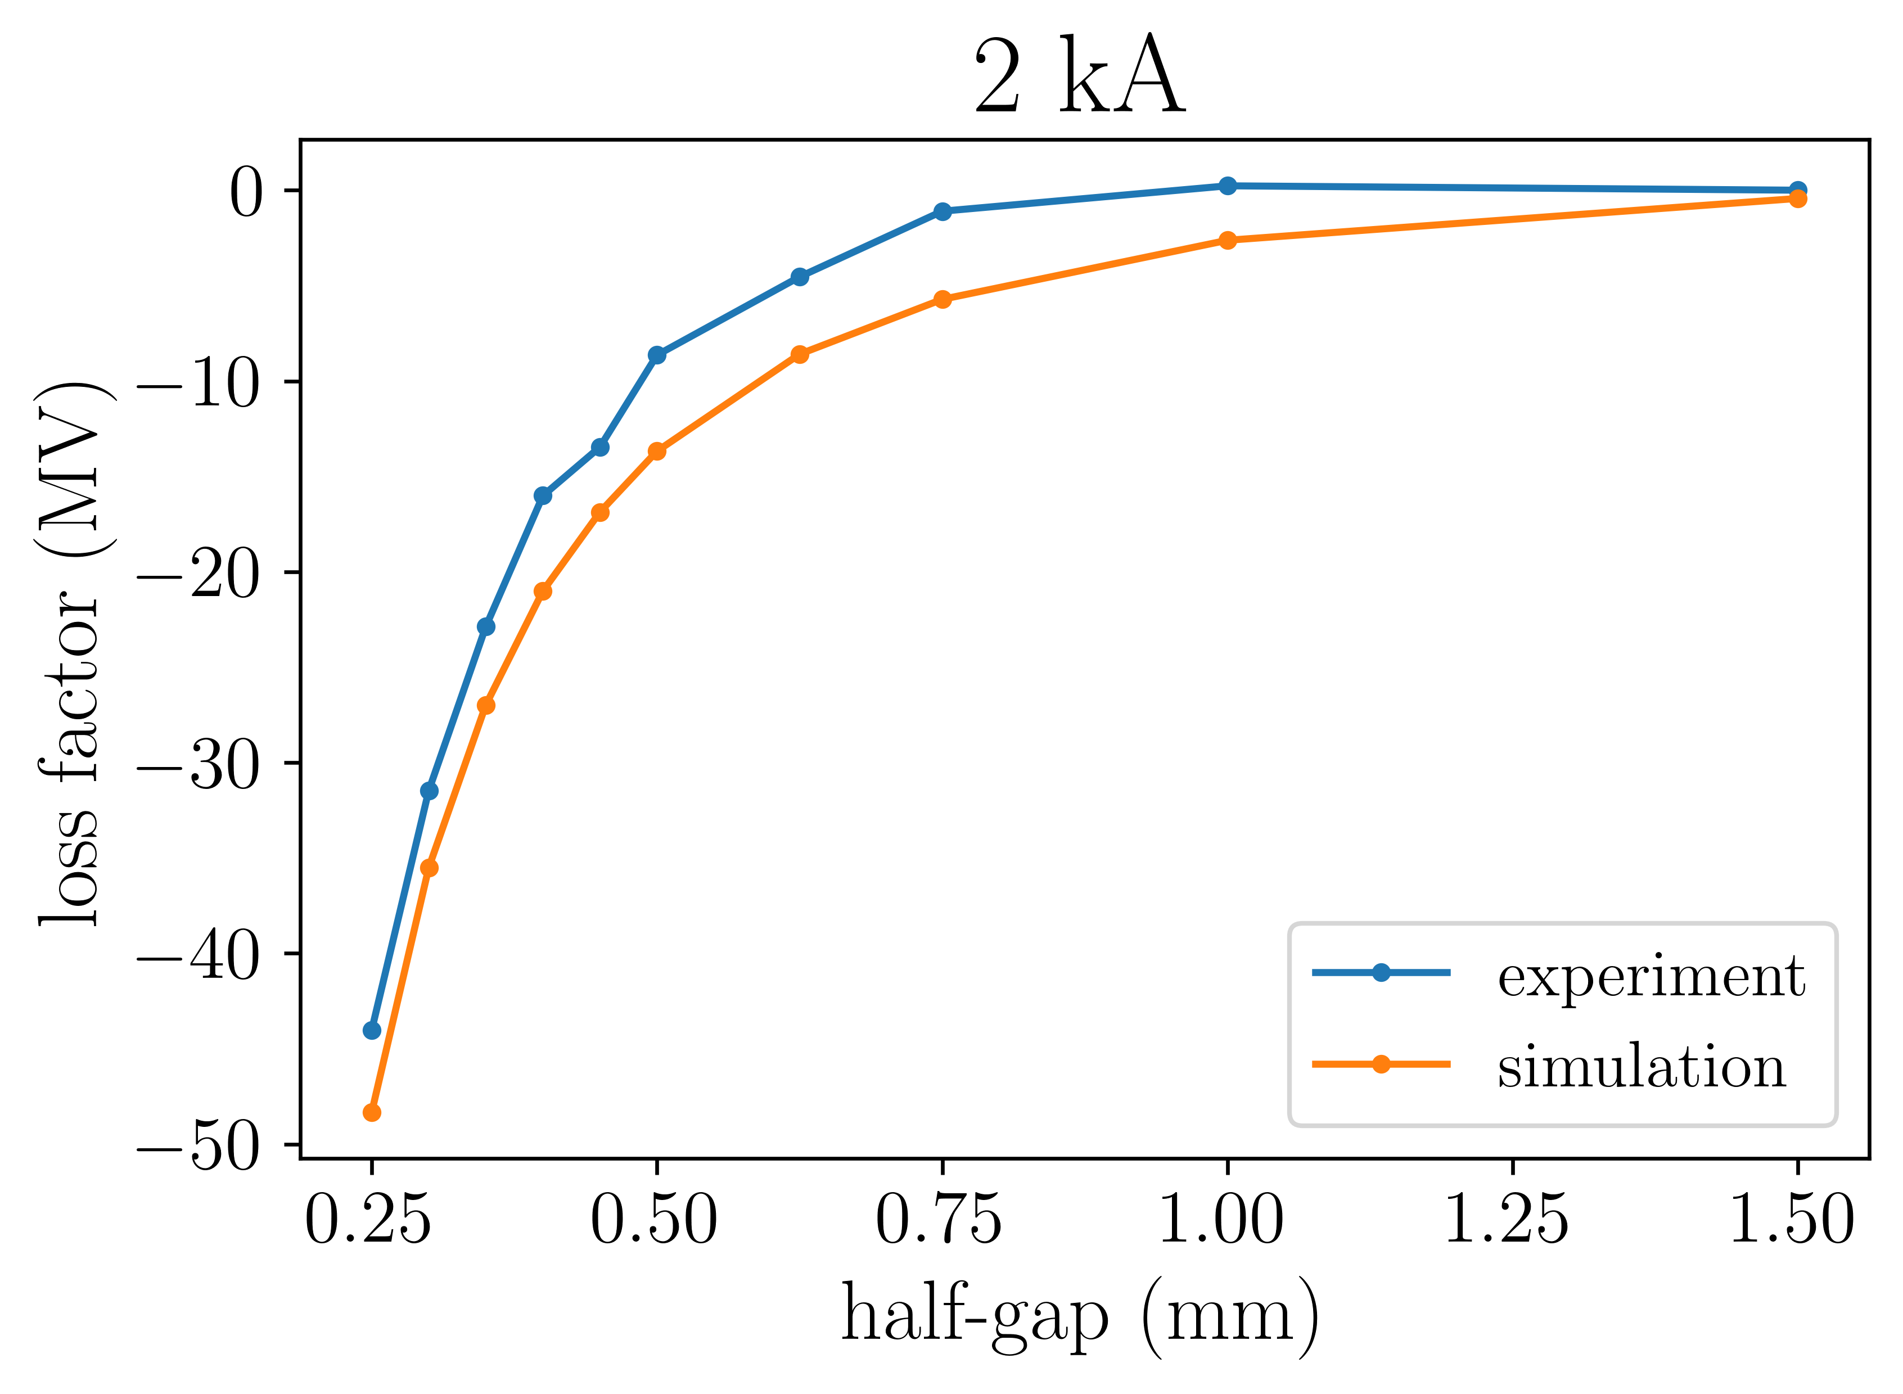
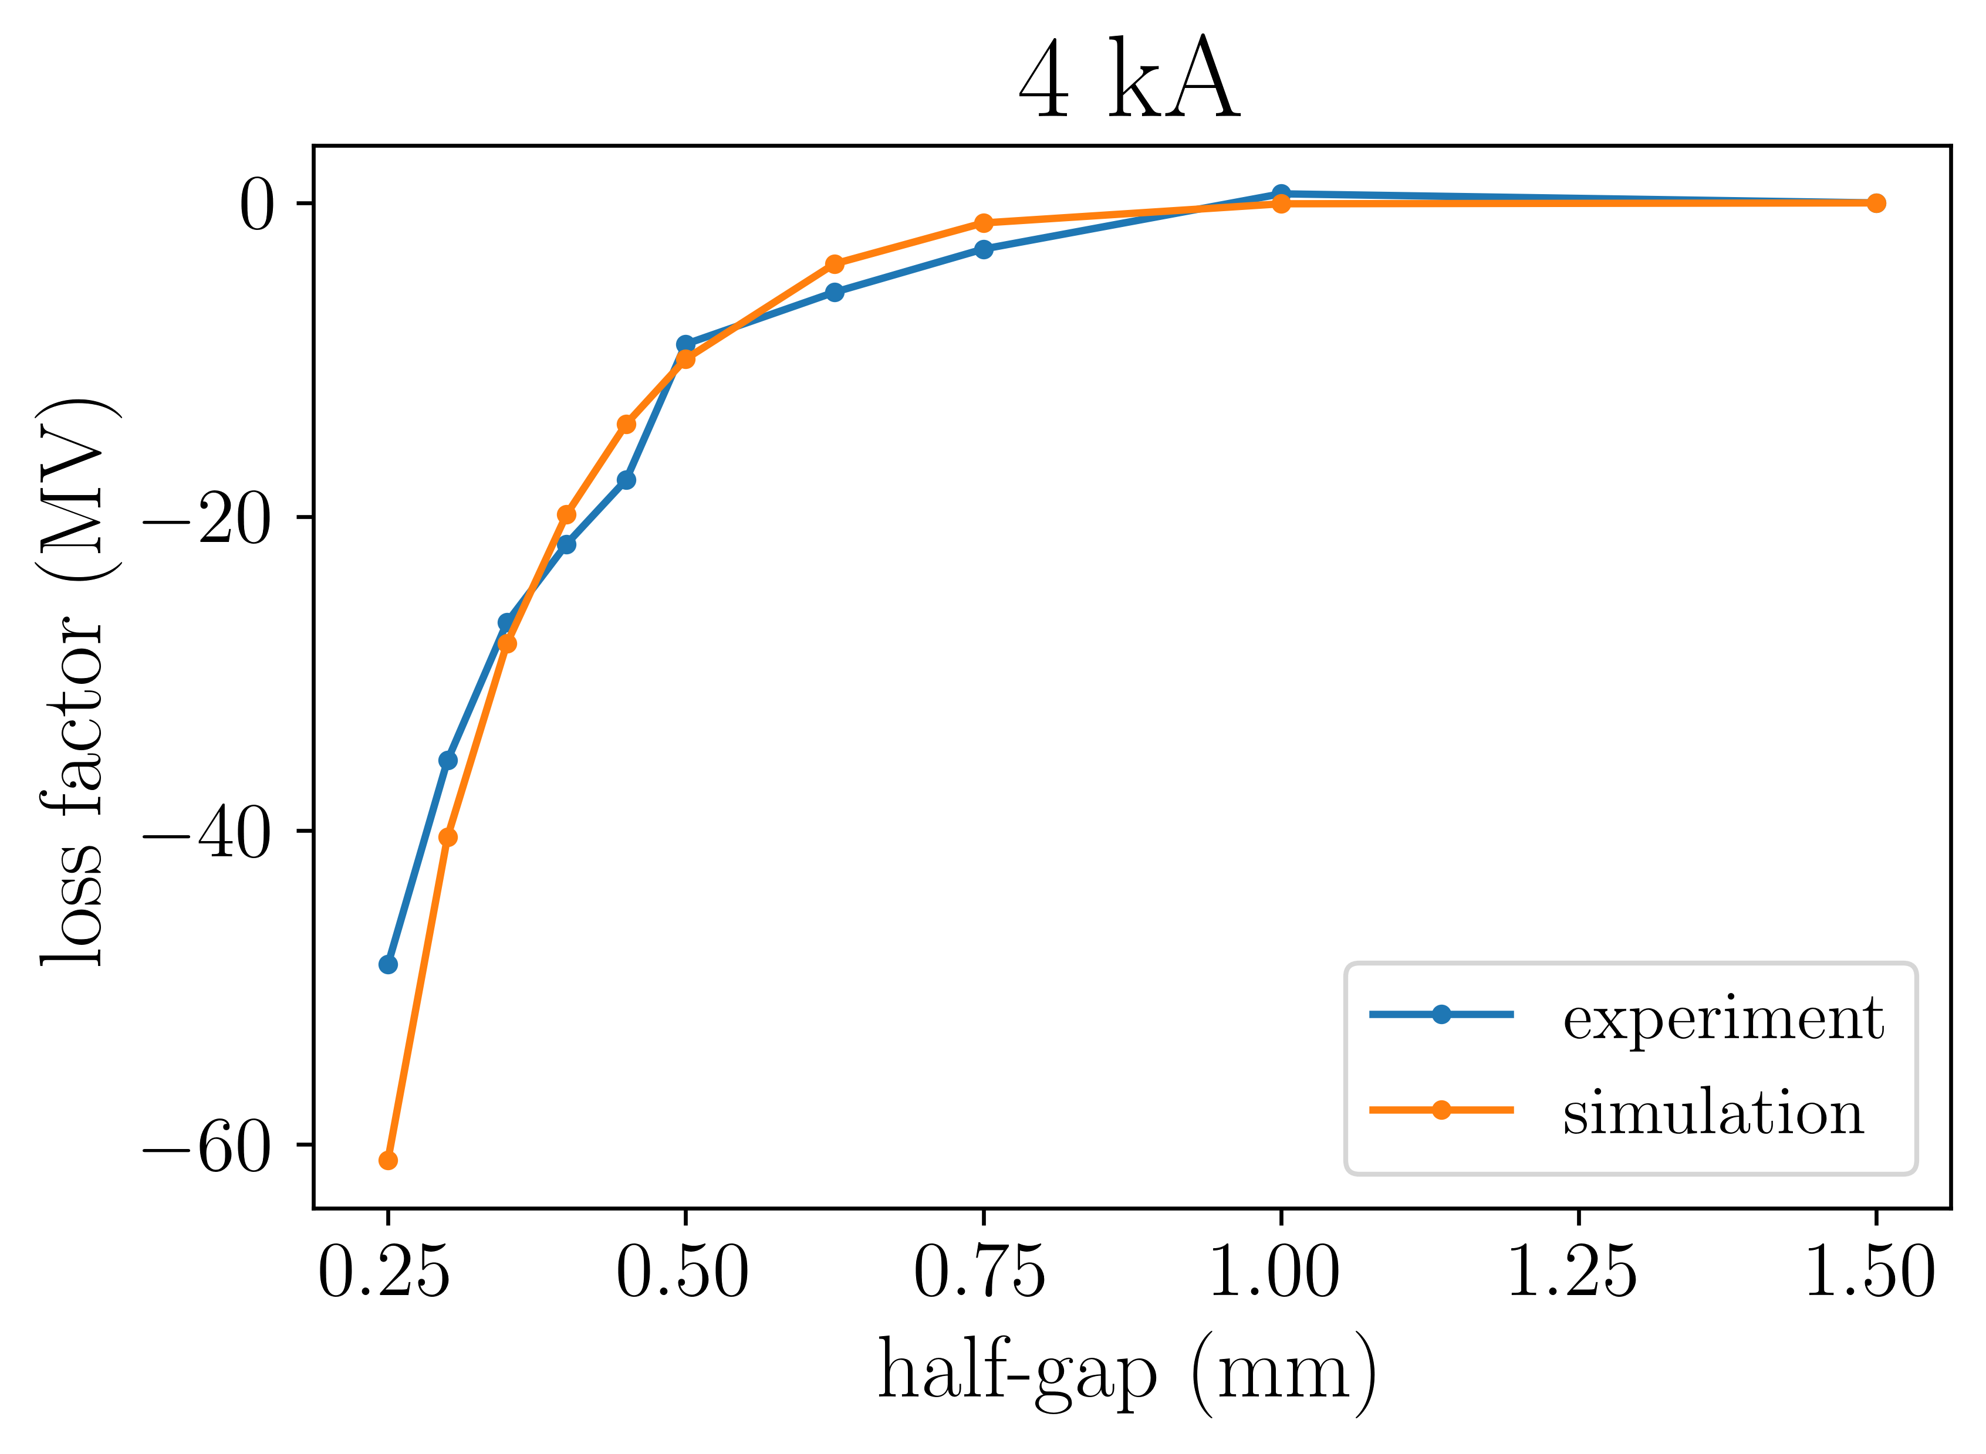
Passive structure – comparison of simulations with single bunch experiment
Error analysis of experiment values to be done

Slide 18
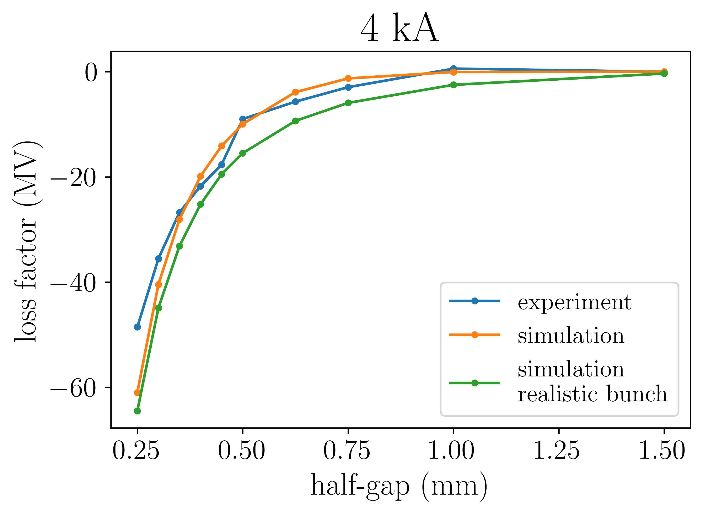
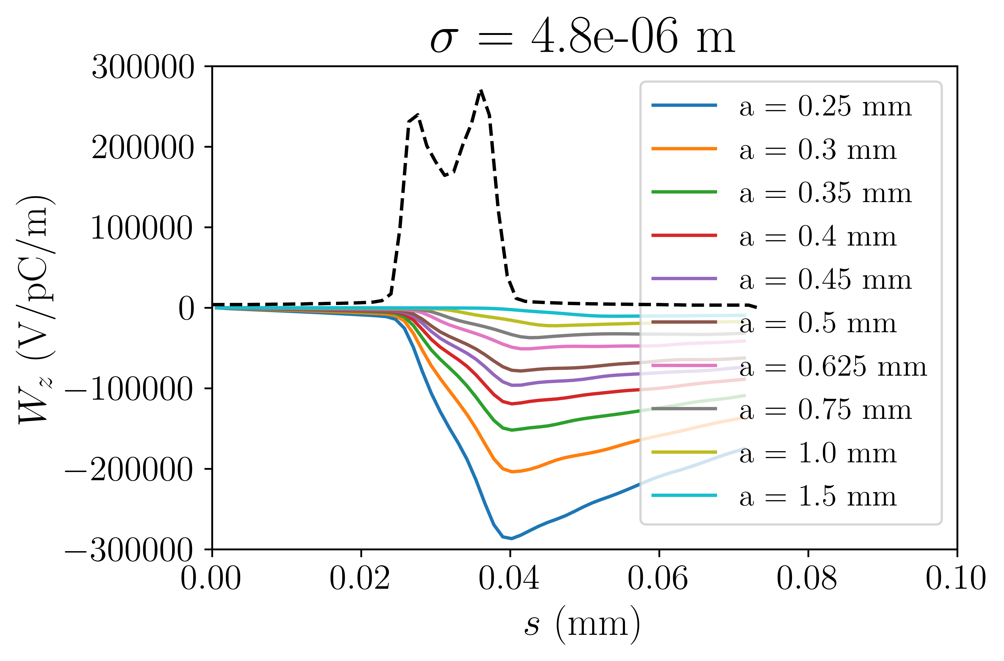
Passive structure – comparison of simulations with single non-gaussian bunch experiment
Measured current profile is non-zero outside of where bunch “is” leading to small, non-zero wake potential for s < 0.02 mm
Sharp increase in current leads to sudden decrease in wake potential compared to gaussian bunch
Convergence studies on-going for non-gaussian current distributions

Slide 19
Passive structure – two bunch experiment
Dielectric induces wakefields that act on the beam
Gap controls strength of the effect
Drive beam is decelerated
Witness beam is accelerated, often with a chirp
E
E
vacuum
witness
dielectric
witness
drive
positioner
drive
Beam (into page)
t
t
Floor

Slide 20
Passive structure – two bunch experiment
Dielectric induces wakefields that act on the beam
Gap controls strength of the effect
Drive beam is decelerated
Witness beam is accelerated, often with a chirp
E
E
vacuum
witness
dielectric
witness
drive
positioner
drive
Beam (into page)
t
t
Floor
Bunch spacing and structure gap are swept during the experiment

Slide 21
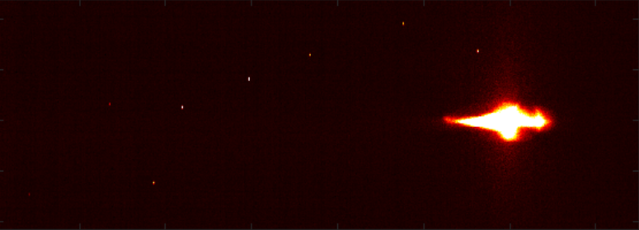
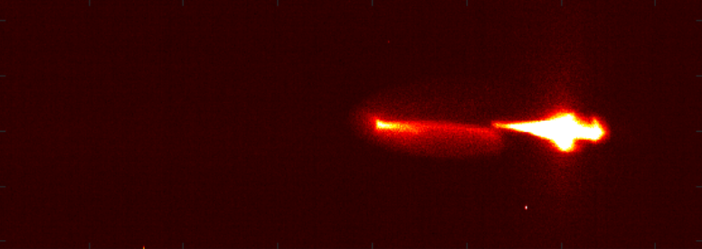
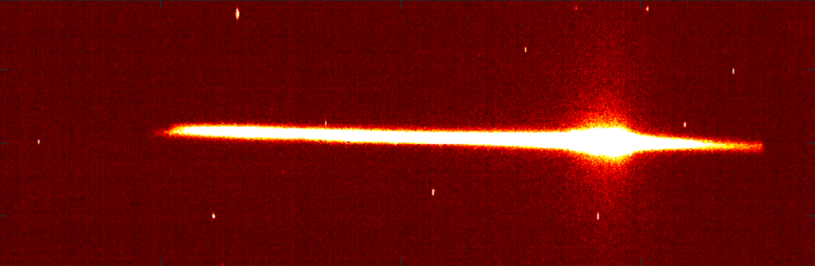
Passive structure – two bunch experiment
Top image: drive and witness beam observed together in same region
Middle image: Two “distinct” beams
  First bunch is same as before
  Second bunch has lower intensity and higher energy than first beam
Bottom image: Large energy spread of drive/witness beams
Measurements suggest: acceleration of a ~25 pC witness beam by a ~200 pC drive beam
Increasing energy

Slide 22
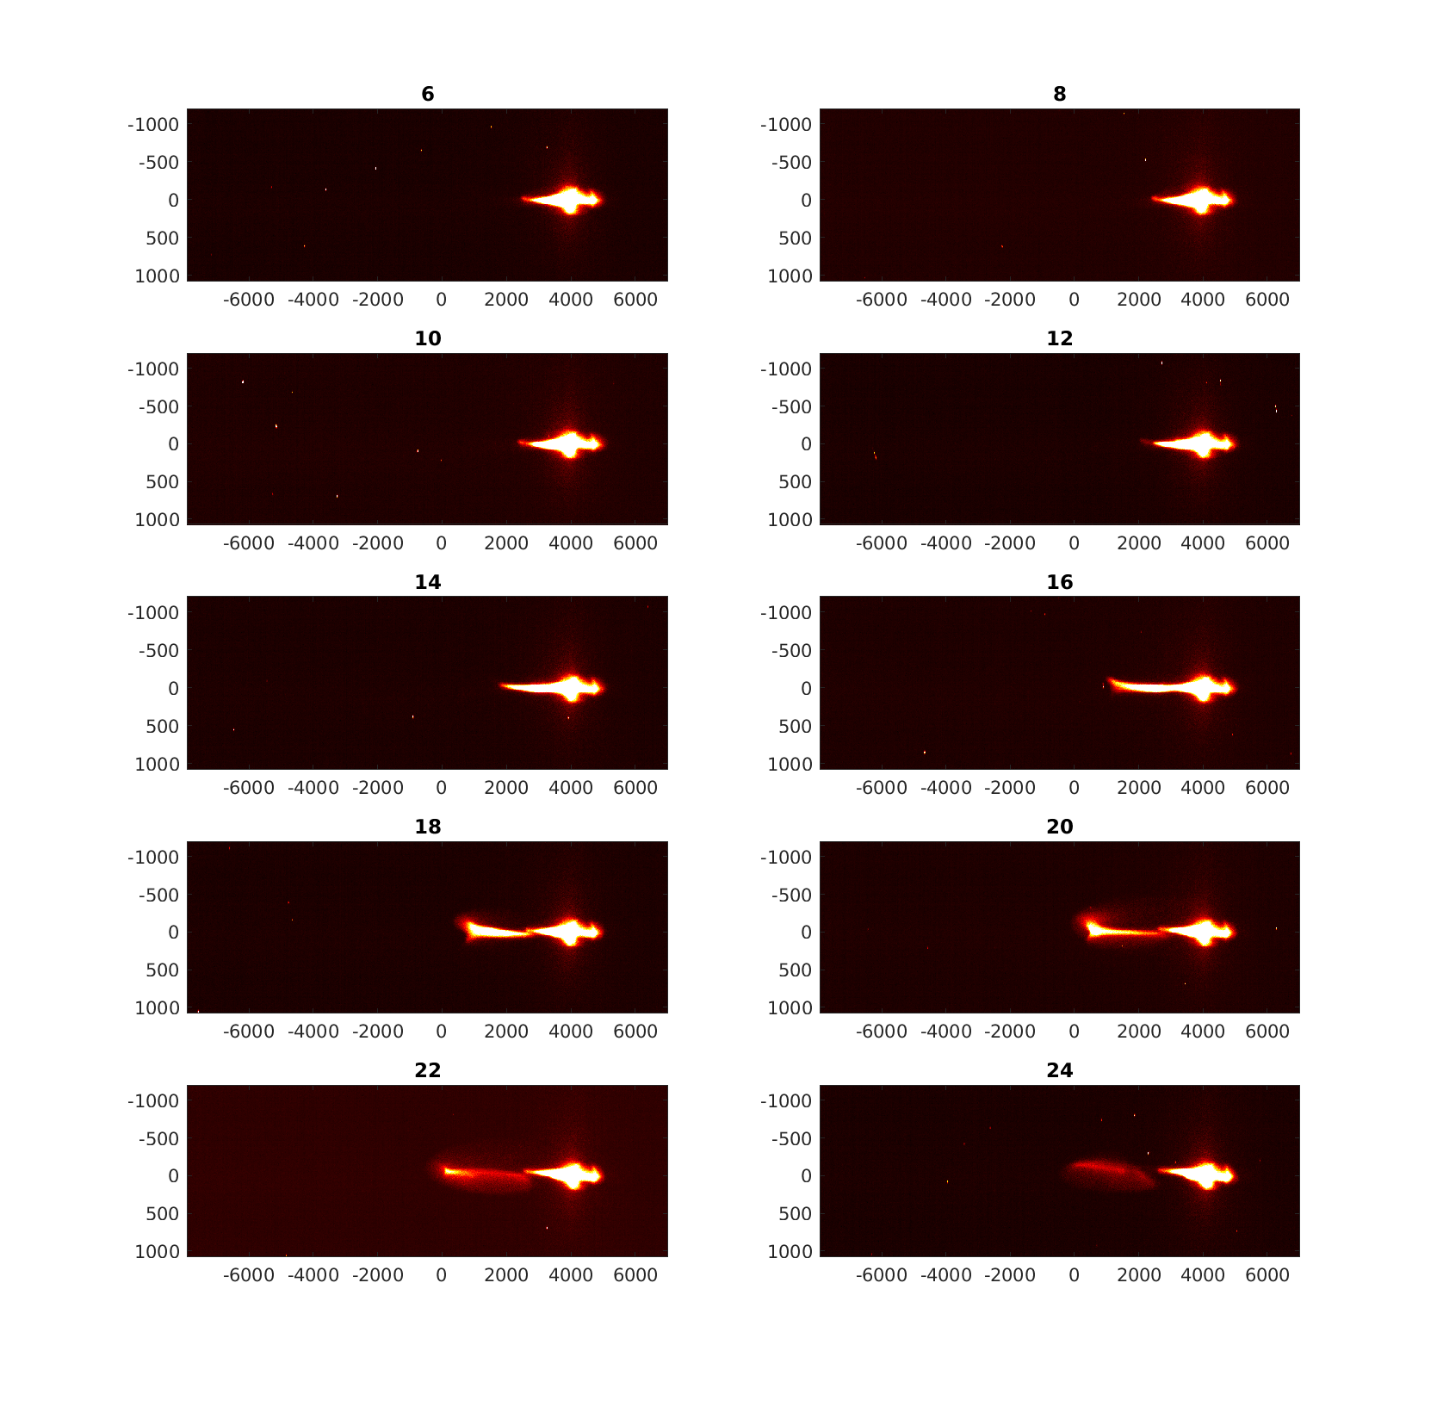

Passive structure – two bunch experiment
Gap = 1.6 mm
Delay Scan (headers in ps)
Delay = 15 ps
Gap Scan (headers in mm)

Slide 23


Conclusion & Outlook
We have confirmed the short-range wakefields are responsible for the change in the centroid energy of the beam
We will investigate if the short-range wakefields can explain the change in energy spread of the beam
We will investigate the long-range wakefields to explain the two-beam acceleration measurement

