Slide 1




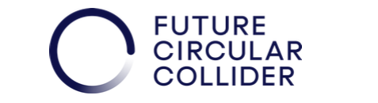
Non-Linear Optics Studies and Comparison
P. Hunchak, J. Keintzel, M. Hofer, M. Boland
FCC Tuning Meeting 17/01/2024

Slide 2
Introduction
Developing a workflow to characterize the chromatic and anharmonic effects using MAD-NG.
Quantify contributions of higher order terms and identify terms to target with optimization and design for maximal gain in DA.
Track progress and trade-offs in design iterations.
In this presentation compare entire Baseline V23 (July 2023) and LCCO v79 (Dec. 2023) without synchrotron radiation.
Entire lattices as they were on the acc-models repository, nothing switched on or off (except RF).

Slide 3
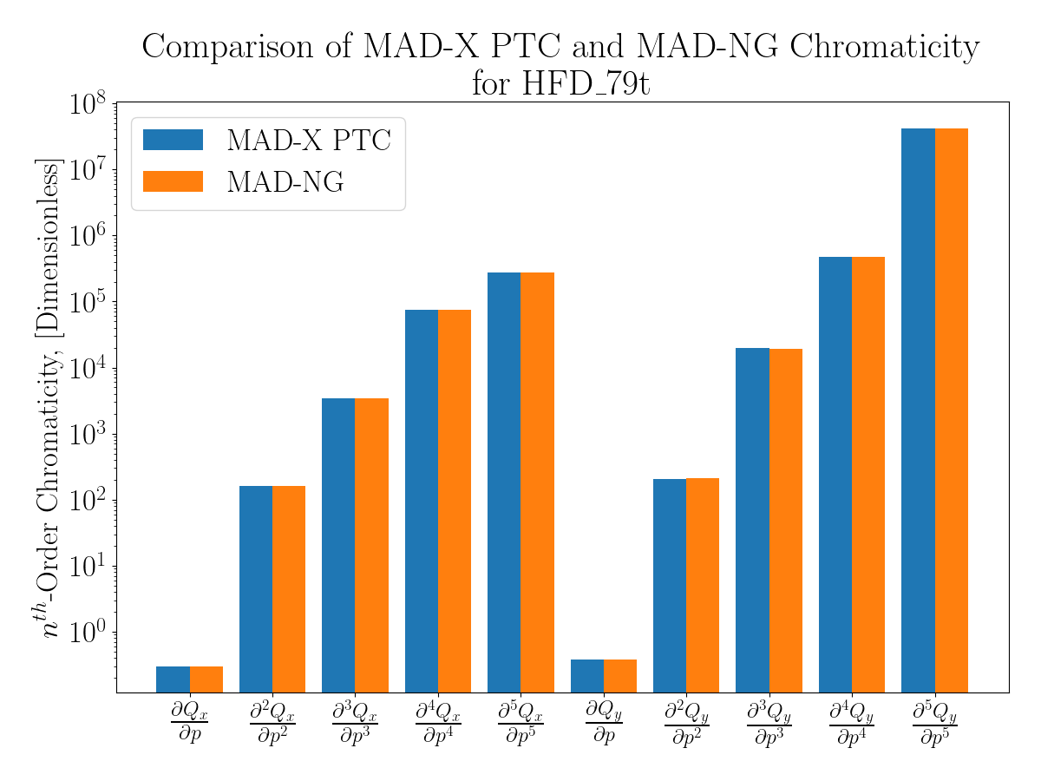

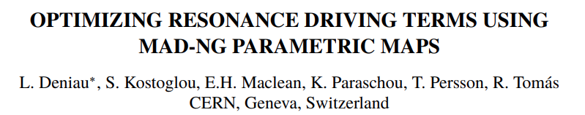
Motivation for MAD-NG
As shown in Deniau et al. 2023, MAD-NG can calculate chromatic/anharmonic parameters of a lattice much more quickly.
MAD-NG performs more than 30 times the calculations in the same time as PTC and is ~14 times faster to optimize the parameters.
Comparison of PTC and MAD-NG on the same lattice show alignment of chromatic terms with less than 1% variation

Slide 4
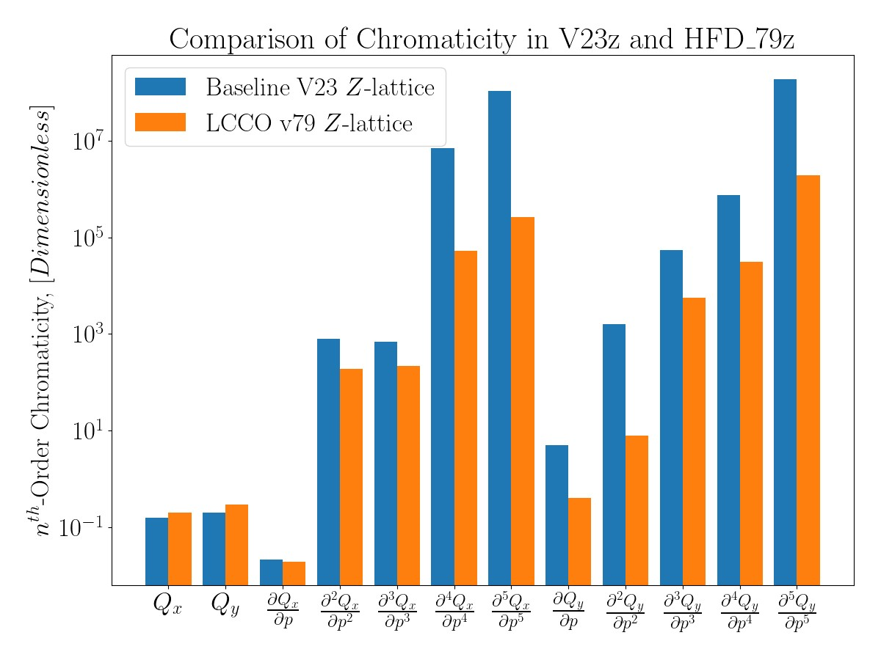
Baseline and LCCO Chromaticity Comparison
Z-lattice
Comparison of the most recent lattice designs on the acc-models repository
Crab sextupoles at 70%/80% as per repository.
LCCO/HFD outperforms the Baseline design in high order terms

Slide 5
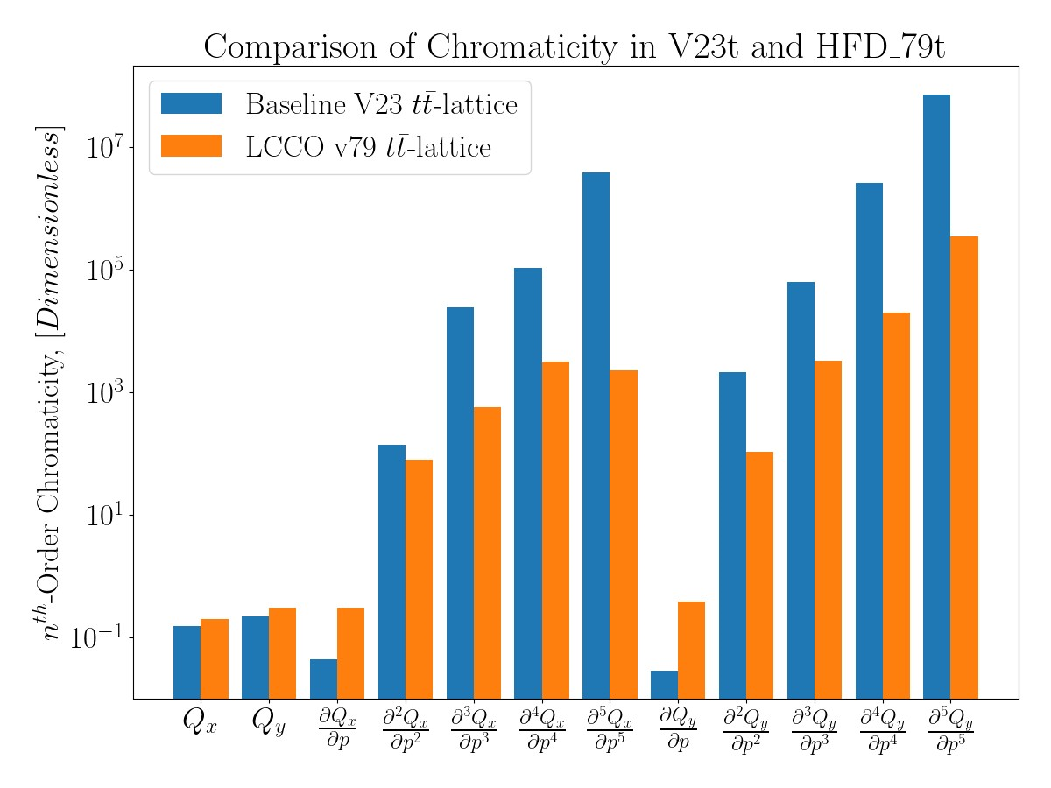
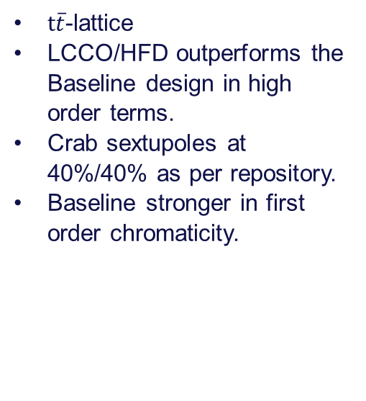
Baseline and LCCO Chromaticity Comparison
$t\overline{t}$-lattice
LCCO/HFD outperforms the Baseline design in high order terms.
Crab sextupoles at 40%/40% as per repository.
Baseline stronger in first order chromaticity.

Slide 6
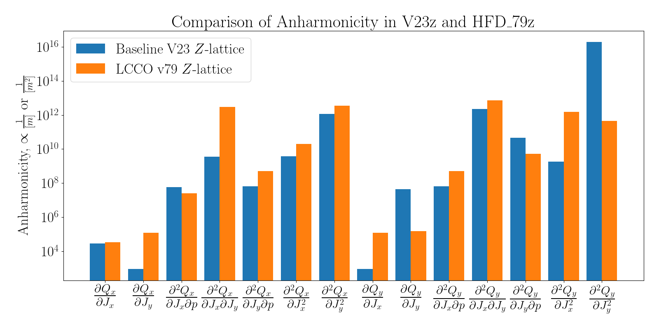
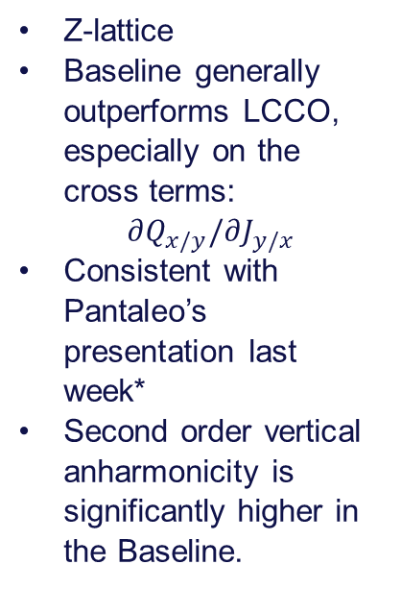
Baseline and LCCO Anharmonicity Comparison
Z-lattice
Baseline generally outperforms LCCO, especially on the cross terms:
$∂Q_{x/y}/∂J_{y/x}$
Consistent with Pantaleo’s presentation last week*
Second order vertical anharmonicity is significantly higher in the Baseline.
*https://indico.cern.ch/event/1364807/

Slide 7
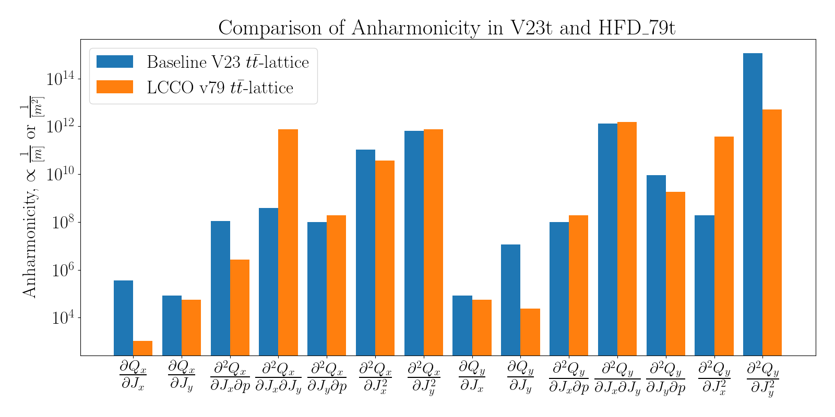
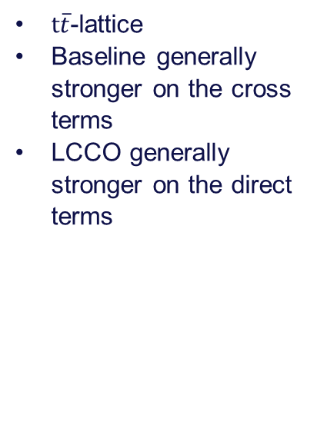
Baseline and LCCO Anharmonicity Comparison
$t\overline{t}$-lattice
Baseline generally stronger on the cross terms
LCCO generally stronger on the direct terms

Slide 8
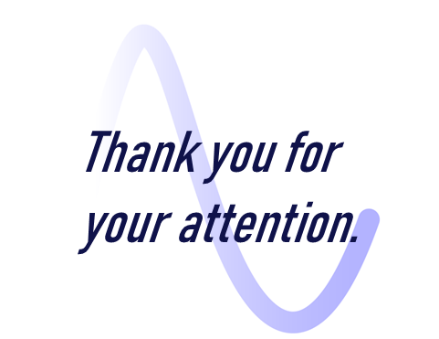
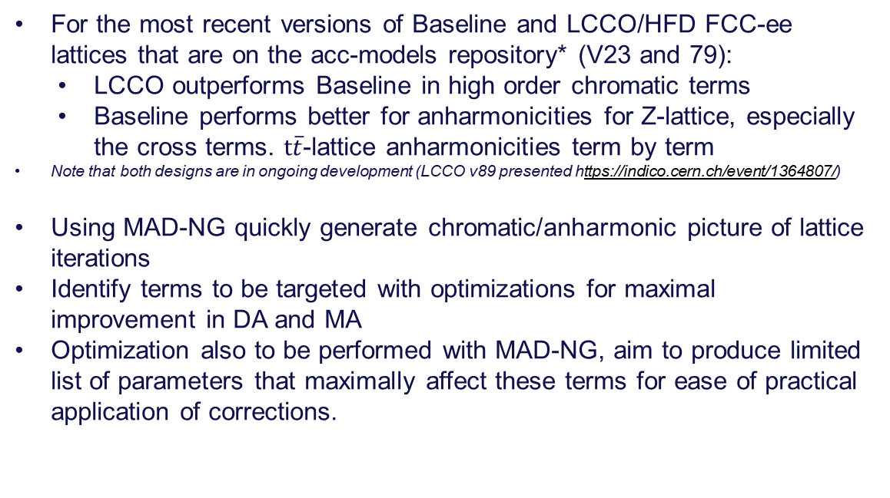
Outlook
For the most recent versions of Baseline and LCCO/HFD FCC-ee lattices that are on the acc-models repository* (V23 and 79):
LCCO outperforms Baseline in high order chromatic terms
Baseline performs better for anharmonicities for Z-lattice, especially the cross terms. $t\overline{t}$-lattice anharmonicities term by term
Note that both designs are in ongoing development (LCCO v89 presented https://indico.cern.ch/event/1364807/)
Using MAD-NG quickly generate chromatic/anharmonic picture of lattice iterations
Identify terms to be targeted with optimizations for maximal improvement in DA and MA
Optimization also to be performed with MAD-NG, aim to produce limited list of parameters that maximally affect these terms for ease of practical application of corrections.
*https://gitlab.cern.ch/acc-models/fcc/fcc-ee-lattice/

Slide 10
