Slide 1
AFT – Status and Plans for 2024
Anti Asko, Lukas Felsberger
Acknowledgements to Bettina Mikulec, Jan Uythoven, Daniel Wollmann, Jack Heron, Machine Coordinators & Operators, System Experts, AFT support

Slide 2
Introduction – AFT Status
AFT tool, database and fault recording
  Anti’s RAWG talk
  Several new features of the tool could be implemented, and review activities were extended in 2023.
Fault reporting
  JAPW talks on Injectors and LHC availability done
  Chamonix talks on Injectors and LHC being prepared
  AFT data was and is instrumental to prepare talks and provide feedback
Automatic Fault Recording
  RAWG talks by Michi and Piotr
  Automatic Fault Recording deployed across proton chain in 2023

Slide 3
Introduction – AFT Plans
Received extensive feedback from AFT users in 2023 on possible AFT improvements (from weekly reviews, RAWG presentations by equipment groups, JAPW preparations, …)
Thank you!
Collected feedback needs to be discussed and prioritized
First iteration done with A. Asko – mainly regarding desiderata related to AFT tool
Results presented in the following.
Goal of this talk is to bring the discussion to the RAWG and get your feedback!
Focus is on short to mid term plans primarily for the AFT tool and organizational aspects of fault tracking

Slide 4


Table of AFT desiderata
Ranked each desiderata by
  Complexity (0 low - 5 high): Difficulty of Implementation
  Importance (0 low – 5 high): Degree of positive impact on AFT usage
  Maturity (0 low – 5 high): Clarity of feature request and possibility to implement
Table can be viewed here.
  Comments can be made (or sent via email)
    Features can still be generally requested by writing to acc-fault-tracking-support@cern.ch
    Overview of existing issues - here
Sub-set of desiderata will be presented in the following.
General observation:
Implementation of all desiderata would largely exceed available resources → prioritization gives set of desiderata that are feasible to be implemented
Even after prioritization, some very relevant desiderata may not be implemented in 2024 with existing resources
Some desiderate are not yet concrete enough to judge whether they can be implemented

Slide 5
Structure of Desiderata
Organizational requests
AFT tool feature requests
Requests regarding integration with other tools and projects

Slide 6
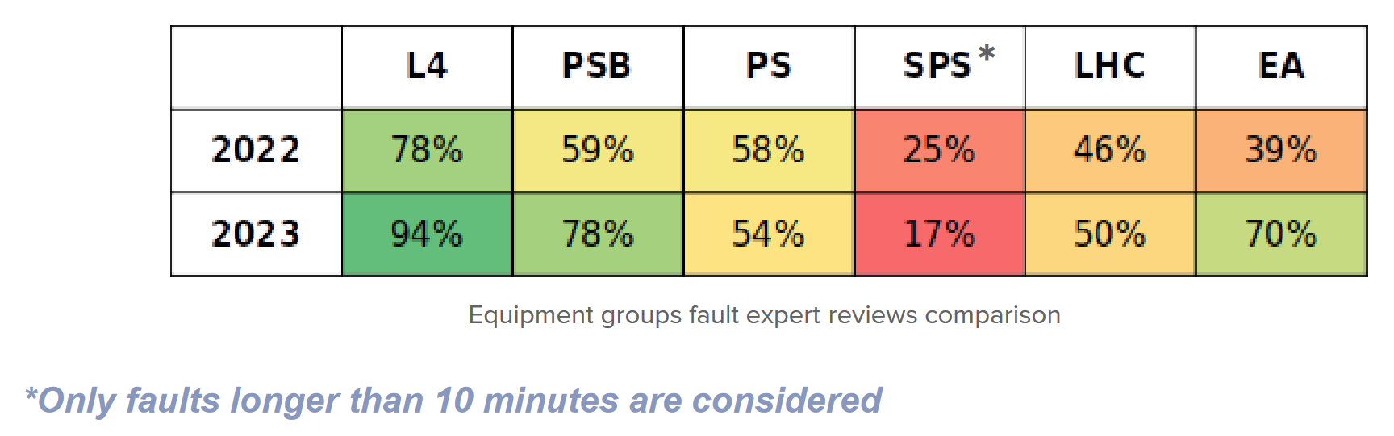
AFT – Organizational Desiderata I
Complexity | Importance | Maturity
1 | 3 | 5
Equipment Expert Review Involvement
Have a demo for equipment experts doing AFT reviews for the first time [D22]
  → Plan to have in beginning of February. Will send email to aft-resp-equipment-contacts for details.
Have a guideline for fault reviews (wiki page) [D1]
  → Plan to compile it during Q1 2024
Review rate [D21]
  Generally improved throughout 2023. Reviewers with low review rate will be contacted directly for feedback throughout 2024.
  Check if relationship with large number of short faults recorded in SPS [D19]
Complexity | Importance | Maturity
2 | 3 | 5

Slide 7
AFT – Organizational Desiderata II
Complexity | Importance | Maturity
2 | 3 | 5
Publish yearly availability reports (again) [D28]
Written summary based on AFT data, JAPW and Chamonix presentations to be published on CDS
Similar as done for run 2 – e.g. https://cds.cern.ch/record/2650574?ln=en
Plan to release in Q1 2024
Release an Update of the Fault Recording Guideline [D27]
https://edms.cern.ch/document/2720138/1
Last version from end of 2021
Capture updates due to automatic fault recording as well as correct treatment of special cases
Plan to release in Q2 2024
Complexity | Importance | Maturity
2 | 3 | 5

Slide 8
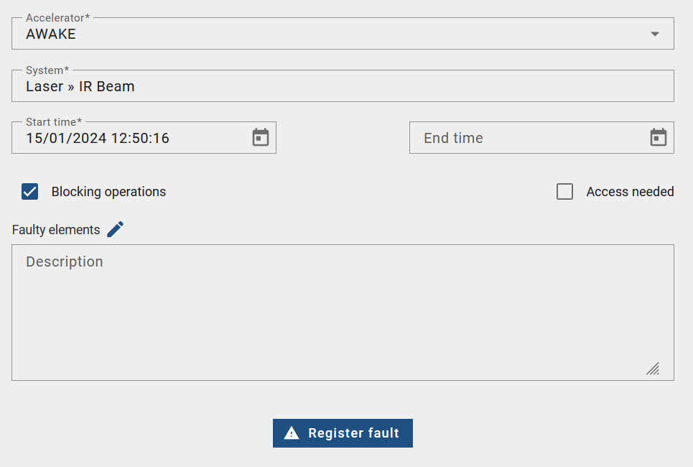
AFT – Organizational Desiderata III
Complexity | Importance | Maturity
1 | 5 | 5
Weekly Monday Reviews 2024 [D22]
Expected to keep structure and time-slot of last year
Plan to have short organizational meeting for early February
AWAKE [D23]
Want to start fault tracking with AFT
Defined AFT set-up in AFT tool
Will do fault tracking “independently”
  No expert reviews requested
  May join reviews throughout 2024
Done

Slide 9
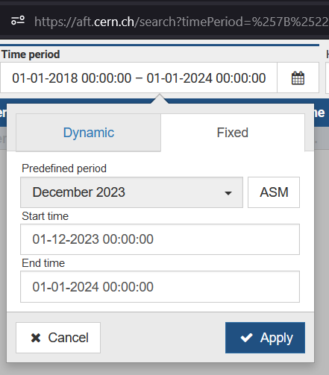
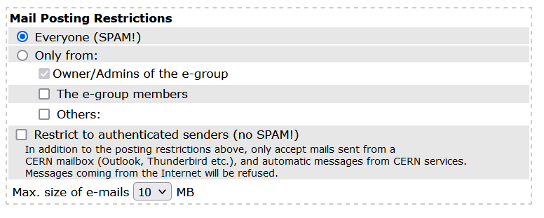

AFT Feature Desiderata I
Complexity | Importance | Maturity
2 | 2 | 4
Weekly fault searching and browsing functionality [D2,3,4]
Includes jumping to fault search from weekly availability chart
Addresses request to keep history of weekly FOM reports
No-spam compatible automatic sender address [D5]
Currently AFT notifications are sent via egroups that are not protected against SPAM
Resolving this requires changing the mail address AFT is sending its mails from
Pre-set rules and filters on users side would need to be re-configured
Plan to send out notification of change to all egroups and make change during this YETS
Complexity | Importance | Maturity
2 | 2 | 4

Slide 10
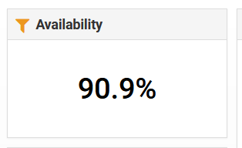

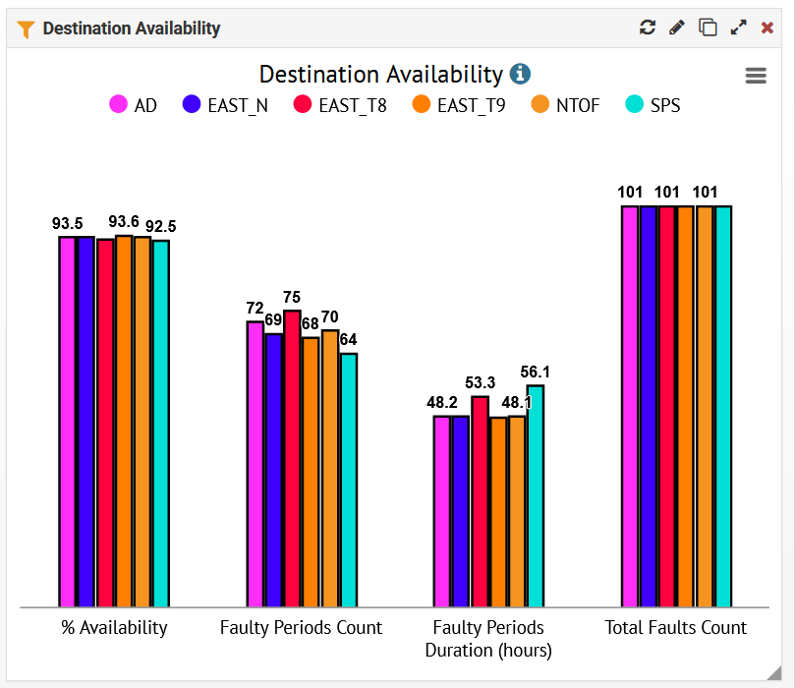

AFT Feature Desiderata II
Complexity | Importance | Maturity
3 | 3 | 4
Showing global availability metric excluding Injector Complex availability [D6]
Plan to extend global availability component by possibility to filter by system
Include “Impacted Destination” in Fault Search [D9]
Currently destination availability only visible on machine level and not by equipment
Problematic for experimental areas, where equipment problems impacting only one beam line
May be possible to extend fault search this year, but extension of statistics needs to be considered as well
Allow filtering by R2E status in selected AFT statistics
Complexity | Importance | Maturity
4 | 4 | 2
Complexity | Importance | Maturity
4 | 3 | 3

Slide 11
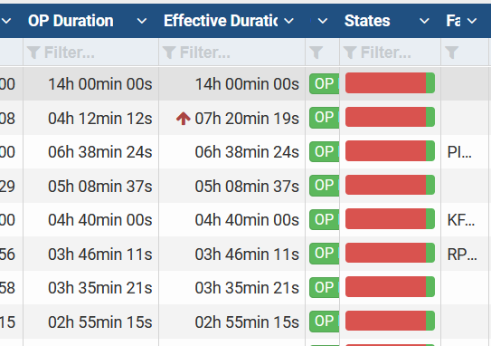
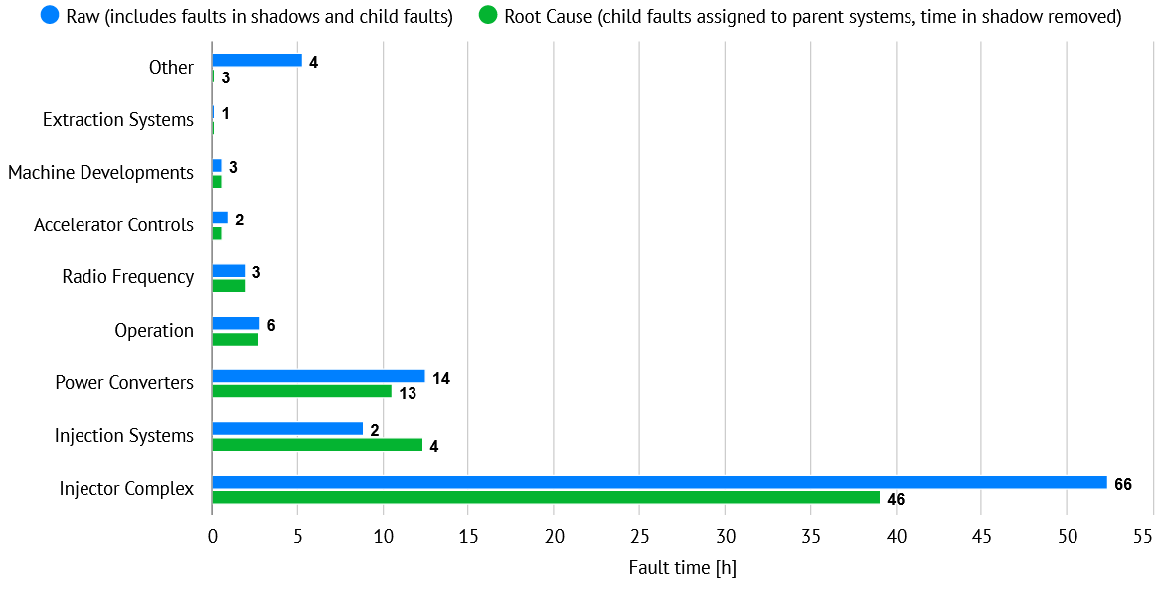
AFT Feature Desiderata III
Complexity | Importance | Maturity
4 | 4 | 2
Availability Metrics shown in AFT Fault Search page [D8]
Fault Search gives OP duration and Effective Duration
For performance and complexity reasons they do not consider shadowing and full set of parent child relationships → generally differ from raw & root-cause durations shown in statistics
Related requests
  Show sum of fault duration in fault search [D15]
  Show faults in shadow in fault search [D10]
Addressing request would require major rework of fault search

Slide 12
AFT Feature Desiderata IV
Have a flag for “Piquet Needed” [D14]
No problem to implement in AFT
Do we manage to fill it consistently?
Have a flag for “Wearout Failure” [D30]
No problem to implement in AFT
Do we manage to fill it consistently?
Allow addition of faulty element so that the beam impact can be seen per individual equipment.
Already implemented in AFT
Do we manage to fill it consistently? Very much depends on equipment group and machine
Some requests cannot be addressed by AFT feature alone but require active effort from experts or automatization.
Try to raise awareness in demos and reviews and/or look for ways to automate.
Complexity | Importance | Maturity
2 (on AFT) | ? | 4
Complexity | Importance | Maturity
? | 3 | 4
Complexity | Importance | Maturity
? | 4 | 5

Slide 13
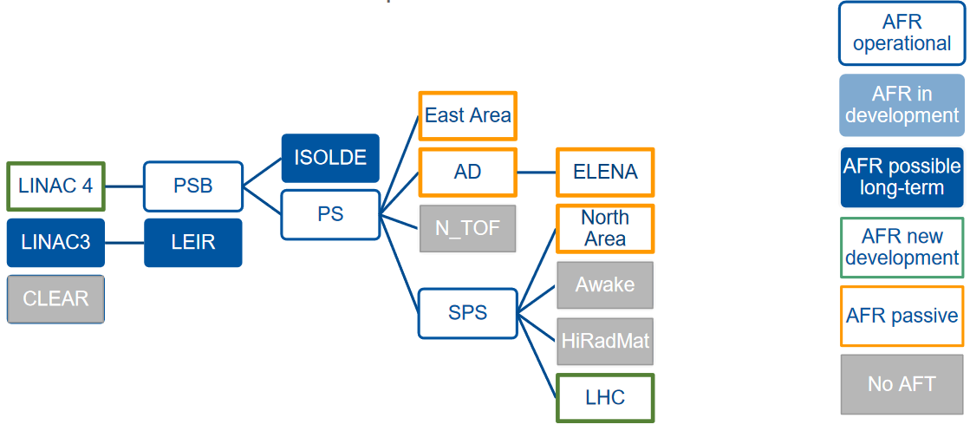
AFT Automation & Integrations I
Complexity | Importance | Maturity
? | 4 | 3
Automatic fault recording has seen significant improvements in 2023
Based on positive experience we would like to extend automatization even further in following aspects:
  Impacted destinations
  Faulty system and faulty element
  Up- and downstream linking
  Better integration between manual and automatic fault recording [D16]
Continue to exchange via afr-core egroup and stay in close contact with Efficient Particle Accelerators (EPA) project for possible synergies.

Slide 14
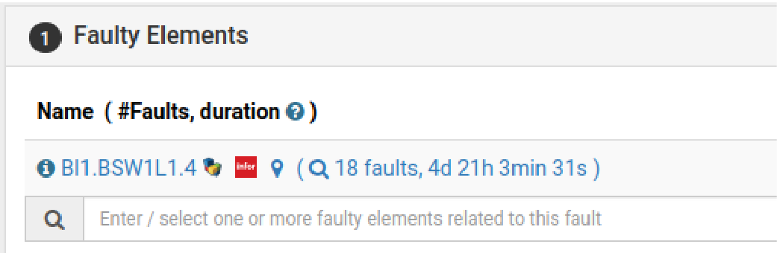
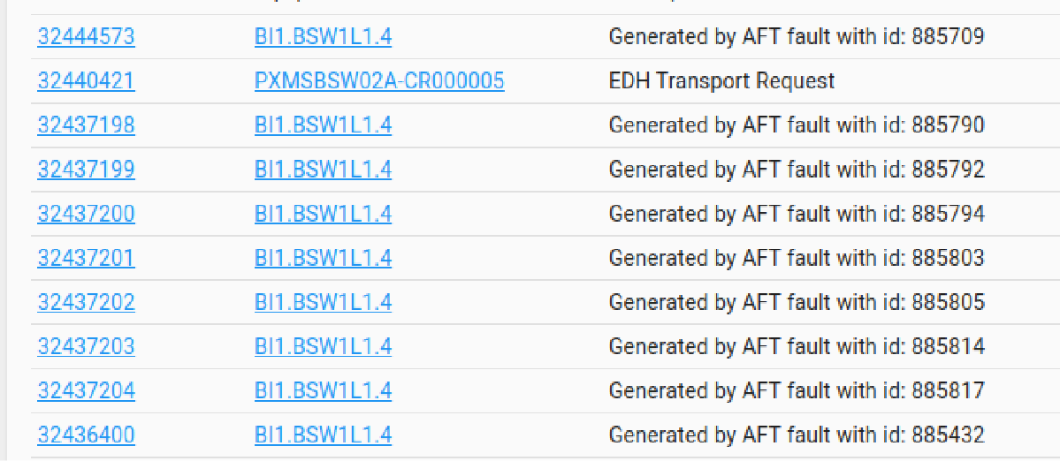
AFT Automation & Integrations II
Complexity | Importance | Maturity
? | 3 | ?
AFT has an integration with EAM since last year.
Allows for automatic creation of work orders on linking of a faulty element
  Currently limited to systems that are registered on LayoutDB and EAM.
Extension of integration would bring further advantages
  Link faults with equipment history (wear out?)
  Assess spares situation
  Automatized analysis looking for trends, warnings etc.
  Avoid double bookkeeping for equipment groups (faults with beam vs. in-shadow)
Precise definition of further integration still needs to be discussed → concretize with EAM team, AFT team, and equipment groups.

Slide 15
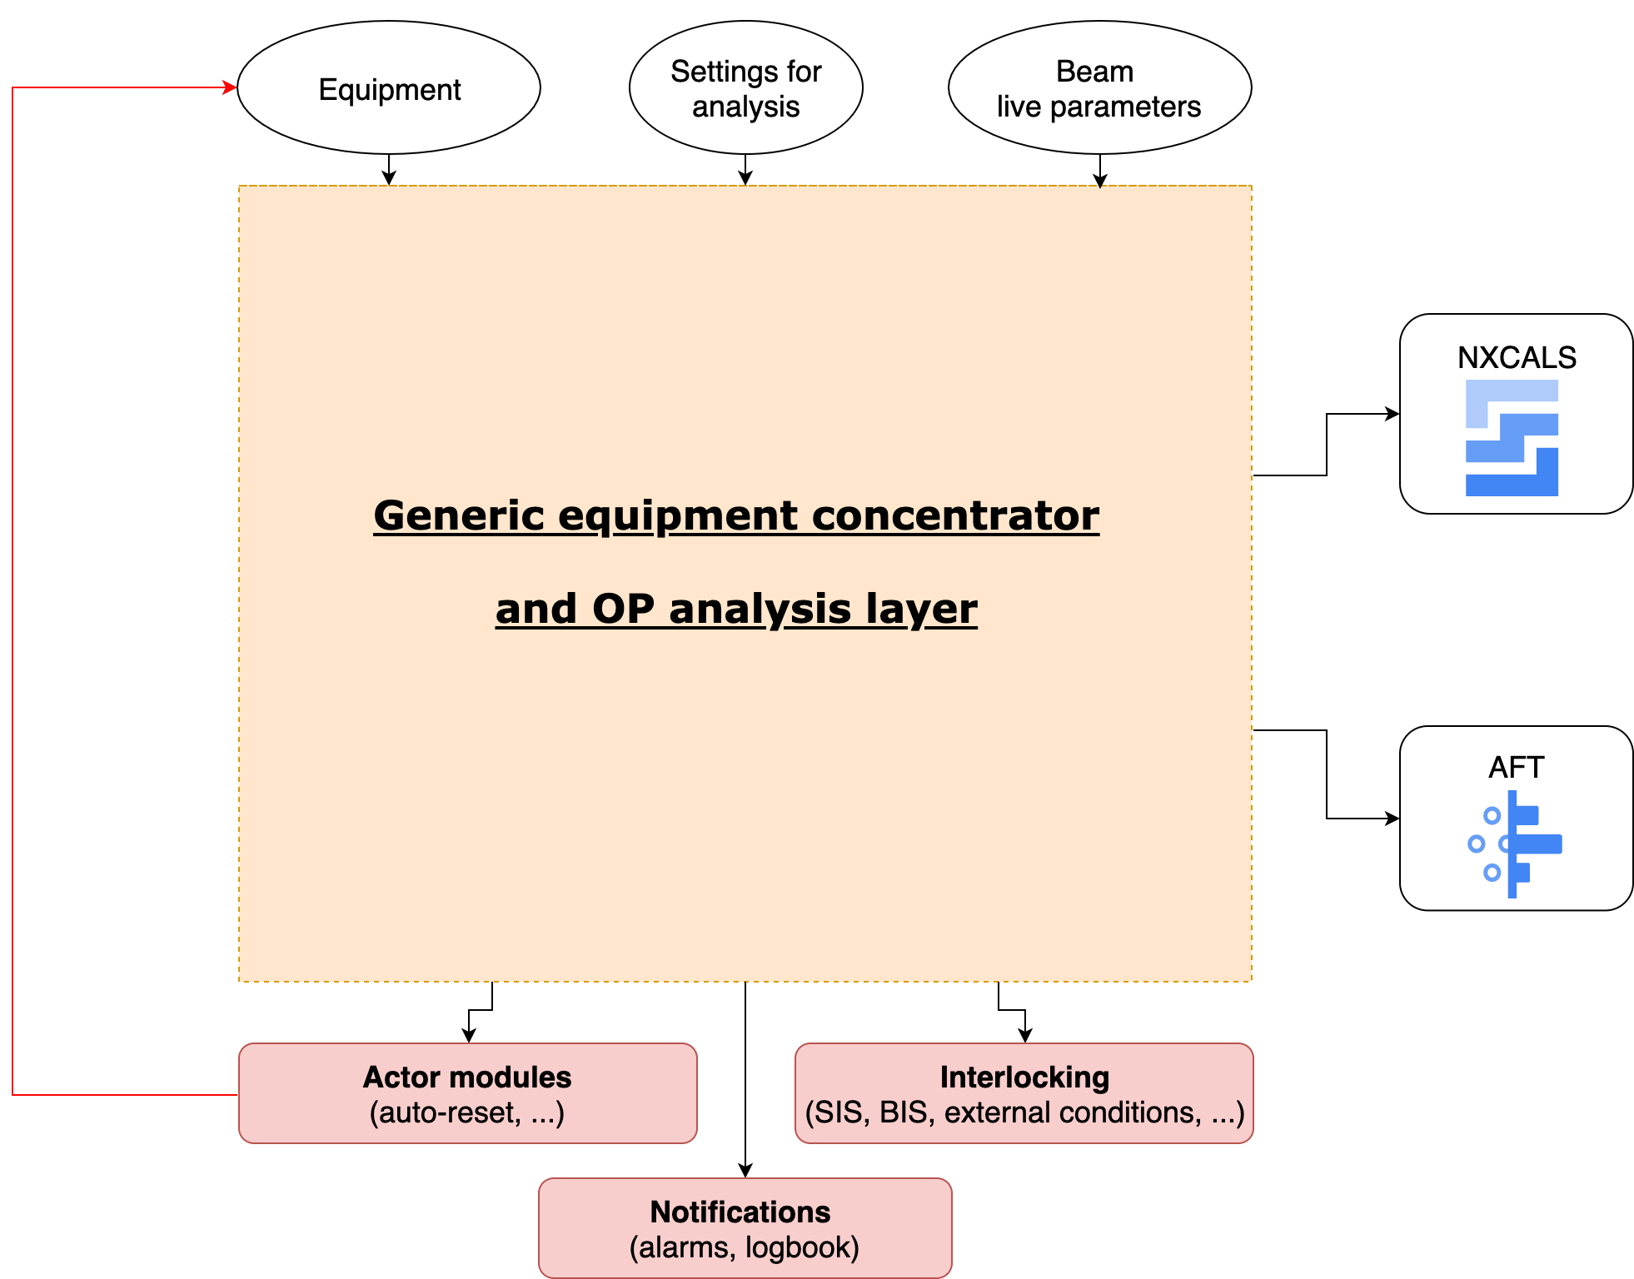
AFT Automation & Integrations III
Complexity | Importance | Maturity
? | 3 | ?
Efficient Particle Accelerators (EPA) project WP8 proposes SW layer providing detailed equipment & accelerator status, settings, configuration etc.
Can mutually profit from exchanging data with AFT:
AFT → SW layer: provide fault status & history of accelerator
SW layer → AFT: Provide equipment status to automatic fault recording instances
→ Allow for faster and more precise fault diagnosis and better fault classification
Precise definition of integration still needs to be discussed → Concretize with EPA WP8, AFT team & automatic fault recording team
EPA WP8
A. Huschauer, “Automated equipment monitoring: status and evolution”, JAPW23

Slide 16
Summary and Outlook
2023 has been used to collect feedback on AFT and its usage
Desiderata were evaluated in terms of feasibility, relevance and maturity
  Some requests can be addressed in the short to mid term
    → Selection was presented and full list available here. Feedback welcome!
  Some ideas to be addressed in the mid- to long-term
    Advanced AFT features, further automation and integration with other tools
    → Continue discussions with equipment groups, EAM team, EPA WP8, automatic fault recording experts, AFT team to develop concrete requirements and allocate resources.
Aim to continue further automatization and integration of fault tracking based on very positive experience in recent years.

Slide 17
Backup slides

