Slide 1

Herwig Schopper - a century in physics
SESAME
Success Continues Despite Challenges
Khaled Toukan
SESAME Director
CERN
Friday March 1, 2024

Slide 2
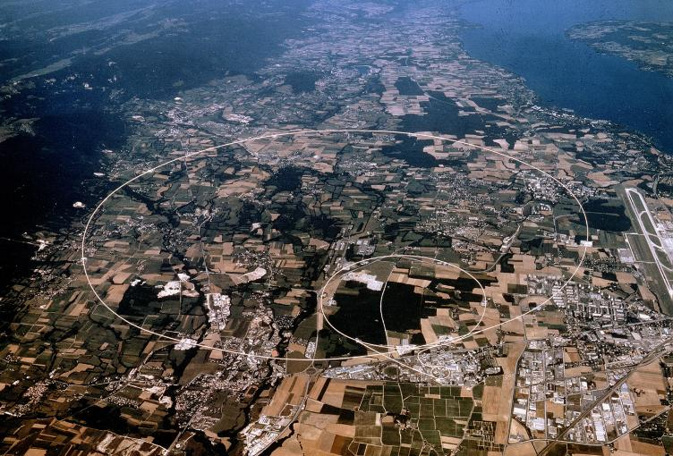
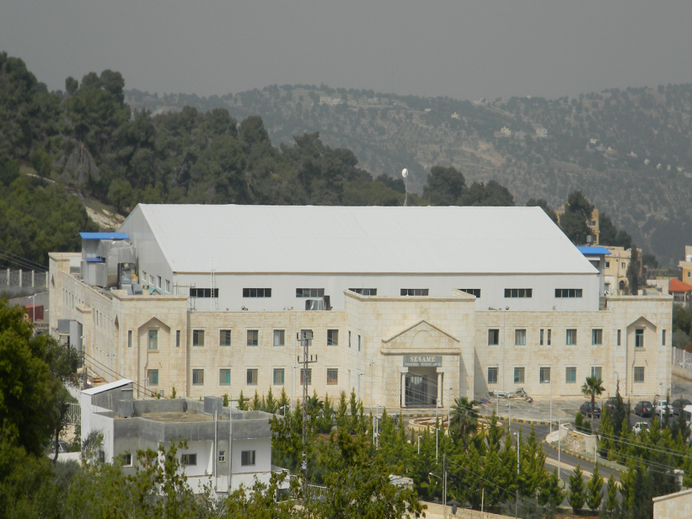
Science for Peace
Two organisations created under the umbrella of UNESCO:
CERN
SESAME
Conceived late 1940s - aim:
Enable construction of a facility beyond means of individual countries
Foster cooperation between peoples recently in conflict
Conceived late 1990s with the same aim:
Members: Cyprus, Egypt, Iran, Israel, Jordan, Pakistan, Palestine, Türkiye
SESAME is more challenging, because of the persistent political crises engulfing the Middle East

Slide 3
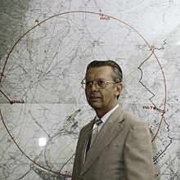
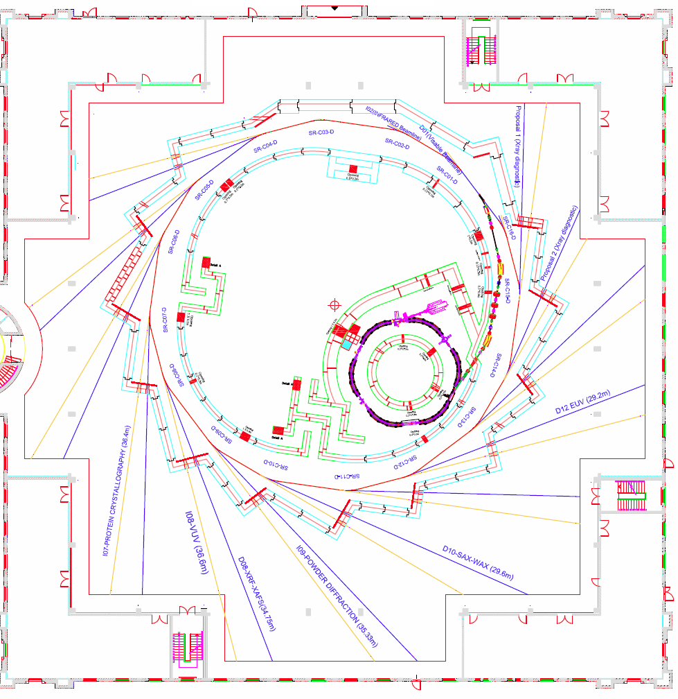
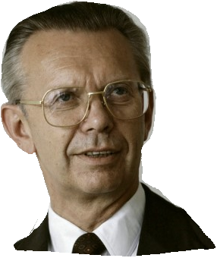
Herwig Schopper
–
CERN & SESAME

Slide 4
Building a Culture of Peace
Herwig Schopper met the enormously difficult challenge of bringing Cyprus, Bahrain, Egypt, Iran, Israel, Jordan, Pakistan, Palestine and Türkiye to the table and persuading them to put aside historical and political differences, and to jointly work together for establishing a scientific centre of excellence in the Middle East. A real success story of science diplomacy.

Slide 5
Jordan Joins SESAME
Isa Khubeis
During a tour of the Middle East in 1999 to identify a host state, Schopper met with representatives of universities and other organisations in Jordan. However, no meeting with government officials could be arranged, and no commitment was obtained.
When Schopper was professor in 1958 at Mainz University in Germany, he had supervised a Jordanian student, Isa Khubeis, who became later Vice-President of Al-Balqa Applied University in Al-Salt. In a last bid, Schopper called Khubeis.
After a dinner at Khubeis’s house, Prince Ghazi bin Muhammad who chaired the Board of Trustees of Al- Balqa Applied University and was a close adviser of King Abdullah II, joined the dinner.
Prince Ghazi was convinced of SESAME’s case and immediately arranged a meeting for the next day with King Abdullah II.
Schopper explained to the King the idea behind SESAME. After asking a number of relevant questions and half an hour later, Schopper was handed a letter signed by King Abdullah II, addressed to the DG of UNESCO, indicating that he agreed to host SESAME in Jordan.

Slide 6
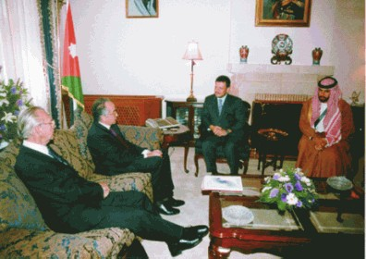
With King Abdullah II of Jordan during SESAME Middle East Tour, 1999

Slide 7
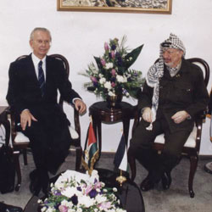
With President Arafat of Palestine during SESAME Middle East Tour, 1999

Slide 8
In 2000, Schopper presided over a meeting at CERN of the restricted Interim Council (IC) of SESAME to select a host country for SESAME from the seven proposals received.
Building a Culture of Peace
After several rounds of secret balloting, Jordan was selected as the host country for SESAME.
The parallels to Switzerland’s hosting of CERN in Europe are evident.

Slide 9
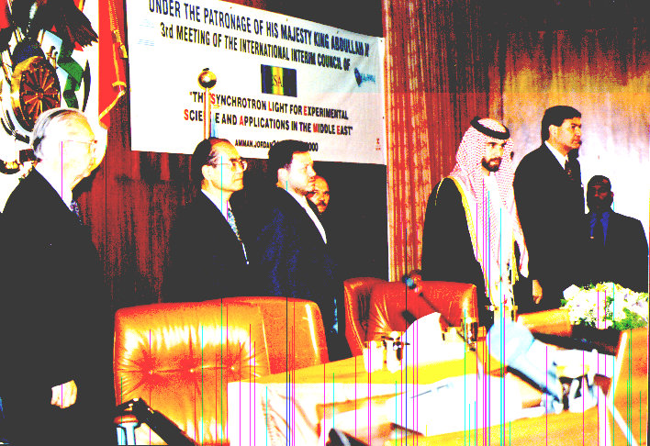
3rd IC Meeting with King Abdullah II
and UNESCO’s DG Matsuura, 2000

Slide 10
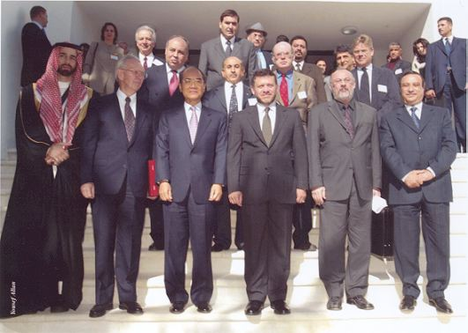
SESAME Groundbreaking Ceremony
January 6, 2003

Slide 11
Receiving Al-Istiqlal Medal of Jordan from King Abdullah II
on January 6, 2003

Slide 12
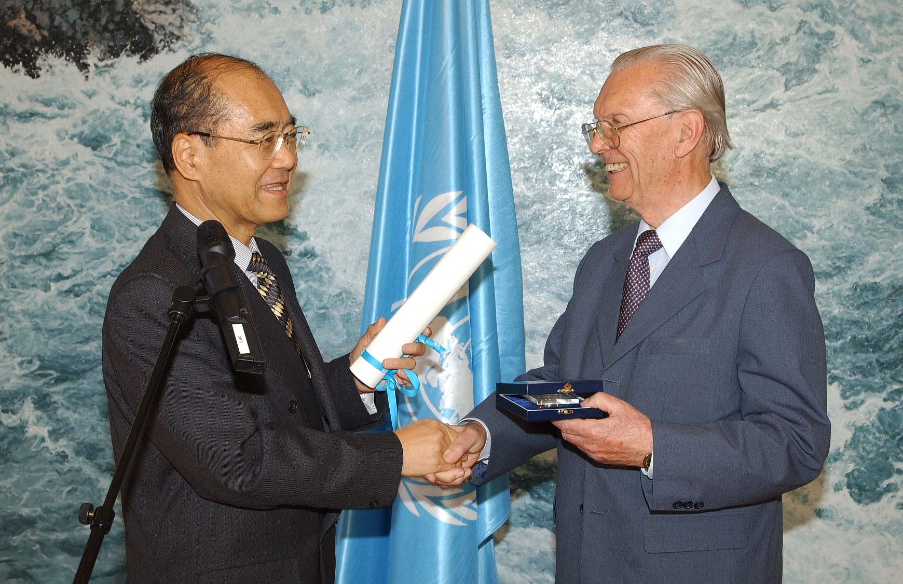
Receiving Albert Einstein Gold Medal from Kōichirō Matsuura, UNESCO’s DG, Paris 2004

Slide 13
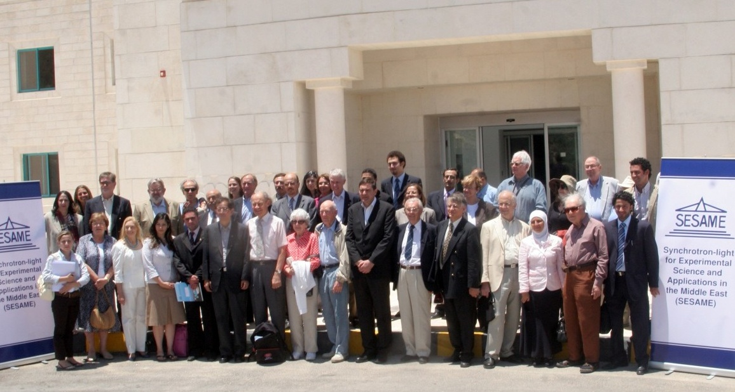
44 Nobel Laureates endorse SESAME, “as a beacon, demonstrating how shared scientific initiatives can help light the way towards peace”, June 2008.

Slide 14





The Dream Comes True
‘95
‘04
SESAME comes into existence, Herwig Schopper presides over Council
‘17
January:
First electron beam circulating
Arab Israeli Cooperation (Dahab)
(Venice Gouda, Eliezer Rabinovici)
‘99
German Government agreed to donate BESSY I components to SESAME following the request of Sergio Fubini and Herwig Schopper
16 May:
Opening by
King Abdullah II
Decision to build a new 2.5 GeV ring using BESSY I booster, competitive 3rd generation facility
Rebuild old 0.8 GeV Berlin Synchrotron (BESSY I) in the Middle East, as a basis for a new international centre (Gus Voss, Herman Winick, followed by Tord Ekelof)
‘97
'03
‘08
Completion of building
Groundbreaking

Slide 15
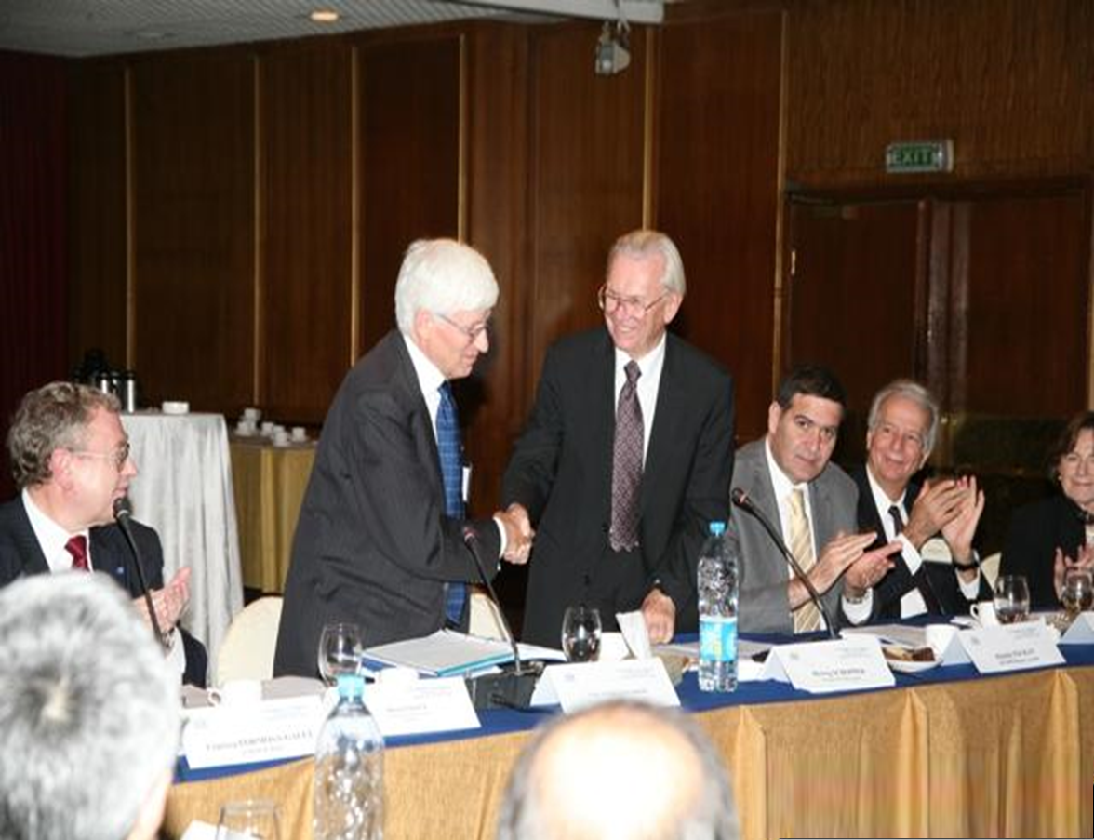
Handover Presidency of SESAME Council,
November 2008

Slide 16
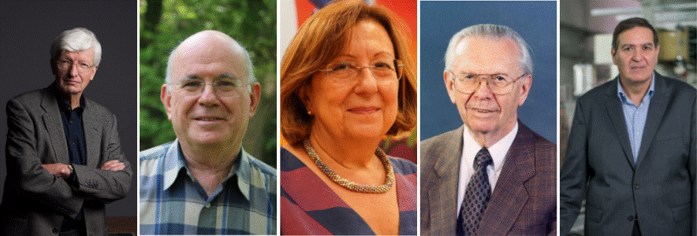
High Award for Science Diplomacy
On February 15, 2019, Khaled Toukan, Herwig Franz Schopper, Zehra Sayers, Eliezer Rabinovici and Sir Christopher Llewellyn Smith, were awarded the 2019 American Association for the Advancement of Science (AAAS) prize for science diplomacy for their considerable contribution to the creation and development of SESAME.

Slide 17
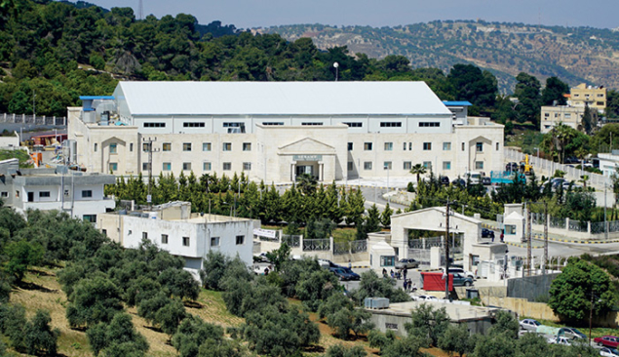
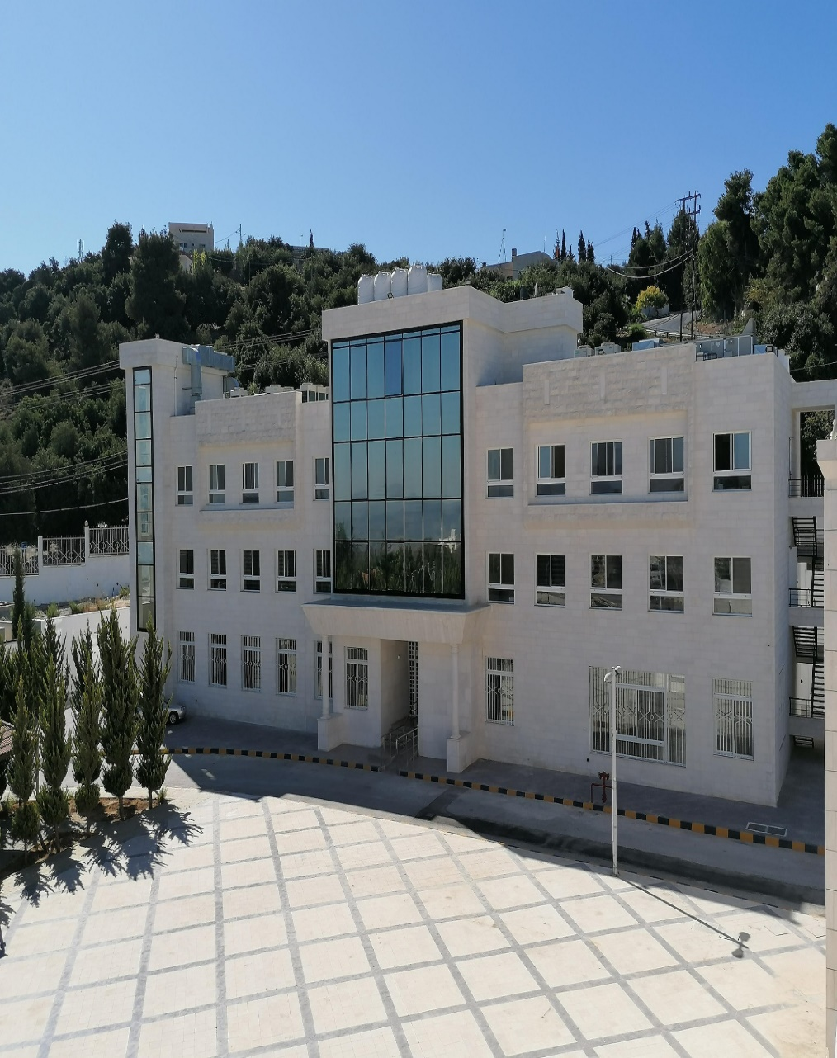
SESAME Building
SESAME Sergio Fubini Guesthouse

Slide 18
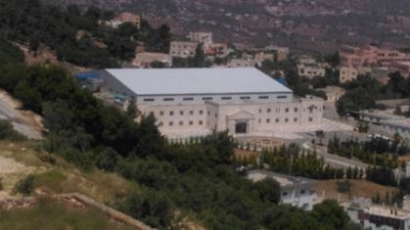
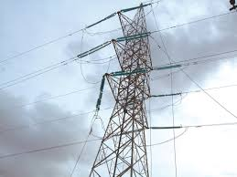
SESAME is Totally Powered by Solar Energy
Transformers
Inverters

Slide 19
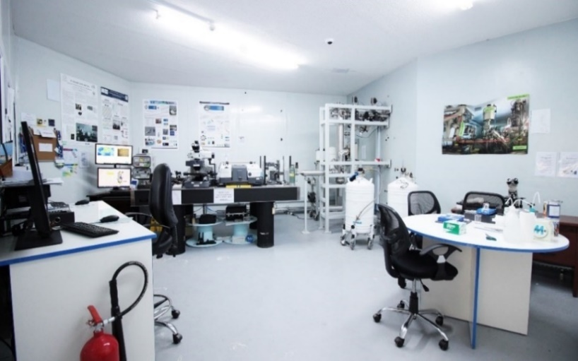
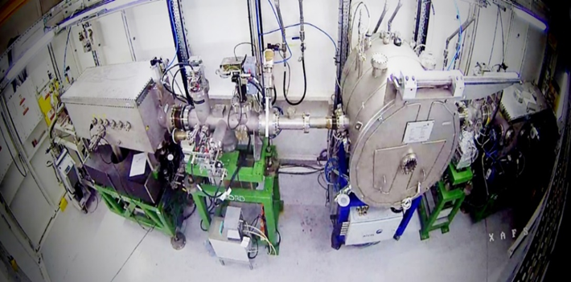
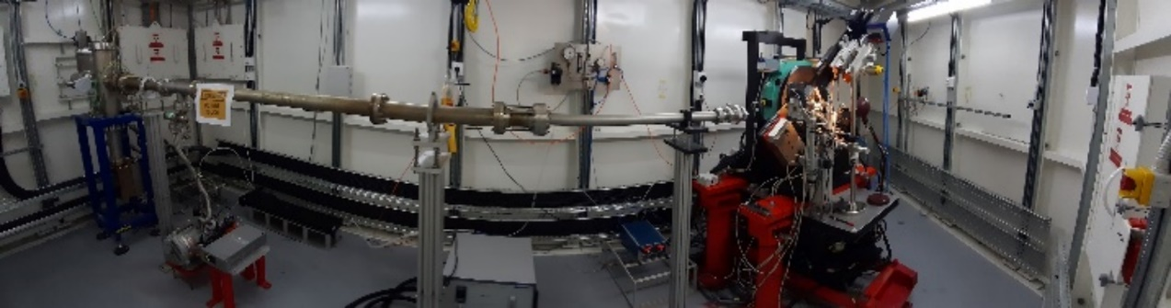
IR
beamline
Current Status of SESAME’s Five Operating Beamlines
XAFS/XRF beamline
MS/XPD beamline

Slide 20
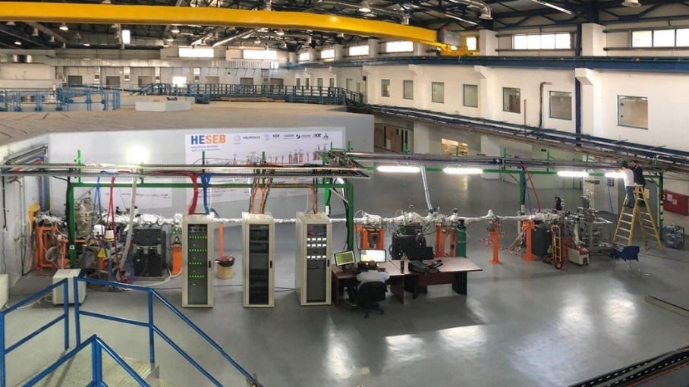
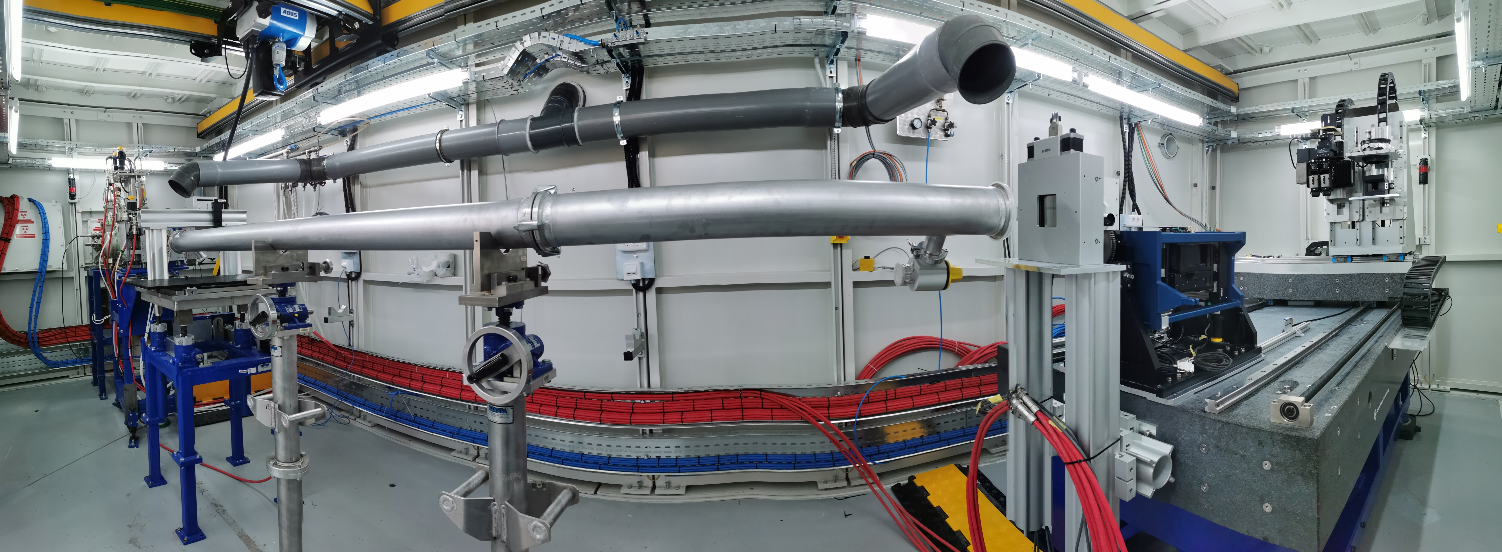
HESEB
beamline
Current Status of SESAME’s Five Operating Beamlines
BEATS
beamline

Slide 21
  Proposals Submitted to SESAME and SESAME Publications
 | Proposals Submitted | Applied proposals
CYPRUS | 30 | 604
EGYPT | 156
IRAN | 90
ISRAEL | 19
JORDAN | 92
PAKISTAN | 74
PALESTINE | 23
TÜRKIYE | 120
SESAME Observers (FRANCE, GERMANY, ITALY, RUSSIAN FEDERATION, UAE, UNITED KINGDOM) |  | 52
Potential Members (ALGERIA, IRAQ, MOROCCO, OMAN, QATAR) |  | 24
OTHERS (AUSTRALIA, AUSTRIA, BELGUIM, BOTSWANA, CANADA, COLOMBIA, DENMARK, INDIA, KENYA, MALAYSIA, MALTA, MEXICO, NETHERLANDS, NIGERIA, SOUTH AFRICA, SWEDEN, UNITED STATES) |  | 49
Totals |  | 729
Total Accepted |  | 350
Publications
87
Peer-reviewed publications until January 2024
Average scientific impact factor > 5
25% of publications have IF > 7

Slide 22

Call 6, closed on Septrember 30, 2023
157 proposals
beamtime Jan.-Jul. 2024
*** Call 7, closed on February 29, 2024 – beamtime Sept.-Dec. 2024

Slide 23
