Slide 1
Safety systems proposal for FRAS motors Enable/Disable, following FRAS hazard identification, risk analysis and protection layers design (EDMS 2727128)
M. Sosin

Slide 2
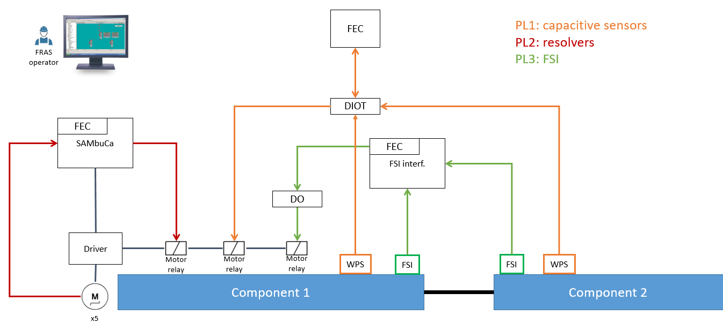
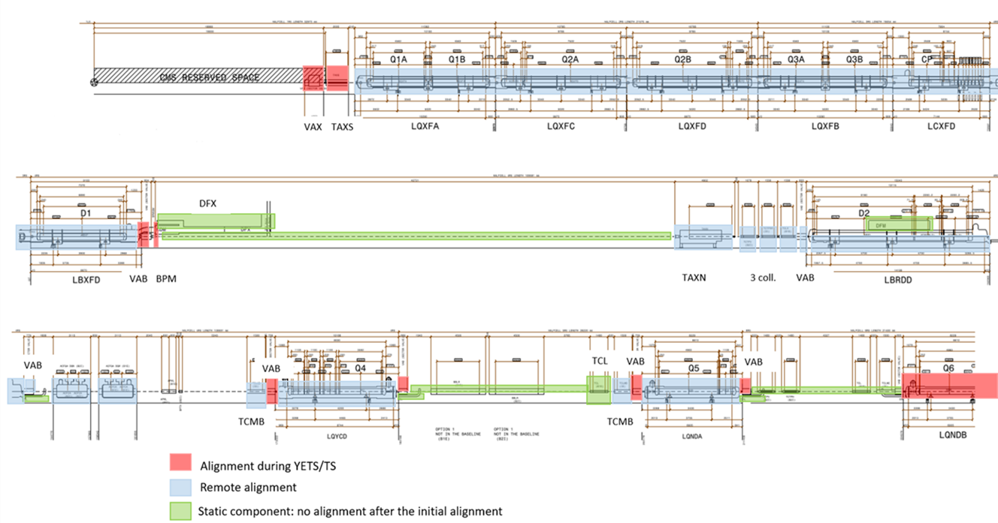
FRAS – Protection by independent component blocks
Per IP side:
4 independent blocks of components, separated by static sections
Independent block 1
Independent block 2
Independent block 3
Independent block 4
According to EDMS 2727128:
The FRAS motors have to be disabled/enabled by different protection layers separately in case of failure
As 4 independent blocks of components are foreseen (Q1-D1, TAXN-CC2; TCLMB-Q4, TCLMB-Q5) – the separation of safety layers relay is proposed for these blocks:
  Each safety layer stack will have to provide a relay line (per each block separately) → 4 relay lines in total
  The relays will need to be deployed in SAMbuCa controls racks in a way, providing disabling/enabling of appropriate sets of motors associated with blocks of components
“FRAS hazard identification, risk analysis and protection layers design” EDMS 2727128
FRAS FCN Specification: EDMS 2166298

Slide 3

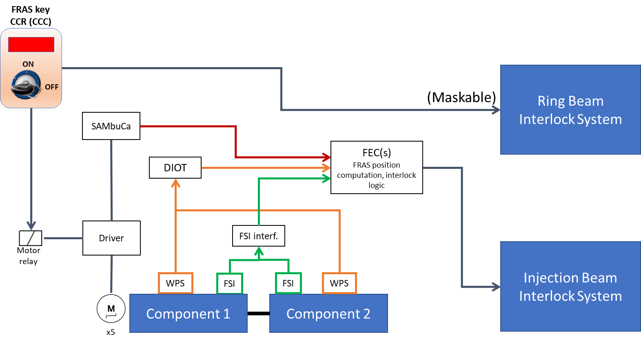
Relay box implementation for HL-LHC FRAS components
Capacitive
(DIOT)
Resolvers
(SAMbuCa)
FSI
SAMbuCa Rack(s) – relay box
Bypass Key
POWER
From CCC key
Ring BIS +
Return info signal
to FRAS controls
Bypass Key
Bypass Key
Bypass Key
Bypass Key
Q1-D1
Motor
drivers
TAXN-CC2
Motor
drivers
TCLMB-Q4
Motor
drivers
TCLMB-Q5
Motor
drivers

Slide 4
Relay box implementation for IT String FRAS components
IT String protection layers (EDMS 2727128)
For interconnecting bellows (exceeding the bellow limits) protection, the three different FRAS protection layers are proposed to mitigate this risk (see section 3.1).
To anticipate ODH risks to the personnel and define relevant IT String access control, the following protection layers are proposed [11]:
Remote Alignment and Maintenance modes are proposed to be executed only once the power converters are locked-out, as in the machine. Therefore, there is no required additional link between the BIC and the FRAS (which would need to be bypassed for “Alignment at Injection Current” mode).
For the powering phases (FRAS movements are not allowed), the FRAS key will be installed in the IT String control room - to be removed (powering disabled) by the String operation team.
For the “Alignment at Injection Current” mode - this stage will be performed in close collaboration between the FRAS and the String operation team. It will be coordinated in dedicated meetings to plan the tests, which will be executed from the String control room.
No for IT String
To be implemented
For IT String

Slide 5
Relay box implementation for IT String FRAS components
Capacitive
(DIOT)
FSI
Resolvers
(SAMbuCa)
SAMbuCa Rack(s)
– relay box
Bypass Key
POWER
“Veto” key from IT String Control room
No for IT String
Return info signal
to FRAS controls
Bypass Key
Q1-D1
Motor
drivers

Slide 6
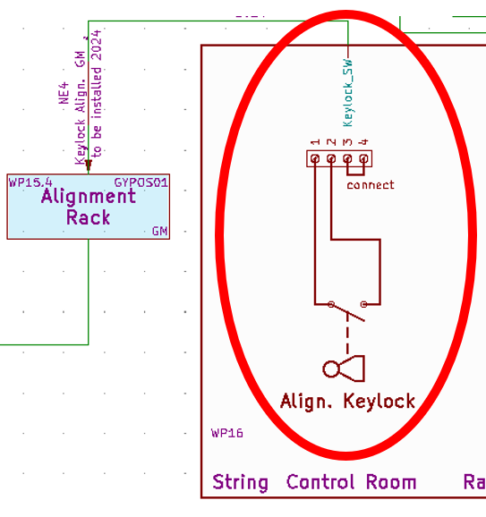
Questions
Relay max current? Voltage?
..or control lines parameters?
The Protection Layers relays specification
  Relays (or relay lines) to be connected to SAMbuCa rack relay box:
    Shall relays be implemented outside relay box and only relay (NC/NO?) lines should be connected to relay box? Or relays shall be implemented inside relay box and voltage/current control lines shall be only provided by Protection Layers equipment
    What should be current/voltage parameters of relays (relay lines) or control lines signals? Which contact type (NO/NC?)
    The relays will be controlled from FESA software, but do we need the dedicated DI lines in FRAS, to read the feedback on the status of relay (if is ON or OFF)
FRAS Key CCC or “Veto” Key from IT String control room
  In case of IT String SAMbuCa rack relay box – the proposed “Veto” key connection is showed on the right. Is such configuration sufficient? Could it be confirmed to WP16? Do we need any supplementary contact line?
  In case of HL-LHC FRAS CCC Key – the key signal will be transferred by “safe” line from CCC to IP1/IP5 FRAS racks. What are parameters of this lines? Shall the dedicated cables be requested? From/To which racks? What are the parameters of these line signals (relay?/current?/voltage?)
Bypass keys of relay SAMbuCa relay boxes
  According to previous discussions – there is a need to implement inside the relay box, the bypass keys (to be able to expert enable the system in case of critical situation). Shall the dedicated DI lines be booked in FRAS, to read the feedback on the status of these keys (if ON or OFF)?
Return info signal
to FRAS controls (?)

