Slide 1



















THE ALPHA COLLABORATION
Aarhus University,
Denmark
University of Brescia,
Italy
University of British
Columbia, Canada
University of California
Berkeley, USA
University of Calgary,
Canada
University of Groningen,
Holland
Pisa and Pavia
Italy
University of Manchester, UK
NRCN - Nuclear Res.
Center Negev, Israel
Purdue University,
USA
Federal University of
Rio de Janeiro, Brazil
Stockholm University,
Sweden
Simon Fraser University,
Canada `
TRIUMF,
Canada
York University,
Canada
University of Wales
Swansea, UK
Cockcroft Institute, UK

Slide 2
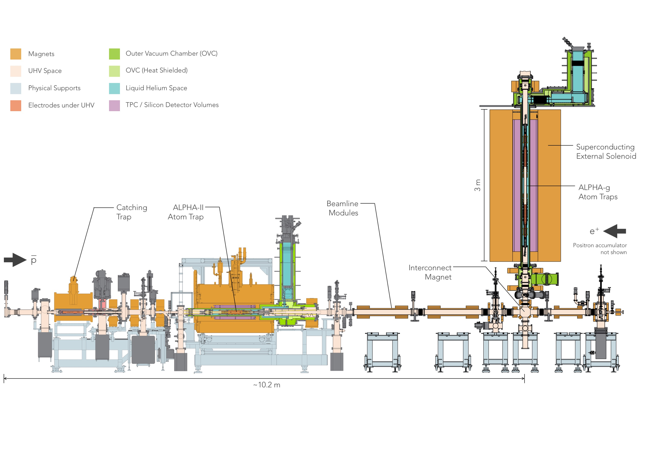
ALPHA spectroscopy and gravitation

Slide 3
ALPHA-g Schematic

Slide 4
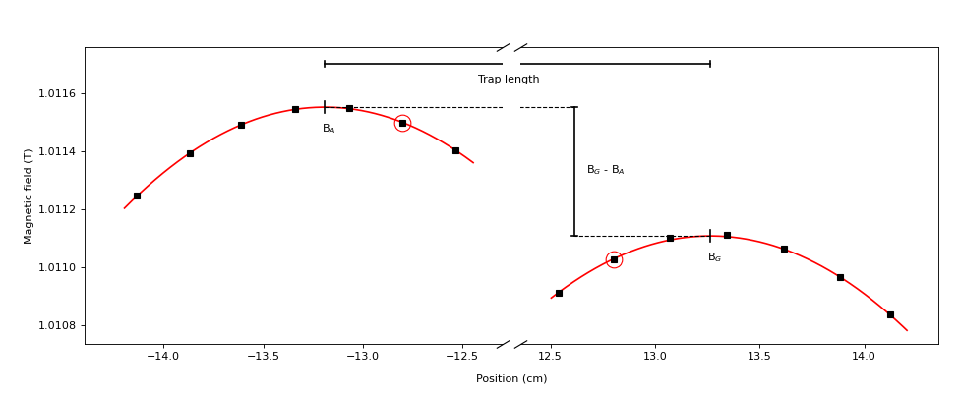

Magnetic bias concept (J. Fajans)
Add a differential current to one of the mirror coils
$$\frac{μ_{B}(B_{G}−B_{A})}{m_{H}(z_{G}−z_{A})}$$
we call this the bias – units of acceleration
in a real experiment – ramp both mirror currents down while maintaining this difference

Slide 5
The S-curve - simulation
fraction that goes down

Slide 6
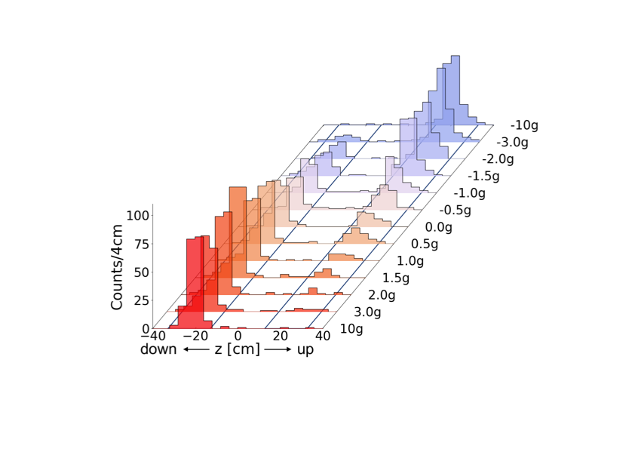
Data from 2022 run
Bias

Slide 7
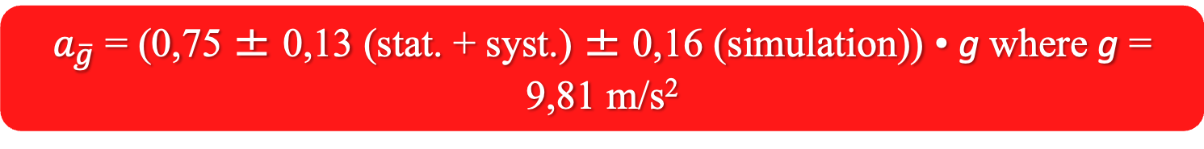
The Result
$a_{\overline{g}}$ = (0,75 ± 0,13 (stat. + syst.) ± 0,16 (simulation)) • g where g = 9,81 m/s²

Slide 8
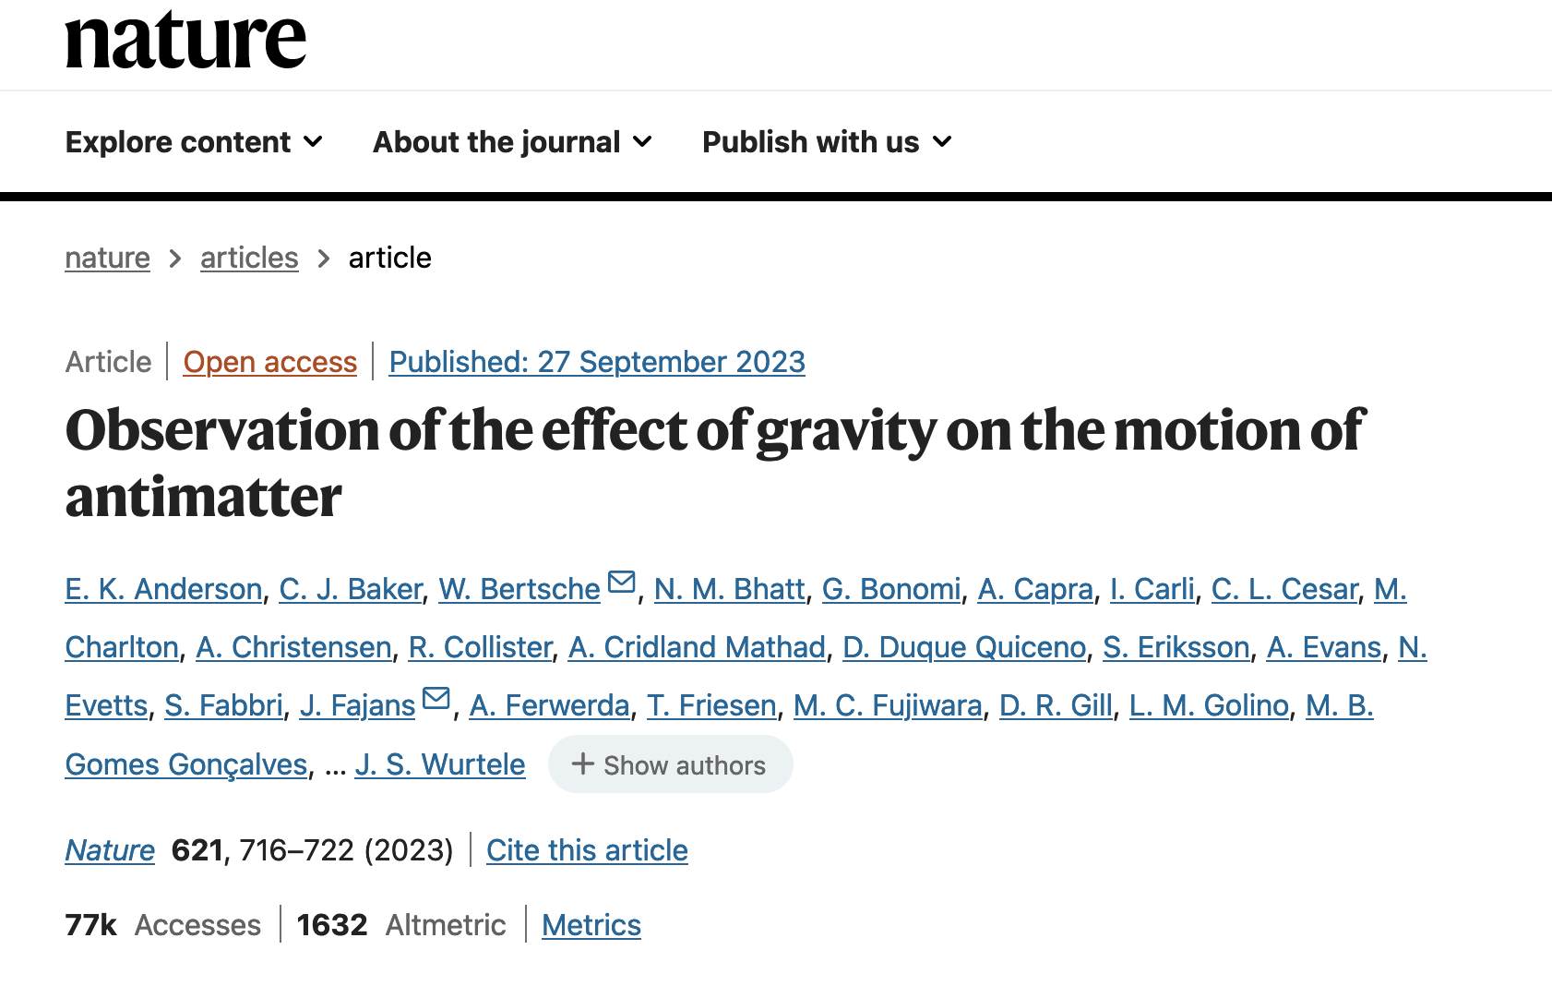

Slide 9

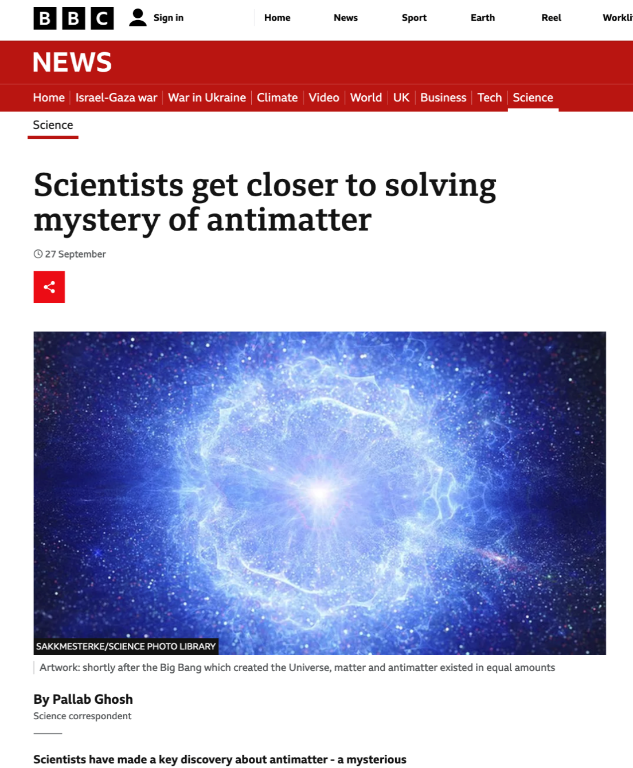

Slide 10
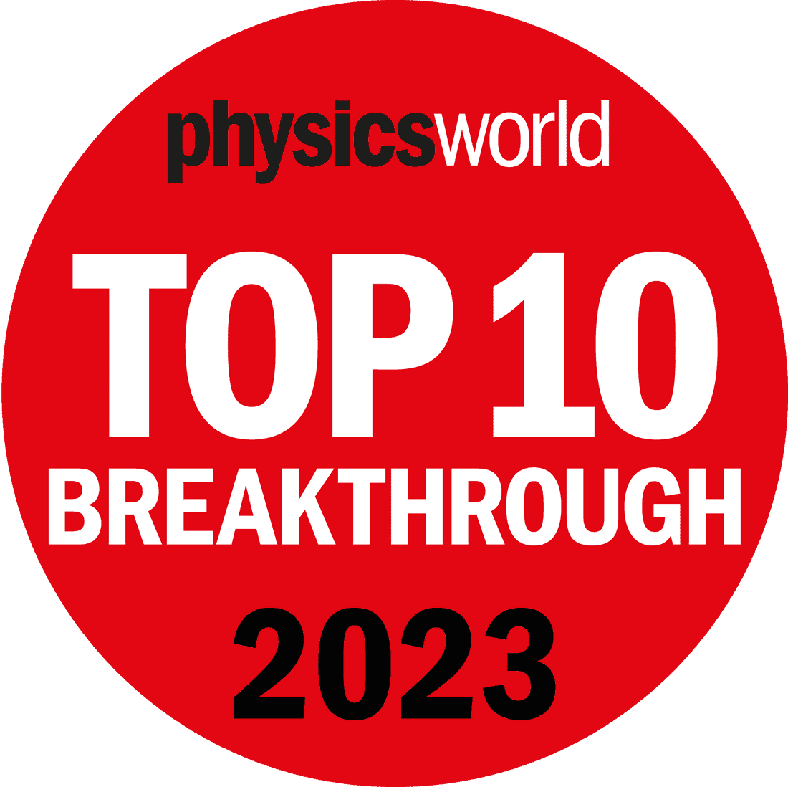
third time ALPHA has been nominated
2010: trapping of antihydrogen (won)
2021: laser cooling of antihydrogen (didn’t win)
2023: gravity experiment (didn’t win again)

Slide 11
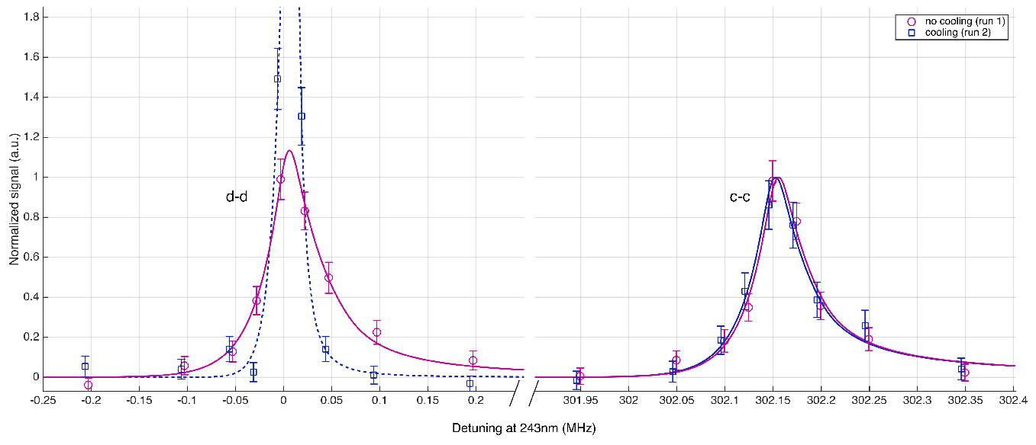
New Publication coming in Nature Physics
“Precision spectroscopy of the hyperfine components of the 1S-2S transition in antihydrogen”
(data pre-LS2)
each curve obtained in 1 day
took 10 weeks in 2017...
one goal of 2023 run was to improve this
resolution

Slide 12
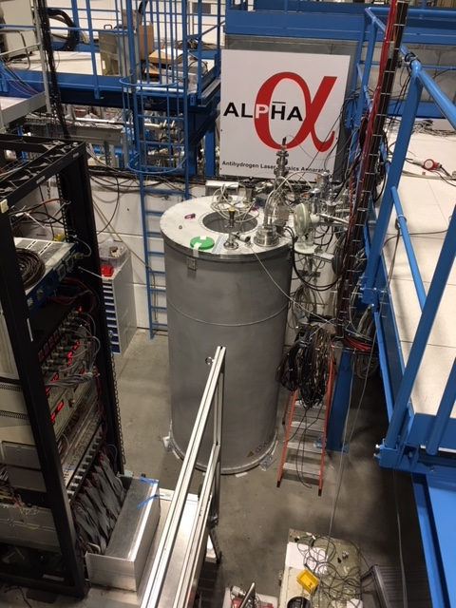
ALPHA in 2023
ALPHA-g was disassembled for external solenoid magnet upgrade; this
was completed successfully and ALPHA-g is back in position
we only ran ALPHA-2 during the 2023 pbar beamtime
we have seven new physics results for which publications are in preparation

Slide 13
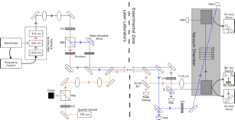
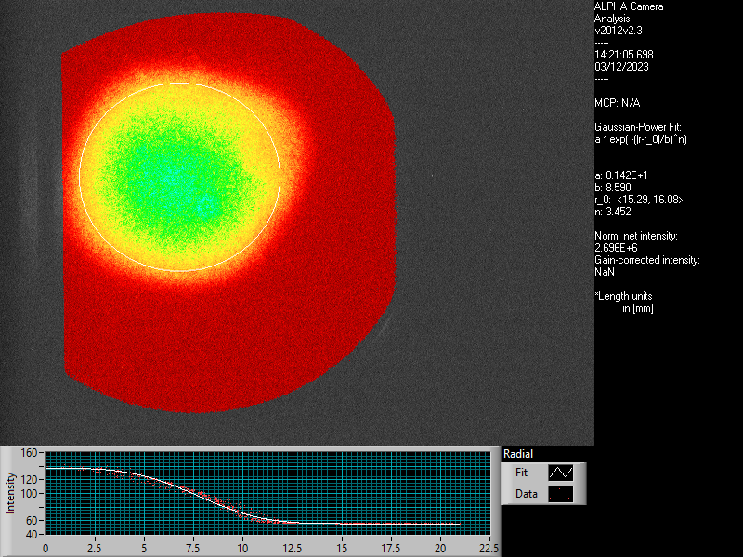
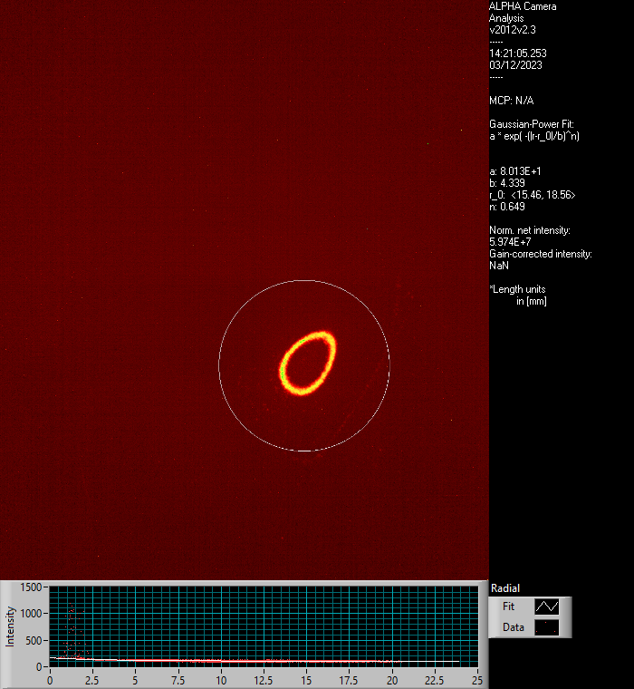
I. Accumulation of 10⁴ hbars using laser-cooled Be ions
from 13 years of trapping experience: positron temperature has a big effect on # of hbars produced and
the trappable fraction Recall the trap is about 0.5K deep.
mixed plasma 1.5 x10⁵ Be⁺ ions and 3 x10⁶ e⁺
laser cool Be ions - positrons are sympathetically cooled by Coulomb interaction
positron T of a few K, maybe diagnostics limited
typical T without Be cooling is 15-20K

Slide 14
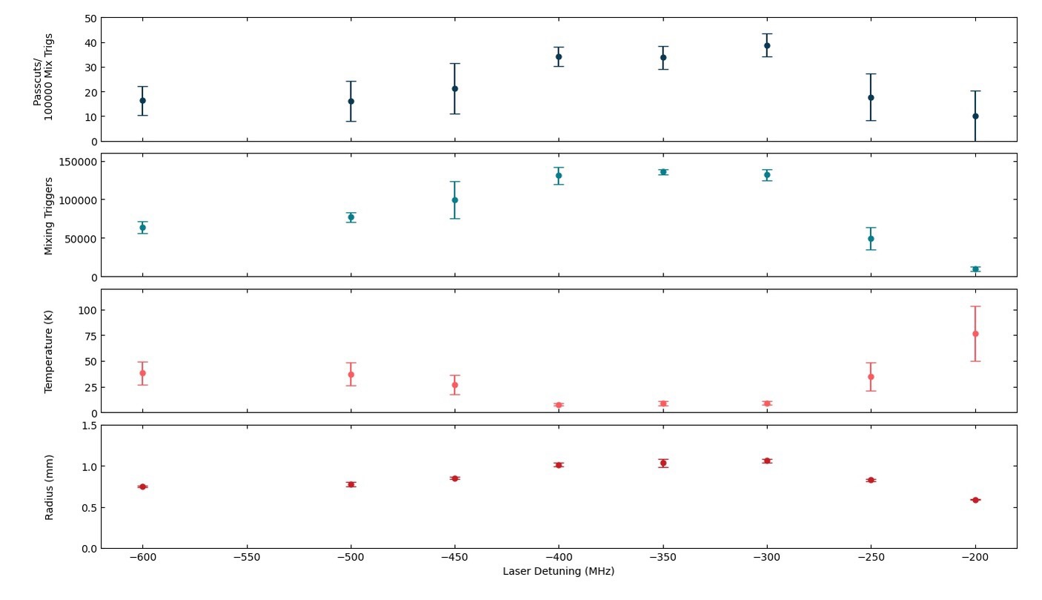
I. Accumulation of 10⁴ hbars using laser-cooled Be ions

Slide 15
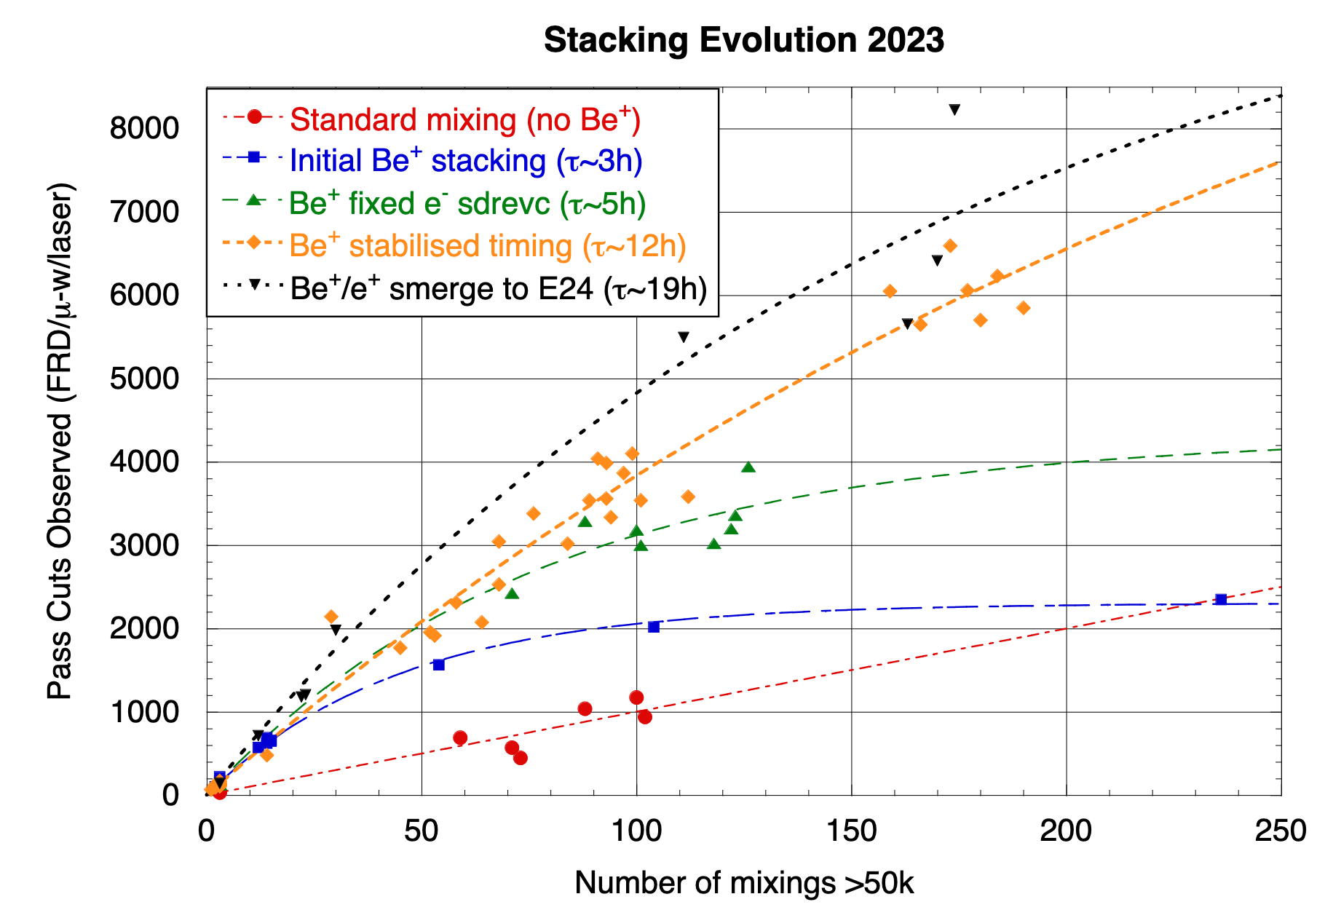
I. Accumulation of 10⁴ hbars using laser-cooled Be ions
N. Madsen,
M. Goncalves,
K. Thompson et al.
maximum short term
result: 20 stacks with
average of 73 atoms per
stack
this is about 650 times the
rate from 2010
typically stack on night
shift – then (cool and)
measure
ALPHA preliminary
ALPHA preliminary
average 15 mixings per hour

Slide 16
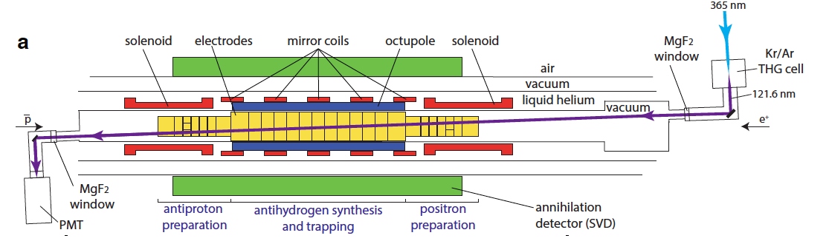
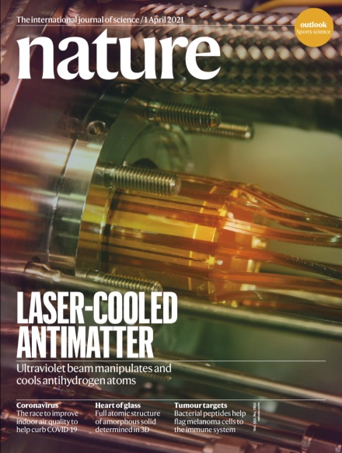
II. Laser Cooling of Antihydrogen
2021

Slide 17
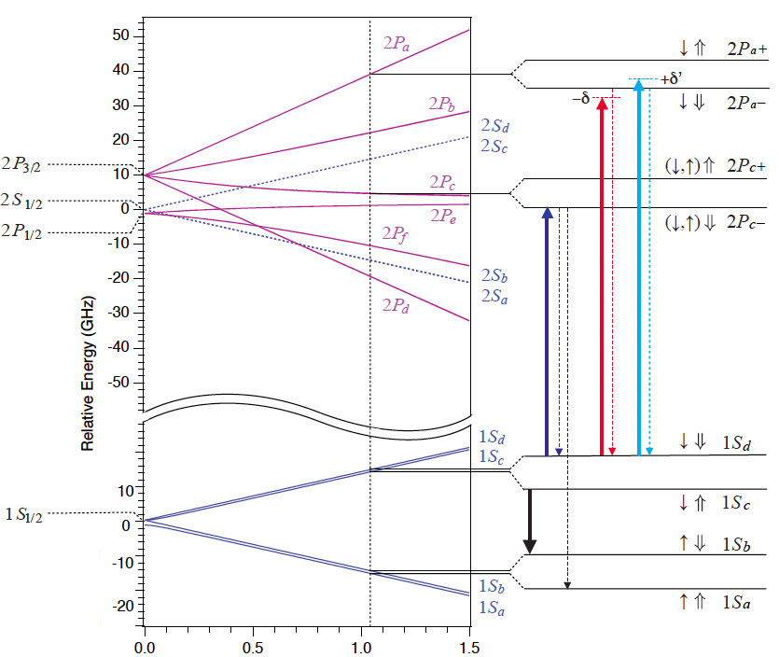
II. Laser Cooling of Antihydrogen
1S – 2P transitions in (anti)hydrogen
probing
probe the sample after cooling
atom will sometimes spin-flip and then annihilate
longitudinal velocity information from Doppler broadening
measure TOF between laser pulse and annihilation – gives information about tranverse speeds

Slide 18
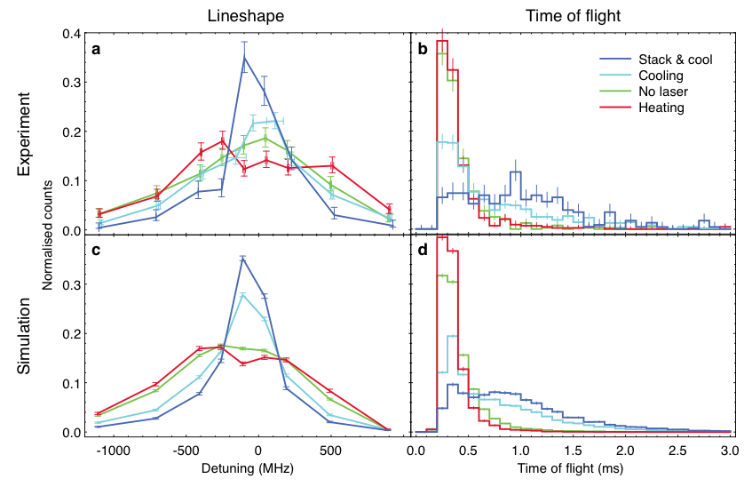
II. Laser Cooling of Antihydrogen
2021 article

Slide 19
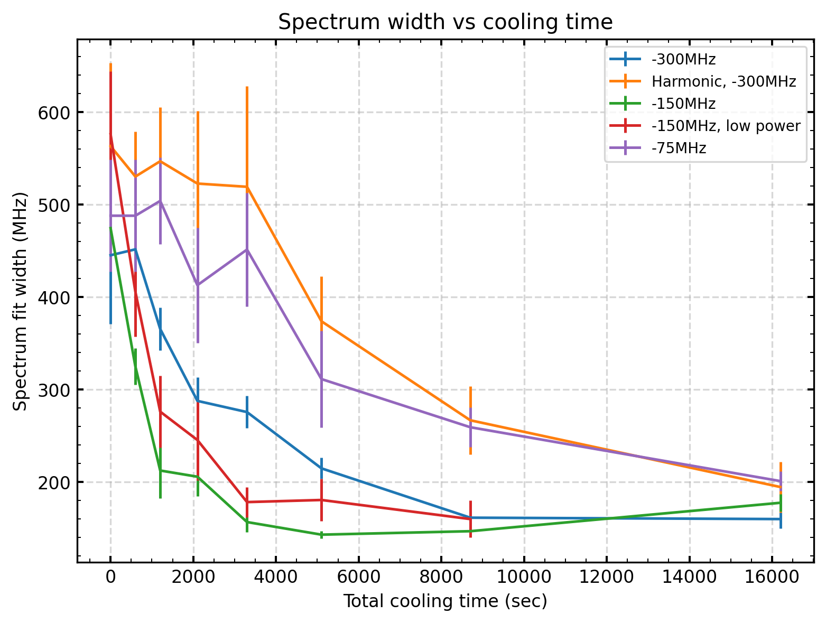
II. Laser Cooling of Antihydrogen
2023: Measured 1S-2P linewidth versus cooling time for various conditions
(laser detuning, trap potential shape)
ALPHA preliminary

Slide 20
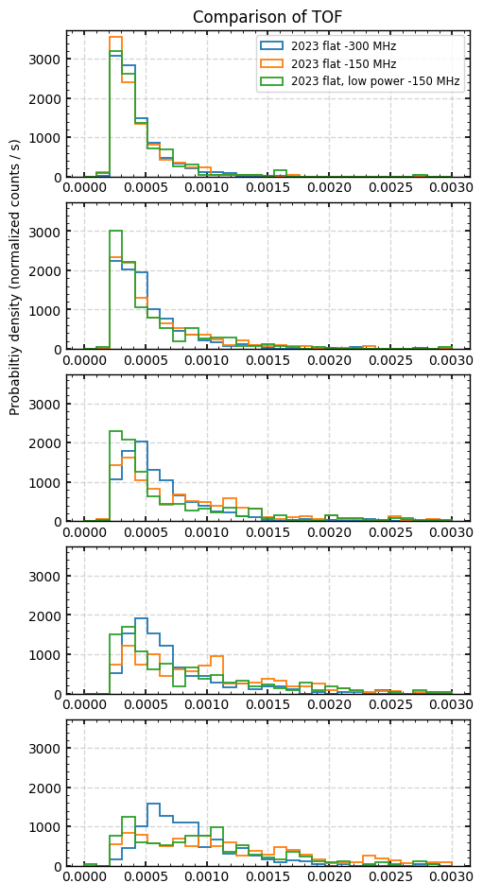
II. Laser Cooling of Antihydrogen
0 minutes
10 minutes
20 minutes
35 minutes
50 minutes
2023: TOF data

Slide 21
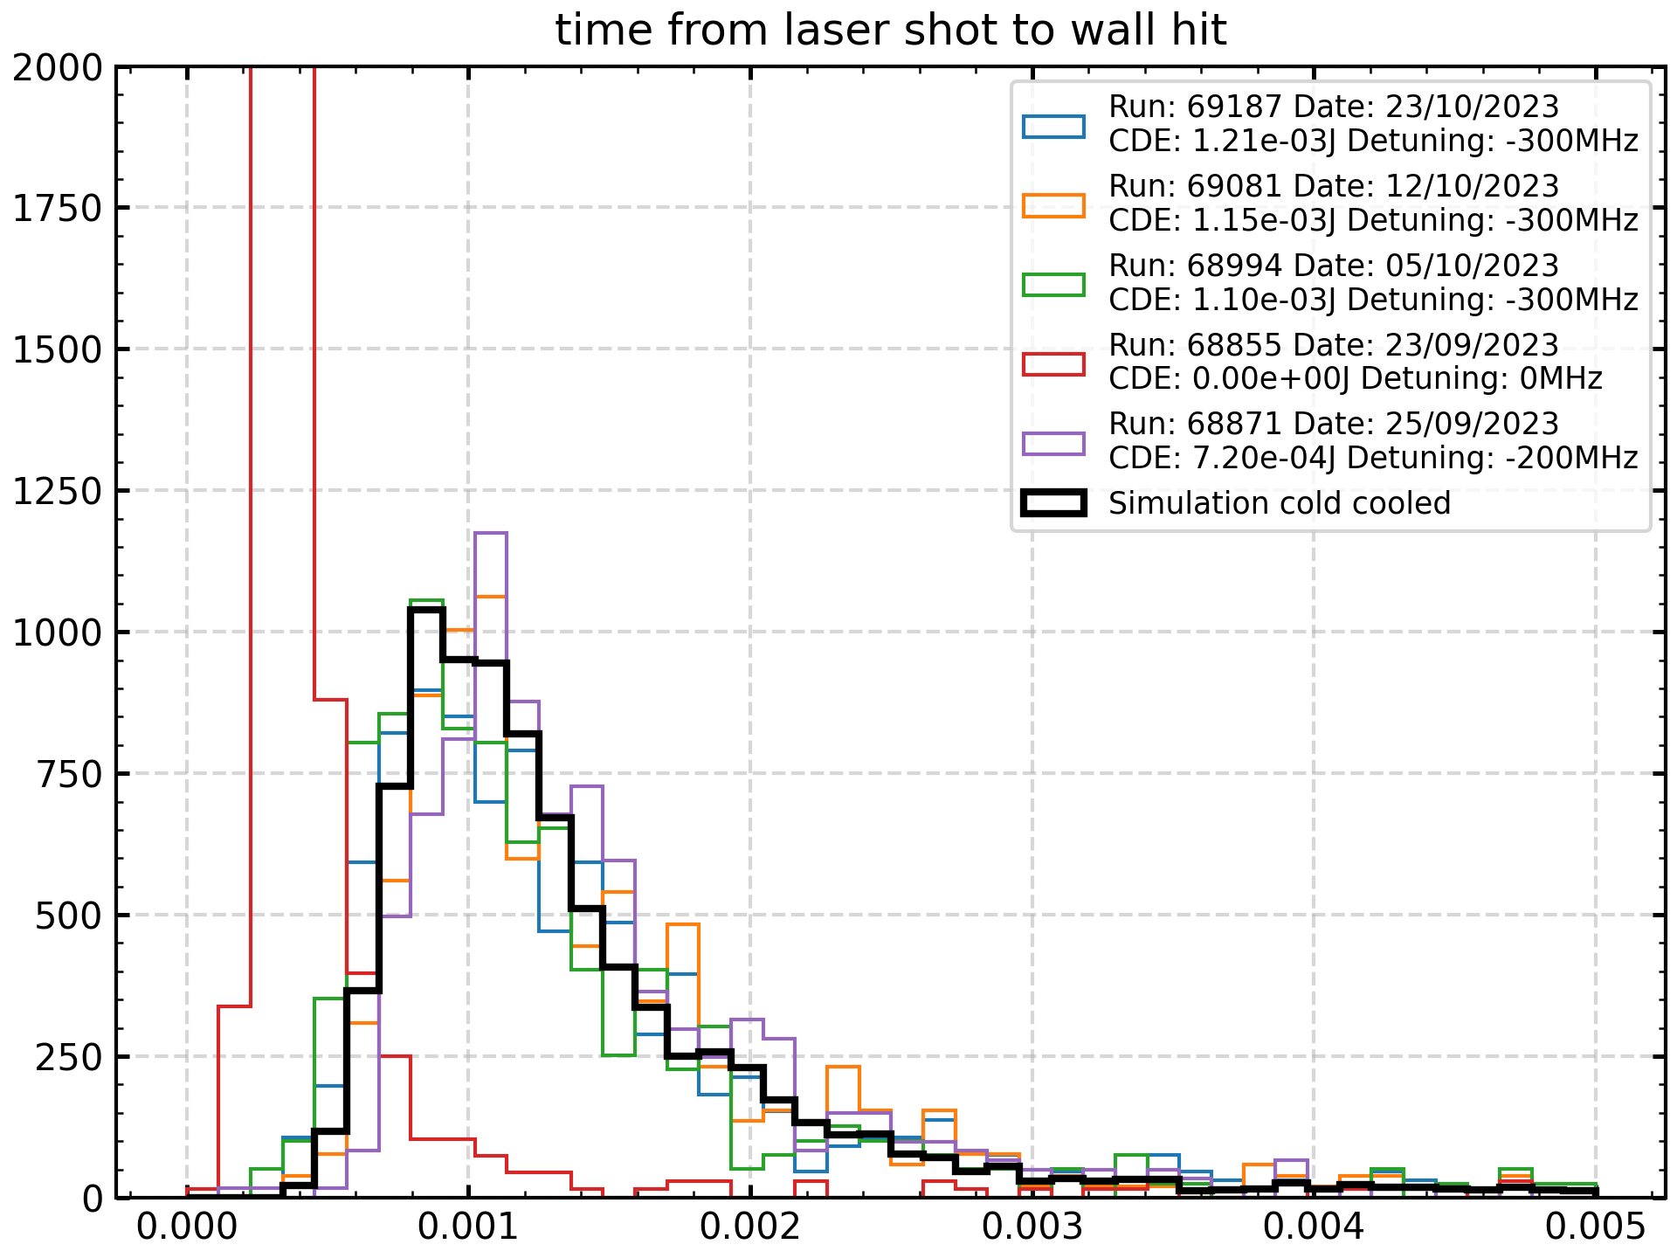
II. Laser Cooling of Antihydrogen
2023: TOF data – reproducibility and comparison with 15 mK simulation
uncooled
probability density (nomalised)

Slide 22
I &II summary
start stacking in the evening – 22:00
laser cool the following morning
up to 10K antihydrogen atoms at 15 mK by late afternoon
Complete paradigm shift – with help from ELENA!

Slide 23
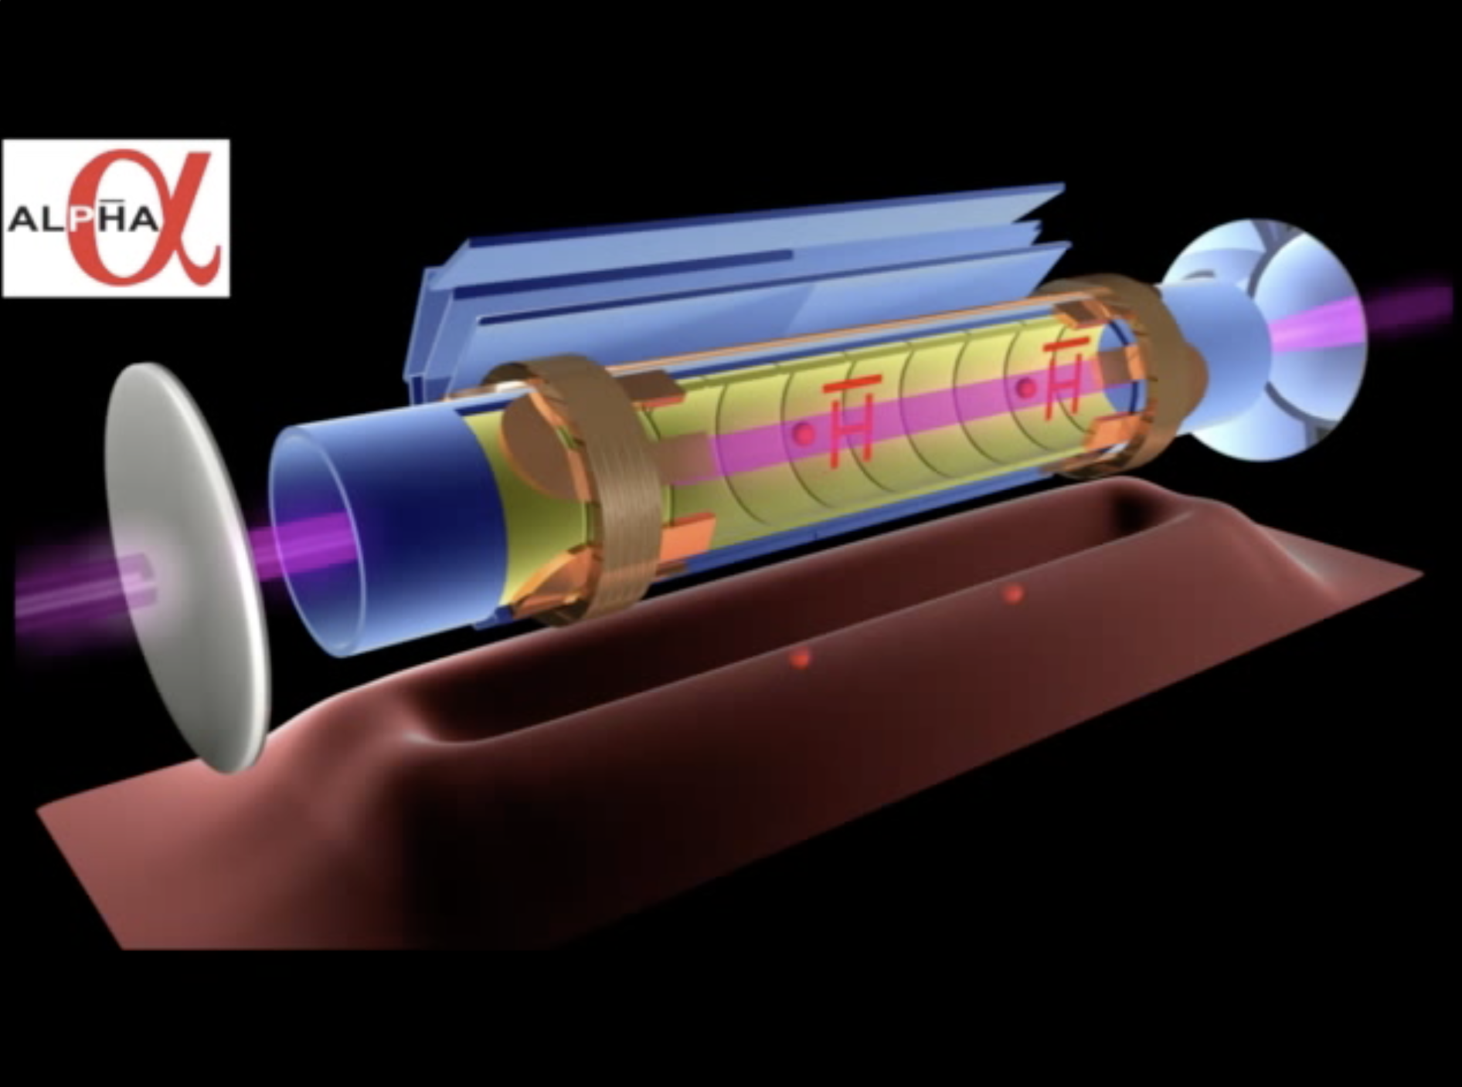
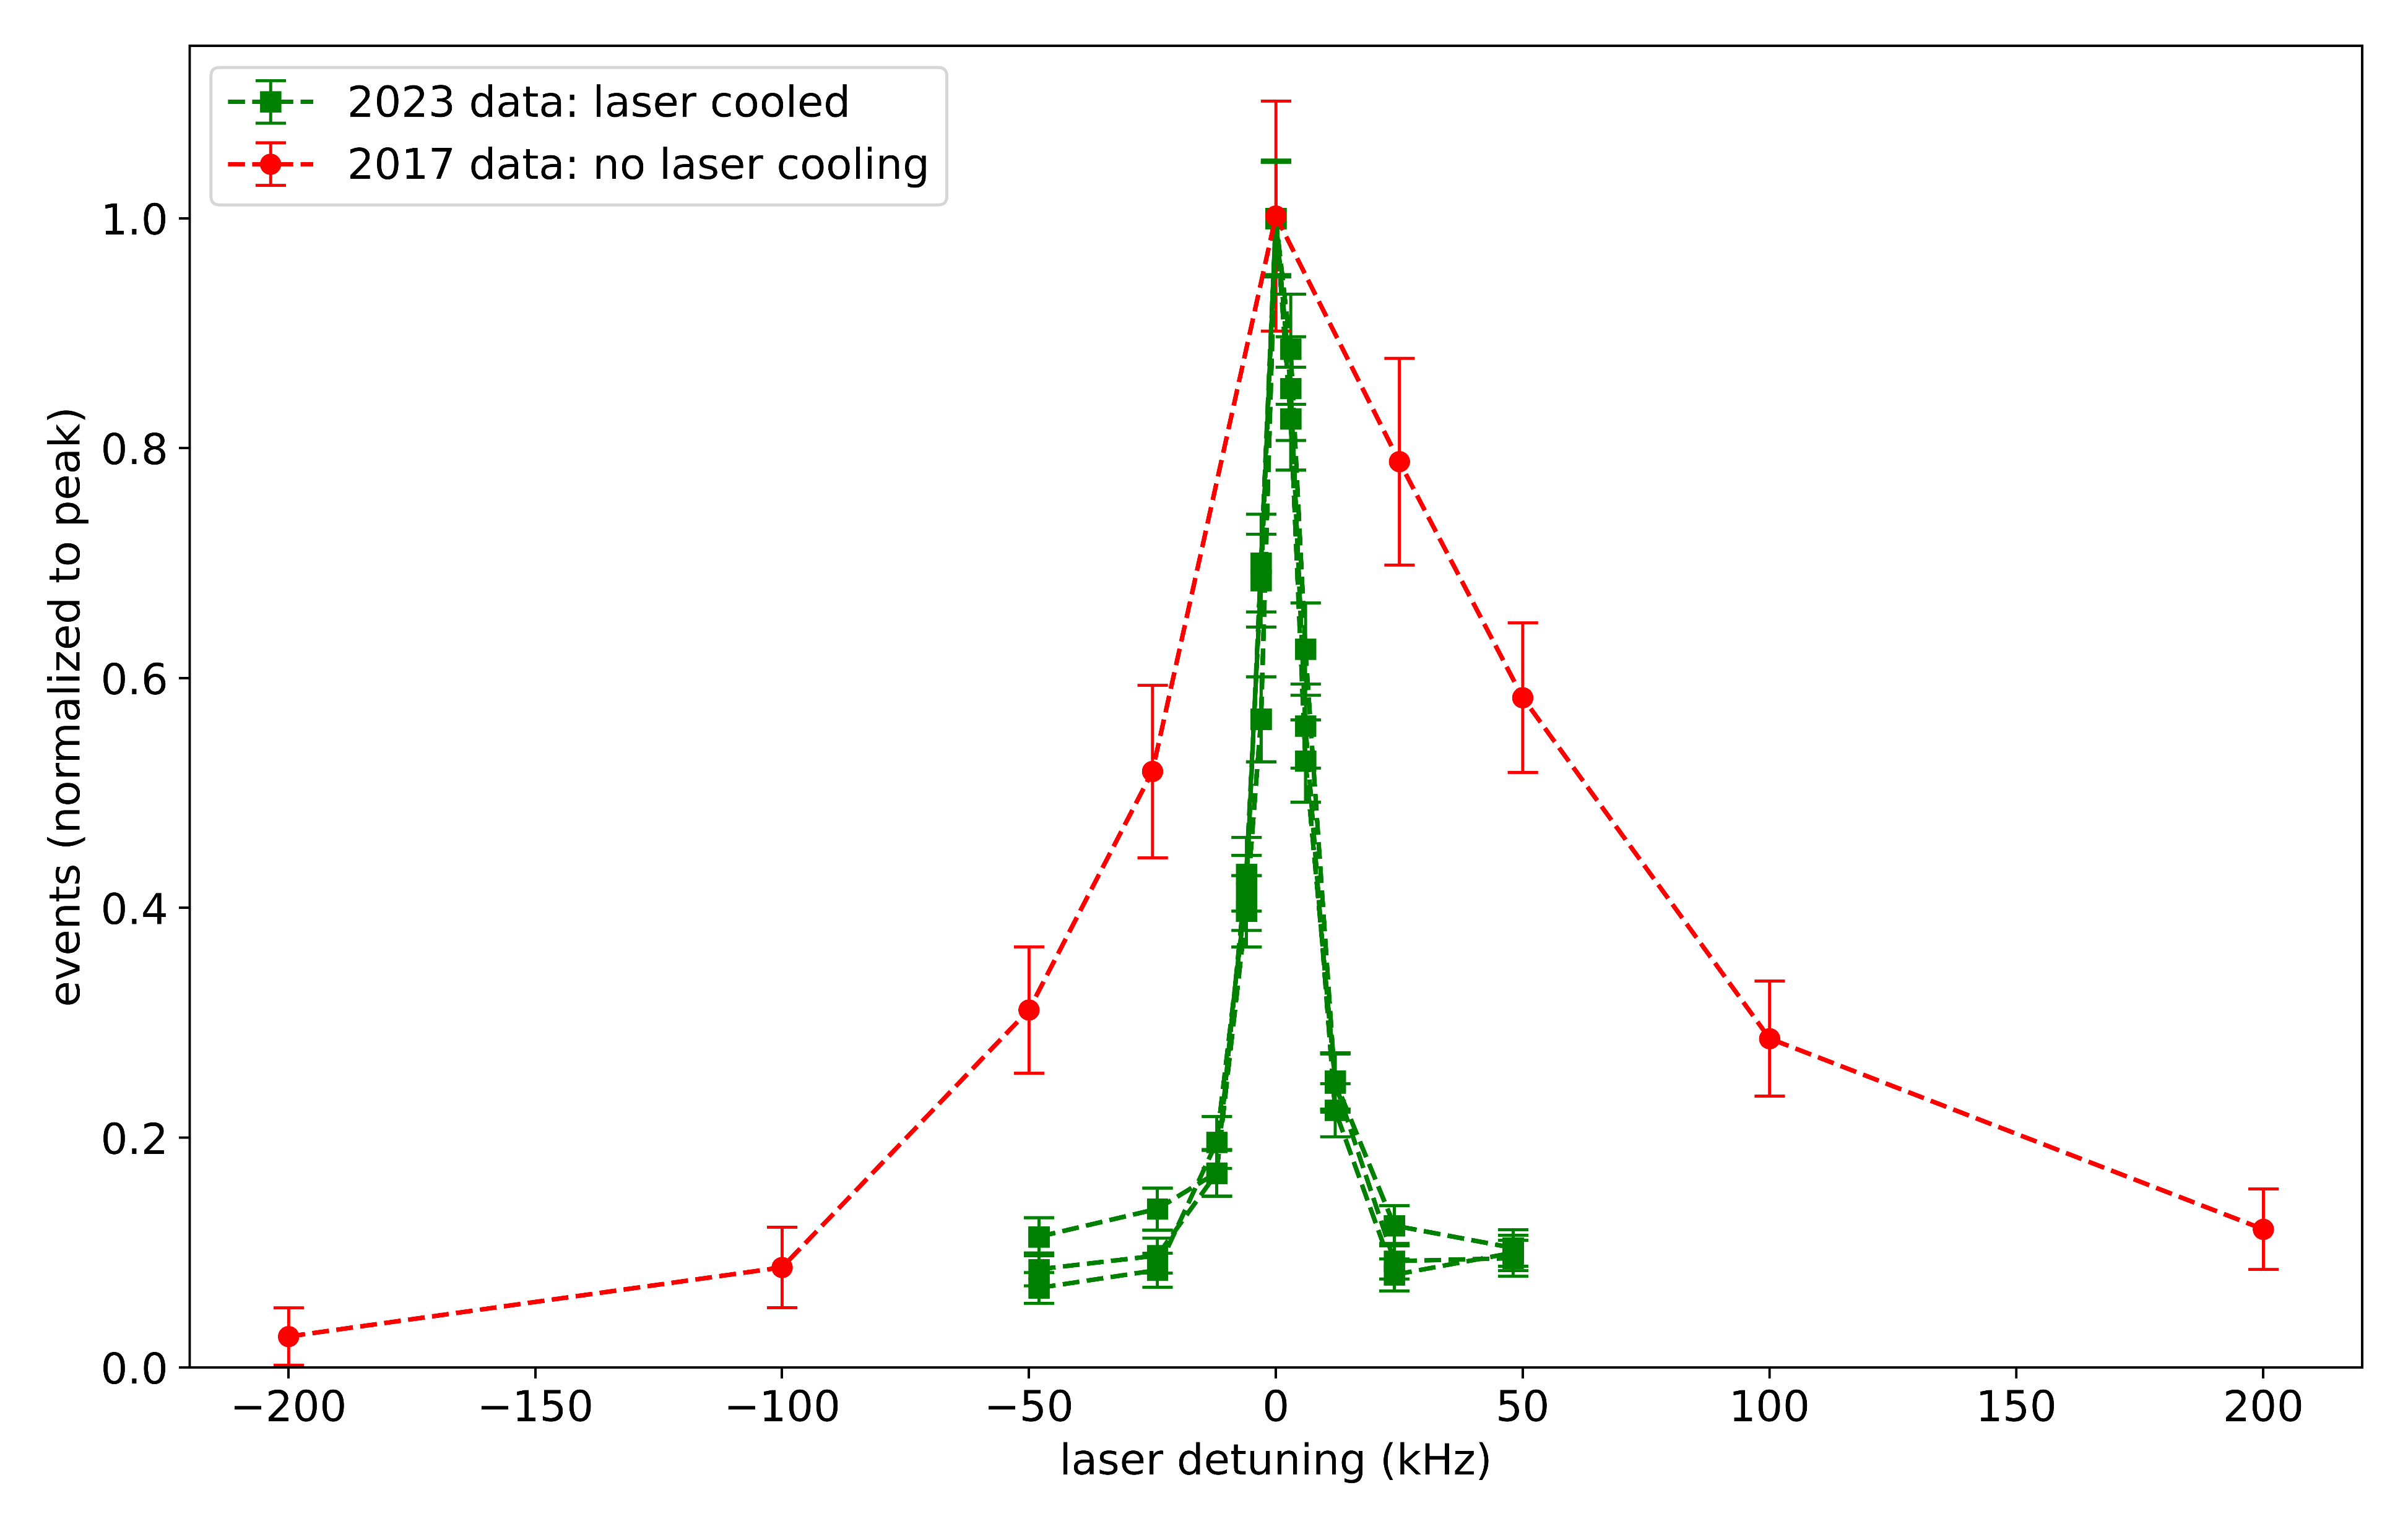
III. the 1S-2S transition with laser cooling
ALPHA preliminary

Slide 24
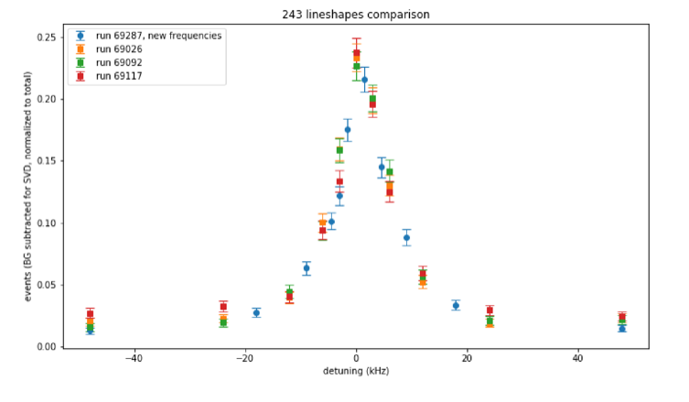
III. the 1S-2S transition with laser cooling
We can now do a complete cycle of this in one day.
Analysis in progress – MVA, magnetic field, velocity distribution, etc.
With lots of atoms, we can user lower laser power
ALPHA preliminary

Slide 25
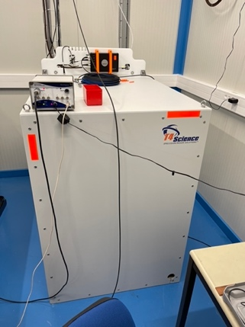
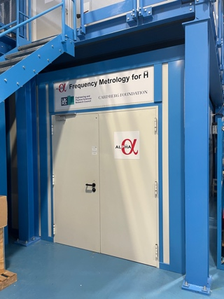
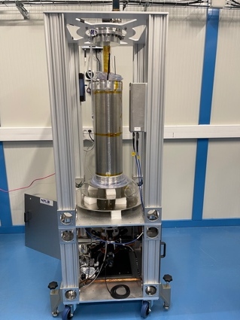
III. the 1S-2S transition with laser cooling
Frequency Metrology Lab
Cesium fountain clock from
NPL
Hydrogen maser

Slide 26
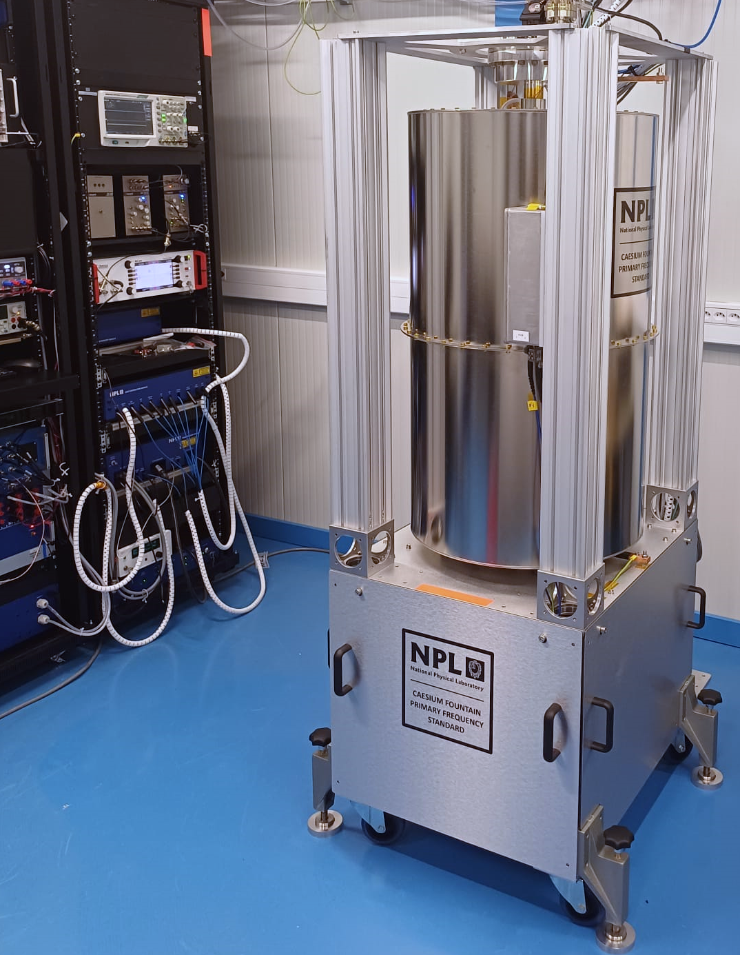
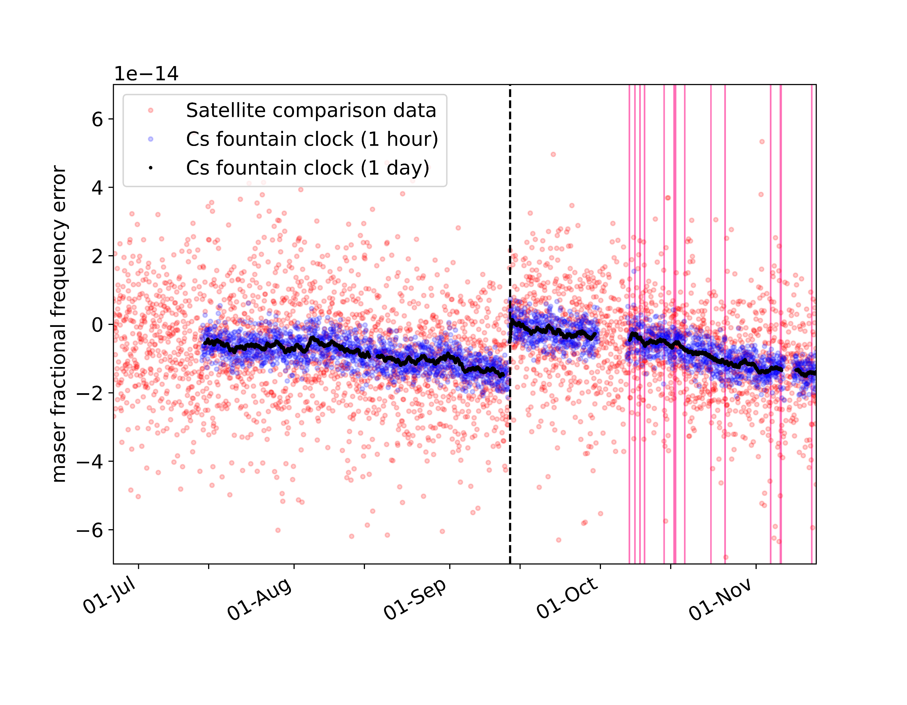
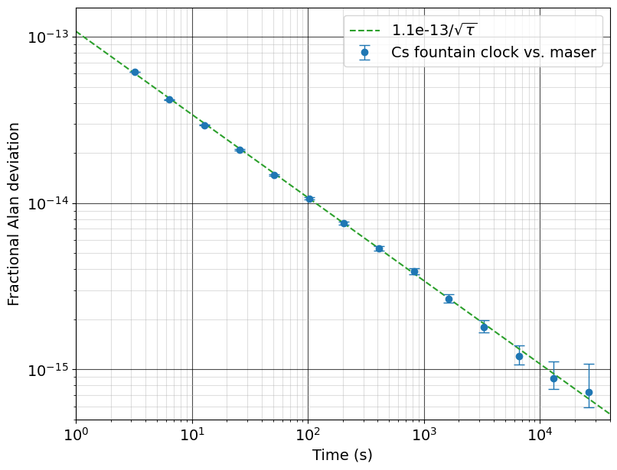
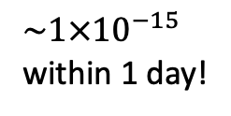
III. the 1S-2S transition with laser cooling
Cs fountain clock performance
Similar to clocks that contribute to UTC (or even slightly better)
1S-2S
spectroscopy
Maser steer
ALPHA preliminary
$\sim 1×{10}^{−15}$
within 1 day!
ALPHA preliminary

Slide 27
IV. excited state spectroscopy: the 2S-2P transition
Double resonant:
two-photon excitation to 2S
microwave excitation to 2P

Slide 28
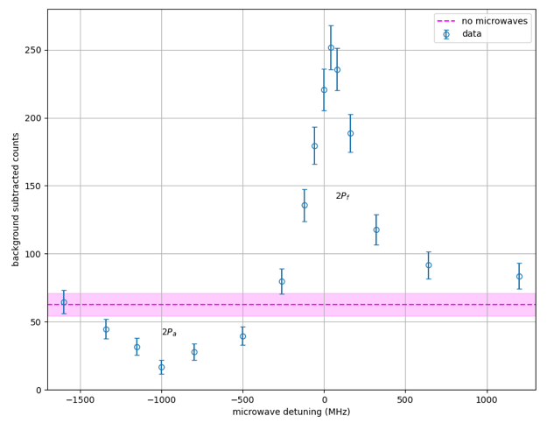
IV. excited state spectroscopy: the 2S-2P transition
ALPHA preliminary

Slide 29
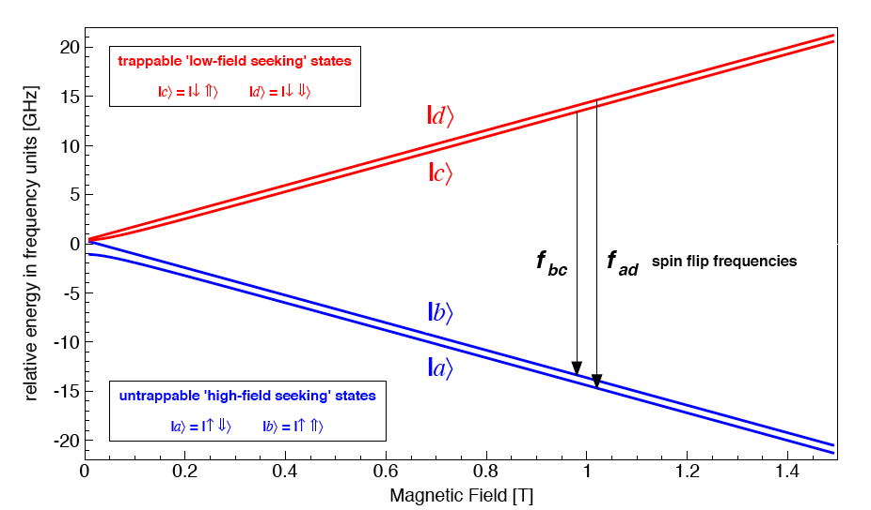
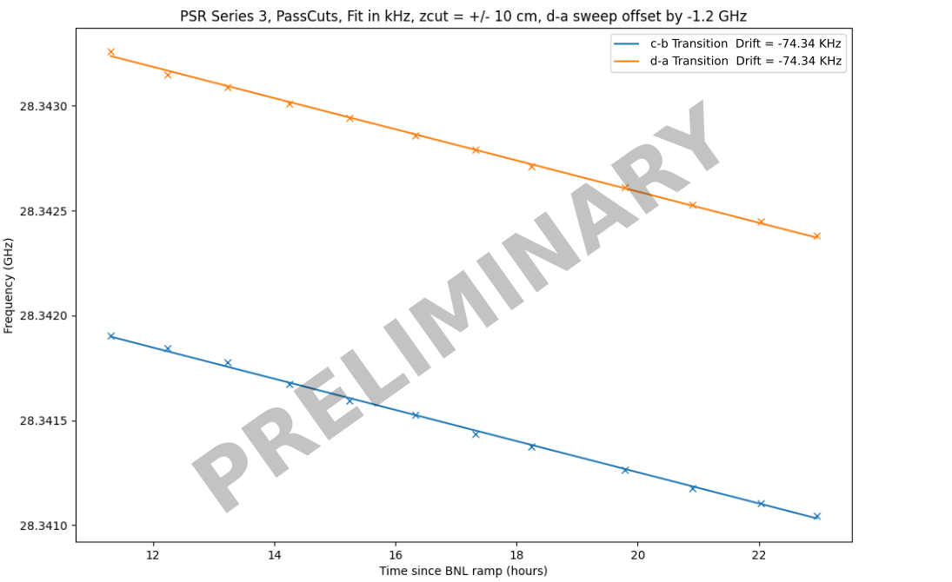
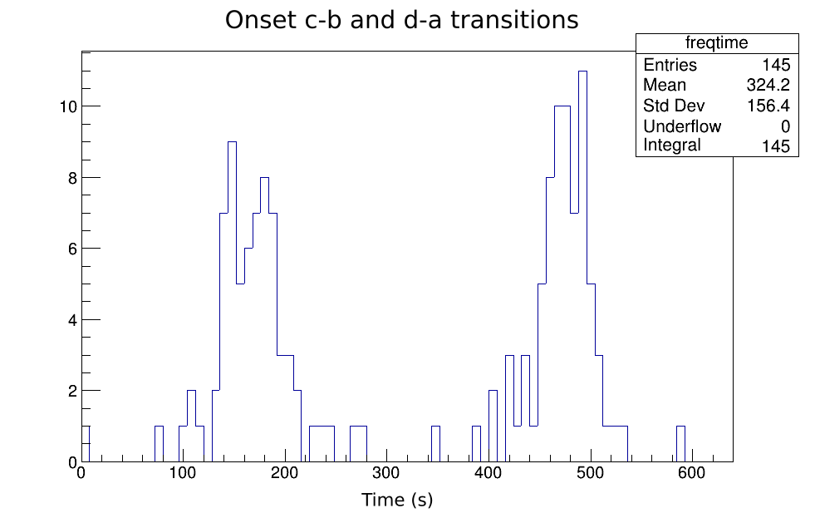
V. positron spin resonance: GSHFS
resonant, microwave driven spin flips
10 stacks per measurement
15 atoms per stack (no Be)
state selective!
We have previously measured the splitting to a few
parts in 10000. Hoping for ppm here.
scan microwave frequency

Slide 30
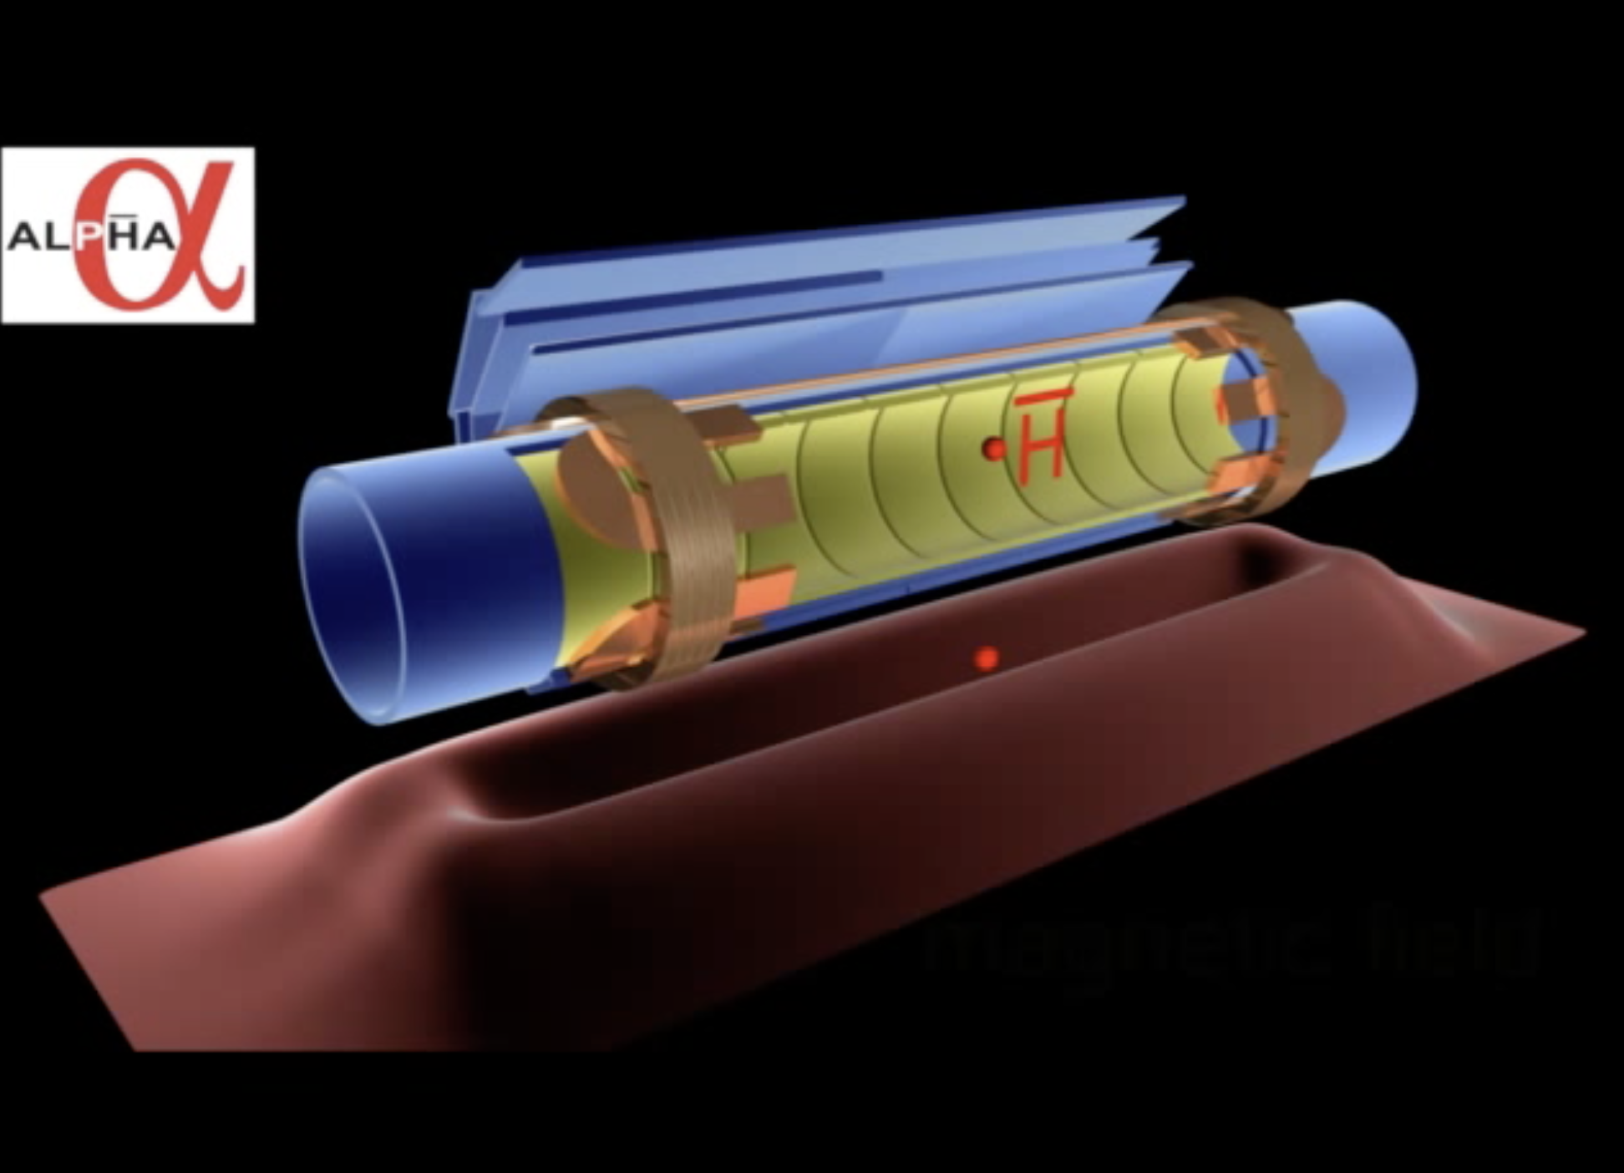
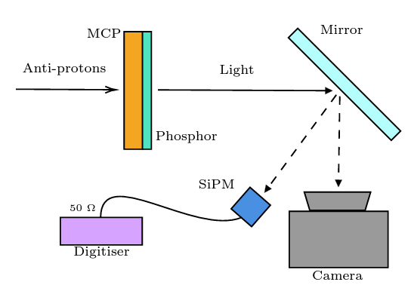
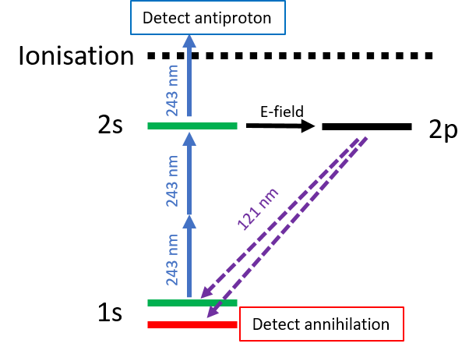
VI. MCP detection for spectroscopy experiments
Recapture ionised (anti)hydrogen in Penning trap.
Detect (anti)protons by ejecting them to an MCP.
S. Jones

Slide 31
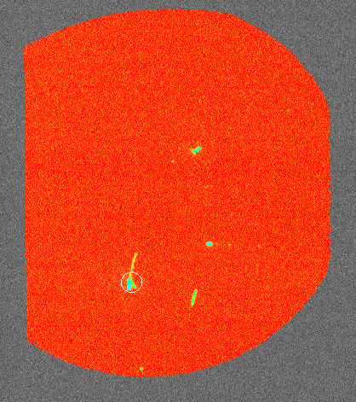
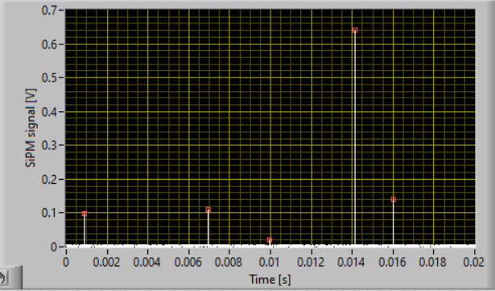
VI. MCP detection for spectroscopy experiments
Detection efficiency
Antiprotons: 94% (measured)
Protons: ~50% (K. Fehre et al., Rev. Sci. Instr. 89, 045112, 2018)
S. Jones
SiPM signal
Camera signal

Slide 32
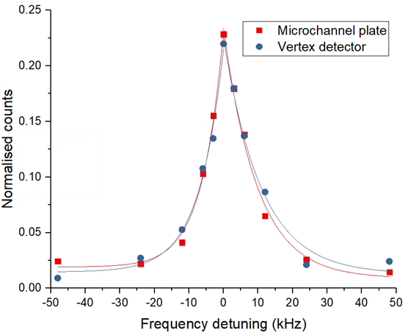
VI. MCP detection for spectroscopy experiments
Comparison of MCP vs SVD spectra (qualitatively the same - linewidth as narrow as annihilation method)
ALPHA preliminary

Slide 33
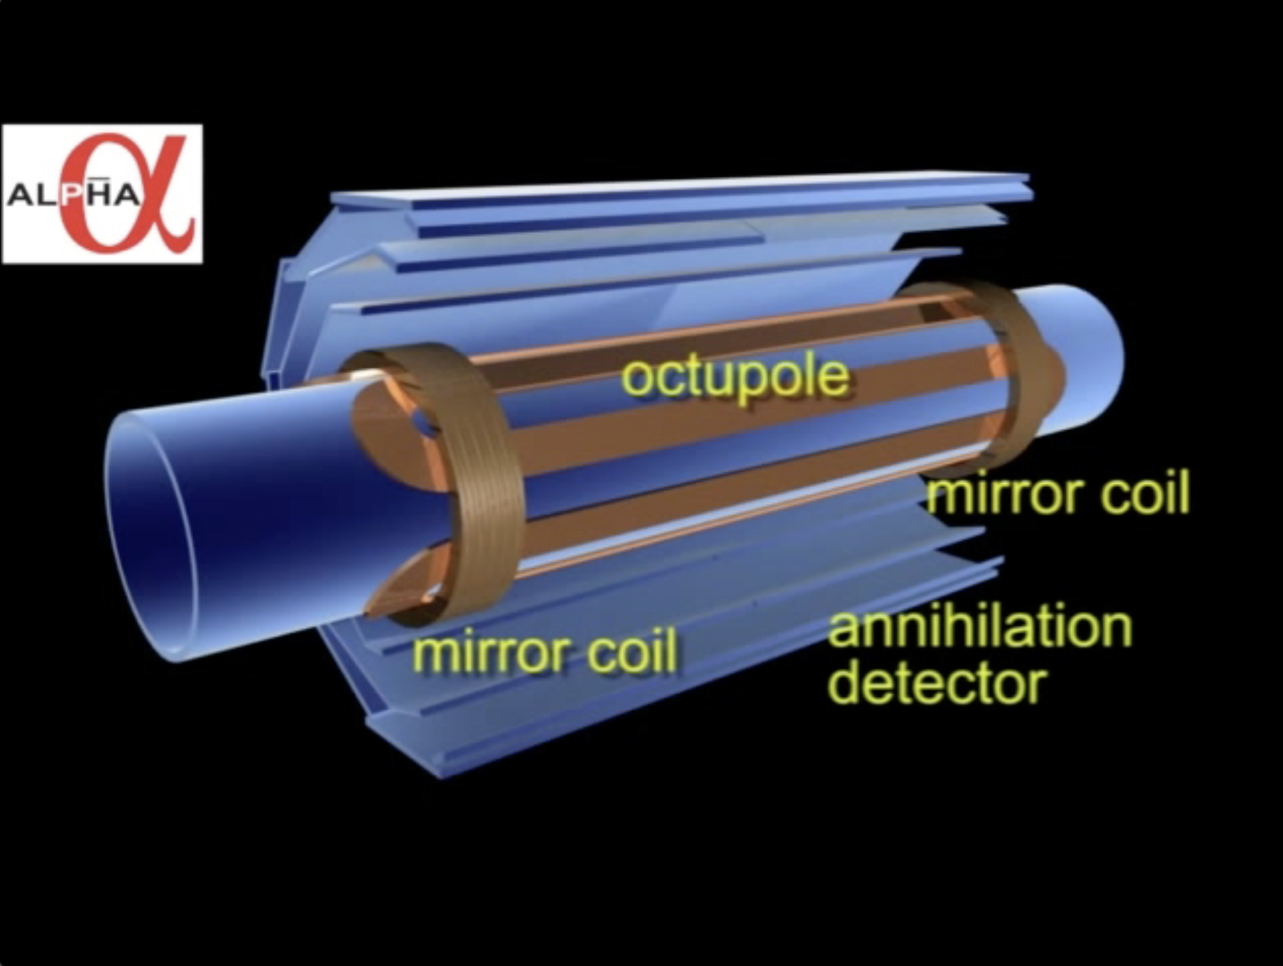
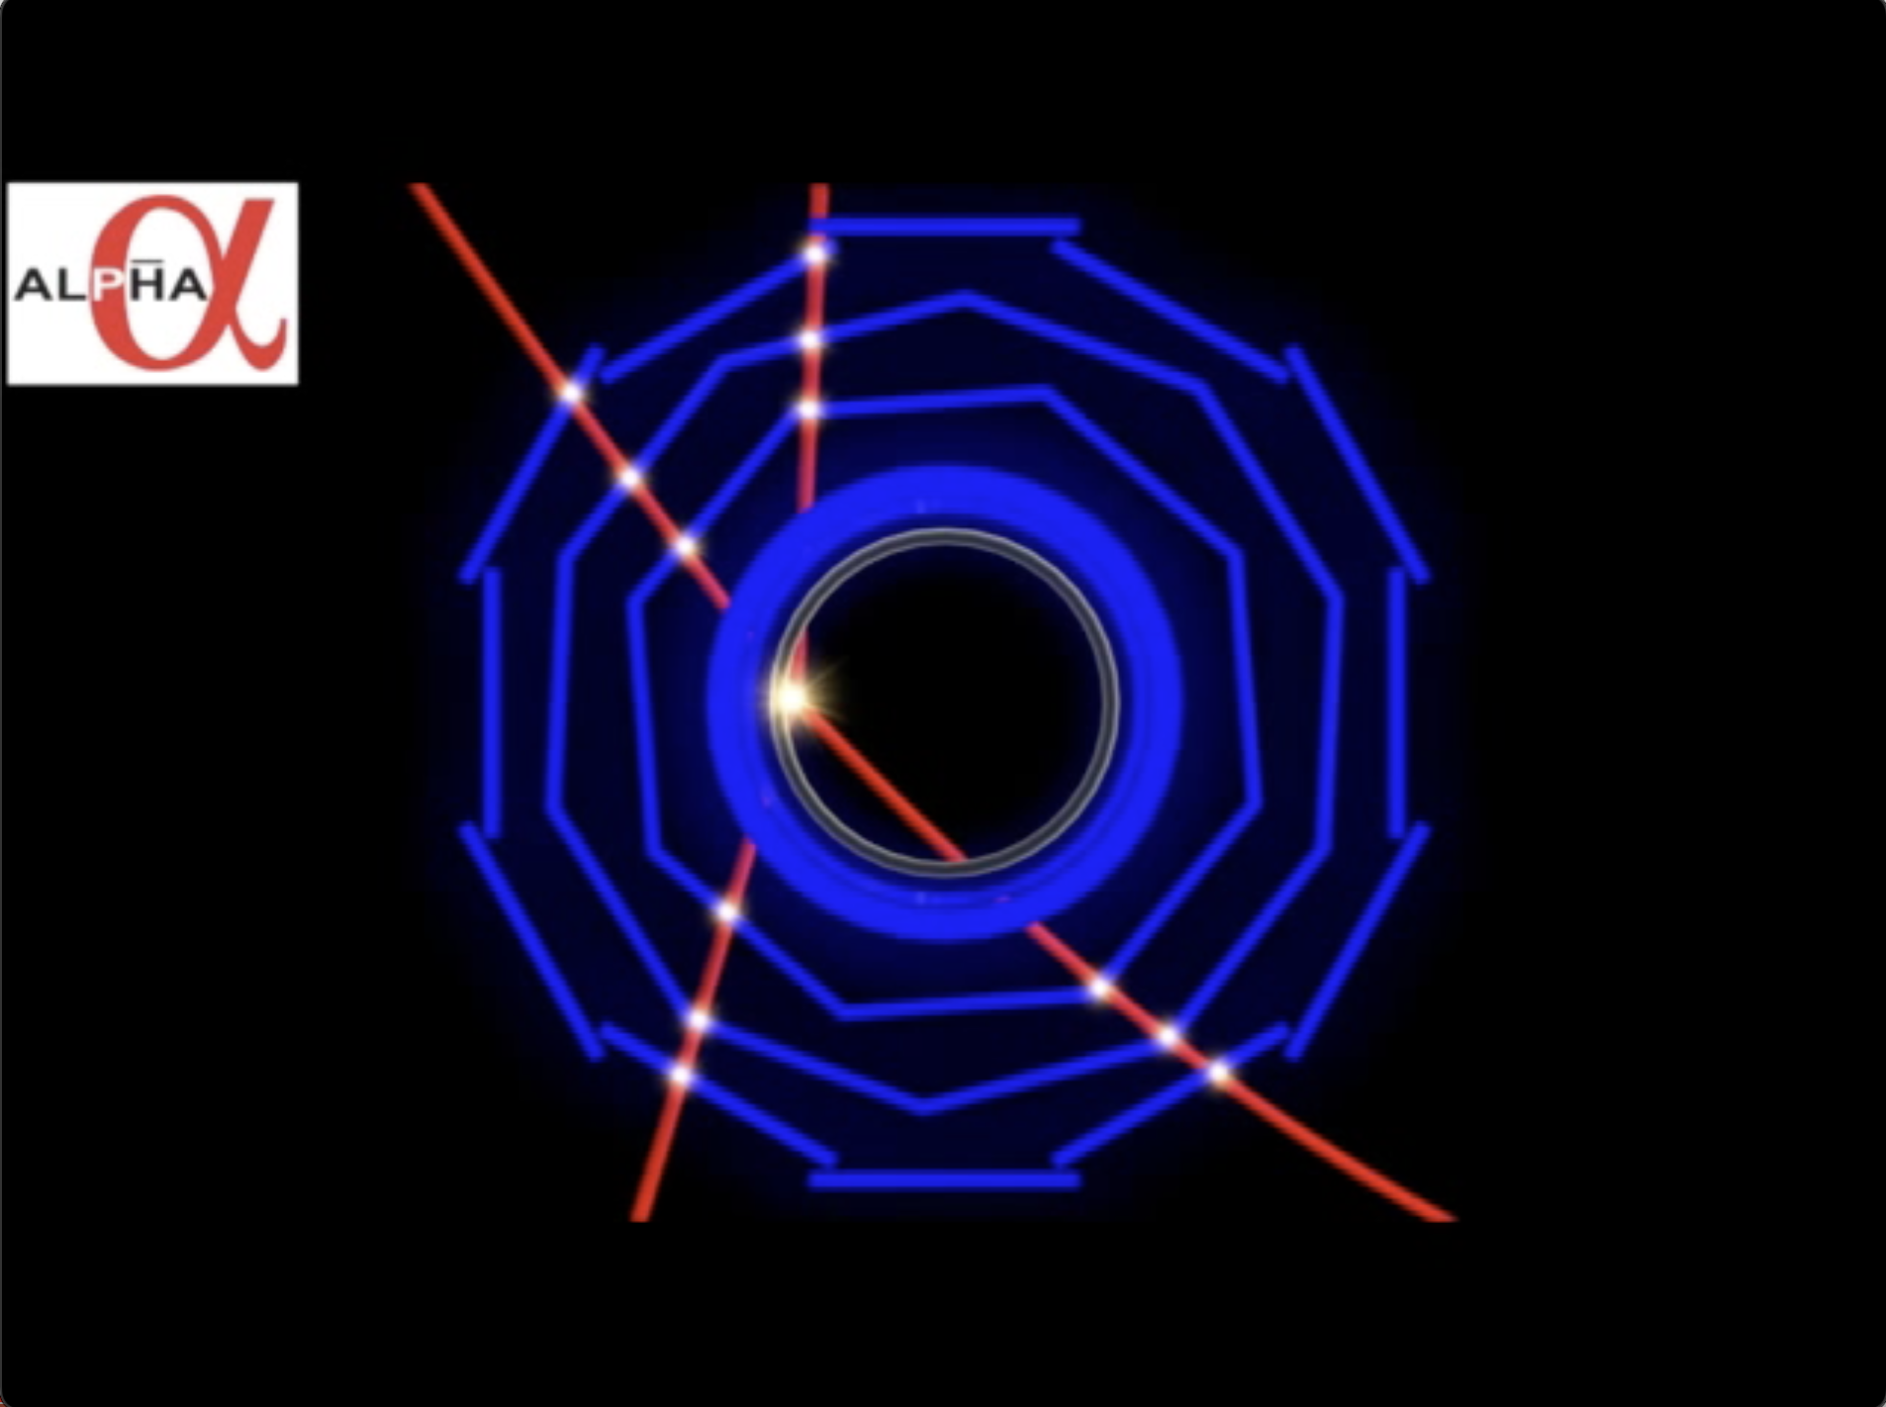
VII. Energy diagnostics using octupole rampdown
knowledge of hbar energy distribution is important for most experiments, and for
benchmarking simulations
release trapped hbar by ramping down the octupole current – e.g. over 15 s (“FRD”)
record annihilations on the silicon vertex detector: temporal and spatial distributions
can study energy distributions, time evolution, mixing between dynamical d.o.f, etc.
can compare to other techniques such as 1S-2P TOF
D. Hodgkinson

Slide 34
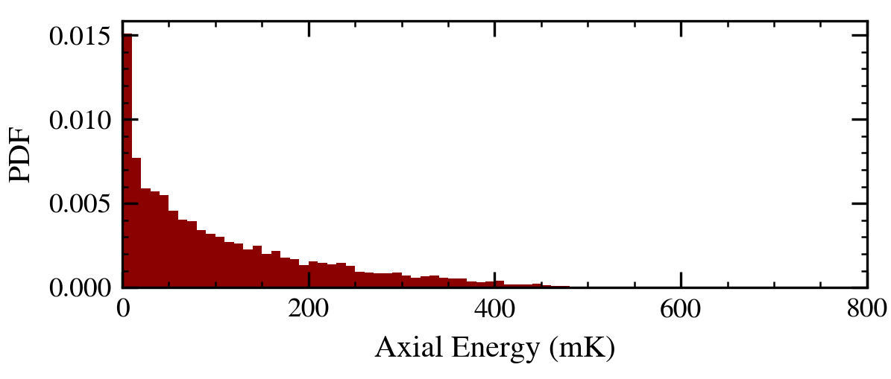
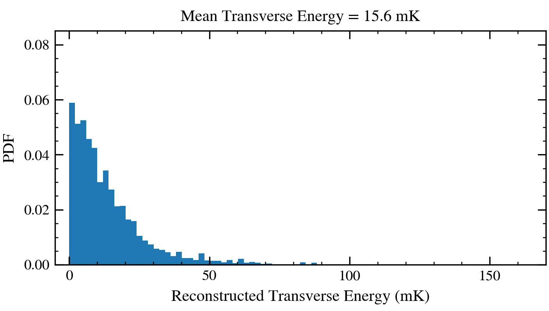
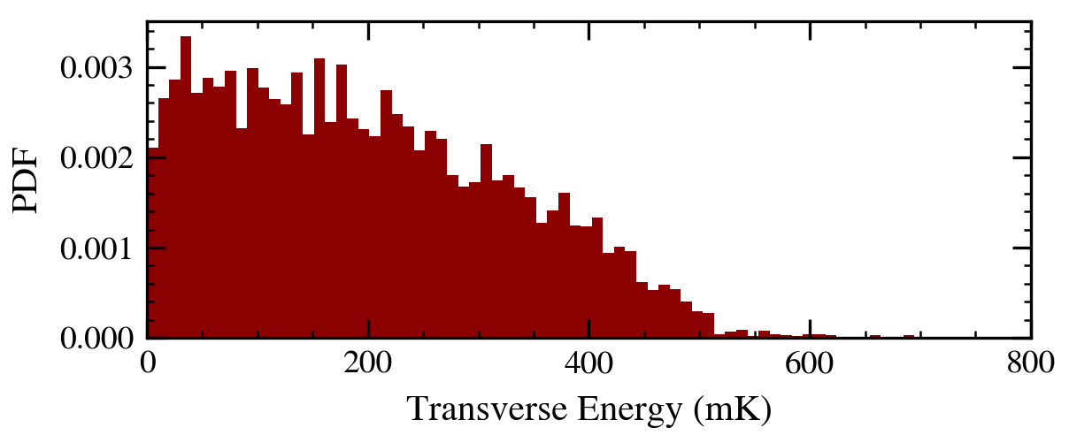
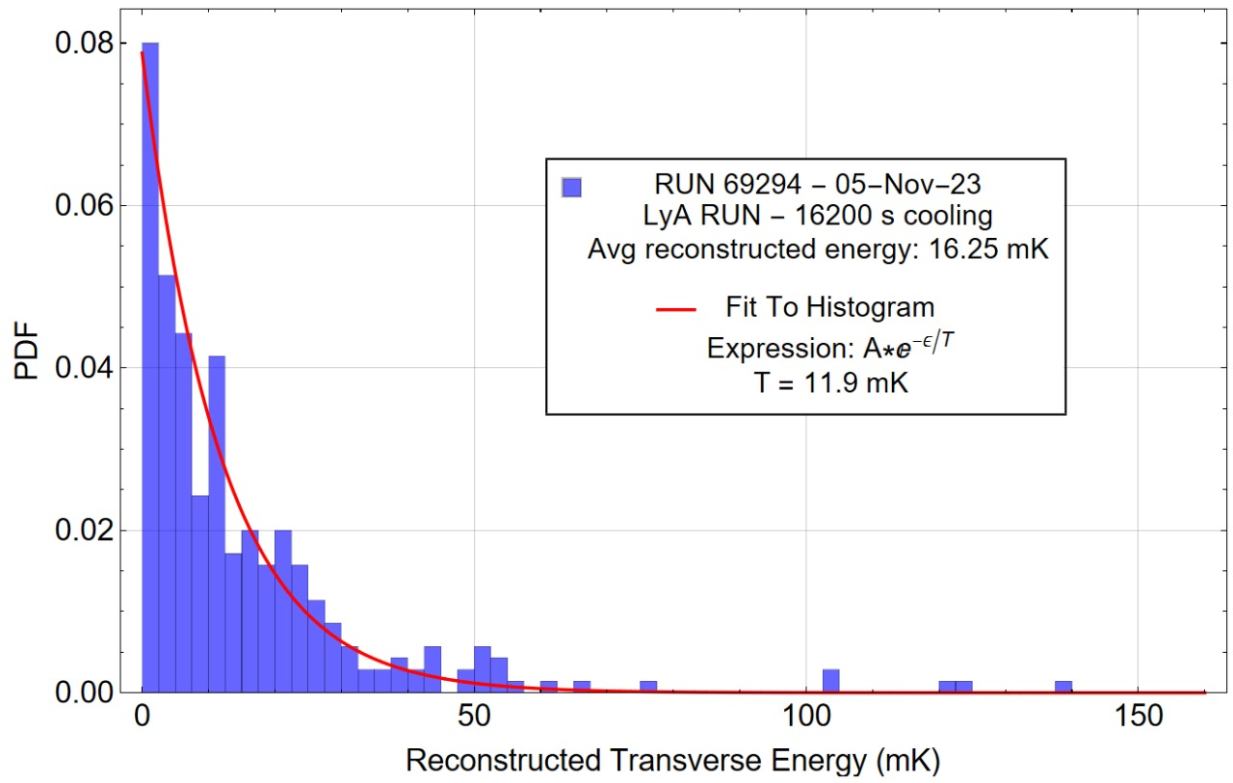
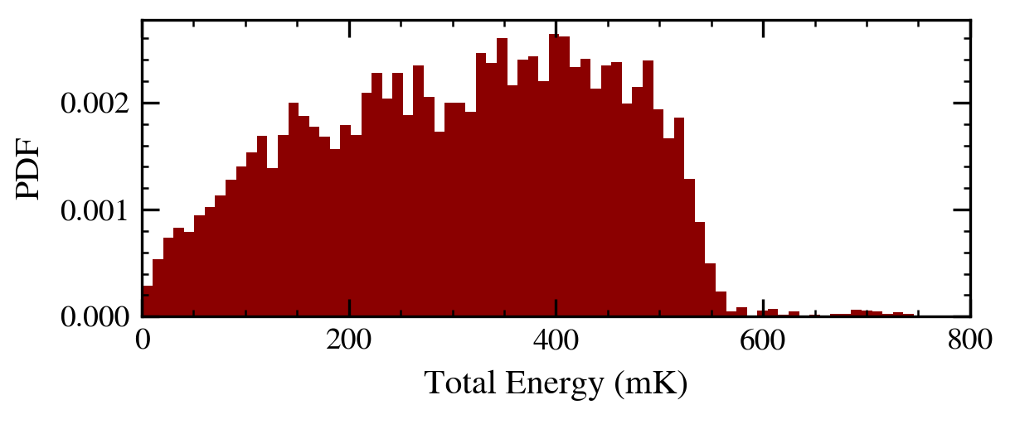
VII. Energy diagnostics using octupole rampdown
Uncooled Antihydrogen
Laser Cooled Antihydrogen
FRD method
FRD method
Mean transverse energy = 15mK
TOF method
Mean transverse energy = 16mK
Expected truncated Maxwell-Boltzmann
D. Hodgkinson

Slide 35
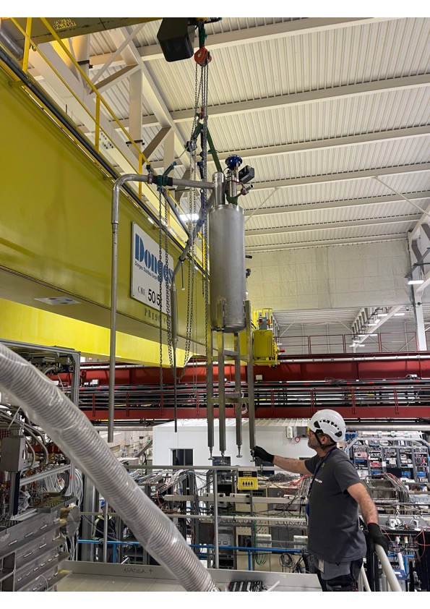

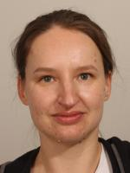

Other news for 2024
new CERN Fellow for 2024:
Janko Nauta
new coordinator for detectors
and analysis: Ina Carli
new, rigid LHe transfer line fabricated
and installed; not tested yet; should reduce ALPHA-g consumption: thanks to Laura Stewart and her crew!
farewell and good luck
to Joseph McKenna!

Slide 36
ALPHA from 2024 onward
gravity with antimatter – precision measurements
laser cooling in ALPHA-g
Be system for ALPHA-g
commissioning of the other traps in ALPHA-g
antimatter spectroscopy to hydrogen-like precision
now have 10⁴ anti-atoms that are colder than the hydrogen used
for the most precise measurements on matter…
excited state spectroscopy: other spectral lines – antiproton charge radius
(e.g. 2S-3S; 2S-4P)
in situ measurements on hydrogen with ALPHA-developed techniques
MCP diagnostics
long-term possibility: anti-deuterium?? Davide Gamba has
agreed to look for some…

Slide 37
As always…
Thanks to the AD/ELENA crew, the cryo and transport teams,
the workshops, procurement, stores and other CERN groups
who make this all possible!
Thanks to our referees for their patience and hard work.

