Slide 1

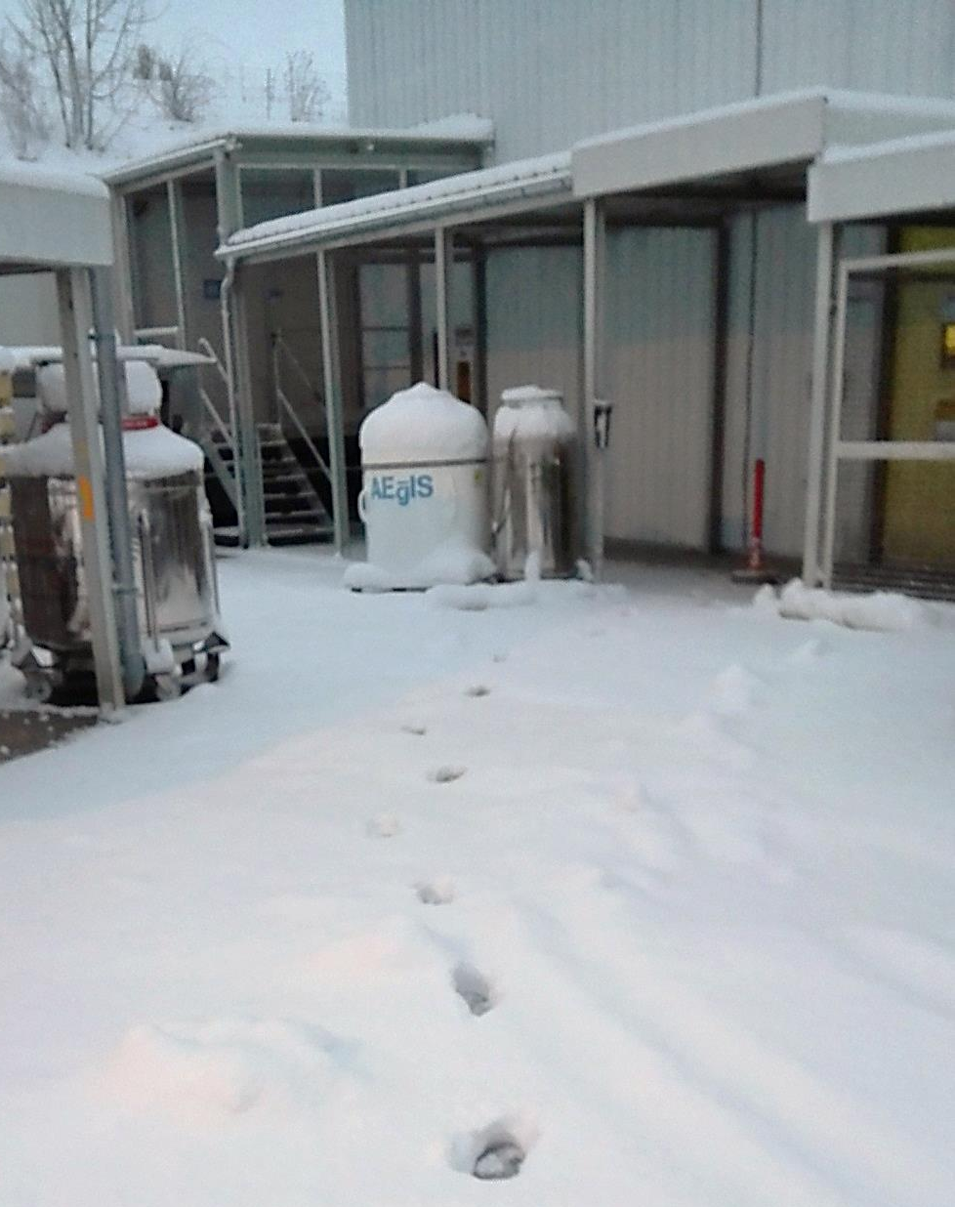

Status and plans of the AEgIS experiment
152th meeting of the SPSC
February 6th, 2024
R. Caravita*
*INFN – TIFPA, Trento (IT)
on behalf of the AEgIS Collaboration

Slide 2

The AEgIS collaboration
Main physics goals
Tests of the Weak Equivalence Principle
Spectroscopy and tests of CPT
Beyond the Standard Model searches
Systems
antihydrogen, positronium, antiprotonic atoms
Main tools
Laser-controlled charge-exchange reactions
Spectroscopy and laser cooling with pulsed lasers
Moiré deflectometry and atom interferometry
57 members from 15 institutes from 10 countries
New groups (MoU signed in 2023)
Jagiellonian University, Poland
1 senior + 1 post.doc + 1 student
New groups (MoU in discussion)
Siegen University, Germany
Technical University of Munchen, Germany
Switzerland
Poland
Italy
Germany
Norway
France
Latvia
India
Czech Republic
UK

Slide 3
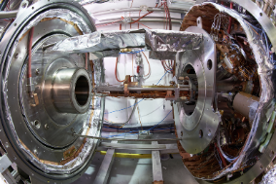
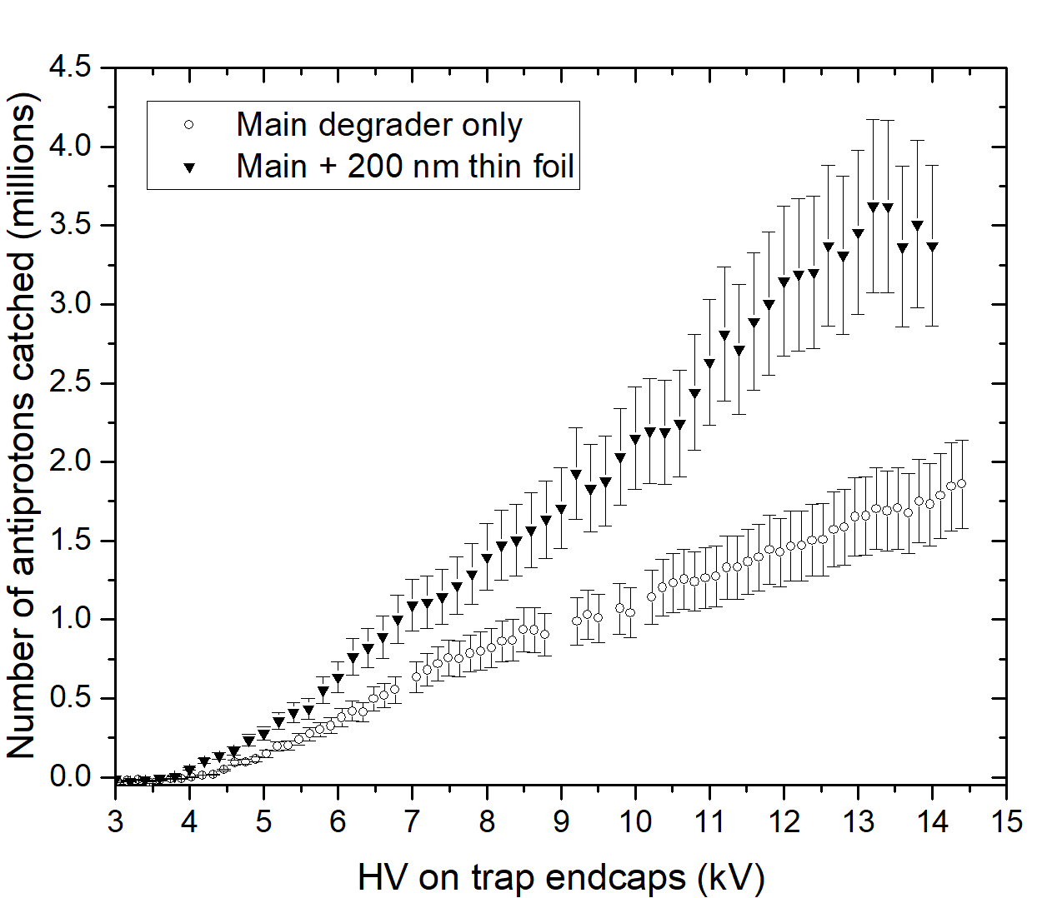

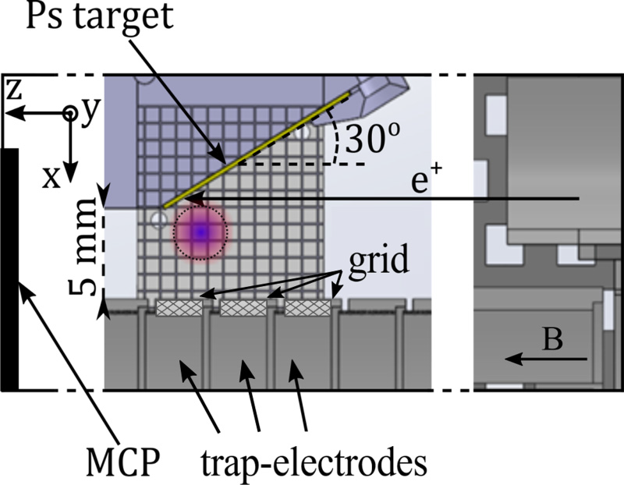
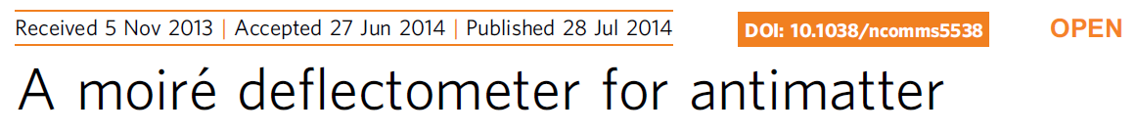
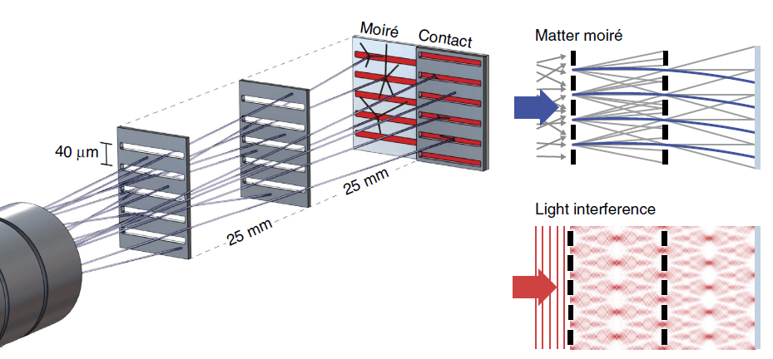
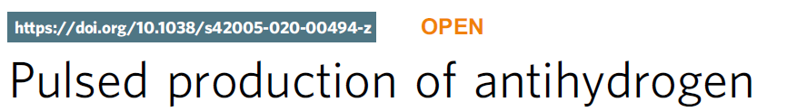
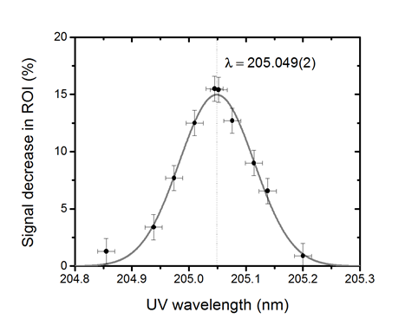
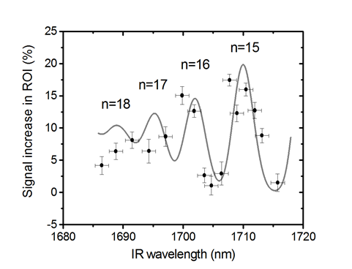
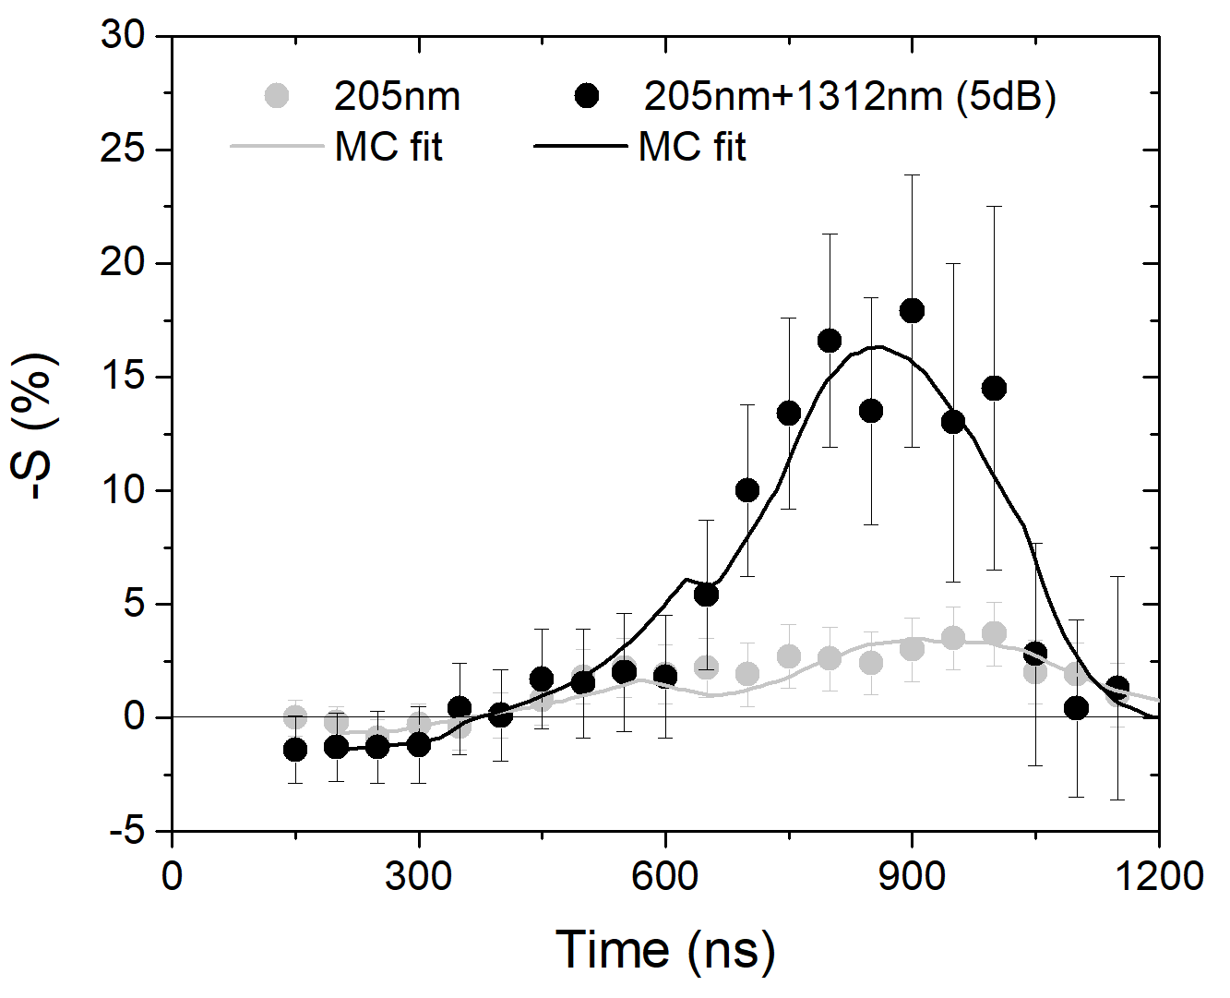
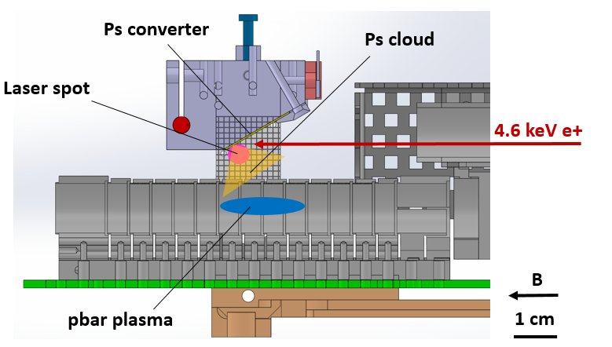
AEgIS research lines
Shared
dev
H
Ps
p atoms
R&D
Construction began
2023
2020
2018
2019
2017
Rydberg Ps in 1T
2016
Pbar compression to mm radius
2014
2008
2012
Efficient catching
from ELENA
M. Antonello et al., PRA 102, 013101 (2020)
S. Aghion et al., Eur. Phys. J. D (2018) 72: 76
Ps 1S-3P-Ry spectroscopy
Ps 2S-3P spectroscopy
S. Aghion et al., PRA 94, 012507 (2016)
M. Antonello et al., PRA 100, 063414 (2019)

Slide 4



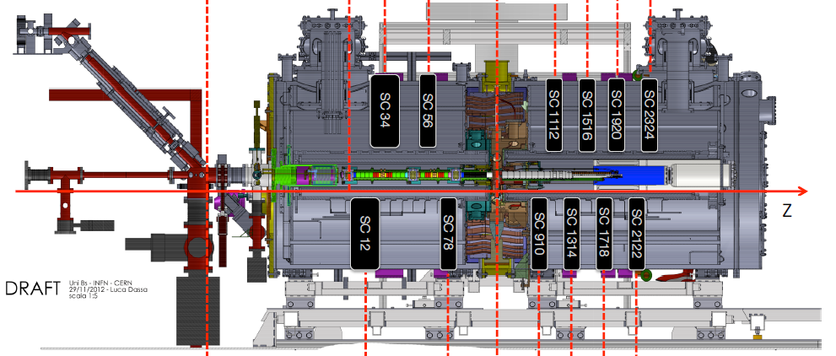

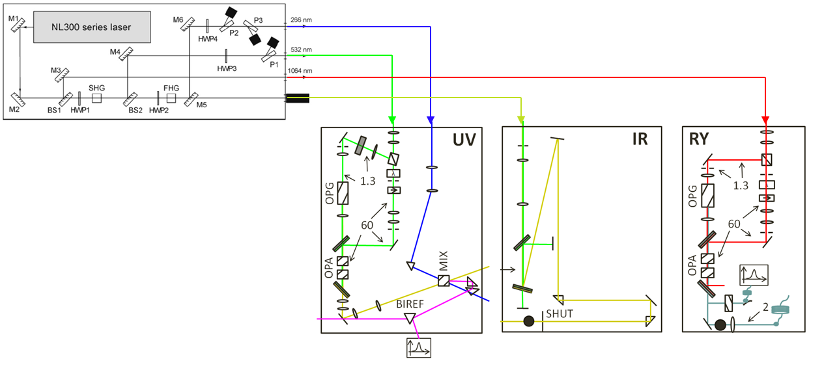
Shared developments in 2023: apparatus upgrade areas
Trap control system
Surko-type positron system
Main AEgIS cryostat
Deflection
chamber
Gravity detector
Ion injection
line
Alexandrite laser system
Antiprotons
extraction line
Nd:YAG
laser system
Notes:
Poco tempo, scala delle dimensioni

Slide 5
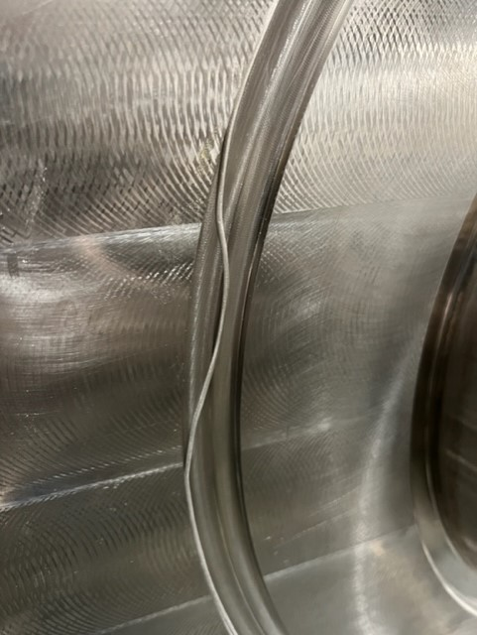
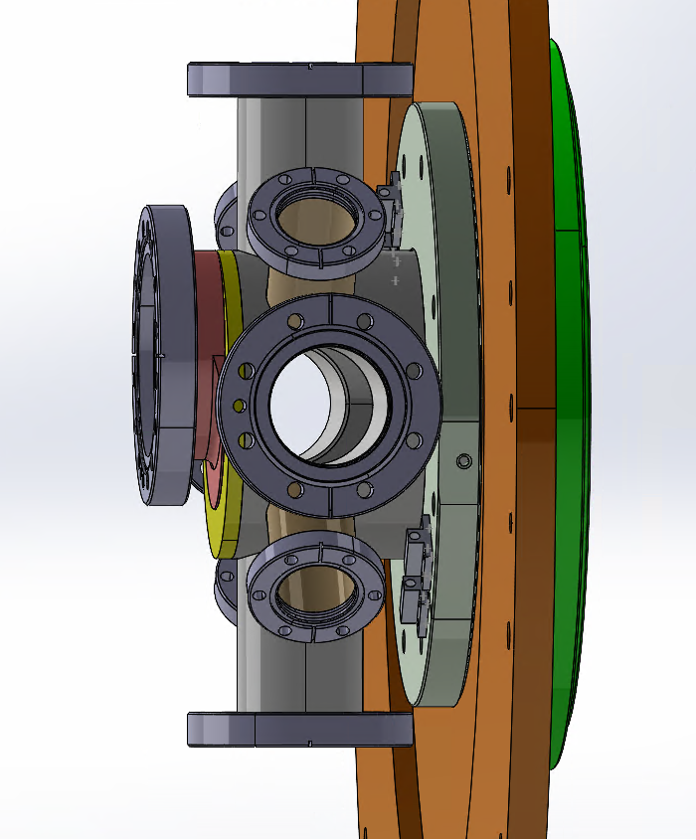
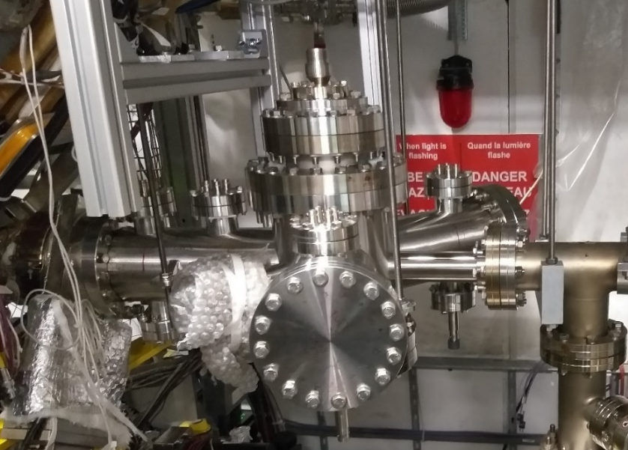
Shared developments in 2023: investments on hardware
Central flange long-term consolidation
Improved indium seal and closure procedure
Invidivual flanges leak-testing campaign
Entrance flange long-term consolidation
Vacuum jacket for 2023 run to remove structural leak
Rebuilt the whole chamber for replacement (YETS)
Deflection chamber commissioning
Testing, installation and alignment
Commissioning with HV and particles

Slide 6
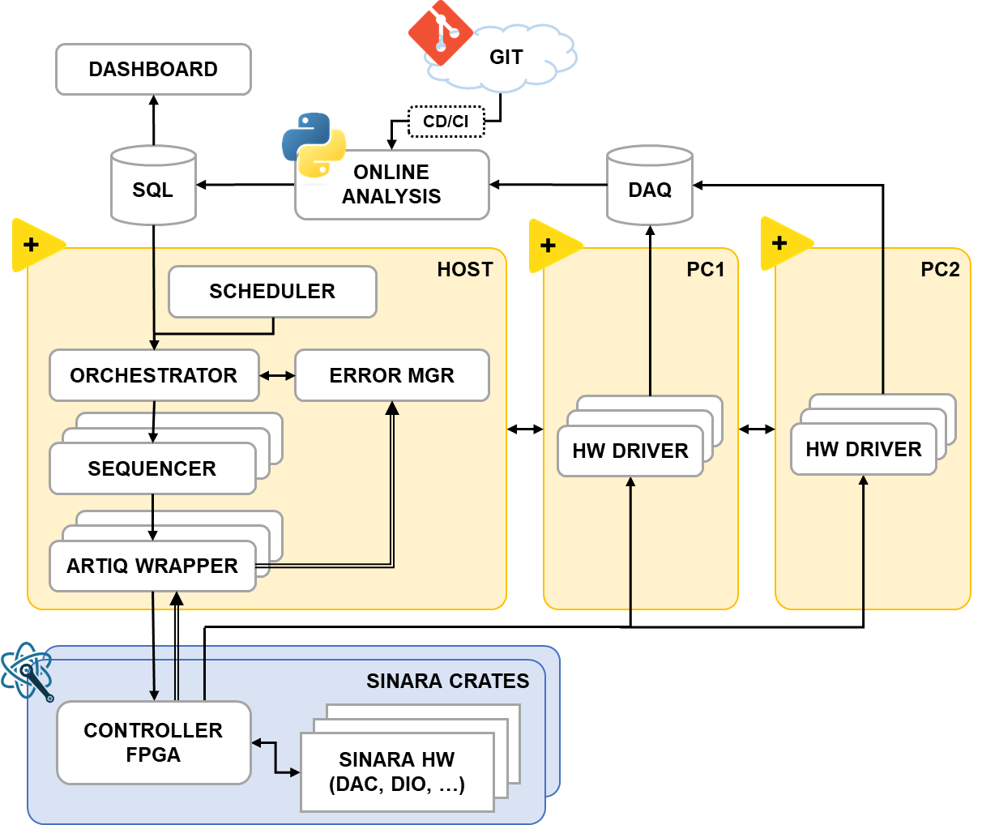
Shared developments in 2023: investments on the control system
Automatic online analysis and data quality check
CD/CI deploy via GIT for in-vivo upgrades
Feedback loop to orchestrator to automate
data quality checks and data re-acquisition
Bayesian optimizer for automatic optimization
Automatic optimizes any ask/tell experiment
Used for automatic beam steering (5 dimensions)
Concurrent multi-controller running modality
Support for multiple Sinara FPGA controllers
Flexible user-selectable synchronous or asynchronous operation
Nanosecond re-synchronization routines
M. Volponi, S. Huck et al. (AEgIS collaboration), accepted on EPJ Quantum Technologies (2024)

Slide 7
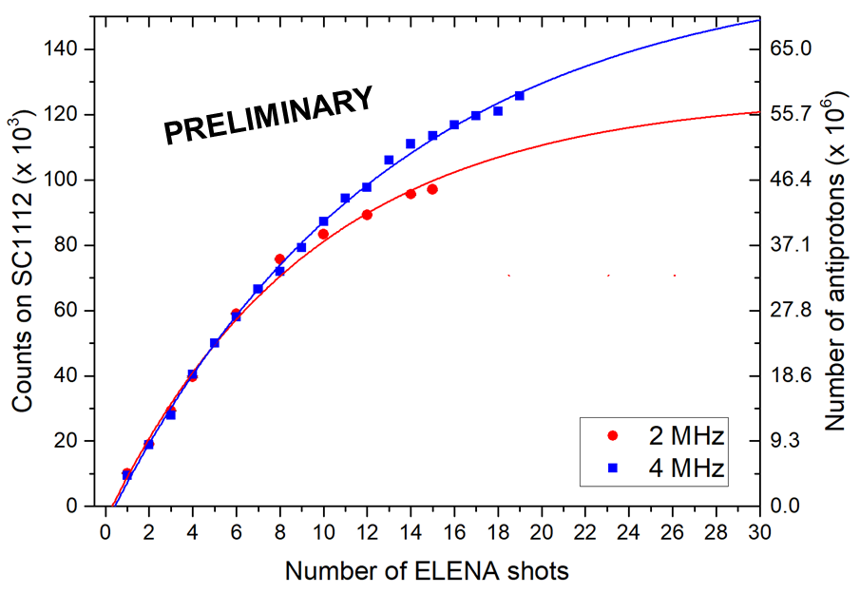
Shared developments in 2023: asynchronous antiproton accumulation
Client-Server asynchronous architecture
5T catching trap controller in a continuous accumulation and listen for messages loop
1T interaction trap controller runs custom experimental sequences and allows debugging
5T Controller (Server)
ParticleServer.py
1T Controller (Client)
PbarTransfer.py
Network + HW Sync
PositronTransfer.py
HbarFormation.py
Raw counts on scintillator (x 10³)
Achievements
Stable operation for weeks in constant accumulation
While constantly accumulating, we reached up to ~100 million antiprotons in our traps

Slide 8
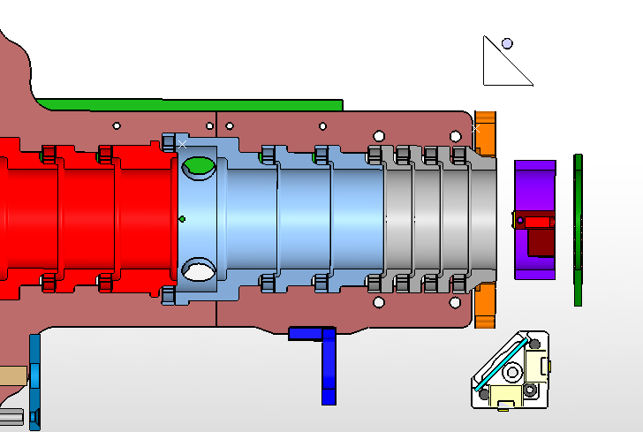
Collinear antihydrogen production scheme
External Scintillation Detector Array (ESDA)
π±
Excitation lasers
Rydberg Ps
2.5 keV e⁺
H
B
π±
e⁺/Ps converter
1 cm
Antiproton plasma
External Scintillation Detector Array (ESDA)
π±

Slide 9
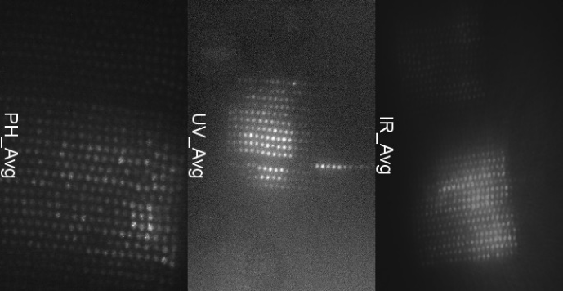
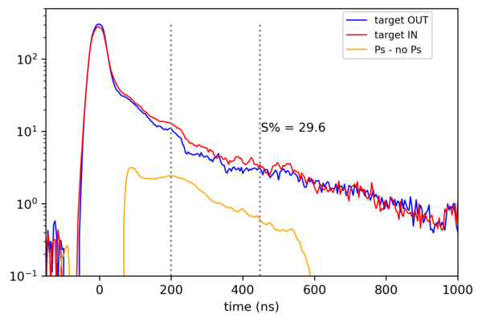
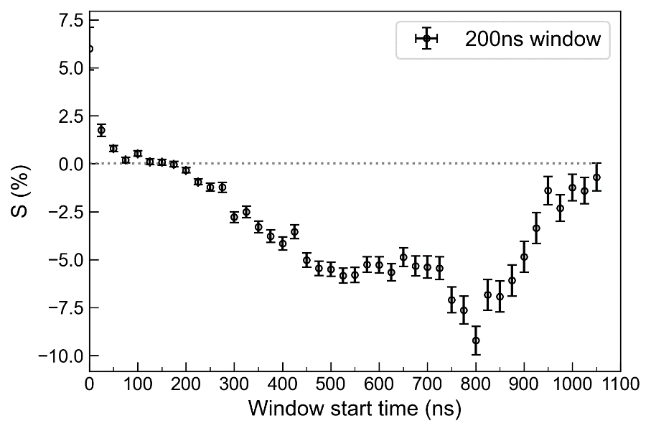
Positronium run achievements
Digitized scintillator spectra with and without Ps production
Realtime diagnostics of laser intensity and alignment from fiber array
1064 nm
1670 nm
Amplitude (V)
205 nm
Difference scintillator spectrum
with and without Rydberg excitation
Achievements
Ps formation from on-axis target observed with scintillators
Lasers’ diagnostics fully consolidated: individual beam monitoring
Established Rydberg Ps excitation to n = 21 (formerly n = 17)
Despite
Low Ps target yield (2.5% Ps/e⁺) – under investigation
Old ²²Na source – new one delivery had 1 year delay (Nov ‘23)

Slide 10
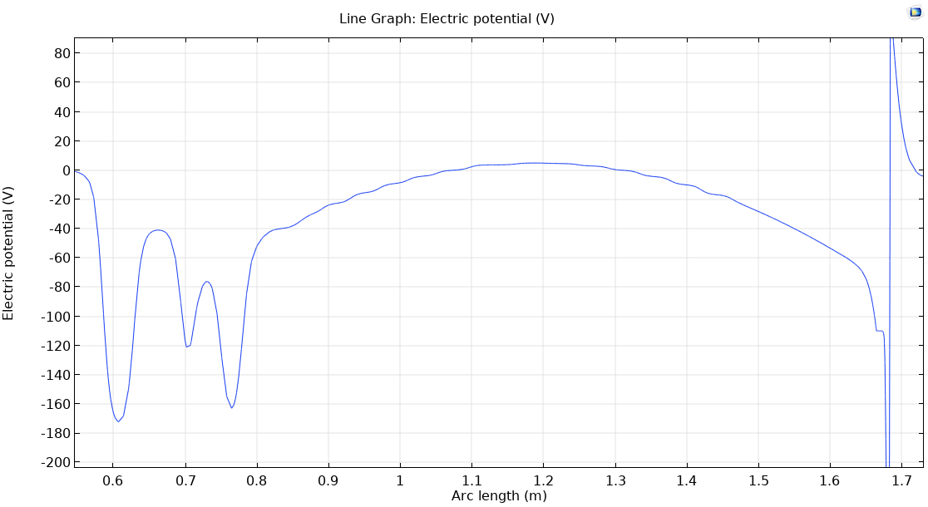
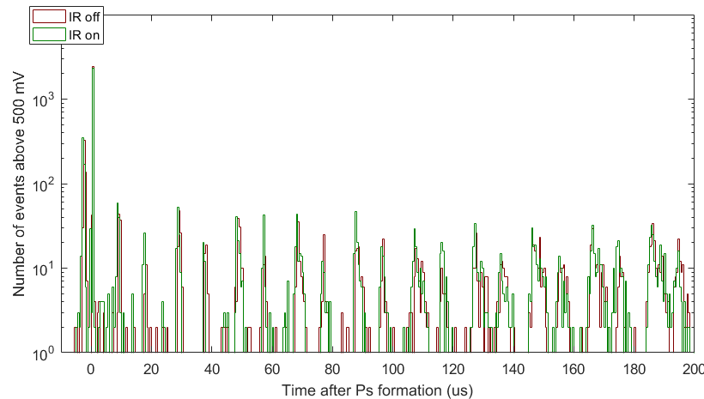
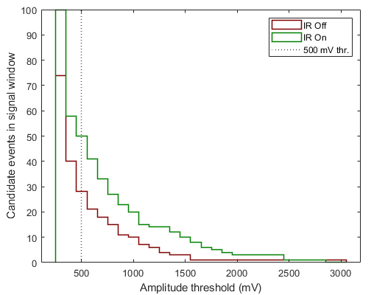
Antihydrogen run achievements
Catching region
Interaction region
e⁺ peak at Ps* formation
PRELIMINARY
Hbar search region
antiproton losses in oscillations
e⁺ bunch (2.5 keV)
pbars
pbar launch trap
Positronium target
Achievements
Antiproton transfer with fine time control and minimal time dispersion
No observed effect from to the e⁺ bunch passage through the antiprotons
Evidence of antihydrogen production with Ps excited to n = 21
Despite
Background due to antiproton cloud oscillations in the transfer potential
Nearly catastrophic abrupt failure of the Surko trap magnet
PRELIMINARY
with IR laser
without IR laser

Slide 11
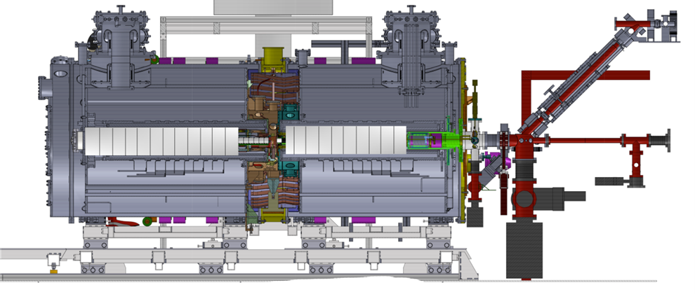
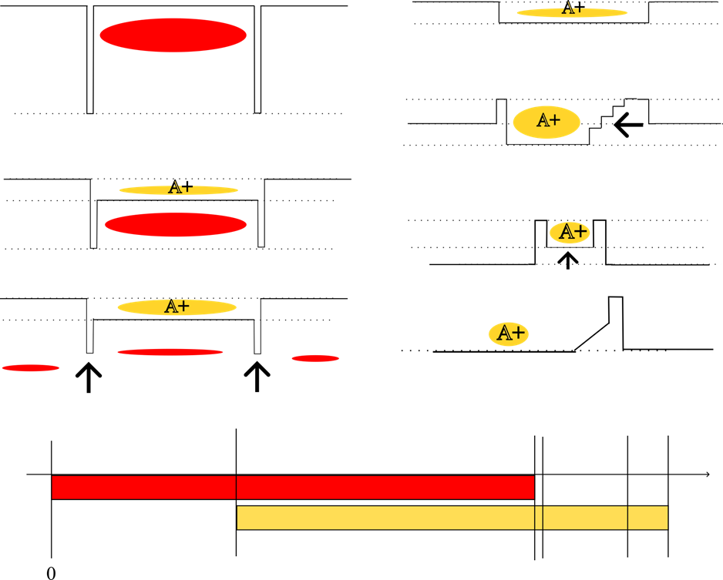


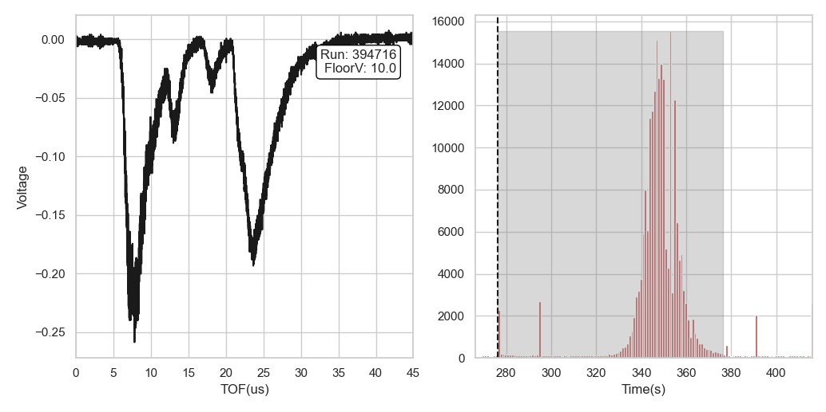
Antiprotonic atoms run achievements
Trapping Pbars
Storing positive ions
Gas injection
site
Squeezing trap
MCP
A+
Creating nested trap
Lifting trap
Ejecting Pbars
MCP
Releasing ions towards MCP
MCP TOF spectrum
Scintillator monitoring
Achievements
Procedure for controlled gas injection and cleaning
Technique to trap the positive ions resulting from antiproton interactions with the rest gas target
Time-of-flight spectroscopy of trapped positive ions
This technique can lead to
Fully stripped and highly charged ions in Penning traps
TOF spectroscopy of annihilation fragments
Produce short-lived nuclei directly in Penning traps

Slide 12
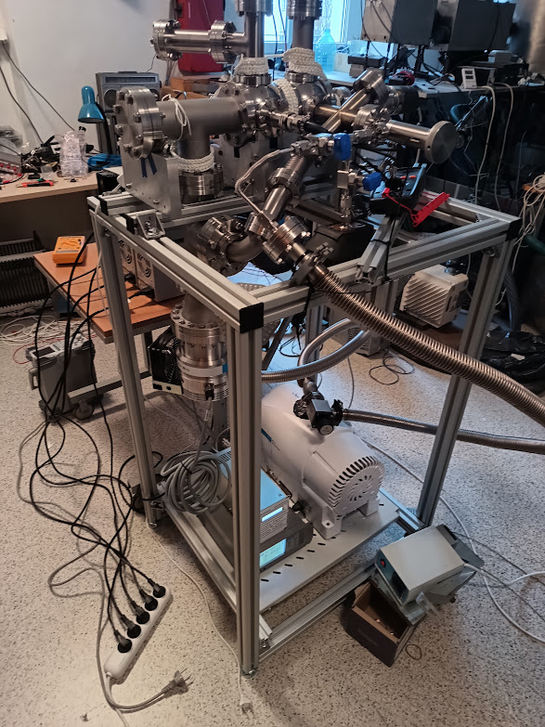
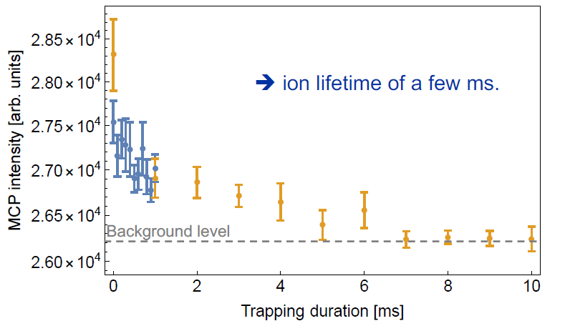
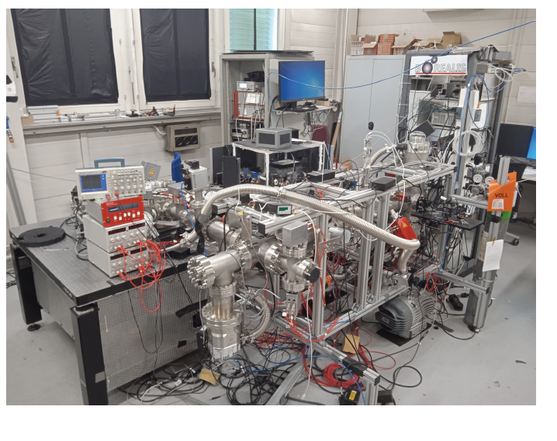
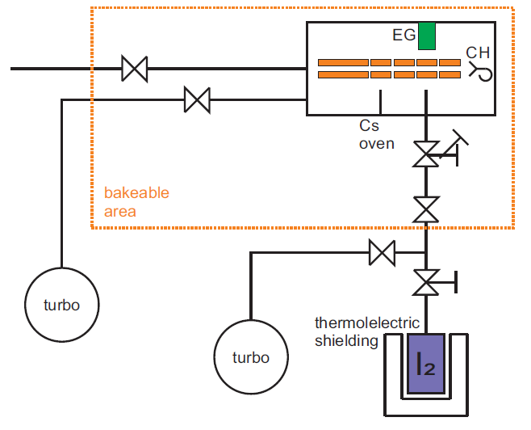
Ongoing R&D activities: anionic system
Construction of a negative iodine source
via electron dissociative attachment for «clean» antiprotonic iodine production
C₂⁻ trapping in Paul trap for spectroscopy
towards establishing laser cooling of anionic molecules to sympatetically cool antiprotons
The I⁻ source at KL-FAMO
The C₂⁻ cooling setup at CERN

Slide 13
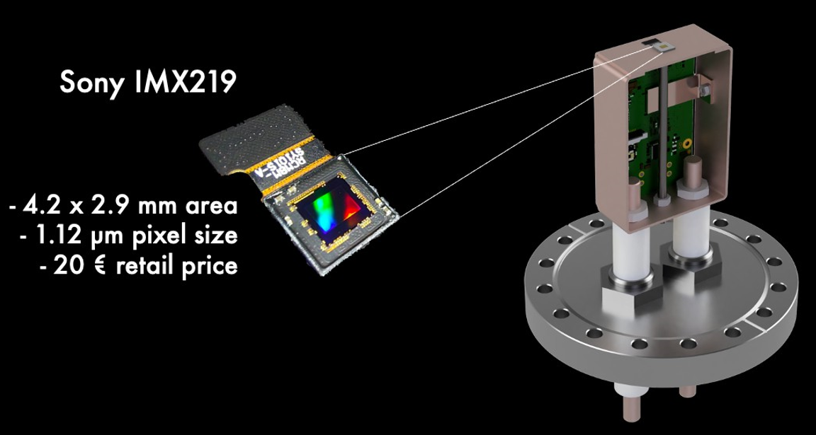
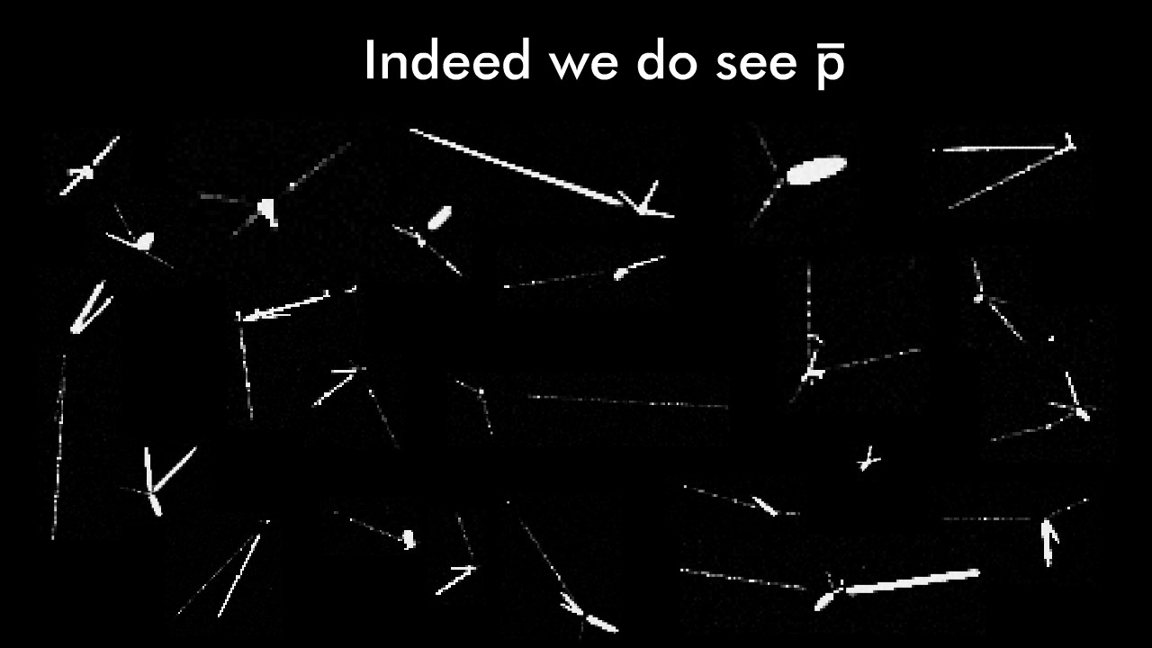
Ongoing R&D activities: imaging detector for deflectometry
PRELIMINARY
Sensitive to photons
Resolution to antiproton vertices < 2.0 μm
In collaboration with: Technical University of Munich

Slide 14
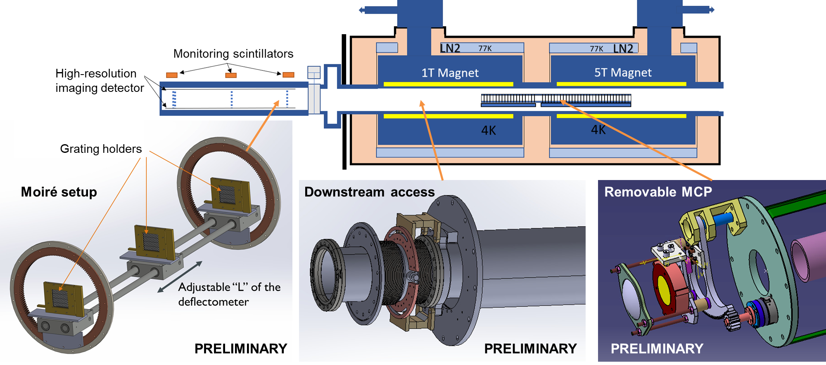
Short term plans
Agenda for 2024: antiproton recapture in catching traps: recycling and background removal
replace aged ²²Na source and replace malfunctioning Ps target
increase Rydberg Ps principal quantum number up to n = 30
Moiré deflectometer integration

Slide 15
Medium and long term plans
Before LS3
Dec. 2025
During LS3
Jun. 2027
After LS3
Precise antihydrogen WEP test in a null magnetic field
Atom interferometry with antihydrogen
Apparatus upgrade for Ps transmission targets in antihydrogen setup
Antihydrogen source flux to 1 Hbar min⁻¹ or higher
First WEP test with antihydrogen in null magnetic field
Ps 1³S-2³P and 1³S-3³P spectroscopy with a laser-cooled source
Ps n=3 hyperfine RF spectroscopy
Two-photon spectroscopy of Ps n³S Rydberg states
Precision Ps 1³S-2³S and 1³S-3³S spectroscopy with laser cooling
Establishing laser cooling of positronium
Cryogenic Ps transmission targets
Spectroscopy of Rydberg antiprotonic atoms
Inertial sensing with Rydberg antiprotonic atoms
Search for an antiproton EDM by antiprotonic molecule spectroscopy
Form Rydberg antiprotonic ions in traps
Time-of-flight spectroscopy of trapped nuclear isotopes
Search of hexaquark DM candidate via pbar-³He in traps
Antideuteronic atoms formation and measurement of X-ray cascade
Anti-³He and Anti-T synthesis by antideuteron fusion in Penning traps
Positron affinity of neutralized anions via charge-exchange

Slide 17
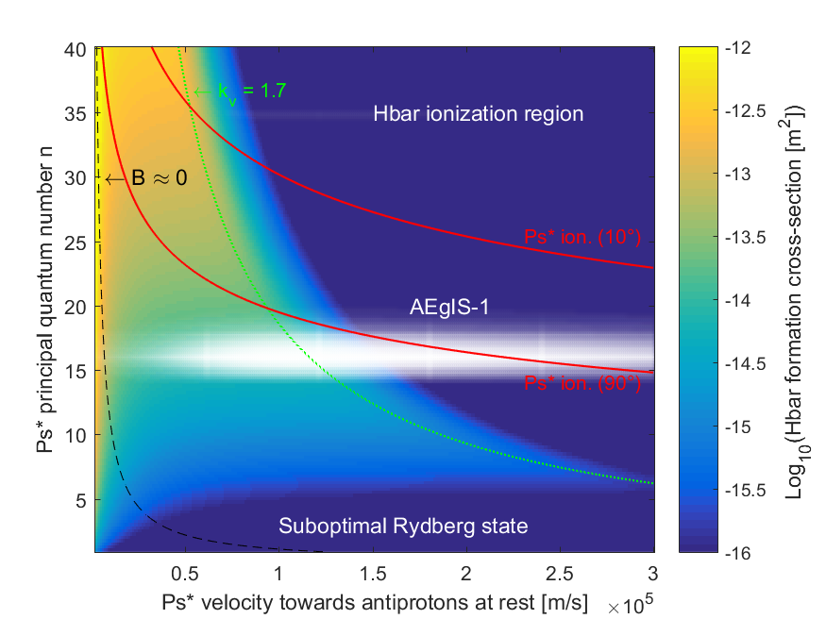

How to further increase the amount of antihydrogen?
10 K
100 K
We need colder Ps sources …
A colder Ps source in a reflection geometry
An efficient cold Ps source in transmission
300 K
$$σ∝n_{Ps}^{4}$$
D. Krasnicky, R. Caravita, C. Canali, G. Testera, Phys. Rev. A 94 (2016) arXiv:1608.02785v1

Slide 18
“The ultimate reduction in the positronium temperature would, of course, be achieved by laser cooling the atoms”
M. S. Fee, S. Chu, A. P. Mills et al. (1993)
“Ps laser cooling has been discussed for many years but has not been experimentally demonstrated, even in a proof-of-principle measurement”
D. B. Cassidy (2018)

Slide 19
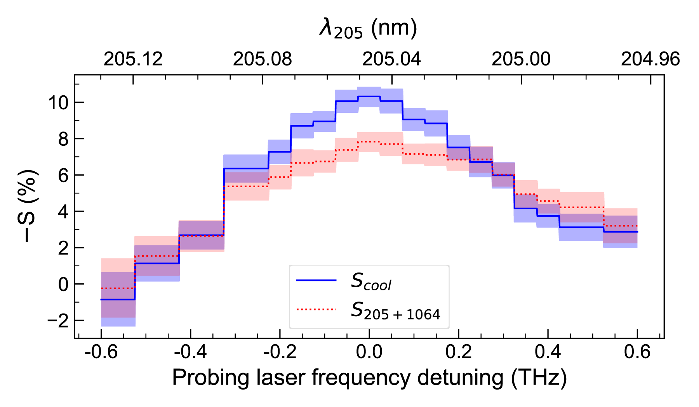
Laser Cooling of Positronium
In 2023, we laser cooled Positronium for the first time
Accepted on Physical Review Letters with Editors’ suggestion
Expected publication date: end of February

Slide 20
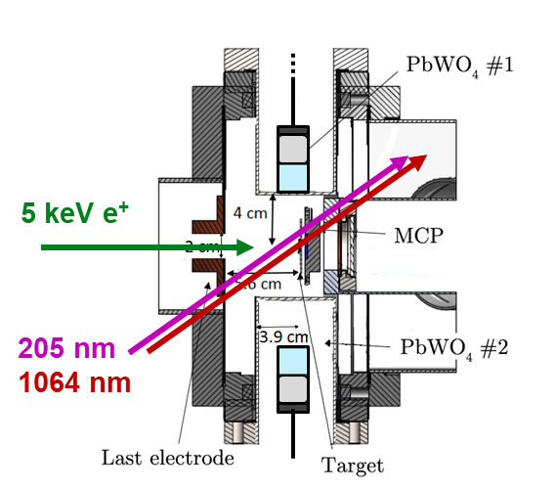
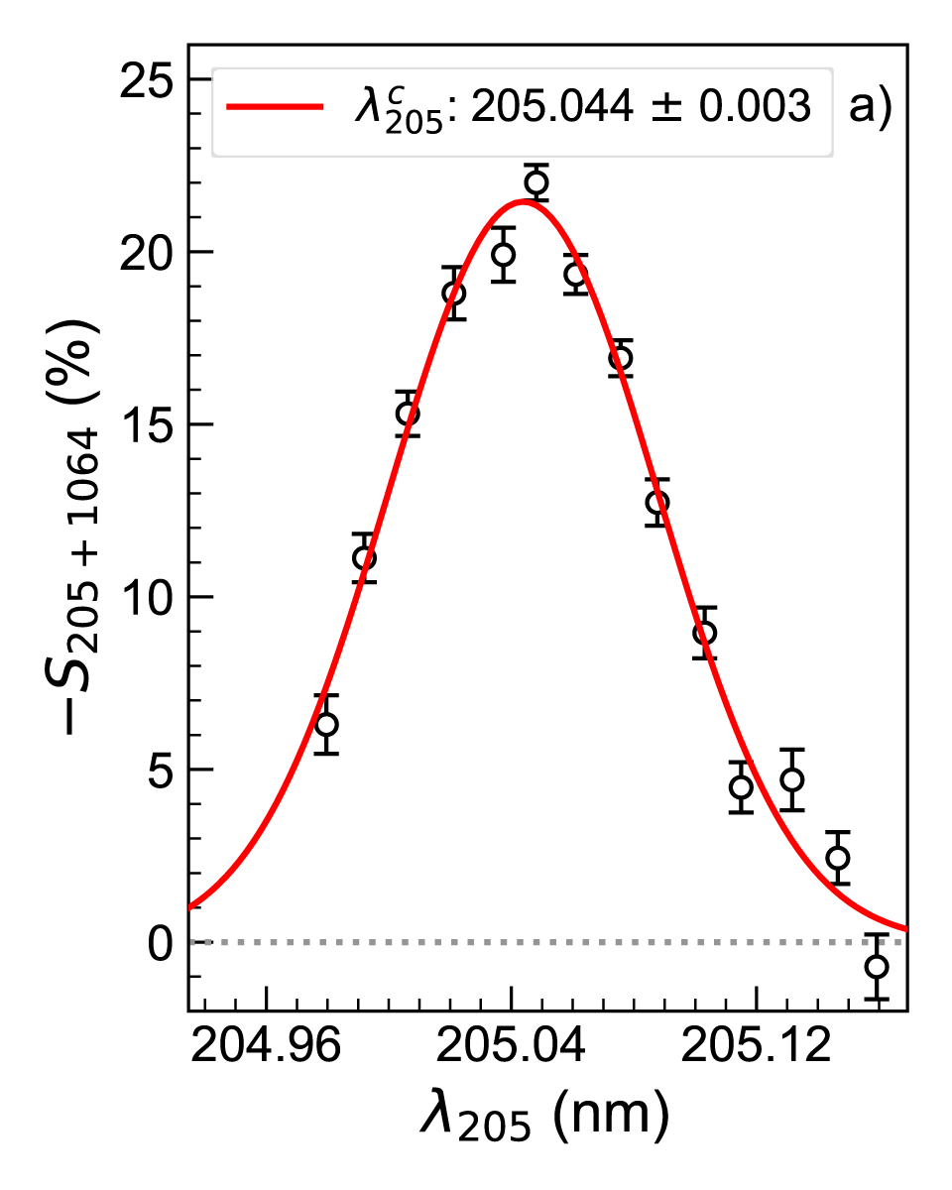
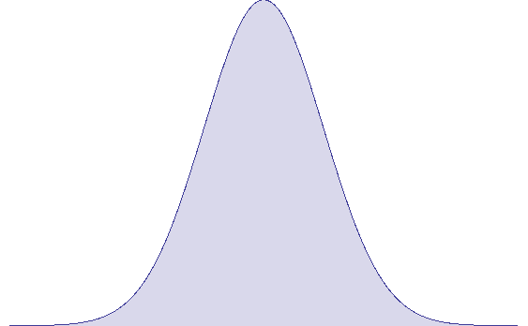
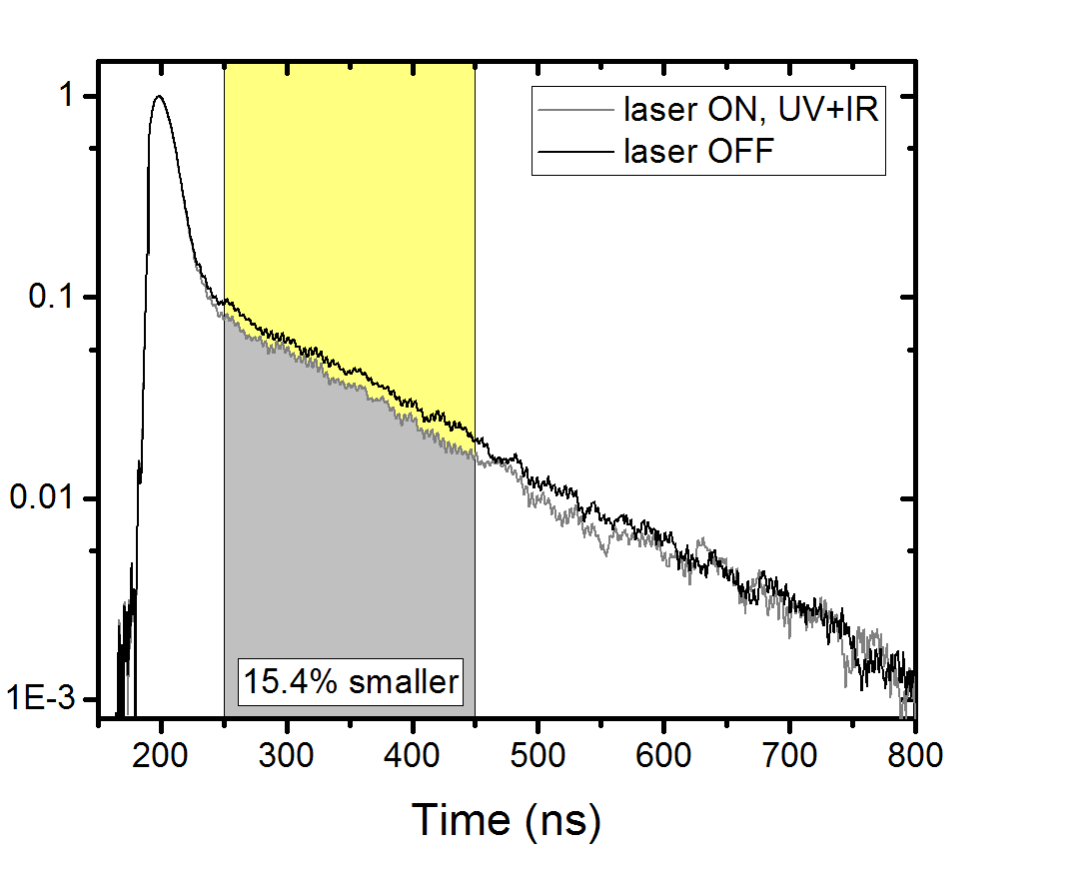
How? Starting from Ps 1³S-3³P Doppler velocimetry
Ps velocity
distribution
Probe laser
T = 380 K
Doppler effect
Ps velocity along laser axis
⬄
Choice of laser detuning
Digitized PbWO₄

Slide 21
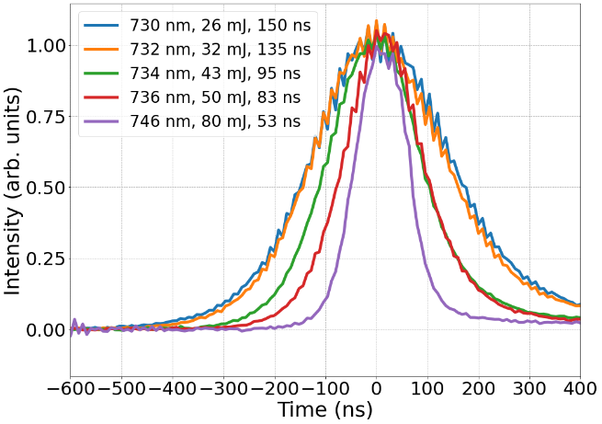
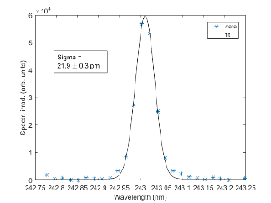
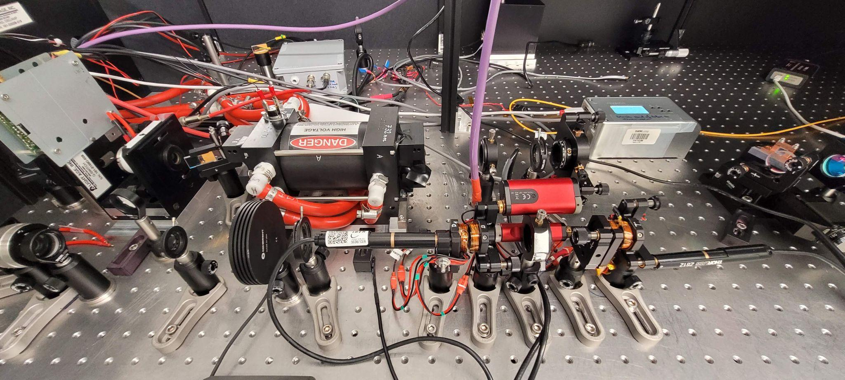
How? Developing a broadband Q-switched alexandrite laser system
Designed for broadband Ps cooling
70 ns, 243 nm pulses, 3 mJ, 120 GHz

Slide 22
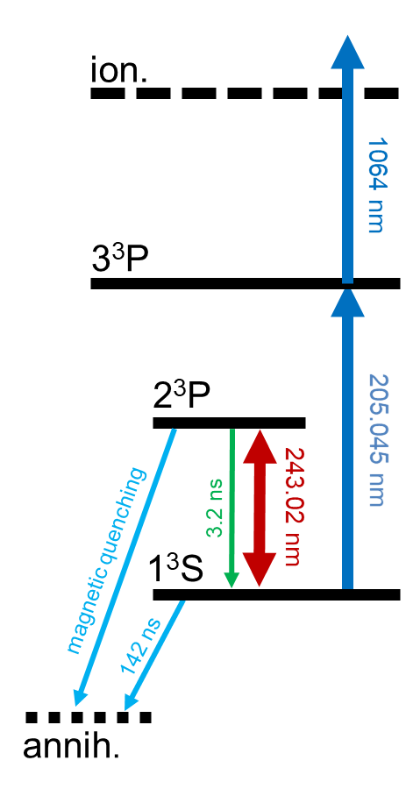
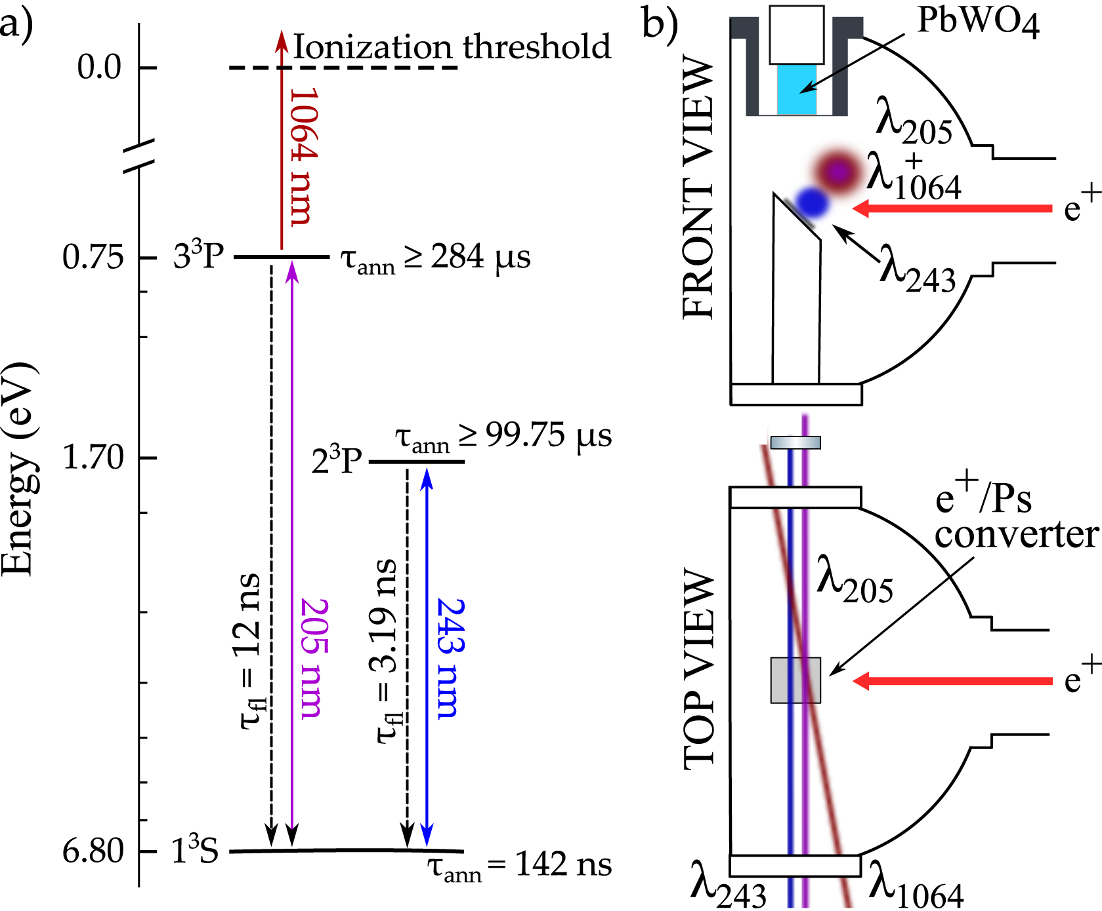
How? Introducing the retroreflected cooling laser
Probing transition
(1³S → 3³P → Ion)
Cooling transition
(1³S ↔ 2³P)

Slide 23
How? Measuring the temperatures with and without cooling
Ps velocity
distribution
Probe laser
170(20) K
380(20) K
Reflected
Cooling beam
Forward
Cooling beam
Scanning the probe laser detuning

Slide 24
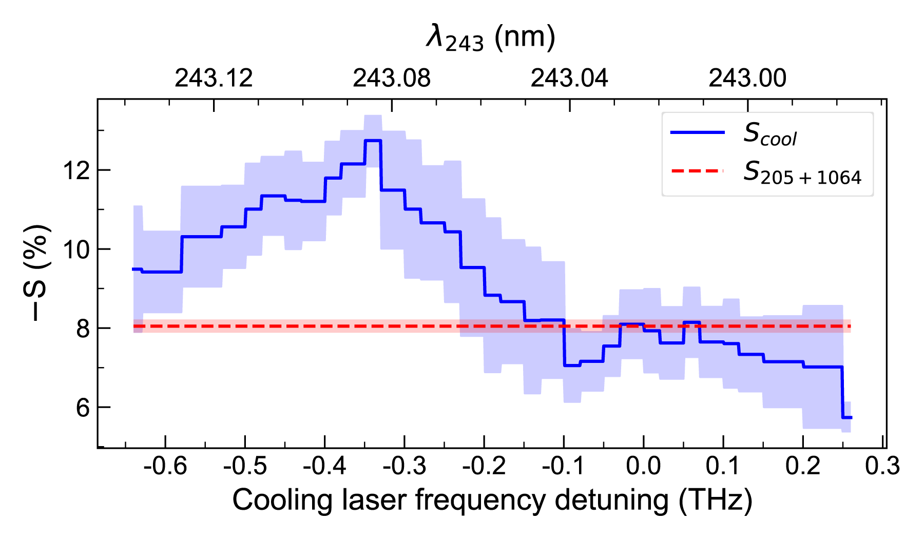
How? Measuring an increase in the cold atoms’ fraction
Ps velocity
distribution
Probe laser
Reflected
Cooling beam
Forward
Cooling beam
Scanning the cooling laser detuning

Slide 25
Wrapping it up
Narrowing of the 1³S – 3³P line
Increase of the number of atoms in the probe laser BW
> we cooled the Ps cloud from 380(20) K to 170(20) K <
> we reached the maximum cooling efficiency allowed by Doppler laser cooling <
The impact of this result goes beyond antihydrogen production:
opens the way for precision spectroscopy, clock tests of the WEP with Ps, and Bose-Einstein condensation

Slide 26
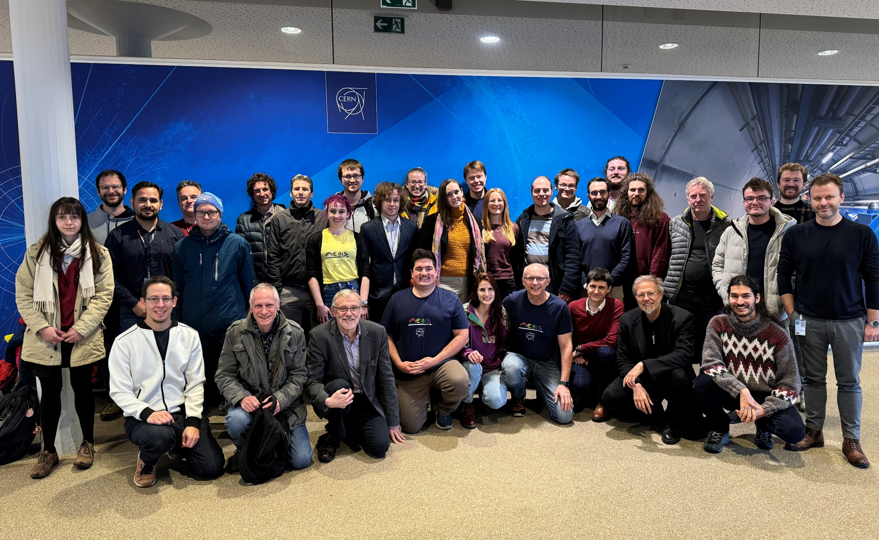
Thank you for your attention
The AEgIS collaboration, CERN, 2023

