Slide 1


DC 2024
Combined Rates
Follow up – Number updates

Slide 2

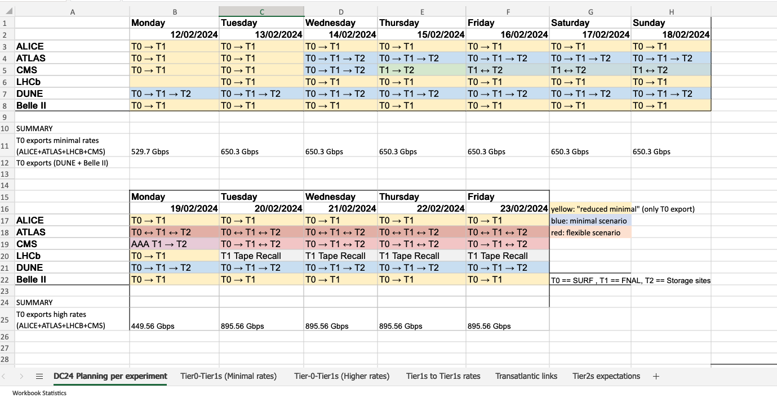
DC24 Planning per experiment – remain the same

Slide 3
Tier0-Tier1s & Tier1s-Tier1s
(Minimal rates and Higher rates)
- remain the same for all experiments

Slide 4
Network capacity updates
T1s Doubled network capacity
FR-CCIN2P3 -> 200Gbps
IT-INFN-CNAF -> 400Gbps
T1s planning to update by DC24 (TBC)
DE-KIT -> 200Gbps to 400Gbps
NLT1 -> 400Gbps to 800Gbps*
* Stress test will be performed after DC24 by ATLAS to reach the 800Gbps

Slide 5
Tier2 ingress/egress
ATLAS has updated some numbers
T2 - network capabilities: https://wlcg-cric.cern.ch/core/netsite/list/ (not yet all numbers IN) 9 shared T2s between ATLAS and CMS Encourage T2 administrators to review the material linked below to better understand the load they will perceive and to ensure that their network capabilities are up to date. If not, please update the CRIC and contact me to update the last numbers.
Viewer permissions: link

Slide 6
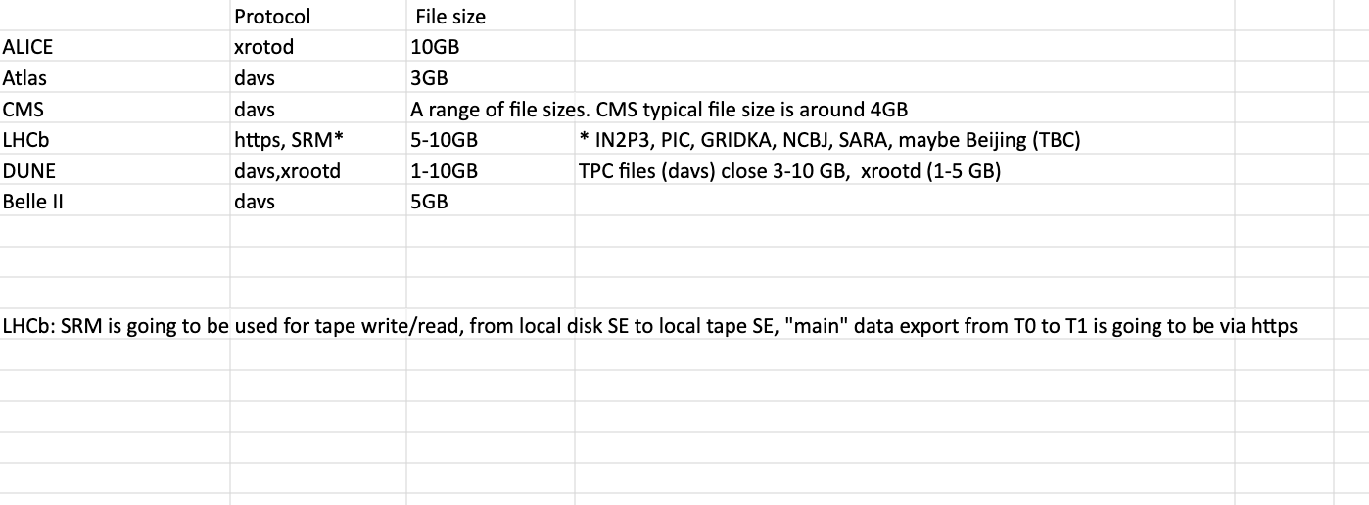
What else we need to know/combine?
Average file size
HTTP for the vast majority of transfers
T2s' verification of network capacity

Slide 7
Rates for DC 2024
Combined numbers:
Experiments/Network/CRIC
Up to date and same language
(site names + units)
One collaborative document
Editors: link
Viewer: link
Thanks to Experiments, Network team and CRIC team

