Slide 1

Poincaré-invariant analysis of meson spectrum
Zhen-Ni Xu
In collaboration with:
José Rodríguez-Quintero, Craig D. Roberts, Si–Xue Qin, et.al
Jan 26, 2024

Slide 2
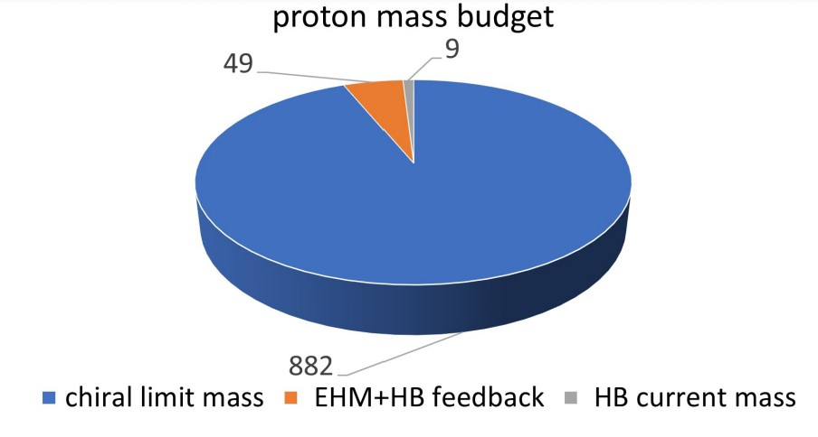
Emergence of Hadron Mass
Proton mass budget
Only 9 MeV/939 MeV is directly from Higgs
Evidently, there is another phenomenon in Nature that is extremely effective in producing mass:
Emergent Hadron Mass (EHM)
  Alone, it produces 94% of the proton’s mass
  Remaining 5% is generated by constructive interference between EHM and Higgs-boson
What is EHM?
Does it have a reductionist explanation?
If so, what are they and do they lie within the Standard Model?
Notes:
As we know, visible matter is constituted from nuclei found on Earth and the mass of each such nucleus is primarily just the sum of the masses of the nucleons they contain. However, only 9 MeV of a nucleon’s mass, mN = 940 MeV, is directly generated by Higgs boson couplings into quantum chromodynamics (QCD). Evidently – as highlighted by this figure, Nature has another, very effective mass-generating mechanism. Today, this is called emergent hadron mass (EHM)…

Slide 3
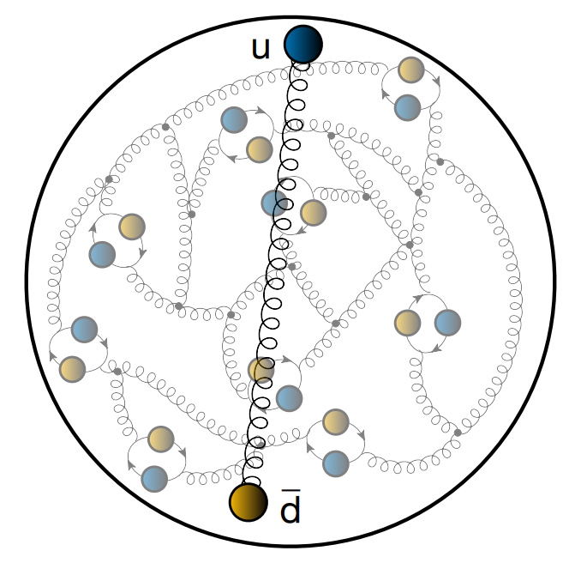
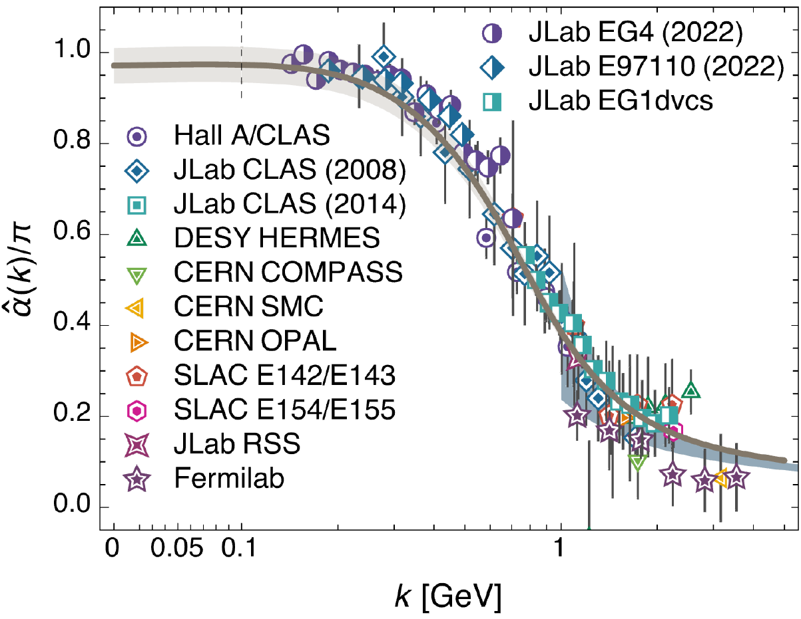
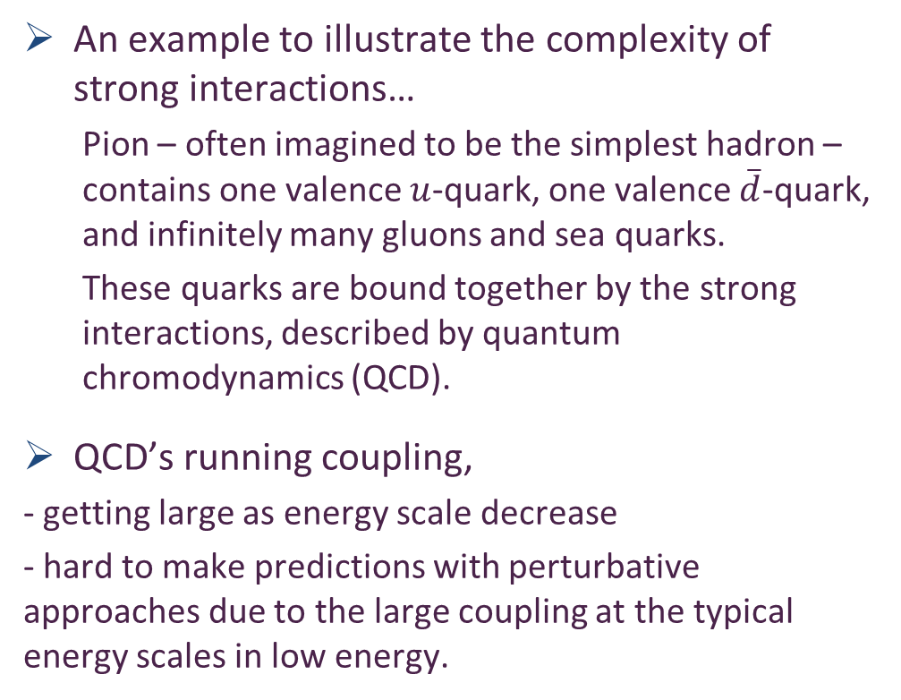
Strong interaction
An example to illustrate the complexity of strong interactions…
  Pion – often imagined to be the simplest hadron – contains one valence $u$-quark, one valence $\overline{d}$-quark, and infinitely many gluons and sea quarks.
  These quarks are bound together by the strong interactions, described by quantum chromodynamics (QCD).
QCD’s running coupling,
- getting large as energy scale decrease
- hard to make predictions with perturbative approaches due to the large coupling at the typical energy scales in low energy.
Z.-F. Cui et al 2020 Chinese Phys. C 44 083102
Saturates owing to emergence of gluon mass
A. Deur; V. Burkert; J.-P. Chen; W. Korsch, Particles 5 (2022) 171
Notes:
As an example to illustrate the complexity of strong interactions, Pion…
This is QCD’s running coupling, which is getting large as energy scale decrease
This coupling saturates to a large, finite value at Q2 = 0 owing to emergence of gluon mass. The dynamical generation of a running gluon mass has eliminated the Landau pole that afflicts perturbative QCD. This saturation making QCD well defined in mathematics. The dynamical generation of a running gluon mass is a basic character of EHM.

Slide 4
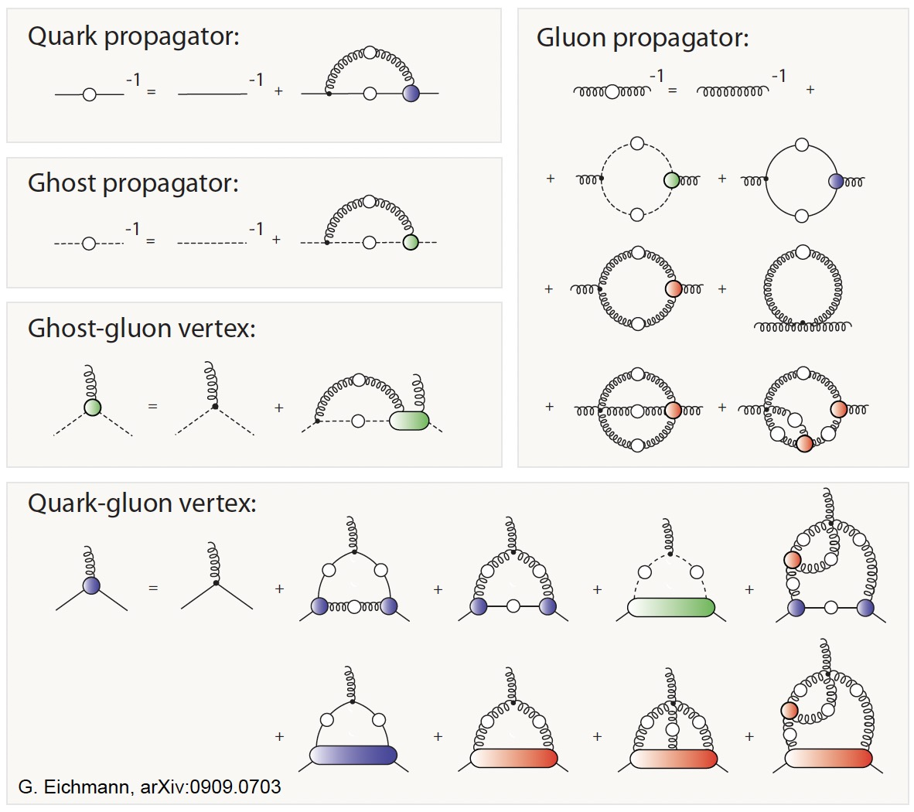
Dyson-Schwinger Equations
an infinite tower of coupled integral equations, incorporating Schwinger functions of all orders.
nonperturbative in character since Schwinger functions all are fully dressed
Owing to the infinite coupling feature, it is necessary to truncate the DSEs at a certain level for practical calculations
Notes:
We will use DSE to study phenomena of strong interactions.

Slide 5
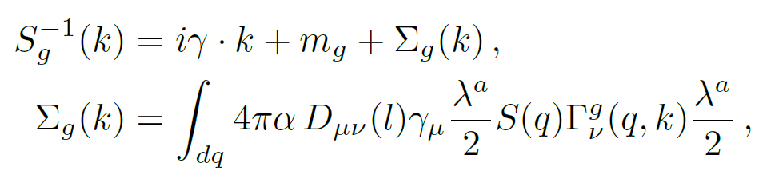
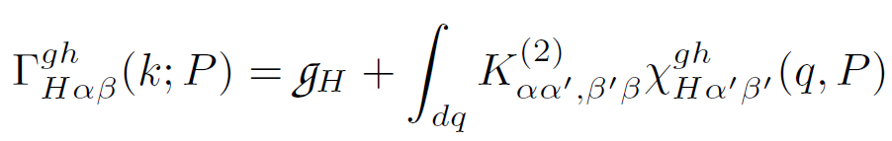
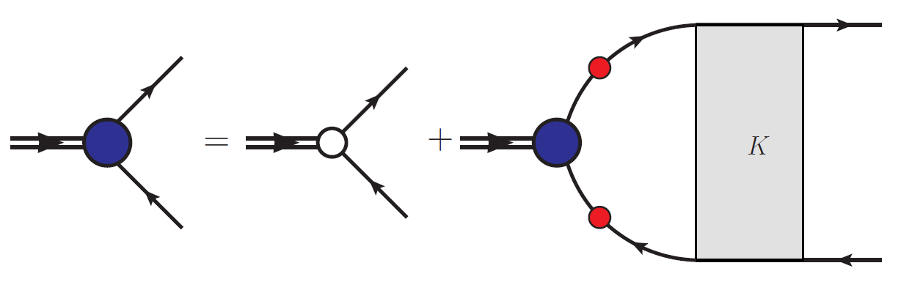
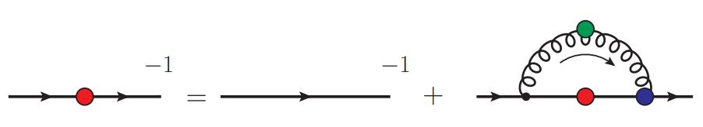









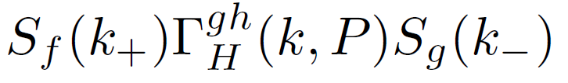


Dyson-Schwinger Equations
Gap equation
Bethe-Salpeter equation
dressed propagator
bare propagator
self energy
the bound-state amplitude
$m_{g}$: Higgs-produced quark current mass
the total momentum
the dressed-gluon propagator
specifies the $J^{P(c)}$
the generators of SU(3) colour
quark + antiquark scattering kernel
the dressed-gluon-quark vertex
Notes:
In the frame work of DSE, we first focus on the gap equation for a quark with flavour g, ...

Slide 6
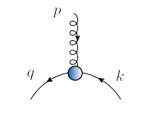

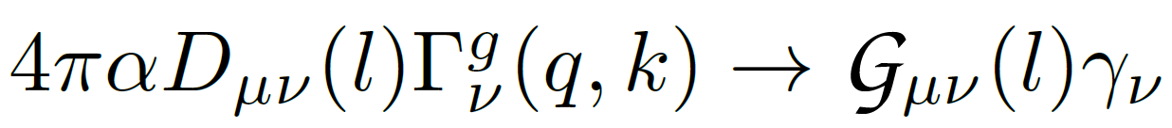
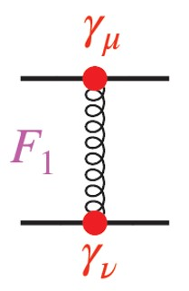
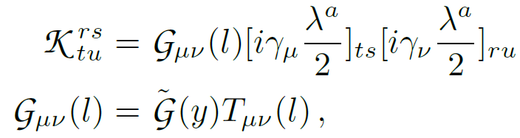

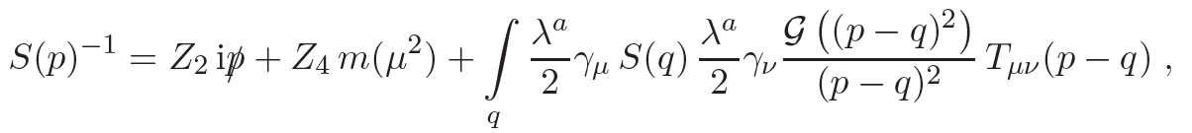
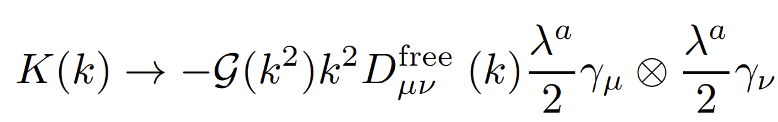
Rainbow-ladder truncation
Rainbow truncation
In the associated ladder truncation, the Bethe-Salpeter kernel is
Munczek H. J. 1995 Phys. Rev. D 52 4736
Bender A., Roberts C. D. and von Smekal L. 1996 Phys. Lett. B 380 7
Notes:
As we have discussed before, the DSEs are a tower of coupled integral equations with a tractable problem obtained only once a truncation scheme is specified. Usually,…
This simplest truncation is known as the RL approximation.

Slide 7
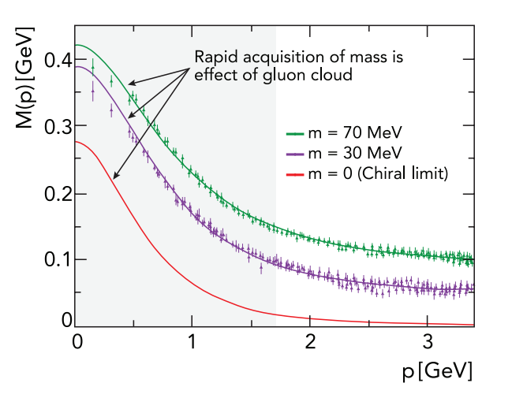

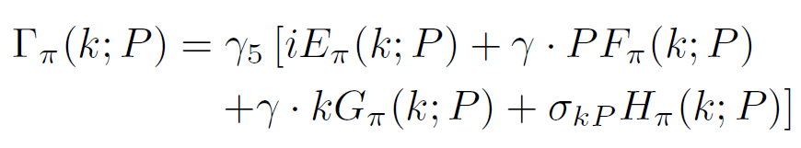

Dynamical Chiral Symmetry Breaking
EHM
Renormalisation-group-invariant dressed-quark mass function
M($p^{2}$) : the dressed-quark mass-function
current-quark of perturbative QCD evolves into a constituent-quark as momentum smaller
The constituent-quark mass arises from a cloud of low-momentum gluons…
Pion property: Goldberger-Treiman relation
-- the most fundamental expression of Goldstone’s theorem and DCSB
Notes:
The emergence of a gluon mass-scale in the Standard Model drives enormous phenomena. Crucial amongst them is dynamical chiral symmetry breaking (DCSB). It is most readily apparent in the dressed-quark propagator. ..
This figure reveals that the current-quark of perturbative QCD evolves into….
The constituent-quark mass...gluons attaching themselves to the current-quark.
This is DCSB, the essentially nonperturbative effect that generates a quark mass from nothing.
DCSB is very clearly revealed in pion properties. The most prominent among them is the Goldberger-Treiman relation.

Slide 8
Hadron spectroscopy: beginnings and Beliefs
Hadron physics … began with the “prediction” of quarks
  Gell-Mann and Zweig … circa 1964
20 years on … Godfrey & Isgur, Mesons in a Relativized Quark Model with Chromodynamics, Phys. Rev. D 32 (1985) 189–231
    “. . . All mesons – from the pion to the upsilon – can be described in a unified framework.” -- made with reference to a quark model potential with one-gluon-like exchange plus linear confinement.
  most reliable for baryons and mesons containing heavy quarks
Challenges
  quantum mechanics description of light-quark systems in terms of a potential
  Mathematical/physical connection with confinement of light quarks
  the Gell-Mann-Oakes-Renner (GMOR) identity
Aznauryan, A. Bashir, V. Braun, S. Brodsky, V. Burkert et al., Int. J. Mod. Phys. E 22, 1330015 (2013)
J. Segovia, D.R. Entem, F. Fernandez, E. Hernandez, Int. J. Mod. Phys. E 22, 1330026 (2013)
F. Fernández, J. Segovia, Symmetry 13(2), 252 (2021)
Notes:
Spectroscopy has long been crucial in searching for an understanding of Nature's fundamental forces, it allows us to study the nature of the strong interaction that binds quarks and gluons into hadrons.
In 1964, Gell-Mann and George Zweig were working independently on a theory for strong interaction symmetry in particle physics. Within this framework, they proposed that important properties of the hadrons could be explained if they were made up of constituent particles. From 20 years on, the statement, which said that…
Owing to complications introduced by the need to faithfully express DCSB, quark models are….., in which the current-quark masses play the dominant role and differences between current- and constituent-quarks are least noticeable.
So in our work we will use DSE to surmount these challenges.

Slide 9
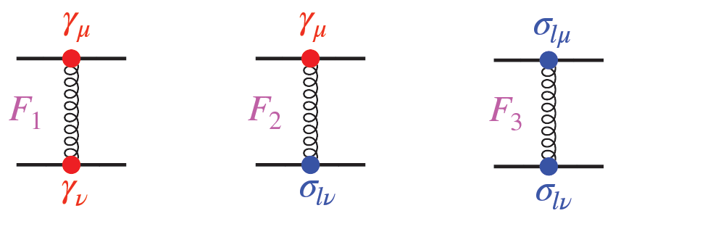
Using quantum field theory to predict spectrum and properties of mesons; showing how EHM expressed in the meson properties.
employing a novel method for constructing a sound, symmetry preserving approximation to the quark + antiquark Bethe-Salpeter kernel
Si-Xue Qin and Craig D. Roberts 2021 Chin. Phys. Lett. 38 071201
Notes:
I am going to extend to more realistic interactions. Quark models has been very effective in spectroscopy. I want to use QFT to calculate spectrum and properties of mesons, because solutions of SM requires that. The big aim is show how EHM is expressed in the spectrum and properties of mesons.

Slide 10
RL Truncation: Challenges
Rainbow-ladder truncation
serves well for ground-state hadrons with little rest-frame orbital angular momentum between the dressed valence constituents.
fails for all other systems; its key weakness being omission of those structures which become large as a consequence of EHM.
Notes:
As we have discussed before, the DSEs are a tower of coupled integral equations with a tractable problem obtained only once a truncation scheme is specified. Usually,…
This simplest truncation is known as the RL approximation.
We will explore the capacity of a new kernel construction to simultaneously treat ground- and first excited- states of mesons.

Slide 11
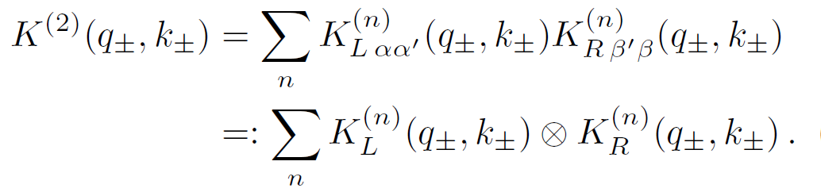
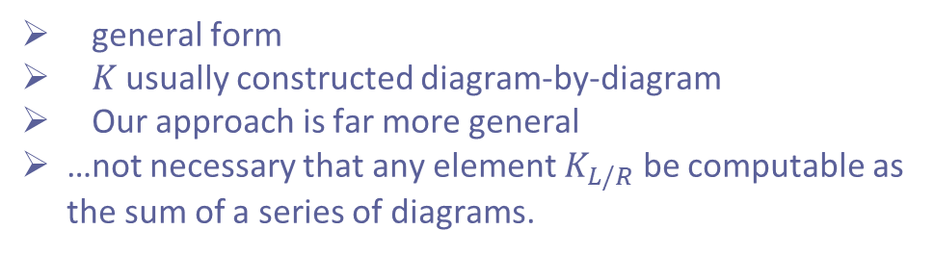
Bethe-Salpeter kernel
general form
$K$ usually constructed diagram-by-diagram
Our approach is far more general
…not necessary that any element $K_{L/R}$ be computable as the sum of a series of diagrams.
Notes:
Since this kernel carries four Dirac indices and connects two incoming fermion lines to two outgoing lines, it can be expressed as the sum of tensor products. of two 4*4 Dirac matrices. This equation is general, and it is not necessary that any element computable as the sum of a series of diagrams.
Potential Question: How do you apply this to different systems?
Ans: We are working towards that. Because we are insisting on using a full machinery of QFT to understand these properties, which will take us some time.

Slide 12
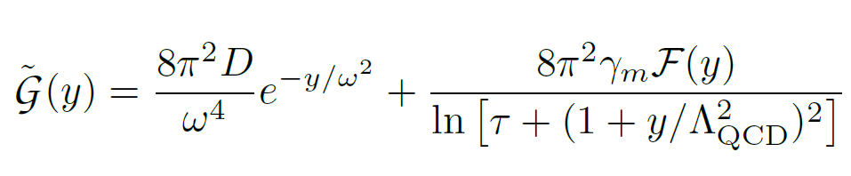

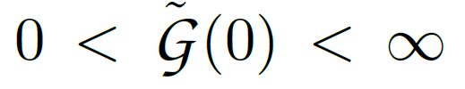
Interaction
S.-X. Qin, L. Chang, Y.-X. Liu, C. D. Roberts, D. J. Wilson, Phys. Rev. C 85 (2012) 035202.
D. Binosi, L. Chang, J. Papavassiliou, C. D. Roberts, Phys. Lett. B 742 (2015) 183-188.
where
, and
A nonzero gluon mass-scale appears as a consequence of EHM in QCD.
Regarding masses, this is critical: even a symmetry-preserving treatment of a momentum-independent interaction can deliver good results.
The large-y behaviour ensures that the one-loop renormalisation group flow of QCD is preserved.
crucial in hadron elastic and transition form factors at large momentum transfer…
Less important: calculation of masses: global, integrated properties.
Notes:
P2.. This property is crucial when considering…and the behaviour of parton distribution functions and amplitudes near the endpoints of their support domains. It is less important..
Potential Question: Why do you use this interaction?
Ans: Because practically, it has a similar pointwise form to the gluon propagator calculated in QCD.

Slide 13

EHM improved kernel
The key to a realistic expression of EHM in mesons –
using gap equation kernels with a more direct connection to QCD.
EHM is known to generate a large anomalous chromomagnetic moment (ACM) for the lighter quarks;
This ACM has a marked impact on the u, d, s meson spectrum.
L. Chang, Y.-X. Liu, C. D. Roberts, Phys. Rev. Lett. 106 (2011) 072001.
D. Binosi, L. Chang, J. Papavassiliou, S.-X. Qin, C. D. Roberts, Phys. Rev. D 95 (2017) 031501(R).
A. Bashir, R. Bermudez, L. Chang, C. D. Roberts, Phys. Rev. C 85 (2012) 045205.
L. Chang and C. D. Roberts, Phys. Rev. C (2012) 052201(R)
S.-X. Qin, C. D. Roberts, Chin. Phys. Lett. Express 38 (7) (2021) 071201.
        therefrom constructing a Bethe-Salpeter kernel which ensures all symmetry constraints germane to the spectrum are preserved
Notes:
The key to a realistic expression of EHM in mesons lies in using gap equation kernels with a more direct connection to QCD. …
This is illustrated in these publications. To expand existing studies and expose ACM effects on mesons containing s and sbar quarks, we write the quark-gluon vertex as....
Tau_\nu is ACM term, with eta the strength.
kappa is power-law suppressed in QCD; but the Gaussian form matches the infrared-dominant term in the QC interaction, and is sufficient for illustrative purposes.

Slide 14
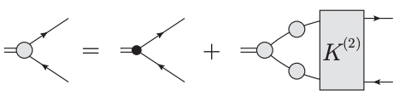
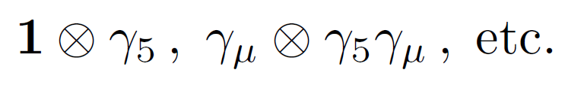
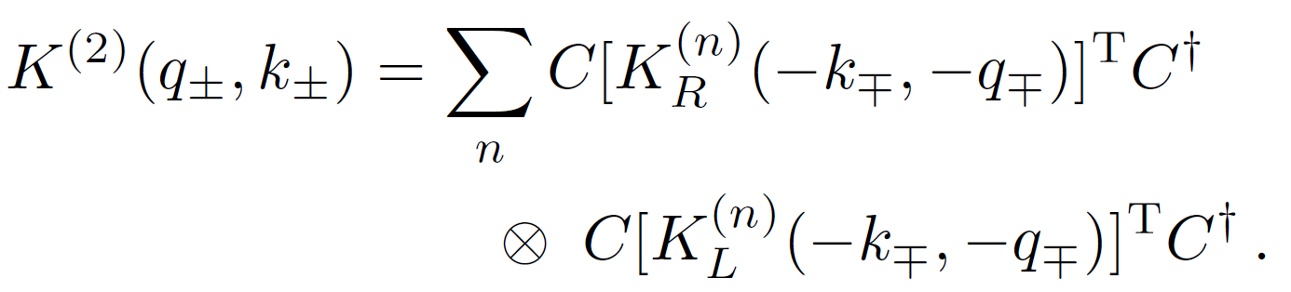




EHM improved kernel
Even under parity operations, forbidding
C-parity even: with C the charge conjugation matrix, the following identity is required:
T-parity even
Continuous symmetries, the unamputated inhomogeneous vector and axial-vector vertices satisfy Ward-Green-Takahashi (WGT) identities
Qin S X, Chang L, Liu Y X, Roberts C D and Schmidt S M 2013 Phys. Lett. B 722 384
Qin S X, Roberts C D and Schmidt S M 2014 Phys. Lett. B 733 202
Notes:
These are the key points in our construction procedure: Symmetries underly everything, and I’m capitalizing on these symmetries and they will be expressed in this slide. Details are not important here, but I use these statements about the three symmetries: The first…
Finally, since all constructions should respect the connection to a Poincare-invariant local quantum field theory, the CPT theorem entails that 𝐾(2) is T even.
QCD also …. In systems that may include nondegenerate valence quarks,…

Slide 15
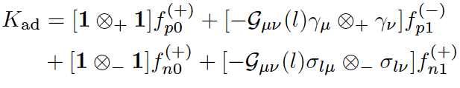
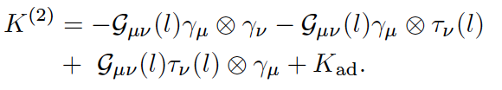
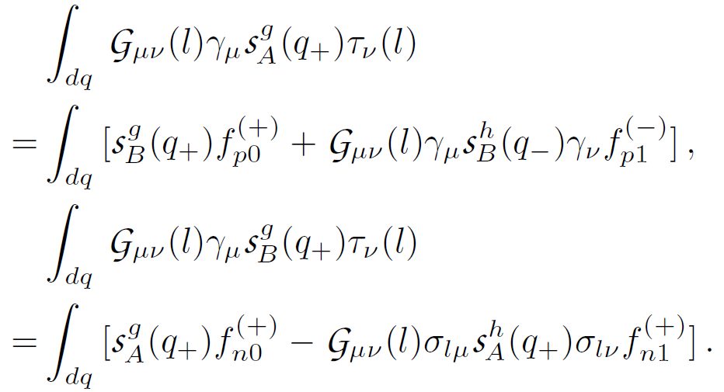
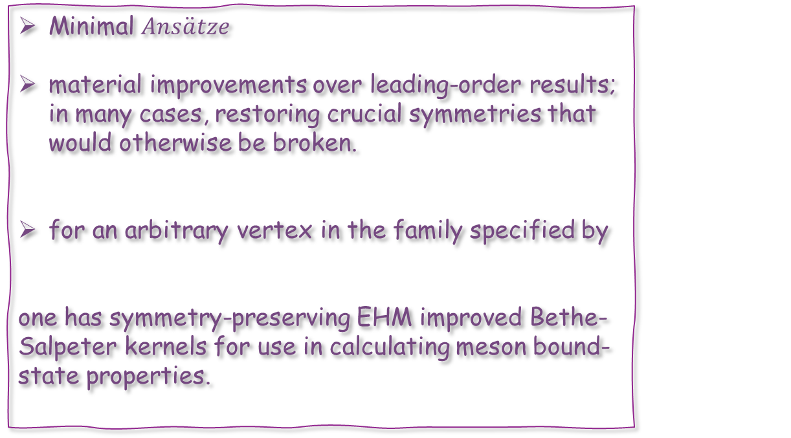
EHM improved kernel
Minimal $Ans\ddot{a}tze$
material improvements over leading-order results; in many cases, restoring crucial symmetries that would otherwise be broken.
for an arbitrary vertex in the family specified by
one has symmetry-preserving EHM improved Bethe-Salpeter kernels for use in calculating meson bound-state properties.
constraint equations
Notes:
Using symmetries, both discrete and continuous, which are important to QCD, we can write down a general form of the kernel, which has an undetermined component which is constrained by those symmetries. These are the constraint equations. Next I solved the constraint equations to complete the kernel.
Determined by resolving WGT identities, the results are minimal Ansatze for the kernels. Notwithstanding their minimal character, the Ansatze deliver..

Slide 16
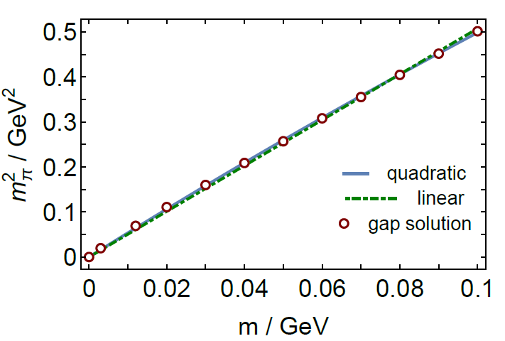
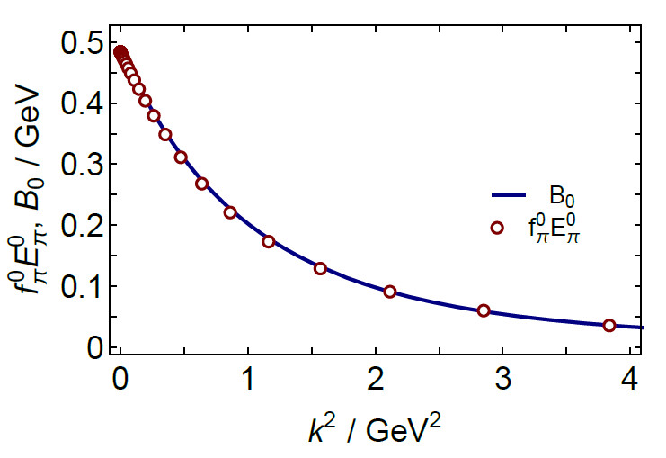
GMOR and GT Relations
key test: the Gell-Mann-Oakes-Renner relation
the chiral-limit Goldberger-Treiman relation:
S.-X. Qin, C. D. Roberts, Chin. Phys. Lett. Express 38 (7) (2021) 071201.
Notes:
A key test of the kernel is the GMOR, and we illustrated here that it is satisfied perfectly. So it is guaranteed that our constructed kernel preserve the symmetries.

Slide 17
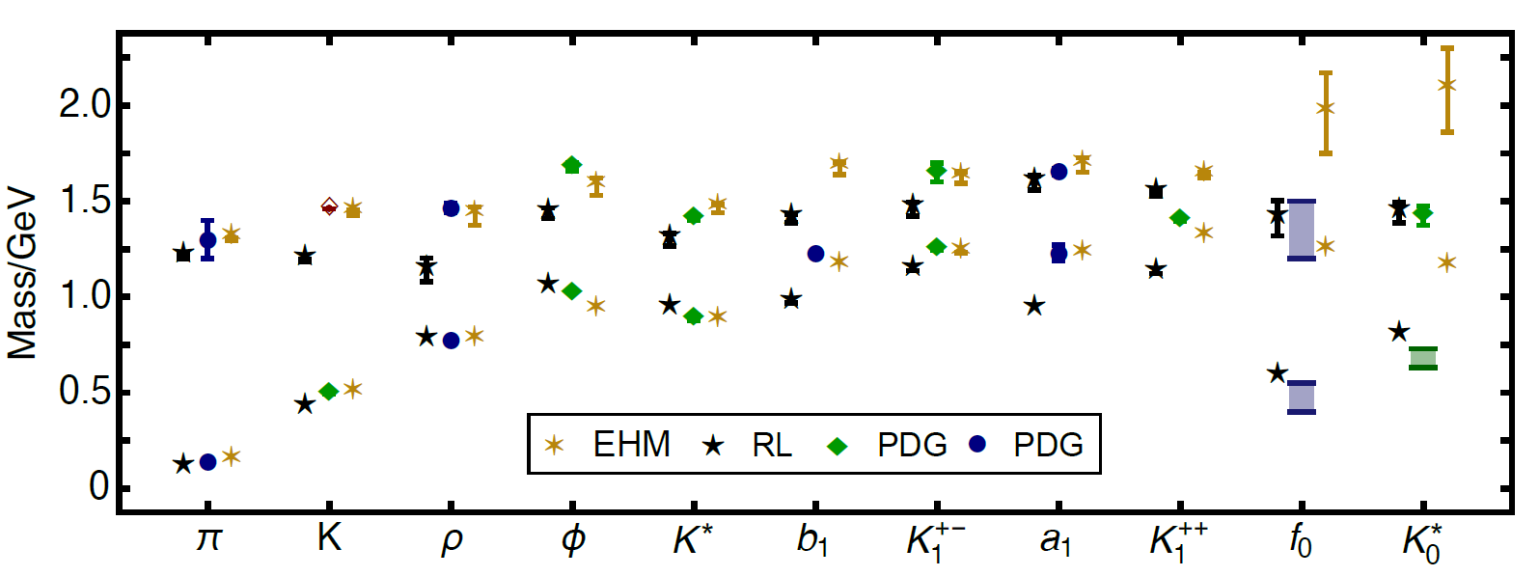
Meson spectrum
Notes:
I am now going to describe the results for the spectrum of mesons including those with strangeness.
Owing to the poles appeared in the dressed-quark propagator, for those states with mass > 1.3GeV, we will use extrapolations to obtain their values.

Slide 18
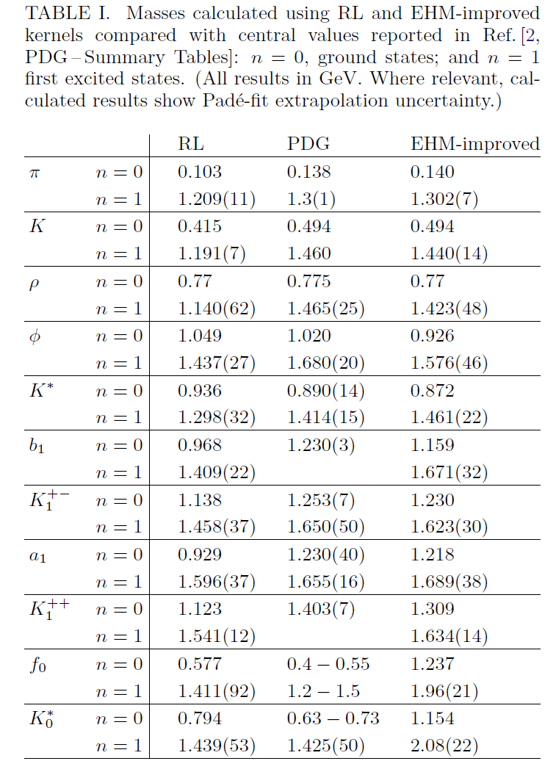
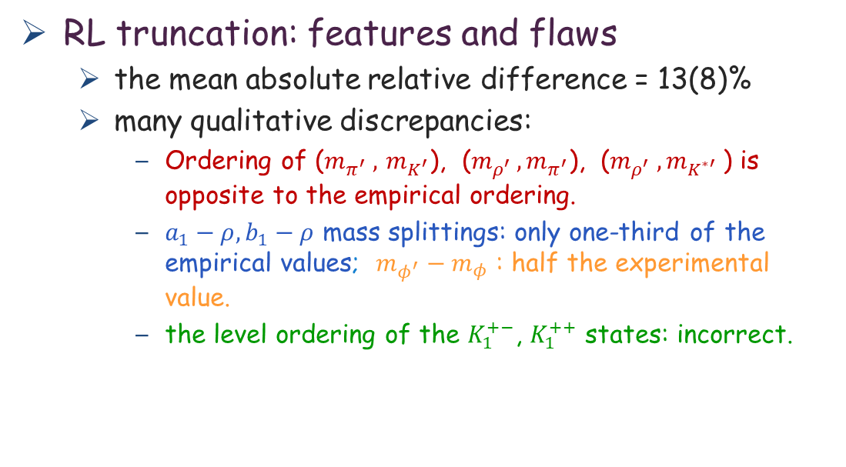
RL truncation: features and flaws
  the mean absolute relative difference = 13(8)%
  many qualitative discrepancies:
    Ordering of ($m_{π^{′}} ,$ $m_{K^{′}}$), ($m_{ρ^{′} }, m_{π^{′}}$), ($m_{ρ^{′}} , m_{K^{∗′}}$) is opposite to the empirical ordering.
    $a_{1}−ρ, b_{1}−ρ$ mass splittings: only one-third of the empirical values; $m_{φ^{′}}−m_{φ}$ : half the experimental value.
    the level ordering of the $K_{1}^{+−}$, $K_{1}^{++}$ states: incorrect.
Notes:
First of all we demonstrate the RL results as witnesses.
The features and flaws of RL truncation are evident in this figure…
Whilst this might appear to be fair agreement, there is substantial scatter; and there are many qualitative discrepancies. For instance…

Slide 19
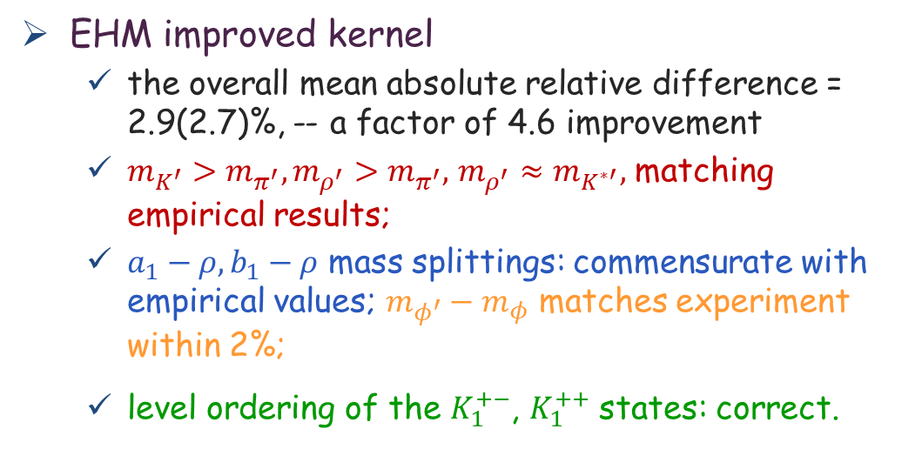
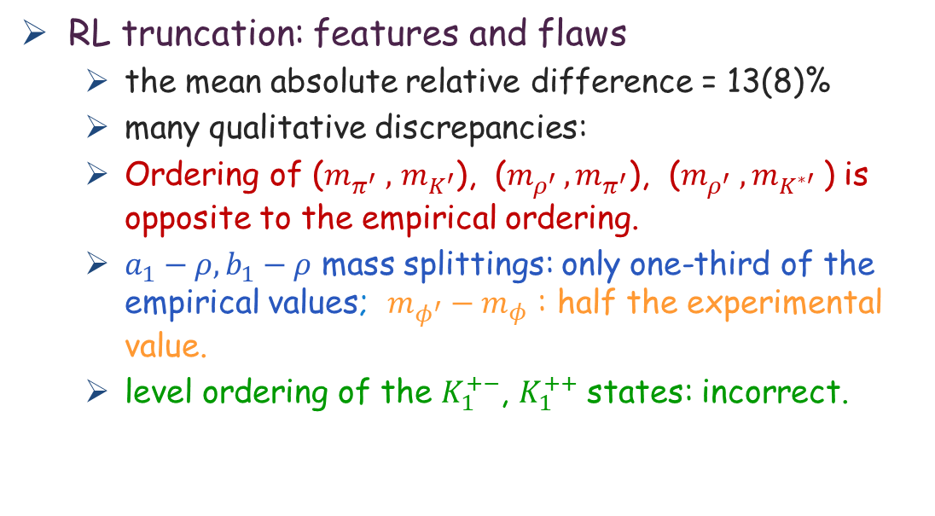
RL truncation: features and flaws
  the mean absolute relative difference = 13(8)%
  many qualitative discrepancies:
  Ordering of ($m_{π^{′}} ,$ $m_{K^{′}}$), ($m_{ρ^{′} }, m_{π^{′}}$), ($m_{ρ^{′}} , m_{K^{∗′}}$) is opposite to the empirical ordering.
  $a_{1}−ρ, b_{1}−ρ$ mass splittings: only one-third of the empirical values; $m_{φ^{′}}−m_{φ}$ : half the experimental value.
  level ordering of the $K_{1}^{+−}$, $K_{1}^{++}$ states: incorrect.
EHM improved kernel
  the overall mean absolute relative difference = 2.9(2.7)%, -- a factor of 4.6 improvement
  $m_{K^{′}}>m_{π^{′}},m_{ρ^{′}}>m_{π^{′}},$ $m_{ρ^{′}}≈m_{K^{∗′}},$ matching empirical results;
  $a_{1}−ρ, b_{1}−ρ$ mass splittings: commensurate with empirical values; $m_{φ^{′}}−m_{φ}$ matches experiment within 2%;
  level ordering of the $K_{1}^{+−}$, $K_{1}^{++}$ states: correct.
Notes:
Now I’m going to show you the impact of the improvements that we made…
We improved the accuracy by a factor of 4;
We’ve changed the ordering to match the empirical results.
The spectrum now looks realistic, whereas for 30 years people were working on the unrealistic QFT spectrum;

Slide 20
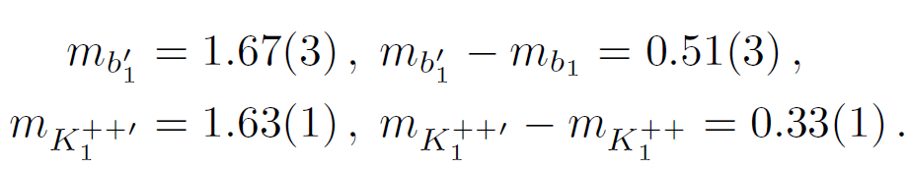




EHM improved kernel
  The mass splittings in the partner channels are
the EHM-improved kernels predict
Notes:
Given that our EHM-improved kernels deliver a realistic meson spectrum, their predictions for the masses of the as-yet unseen radial excitations of the b1 and K++ states should be reasonable:…

Slide 21
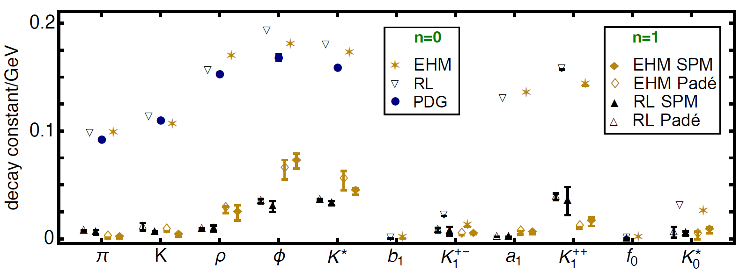
Decay constants
Notes:
Decay constants is a crucial property of the mesons. We calculated them using EHM kernels and found that they produce better agreement with available empirical values, and can make predictions that should be reliable for the other states and can be tested.

Slide 22
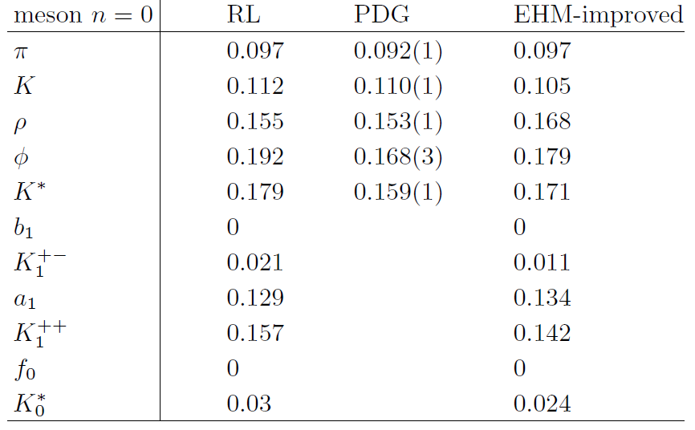
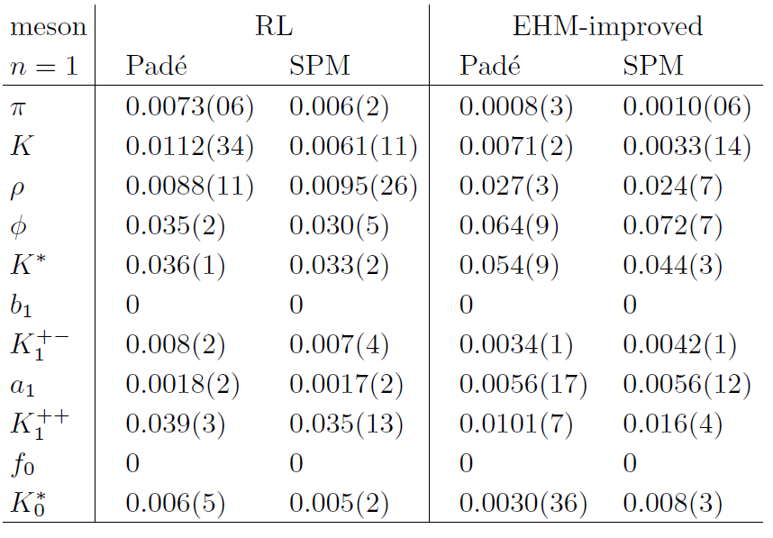
Ground states: favourable;
the EHM-improved kernels deliver better agreement.
First radial excitations:
the decay constant of a first radial excitation is (1/8)-times that of the ground state.
Notes:
We found that EHM-improved kernel provide a much better agreement with known leptonic decay constants.
especially since decay constants are sensitive to ultraviolet physics, which we have omitted.
And we have the first QFT predictions of decay constants for excited states.
Owing to zeros in the radial wave functions in quantum mechanics models of positronium-like systems, the decay constant of a first radial excitation is (1/8)-times that of the ground state. Our predictions are broadly consistent with this pattern, except for pseudoscalar mesons, in which the leptonic decay constant must vanish in the chiral limit

Slide 23
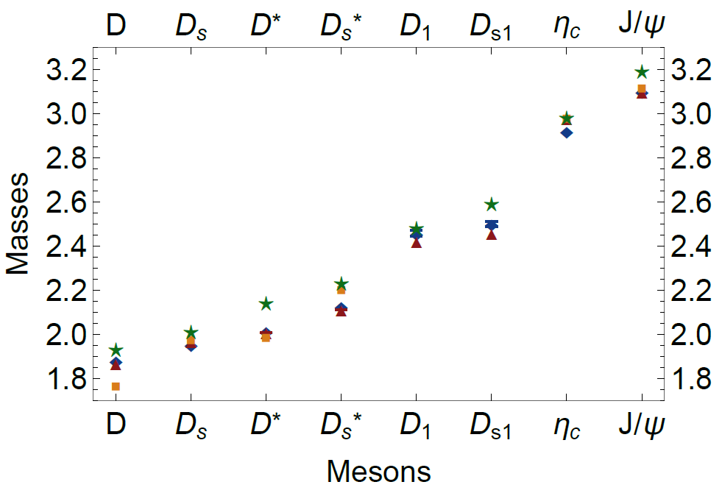
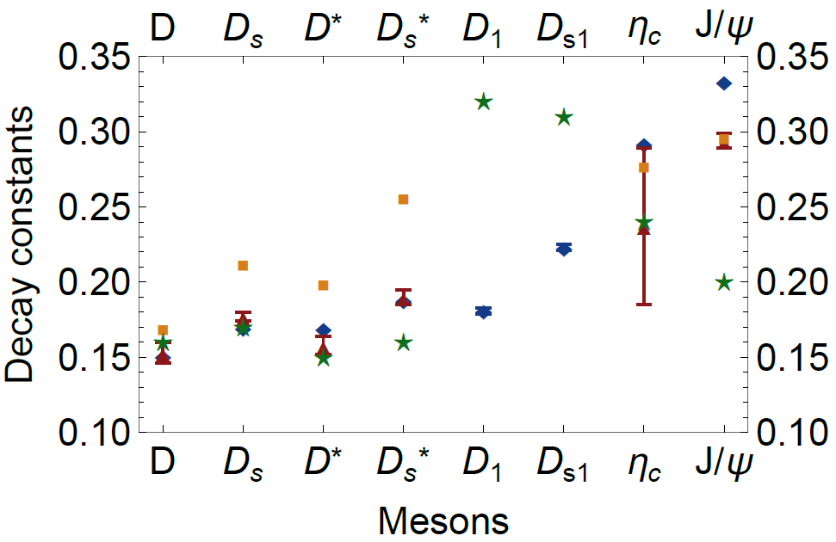
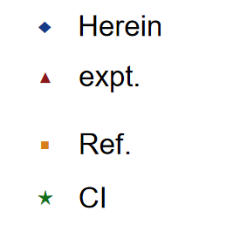
New results on charm quark mesons
Pianpian Qin, Si-xue Qin, and Yu-xin Liu Phys. Rev. D 101, 114014
Yin, PL., Cui, ZF., Roberts, C.D. et al. Eur. Phys. J. C 81, 327 (2021).

Slide 24
Conclusions
We provide the first symmetry-preserving, Poincaré covariant treatment of the spectrum of u, d, s mesons, both ground and first excited states.
Our scheme produces a closed-form kernel that is symmetry-consistent (discrete and continuous) with the gap equation defined by any admissible gluon-quark vertex.
The construction is applicable even when the diagrammatic content of that vertex is unknown, as would be the case if the vertex were obtained using lattice-QCD.
It therefore establishes a route to new synergies between continuum and lattice approaches to strong interactions.

Slide 25
Conclusions
The presence of a dressed-quark anomalous magnetic moment in the gluon-quark vertex, an emergent feature of strong interactions, can remedy many defects of widely used meson bound-state kernels
  the mass splittings between vector and axial-vector mesons and the level ordering of pseudoscalar and vector meson radial excitations.
Adding the ACM is sufficient to explain the light+light, light+strange, and strange+strange mesons.

Slide 26
Thank You!

Slide 27
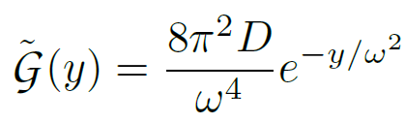

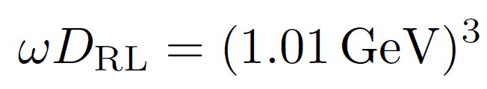




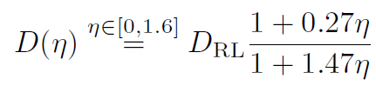
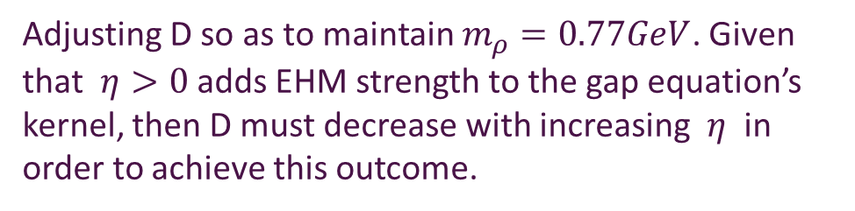
GMOR and GT Relations
the Gell-Mann-Oakes-Renner relation
a good match, cf.
Adjusting D so as to maintain $m_{ρ}=0.77GeV$. Given that $η>0$ adds EHM strength to the gap equation’s kernel, then D must decrease with increasing $η$ in order to achieve this outcome.
S.-X. Qin, C. D. Roberts, Chin. Phys. Lett. Express 38 (7) (2021) 071201.

