Slide 1
Evolving your APIs
A step-by-step approach

Slide 2

Me, myself and I
Developer
Developer advocate

Slide 3

Your first API
Probably focused on REST(ful) semantics

Slide 4

We need to deploy v2!

Slide 5
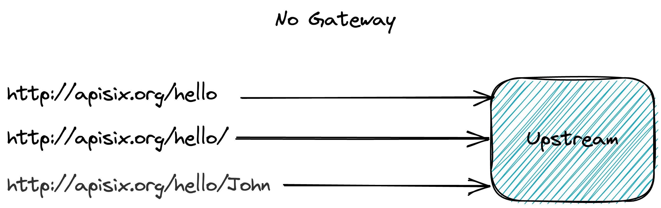
Step 1 – The initial situation
Notes:
https://excalidraw.com/#json=EyeBltUdnowyNOfpKoNDt,QCQScoI7e0KNwePIMw5KWg

Slide 6
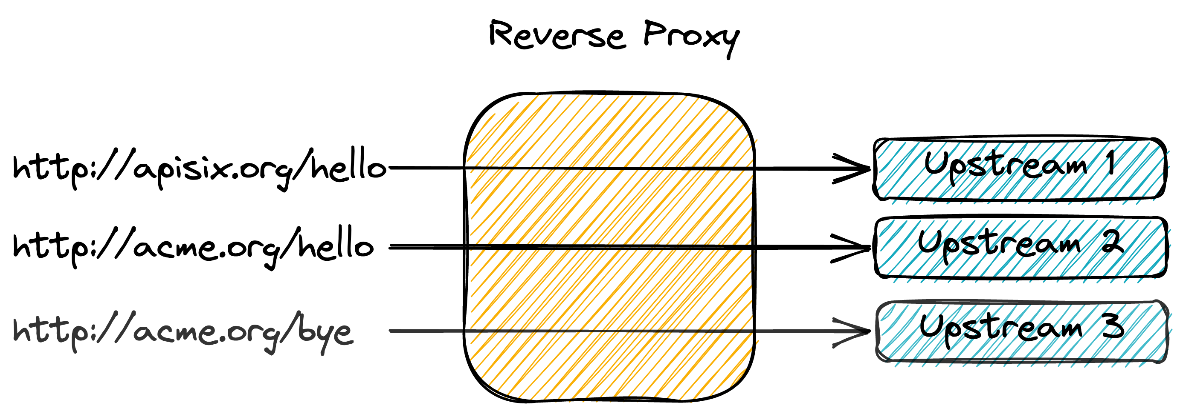
You (probably) lied
Notes:
https://excalidraw.com/#json=y9oYPqcDtc6SI3MThk5Hj,O1NBJpASw8oiLzh1ZpJ9Yg

Slide 7
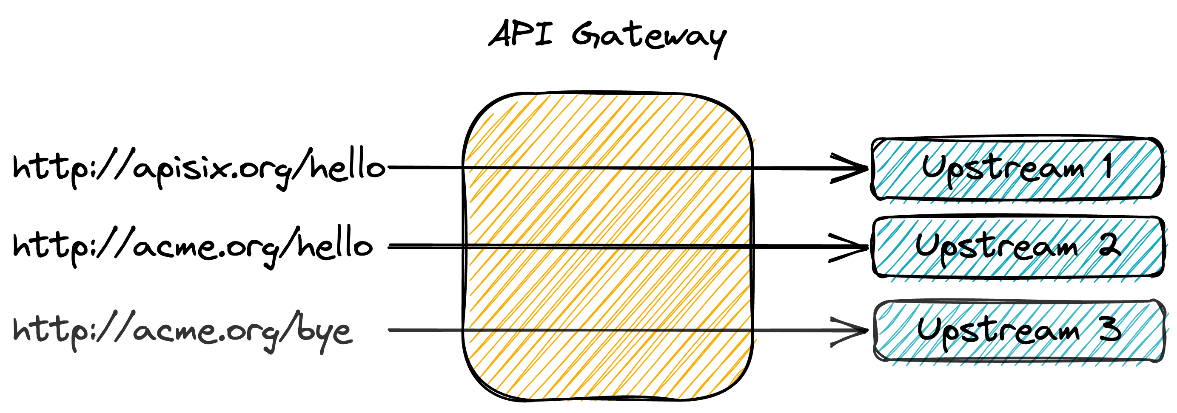
An API Gateway can help!
Notes:
https://excalidraw.com/#json=qprVAV3mvcjgCBQJSkoJf,q7Ka6W9mIQ4zi27-WVGf_A

Slide 8

Let’s go back a bit
I started to use the Internet a bit before 2000

Slide 9
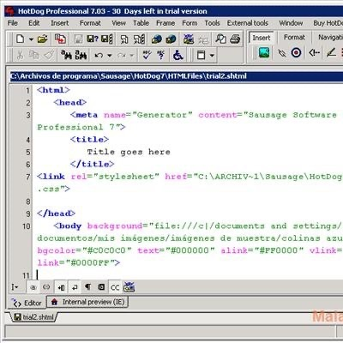
My first website
HTML:
  With images
  With MIDI audio
  No CSS
  No JavaScript

Slide 10

Web server
Serve static content

Slide 11

Personal Home Page
Apache Web Server
People wanted more dynamic content
  CGI scripts
  PHP

Slide 12

The rise of WWW
Companies started to use it as an official communication channel
  Redundancy
  Load balancing

Slide 13
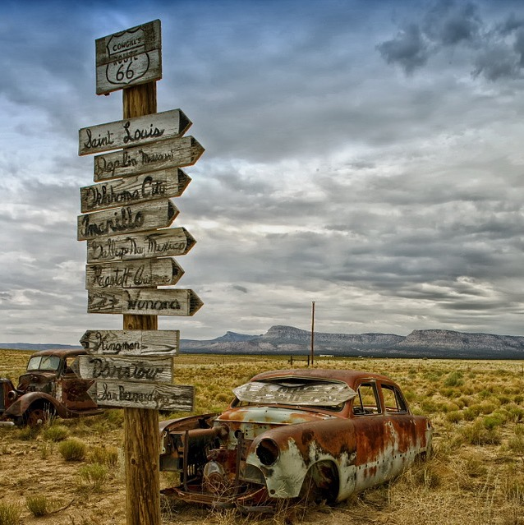
WWW becomes ubiquitous
More unrelated nodes
  Routing

Slide 14

The evolution of the Web Server
Serve static content
Serve dynamic content
Load balancer
Routing

Slide 15

Reverse Proxy: Single Point of Entry
Any cross-concern feature
  Authentication
  Authorization
  Caching
  IP Blocking

Slide 16

Interconnecting heterogeneous Information Systems
File sharing with FTP
Synchronous communication inside a tech stack
Synchronous communication via HTTP

Slide 17

API Gateway
Specialized Reverse Proxy
Features dedicated to APIs
  Billing
  Complex rate-limiting
  Etc.

Slide 18

API Gateways
Apache APISIX
Kong Gateway
Tyk
Gloo
Ambassador
Gravitee

Slide 19

Apache APISIX
Donated to the Apache Foundation in 2019
Became a Top-Level Project in 2020

Slide 20
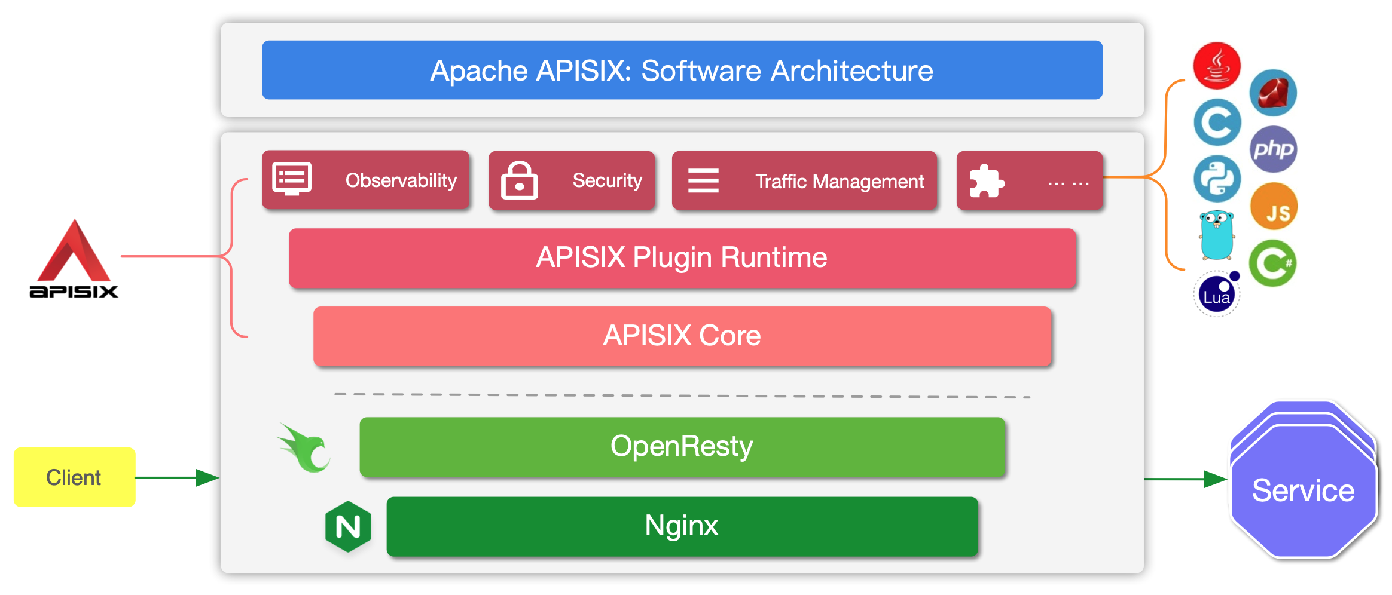
Apache APISIX, an API Gateway the Apache way

Slide 21
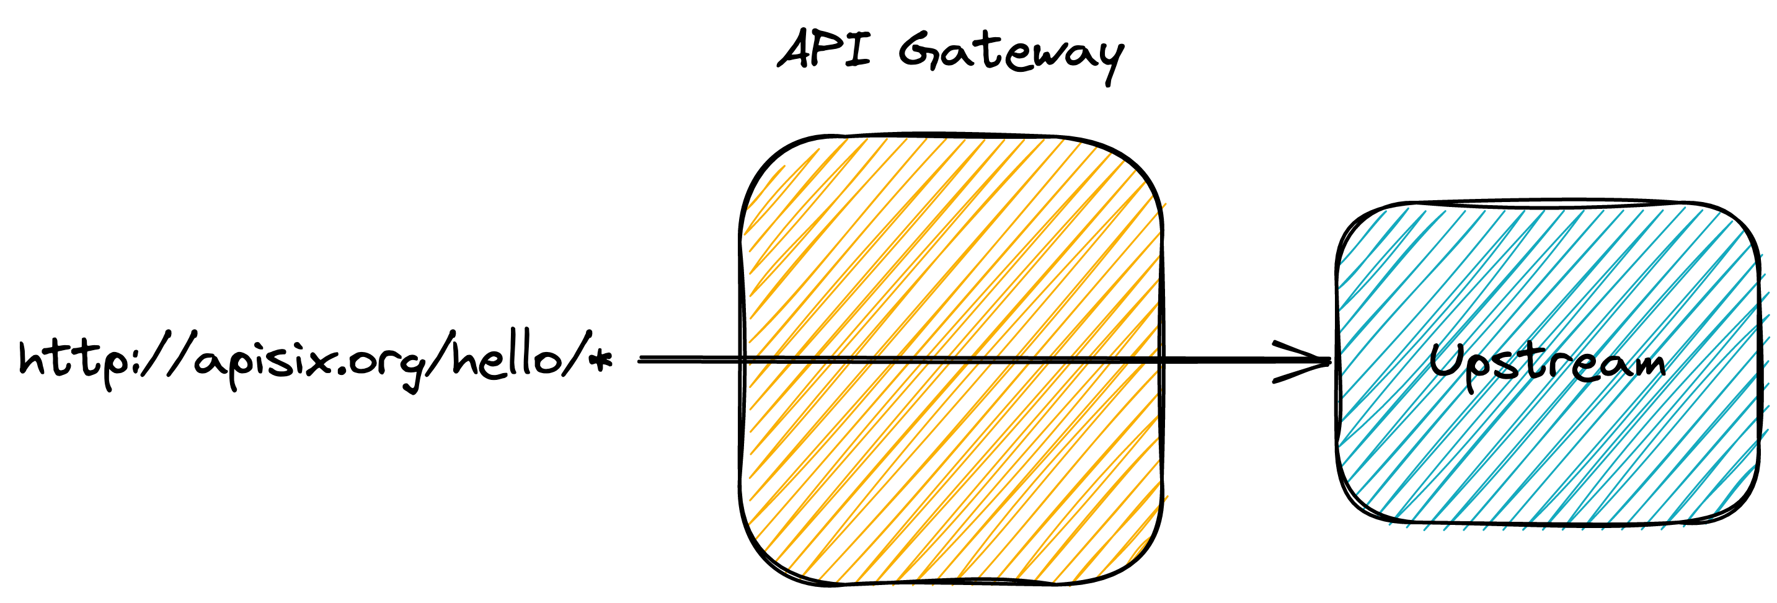
Step 2 – Introduce an API Gateway
Notes:
https://excalidraw.com/#json=MKpUO7CEklZpPJWZLvHA4,yC8RO-hZgnhHbx0hZ54_Uw

Slide 22
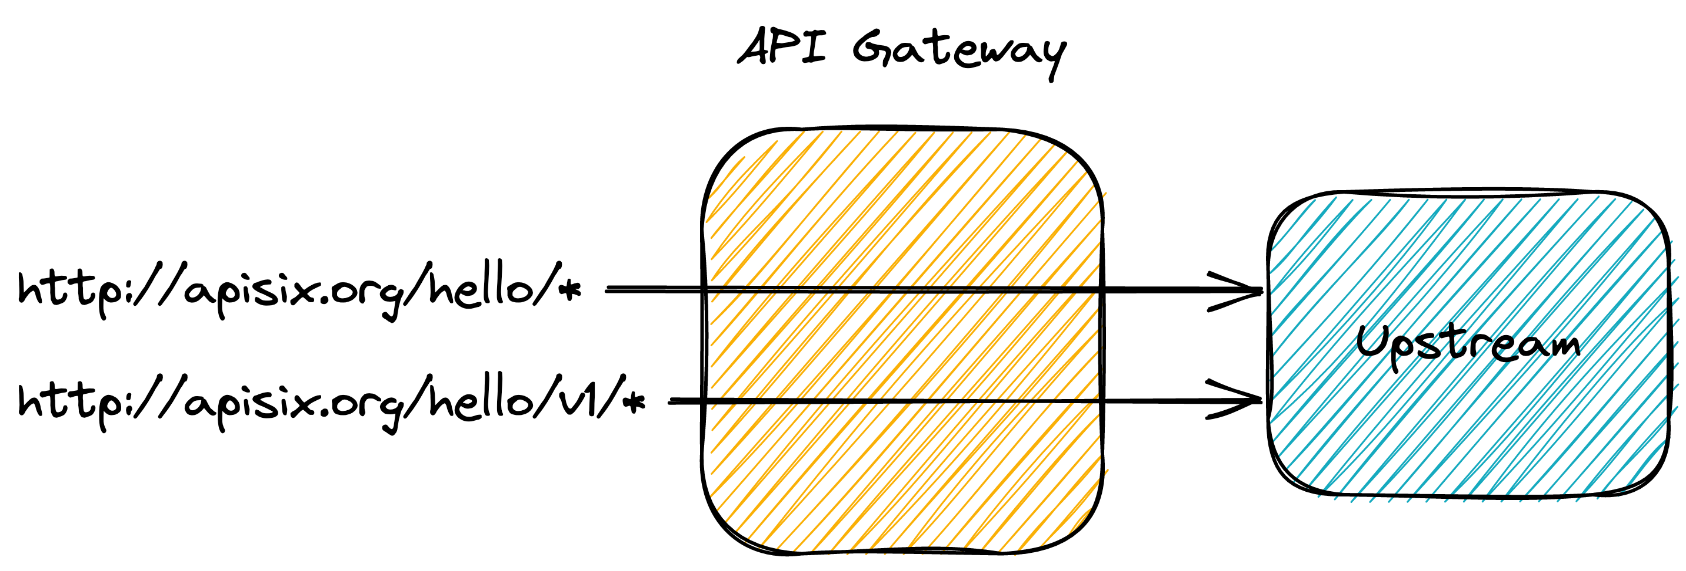
Step 3 – Introduce a versioned resource
Notes:
https://excalidraw.com/#json=VQLopkEdENU3QDafyFEcI,Ud2fGJlAtpxJM37nVhvLLQ

Slide 23
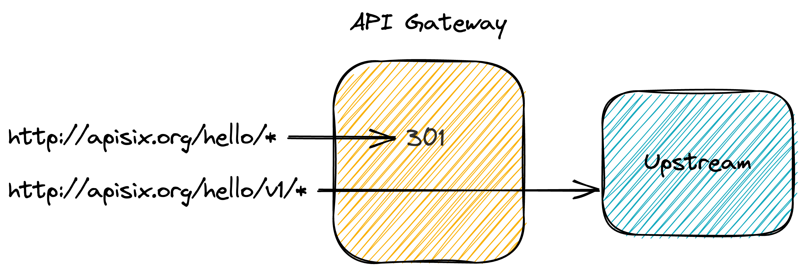
Step 4 – Move the unversioned resource permanently
Notes:
https://excalidraw.com/#json=e6BMe1HR8HNUW27gOX2wI,C5t7euoJ46t3-JFj_sC9eQ

Slide 24
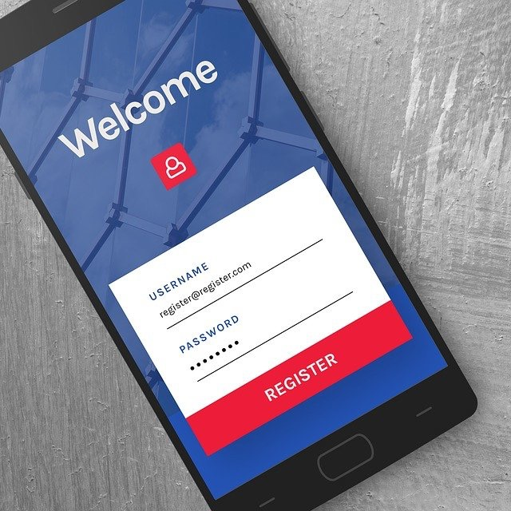
Step 5 – Make users register
Hard to change because we don’t know our users
But developers don’t like to register
Provide them an incentive
  429

Slide 25
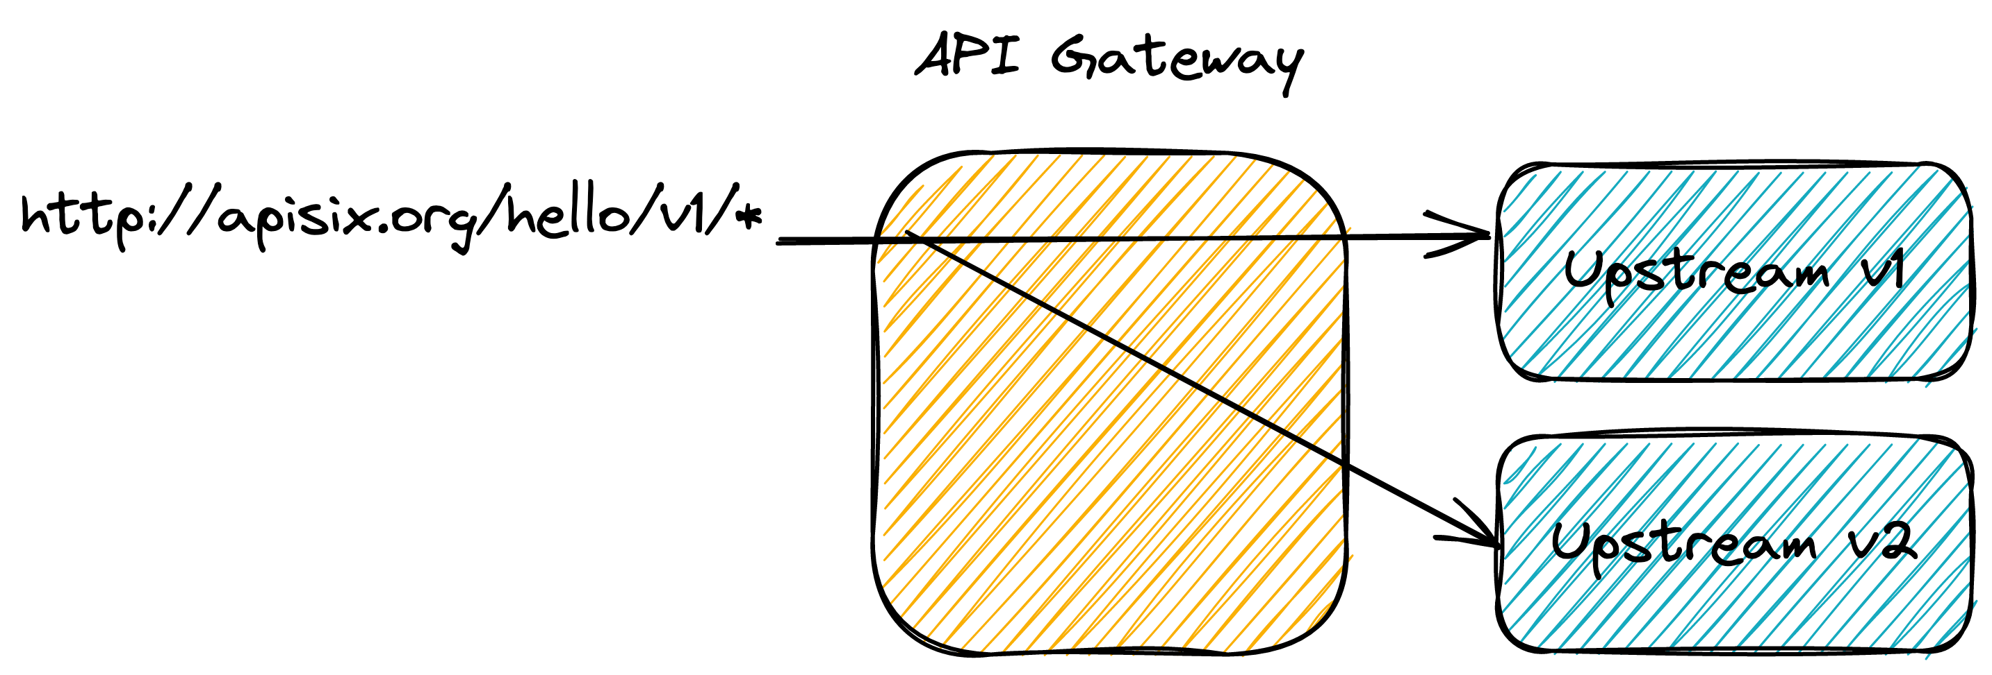
Step 6 – Test in production but be smart about it
Notes:
https://excalidraw.com/#json=6dQdcO7oUVKmNGSsyzOVM,pcWDq0NIaQJrP9zQcnrq-w

Slide 26
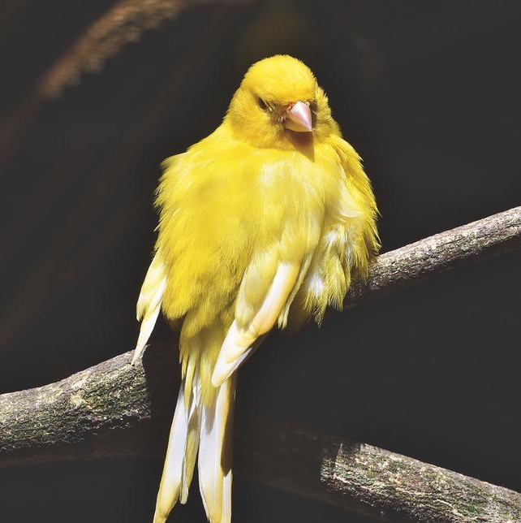
Step 7 – Use proven deployment methods
Canary release for the win

Slide 27

Step 8 – Deprecate your endpoints
IETF Draft
Deprecation header
  Date or Boolean
Link header to point to the new resource
Sunset header

Slide 28

Step 9 and afterwards – Time for v3!

Slide 29



Thanks for your attention!
@nicolas_frankel
@nico@frankel.ch
nfrankel.bsky.social
https://bit.ly/evolve-apis
https://apisix.apache.org/

