Slide 1
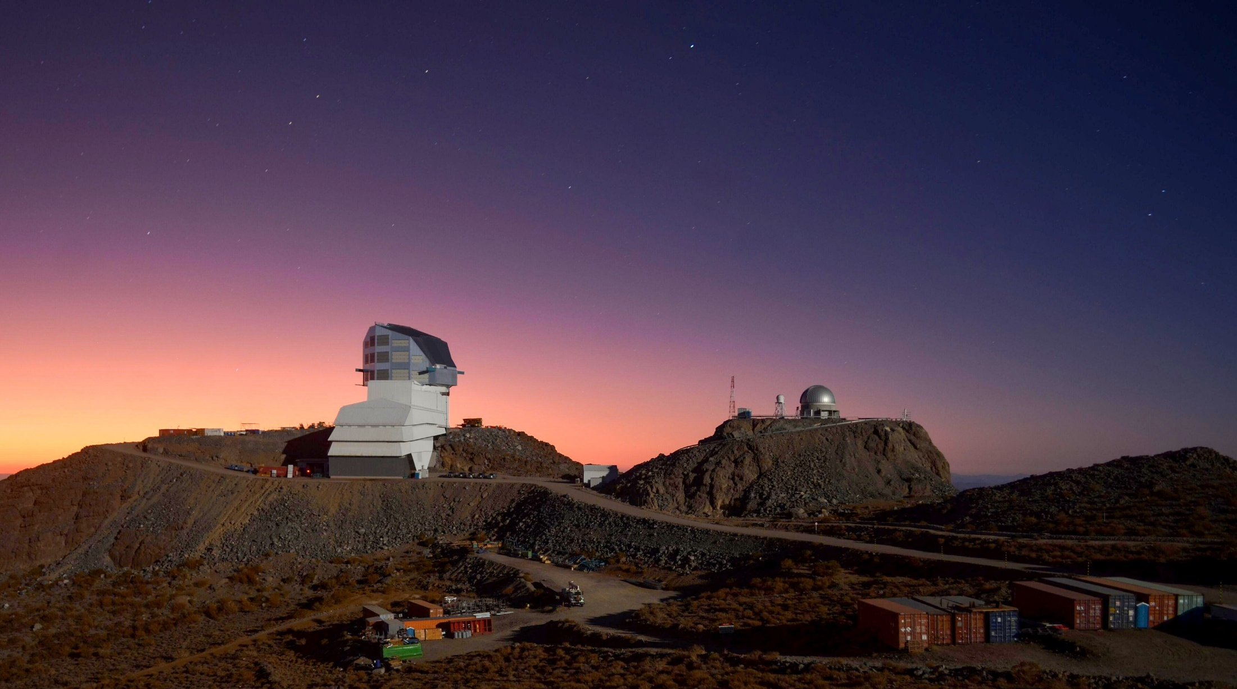

Survey Astronomy in the Big Data Era with LSST
Timothy Noble, STFC
GridPP / Swift-HEP
Thursday 30th March 2023
Acknowledgement: Rubin Obs/NSF/AURA

Slide 2
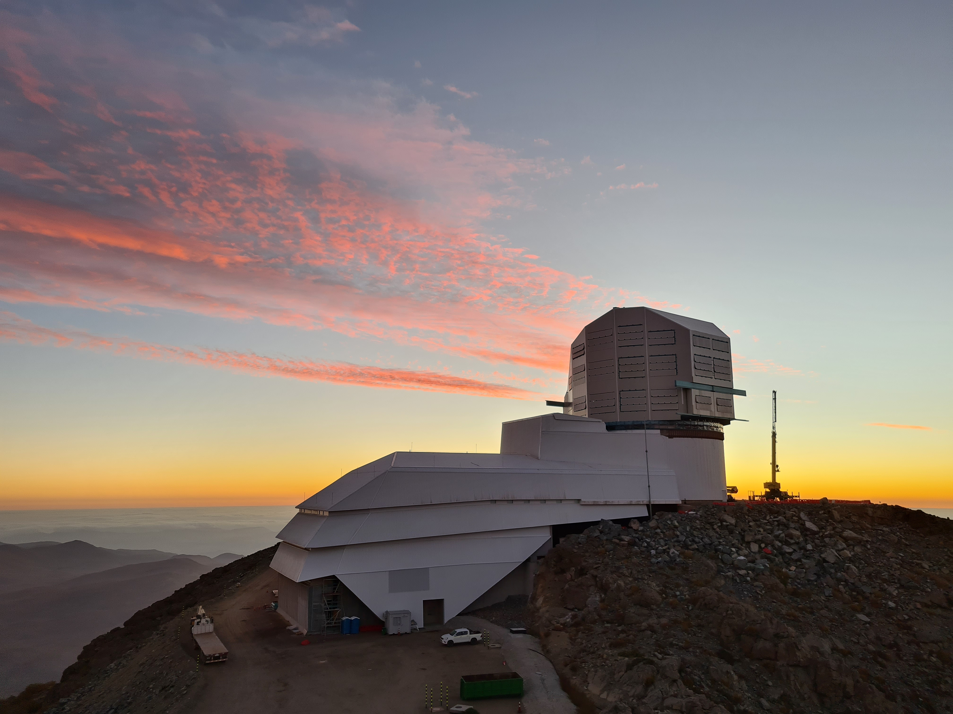
Vera C. Rubin Observatory
New observatory being constructed in northern Chile (Cerro Pachón)
High altitude and very dry climate
  best site for (ground-based) optical astronomy
Hosts 8.4m Simonyi optical telescope
  3-mirror configuration gives extremely wide field of view
  Survey whole (Southern) sky in 3 nights
Acknowledgement: Rubin Obs/NSF/AURA

Slide 3
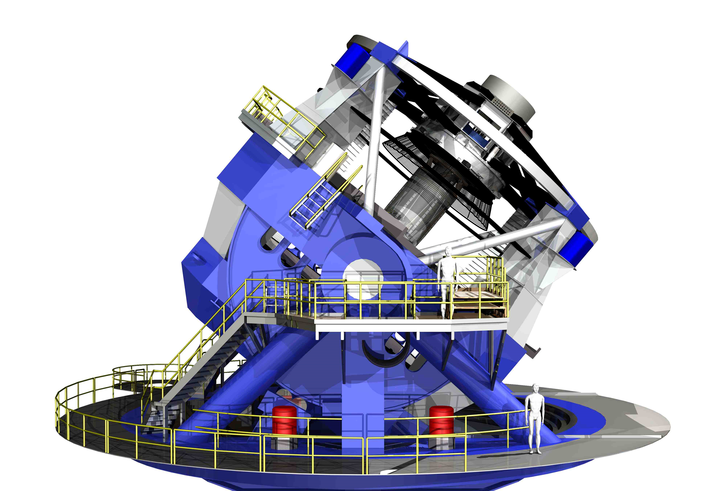
Legacy Survey of Space and Time (LSST)
10-year survey, starting in 2024 (*)
Imaging 30,000 sq. deg. of sky (in three nights)
Observes each patch 800+ times during survey
Stacked images help identify very faint objects
  24Bn galaxies, 14Bn stars plus solar-system objects
Frequent, regular visits allow time-series for dynamic objects
  Near-earth Objects
  Supernovae
(*) Construction delayed by Covid-19

Slide 4
Primary Science Drivers
Understanding Dark Energy and Dark Matter
Creating inventory of solar system
Cataloguing transient sky
Mapping Milky Way
However, LSST data expected to have huge impact on almost all areas of astronomy

Slide 5
Data Products
Annual LSST Data Releases (*)
  Processed visit images, co-adds, and object catalogues
  Published annually (two releases in first year)
  Served to community through Data Access Centres
Nightly Alert Stream/ Prompt Products
  Near-real-time issue of detected transient activity
  Expect ~10M alerts per night (though not all interesting)
  Streamed to small number of Community Broker sites
User-generated Products (*)
  Downstream enhancements from key communities/ groups
(*) Data is proprietary for two years, only for designated data rights holders

Slide 6





LSST:UK Consortium
Representation from every (that is, 36) UK astronomy groups

Slide 7
LSST:UK Consortium
Remit
  Responsible for securing and managing funding for UK Programme – called Science Centre Programme
  Delegated authority for administration of Rubin data-rights in UK
Roles
  Project Leader – Bob Mann (Edinburgh)
  Project Scientist – Stephen Smartt (QUB)
  Commissioning Coordinator – Graham Smith (Birmingham)
  Project Managers – George Beckett and Terry Sloan (Edinburgh)
  Consortium Board Chair – Mike Watson (Leicester)

Slide 8
UK In-kind Contribution Make-up
Activity groups
  DRP – Contribute to Data Release Processing
    to process 25% of survey data (alongside CC-IN2P3, France and SLAC, USA)
  DAC – Design, deploy, and operate (full) Independent Data Access Centre
    Serving 20% of international Rubin community (1,500 data-rights holders)
  DEV – Develop software and services for UK priority science areas
    Creation of User-generated Products
    (Operation of Community Broker to receive and process nightly alert stream)
  Plus contributions to Commissioning, International Coordination and EPO

Slide 9
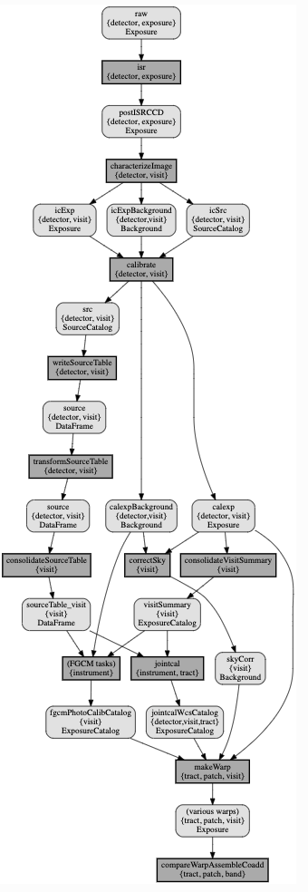



Data Flows
US Data Facility
French Data Facility
50% of annual data release processing
Archive Site
US DAC
Calibration products
L2 Data Products
25% of annual DRP
UK Data Facility
EPO Center
Prompt processing: goal 1 minute
Eastbound Westbound
Raw images 1/2 of L2 Data Products
Calibration products
Engineering Facility Database
1/2 of L2 Data Products
(coadds, catalogs, SDQA)
L2 Data Products
Base Site
Eastbound Westbound
Raw images 1/4 of L2 Data Products
Calibration products
Engineering Facility Database
1/4 of L2 Data Products
(coadds, catalogs, SDQA)
Chilean DAC
15 TB/night
Calibration products
L2 Data Products
Data Release:
Coadds
Object catalog
Source catalog
Forced Source catalog
10s k concurrent processing jobs:
3 sites
Transferring 100s PB of results by yr 10
ESnet handles traffic to Europe
Physical Shipments
Archive Site to Base Site
Annually
Hardware
Data Release Products (secondary method)

Slide 10
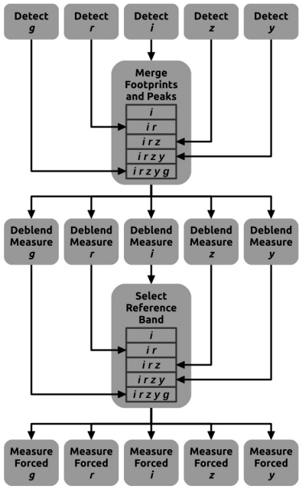
Data Release Processing (DRP)
Work shared across three facilities:
  US Data Facility – SLAC
  French Data Facility – CC-IN2P3
  UK Data Facility – IRIS
Looking to HEP technologies for distributed processing
  Rucio – distributed data management
  PanDA – workload distribution/ management
  FTS – data transfer
Integrated with LSST Stack technologies
  LSST Science Pipeline – processing
  Data Butler – data/ metadata curation
  Qserv – catalogue database

Slide 11
Preparing for DRP (SLAC, France, UK)
DP0.2 done, using PanDA
  Redone at CC-IN2P3, though with different workflow tool (Parsl)
Routine HSC reprocessing in progress at the USDF for a couple of months now
  Engagement of Campaign Mgmt, Pipelines and Infrastructure groups
  Pipelines group proposing a full HSC PDR3 multi-site reprocessing by July
Rucio and PanDA servers installed at SLAC; in final testing
Multi-site testing/scaling work is underway, via increasingly complex stages
  Start with job submission to central PanDA server from each site, to be executed at those sites (done)
  Expand to central submission
  Use Rucio/FTS to move input/output files among sites
  Test scaling up numbers of processes and volume of data

Slide 12
LSST:UK Science Centre Programme
Phase A:
Development
Phase B:
Commissioning
Phase C:
Early Ops.
Phase D:
Standard Operations
Phase E:
Standard Operations
2014 | 2015 | 2016 | 2017 | 2018 | 2019 | 2020 | 2021 | 2022 | 2023 | 2024 | 2025 | 2026 | 2027 | 2028 | 2029 | 2030 | 2031 | 2032 | 2033 | 2034 | 2035 | 2036
Five-phase programme
  Phase A (Jul’15—Jun'19) – Development
  Phase B (Jul'19—Mar’23) – Commissioning
  Phase C (Apr'23—Mar’27) – Early Operations
  Phase D (Apr'27—Mar’31*) – Standard Operations
  Phase E (Apr’31--~2036*) – Standard Operations (cont’d)
Forecast budget of £56M (including capital for DAC and DRP)
  Infrastructure element funded through IRIS Programme

Slide 13

STFC IRIS Programme
Infrastructure provision for large-scale UK PPAN facilities
  LSST, LHC, Dune, SKA, Euclid, Diamond Light Source, …
  LSST:UK founding partner of IRIS Programme
Distributed provision of cloud, grid, HPC, storage (+ supporting infra)
LSST:UK developing long-term sizing model (2022—2036)
  Cloud, HPC and storage for DAC services
  HPC and storage for DEV
  Grid and storage for DRP
  (Networking bandwidth for all aspects of operation)

Slide 14
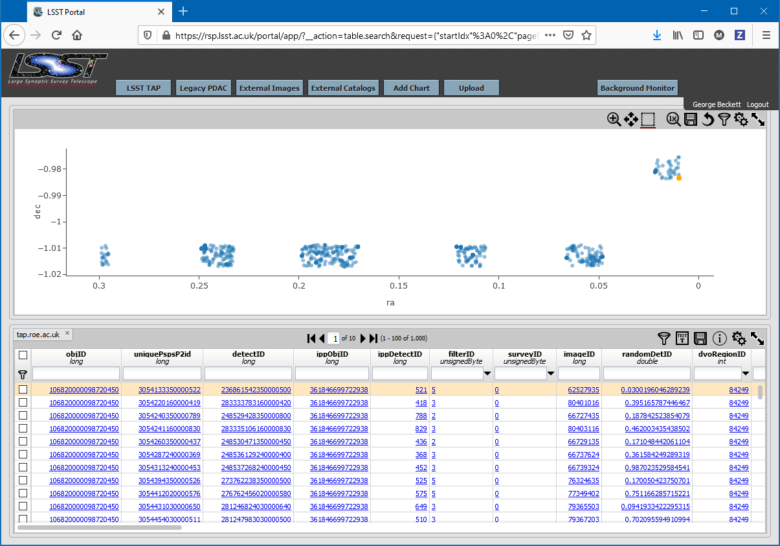
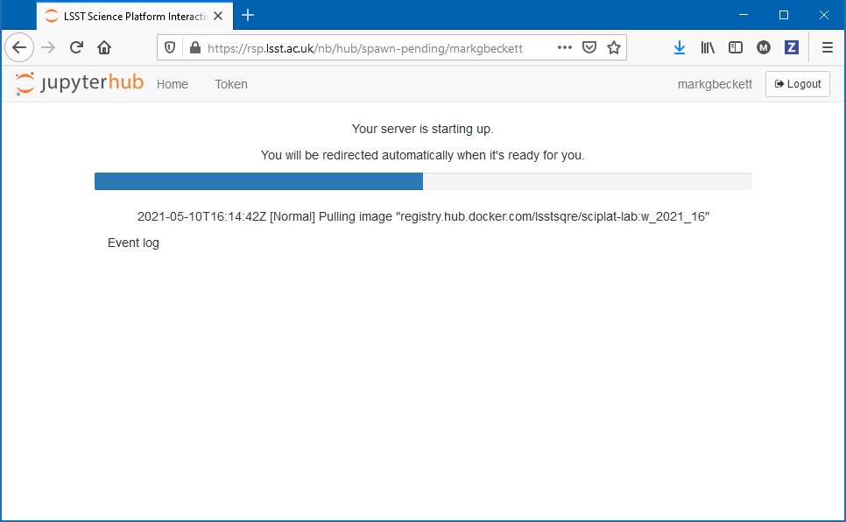
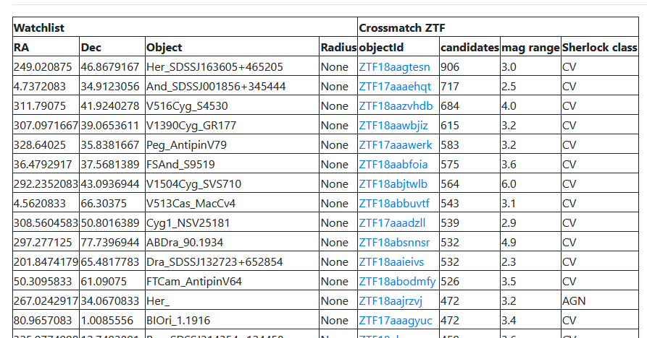
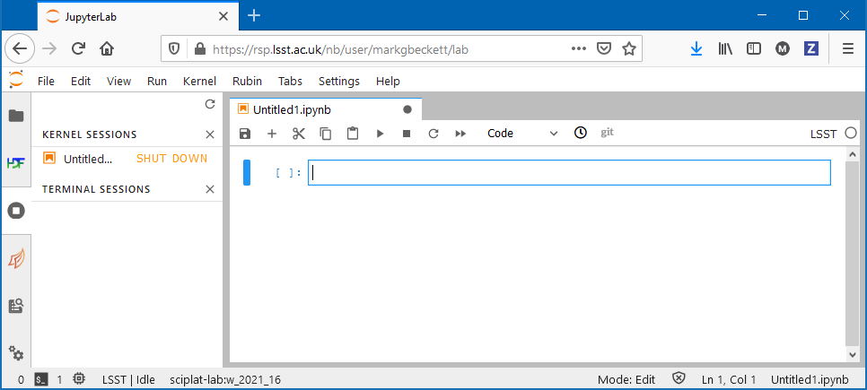
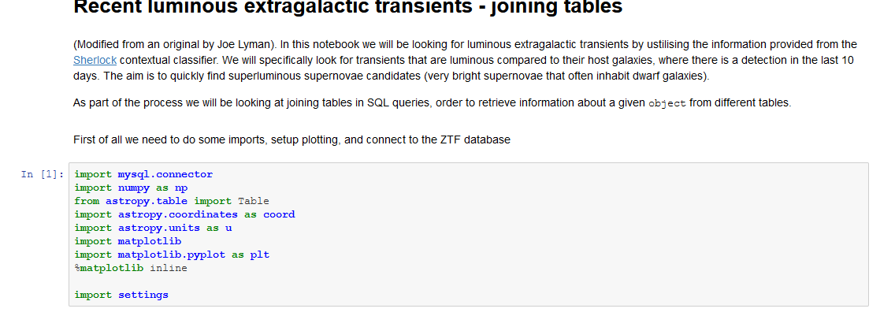

UK Data Access Centre
Proto-DAC
  Based on Rubin Science Platform
Analysis Platform for LSST Data
  Bring compute to data
  Catalogue and image services
  Portal, notebooks (and batch) UI
  Containerised (Kubernetes)
Running on IRIS cloud
  Hosting early datasets (see later)
  Deployed on Scientific OpenStack
  Running at Edinburgh (and RAL)
Rubin Science Platform/ Lasair:ZTF
Running on IRIS Cloud in Edinburgh

Slide 15

Community Broker for astronomical transients
UK Community Broker confirmed for operations (one of seven)
Rubin Alerts with enhancements
  Sherlock (sky context), known supernovae (TNS), user-made watchlists/ areas
SQL access to alerts, both on-demand and real-time streaming
Users can "annotate" the data objects with classifications
  Zooniverse, Fastfinder, Fink, Alerce
Machine-to-machine filtered output streams via public Kafka service
Running on IRIS Cloud in RAL and Edinburgh
University of Edinburgh and Queen’s University Belfast

Slide 16
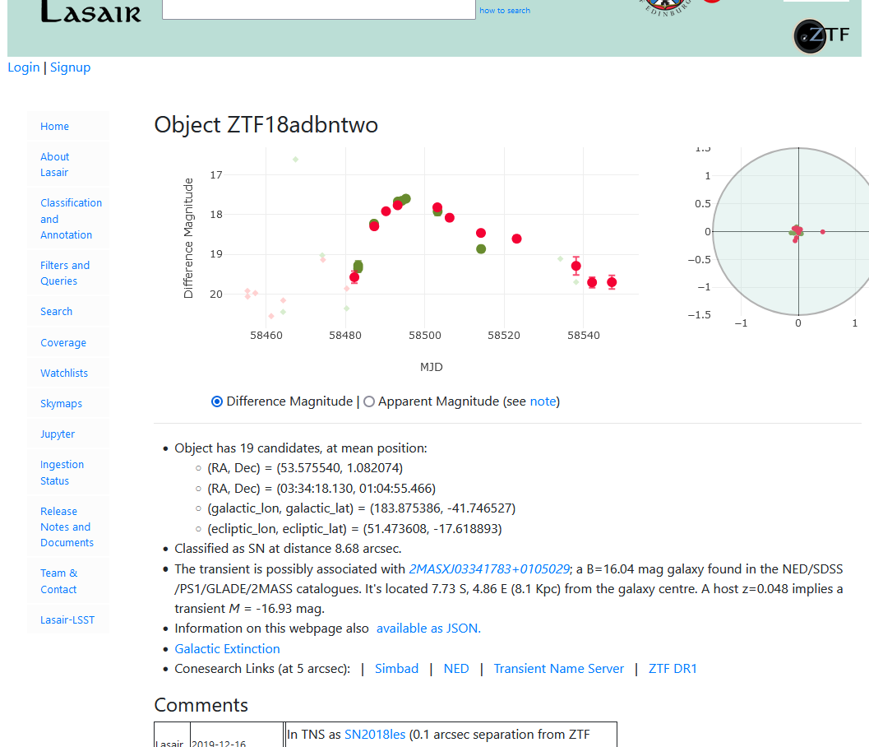
:ZTF—Precursor for Rubin
Running on IRIS cloud (Edinburgh and RAL)
Ingest nightly alerts from ZTF
  400,000 alerts per night (20kb each)
  Filter, annotate, and follow-up
Publish via web interface
  Standard queries
  Cross-match to other surveys (5TB catalogues)
  Personalised watch lists/ alerts
… and notebook service
  Flexible scripted analysis
  Astronomy/ Rubin software and Lasair API
Collaborations with
  Zooniverse, Fink & Ampel, 4MOST/Tides
http://lasair.roe.ac.uk

Slide 17
UK Contributions

Slide 18
UK DAC Data movement
Pre-LSST data generated and processed at Cambridge (CSD3)
  Need to move data from CSD3 to RAL for long-term storage and access
Challenge – Move data from Cambridge to RAL and register metadata in Data Butler
  Rucio to be used to manage the data movement
  Then register the files and their metadata to Data Butler for user lookup
  Data should then be accessible for Users in Edinburgh and highly used data moved to Edinburgh to reduce network traffic
To be carried out by Mathew Sims at RAL

Slide 19
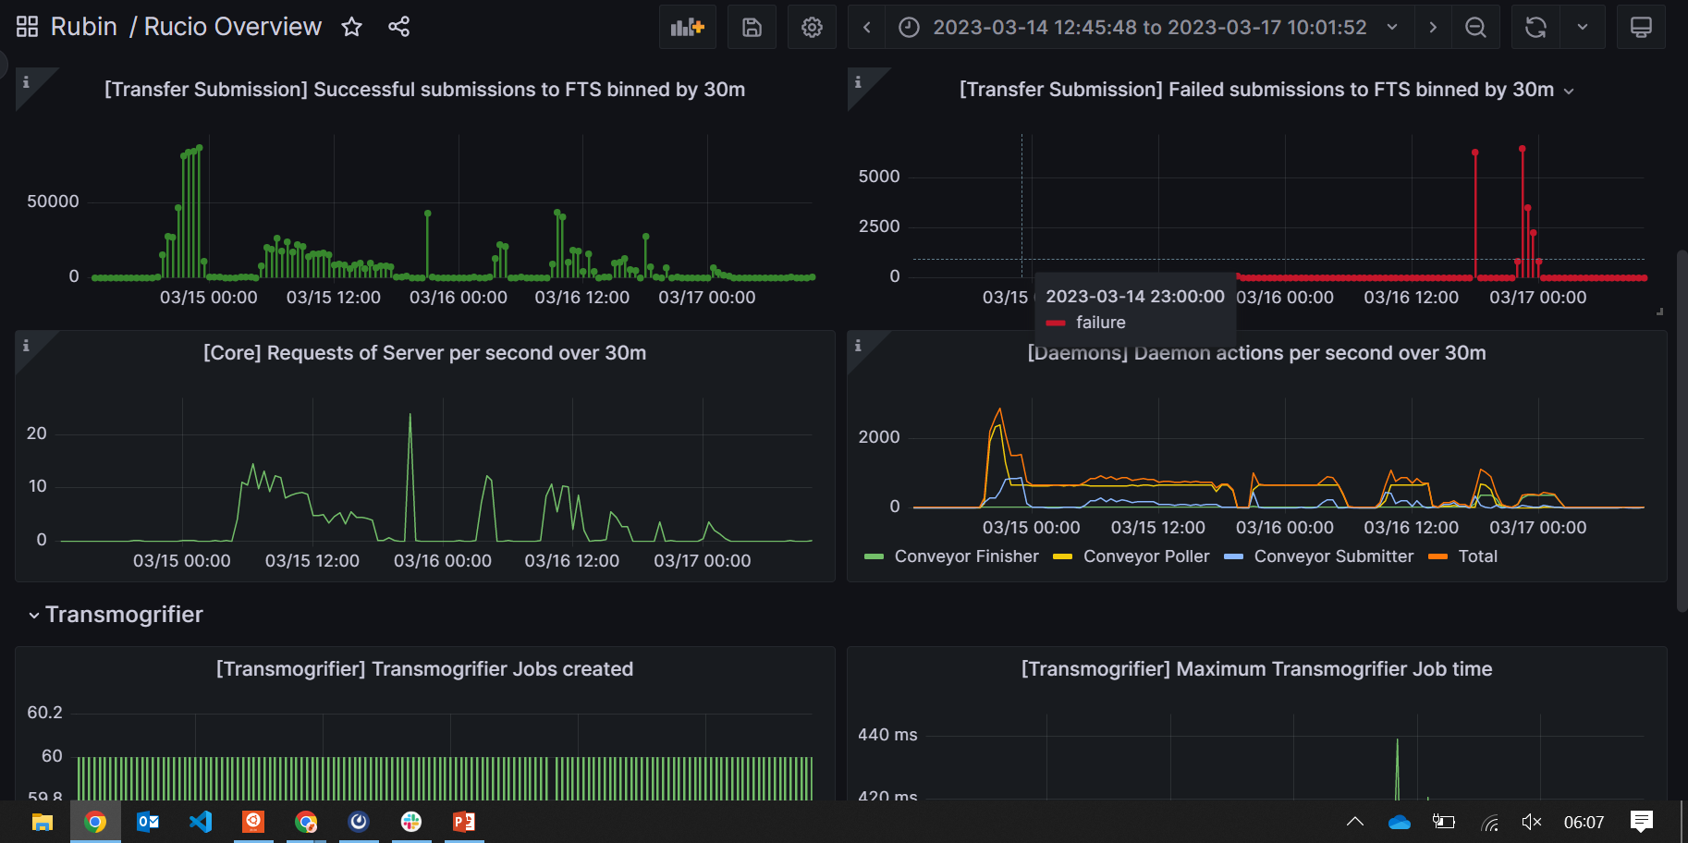
Data Transfer Monitoring
Begun setting up monitoring pages to help all data facilities understand data flows and troubleshoot problems
More infrastructure is needed for further information, desired monitoring like Edinburgh
Use of RAL production FTS has highlighted monitoring hole, and to be worked on

Slide 20
LSST Requirements for future

Slide 21
Sizing Model (High-level Summary)
DRP
 | Preops | Survey Operations (based on commencement of survey in FY24) |  |  |  |  |  |  |  |  |  | Post-ops
Capability | FY23 | LOY1 | LOY2 | LOY3 | LOY4 | LOY5 | LOY6 | LOY7 | LOY8 | LOY9 | LOY10 | FY34 | FY35
CPU (M core hrs) | 11 | 11 | 21 | 30 | 40 | 50 | 63 | 73 | 83 | 93 | 103 | 100 | 50
Normal/ Object (PB) | 8.0 | 9.0 | 16.0 | 23.0 | 30.0 | 37.0 | 44.0 | 51.0 | 58.0 | 65.0 | 72.0 | 61.4 | 0
DAC
 | Preops | Survey Operations (based on commencement of survey in FY24) |  |  |  |  |  |  |  |  |  | Post-ops
Capability | FY23 | LOY1 | LOY2 | LOY3 | LOY4 | LOY5 | LOY6 | LOY7 | LOY8 | LOY9 | LOY10 | FY34 | FY35
CPU (M core hrs) | 0.53 | 0.88 | 2.10 | 2.45 | 2.63 | 3.94 | 5.26 | 5.26 | 6.57 | 7.88 | 7.88 | 7.88 | 7.9
Normal/ Object (PB) | 2.2 | 21.9 | 50.0 | 72.1 | 94.9 | 117.6 | 140.2 | 162.9 | 185.6 | 208.3 | 231.0 | 231.0 | 231.0

Slide 22
Sizing Model (cont.)
Lasair
User compute/ storage is part of RSP
 | Preops | Survey Operations (based on commencement of survey in FY24) |  |  |  |  |  |  |  |  |  | Post-ops
Capability | FY23 | LOY1 | LOY2 | LOY3 | LOY4 | LOY5 | LOY6 | LOY7 | LOY8 | LOY9 | LOY10 | FY34 | FY35
CPU (M core hrs) | 0 | 4 | 4 | 4 | 4 | 4 | 4 | 4 | 4 | 4 | 4 | 4 | 4
Normal/ Object (PB) | 0.0 | 0.3 | 0.5 | 0.8 | 1.1 | 1.3 | 1.6 | 1.8 | 2.1 | 2.4 | 2.6 | 2.6 | 2.6
Fast/ NVMe (TB) | 115 | 136 | 156 | 177 | 197 | 218 | 238 | 259 | 279 | 300 | 300 | 300 | 136
DEV
??? – though less than DRP

Slide 23
Summary
UK astronomers and sites working together to maximise opportunity of Vera C. Rubin Observatory
  In-kind programme means more involvement/ influence in Operations
Ambitious plans
  Operate UK-based Data Access Centre (and Community Broker)
  Extend LSST science potential through user-generated products and integration with ancillary surveys
  Undertake contribution to Data Release Processing
Significant requirements for diverse computing infrastructure over next 10—15 years

Slide 24
Thank you

