Slide 1



ARM compute @ Glasgow
& Power Update
Emanuele Simili & Dwayne Spiteri GridPP51 & SWIFT-HEP07 Sheffield - 26 March 2024
Notes:
PoW @ GridPP

Slide 2

Outline
Update on Glasgow cluster & new kit testing
- heterogeneous computing!
- doubling our ARM farm with new AltraMax
Updates benchmarks results:
- new Figure of Merit to estimate power usage (HEP-Score → standard job)
- HEPscore/Watt comparison extended to more machines
- new Frequency Scan
- idle vs. frequency
ARM validation campaign
- High level summary of experiment tests
- Validation results
Outlook …
Notes:
outline

Slide 3
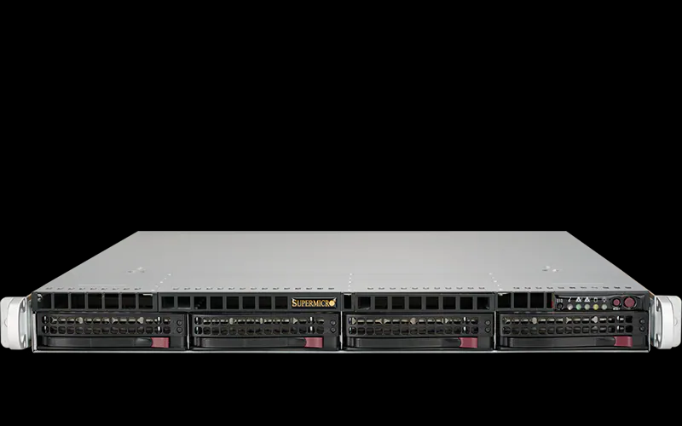

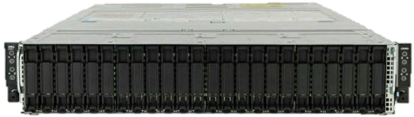
in-House (production)
2xIntel40ht: Dual Socket Intel XEON 10-Core CPU E5-2630 v4 (HP)
CPU: 2 * Intel(R) Xeon(R) 10-core CPU E5-2630 v4 @ 2.2GHz (TDP 85W)
RAM: 160GB (4*32GiB + 4*8GiB) DDR4 2400 MHz → 4 GB/core
HDD: 2TB disk SATA 6Gb/s @ ‎7200 RPM (SEAGATE)
OS: CentOS 7.9 →
~ 1.5k cores
2xAMD64ht: Dual Socket AMD EPYC 7513 32-Core Processor (DELL)
CPU: 2 * x86 AMD EPYC 7513, 32C/64HT @ 2.6GHz (TDP 200W)
RAM: 512GB (16 x 32GB) DDR4 3200MT/s → 4 GB/core
HDD: 3.84TB SSD SATA Read Intensive
OS: CentOS 7.9 → Alma 9
~ 5k cores
2xAMD64ht: Dual Socket AMD EPYC 7452 32-Core Processor (DELL)
CPU: 2 * x86 AMD EPYC 7452, 32C/64HT @ 2.32GHz (TDP 200W)
RAM: 512GB (16 x 32GB) DDR4 3200MT/s → 4 GB/core
HDD: 3.84TB SSD SATA Read Intensive
OS: CentOS 7.9 → Alma 9
~ 7.5k cores
2*ARM80c: Dual Socket Ampere Altra Q80-30 80-Core Processor (Ampere)
CPU: 2 * ARM Q80-30 80C @ 3GHz (TDP 210W)
RAM: 512GB (32 x 16GB or 16 x 32GB) DDR4 3200MT/s → 3.2 GB/core
HDD: 2 * 1Tb NVMe (INTEL + SAMSUNG)
OS: Rocky 9.2
~ 2k cores
~ 2k cores Single Socket Ampere Altra Max M128-30 coming soon …
Notes:
Snapshot of our Tier2 compute cluster

Slide 4
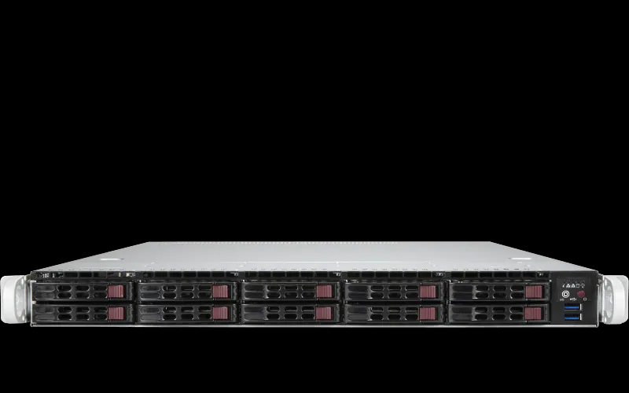
in-House (testing)
AMD96ht: Single AMD EPYC 7003 48-Core Processor (GIGABYTE)
CPU: x86 AMD EPYC 7643 48C/96HT @ 2.3GHz (TDP 225W)
RAM: 256GB (16 x 16GB) DDR4 3200MHz → 2.7 GB/core
HDD: 3.84TB SSD SATA (SAMSUNG)
OS: Alma 9
*
2xAMD96ht: Single AMD EPYC 7003 48-Core Processor (DELL)
CPU: 2* AMD EPYC 7443 24-Core Processor @ 4GHz @ 2.3GHz (TDP 200W)
GPU: 2* NVidia A100 PCIe 80GB (TDP 300W)
RAM: 256GB (16 x 16GB) DDR4 3200MHz → 2.7 GB/core
HDD: 480GB SSD SATA + 5TB SSD SCSI (DELL)
OS: Rocky 8
ARM80c: Single socket Ampere Altra Q80-30 80-Core Processor (GIGABYTE)
CPU: ARM Q80-30 80C @ 3GHz (TDP 210W)
RAM: 256GB (16 x 16GB) DDR4 3200MHz → 3.2 GB/core
HDD: 3.84TB SSD SATA (SAMSUNG)
OS: Alma 9
Grace144c: Dual Socket NVidia Grace 144-Core Processor (SuperMicro)
CPU: NVidia Grace 144-Core 480GB DDR5 @ 3.4GHz (TDP 500W)
RAM: 480GB (on chip) DDR5 4237MHz → 3.3 GB/core
HDD: 1TB NVMe + 4TB NVMe (SAMSUNG)
OS: Alma 9
+ a recently purchased RISC-V desktop PC (see next slides)
Notes:
in-house

Slide 5

Tested Remotely
2*AMD256ht: Dual Socket AMD EPYC 9754 128-Core Processor (SuperMicro)
CPU: 2 * x86 AMD EPYC 9754, 128C/256HT @ 3.1GHz (TDP 360W)
RAM: 1.536TB (24 x 64GB) DDR4 3200MHz → 3 GB/core
HDD: 512GB NVMe + 3.84TB SSD
OS: Rocky 9.2
SuperMicro
AMD128c: Single Socket AMD EPYC 8534P 64-Core Processor (SuperMicro)
CPU: AMD EPYC 8534P @ 3.1GHz (TDP 200W)
RAM: 576GB (6 x 96GB) DDR5 3200MT/s → 4.5 GB/core
HDD: 1Tb NVMe Storage
OS: Rocky 8.8 Green Obsidian
SuperMicro
ARM128c: Single Socket Ampere Altra Max M128-28 128-Core Processor (XMA)
CPU: ARM M128-28 @ 2.8GHz (TDP 250W)
RAM: 512GB (64 x 8GB) DDR4 3200MHz → 4 GB/core
HDD: 1Tb NVMe Storage
OS: Rocky 8.8 Green Obsidian
XMA
More coming soon. We notified vendors about our interest.
Looking for: AmpereOne, Grace Hopper, Blackwell …
Notes:
Looks like we’ve found one ☺

Slide 6



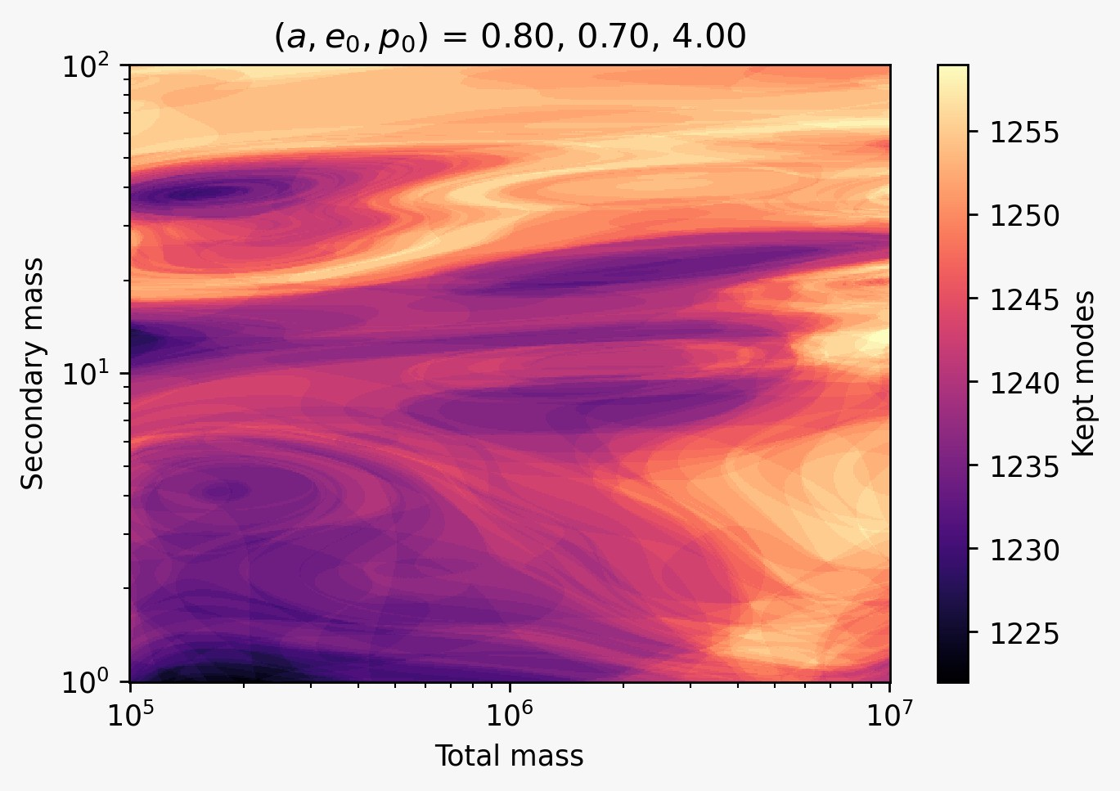

GPU testing
We had our GPU node for a while now, so far it has been used:
- by local users, as A.I. playground
(from early GPTs to the latest SDXL)
- by Gravitational Waves groups (LIGO/LISA) for
running a Neural-Network interpolator (EMRI SNR function)
https://academic.oup.com/mnras/article/522/4/6043/7159736
- by Bruno for trying out the Celeritas CPU+GPU framework
https://github.com/celeritas-project/celeritas
first goal: reproduce the ATLAS EM-Calorimeter simulation
Notes:
Bruno alias Albert Borbely (ScotGrid Glasgow)
GPU resources used by gravitational waves people (LIGO / LISA) to “fit the EMRI SNR function with a neural network interpolator“
Paper: https://academic.oup.com/mnras/article/522/4/6043/7159736#406304487
Abstract: “In this work, we propose an alternative approach that leverages the speed of the recently developed GPU-accelerated EMRI waveform package FastEMRIWaveforms (FEW; Katz et al. 2021) and machine-learning techniques to interpolate the EMRI SNR function, directly correcting for an SNR-based selection bias without the need for major systematic approximations or simplifications. In Section 2, we outline the Bayesian population inference framework employed, including the correction for selection biases. In Section 3, we introduce our approach for estimating the selection bias with machine learning, which we achieve by replacing the bottleneck in the selection bias calculation (the EMRI SNR function) with a neural network interpolator. The effectiveness of our framework is demonstrated in Section 4 for a typical EMRI population, presenting clearly the manifestation of the selection bias in the obtained results and how this is corrected for in practice; the corrected results provide an unbiased estimate for the precision to which LISA observations could constrain the astrophysical EMRI population. Finally, in Section 5, we perform a global posterior consistency check to verify the analysis.”
So neural network based interpolation to speed up a phase space search for gauging how well a future gravitiational wave decetor (LISA) could constrain the astrophysical EMRI population.

Slide 7
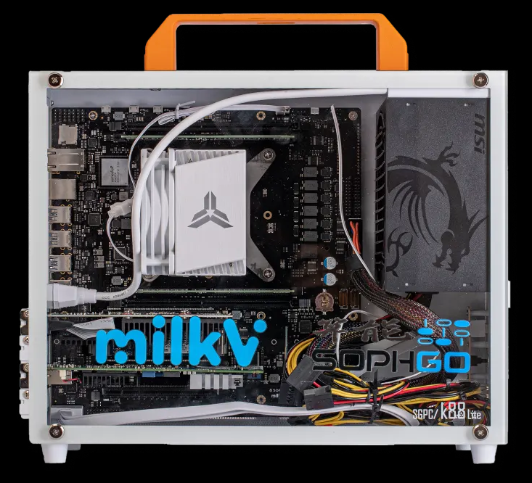
RISC-V testing
Milk-V Pioneer : Single socket RISC-V 64-Core Processor (Milk-V)
CPU: SOPHON SG2042 (64 Core C920, RVV 0.71) riscv64 @ 2GHz (TDP 120W)
RAM: 128GB (4 x 32GB) DDR4 3600 MT/s → 2 GB/core
HDD: 1TB PCIe 3.0 NVMe
OS: Fedora 38
We managed to install ROOT for RISC (https://github.com/hahnjo/root.git), CVMFS and XRootD by compiling from source.
We could run ROOT stress tests: all 64 cores seem to do work and the peak power consumption is ~140W … but this is a desktop PC.
We have been talking with Tommaso (INFN), who also has a couple of RISC-V machines and had plan to try porting CMS …
Notes:
ROOT: https://github.com/hahnjo/root.git
cmake -DCMAKE_INSTALL_PREFIX=../root_install2 -Dtesting=ON -Droottest=ON -Dx11=ON -Dxrootd=ON --fresh ../root_riscv
CVMFS: https://github.com/cvmfs/cvmfs.git
XRootD: …

Slide 8
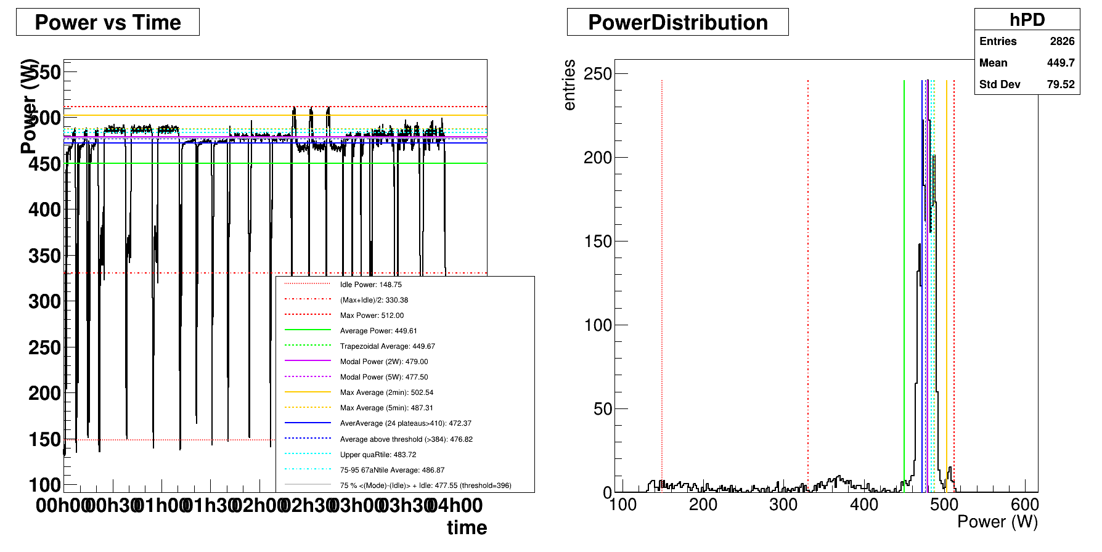

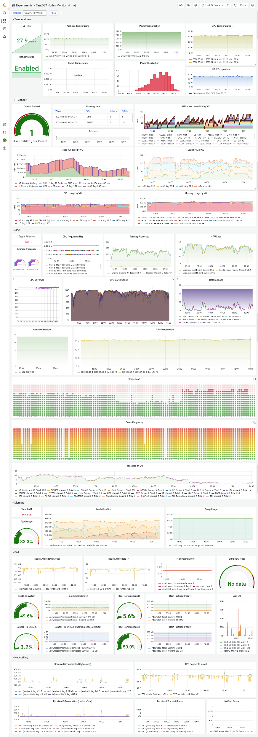
What Watt
We benchmark using the HEP-Score suite (i.e., 3 x 7 workloads of 10-30 min. each, including start-up phase).
This does not well represent the standard running conditions at grid sites, where typical pilots last 24-48h and multiple jobs run simultaneously, keeping the CPU at ~100% all time.
2*AMD64ht
So … what is the most representative figure for of power usage?
Or, in other words: What Watt ?
Notes:
If we want to talk about HEP-Score/Watt, we must define what we mean by Watt !

Slide 9
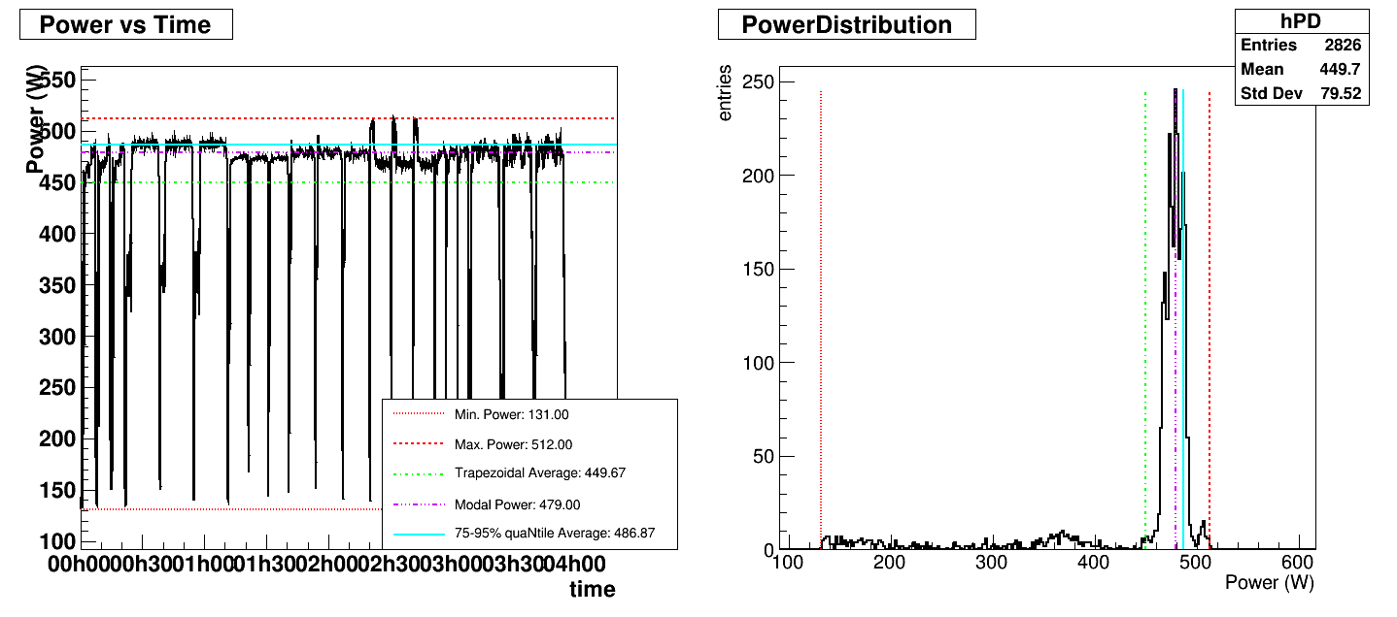
What Watt (2)
New Figure of Merit (FoM), i.e., the best proxy of power usage for standard HEP workloads:
2*AMD64ht
FoM should be tuned to the power profile of typical runs:
Runs start with low power while staging and then run in a plateau for most of the run.
Don’t want to be swayed by small spikes above the plateau or regions of time where power is low between runs.
Maximum (red dashed) – Overestimates usage
Average (green dashed) – Underestimates usage
Notice that power usage during HEP-Score run follows a peaked distribution.
FoM should reflect typical power usage, so we want to be inside the peak.
Notes:
Maximum – Overestimates usage
Average – Underestimates usage

Slide 10
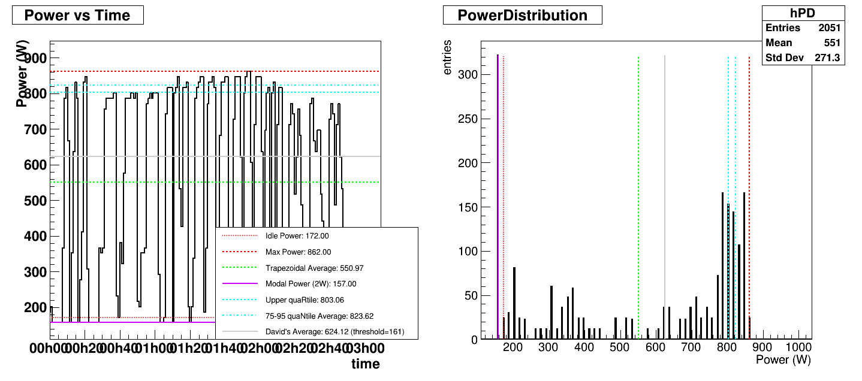
What Watt (3)
New Figure of Merit (FoM), i.e., the best proxy of power usage for standard HEP workloads:
FoM should be easy to implement, we could fit this peak, but there are other ways of doing it.
Arrange the data in power order and perform an upper quaRtile average, but removing the top 5% of data
2*AMD64ht
*
<75-95%> Blue line sits nicely in the plateau
75-95% quaNtile
average
Modal power also sits in the plateau – but we found edge cases where this breaks (e.g., Grace has a very steady idle state)
Notes:
Wordy explanation/motivation:
Neither the Max nor the Average power is the best way of characterizing the performance. The Max can be exaggerated by significant 'spikes' that can momentarily be higher than the plateau; the average is suppressed by the low-power start-up phase that can extend to 20% of the run-time for the short jobs in the HEP-Score suite. Thus, using Max power will underestimate HEP-Score/Watt and using Average power will overestimate HEP-Score/Watt. Instead, we propose to use the average power calculated from the 75-95% quaNtile. The upper quartile eliminates most of the start-up phase that would be over-emphasized by short benchmarking jobs, while the cut of the highest 5% prevents power spikes to have any significant effect.
The result is relatively insensitive to the shape of the distribution and well fits the upper plateau in the power drain plots, while giving less importance to the start-up phase and to isolated spikes in power. It can be noted that the modal power itself (the mode of the power distribution, corresponding to the most common power-draw) is a good estimate for single workloads, but not for the combination of different workloads in the HEP-Score suite that can have different power draws.

Slide 11
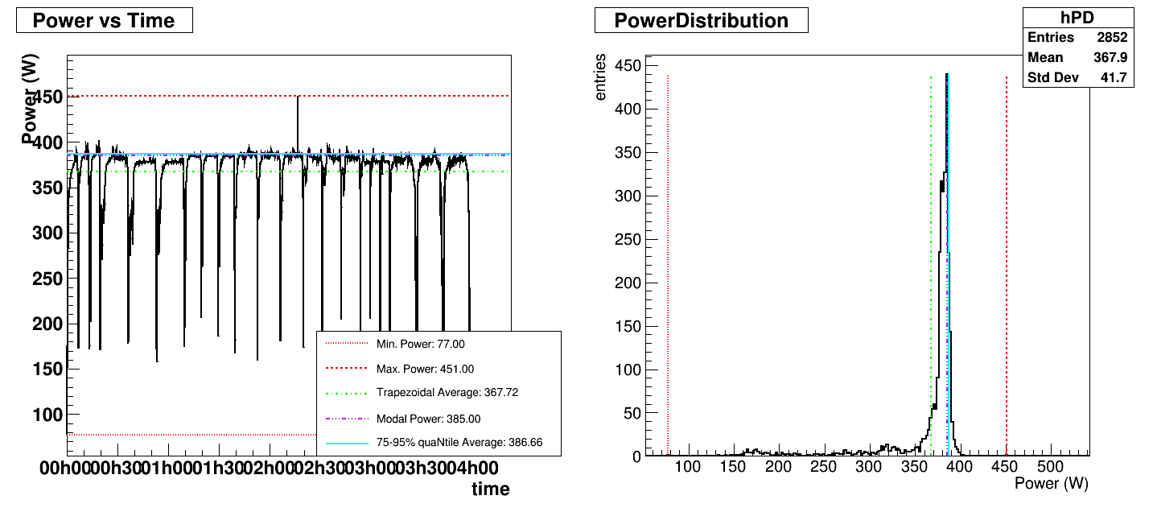
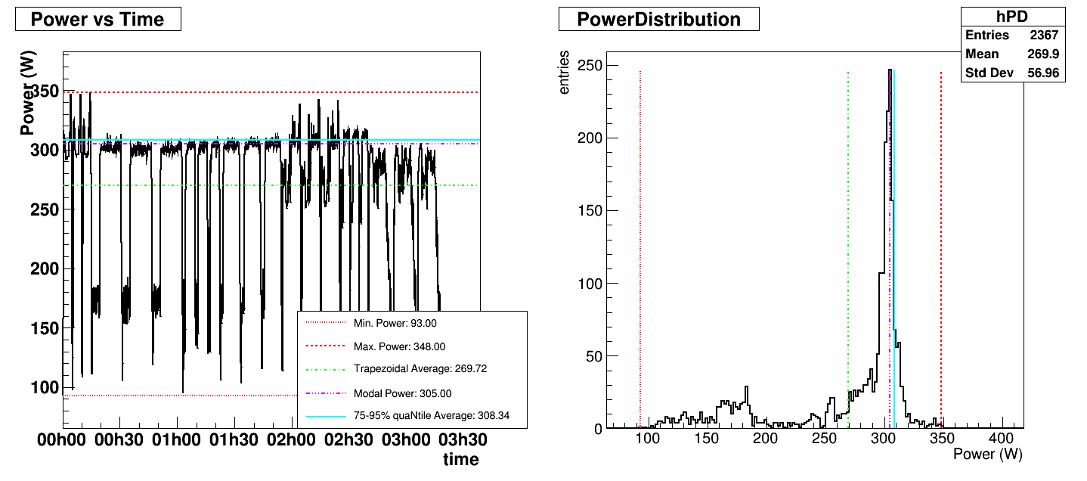
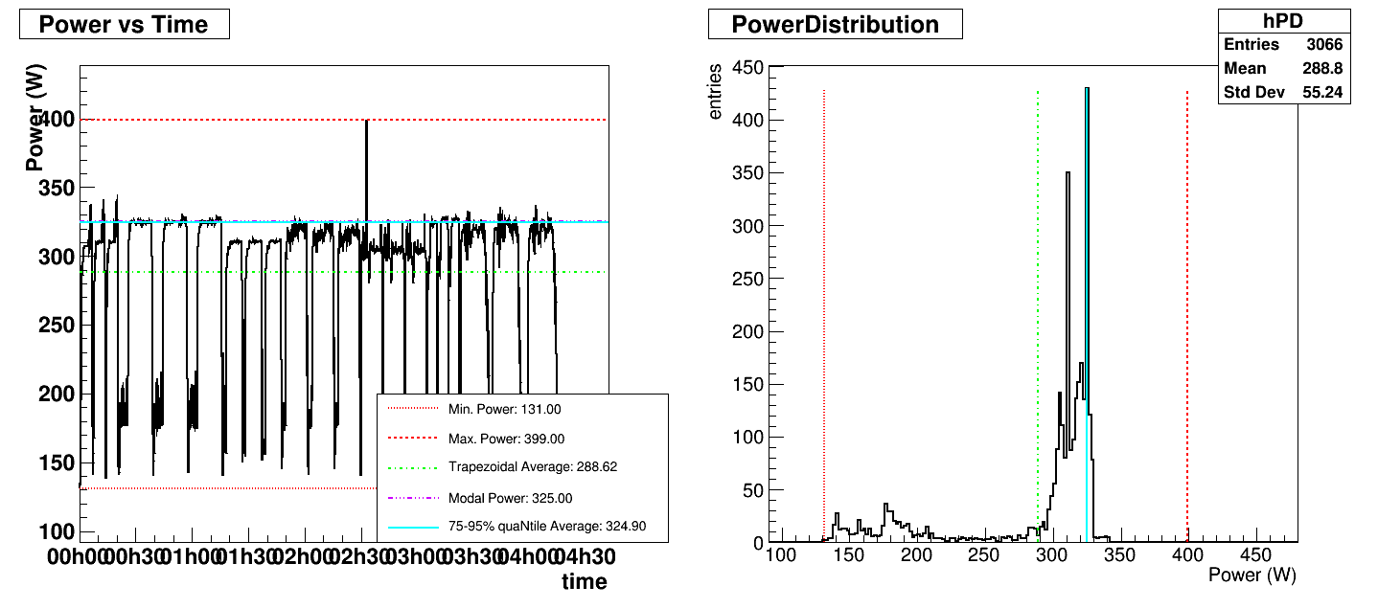
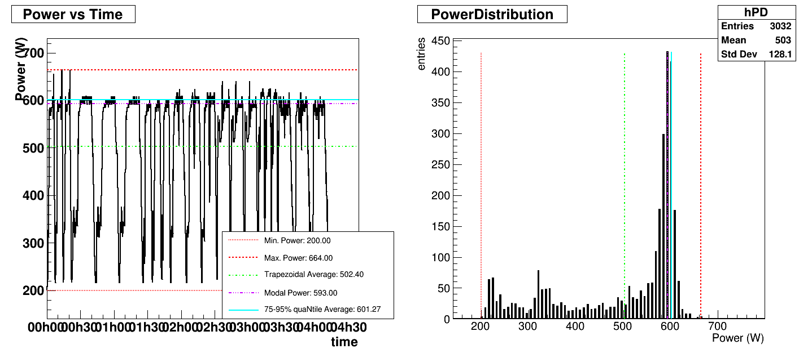
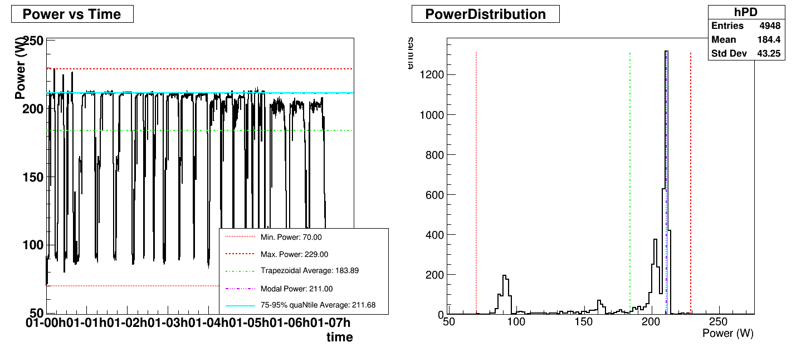
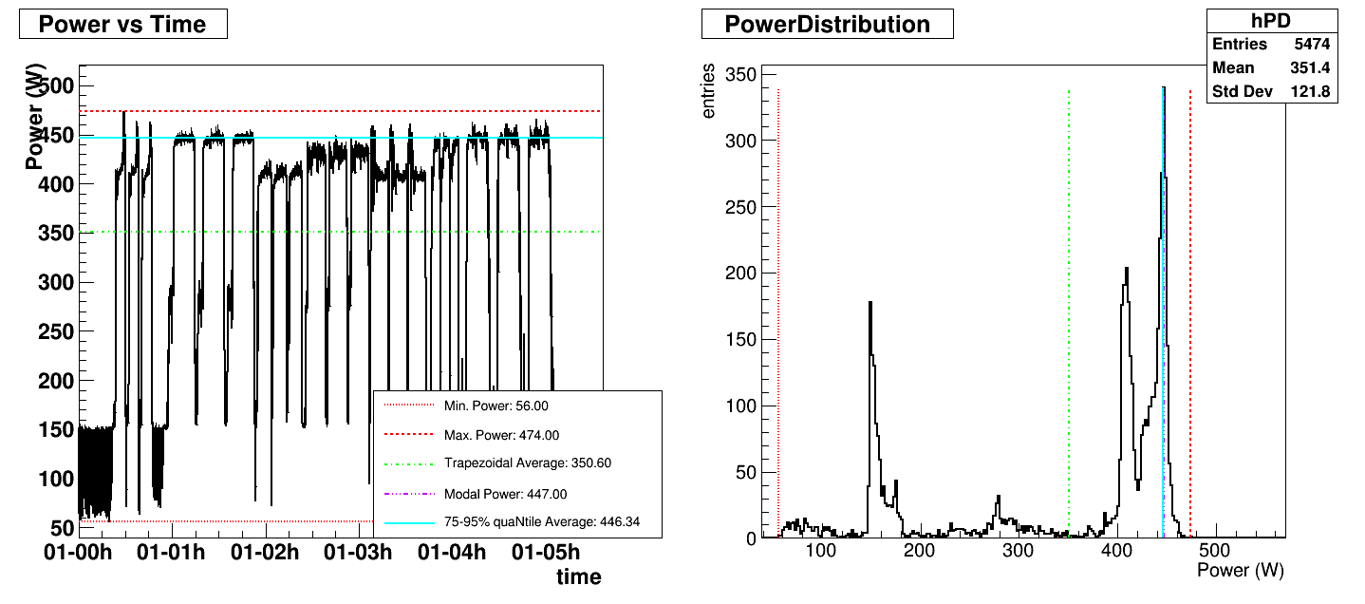
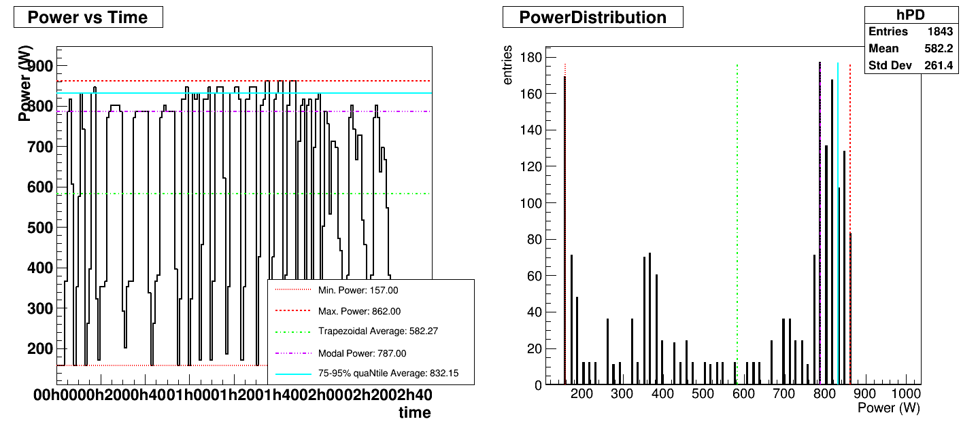
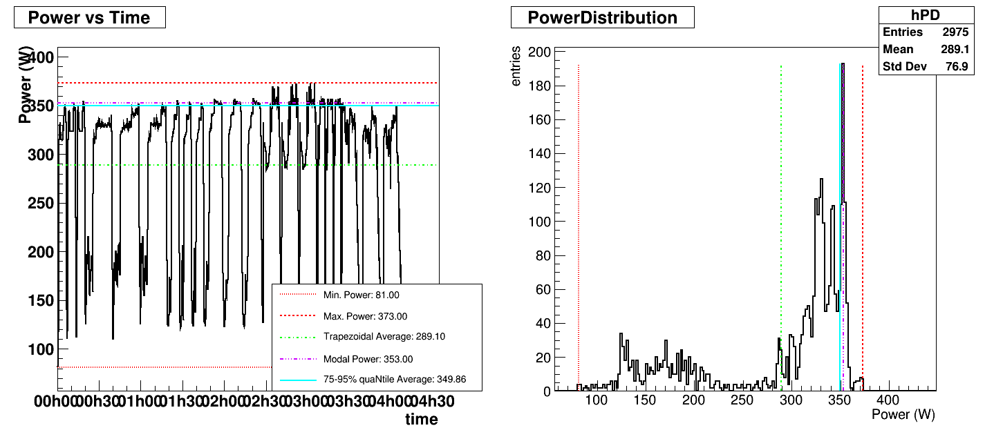
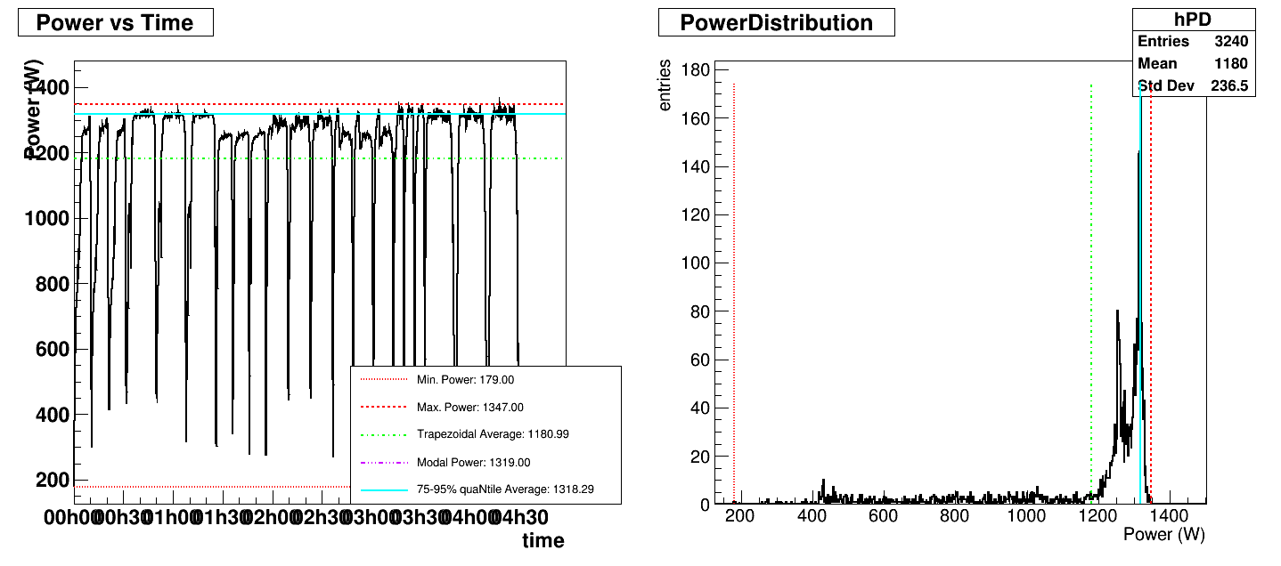

What Watt (4)
AMD96ht
ARM80c
AMD128ht
2*AMD64ht
2*ARM80c
2*Intel20ht
2*AMD64ht
Grace144c
ARM128c
2*AMD256ht
You can convince yourself that the new FoM well fits the power usage plateau on all tested machines …
Notes:
all machines tested

Slide 12
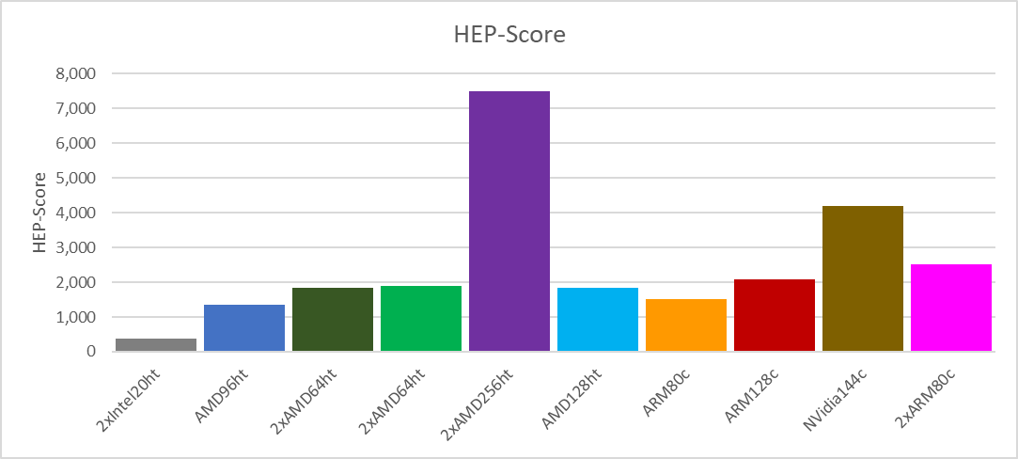
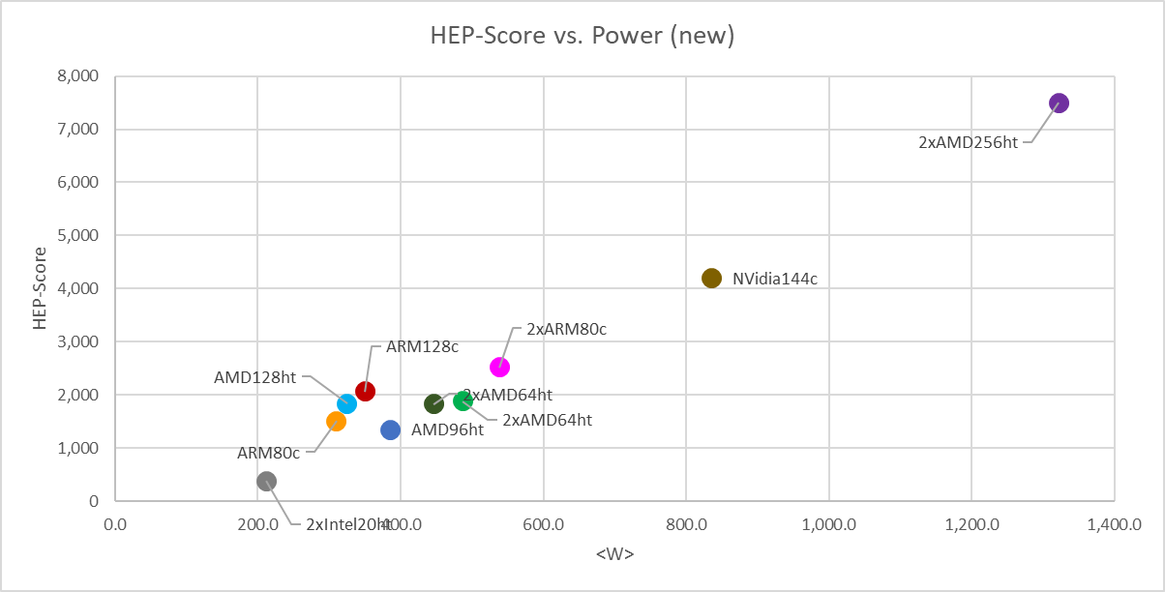
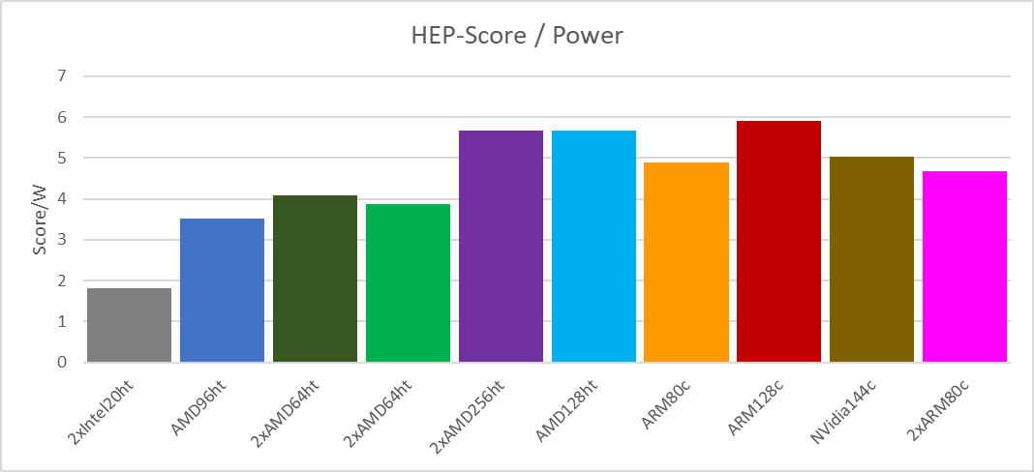
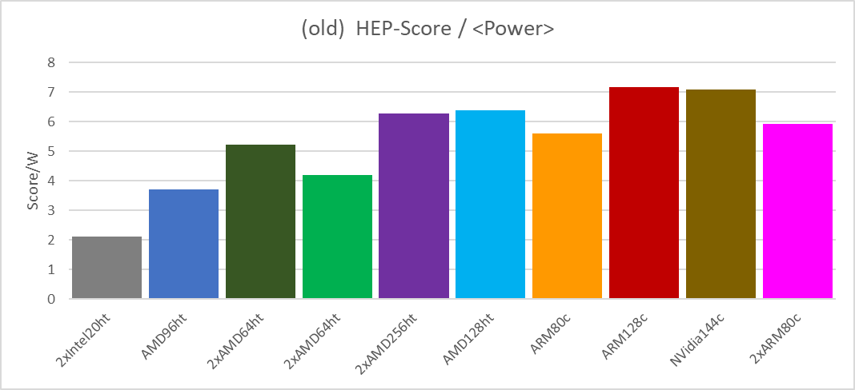
HEPscore/Watt
Using this new Figure of Merit, we have tested few more machines, and re-calculated the charts ...
*
The ranking does not change w.r.t. to the standard average, but distances do:
Notes:
… but, this is not the whole story: see next slide (!)

Slide 13
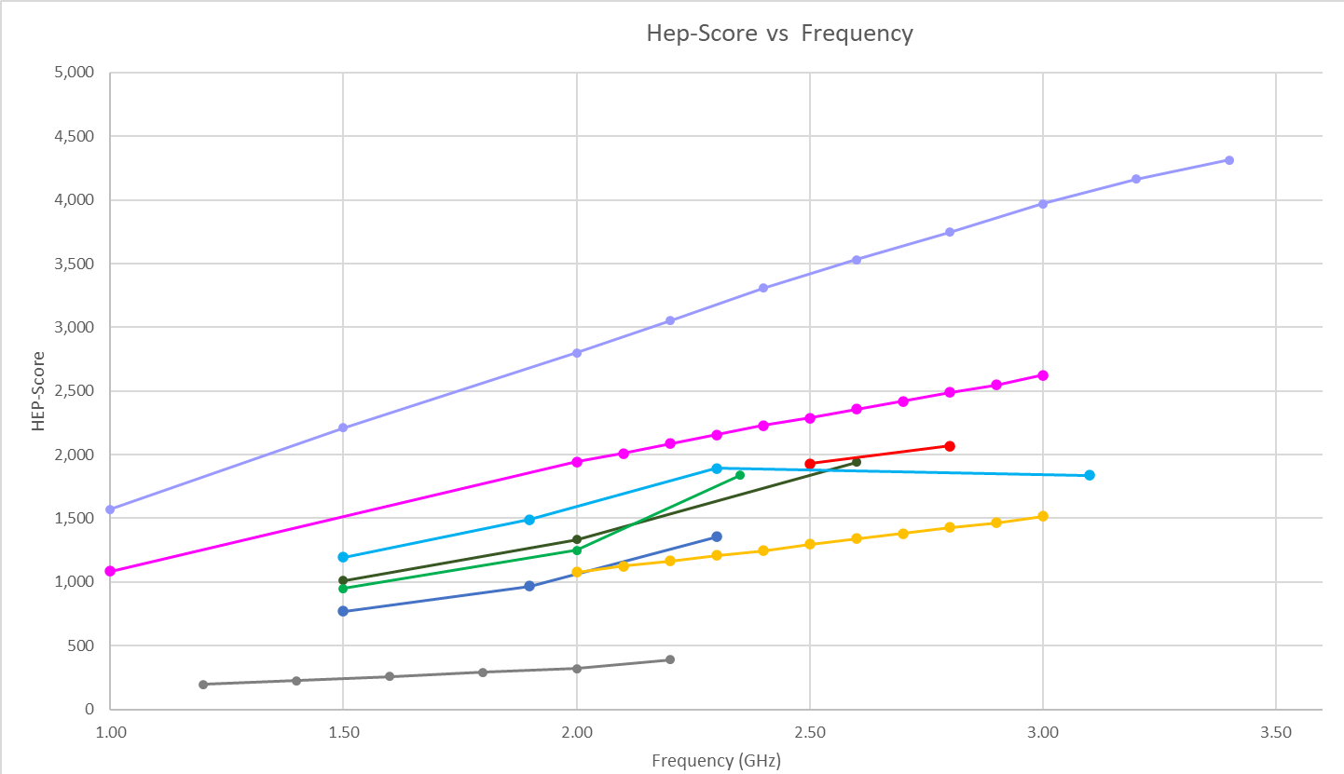
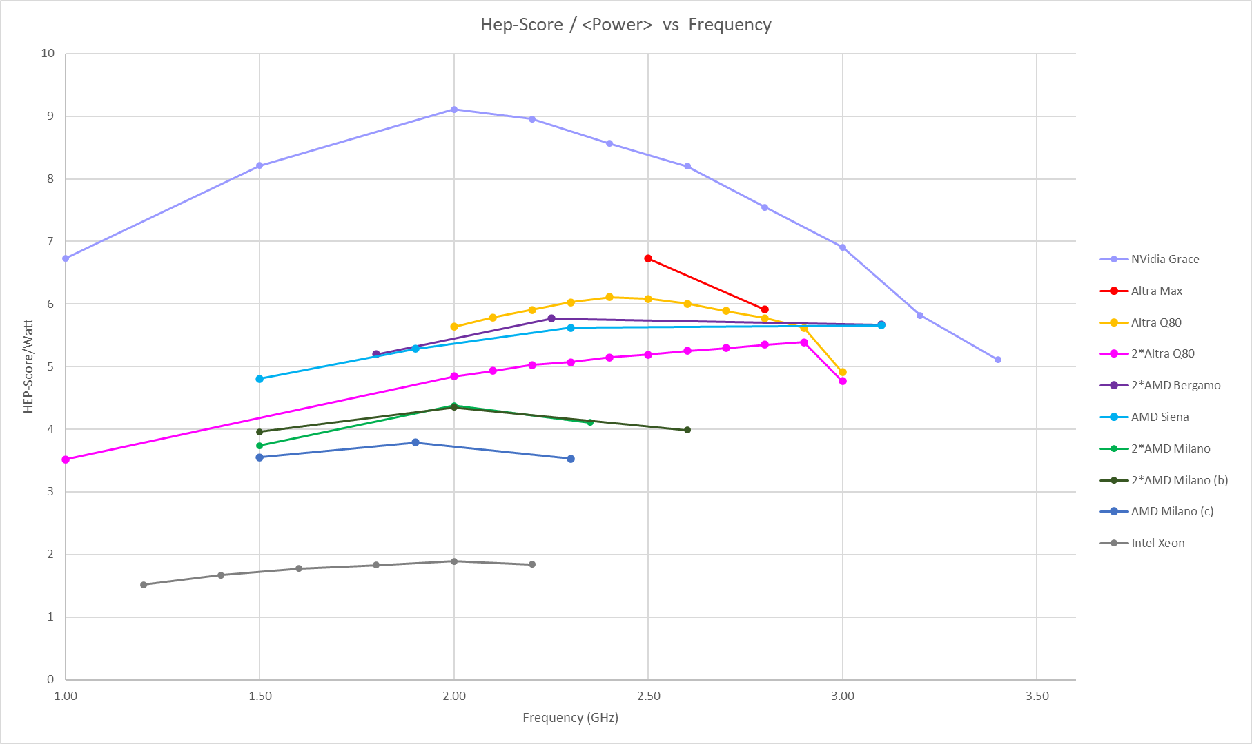
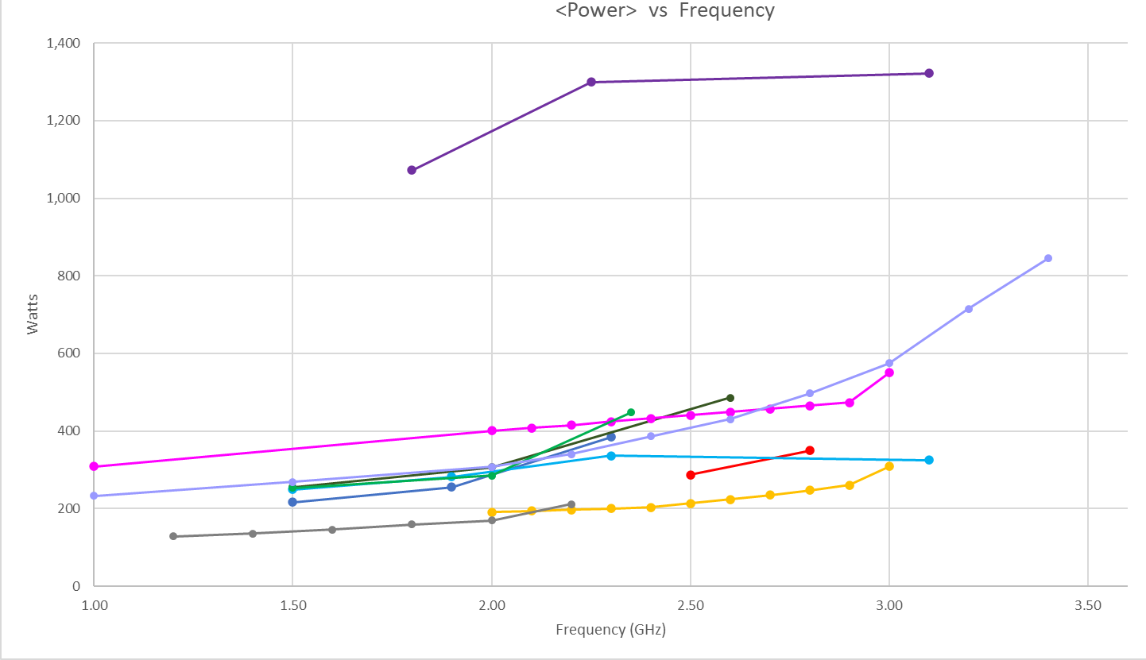
Frequency Throttling
HEP-Score increases with frequency (indeed), as power usage does too ...
HEP-Score/Watt vs. CPU Frequency gives a better picture of hardware potentials, and also shows optimal performances per watt at mid range.
*
(nominal)
Notes:
(!) see performance/watt of Max vs Grace …
NOTE: the x coordinate shows the “nominal” frequency, i.e., the frequency that has been set via ‘cpupower frequency-set’.
This does not always stay constant during the run, especially x86 have a “high frequency” turbo mode that is switched on/off depending on load.

Slide 14
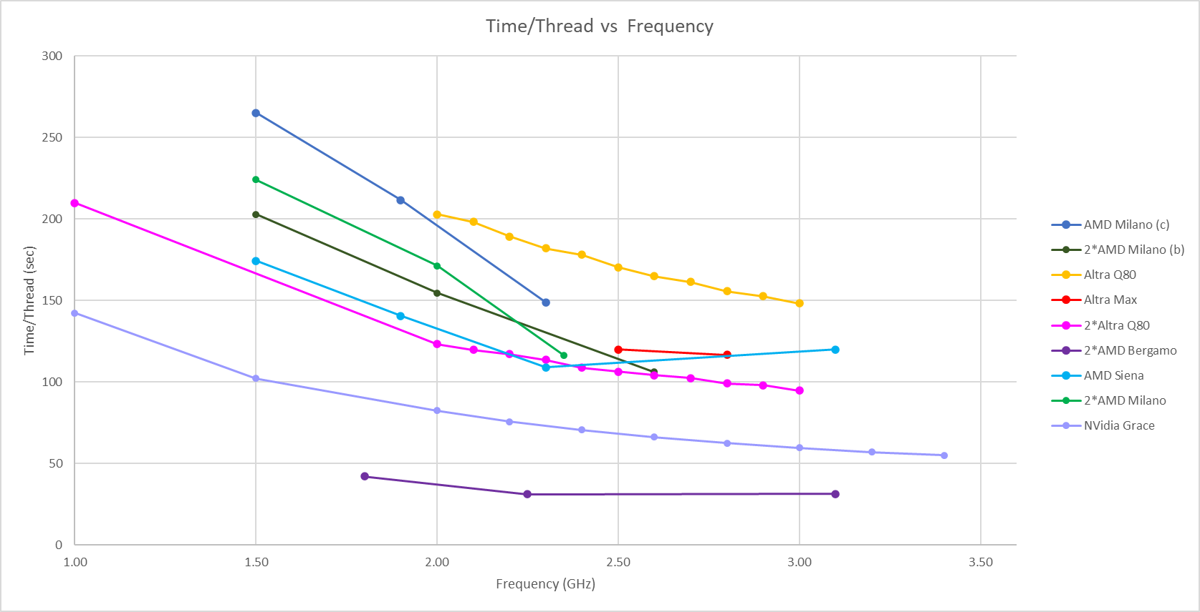
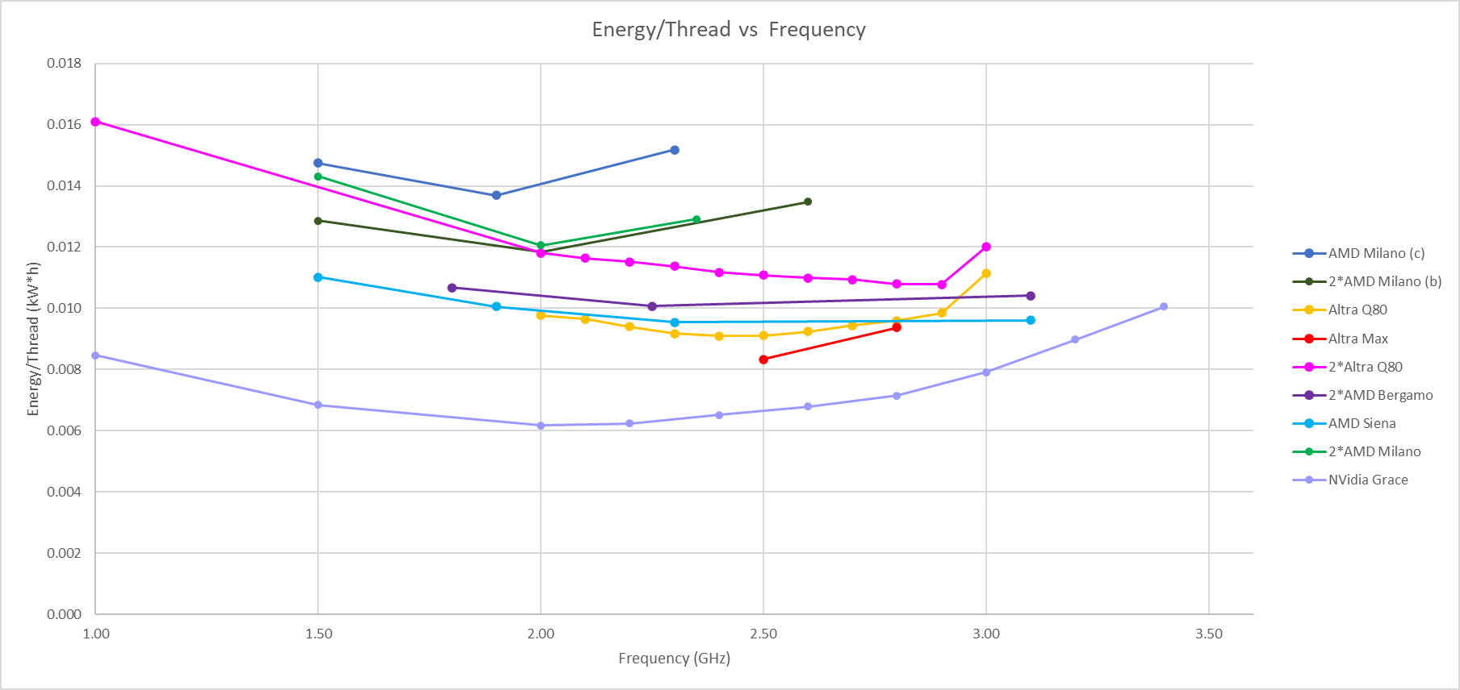

Frequency Throttling (2)
Execution time decreases almost linearly with frequency, while the total energy per job has a minimum below max. frequency (on all hardware).
What is clear is that tuning the frequency down a notch can save quite some energy at the cost of a small increase in time, but how much time and energy savings greatly depends on the hardware!
In the end, it is up to each sites to find a compromise ...
Notes:
Depending on hardware, time constraints, time of the day (& dirty power fractio), etc.

Slide 15
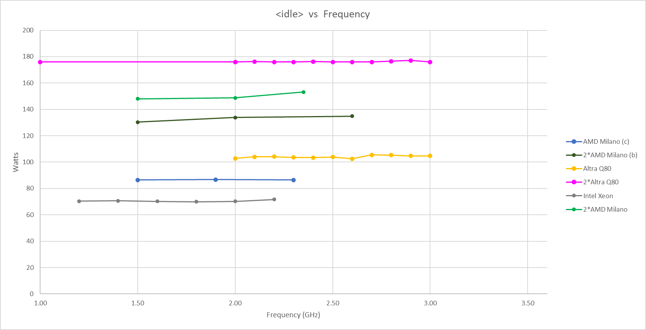

Idle
When power measurements are taken during a pure ‘sleep’ job, the idle power drain is independent from the CPU frequency !
This was done out of curiosity, after we observed a small correlation between CPU frequency and idle consumption …
… which turned out to come from the tail of the workloads, as the idle measurement was taken between workloads.
Notes:
idle vs. frequency

Slide 16
ARM Farm
From these tests, ARM compute have shown indications that it could outperform x86 in terms of energy efficiency for HEP-style workloads.
Following our work in this field, we received a donation of ~2000 cores ARM Q80-30 machines from Ampere and created an ‘ARM farm’ to see how easy it would be to advertise ARM resource on a Tier-2 grid site.
2*ARM80c: Dual Socket Ampere Altra Q80-30 80-Core Processor (MegaRAC)
CPU: 2 * ARM Q80-30 80C @ 3GHz (TDP 210W)
RAM: 512GB (32 x 16GB or 16 x 32GB) DDR4 3200MT/s → 3.2 GB/core
HDD: 2 * 1Tb NVMe (INTEL + SAMSUNG)
OS: Rocky 9.2
~ 2k cores
Initially this ARM resource was offered out for testing the to 4 main LHC experiments, with the idea being that once these 4 main experiments had run and validated their physics outputs, we could move to fully integrating said ARM resource at our grid site.
Notes:
Dwayne’s

Slide 17
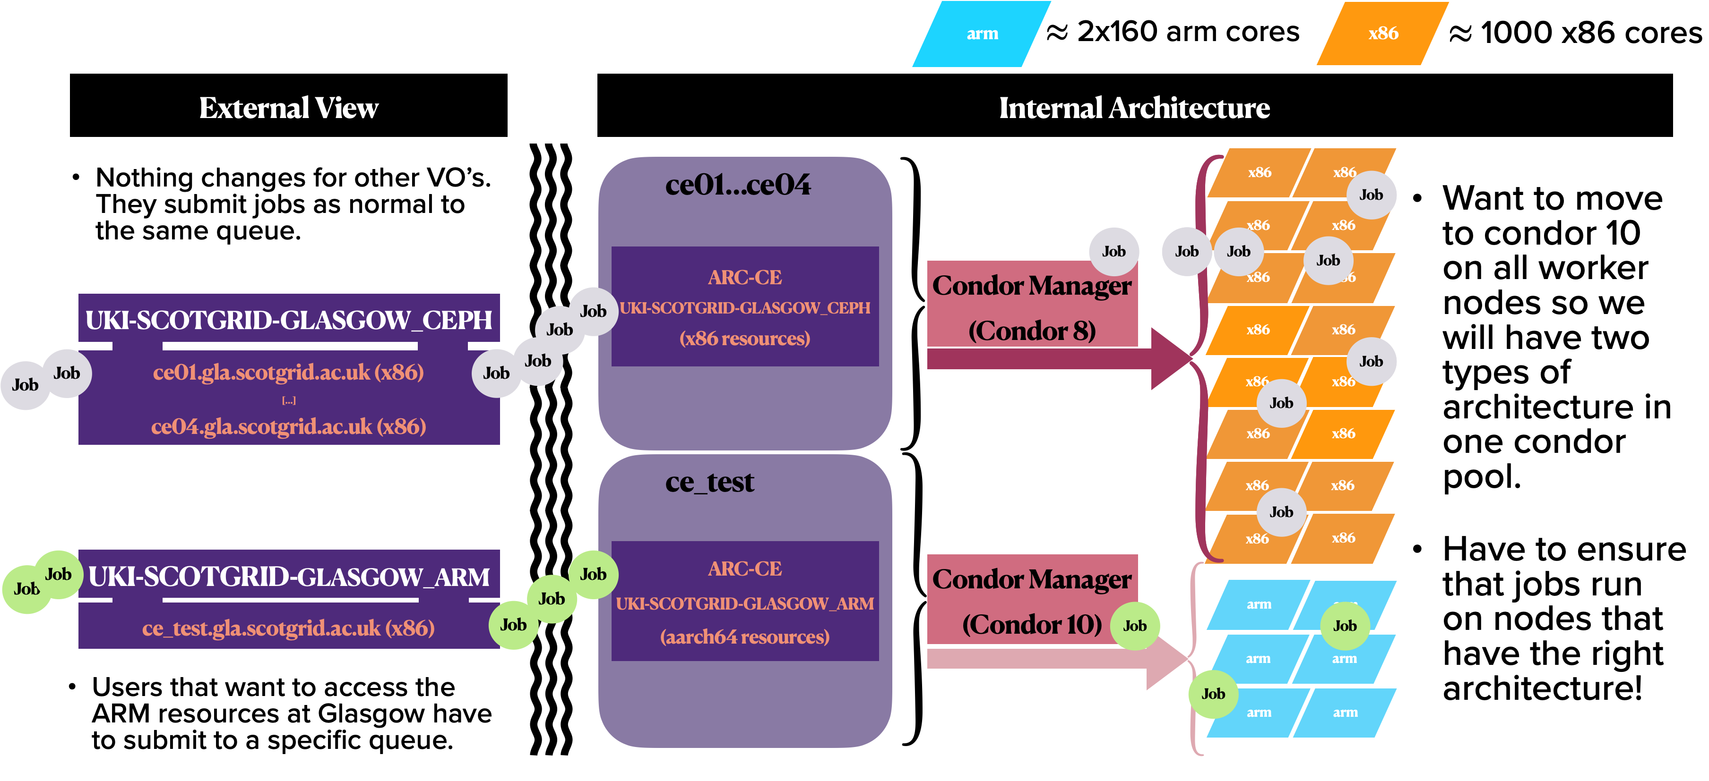
ARM Farm (2)
Job submission chain @ ScotGrid Glasgow:
Notes:
Dwayne’s

Slide 18

ARM Validation
Currently ATLAS, CMS, and ALICE, have finished running extensive campaigns against our ARM cluster.
  ATLAS: Successfully ran at our site and physics validated
    ATLAS have already fully validated ARM work
    https://its.cern.ch/jira/browse/ATLPHYSVAL-919
  CMS: ARM work was run for physics validation purposes …
    Ran into problems with AAA – not a CMS site so data not local
    … but, as Katy said, the Physics Validation was unsuccessful ☹
  ALICE: Successfully ran work and it is physics validated (see next slide).
  LHCb: Should start running after the Easter Break.
Expanding the ARM farm:
we have purchased ~2000 cores AltraMax M128-30 to double our ARM provision!
Notes:
Dwayne’s

Slide 19
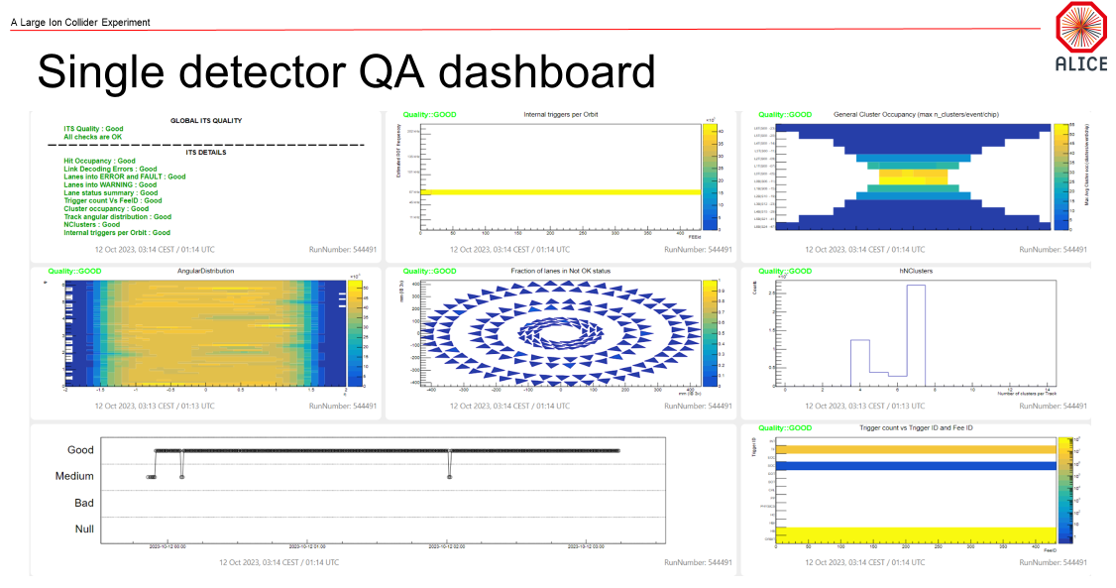
ALICE Validation
ARM plots here are made in comparison to a prior production on x86.
Good means that they are equivalent.
Snapshot of the ALICE Inner Tracking System – by Latchezar Betev (ALICE)
Notes:
Latchezar’s

Slide 20
Outlook
Improve on the calculation, consolidate results, streamline the process from benchmarking to a reference table/excel (a lot of copy/paste still done by hands, and details are still changing).
- energy measurement is now integrated as HEP-Score plugin (v2 ?)
- port/improve the analysis routine as yet another plug-in (v2 +1 ?)
Study the effect of frequency throttling at cluster level: we have an Ansible script to tune the frequency remotely!
- How to use in production (e.g., daytime)?
- We are testing the potential savings on a simulated cluster (Dwayne)
Keep testing new hardware with old and new benchmarks:
- benchmark GPU+CPU using Celeritas (Bruno)
- benchmark RISC-V with ROOT & look for new developments (CMS)
Notes:
outlook

Slide 21

end
Emanuele Simili & Dwayne Spiteri GridPP51 & SWIFT-HEP07 Sheffield - 26 March 2024
Notes:
PoW @ GridPP

Slide 22
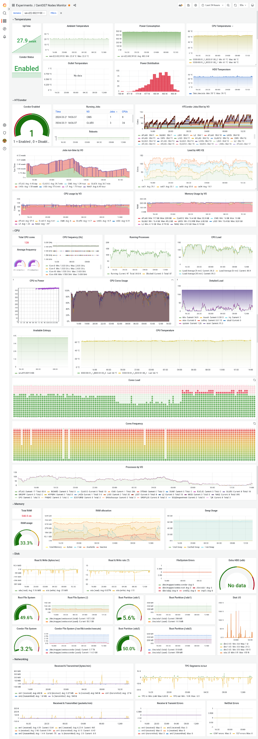
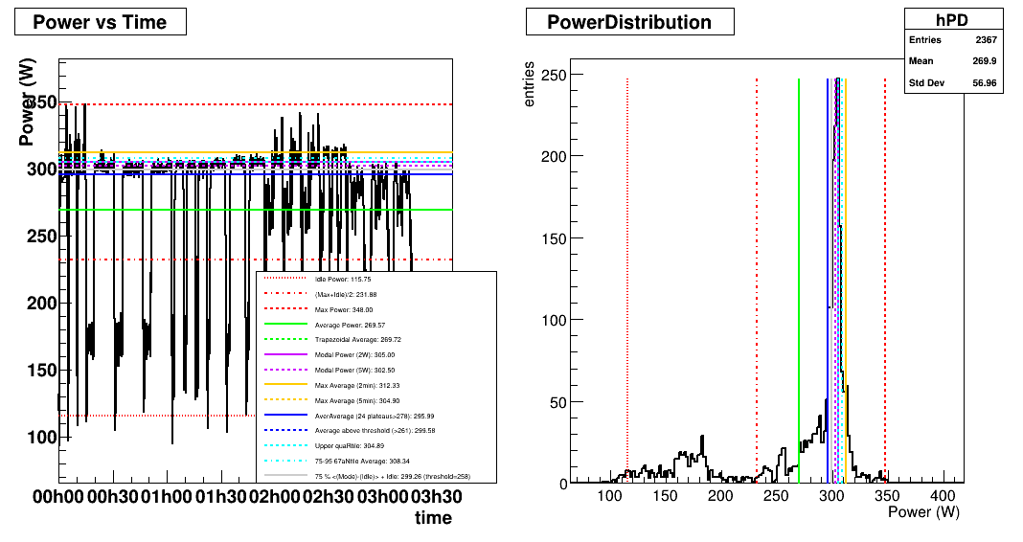
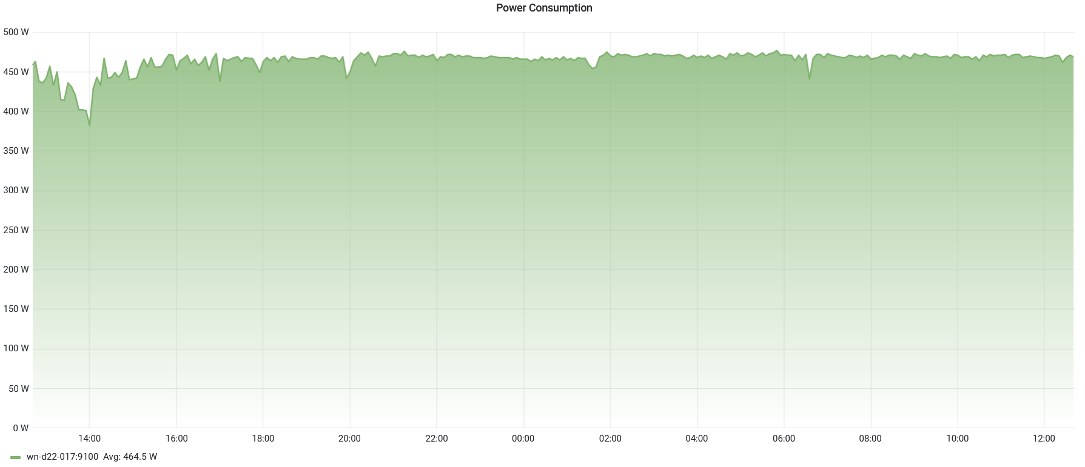


Leftovers …
2*AMD64ht
ARM80c
Notes:
ww

Slide 23
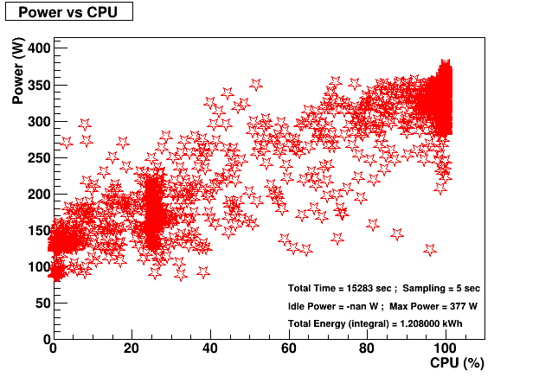
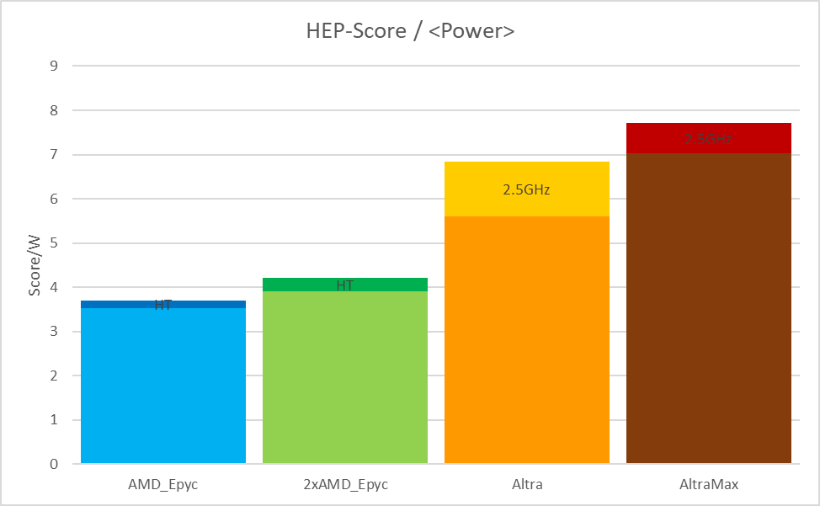
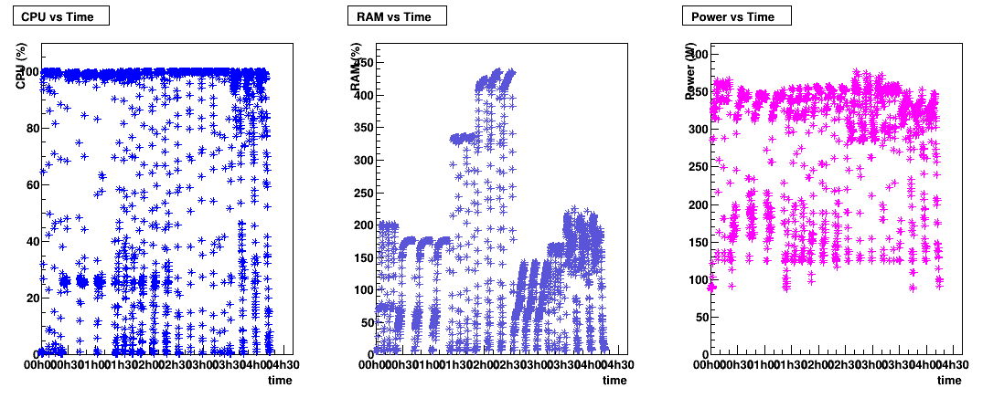
My IPMI collector & analyser
jdump.sh
jget.sh + Job
IPMI
/tmp/ipmidump.json
ipmi_runtime.csv
(root’s crontab)
(user’s script)
{
"date_yyyymmdd": "$DATE" ,
"time_hhmmss": "$TIME" ,
"cpu_usage_percent": "$CPUSE" ,
"memory_usage_gb": "$MEMUSE" ,
"cpu_frequency_ghz": "$FREQ" ,
"ipmi_power_watt": "$POWER"
}
Excel
ipmi2root.C
(ROOT script)
Notes:
HEPiX ppt

Slide 24
HEPscore Energy Plug-in
run.sh
IPMI
energy_plugin
bmkrun_report.json
HEPscore
{
"host": {
"hostname": "arm-e22",
...
"plugins": {
...
"hepscore": {
"cpu-frequency": {
...
"power-consumption": {
"start_time": "2023-11-03T15:55:11.310751Z",
"end_time": "2023-11-03T19:11:11.293188Z",
"values": [
115.0,
303.0,
...
169.0
],
"statistics": {
"min": 108.0,
"mean": 269.0862944162437,
"max": 344.0
},
"config": {
...
},
...
"score": 1509.9384,
"status": "success"
}
}
}
Values can be exported back to CSV file via custom script, and from there follow the same analysis chain …
about 500 lines
ipmi2root.C
Notes:
HEPiX ppt

