Slide 1



Tier-1 in GridPP7
Alastair Dewhurst
Notes:
The abstract pattern can be removed or repositioned if required. Be careful to ‘Send to Back’ so that it does not obscure any important information.

Slide 2
Introduction
DC24 Overview
  Details will be covered by many others
Antares
Echo
  Ceph – I will present slides made by Rob.
  XRootD – Jyothish Thomas
Batch
Network – James Adams
Projects
  VMWare
  Victoria Metrics
  Procurements

Slide 3
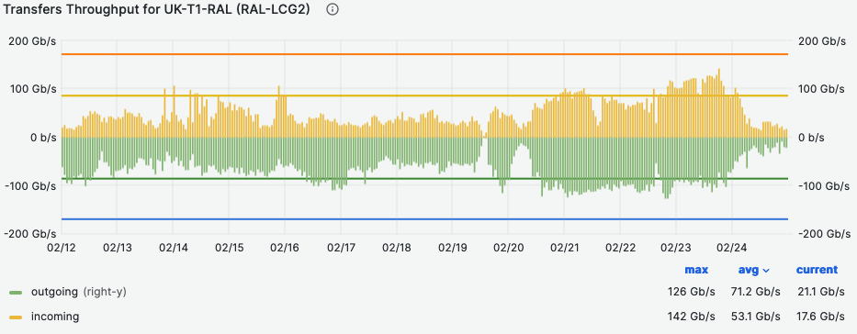
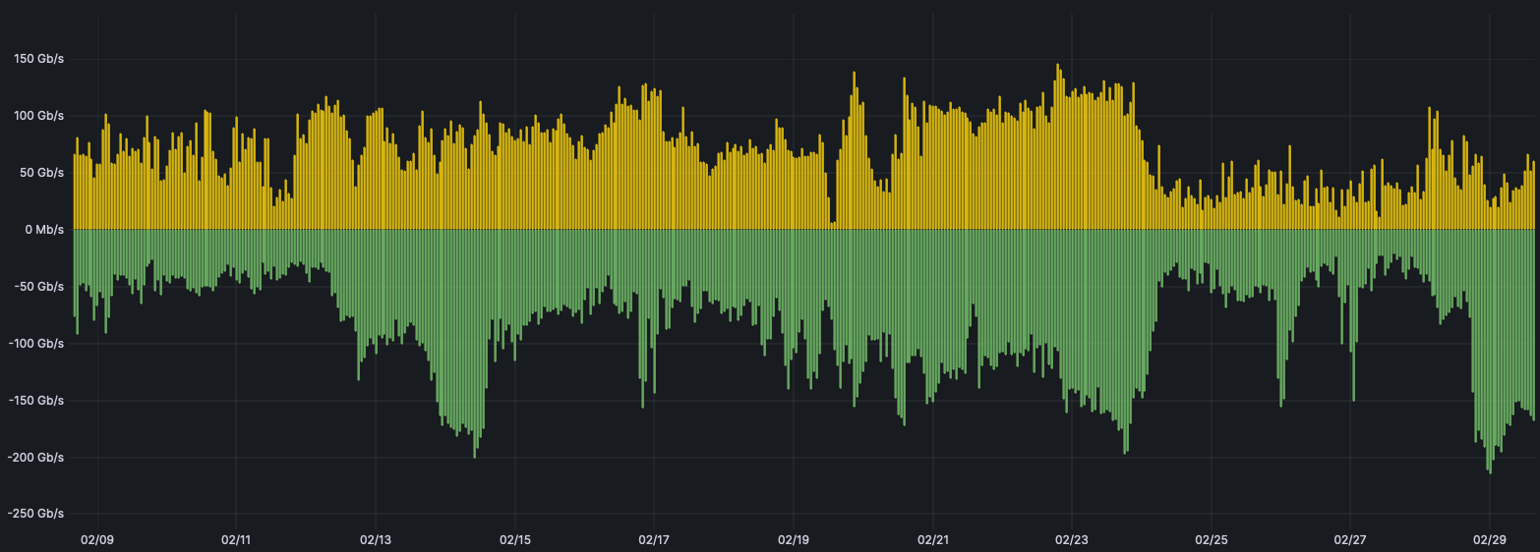

DC24 - Overview
Overall DC24 was very successful for RAL.
  Significant network problems at the start of challenge resulted in low initial throughput.
At the end, throughput was 2 – 3 times higher than we ever saw before:
  We found a new set of bottlenecks well above Run 3 normal load that can be worked on over the next few years.
  Fantastic effort from the Tier-1 to debug, fix/optimize in real time.
WLCG DC24 Monitoring
Site Link Monitoring

Slide 4
DC24 – Things to improve
Deletes
  Under high load deletes go very slowly. Deletes quickly caught up after DC24 finished. Described in Jyothish’s Talk.
Load Balancing
  We got lots of experience trying to balance the load across the gateways. Described in detail in Jyothish’s Talk.
Check-summing
  When a file is written via FTS, it is then recalled to the gateway to calculate the checksum. It is on Brian Bockelman’s ToDo list to add check-summing while the data is being streamed.
Gateway Hardware
  We hit the 25Gb/s network limit on our gateways, we have purchased a 100Gb/s capable gateway. There is explicit effort in GridPP7 for improving throughput.
Tokens
  For various reasons these had to be disabled. Most of the improvements will come from the VOs, but there are some XRootD patches needed.

Slide 5
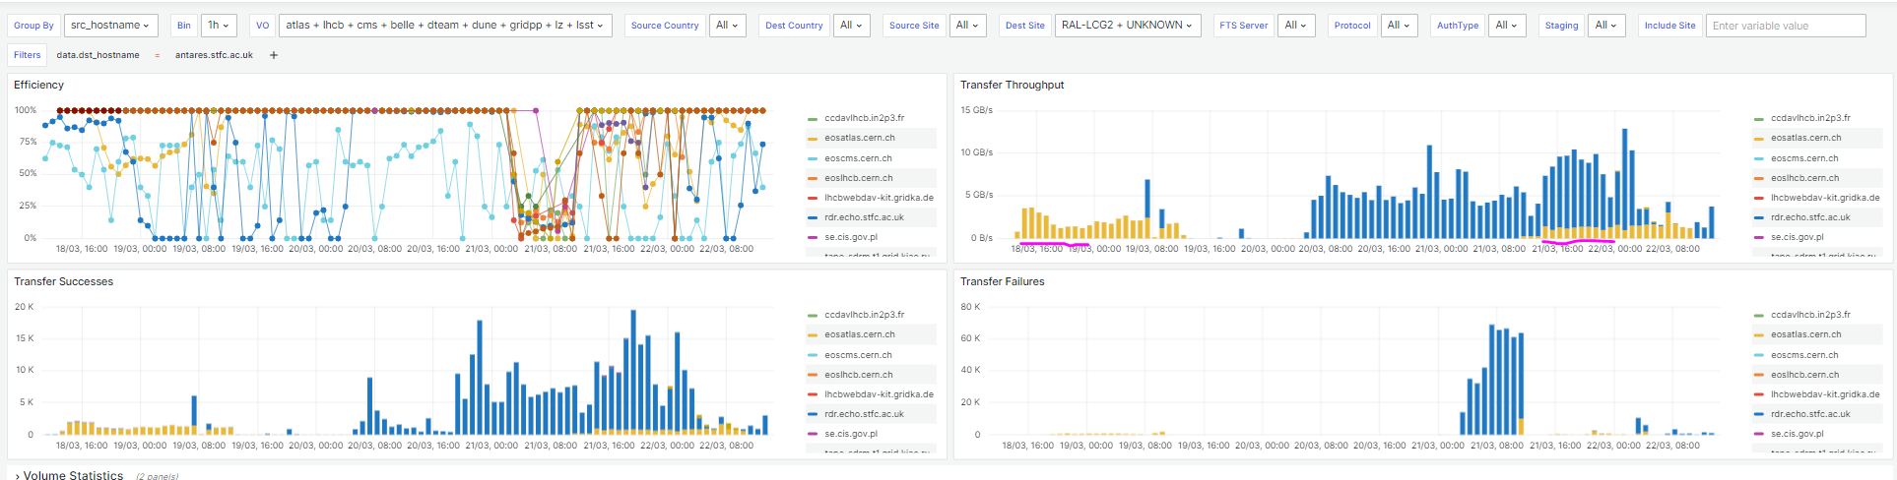
Antares – Data Export test
Webdav and the HTTP REST Tape API mean that Antares can be accessed directly.
  Raw Data export will be going directly from CERN to Antares.
In the repeat DC24 test we asked for Antares to be tested.
  Various teething problems (e.g. FTS config wasn’t correct, deletes were slow).
  Antares was ingesting data at 10GB/s but most of it wasn’t DC data…

Slide 6
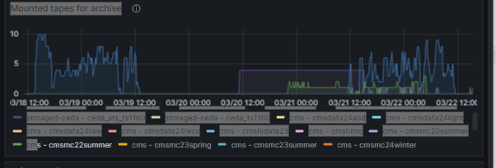
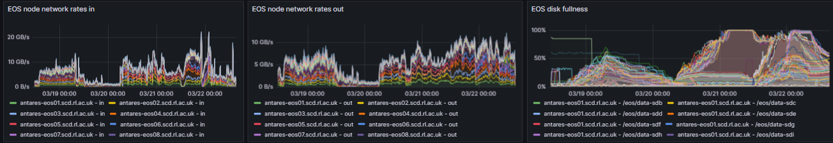
Antares – Tape backend
Tape backend was definitely well tested!
The EOS buffer did fill up during the test, which then reduced transfer speeds.
SSD costs are coming down so buffer can be expanded.
Plenty of room to optimize tape drive usage.
Blue in data challenge, Purple is atlas21mcother, Green is cmsmc23summer

Slide 7
Echo status and plans
Echo recently exceed 100PiB of raw capacity.
Backend storage working very well.
  Many operational changes can be done transparently, and the team is trying to automate them where possible.
2024 Q2:
  SL7 → Rocky 8
  Decommission 2017/18 generations of hardware
  Continue deployment/weighting up of 2022 hardware
Q3
  Complete deployment and decommissioning
  Upgrade to Pacific
  Start deployment of 2023
Longer term we still would like to implement rack-level failure domains.

Slide 8
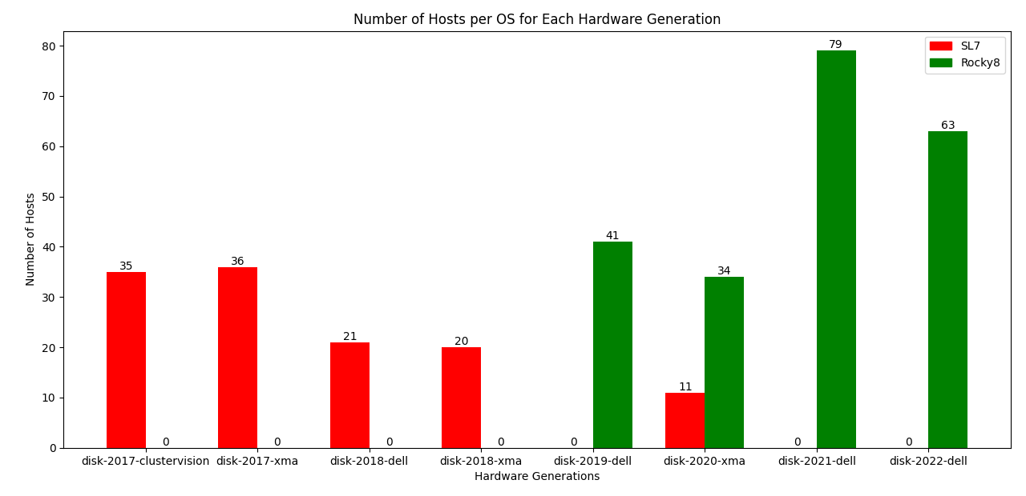
Rocky 8 Upgrade Progress– Echo Storage
OS upgrades to Echo storage nodes are automated
  Working hours only
Each storage generation has its own foibles
  Development needed each time
  We intend to decommission 2017 before the SL7 EOL
  If we can decommission 2018 as well, we will.
Credit to Maksim for the graph and much of the work.

Slide 9
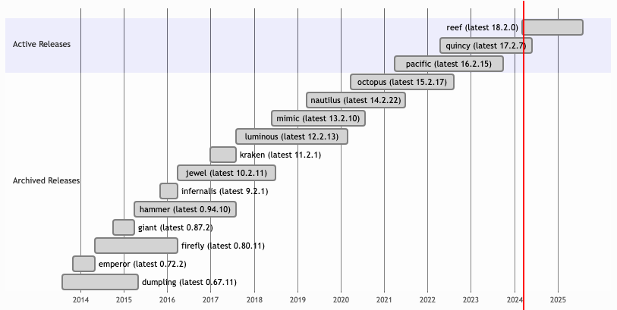
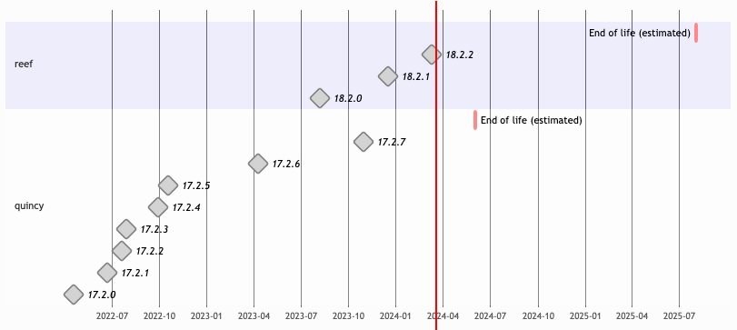
Ceph release schedule
Our last major Ceph upgrade was in May 2020!
Currently we are on Nautilus.
Double upgrade to Pacific by September 2024.
Double upgrade to Reef for April 2025.
In GridPP7 want to aim to be looking to upgrade to latest release once it has been out for 6+ months.

Slide 10
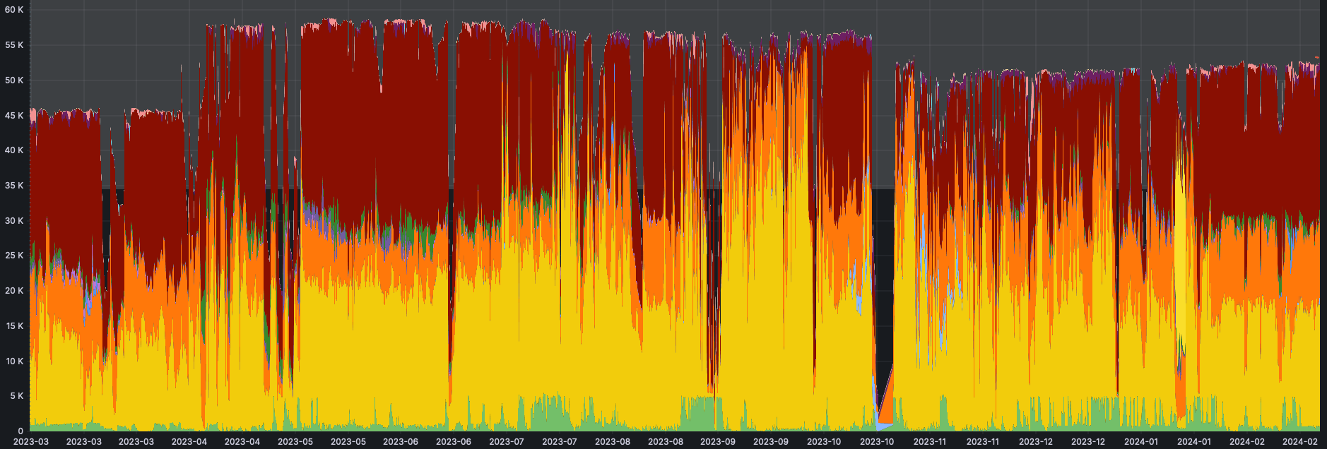
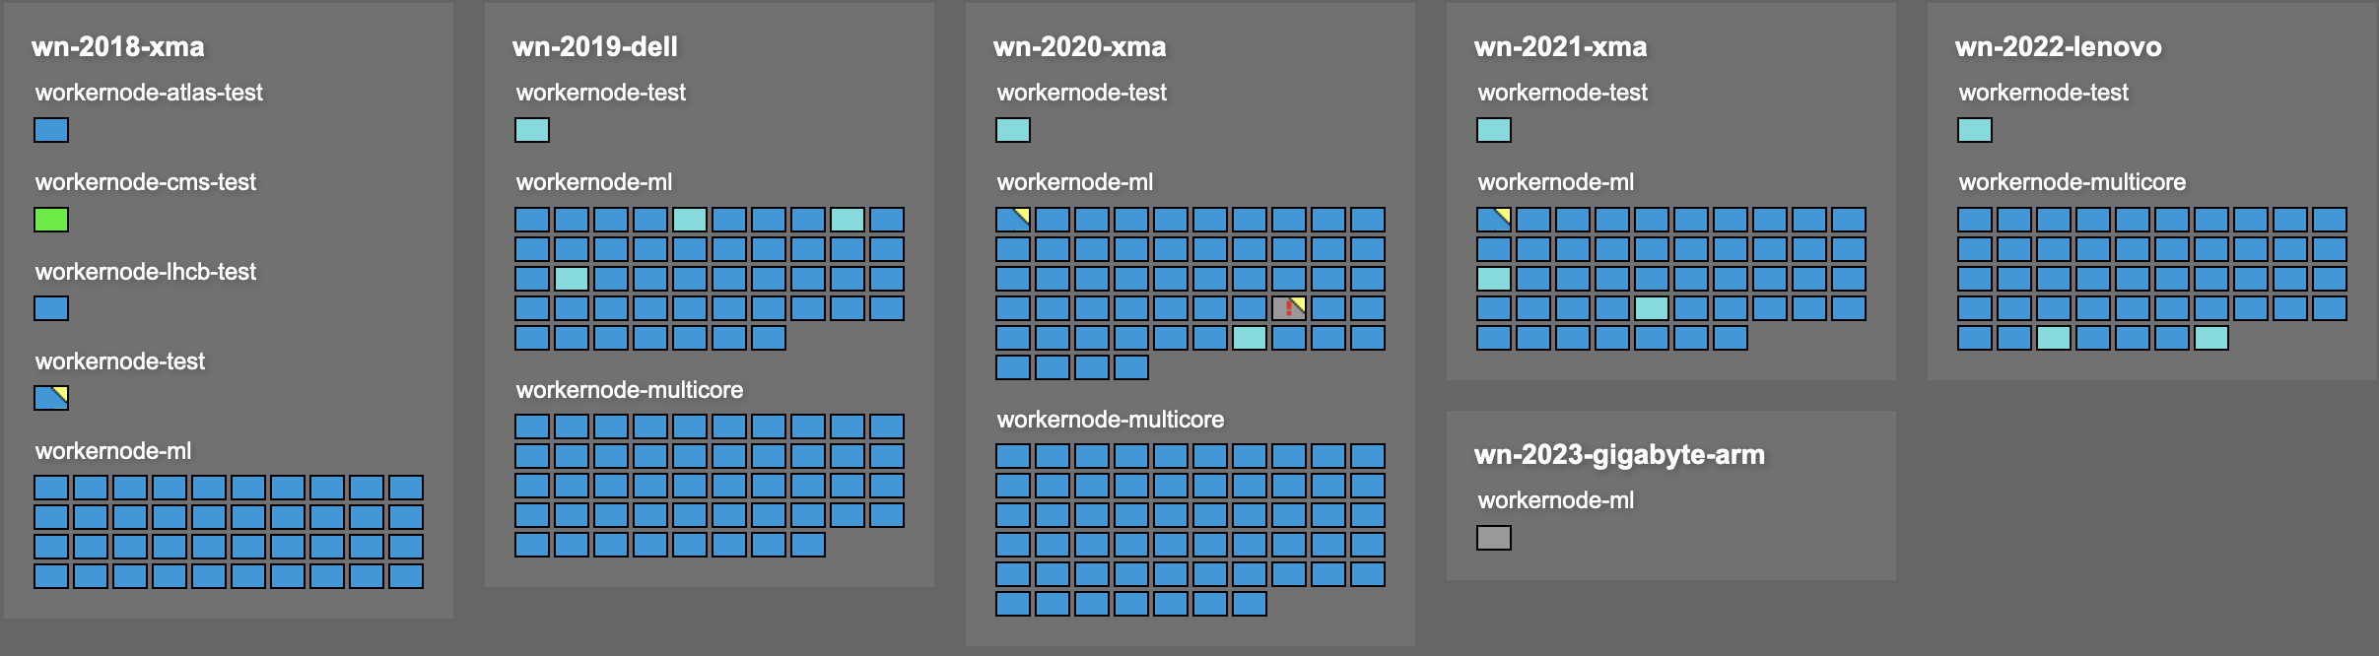
Batch Farm
HTCondor and ARC CEs continue to perform very well for the Tier-1.
  The utilization of the resources very impressive when compared to other science areas.
The most frequent operational problem is with VOs not always receiving their desired fairshare.
  This problem will become more complex as we add different architectures.
Tom Birkett has setup a pre-prod cluster (which runs actual work and is accounted, and can be used to test the latest patches).
  We have a single node dual stack which is being tested.

Slide 11
VMWare replacement
SCD currently runs multiple VMWare instances.
Tier-1 VMWare Cluster is 5 years old and we plan to replace it.
  Joint SCD project underway to replace it.
“Small” issue with VMWare license costs means we are migrating to something else which is being actively researched!
Legacy Tier-1 network
New dedicated network pod
Phase 1
Hypervisor
Hypervisor
Hypervisor
Hypervisor
Hypervisor
Hypervisor
x10
x lots
Dell HDD Storage Array
Dell HDD Storage Array
Pure (Flash) Storage Array
Pure (Flash) Storage Array
Purchased by Tier-1
Existing RIG array

Slide 12
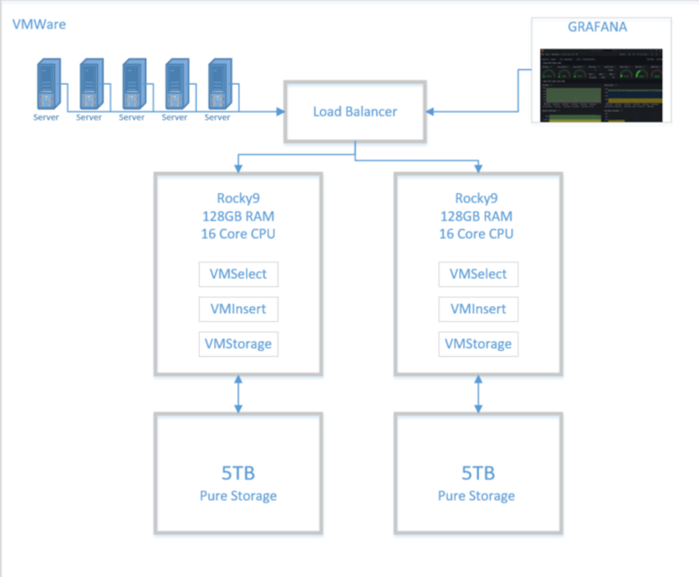

Victoria Metrics
We currently use InfluxDB for our time series monitoring.
  Very old version – Security is OK because not publicly accessible.
We are running a (joint) project to replace it.
  New service will be called Timon = TIme MONitor
We currently plan to move to Victoria Metrics.
  I am negotiating to get the Enterprise version for a 3 year contract at ~£20k per year for 0.5 million data points per second ingest.

Slide 13
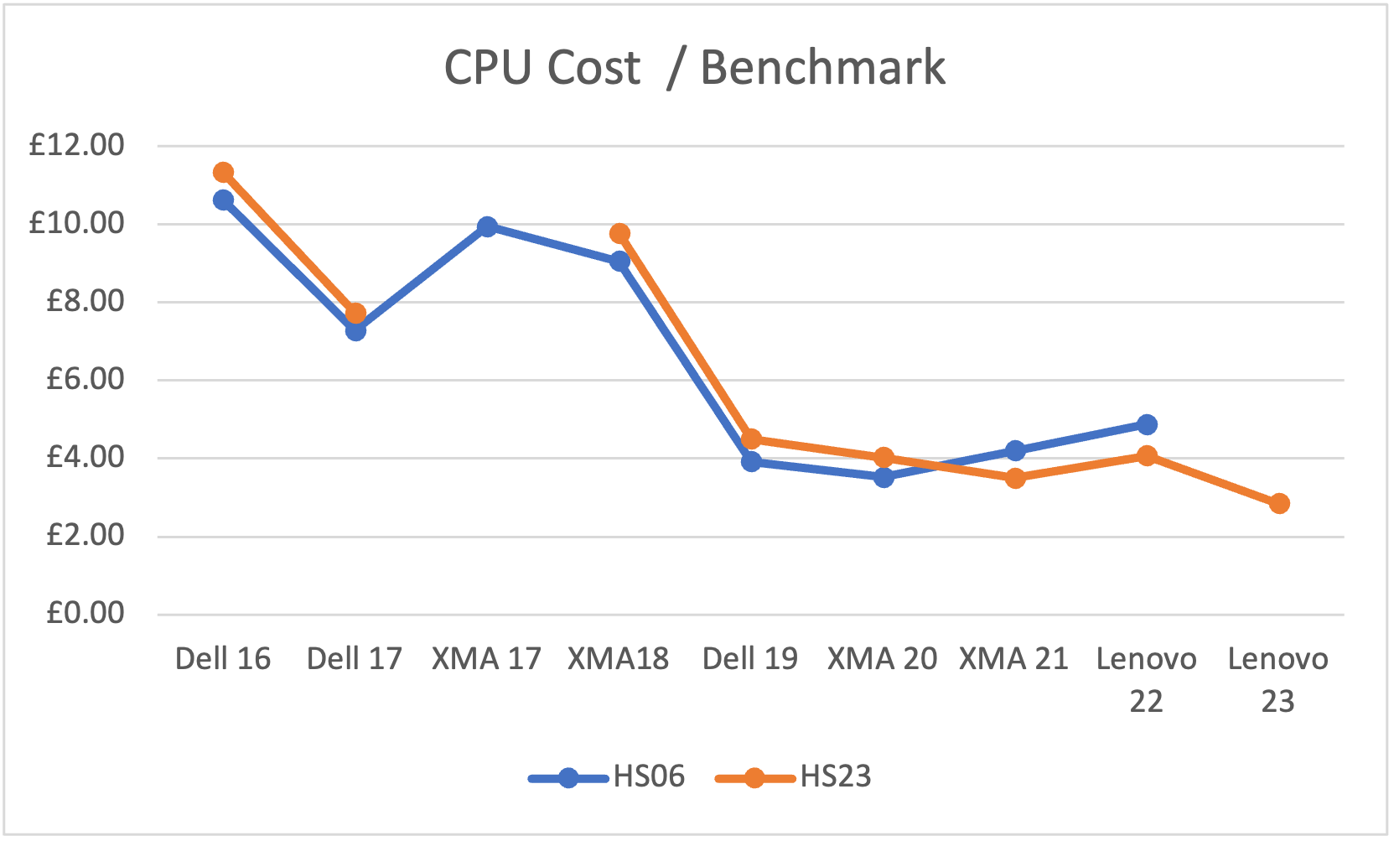
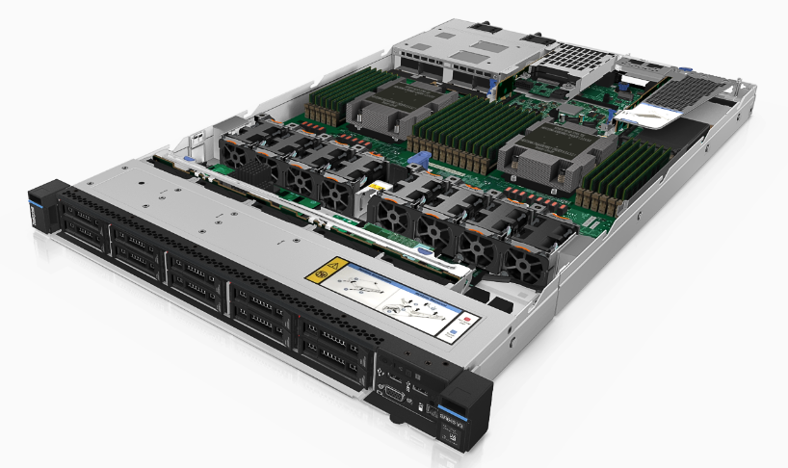
CPU procurement
This year SCD did a joint CPU procurement for JASMIN, SCARF, Tier-1 and the STFC Cloud.
  Compute, Memory and OS Disk were identical, differences in networking and local storage.
  Total value of £7,772,995.52 (inc VAT) was awarded to Lenovo.
407 servers in total (36 for Tier-1) with:
  Dual AMD EPYC 9654 (HS23= 6000.6 each).
  24 x 64GB memory (= 1.5TB memory).
    JASMIN purchased some 6TB memory servers.
  480GB SSD OS drive.
  Mellanox ConnectX-6 25Gb/s NICs.

Slide 14
Disk and other procurement
We purchased 32 Dell Storage nodes
  28 x 22TB drives.
  2 x 16C/32T CPUs
  480GB SSD OS Disk
  256GB memory
  25Gb/s Mellanox NIC.
Echo gateways
  4 with 25Gb/s NICs
  1 with 100Gb/s NICs
We are buying individually metered power supplies.
Earlier in the year we purchase a single ARM server which we integrated into the farm, we intend to buy more this year.

Slide 15



Notes:
The abstract pattern can be removed or repositioned if required. Be careful to ‘Send to Back’ so that it does not obscure any important information.

