Slide 1




Notes:
To edit the background image, select ‘Format’ from the PowerPoint menu and ‘Slide Background’ from the drop-down menu. Within the new list of options that appears on the right of the screen, select the ‘File’ button under ‘Insert picture from’ and select your image from your file browser. Please remove or amend the image credit if you are using a different image to the one provided.

Slide 2


Grid Tools @ RAL
An update on the services and activities underway
Authored by Tom Dack
GridPP 51, Sheffield, 27 March 2024
Notes:
The abstract pattern can be removed or repositioned if required. Be careful to ‘Send to Back’ so that it does not obscure any important information.

Slide 3

Topics
1 Team Management & Structure
An overview of the team, its members, and operational structure
2 Service Updates
Updates on the services under the GridTools umbrella
3 Looking Forward
A brief overview of current organisational plans
Notes:
To replace photo with one of your own. 1) Send the geometric shape overlay to the back – Right-Click > Send to Back > Send to Back. 2) Replace image – use the guides provided to correctly position it. 3) Send your image to the back so that the geometric overlay re-appears over the image. Please remove or amend the image credit if you are using a different image to the one provided.

Slide 4
Team Management & Structure
Notes:
The abstract pattern can be removed or repositioned if required. Be careful to ‘Send to Back’ so that it does not obscure any important information.

Slide 5
What is Grid Tools?
SCD Team Operating and Developing Federating Services
Team coordinating the delivery of services to facilitate federating workflows at partner communities
Shared operational and development effort across the services
Team currently focussed primarily in two directions
  Grid Federating Services
  SKA Federating Services
Overall team split into two Agile teams, in line with these areas.
New Product Owner/Team Lead role intended to provide a consistent contact for stakeholder engagement, reporting, and requirement identification
Notes:
Replace this guidance text with your own bullet pointed content.
For further guidance please see https://www.bdadyslexia.org.uk/advice/employers/creating-a-dyslexia-friendly-workplace/dyslexia-friendly-style-guide

Slide 6
Team Membership
Tom Dack: Grid Tools team lead and Product Owner, SKA IAM lead
Adrian Coveney: APEL service manager and lead developer
Greg Corbett: GOCDB service manager and lead developer
Rose Cooper: FTS service manager and SKA Scrum Master
Donald Chung: IRIS IAM service manager
Matt Mayer: perfSONAR service manager
Saiteja Vennapusa: Grid Tools Software Developer & Grid Scrum Master
Manoj Garai: Grid Tools Software Developer
Abdul Aziz: STFC SCD Graduate Scheme, working on OpenSearch
Notes:
Replace this guidance text with your own bullet pointed content.
For further guidance please see https://www.bdadyslexia.org.uk/advice/employers/creating-a-dyslexia-friendly-workplace/dyslexia-friendly-style-guide

Slide 7
Grid Tools Agile Teams
Product Owner:
Tom Dack
Scrum Master:
Rose Cooper
FTS:
Rose Cooper
PerfSONAR
Matt Mayer
SKA IAM
Tom Dack
Scrum Master:
Saiteja Vennapusa
APEL :
Adrian Coveney
GOCDB:
Greg Corbett
IRIS IAM
Donald Chung
CA:
Not in post at current
Developer Team:
Saiteja Vennapusa
Manoj Garai
Graduates:
Abdul Aziz
SKA Federating Services
Grid Federating Services
+ other members of SRCNet Purple Team

Slide 8
Service Updates
Notes:
The abstract pattern can be removed or repositioned if required. Be careful to ‘Send to Back’ so that it does not obscure any important information.

Slide 9
GOCDB
Slides by Greg Corbett
Notes:
The abstract pattern can be removed or repositioned if required. Be careful to ‘Send to Back’ so that it does not obscure any important information.

Slide 10

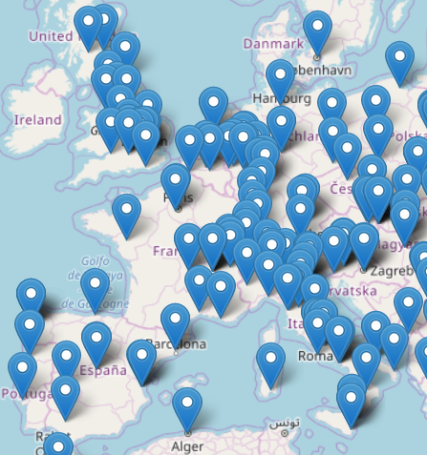
GOCDB – work done in the last three years
Work to better align exposure of personal data in GOCDB with requirements of the EU General Data Protection Regulation and UK GDPR
Automatic deletion of inactive users
Restricting access to personal information
Account Linking within GOCDB
Reduces account and personal information duplication
Will aid in the move away from user certificates
GOCDB’s use case have extended to the EOSC Core and the IRIS community in the UK.
Notes:
Automatic deletion of inactive users EGITCB-124
Restricting access to personal information EGITCB-123
Account Linking within GOCDB EGITCB-126

Slide 11
GOCDB – plans for the next three years
Allow access to the APIs via Check-in credentials
Deprecation and removal of user’s direct certificate access to the portal
X509 authentication for will be done via the IGTF Proxy IdP in EGI CheckIn
Evaluate improvements to the failover architecture and if feasible implement:
New failover(s) at iris.ac.uk site(s) removing the dependency on the STFC network
Read/Write “failover” using the IRIS supported geographically distributed GaleraDB

Slide 12
APEL
Slides by Adrian Coveney
Notes:
The abstract pattern can be removed or repositioned if required. Be careful to ‘Send to Back’ so that it does not obscure any important information.

Slide 13
APEL – EGI/WLCG
WLCG HEPscore Accounting group
A group formed by Julia Andreeva of those working on HEPscore deployment for accounting
Brings together APEL Accounting Repository, EGI Accounting Portal developers, EGI and WLCG Ops
Supporting this additional benchmark involves significant schema and accounting pipeline changes
Development complete but thorough testing of the deployment process required
SSM (messaging component)
Released a series of updates as we’ve gained experience with the Argo Messaging Service and AMS itself has developed
Recently finished the changes needed for Python 3 compatibility and are getting some sites to test this packaged with EL 8+
Learning from SSM migration being applied to the APEL server and client

Slide 14
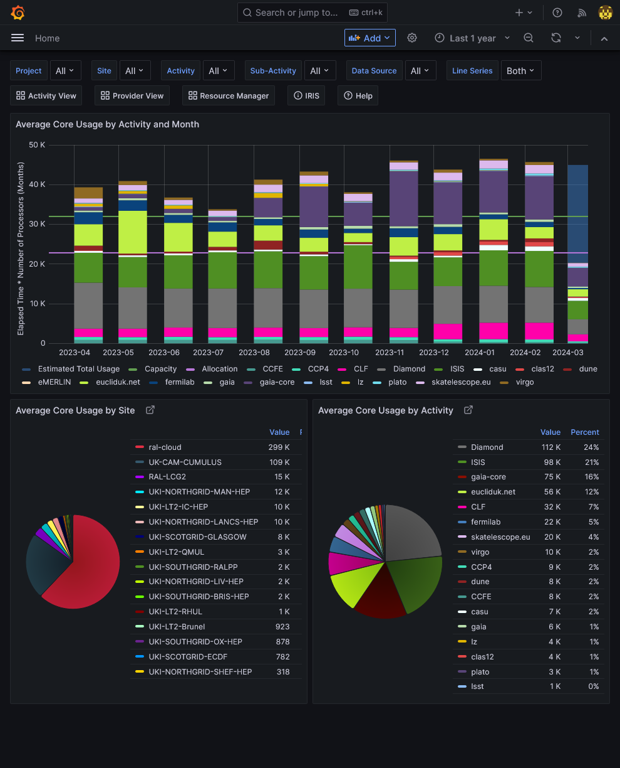
APEL – IRIS
IRIS Accounting Dashboard
APEL is now an important part of IRIS with a number of improvements made to the interface
The Dashboard will be used as a test-bed for the recently prepared GPU accounting system (technical work done in interTwin and IRIS contexts) that will feed into the EGI/WLCG accounting

Slide 15
APEL – Plans
Python 3 and EL 8+ migration
Applying what we’ve learnt from SSM to the APEL server and client
Preview release for testing with sites being finalised (hopefully available by this meeting!)
Plans being developed for APEL database and server migration
Data validation
Replacement for pub/sync system
There is a technical debt hurdle from the old system to overcome, but underway
HEPscore benchmarking
Most issues in the updated accounting flow have been ironed out through testing and work is now focussing on the deployment plan
We are still looking for more sites to test with so that we can thoroughly verify this major change
Tokens support
WLCG is still discussing how VO information should be shown in (or be discoverable from) the token – decisions needed here before anything can be planned or implemented in APEL

Slide 16
IRIS IAM
Slides by Donald Chung
Notes:
The abstract pattern can be removed or repositioned if required. Be careful to ‘Send to Back’ so that it does not obscure any important information.

Slide 17
IAM: Current status
Grid Tools runs two INDIGO IAM instances:
  IRIS IAM – production service for IRIS
    672 users
    140 groups
    234 clients
  SKA IAM – prototyping service for SKA SRCNet AAI design
    83 users
    55 groups
    210 clients
Current work underway to:
  Migrate IAM hosts to Rocky hosts, in a way to support future high-availability, geographically distributed, front-end
  Migration to full HA Architecture, detailed in following slides

Slide 18

HA-IAM Current Status
HA(High availability)-IRIS-IAM
Deployed
  Geographically distributed database (Backend)
    RAL
    Glasgow
    London (Imperial)
On-going
  Frontend
    Have demo services up and running with load balancer to divert traffic to heathy server
Glasgow
London (ICL)
RAL
Notes:
To change the map, select ‘Format’ from the PowerPoint menu and ‘Slide Background’ from the drop-down menu. Within the new list of options that appears on the right of the screen, select the ‘File’ button under ‘Insert picture from’ and select your image from your file browser. Remember to delete the image credit if using your own image.
To edit the points on the map, click the box and reposition. You can then drag the dot to show your specific location. Click into the box to edit the copy. To add more points, click the box and copy and paste the box.

Slide 19
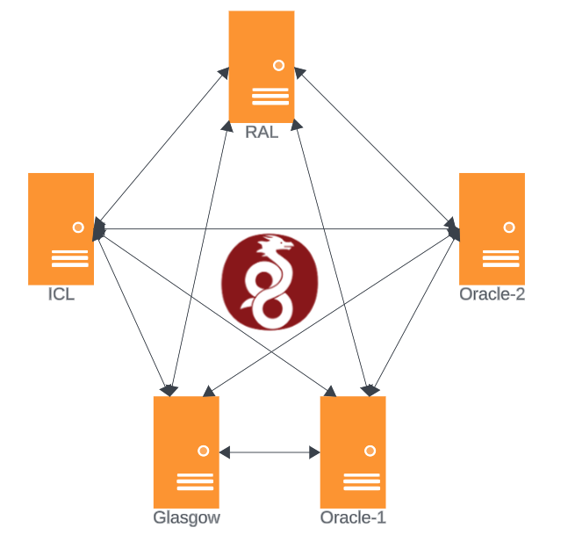
HA-IAM Plan
Work with developer on INFN(indigoiam) to enhance HA setup performance
  Backend database overhaul
Planned Publication
  HA-IRIS-IAM Setup (technical report)
    Comparison of load balancing strategies
  Discussion and comparison with RCauth setup
Portable configuration management/deployment of IRIS-IAM
  For non-Aquilon partners
Monitoring and logging
  Ichinga/opensearch
Managing VPN access
  Build more robust authentication layer on top of wireguard
Notes:
To edit the graph data. Click on the chart, Chart design, and choose select data or edit chart data in excel.

Slide 20
FTS
Slides by Rose Cooper
Notes:
The abstract pattern can be removed or repositioned if required. Be careful to ‘Send to Back’ so that it does not obscure any important information.

Slide 21
FTS: Current status
Maintaining three FTS instances:
  WLCG production instance (lcgft3)
  Prototyping SKA instance (fts3-ska)
  Test instance
FTS usage has shifted to include communities in addition to the Tier-1
  SKA – Component in the data movement prototyping
  LSST – testing data transfers using the RAL FTS
  Included in EGI up until June 2023
Testing integration with token authentication:
  Integrated SKA-FTS with SKA-IAM and Escape-IAM as part of the prototyping for SKA
  Work to include token authentication on the WLCG production instance following the upcoming FTS major release

Slide 22
FTS: Future plans
New FTS version 3.14 expected to be available in April
  Will be compatible with Alma 9/Rocky 9, which is essential with SL7 will reaching end of life at the end of June this year.
  Other major change in this release is a refactor of the token workflow within FTS
  Expecting another follow up major release later this year to fix any issues with the operating system migration
Continuing development of SKA-FTS instance at RAL
  Focus on integration with SKA-IAM to meet the AAI requirements for SKA
  Support use case for FTS as part of the data movement workflow alongside Rucio
  Begin work to tune & refine links between SKA storage endpoints
Scale back WLCG FTS instance
  No longer used as the primary back FTS for any of the Major CERN experiments so doesn’t need as many VMs supporting it
  Won’t impact availability of the service
  Can be scaled back up if needed

Slide 23
perfSONAR
Slides by Matt Mayer & Brian Davies
Notes:
The abstract pattern can be removed or repositioned if required. Be careful to ‘Send to Back’ so that it does not obscure any important information.

Slide 24
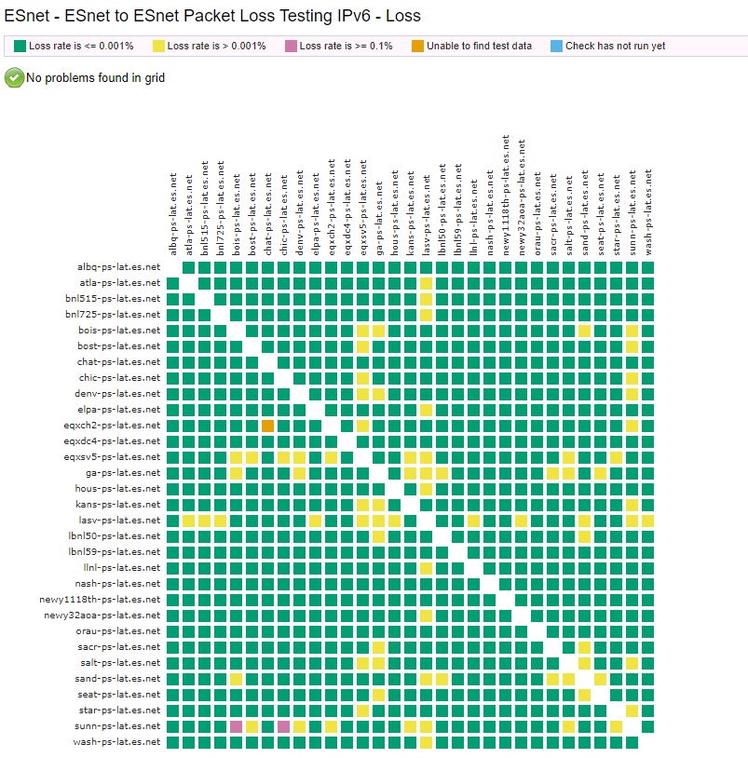
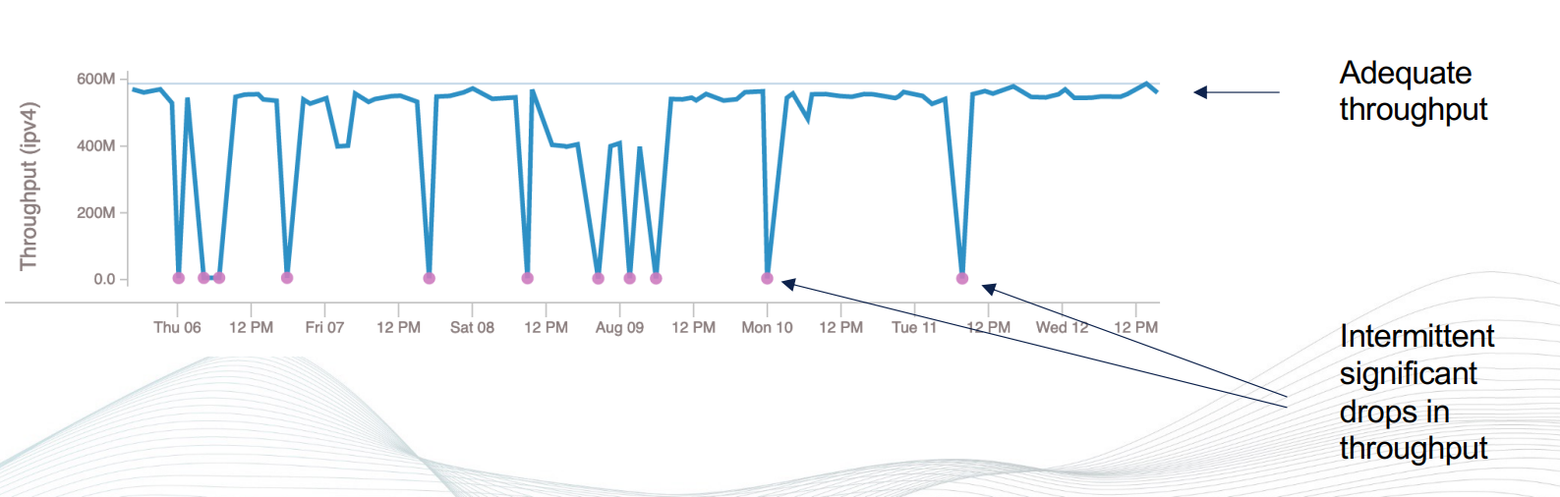
Grid tools - perfSONAR
Used for monitoring “health” of network.
Package of multiple tools for measuring bandwidth and latency with automation/scheduling (iperf, ping, traceroute etc).
Can output results to maddashboard/Grafana
Used for long term monitoring of network

Slide 25
perfSONAR for SKA
Grid tools at RAL creating the perfSONAR mesh for the Square Kilometer Array (SKA) project
This will support SKA for long distance connections (Australia/South Africa to SKA partners).
Status:
perfSONAR host setup at RAL/UK with dashboard
Using two external nodes for testing
To do:
Coordinate with external sites for other perfSONAR nodes
Organise scheduled tests into MESH
Tune hosts for high bandwidth connections (100GB)

Slide 26
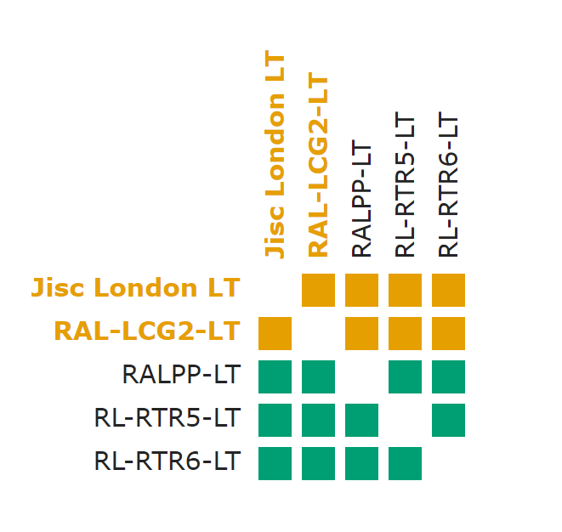
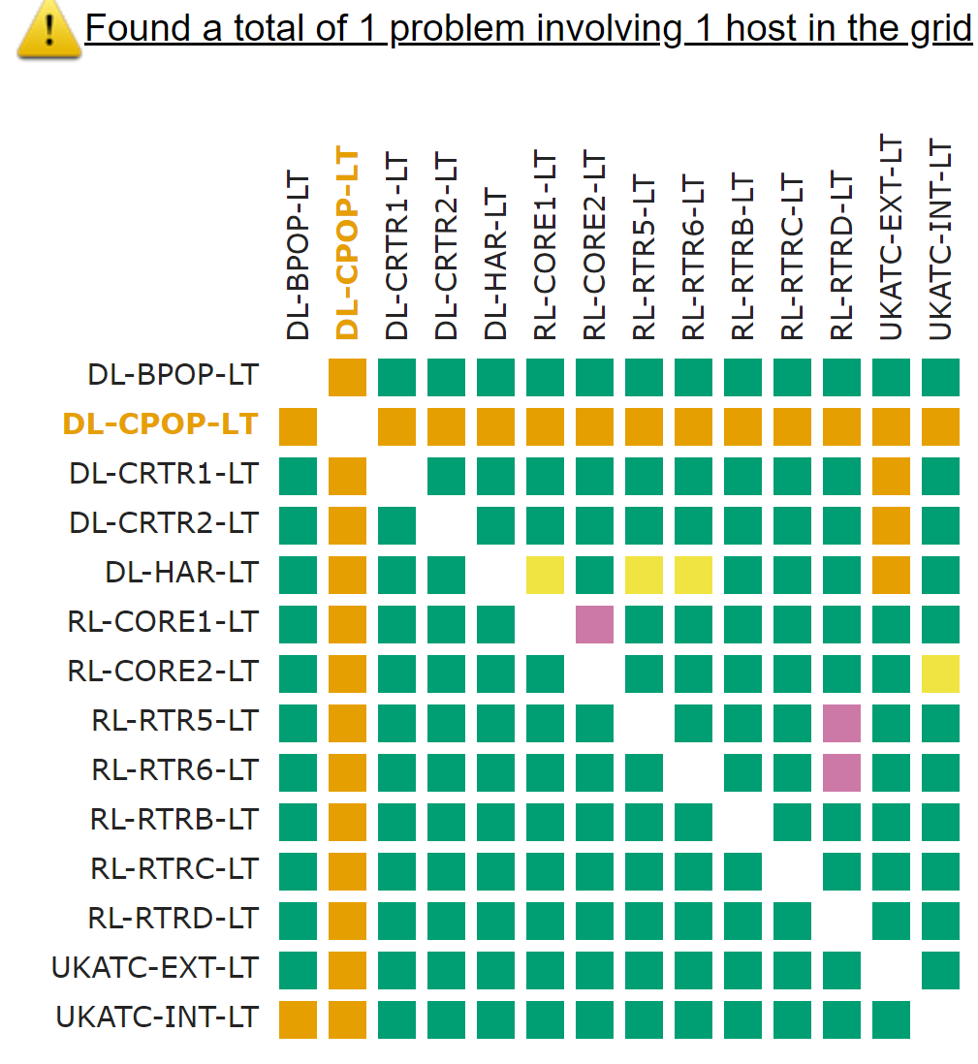
perfSONAR for Tier 1
Status
  Deployed 100G T1 and CTA hosts into different parts of SCD network
  Added to WLCG mesh.
  Part of intra-RAL site mesh
    https://psmaster.rl.ac.uk/maddash-webui/index.cgi?
To Do
  Routing changes
  Enable IPv6 for CTA host
  Upgrade to Rocky 8/9
  Issues with logstash/archive service

Slide 27
Looking Forward
Notes:
The abstract pattern can be removed or repositioned if required. Be careful to ‘Send to Back’ so that it does not obscure any important information.

Slide 28
Next Steps for Grid Tools
Focus on improving the Team’s ways of working, to offer a coherent platform of federating services
The new Agile structure facilitates coherent and granular activity planning and delivery estimates
Looking to shift towards value-focussed delivery, aiming to deliver new features when ready, instead of in larger releases.
Ongoing recruitment for a new CA service manager
  This role is intended to have some helpdesk/service support responsibility across the team
  Support shared operational activities
Notes:
Replace this guidance text with your own bullet pointed content.
For further guidance please see https://www.bdadyslexia.org.uk/advice/employers/creating-a-dyslexia-friendly-workplace/dyslexia-friendly-style-guide

Slide 29


Notes:
The abstract pattern can be removed or repositioned if required. Be careful to ‘Send to Back’ so that it does not obscure any important information.

Slide 30


scd.stfc.ac.uk
@SciComp_STFC
Notes:
The abstract pattern can be removed or repositioned if required. Be careful to ‘Send to Back’ so that it does not obscure any important information.

