Slide 1
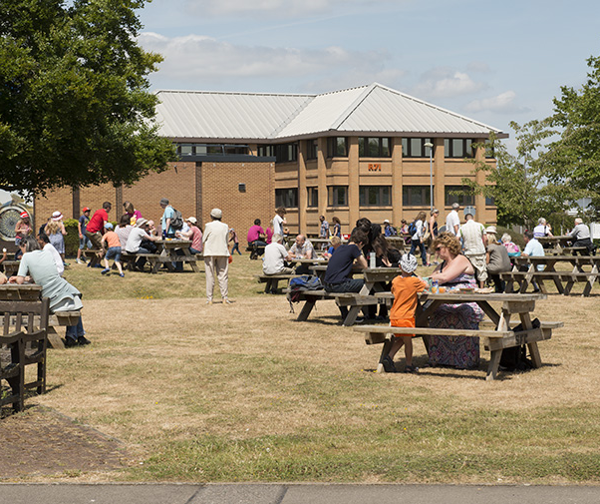
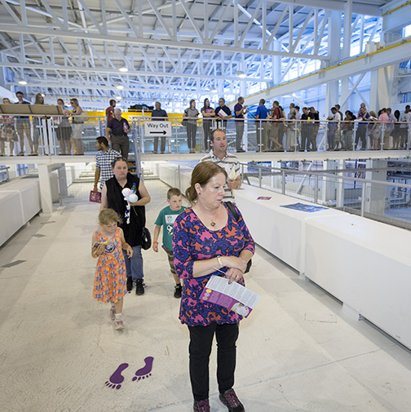
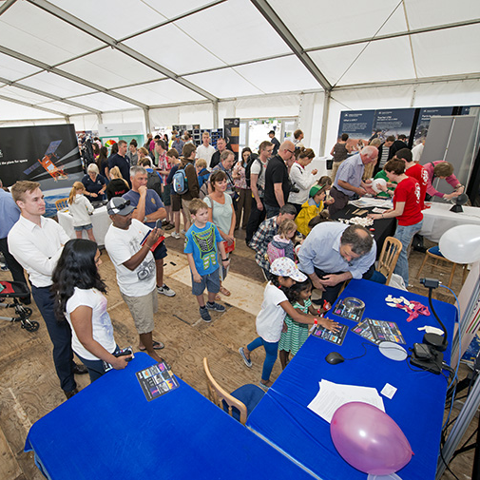
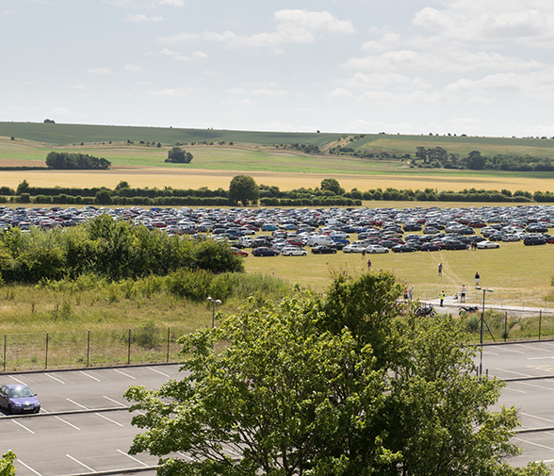
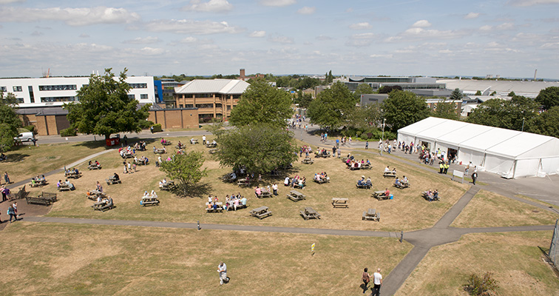
STFC Open Week @ RAL
Greg Corbett
greg.corbett@stfc.ac.uk

Slide 2
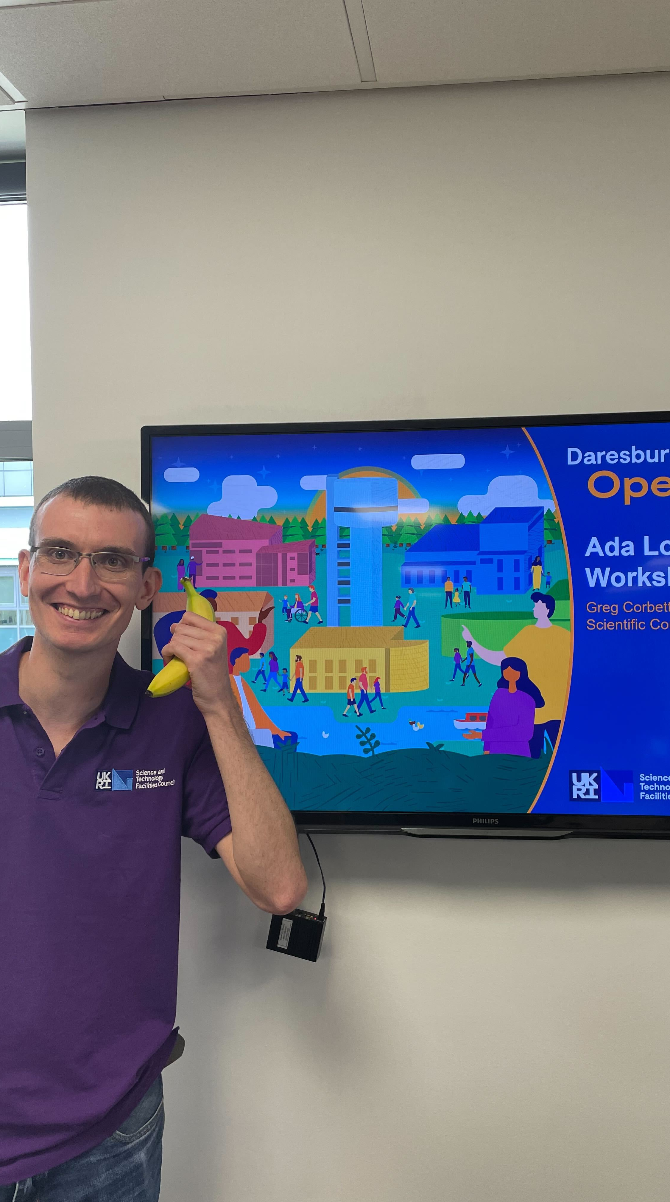
Why Public Engagement?
GridPP has a mandate to for outreach and public engagement. It was part of the GridPP7 proposal.
Public Engagement is great way for GridPP:
colleagues to engage both school groups and the public with our field and the work we do.
as a community to show they are taking steps to actively encourage the next generation into Computing careers (an STFC strategic objective).
STFC is planning a large scale Public ‘Harwell Open Week’ in June where we will engage 2,400 schoolchildren and 20,000 members of the public.
Notes:
One of the ways STFC achieves this objective is by showcasing the huge range of science, technology, research and development undertaken as part of national and international collaborations.

Slide 3
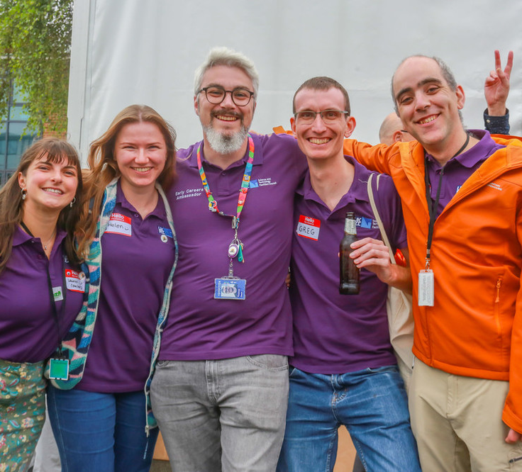
Harwell Open Week (HOW)
Where
Harwell Campus, Oxfordshire.
When
w/c Mon 24th June 2024
Tue 25th & Wed 26th – Schools Days
Sat 29th - Public Day
Image © STFC John Dawson

Slide 4
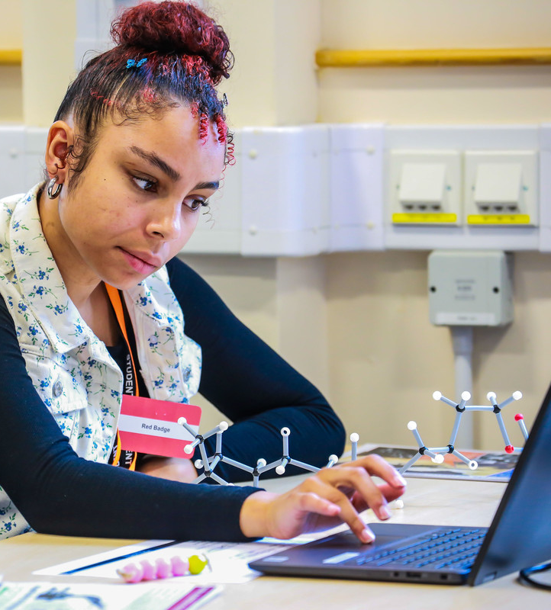
How can GridPP be involved?
Supporting Scientific Computing Department (SCD) activities
On the Schools Days and / or Public Day
More explicit contributions from individual institutions or GridPP more broadly.

Slide 5
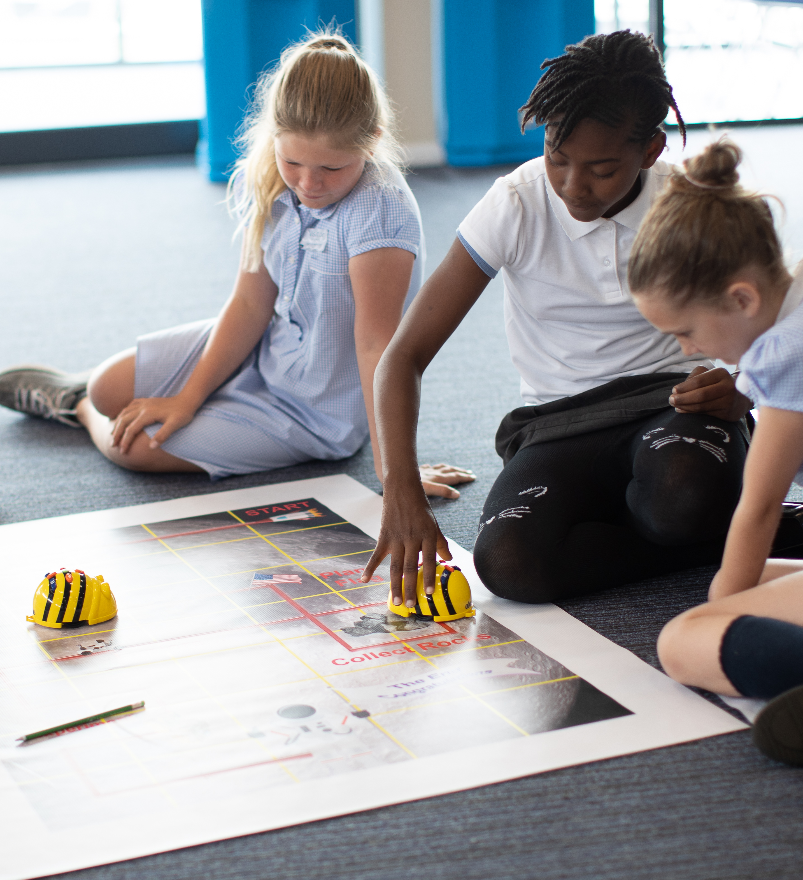
Schools Days
Tue 25th and Wednesday 26th
SCD will engage with school groups across KS2, KS4 and KS5 with several workshops
Coding without Computers (groups of 60)
Arduino Challenges (groups of 30)
Internet of Things Workshop (groups of 30)
Nuclear Physics Workshop (groups of 30)
GridPP colleagues can help support these workshops
Good opportunity to exchange public engagement best practices and ideas.
Notes:
KS2 7 to 11
KS4 14 to 16
KS5 16 to 18

Slide 6
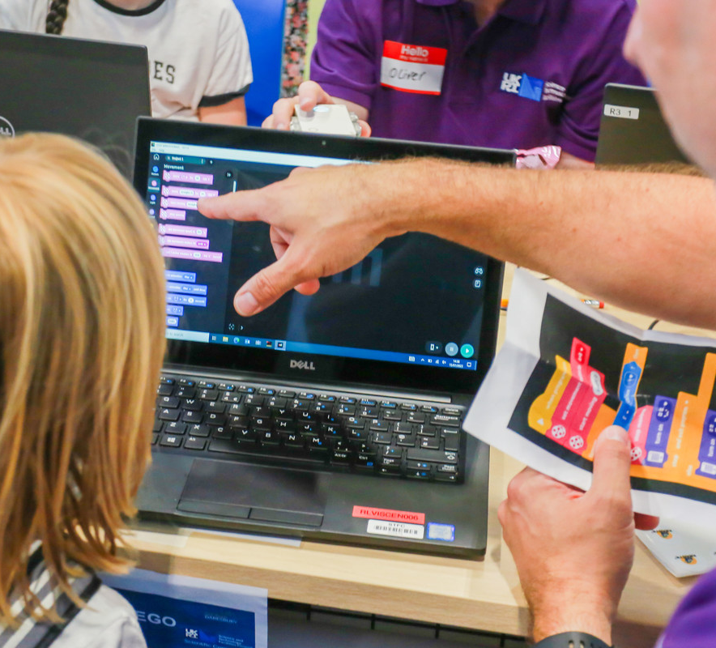
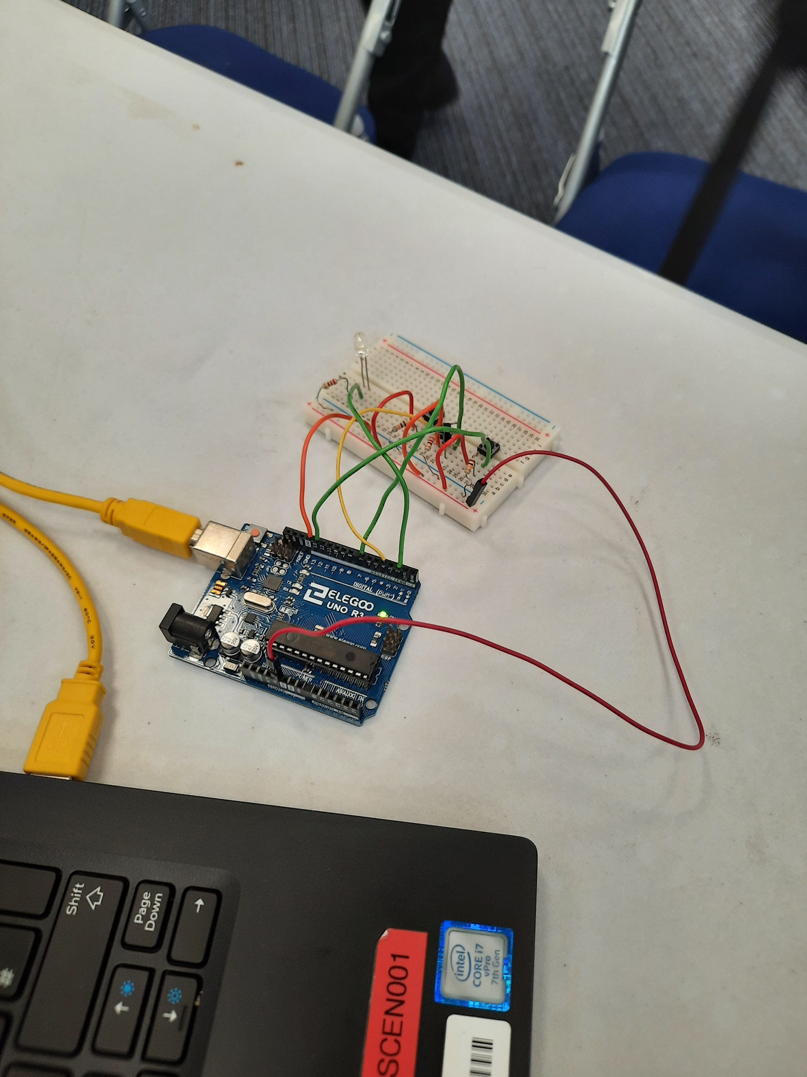
Public Day
Sat 29th
GridPP colleagues can support the various activities and displays being developed by SCD for half or full day.
History of Computing display
Human HTC activity
Data Transfer activity
Helping children to learn to code (Scratch, Microcontrollers, LEGO Mindstorm Rovers and Python)
Talking to the public about your career and your work.

Slide 7
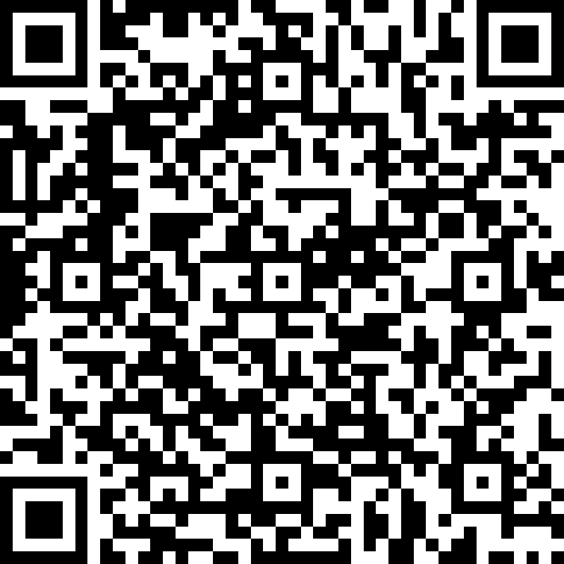
Where do I sign up?
To volunteer to support SCD activities for the school days and / or the public day, sign up here (or use the QR code).
“activities led by my department/group”
“SCD activities”
“I will reserve my own accommodation”
Volunteers can also reserved tickets for friends and family if they sign up by 10th April.
GridPP will support staff by covering travel and subsistence costs.
Volunteer for Harwell Open Week

Slide 8
More explicit GridPP involvement?
“My university has a great computing public engagement activity already made! Can we bring that and people to staff it to the public day?”
“Can GridPP do something in its own right?”
Yes! Happy to talk about ideas over coffee or at a later date.
Caveat: HOW activities need to be finalised by 19th April – so get in touch sooner rather than later.

