Slide 1
Graphical Tools for Detector Operations and Validation:
Should we be involved?
Sam Harper (RAL)
SwiftHEP Meeting
March 27th 2024

Slide 2
Introduction
was CMS trigger coordinator, during my term oversaw
  Phase II HLT TDR with first realistic compute estimates
  CMS’s transition to GPUs
  Run3 prep
During my term, the biggest problem I identified was not making our code faster
  this is under control, its challenging but there is a well-thought out plan which SWIFTHEP is a key part of
It was the lack of tools to operate and run CMS
  there is laughably little effort on this and the skill set to do so does not overlap with typical skill set we have available

Slide 3
Introduction (II)
More succinctly
I’m not worried about CMS not being able to meet the computing of the HL-LHC
  GPU efforts are advanced, lots of code development on going, this is going to converge
I am worried about not able to turn on the detector or configure it due to broken tools to do so
  CMS came worryingly close to not being able to change trigger keys when the CERN SSO upgrade happened
    simply because almost nobody knows how our webbased tooling worked

Slide 4
What I am talking about
I mean tools like
  displaying DQM histograms
  developing trigger paths
  configuring detector settings
  displaying detector information
  presenting information to analyses
I don’t mean analysis tools
  RDataframe, coffea, other popular tools
  already well served by others and in general this is in good shape
typically all need some sort of GUI

Slide 5
Efficient Tools are key to unlocking Physics Potential
physicists try to do too much
goal for maximising physics is allow them to achieve more
efficient tools are key here
  CMS’s physics potential is absolutely limited by the quality of its tools
    there are some good ones (eg OMS our online monitoring) but the majority are bad
  trigger development barrier is too high, folks spend their time battling with the substandard tools rather than making performant triggers
the problem (at least on CMS) is that we have very little ability to build efficient (non-analysis) tools
  maybe its better on other experiments?

Slide 6
Graphical Tools
trend is all GUIs moving to running in the browser
  sometimes it looks native but often can actually be a webapp running on a bundled version of chromium
    electron is common framework
    vscode is probably the most popular one
GUIs in a browser means written in javascript*
  there have been attempts with python, so far I’ve not been impressed
physicists in general do not know javascript
  nor do they have much experience with REST APIs and other key pardims here
therefore its very hard to for collaborations to develop such tools as there is a very limited talent pool with the correct skill set
  difficult to import the skill set: hard to retain full stack devs and hard to communicate the requirements to them
*IMHO any serious development should use typescript which is a superset of javascript
in this talk whenever I say javascript, I really mean typescript

Slide 7
Commonality Between Experiments
many tools needed by experiments will be bespoke
  say something unique to configurating a CMS run
but many will be common
  every experiment needs a way to visualise validation plots efficiently
even the bespoke tools have common elements
  usually its just the “business logic” or exactly what information to display
  having a good example or libraries will help
  eg if you want to interact with the CERN SSO can use a common package like tsgauth

Slide 8
Designing Tools
a tool must provide the correct information
a tool needs to enable the correct workflows
Typically the experts (aka physicists) know what they need do and an external programmer doesn’t
There are two approaches
teach a physicist how to write the tool
have the physicist write a detailed specification and requirements document
  this is harder than it sounds!

Slide 9
Case Studies
I learnt typescript, make simple websites hosted on CERN PAAS
I make tools which I think are most needed
all tools are somewhat similar architecture
  frontend : typescript + vue
    vue is frontend framework, one of the big three (react, angular, vue)
    still js ecosystem is fast moving, frameworks do get deprecated
  backend : python using flask (moving to fastapi)
    try and do as much as possible on the backend as python is very physicist friendly
  usually some sort of db such as mongo
    again very physicist friendly, its just json docs
    note I’m using this to store root histograms now
once you know how, its very easy to do this
  the trick is knowing how
it has been a game changer, I’ve been busy solving many of the things that irate me on CMS
  and the tools work exactly how we want it to work

Slide 10
Case Studies: examples
examples:
hltsupervisor: assists shift crew & experts handle trigger issues at P5
  analyses the trigger rates and offers clear advice on what to do
  improves operational efficiency at p5
hltinfo: provides HLT information for analyses
  before this, very difficult in CMS to find out basic trigger info
multi run DQM:
  CMS DQM plots are run based
  this agreates key plots over a fill and displays a quick summary on triggr health intended for a busy expert
timing measurement service
  allows users to run the standard benchmarks to estimate CPU resources of their path with a single script
  displays the results easily

Slide 11
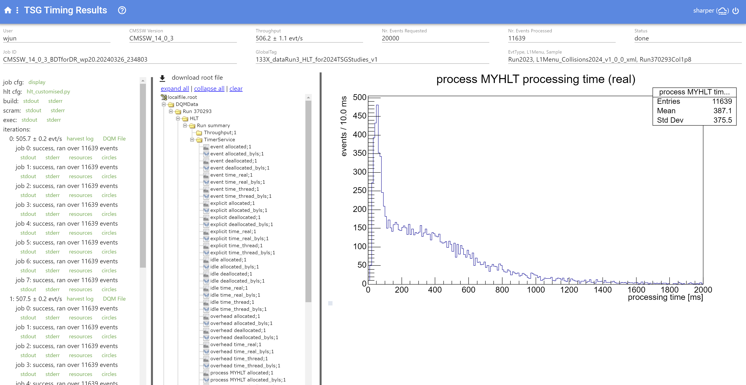
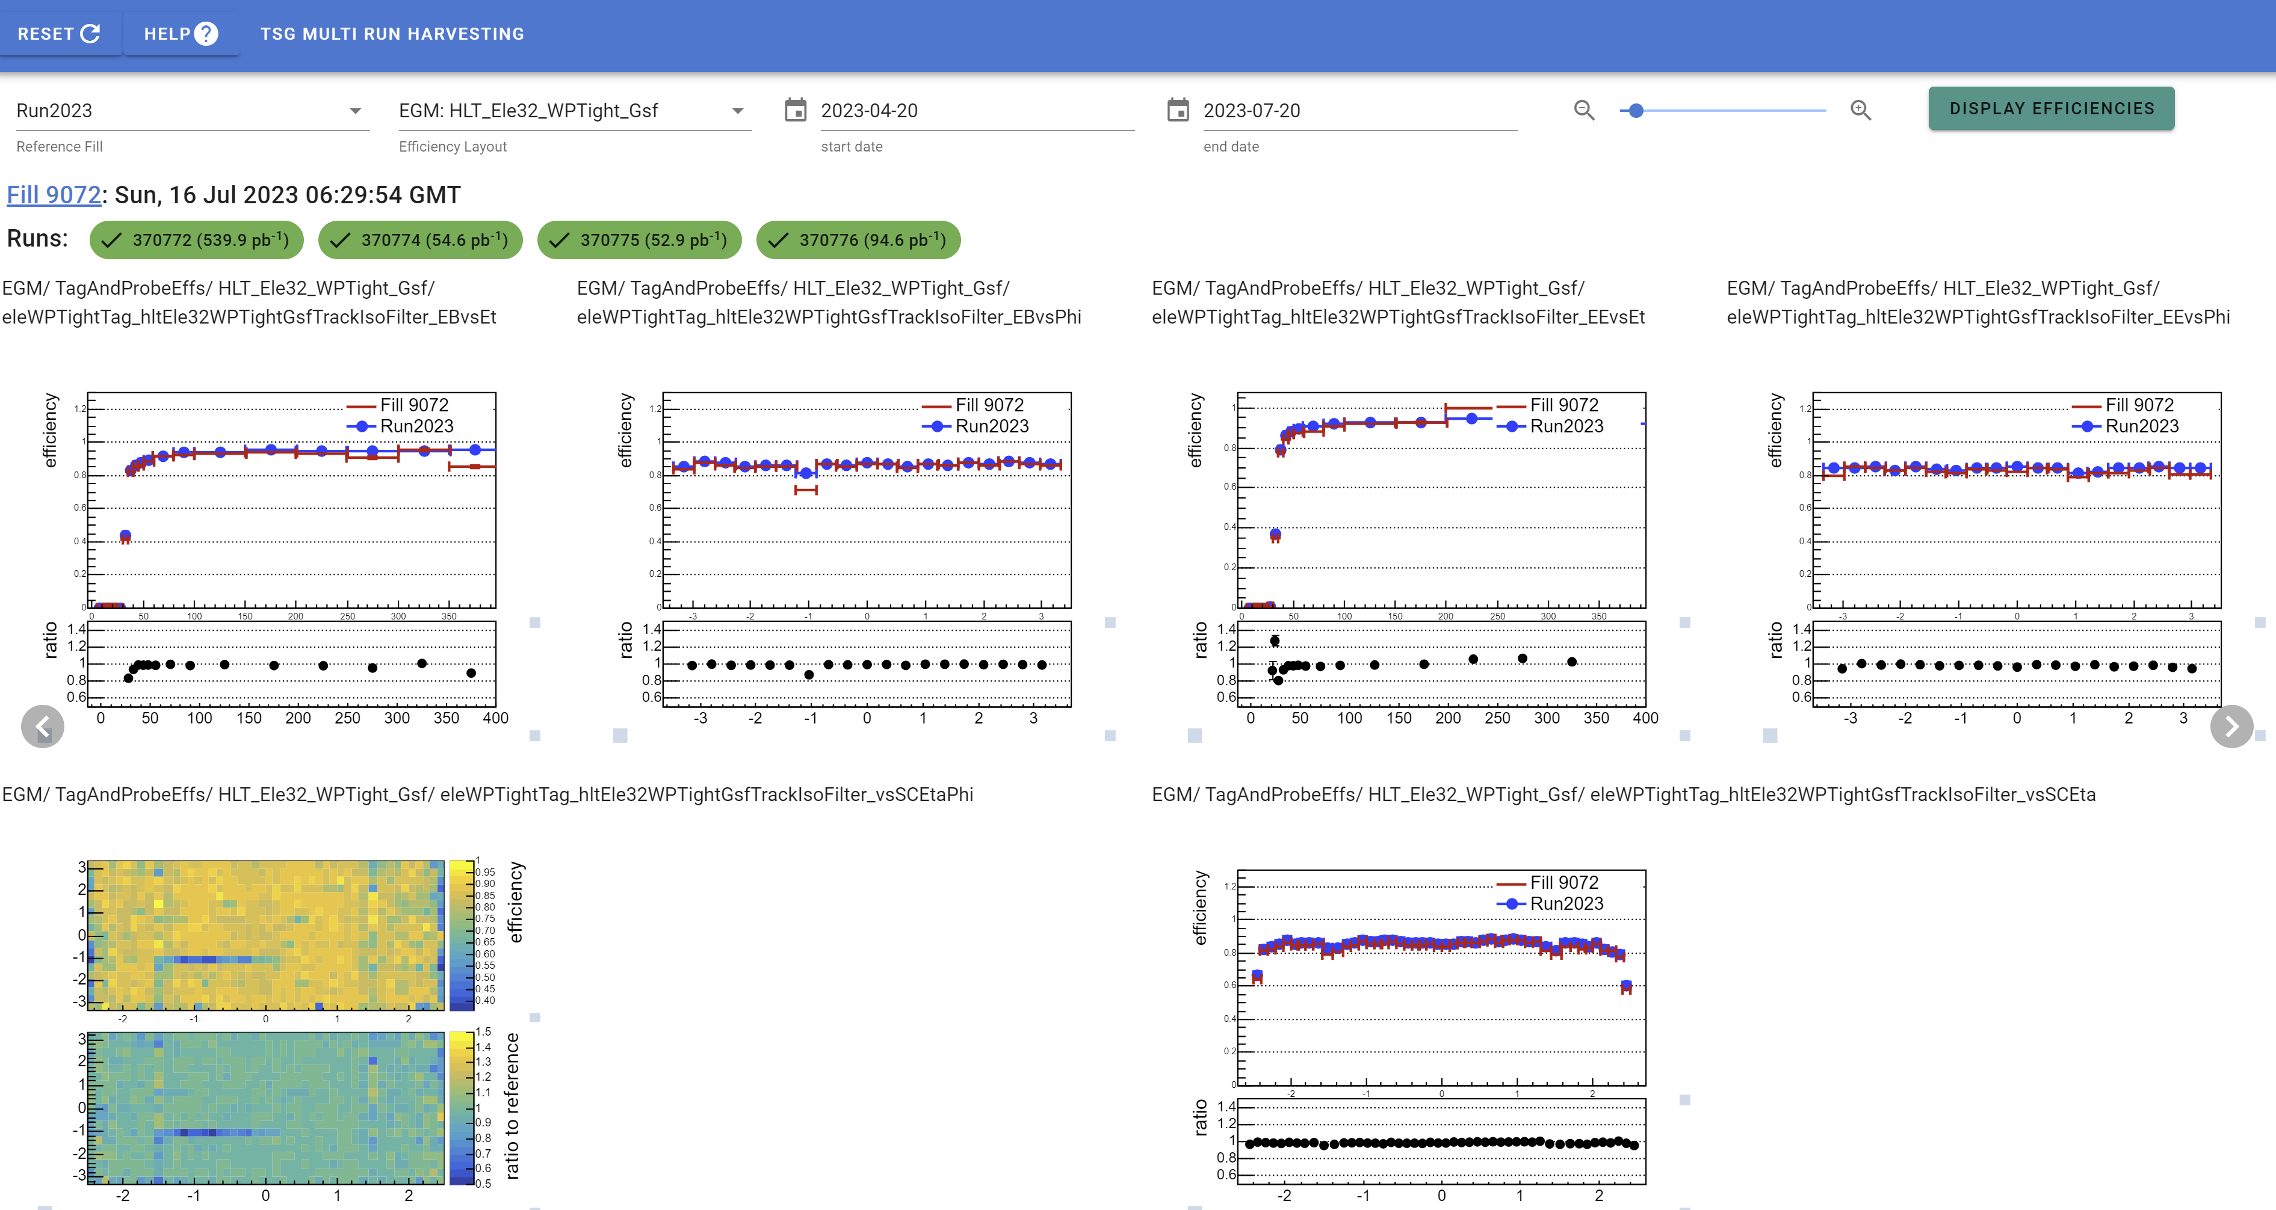
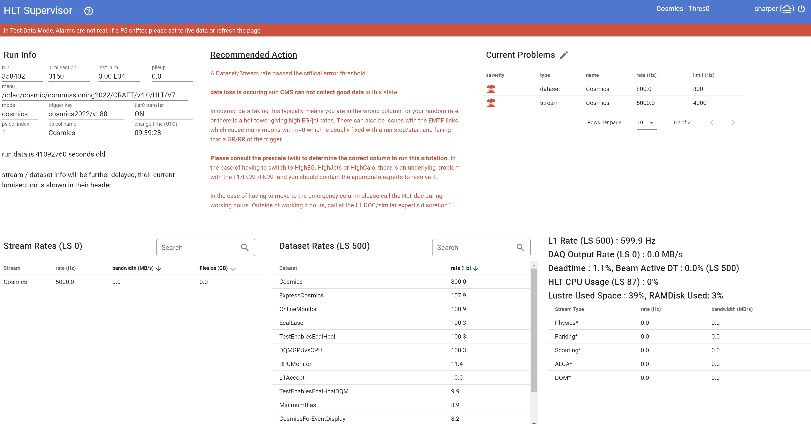
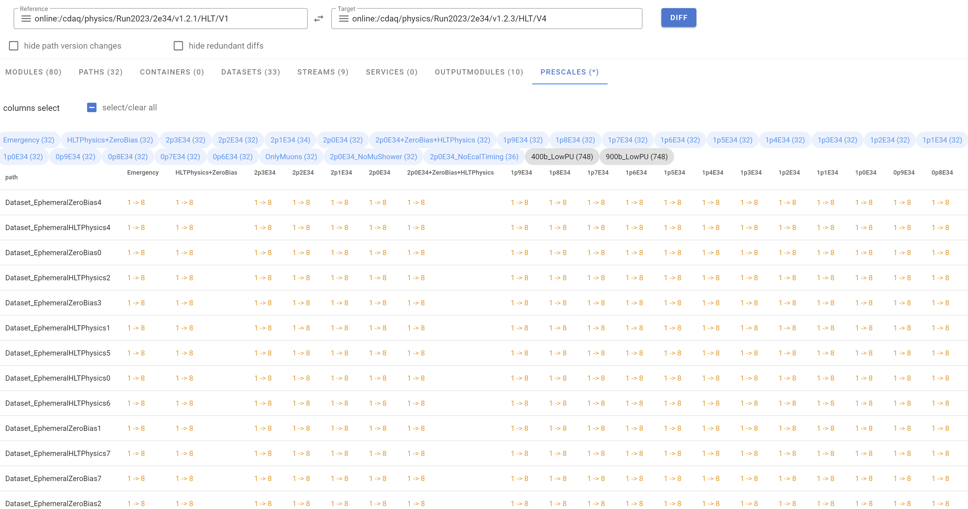
Examples of tools

Slide 12
Summary
I see a big problem limiting our physics by wasting our personpower due to substandard tools
  its absolutely limiting our physics on CMS
I have no idea how to properly solve it
should swifthep be involved here, is this something we should think about?
  eg provide off the shelf solutions /examples
  it would have been a huge help for me when starting out
or is this something we consider more appropriate for others to solve ?

