Slide 1
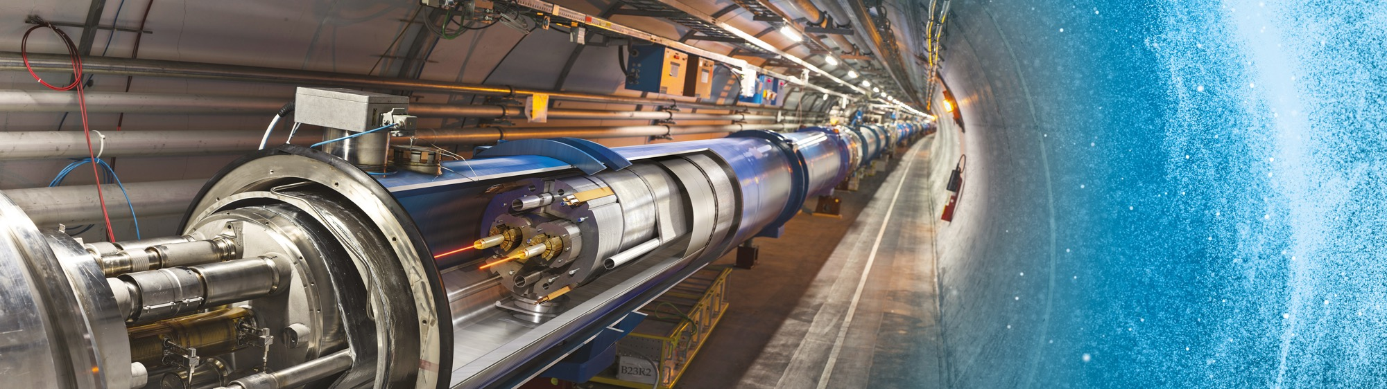
Doing Business with CERN
INGOs
Lisa Bellini-Devictor
7 February 2024

Slide 2
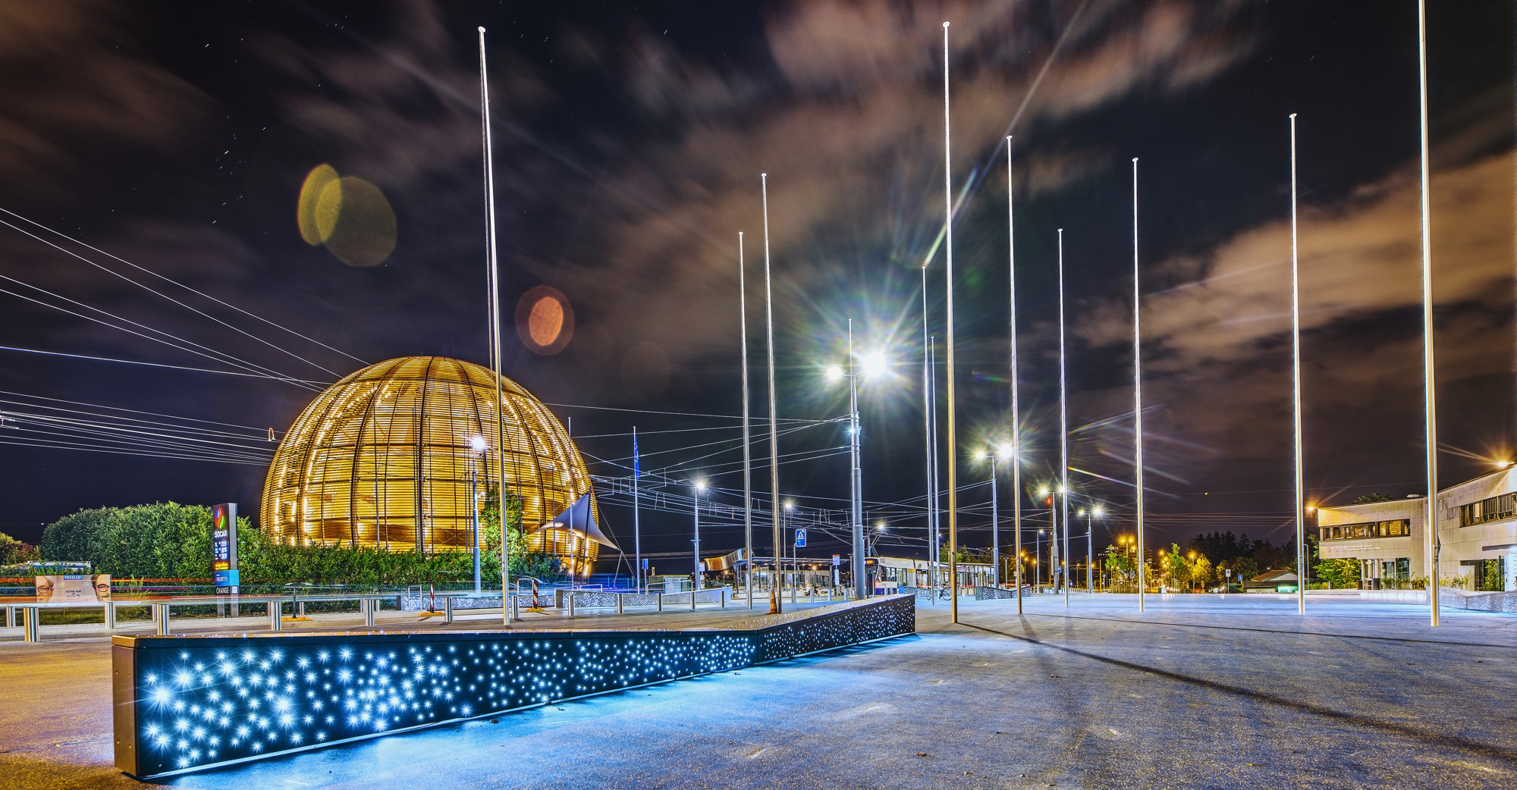
AGENDA
Introduction
What we buy
Procurement @ CERN - the rules
Impact of
Doing business with CERN
Procurement website

Slide 3

INTRODUCTION

Slide 4

CERN - the world’s biggest laboratory for particle physics.
Intergovernmental Organization
established on 1 July 1953 -
“Science for Peace”.
Immunity of jurisdiction
and execution.
Notes:
This slide addresses two questions:
“Where are we?”
Use the map to indicate the location of CERN, headquartered in Geneva, straddling the Franco-Swiss border
“What is CERN?”
CERN is one of the world’s leading laboratories for particle physics
CERN’s vision (long-term goal) is to understand the fundamental particles and laws of the Universe (This is the Vision statement that features in CERN’s communication strategy)
Thus, CERN is first and foremost a research laboratory

Slide 5

CERN is entitled to establish its own internal rules necessary for its proper functioning, including:
Procurement Rules
Safety Rules
Staff Regulation of its own personnel

Slide 6

In 1954 CERN had 12 Member States
Today CERN has 23 Member States
23 Member States
3 Associate Member States in the pre-stage to membership
7 Associate Member States
6 Observers
Geographical & cultural diversity
110 nationalities,
from 77 countries
~ 2676 Staff members
~ 2000 contractors’ employees
~ 13000 physicists /users
Yearly budget ~ 1350 MCHF
2/7/2024
Notes:
The speaker can highlight CERN’s second mission as stated when it was established: to foster peaceful collaborations between nations that had recently been at war.
This slide will have information on the country of the visiting delegation:
Location on the world map
Date of accession (if Member State or Associate Member State)
For information:
Member States – Austria, Belgium, Bulgaria, Czech Republic, Denmark, Finland, France, Germany, Greece, Hungary, Israel, Italy, Netherlands, Norway, Poland, Portugal, Romania, Serbia, Slovak Republic, Spain, Sweden, Switzerland, United Kingdom
Associate Member States in the pre-stage to membership – Cyprus, Estonia, Slovenia
Associate Member States – Croatia, India, Latvia, Lithuania, Pakistan, Turkey, Ukraine
Observers – USA, Russia, Japan, (EU, JINR, UNESCO)

Slide 7

Four pillars underpin CERN’s mission
RESEARCH
EDUCATION
& TRAINING
COLLABORATION
INNOVATION

Slide 8
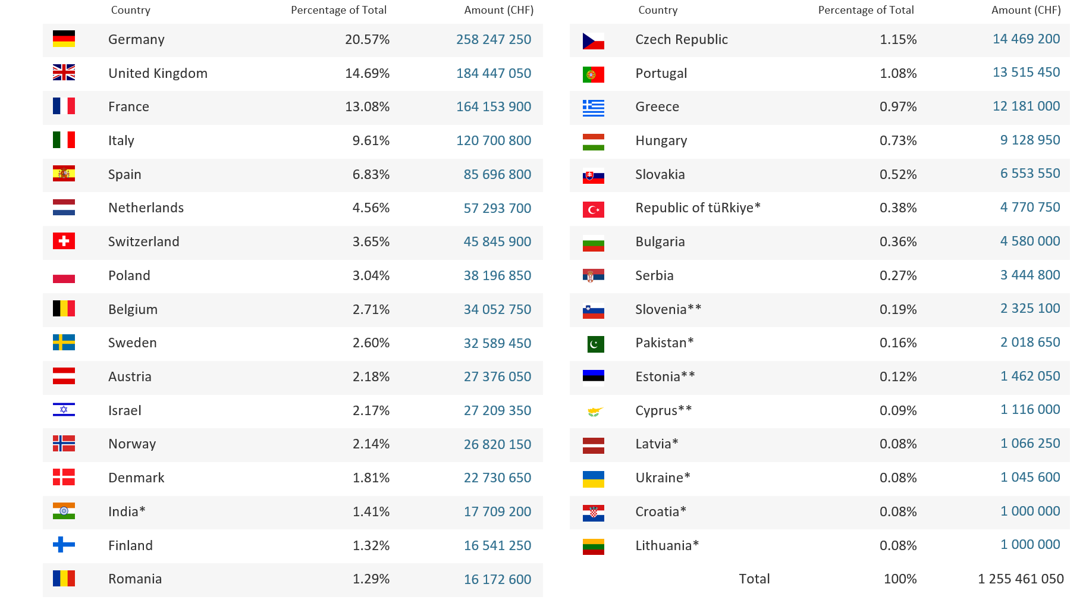
Yearly Budget (contributions 2024)

Slide 9

Recurrent supplies & services
Accelerator technologies required for consolidation projects and new developments
Detector technologies for experiments
What do we buy?

Slide 10
Procurement Expenditure

Slide 11
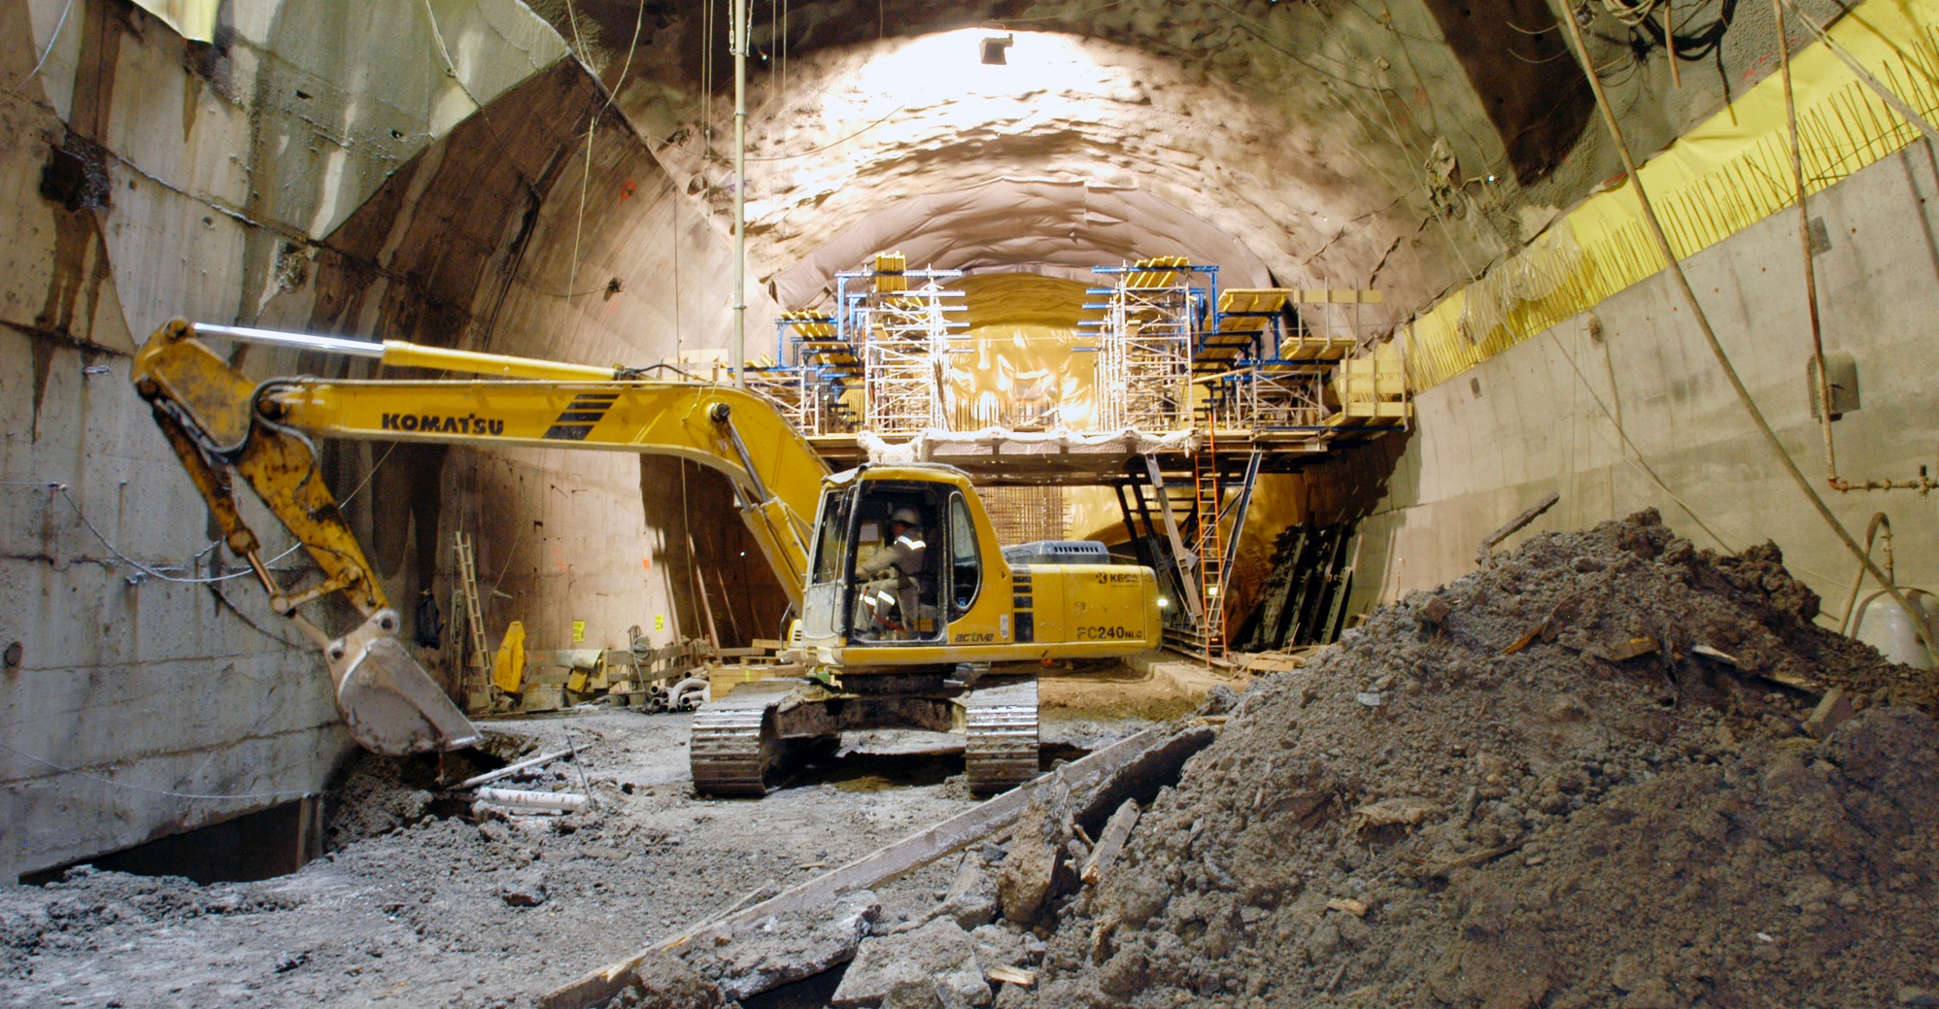
What do we buy?
Civil engineering:
  Construction
  Renovation of buildings
  Metallic structures
  Earthworks
  Roads
Cooling and ventilation
equipment

Slide 12
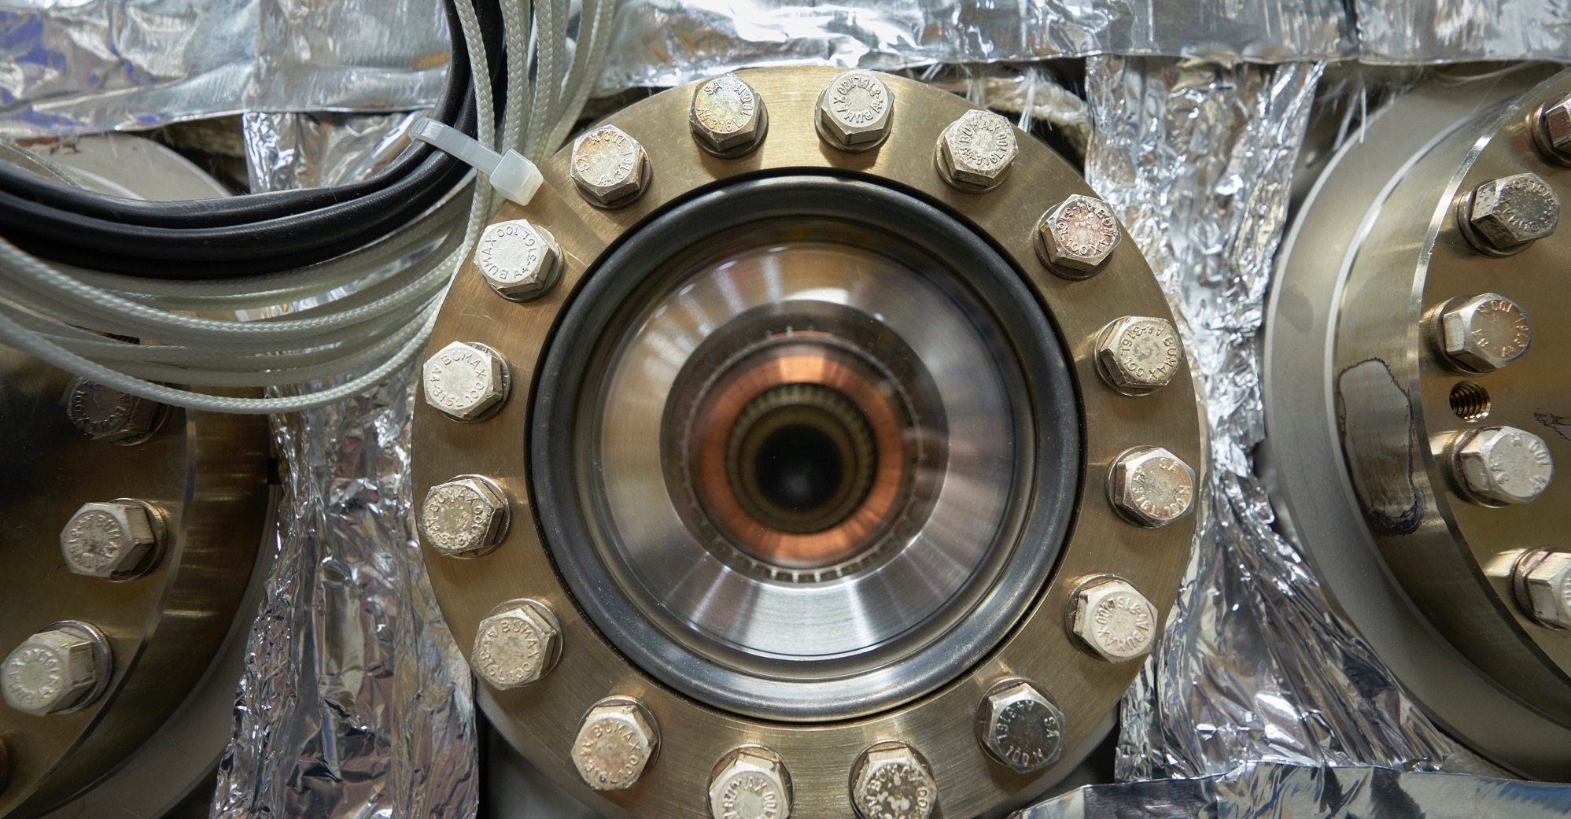
What do we buy?
Electical engineering and magnets
  Transformers
  Switchboards and switchgear
  Cables
  Automation
  Power supplies
  Magnets

Slide 13
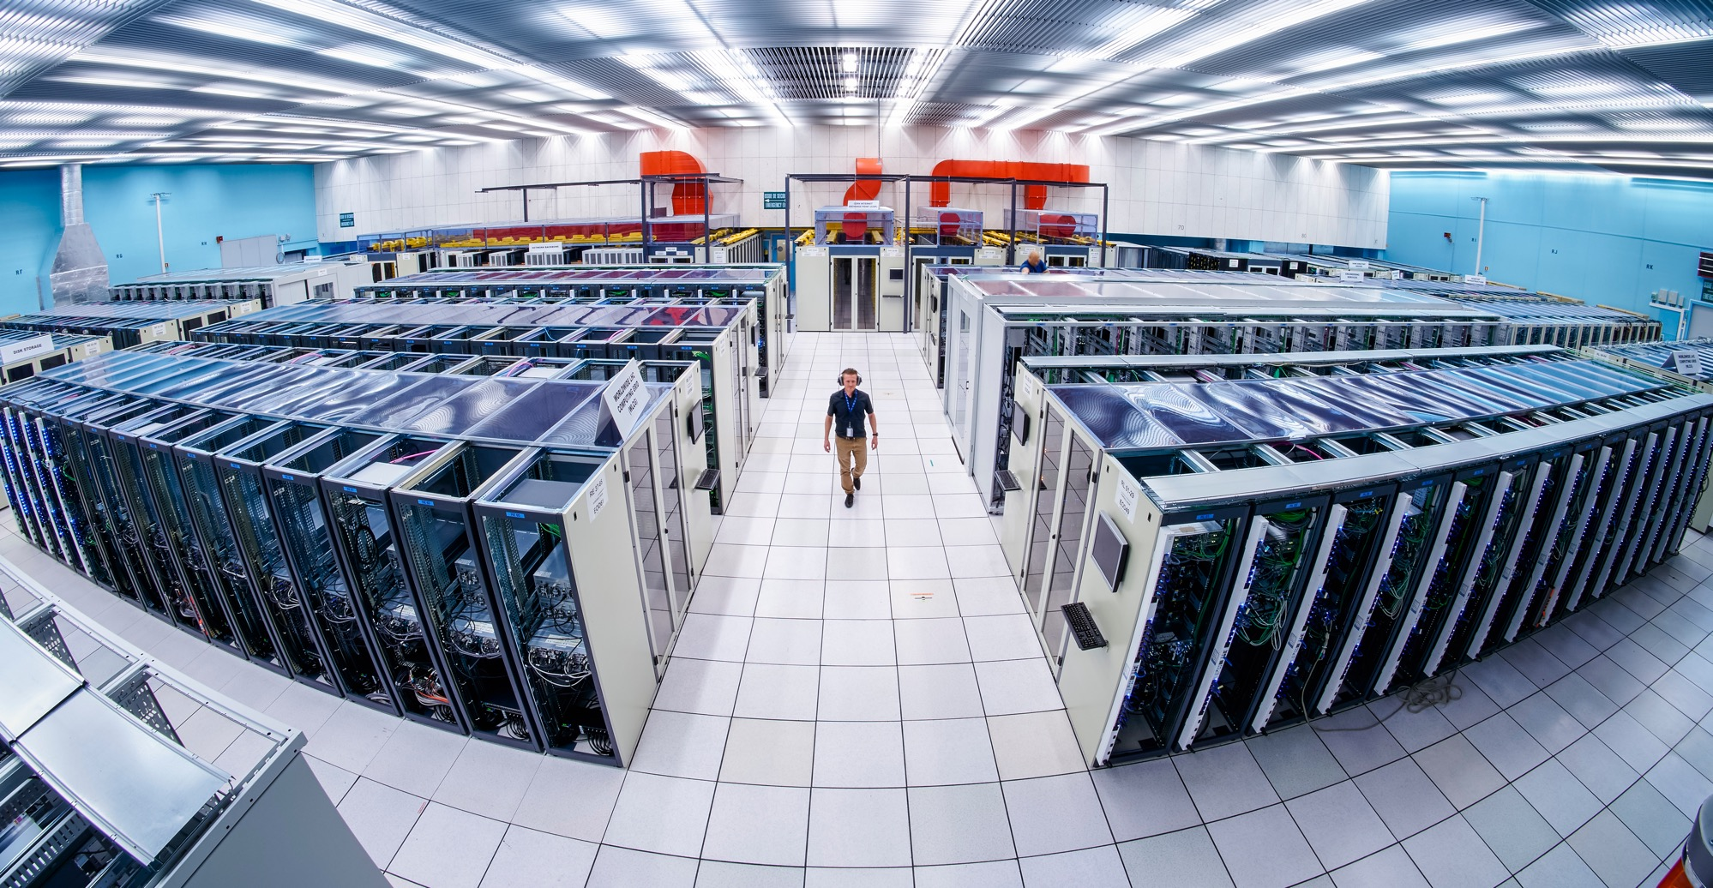
What do we buy:
Information Technology
  Computing systems
  Servers
  Software
  Network equipment
  Personal computer equipment

Slide 14
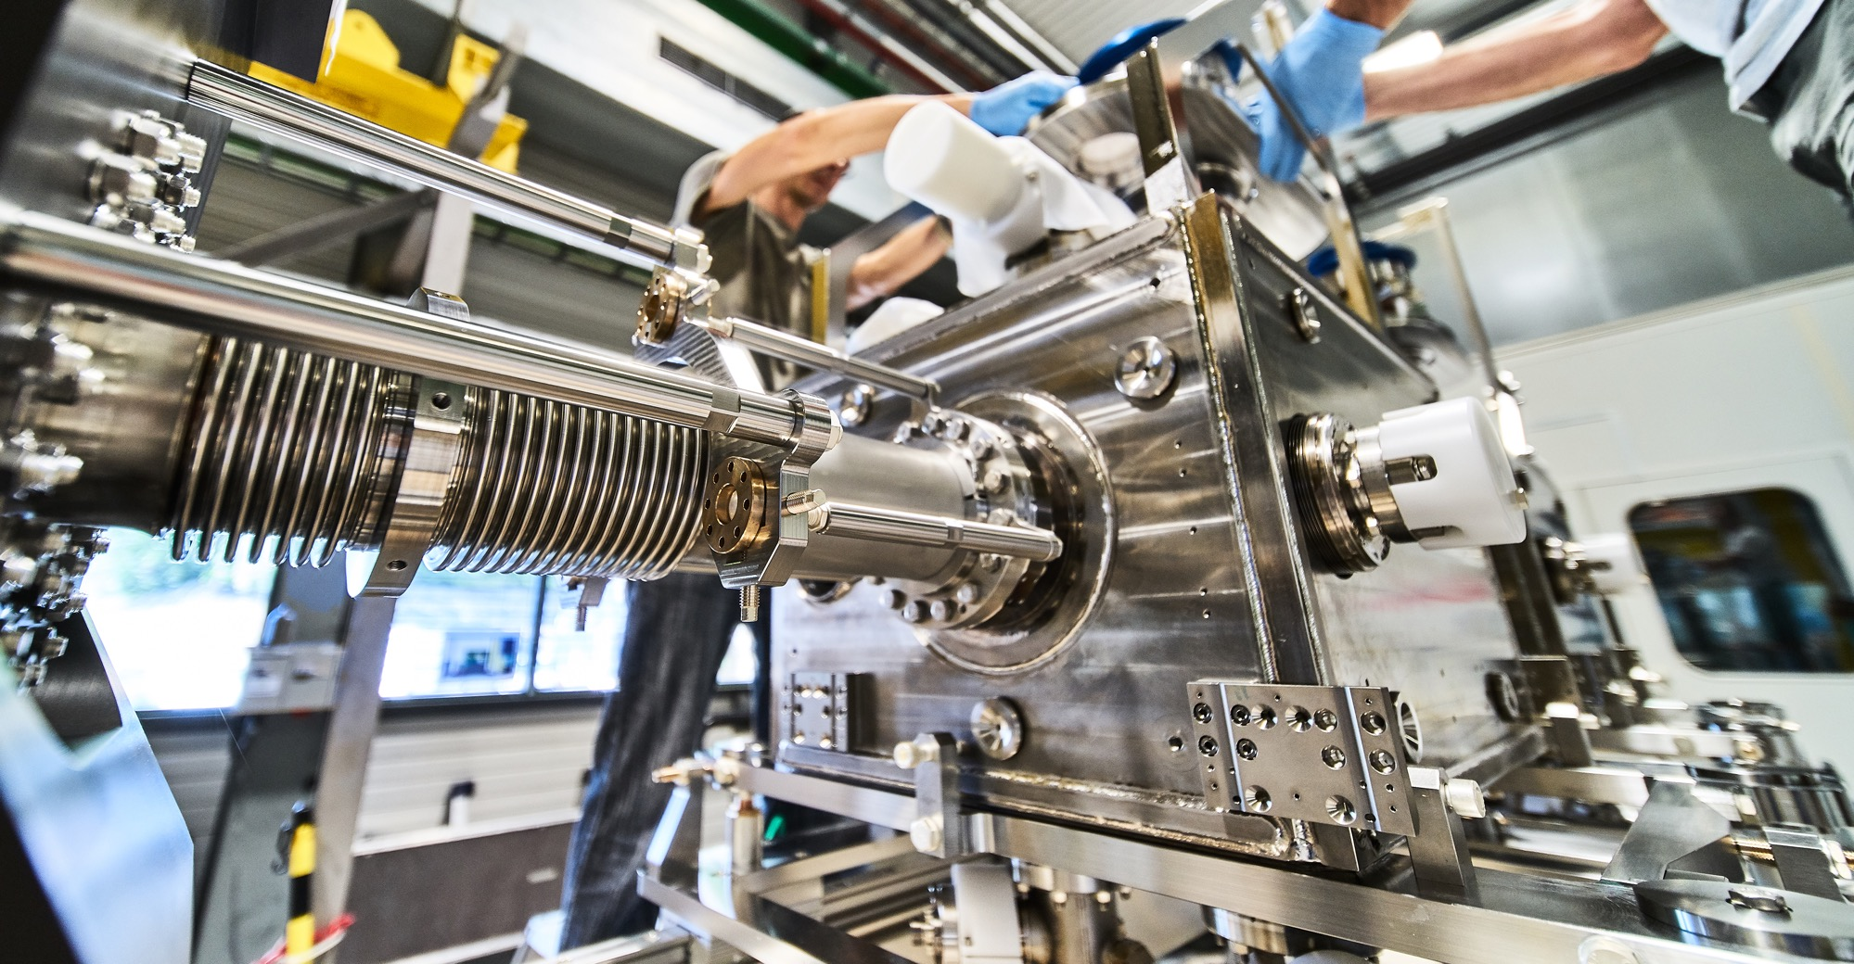
What do we buy?
Mechanical engineering and raw materials:
  Machining
  Sheet metal work and arc welding
  Special fabrication techniques
  Raw materials, finished and semi-finished products (plates, pipes, etc.)
  Offsite engineering and testing

Slide 15
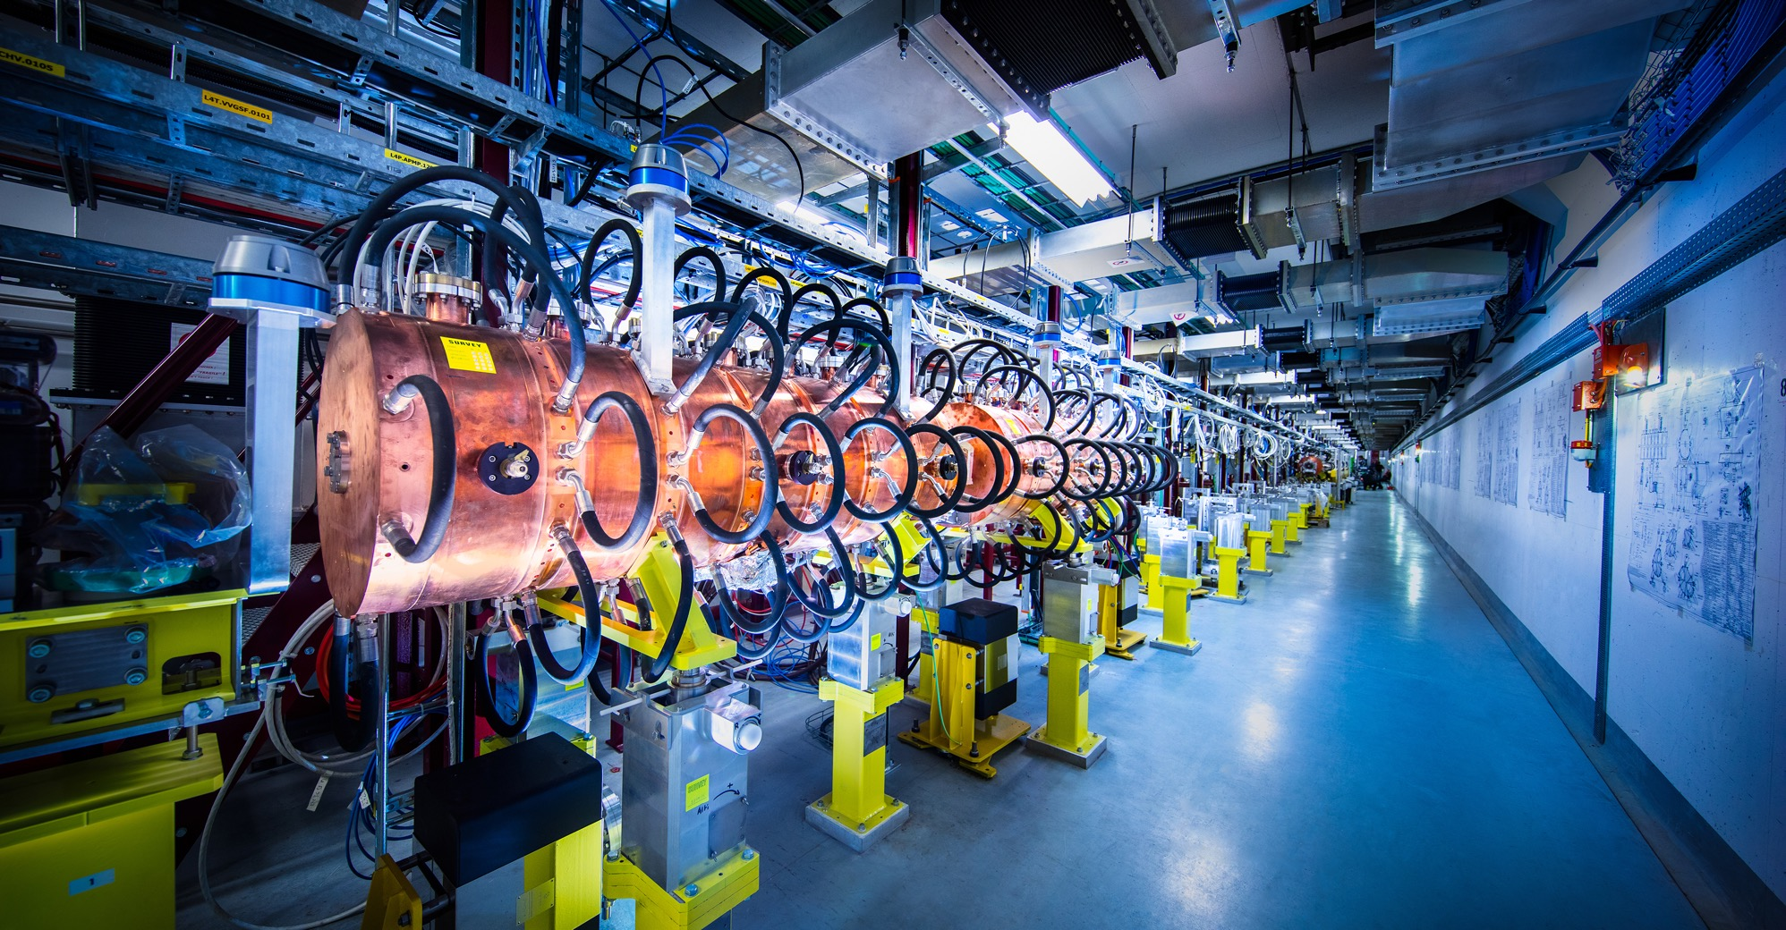
What do we buy?
Electronics and radiofrequency:
  Electronic components (active, passive)
  PCBs and assembled boards
  LV and HV power supplies
  Radiofrequency plants
  Amplifiers

Slide 16
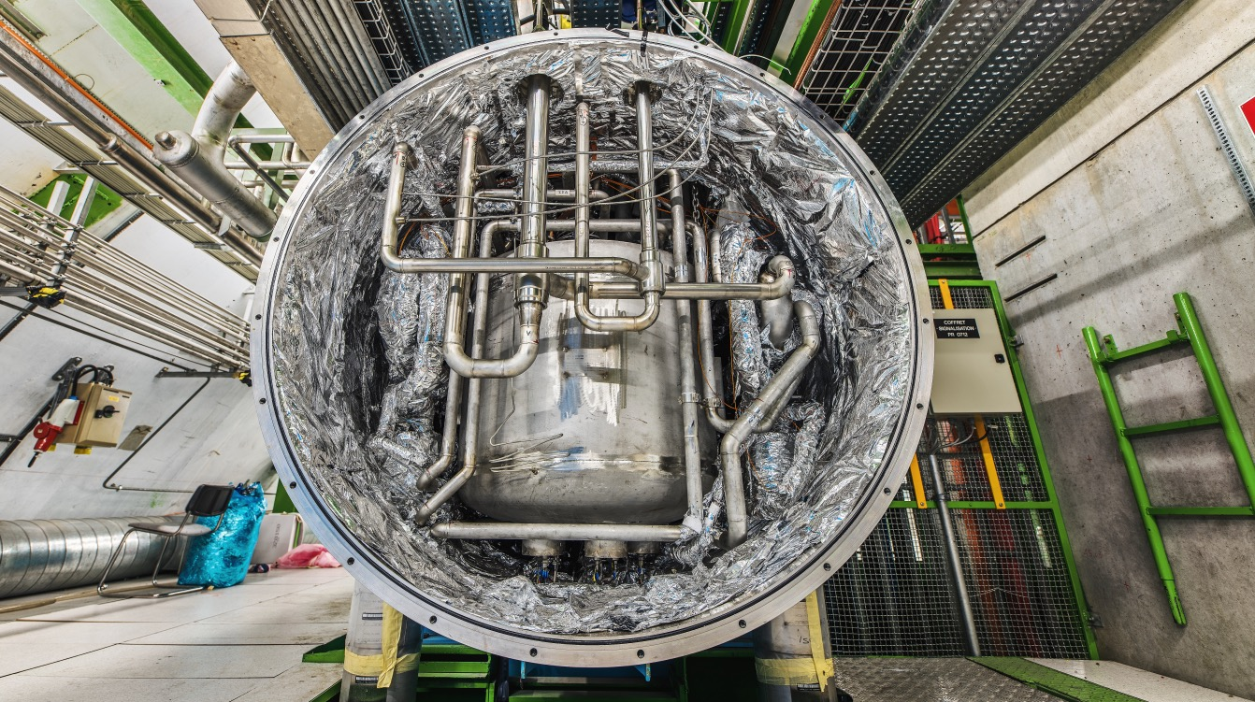
What do we buy?
As well as:
  Cryogenic and vacuum equipment
  Optics and photonics
  Particle and photon detectors
  Health and safety equipment,
  Transport and handling equipment
  Office supply, furniture
  Industrial services on the CERN site

Slide 17
Supplies (254MCHF spent in 2022 – CERN budget only)

Slide 18
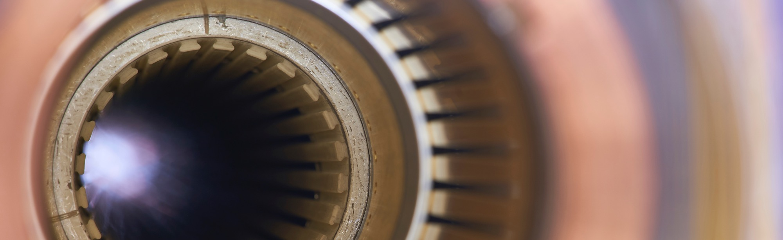
Current project - upgrade of the LHC to High Luminosity
Hi-Lumi will provide greater precision and discovery potential
Hi-Lumi will start operating in 2029, and run until 2040
CERN is already looking beyond 2040, with several projects in R&D or study stages

Slide 19
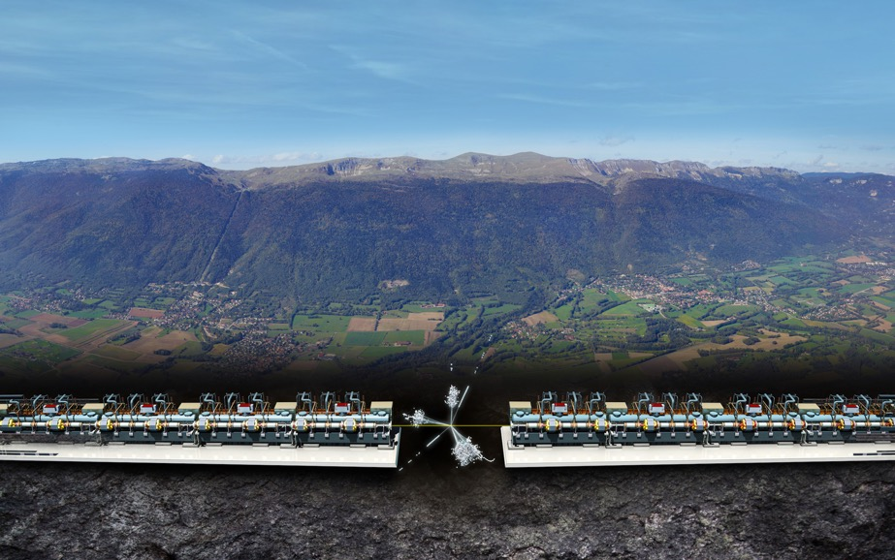
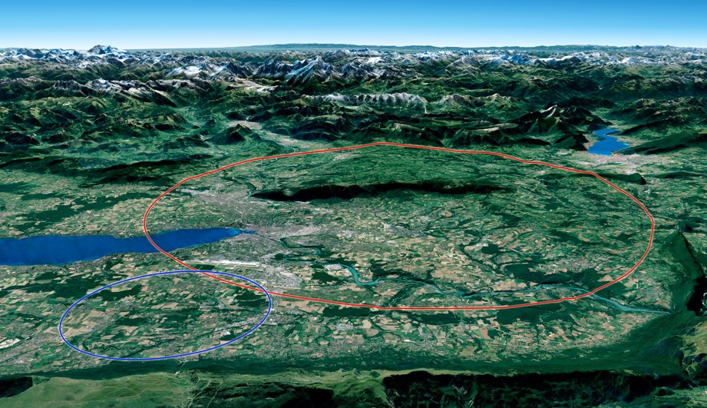

Two biggest projects for future of particle physics
Future Circular Collider (FCC)
New technology magnets 100 TeV pp collisions in 100km ring
e⁺e⁻ collider (FCC-ee) as 1st step?
FCC
Compact Linear Collider (CLIC)
Linear e⁺e⁻ collider √s up to 3 TeV
LHC

Slide 20
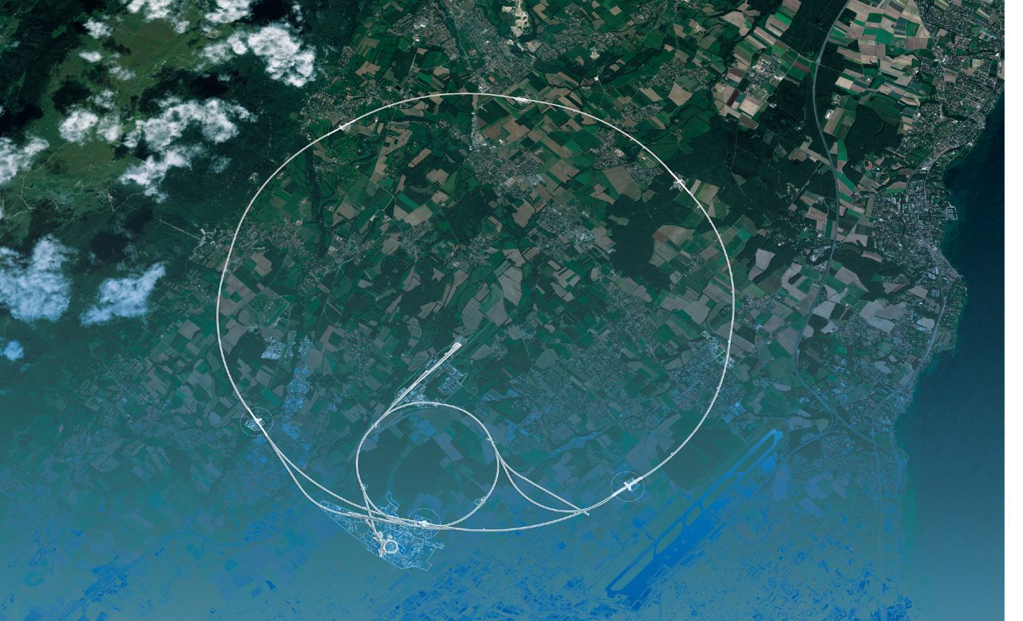
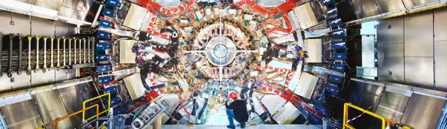
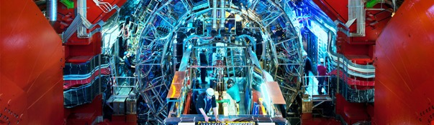
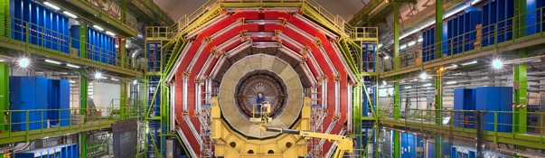
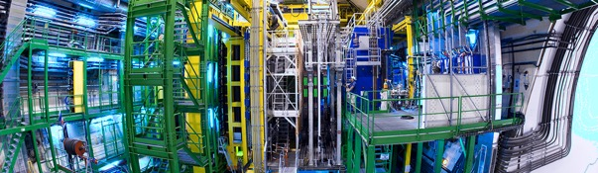
We also buy for the LHC experiments
CMS
ALICE
ATLAS
LHCb

Slide 21

How do we buy?
  Off-the shelf or non-standard products which can be produced with existing manufacturing techniques or technologies:
  Functional specification
  Non-standard products where industry has neither the required know-how nor the interest to develop and design the products:
  Build-to-Print specification
Prototypes and or Pre-series might be required.

Slide 22


PROCUREMENT @CERN
the rules

Slide 23
The Procurement Service
Mission
The Procurement Service (PS) procures all supplies and services for CERN
Meeting the specified and contractual technical, delivery
and performance requirements
At the lowest possible overall cost
While achieving balanced industrial return for CERN Member States
Respecting CERN
Procurement Rules

Slide 24
Principles of the Procurement Rules (1/4)
1
Transparency and Impartiality
2
Tenders open to Member States only
3
Objectivity and equal treatment: tendering packages are objective and impartial

Slide 25
Principles of the Procurement Rules (2/4)
Selective tendering procedures: CERN’s tendering procedures are not open to any interested firms
Confidentiality: Opening and evaluation of bids as well as negotiations are not public

Slide 26
Principles of the Procurement Rules (3/4)
Award for supplies (and services, exceptionally) based on:
Lowest compliant bid
Technical
Financial
2
Delivery

Slide 27
Principles of the Procurement Rules (4/4)
Award for industrial services based on:
Best Value For Money
2
No alignment rule

Slide 28

Enquiries between 10’000 and 200’000 CHF
“Price enquiry” (Demande d’Offre - DO)
Submission deadline: 4 weeks from date of dispatch;
All price enquiries above 50’000 CHF are also sent to the
Industrial Liaison Officers (ILOs) for information;
Price enquiries consist of:
  Technical specification and annexes;
  Tender form (and a technical annex - optional);
  CERN’s General Conditions (contracts, invitations to tender, safety, etc.)

Slide 29

Enquiries exceeding 200’000 CHF (1/2)
“Market Survey” (MS)
Prior announcement in CERN’s procurement website, see
“Business Opportunities”
  At this stage, interested firms are encouraged to contact CERN in
  order to have a clear understanding of the requirement, allowing
  them to begin their organization ahead of the tendering process.
Market surveys consist of:
  “Technical Description” and;
  “Qualification Questionnaire” (financial and technical).
Submission deadline: 4 weeks, or more if the MS is still online.

Slide 30

Enquiries exceeding 200’000 CHF (2/2)
“Invitation to tender” (IT)
Sent to qualified and selected firms only;
Submission deadline: 4 weeks from date of dispatch (with a longer period for more complex requirements);
Firms shall ask all necessary questions in writing to understand all requirements and prepare a bid that best matches CERN’s needs;
All invitations to tender are sent to the Industrial Liaison Officers (ILOs) for information;
Bids shall be submitted via CERN’s e-tendering application.
Notes:
Invitations to tender consist of:
Technical specification and annexes;
Tender form (and a technical annex - optional);
General Conditions of CERN (contracts, invitations to tender, Safety, etc.)

Slide 31
Country of origin
SUPPLIES
“Country(ies) where the supplies (including their components and sub-assemblies) are manufactured or undergo the last major transformation by the contractor or its sub-contractor”
If at least 60% of the total amount of the bid comes from a poorly balanced MS, then the whole bid will be treated as that from a bidder in a poorly balanced MS.
SERVICES
“Country(ies) in which the bidder is established.”
If at least 40% of the total amount of the bid comes from a poorly balanced MS, then the whole bid will be treated as that from a bidder in a poorly balanced MS.

Slide 32

Industrial return coefficient
Industrial return
coefficient
Over a 4-year period:
Very poorly balanced : < 0.40
Poorly balanced (PB) : 0.40 ≥ x < 1
Well balanced (WB): ≥ 1
For Supply contracts and for a
12-month period starting on
1st March, defined as:
“The ratio between a Member State's percentage share of the value of all Supply contracts and that Member State's percentage contribution to the CERN Budget over the same period”.
Status definition
% expenditure in the MS
Return Coef.=
% contribution to CERN budget for this MS

Slide 33
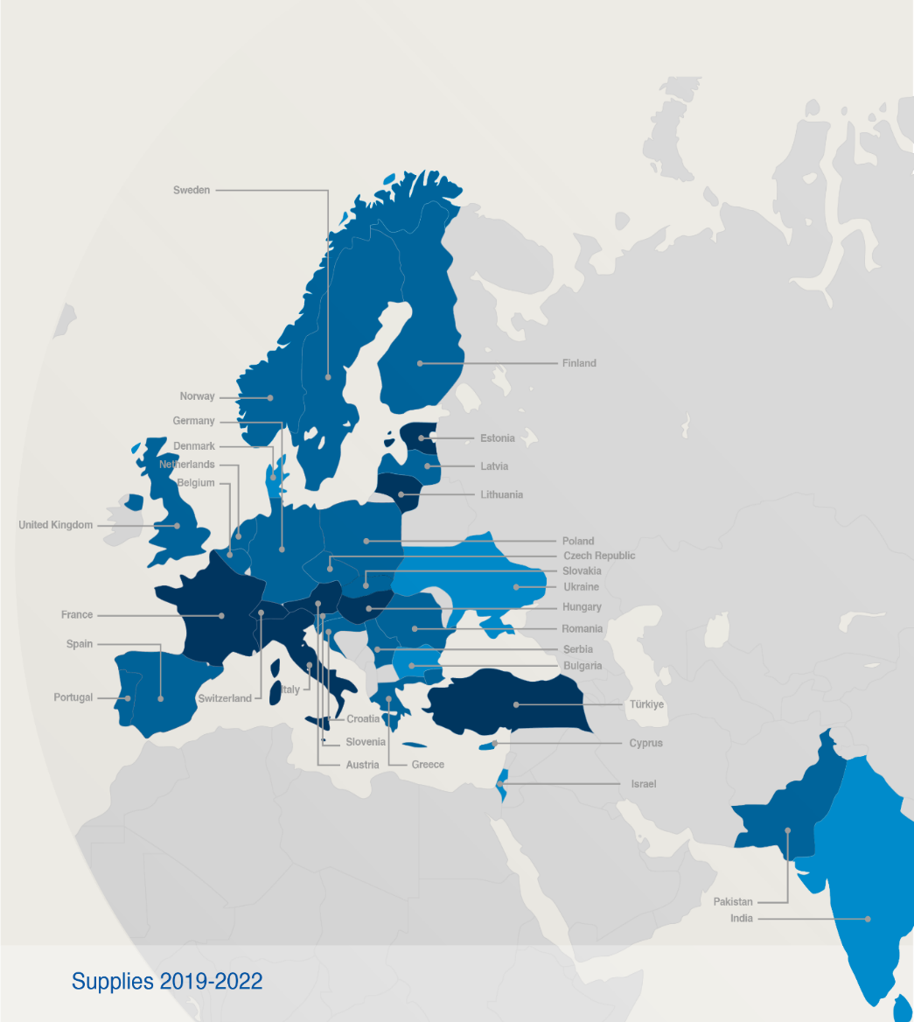

Poorly balanced Member States (Supplies)
(1st March 2023 – 29 February 2024, based on the previous 4 calendar years):
Well Balanced (≥1) | Poorly Balanced (0.40 ≥ x < 1) | Very Poorly Balanced (< 0.40)
Austria Estonia* France Hungary Italy Lithuania* Switzerland Türkiye | Belgium Croatia* Cyprus* Czech Republic Finland Germany Greece Netherlands Pakistan* Poland Portugal Romania Slovenia* Spain Sweden Ukraine* Latvia* Norway Serbia* United Kingdom | Bulgaria Denmark India* Israel Ukraine*
*Associate Member States

Slide 34
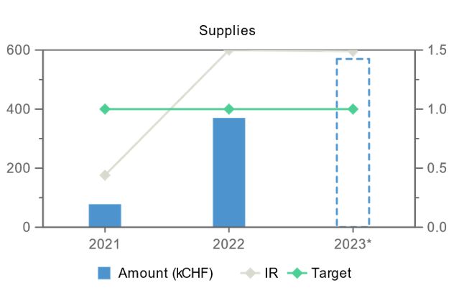
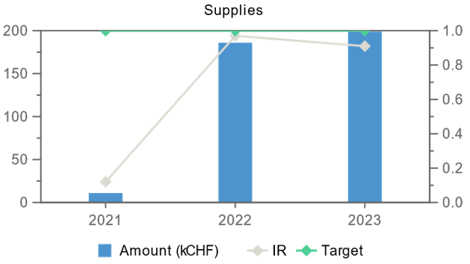
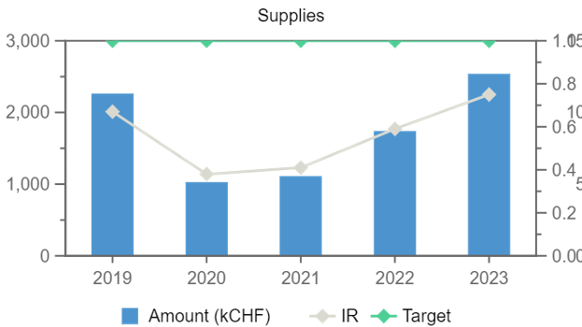
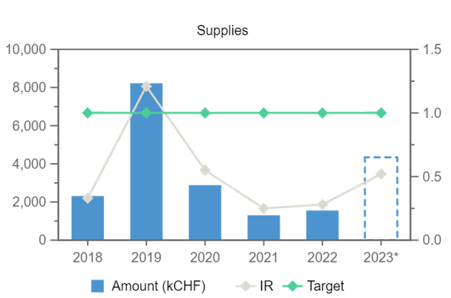
Industrial Return (supplies)
Estonia
Latvia
Finland
Sweden
* 2023 FIGURES PROVISIONAL

Slide 35
Alignment rule
Applicable for:
1
Contracts awarded on the lowest
compliant basis (mainly supply contracts)
2
With a total amount exceeding
100’000 CHF.
Under certain conditions as defined in CERN Procurement Rules, a bidder offering goods originating* in poorly balanced Member States is allowed to align his price to that of the
lowest bidder and thereby be awarded the contract.
RULE
* At least 60% for supply contracts or; at least 40% for service contracts awarded on the lowest compliant basis.

Slide 36
Alignment rule (Scenario 1)
Lowest bid from a PB MS
Bid (CHF)
Contract
Well balanced MS
Poorly balanced MS

Slide 37
Alignment rule (Scenario 2)
Lowest bid from a WB MS
  (a) 1st bidder from PB MS aligns
Bid (CHF)
<20%
Contract
Well balanced MS
Poorly balanced MS

Slide 38
Alignment rule (Scenario 2)
Lowest bid from a WB MS
  (b) if not, 2nd lowest bidder from PB MS aligns
Bid (CHF)
<20%
Contract
Well balanced MS
Poorly balanced MS

Slide 39
Alignment rule (Scenario 2)
Lowest bid from a WB MS
  (c) if no alignment of second two bids, contract placed with lowest bidder from WB MS
Bid (CHF)
<20%
Contract
Well balanced MS
Poorly balanced MS

Slide 40
Limited tendering
« Limited tendering is foreseen by the CERN Procurement Rules to improve the industrial return of very poorly balanced Member States. »
Conditions
Firms established in very poorly balanced Member States only (industrial return <0.4);
ILO can ask to add firms, provided they are established in very poorly Member States.
Used in case where there is sufficient competition;

Slide 41

Impact of
Doing business with CERN

Slide 42
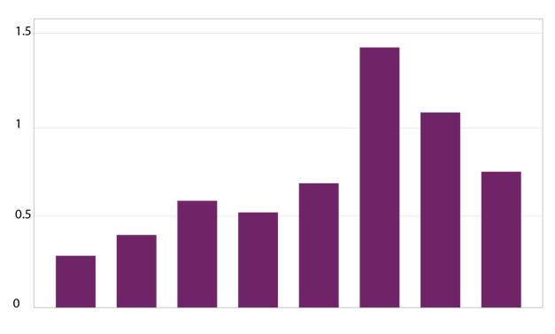
The economical impact of CERN Procurement on supplier’s performance (Castelnovo et al, 2018)
Empirical studies (by the analysis of financial data from 1995 to 2008 from 365 CERN suppliers for the LHC) show that after working with CERN on high-tech contracts, CERN suppliers
out-perform their peers by:
Investing more in R&D and filing more patents
Higher productivity, revenue and profitability
Order/contract received from CERN
Increase in R&D
Innovation
Productivity growth
increase revenues & profitability
Patents per firm
More than
2 years before
2-1 years before
Date of order
1,2 years later
3,4 years later
5,6 years later
7,8 years later
More than
8 years later
Notes:
Average number of patents filed before and after the beginning of the procurement relationship with CERN
The X-axis shows the «relative years», that are the difference between a given year and the year the first order is received. Therefore, CERN(0) is, for each company, the year of beginning of the procurement relationship.

Slide 43
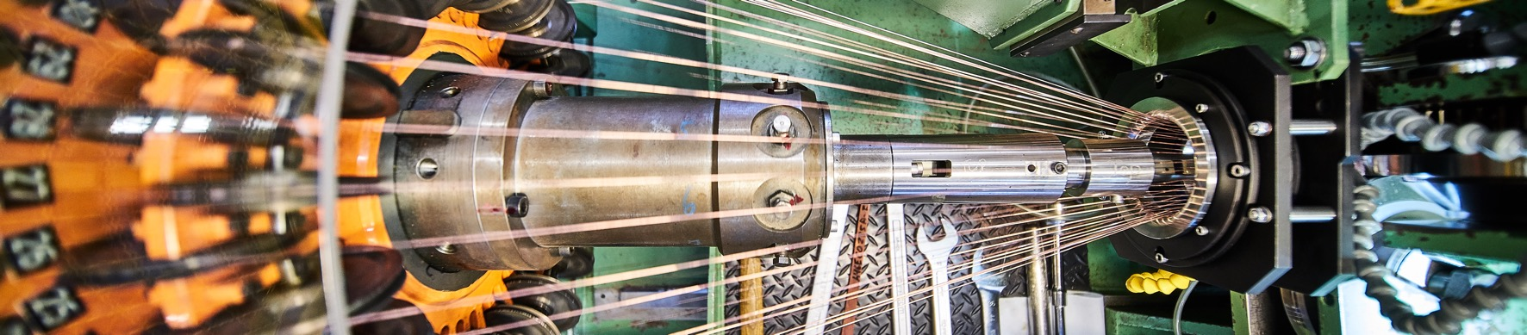
Doing business with CERN: the facts
Supplier survey (669 suppliers in 33 countries, 2017):
48%
improved products and services
42%
developed new products
55%
improved technical knowledge
in their field
18%
found or opened a new market to address
62%
used CERN as a marketing reference
Most firms experienced
no financial loss.
Notes:
The key message here is that CERN is an open institution: open to its neighbours, and open to citizens from across the globe. We welcome them to CERN and go out to meet them
This slides summarises the outreach activities carried out by CERN.
It also includes a mention of CERN’s fundraising activities, for projects that are not part of CERN’s core activity. These fall into three categories: education & outreach, culture and creativity, innovation and knowledge exchange

Slide 44
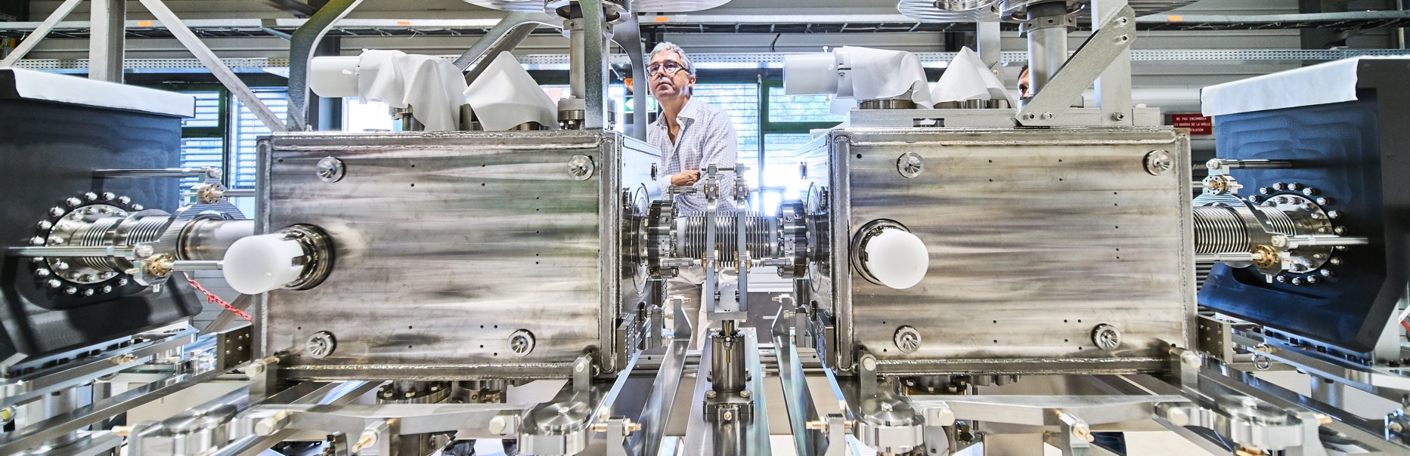
Doing business with CERN: the facts
Using CERN as a marketing reference improve
the reputation as suppliers

Slide 45
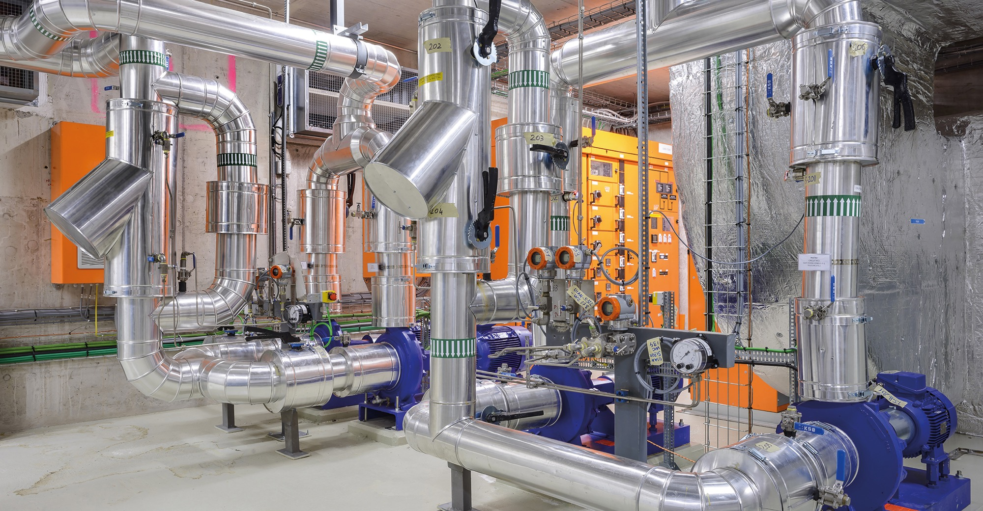
Social
Cost-Benefit Analysis (CBA) calculated by the University of Milan
“Each CHF invested in
HL-LHC project pays back approximately 1.8 CHF on societal benefits, including scientific, economic and cultural value (development of innovative technologies, industrial spillovers, skills acquired by students, etc.).”

Slide 46

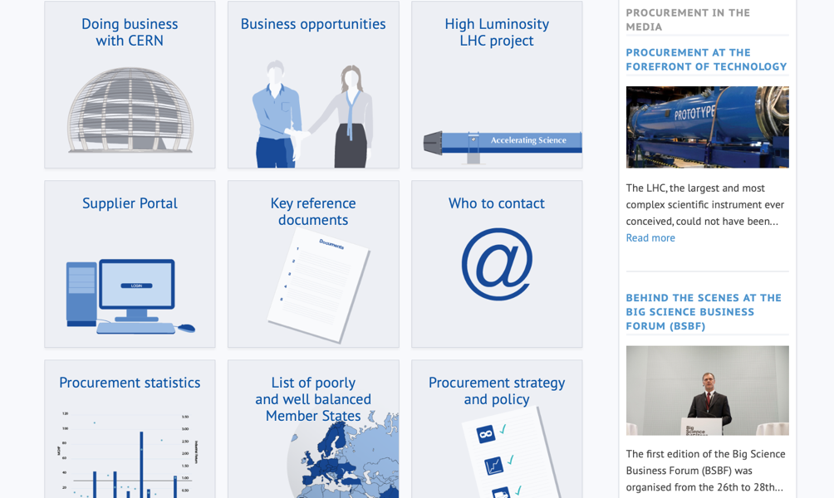
Procurement
website

Slide 47
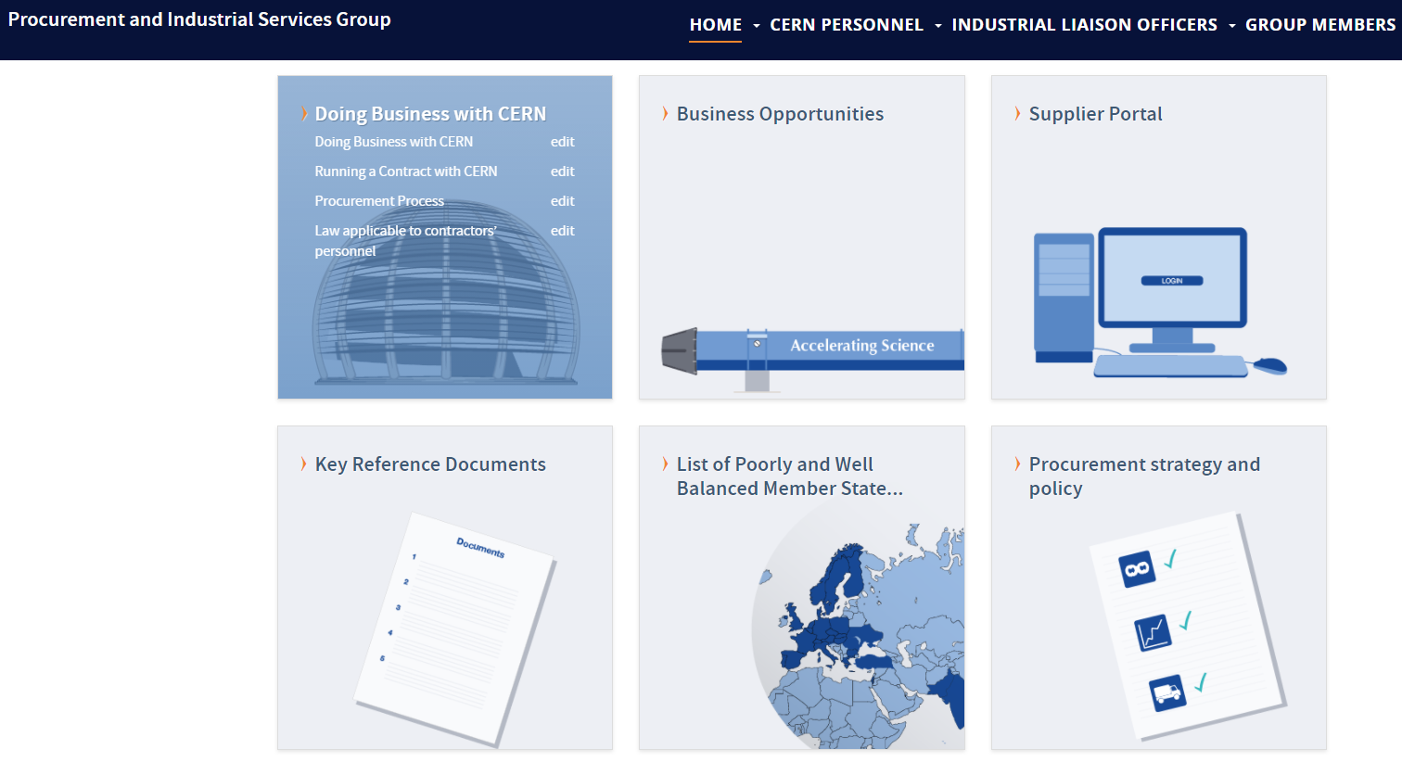
Website of the Procurement Service
http://procurement.web.cern.ch

Slide 48
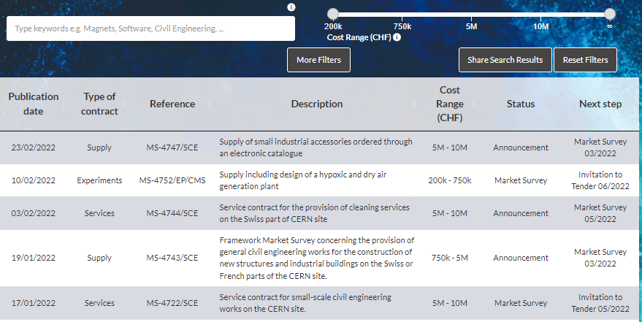
CERN Shopping List
https://forthcoming-ms.app.cern.ch/#!/

Slide 49
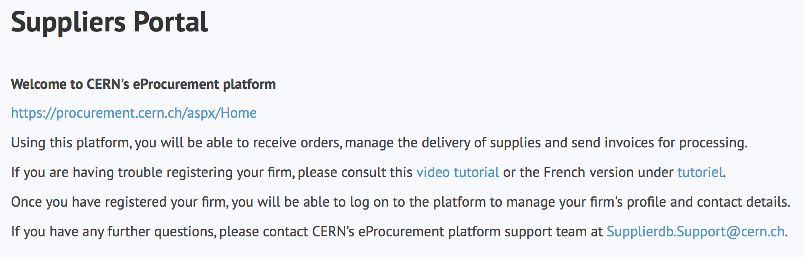
Register in the Suppliers Portal
for all exchanges with CERN, in particular to:
Be visible for future opportunities
(with the procurement codes you have indicated),
Receive and follow-up orders,
Send invoices.
MANDATORY

Slide 50
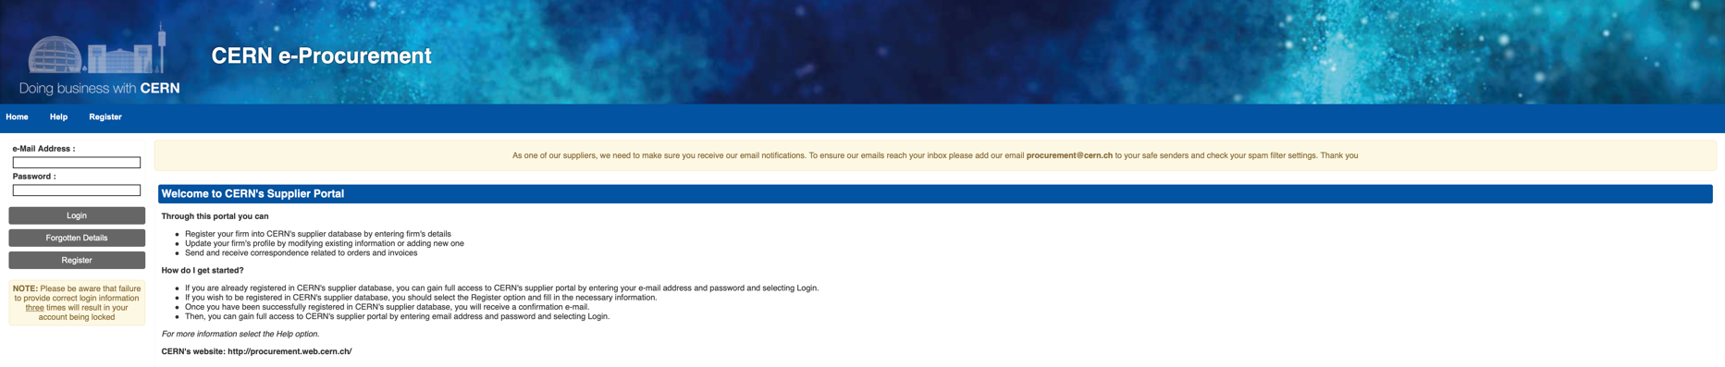
CERN e-Procurement
To ensure our emails reach your inbox please add our email procurement@cern.ch to your safe senders and check your spam filter settings.

Slide 51

Contacts at CERN (Procurement and Technical)

Slide 52
Contact in your country
ILO: Industrial Liaison Officer
Who to contact in your Country
    Industrial Liaison Officers (ILO's) are appointed by CERN's Member States to facilitate the flow of communication between CERN and its suppliers. ILO's can provide advice on the opportunities available for doing business with CERN and the support available to firms
    in their local regions.
Estonia: Robert Aare
robert.aare@eas.ee
Finland: Sakari Karppinen
sakari.karppinen@businessfinland.fi
Latvia: Alise Pika-Ozola
Alise.Pika-Ozola@liaa.gov.lv
Sweden: Fredrik ENGELMARK
fredrik.engelmark@bigsciencesweden.se

Slide 53
Thank you

