Slide 1


PAW’24 introductory slides
Oleg Denisov
INFN Torino, CERN
Jan Friedrich
Technische Universität München

Slide 2
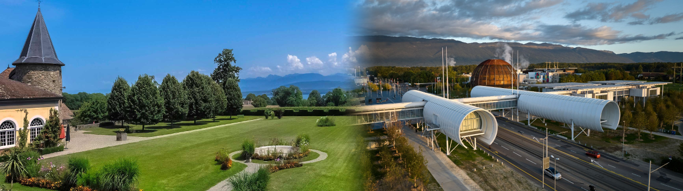
Welcome to the inaugural
Physics at
AMBER international
Workshop ‘24
18./19.3.2024 Château de Bossey
20.3.2024 CERN

Slide 3
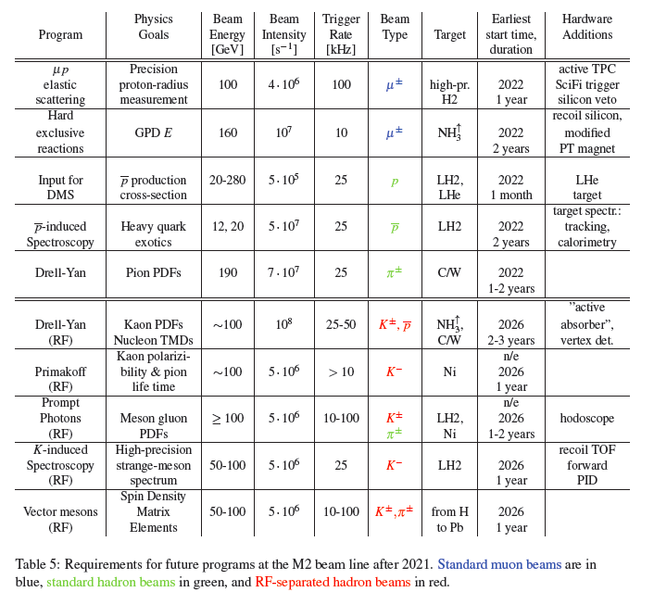
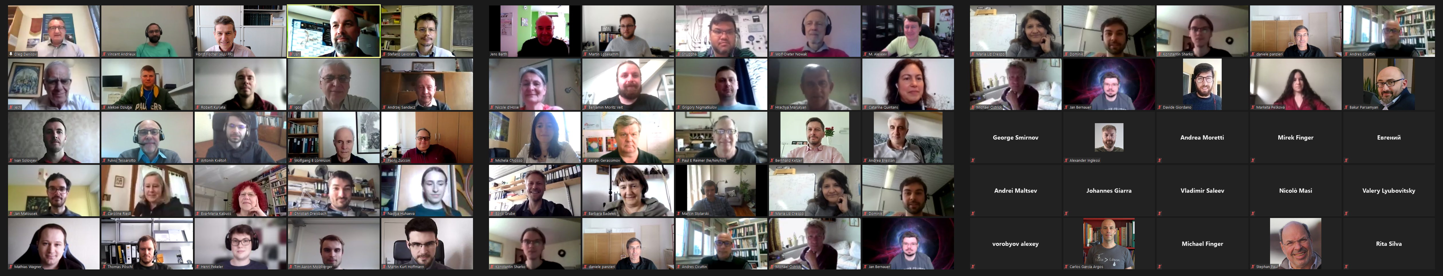
How AMBER was born…
~2009 early ideas of future high-intensity hadron beams for COMPASS are discussed
March 2016 Workshop “COMPASS beyond 2020”
September 2016: Physics Beyond Colliders initiative of CERN
June 2018 Workshop “New QCD Facility at the M2 SPS beamline”
August 2018 Letter of Intent: COMPASS++/AMBER
April 19, 2019 Towards a new collaboration: COMPASS++/AMBER Kick-off meeting
May 2021 First Collaboration Meeting (zoom)

Slide 4
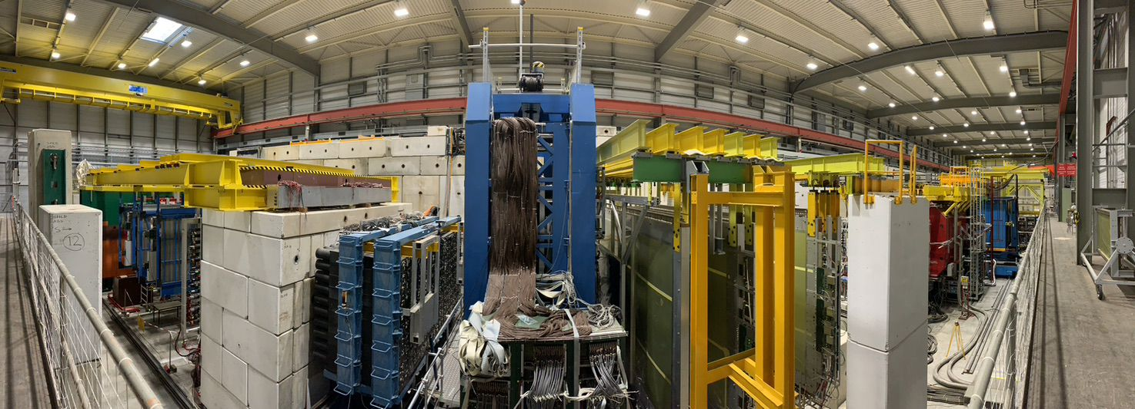
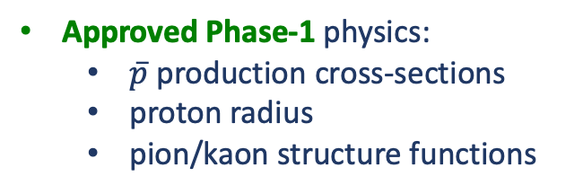
Apparatus for Meson and Baryon Experimental Research
AMBER has been approved as NA66 experiment in December 2020
the Collaboration consists of ~200 physicists from 34 institutes
at the M2 beamline at SPS: muon and hadron beams 60 – 250 GeV
AMBER inherited, extended and modernized the 2-stage spectrometer of the COMPASS collaboration
Approved Phase-1 physics:
  $\overline{p}$ production cross-sections
  proton radius
  pion/kaon structure functions
Intended Phase-2 physics (>Long Shutdown 4):
  strange-meson spectroscopy
  kaon polarizability
  prompt-photon production

Slide 5
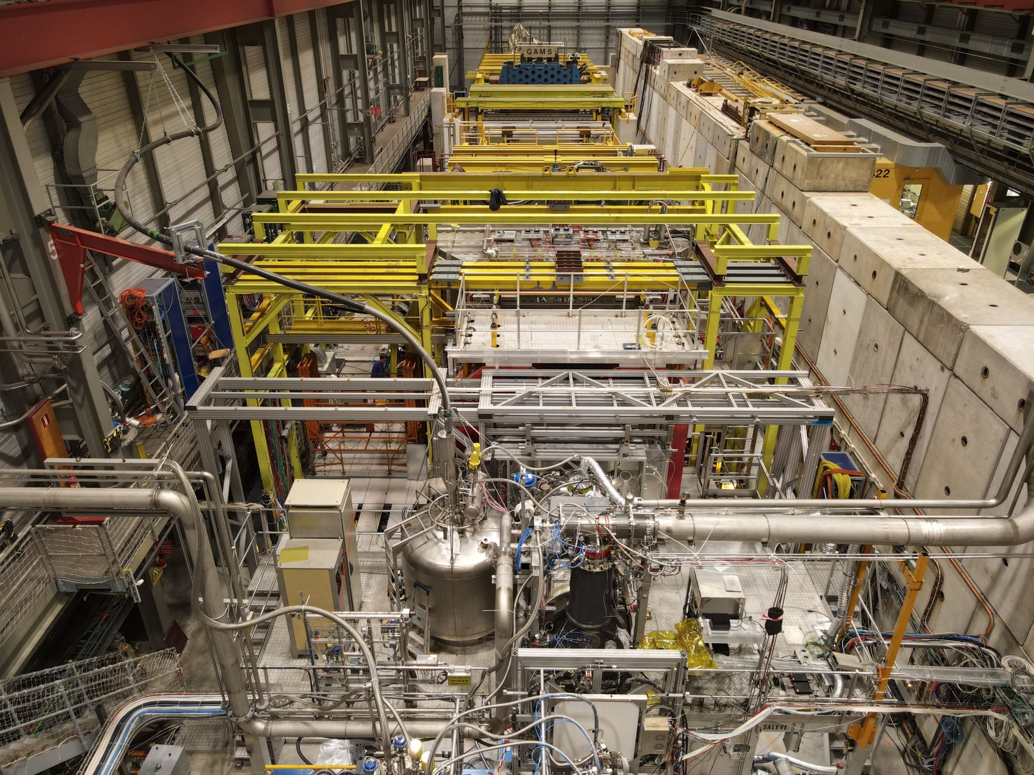
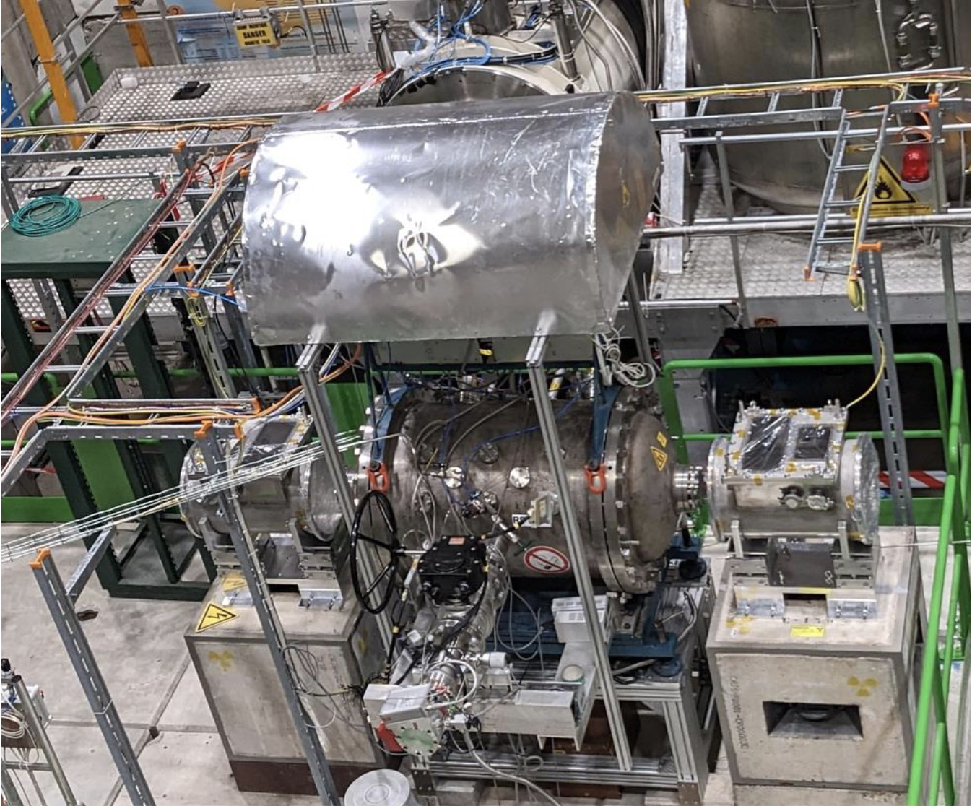
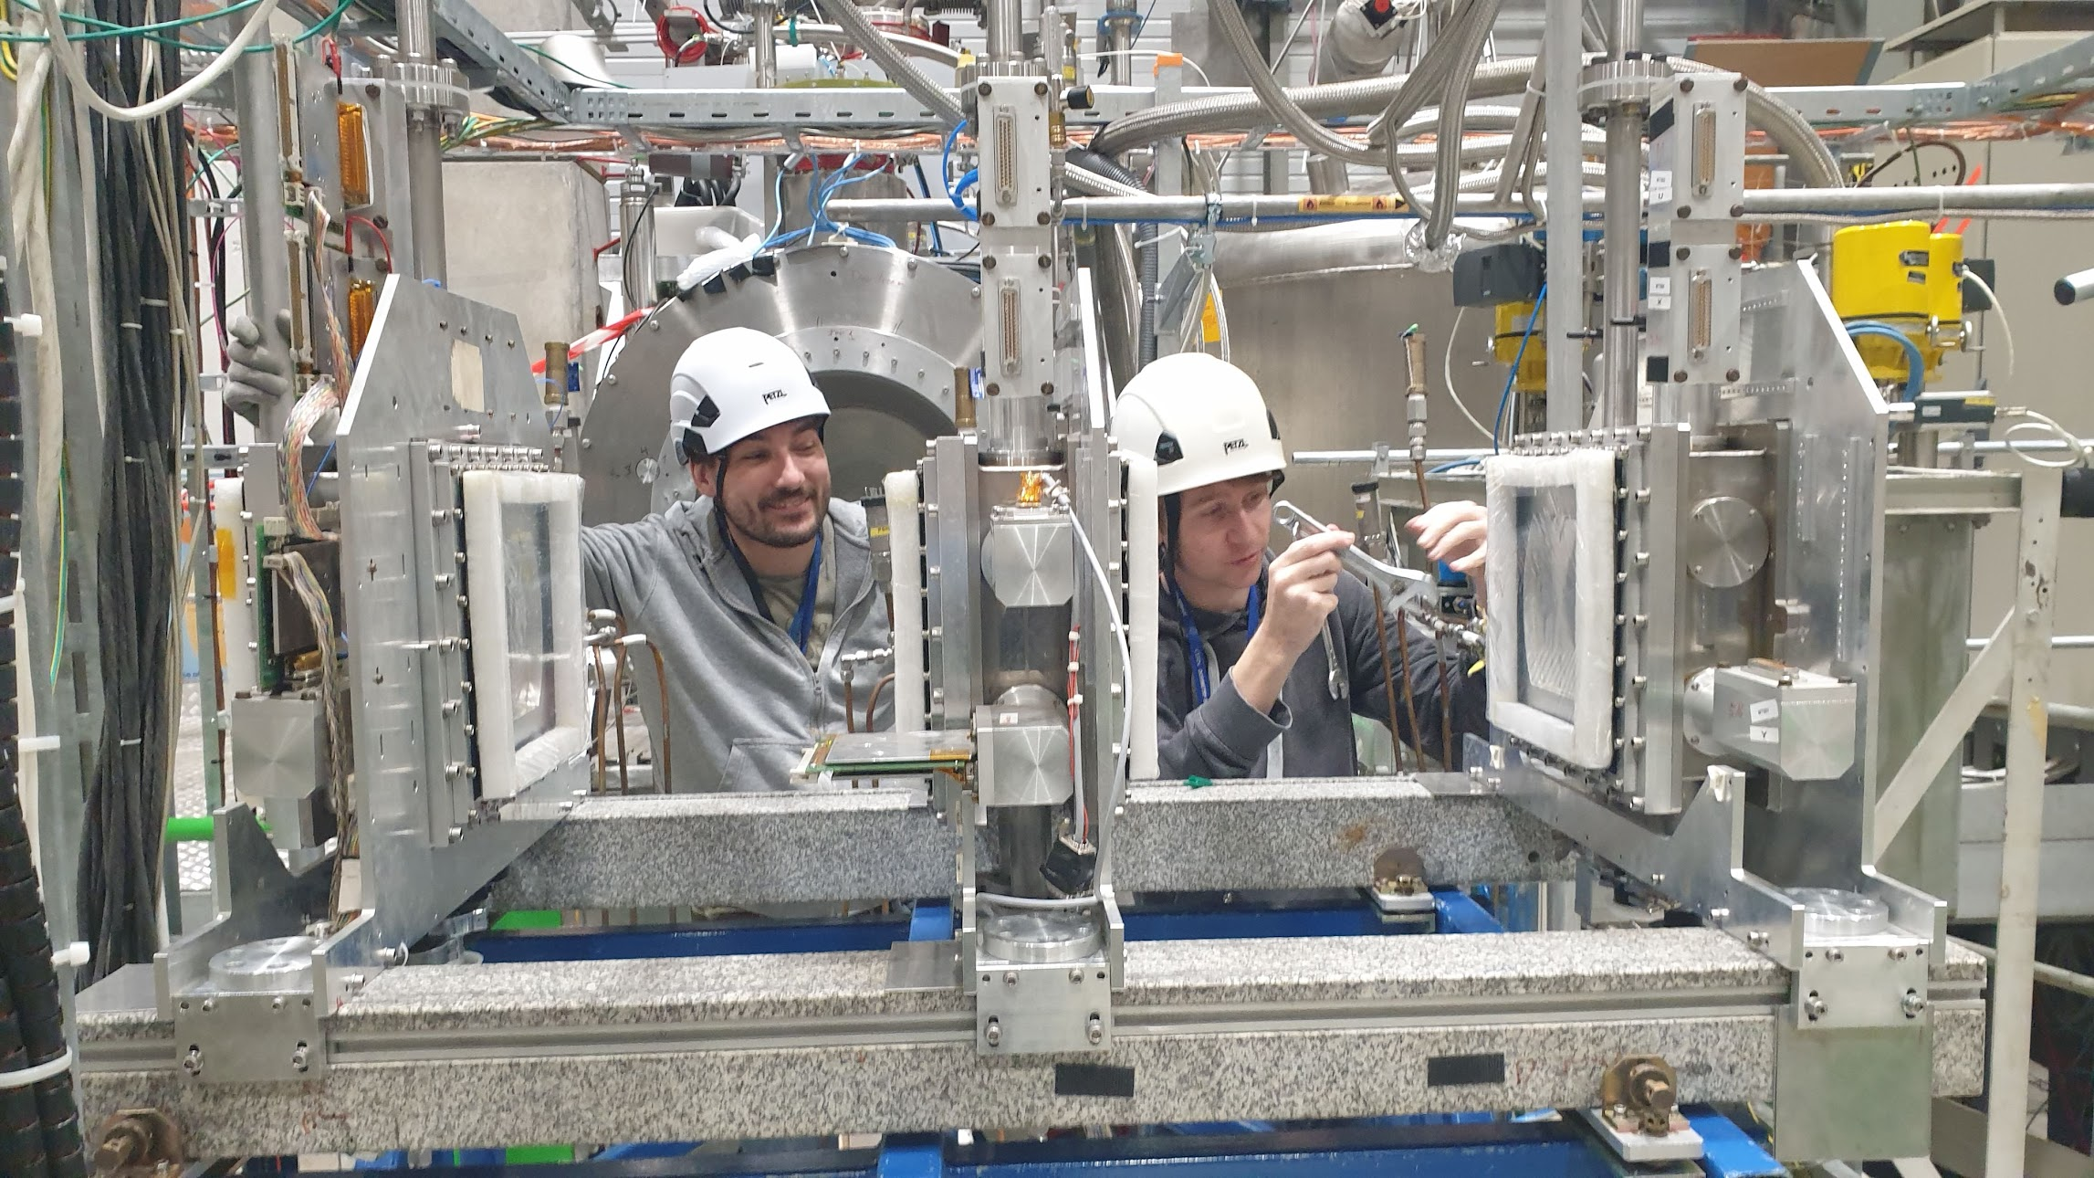
  AMBER 2023 setup
  preparations for AMBER 2025
  setting up for AMBER 2024

Slide 6

PAW’24 Programme
3 days with 5 double-session blocks:
Monday morning:
Antiproton production cross-sections (APX)
Monday afternoon:
Proton radius measurement (PRM)
19:00 Social Dinner
Tuesday morning:
Meson structure in Drell-Yan reactions (DY)
Tuesday afternoon:
Ideas for a follow-up proposal (AMBER Phase-2)
on the CERN site
Wednesday morning:
Beams for AMBER (BE)
we thank our supporters:
…and Martin Zemko, Anne Lissajoux and the whole Local Organizing Committee!

