Slide 1



Grant no. 12135007
Craig Roberts … http://inp.nju.edu.cn/
Emergent Hadron Mass $⇔$ Pion and Kaon Structure
Notes:
25+5

Slide 2
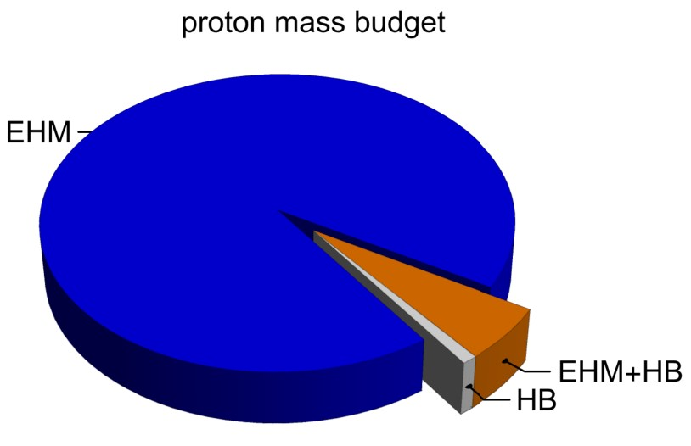
Emergence of Hadron Mass
Standard Model of Particle Physics has one obvious mass-generating mechanism
= Higgs Boson … impacts are critical to evolution of Universe as we know it
However, Higgs boson alone is responsible for just ∼ 1% of the visible mass in the Universe
Proton mass budget … only 9 MeV/939 MeV is directly from Higgs
Decomposition is
gauge invariant
Poincaré invariant
scale invariant
Evidently, Nature has another very effective mechanism for producing mass:
Emergent Hadron Mass (EHM)
  Alone, it produces 94% of the proton’s mass
  Remaining 5% is generated by constructive interference between EHM and Higgs-boson

Slide 3
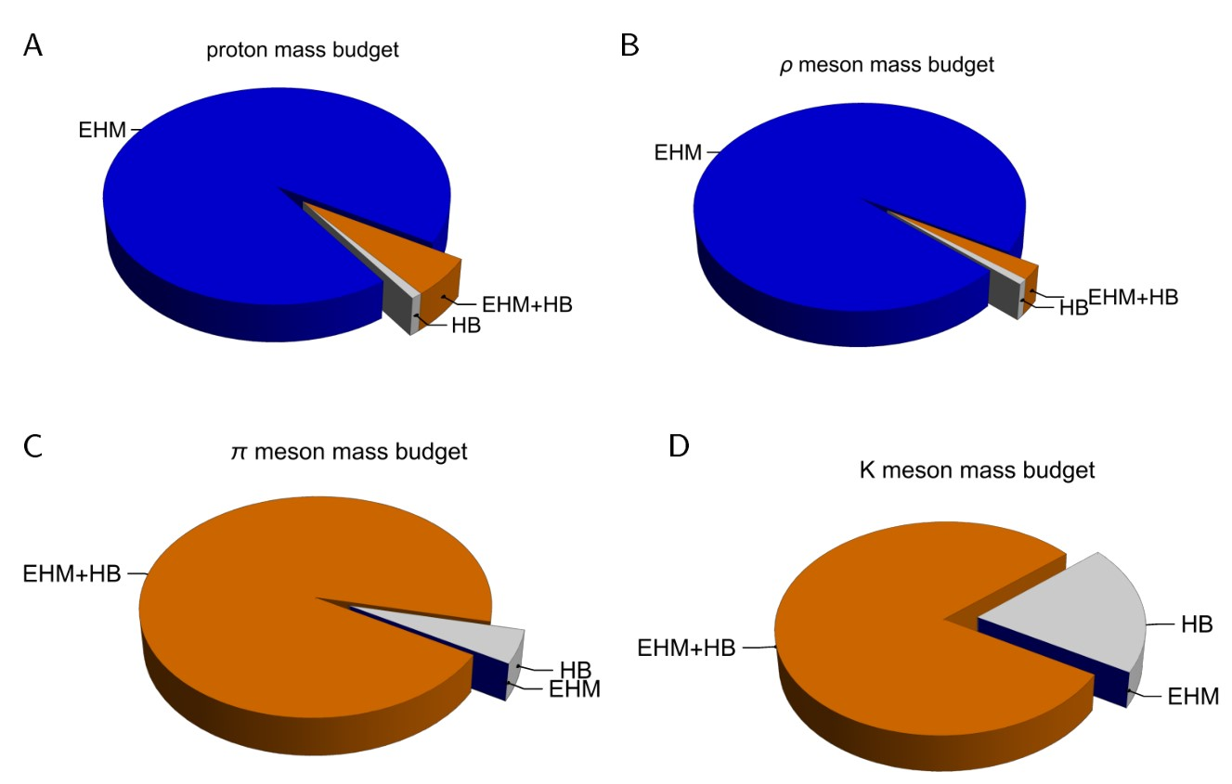
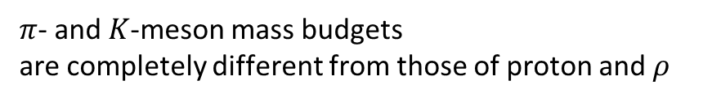
Emergence of Hadron Mass - Basic Questions
Decompositions are
gauge invariant
Poincaré invariant
scale invariant
What is the origin of EHM?
Does it lie within QCD?
What are the connections with …
  Gluon and quark confinement?
  Dynamical chiral symmetry breaking (DCSB)?
  Nambu-Goldstone modes = π & K?
What is the role of Higgs in modulating observable properties of hadrons?
  Without Higgs mechanism of mass generation, π and K would be indistinguishable
What is and wherefrom mass?
Proton and $ρ$-meson mass budgets are practically identical
$π$- and $K$-meson mass budgets
are completely different from those of proton and $ρ$

Slide 4
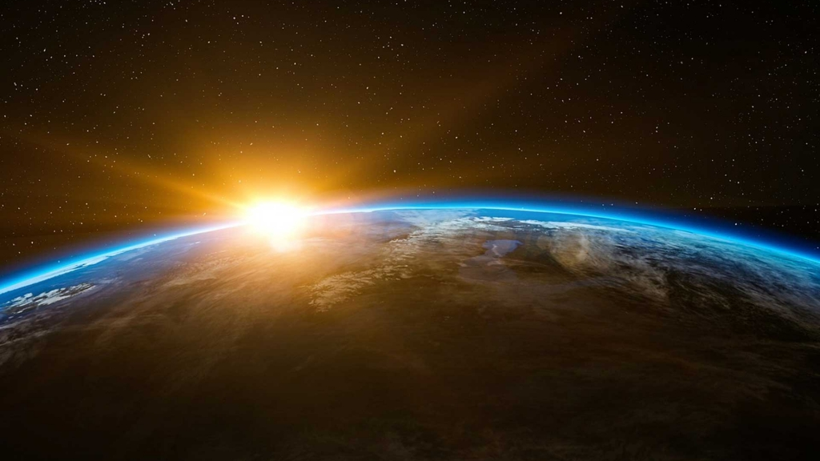

The Frontier of Physics:
Emergence of $m_{Nature}$

Slide 5
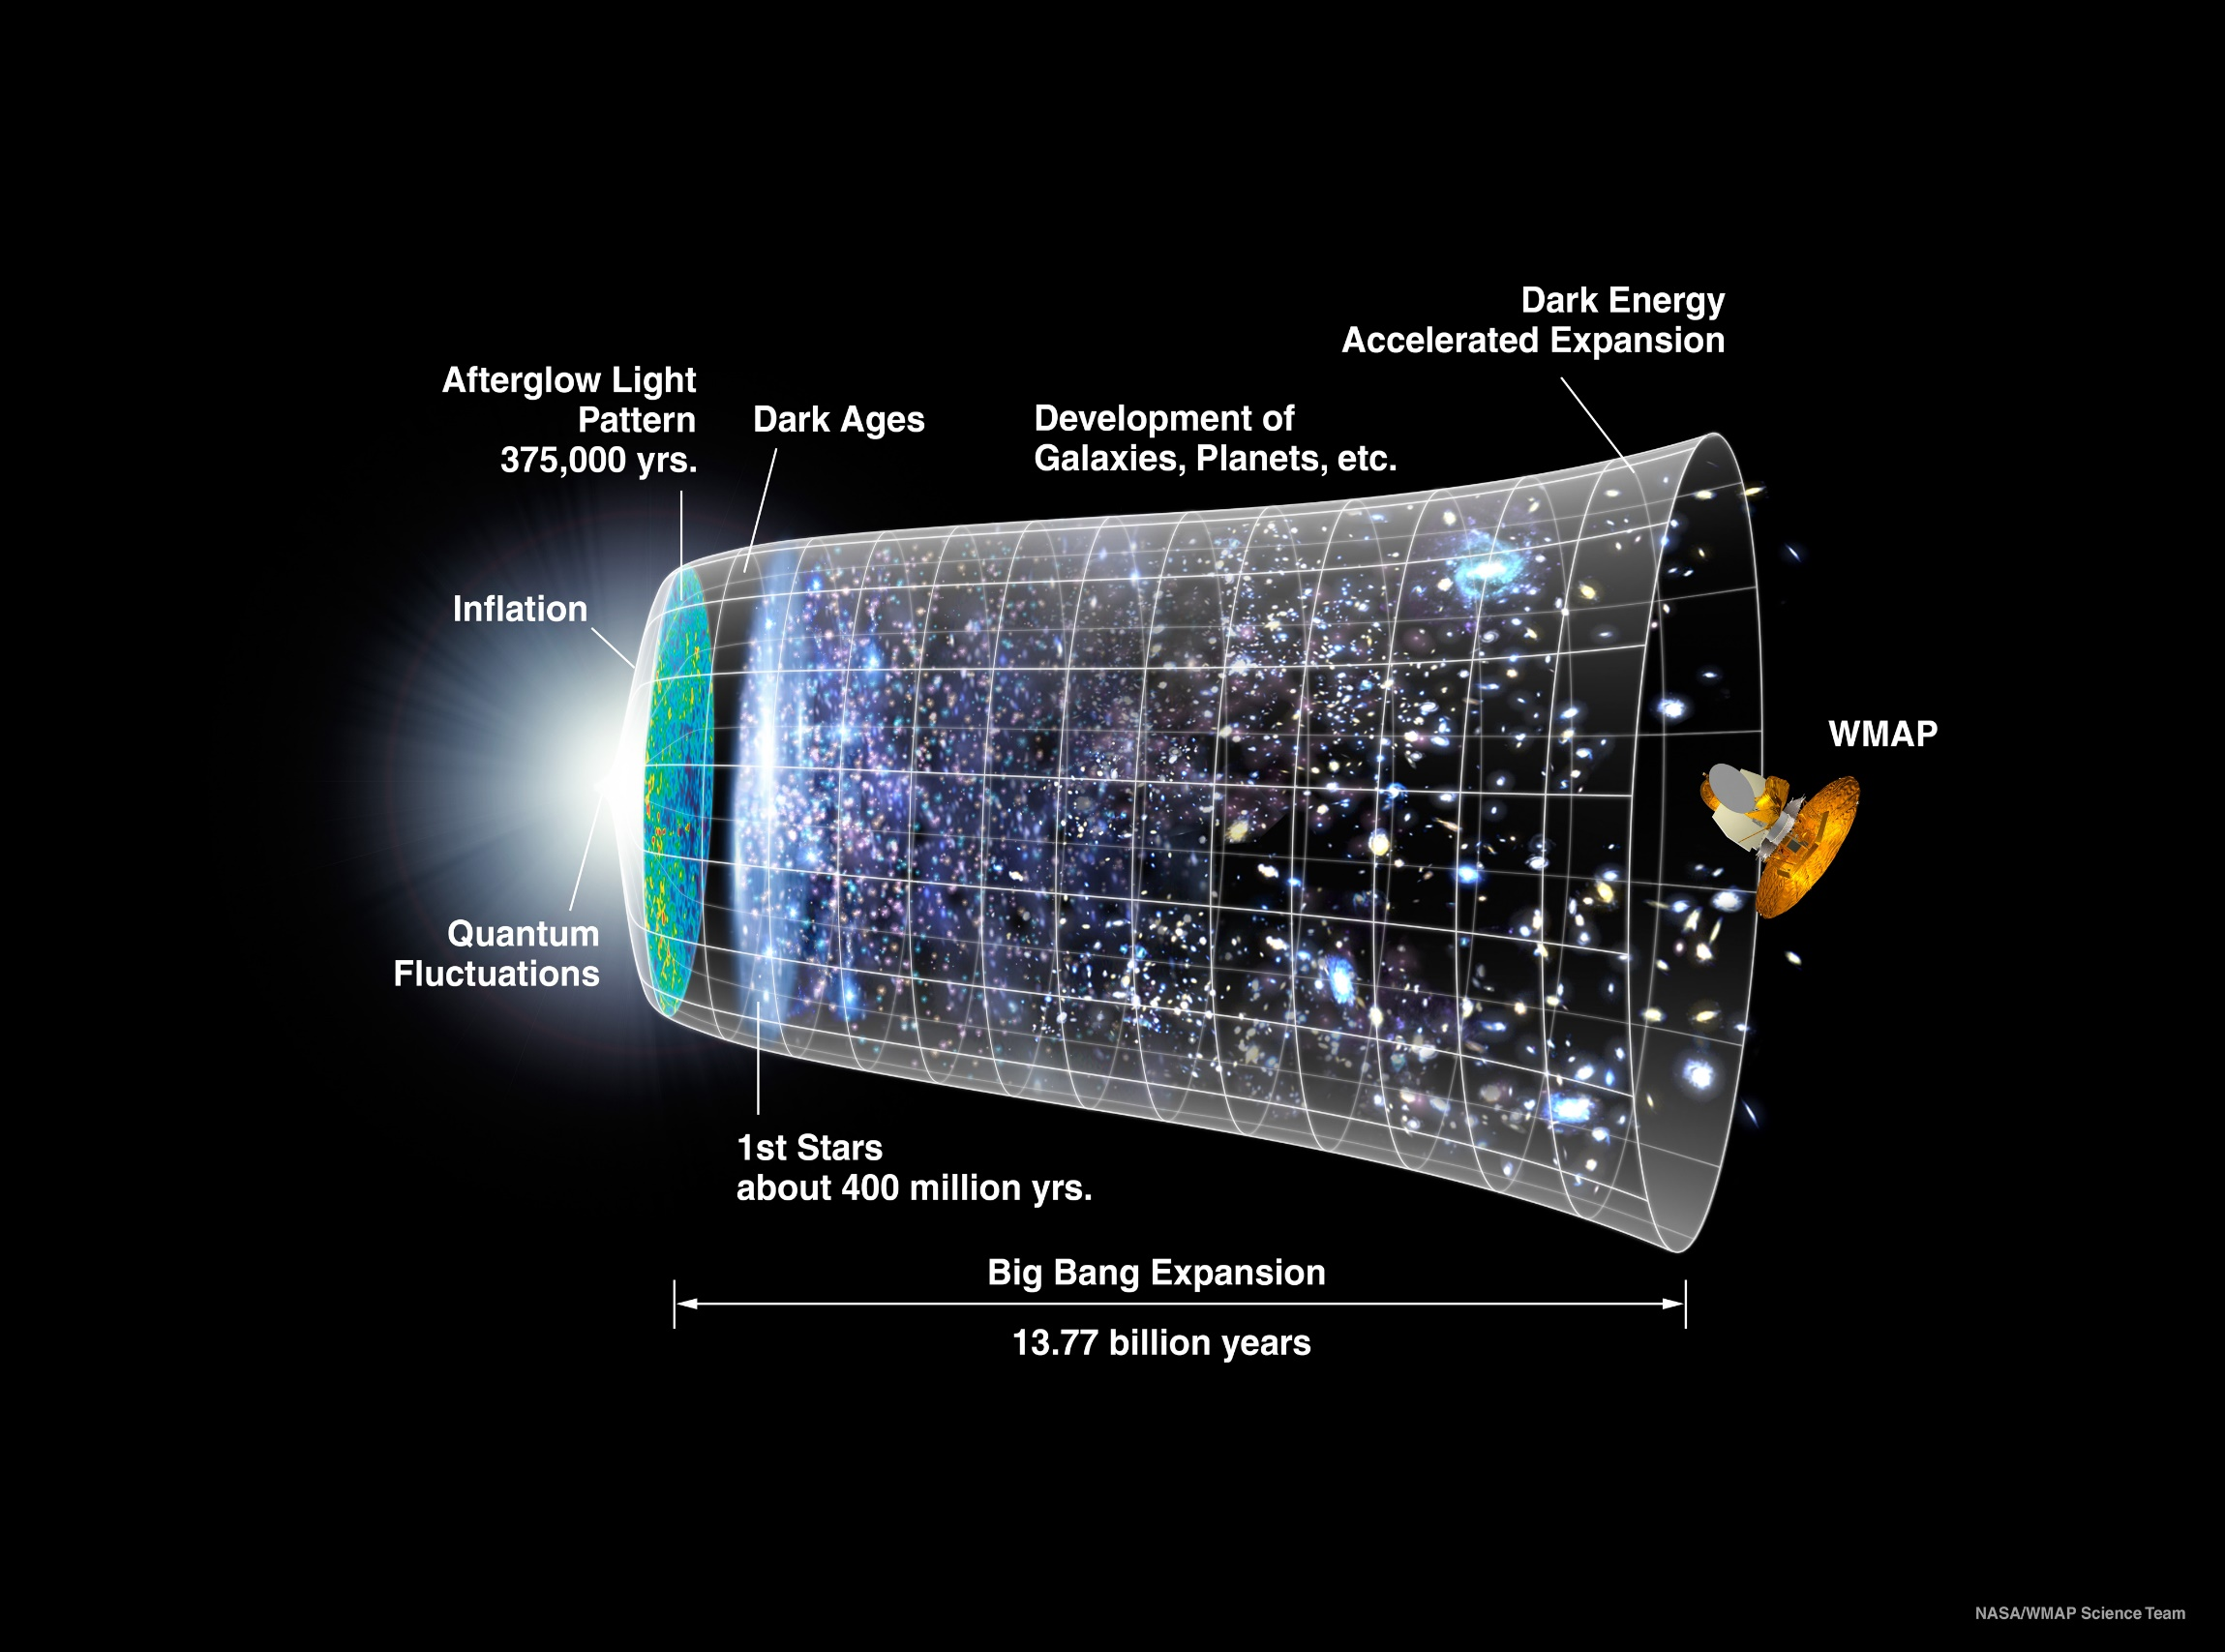
Our Universe
Mass emerged 0.000001 seconds after the Big Bang
Its appearance was crucial to the formation of the Universe as we know it

Slide 6
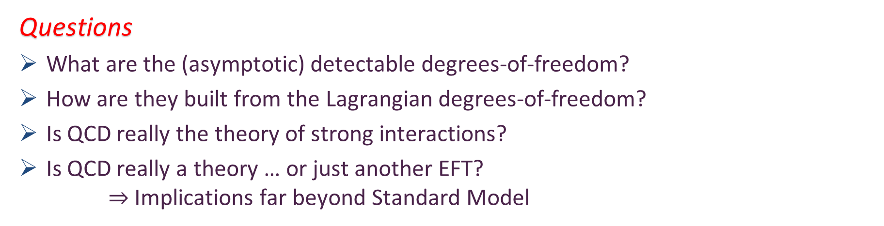
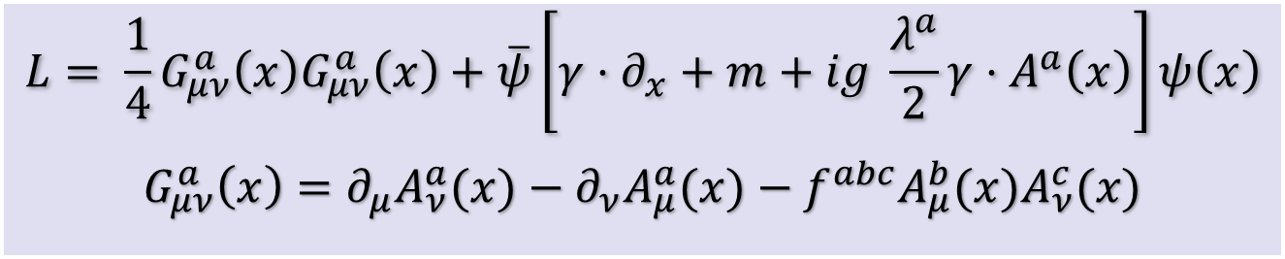
Quantum Chromodynamics
$$L= \frac{1}{4}G_{μν}^{a}\left(x\right)G_{μν}^{a}\left(x\right)+\overline{ψ}\left[γ⋅∂_{x}+m+ig \frac{λ^{a}}{2}γ⋅A^{a}\left(x\right)\right]ψ\left(x\right)$$
$$G_{μν}^{a}\left(x\right)=∂_{μ}A_{ν}^{a}(x)−∂_{ν}A_{μ}^{a}(x)−f^{abc}A_{μ}^{b}{(x)A}_{ν}^{c}(x)$$
One-line Lagrangian – expressed in terms of gluon and quark partons
Which are NOT the degrees-of-freedom measured in detectors
Questions
What are the (asymptotic) detectable degrees-of-freedom?
How are they built from the Lagrangian degrees-of-freedom?
Is QCD really the theory of strong interactions?
Is QCD really a theory … or just another EFT?
$⇒$ Implications far beyond Standard Model

Slide 7
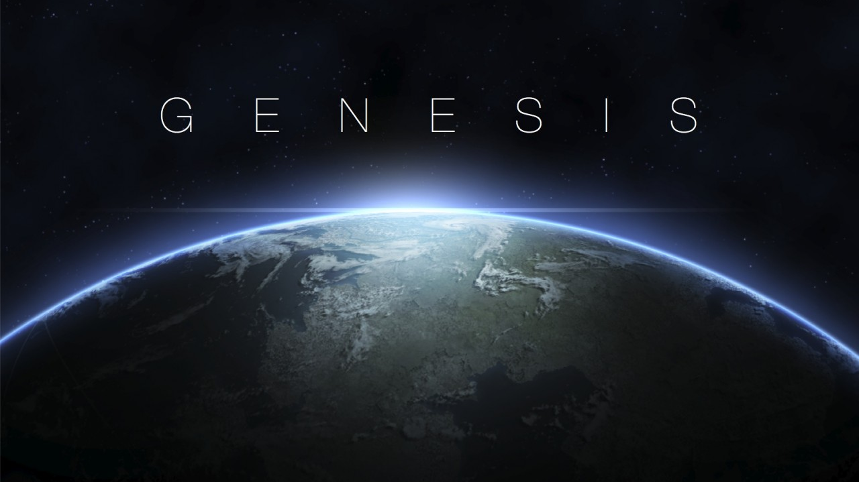


Slide 8
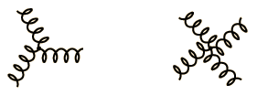
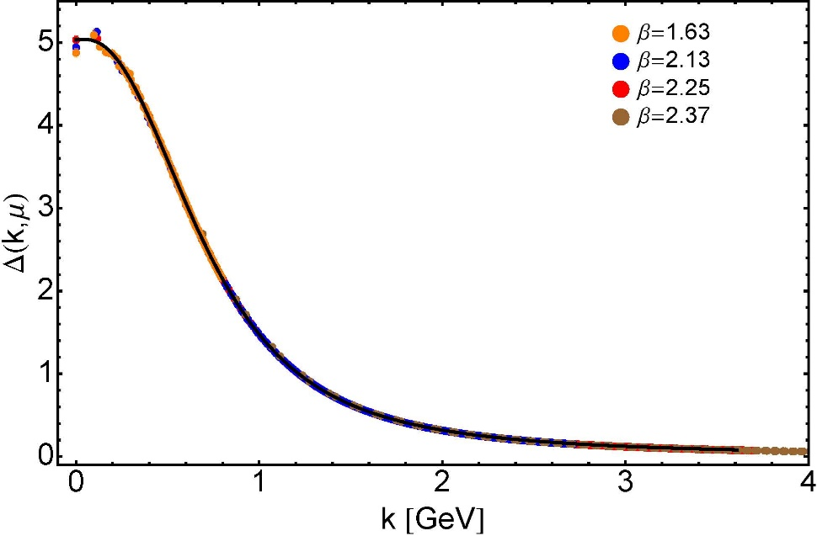


Modern Understanding
Grew Slowly from Ancient Origins
More than 40 years ago
  Dynamical mass generation in continuum quantum chromodynamics,
  J.M. Cornwall, Phys. Rev. D 26 (1981) 1453 … $>1100$ citations
Owing to strong self-interactions, gluon partons $⇒$ gluon quasiparticles,
described by a mass function that is large at infrared momenta
3-gluon vertex
4-gluon vertex
$$\frac{1}{m_{g}^{2}}$$
Truly mass from nothing
An interacting theory, written in terms of massless gluon fields, produces dressed gluon fields that are characterised by a mass function that is large at infrared momenta
Gluon propagator … continuum and lattice QCD agree
QCD fact
Continuum theory and lattice simulations agree
Empirical verification?

Slide 9


Modern Understanding
Grew Slowly from Ancient Origins
D. Binosi, Emergent Hadron Mass in Strong Dynamics, Few Body Syst. 63 (2022) 42.
M. N. Ferreira, J. Papavassiliou, Gauge Sector Dynamics in QCD, Particles 6 (1) (2023) 312–363.
EHM means
Gluons are massive – Schwinger Mechanism
More than 40 years ago
  Dynamical mass generation in continuum quantum chromodynamics,
  J.M. Cornwall, Phys. Rev. D 26 (1981) 1453 … $∼1050$ citations
Owing to strong self-interactions, gluon partons $⇒$ gluon quasiparticles,
described by a mass function that is large at infrared momenta
3-gluon vertex
4-gluon vertex
$$\frac{1}{m_{g}^{2}}$$
Truly mass from nothing
An interacting theory, written in terms of massless gluon fields, produces dressed gluon fields that are characterised by a mass function that is large at infrared momenta
Gluon propagator … continuum and lattice QCD agree
QCD fact
Continuum theory and lattice simulations agree
Empirical verification?

Slide 10

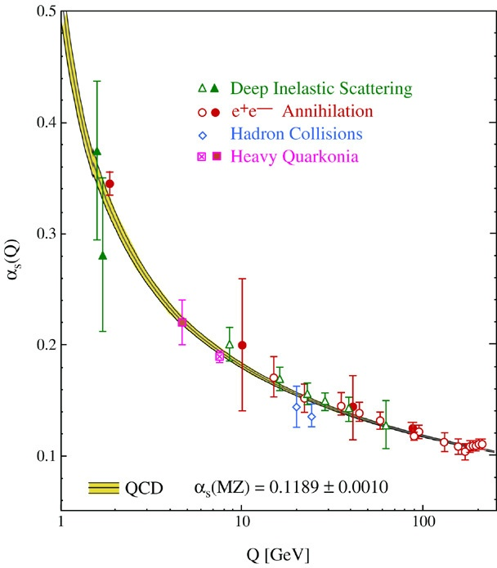
QCD’s Running Coupling
This is where we live
Asymptotic Freedom
Interaction becomes weaker
as energy grows
(as charges get closer together)
⇐
What’s happening
out here?!

Slide 11
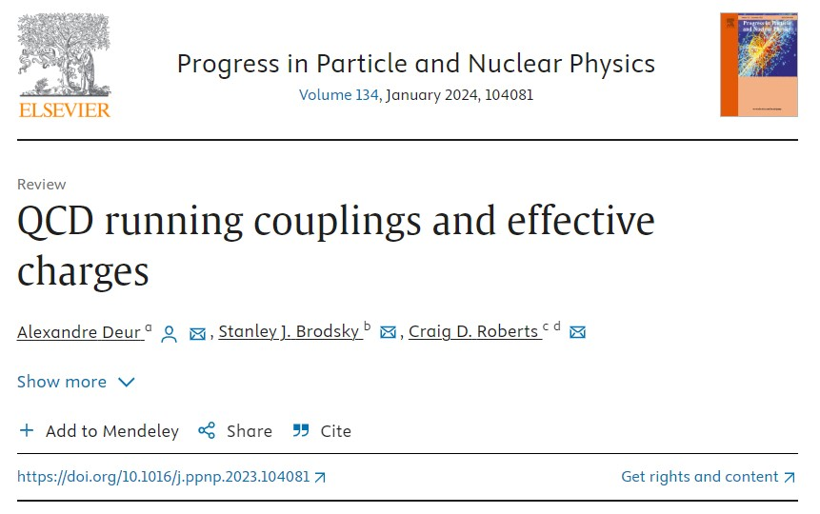
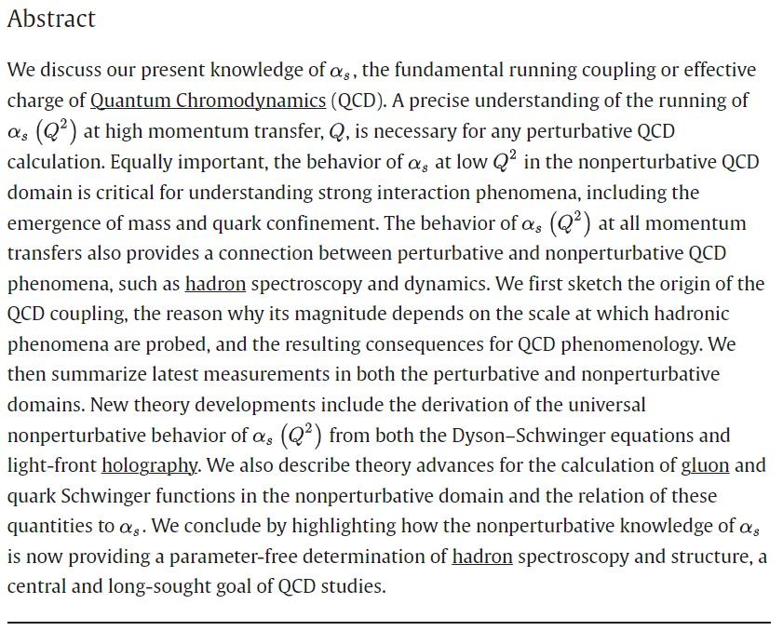


May 2024

Slide 12

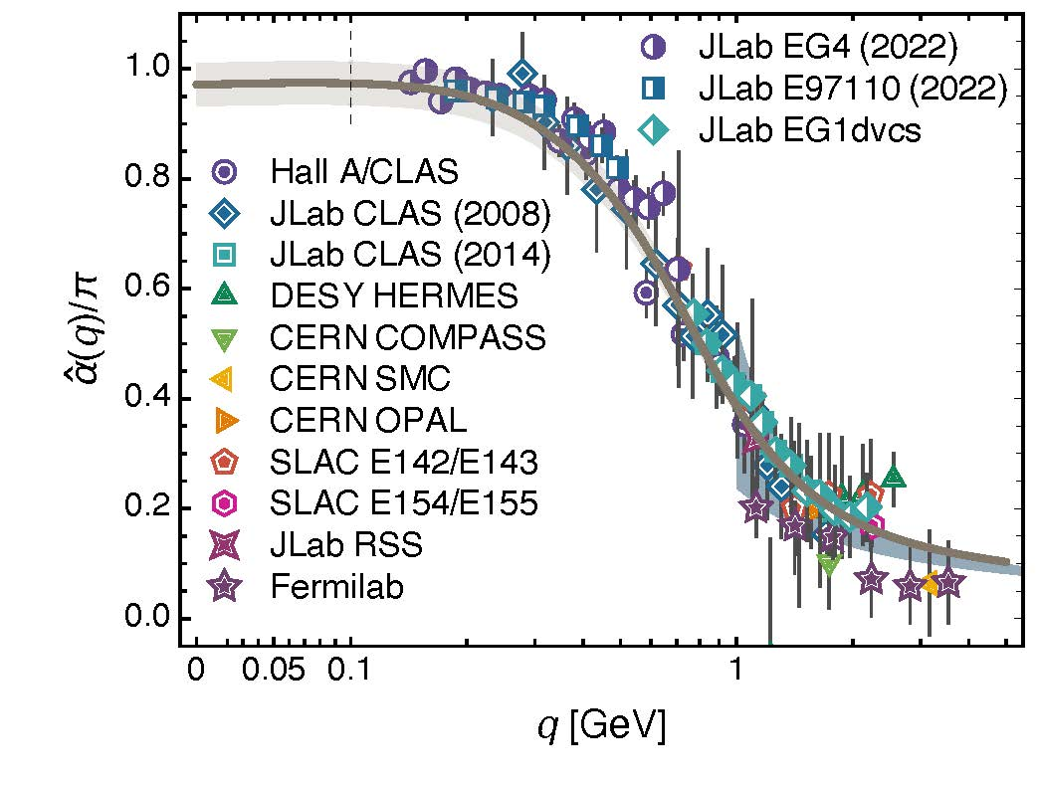
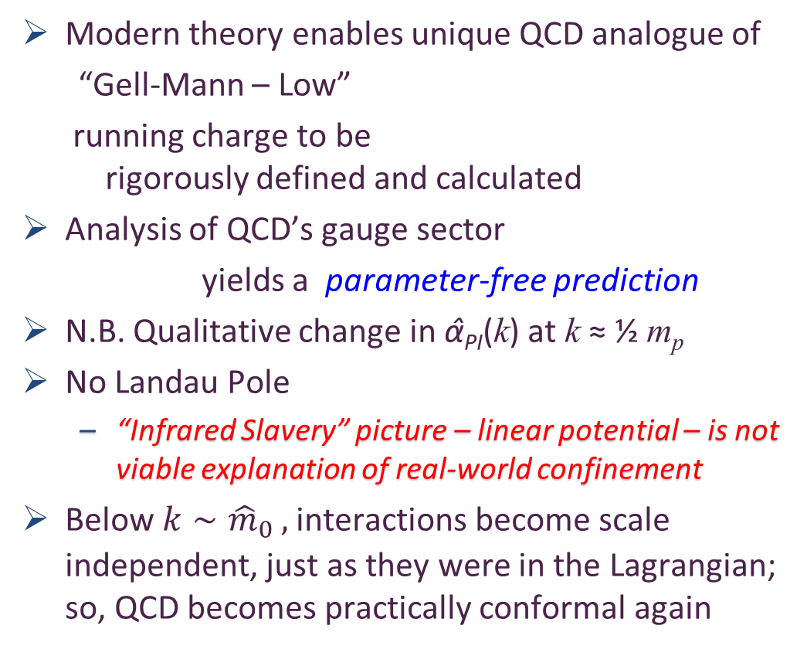

Process independent effective charge = running coupling
W orkshop on Dyson-Schwinger Equations in Modern Mathematics
and Physics (DSEMP2014) Trento, Italy, September 22-26, 2014
Effective charge from lattice QCD, Zhu-Fang Cui, Jin-Li Zhang et al.,
NJU-INP 014/19, arXiv:1912.08232 [hep-ph], Chin. Phys. C 44 (2020) 083102/1-10
$∼$2500 total downloads
Modern theory enables unique QCD analogue of
“Gell-Mann – Low”
  running charge to be
  rigorously defined and calculated
Analysis of QCD’s gauge sector
  yields a parameter-free prediction
N.B. Qualitative change in α̂_{PI}(k) at k ≈ ½ m_{p}
No Landau Pole
  “Infrared Slavery” picture – linear potential – is not viable explanation of real-world confinement
Below $k∼{{\hat{m}}_{0}}_{ },$interactions become scale independent, just as they were in the Lagrangian; so, QCD becomes practically conformal again
Process independent strong running coupling
Daniele Binosi et al., arXiv:1612.04835 [nucl-th], Phys. Rev. D 96 (2017) 054026/1-7
Experimental determination of the QCD effective charge α_{g1}(Q).
A. Deur; V. Burkert; J.-P. Chen; W. Korsch, Particles 5 (2022) 171
QCD Running Couplings and Effective Charges, Alexandre Deur, Stanley J. Brodsky and Craig Roberts, e-Print: 2303.00723 [hep-ph], Prog. Part. Nucl. Phys. 134 (2024) 104081

Slide 13
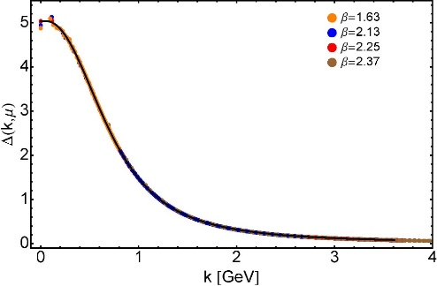

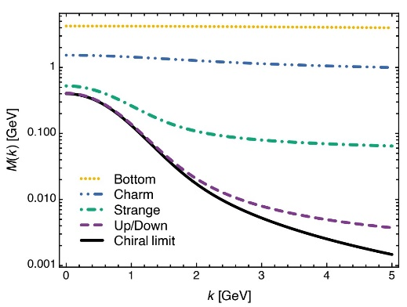
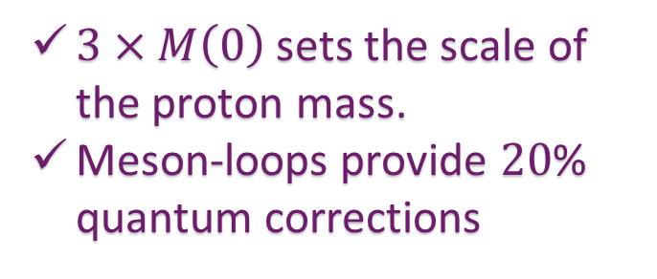
EHM Basics
Absent Higgs boson couplings, QCD Lagrangian is scale invariant
Yet …
  Massless gluons become massive
  A momentum-dependent charge is produced
  Massless quarks become massive
EHM is expressed in
    EVERY strong interaction observable
Challenge to Theory =
    Elucidate all observable consequences of these phenomena
    and highlight the paths to measuring them
Challenge to Experiment =
    Test the theory predictions so that
    the boundaries of the Standard Model can finally be drawn
Three pillars of EHM
$3×M\left(0\right)$ sets the scale of the proton mass.
Meson-loops provide $20$% quantum corrections

Slide 14
QCD Fact Pion (Nambu-Goldstone modes) and mass
EHM demands equivalence between
one-body mass and two-body correlation strength
in Nature’s most fundamental Nambu-Goldstone bosons
Higgs boson couplings → 0
Pion exists and is massless
Pion Bethe-Salpeter amplitude
Pion wave function: 2 body problem quark mass function: one body problem
This identity is the most basic expression of the Nambu-Goldstone Theorem in the Standard Model
f_{π} E_{π}(p²) = B(p²)

Slide 15
QCD Fact Pion (Nambu-Goldstone modes) and mass
EHM demands equivalence between
one-body mass and two-body correlation strength
in Nature’s most fundamental Nambu-Goldstone bosons
Higgs boson couplings → 0
Pion exists and is massless
Pion Bethe-Salpeter amplitude
Pion wave function: 2 body problem quark mass function: one body problem
Entails, enigmatically, properties of the nearly massless pion are the cleanest expression of EHM in the Standard Model !
f_{π} E_{π}(p²) = B(p²)

Slide 16
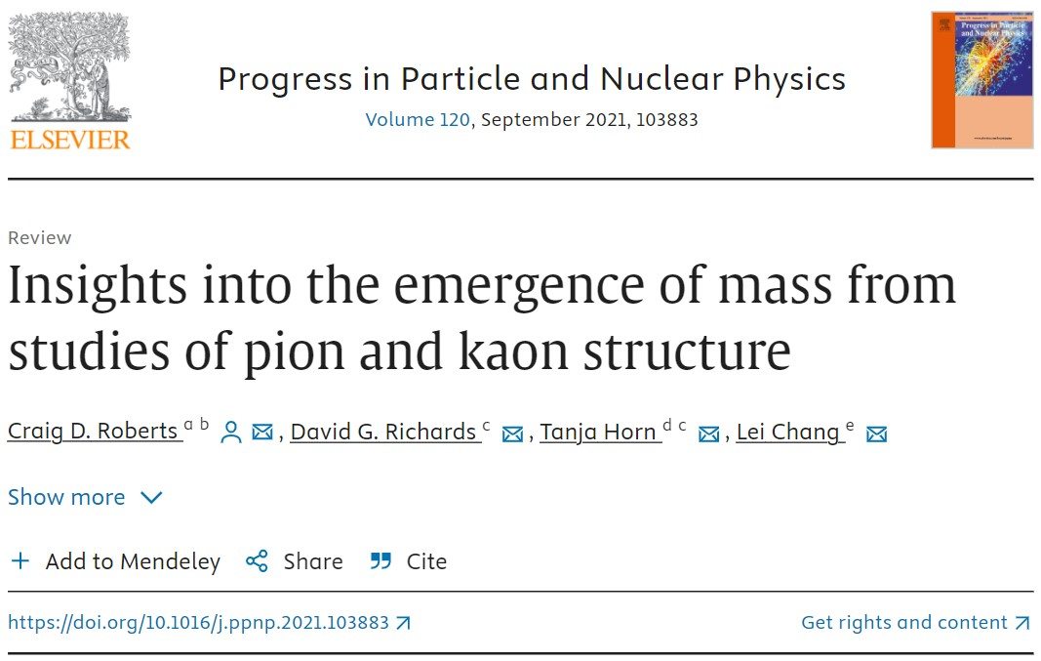
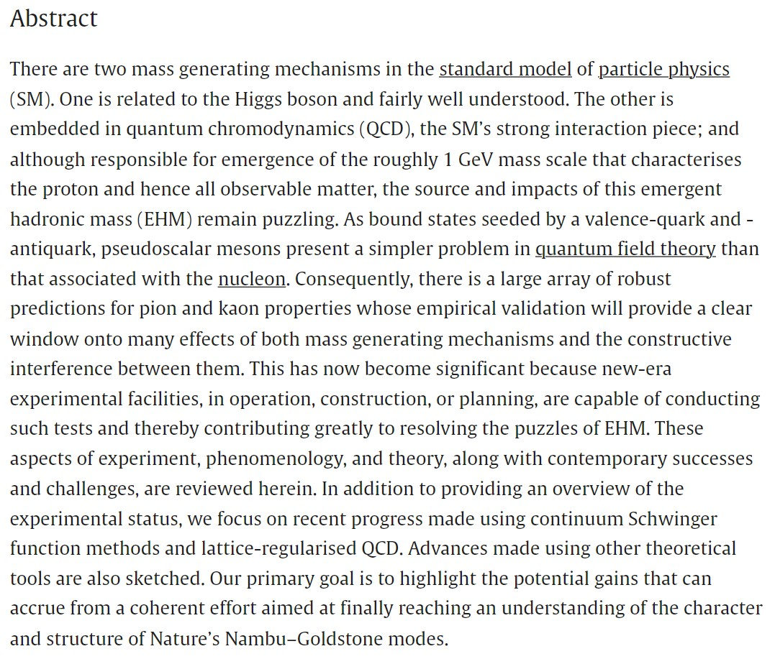

Slide 17

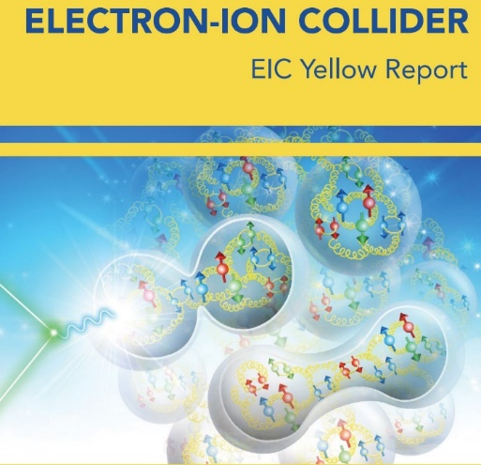



Charting EHM using
High Intensity, High Luminosity Facilities

Slide 18
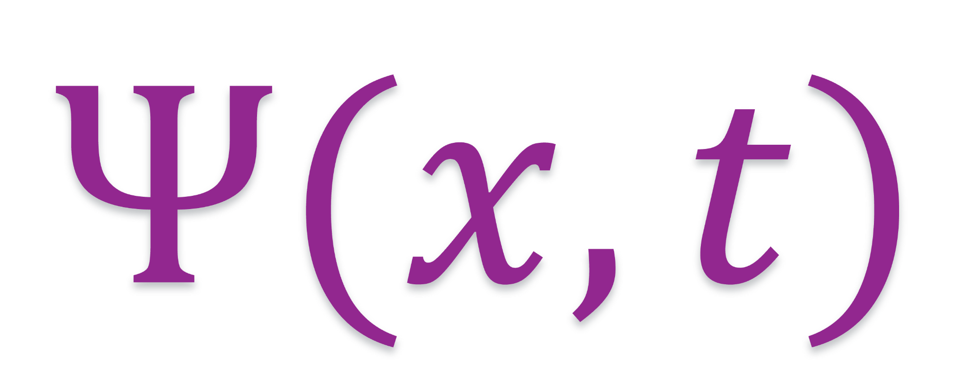
Measuring $π \& K$ Wave Functions

Slide 19
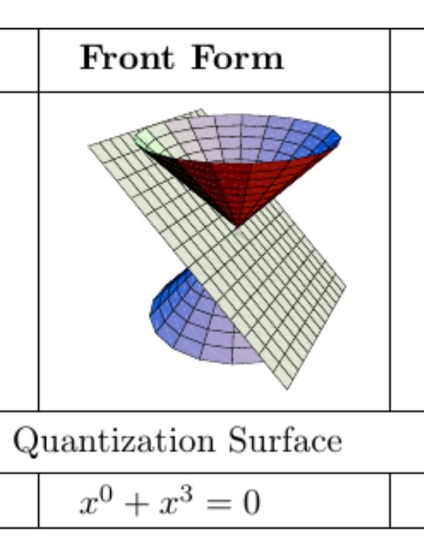
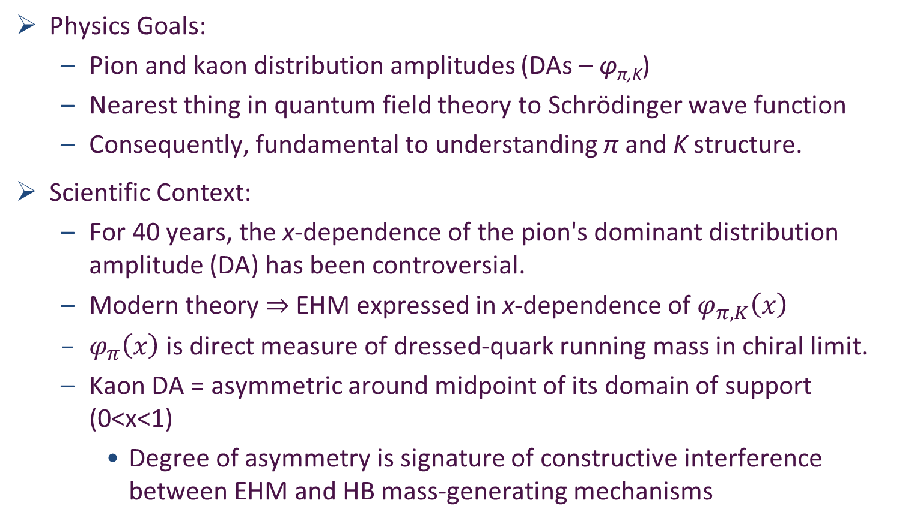
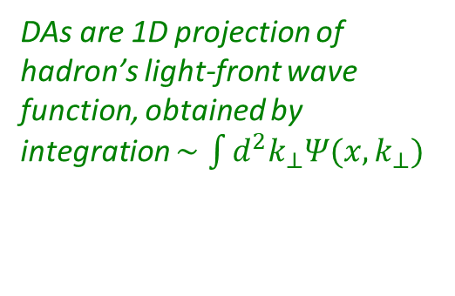
Wave Functions of Nambu Goldstone Bosons
DAs are 1D projection of hadron’s light-front wave function, obtained by integration $∼\int{d^{2}k_{⊥}Ψ(x,k_{⊥})}$
Physics Goals:
  Pion and kaon distribution amplitudes (DAs – φ_{π,K})
  Nearest thing in quantum field theory to Schrödinger wave function
  Consequently, fundamental to understanding π and K structure.
Scientific Context:
  For 40 years, the x-dependence of the pion's dominant distribution amplitude (DA) has been controversial.
  Modern theory $⇒$EHM expressed in x-dependence of $φ_{π,K}\left(x\right)$
  $φ_{π}\left(x\right)$ is direct measure of dressed-quark running mass in chiral limit.
  Kaon DA = asymmetric around midpoint of its domain of support (0<x<1)
    Degree of asymmetry is signature of constructive interference between EHM and HB mass-generating mechanisms
LF longitudinal direction
Insights into the Emergence of Mass from Studies of Pion and Kaon Structure, Craig D. Roberts, David G. Richards, Tanja Horn and Lei Chang, NJU-INP 034/21, arXiv: 2102.01765 [hep-ph], Prog. Part. Nucl. Phys. 120 (2021) 103883/1-65

Slide 20
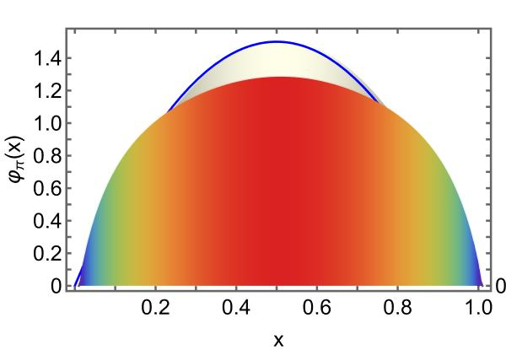
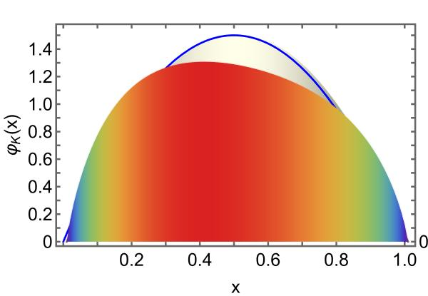

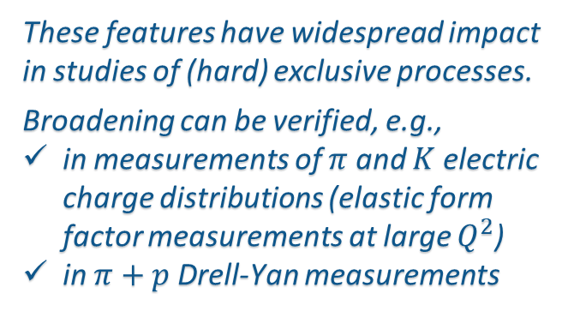

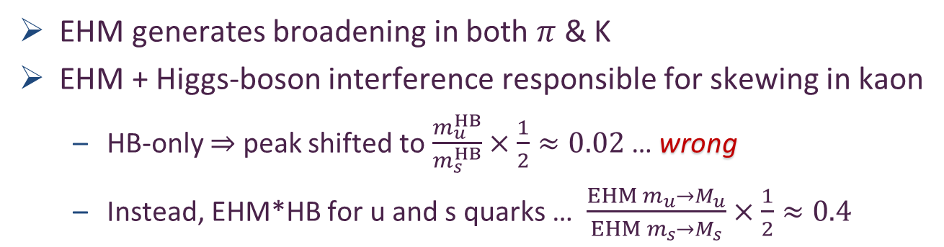
$π$ & K DAs cf. asymptotic profile
Exposing strangeness: projections for kaon electromagnetic form factors, Fei Gao et al., arXiv:1703.04875 [nucl-th], Phys. Rev. D 96 (2017) 034024/1-8
Constraining the pion DA using Drell-Yan reactions on a proton, H.-Y. Xing (邢惠瑜) et al., NJU-INP 077/23, e-Print: 2308.13695 [hep-ph], Phys. Lett. B 849 (2024), 138462/1-7
$$φ_{asymptotic}$$
EHM generates broadening in both $π$ & K
EHM + Higgs-boson interference responsible for skewing in kaon
  HB-only $⇒$ peak shifted to $\frac{m_{u}^{HB}}{m_{s}^{HB}}×\frac{1}{2}≈0.02$ … wrong
  Instead, EHM*HB for u and s quarks … $\frac{{EHM m_{u}→M}_{u}}{EHM m_{s}→M_{s}}×\frac{1}{2}≈0.4$
These features have widespread impact in studies of (hard) exclusive processes.
Broadening can be verified, e.g.,
in measurements of $π$ and $K$ electric charge distributions (elastic form factor measurements at large $Q^{2}$)
in $π+p$ Drell-Yan measurements

Slide 21
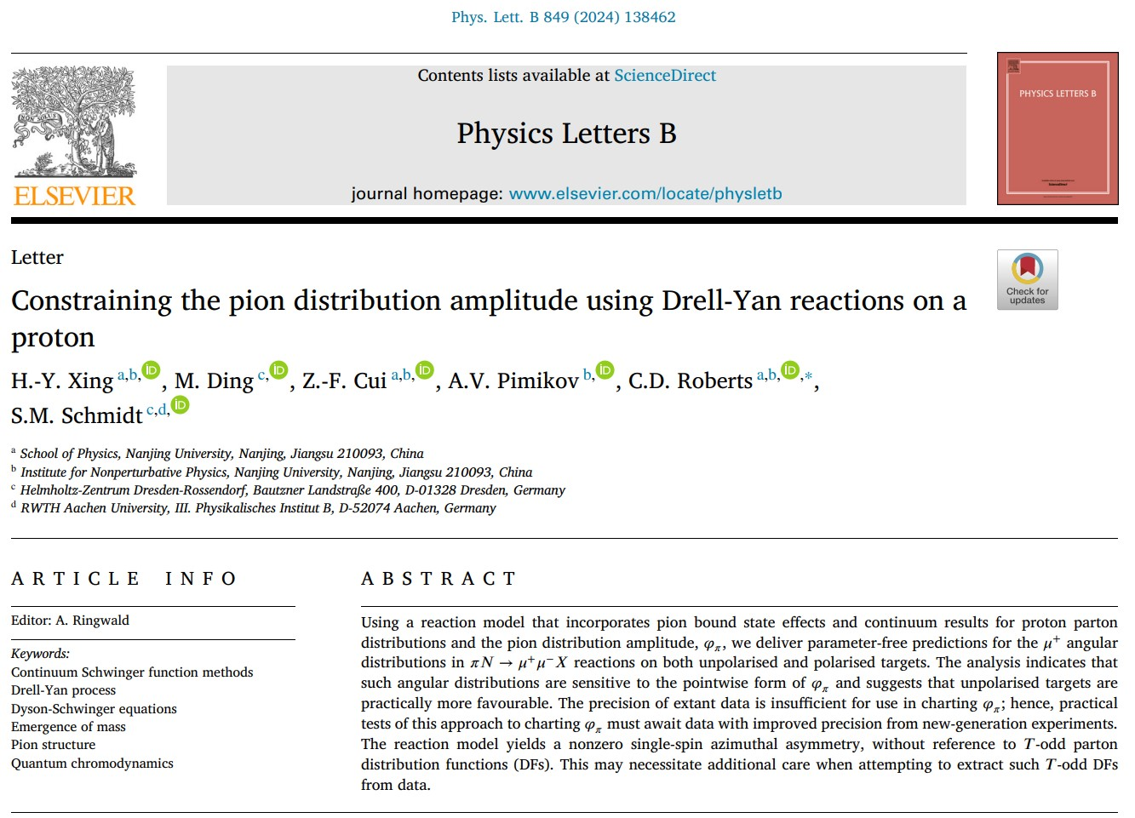
Pion Distribution Amplitude
Possibility discussed throughout the series of teleworkshops:
Perceiving EHM through AMBER @ CERN
Crystalised during EHM AMBER @ CERN VI
2021 Sept 27-29
Large part of Hui-Yu’s PhD thesis

Slide 22
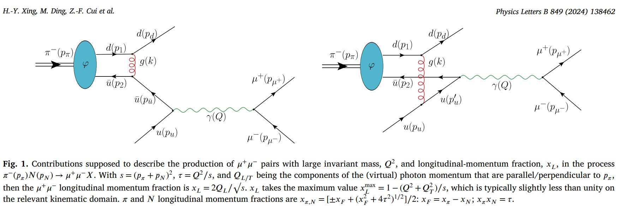
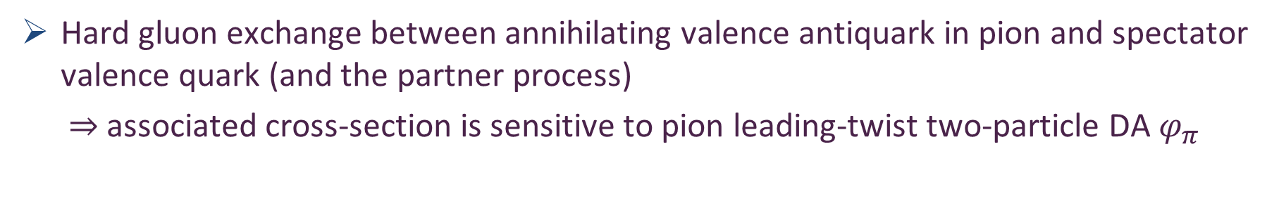
Pion DA
Hard gluon exchange between annihilating valence antiquark in pion and spectator valence quark (and the partner process)
$⇒$ associated cross-section is sensitive to pion leading-twist two-particle DA $φ_{π}$

Slide 23
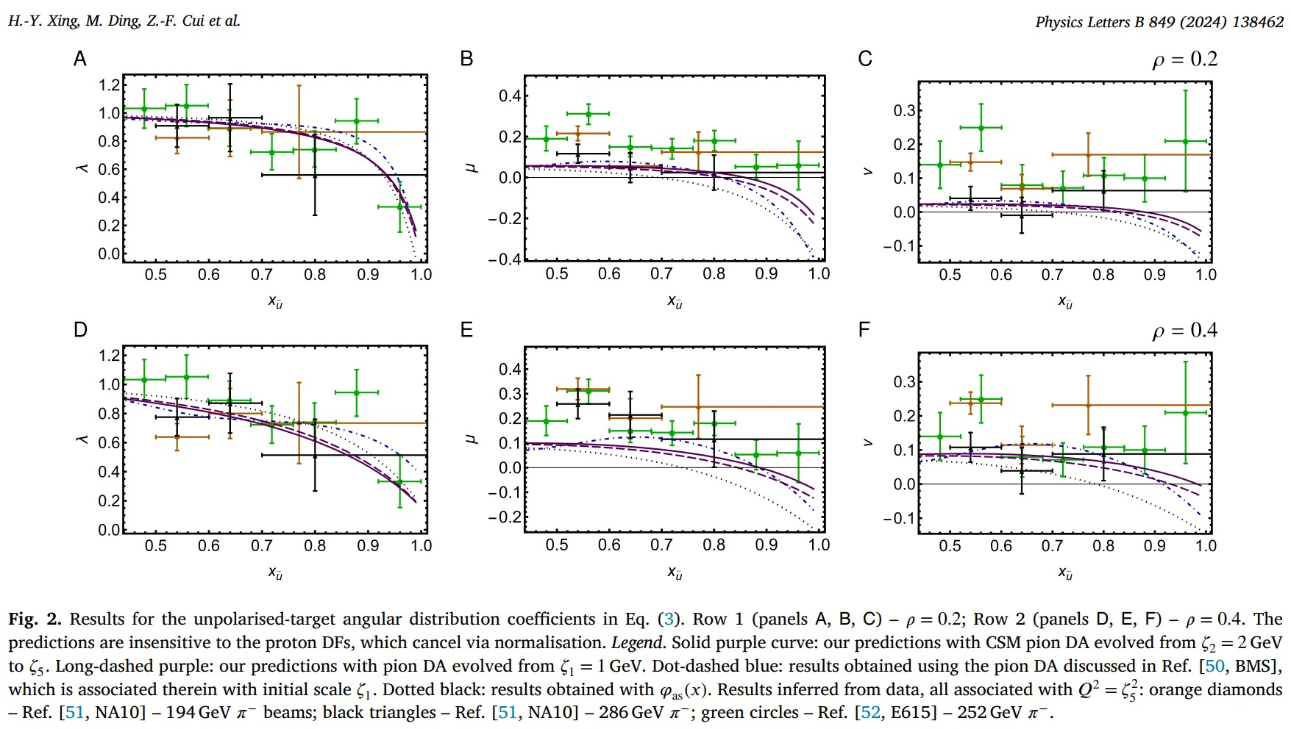
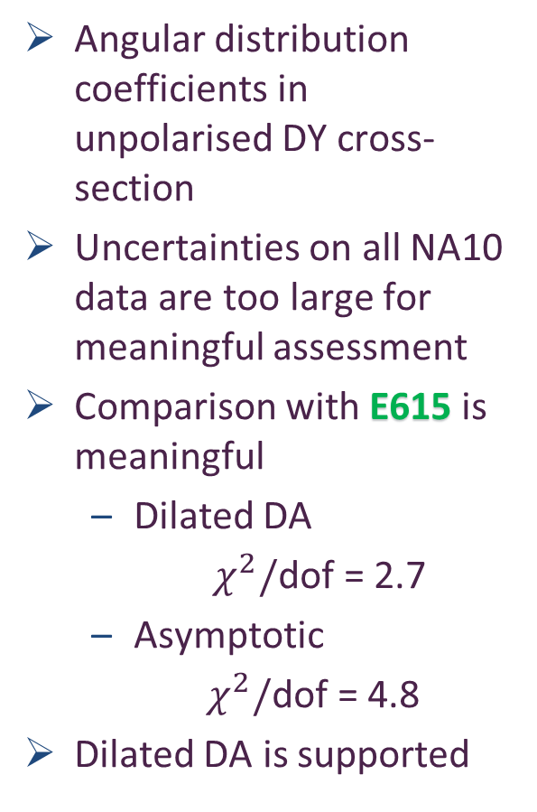
Pion DA
Angular distribution coefficients in unpolarised DY cross-section
Uncertainties on all NA10 data are too large for meaningful assessment
Comparison with E615 is meaningful
  Dilated DA
  $χ^{2}/$dof = 2.7
  Asymptotic
    $χ^{2}/$dof = 4.8
Dilated DA is supported
Plainly, however, modern experiment with precise data is needed to make a strong case.

Slide 24
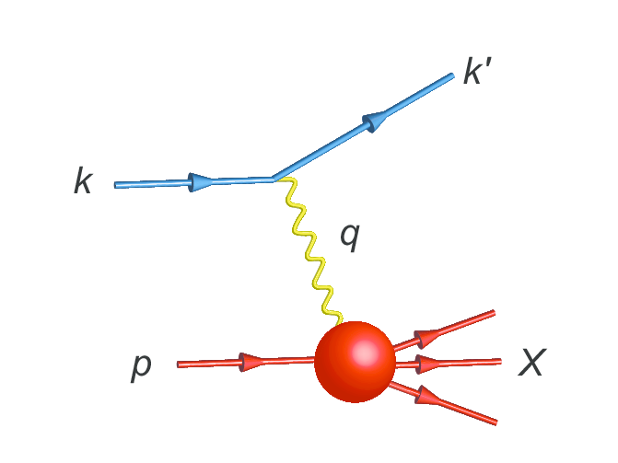
Parton Distribution Functions

Slide 25
NG Boson Distribution Functions
Insights into the Emergence of Mass from Studies of Pion and Kaon Structure, Craig D. Roberts, David G. Richards, Tanja Horn and Lei Chang, NJU-INP 034/21, arXiv: 2102.01765 [hep-ph], Prog. Part. Nucl. Phys. 120 (2021) 103883/1-65
Physics Goals:
  Precise data that can be used to determine
  Pion and Kaon Distribution Functions – valence, sea and glue
  Provide the first complete charts of the internal structure of Nature's most fundamental Nambu-Goldstone bosons.
Today:
  Existing pion data are more than 40-years-old
  That data only covers the valence-quark domain
  A forty-year controversy, with doubts persisting over whether the data agree with QCD predictions or challenge the truth of QCD
  Regarding the kaon, worldwide, only 8 points of data exist

Slide 26
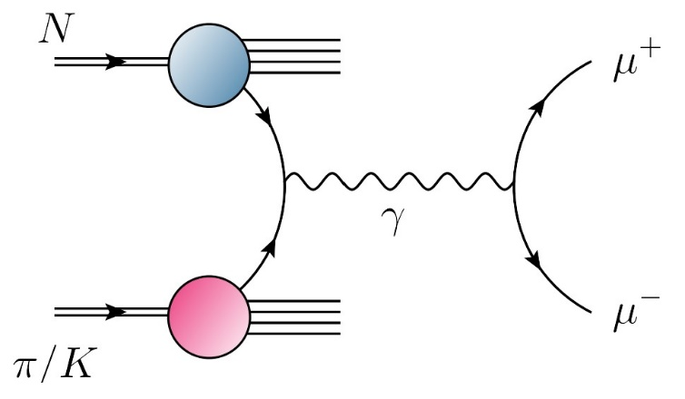
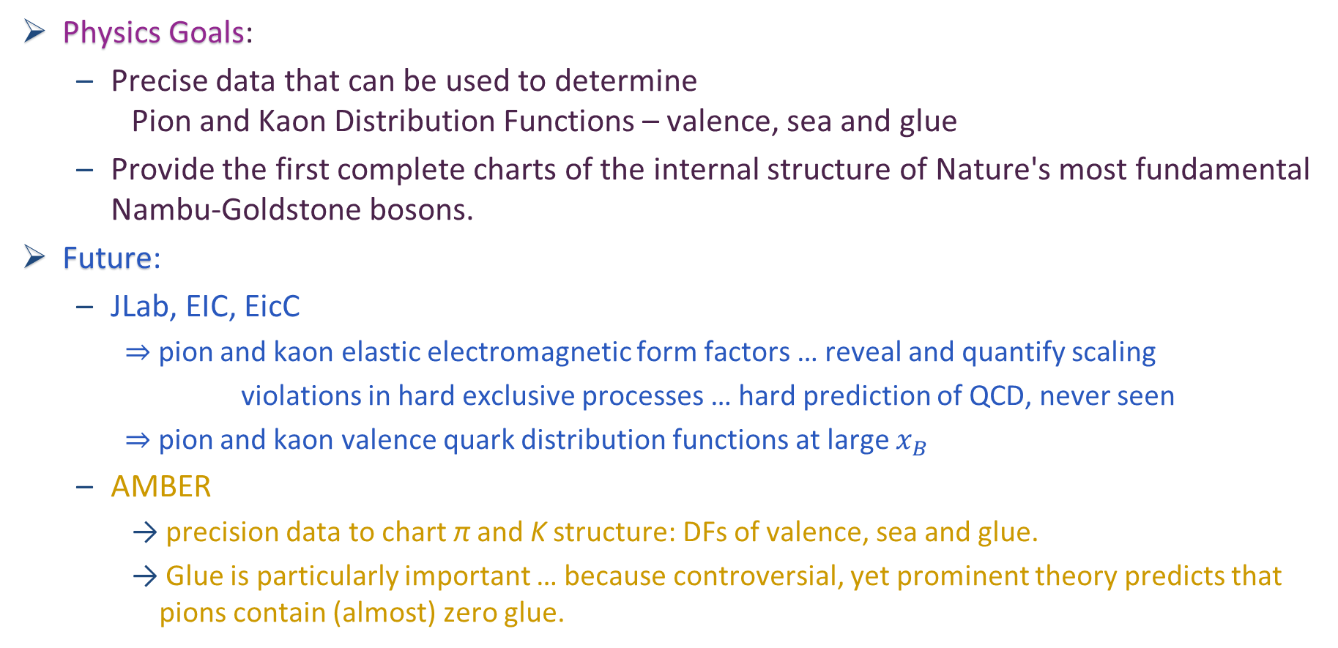
NG Boson Distribution Functions
Physics Goals:
  Precise data that can be used to determine
  Pion and Kaon Distribution Functions – valence, sea and glue
  Provide the first complete charts of the internal structure of Nature's most fundamental Nambu-Goldstone bosons.
Future:
  JLab, EIC, EicC
    ⇒ pion and kaon elastic electromagnetic form factors … reveal and quantify scaling
    violations in hard exclusive processes … hard prediction of QCD, never seen
    ⇒ pion and kaon valence quark distribution functions at large $x_{B}$
  AMBER
    precision data to chart π and K structure: DFs of valence, sea and glue.
    Glue is particularly important … because controversial, yet prominent theory predicts that pions contain (almost) zero glue.

Slide 27

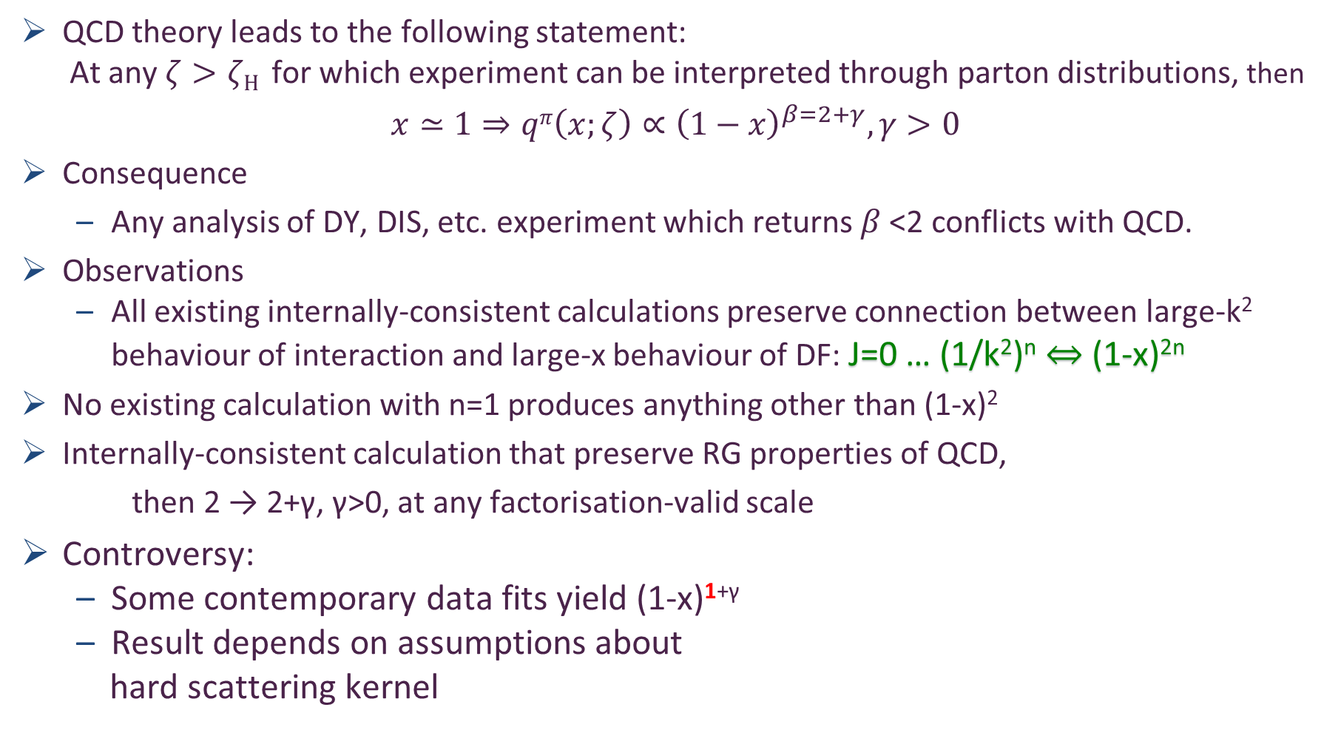
Controversy over pion valence DF
QCD theory leads to the following statement:
  At any $ζ>ζH$ for which experiment can be interpreted through parton distributions, then
$$x≃1⇒qπ\left(x;ζ\right)∝{\left(1−x\right)}^{β=2+γ}, γ>0$$
Consequence
  Any analysis of DY, DIS, etc. experiment which returns $β$<2 conflicts with QCD.
Observations
  All existing internally-consistent calculations preserve connection between large-k² behaviour of interaction and large-x behaviour of DF: J=0 … (1/k²)^{n} ⇔ (1-x)^{2n}
No existing calculation with n=1 produces anything other than (1-x)²
Internally-consistent calculation that preserve RG properties of QCD,
then 2 → 2+γ, γ>0, at any factorisation-valid scale
Controversy:
  Some contemporary data fits yield (1-x)^{1+γ}
  Result depends on assumptions about
  hard scattering kernel
Is QCD wrong?
Is existing large-x data a true measure of $qπ\left(x;ζ\right)$?
Are fitter-favoured analysis methods correct/complete?

Slide 28
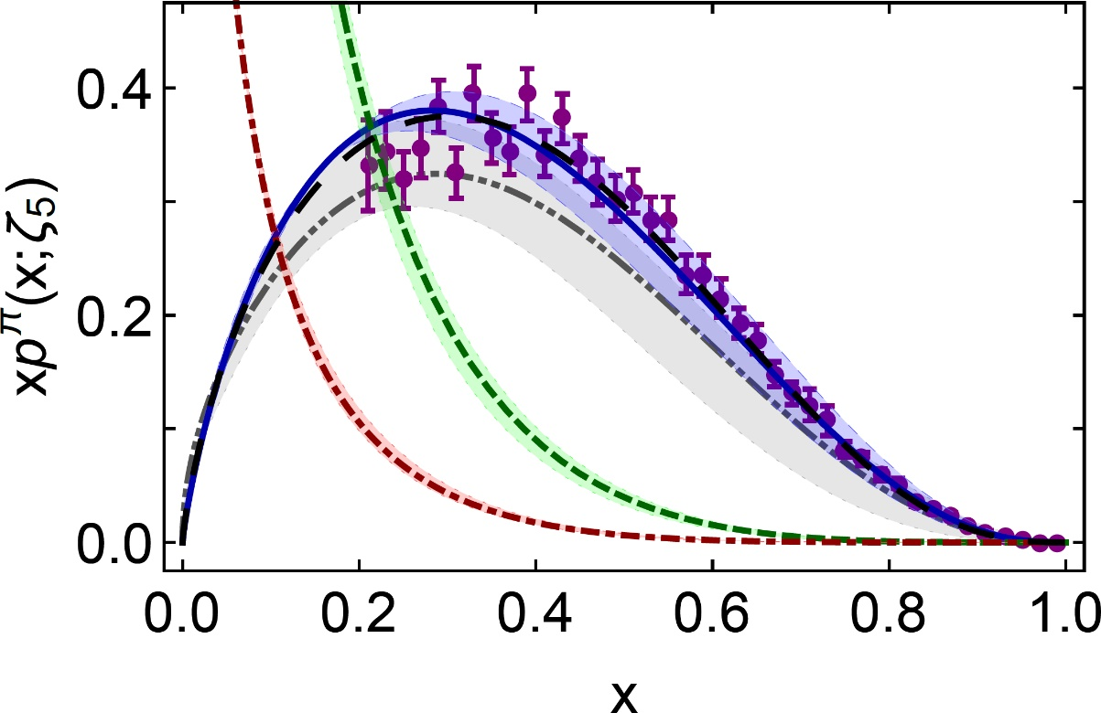
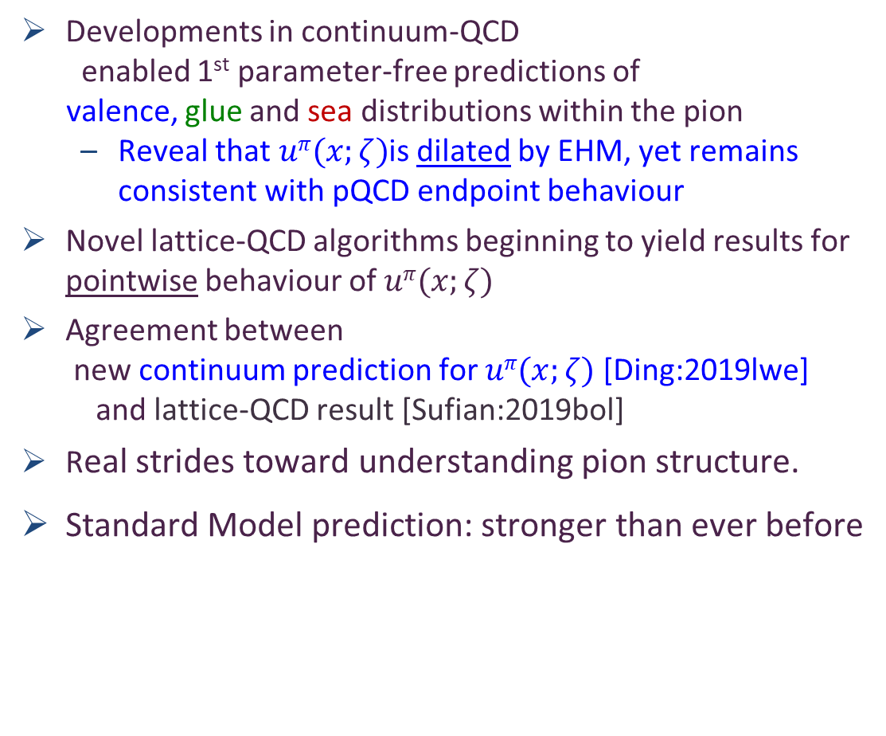
π valence-quark distributions
25 Years of Theory Evolution → 2024
β^{contm}(ζ₅) = 2.66(12)
β^{lattice}(ζ₅) = 2.45(58)
Developments in continuum-QCD
enabled 1st parameter-free predictions of
valence, glue and sea distributions within the pion
  Reveal that $uπ(x;ζ)$is dilated by EHM, yet remains consistent with pQCD endpoint behaviour
Novel lattice-QCD algorithms beginning to yield results for pointwise behaviour of $uπ(x;ζ)$
Agreement between
  new continuum prediction for $uπ(x;ζ)$ [Ding:2019lwe]
  and lattice-QCD result [Sufian:2019bol]
Real strides toward understanding pion structure.
Standard Model prediction: stronger than ever before
After 30 years – new era dawning in which the ultimate experimental checks can be made:
M2 beam-line @ CERN … JLab12 … EIC … EicC

Slide 29
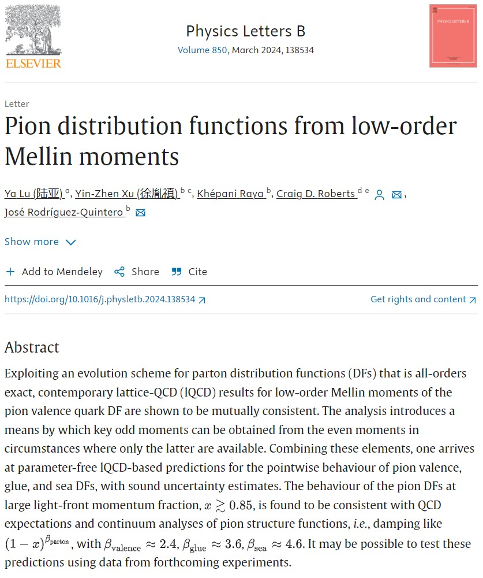

π valence-quark distributions
25 Years of Theory Evolution → 2024
β^{contm}(ζ₅) = 2.66(12)
β^{lattice}(ζ₅) = 2.45(58)
Developments in continuum-QCD
enabled 1st parameter-free predictions of
valence, glue and sea distributions within the pion
  Reveal that $uπ(x;ζ)$is dilated by EHM, yet remains consistent with pQCD endpoint behaviour
Novel lattice-QCD algorithms beginning to yield results for pointwise behaviour of $uπ(x;ζ)$
Agreement between
  new continuum prediction for $uπ(x;ζ)$ [Ding:2019lwe]
  and lattice-QCD result [Sufian:2019bol]
Real strides toward understanding pion structure.
Standard Model prediction: stronger than ever before
After 30 years – new era dawning in which the ultimate experimental checks can be made:
M2 beam-line @ CERN … JLab12 … EIC … EicC

Slide 30
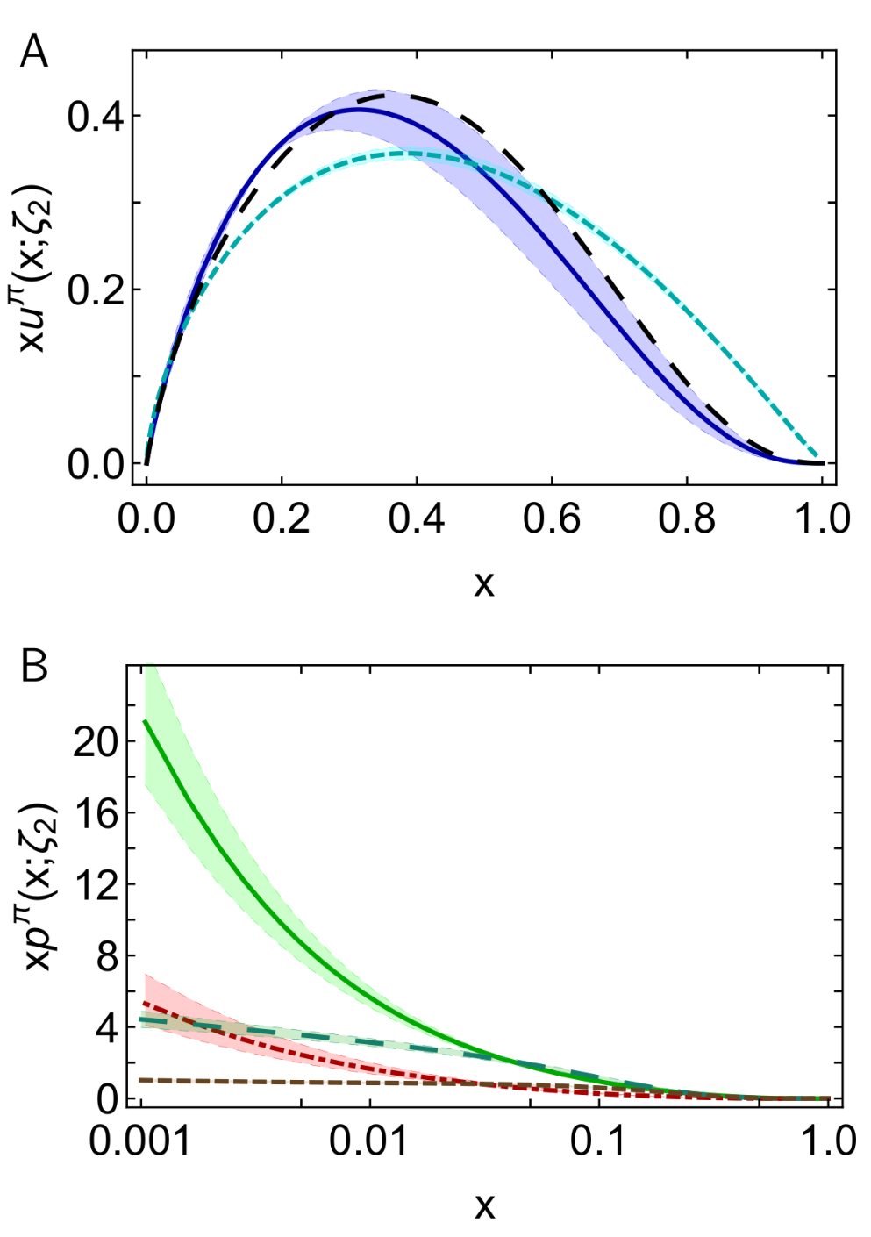
π DFs … Modern Theory Predictions vs Traditional Phenomenological Fits to Data
Valence:
  momentum fraction similar
  Phenomenological Fits … profile much harder
  & inconsistent with QCD prediction
Glue:
  Qualitative similarities on x ≥ 0.05, but marked quantitative disagreement, especially on complementary domain
  Both continuum prediction and fit are very different from early phenomenology
  Should be tested in new experiments that are directly sensitive to the pion’s gluon content.
  E.g., prompt photon & J/Ψ production
Sea:
  Prediction and fit disagree on entire x-domain
  If pion’s gluon content is considered uncertain, then fair to describe sea-quark distribution as empirically unknown
  Motivation for the collection and analysis of DY data with π± beams on isoscalar targets
CSM prediction
JAM valence
DSE prediction
glue & sea
JAM:
glue & sea

Slide 31
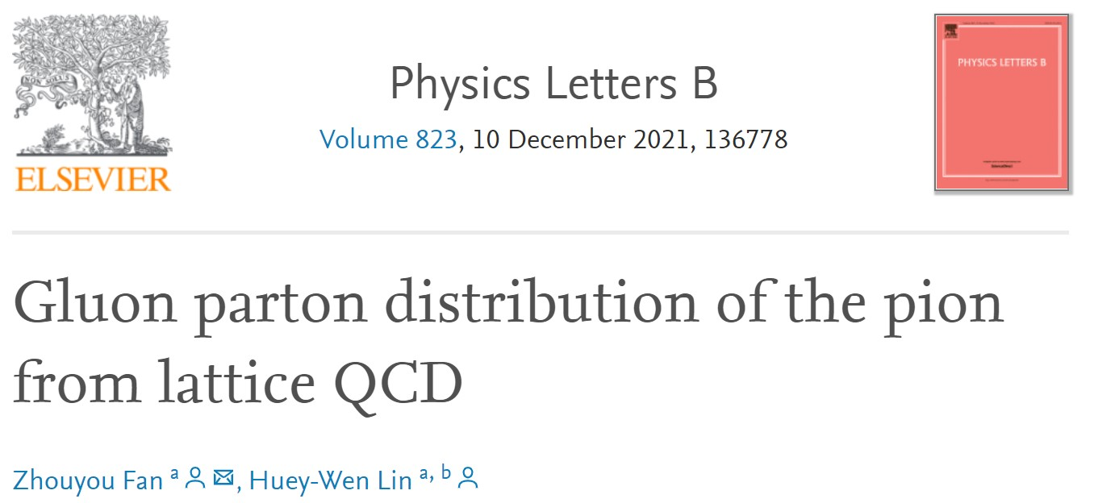
π DFs … Modern Theory Predictions vs Traditional Phenomenological Fits to Data
Valence:
  momentum fraction similar
  JAM … publication ignores NLL resummation … profile much harder & inconsistent with QCD prediction
Glue:
  Similarities on x ≥ 0.05, but marked disagreement on important complementary domain
  Both continuum prediction and JAM fit are very different from early phenomenology
  Should be tested in new experiments that are directly sensitive to the pion’s gluon content.
  Perhaps, prompt photon & J/Ψ production
Sea:
  Prediction and fit disagree on entire x-domain
  If pion’s gluon content is considered uncertain, then fair to describe sea-quark distribution as empirically unknown
  Motivation for the collection and analysis of DY data with π± beams on isoscalar targets
DSE prediction
JAM valence
Exploratory lQCD results for pion’s glue DF are now available
DSE prediction
glue & sea
JAM:
glue & sea

Slide 32
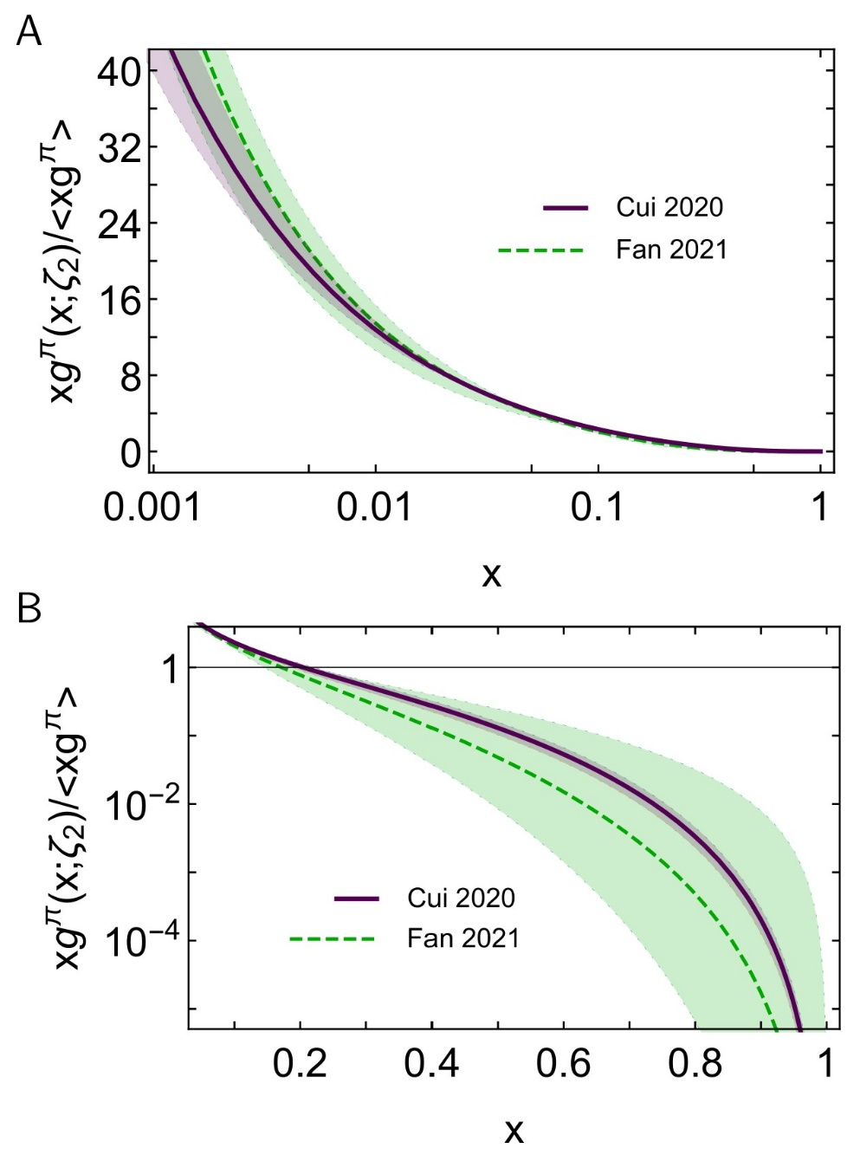

Glue in π: Continuum (Eur. Phys. J. C 80 (2020) 1064/1-20)
& Lattice Predictions (arXiv: Phys.Lett.B 823 (2021) 136778)
Two distinct methods for tackling QCD
Agree quantitatively on $g_{ }^{π}\left(x\right)$
continuum
Phenomenological analyses
exhibit qualitatively different behaviour
Highlights need for new data and improved phenomenology in order to turn that data into a real test of QCD and our understanding of Nambu-Goldstone modes.
AMBER @ CERN can provide the necessary precise data.
lattice
Regarding the distribution of glue in the pion, Lei Chang (常雷) and Craig D Roberts,
e-Print: 2106.08451 [hep-ph], Chin. Phys. Lett. 38 (8) (2021) 081101/1-6 - Editors' Suggestion

Slide 33
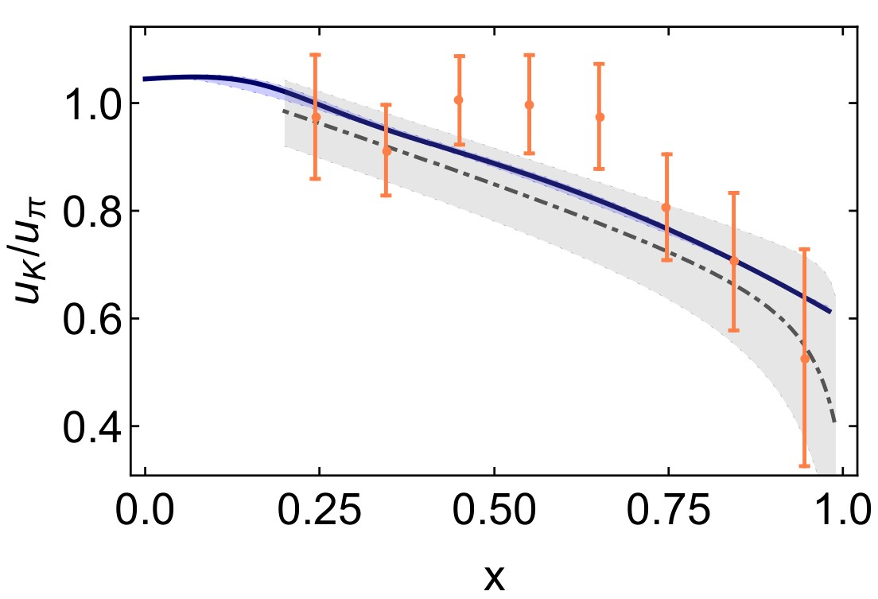
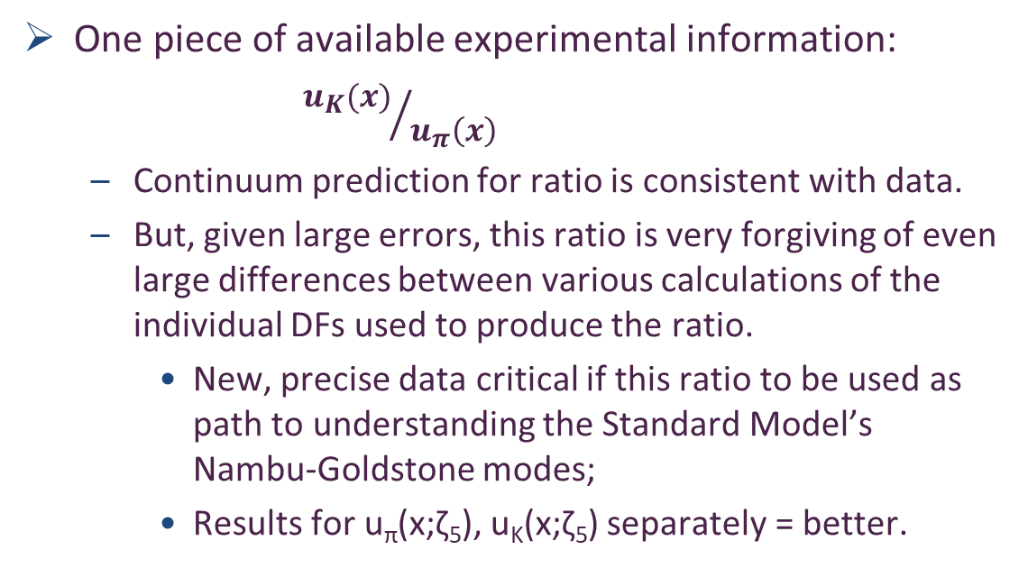
Status: Kaon
Programmes at JLab, AMBER
Proposals at EIC and EicC
Tackling the kaon structure function at EicC
Gang Xie et al. e-Print: 2109.08483 [hep-ph].
Chin. Phys. C 46 (2022) 6, 064107
Little empirical information available on K DFs ⇒ no recent phenom. inferences.
  Valence-quark distributions: results from models and a single, recent lQCD study
  Kaon’s glue and sea distributions: no results
Entirety of human history
– only 8 kaon data in existence
CERN … Phys. Lett. B 93 (1980) 354-356
One piece of available experimental information:
${u_{K}(x)}/{u_{π}\left(x\right)}$
  Continuum prediction for ratio is consistent with data.
  But, given large errors, this ratio is very forgiving of even large differences between various calculations of the individual DFs used to produce the ratio.
    New, precise data critical if this ratio to be used as path to understanding the Standard Model’s Nambu-Goldstone modes;
    Results for u_{π}(x;ζ₅), u_{K}(x;ζ₅) separately = better.
CSM
lQCD_{MSU}

Slide 34
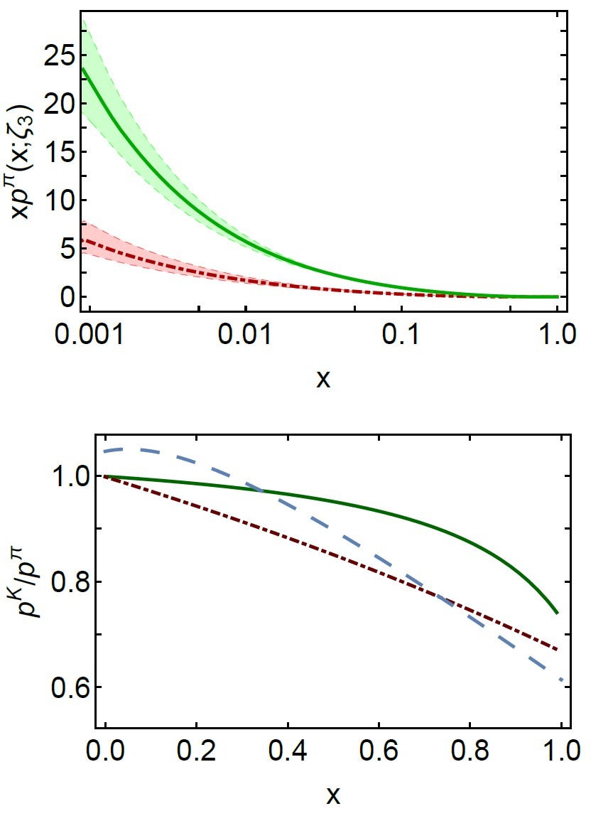
Status: Kaon
Kaon parton distributions, Z.-F. Cui et al., arXiv:2006.14075 [hep-ph], Eur. Phys. J. C 80 (2020) 1064/1-20
Little empirical information available on K DFs ⇒ no recent phenom. inferences.
  Valence-quark distributions: results from models and a single, recent lQCD study
  Kaon’s glue and sea distributions: no predictions … until now
Glue and Sea – Predictions:
  DFs similar to those in the pion
  Detailed comparison requires use of mass-dependent splitting functions.
  Conclusions:
    Light-front momentum fraction carried by s-quarks in the kaon increases by ∼ 5%;
    Compensated by a commensurate decrease in fractions carried by glue (−1%) and sea (−2%).
Glue
Sea
Valence
Glue
Sea

Slide 35
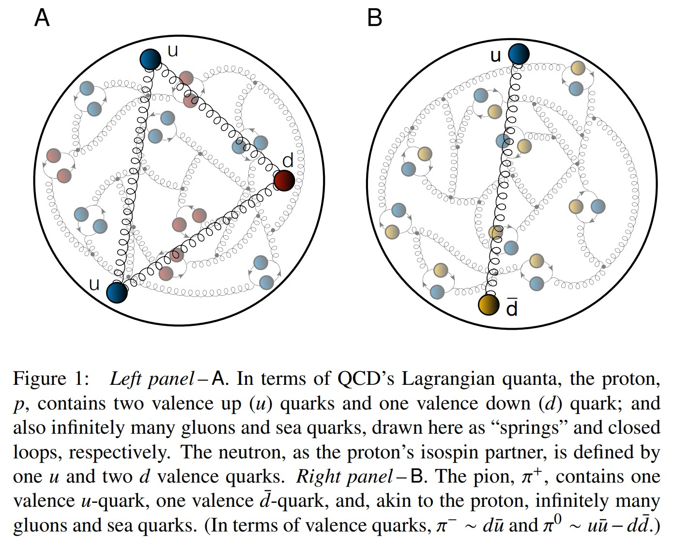
Proton and pion distribution functions in counterpoint
massive
almost massless
Today, despite enormous expense of time and effort, much must still be learnt before proton and pion structure may be considered understood in terms of DFs
Most simply, what are the differences, if any, between the distributions of partons within the proton and the pion?
The question of similarity/difference between proton and pion DFs has particular resonance today as science seeks to explain EHM
How are obvious macroscopic differences between protons and pions expressed in the structural features of these two bound-states?
proton
pion
skip

Slide 36


Proton and pion distribution functions in counterpoint
Proton and pion distribution functions in counterpoint, Ya Lu (陆亚) et al.,
NJU-INP 056/22, e-Print: 2203.00753 [hep-ph], Phys. Lett. B 830 (2022) 137130
Valence-quark domain: there is a scale $ζ_{H}<m_{p}$ at which
$ζ>m_{p}$: val. $∝{\left(1−x\right)}^{β_{p,π}}$ , $β_{p}=3+γ_{p}$, $β_{π}=2+γ_{π}$
  Gluon DFs: $β_{p,π}^{glue}≥$ $β_{p,π}^{val}+1$
  Sea DFs: $β_{p,π}^{sea}≥$ $β_{p,π}^{val}+2$
These are simple consequences of DGLAP equations.
Argument can be reversed:
  if large-x glue or sea DF exponent is smaller than that of valence DF at any given scale, then it is smaller at all lower scales.
DF with lowest exponent
defines the valence degree-of-freedom.
Proton is supposed to be a stable bound-state of three valence-quarks
Yet, modern global analyses of proton DIS and related data encompass fits with role of glue and valence-quarks reversed!
Proton has valence glue but no valence quarks!
Further, no simultaneous global fits to proton and pion data have ever been performed
  Largely because pion data are scarce
Existing approaches are unlikely to yield definitive answers because fitting practitioners typically overlook QCD constraints

Slide 37


Proton Spin Crisis
Long story … 35+ years … $-billions …
Future … Electron Ion Collider
… Total project cost is expected to range from $1.7-2.8 billion
… First beam $∼2034$
USA NAS Report
EHM is the keystone for future experiments in hadroparticle physics

Slide 38



Proton Spin
Polarised parton distribution functions and proton spin, Peng Cheng (程鹏), Yang Yu (俞杨), Hui-Yu Xing (邢惠瑜) et al., e-print: 2304.12469 [hep-ph], Phys. Lett. B 844 (2023) 138074/1-7
CSMs predict
$a_{0}≈65\%$of proton spin
carried by valence quark
quasiparticle degrees of freedom at the hadron scale.
Under P1 evolution, this value is independent of scale.
However, measurements of the proton spin are sensitive to
non-Abelian anomaly corrected combination $\left(n_{f}=4\right)$
CSM prediction: $a_{0}^{E}\left(ζ=\sqrt{3}GeV\right)=0.35(2)$
COMPASS: $a_{0}^{COMPASS}\left(ζ=\sqrt{3}GeV\right)=0.32(7)$
Parameter-free explanation
of proton spin measurement

Slide 39




Theory Predictions
Viable parameter-free explanation
of proton spin measurement
Novel approach to understanding character of proton internal structure has enabled derivation of algebraic formula for the gluon contribution to the proton spin
Reveals that gluon contribution is positive
and grows as resolving scale of the probe increases,
removing measurable spin from the quarks
Prediction for valence-quark part of proton spin: $a_{0}^{E}\left(ζ=\sqrt{3}GeV\right)=0.32(3)$
COMPASS (CERN) measurement (2016): $a_{0}^{COMPASS}\left(ζ=\sqrt{3}GeV\right)=0.32(7)$
Symmetry, symmetry breaking, and pion parton distributions, Minghui Ding, Khépani Raya et al., arXiv:1905.05208 [nucl-th], Phys. Rev. D 101 (2020) 054014/1-14
Parton distributions of light quarks and antiquarks in the proton, Lei Chang (常雷), Fei Gao (高飞) and Craig D. Roberts, e-Print: 2201.07870 [hep-ph], Phys. Lett. B 829 (2022) 137078/1-7
All-Orders Evolution of Parton Distributions: Principle, Practice, and Predictions, Pei-Lin Yin (尹佩林), Yin-Zhen Xu (徐胤禛), Zhu-Fang Cui (崔著钫) et al., e-Print: 2306.03274 [hep-ph], Chin. Phys. Lett. Express 40 (2023) 091201/1-8. Express Letter.
“Empirical $a_{0}$”

Slide 40

Proton Spin Budget
Contact interaction study of proton parton distributions, Yang Yu (俞杨), Peng Cheng (程鹏), Hui-Yu Xing (邢惠瑜),
Fei Gao (高飞) and Craig D. Roberts,
NJU-INP 083/24, e-Print: 2402.06095 [hep-ph]
Consider a light-front separation of the proton spin into contributions from quark and gluon spin and angular momenta:
$\frac{1}{2}=\frac{1}{2}a_{0}+L_{q}\left(ζ\right)+ΔG\left(ζ\right)+L_{g}(ζ)$
At hadron scale:
  $a_{0}=0.55$, $L_{q}\left(ζ_{H}\right)=0.23$
  $ΔG\left(ζ_{H}\right)=0$, $L_{g}\left(ζ_{H}\right)=0$
all proton spin is lodged with valence quark helicity and orbital angular momentum
Evolved to COMPASS scale
$a_{0}=0.54$, $L_{q}\left(ζ\right)=0.03$, $ΔG\left(ζ\right)=1.07$, $L_{g}\left(ζ\right)=−0.87$
Including calculation uncertainties
  Valence quark helicity: $(50±12)$%,
  glue: $≈40$%,
  sign and magnitude of valence quark light-front orbital angular momentum is uncertain

Slide 41

Proton and pion distribution functions in counterpoint
CSMs delivered 1st ever
unified body of predictions for all proton and pion DFs
– valence, glue, and 4-flavour-separated sea, unpol. and pol.
– explain COMPASS measurement of quark helicity
$x$-dependence of DFs is strongly hadron dependent
Smoking gun for EHM
  At any resolving scale, ζ, those in the pion are the hardest (most dilated).
All CSM DFs comply with QCD constraints on endpoint (low- and high-x) scaling behaviour.
However, existing global fits ignore QCD constraints, so:
  Fail to deliver realistic DFs, even from abundant proton data
  Meson data almost nonexistent and controversial results from fits
Only after imposing QCD constraints on future phenomenological data fits will it be possible to draw reliable pictures of hadron structure.
Especially important for attempts to expose and understand differences between Nambu-Goldstone bosons and seemingly less complex hadrons.

Slide 42

Synergy of Experiment, Phenomenology, Theory
Drawing detailed map of the proton is important because proton is Nature’s only absolutely stable bound state.
  However, while QCD is the proton, the proton is not QCD
Strong interaction theory is maturing
  Expanding array of parameter-free predictions for the proton – yes
  And all the other hadrons whose properties express the full meaning of QCD
Understanding how QCD’s simplicity explains the emergence of hadron mass and structure requires investment in facilities that can deliver precision data on much more than one of Nature’s hadrons.
AMBER@CERN, EIC, EicC, STCF, CEPC, JLab22, LHeC could …
  Deliver precise structure data on a wide range of hadrons with distinctly different quantum numbers
  Thereby move Science into a new realm of understanding.
Gather all pieces of the puzzle … Reveal the source of Nature’s basic mass-scale

Slide 43
Emergent Hadron Mass
Grant no. 12135007
QCD is unique amongst known fundamental theories of natural phenomena
  The degrees-of-freedom used to express the scale-free Lagrangian are not directly observable
  Massless gauge bosons become massive, with no “human” interference
  Gluon mass ensures a stable, infrared completion of the theory through the appearance of a running coupling that saturates at infrared momenta, being everywhere finite
  Massless fermions become massive, producing
    Massive baryons and simultaneously Massless mesons
These emergent features of QCD are expressed in every strong interaction observable
They can also be revealed via
EHM interference with Nature’s other known source of mass = Higgs
We are capable of building facilities that can validate these concepts, proving QCD to be
the 1st well-defined four-dimensional quantum field theory ever contemplated
This may open doors that lead far beyond the Standard Model

Slide 44


Emergent Hadron Mass
Grant no. 12135007
$${\text{L}}_{Nature}= ?$$
$${\text{L}}_{Nature}= ?$$
QCD is unique amongst known fundamental theories of natural phenomena
  The degrees-of-freedom used to express the scale-free Lagrangian are not directly observable
  Massless gauge bosons become massive, with no “human” interference
  Gluon mass ensures a stable, infrared completion of the theory through the appearance of a running coupling that saturates at infrared momenta, being everywhere finite
  Massless fermions become massive, producing
    Massive baryons and simultaneously Massless mesons
These emergent features of QCD are expressed in every strong interaction observable
They can also be revealed via
EHM interference with Nature’s other known source of mass = Higgs
We are capable of building facilities that can validate these concepts, proving QCD to be
the 1st well-defined four-dimensional quantum field theory ever contemplated
This may open doors that lead far beyond the Standard Model
There are theories of many things,
But is there a theory of everything?

Slide 45


Thankyou
$${\text{L}}_{Nature}= ?$$
There are theories of many things,
But is there a theory of everything?

Slide 47




All-orders $ζ$-evolution
All-Orders Evolution of Parton Distributions: Principle, Practice, and Predictions
Pei-Lin Yin (尹佩林) et al., e-Print: 2306.03274 [hep-ph]
Chin. Phys. Lett. Express 40 (2023) 091201/1-8.
New Paradigm
P1 – In the context of Refs. [73, 74], there exists at least one effective charge, $α_{1ℓ}(k^{2})$, which, when used to integrate the leading-order perturbative evolution (DGLAP) equations, defines an evolution scheme for parton DFs that is all-orders exact.
CSM Process-Independent charge serves this purpose
Hadron scale, $ζ_{H}$
  Scale at which all properties of a given hadron are carried by valence degrees-of-freedom

Slide 48



Proton and pion distribution functions in counterpoint
Proton and pion distribution functions in counterpoint, Ya Lu (陆亚) et al.,
NJU-INP 056/22, e-Print: 2203.00753 [hep-ph], Phys. Lett. B 830 (2022) 137130
Symmetry-preserving analyses using continuum Schwinger function methods (CSMs) deliver hadron scale DFs that agree with QCD constraints
Valence-quark degrees-of-freedom carry all hadron’s momentum at $ζ_{H}$:
Diquark correlations in proton, induced by EHM
    ${⇒u}_{V}(x)≠2d_{V}\left(x\right)$
Proton and pion valence-quark DFs have markedly different behaviour
  $u^{π}(x;ζ_{H})$ is Nature’s most dilated DF
  “Obvious” because ${\left(1−x\right)}^{2}$ vs. ${\left(1−x\right)}^{3}$ behaviour & preservation of this unit difference under evolution
  Also “hidden” = strong EHM-induced broadening
dilation
u in proton
d in proton
u in pion
dilation

Slide 49


Proton and pion distribution functions in counterpoint
– glue and sea
CSM prediction for glue-in-pion DF confirmed by recent lQCD simulation
    [Regarding the distribution of glue in the pion, Lei Chang (常雷) and Craig D Roberts, e-Print: 2106.08451 [hep-ph], Chin. Phys. Lett. 38 (8) (2021) 081101/1-6]
Glue-in-π DF possess significantly more support on the valence domain $\left(x≥0.2\right)$ than the glue-in-p DF
Sea-in-π DF possess significantly more support on the valence domain than sea-in-p DFs.
s and c sea DFs are commensurate in size with those of the light-quark sea DFs
For s-and c-quarks, too, the pion DFs possess significantly greater support on the valence domain than the kindred proton DFs.
These outcomes are measurable expressions of EHM

Slide 50
Proton Spin Crisis
Long story … 35+ years … $-billions …
Future … Electron Ion Collider
… Total project cost is expected to range from $1.7-2.8 billion
… First beam $∼2034$
USA NAS Report
EHM is the keystone for future experiments in hadroparticle physics

Slide 51




Origin of Proton Spin
Basic answer
This is NOT the proton
In relativistic quantum non-Abelian gauge field theory (QCD), this is the proton
2 valence $u$ quarks + 1 valence $d$ quark + sea of infinitely many quarks and antiquarks and gluons
$∃$orbital angular momentum in every frame
Infinitely many spin $\left(J\right)=1$ gluons can potentially carry a lot of the proton spin

Slide 52



Polarised quark distribution functions at $ζ=\sqrt{3}$GeV
Continuum predictions for helicity-dependent quark DFs deliver quantitative agreement with all available world data
COMPASS $Δu(x)$ lead to underestimate of $g_{A}$ by 25%
  Explains why COMPASS data lie below prediction
Polarised parton distribution functions and proton spin, Peng Cheng (程鹏), Yang Yu (俞杨), Hui-Yu Xing (邢惠瑜) et al., e-print: 2304.12469 [hep-ph], Phys. Lett. B 844 (2023) 138074/1-7

Slide 53



Polarised quark distribution functions at $ζ=\sqrt{3}$GeV
Continuum predictions for helicity-dependent quark DFs deliver quantitative agreement with all available world data
COMPASS $Δu(x)$ lead to underestimate of $g_{A}$ by 25%
  Explains why COMPASS data lie below prediction
Predictions for sea are consistent with available data
Polarised parton distribution functions and proton spin, Peng Cheng (程鹏), Yang Yu (俞杨), Hui-Yu Xing (邢惠瑜) et al., e-print: 2304.12469 [hep-ph], Phys. Lett. B 844 (2023) 138074/1-7

Slide 54




Polarised glue distribution functions at $ζ=\sqrt{3}$GeV
Parameter-free CSM prediction
compared with COMPASS data
    C. Adolph, et al., Leading-order determination of the gluon polarization from semi-inclusive deep inelastic scattering data, Eur. Phys. J. C 77 (4) (2017) 209
  e.g. average value over data window
  $0.167{\left(3\right)}_{CSM}$ cf. $0.113±0.038±{0.036}_{COMPASS}$
Comparison with phenomenological global fits
$$\int_{0.05}^{1}{dx ΔG(x;ζ=10GeV)}=0.199{\left(3\right)}_{CSM}$$
cf. DSSV14: $0.19(6)$
$ΔG/G$ is positive definite
Phenomenological fits should implement this constraint

Slide 55

Proton Spin
Polarised parton distribution functions and proton spin, Peng Cheng (程鹏), Yang Yu (俞杨), Hui-Yu Xing (邢惠瑜) et al., e-print: 2304.12469 [hep-ph], Phys. Lett. B 844 (2023) 138074/1-7
Recall page 19, which records
$a_{0}≈65\%$of proton spin
carried by valence quark
quasiparticle degrees of freedom at the hadron scale.
Under P1 evolution, this value is independent of scale.
However, measurements of the proton spin are sensitive to
non-Abelian anomaly corrected combination $\left(n_{f}=4\right)$
CSM prediction: $a_{0}^{E}\left(ζ=\sqrt{3}GeV\right)=0.35(2)$
COMPASS: $a_{0}^{COMPASS}\left(ζ=\sqrt{3}GeV\right)=0.32(7)$
Parameter-free explanation
of proton spin measurement

Slide 56
Theory Predictions
Viable parameter-free explanation
of proton spin measurement
Novel approach to understanding character of proton internal structure has enabled derivation of algebraic formula for the gluon contribution to the proton spin
Reveals that gluon contribution is positive
and grows as resolving scale of the probe increases,
removing measurable spin from the quarks
Prediction for valence-quark part of proton spin: $a_{0}^{E}\left(ζ=\sqrt{3}GeV\right)=0.32(3)$
COMPASS (CERN) measurement (2016): $a_{0}^{COMPASS}\left(ζ=\sqrt{3}GeV\right)=0.32(7)$
Symmetry, symmetry breaking, and pion parton distributions, Minghui Ding, Khépani Raya et al., arXiv:1905.05208 [nucl-th], Phys. Rev. D 101 (2020) 054014/1-14
Parton distributions of light quarks and antiquarks in the proton, Lei Chang (常雷), Fei Gao (高飞) and Craig D. Roberts, e-Print: 2201.07870 [hep-ph], Phys. Lett. B 829 (2022) 137078/1-7
All-Orders Evolution of Parton Distributions: Principle, Practice, and Predictions, Pei-Lin Yin (尹佩林), Yin-Zhen Xu (徐胤禛), Zhu-Fang Cui (崔著钫) et al., e-Print: 2306.03274 [hep-ph], Chin. Phys. Lett. Express 40 (2023) 091201/1-8. Express Letter.
“Empirical $a_{0}$”

Slide 57
Proton Spin Budget
Contact interaction study of proton parton distributions, Yang Yu (俞杨), Peng Cheng (程鹏), Hui-Yu Xing (邢惠瑜),
Fei Gao (高飞) and Craig D. Roberts,
NJU-INP 083/24, e-Print: 2402.06095 [hep-ph]
Consider a light-front separation of the proton spin into contributions from quark and gluon spin and angular momenta:
$\frac{1}{2}=\frac{1}{2}a_{0}+L_{q}\left(ζ\right)+ΔG\left(ζ\right)+L_{g}(ζ)$
At hadron scale:
  $a_{0}=0.55$, $L_{q}\left(ζ_{H}\right)=0.23$
  $ΔG\left(ζ_{H}\right)=0$, $L_{g}\left(ζ_{H}\right)=0$
all proton spin is lodged with valence quark helicity and orbital angular momentum
Evolved to COMPASS scale
$a_{0}=0.54$, $L_{q}\left(ζ\right)=0.03$, $ΔG\left(ζ\right)=1.07$, $L_{g}\left(ζ\right)=−0.87$
Including calculation uncertainties
  Valence quark helicity: $(50±12)$%,
  glue: $≈40$%,
  sign and magnitude of valence quark light-front orbital angular momentum is uncertain

