Slide 1


The Proton Charge Radius Measurement at
Jan Friedrich
Technische Universität München

Slide 2
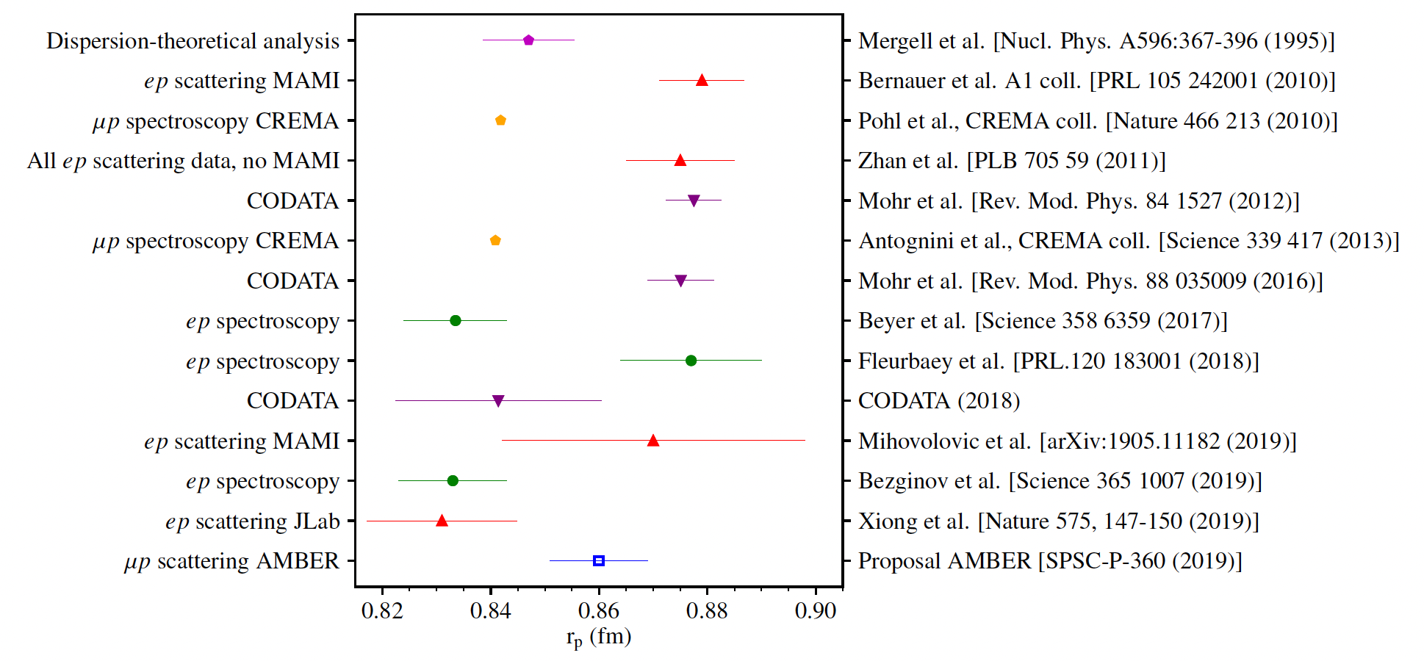
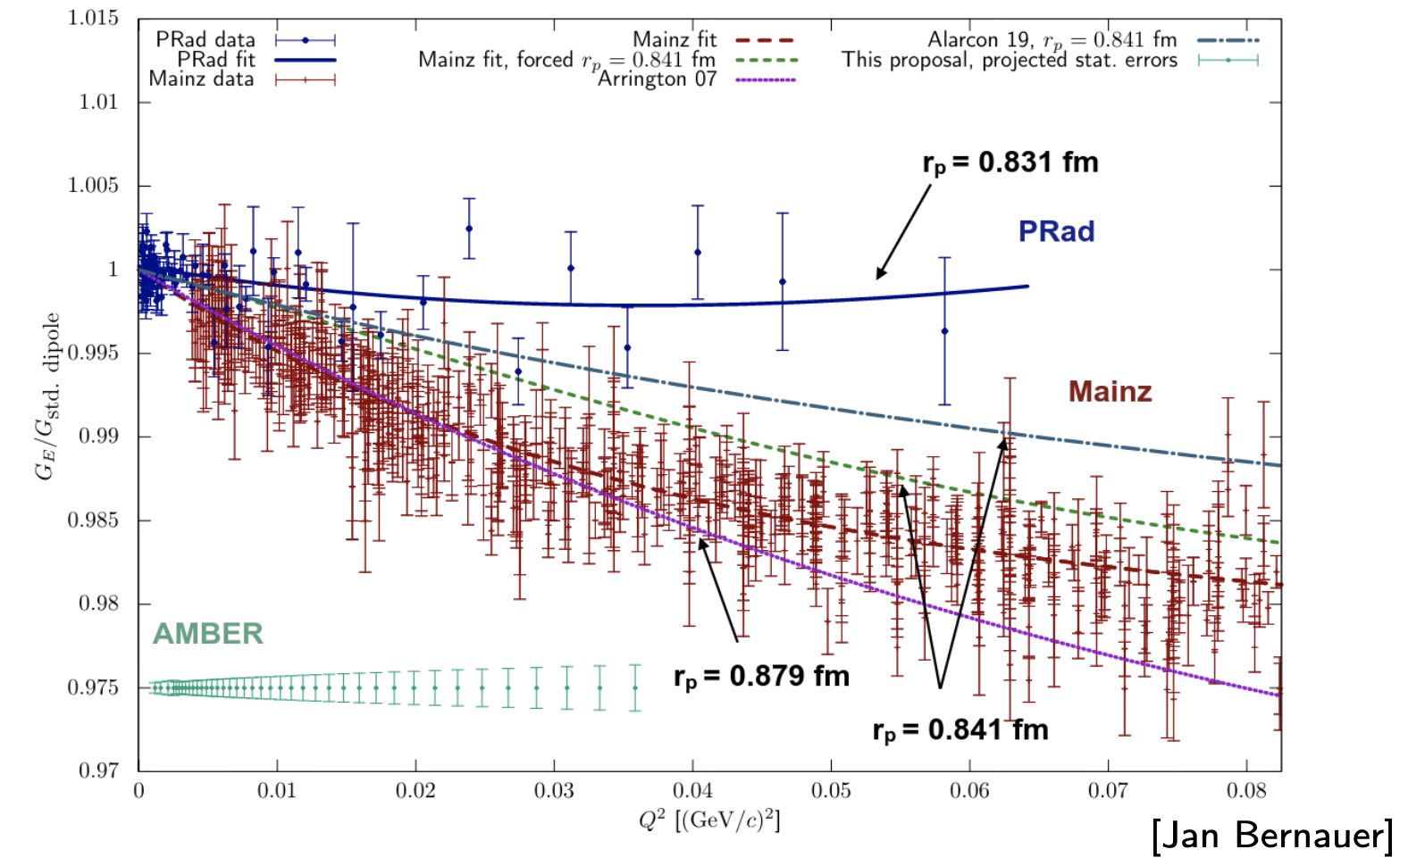
Proton Charge Radius
since the first measurement of the proton charge radius of about 0.8 fm (Hofstadter 1956), a wealth of measurements with different techniques have been done
the charge radius is defined as the slope of the electric form factor at vanishing momentum transfer
the most detailed information about the el-mgn form factors of hadrons can be collected in lepton scattering

Slide 3
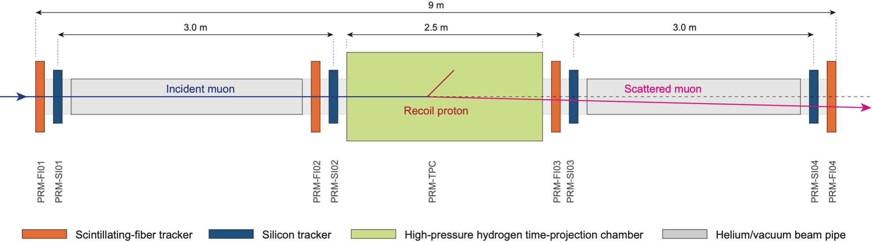
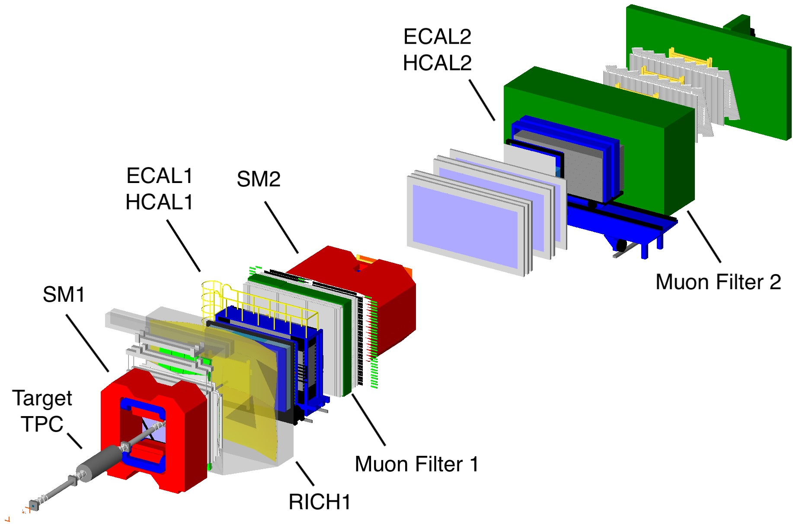
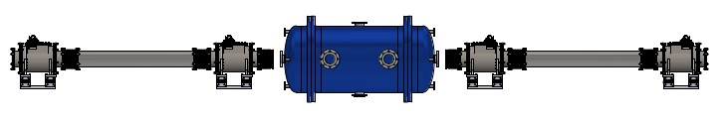
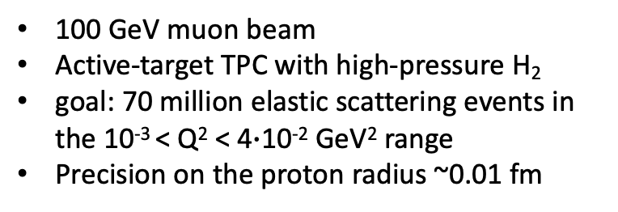
Proton Radius at AMBER
100 GeV muon beam
Active-target TPC with high-pressure H₂
goal: 70 million elastic scattering events in the 10⁻³ < Q² < 4$∙$10⁻² GeV² range
Precision on the proton radius ~0.01 fm
unexplored and presumably favourable territory of systematics: muon interaction with material and radiative corrections small
New device: Unified Tracking station

Slide 4
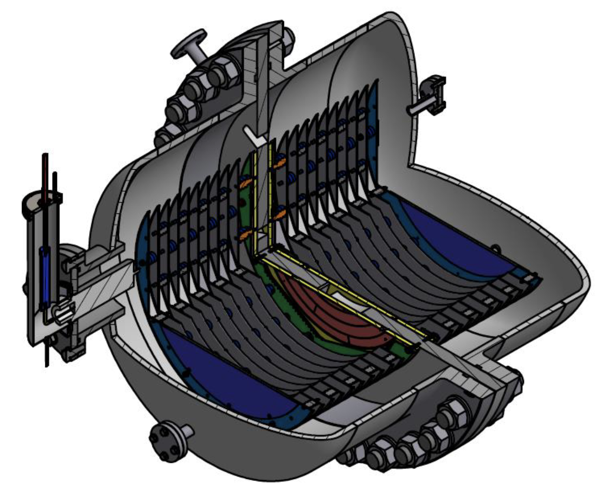
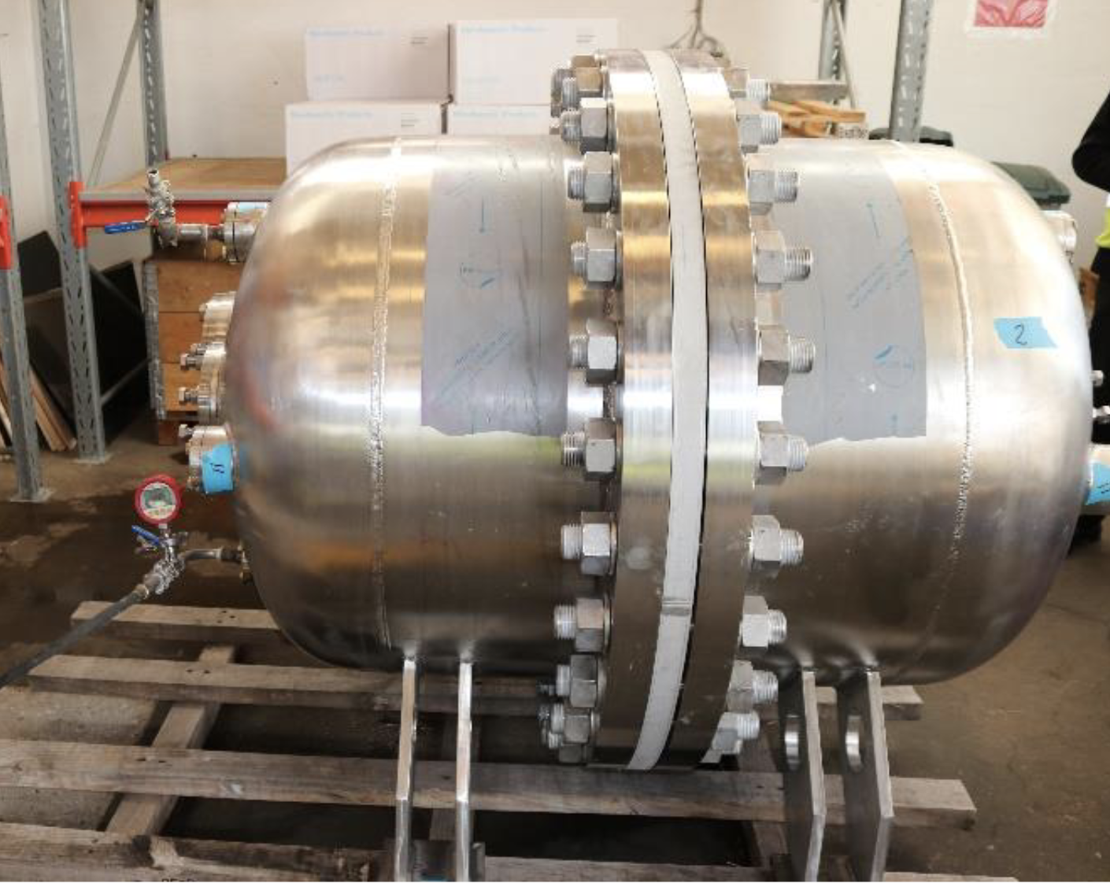
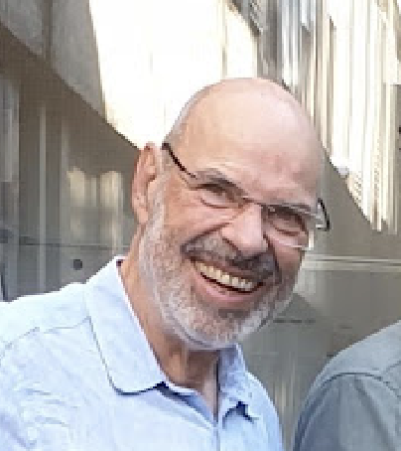
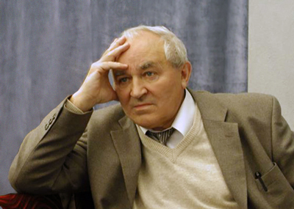
The active-target TPC
production in cooperation with GSI, coordination: Oleg Kiselev
Stephan Paul
Alexey Alexeevich Vorobyov 20.12.1931 – 2.11.2021

Slide 5
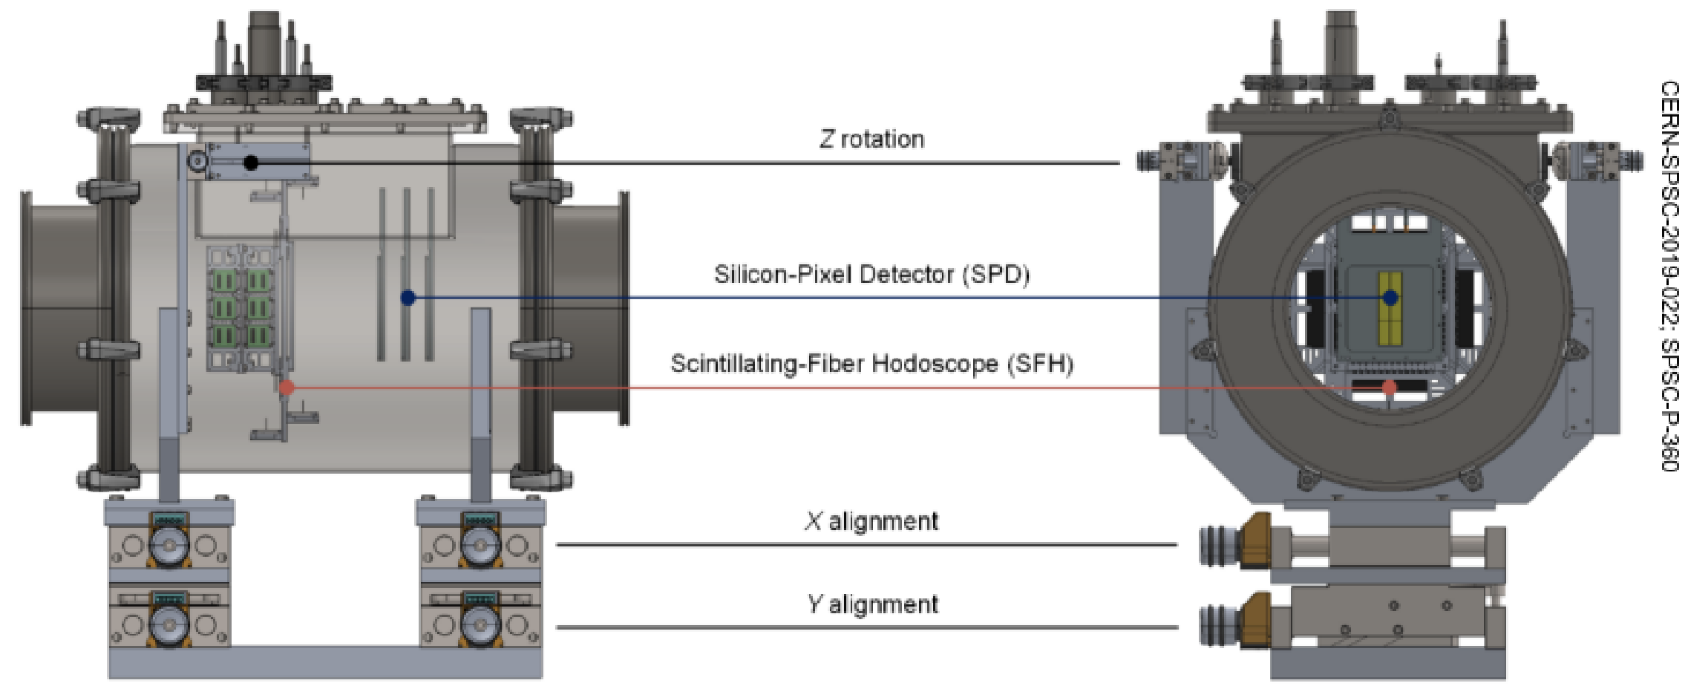
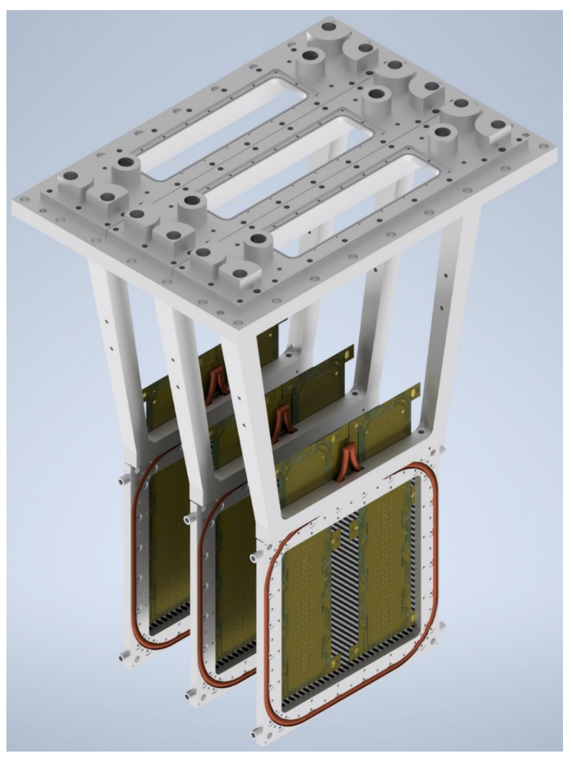
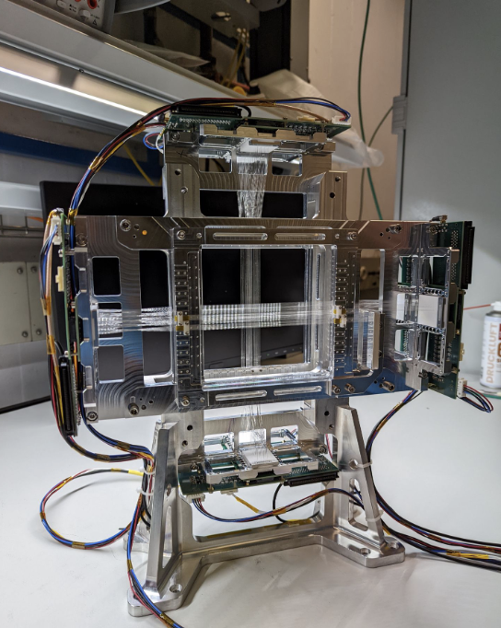
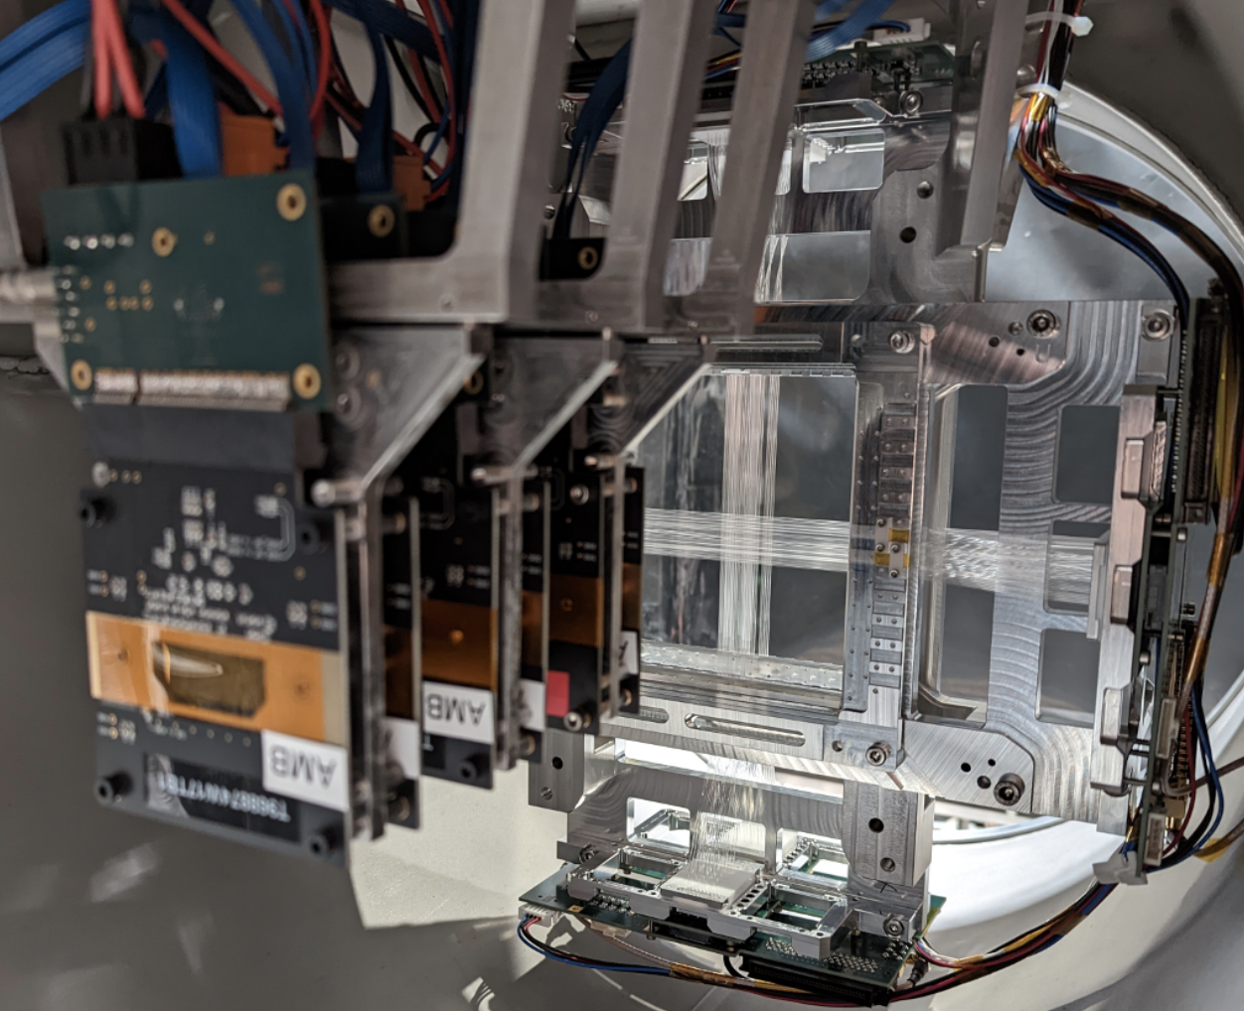
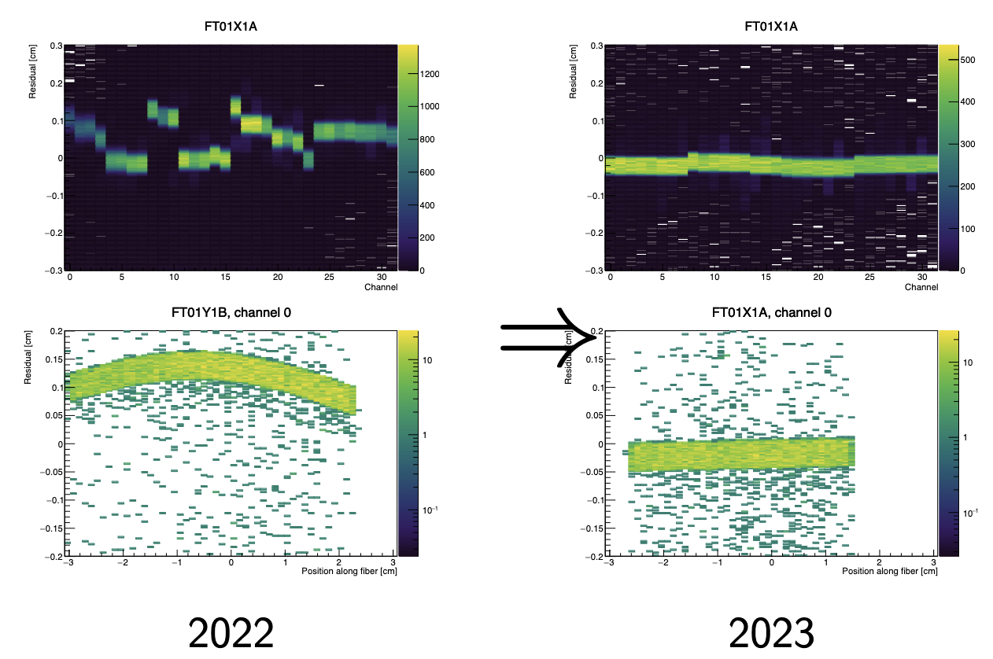
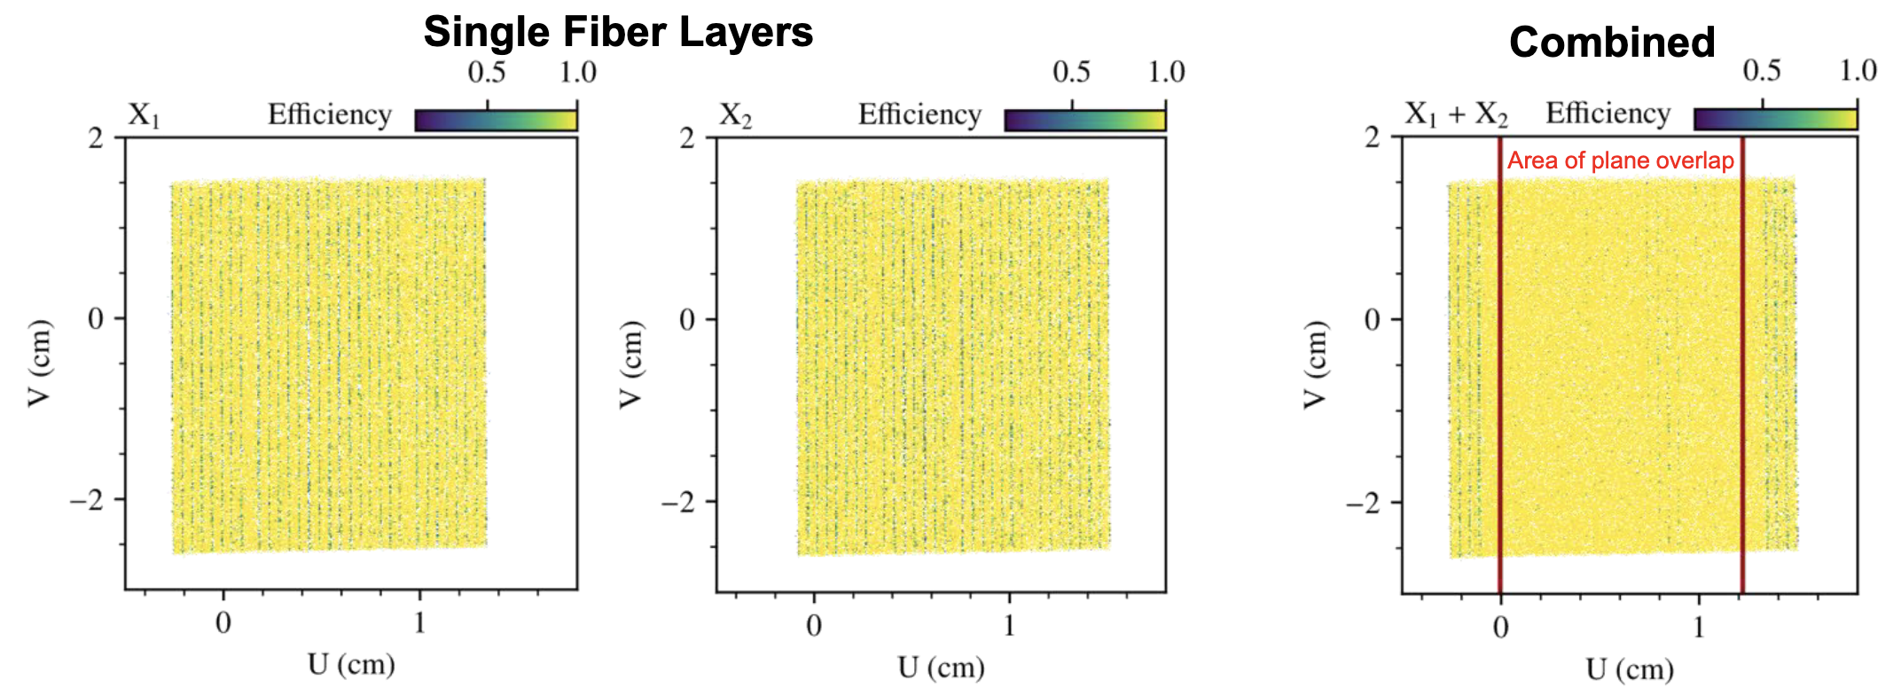
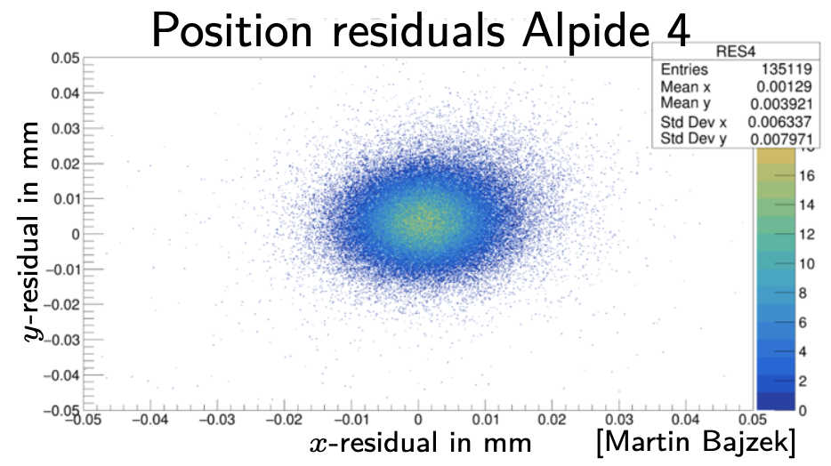
Highlights from test beams
results from tests in muon beam 2022

Slide 6
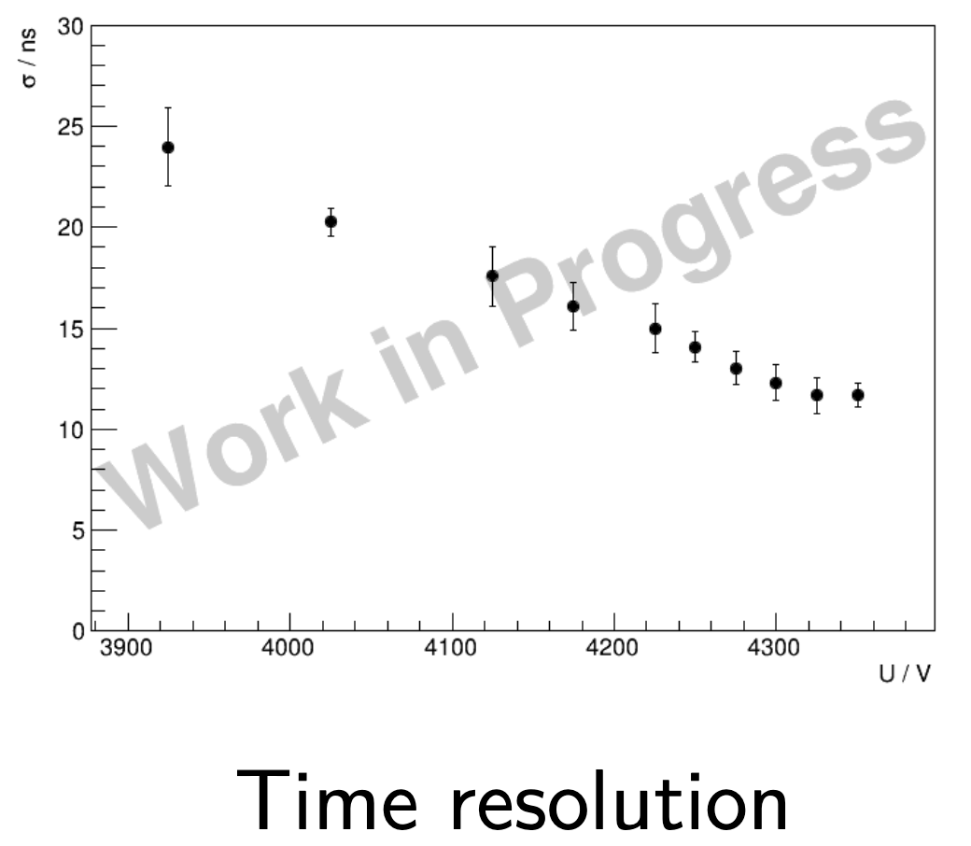
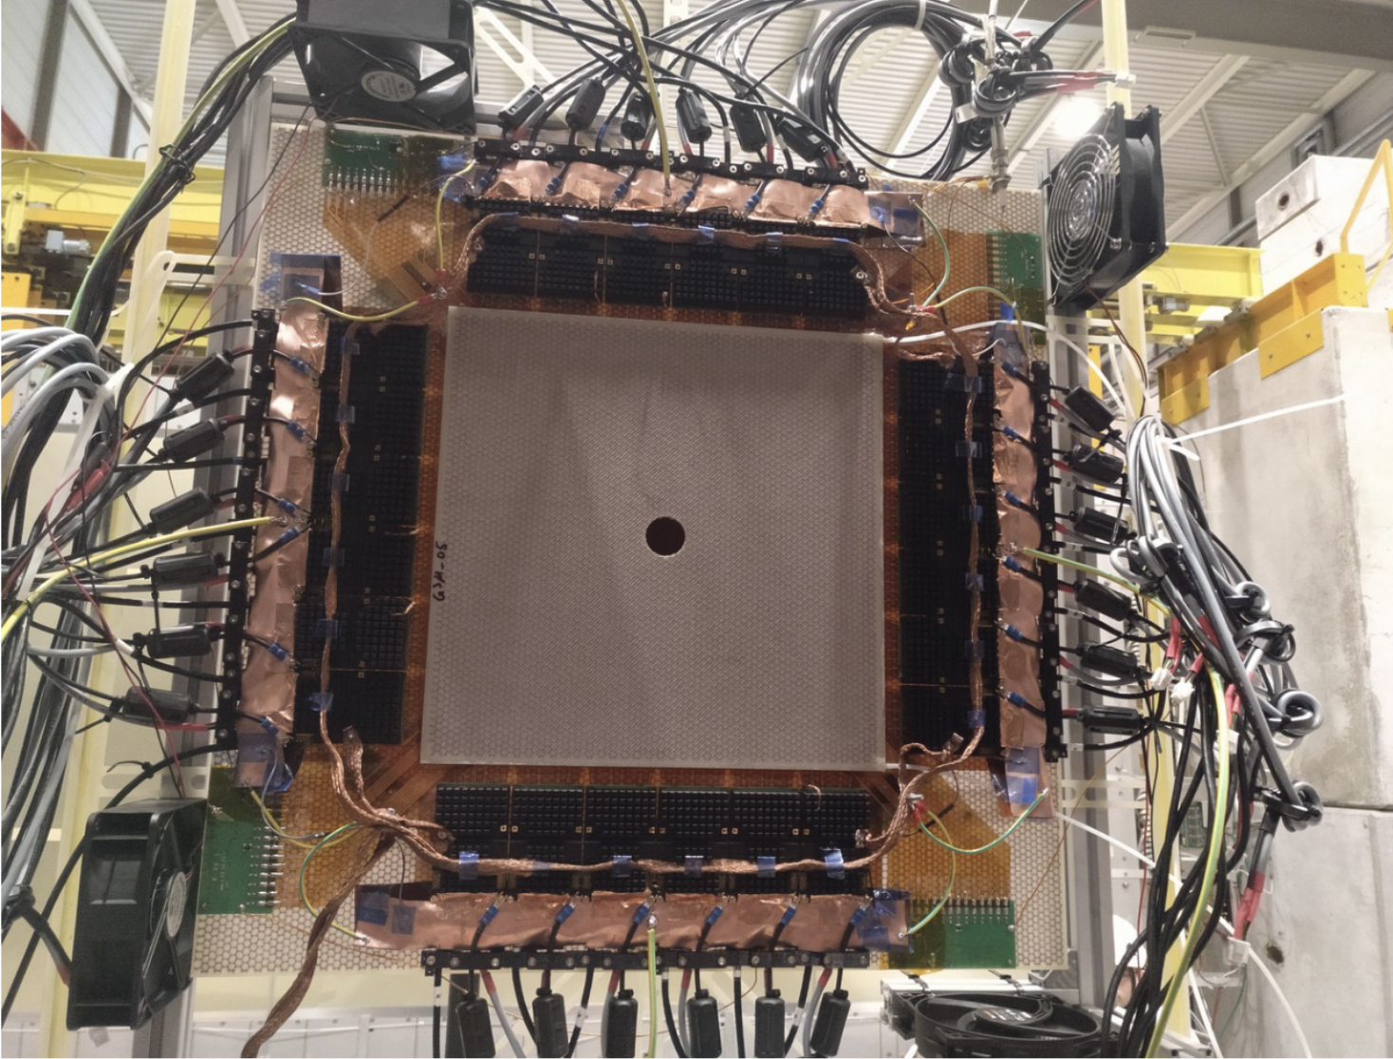
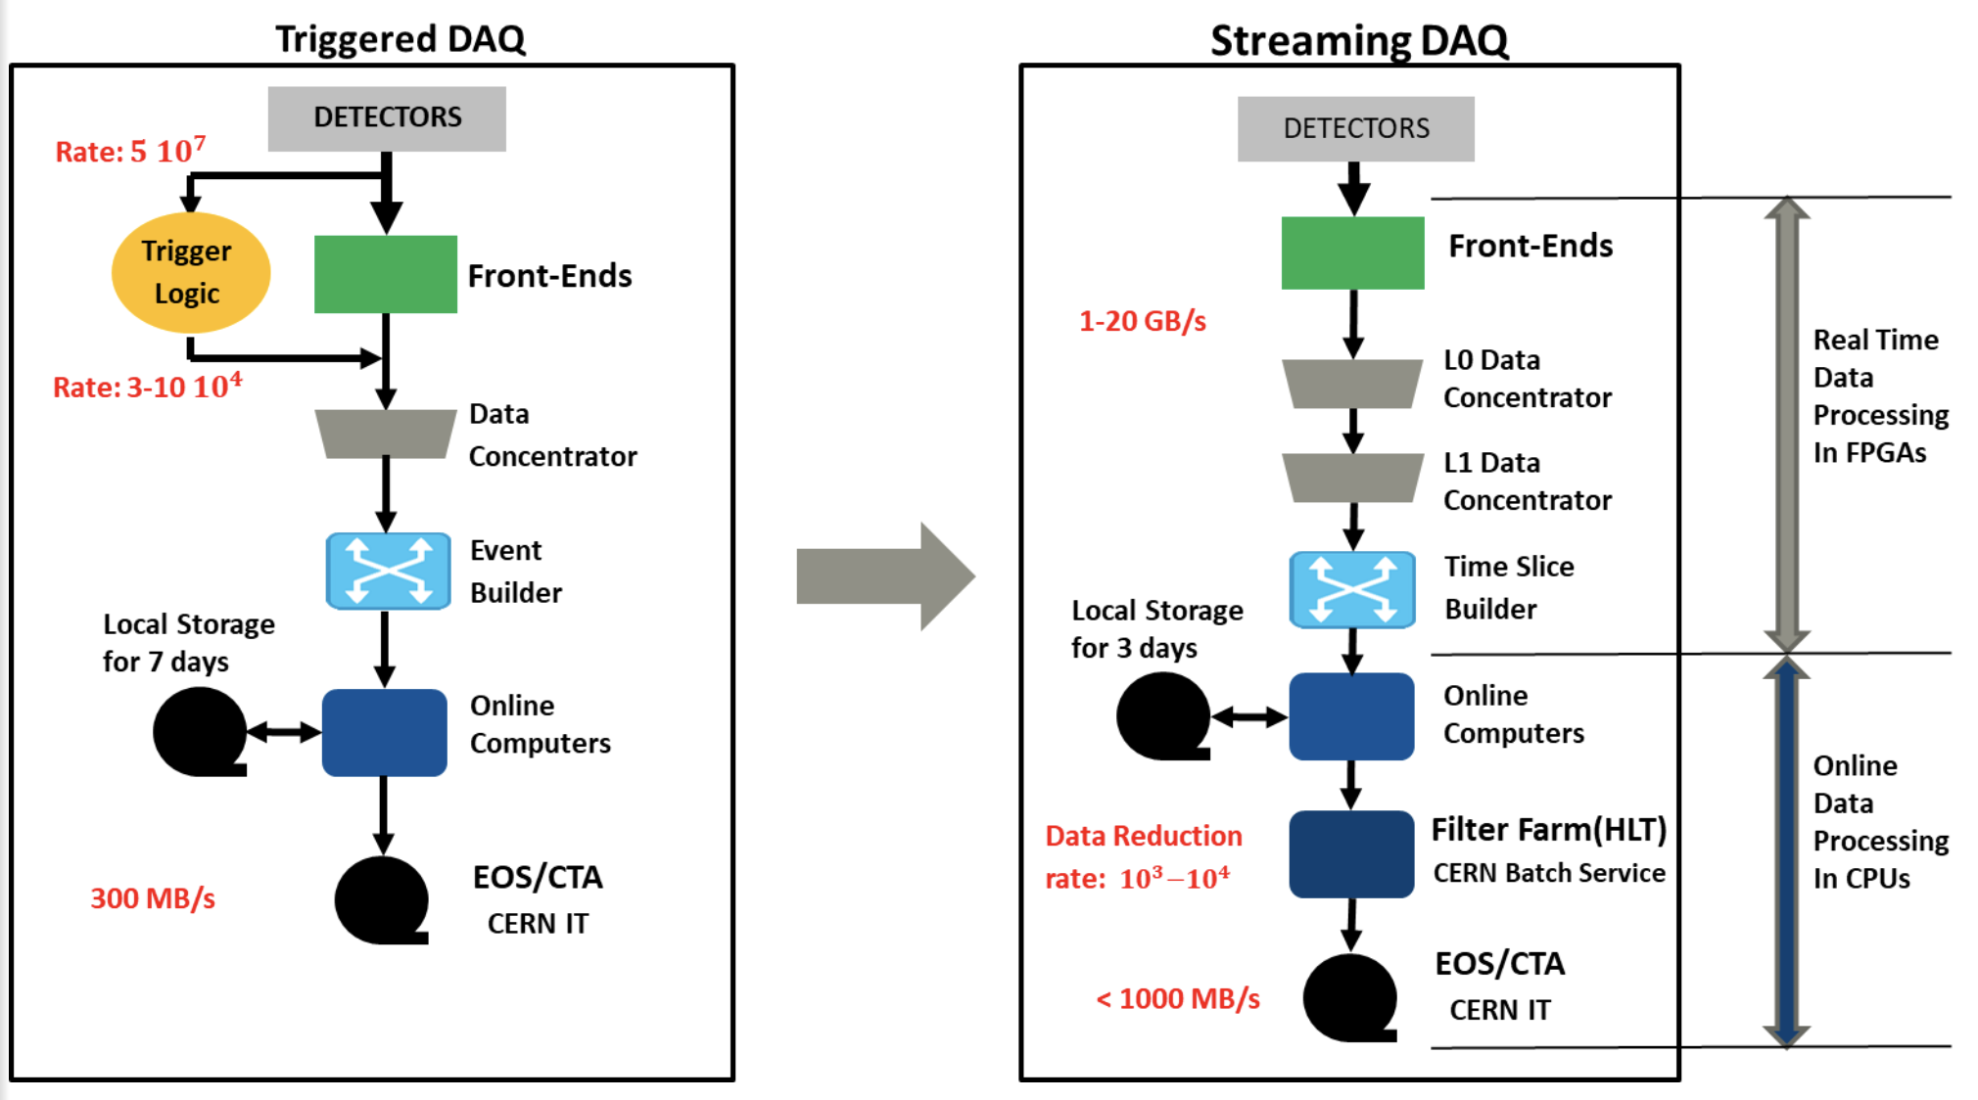
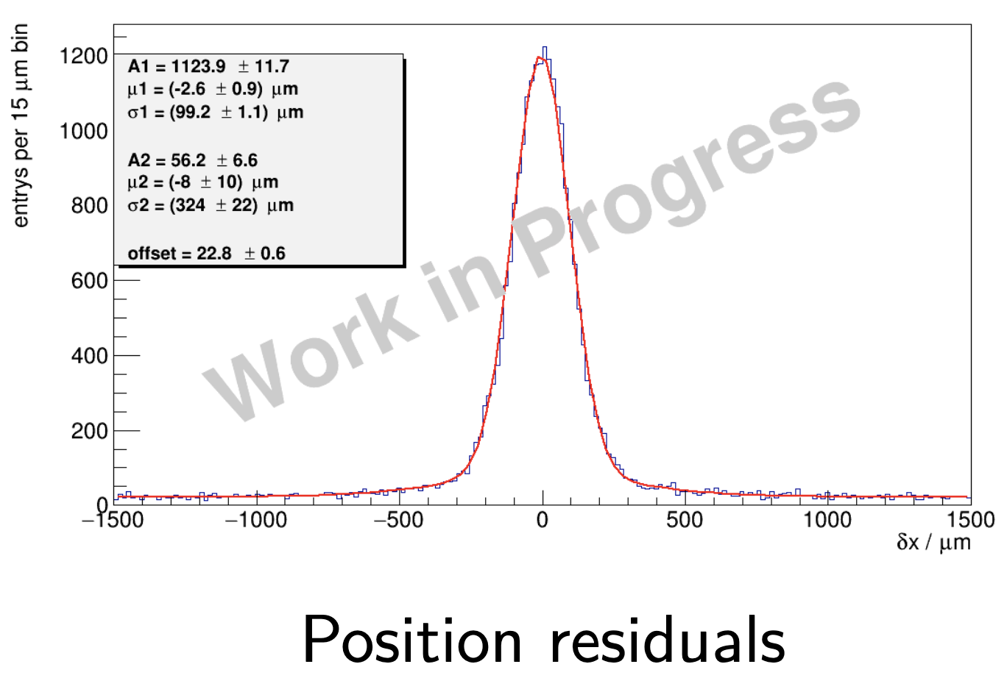
Highlights from test beams and plans
Test of new GEM detectors with VMM readout in the beam 2023
Implementation of the new streaming acquisition system FriDAQ
Many new components are planned to be realized in 2024, with challenging timelines,
aiming at PRM physics data taking in 2025

