Slide 1






MUSE - Status of proton radius measurement
Matt Nicol – University of South Carolina
18th March 2024
PAW24
Supported in parts by the U.S. National Science Foundation: NSF PHY-2111050 (USC).
The MUSE experiment is supported by the U.S. Department of Energy, the U.S. National Science Foundation, the Paul Scherrer Institute, and the US-Israel Binational Science Foundation

Slide 2
Contents
Proton radius puzzle
Overview of current and future experiments
Motivation for MUSE
MUSE experiment
Status of MUSE

Slide 3
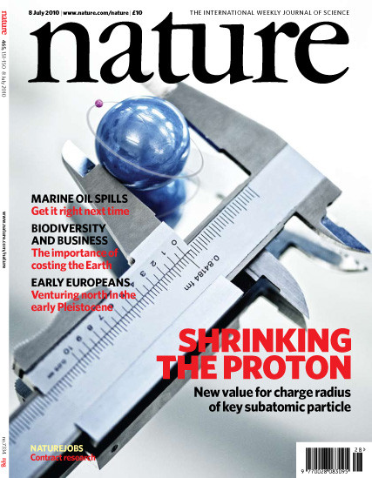
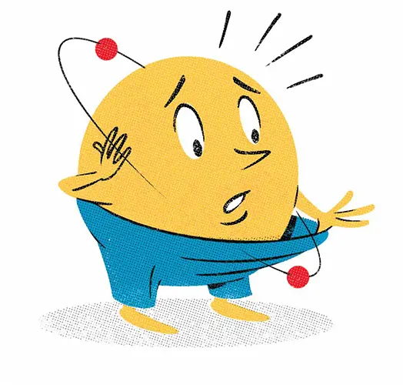

Proton Radius Puzzle
Discrepancy between radius measured by electrons and muons
Nature 466, 213 (2010)

Slide 4
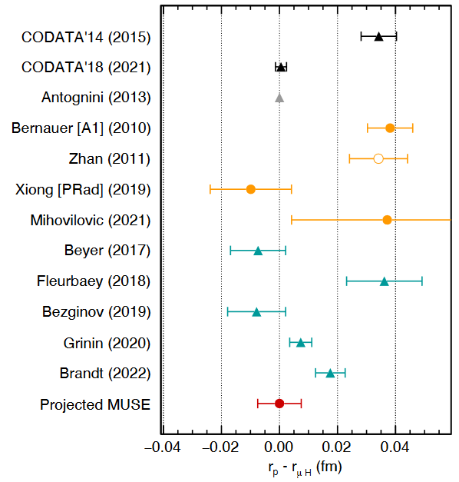
Proton Radius Puzzle
Inconsistent electron-scattering data
Inconsistent hydrogen-spectroscopy data
No adequate muon-scattering data yet

Slide 5
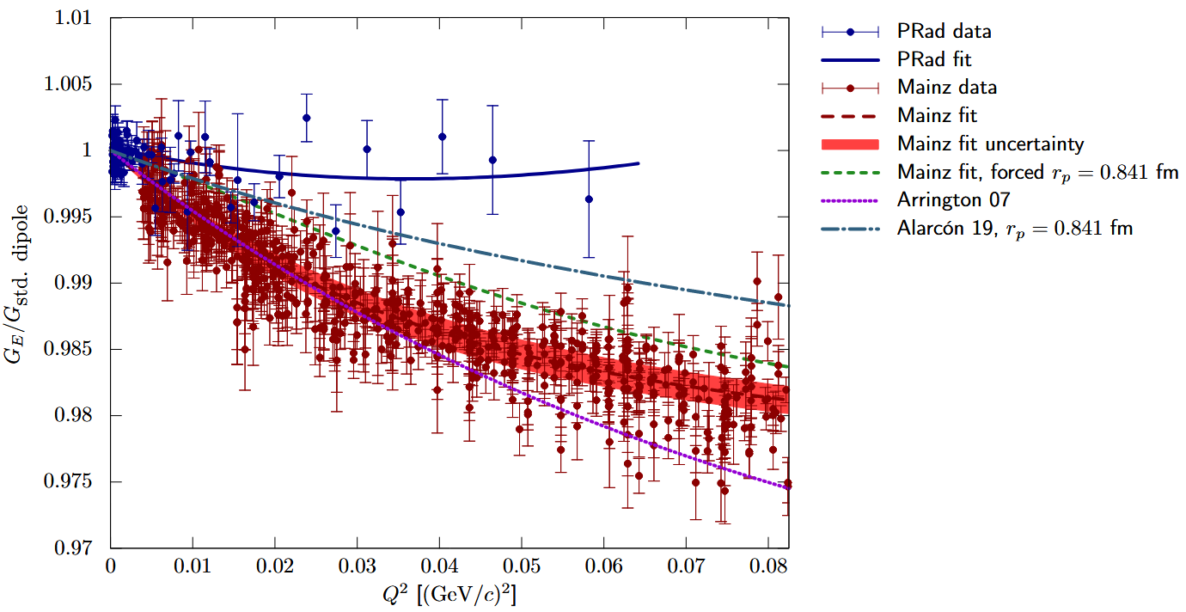
Update on scattering experiments
Why are form factors different for Prad?
Which result should be favoured and why?
Inaccurate radiative corrections?
Incorrect methodology?
Independent checks needed:
ISR, ULQ2, MUSE

Slide 6
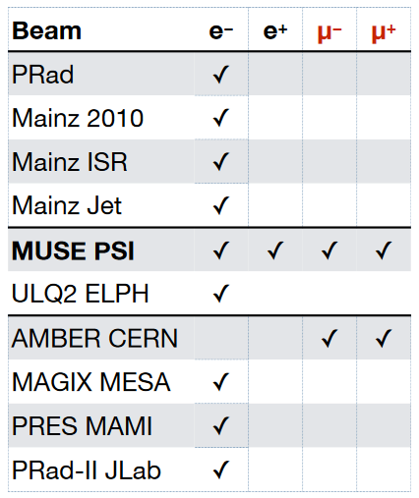
Update on scattering experiments
Many different scattering experiments underway and to come
MUSE is the only simultaneous electron- and muon-scattering experiment
MUSE is first muon-scattering experiment
  AMBER to follow soon
Data taken
Running
Future

Slide 7
MUSE – Accessing further physics
Lepton-universality
  Simultaneous electron and muon scattering experiment
  Comparison gives direct test of lepton non-universality
Radiative Corrections
  Muons have a mass approximately 200 times that of an electron
    Radiative effects are much smaller
  Comparing these results can provide a greater understanding of these effects
Two Photon Exchange
  Both polarities provide access to explore two-photon contributions
W. Xiong and C. Peng, ``Proton Electric Charge Radius from Lepton Scattering,’' Universe 9, no.4, 182
(2023), doi:10.3390/universe9040182, [arXiv:2302.13818 [nucl-ex]].

Slide 8
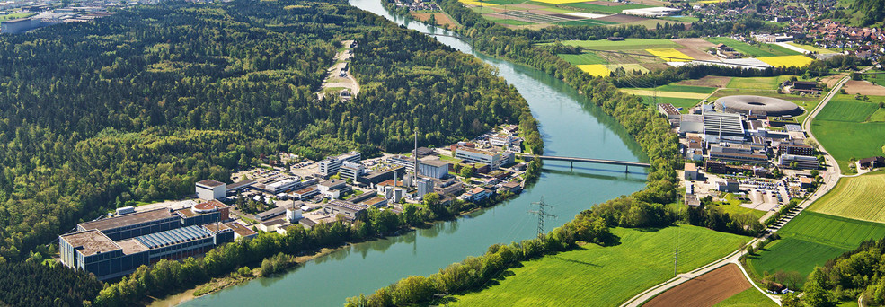
MUSE: MUon Scattering Experiment at PSI
The world’s most powerful low-energy separated p beam
Simultaneous, separated beam of (π⁻,e⁻,µ⁻) or (π⁺,e⁺,µ⁺) on liquid H₂ target
Beam momentum of 100 – 500 MeV available gives a broad low Q² range

Slide 9
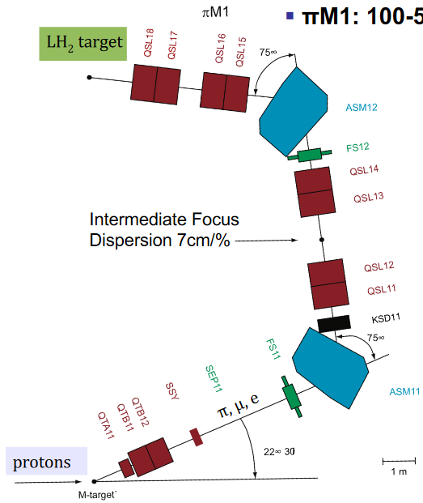
πM1 MUSE Beamline
Secondary beams of π,e,µ produced at M-target with 590 MeV protons
Beam properties well understood with TRANSPORT, TURTLE, and G4Beamline (E. Cline et al., PRC105, 055201 (2022))

Slide 10
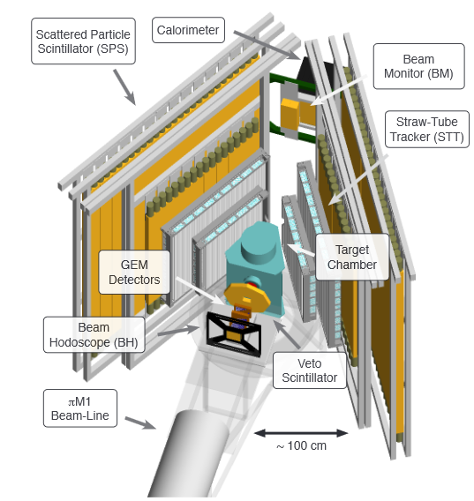
MUSE Experiment
Beam particle tracking
Liquid hydrogen target
Scattered lepton tracking
3.3 MHz total beam flux
  ≈ 2-15% μ’s
  ≈ 10-98% e’s
  ≈ 0-80% π’s
p = 115, 160, 210 MeV/c

Slide 11
MUSE Experiment
Beam particle tracking
Liquid hydrogen target
Scattered lepton tracking
Q² ≈ 0.002 - 0.07 GeV²
θ ≈ 20° - 100°
180° coverage in Ø

Slide 12
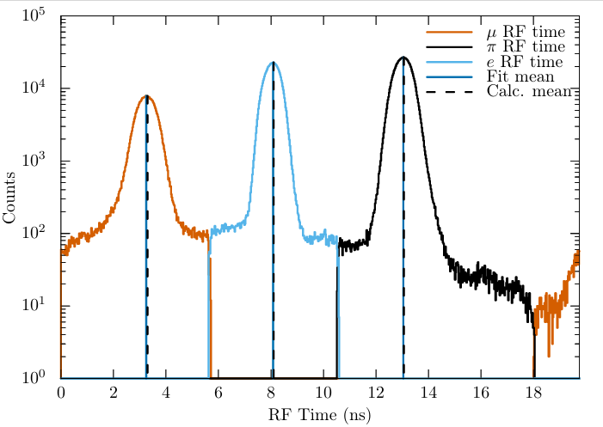
MUSE Experiment – Beam Particle Separation
π,e,µ beam particles separated by RF
RF of all planes, p = 160 MeV/c

Slide 13
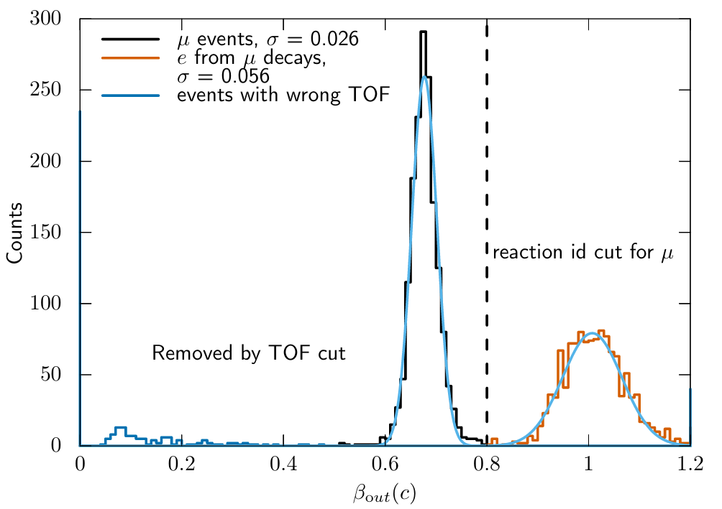
MUSE Experiment – Reaction Identification
Muons decay after identification in beamline detectors
Time of Flight used for reaction identification
Outgoing beta of particles identified as muons, p = +115 MeV/c

Slide 14
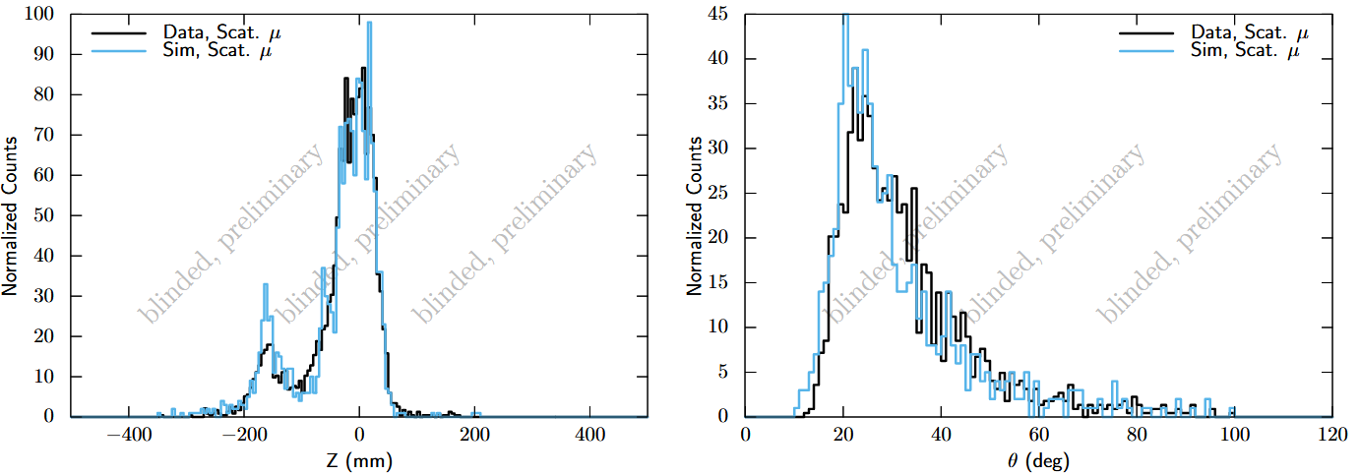
Muon scattering events
p = +115 MeV/c, Left: Reconstructed Z vertex, Right: Reconstructed angle

Slide 15
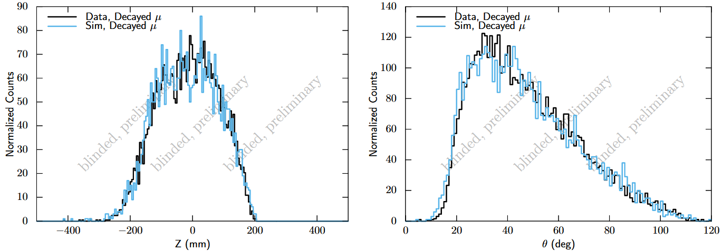
Muon decay events
p = +115 MeV/c, Left: Reconstructed Z vertex, Right: Reconstructed angle

Slide 16
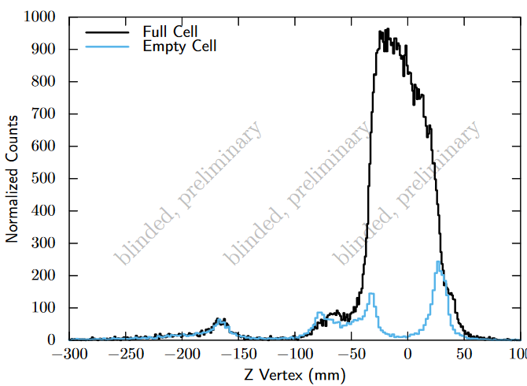
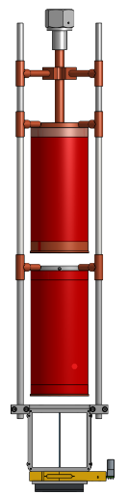
Vertex Reconstruction
Luminosity-normalised full and empty cells for 210 MeV/c π⁺ beam
Cell wall
Cell wall
Full cell
Empty cell
Aluminized mylar
Aluminized mylar
Entrance window
P. Roy et al., A Liquid Hydrogen Target for the MUSE Experiment at PSI, NIM A, 2019, https://doi.org/10.1016/j.nima.2019.162874

Slide 17
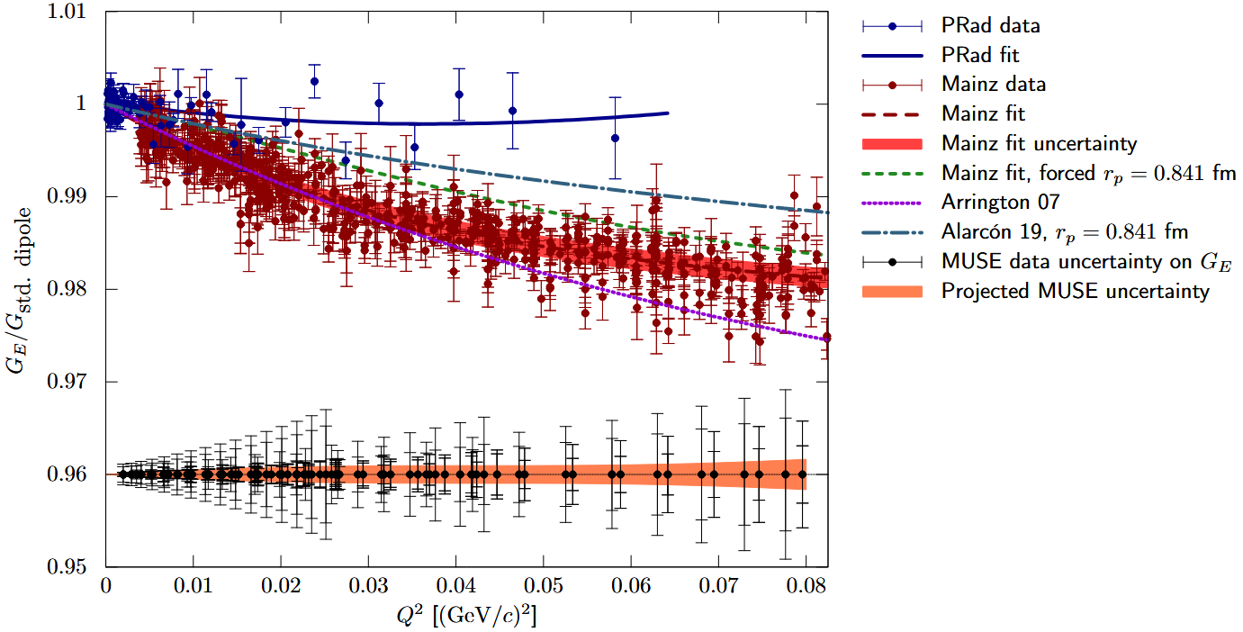
Anticipated results
Anticipated form factor uncertainty
E. Cline, et al., SciPost Phys. Proc. 5, 023(2021)

Slide 18

Status of MUSE
Currently taking data
  ~5 months beamtime allocation received this year
  2 years data taking left
Ongoing:
Extracting preliminary, blinded cross sections with good agreement to simulation within blinding
Future:
Calibrations and alignment
Simulations (radiative corrections, digitization, trigger)
Systematic errors

Slide 19
MUSE Publications
R. Gilman, E. J. Downie, G. Ron, et al.,Technical Design Report for the Paul Scherrer Institute Experiment, arXiv, 2017, https://doi.org/10.48550/arXiv.1709.09753
A. Liyanage, M. Kohl, J. Nazeer, T. Patel, Development of GEM Detectors at Hampton University, arXiv, 2018, https://doi.org/10.48550/arXiv.1803.00132
E.O. Cohen et al., Development of a scintillating-fiber beam detector for the MUSE experiment, NIM A, 2016, https://doi.org/10.1016/j.nima.2016.01.044
P. Roy et al., A Liquid Hydrogen Target for the MUSE Experiment at PSI, NIM A, 2019, https://doi.org/10.1016/j.nima.2019.162874
T. Rostomyan et al., Timing Detectors with SiPM read-out for the MUSE Experiment at PSI, NIM A, 2020, https://doi.org/10.1016/j.nima.2020.164801
E. Cline, J. Bernauer, E.J. Downie, R. Gilman, MUSE: The MUon Scattering Experiment, Review of Particle Physics at PSI, 2021, https://doi.org/10.21468/SciPostPhysProc.5
E. Cline et al., Characterization of Muon and Electron Beams in the Paul Scherrer Institute PiM1 Channel for the MUSE, Experiment, PRC 105, 055201 (2022); arXiv: 2109.09508, https://doi.org/10.1103/PhysRevC.105.055201
J.C. Bernauer et al., Blinding for precision scattering experiments: The MUSE approach as a case study, arXiv, 2023, https://doi.org/10.48550/arXiv.2310.11469

Slide 20
Conclusion
Proton radius puzzle still unsolved
Large variety of scattering experiments, e and µ
MUSE will play a crucial role in the proton radius puzzle
MUSE will expand our understanding in other areas
  Lepton universality
  Radiative corrections
  Two photon exchange

Slide 21
Thank You!

