Slide 1
The North-Area Consolidation project and its impact on physics in CERN's North Area
Y. Kadi, Physics at AMBER Int. Workshop, PAW’24, 20 March 2024

Slide 2
Overview
Project Roadmap until LS4
    Scope modification following CSSR’23
    Impact on Physics
Project Status:
    EVM KPIs, budget situation, Procurement Plan
    2023 Operation
    YETS/EYETS Planning & LS3 readiness
Summary

Slide 3
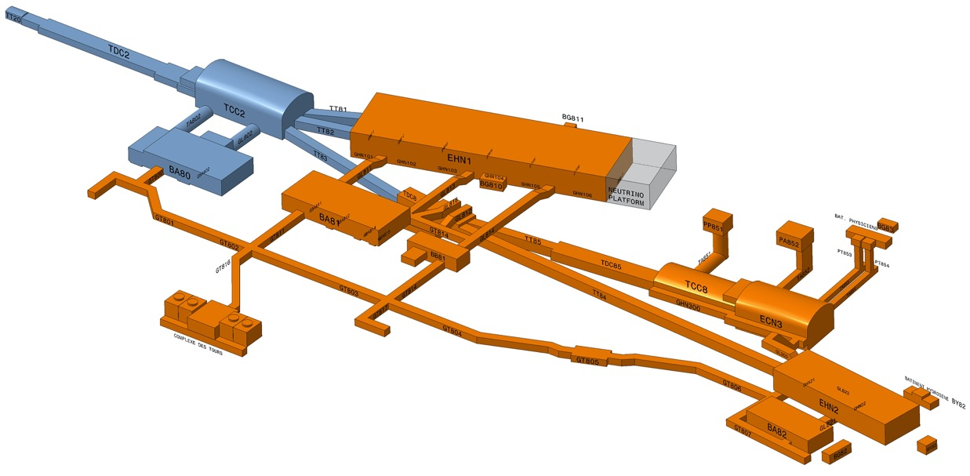
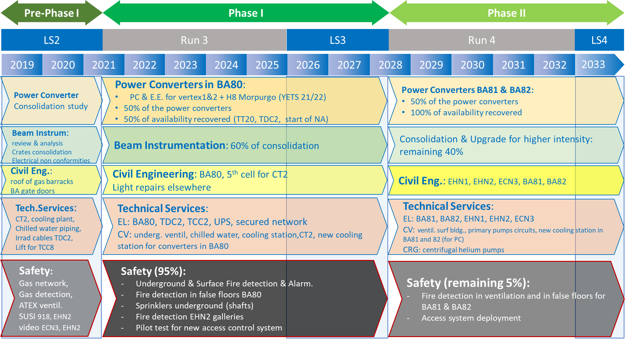
NA-CONS Scope/Roadmap
EDMS 2458866
Consolidation Phase 1:
2019 – 2028: primary areas (incl. BA2), BA80 & beamlines towards EHN1 & TDC8
Consolidation Phase 2:
2029 – 2034: BA81, BA82, EHN1, EHN2 & associated beamlines

Slide 4
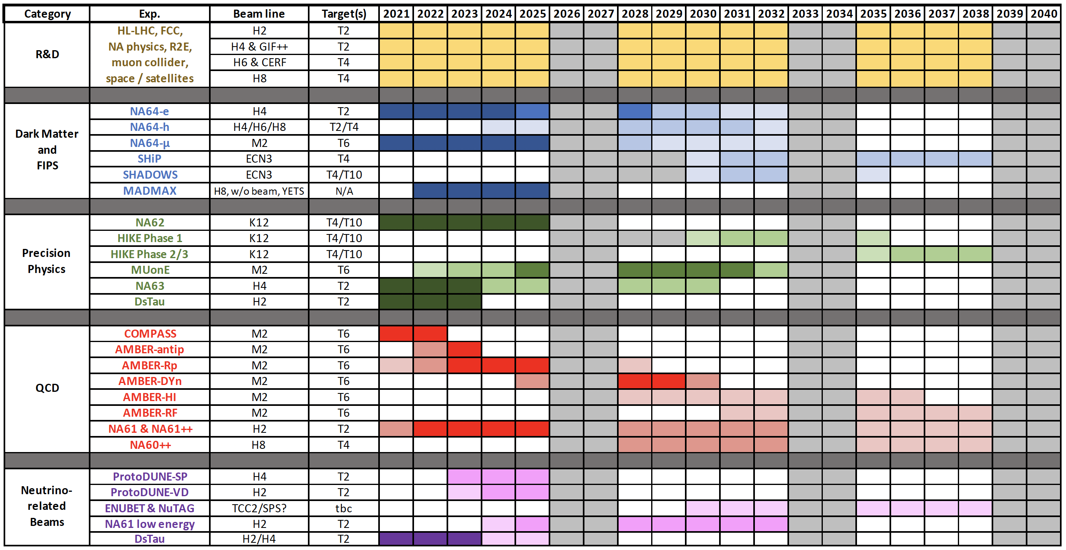
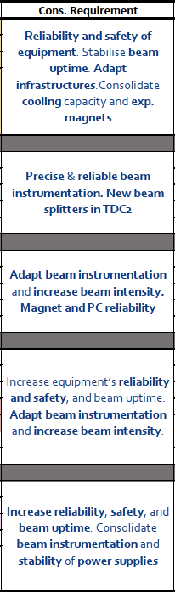
Experimental Timelines
Increase beam intensity

Slide 5
NA-CONS -> ECN3 Intensity Upgrade
Consolidation Phase 1:
2019 – 2028: primary areas (incl. BA2), BA80 & beamlines towards EHN1 & TDC8
  TCC2/P42: Intensity upgrade options (for all experiments)
  BI, BIDs, Vacuum, shielding
  TCC8/ECN3: Experiment specific:
  Beam Dump Facility
  HI Target Complex
  Related Infr. & Services
  Beam Areas concerned with the upgrade of ECN3 to a high intensity facility
  SHiP
Consolidation Phase 2:
2029 – 2034: BA81, BA82, EHN1, EHN2 & associated beamlines

Slide 6
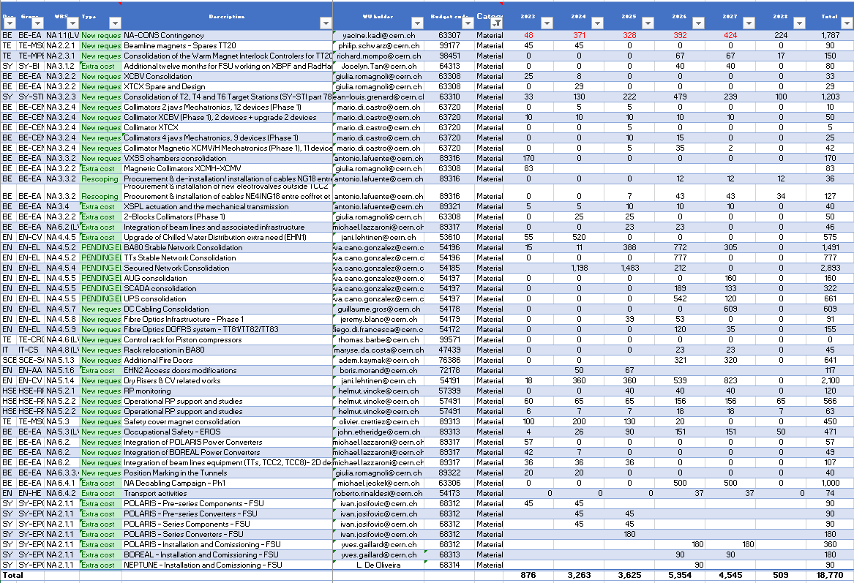
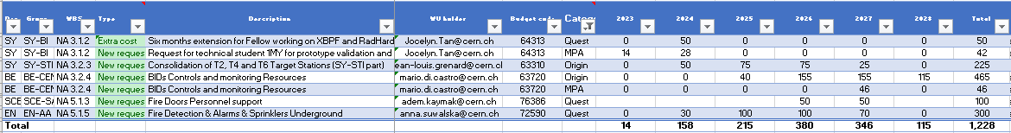
Approved Requests from Modified Scope – MTP 2023
Beam Delivery:
- Power Converters
- Magnets & Interlock
Beamline Engineering:
- Beam Instrumentation
- Beam Intercepting Devices
- Survey & Alignment
Infrastructure & Services
Safety

Slide 7
Impact of HI-ECN3 on NA-CONS Systems 1/2
7

Slide 8
NA-CONS Phase 2
No | Classification for MTP document | Sector/Unit | Department | sub-PPA | Project Name/ Operation | Type of Budget | Request short description | Request Justification / Comments | Dep's Priority | Internal Request Status (Approved by) | Contact People | Reference / Documentation | Already requested in MTP 2022 and not approved | 2023 | 2024 | 2025 | 2026 | 2027 | 2028 | 2029 | 2030 | 2031 | 2032 | 2033 | Total 2023 - 2033 [kCHF] | Total 2023 - 2028 [kCHF] | Total 2024 - 2033 [kCHF] | Total 2024 - 2028 [kCHF] | Total 2023-2024 [kCHF]
1 | MTP Funding Request | ATS | BE | ACS-NA | NA-CONS | Materials | NA-CONS Phase 1 | Bottom up from the CSSR 2023 -> 54.9MCHF. After prioritization and optimization: -15.7MCHF for HI-ECN3 (included in HI-ECN3 MTP request), -20.3MCHF postponed post LS3 (included in NA-CONS Phase2 MTP request) =17.7 MCHF (6.3MCHF for EL-CONS + 3.2MCHF for extra cost + 8.2MCHF for new requests) + 1.2MCHF included in the NA-CONS Phase 1 Grad MTP request) |  |  | Yacine Kadi | CSSR presentation available |  | 876 | 4'263 | 2'625 | 5'954 | 4'545 | 509 |  |  |  |  |  | 18772 | 18772 | 17896 | 17896 | 5139
2 | MTP Funding Request | ATS | BE | ACS-NA | NA-CONS | Grad | NA-CONS Phase 1 | See comment on MTP request NA-CONS Phase 1 Materials |  |  | Yacine Kadi | CSSR presentation available |  | 14 | 158 | 215 | 380 | 346 | 115 |  |  |  |  |  | 1228 | 1228 | 1214 | 1214 | 172
4 | MTP Funding Request | ATS | BE | ACS-NA | NA-CONS | Materials | NA-CONS Phase 2 | Bottom up from the PAR 2021. The NA-CONS Phase 2 extending up to LS4 is mandatory to adress all issues and reap the full benefits of the NA consolidation and ECN3 upgrade program. Including EL-CONS Phase 2 (NA Stable network 10MCHF) |  |  | Yacine Kadi |  |  |  |  |  |  |  | 1'600 | 4'000 | 8'000 | 16'800 | 20'000 | 29'600 | 80000 | 1600 | 80000 | 1600 | 0
Initial budget allocation of 65 MCHF approved at MTP 2023
Scope & Schedule to be reviewed next CSR in 2025

Slide 9
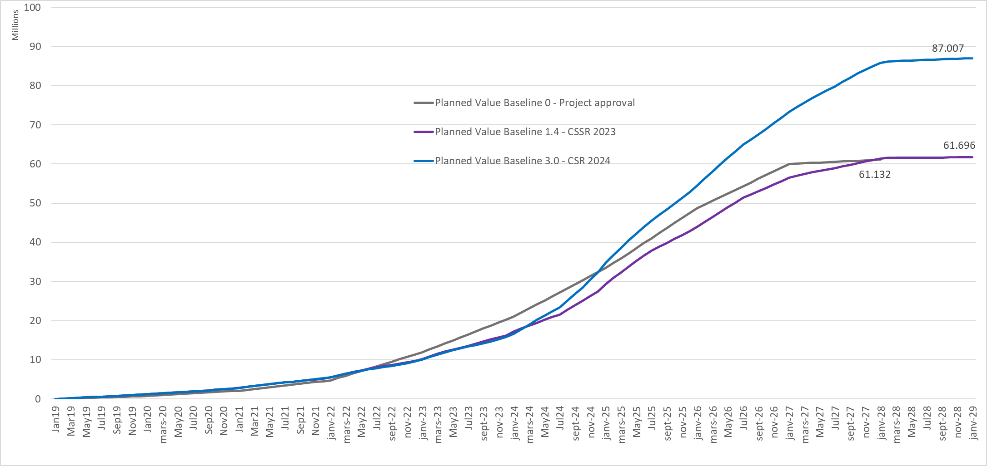
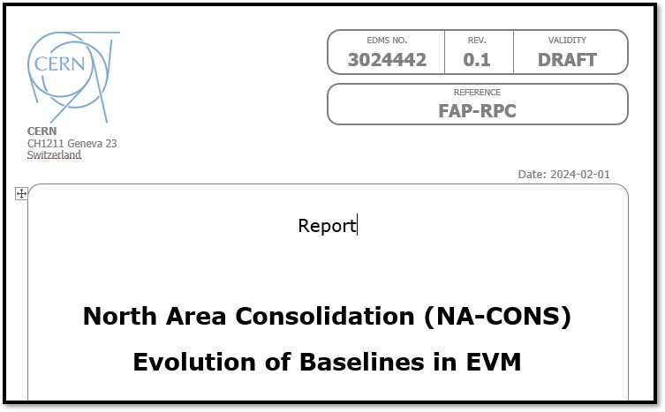
Baseline evolution – Phase 1
9

Slide 10
Overview
Project Roadmap until LS4
    Scope modification following CSSR’23
    Impact of HI-ECN3
Project Status:
    EVM KPIs, budget situation, Procurement Plan
    2023 Operation
    YETS/EYETS Planning & LS3 readiness
Summary

Slide 11
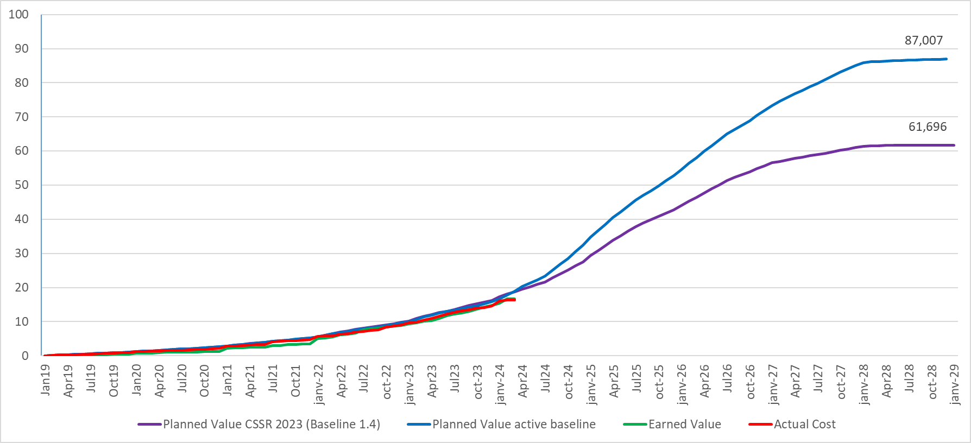
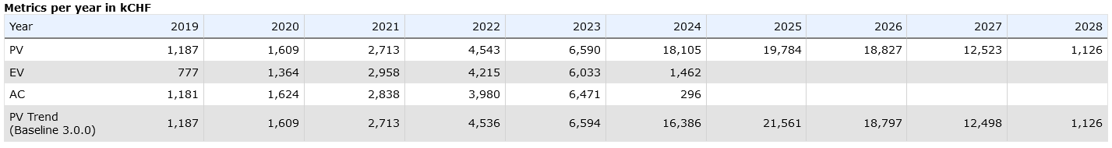
Project EVM Situation – Baseline 3.0
Data 01.02.2024 :
PV CSSR 2023 | 18,034
PV active baseline | 17,795
EV | 16,624
AC | 16,381
Cost variance
 |  | in kCHF
 |  | 243
Schedule variance
 |  | in kCHF | in month
Active baseline |  | -1,171 | -1.1
CSSR 2023 baseline |  | -1,410 | -1.7
Power Converters 7.3 MCHF
EL 2.2 MCHF
Fire Safety 2.0 MCHF
BIDs 1.1 MCHF
Magnets/Interlock 0.8 MCHF
Beam Instrumentation 0.8 MCHF
CV 0.5 MCHF
Others 3.4 MCHF

Slide 12
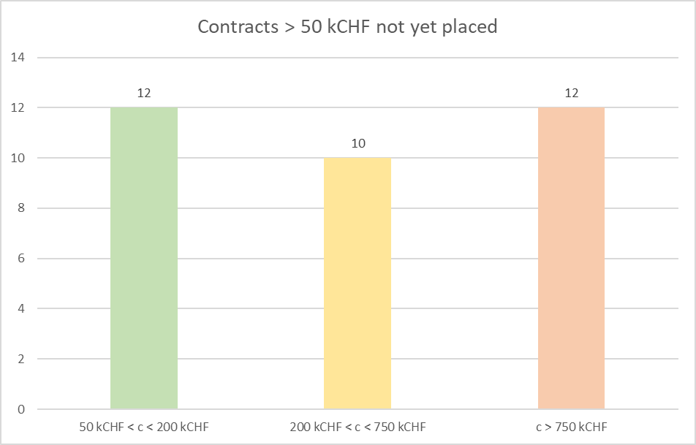
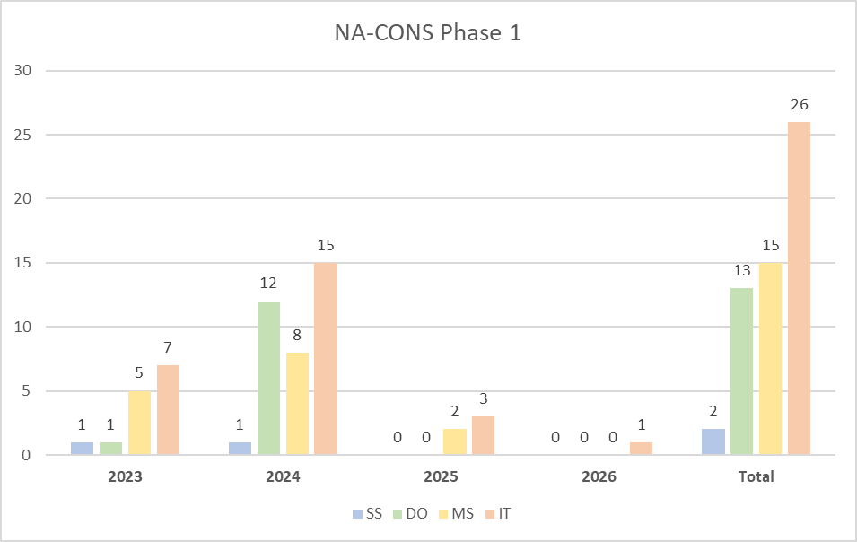
Procurement Outlook 2024-26
Intense procurement activities expected for the next 15 months (in competition with HL-LHC!).
Cases can slightly shift wrt today’s baseline scenario.

Slide 13
2023 Operation
Proton Run
Ion Run
CEDAR Issues (AMBER run)
Cryogenics issue on NA61 VERTEX spectrometer
MSN fire in TCC2
A VXSS vacuum chamber downstream the T4 target was found obstructing the beam ahead of operation. Its removal had a profoundly positive impact on long standing issues, such as a better beam spot on the T10 target and restoration of electron beam quality in the H8 and H6 lines.
The TOP 3 faults of 2023 were issues with the CEDAR beam instrumentation, cryogenics operation of the NA61 VTX magnets, and a fire of an MSN magnet in TCC2.
A control issue with the NA power converters did not cause significant downtime, but clearly impacted operation for weeks and is not yet resolved.

Slide 14
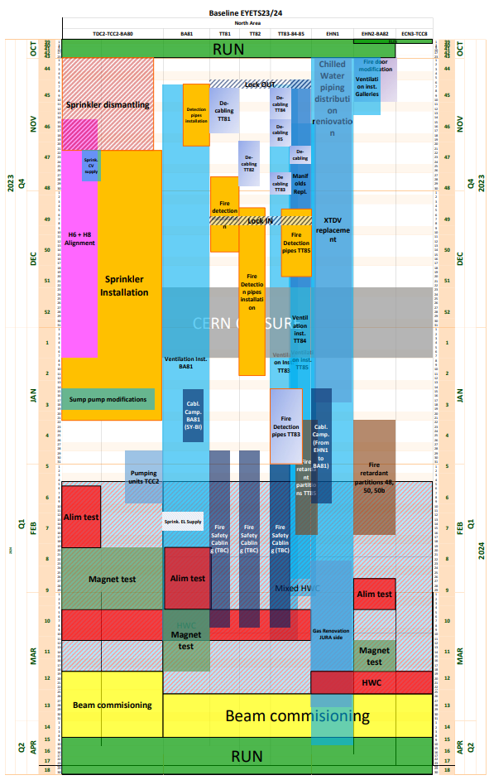
EYETS23-24 activities – Linear Planning
Red arrows highlight the shift (delays* (welding, scaffolding, resources availability), re-schedule, postponed) in activities from baseline planning:
Current status of delayed activities (13.03.24)
On-going activities:
Fire retardant partitions – BA81-EHN1 & EHN2/GHN2 → on-going, delayed by 3 weeks for BA81/EHN1, completion foreseen for EHN2/GHN2 → Installation is finished wk10. EN-CV & SCE-SAM – Interlock discussion on-going
Fire safety cabling → on-going, WSS will check and revert
Rad-hard proto installation → ongoing, completion foreseen in wk11
Ventilation underground TT83-TT85 → ongoing, underground works are finished, completion foreseen wk11
EHN1 Gas extraction EN-CV →began on wk12
EHN1 chilled water distribution works → ongoing and progressing well more manpower
Installation of ventilation galleries EHN2/GHN2 → ongoing, commissioning next week 11 without lights (supply issues)
Critical Activity:
Fire doors for BA81-EHN1 → delay of 3 weeks, door installed with no insulation, impact to be evaluated, informed Filipa
Chilled water distribution EHN1 → ongoing, close monitoring, mitigation measures identified with BE-EA physicists
Completed Activity:
Fire detection BA81-TT81-TT85 – partial works (electrical components installation)
Replacement of manifolds TT84
H6-H8 alignment (to be updated in PLAN)
DC interconnections
De-cabling campaign TT81-TT85
Cabling campaign – BA81—EHN1
Cabling safety trays installation – BA81-TT81-TT82 zone
NA supports inspection
DC cabling samples collection for aging assessment
Repl. of PLCs & NG18 patch panels
Fire sprinkler underground BA80 zone – sprinkler is operational now
Consolidation of pumping units TCC2
XTDV replacement EHN1
Collimator consolidation 2 block & 4 block
Postponed RUN2024/EYETS24/25:
XTDV 2 tables – EHN1, - partially
Gas mixing area Jura side EHN1,
Exchange micro-coll TT82,
Consolidation of pumping units – BA81-TT83-TT85
Fire Sprinkler underground installation BA80 – partially
Fire detection BA81-TT81-85 – partially
[SURVEY] Failing and non-adapted supporting systems and jacks
Geodetic and network measurements - extended
XCBV replacement
Underground ventilation TT83-TT85 – extended
PLCs & NG18 patch panels replacement – extended
DSO tests completed
BA80 & BA81 zone close → 15.03.24
I. Angulo & F.Pedrosa (EN-ACE)
20th March 2024
Y. Kadi | NA-CONS Project Status Report | PAW’24
14

Slide 15
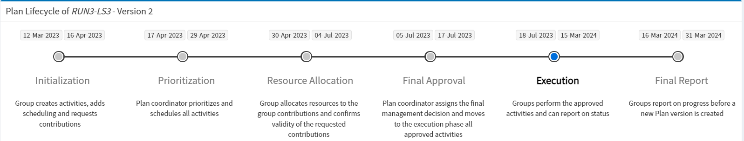
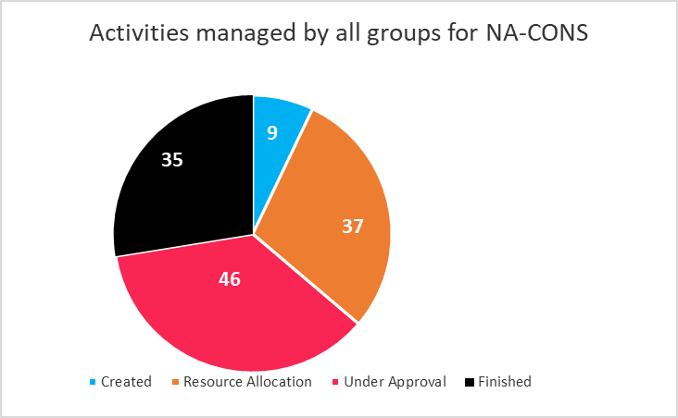
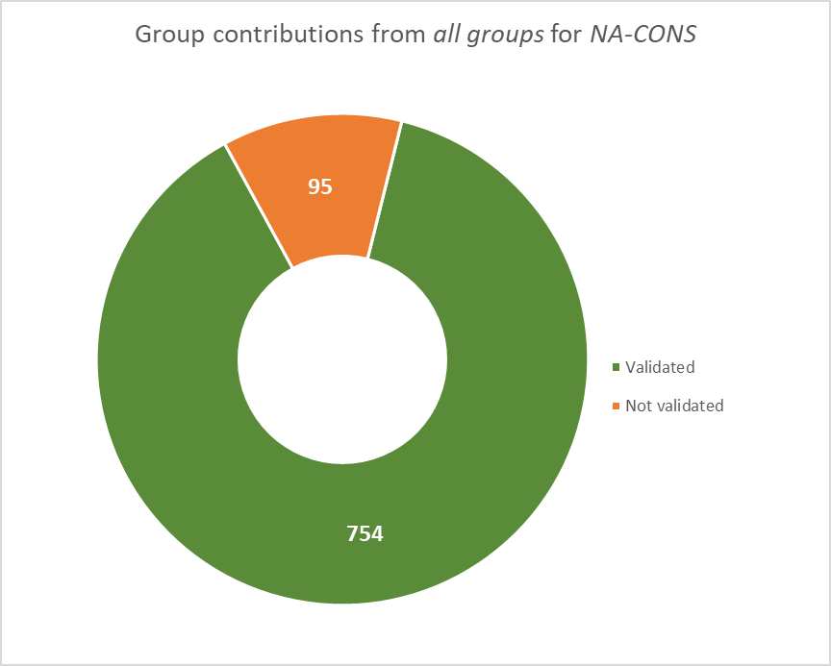
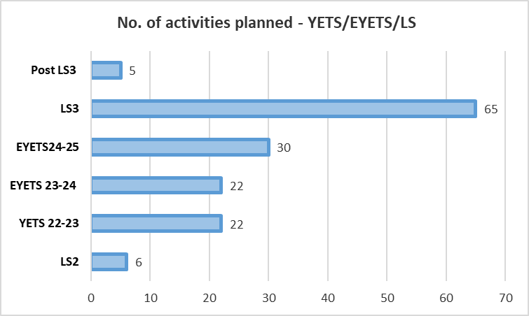
PLAN tool (version2)- Dashboard (13.03.24)
PLAN - RUN3-LS3- Version 2 tool in the execution phase
NA-CONS activities overview for RUN3-LS3
Contributions requested for NA-CONS activities RUN3-LS3
Activities foreseen for EYETS/LS
(+2)
(+4)
(+8)
(+3)
(-5)
4 activities declared finished
(-4)
Total number of activities in PLAN: 125
Current activities in PLAN: 94
Finished: 31
2 new activities created : Awaiting MTP approval
Activity 13869 - New XCET gas control systems (10 pieces) consolidation
Activity 13868 - New XCET gas panels (10 pieces) consolidation
Plots will evolve with updates in the PLAN tool.
No. of activities postponed/extended:
YETS22/23→YETS23/24 : 8
EYETS23/24 → EYETS24/25 :12
BE-EA – 7, EN-AA – 1, BE-GM – 2, TE-VSC -1, EN-CV -1
Total no. of contributions: 849
Validated contributions: 753(89%)
Pending contributions: 95
Groups to update the status of NA-CONS activities in the PLAN tool version-2 for EYETS23-24.
Further to update in PLAN tool version -3 before the end of the “Initialization” stage (31st March 2024)
Plan : Dashboard (cern.ch)
https://plananalytics.web.cern.ch/
20th March 2024
Y. Kadi | NA-CONS Project Status Report | PAW’24
15

Slide 16
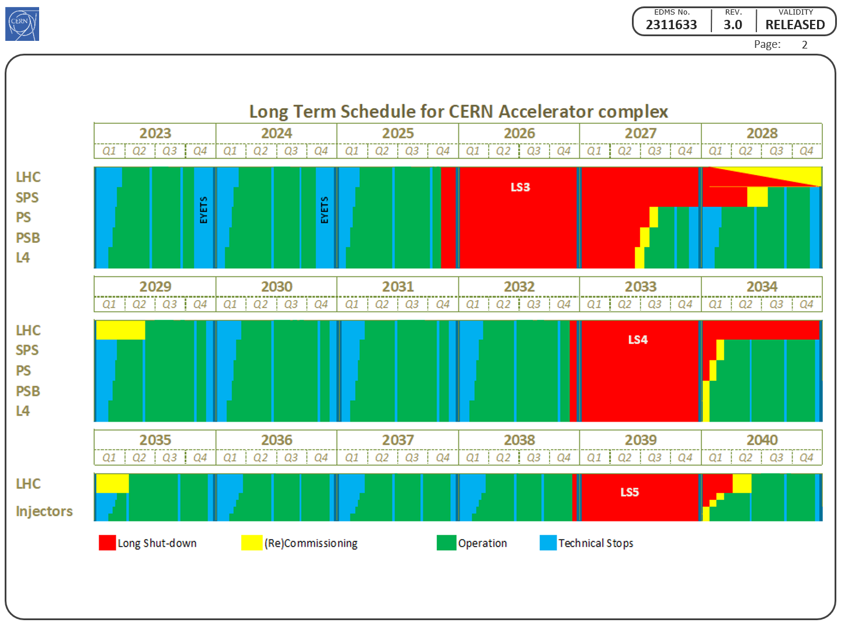
LS3 Master Schedule
Key information:
LS3 start date on 17.11.2025
SPS LS3 extended to 30 months for interventions in the SPS i.e. NA-CONS
North Area must be ready to receive beam by Q3 2028
Note: There is no margin for major surprises, so everything must be prepared carefully and timely by all involved teams (including contractors)

Slide 17
LS3 Overview: Zone-wise per systems
TDC2-TCC2-TT20/BA2-BA80
20th March 2024
Y. Kadi | NA-CONS Project Status Report | PAW’24
17

Slide 18
LS3 Overview: Zone-wise per systems
TT81-TT85-BA81
20th March 2024
Y. Kadi | NA-CONS Project Status Report | PAW’24
18

Slide 19
LS3 Overview: Zone-wise per systems
20th March 2024
Y. Kadi | NA-CONS Project Status Report | PAW’24
19

Slide 20
LS3 Overview: Zone-wise per systems
20th March 2024
Y. Kadi | NA-CONS Project Status Report | PAW’24
20

Slide 21
Summary
Missing resources (M+P) addressed at MTP 2023
New baseline in place following important scope changes resulting from CSSR’23.
Project progressing according to Baseline
Almost all recommendations from Review Panel addressed
Limits of scope + impact from HI Facility in ECN3 identified and taken into consideration
All technical options validated => scope refined
Joint Coordination with HI-ECN3 Study Project in place
Phase-1 Schedule v. busy: anticipate in (E)YETS but constrained by M&O and Physics => Prioritization => Require detailed coordination
Milestone monitoring in place for all WPs
Procurement is well under way => 2024 crucial year !

