Slide 1
CernVM on the Cloud
Predrag Buncic, CERN/PH-SFT

Slide 2

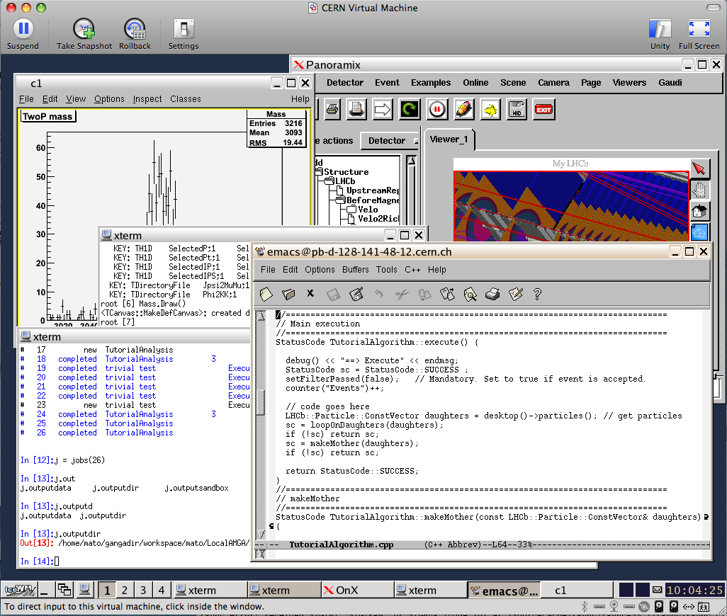
CernVM Project
Checkout
Submit to Grid
Display results
Suspend
Test
Compile
Resume
Debug
Notes:
2

Slide 3
Is CernVM suitable for deployment on Grid and Cloud infrastructure?
What are the benefits of going CernVM way comparing to more traditional¹⁾ approach to batch node virtualization?
Traditional approach:
  Take “standard” batch node [2GB] and add experiment software [10GB] and generate VM image. Have experiment and security team certify the image, deploy it to all sites and worker nodes. Repeat this procedure 1-2 times per week and per experiment.

Slide 4
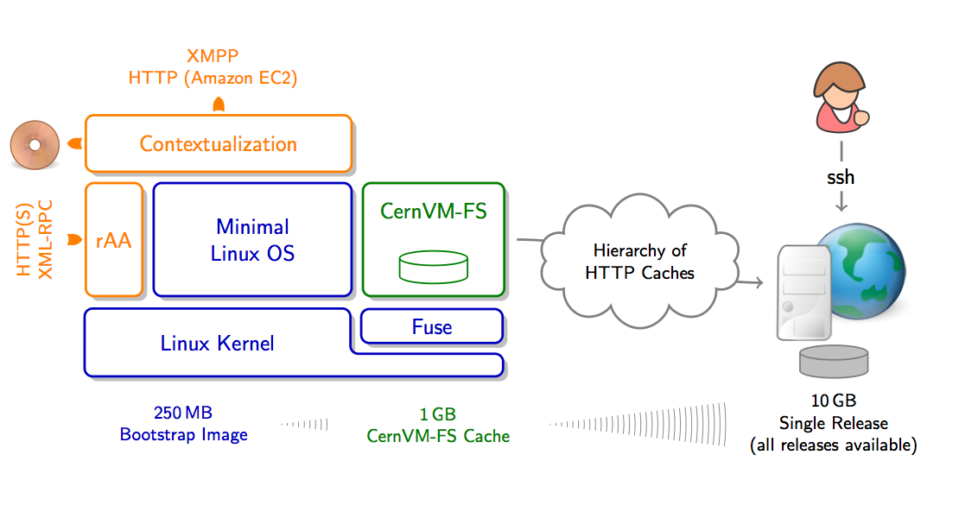
CernVM Way
  Minimal Linux OS (SL5)
  CernVM-FS - HTTP network file system optimized for jus in time delivery of experiment software
  Flexible configuration and contextualization mechanism based on public Cloud API

Slide 5
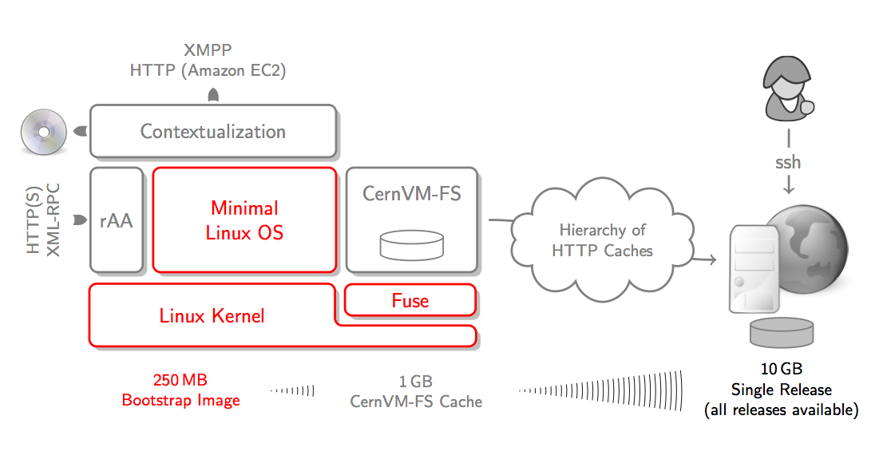
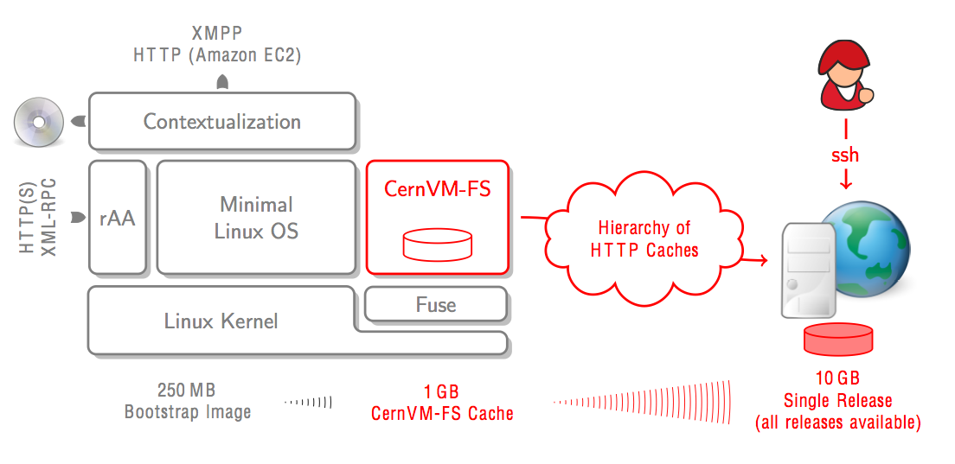
Part #1: Minimal OS image
Just enough OS to run LHC applications
Built using commercial tool (rBuilder by rPath)
  Top-down approach - starting from application and automatically discovering dependencies
Small images (250MB), easy to move around

Slide 6
Part #2: CernVM-FS
  Experiment software is changing frequently and we want to avoid need to frequently update, certify and redistribute VM images with every release
  Only a small fraction of software release is really used
  Demonstrated scalability and reliability
  Now being deployed on across all Grid sites as the channel for software distributions

Slide 7
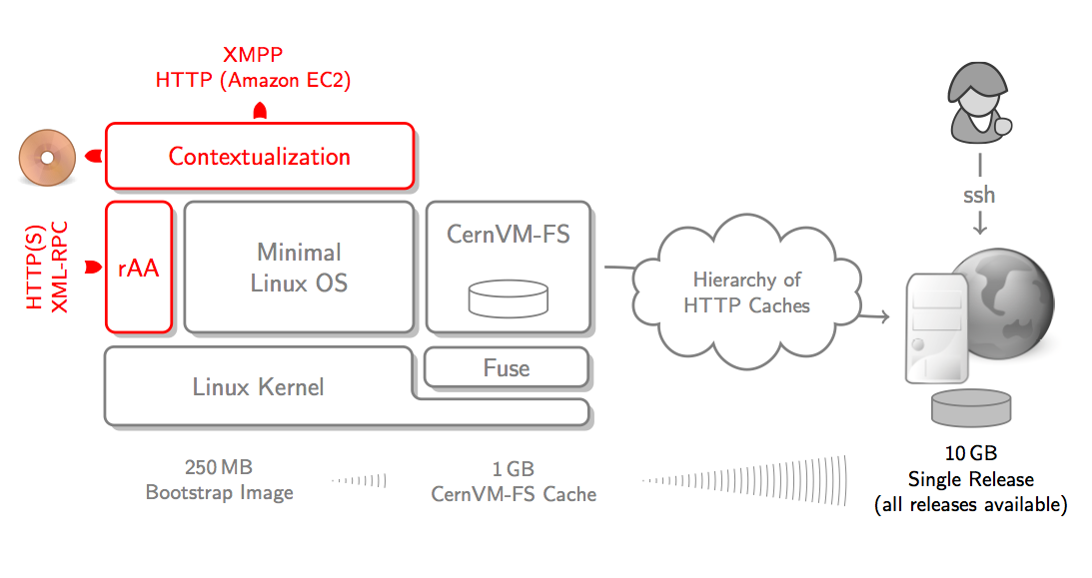
Part #3: Contextualization
There are several ways to contextualize CernVM
  Web UI (for individual user)
  CernVM Contextualization Agent
  Hepix CDROM method
  Amazon EC2 API user_data method

Slide 8
EC2 API – user data
Syntax
ec2-run-instances ami_id [-n instance_count] [-g group [-g group ...]] [-k keypair]
[-d user_data |-f user_data_file] [--addressing addressing_type] [--instance-type instance_type] [--availability-zone zone] [--kernel kernel_id] [--ramdisk ramdisk_id] [--block-device-mapping block_device_mapping] [--monitor] [--disable-api-termination] [--instance-initiated-shutdown-behavior behavior] [--placement-group placement-group] [--tenancy tenancy] [--subnet subnet] [--private-ip-address ip_address] [--client-token token]
user_data specifies Base64-encoded MIME user data to be made available to the instance(s) in this reservation.
Type: String
Default: None

Slide 9
EC2 Contextualization
Basic principles:
  Owner of CernVM instance can contextualize and configure it to run arbitrary service as unprivileged user
  Site can use HEPIX method to inject monitoring and accounting hooks w/o functionally modifying the image
The contextualization is based on rPath amiconfig package extended with CernVM plugin
  This tool will execute on boot time (before network services are available), parse user data and look for python style configuration blocks.
  If match is found the corresponding plugin will process the options and execute configuration steps if needed.
For more info on CernVM contextualization using EC2 API, see:https://cernvm.cern.ch/project/trac/cernvm/wiki/EC2Contextualization

Slide 10
user_data example
[cernvm]
# list of ',' separated organizations/experiments (lowercase)
organisations = cms
# list of ',' separated repositories (lowercase)
repositories = cms,grid
# list of ',' separated user accounts to create <user:group:[password]>
users = cms:cms:
# CVMFS HTTP proxy
proxy = http://<host>:<port>;DIRECT
# install extra conary group
group_profile = group-cms
# script to be executed as given user: <user>:/path/to/script.sh
contextualization_command = cms:/path/to/script.sh
# list of ',' seperated services to start
services = <list>
# extra environment variables to define
environment = CMS_SITECONFIG=EC2,CMS_ROOT=/opt/cms

Slide 11
cernvm-tools
A tool to simplify interaction with multiple clouds supporting minimal EC2 API
  Aims to simplify instantiation of contextualized CernVM images using EC2 user_data mechanism
Supports
  user_data templates, bulk submission
  delegation of proxy certificate in user_data
Example:
[pbuncic@localhost ~]$ cat panda-wn.tpl
[cernvm]
organisations = atlas
repositories = atlas,grid,atlas-condb,sft
users = panda:atlas:
eos-server = eosatlas.cern.ch
contextualization_command = panda:'/cvmfs/sft.cern.ch/lcg/external/experimental/panda-pilot/runPanda -m /eos/atlas/vm/copilot -t 1'
[[IF X509_CERT]]x509-cert = [[X509_CERT]] [[ENDIF]]

Slide 12
Now we have CernVM OS, FS, Ctx, API…
What’s next?

Slide 13









Run PanDA in
CernVM on the Clouds
Private/Academic Clouds
PanDA Server
EC2 API
Store results
Public/Commercial Clouds

Slide 14


EOS: Scalable Service Architecture
Clients
XROOT client & FUSE
KRB5 + X509 authenticated
FUSE
bash# df /eos
eosatlas.cern.ch 3.8P 39G 3.8P 1% /eos
XrdClient
Management Server
Pluggable Namespace, Quota, ACLs,HA
Strong Authentication
Capability Engine
File Placement
File Location
Implemented as plugins in xrootd
Failover
xrootd
server
MGM
Plugin
MGM
NS
NS
async
MQ
xrootd
server
MQ
Plugin
Message Queue
Service State Messages
File Transaction Reports
sync
File Storage
File & File Meta Data Store
Capability Authorization
File & Block Disk Error Detection (Scrubbing)
Layout Plugins [ currently Raid-1(n) ]
async
xrootd
server
FST
Plugin
FST
Andreas Peters IT/DM
[root@vmbsq090700 ~]# df /eos
Filesystem 1K-blocks Used Available Use% Mounted on
eos 3413376370848 23790724 3413352580124 1% /eos

Slide 15
Using cernvm-tools
Listing available images:
[pbuncic@localhost ~]$ cvm --region CERN -H ls -i
AMI LOCATION STATE VISIBILITY ARCH TYPE
ami-00000008 hepix_sl55_x86_64_kvm available Public i386 machine
ami-00000002 cernvm232_head_slc5_x86_64_kvm available Public i386 machine
ami-00000004 cernvm231_slc5_x86_64_kvm available Public i386 machine
ami-00000003 cernvm232_batch_slc5_x86_64_kvm available Public i386 machine
ami-00000010 lxdev_slc6_quattor_slc6_x86_64_kvm available Public i386 machine
Support for multiple regions:
[pbuncic@localhost ~]$ cvm --region EC2 -H ls -i ami-5c3ec235
AMI LOCATION STATE VISIBILITY ARCH TYPE
ami-5c3ec235 download.cernvm.cern.ch.s3.amazonaws.com/cernvm-2.3.1-x86_64_1899.img.manifest.xml available Public x86_64 machine

Slide 16
Initializing credentials
Proxy certificate
[pbuncic@localhost ~]$ lcg grid-proxy-init
Your identity: /DC=ch/DC=cern/OU=computers/CN=pilot/copilot.cern.ch
Creating proxy ................................................ Done
Your proxy is valid until: Thu May 19 06:43:50 2011
[pbuncic@localhost ~]$ lcg grid-proxy-info
subject : /DC=ch/DC=cern/OU=computers/CN=pilot/copilot.cern.ch/CN=1766683191
issuer : /DC=ch/DC=cern/OU=computers/CN=pilot/copilot.cern.ch
identity : /DC=ch/DC=cern/OU=computers/CN=pilot/copilot.cern.ch
type : Proxy draft (pre-RFC) compliant impersonation proxy
strength : 512 bits
path : /tmp/x509up_u500
timeleft : 11:59:56
This proxy certificate is time limited and authorized only to
  Request jobs from dedicated PanDA queue
  Write (but not delete) files in a given EOS directory

Slide 17
lxCloud
Starting contextualized CernVM images on lxCloud:
[pbuncic@localhost ~]$ cvm --region CERN run ami-00000003 --proxy --template panda-wn:1
r-47a5402e predrag default i-195 ami-00000003 128.142.192.62 128.142.192.62 pending default 0 m1.small 1970-01-01T01:00:00+01:00 default
[pbuncic@localhost ~]$ cvm --region CERN -H ls
ID RID OWNER GROUP DNS STATE KEY TYPE
i-195 default predrag default 128.142.192.62 running default m1.small
[pbuncic@localhost ~]$ cvm --region CERN -H ls
ID RID OWNER GROUP DNS STATE KEY TYPE
i-195 default predrag default 128.142.192.62 running default m1.small
i-196 default predrag default 128.142.192.63 running default m1.small
i-197 default predrag default 128.142.192.64 running default m1.small
i-198 default predrag default 128.142.192.65 running default m1.small
i-199 default predrag default 128.142.192.66 pending default m1.small
i-200 default predrag default 128.142.192.67 pending default m1.small
i-201 default predrag default 128.142.192.52 pending default m1.small
i-202 default predrag default 128.142.192.53 pending default m1.small
i-203 default predrag default 128.142.192.54 pending default m1.small
i-204 default predrag default 128.142.192.55 pending default m1.small
i-205 default predrag default 128.142.192.56 pending default m1.small
i-206 default predrag default 128.142.192.57 pending default m1.small

Slide 18
Amazon EC2
Starting more contextualized CernVM images on EC2:
[pbuncic@localhost ~]$ cvm run ami-5c3ec235 -g default -t m1.large --kernel aki-9800e5f1 --key ami --proxy --template panda-wn:10
r-ad962dc1 392941794136 default i-f3b04a9d ami-5c3ec235 pending ami 0 m1.large
r-ad962dc1 392941794136 default i-f1b04a9f ami-5c3ec235 pending ami 1 m1.large
r-ad962dc1 392941794136 default i-cfb04aa1 ami-5c3ec235 pending ami 2 m1.large
r-ad962dc1 392941794136 default i-cdb04aa3 ami-5c3ec235 pending ami 3 m1.large
....
[pbuncic@localhost ~]$ cvm --region EC2 -H ls
ID RID OWNER GROUP DNS STATE KEY TYPE
i-f3b04a9d r-ad962dc1 392941794136 default ec2-50-16-144-41 running ami m1.large
i-f1b04a9f r-ad962dc1 392941794136 default ec2-75-101-214-247 running ami m1.large
i-cfb04aa1 r-ad962dc1 392941794136 default ec2-184-72-183-26 running ami m1.large
i-cdb04aa3 r-ad962dc1 392941794136 default ec2-184-73-56-72 running ami m1.large
i-cbb04aa5 r-ad962dc1 392941794136 default ec2-50-16-32-51 running ami m1.large
i-c9b04aa7 r-ad962dc1 392941794136 default ec2-75-101-184-46 running ami m1.large
i-c7b04aa9 r-ad962dc1 392941794136 default ec2-50-19-38-225 running ami m1.large
i-c5b04aab r-ad962dc1 392941794136 default ec2-50-16-105-241 running ami m1.large
i-c3b04aad r-ad962dc1 392941794136 default ec2-174-129-86-61 running ami m1.large
i-c1b04aaf r-ad962dc1 392941794136 default ec2-50-19-9-47 running ami m1.large

Slide 19
PanDA Monitor

Slide 20
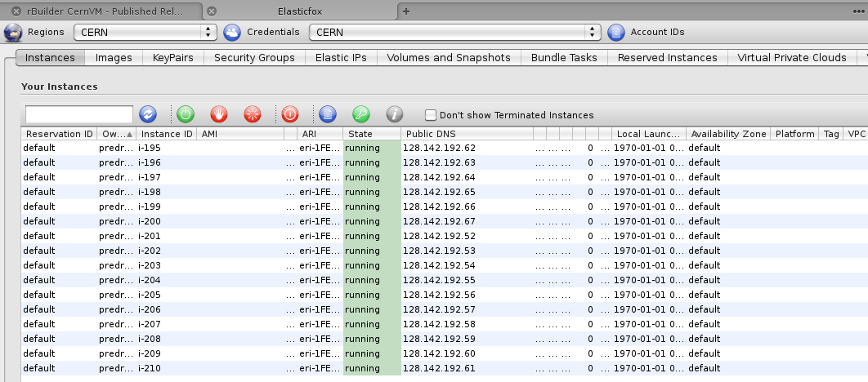
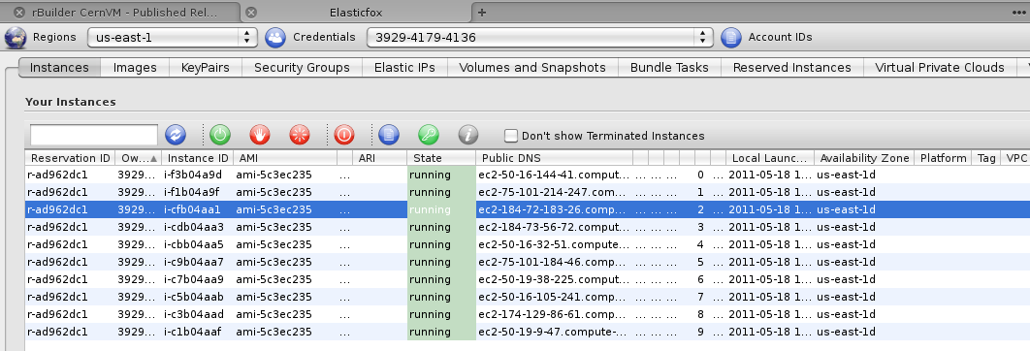
Elasticfox

Slide 21
Problems
No external connectivity to eosatlas.cern.ch (had to use local disk):
18 May 13:33:44| pilot.py | Collecting WN info from: /tmp/panda-pilot/3158/WORK/Panda_Pilot_3994_1305725624 (again)
18 May 13:33:44| pilot.py | Job memory set by queuedata to:
18 May 13:33:44| pilot.py | Local space limit: 5368709120 B
18 May 13:33:44| pilot.py | !!FAILED!!1999!! Too little space left on local disk to run job: 1967128576 B (need > 5368709120 B)
18 May 13:33:44| pilot.py | Pilot was executed on host: ip-10-212-183-96
....
EOD storage worked well on lxCloud:
[root@vmbsq090700 ~]# df
Filesystem 1K-blocks Used Available Use% Mounted on
/dev/hda1 13577676 4131152 8762240 33% /
none 513176 0 513176 0% /dev/shm
eos 3413376370848 23790724 3413352580124 1% /eos
[panda@vmbsq090700 copilot]$ ls -1 *.root
024653d9-99f6-49e5-8dad-0b826f84fa3b_0.evgen.pool.root
02746a4b-ab5e-48a2-b5ff-4359f22b5da7_0.evgen.pool.root
0665543c-359a-4265-84ec-82ffdab2d8dd_0.evgen.pool.root
09719f1b-ae99-441f-9ee5-7fc265f099b4_0.evgen.pool.root
107acb02-7f9b-4b4d-bdaf-dc9b86c58dca_0.evgen.pool.root
…………..

Slide 22
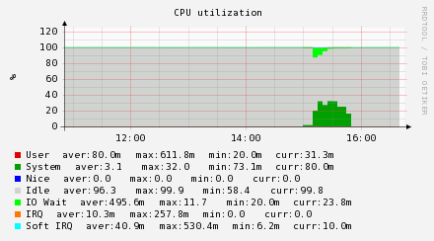
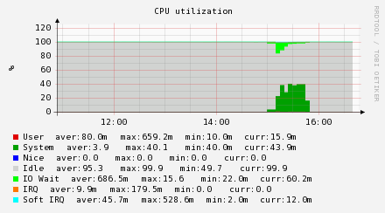
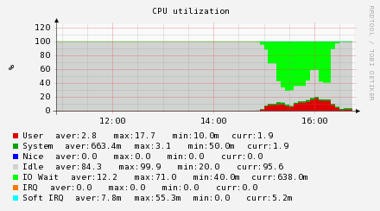
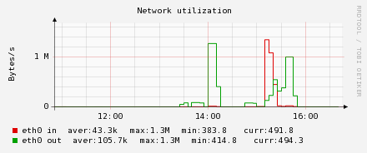
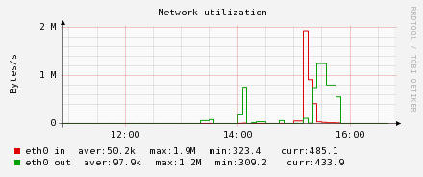
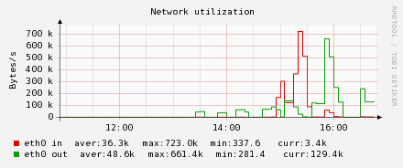
SLC5 vs SLC6
SLC5
hypervisor
SLC6
hypervisor

Slide 23
Work in progress, blue sky ideas…

Slide 24
Computer Center in a Box
Common services hosted by front-end node
  Batch master, NAT gateway, storage and HTTP proxy
Each physical node
  Contributes to common storage pool
  Runs hypervisor, batch worker
  Exports storage local storage to common pool
Virtual Machines
  Started by the suitable Cloud middleware
  Only limited outgoing network connectivity via gateway node/HTTP proxy
  Access to data files via POSIX (file system) layer
  Software delivered to VMs from Web server repository
  Built form recipes and components stored in strongly versioned repository
Access to external mass storage via storage proxy
End user API to submit jobs
1..n
1..n
CernVM
CernVM
CernVM
Storage
Server
Batch
Worker
Hypervisor
1
Storage
Proxy
HTTP
Proxy
NAT
Gateway
Batch
Master
MSS
S/W
TCP/IP
API

Slide 25
NA61 Testbed
(long term data preservation use case)
CernVM for NA61
KVM - Linux native hypervisor
Condor - batch system that works well in dynamic environment and supports running jobs in VMs
Xrootd server - high performance file server, used by LHC experiments and distributed with ROOT
Xrootd redirector - each aggregates up to 64 servers, can cluster up to 64k servers
Xrootd supports access to MSS systems using SRM extension
Standard HTTP proxy (Squid)
CernVM-FS repository for software distribution
eosfs - POSIX File System for Xrootd
GANGA - user interface and front-end to various batch systems and Grid
Ganglia - monitoring
CernVM
11
CernVM
CernVM
1
9
Storage
Server
4
Batch
Worker
3
Hypervisor
2
Storage
Proxy
5
HTTP
Proxy
7
NAT
Gateway
Batch
Master
3
6
8
10
MSS
S/W
TCP/IP
API

Slide 26
Scaling EOS across the sites: Storage Cloud?
Xrootd Redirector
Site A
Site B
/eos/atlas/siteA
/eos/atlas/siteC
Site C
Andreas Peters IT/DM
/eos/atlas/siteC
Storage Cloud plays fundamental role in Cloud concept, cannot be factored out as separate problem and solved later…

Slide 27
In the pipeline…
DIRAC Pilot for LHCb…
  and other experiments that use pilot job frameworks
On demand Condor cluster
  contextualization templates currently under testing
PROOF on demand
GridFactory scheduler
  Ad-hoc cloud for small workgroups
Volunteer computing using BOINC adapted to run jobs in CernVM
  Ongoing activity with Theory Group at CERN
  MonteCarlo validation project

Slide 28
Conclusions
In combination with various contextualization options and CernVM-FS, just one small image can run frameworks of all LHC experiments and be easily moved around requiring far less frequent updates than traditional worker node
CernVM-FS provides efficient, scalable, secure and maintenance free way do distribute software in CernVM and physical nodes alike
Flexible contextualization options allow the same image to play different roles reducing the need for creation and certification of specialized images
Storage Cloud plays fundamental role in Cloud concept, cannot be factored out as separate problem and solved later
lxCloud is operational and usable, can run PanDA in CernVM with EOS as storage backend (thanks to Sebastian Goasguen and Ulrich Schwickerath)
  Time to do some stress testing…

