Slide 1


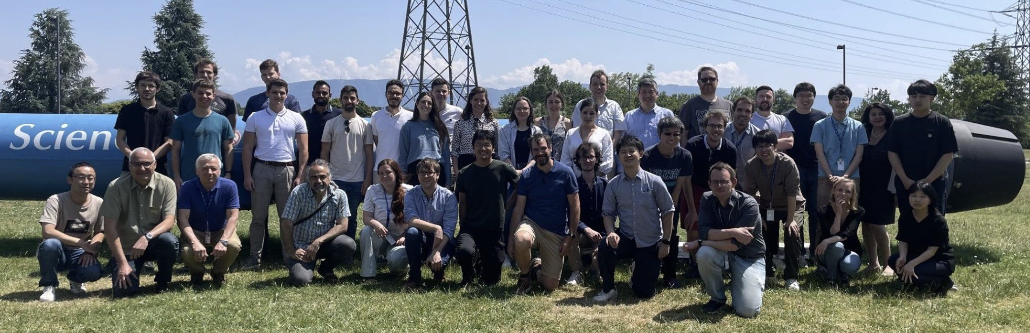







FASER 2023 Overview
LHC Forward Physics Meeting, 15/03/2024
Presented by Alex Keyken, on behalf of the FASER Collaboration

Slide 2
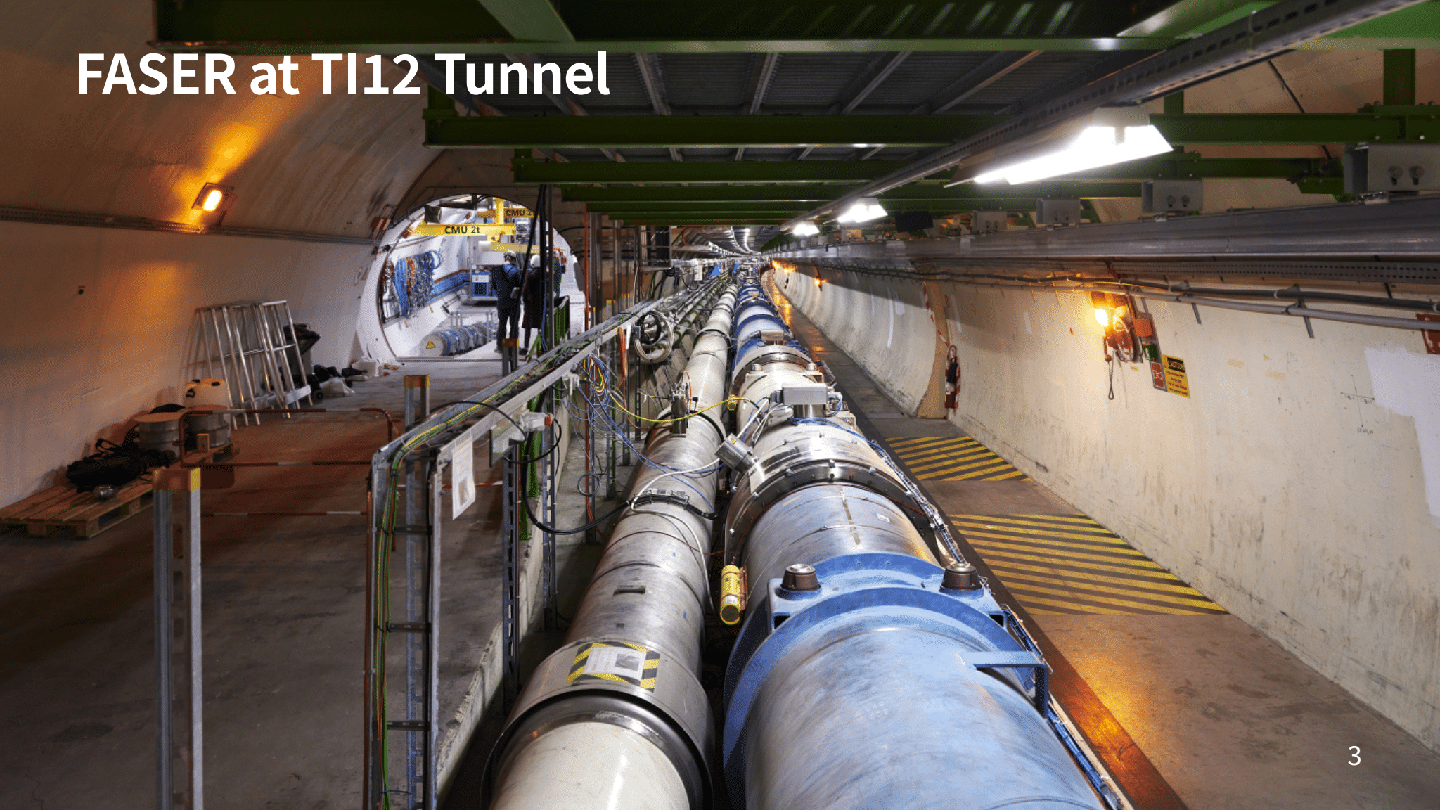
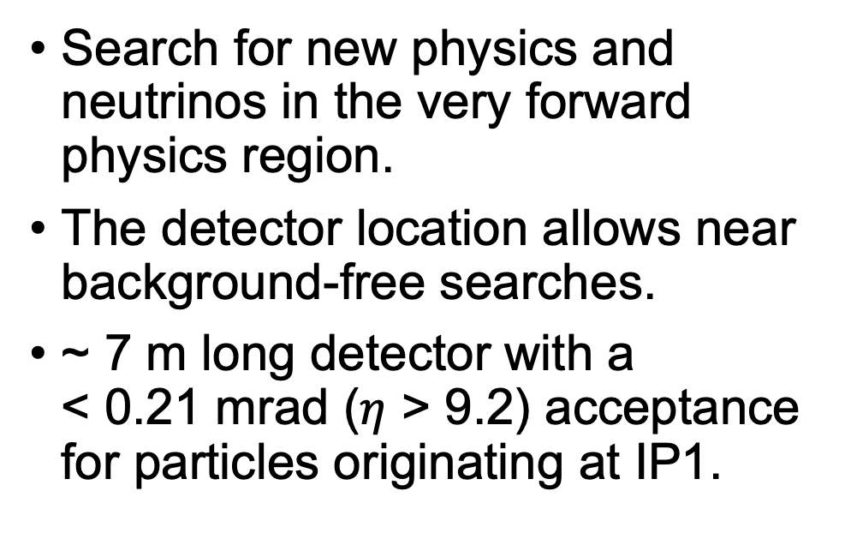
ForwArd Search ExpeRiment
Search for new physics and neutrinos in the very forward physics region.
The detector location allows near background-free searches.
~ 7 m long detector with a
< 0.21 mrad ($η$ > 9.2) acceptance for particles originating at IP1.
Magnets
LHC Tunnel
FASER
ATLAS IP1
~100 m concrete
~480 m between IP1 and FASER
TI12 Tunnel
Notes:
FASER is a small detector searching for new physics and neutrinos in the very forward physics region.
The detector is only about 7m long with a decay volume of 1.5 m and a diameter of 20 cm.
This corresponds to an angular acceptance of < 0.21 mrad or a pseudorapidity of $η$ > 9.2, for particles produced in ATLAS collisions.
The detector was installed in maintenance tunnel TI12, 480 m away from IP1.
The idea is to use the long distance, the magnets along the way and 100 m of concrete between the tunnels to do background free searches for weakly interacting LLPs.
Despite this distance, FASER is transversely displaced from the collision axis line of sight by only 6.3 cm (and this will vary if the bunch crossing angle or other settings near ATLAS change).

Slide 3
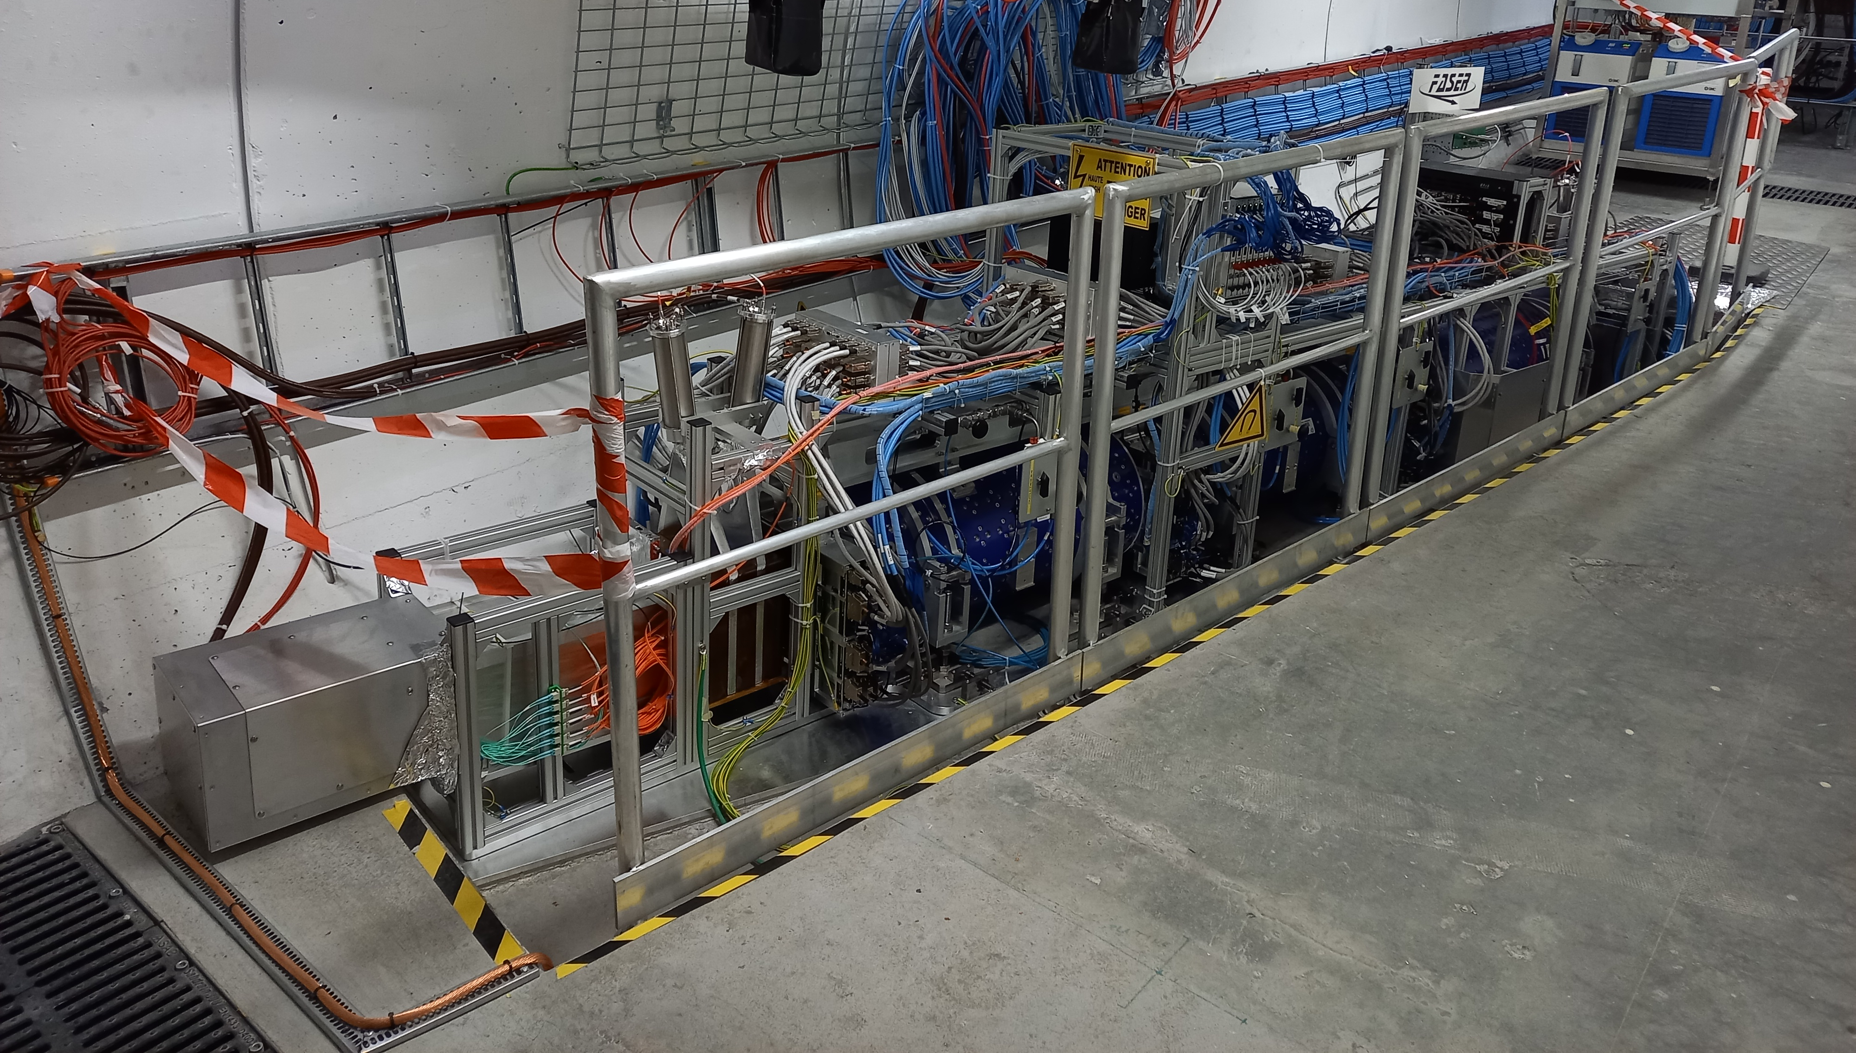
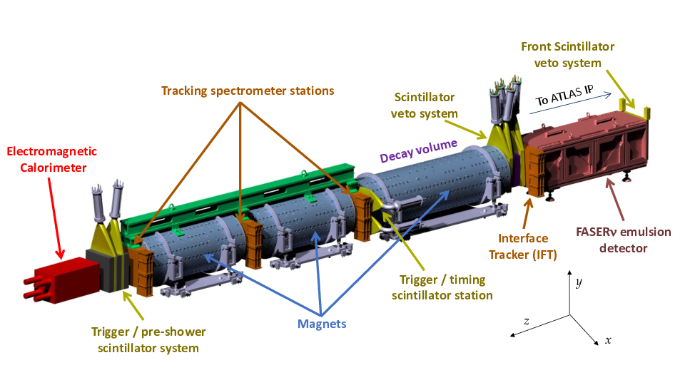
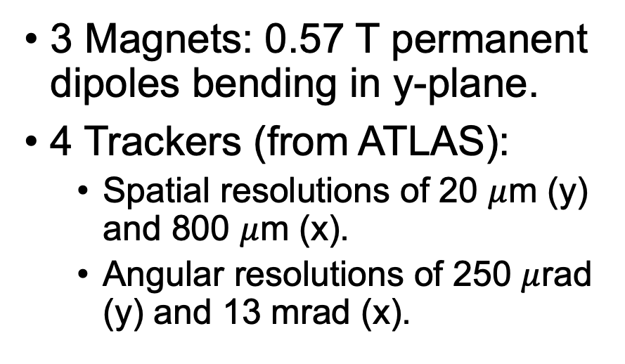
3 Magnets: 0.57 T permanent dipoles bending in y-plane.
4 Trackers (from ATLAS):
  Spatial resolutions of 20 $μ$m (y) and 800 $μ$m (x).
  Angular resolutions of 250 $μ$rad (y) and 13 mrad (x).
To ATLAS IP1
Calorimeter (from LHCb): 25 radiation lengths of alternating lead and plastic.
4 Scintillators: veto (~30 cm diameter), timing and pre-shower.
Notes:
So the detector a bit camera shy, you can see them hiding in their trench in the left picture. For reference, the left-most metal box on the left is also the left-most red box in the diagram.
It is the EM calorimeter, which consists of 4 indefinetly borrowed spare LHCb modules, 25 radiation lengths long (alternating lead and plastic). (4G antenna in tunnel produced considerable noise, so needed a faraday cage)
While FASER has 3 0.5 T permanent dipole magnets, only the first seen by IP1 surrounds the decay volume, while the others are part of the tracking spectrometer system.
These 3 stations are different to the interface tracker or IFT, which matches tracks between FASERnu and FASER.
Each tracker is made of 3 double-layer silicon microstrip detectors, graciously donated to us by ATLAS. They have better resolution in the magnet bending plane to identify separated charged tracks.
Finally, there’s the 4 scintillators, 2 of them surround FASERnu on either side to veto charged particles. The front-most has the largest transverse size (at least 30 cm), to rule-out particles scattering in from the side.
The timing scintillator has a resolution sub ns resolution, acting as a trigger for particles exiting the decay volume. Finally, the pre-shower scintillator distinguishes photon showers in the ECAL from neutrino interactions.

Slide 4
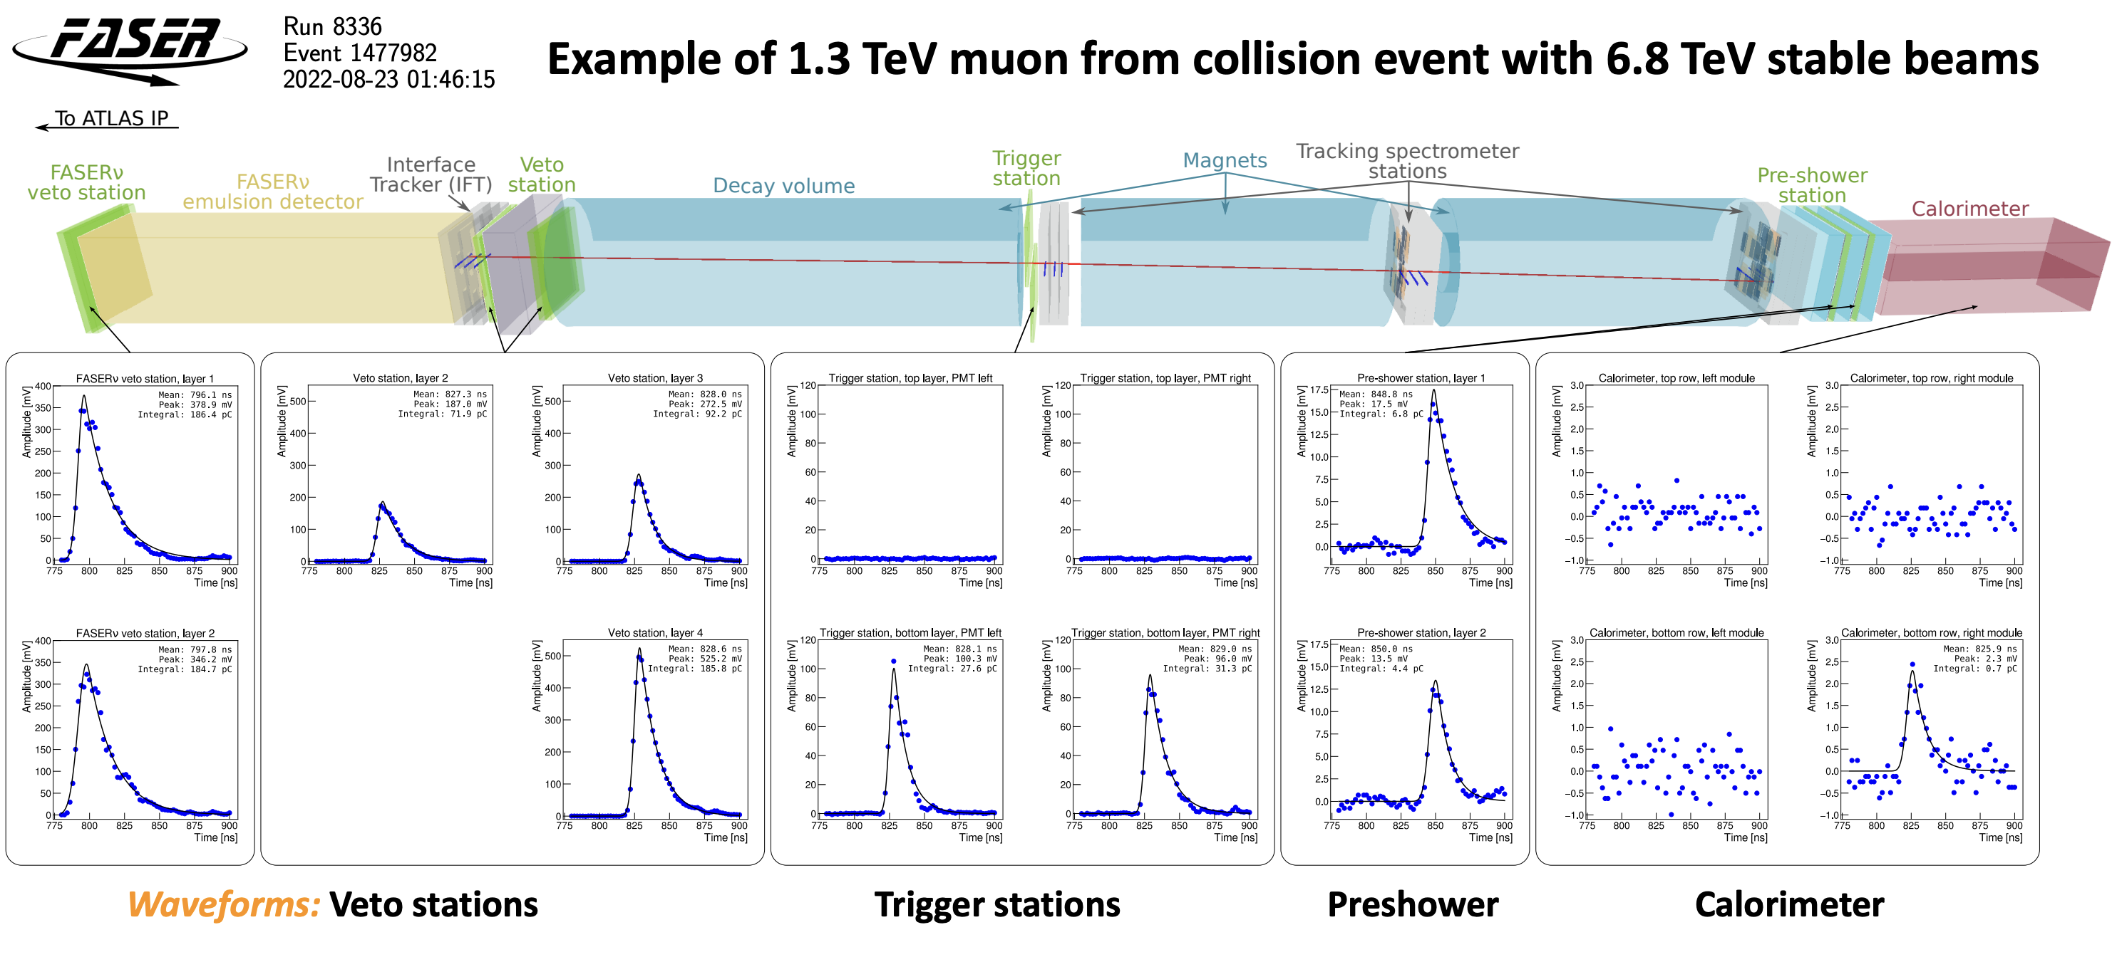
Notes:
That being said, what would an event actually look like? Well imagine a muon from an ATLAS collision enters FASER.
It leaves a signal in the veto counters in front and behind the FASERnu emulsion detector, ruling out the possibility of being a dark photon or interacting neutrino.
The decay volume is air so nothing of interest happens and then satisfied with its job, the muon clocks out at the trigger station which attributes it to a particular atlas bunch crossing.
The spectrometers along the way give us track information, whilst the calorimeter records its energy.

Slide 5
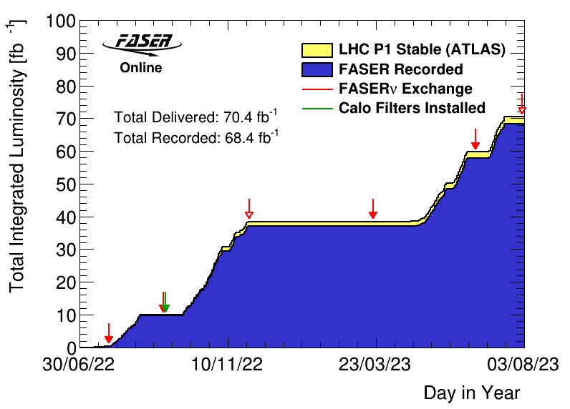
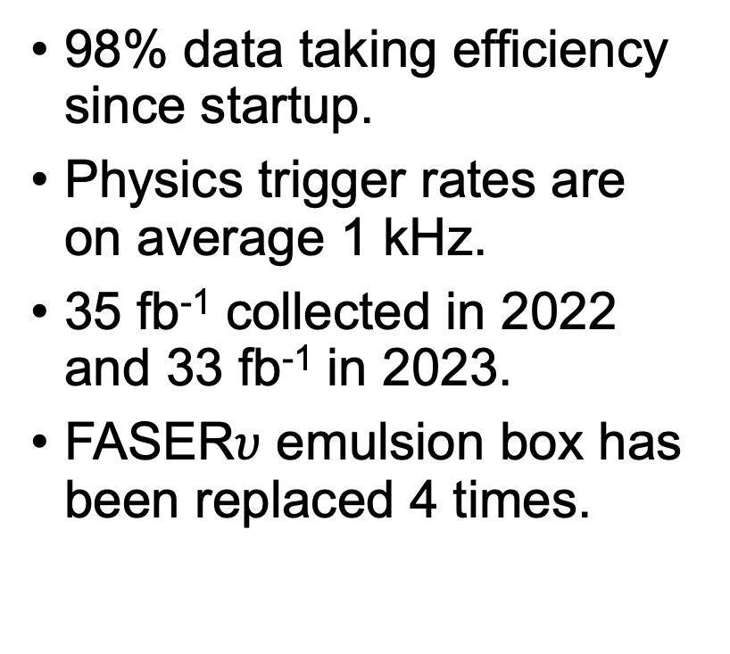
Data Taking
98% data taking efficiency since startup.
Physics trigger rates are on average 1 kHz.
35 fb⁻¹ collected in 2022 and 33 fb⁻¹ in 2023.
FASER$υ$ emulsion box has been replaced 4 times.
Notes:
FASER has been recording events since it’s installation in 2022.
This plot shows the cumulative integrated luminosity of ATLAS collisions since then in yellow, whereas blue is the amount of that luminosity that FASER recorded.
You can see we only missed out on 2 out of 70 inv fb.
I have a slide on emulsion later in case someone hasn’t heard of it before, but essentially FASERnu boxes need to be replaced during LHC technical stops, to prevent the track-recording films from saturating.

Slide 6
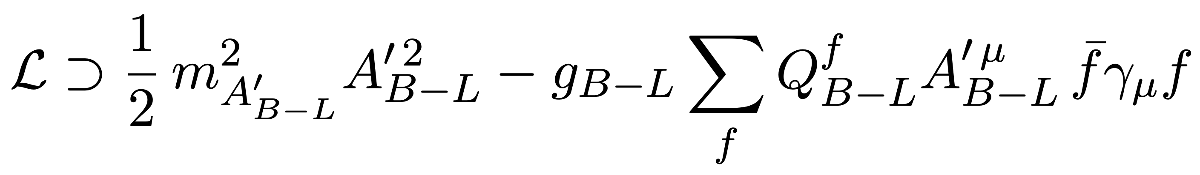
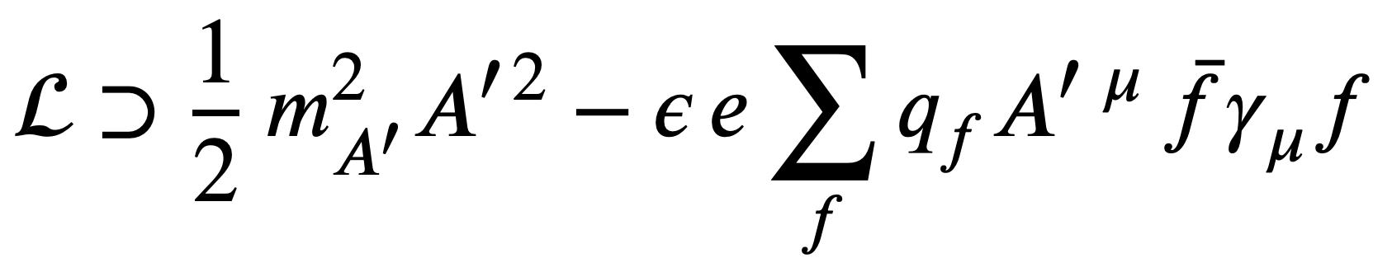
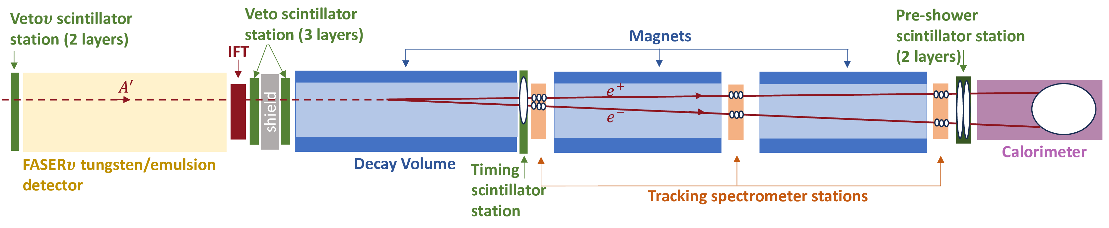
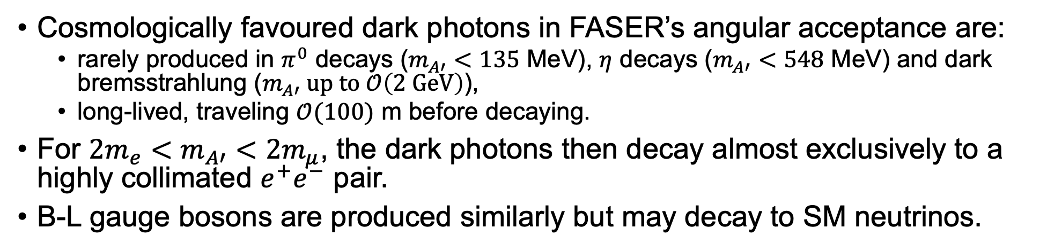
Dark Photons at FASER
Phys. Lett. B 848 (2024) 13837
Cosmologically favoured dark photons in FASER’s angular acceptance are:
  rarely produced in $π^{0}$ decays ($m_{A′}<135$ MeV), $η$ decays ($m_{A′}<548$ MeV) and dark bremsstrahlung ($m_{A′} \text{up} \text{to} 𝒪\left(\text{2 }\text{GeV}\right)$),
  long-lived, traveling $𝒪(100)$ m before decaying.
For ${{2m}_{e}<m}_{A′}<2m_{μ}$, the dark photons then decay almost exclusively to a highly collimated $e^{+}e^{−}$ pair.
B-L gauge bosons are produced similarly but may decay to SM neutrinos.
Benchmark
Dark Photon:
B-L Gauge
Boson:
Notes:
Now that I’ve summarized the detector functionality, let’s talk about the first results, starting with the search for Dark Photons:
Dark photons emerge from the consideration that there is a dark matter equivalent of the EM force. One possible detection channel would then be kinematic mixing with the SM photon.
Dark photons that reach FASER would be produced by $π^{0}$(as long as their mass is below that of the pion, 135 MeV), etas (again for a mass under 548 MeV) and dark bremsstrahlung for masses up to $𝒪\left(\text{2 }\text{GeV}\right)$.
Should the dark photon have a mass between those of electron and muon pairs (~211 MeV), they would decay to the electron pair exclusively.
It’s worth noting that besides this benchmark model, we also consider a model that predicts a B-L gauge boson originating from the U(1) baryon and lepton number conserving gauge symmetry.
The BL signal is very similar if the boson has mass in the MeV to GeV range and the gauge coupling is small (~10^-5).
The difference is that this boson would couple to SM neutrinos or even sterile neutrinos, only decaying to electrons 40% to 25% of the time.
In any case, the high energy dark photon denoted A’ would leave no signal in the veto stations, then decay within the first magnet leading to a highly collimated electron-positron pair separated by the magnets.
These then leave a large energy deposit in the calorimeter.
!!! Following analysis assumes $A′$ decays visibly to SM particles and that $m_{A′}<2m_{χ}$ for a dark matter particle $χ$.

Slide 7
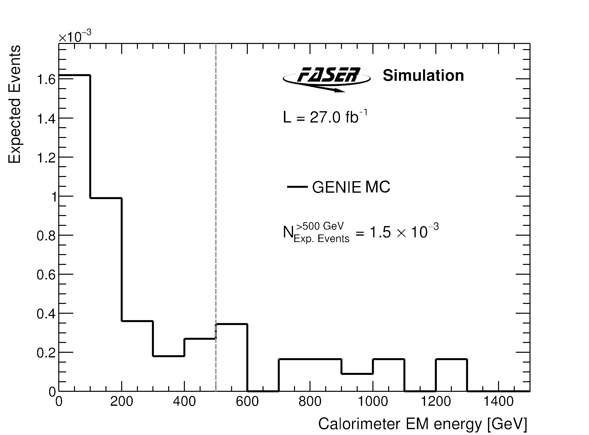
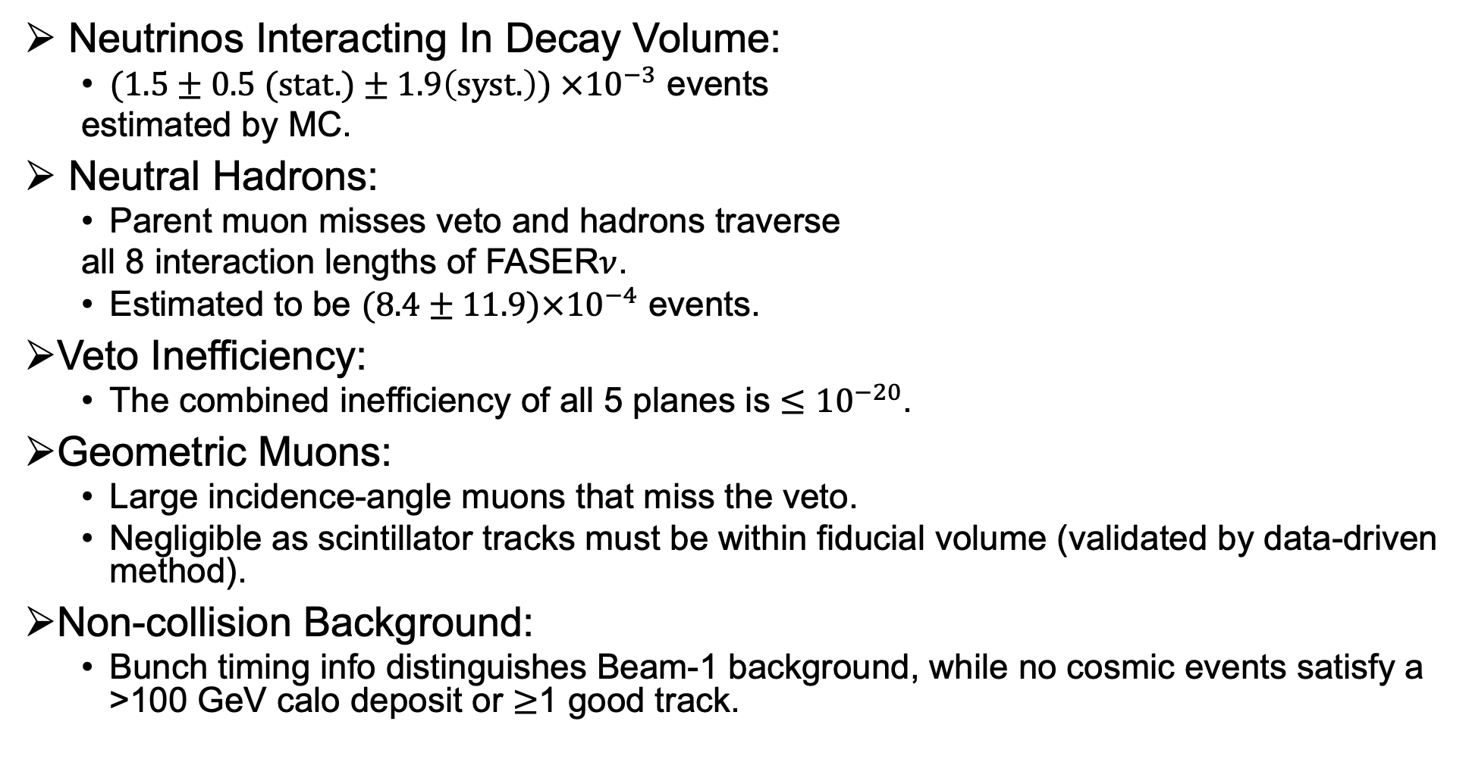
Dark Photon Backgrounds
Neutrinos Interacting In Decay Volume:
  $(1.5±0.5 \text{(}\text{stat}\text{.)}±1.9\left(\text{syst}\text{.}\right)\text{) }×{10}^{−3}$ events
  estimated by MC.
Neutral Hadrons:
  Parent muon misses veto and hadrons traverse
  all 8 interaction lengths of FASER$ν$.
  Estimated to be $(8.4±11.9)×{10}^{−4}$ events.
Veto Inefficiency:
  The combined inefficiency of all 5 planes is ${≤10}^{−20}$.
Geometric Muons:
  Large incidence-angle muons that miss the veto.
  Negligible as scintillator tracks must be within fiducial volume (validated by data-driven method).
Non-collision Background:
  Bunch timing info distinguishes Beam-1 background, while no cosmic events satisfy a >100 GeV calo deposit or $≥$1 good track.
Notes:
For this study, the following backgrounds were considered:
Neutrinos interacting in the decay volume which is why the material in the decay volume was minimized. These were estimated by a very large (300 inv ab) MC sample.
Only 0.0015 events passed the >500 GeV calo cut as shown in the figure and this is the background.
Neutral Hadrons are a background if the generate within the concrete in front of FASER, then pass FASERnu without interacting and finally decay into two charged particles within the decay volume producing two charged tracks.
To estimate this background, we used a three-track control region where the parent muon is reconstructed alongside the final state charged tracks, taking the ratio of high (>500 GeV) to low (<100GeV) energy depositing events. This ratio is then used to scale low energy two-track events, where the muon is not present, to the higher energy signal region.
!!! Ks decays must be separated from photon conversion in the three-track sample, by requiring that the invariant mass of the non-muon tracks is >200 MeV (verified with MC). Additionally, muon background contribution to the sample is conservatively neglected.
The veto inefficiency is estimated as the fraction of good fiducial tracks with scintillator charge lower than that of Minimum Ionizing Particles and as the combined inefficiency of all 5 planes is ${≤10}^{−20}$, this background is negligible as we only observe 10^8 muons.
The there are geometric muons, which scatter into the detector beyond the veto plane. As you can imagine, this background turns out to be negligible as well, as seen in a MC sample of these muons, where none pass the selection criteria.
Similarly, we see no events pass the selection in data recorder at times when the beams were off which accounts for the cosmic non–collision background. Finally, there’s events reaching FASER from clockwise circulating beam 1, for which we use timing info.

Slide 8
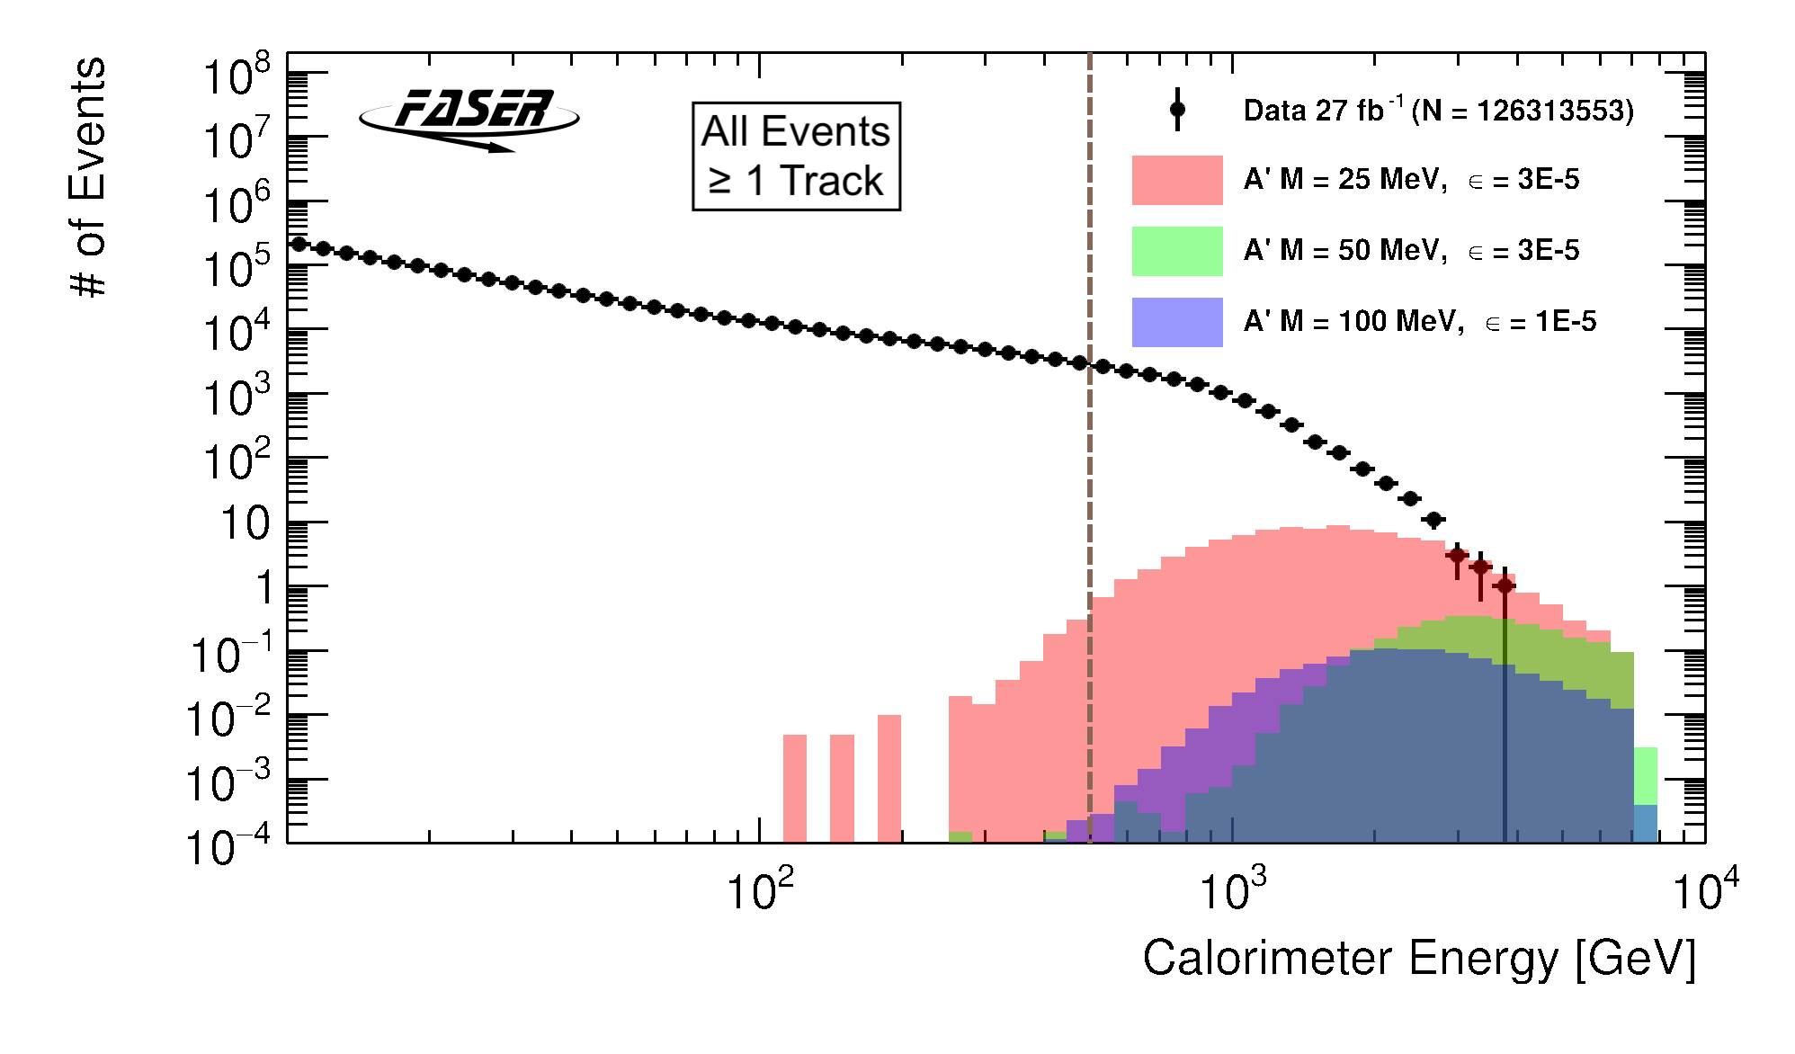
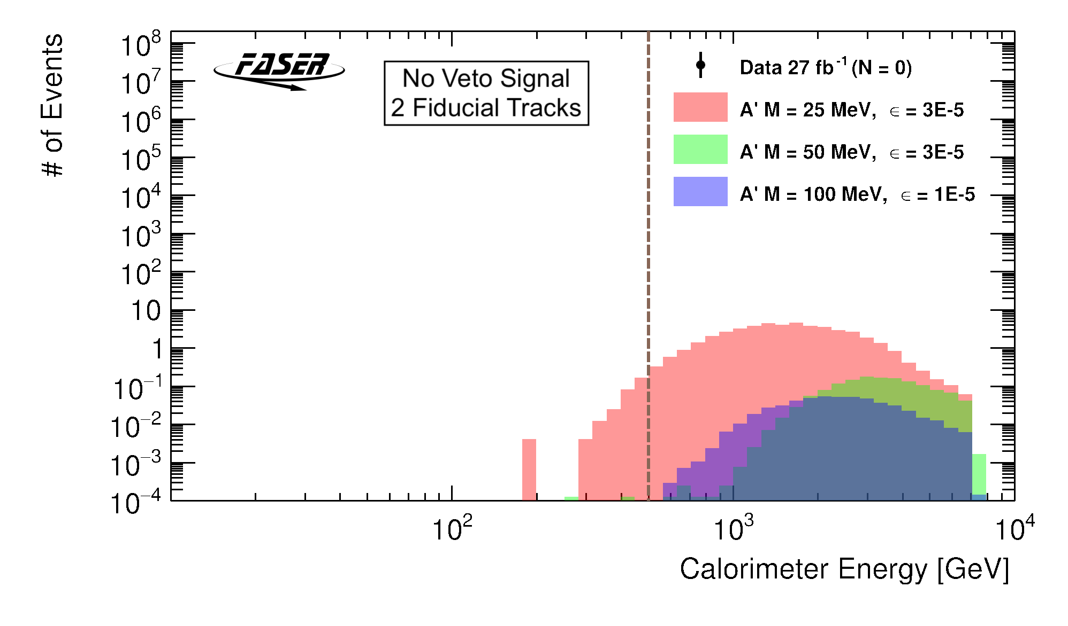
Dark Photon Results
Selection Cuts:
Event time consistent with colliding bunch.
No veto scintillator signal.
Two fiducial tracks
(p >20 GeV).
E >500 GeV deposited in calo.
For 27 fb⁻¹, no events are found in the signal region…
Notes:
In summary, here’s a list of the most important selections applied to data as. Event time matching colliding bunch to rule out non-collision background, no veto signal to rule out charged particles interacting in the detector, good quality fiducial tracks as determined by the chi squared (>= 12 hits along the trackers) and at least 500 GeV deposited in the calorimeter.
Top plot shows all events with at least 1 good track, with several bins in the signal region, whilst the bottom plot shows no events are left after the no veto signal and 2 track requirements.
In other words, given the 27 fb⁻¹ of 2022 data that this study was performed on, no dark photons were seen…

Slide 9
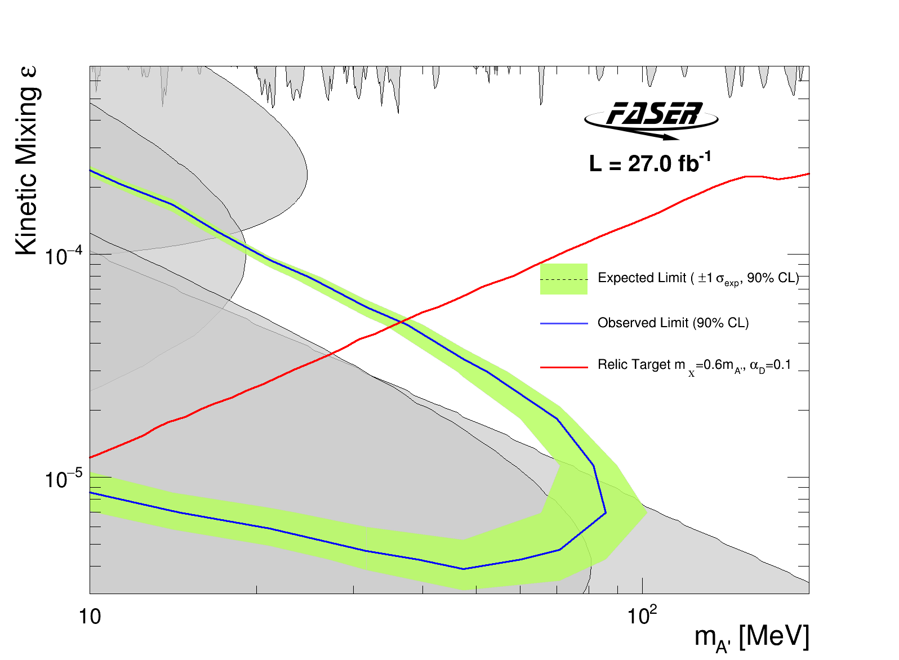
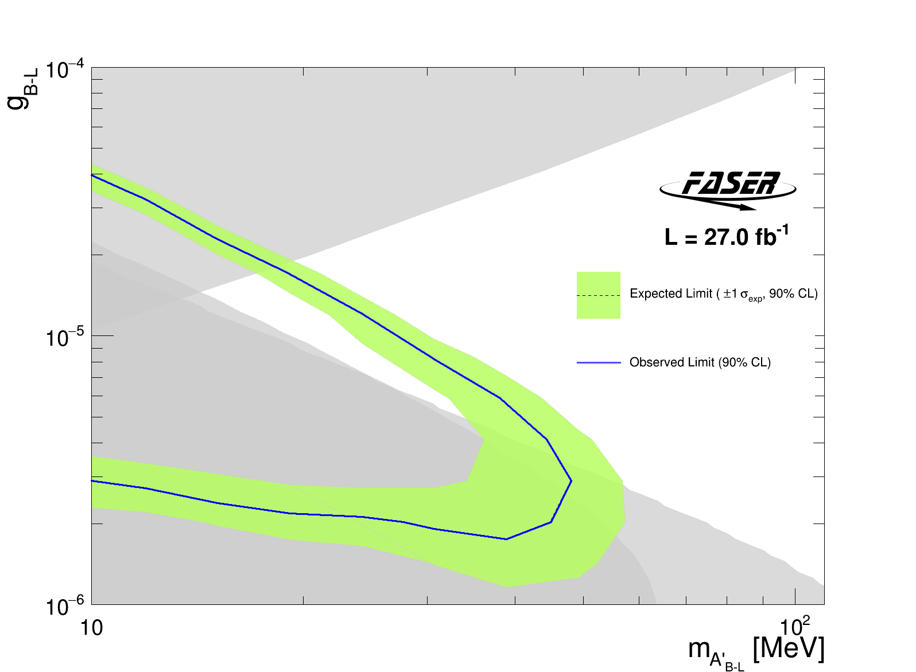
90% confidence exclusion regions for dark photons (left) and B-L gauge bosons (right). Red line represents the relic target density region that is cosmologically favored.
Notes:
Which means we can use the data to set 90% confidence exclusion regions for the two models analyzed. Green and blue mark the border of the exclusion region set by FASER, whilst the grey bands are existing exclusion regions from previous experiments.
The red line on the benchmark model plot is relevant because it would yield the cosmologically favored dark matter relic density for a given coupling constant and mass ratio between the dark photon and a light complex scalar field for DM particle denoted by chi. Since these two parameters are model dependent, the line may shift left or right diagonally.

Slide 10
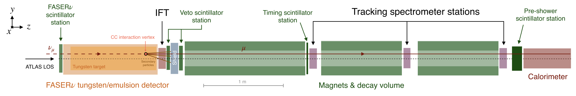
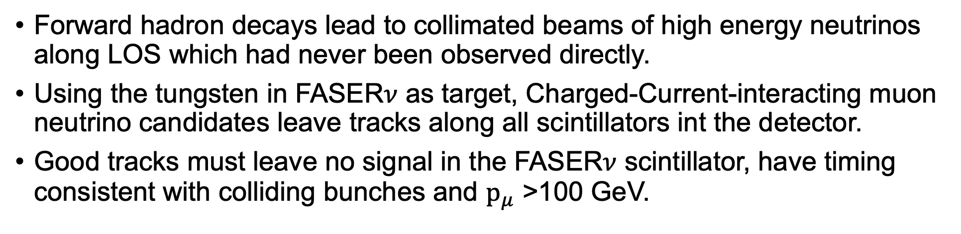
Collider Neutrinos at FASER
Forward hadron decays lead to collimated beams of high energy neutrinos along LOS which had never been observed directly.
Using the tungsten in FASER$ν$ as target, Charged-Current-interacting muon neutrino candidates leave tracks along all scintillators int the detector.
Good tracks must leave no signal in the FASER$ν$ scintillator, have timing consistent with colliding bunches and ${\text{p}}_{μ}$ >100 GeV.
Phys. Rev. Lett. 131, 031801 (2023)
Notes:
But dark photons are not all there is to see along LOS, forward hadrons produce a large high energy and highly collimated neutrino flux.
To look for Charged Current muon neutrinos, we use FASERnu as a tungsten target, which means only the second veto scintillator triggers.
The vertex is recorded in the emulsion detector, however this can only be read out after the films are taken out of the detector and developed in the lab. Instead, we use the Interface tracker to relate the vertex to the muon track reconstructed using the rest of the trackers.
So we look for bunch consistent timing, no signal in the frontmost veto and a single high momentum track.

Slide 11

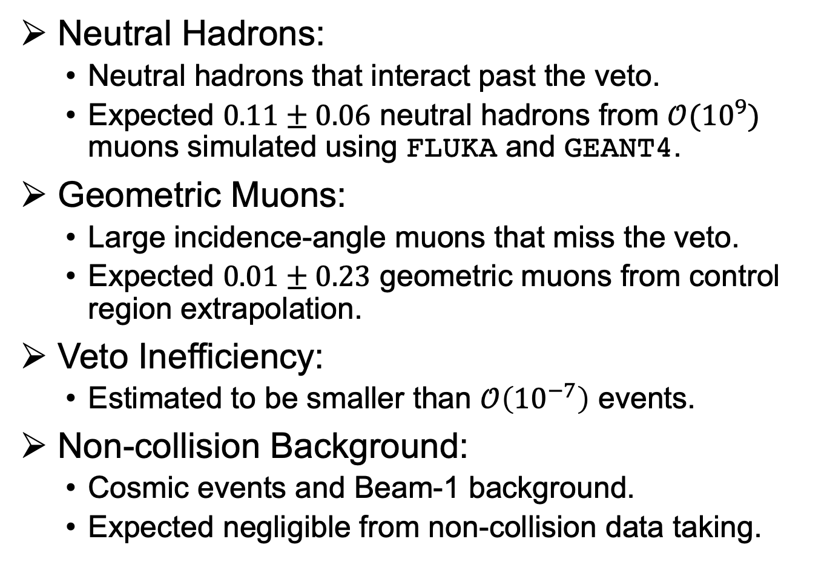







Collider Neutrino Backgrounds
$$μ^{−}$$
Neutral Hadrons
Neutral Hadrons:
  Neutral hadrons that interact past the veto.
  Expected $0.11±0.06$ neutral hadrons from $𝒪({10}^{9})$ muons simulated using FLUKA and GEANT4.
Geometric Muons:
  Large incidence-angle muons that miss the veto.
  Expected $0.01±0.23$ geometric muons from control region extrapolation.
Veto Inefficiency:
  Estimated to be smaller than $𝒪\left({10}^{−7}\right)$ events.
Non-collision Background:
  Cosmic events and Beam-1 background.
  Expected negligible from non-collision data taking.
$$μ^{−}$$
$$K_{s}$$
$$μ^{−}$$
$$ν_{μ}$$
$$π^{+}$$
Geometric Muons
$$μ^{−}$$
$$μ^{−}$$
Veto Inefficiency
$$μ^{−}$$
Notes:
In terms of background, we expect muons to very rarely produce neutral hadrons in the concrete, which then pass the veto and decay in the emulsion detector. To estimate this, we simulate many muons starting 8 m inside the concrete in front of FASER and count how many produce a high momentum muon. We found that most often muons enter the emulsion detector alongside the neutral hadron, which would trigger the veto.
Muons may also enter the detector from the side as is the case with geometric muons, which are estimated in the control region by selecting track with a low amount of hits on the trackers, then scaling this to the signal region. Zero tracks met the momentum requirement (the error is the 3 sigma upper limit of the expectation value of a poisson process with zero observed events).
The remaining two backgrounds can be dealt with in the same way as for the dark photon.

Slide 12
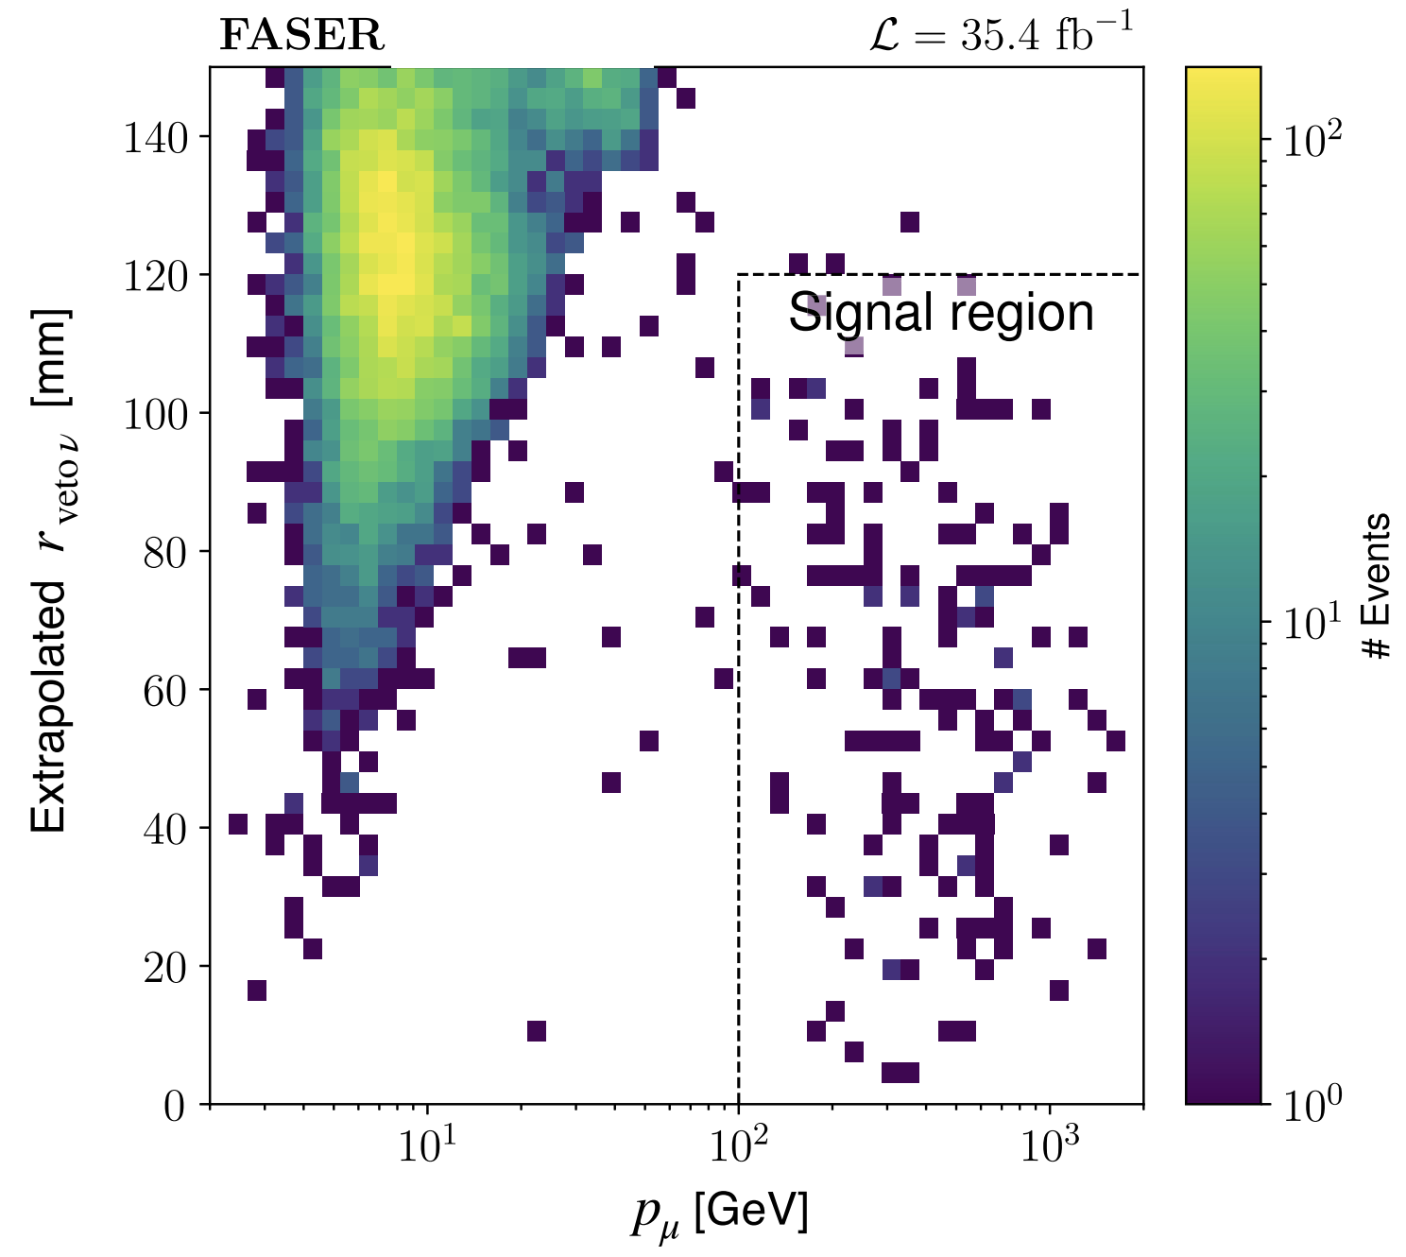
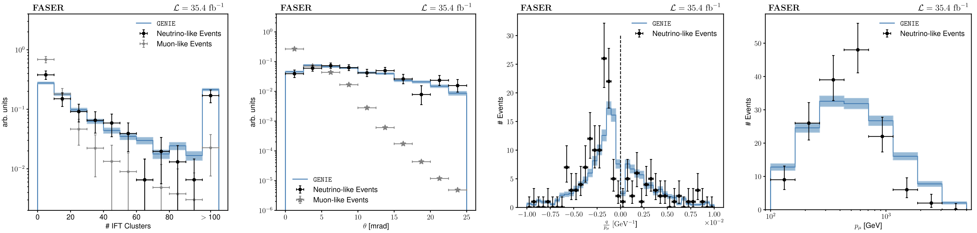
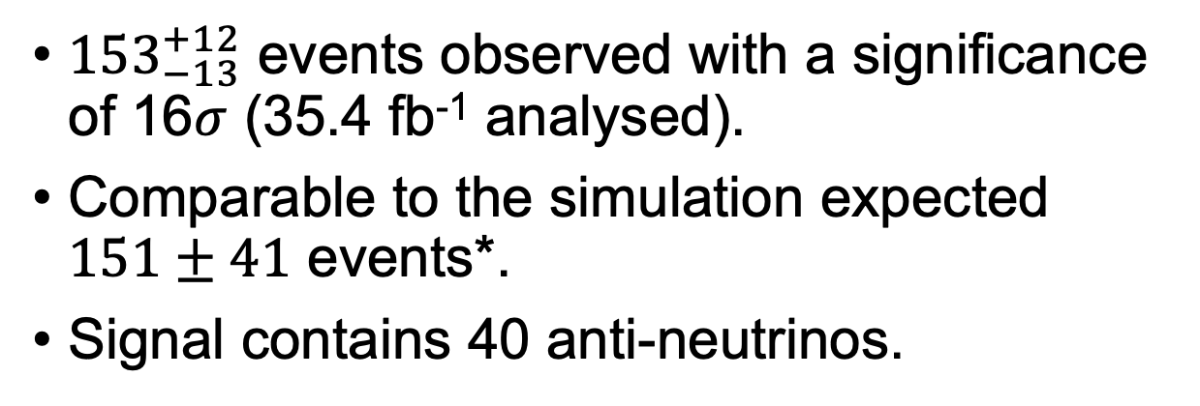


Collider Neutrino Results
${153}_{−13}^{+12}$ events observed with a significance of 16$σ$ (35.4 fb⁻¹ analysed).
Comparable to the simulation expected $151±41$ events*.
Signal contains 40 anti-neutrinos.
*Uncertainty due to the generator discrepancy for forward hadron production.
$$ν_{μ}$$
$$\overline{ν_{μ}}$$
GENIE does not include experimental systematic uncertainties such as that on momentum resolution.
Notes:
After analyzing 35.4 inv fb, about 150 neutrinos were observed with a 16 sigma significance, which is comparable to the number predicted from the GENIE simulation of muons interacting in the emulsion volume. The uncertainty comes from using an average of the not so well understood forward hadron fluxes as predicted by DPMJET and SYBILL (discrepancy from the mean is about 27%). However, this does not include experimental systematics.
The bottom plots show that neutrino-like events match the genie prediction much better than muon-like events, and also noteworthy is the third graph showing the q/p distribution, having both negative and positive values, which indicates we are seeing anit-neutrinos.

Slide 13
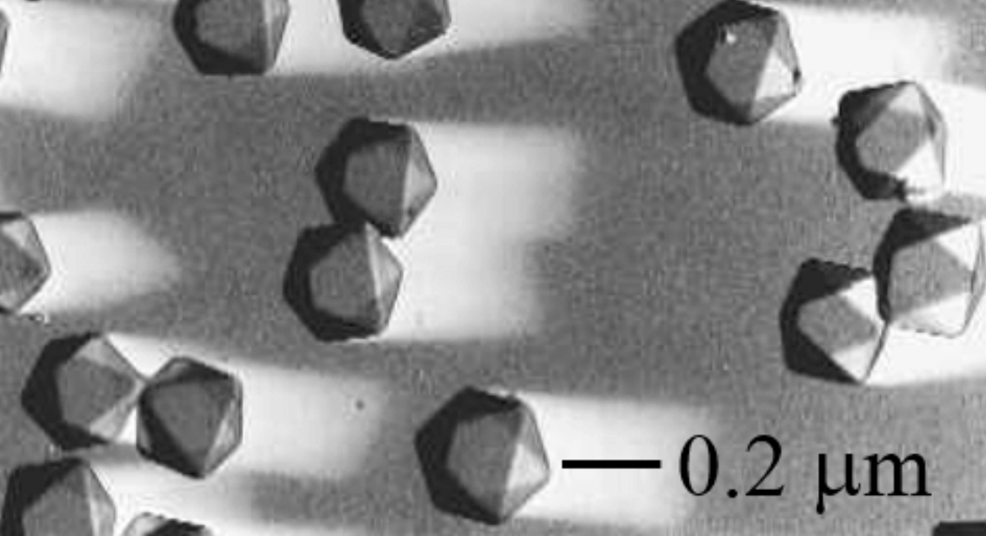
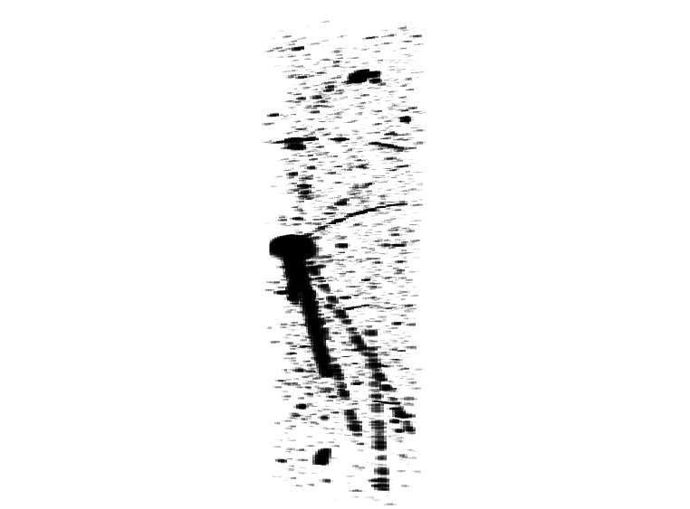

FASER$ν$
1.1 ton, 1m long target mass: 730 layers of interleaved tungsten and emulsion films.
Emulsion film contains silver bromide crystals (AgBr) which, after chemical development, record ionization quasi-permanently.
Spatial resolution of 50 nm.
Films saturate at ~ 5x10⁵ tracks/cm² and must be replaced periodically.
First neutrino analysis uses 150 films or 68 Kg (9.5 fb⁻¹ in 2022).
Notes:
I kept mentioning emulsion in pervious slides but I’m aware that not everyone knows this technique, so before I continue with neutrinos, let me introduce FASERnu.
FASERnu is a 1 ton box filled with 730 alternating layers of tungsten sheet and emulsion films.
These films contain microscopic crystals which record ionization quasi-permanently, but need to be chemically developed a little like polaroids in the past.
While this gives us a stunning 10^14 detection channels per cm^3, it also means that if we collect more than 10^6 tracks we may no longer be able to tell them apart, which is why the films are replaced during technical stops.
What’s more, the films take time to develop and because of this, only 150 films were used for last year’s analysis.
!!! The picture is a scanned neutrino vertex from the FASERnu pilot study. Energy deposition is proportional to the denseness of the track. The image is 150x120x50 microns.

Slide 14
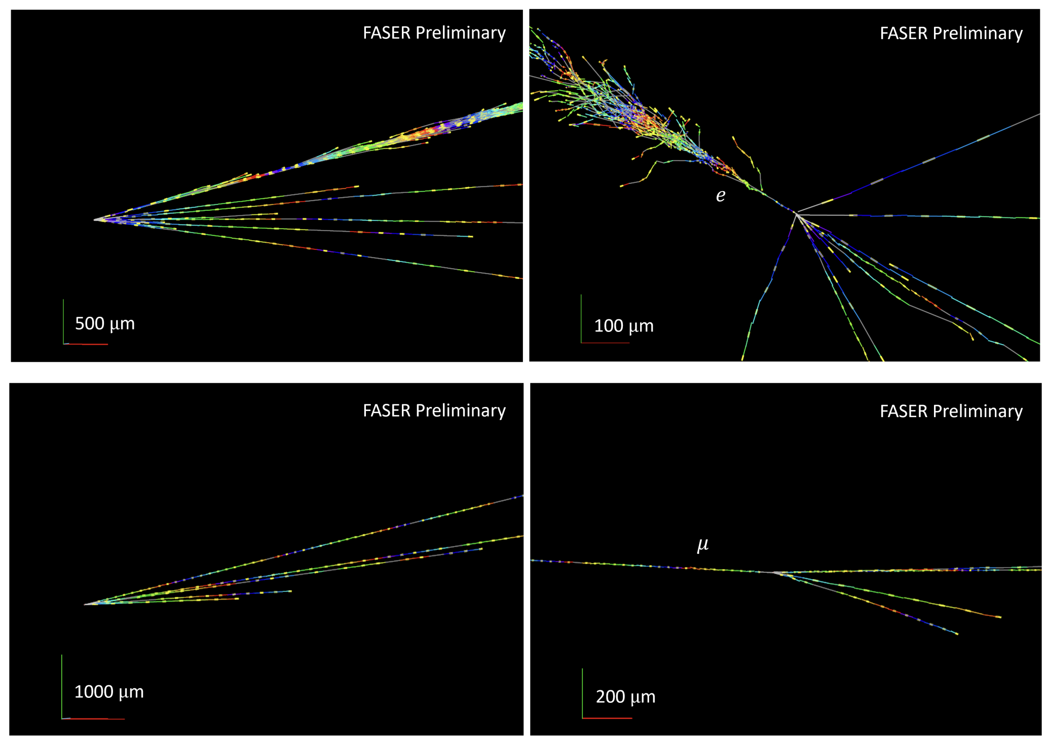

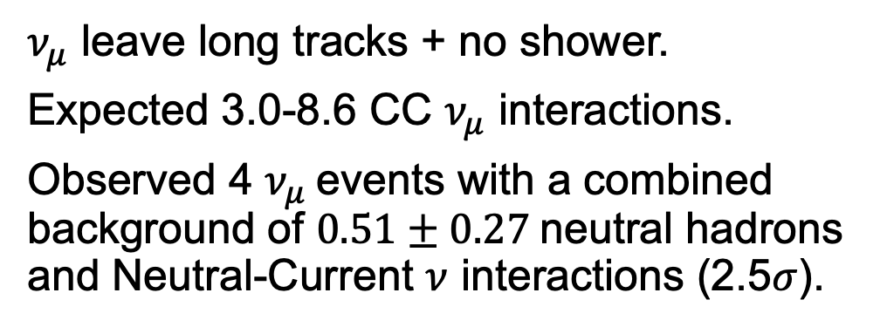
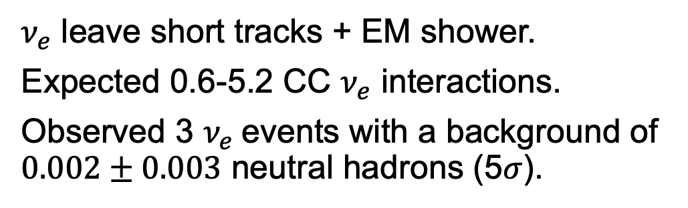
Transverse View
Lab Frame
Transverse View
Lab Frame
$ν_{e}$ leave short tracks + EM shower.
Expected 0.6-5.2 CC $ν_{e}$ interactions.
Observed 3 $ν_{e}$events with a background of $0.002±0.003$ neutral hadrons (5$σ$).
$ν_{μ}$ leave long tracks + no shower.
Expected 3.0-8.6 CC $ν_{μ}$ interactions.
Observed 4 $ν_{μ}$events with a combined background of $0.51±0.27$neutral hadrons and Neutral-Current $ν$ interactions (2.5$σ$).
First collider $ν_{e}$ observation!
CERN-FASER-CONF-2023-002
Notes:
However, the results are stunningly detailed images of Charge-Current neutrino interactions.
FASERnu identified 3 electron neutrinos by their shorter tracks and electromagnetic shower, and 4 muon neutrinos by the absence of those traits.
In the case of electrons, these are the first up to 1.5 TeV energy collider neutrinos ever observed.
Track reconstruction inefficiency is negligible (10^-5) and so one can easily distinguish between events with a charged parent, whose track was recorded upstream, and those with a neutral parent.
To distinguish neutrinos from neutral hadrons tracks are required to be highly boosted in the lab frame (>=3 tracks with tan(theta) < 0.1), as the energy distribution of neutral hadrons reaching the detector drops off much faster than that of neutrinos.

Slide 15
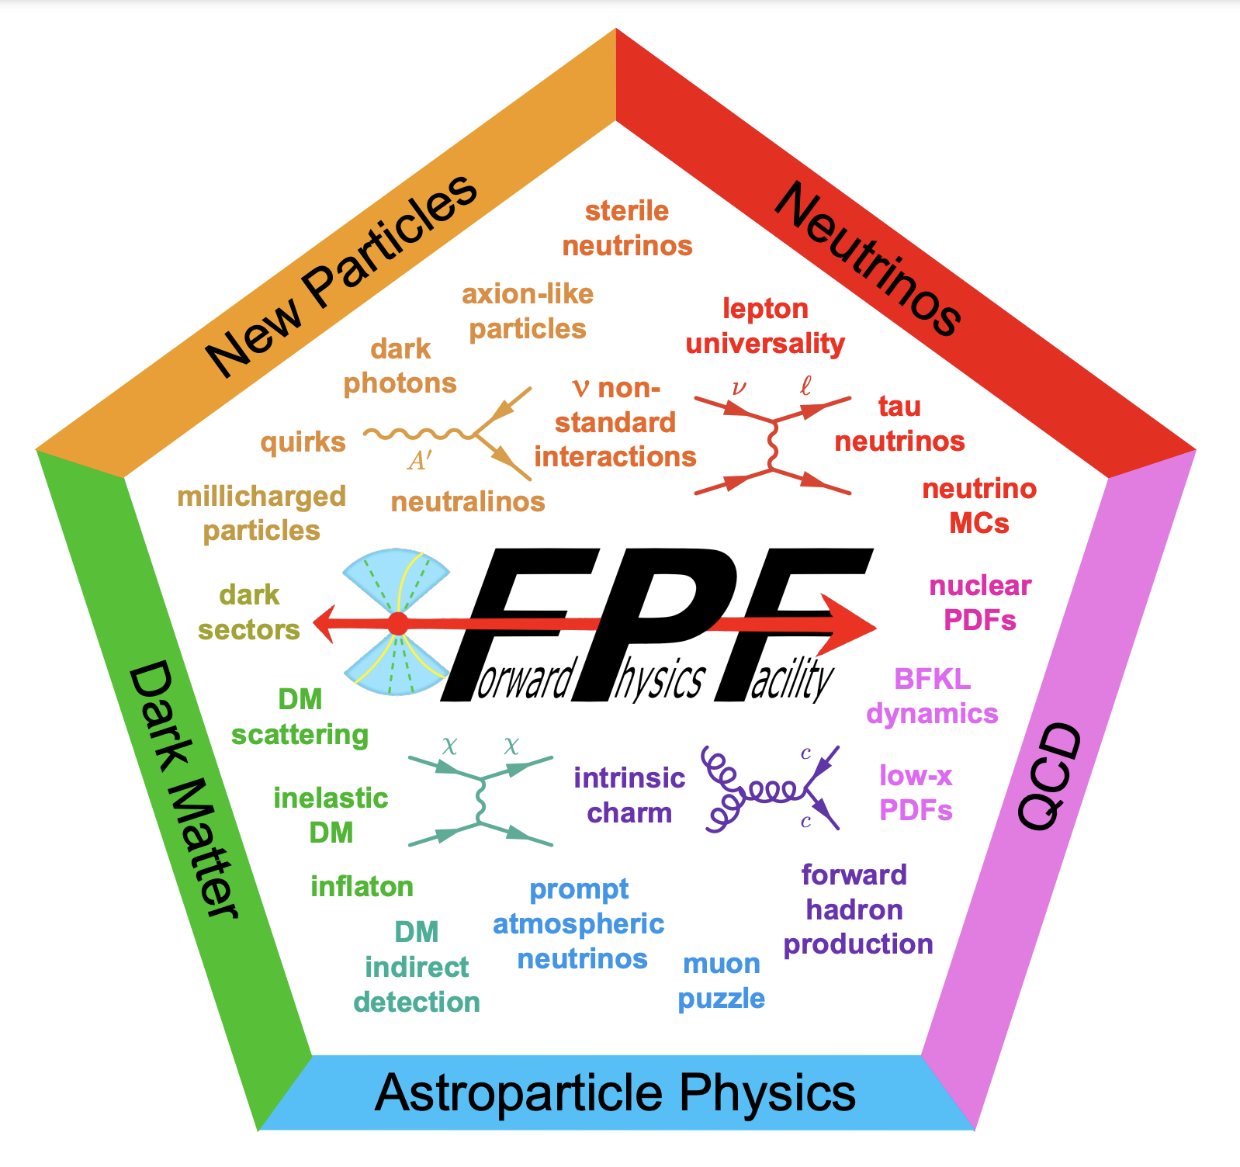
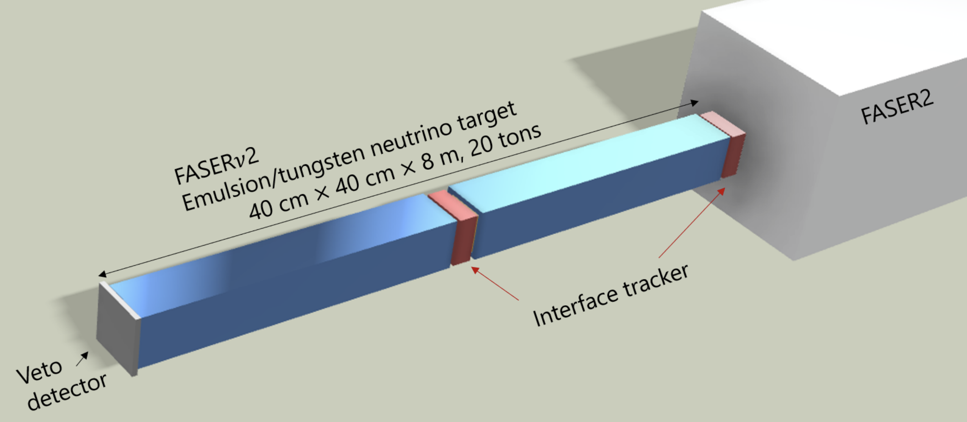
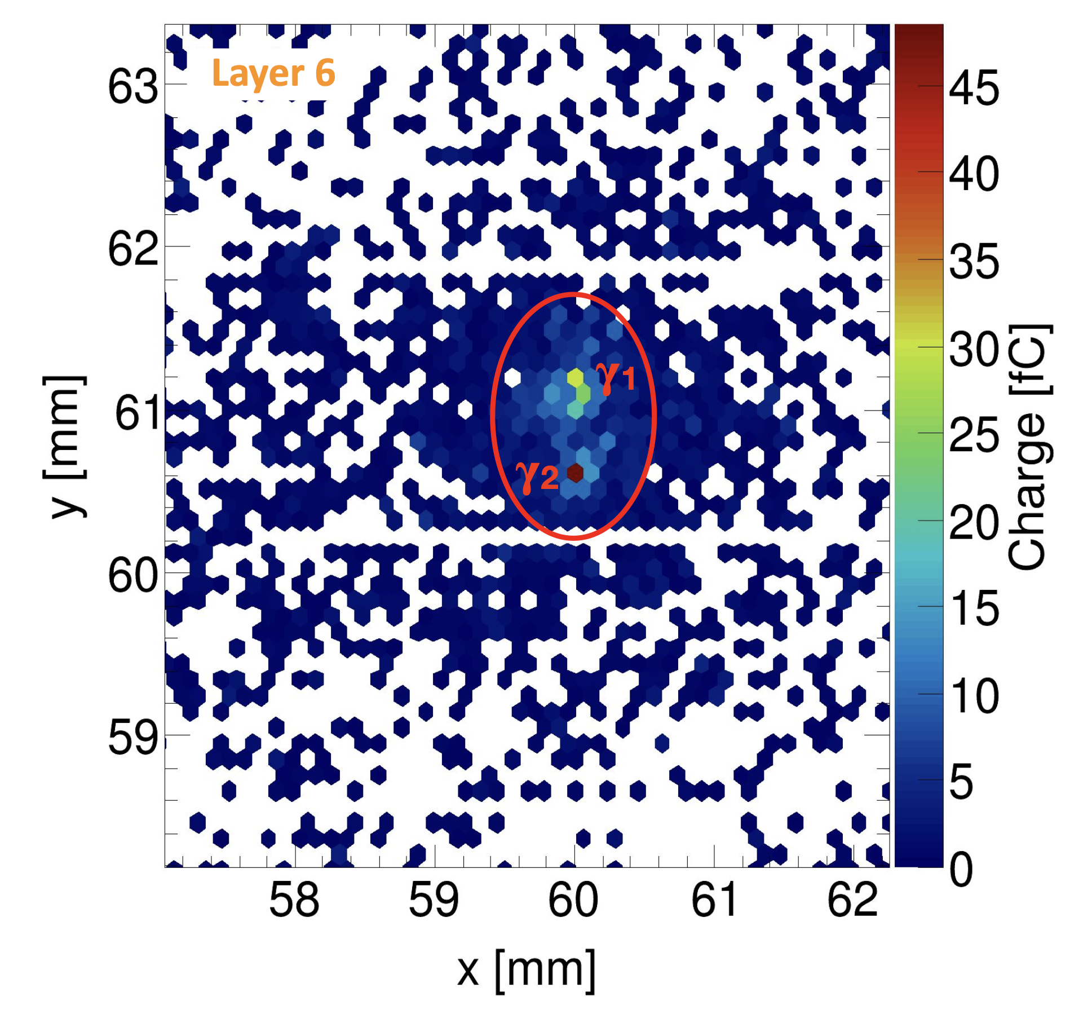
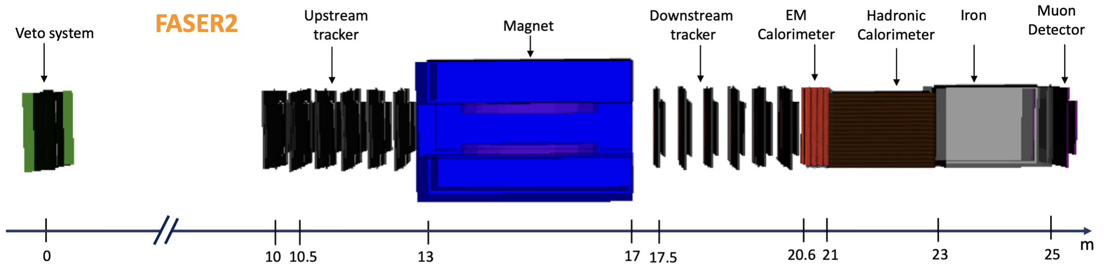
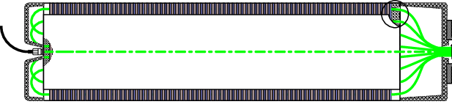
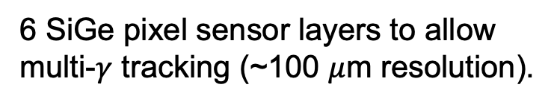
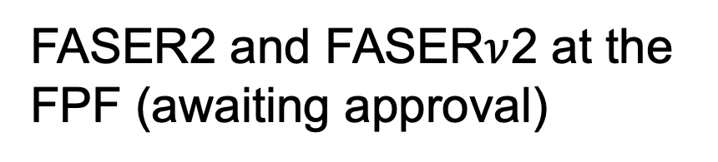
What to Look Forward To
Preshower Technical Proposal (2022)
YETS 2023
FPF Facility Project Proposal (2022)
YETS 2024
HL-LHC
Preshower Upgrade
FASER2 and FASER$ν$2 at the FPF (awaiting approval)
6 SiGe pixel sensor layers to allow multi-$γ$ tracking (~100 $μ$m resolution).
1st ALPs Results
You are here
Calorimeter Readout Upgrade
Previously operated at reduced light output.
New readout uses 2 PMTs (high and low gain).
PMT
FASER approved for Run 4!
PMT
FASER Run 4 Letter of Intent (2023)
Notes:
Run 4 approved running of FASER without emulsion sheets, for minimal extra runtime costs. 250 inv fb (Run 3) + 680 inv fb (Run 4) of data.

Slide 16
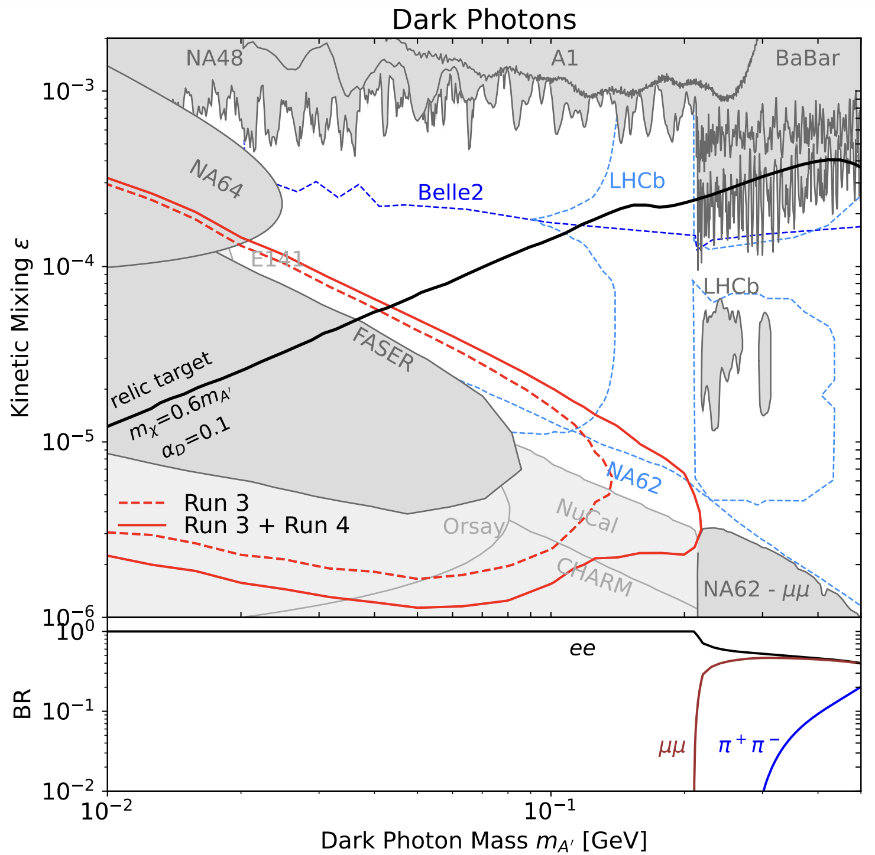
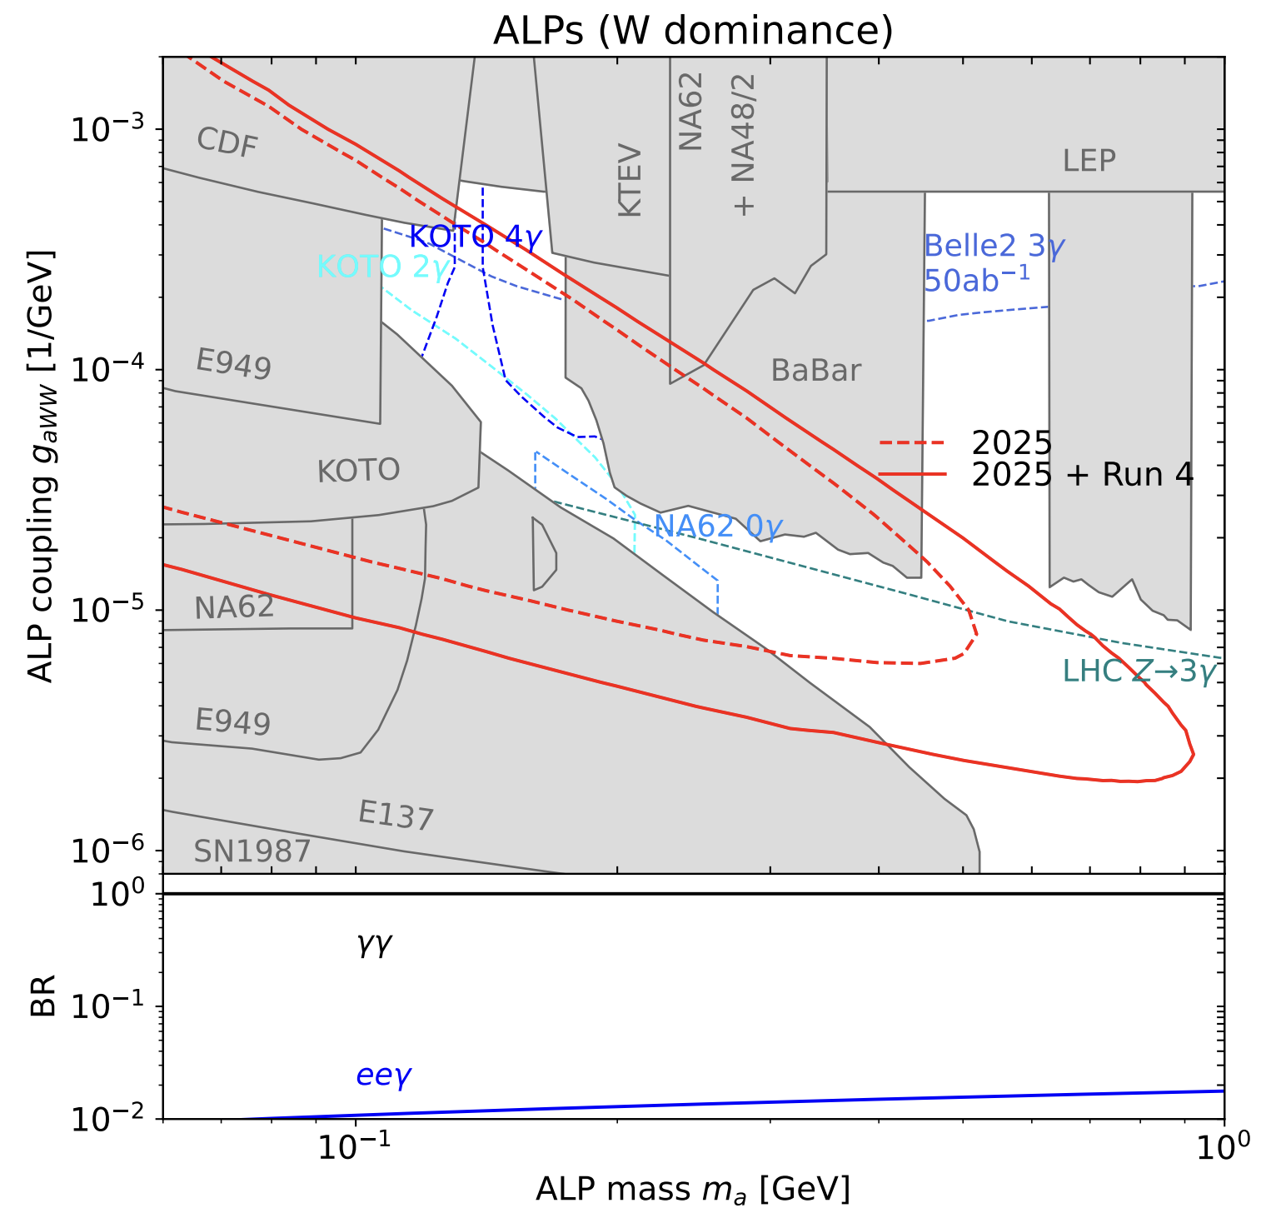
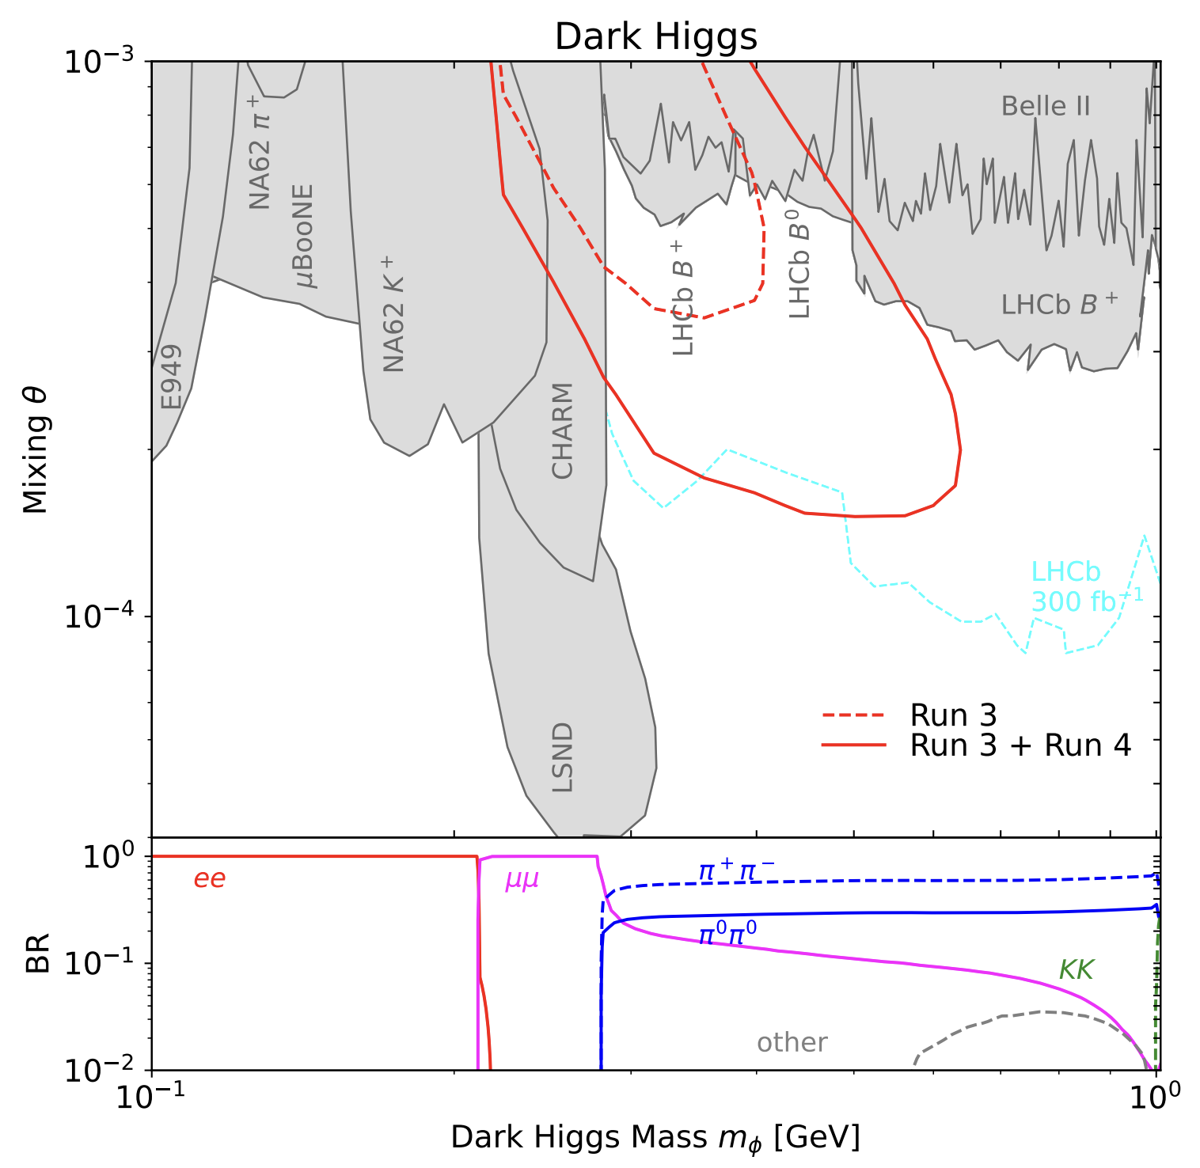
What to Look Forward To… For Run 4
(assuming 250 fb⁻¹ in Run 3 and 680 fb⁻¹ in Run 4)

Slide 17
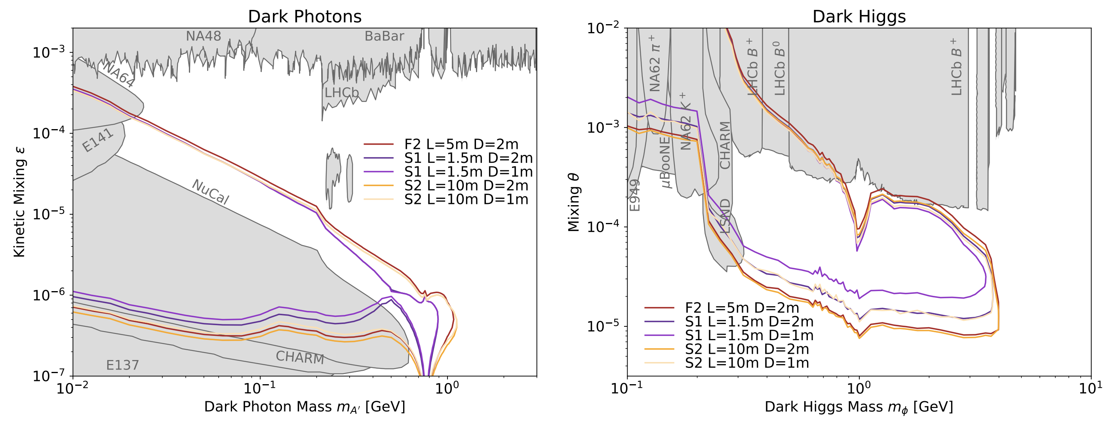
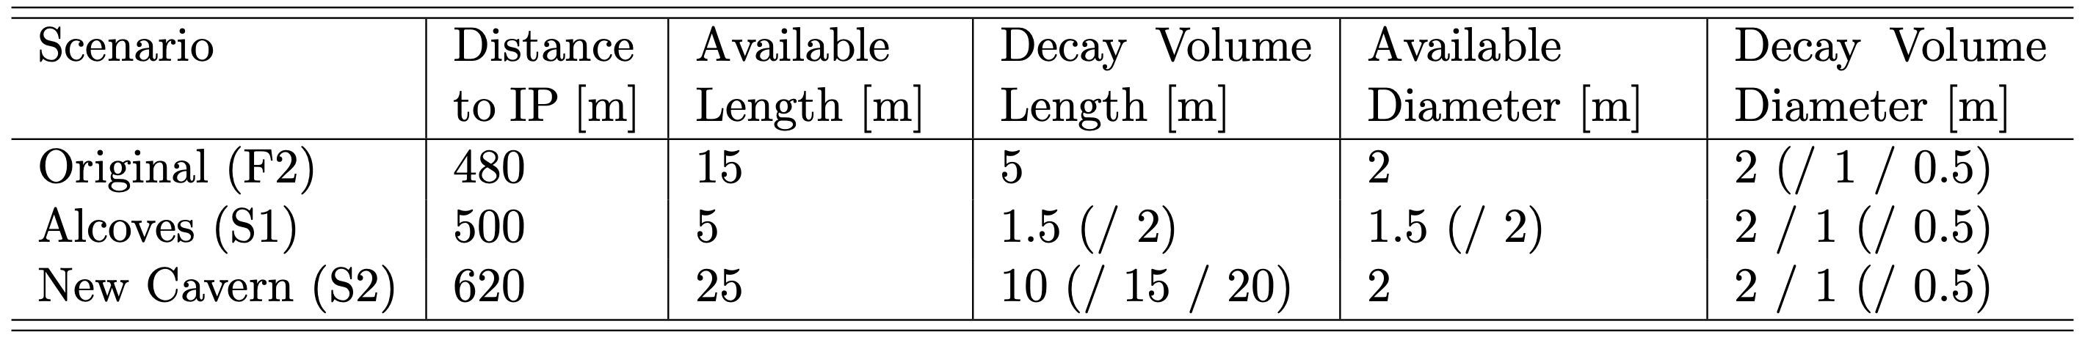
FASER2 at the Forward Physics Facility
awaiting
approval

Slide 18
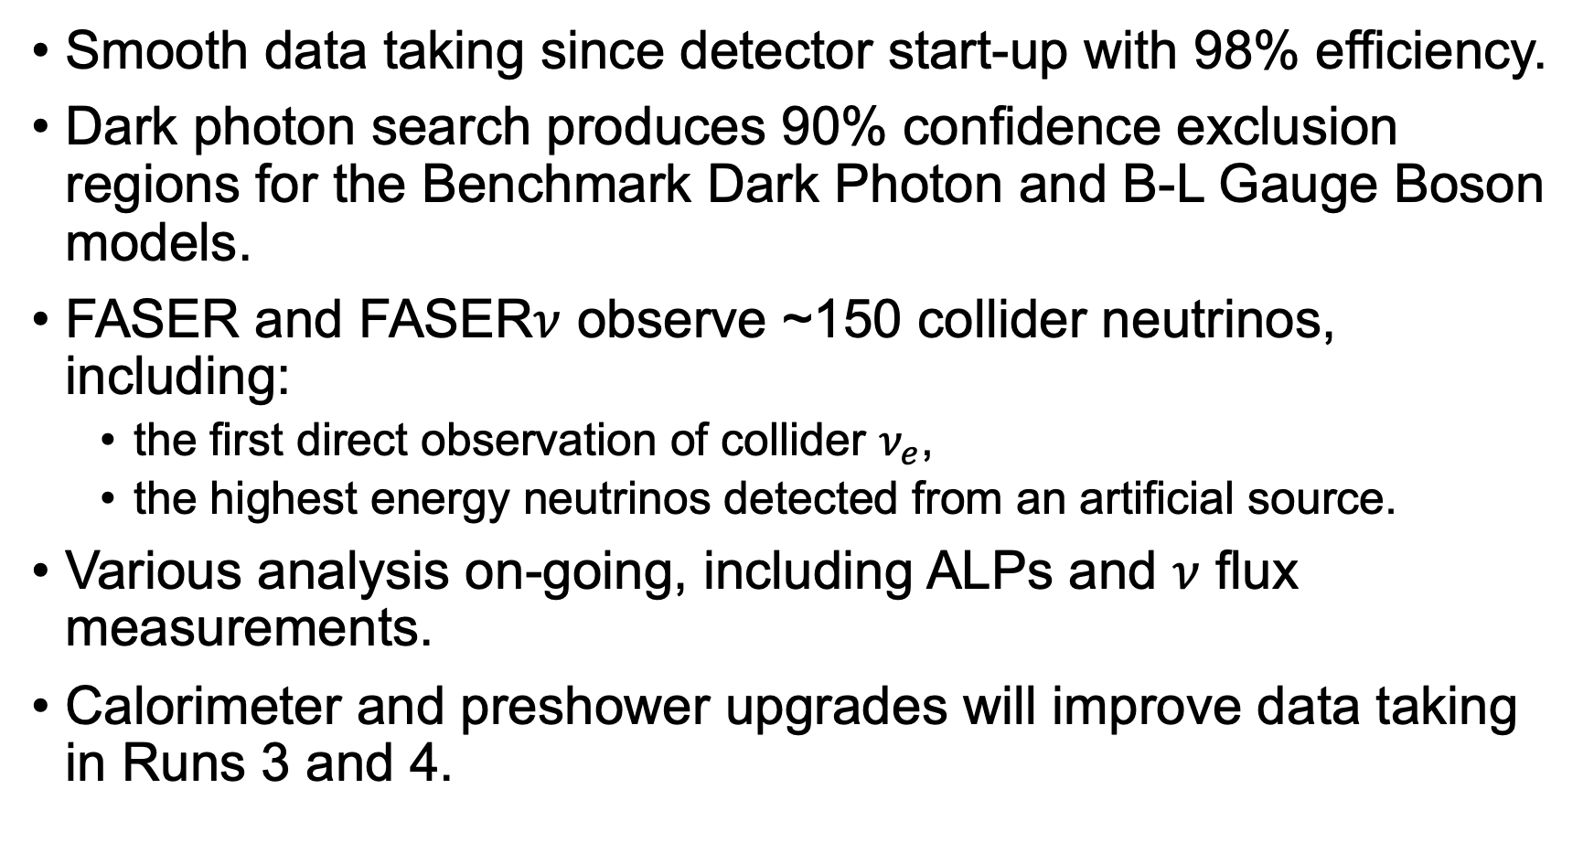
Summary
Smooth data taking since detector start-up with 98% efficiency.
Dark photon search produces 90% confidence exclusion regions for the Benchmark Dark Photon and B-L Gauge Boson models.
FASER and FASER$ν$ observe ~150 collider neutrinos, including:
  the first direct observation of collider $ν_{e}$,
  the highest energy neutrinos detected from an artificial source.
Various analysis on-going, including ALPs and $ν$ flux measurements.
Calorimeter and preshower upgrades will improve data taking in Runs 3 and 4.

Slide 19
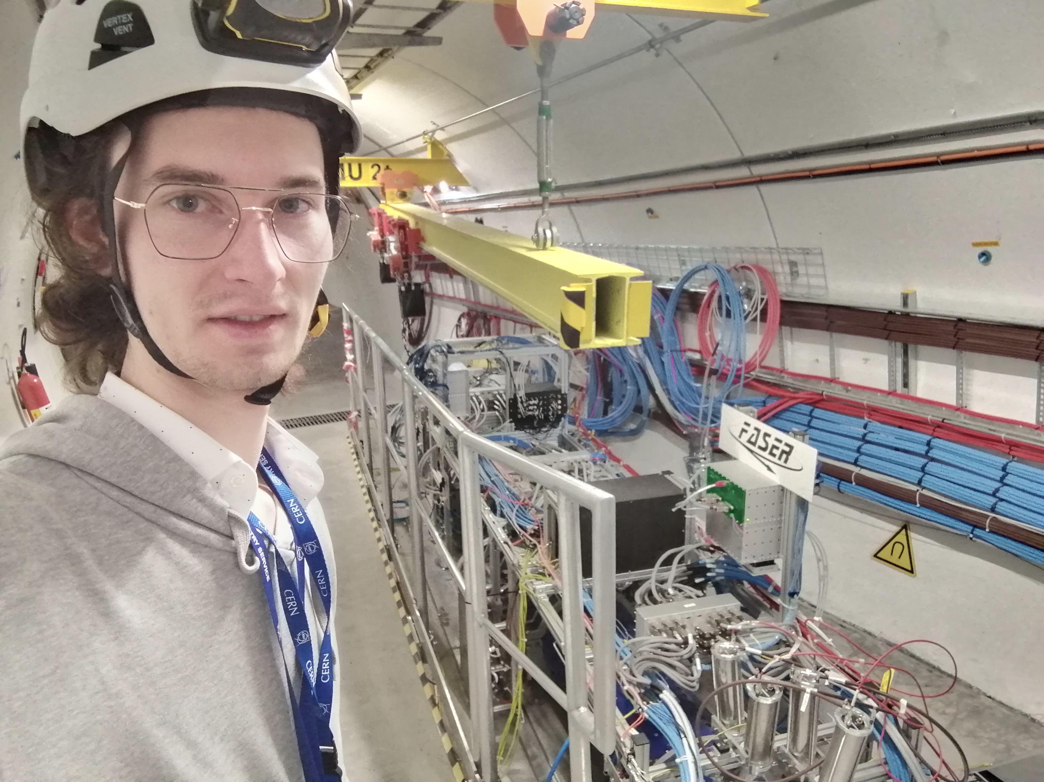
Thank you for your attention :)

Slide 20
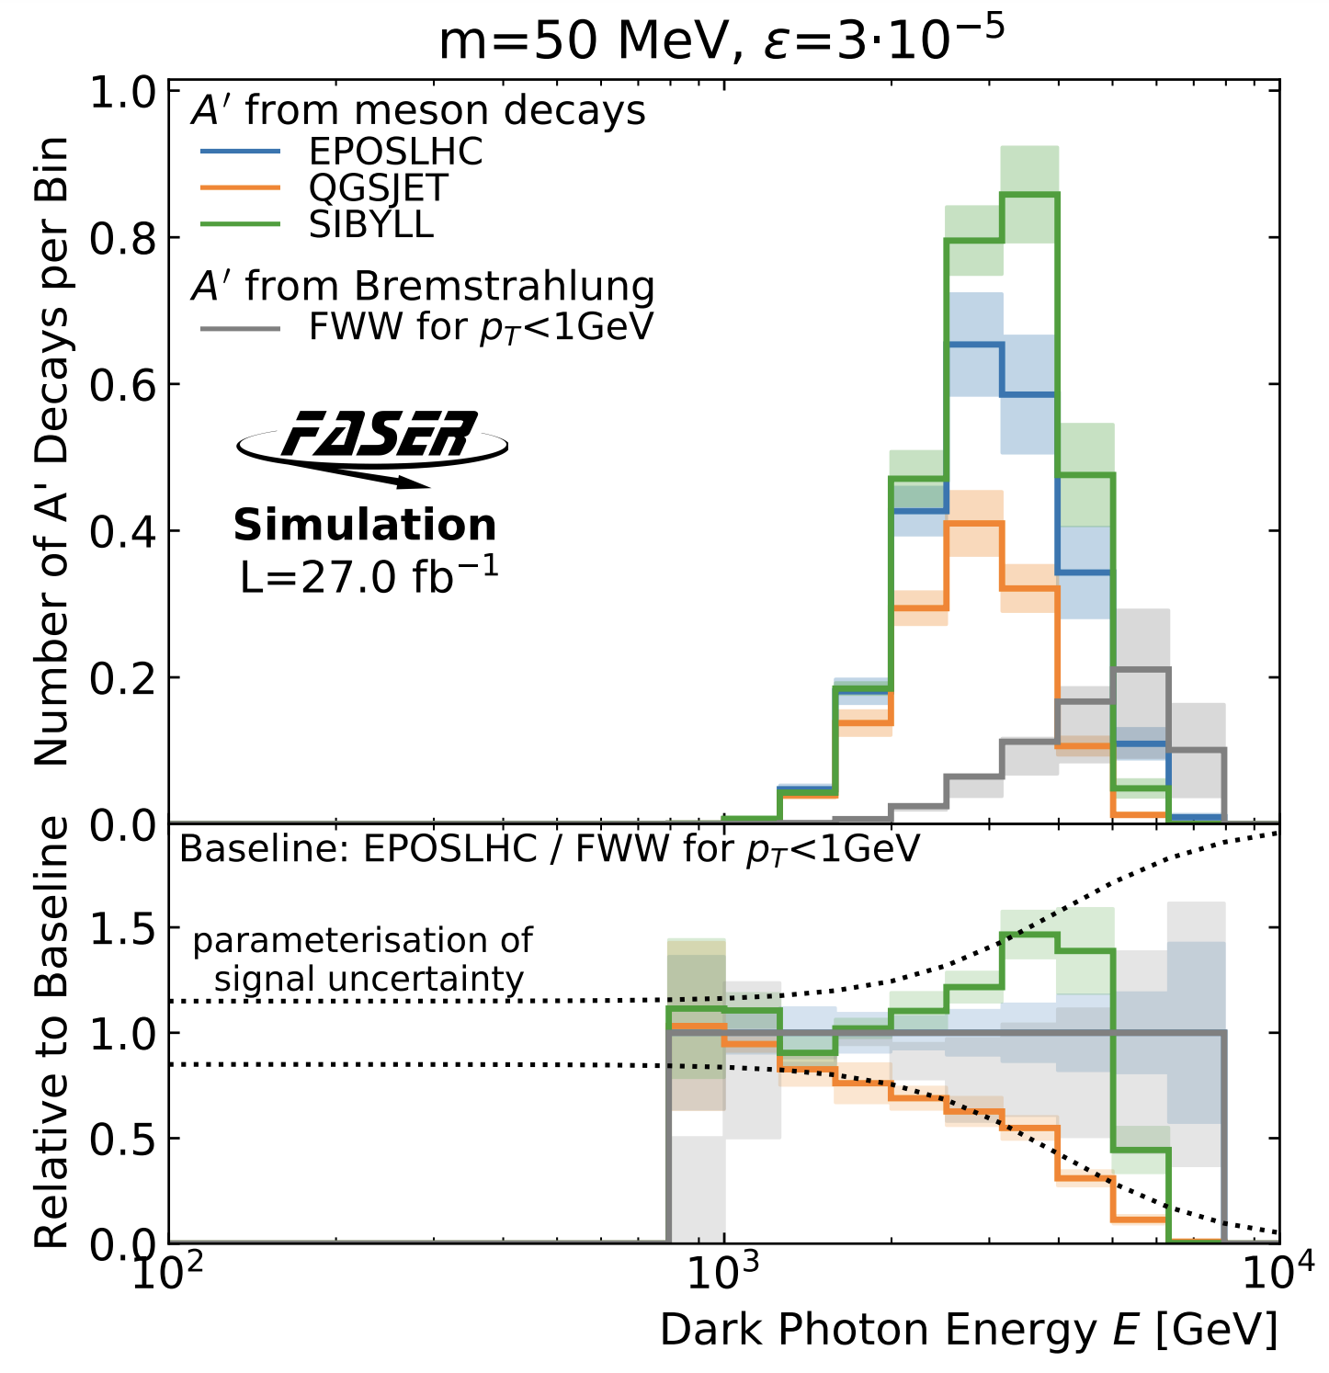
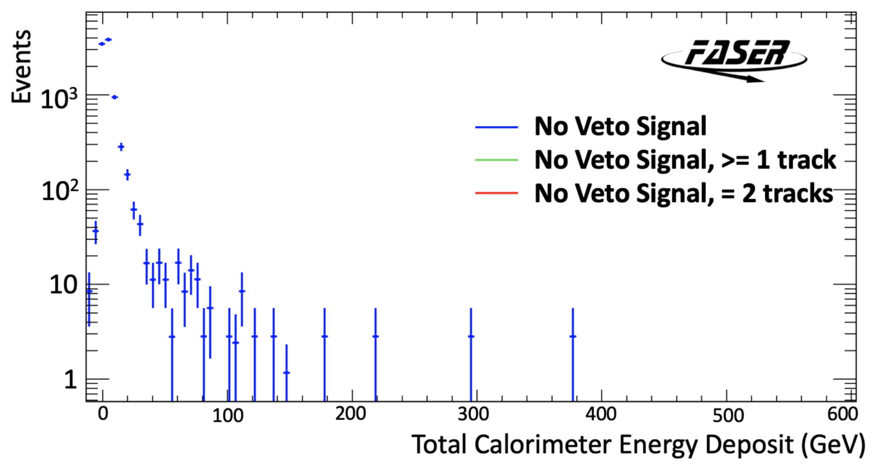
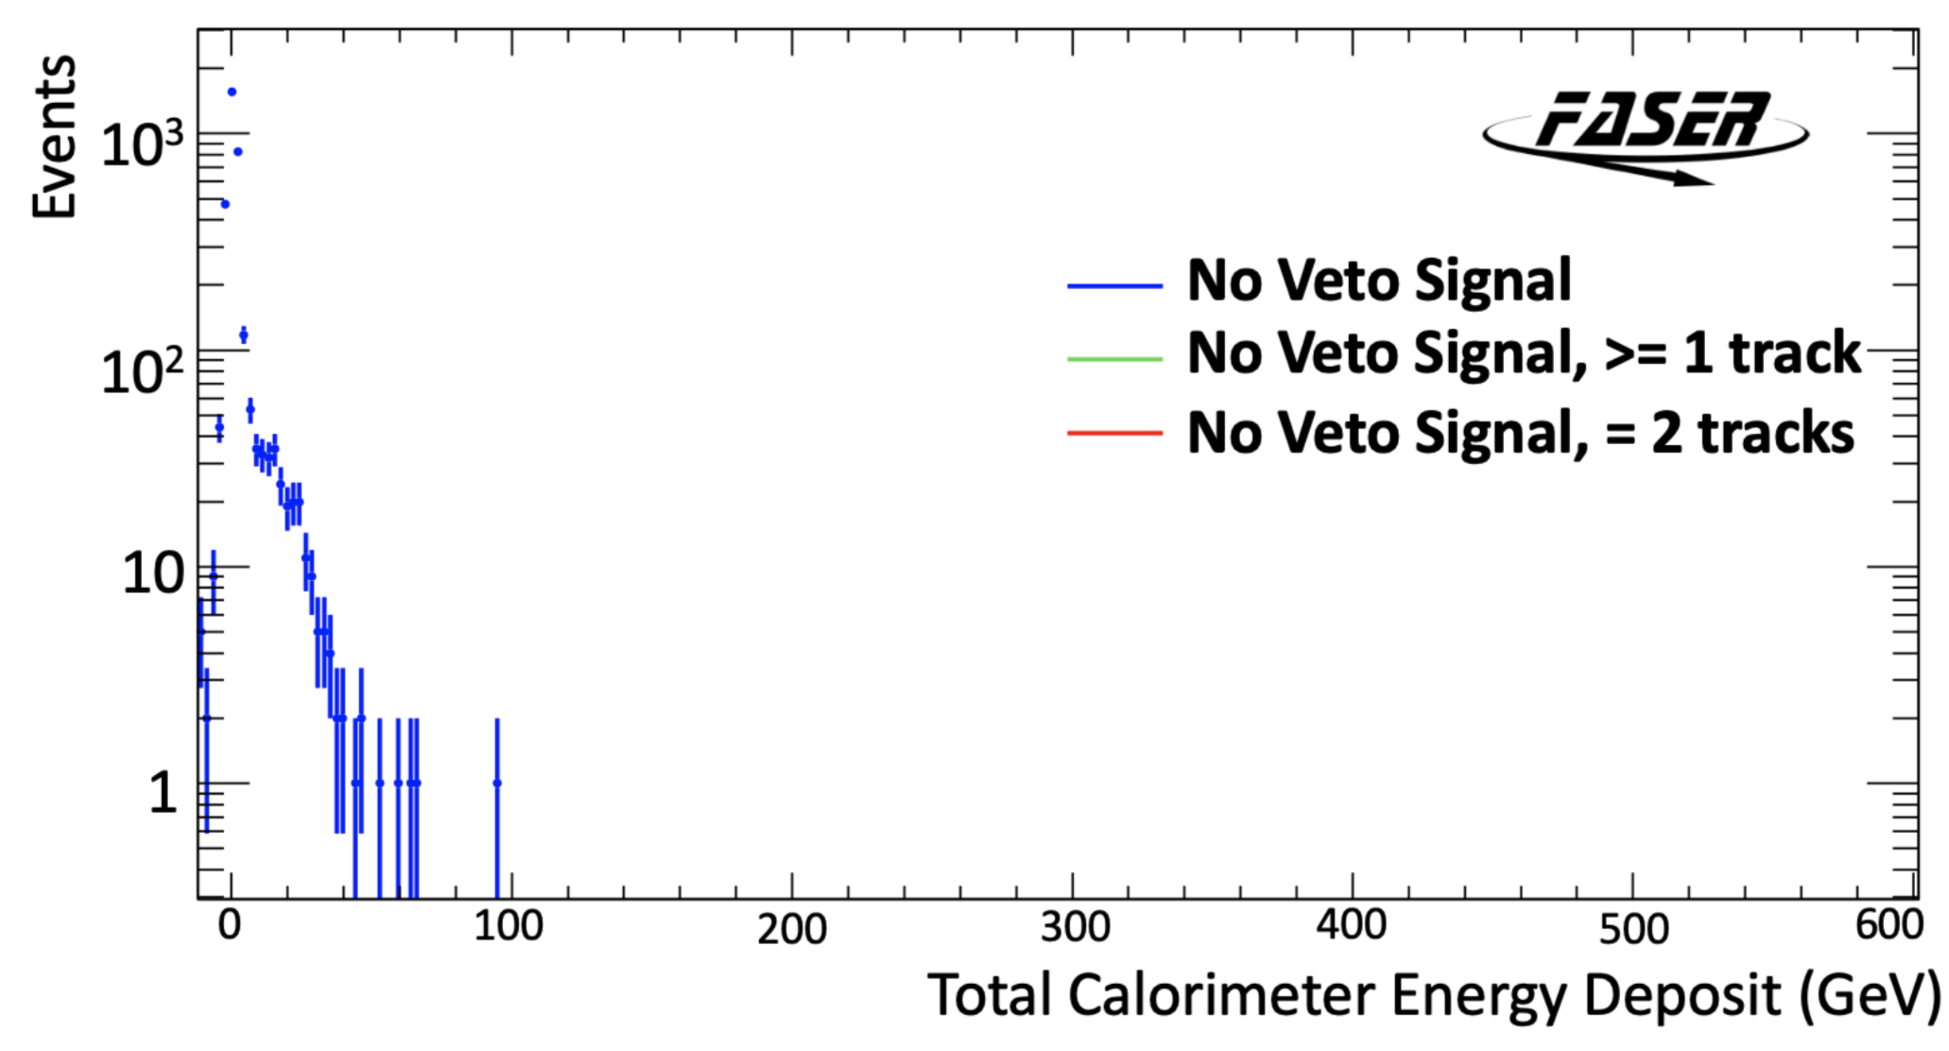
Dark Photons: energy-dependent generator model uncertainty estimation (left) and non-collision background control samples after various selections (right).
Beam-1 Control Sample
Cosmic Control Sample

Slide 21
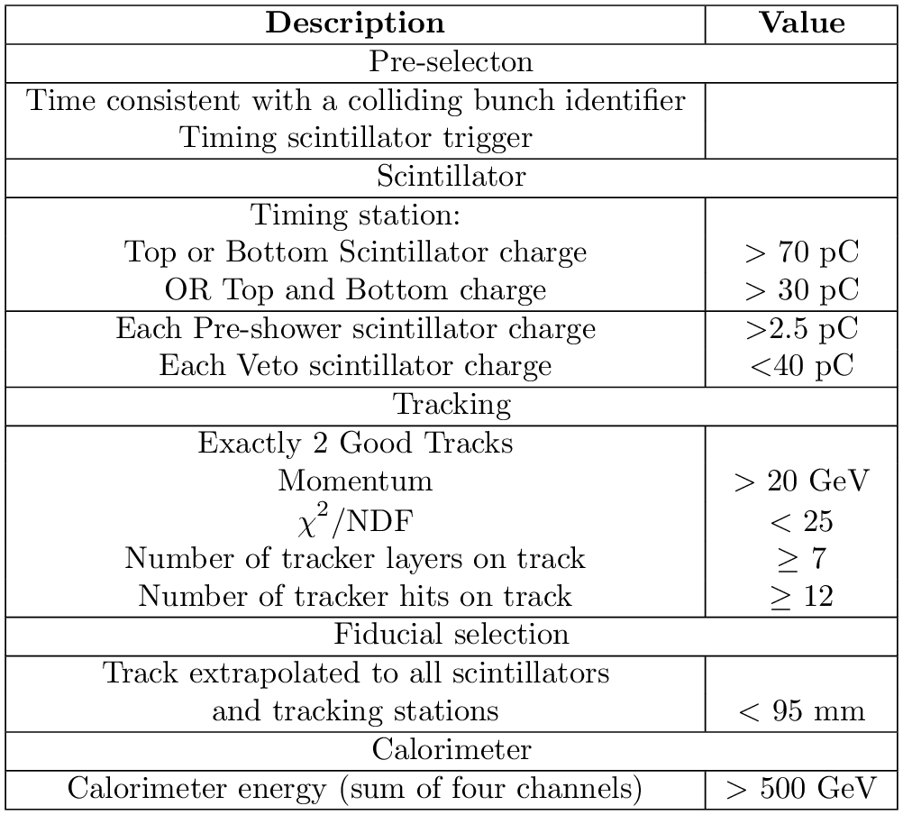
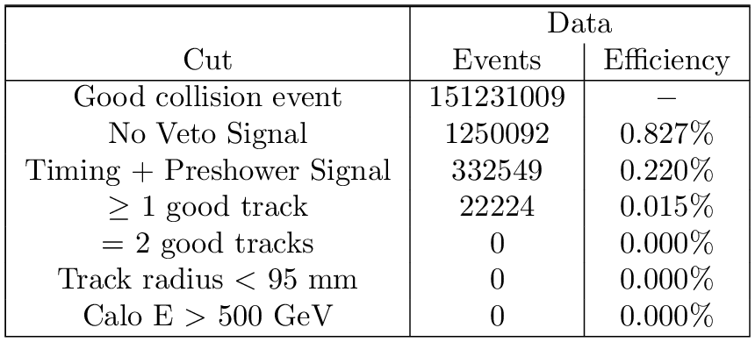
Dark Photons: events remaining after applying different selection criteria (bottom) and all selection criteria applied(right).

Slide 22
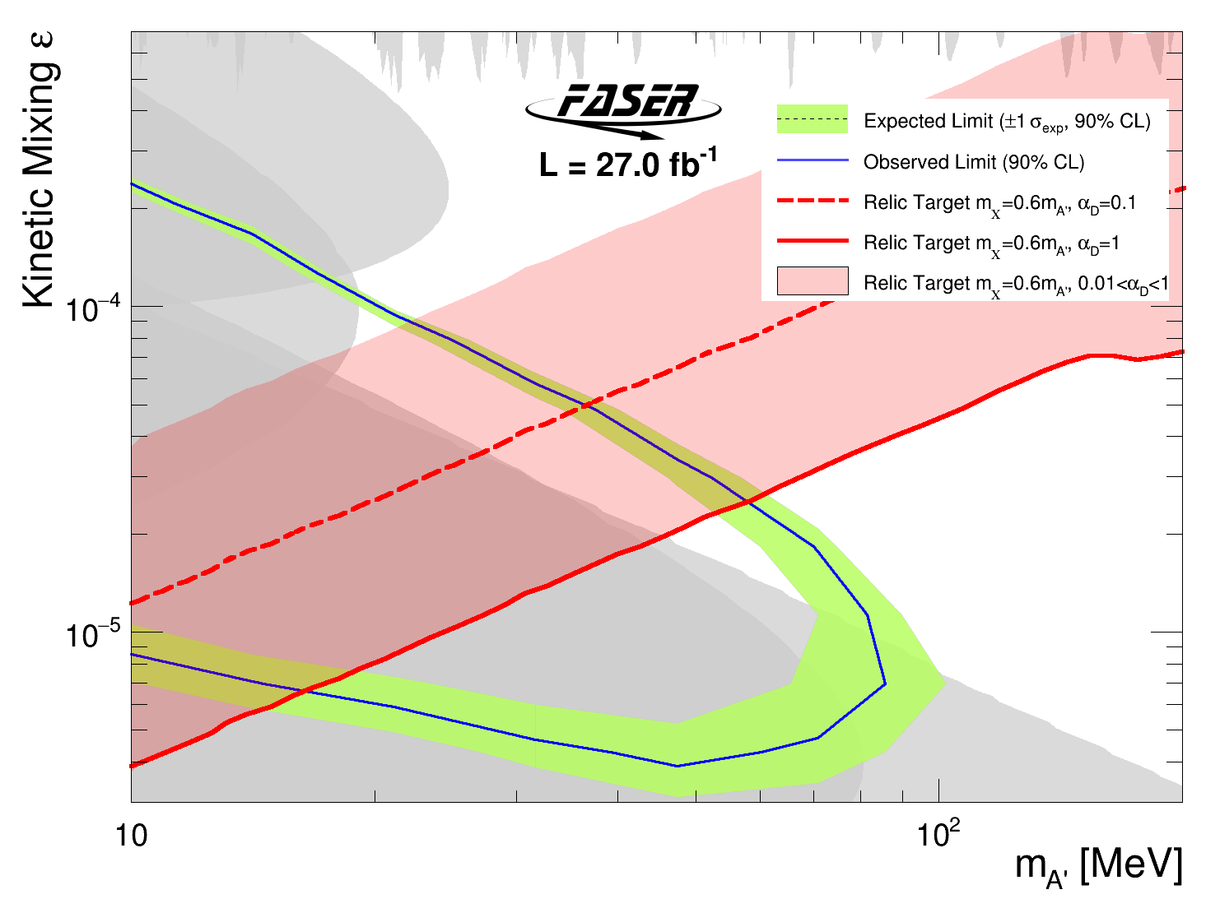
Dark Photons: exclusion plot with a cosmic relic target band, corresponding to different values of the model-dependent parameters $m_{χ}$ and $α_{D}$.

Slide 23


Dark Photons: FASER comparison with exclusion regions set by other experiments.

Slide 24

Collider Neutrinos: geometric muon background estimation using control region data.

Slide 25


FASER$ν$: 2 fb⁻¹ MC energy spectra of neutral hadrons and neutrinos entering the detector.

Slide 26





FASER$ν$: $v_{e}$ (top) and $v_{μ}$ (bottom) MC and data comparison of track multiplicity, collision axis angle, momentum and azimuthal angle.
$$ν_{e}$$
$$ν_{μ}$$

