Slide 1




Updating cuts for the FCC-ee Higgs CP Study
Nicholas Pinto (JHU), Andrei Gritsan (JHU), Jan Eysermans (MIT), Valdis Slokenbergs (JHU)
Higgs/Top Performance Meeting
23 January 2024

Slide 2
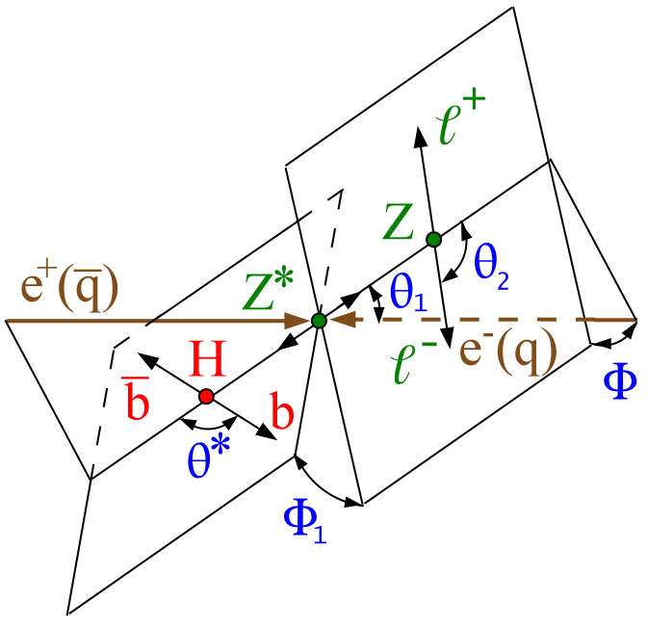
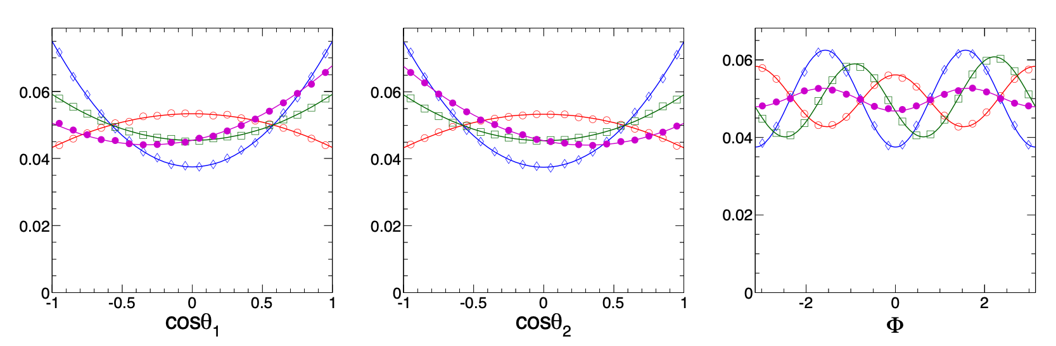
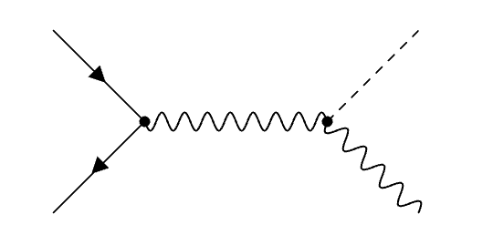
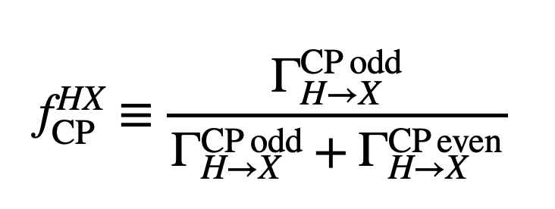
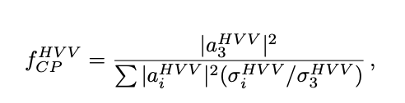









Past Studies: Snowmass 2013
arXiv:1309.4819
$$0^{+}$$
$$0^{−}$$
$$f_{CP}^{VH}=0.5,φ=\frac{π}{2}$$
$$f_{CP}^{VH}=0.5$$
$$e^{−}$$
$$H$$
$$Z^{∗}$$
$$e^{+}$$
$$Z$$
Notes:
Note to self, do I need these?

Slide 3
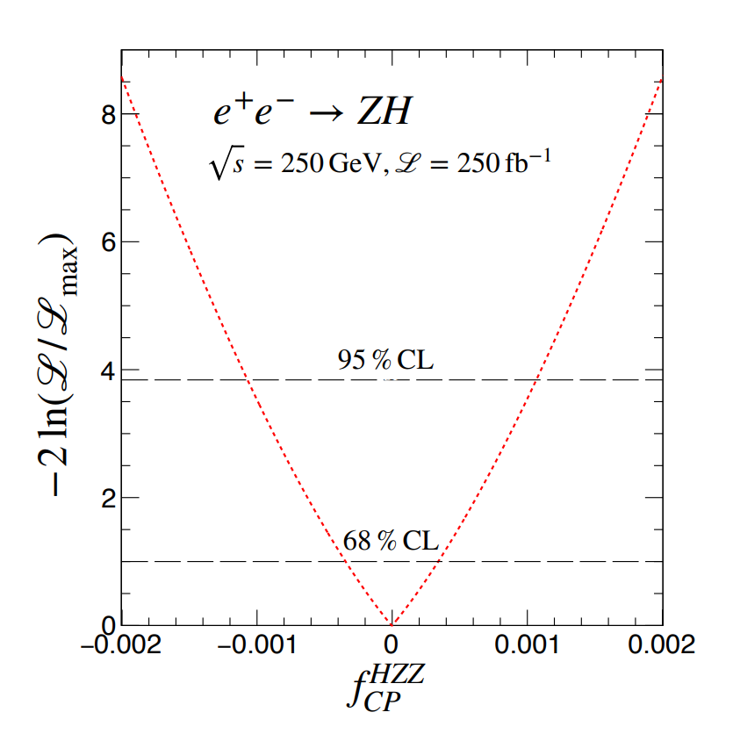
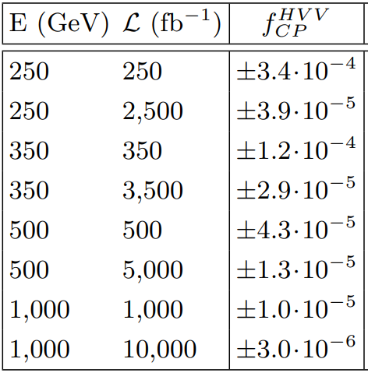
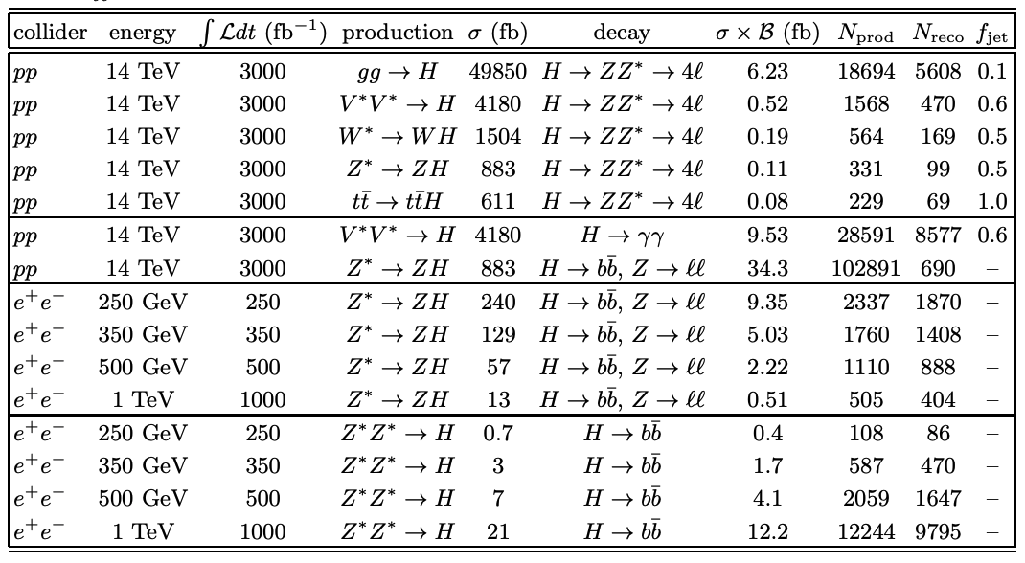
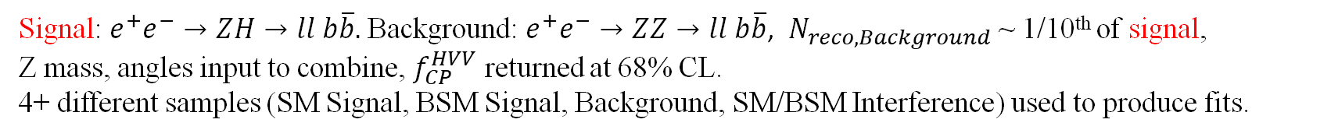
Past Studies: Snowmass 2022
arXiv:2205.07715
Signal: $e^{+}e^{−}→ZH→ll b\overline{b}.$Background: $e^{+}e^{−}→ZZ→ll b\overline{b}$, $N_{reco, Background}$ ~ 1/10th of signal,
Z mass, angles input to combine, $f_{CP}^{HVV}$ returned at 68% CL.
4+ different samples (SM Signal, BSM Signal, Background, SM/BSM Interference) used to produce fits.

Slide 4
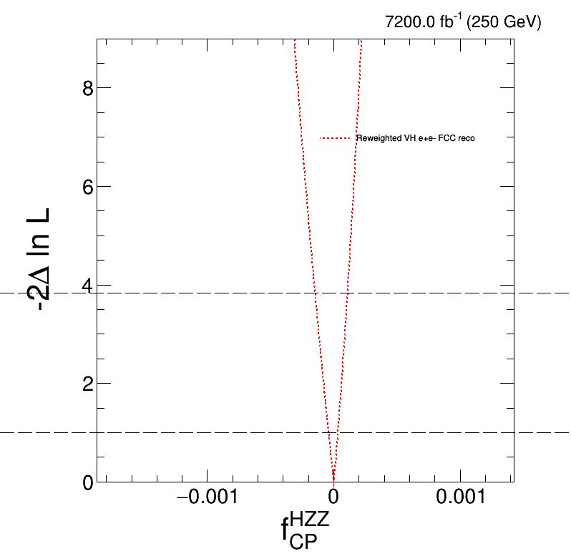
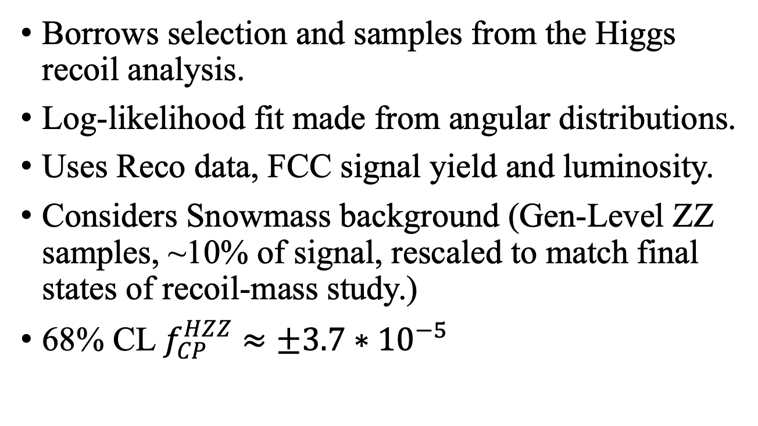
Previous Results:
Borrows selection and samples from the Higgs recoil analysis.
Log-likelihood fit made from angular distributions.
Uses Reco data, FCC signal yield and luminosity.
Considers Snowmass background (Gen-Level ZZ samples, ~10% of signal, rescaled to match final states of recoil-mass study.)
68% CL $f_{CP}^{HZZ}$ $≈±3.7∗{10}^{−5}$
Nicholas Pinto – Johns Hopkins University – Higgs/Top Performance Meeting– 23 Jan. 2024

Slide 5
Goals of Study:
Physics Goals:
Examine behavior of spikes at the extrema of the cosine plots.
Update cuts to reduce background. Include a new cut on the cosine parameter.
Produce updated likelihood fits with all background samples and yields reflective of updated cuts.
Technical Goal:
Incorporate Matrix Element Likelihood Approach (MELA) into the FCC framework directly, rather than reweighting separately.
Nicholas Pinto – Johns Hopkins University – Higgs/Top Performance Meeting– 23 Jan. 2024

Slide 6
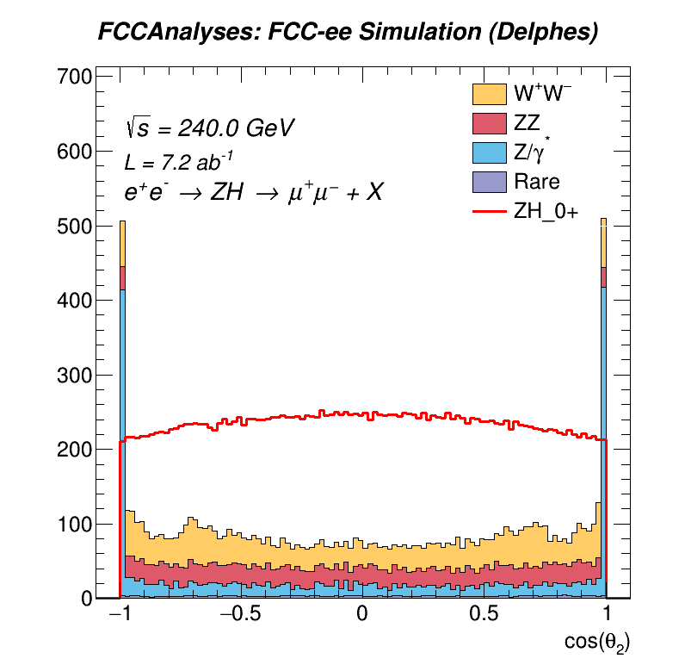
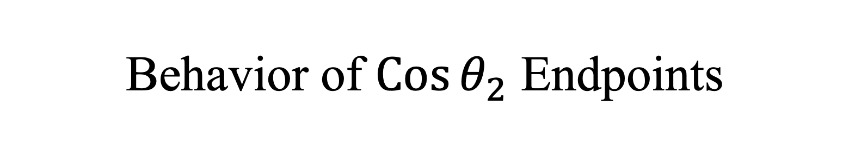
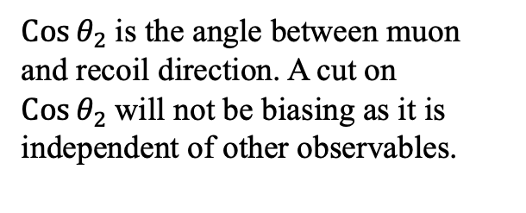
Behavior of $\operatorname{Cos}{θ_{2}}$ Endpoints
$\operatorname{Cos}{θ_{2} }$is the angle between muon and recoil direction. A cut on $\operatorname{Cos}{θ_{2} }$will not be biasing as it is independent of other observables.
Nicholas Pinto – Johns Hopkins University – Higgs/Top Performance Meeting– 23 Jan. 2024

Slide 7
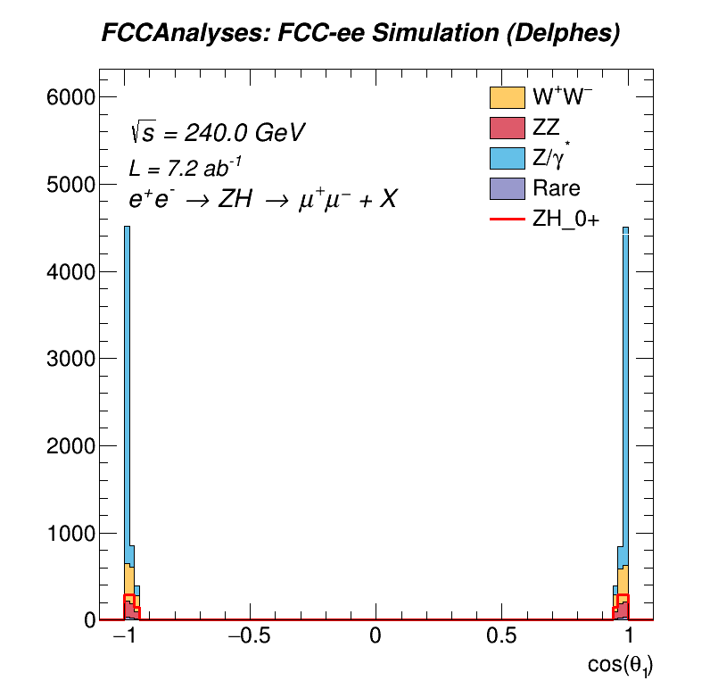
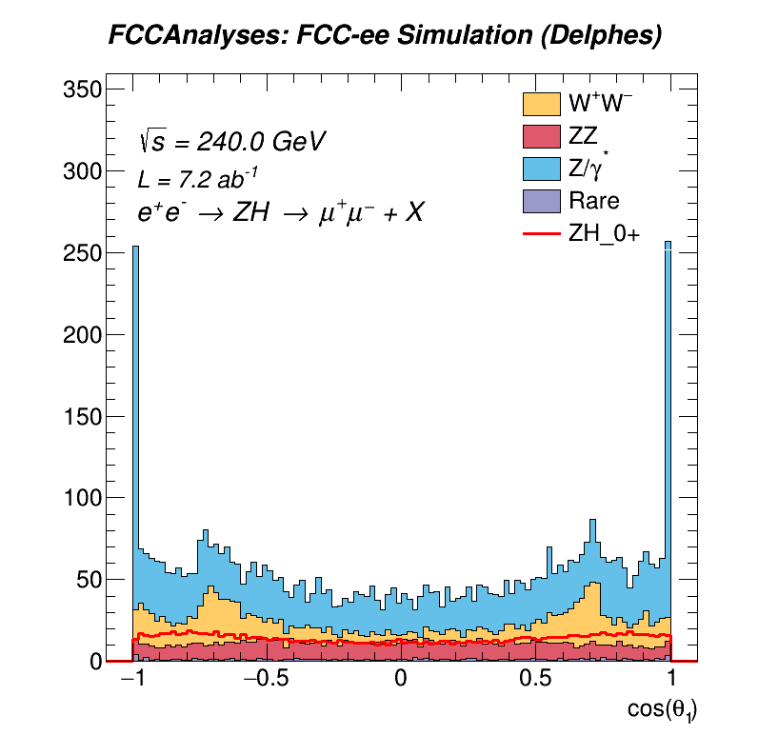
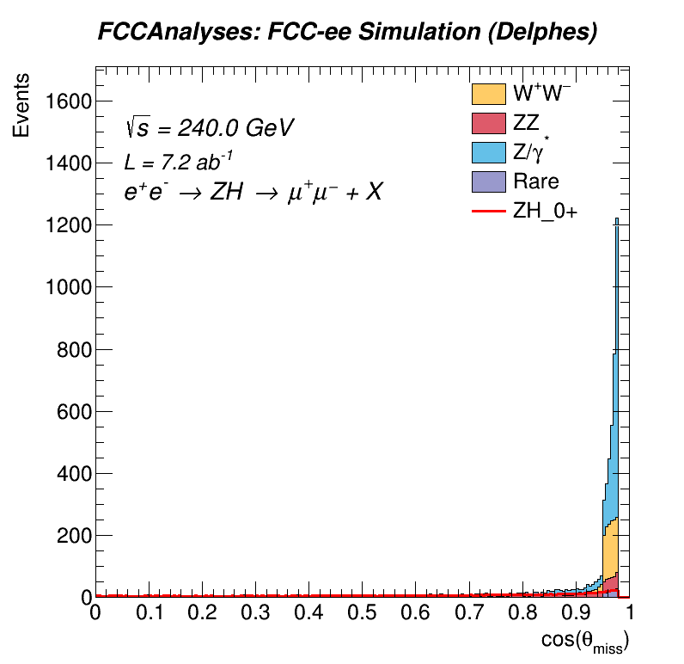
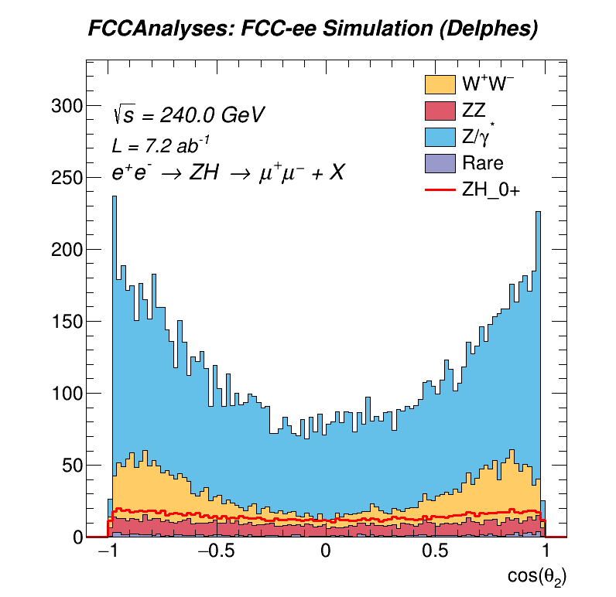

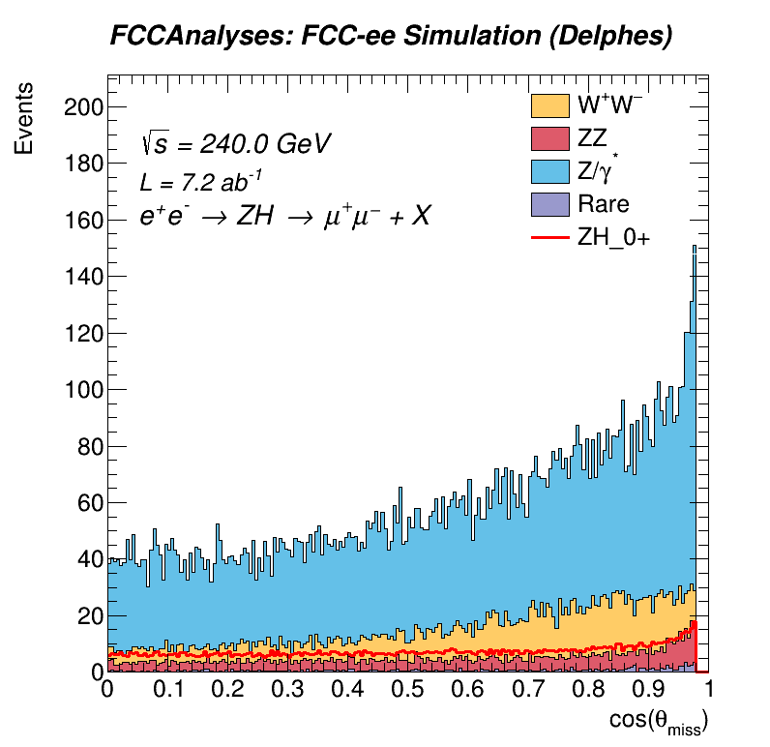
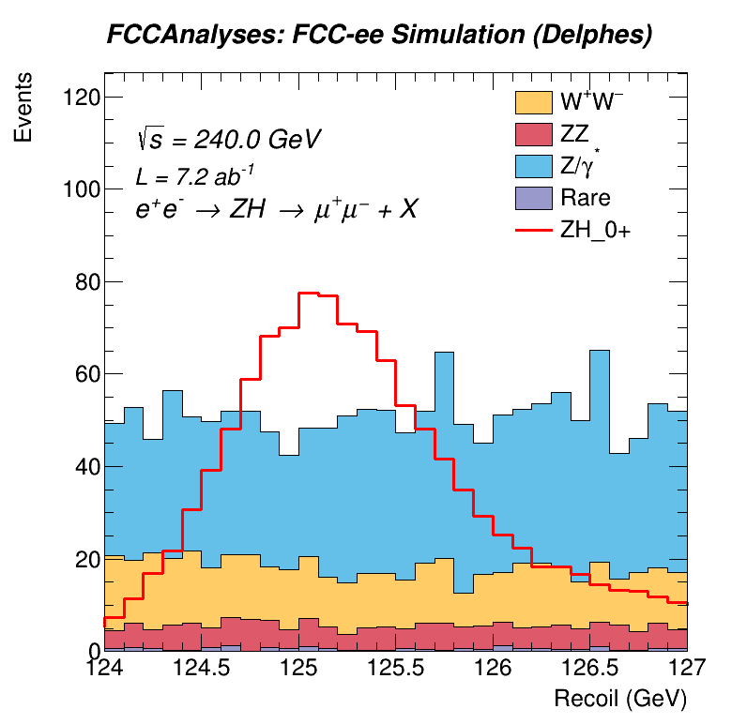
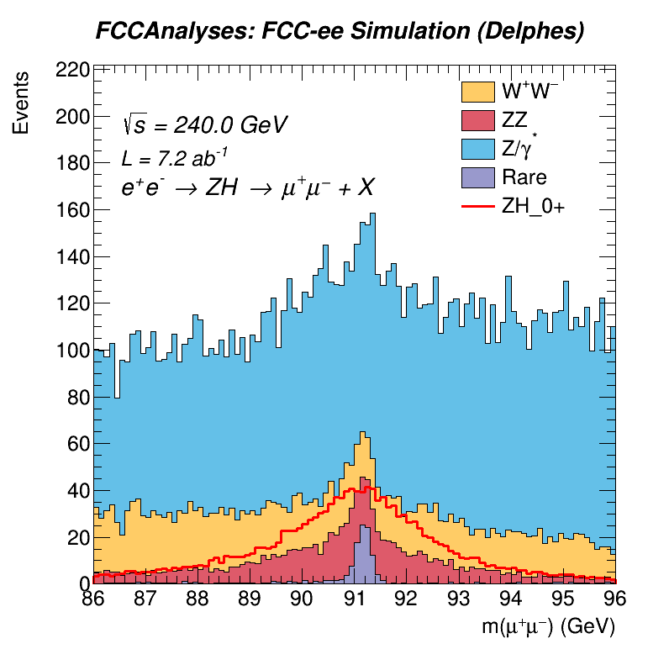
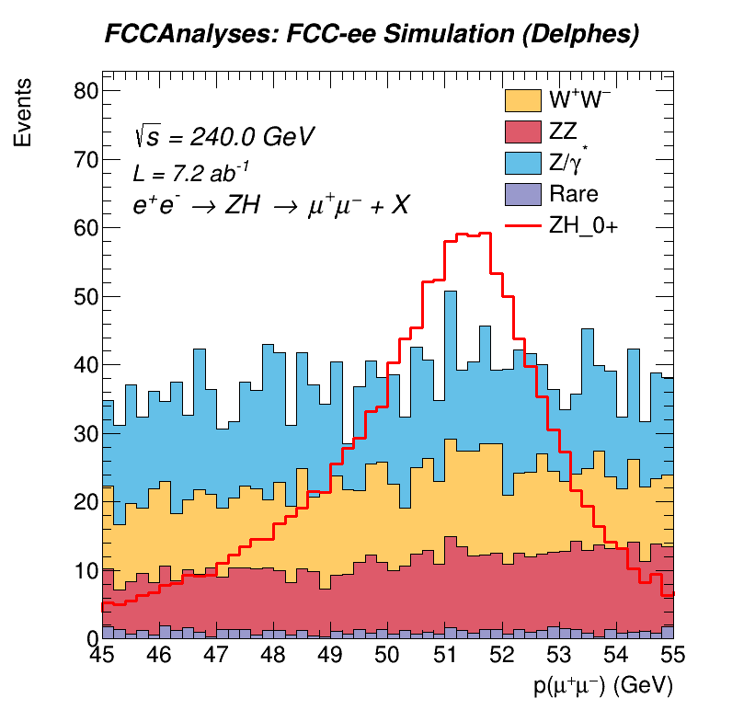
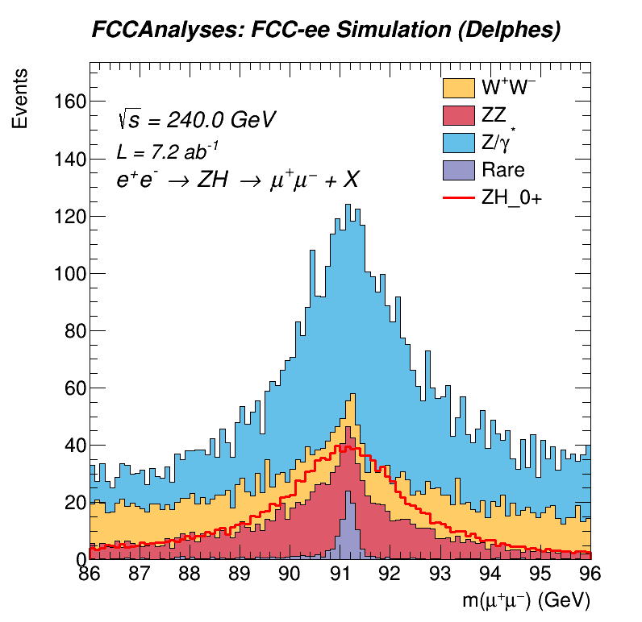
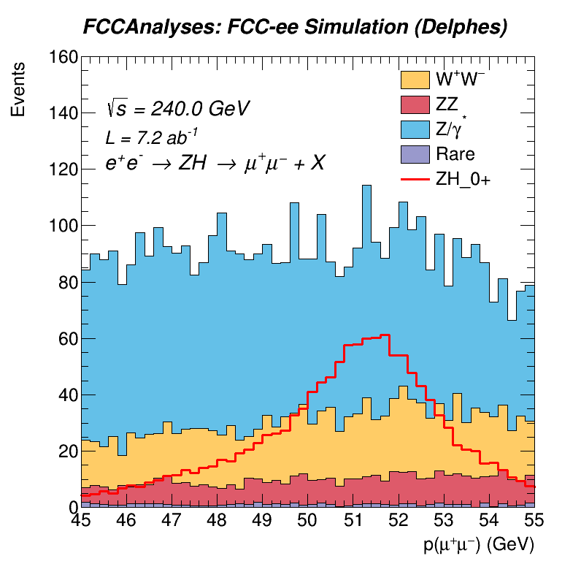

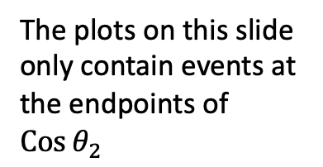
$Events at Cos{θ_{2}}$Endpoints and Correlations to Other Observables:
The plots on this slide only contain events at the endpoints of $\operatorname{Cos}{θ_{2}}$
Nicholas Pinto – Johns Hopkins University – Higgs/Top Performance Meeting– 23 Jan. 2024

Slide 8
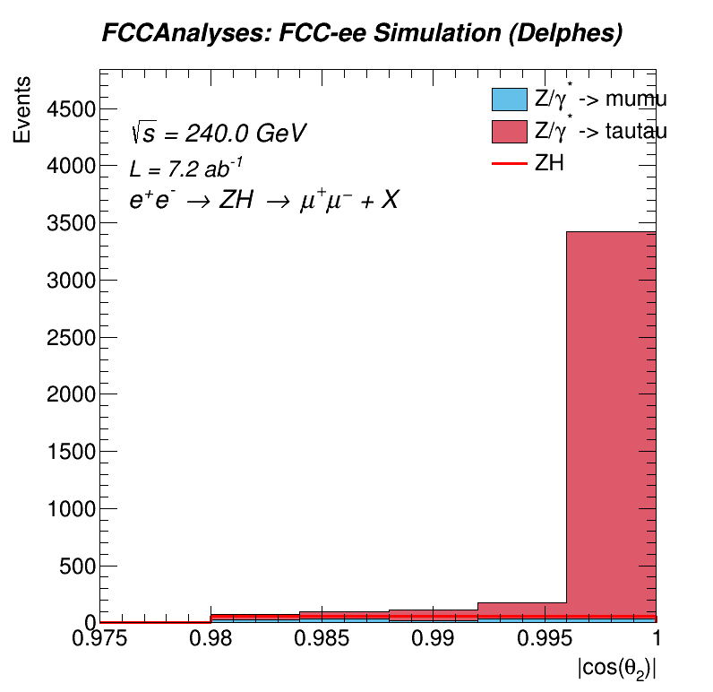
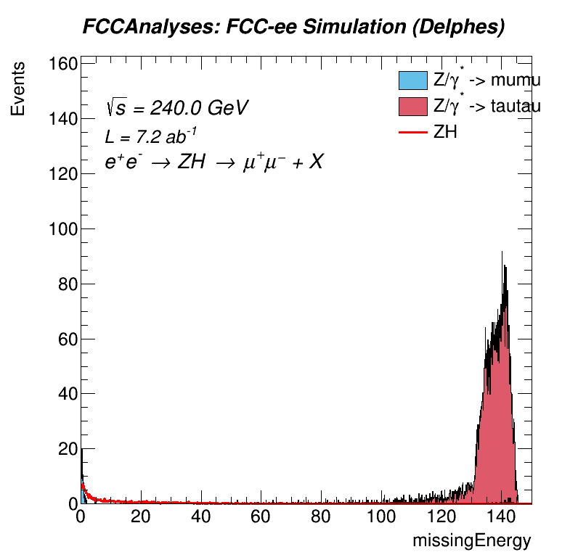
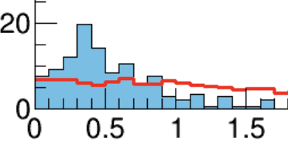
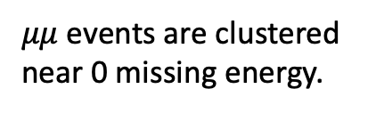

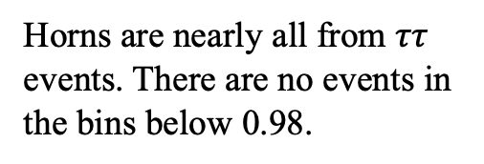
$\operatorname{Cos}{θ_{2}}$ of Z/$γ$* $⟶μμ$and $ττ$:
$μμ$ events are clustered near 0 missing energy.
Horns are nearly all from $ττ$ events. There are no events in the bins below 0.98.
Nicholas Pinto – Johns Hopkins University – Higgs/Top Performance Meeting– 23 Jan. 2024

Slide 9
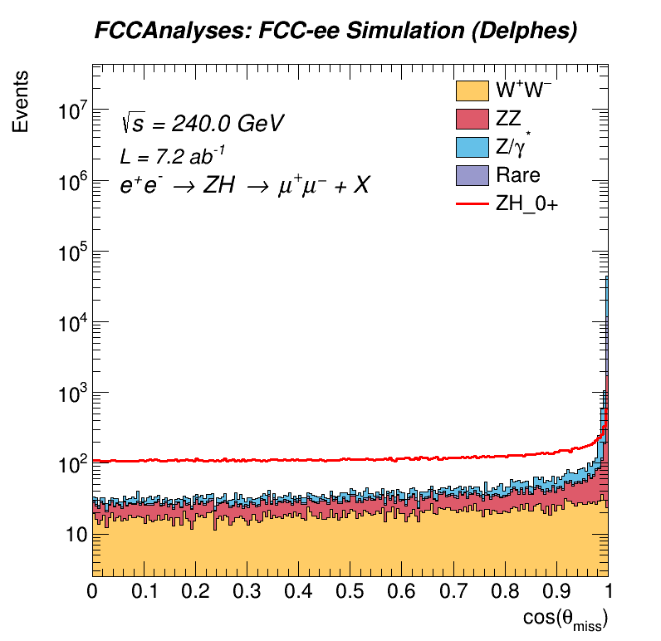

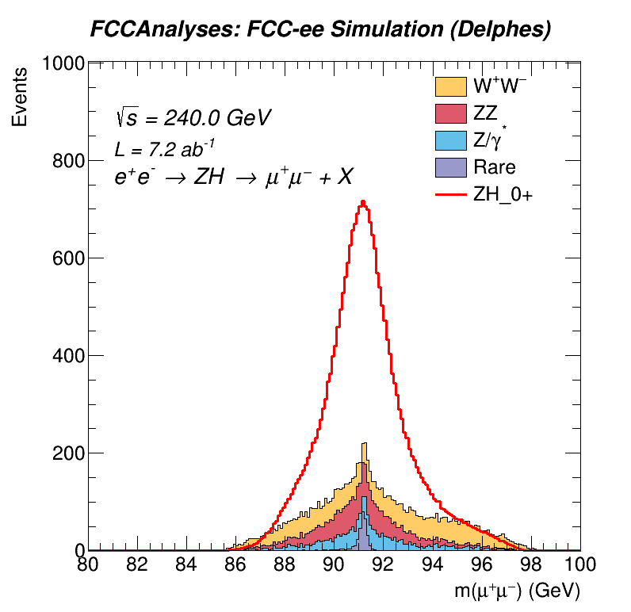
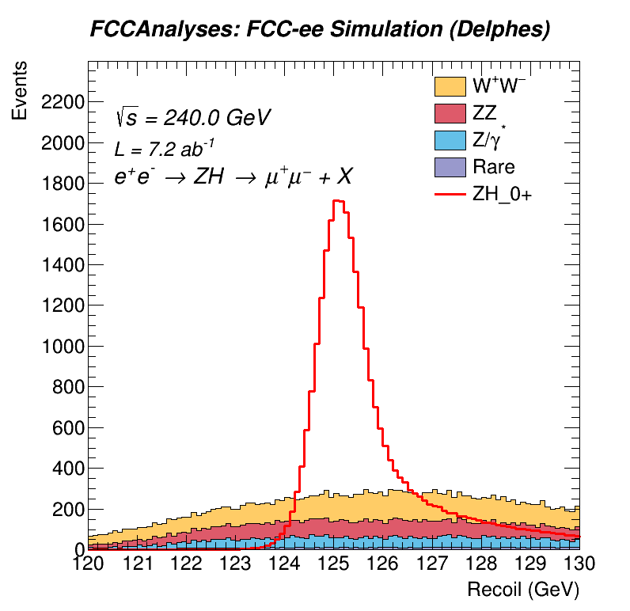
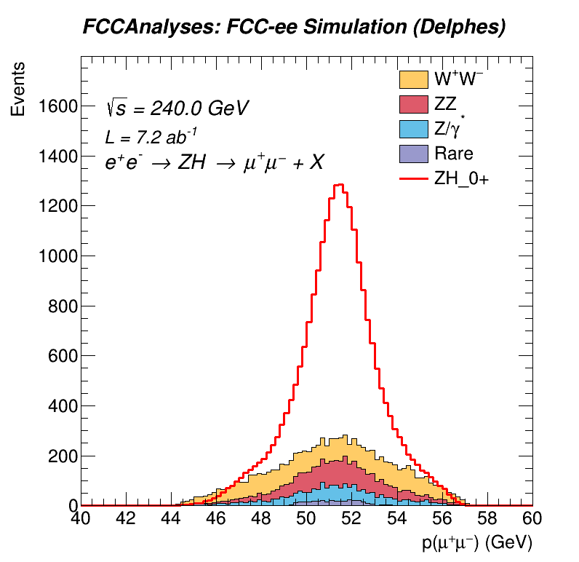
New Cuts Being Made: N-1 Plots
In these plots, every cut is made using values from the updated selection criteria, except the cut on the observable being plotted.
Nicholas Pinto – Johns Hopkins University – Higgs/Top Performance Meeting– 23 Jan. 2024

Slide 10
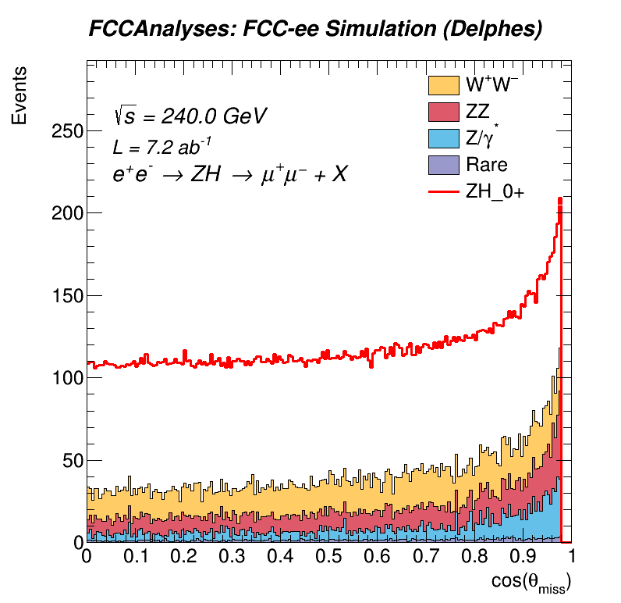
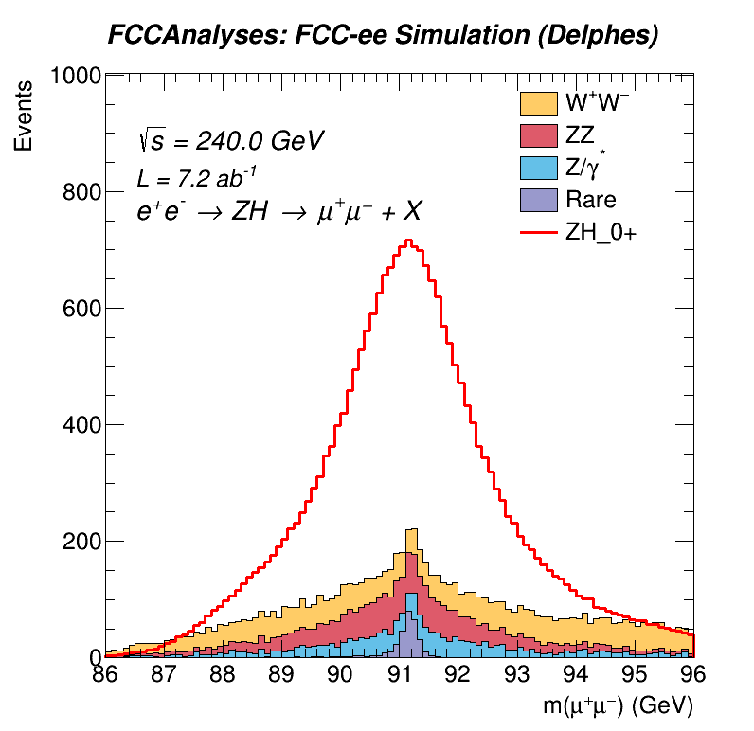
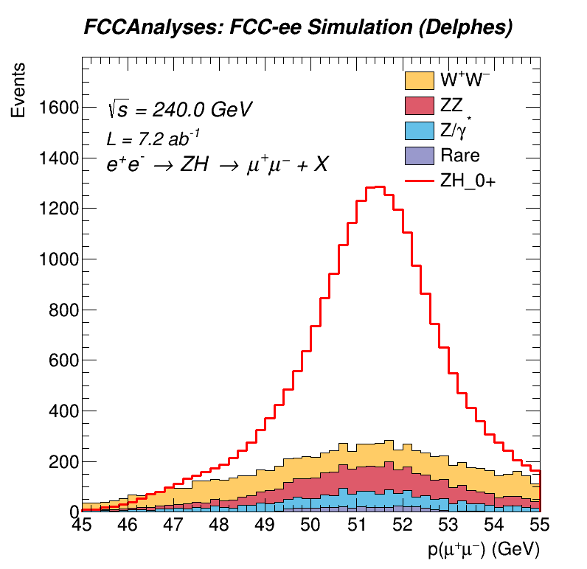
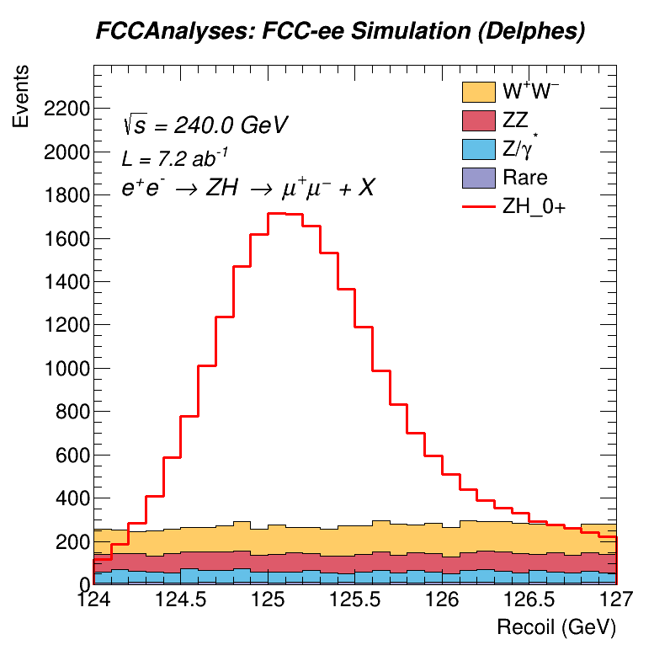
All Cuts Made
Nicholas Pinto – Johns Hopkins University – Higgs/Top Performance Meeting– 23 Jan. 2024

Slide 11
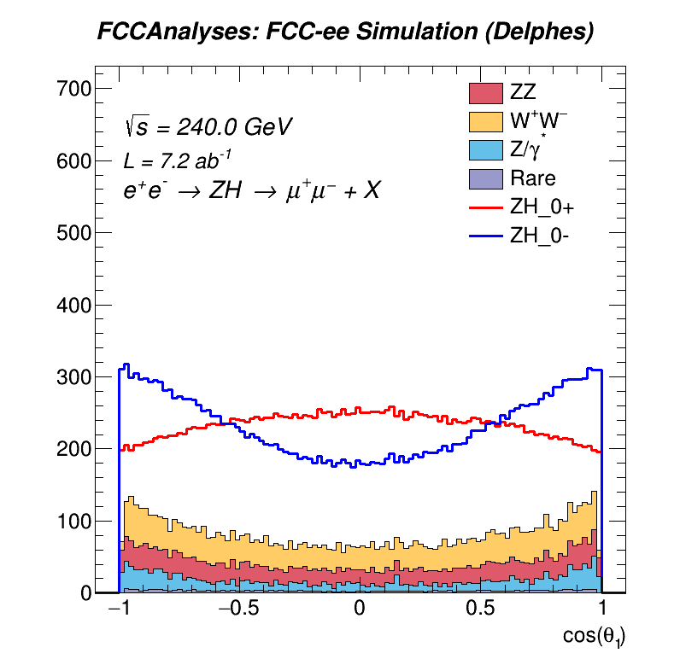
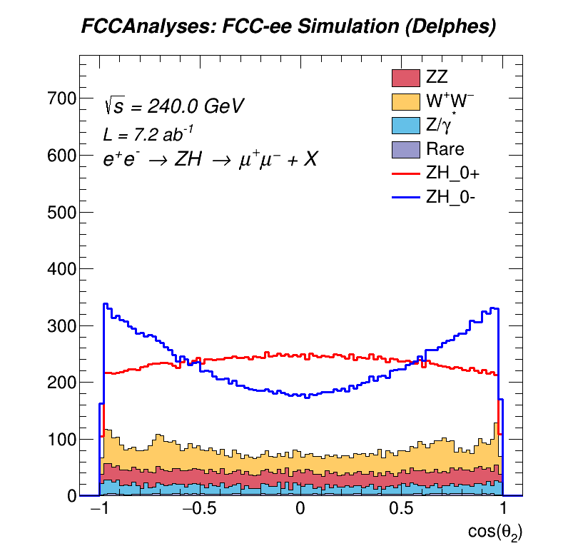
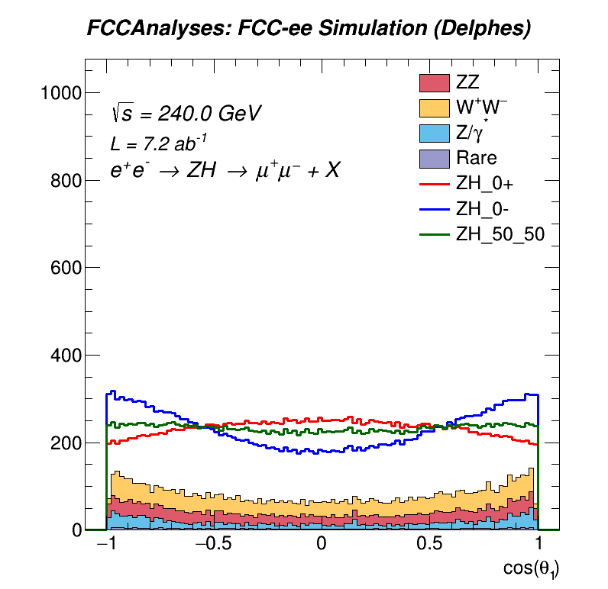
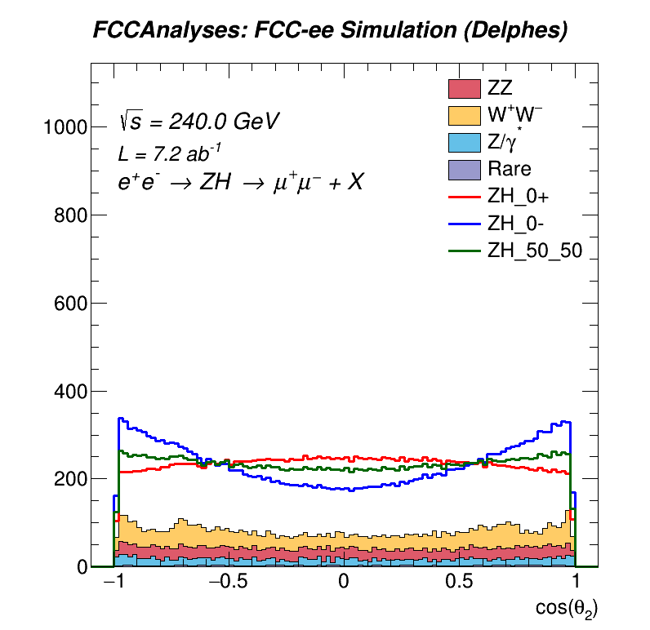
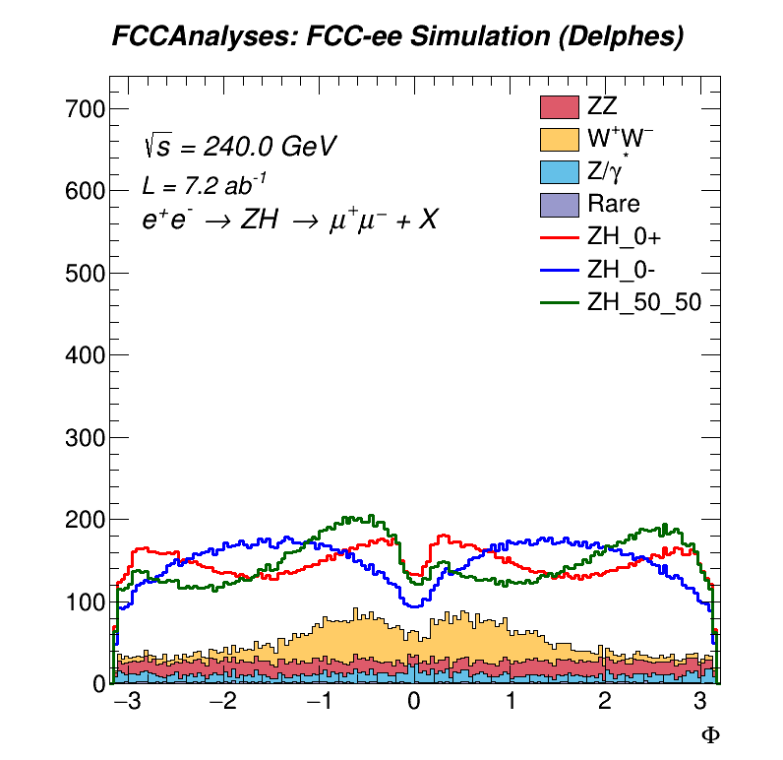
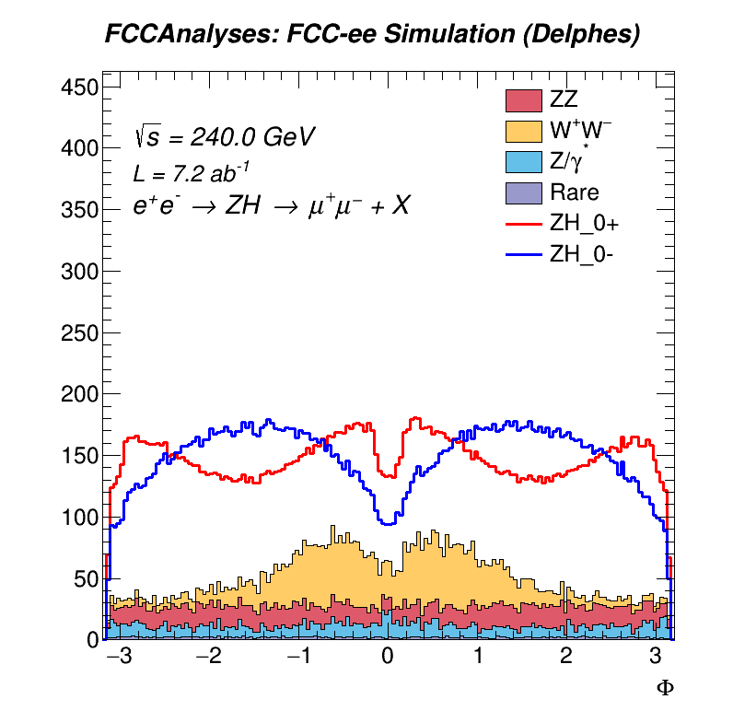
All Cuts Made: Angular Distributions
Nicholas Pinto – Johns Hopkins University – Higgs/Top Performance Meeting– 23 Jan. 2024

Slide 12
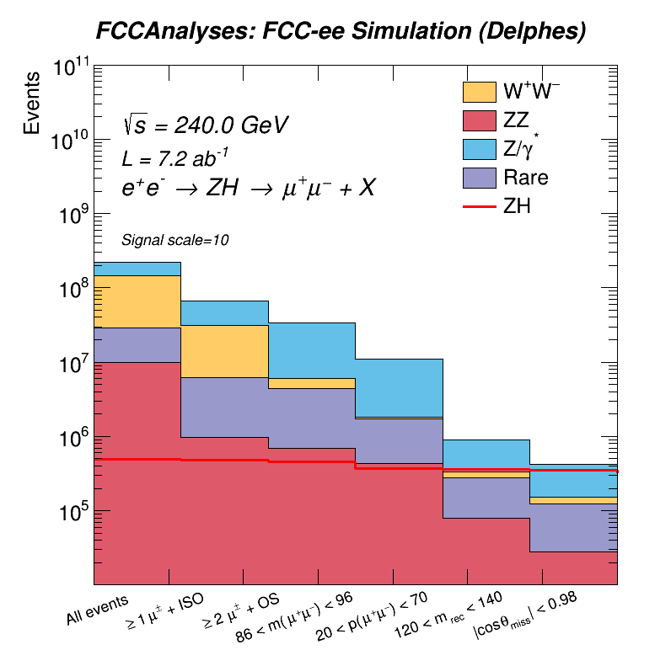
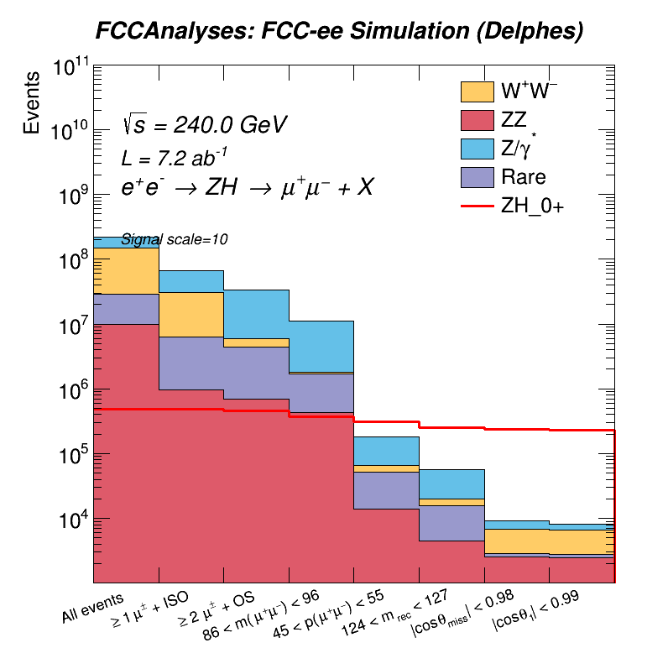
Comparing Cut Flows: Old vs New Cuts
Original Selection
Updated Selection
Nicholas Pinto – Johns Hopkins University – Higgs/Top Performance Meeting– 23 Jan. 2024

Slide 13
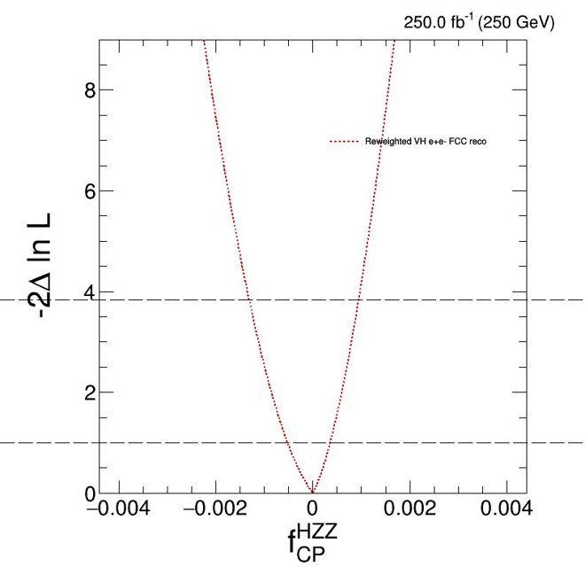
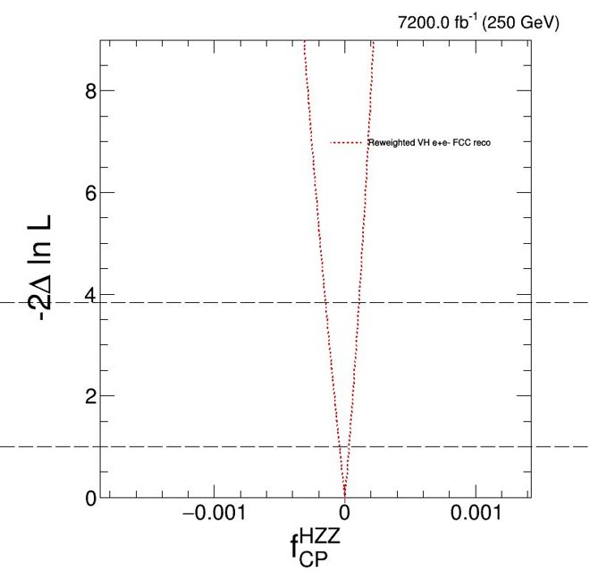
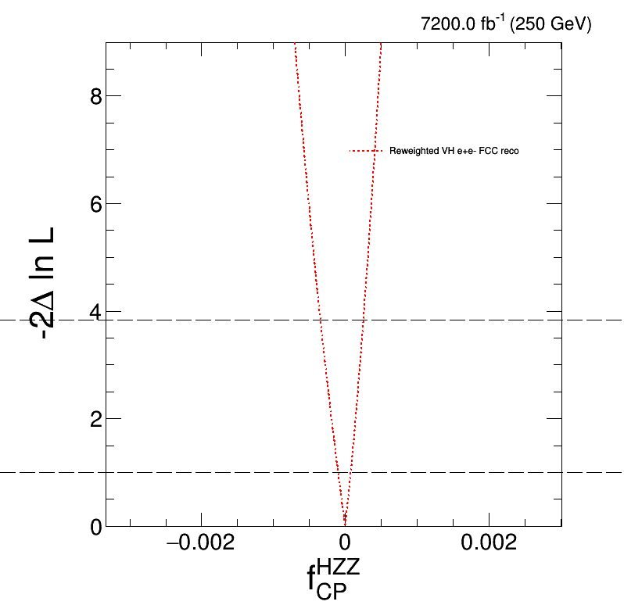
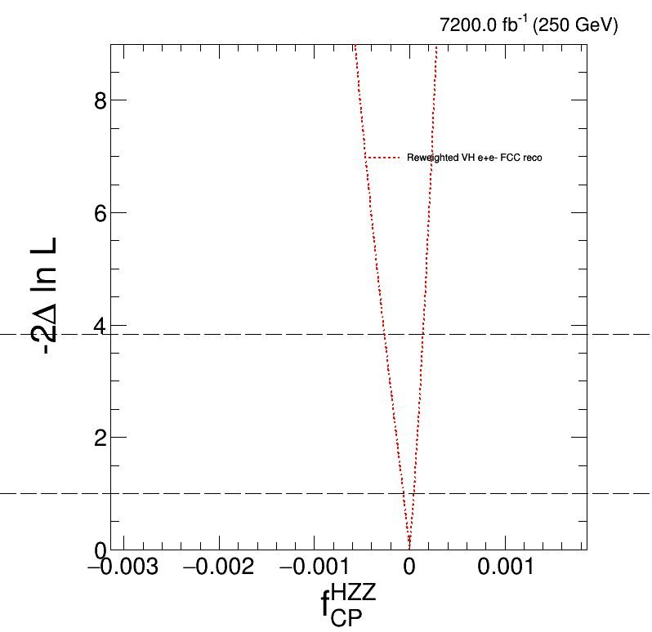



Progression of fits with Reconstructed Signal H $⟶$X, Z $⟶μμ$:
Snowmass
Intermediate
Original Selection
New Selection
Adjusted Snowmass yields for final state. Snowmass lumi. Gen-Level ee $⟶$ZZ background (~10% of signal).
68% CL ≈ +/- 4.1 E-4
FCC yield (Uses reported x-sec from recoil-mass analysis note) and FCC lumi. Gen-Level ee $⟶$ZZ background.
68% CL ≈ +/- 3.8 E-5 ​
FCC yield, FCC lumi, full background samples. Original selection from analysis note.
68% CL ≈ +/-8.8E-5​
Updated selection, FCC yields, FCC lumi, full backgrounds,
68% CL ≈ +/- 5.4 E-5​
Nicholas Pinto – Johns Hopkins University – Higgs/Top Performance Meeting– 23 Jan. 2024

Slide 14

Conclusions
Extra cut on $\operatorname{Cos}{θ_{2}}$removes majority of Z/$γ$* $→ττ$ events.
Updated cuts reduce background to below signal.
Updated likelihood fits incorporate all backgrounds considered in the cross-sectional study and now represent more realistic constraints on $f_{CP}^{Hzz}$.
MELA calculations are now incorporated into the FCC framework. Reweighting can be done within an analysis job.
The techniques of this analysis can be extended to other channels.

