Slide 1

DRD1 and DRD2 overlap
D. González-Díaz
(5-2-2024)
DRD2 meeting

Slide 2
DRD1-DRD2 synergies
Link persons:
DRD1 side (Diego Gonzalez Diaz, diego.gonzalez.diaz@usc.es)
DRD2 side (Kostas Mavrokoridis, k.mavrokoridis@liverpool.ac.uk)
DRD2-DRD1 Overlap (executive summary):
Stable amplification of the ionization signal in pure noble gases is achieved regularly through wires and meshes and, more recently: THGEM, M-THGEM, glass-THGEM, FAT-GEM, and RWELL/RPWELL structures. Those offer attractive possibilities for customization and scalability. Future R&D towards dual-phase operation will involve studies at room temperature and/or in small cryogenic setups.
Operation of wires and MPGD-like structures directly in liquid phase for signal induction and even light amplification has been demonstrated/revisited recently and future R&D is planned. (Charge amplification is still pursued by some groups). It seems a given that new structures will be designed and implemented in the framework of both DRD1 and DRD2.
Technological Overlap:
Possibility of i) sharing manufacturing techniques, or ii) sharing facilities between DRD1 and DRD2 communities.
Simulations and Transport:
Simulations of electron & ion transport either in MC or through Boltzmann-based techniques should be beneficial to both communities:
  A powerful transport code (and know-how) exists in gas (Garfield++/Magboltz) and extension to liquid seems natural.
  Charge recombination and Space-Charge are difficult areas (numerically and technically), of common interest to gas and liquid.
Areas of Cross-Fertilization:
Gas/liquid recirculation.
System purification.
Fluid-dynamics simulations.
UV-photon detection.
Radiopurity and material selection.
Barium tagging.

Slide 3
In general, DRD1 assumes that detectors that require operation in cryogenic infrastructures are primarily associated with DRD2.
Therefore: DRD1 does not plan to offer support for cryogenic operation.
However: groups already having cryogenics labs, doing work in gas phase and feeling comfortable within DRD1, will transition from RD51 to DRD1 in a seamless way.
In fact: many groups with interest in dual-phase operation belong to both DRD1 and DRD2.

Slide 4
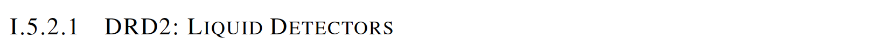
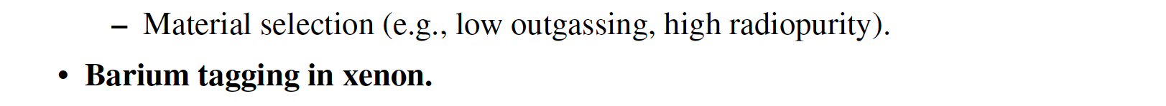
From DRD1 proposal
Important to have a matching text on DRD2 side

