Slide 1
NOVEL SINGLE-PHASE TPC CONCEPTS
Amos Breskin
Weizmann Institute of Science
In cooperation with
Vitaly Chepel (Coimbra) & Gonzalo Martinez-Lema (WIS/BGU)
Goal - combined high-sensitivity S1 & S2 detection
Aims - overcome physical/technical 2-phase issues; lowering detection thresholds.
Potential applications - large-volume DM experiments & more.
Various multiplier configurations for S2 & combined S1&S2 detection
Breskin 2022
https://doi.org/10.1088/1748-0221/17/08/P08002
Martinez Lema 2023
https://arxiv.org/abs/2308.08314

Slide 2
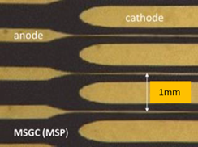
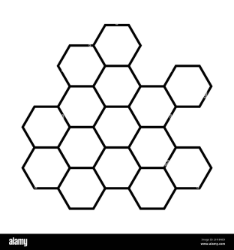
Charge & Light multiplication with microstructures
S2 detection
MSP formed on VUV-transparent substrate, with semi-transparent Ni or Cr electrodes.
Deposited charges drift in liquid; undergo EL & small charge multiplication (CM) near thin (μm) anode strips.
The EL photo-yield depends on MSP type.
EL+CM S2 Photons recorded above.
S1 scintillation photons: with top & bottom photo-sensors (or reflective cathode)
Photosensors: PMT, SiPM, SPAD etc.
S1
UV
hν
Microstructure:
E.g. Micro Strip Plates
S2
UV transparent plate
EL+CM
Printed anode strips
e
cathode
PMT, SiPM, SPAD etc.
or reflective cathode.
Robust
Modular
MSP LXe: gain 10
Policarpo et al. NIMA 1995

Slide 3
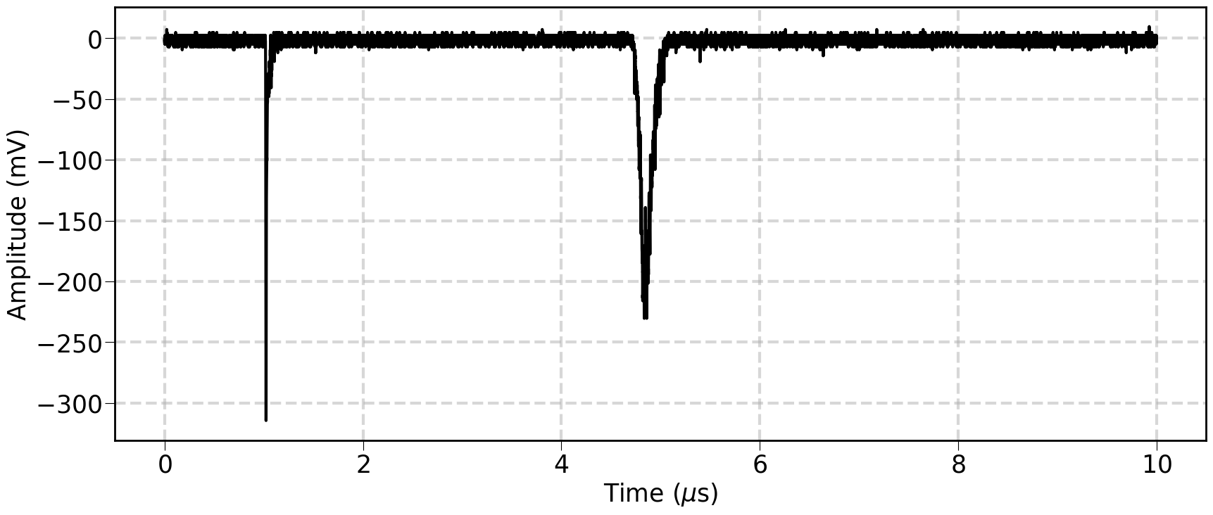
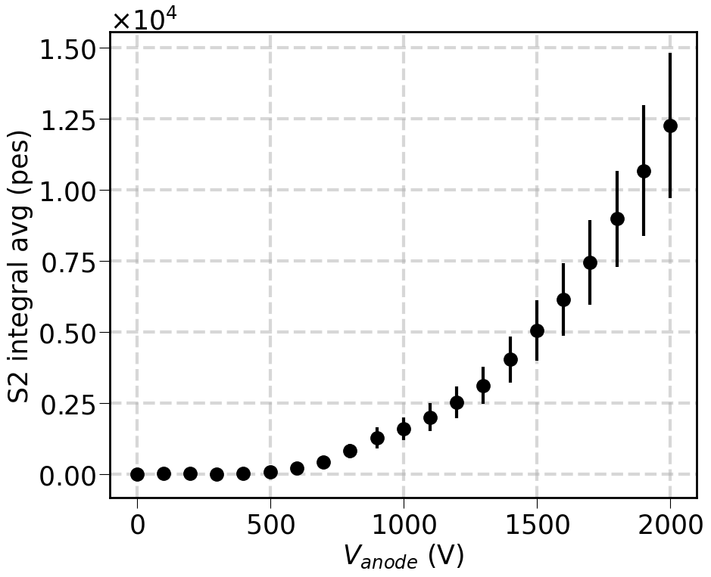
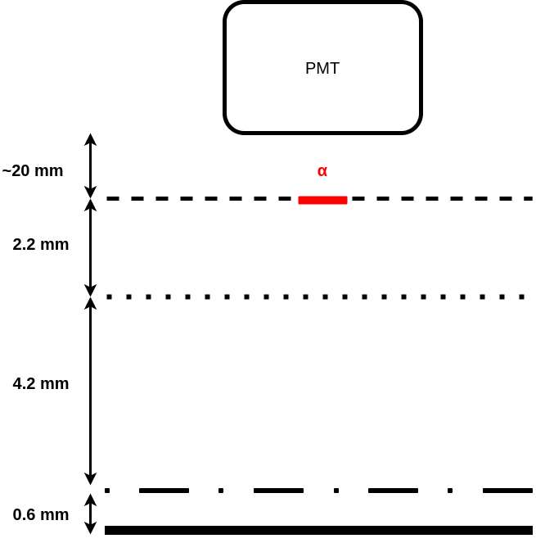
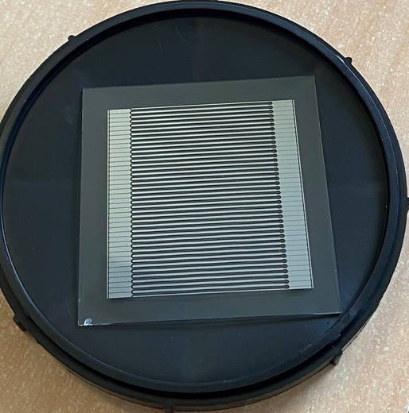
Setup
Microstrip Plate - Preliminary results in LXe
Single event
https://arxiv.org/abs/2308.08314
Martinez Lema
Electroluminescence vs strip voltage
S2
S1
V_{source} = -2.0 kV
V_{cathode} = ground
V_{back} = -2.0 kV
PMT
3.6 mm
V_{α}
α
1mm
.
Mesh + α source
.
.
.
.
.
2.6mm
V_{grid}
hν
grid
Hh
e⁻
E_{drift}
8 mm
LXe
8mm
φ8μm
MSGC
MSGC; LXe
0.4mm
1mm
Ω
Microstrips plate
0.6 mm
Back plane
V_{back}
Photo-yield @ 2.0 kV ~ 33 photons/e-
(MSP discharge limit)
V_{anode}
V_{cathode}
Much higher Q-gains/photoyields expected with other multipliers @ higher V_{anode}
From: Bruno Guerard ILL
Amos Breskin - Novel Single-phase TPC Concepts DRD2-CERN 5.2.2024

Slide 4
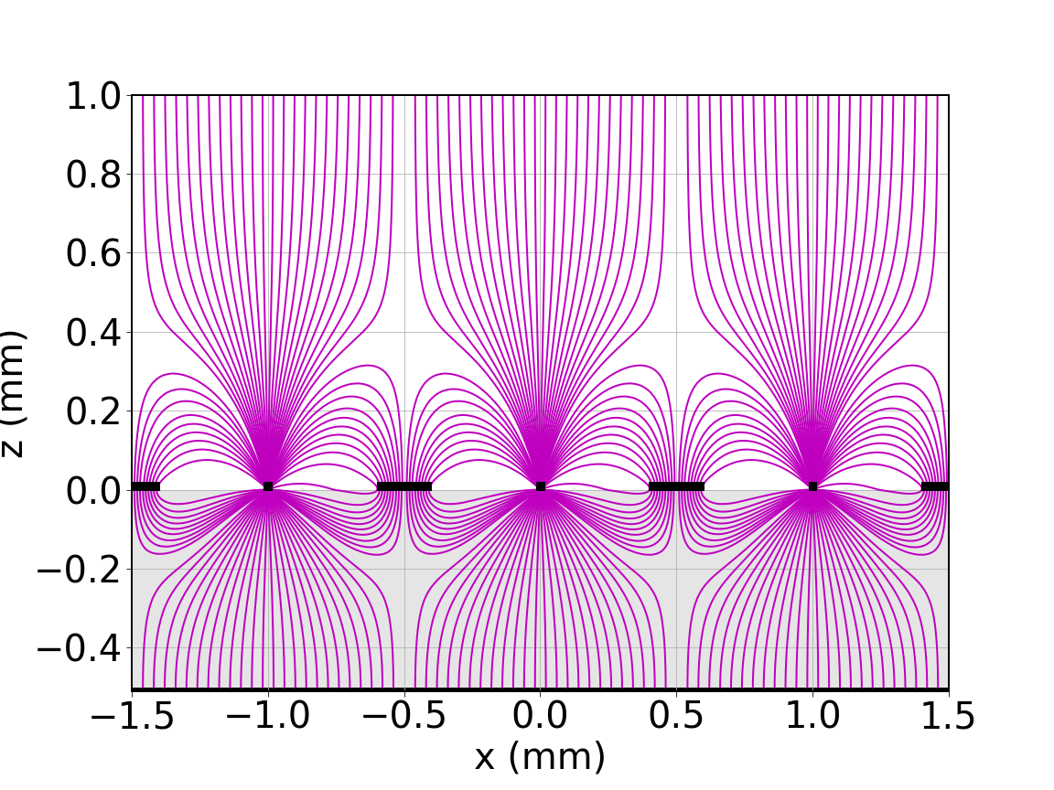
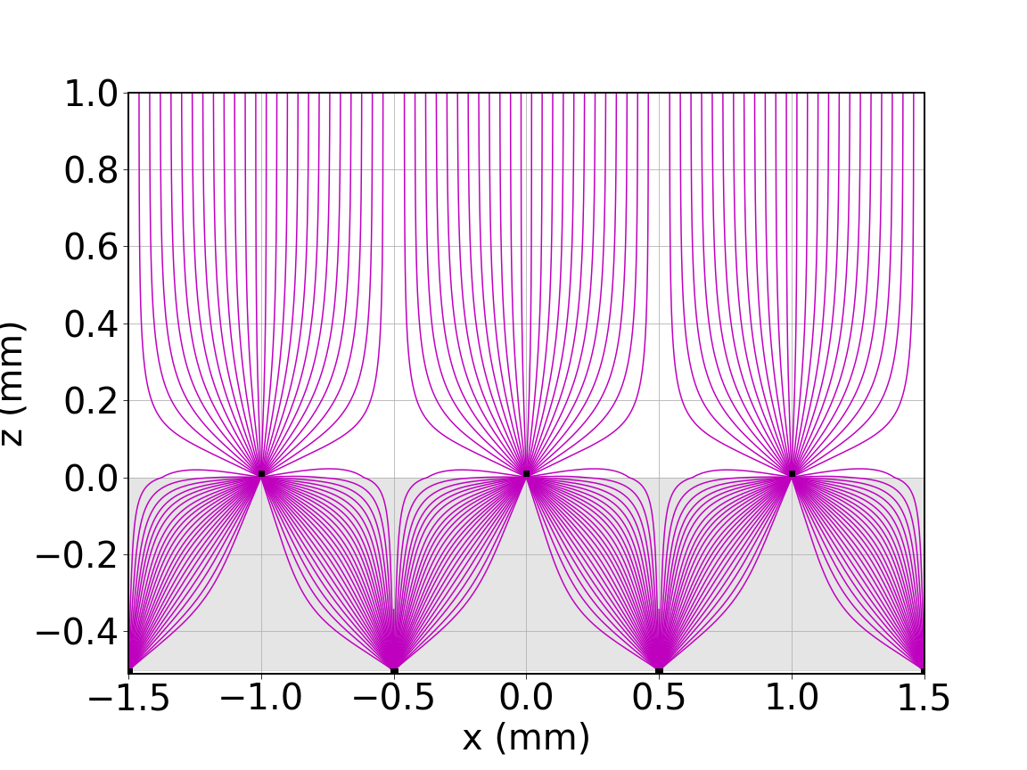
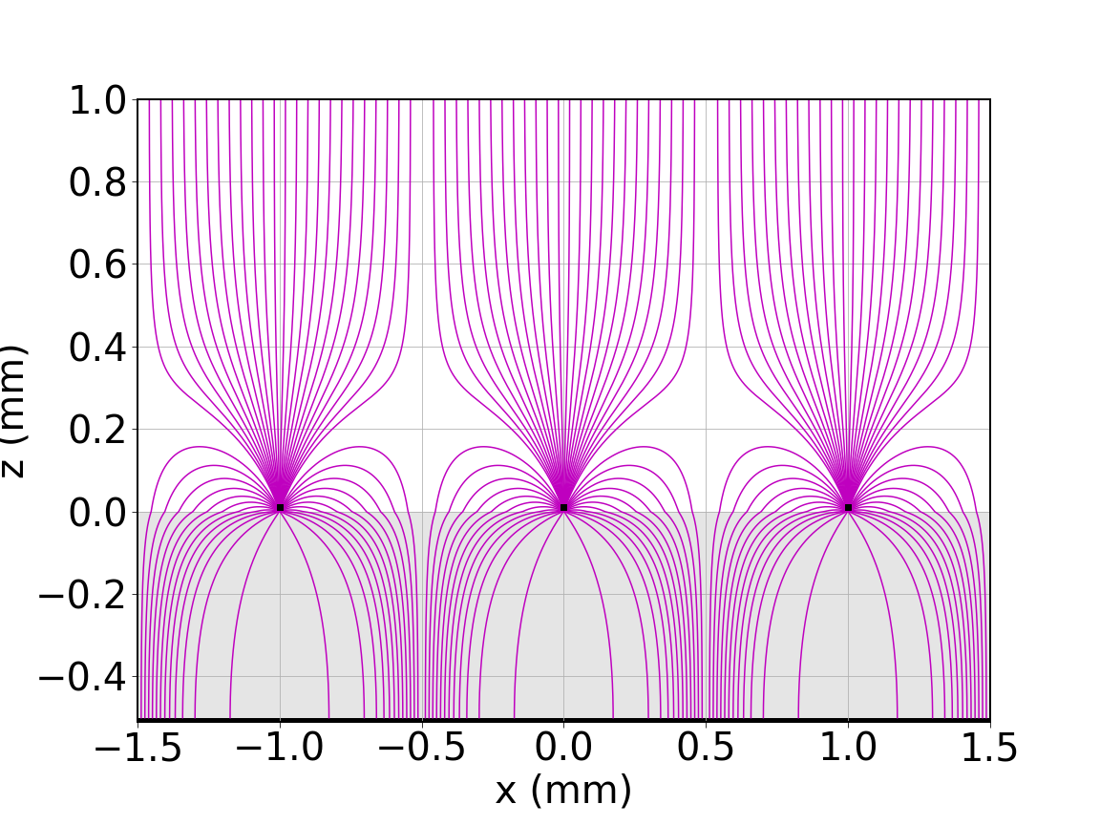
Prospects: MSGC vs COCA-COLA vs VCC
MSGC
COCA-COLA
VCC
Oed 1988
Capeans 1997
  Bouclier 1991
e
a
c
a
a
a
a
a
c
c
Conductive surface/grid
Cathode strips
Conductive surface/grid
hν
MSGC has the best field configuration
But operation (discharge limit) is limited to ~2kV a-to-c (~33photons/e)
COCA-COLA & VCC can operate at higher V without discharges
➔ higher e⁻ multiplication and light yields
@ 5kV; 8μm strips:
COCA-COLA COated CAthode - COnductive LAyer ➔ Model-predicted: > 200 photons /e
VCC Virtual Cathode Chamber ➔ Model predicted: > 800 photons /e
anode strip
hν
EL
e-
Δr
EL+CM

Slide 5
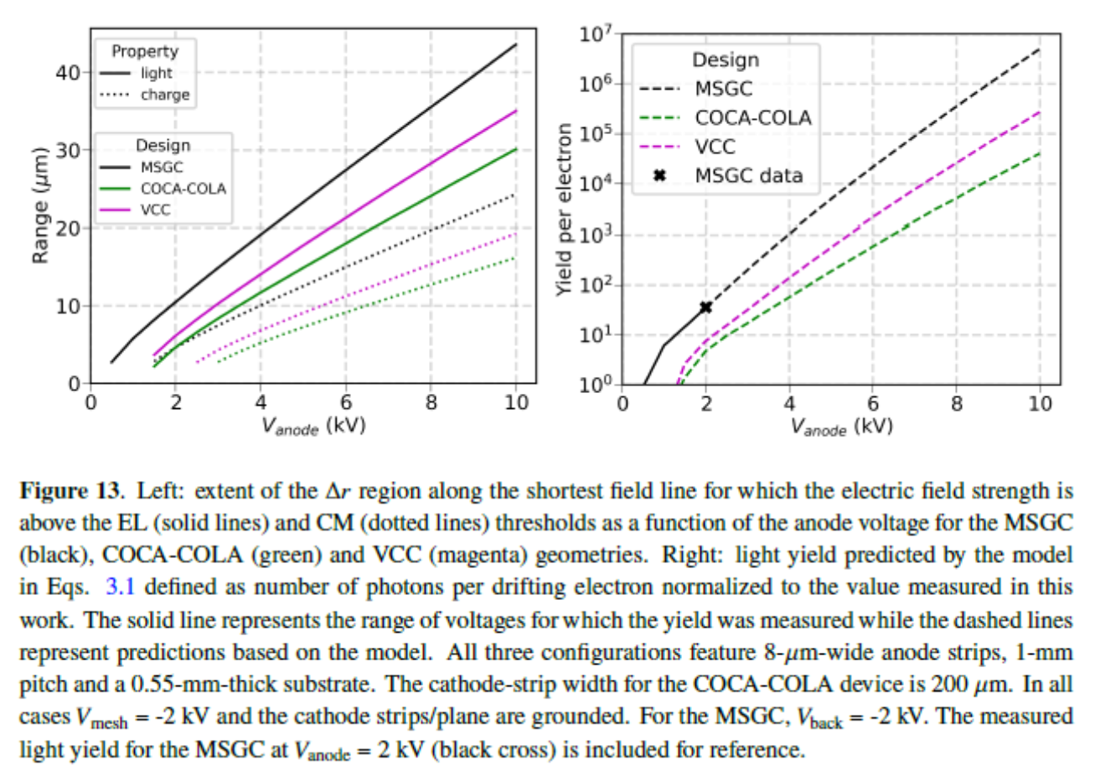
Model Predictions
https://arxiv.org/abs/2308.08314
Martinez Lema
Range for:
CM & EL
> threshold fields
  @ 5kV; 8μm strips:
Aprile JINST 2014
EL, ~400KV/cm;
CM, ~700KV/cm
VCC:
>800 photons/e
COCA-COLA:
>200 photons/e

Slide 6
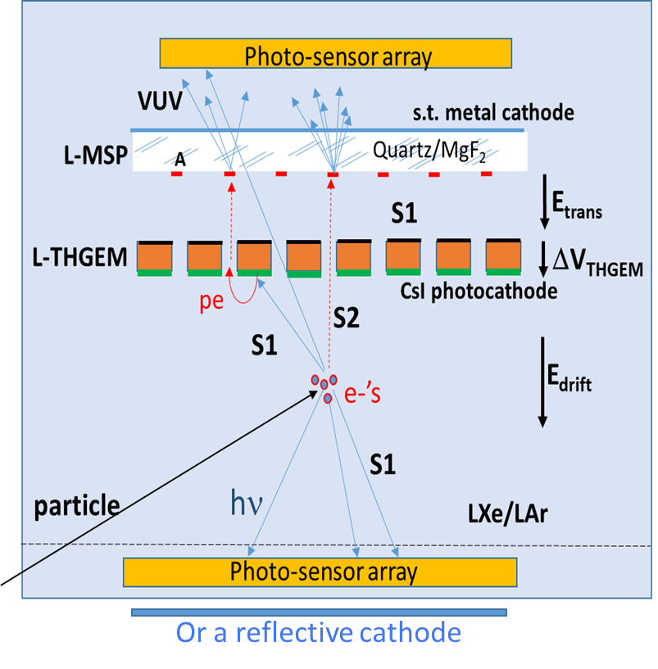
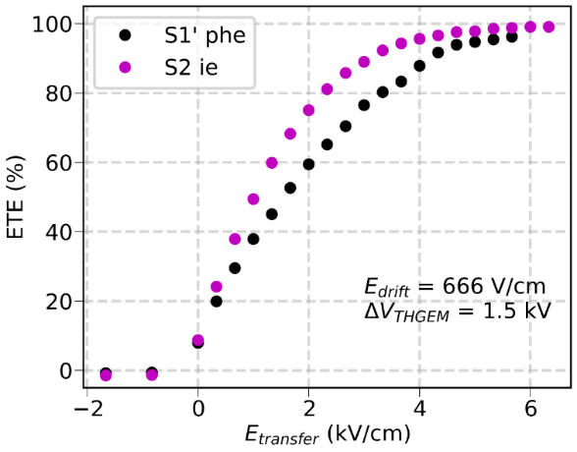
Charge & Light multiplication with cascaded microstructures
S1 & S2 detection
2-stage TPC with CsI-coated perforated electrode (L-THGEM) followed by a L-MSP
S2 e⁻ & S1 VUV-pe⁻ collected into L-THGEM holes & efficiently* transferred to the L-MSP.
EL+CM VUV photons emitted at the microstructure - detected above, by top photo-sensors.
A fraction of S1 photons – detected by bottom photo-sensors or reflected by a reflective-cathode to the CsI.
Option: top L-THGEM surface can be reflective or WLS-coated (➔ visible-range photo-sensors, glass substrate).
Martinez-Lema
https://doi.org/10.1088/1748-0221/19/01/P01030
Experimental Transfer Efficiency of e⁻ and pe⁻ through THGEM holes in LXe.
QE_{eff} of CsI in LXe @ E> 5kV/cm: 25%
Erdal 2021
https://jinst.sissa.it/jinst/theses/2021_JINST_TH_002.jsp

Slide 7
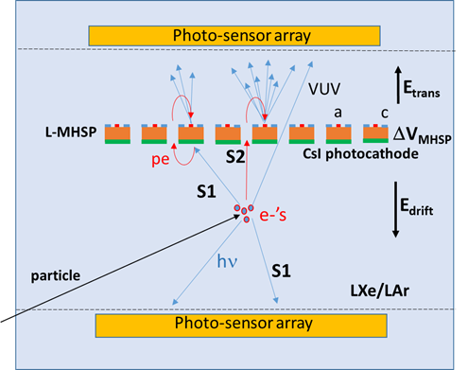
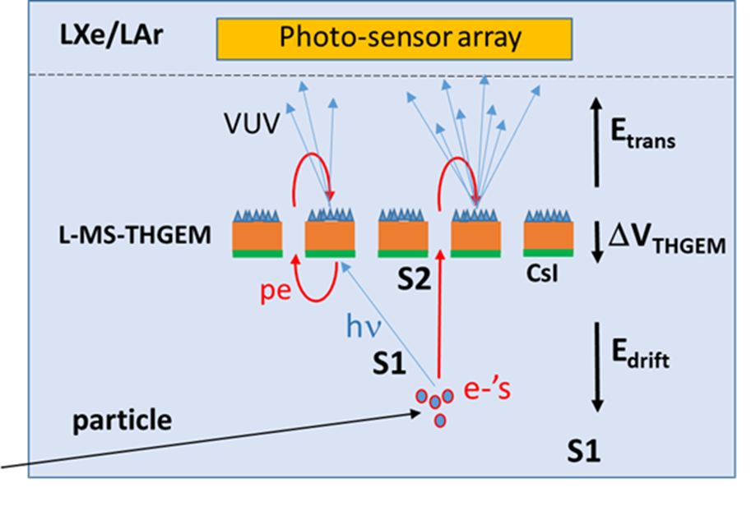
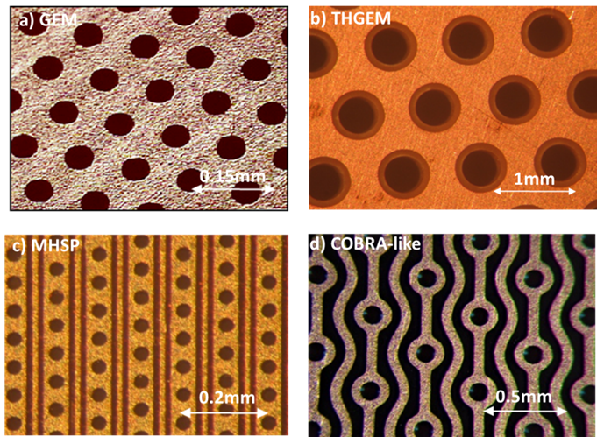
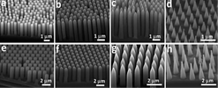
Charge & Light multiplication with single microstructures
S1 & S2 detection
CsI + STRIP Multiplier on top
CsI + microstructure
photocathode
photocathode
MHSP/COBRA

Slide 8
AIMS:
Light sensing from EL & CM from microstructured electrodes in NL – coupled to photosensor arrays.
- Single-element multiplier for S2 detection
- Cascaded- & single-element multipliers for combined S1 & S2
POTENTIAL ADVANTAGES:
Potentially Robust
Modular
Intense & fast S2 & S1 induced light flashes by single e & pe (100’s of photons/e)
➔ permits deploying “high dark-noise” photosensors (SiPM, SPAD, etc)
➔ Potentially reduces detection threshold
R&D:
Focus - combined high-sensitivity light & charge multipliers.
Currently: VCC light-emission studies in LXe (future: LAr).
Many open questions requiring simulations & exp. R&D (LAr, LXe):
maximizing photoyield, robustness, photocathode stability in NL, physical parameters in LAr, multiplier/sensor studies etc.
EQUIPMENT:
We possess 2 fully-equipped cryostat systems with LXe & LAr purification,
CsI evaporator, VUV monochromator etc.
Open to collaborations – seeking for students/postdocs!
Summary & Outlook
photosensor
MSP
ST substrate
CsI/THGEM
Example: cascaded S1/S2 sensor module
Thank you!

