Slide 1
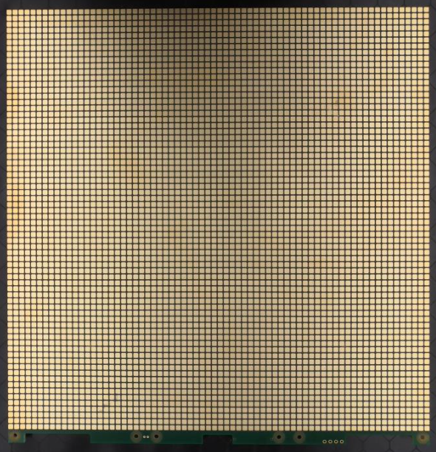
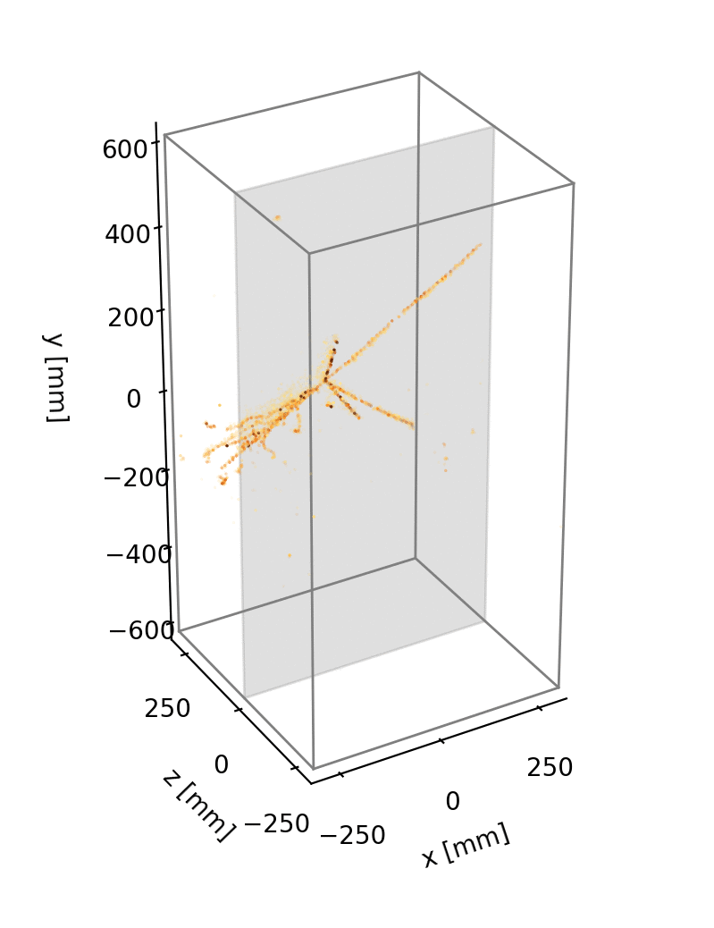
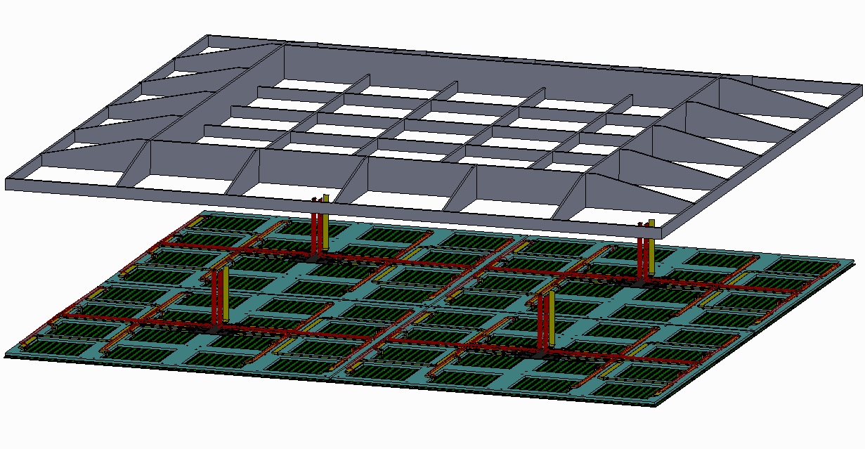
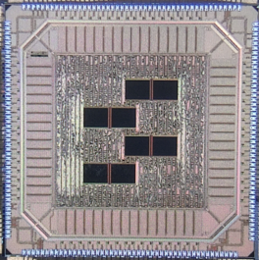
Scaling LArTPC pixel readout:
Progress and Plans
Dan Dwyer (Berkeley Lab)
DRD2 Collaboration Meeting
5-7 Feb 2024

Slide 2
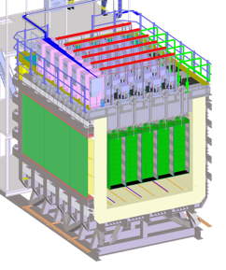
Pixel Readout: Technical Challenges
Pixel readout requires high channel densities:
3 mm pixel spacing -> O(10⁵) pixels / m²
Obstacles for LArTPCs:
Noise:
- Need < 1000 e- equivalent noise for detection of minimum-ionizing particles
- Requires cryogenic-compatible amplifiers, low-noise system design
Cabling:
- Limited cabling in/out of cryogenic environment
- Need to carry signals from >1000 pixels per I/O channel
- Requires cryogenic-compatible multiplexing electronics
Waste heat:
- LAr near boiling point, places stringent limit on waste heat
- Requires extremely low-power electronics: amplification, digitization, multiplexing at O(100) uW / pixel
Reliability:
- System largely inaccessible in high-purity LArTPC
- Requires design robust to single-point failures
Scalability:
- Needs to cover LArTPC anodes of ~100 m² to ~1000 m²
- Requires scalable system production to >10⁷ pixels at < $0.10 / pixel
Example: DUNE Liquid Argon Near Detector
~200 m² of anode
14 million pixels

Slide 3
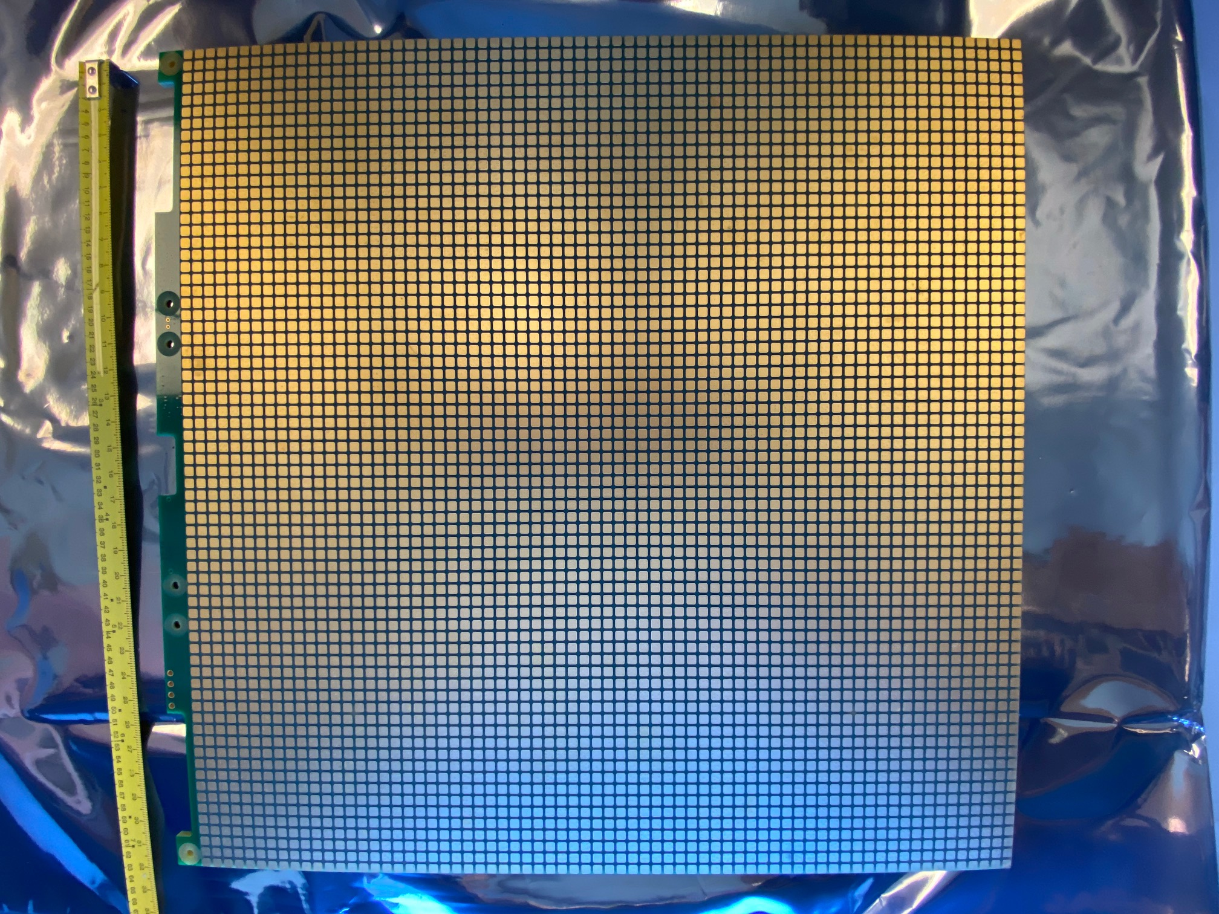
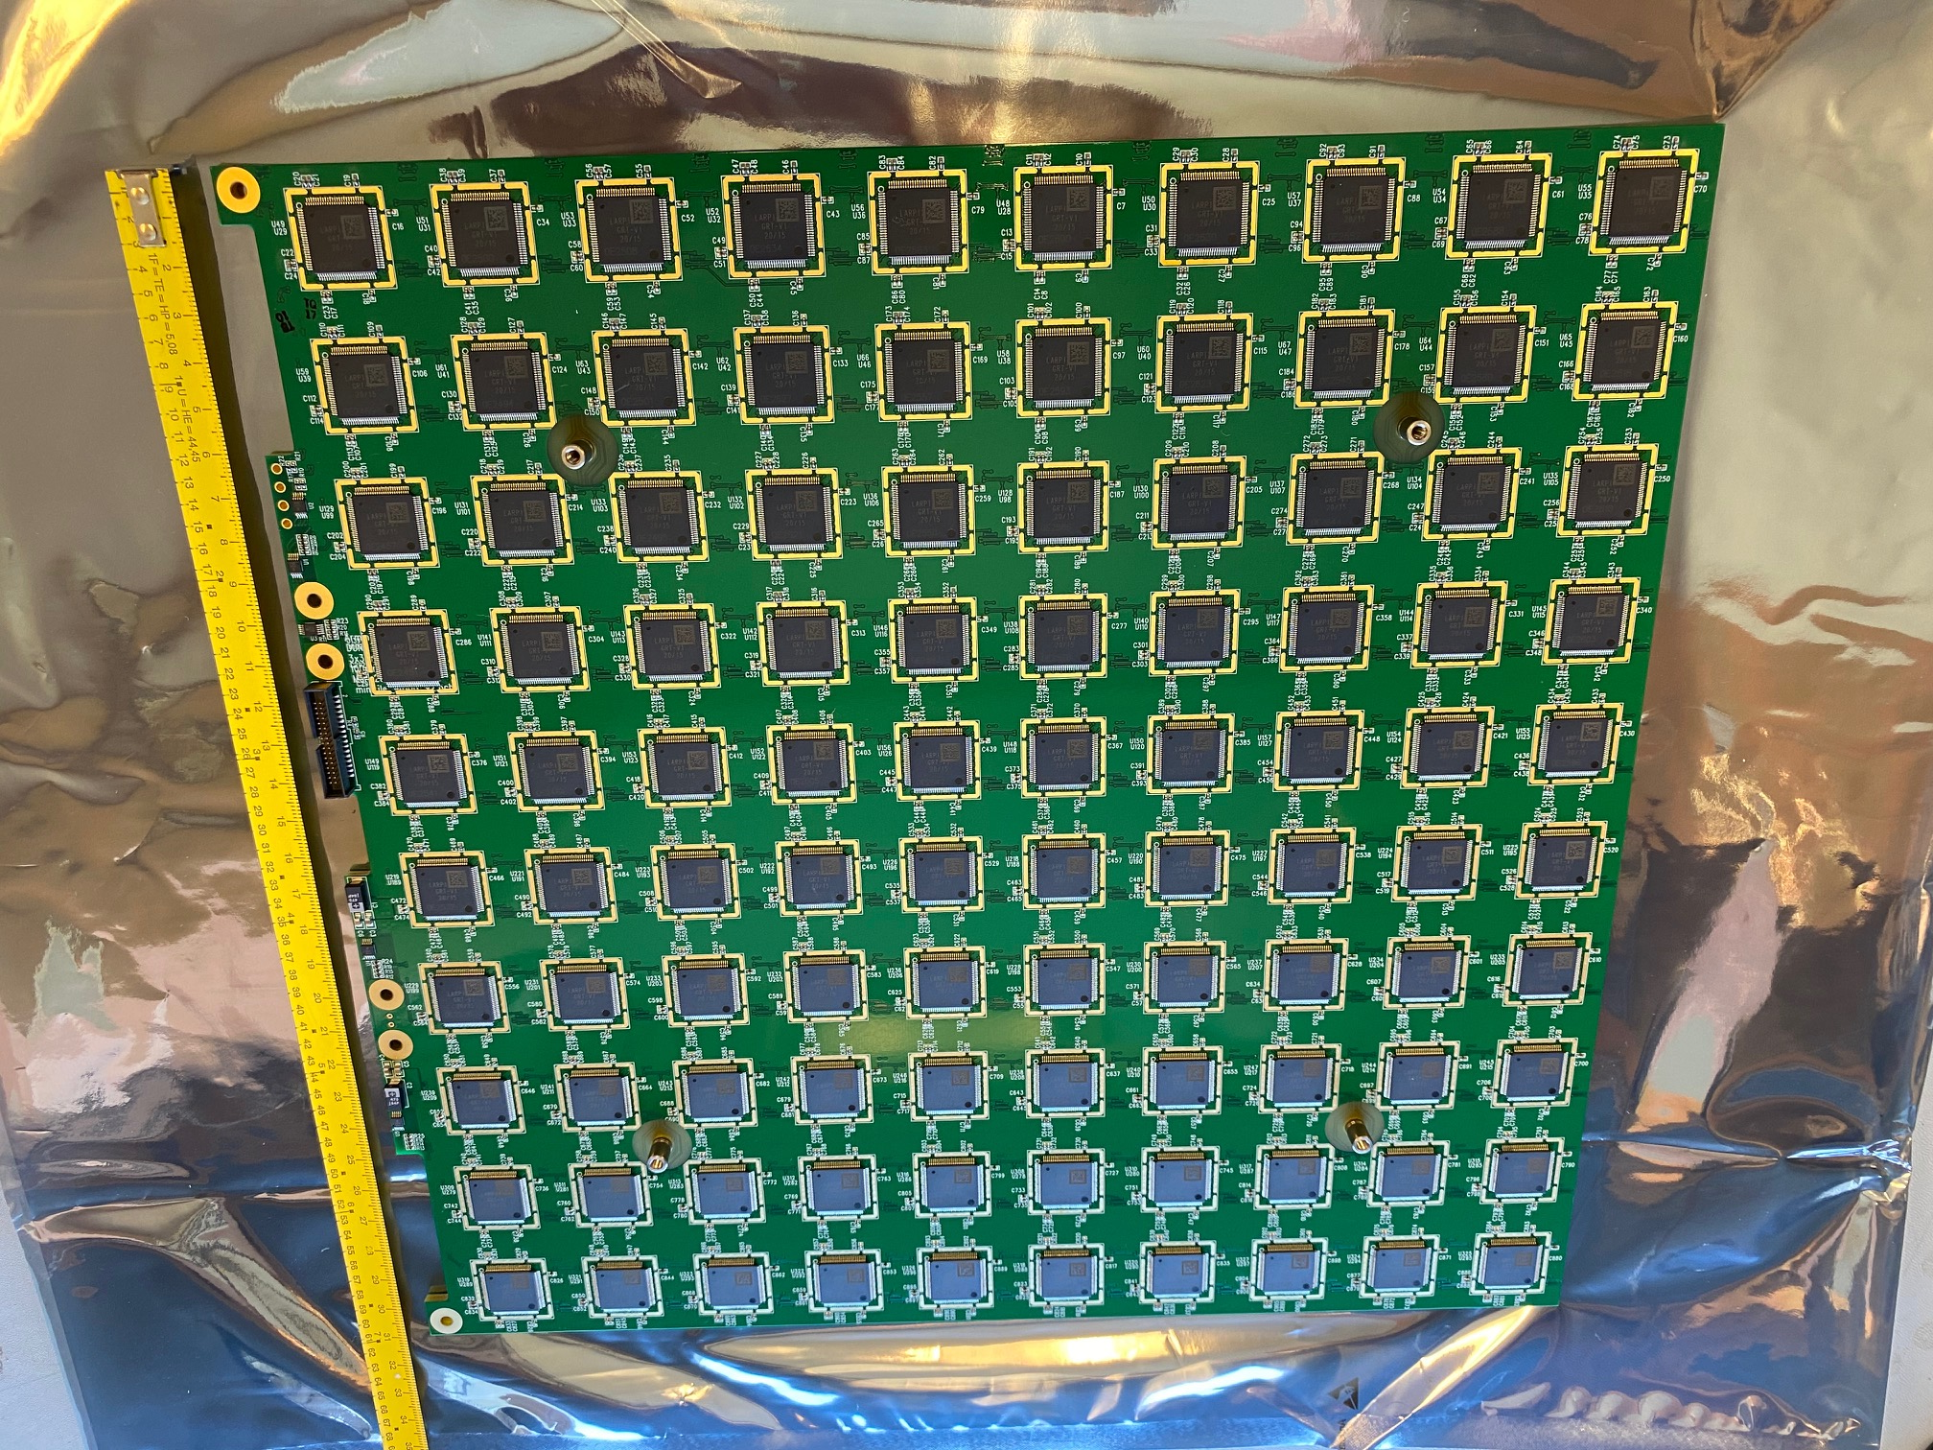
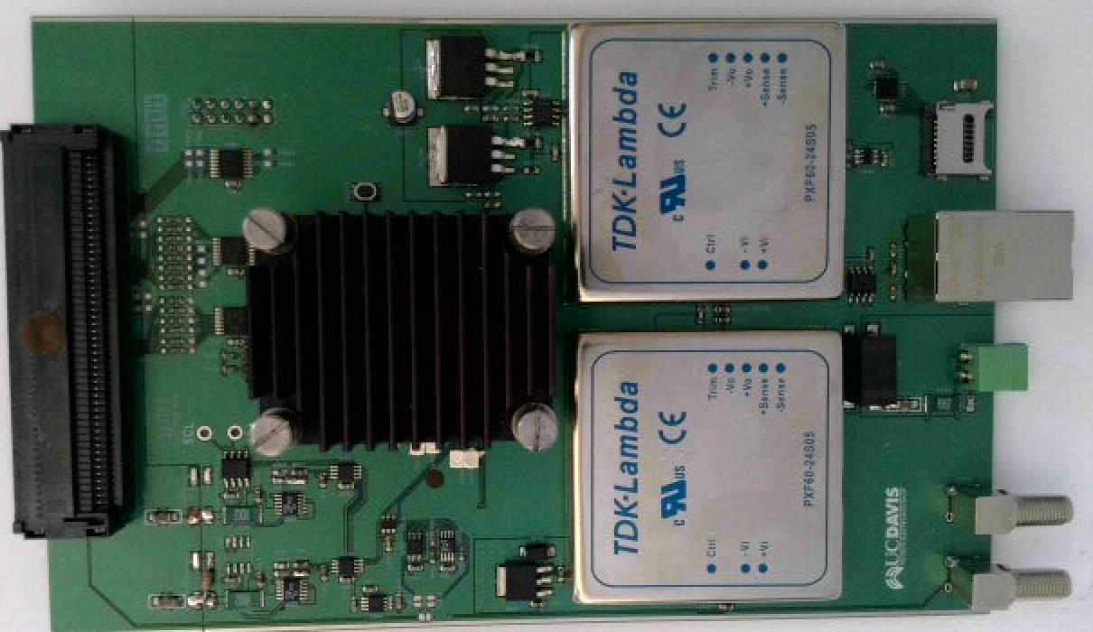
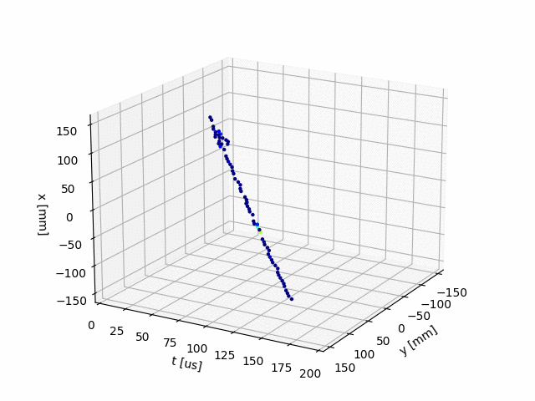
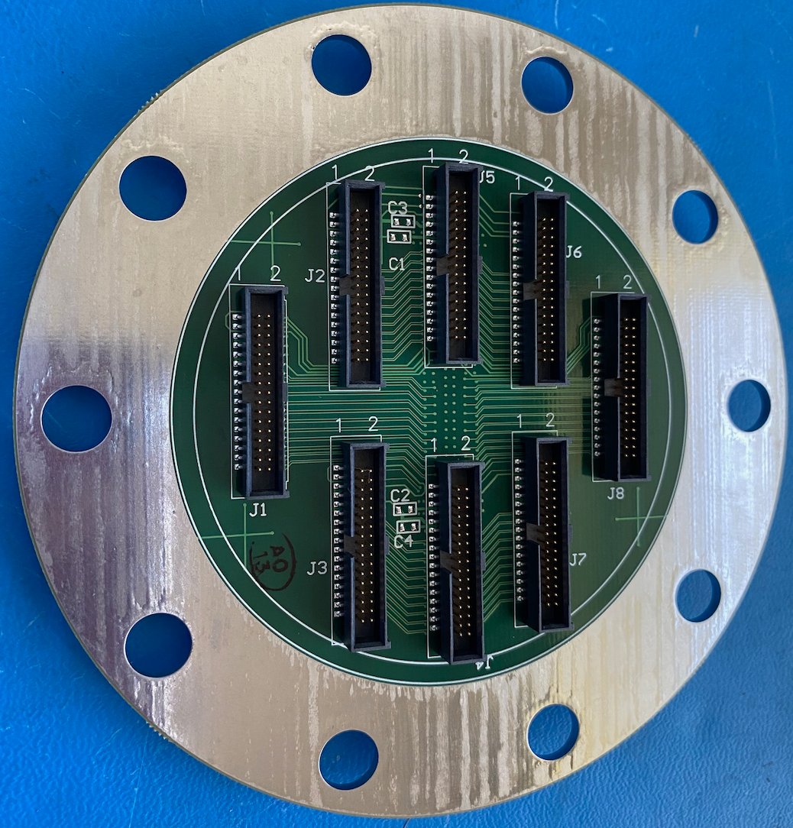
R&D on Scalability: LArPix-v2 System
See yesterday’s talk
Production-scale LArPix-v2 Pixel Anode
LArPix-v2: 2019-2021
Substantial Design Evolution:
ASIC Improvements:
- 64 channels/ASIC (twice channel density of v1)
- Hydra-I/O: Dynamic routing, robust to chip failure
- Cryogenic-compatible custom SRAM memory
- Improved tunability, testability
- Packaged to facilitate commercial mass production
Pixel Anode Design Overhaul:
- ‘Tileable’ design to cover anodes of arbitrary scale
- 32cm by 32cm pixel anode PCB tile
- Frontside:
v2a: 4900 square pixels, 4.4 mm spacing
v2b: 6400 square pixels, 3.8 mm spacing
- Backside: 10x10 grid of ASICs
- Enable fully-commercial mass production and assembly
Warm Controller (PACMAN) Redesign:
- Noise-isolated, compact, flange-mounted
Key R&D Achievement:
Demonstrated robust and scalable pixel anode
- Fast (~few weeks) fully-commercial production/assembly
- Robust to repeated cryogenic cycling
- Successfully imaged cosmic rays in LArTPC
on first try
LArPix-v2 ASIC
PACMAN Tile Controller
Raw 3D images of cosmic rays from initial single-tile test
8-Tile Feedthrough
“LArPix-v2: a commercially scalable large-format 3D charge-readout scheme for LArTPCs”
publication in preparation

Slide 4
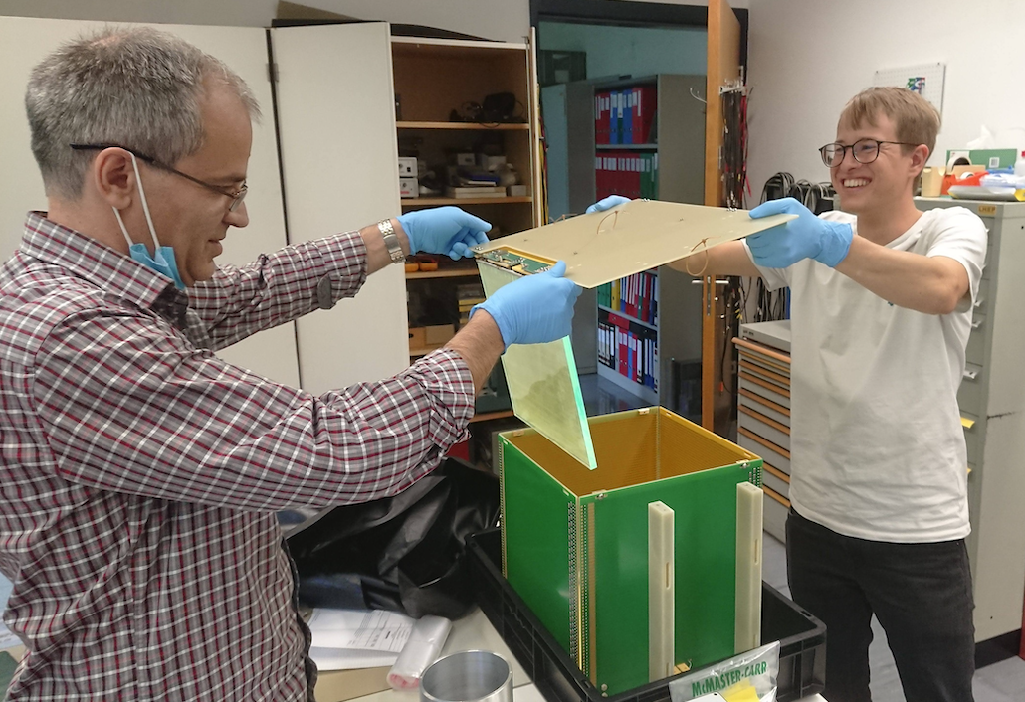
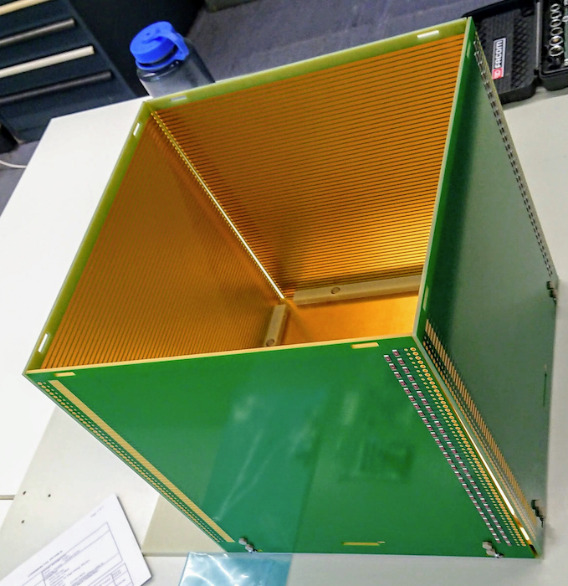
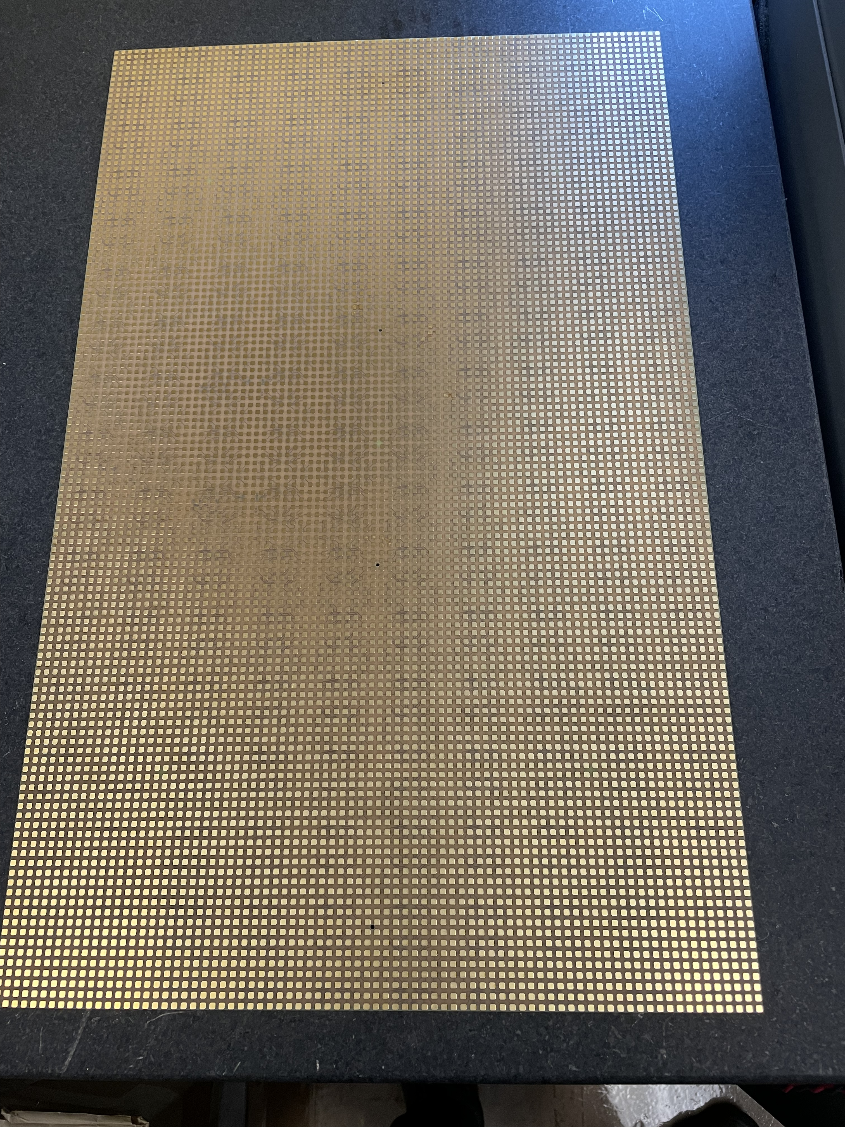
R&D on Scalability: SingleCube TPC
Installation of Pixel Tile and Light Trap
SingleCube LArTPC Field Cage
SingleCube TPC ‘Kits’:
Multiple TPCs produced and shared with
Collaborators to advance R&D program
Details:
- 32 cm x 32 cm x 32 cm field cage (fiberglass)
- Demonstrated at fields up to 1 kV/cm
- 6,400-pixel LArPix anode tile, feedthrough, controller
SingleCube operation sites:
- Univ. of Bern, LBNL, CSU, SLAC
Preparing for next-generation SingleCube production
- 50 cm x 50 cm x 32 cm
- Ready for new 10k-pixel LArPix tile
If you have a high-purity noble liquid system,
I can send you a kit.
See other DRD2 talks using SingleCubes:
- SoLAr [D. Guffanti (Univ. & INFN Milano-Bicocca)]
- LAr Property Measurements at LArTPC Neutrino Experiments
and 220Rn Injection at CSU LArTPC R&D Setup [M. Mooney (CSU)]
Raw 3D images of cosmic rays
from SingleCube LArTPC test
New 10k-pixel
LArPix Tile
32 cm x 48 cm

Slide 5
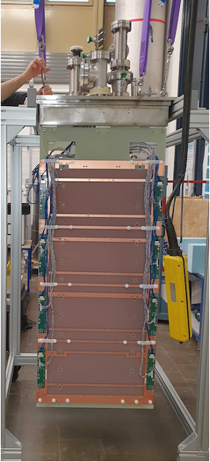
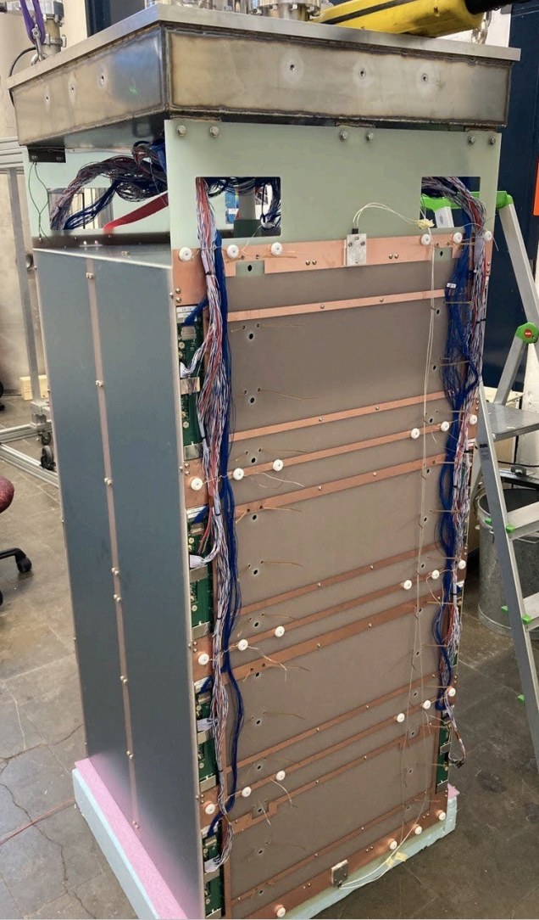
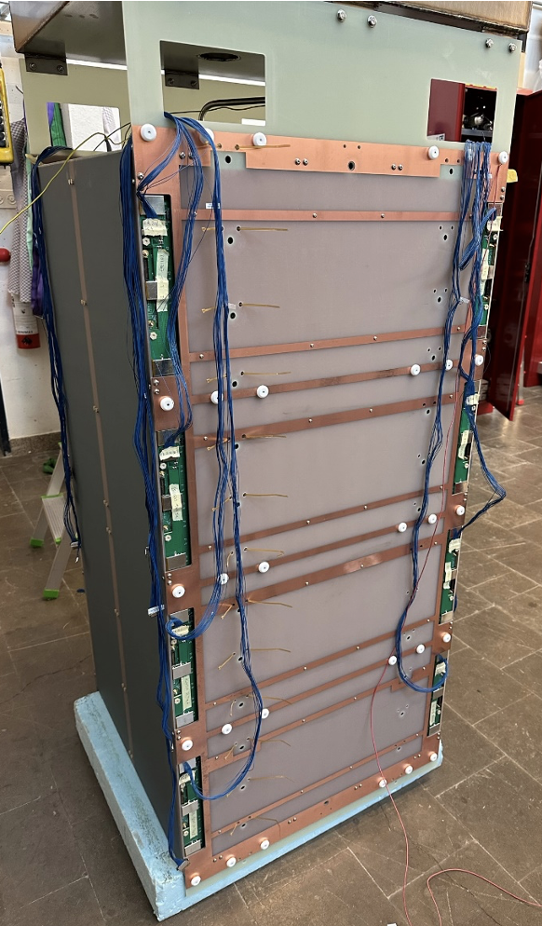
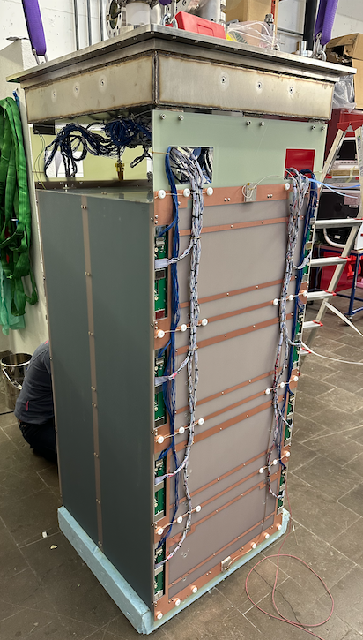
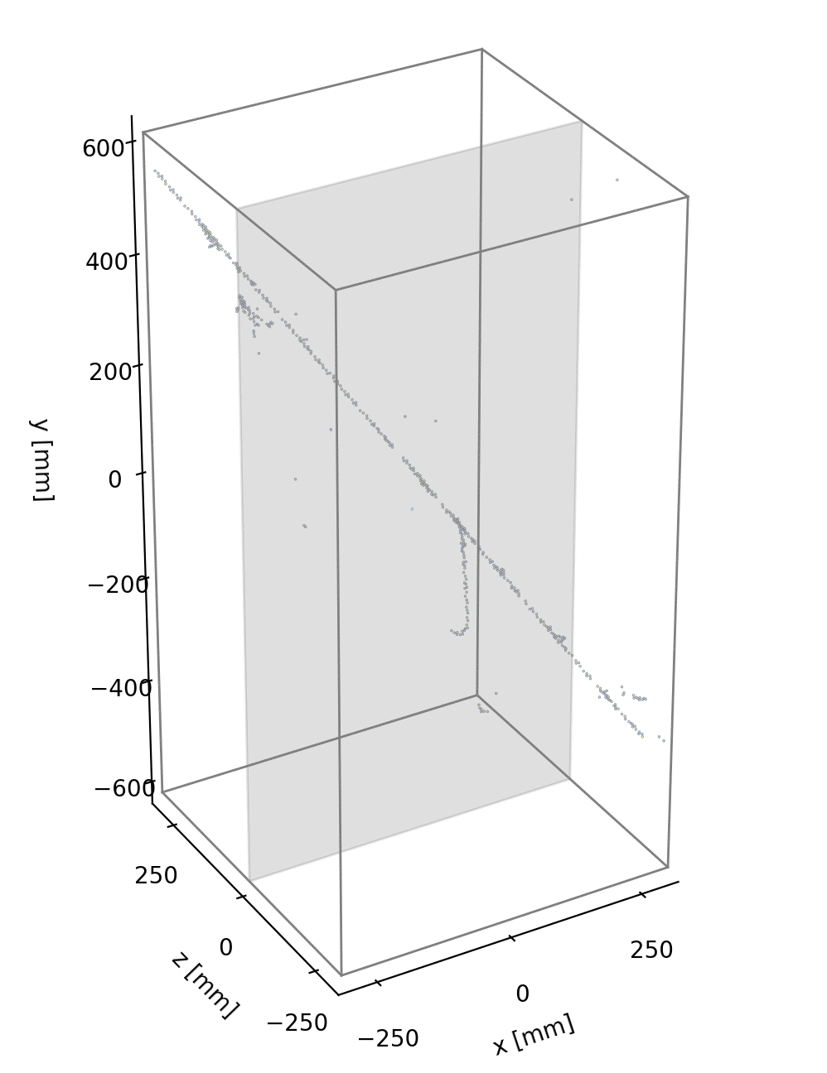
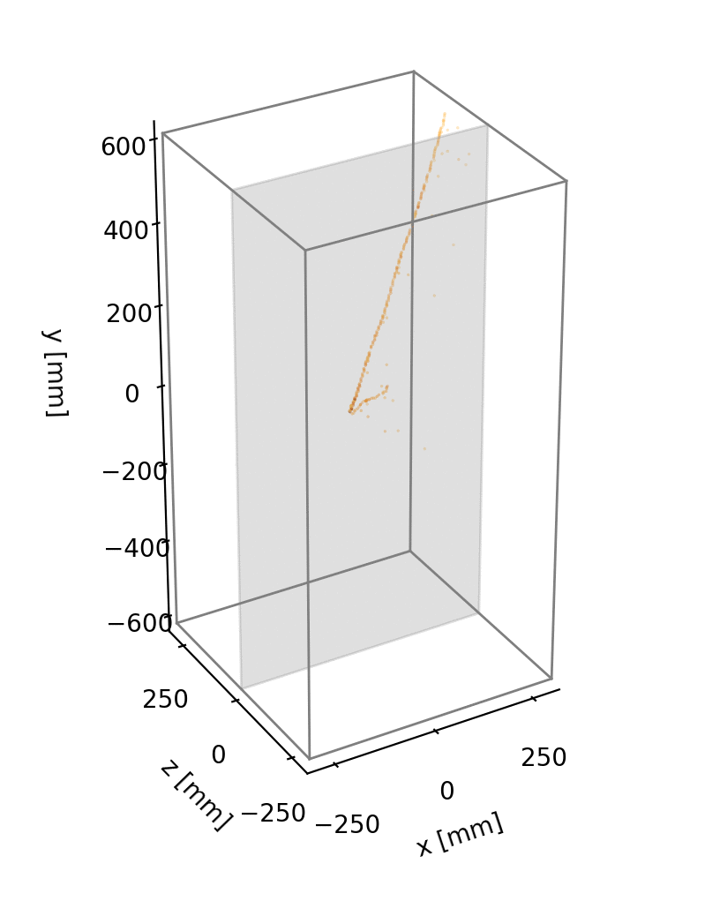
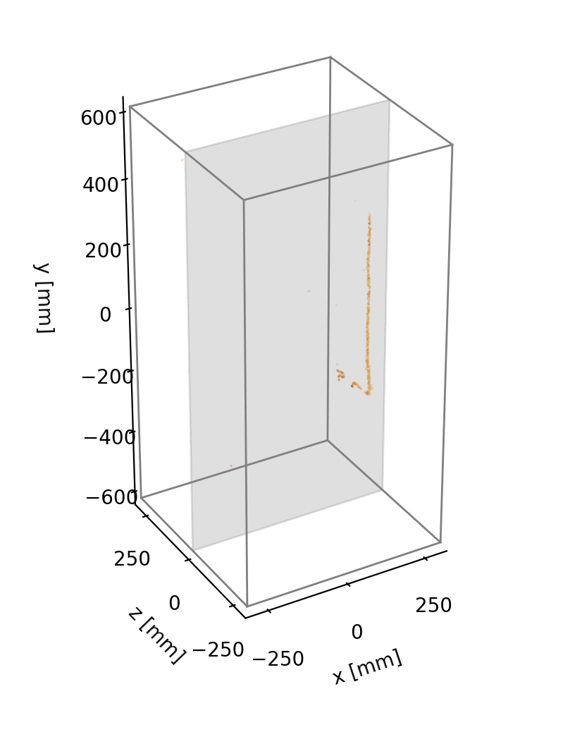
Near Detector Prototyping: ArgonCube 2x2 LArTPCs @ Bern
See yesterday’s talk
Produced and operated LArPix systems for four ton-scale LArTPCs, with a total of ~300k channels
Module 0
Module 1
Module 2
Module 3
Operations:
Apr. 1-10, 2021
Jun. 21-26, 2021
Operation:
Feb. 5-13, 2022
Operations:
Nov. 14-22, 2022
Nov. 29-Dec. 6, 2022
Operations:
Jan. 27-Feb. 5, 2023
Feb. 21-23, 2023
Mar. 13-16, 2023
Roughly 100 million cosmic events collected!
Next Step: Operation in NuMI Neutrino Beam

Slide 6
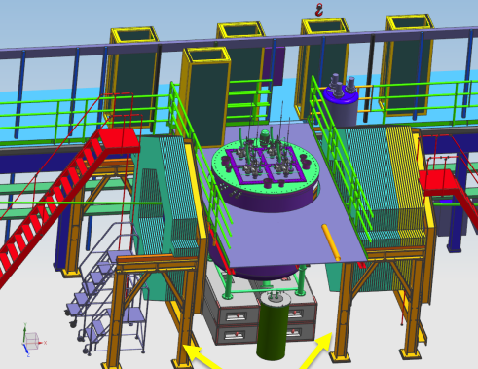
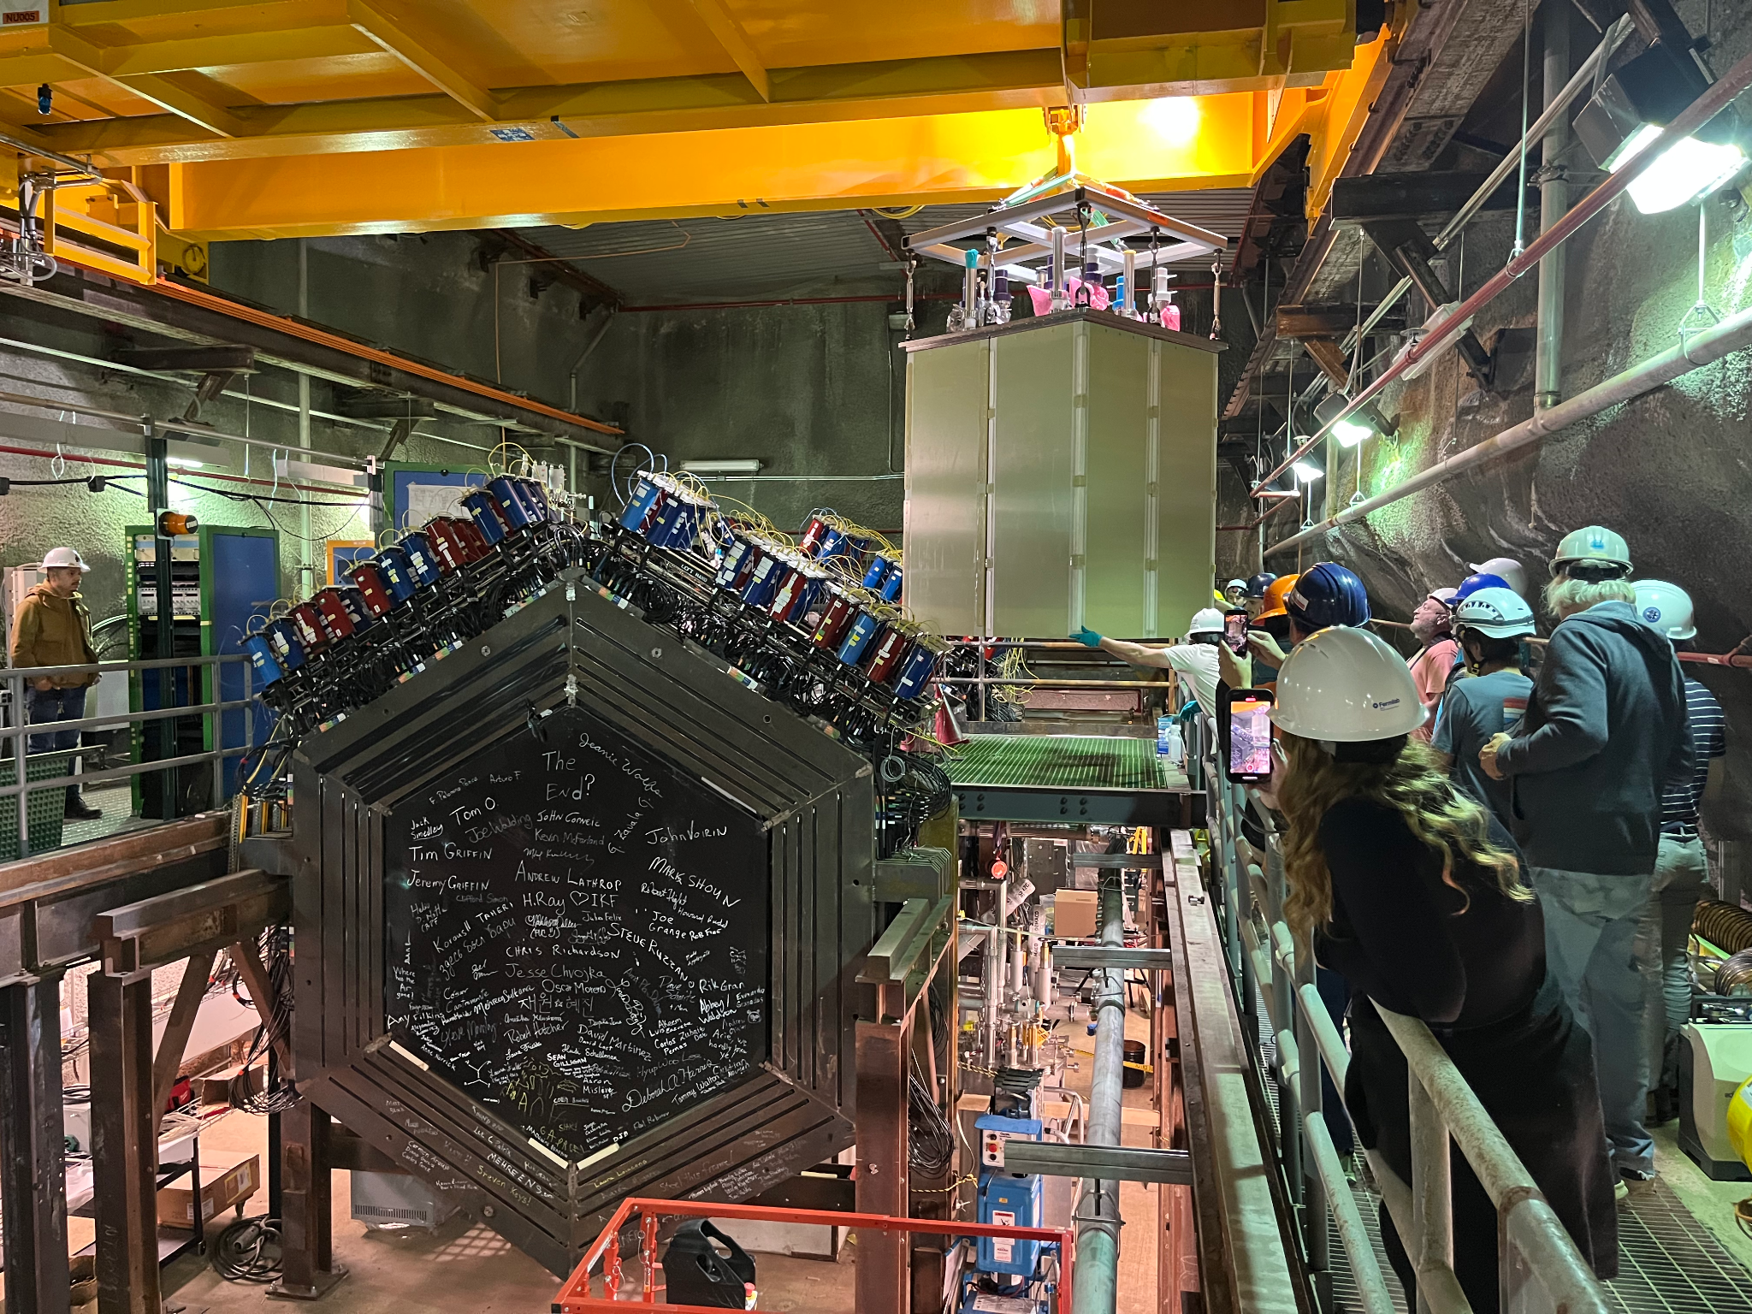
2x2 Demonstrator @ NuMI
See yesterday’s talk
2x2 Operation in NuMI Neutrino Beam 2023-2025
- Install four TPC modules in former location of MINOS Near Detector
- Includes upstream/downstream trackers, repurposed from the MINERvA Experiment
Goal:
- Characterize GeV-energy neutrino interactions on argon nuclei
Status:
- TPC Modules installed in cryostat, Oct 2023
- Installation nearing completion, Dec 2023
- Start of operations in early 2024
Operation of a 300k-pixel LArTPC
in a GeV-energy neutrino beam!

Slide 7
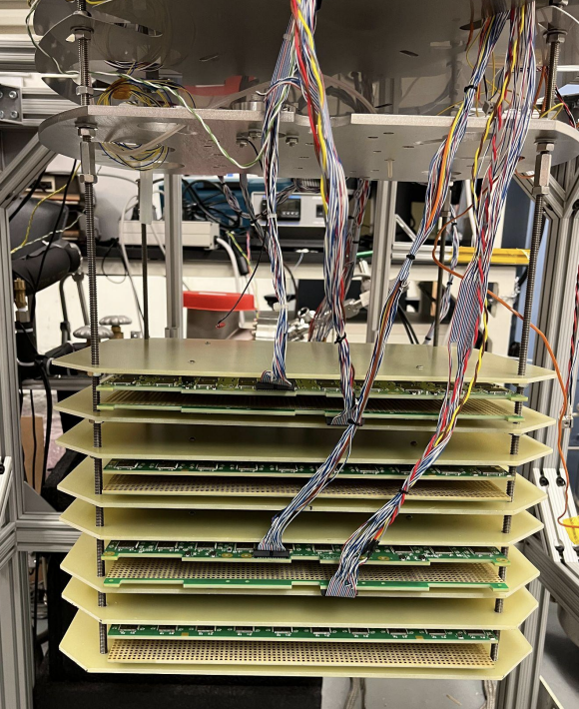
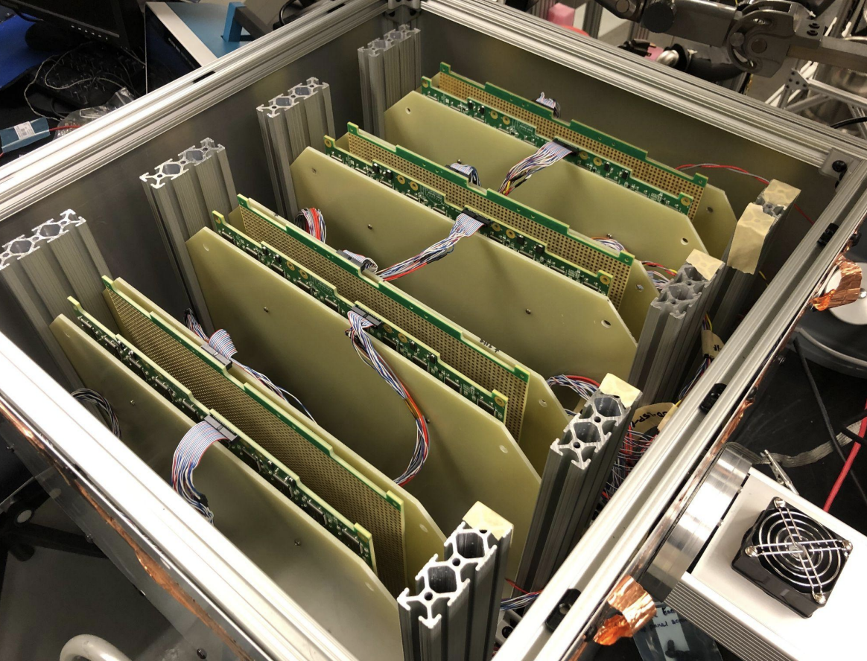
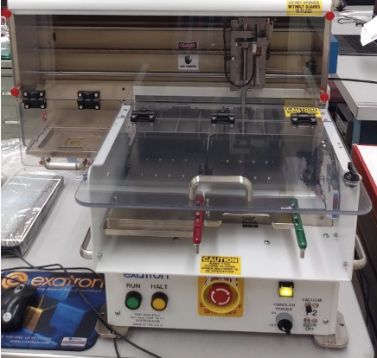
LArPix-v2: Scalable Production and Testing Process
All production/assembly done via commercial vendors; QC testing performed by scientific staff
ASICs produced and packaged
(@ vendors)
Anode tiles produced and checked
(@ vendor)
Controllers, cables, feedthroughs produced and checked
(@ vendor)
Room-temp System Test
Cryo-test of Pixel Tiles
ASIC room-temp QC testing
(@ Lab/Univ. partners)
Anode tiles loaded
and inspected
(@ vendor)
LArPix System
room-temp QC testing
(@ Lab/Univ. partners)
LArPix System
QC Cryo-testing
(@ Lab/Univ. partners)
LArPix-v2 testing:
~10,000 ASICs tested (so far)
~600 chips/day (1 robot)
Results:
~1% DOA
~10% sub-spec performance
LArPix-v2 testing:
~80 tiles tested (so far)
~8 tile batches, ~1hr
Results:
~0.5% chips failed post-assembly
Chip replacement: ~30 min
LArPix-v2 testing:
~80 tiles tested (so far)
~8 tile batches (time limited by LN fill/empty)
Results:
No cryo-failures yet
ASIC Testing Robot

Slide 8
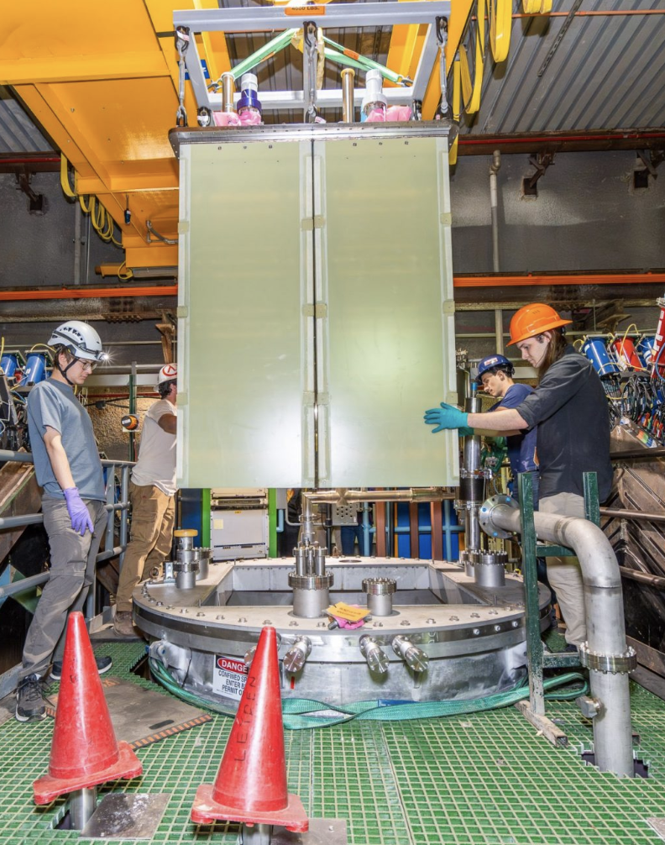

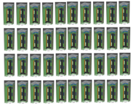
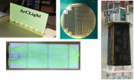

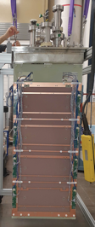
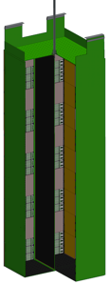

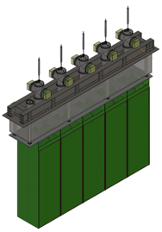
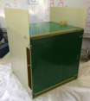
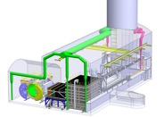
DUNE ND-LAr
Development
2022-2024
2026-2028
“2x2”
Physics Demonstrator
Production
35 (+5) production
modules, each
fully tested
2016-2019
Four mid-scale
TPC modules in
neutrino beam
ArgonCube R&D
2025-2026
Demonstrations of
component technologies
2021
ArgonCube
Module 0
Module Row
Prototype
Full
functionality
mid-scale prototype
Demonstrate production at 15% scale, assembly throughput, & integration with cryostat lid
TRL-7 (physics)
210 m² anode,
14M-pixel
TRL-4
2028-2030
Installation
2020
Support of TPC module
installation in Near Site
Activity driven by Near
Site Integration (NSI)
SingleCube
Integrated TPC test
at small-scale
125 cm
300 cm
6 m² anode,
410k-pixels
2023-2024
Full-scale ND
Demonstrator
30 m² anode,
2M-pixel
32 cm
70 cm
1 Full-scale
ND-LAr TPC
module
70 cm
TRL-7
(engineering)
TRL-6
100 cm
100 cm
32 cm
32 cm
TRL-5

Slide 9
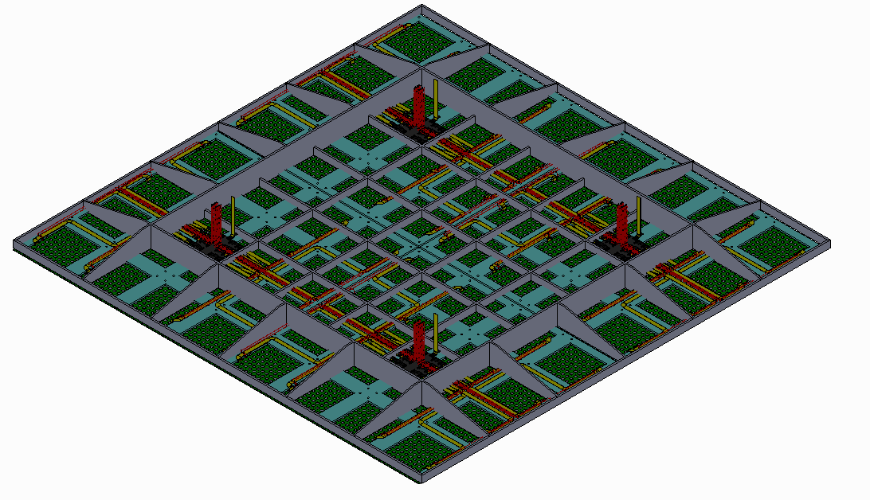
LArPix: Toward a LArPix DUNE Far Detector Module
For a credible technical design, a 3D Pixel FD likely needs:
- Viable production and testing plans
- Reasonable mechanical/electrical interfaces to existing DUNE FD cryostat
- Credible process for assembly and installation in detector
- Demonstrations of assembly/installation/operation at the ProtoDUNE scale
A Minimal Concept: LArPix in a DUNE Vertical Drift Far Detector
- Replace 2D strip PCBs with LArPix tiles
- Grid of 8 x 8 tiles forming 3m x 3m anode segments
- Digital aggregator multiplexes data I/O for 16 tiles
- Reuse existing 3m x 3m VD mechanical support structure
- Light collection in the cathode or along field cage walls
- Prototype in future ProtoDUNE-VD run?
- Note that such an FD design requires:
- ~1500 m² of anode area (half at top, half at bottom)
- ~100 million pixels
Other potential concepts:
- SoLAr integrated light & charge, Q-Pix, etc.
8 x 8 grid of LArPix tiles (3m x 3m) interfaced
to FD-VD anode support structure

Slide 10
Far Detector Pixel Readout: Key Requirements
My summary of the requirements that would drive system design and production for a future Far Detector
Requirement Approx. Value LArPix Comment
Granularity < 4.7 mm 3.8 mm Latest LArPix-v2b design has 3.8mm pixel pitch
Noise < 1000 e- ENC 900 e- ENC Noise as measured in ~100k-pixel TPC with LArPix-v2a
Threshold < 200 keV 200 keV 1/4-MIP signal efficiency currently marginal for both ND and FD
Power < 20 W/m² 14 W/m² Anode heat flux less than heat from cryostat walls. Mitigate boiling at anode.
Digital Multiplexing > 10⁶ pixels/channel 10⁵ pixels/channel Ok for ND. O(10x) digital aggregator needed to reduce FD cabling/feedthroughs
Reliability/Longevity < 5% failure/10yrs (Unknown) Cryo-longevity to be assessed as part of ND prototyping program
Total system cost < $20k/m² $10k/m² Total production cost includes full system assembly, cold/warm electronics, etc.
Production throughput > 1000 m²/yr O(200) m²/yr OK for ND. 5x needed for FD. May be possible with current or additional vendors.
Testing throughput > 1000 m²/yr O(50) m²/yr 4x needed for ND; 20x needed for FD. More QC testing partners needed.
Science
Engineering
Production
Most important steps toward Pixelization of a Far Detector:
- Design and prototype a cryo-robust digital aggregator
- Develop plan and partners to achieve FD-scale QC testing throughput

Slide 11
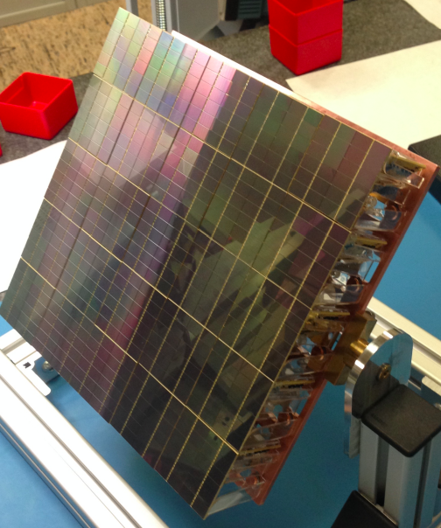
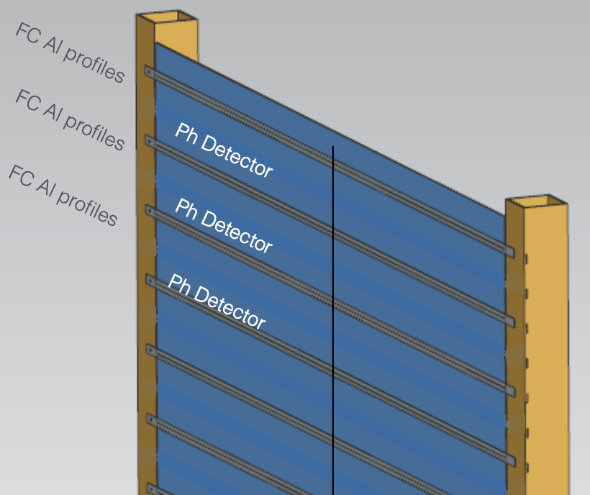
LightPix: Scalable Cryogenic SiPM Readout Electronics
See yesterday’s talk
R&D Goals:
- Highly-granular cryo-compatible scalable SiPM readout electronics at very low cost
LightPix:
- Adapt existing LArPix ASIC to provide scalable readout for many (e.g. >10⁶) Silicon Photomultipliers
- Reuse demonstrated LArPix system architecture:
Very-low-power (~100 μW/channel), cryo-compatible (87 K), highly-scalable at O($0.10)/channel system cost
- Unique channel for every SiPM (no analog ganging) → Highly granular detector
Rough concept:
Replace LArPix charge-collection pixels with SiPMs
Potential detector formats
Full SiPM Coverage
Coupled to light collectors
e.g. Cosmic rays imaged in ton-scale
10⁵-channel LArPix LArTPC prototype
e.g. Prototype 6.4k-channel LArPix-v2 tile
e.g. Darkside-20k prototype light sensor
e.g. APEX concept for DUNE

Slide 12
Summary
LArPix-v2 ASIC
LArPix-v2 Tile
DUNE Near Detector
Prototype LArTPC
Cosmic ray 3D images
from prototype
Pixels at O(10) m²:
- Demonstrated in ND-LAr 2x2 program
- Achieved performance and cost targets
- Leverages commercial production
- Prototyped production and QA/QC testing processes
Pixels at O(100) m²: e.g. DUNE ND-LAr
- No obvious technical barriers, but…
- Requires:
- Careful vendor management
- Robust QA/QC testing processes
- Coordination of large teams, parts tracking, etc.
- Must be ready in ~2 years for DUNE ND-LAr
Pixels at O(1000) m²: e.g. Future DUNE Far Detector
- Modest scale from vendor perspective, but…
- Requires:
- Additional level of cryo-compatible digital multiplexing
- Prototyping / demonstration at CERN Neutrino Platform
- Much larger QA/QC program, teams, throughput
- Additional R&D to enhance physics reach
SingleCube LArTPC
Field Cage
Pixel Vertical Drift Concept
Bulk Cryo-testing

