Slide 1
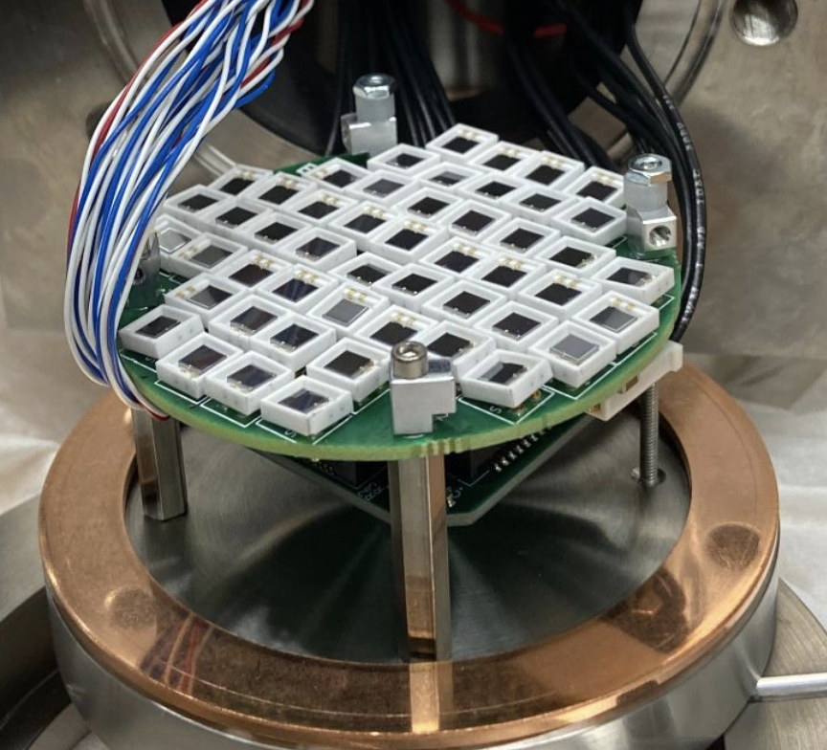
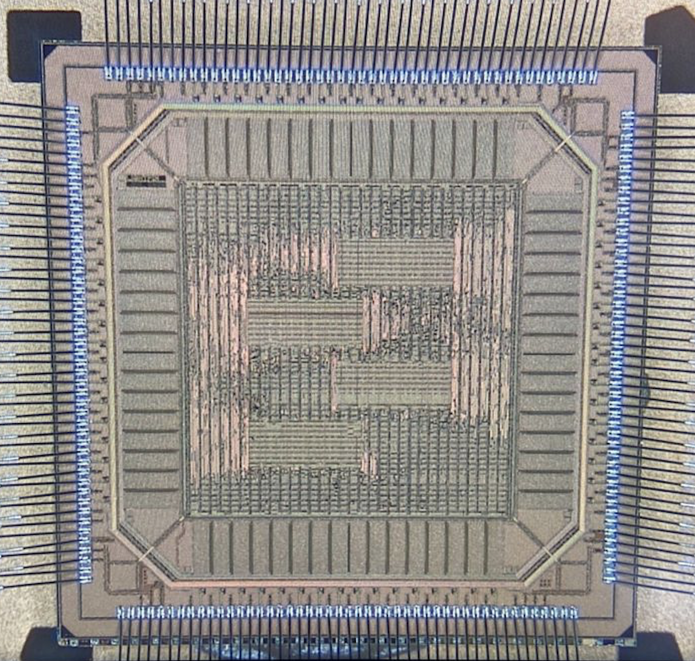
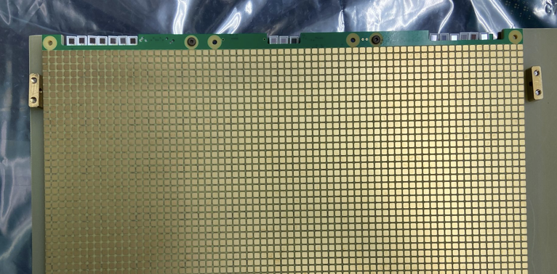
LightPix:
Scalable Readout for
SiPM-based Detectors
Dan Dwyer (Berkeley Lab)
DRD2 Collaboration Meeting
5-7 Feb 2024

Slide 2
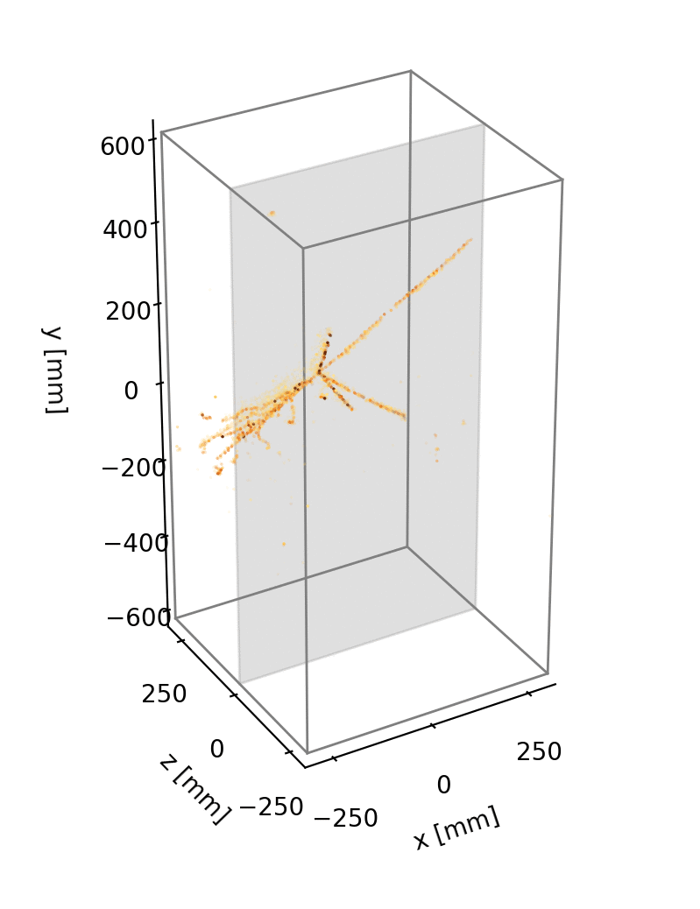
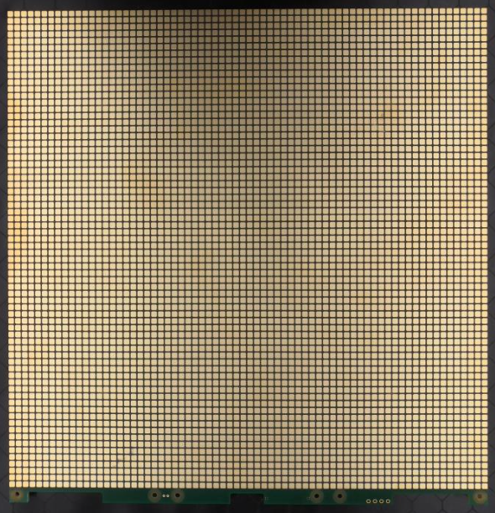
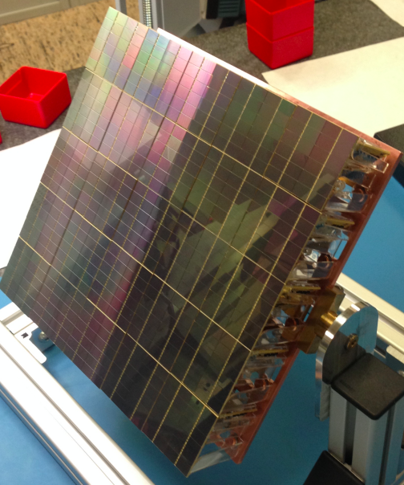
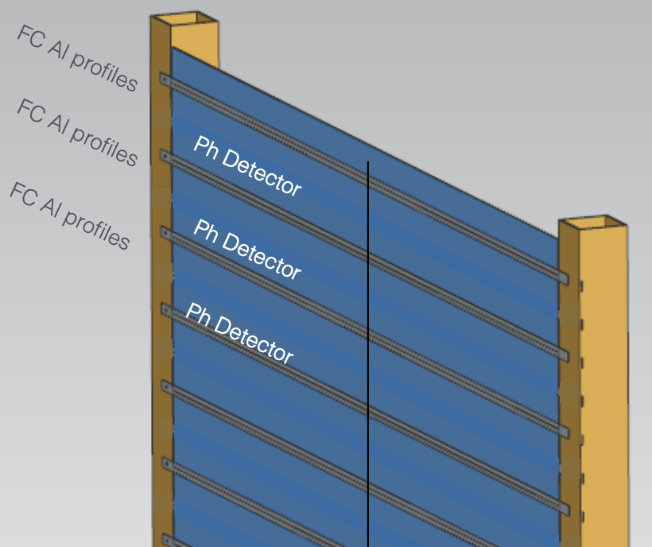
LightPix: Scalable Cryogenic SiPM Readout Electronics
R&D Goals:
- Highly-granular cryo-compatible scalable SiPM readout electronics at very low cost
LightPix:
- Adapt existing LArPix ASIC to provide scalable readout for many (e.g. >10⁶) Silicon Photomultipliers
- Reuse demonstrated LArPix system architecture:
Very-low-power (~100 μW/channel), cryo-compatible (87 K), highly-scalable at O($0.10)/channel system cost
- Unique channel for every SiPM (no analog ganging) → Highly granular detector
Rough concept:
Replace LArPix charge-collection pixels with SiPMs
Potential detector formats
Full SiPM Coverage
Coupled to light collectors
e.g. Cosmic rays imaged in ton-scale
10⁵-channel LArPix LArTPC prototype
e.g. Prototype 6.4k-channel LArPix-v2 tile
e.g. Darkside-20k prototype light sensor
e.g. APEX concept for DUNE

Slide 3
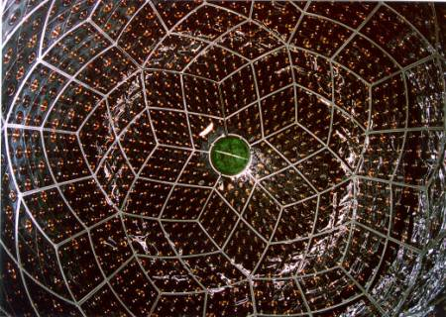
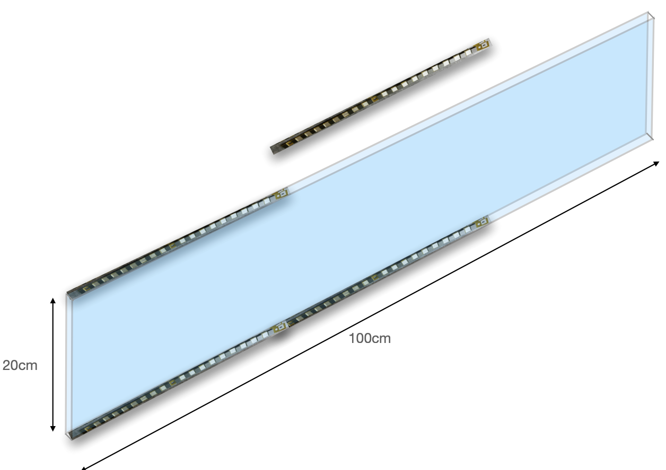
LightPix: Comments on Front-End Optimization
KamLAND Detector:
~1 kton of liquid scintillator surrounded
by ~2000 photomultipliers, MeV-scale physics
Front-end requirements depend strongly on channel occupancy
High-Occupancy Regime: N_{photoelectrons}/channel ≫ 1
- Important to capture signal waveform
- Accurate calorimetry
- Pulse shape discrimination
- Demanding requirements on readout electronics performance:
- High-bandwidth (i.e. high-power) front-end / ADC / readout.
→ Gang SiPMs to reduce channel count / power budget
- Or pursue novel techniques (e.g. digital SiPMs)
Low-Occupancy Regime: N_{photoelectrons}/channel ≲ 1
- Important to capture hit time (not charge/waveform)
- Calorimetry and PSD come from aggregate (many-channel) data
- Example: Performance of KamLAND hit/no-hit reconstruction
- Front-end can be primitive (e.g. single-photon discriminator & TDC)
- Low power per channel
Many many SiPMs in low-occupancy regime
→ Target of LightPix-v1 R&D
Maximizing light collector coverage
for DUNE Far Detector #3:
SiPMs likely in low-occupancy regime

Slide 4
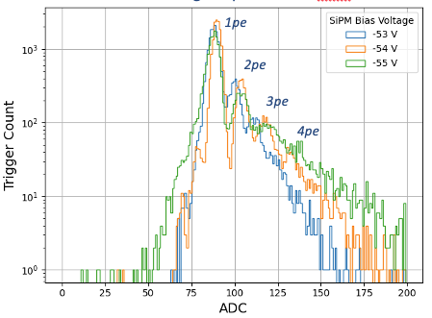
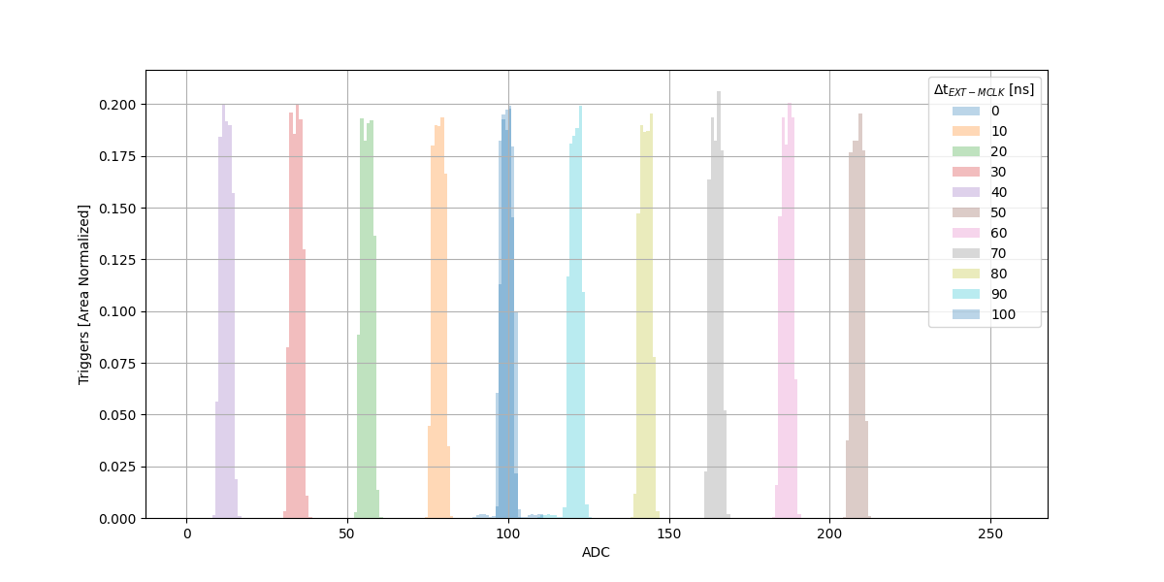
LightPix ASIC
LightPix-v1b ASIC
Photoelectron signal spectrum vs. SiPM bias
with unoptimized LArPix CSA
LightPix-v1:
- Develop and test dedicated time-to-digital converter (TDC)
to provide O(1) ns time resolution
- Add multi-channel coincidence triggering mode to suppress
excess data from dark noise at room temp
Shares LArPix scalable system design:
- 64 channels per chip
- 6,400 channels per cable
- 51,200 channels per controller
Progress:
- Received Aug. 2021
- Power-up, configuration successful
- TDC meets design targets
- Dark count suppression logic validated
- Tested performance of existing front-end performance
with Hamamatsu and FBK VUV SiPMs
Next Steps:
- Optimize front-end for larger SiPMs
Very-low-power TDC achieves ~ns-scale
precision in response to external pulse
Offset between
external pulse
and TDC stop
signal
Triggers (normalized)
TDC
Tunable TDC (here ~0.5ns/tick)

Slide 5
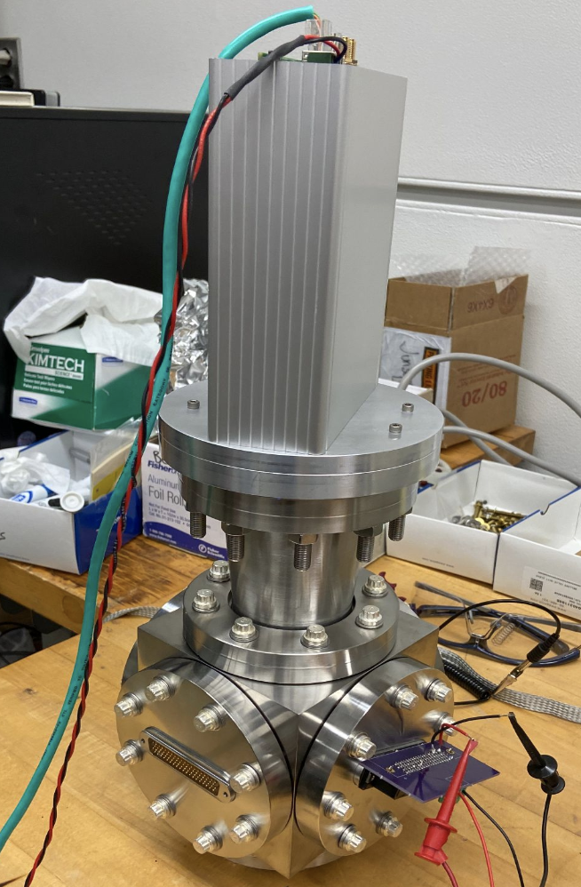
LightPix System Testing
LAr Testing:
- LightPix-v1 system coupled to VUV-sensitive SiPMs
Hamamatsu S13370-3075CN (3 mm x 3 mm)
FBK VUV-HD (3 mm x 3 mm)
- Verified detection of VUV (~127 nm) scintillation photons
produced by cosmic rays in liquid argon in existing LArPix TPC
High-Pressure Helium Testing:
- LightPix-v1 system coupled to 300 VUV-sensitive SiPMs
6 boards of 50 Hamamatsu S13370-3075CN (3 mm x 3 mm)
- Operated up to P = 12 bar, doped with ~1% argon for wavelength shifting
- Verified room-temp dark count suppression, and photon detection in
response to ²⁴¹Am alpha source
VUV SiPMs readout in joint LightPix/LArPix Network
Complete
LightPix
Readout
System
Prototype 50-SiPM board
Helium test chamber

Slide 6
Future R&D
LIghtPix-v1 ASIC
Prototype 50-SiPM system
Enhanced Performance:
- Development for high-occupancy detectors
- Architecture for detector-wide dark count suppression
Enhanced Scalability:
- Operation in high-field environment
- System fabrication/integration techniques
- Alternate photoamplification techniques
Exploring technologies to enable future
very large high-granularity detectors
e.g. Darkside-20k
prototype light sensor
APEX Concept
LArPix + LightPix TPC Readout

Slide 7
Backup

Slide 8
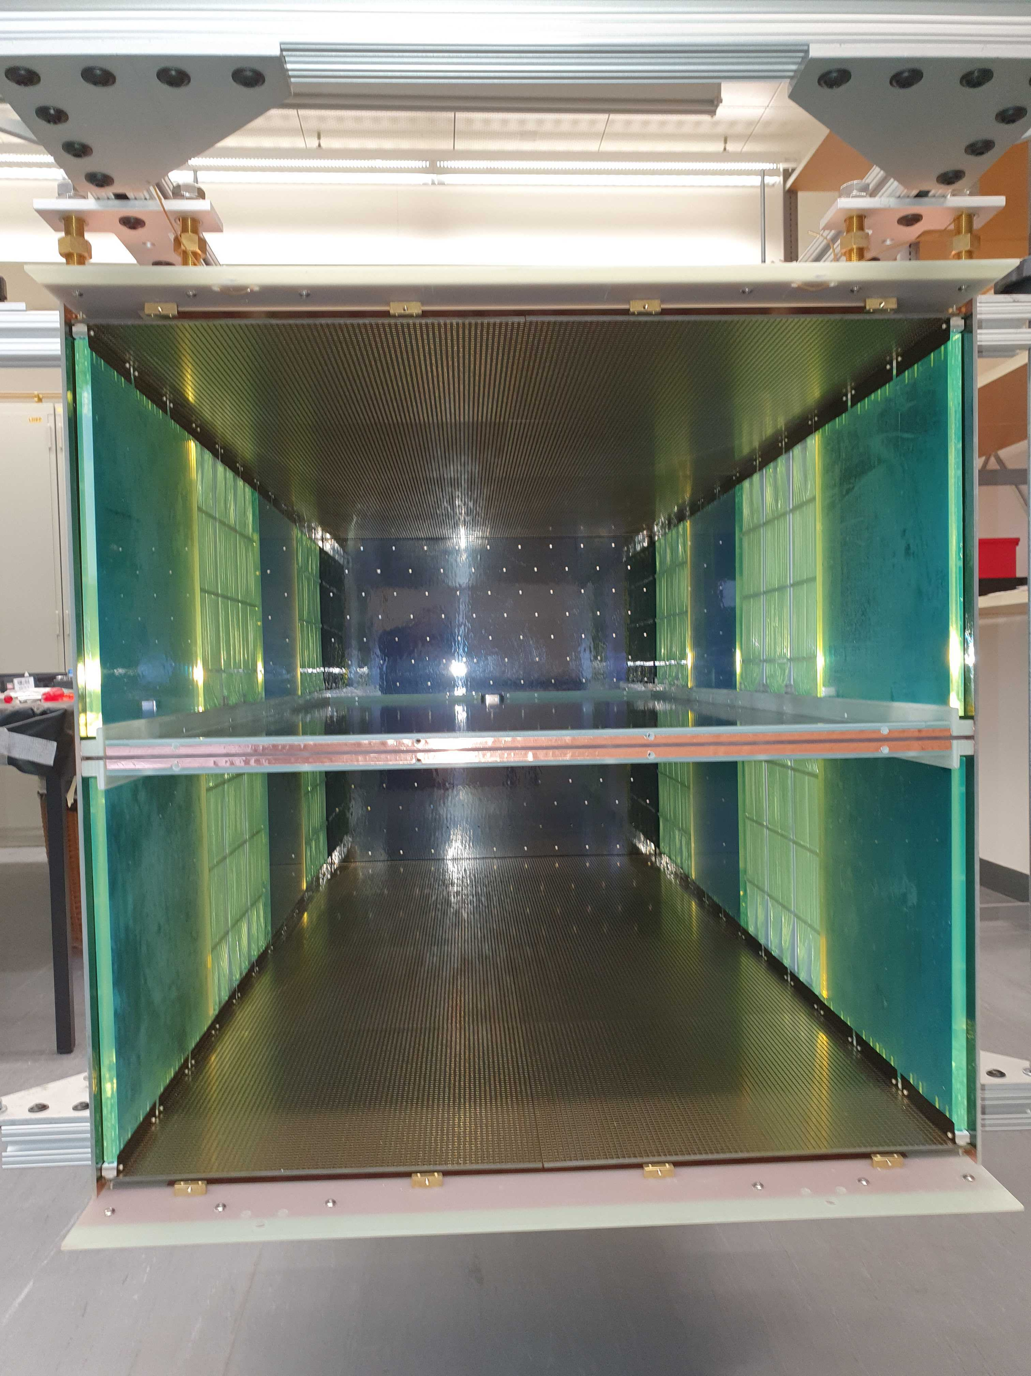
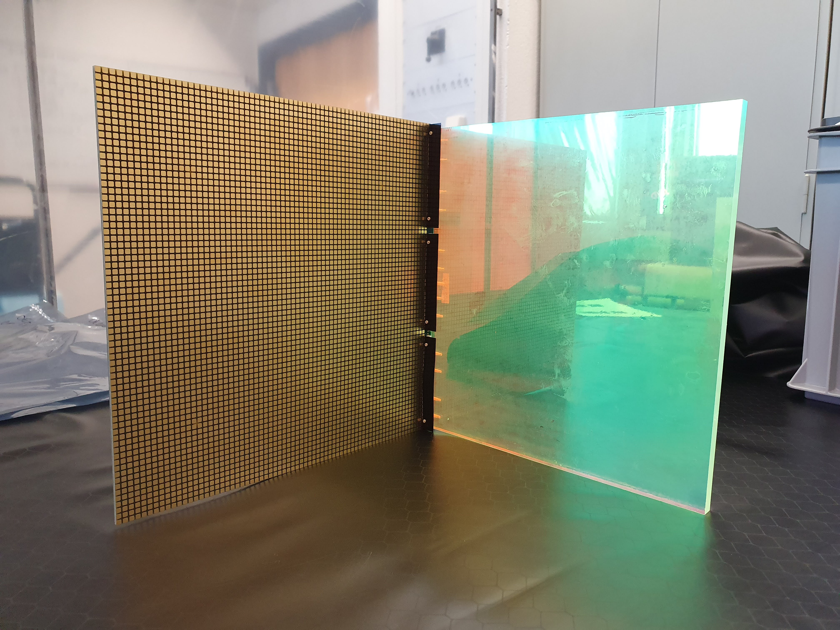
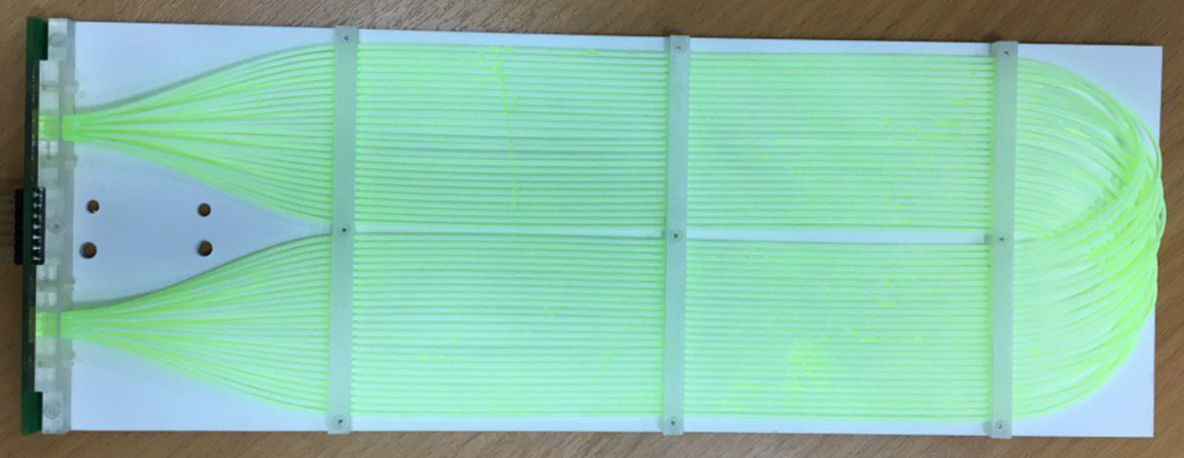
Photon Detector Systems: ArCLight (U-Bern) and LCMs (JINR)
Lessons from Near Detector Light Trap Technologies for a DUNE Far Detector?
  ND achieves ~40% light trap coverage by covering field cage with dielectric light traps
  TBP coating converts LAr scintillation UV to blue, WLS plate/fibers shift blue to green, dichroic film traps, funnels photons to SiPMs
Two complete anodes (16 tiles)
with light traps attached, inside
field cage (bottom open for viewing)
Example: Existing DUNE-ND design
- SiPMs at anode (low field)
- Trap extends into drift field along field cage
- Two styles: WLS plastic core vs. WLS fiber bundle
- Occludes ~3% of volume, charge readout anode
Anode
Cathode
Fiber-bundle style light trap:
JINR LCMs
Anode
One pixel tile with one WLS plastic light trap attached
Bern ArCLight
Instruments 2018, 2(1), 3

Slide 9
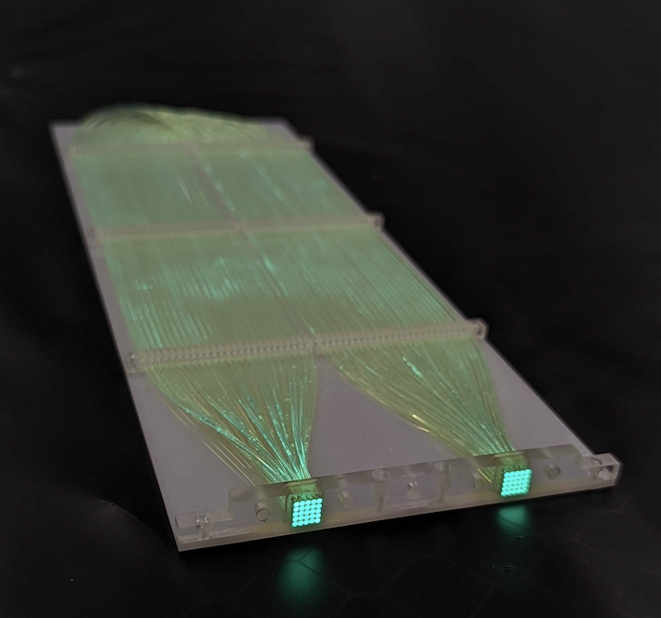
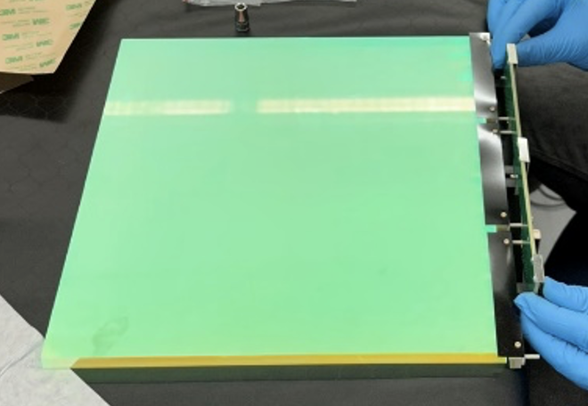
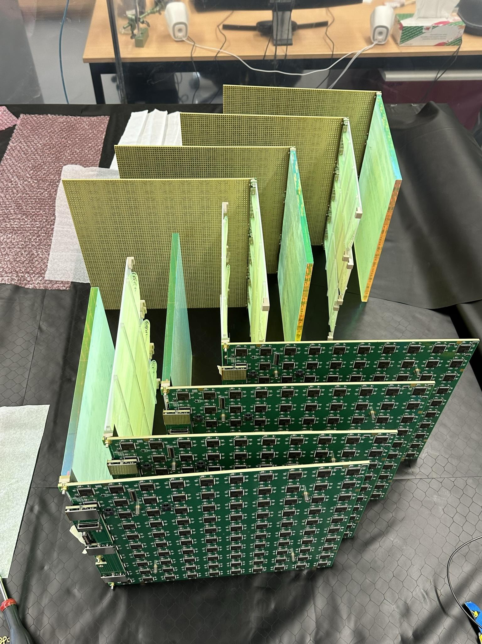
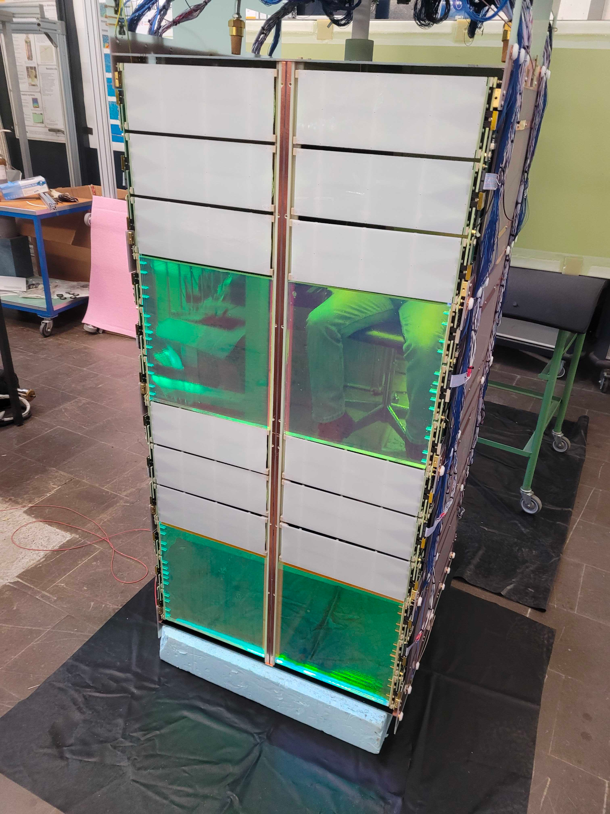
Light Readout Prototyping
LCM (fiber-based) Light Trap from JINR
ArCLight Light Trap from Univ. of Bern
Scintillation Light traps mounted to Pixel Tiles for 2x2
View of alternating LCM/ArCLight traps in 2x2 TPC Module 3

Slide 10
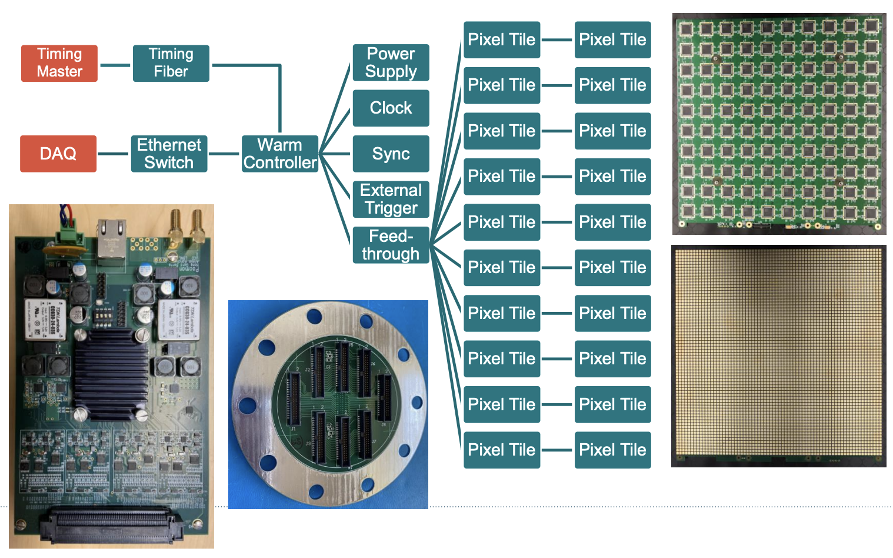
R&D on Scalability: LArPix-v2 Concept
Design Principles:
Minimize cryo-side components:
- LArPix ASIC is the only active element
- Multiple identical pixel tiles
Reliability:
- Tile robust to single ASIC failures
- Redundant I/O paths (x4 per tile)
Fully-integrated Controller:
- Drives 8 tiles
- Programmable logic
- Clean power
- Built-in DAQ and full OS
All components fabricated commercially

Slide 11
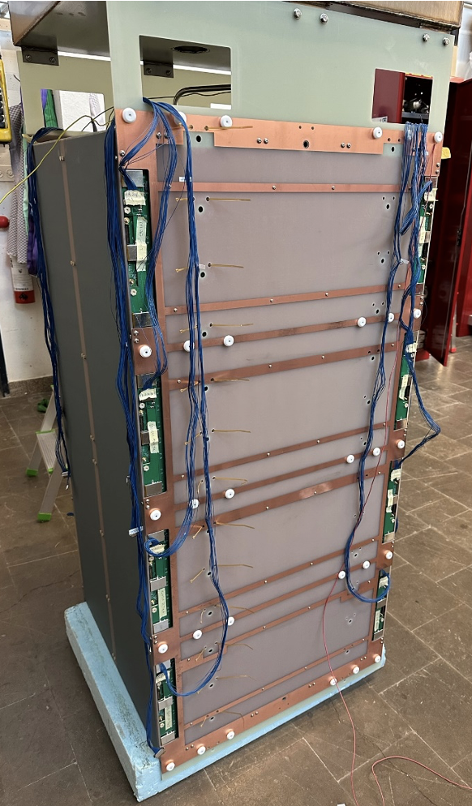
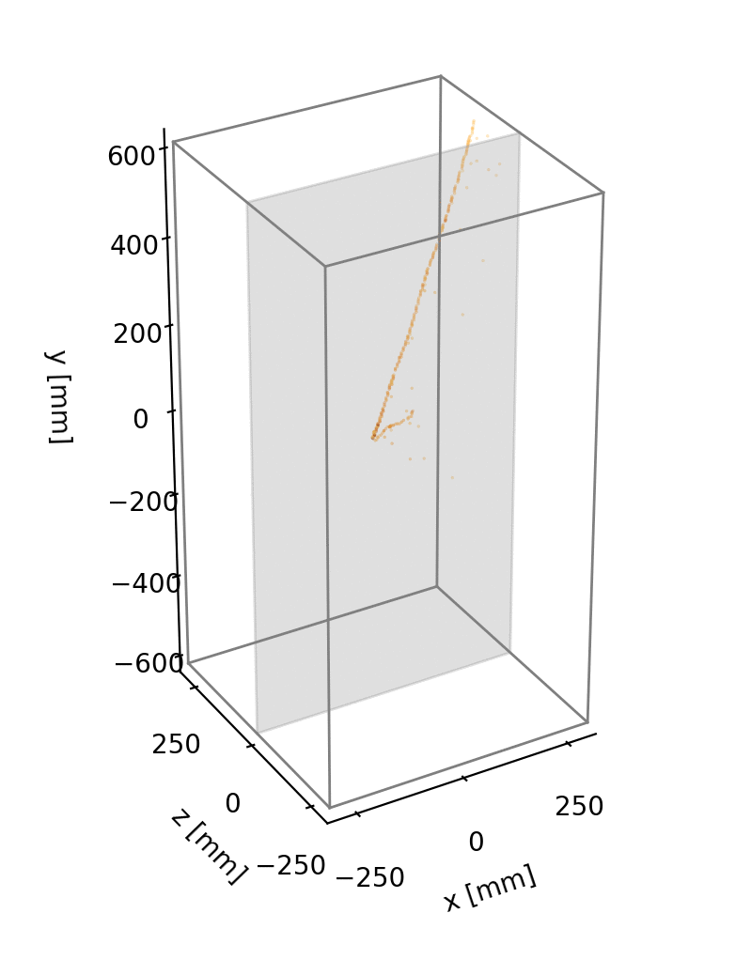
Near Detector Prototyping: ArgonCube 2x2 LArTPCs
Typical raw data from cosmic ray interactions
imaged in 3D prototype detectors
Verified design meets technical requirements:
- Collected >10⁷ cosmic ray events
- Stable HV at ~30kV (~1 kV/cm drift, 2x target)
- Stable Purity at >2ms (>4x target)
- MIP Charge Signal-to-Noise >20:1 (at target)
Continuous streaming readout:
~100% live, independent of scintillation system
Achieved ~200 keV thresholds
Low data rate due to self-triggered design
Arguably the most performant
ton-scale LArTPC to date.
Example:
LArPix-v2b system, 102,400 pixels, 3.8mm spacing

Slide 12
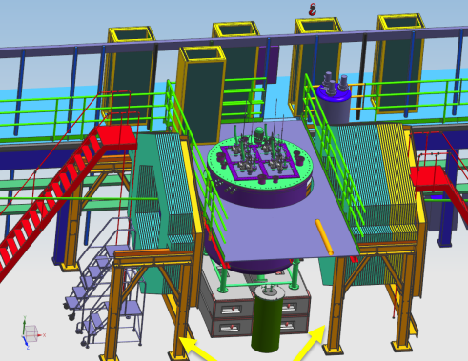
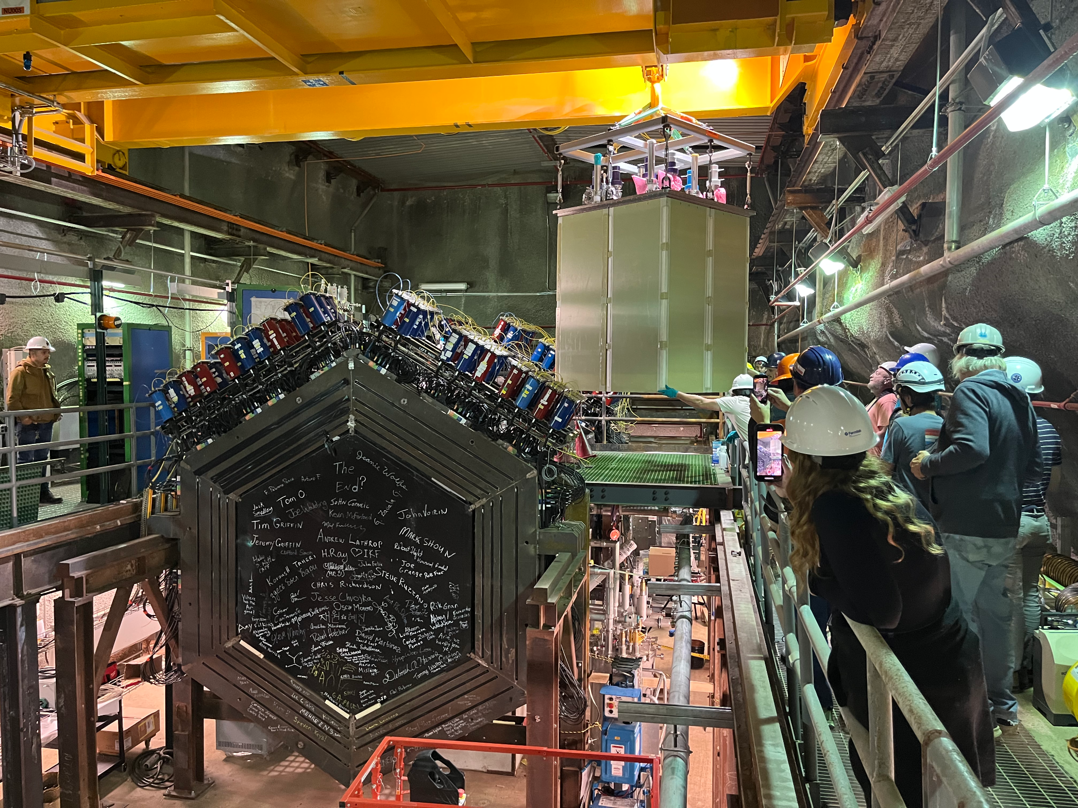
2x2 Demonstrator @ NuMI
2x2 Operation in NuMI Neutrino Beam 2023-2025
- Install four TPC modules in former location of MINOS Near Detector
- Includes upstream/downstream trackers, repurposed from the MINERvA Experiment
Goal:
- Characterize GeV-energy neutrino interactions on argon nuclei
Status:
- TPC Modules installed in cryostat, Oct 2023
- Installation nearing completion, Dec 2023
- Start of operations in early 2024
Operation of a 300k-pixel LArTPC
in a GeV-energy neutrino beam!

