Slide 1





Q-Pix: a scalable pixel readout for
liquid noble detectors
James Battat, Wellesley College
on behalf of the Q-Pix consortium
DRD2 Collaboration Meeting, Feb. 5-7, 2024, CERN

Slide 2
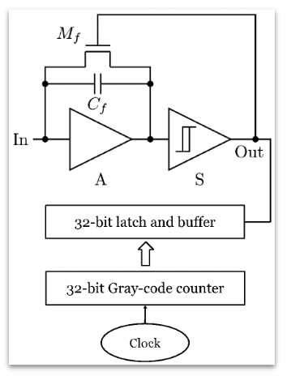


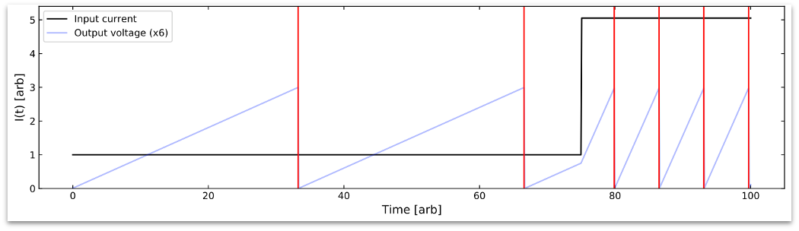

Q-Pix: record the time per unit charge
Integrator with reset
Comparator
Reconstruct current (average)
David Nygren, Yuan Mei
arXiv:1809.10213

Slide 3

Q-Pix: record the time per unit charge
…
Integrator with reset
Comparator
Reconstruct current (average)
David Nygren, Yuan Mei
arXiv:1809.10213

Slide 4
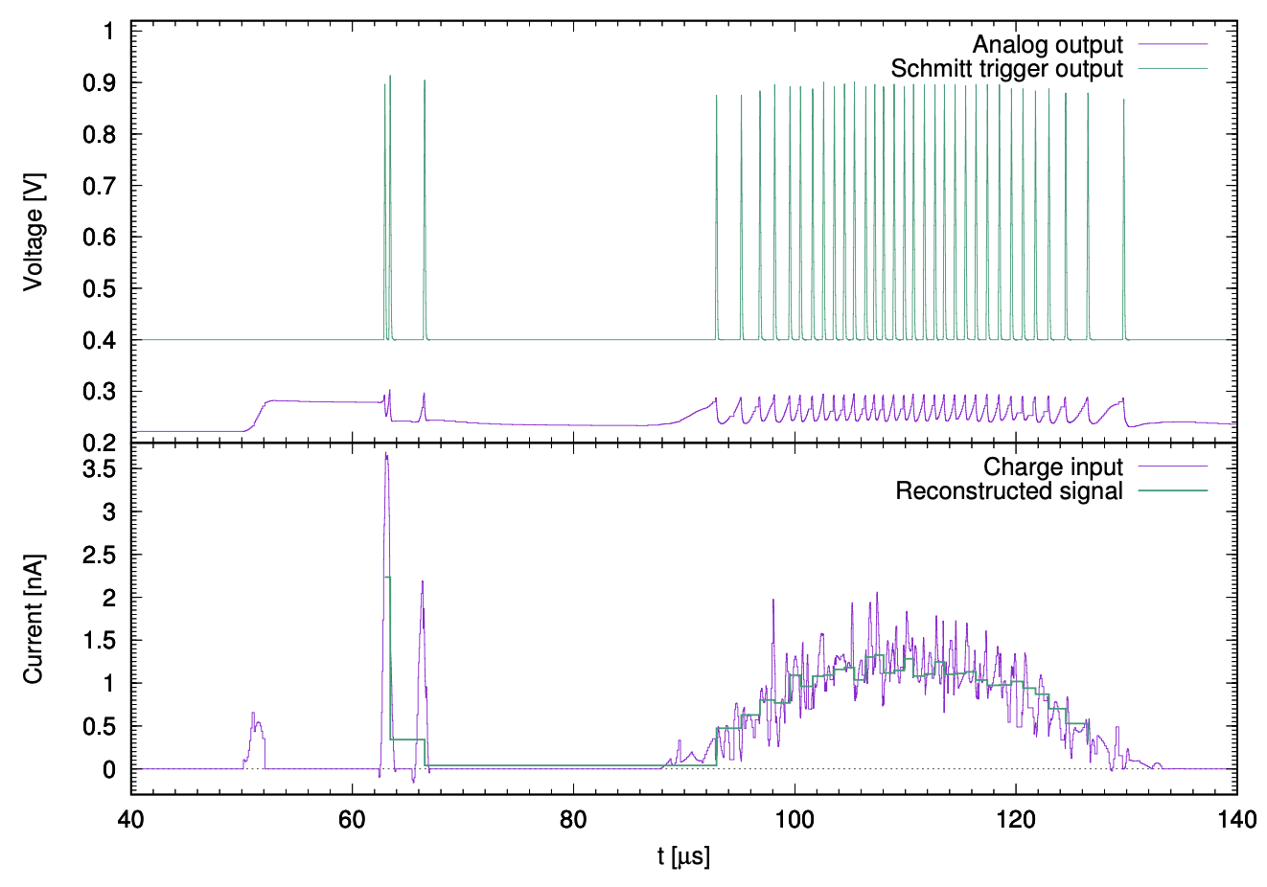
Q-Pix: record the time per unit charge
Reset threshold: 0.3 fC = 1,900 e-
Integrator with reset
Comparator
David Nygren, Yuan Mei
arXiv:1809.10213

Slide 5
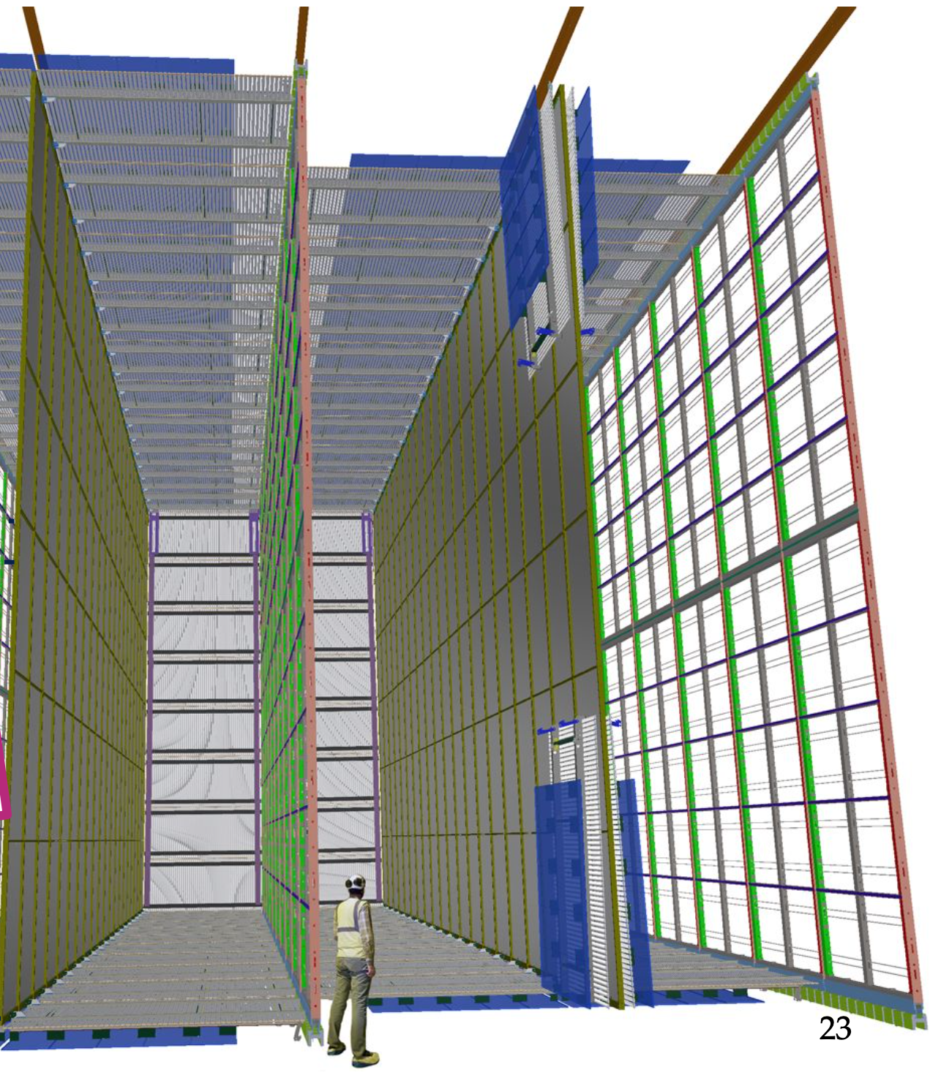

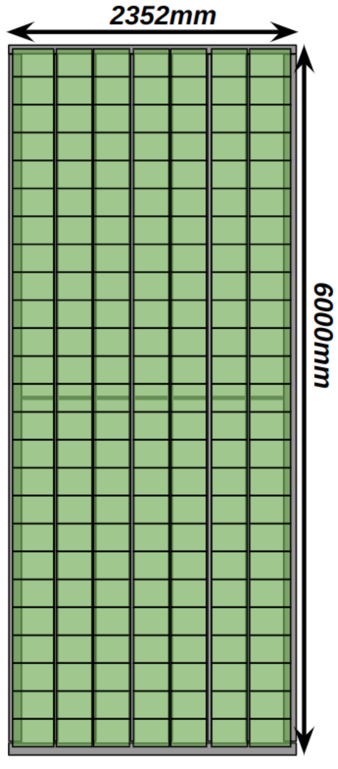
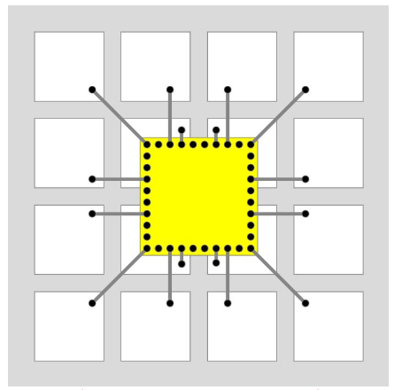
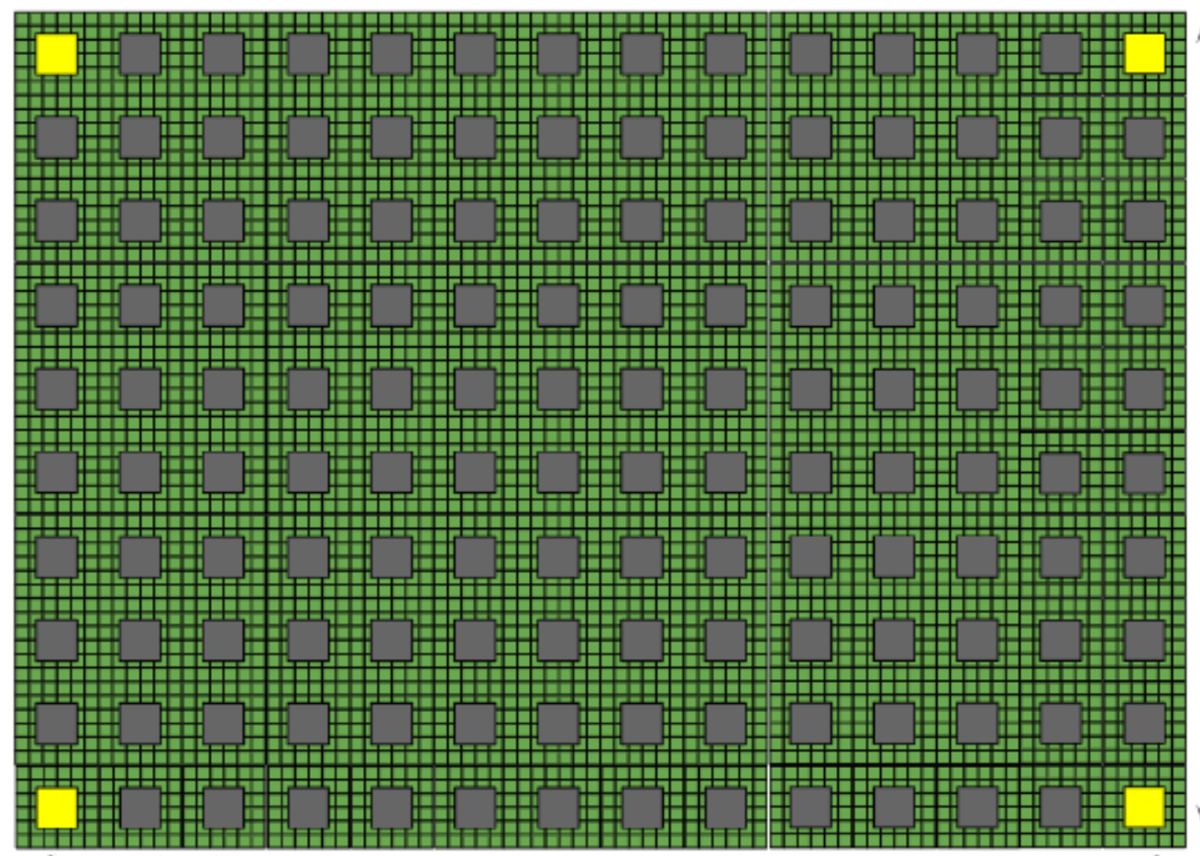
Q-Pix at scale
Pixel
Tile array
ASIC
Tile

Slide 6

Prior work
Prototypes (COTS)
  Single-pixel (low noise)
  Multi-pixel (event topology)
ASICs v0

Slide 7
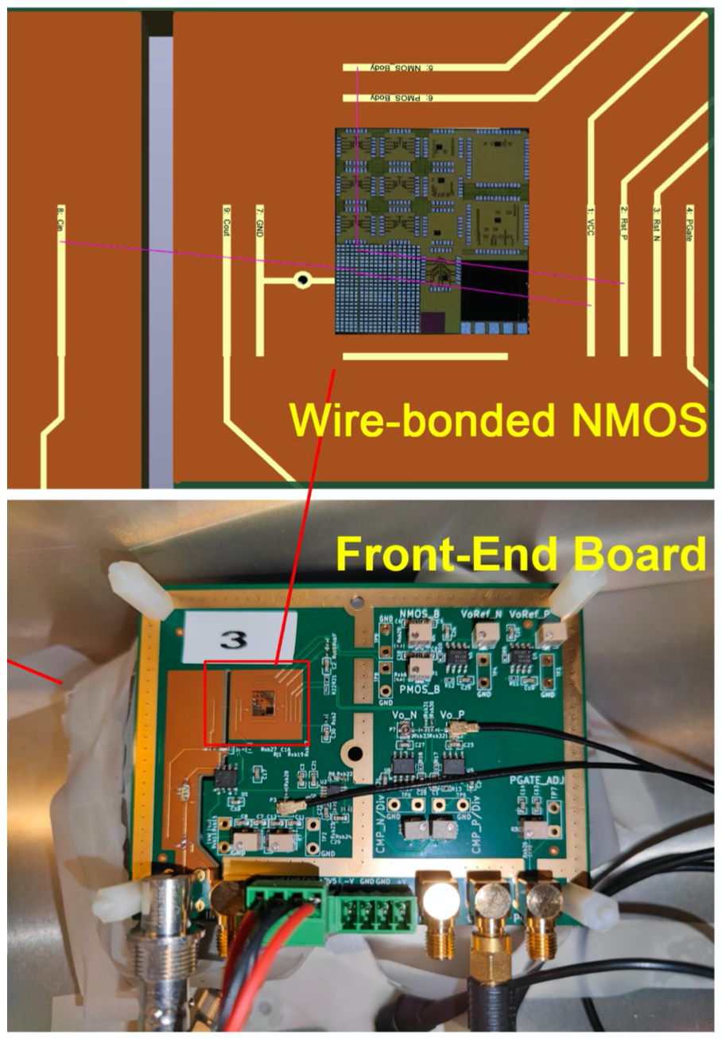
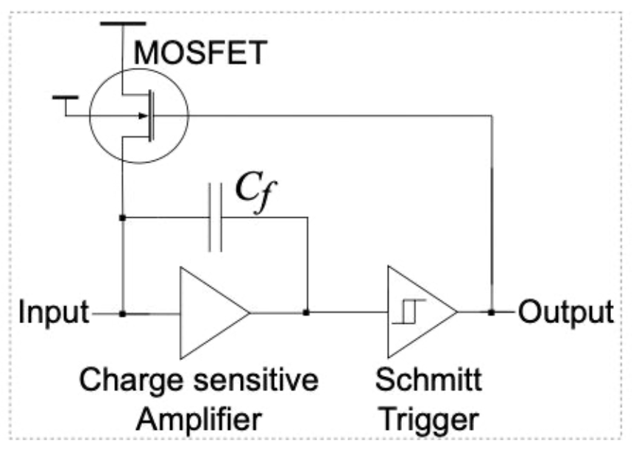
Q-Pix front-end with sub-fC reset threshold
Demonstrated 0.46 fC per reset (~2,900 e-)
Demonstrated “replenishment” rather than “reset” (prevents lost signal charge)
Demonstrated reconstruction of signal current equivalent to MIP in LAr
Led by Yuan Mei (LBL) and Peng Miao (LBL)
arXiv:2311.09568

Slide 8
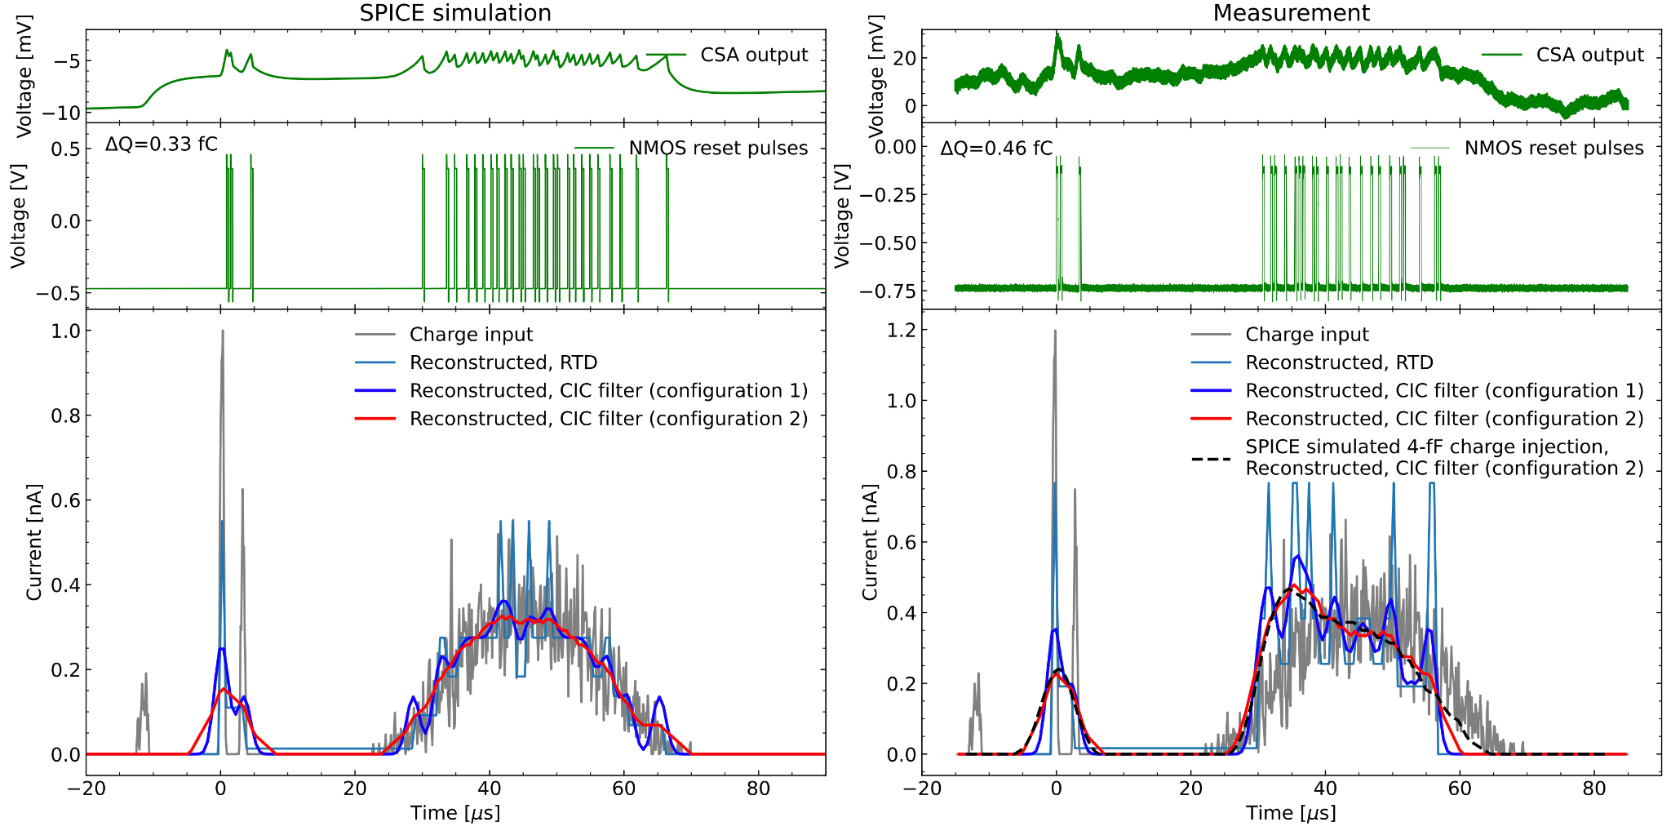
Q-Pix front-end with sub-fC reset threshold
Simulation
Data
arXiv:2311.09568

Slide 9
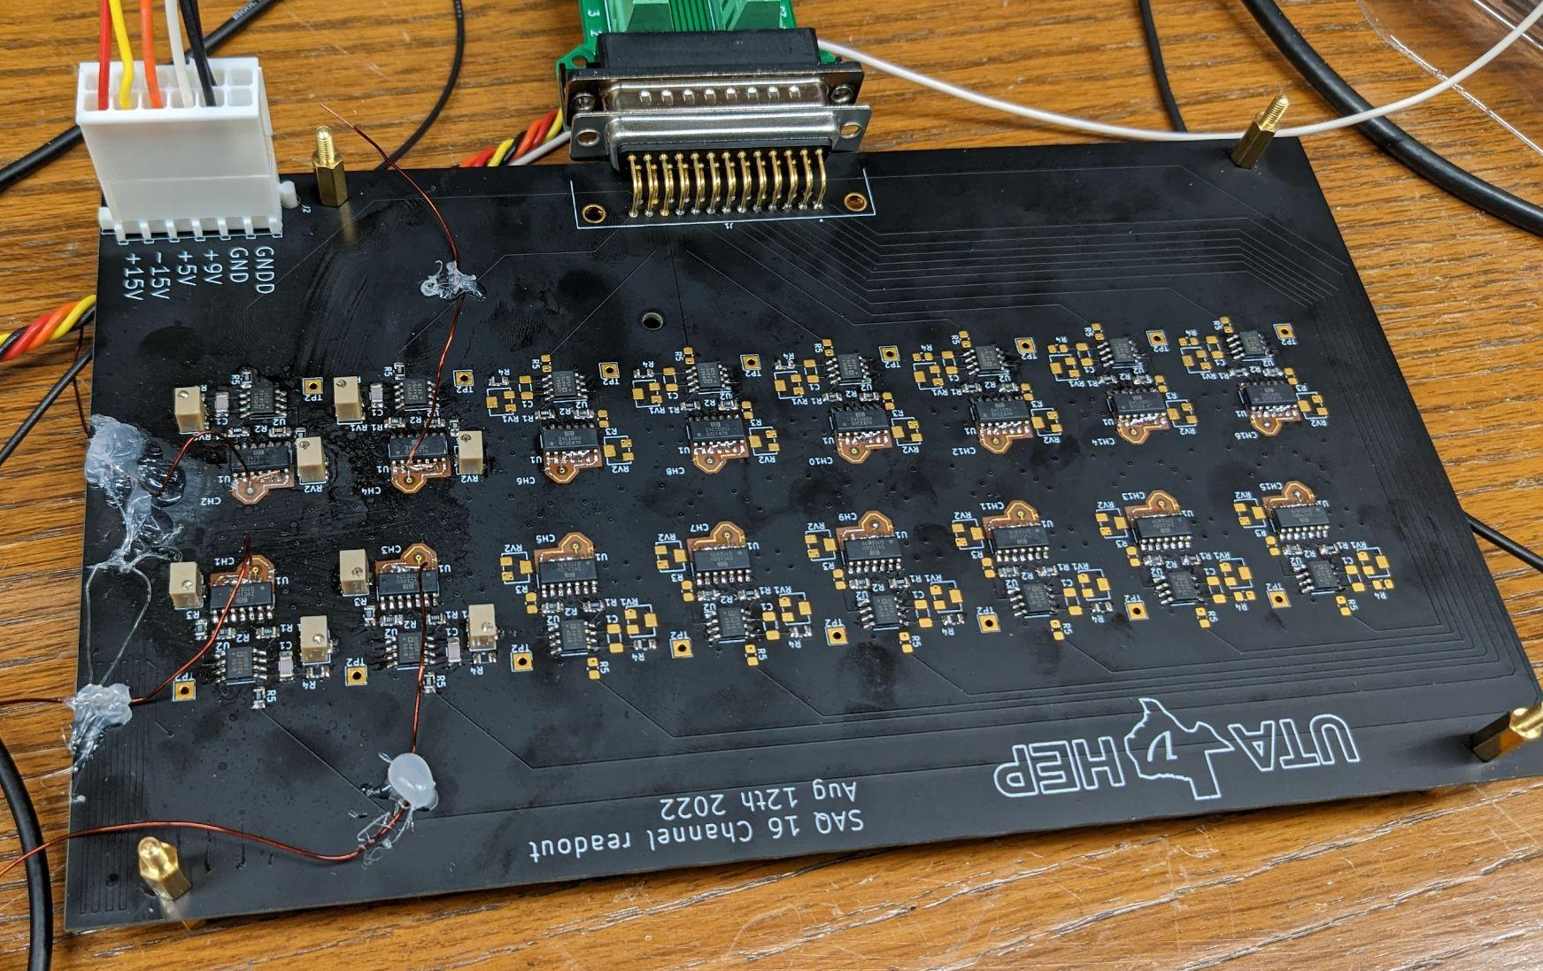

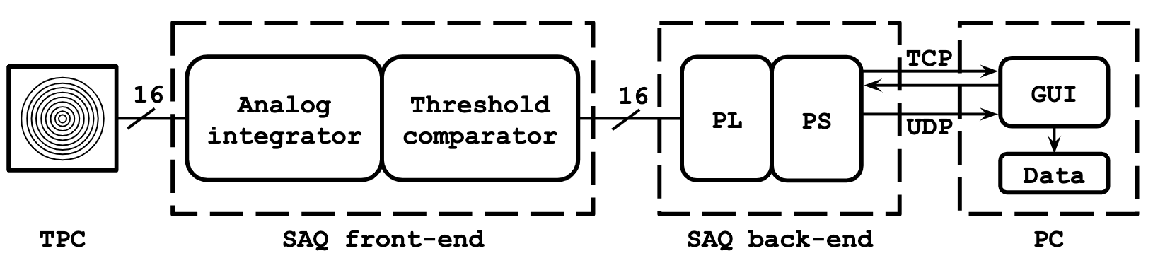
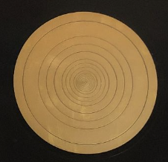
Multi-channel Q-Pix front-end, event topology
16 channels
COTS integrator and comparator
TI IVC102 & AD8561
Measure transverse diffusion of e⁻ in gas TPC at room temp.
Gold
Xenon Flash Lamp (fiber)
GEM
Readout
Electronics
Led by UTA (Asaadi) & Wellesley (JB)
Upcoming submission, JINST

Slide 10
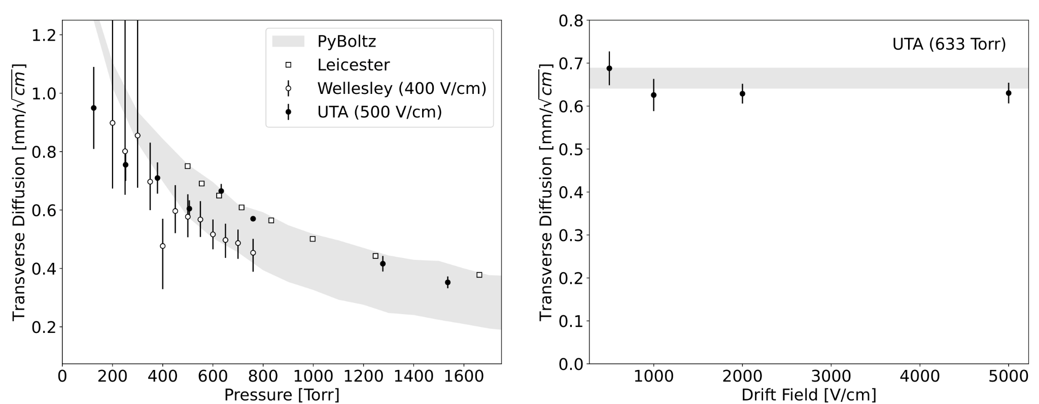
Multi-channel Q-Pix front-end, event topology
Transverse diffusion from reset times alone
Measurements consistent with PyBoltz and prior measurements
Diffusion constant with E-field, decreases with pressure
preliminary
Fixed pressure, various drift field
Fixed drift field, various pressures
Upcoming submission, JINST

Slide 11
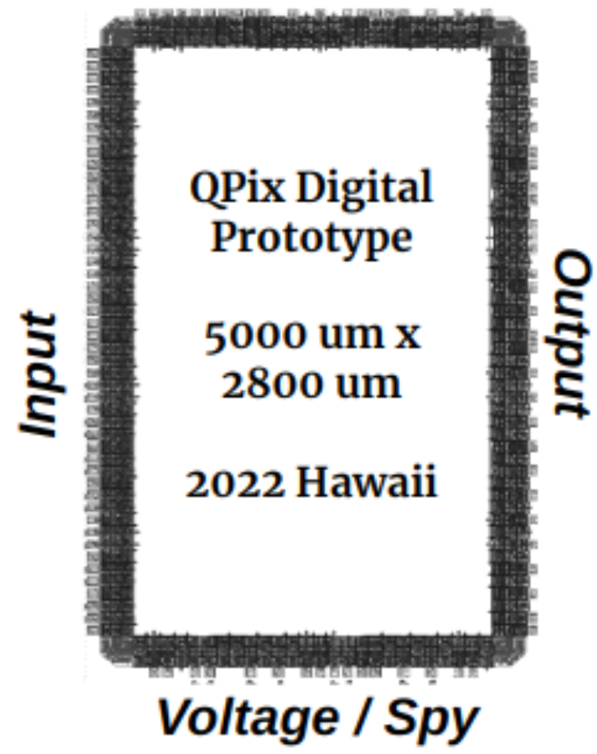
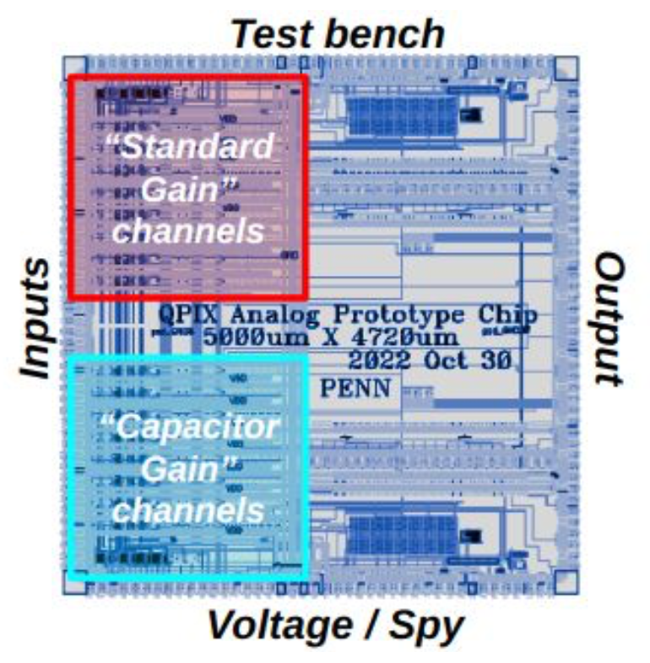
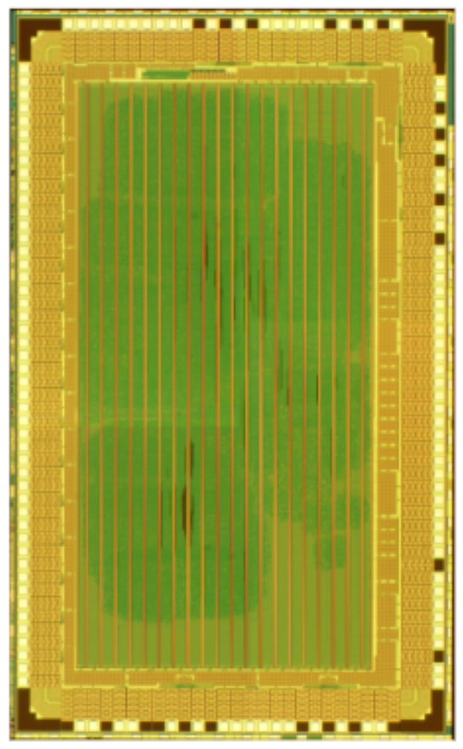
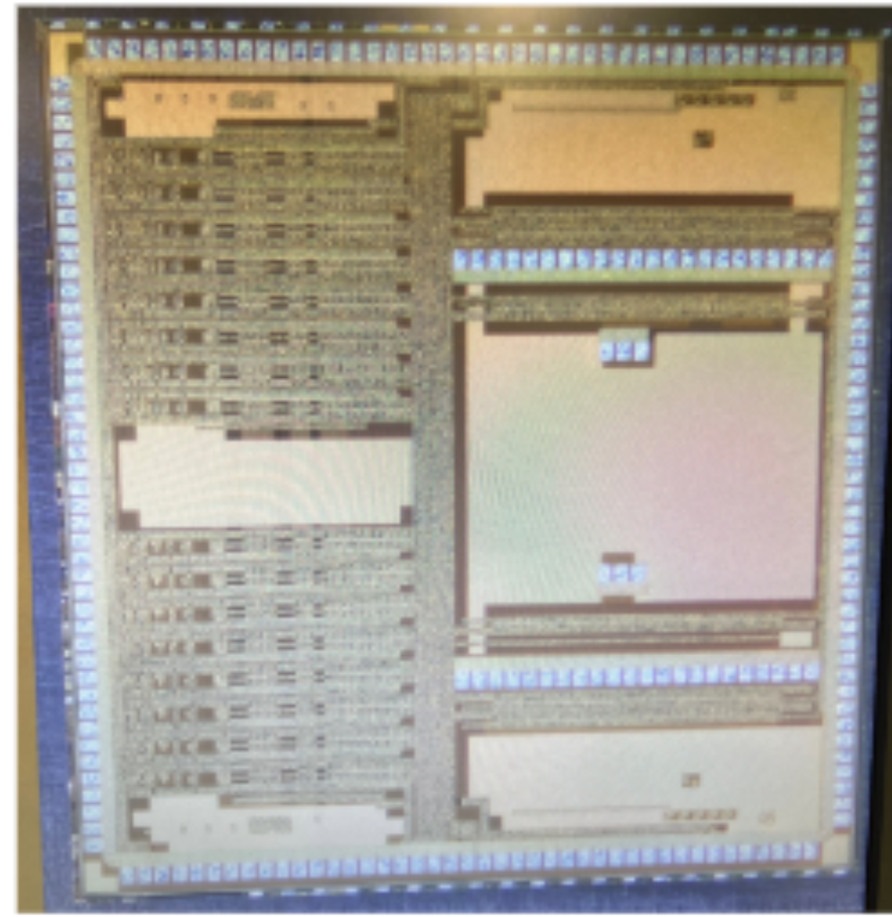
Q-Pix ASICs (v0 in-hand)
Analog front-end
Digital back-end
+ TSMC 180 nm
+ 16 channels
+ 8 standard (45 uW/chan)
+ 8 low-power (25 uW/chan)
+ Testing underway: measured our
first current-induced triggers
+ TSMC 180 nm
+ 16 channels, differential inputs
+ Ring oscillator, timestamping
+ Wirebonding to test boards underway

Slide 12
Looking ahead
Multimodal charge & light
LArTPC demonstrators
Further ASIC development

Slide 13
Multimodal Q-Pix: charge & light
Integrator with reset
Comparator

Slide 14
Multimodal Q-Pix: charge & light
Ionization charge
Integrator with reset
Comparator

Slide 15
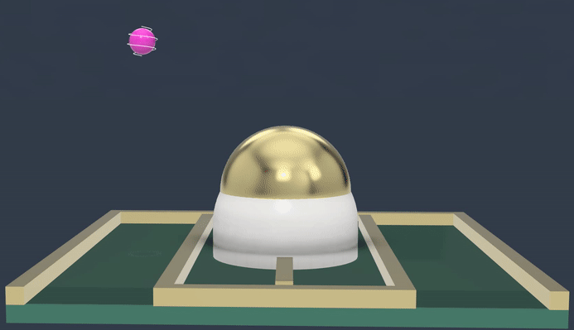
Multimodal Q-Pix: charge & light
Ionization charge
Photogenerated charge
Integrator with reset
Comparator
+ Amorphous selenium (aSe)
+ Direct sensitivity to VUV light
+ Avalanche gain possible
+ Large area coverage
+ Demonstrated at LAr temperatures
+ See e.g.
JINST 18 (2023) 01, P01029
Langmuir 2022, 38, 28, 8485–8494
Review of Scientific Instruments 93, 053103
Elena Gramellini in WP2 this afternoon
Michael Rooks at CPAD 2023
Charge
button
Interdigitated
Electrode (IDE)
aSe
GND
Avalanche electrode → to readout system

Slide 16
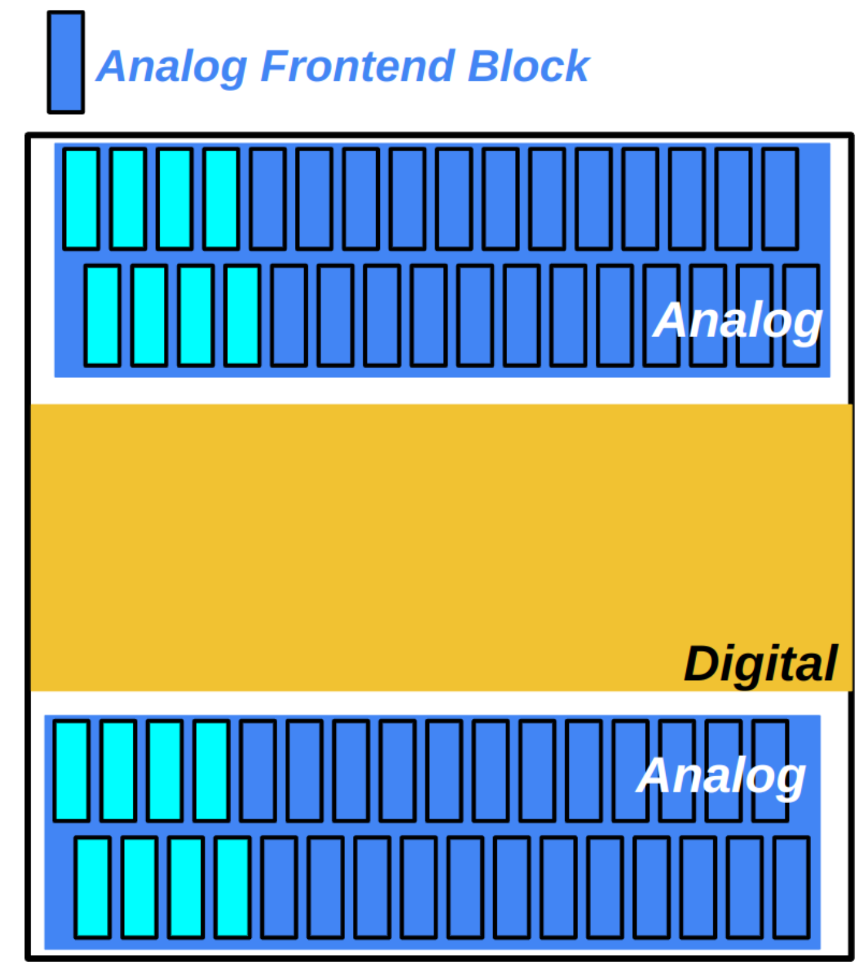
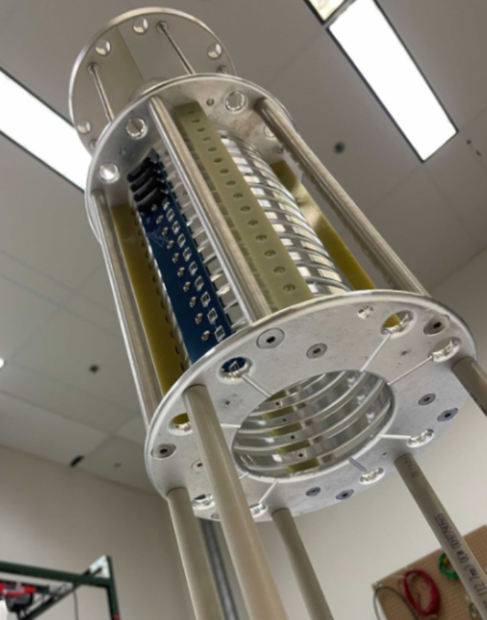
ASIC testing and development
LArTPC ASIC demonstrators
Future ASIC versions
New facility under development at Wellesley College
Cryogenic labs at UTA, Manchester, Syracuse.
Higher channel count (64)
Combine analog and digital ASICs

Slide 17
Wish list / DRD2 synergy
Access (and contribute to) Network of Small Experimental Efforts (NoSEE)
  LAr purification
  LArTPC demonstrators
fC charge sensing /
low power T1.1.G1
scale-up T1.1.G2
multimodal Q+L T1.1.G3
Notes:
Task 1.1, Goals 1, 2, 3

Slide 18
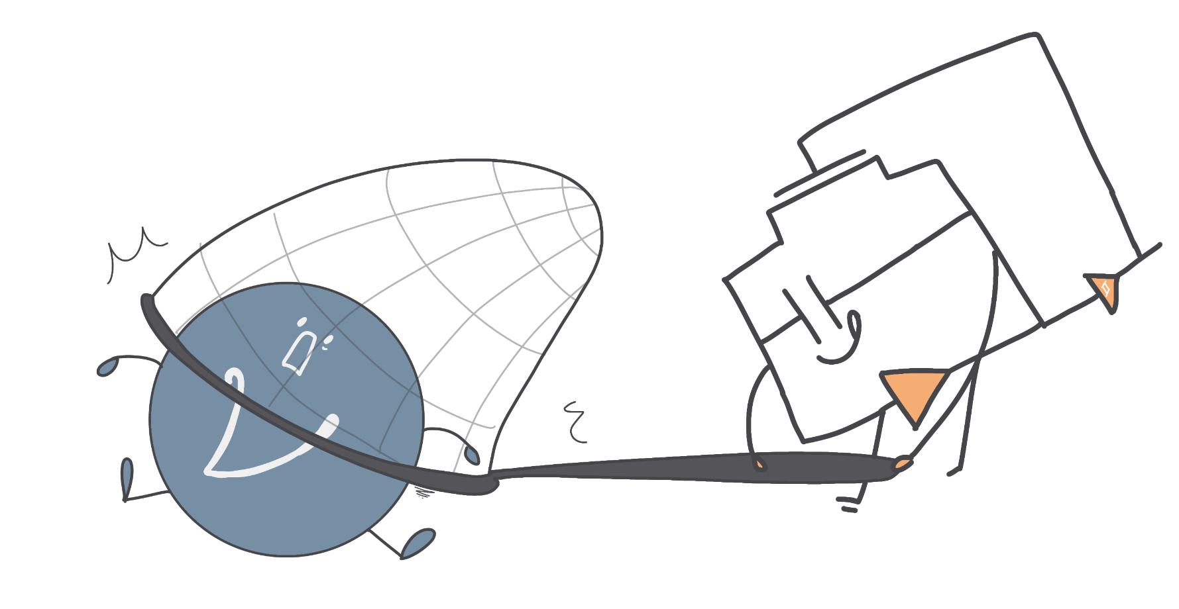
Thank you
Q-Pix: low power, low threshold pixel readout for kTon liquid noble detectors
Prototypes demonstrated
  0.46 fC reset threshold
  event geometry from resets
ASICs v0 testing underway
  Room temperature
  LArTPC
Charge & Light R&D ongoing

Slide 19
Extras

Slide 20
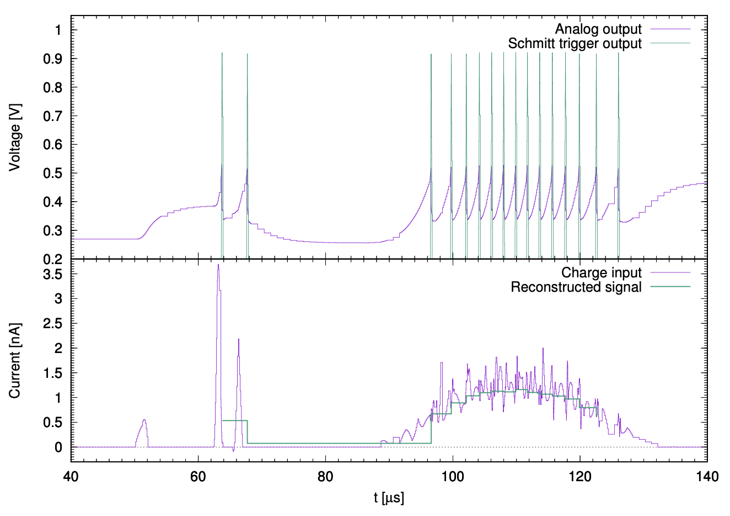
Example waveform (MIP in LAr)
Threshold: 1.0 fC 6,200 e-
Threshold: 0.3 fC 1,900 e-

Slide 21
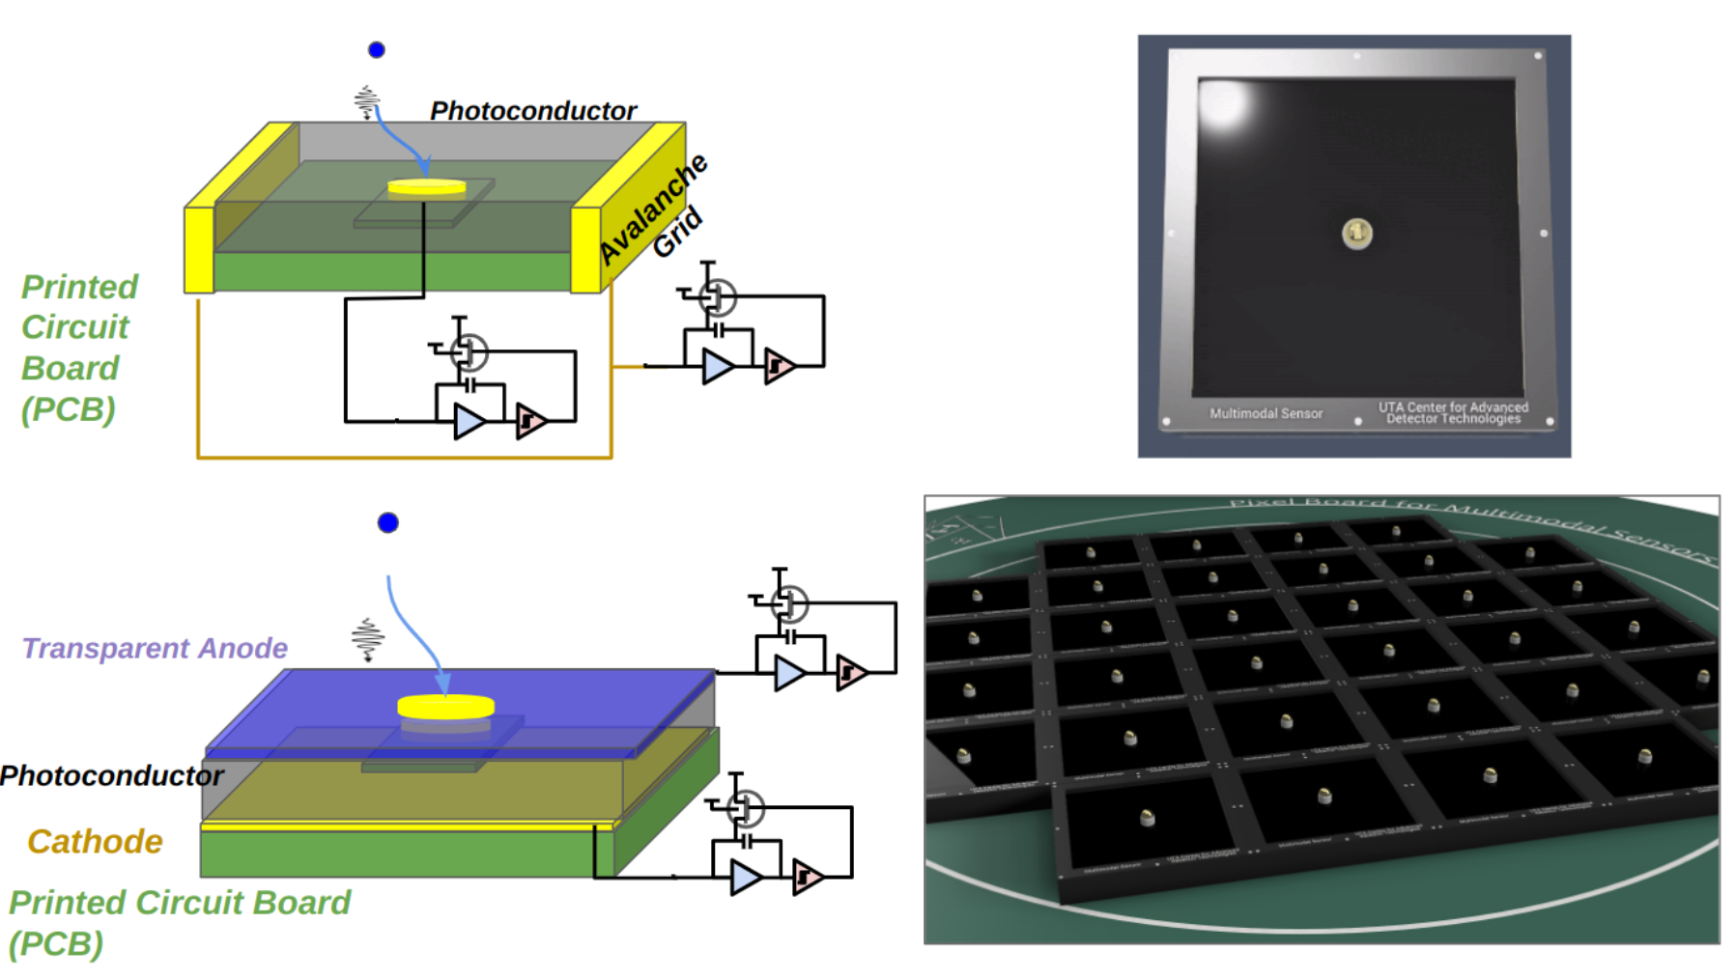
Multimodal Q-Pix: charge & light

Slide 22
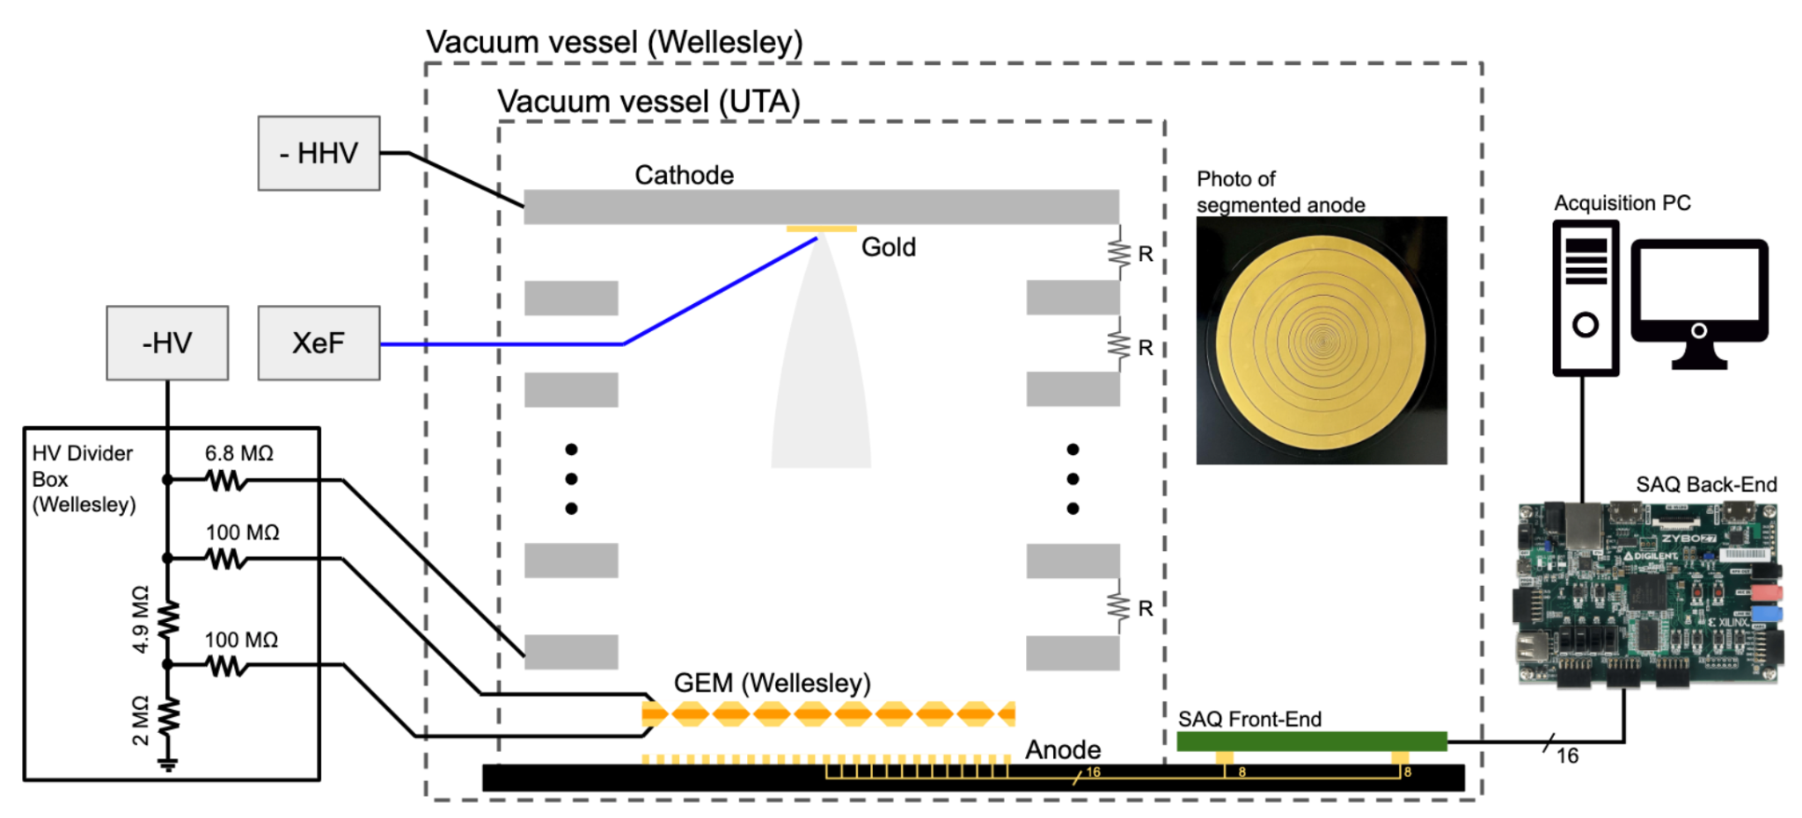
Multi-channel Q-Pix front-end, event topology

