Slide 1

LHC-BGI:
Design with 4DPhoton Timepix4 Mount
Clara Fleisig
HL-LHC BGI Meeting – 24th January 2024

Slide 2
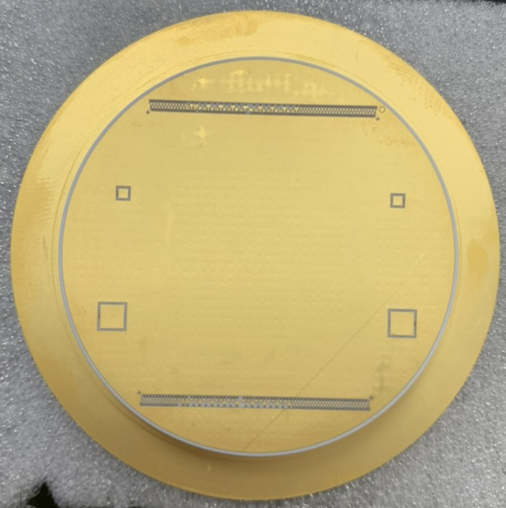
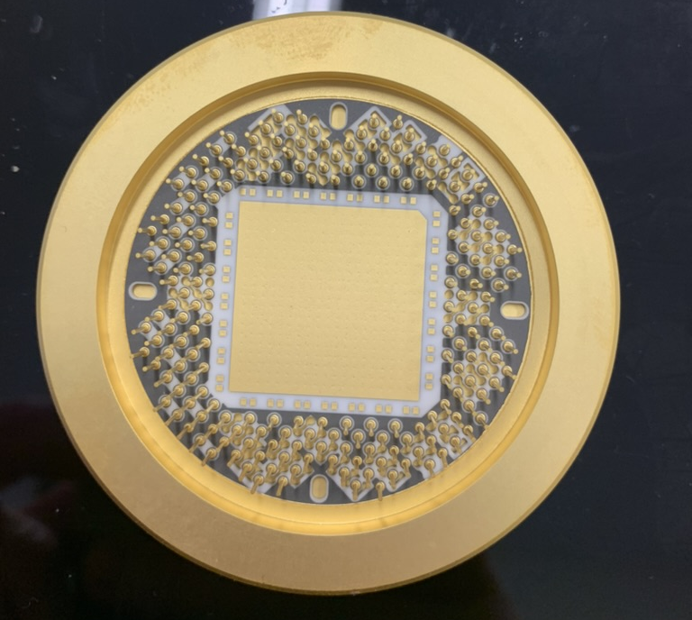
Objectives for 4DPhoton Based Design
Reduce cost
  Use standard CF flanges instead of custom rectangular CF flange
Reduce complexity
  Electronics and cooling outside of vacuum
Modular design
  Could use most of the same components on different accelerators, with accelerator-unique 4-way cross
  Easier to replace single components (e.g. replace Timepix, but use the same tank)
Clara Fleisig, 24 Jan 2024
As expected from Run1 - significant distortion to beam profile.

Slide 3
Conceptual Design Considerations
Goal #1. Provides measurements with < 5% uncertainty (consider beam size contribution to emittance uncertainty, and beam position)
Design Considerations | Pre-Build Testing | Verification
Large electrodes should be sufficiently large to ensure uniform E-field Electrodes should be parallel to prevent profile distortion Magnetic field must be sufficiently high and uniform Electrodes and magnet should be well aligned | CST & IPM simulations with worst-case scenario beams (e.g. worst beam position & space charge) Check uniformity of electric and magnetic fields with CST Simulate misalignment within tolerances with CST and IPM? | Compare BGI measurements with those of other instruments
Clara Fleisig, 24 Jan 2024
As expected from Run1 - significant distortion to beam profile.

Slide 4
Conceptual Design Considerations
Goal #2. BGI should fit the given space
Design Considerations | Pre-Build Testing | Verification
Accommodate 50 mm LHC beam-pipe Fit inside existing 7 Tesla magnet ~10 mm of space required for electronics and cooling | CAD model with attention to tolerances | Smooth installation process
Goal #3. Meet LHC standards for installation (e.g. vacuum, HV, impedance)
Design Considerations | Pre-Build Testing | Verification
Follow HV design guidelines (e.g. 3 kV/mm in vacuum) Minimize sudden changes in beam-pipe No materials with high outgassing | Design approval from vacuum group Impedance simulations | HV testing Vacuum acceptance test
Clara Fleisig, 24 Jan 2024
As expected from Run1 - significant distortion to beam profile.

Slide 5
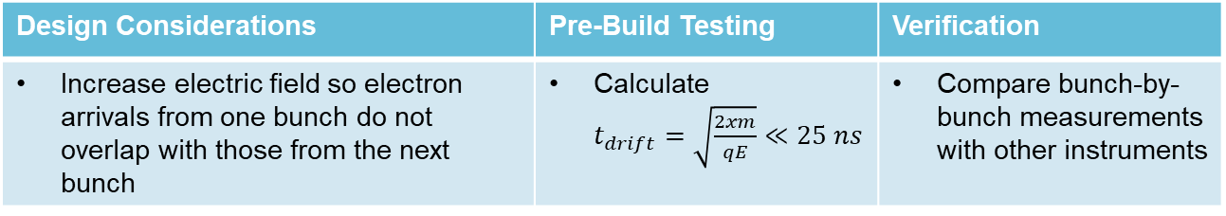
Conceptual Design Considerations
Goal #4. Bunch-by-bunch Measurements
Design Considerations | Pre-Build Testing | Verification
Increase electric field so electron arrivals from one bunch do not overlap with those from the next bunch | Calculate $t_{drift}=\sqrt{\frac{2xm}{qE}}≪25 ns$ | Compare bunch-by-bunch measurements with other instruments
Goal #5. Increase event rate
Design Considerations | Pre-Build Testing | Verification
High electric field integrated over ionised electron path length Thin entrance window if necessary | Compare electric field with PS and SPS instruments to predict event rate | Measurement with < 5% uncertainties integrating over period where beam is stationary
Clara Fleisig, 24 Jan 2024
As expected from Run1 - significant distortion to beam profile.

Slide 6
Design Ideas
Clara Fleisig, 24 Jan 2024
As expected from Run1 - significant distortion to beam profile.

Slide 7
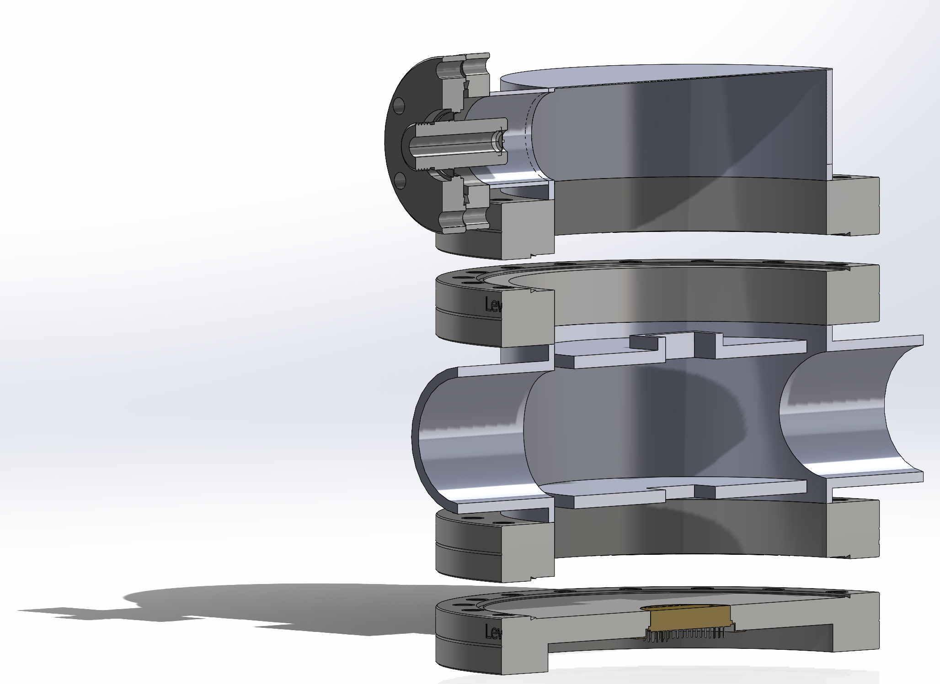
Design Concept
HV-Feedthrough Flange
4-Way Reducing Cross Tank
Electrodes
TPX4 Flange
Clara Fleisig, 24 Jan 2024
As expected from Run1 - significant distortion to beam profile.

Slide 8
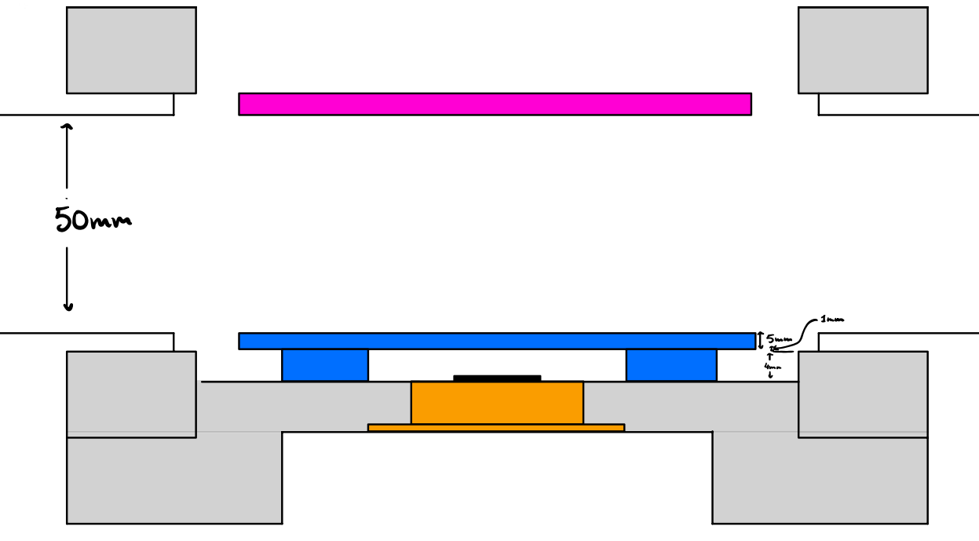
TPX4 Flange
Minimize distance between TPX4 and flange
Potentially attach electrode to the tank instead of the flange
Allow easy replacement of TPX4
Clara Fleisig, 24 Jan 2024
As expected from Run1 - significant distortion to beam profile.

Slide 9
Choosing Flange Sizes and Electrodes
Clara Fleisig, 24 Jan 2024
As expected from Run1 - significant distortion to beam profile.

Slide 10
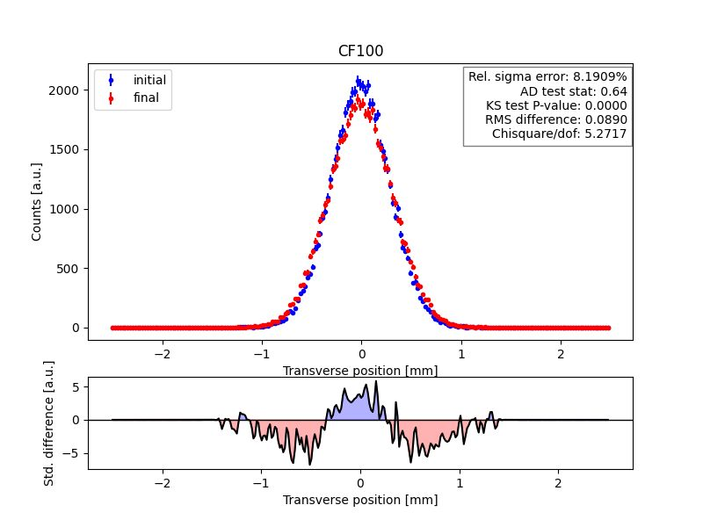
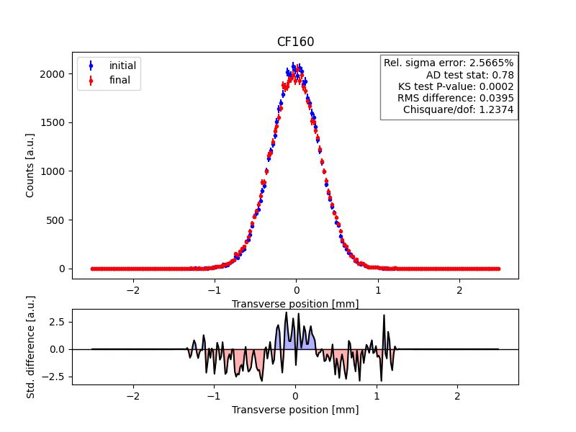
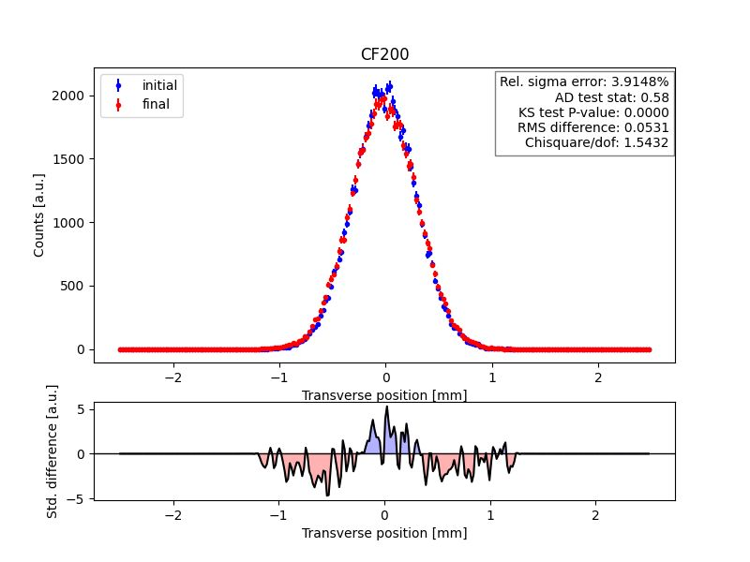
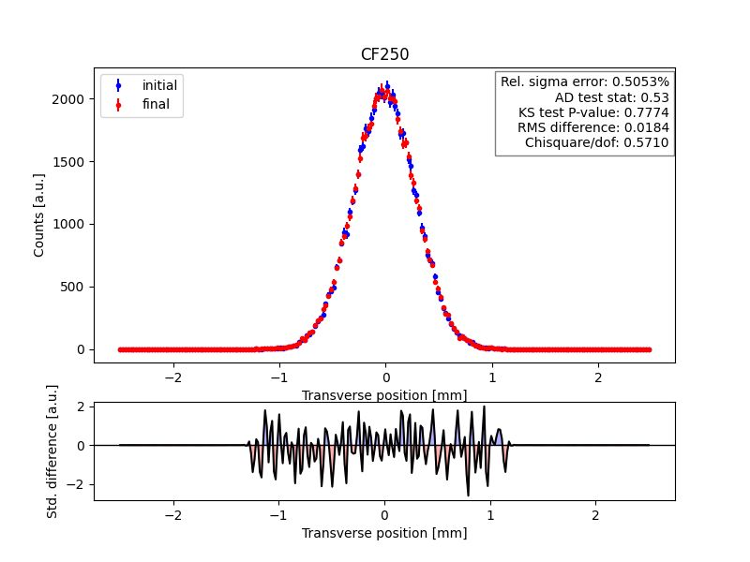
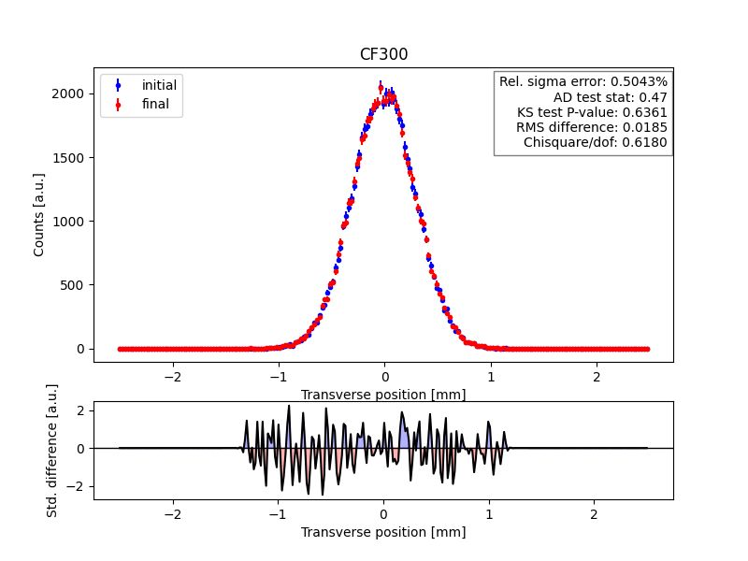
Varying Flange Size
Clara Fleisig, 24 Jan 2024
As expected from Run1 - significant distortion to beam profile.

Slide 11
Varying Flange Size Recommendations
Other Considerations
> CF250 require M10 instead of M8 screws
Recommendation
Recommend using CF250, given current information
Consider investigating electrode geometries
Must simulate with magnetic field CST file
Clara Fleisig, 24 Jan 2024
As expected from Run1 - significant distortion to beam profile.

Slide 12
Considering Mechanical Constraints
Clara Fleisig, 24 Jan 2024
As expected from Run1 - significant distortion to beam profile.

Slide 13
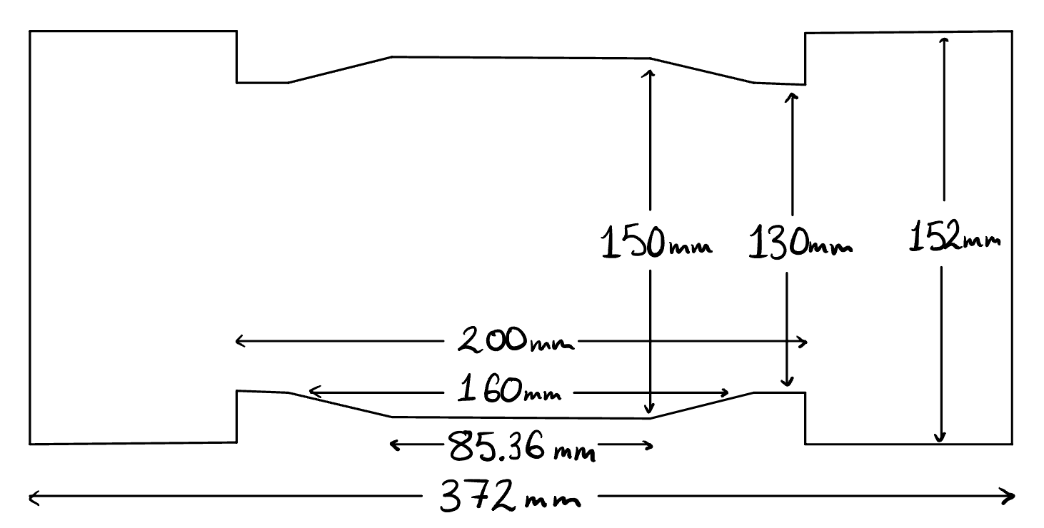
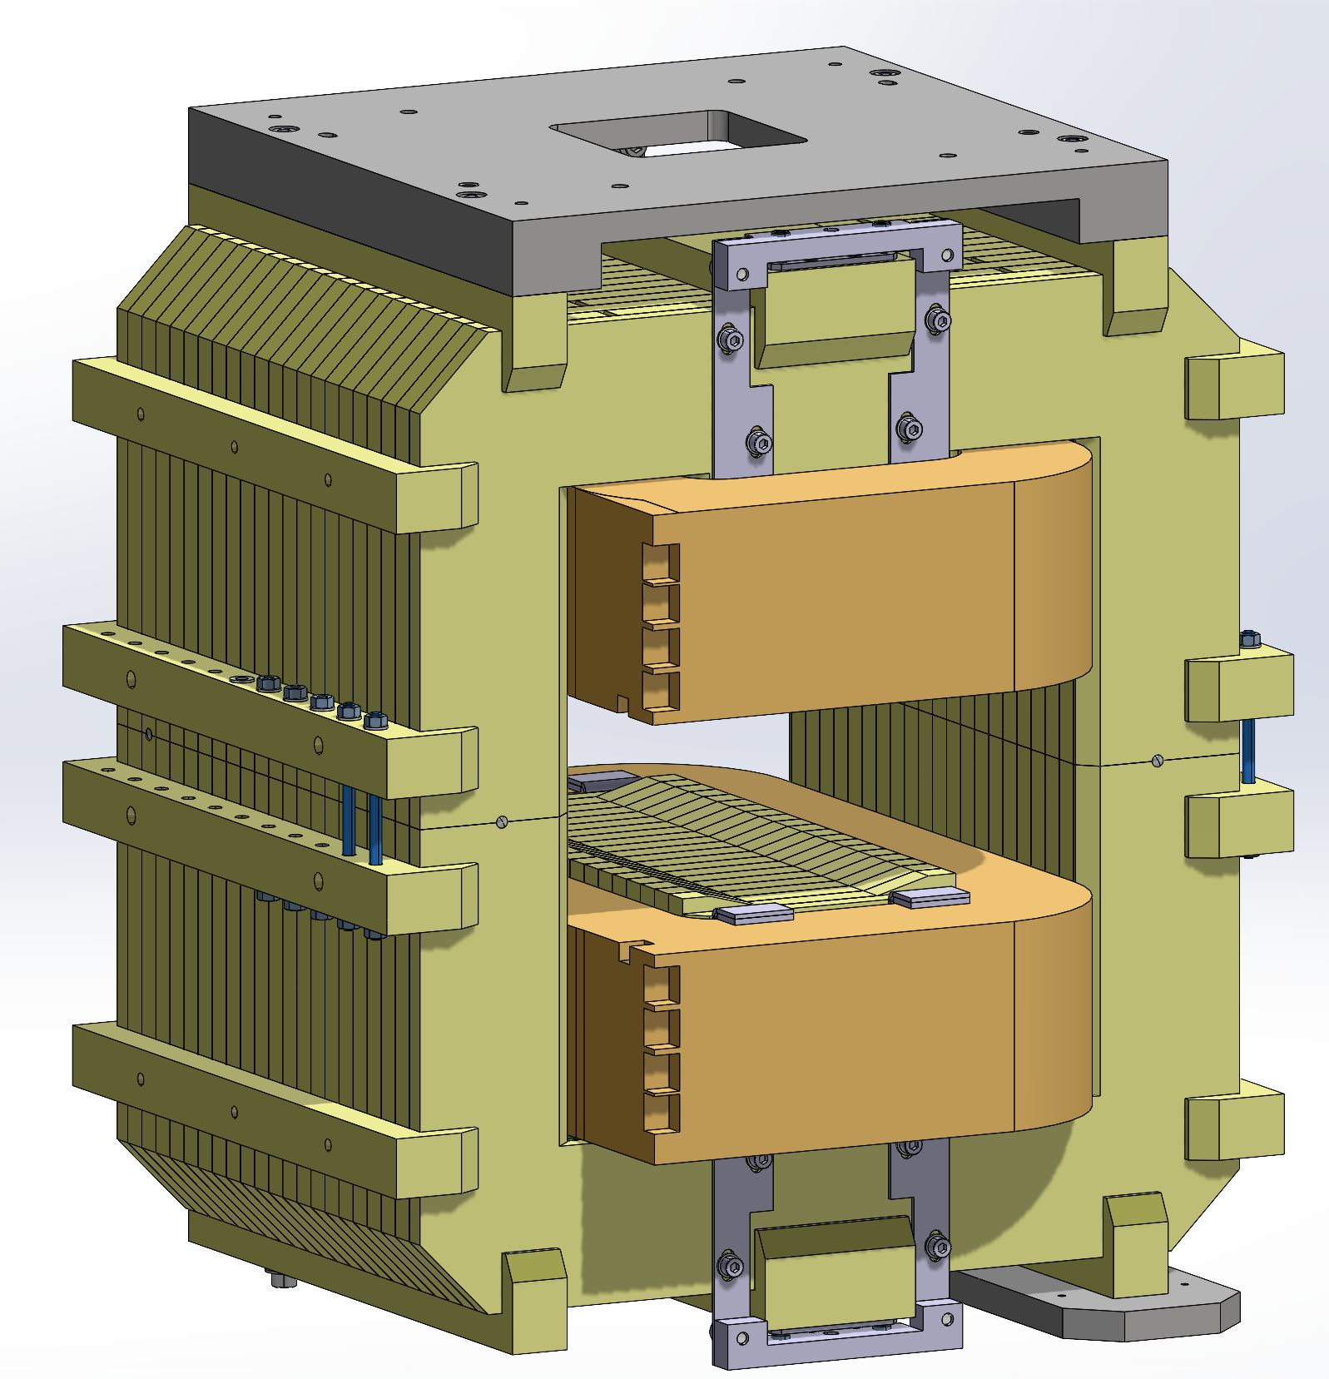
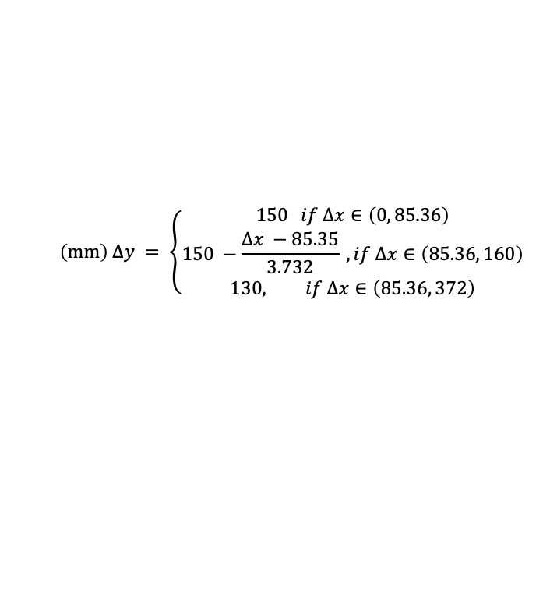
Mechanical Constraints from Magnet
$$\left(mm\right) Δy = \left\{\begin{aligned}150 if Δx∈\left(0, 85.36\right) \\ 150 −\frac{Δx −85.35}{3.732} , if Δx∈\left(85.36, 160\right) \\ 130, if Δx∈\left(85.36, 372\right)\end{aligned} \right.$$
All designs with flange sizes > CF100 only have 130mm of vertical space
Clara Fleisig, 24 Jan 2024

Slide 14
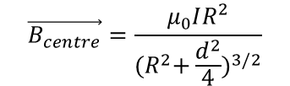

Potentially Increasing Magnet Size
Simulation from Swann:
Our Magnet Model:
$\vec{B}=\frac{μ_{0}IR^{2}}{2}$ ($\frac{1}{{\left(R^{2}+y^{2}\right)}^{3/2}}$ + $\frac{1}{{\left(R^{2}+{(d−y)}^{2}\right)}^{3/2}}$) $\hat{y}$
$$\vec{B_{centre}}=\frac{μ_{0}IR^{2}}{{{(R}^{2}+\frac{d^{2}}{4})}^{3/2}}$$
Conclusion: We can likely increase magnet size by ~20 mm
Clara Fleisig, 24 Jan 2024
As expected from Run1 - significant distortion to beam profile.

Slide 15
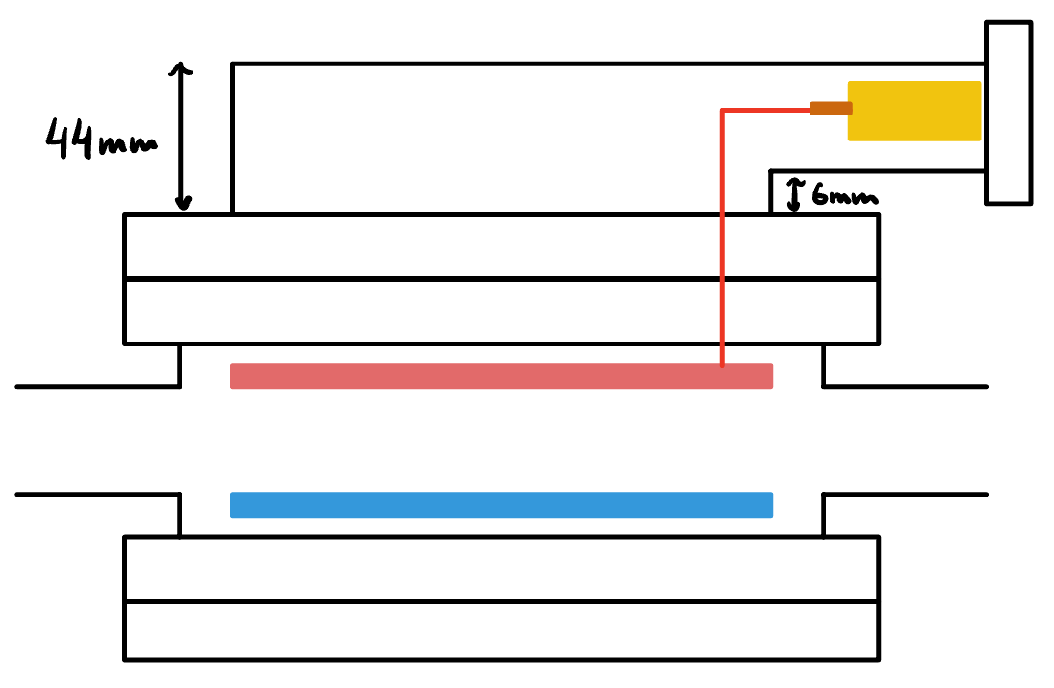
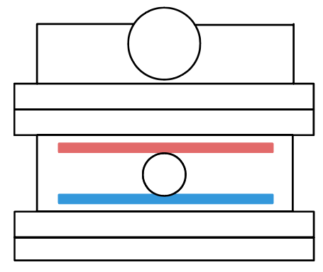
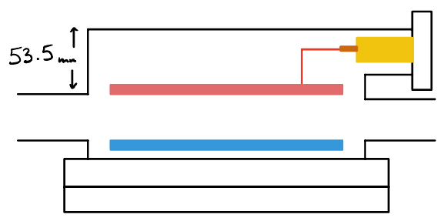
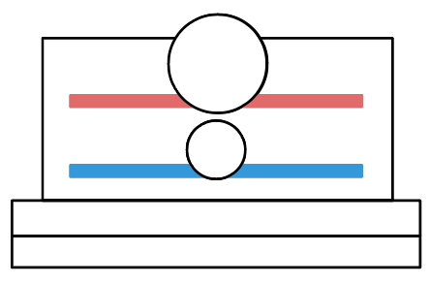
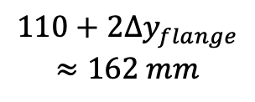
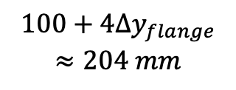
HV Feedthrough Design Ideas
Name
Side View
Front View
Height
$$100+4{Δy}_{flange}$$
$$≈204 mm$$
1a – Elbow HV
1b – Elbow HV
$$110+2{Δy}_{flange}$$
$$≈162 mm$$
Clara Fleisig, 24 Jan 2024
As expected from Run1 - significant distortion to beam profile.

Slide 16
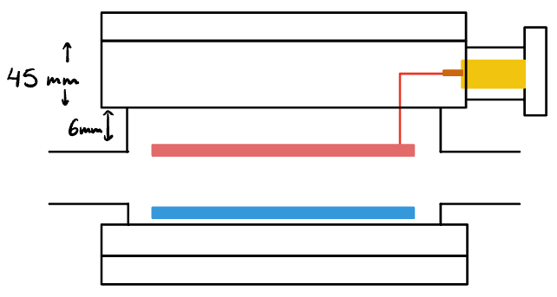
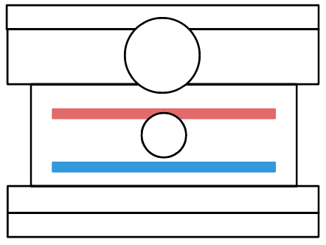
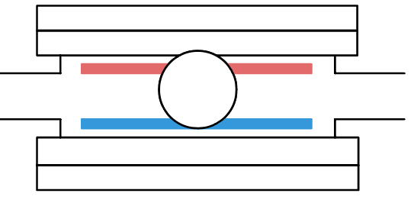
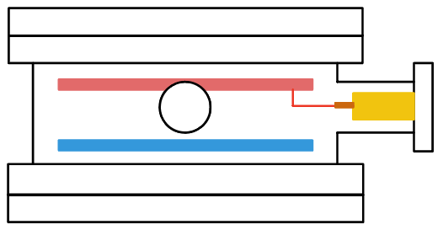
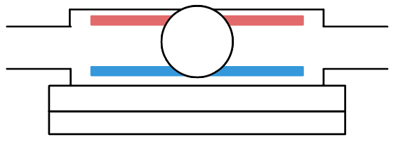
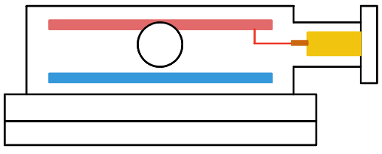
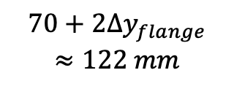
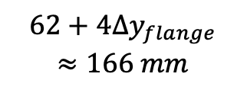
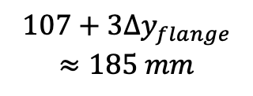
Name
Side View
Front View
Height
2 – In-Flange HV
$$107+3{Δy}_{flange}$$
$$≈185 mm$$
3a – Side HV
$$62+4{Δy}_{flange}$$
$$≈166 mm$$
3b – Side HV
$$70+2{Δy}_{flange}$$
$$≈122 mm$$
Clara Fleisig, 24 Jan 2024
As expected from Run1 - significant distortion to beam profile.

Slide 17
Recommendation
3b is best case, but will likely have impedance issues
1b is second best case, but will likely not fit inside magnet
Simulate impedance for 1b and 3b
Investigate impedance mitigation for 3b
Inquire about 4 cm increase in magnet size for 1b
Clara Fleisig, 24 Jan 2024
As expected from Run1 - significant distortion to beam profile.

Slide 18
Next Steps
Clara Fleisig, 24 Jan 2024
As expected from Run1 - significant distortion to beam profile.

Slide 19
Next Steps
Decisions to be made
High voltage feedthrough approach
Is the magnet sufficient? What changes should we request?
How to hold/secure electrodes
Simulations to be done
Beam near the edges of Timepix4 detector
Design and simulate ion trap
Simulations for tilt tolerances
Simulation with final detailed mechanical design
Other
Talk to magnet group about increasing magnet size
Clara Fleisig, 24 Jan 2024

Slide 20
Appendix
Clara Fleisig, 24 Jan 2024
As expected from Run1 - significant distortion to beam profile.

Slide 21
Standard Flanges
Name | Thickness (mm) | Flange OD (mm) | Screws
CF63 | 17.3 | 131.5 | M8
CF75 | 19,1 | 117.5 | M8
CF100 | 19.8 | 151.6 | M8
CF125 | 21.3 | 171.5 | M8
CF150/160 | 22.4 | 202.4 | M8
CF200 | 24.6 | 253.2 | M8
CF250 | 25.9 | 304.0 | M8
CF275 | 28.4 | 336.6 | M10
CF300 | 28.5 | 368.3 | M10
Clara Fleisig, 24 Jan 2024
As expected from Run1 - significant distortion to beam profile.

Slide 22
Mechanical Constraints with Option 1a
Possible flanges that could be used instead of CF160: CF63 – CF300
Estimates include:
  10 mm for electronics
  50 mm for LHC beam pipe
  6x3 mm for bolts
  44 mm for HV feedthrough
Estimates do not include:
  Tolerances
  15.5 mm for HV feedthrough flange top-edge
Flange Size | ∆y-flange | ∆y- design | ∆y- magnet
CF63 | 17.3 mm | 192 mm | 142 mm
CF100 | 19.8 mm | 202 mm | 132 mm
CF160 | 22.4 mm | 212 mm | 130 mm
CF200 | 24.6 mm | 220 mm | 130 mm
CF300 | 28.5 mm | 236 mm | 130 mm
Conclusion: Will need to expand magnet yoke by 5 to 10 cm
Clara Fleisig, 24 Jan 2024
As expected from Run1 - significant distortion to beam profile.

