Slide 1
Moderators´ orientation
Uta Bilow, TU Dresden
CERN, 12.02.2024

Slide 2
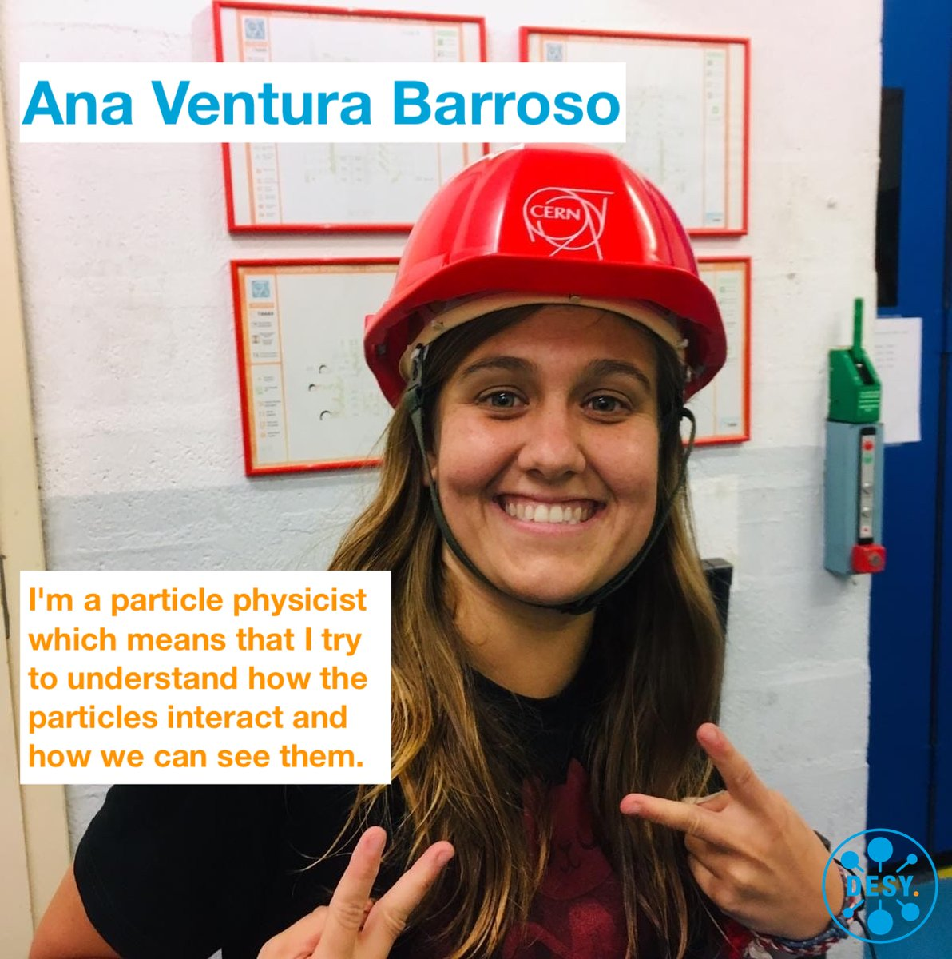
Inspiring the next generation
“
I did this masterclass in 2012 when in high school and that's why I decided to study physics so I would love to encourage people to join our community.
”
Moderator in 2021, 2022, 2024

Slide 3
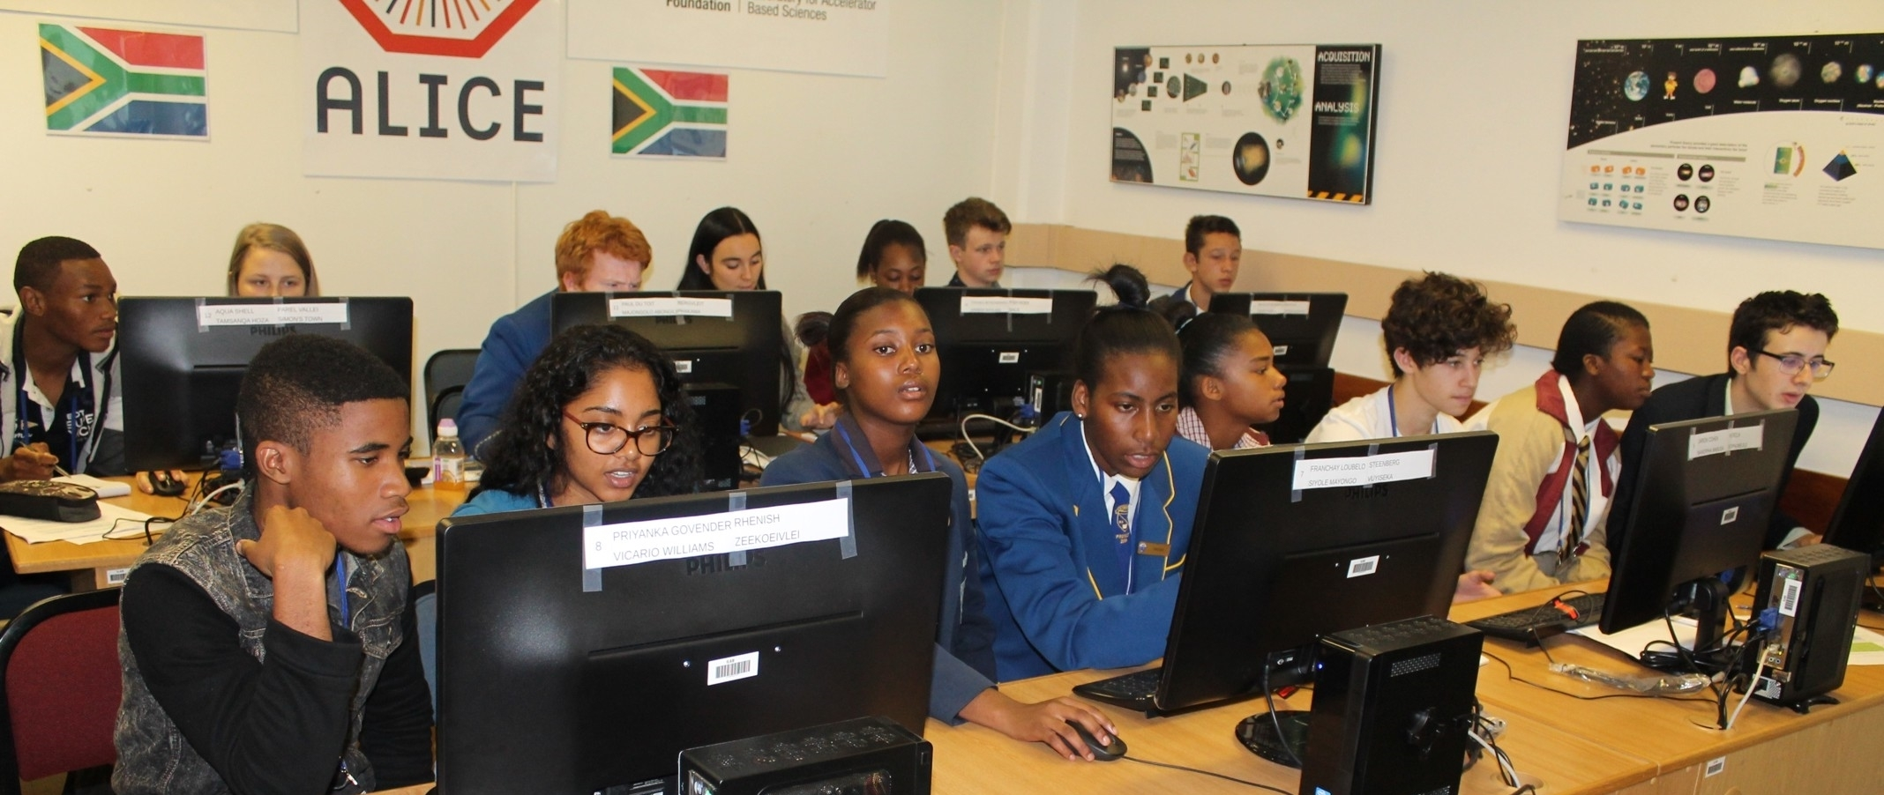
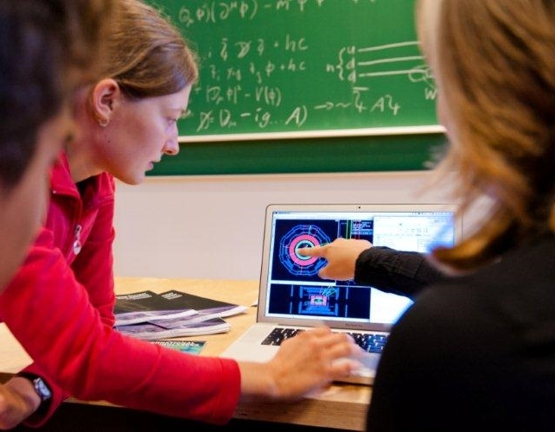
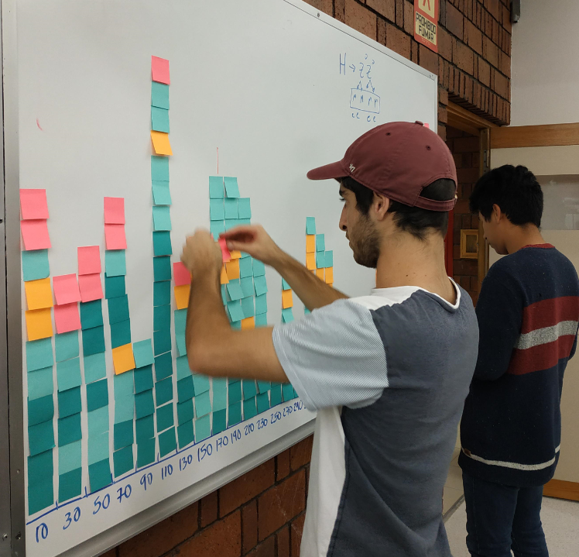
The idea behind Masterclasses
High school students (16-19y) at a university or research lab
Act as a „scientists for one day“
Close to current research
Hands-on activity
Real scientific data
Relevant methods and tools
Nature of science
Organisation of HEP research
Meeting and discussion with scientists
Notes:
get insight into methods and organisation of HEP research (international collaborations)
learn to identify different particles, categorize events, do a measurement of a physics variable, combine results to improve results, understand pre-conditions for claiming a discovery

Slide 4
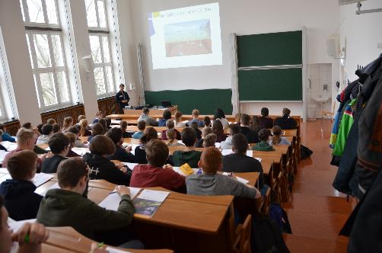
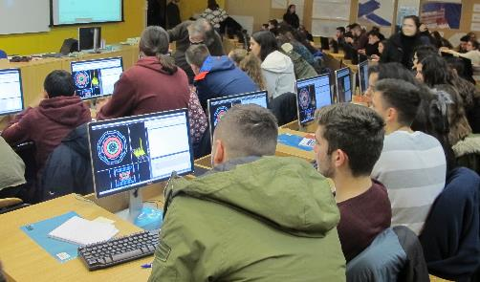
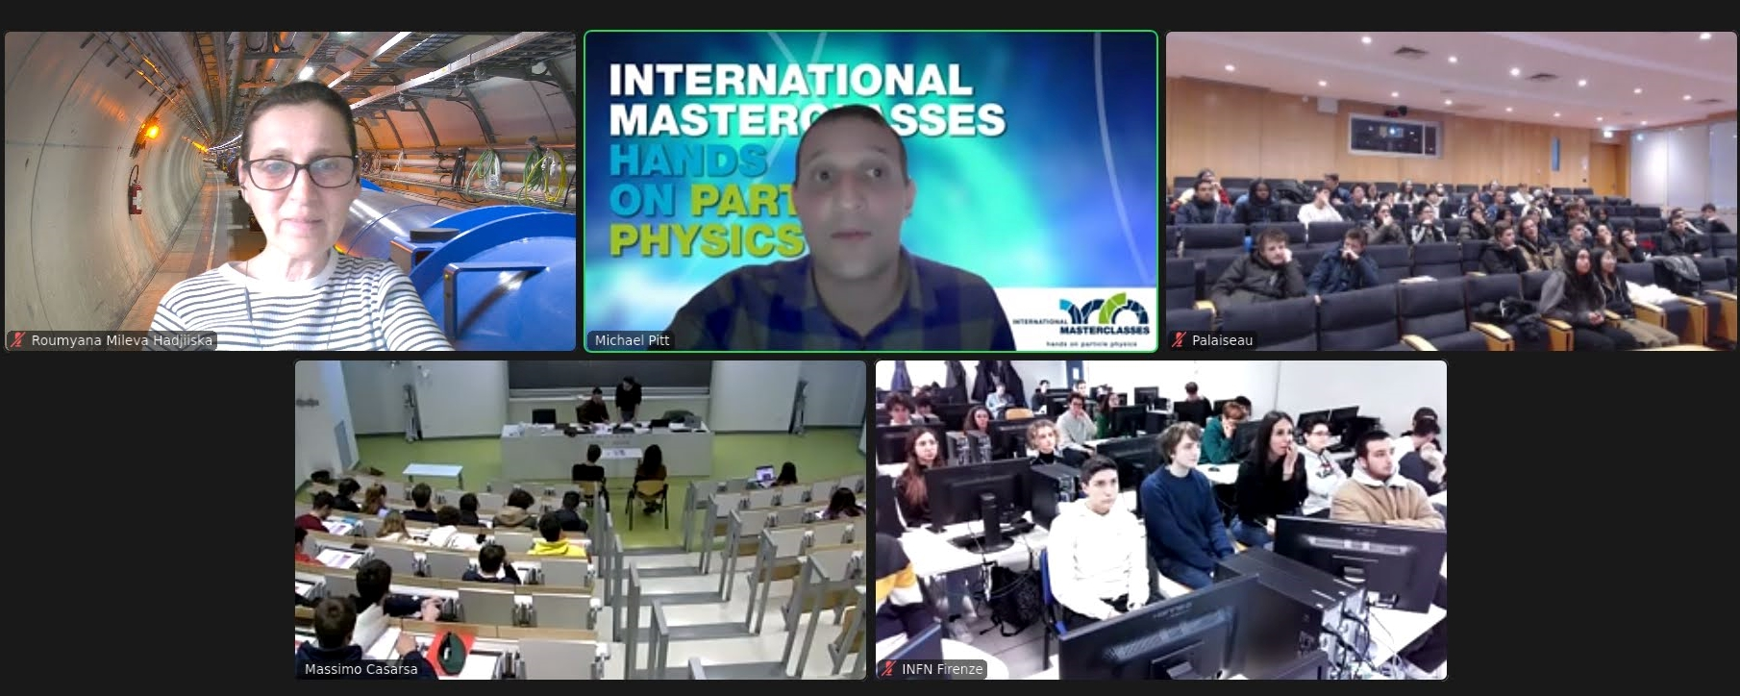
Sample Agenda
8:30 - 9:00 registration & welcome
9:00 - 10:00 introduction to Particle Physics (standard model, detectors, accelerators)
10:30 - 11:30 second talk or tour
12:00 - 13:00 lunch
13:00 - 15:00 data analysis: measurement with LHC data (ALICE, ATLAS, CMS, LHCb)
15:00 - 16:00 local combination + discussion
16:00 - 17:00 video conference with CERN
(3-5 groups from different countries = international collaboration)
You might be sitting here!

Slide 5
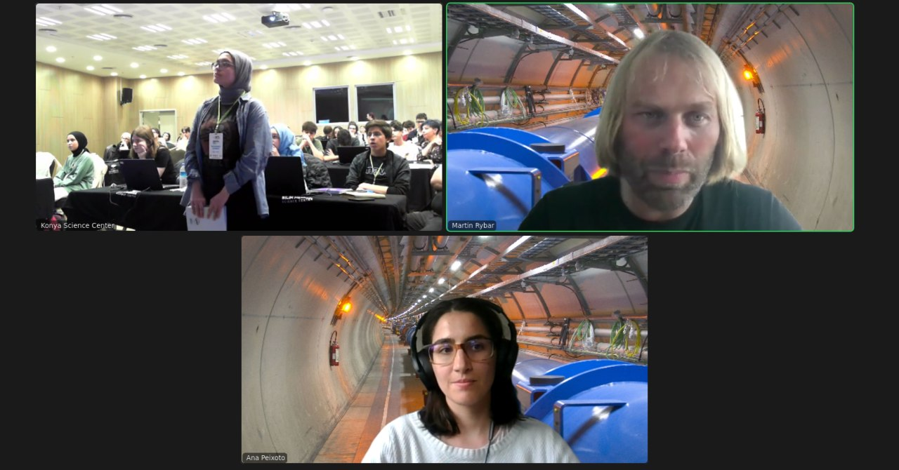
Key points of the video confeence
Typical situation:
2 moderators
groups of students (16-19 y)
Connect to CERN
Students are exited ... and a bit exhausted ...
Long day
Challenges
English not mother tongue
shy to speak
groups should predefine speakers, but…
poor sound quality
To meet the challenges
this training
strict agenda (script)
rich documentation
support by CERN IT
moderators work in pairs

Slide 6
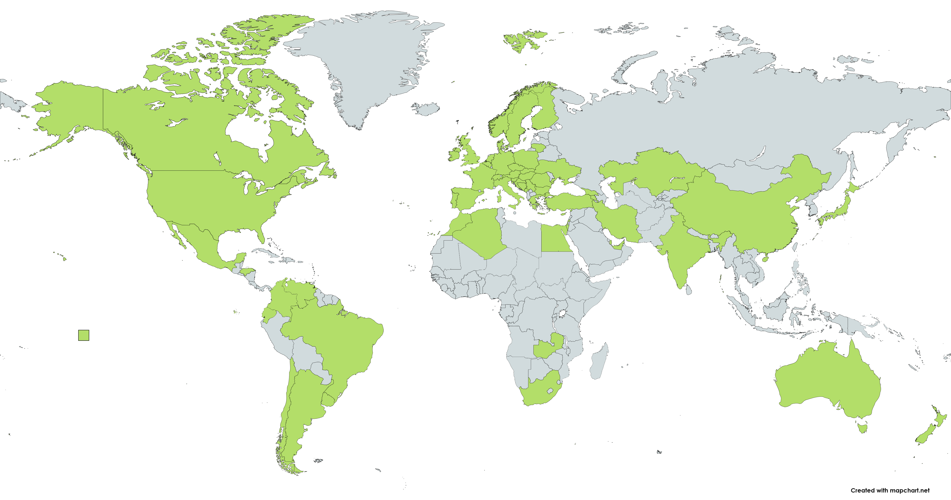
International Masterclasses
key activity of IPPOG (International Particle Physics Outreach Group)
Masterclasses: LHC, Belle II, Neutrinos experiments, Auger, Particle Therapy, ...
Moderation centers: CERN, Fermilab, KEK, GSI, Malargue
63 countries, >220 institutes
More at https://ippog.org/imc-international-masterclasses

Slide 7
IMC: a growing program
2005: 18 countries 2024: 63 countries

Slide 8
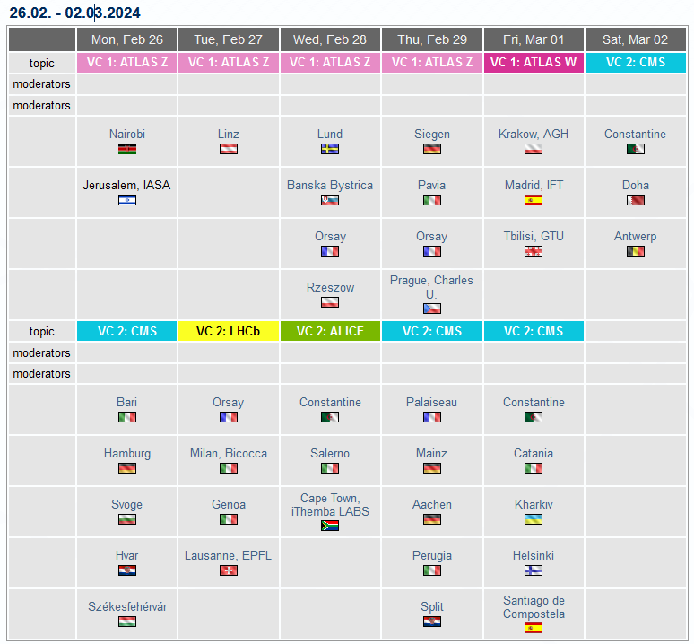
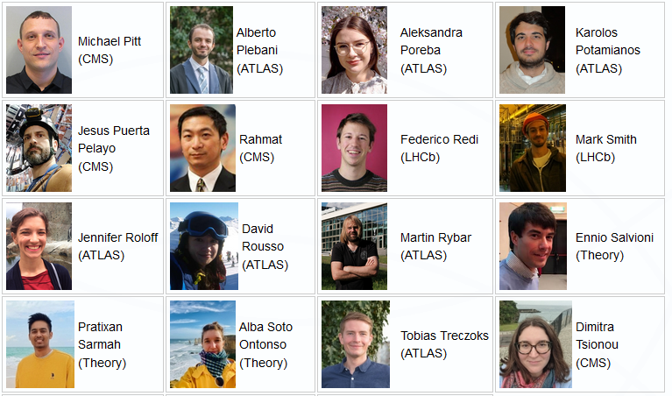

Schedule ... and moderators
Team of ~ 60 moderators
www.physicsmasterclasses.org/index.php?cat=schedule#moderators
e-group: ippog-masterclass-moderators@cern.ch
https://physicsmasterclasses.org/index.php?cat=schedule&page=schedule_2024

Slide 9
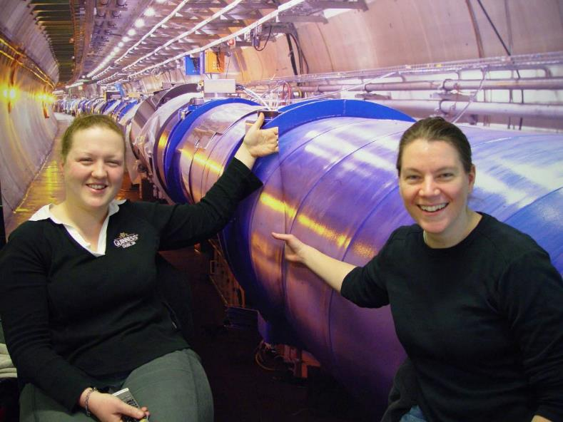
Quotes from Masterclasses moderators:
“The best thing is actually answering the questions and seeing how excited and how happy they are, waving at the camera. They're really excited to be talking to physicists based at CERN!”
“It is very satisfying, because we do many video conferences and rarely do people cheer on the other side if you say something. Here they do!”
Thank you for being part of IMC24 – enjoy your sessions!

