Slide 1

OEC Integration Workshop in Frascati
31/01/2024
https://indico.cern.ch/event/1367997/
On detector piping loop assembly
Simone Coelli, Andrea Capsoni, Daniele Viganò, Ennio Viscione, Mauro Monti
For the INFN Milano group

Slide 2
SUMMARY
TYPE-1 PIPING AND MANIFOLDING
INLET LINE FOR THE CO2 COOLING DISTRIBUTION
ORBITAL WELDING EXPERIENCE
DE-MOUNTABLE FITTINGS ALTERNATIVE

Slide 3
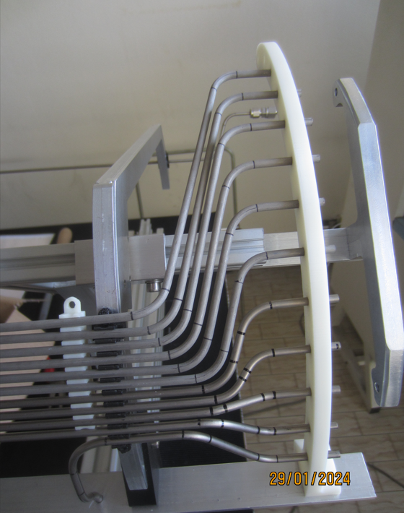
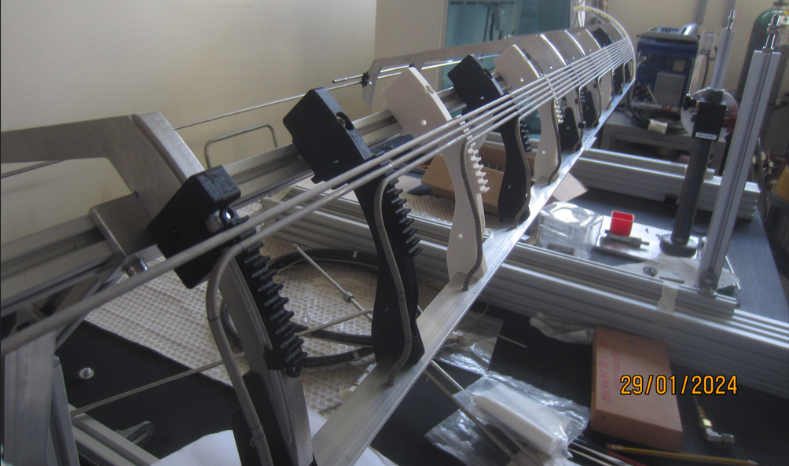
DETECTOR COOLING SYSTEM DISTRIBUTION CONSTRUCTION
Assembly of a complete Half-Shell piping system, work in progress
For demonstration of the techniques and validation, pressure test
To feed-back the design and relevant working drawings, that should include our production experience
To test the Milano “INTEGRATION TOOL” design (and proposing a full integration test)
Layer-2, Starting from the available Fred Gannaway model

Slide 4
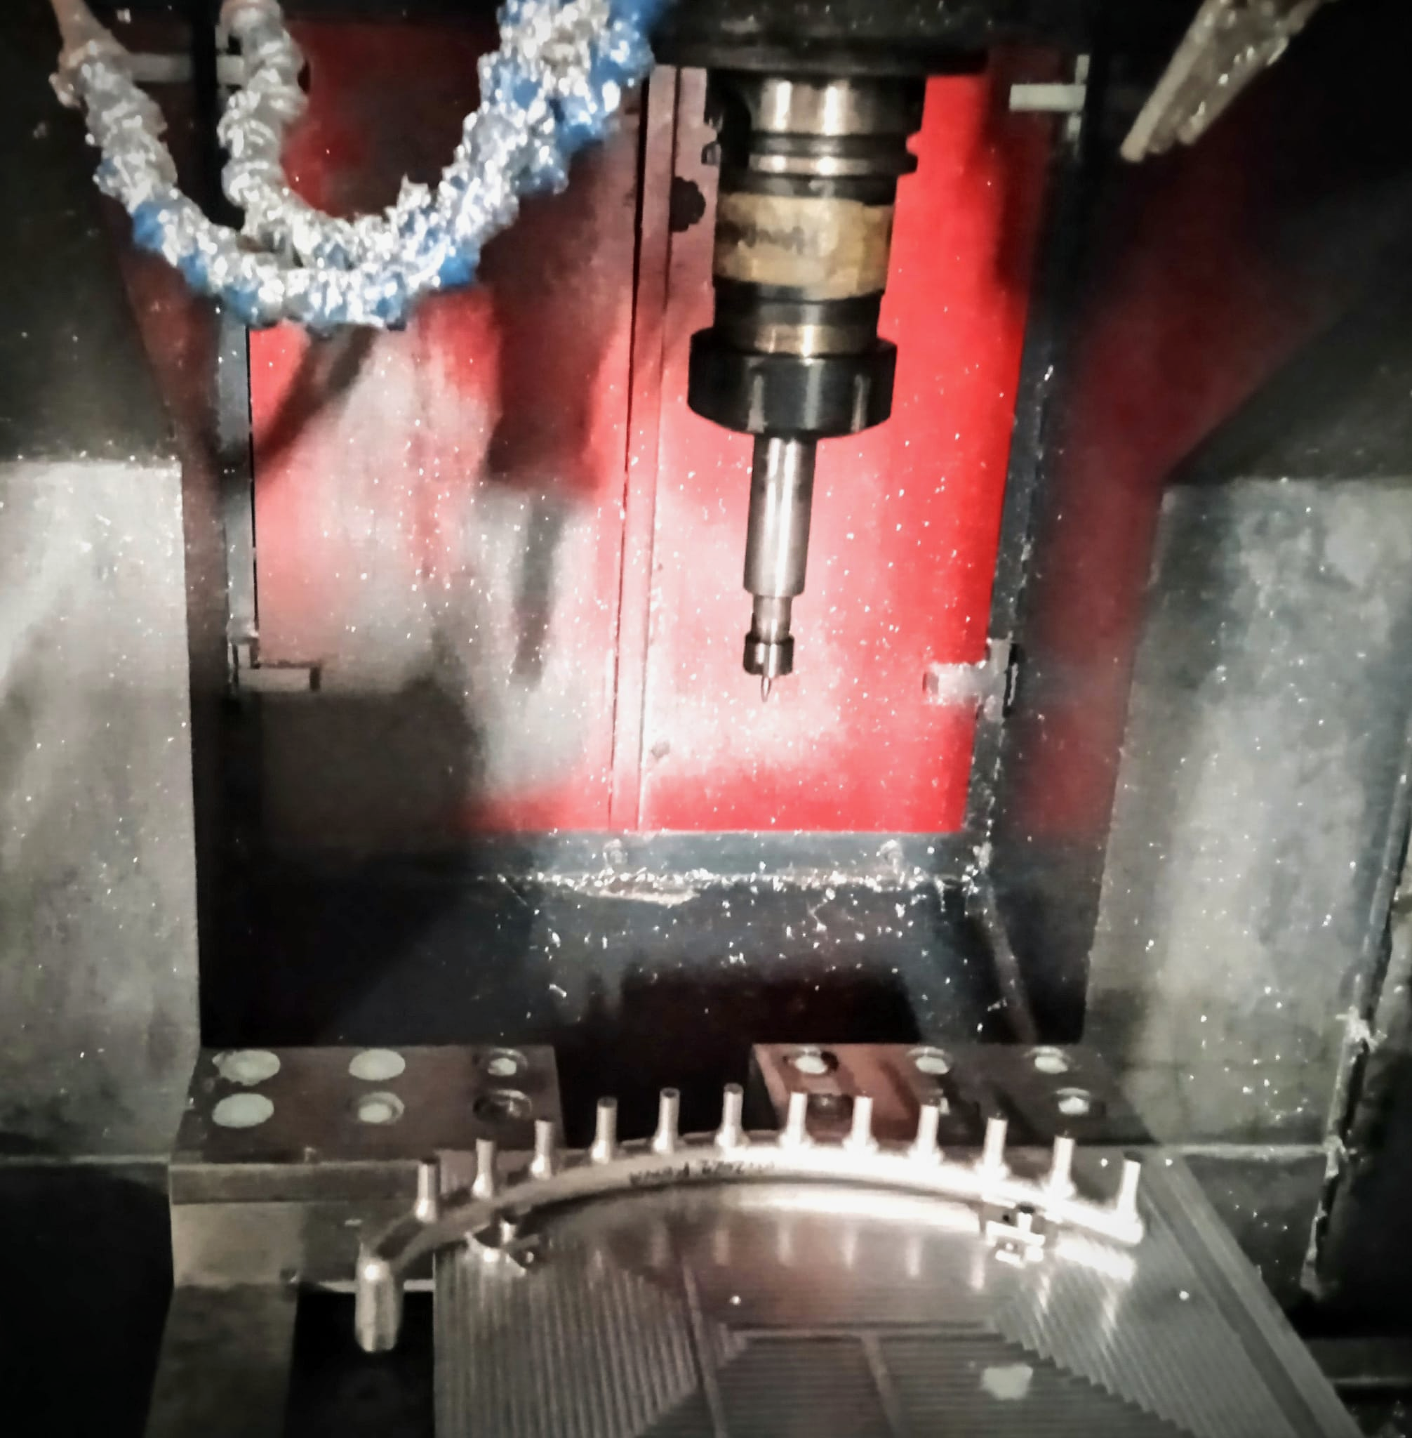
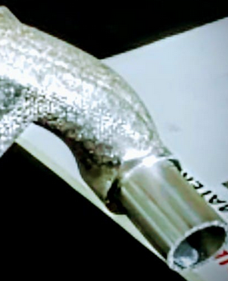
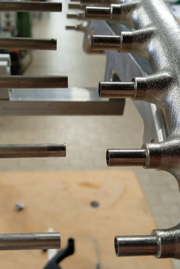
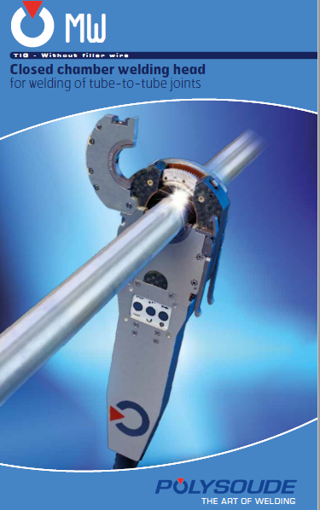
MACHINING THE MANIFOLD
ID 11 mm/ OD 12.7 mm/ th 0.85 mm
Remnant from the cooling test
Preparation of interfaces:
Cnc Machining
reaming
Manifold/pipe (OD 4mm in layer 2)
socket weld
Manifold to pipe OD 12,7mm
butt welded extension
30 mm in the prototype
used as connecton for the pressure test of the assembly after weldings
For INTEGRATION purposes, PP1 design to be verified.
BENDING THE PIPES
The technology used to produce the piping system from the CAD model should be quality checked and approved (design feasibility feed-back).
Quality Control to be done formally on the prototype (drawings with important quotes are needed)

Slide 5
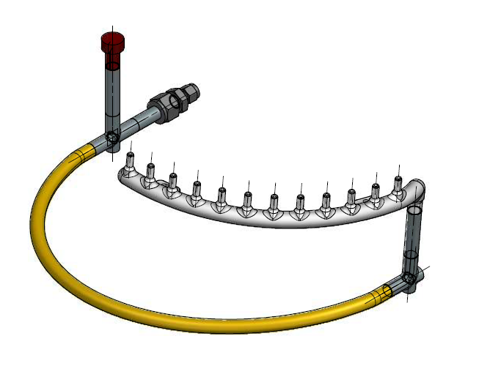
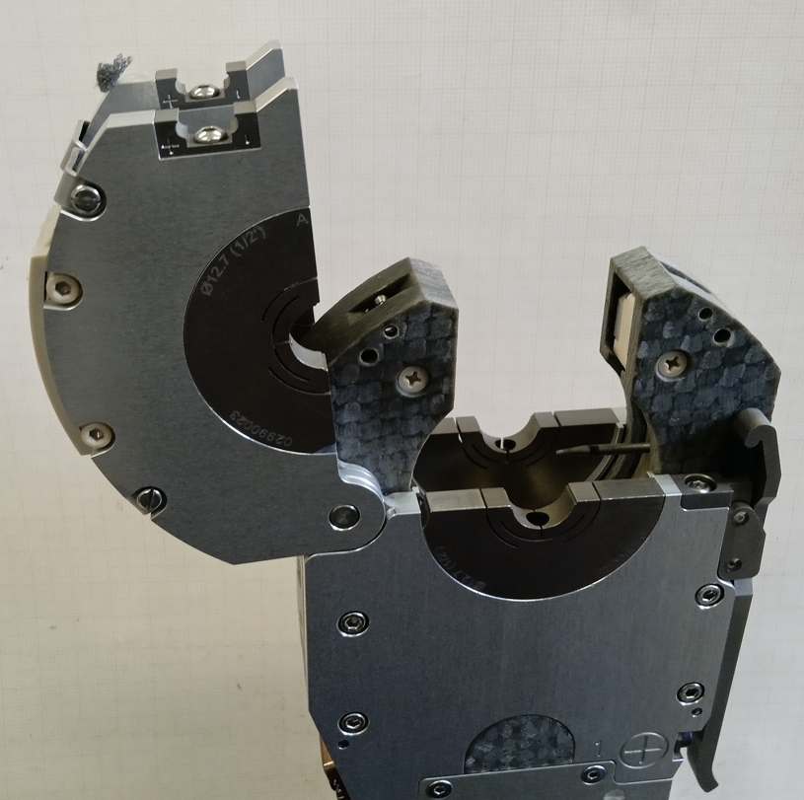
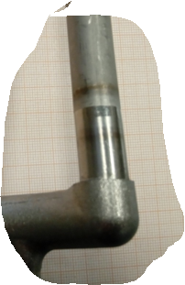
Detail of the manifold connection at PP1
MW34 POLYSOUDE welding head
BUTT WELDING
Notes:
A minimum pipe length of 17 mm
is needed on both sides to close it around the pipe during orbital welding.
This has to be taken in account into the design, besides the accessibility of the head.
A very pure Argon atmosphere is mandatory inside the tube.
Image from the prototype construction.
To be pressure tested > 162 bar

Slide 6
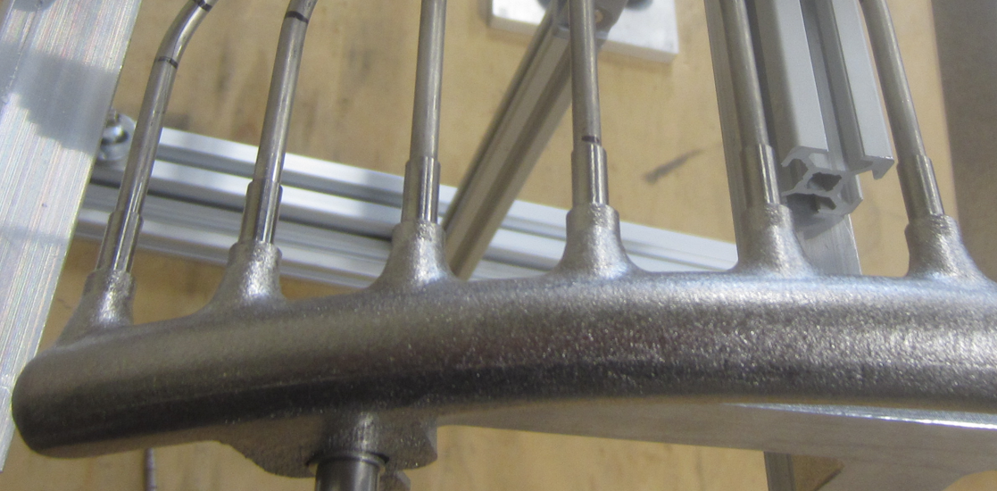
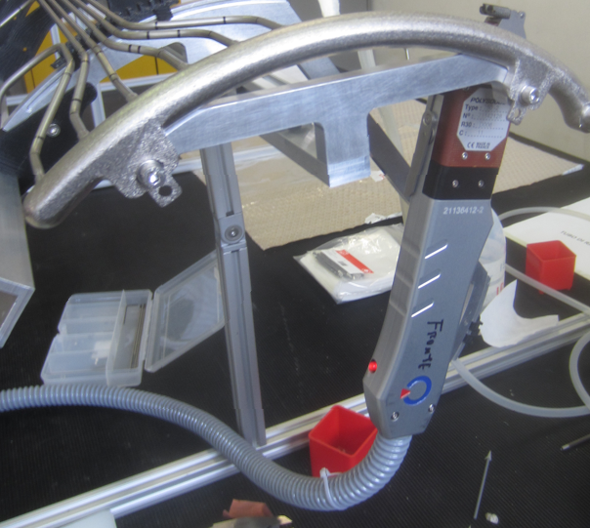
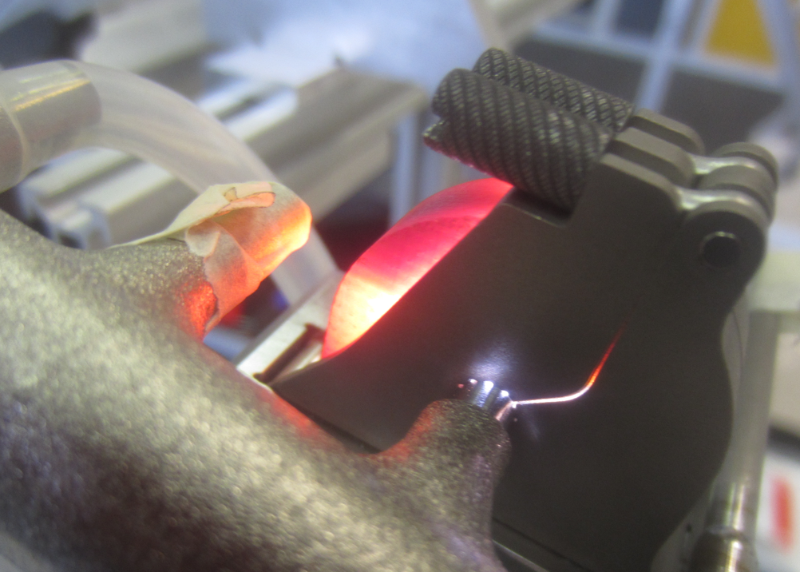
TYPE-1 PIPING AND MANIFOLDING
Socket orbital welding
UHP 250-2 POLYSOUDE
Welding head
Exhaust CO2 type-1 return lines (11 + 1 bypass in Layer 2)
Internal
Argon flux pipe
Pipes are collected into the 3D printed Manifold.
Manifold is from SLM Additive Manufacturing
Heat treated , cleaned
Hirtization process

Slide 7
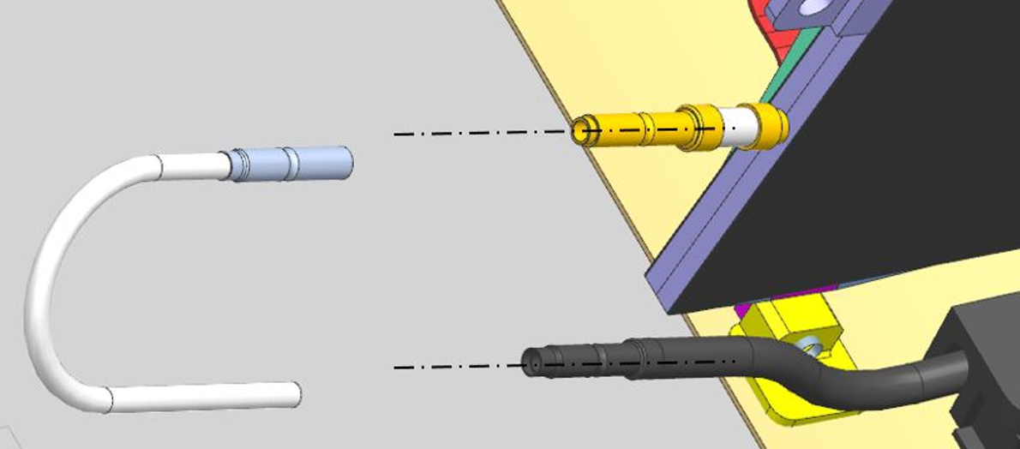
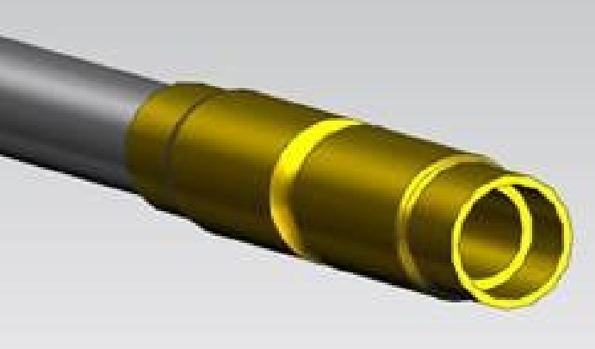
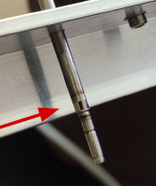
OUTLET HALF-RING COOLING CONNECTION
A very critical step in the integration of the Hal Ring cooling system.
“customized” ”U” connector
to be welded in opera without a fitting sleeve?!
FITTING 4-2,5 (5-2,5 for layer-4), needed from beginning in the assembly
For the prototype we’ve produced these fitting in house.
For the production these fitting have to be produced by a “precision company” based on detaile working drawings.
As always I think that to approve a design it is mandatory to have done prototypes and qualification of components (P test etc). To be planned.

Slide 8
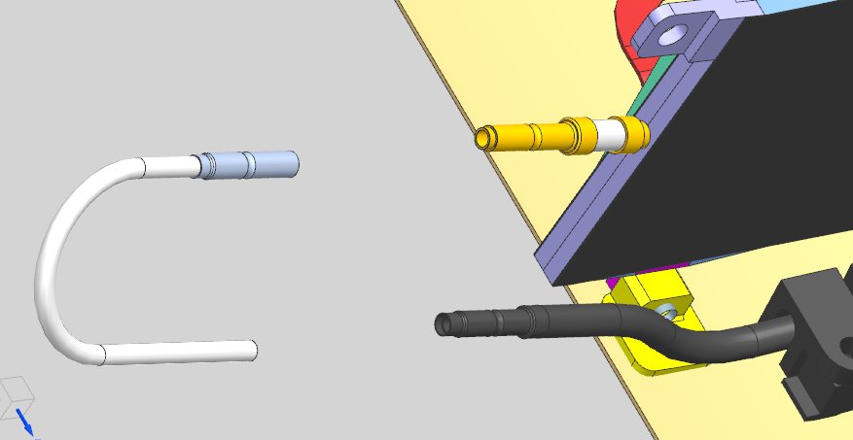

Slide 9
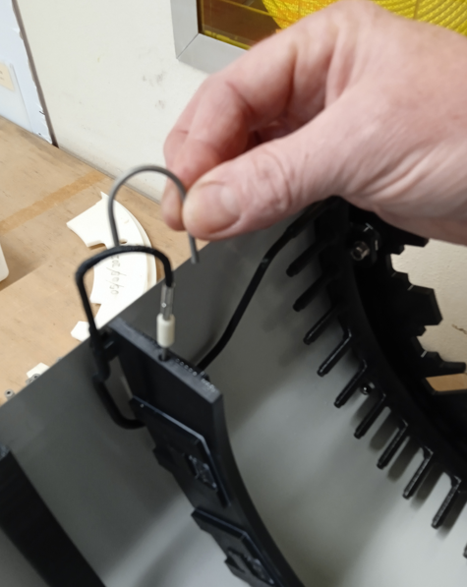
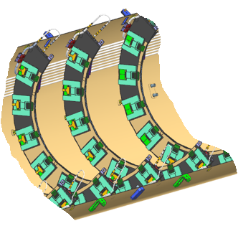
COOLING SYSTEM - INTEGRATION PROPOSAL
We propose TO DO a complete cooling circuit connection
In Milano we have a short layer 2 dummy section
Are needed ‘some’ Layer-2 Half-ring cooling pipes, to be connected on the distribution system prototype, INLET and OUTLET sides
HR dummies, with real pipe INTERFACES: REAL FITTINGS
At the INLET side: Brazed Capillaries (Length to be verified) to be accommodated in the Half- shell dummy => geometry check for the design
Pressure test >162 bar (multiple times?), He leak rate to be performed
for validation

Slide 10
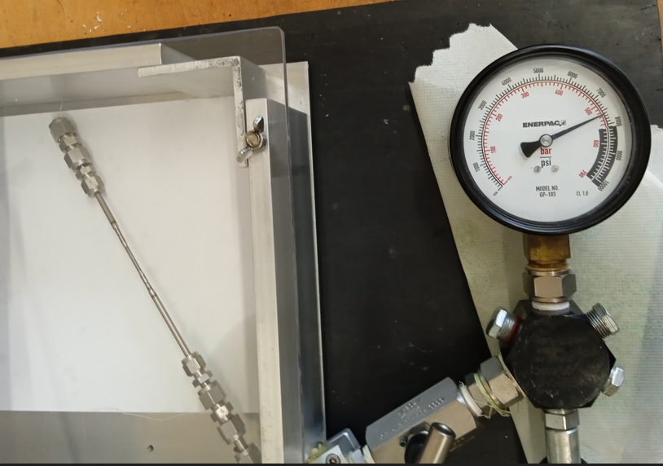
WELDED SAMPLES
pipes to be used for the “U connectors” OD=2,5mm
OIL PUMP PRESSURIZATION
RESISTING UP TO 520 bar

Slide 11
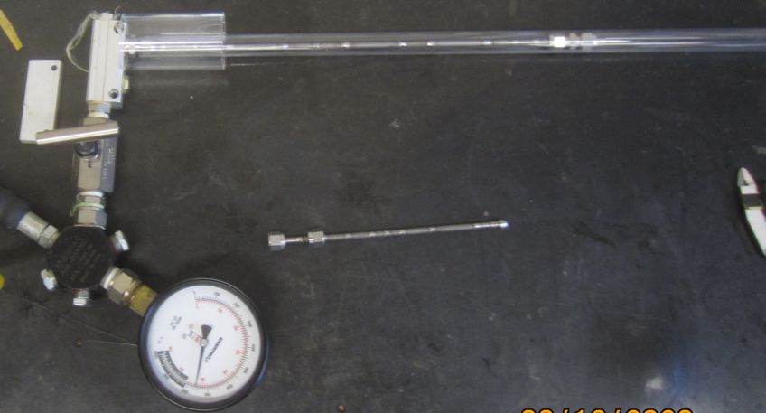
WELDED SAMPLES
pipes butt and socket welded
OD=4mm
OIL PUMP PRESSURIZATION
RESISTING UP TO 520 bar

Slide 12
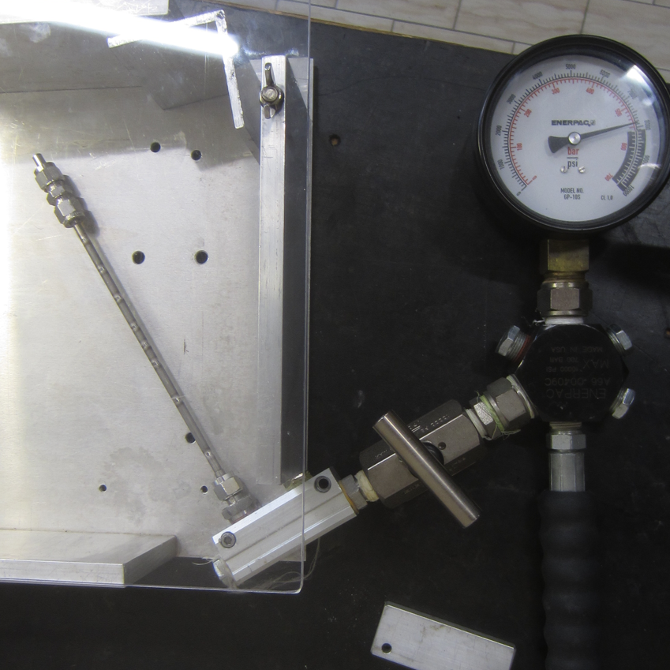
WELDED SAMPLES
pipes butt and socket welded
OD=5mm
OIL PUMP PRESSURIZATION
RESISTING UP TO 520 bar

Slide 13
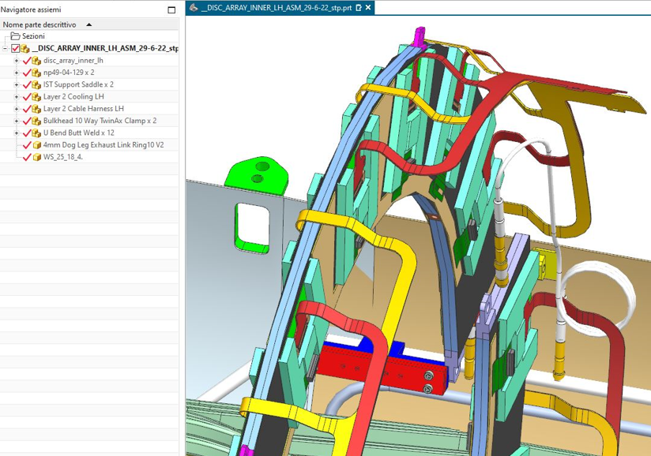
INLET LINE FOR THE CO2 COOLING DISTRIBUTION
FROM THE 3D CONCEPT
TO A PROTOTYPE
FOR AN ACCEPTANCE TEST
last concept model for a half shell LAYER 2
by Fred Gannaway June 2022
https://edms.cern.ch/document/2858201/1

Slide 14
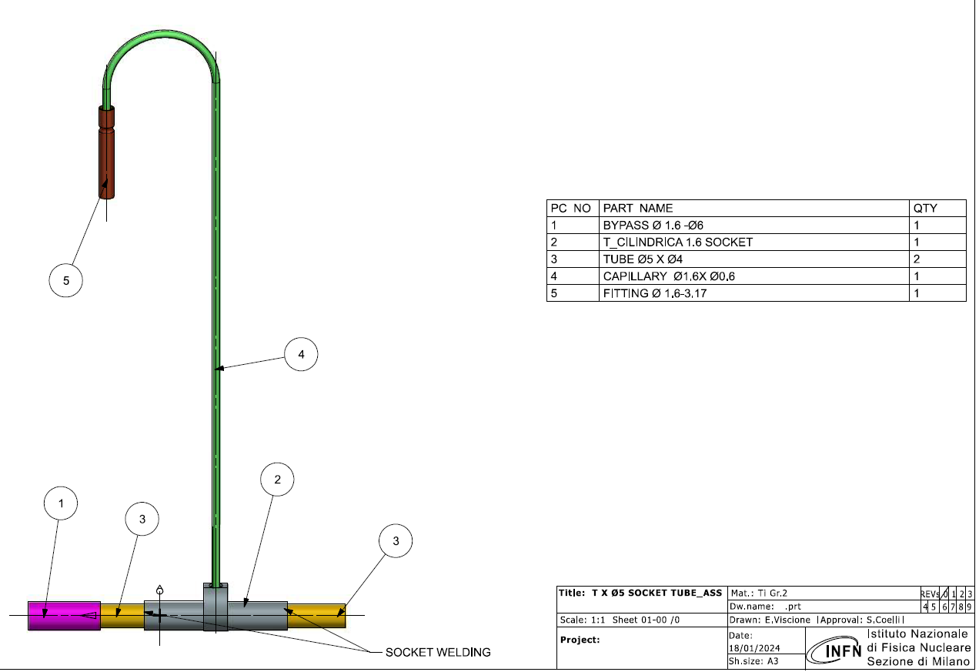
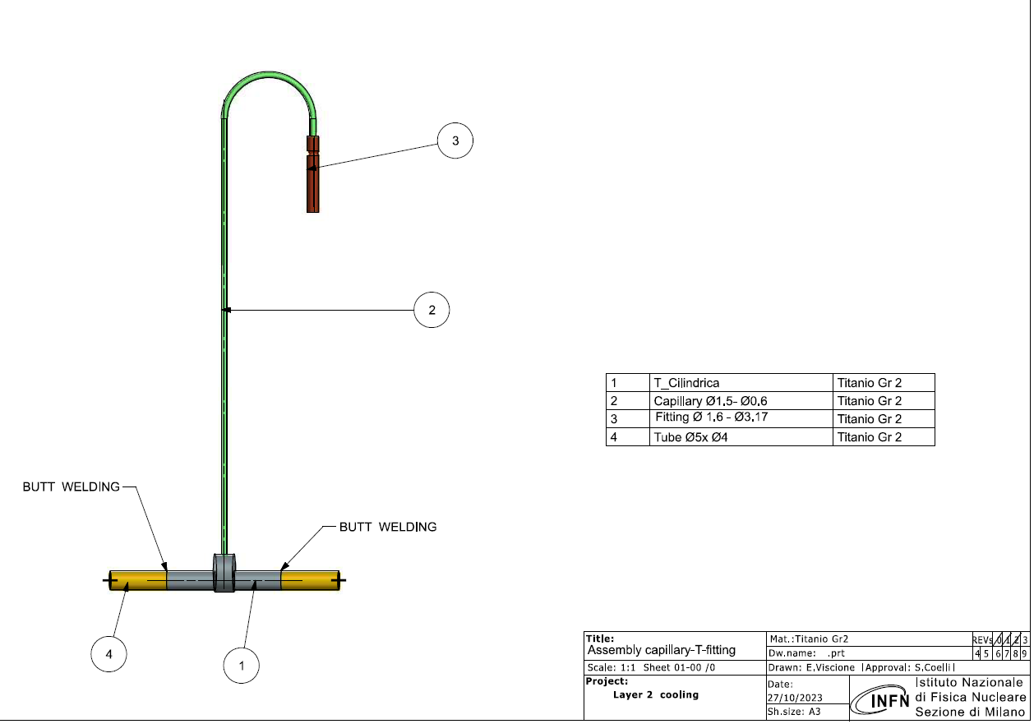
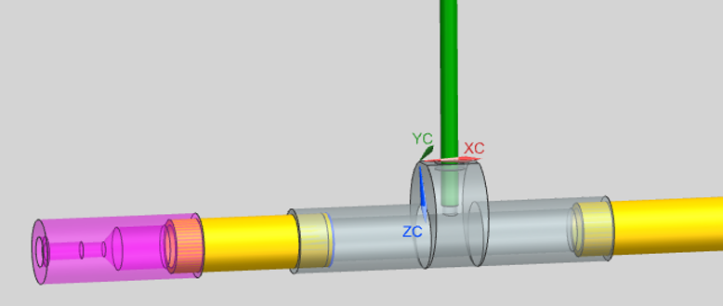
INLET LINE ASSEMBLY
ORBITAL WELDING ON BOTH SIDES OF THE «T» COMPONENT
AFTER WELDING TEST, NOT SATISFACTORY WITH BUTT WELDING
NEW DESIGN IMPLEMENTING SOCKET WELDING
TITANIUM GR.2 OD 5mm/ID 4mm

Slide 15
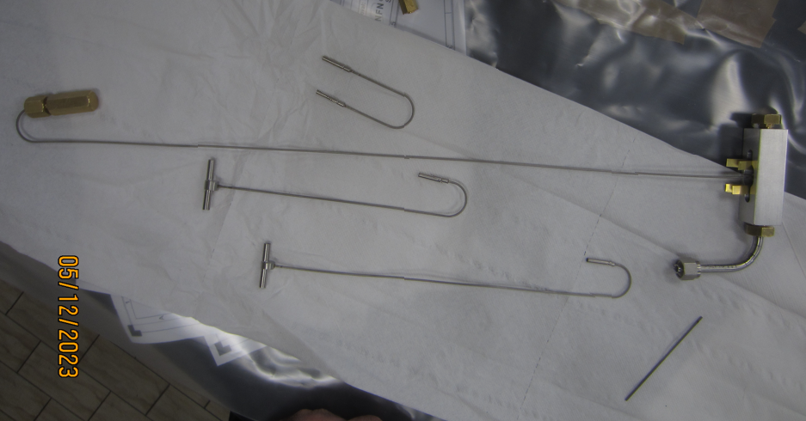
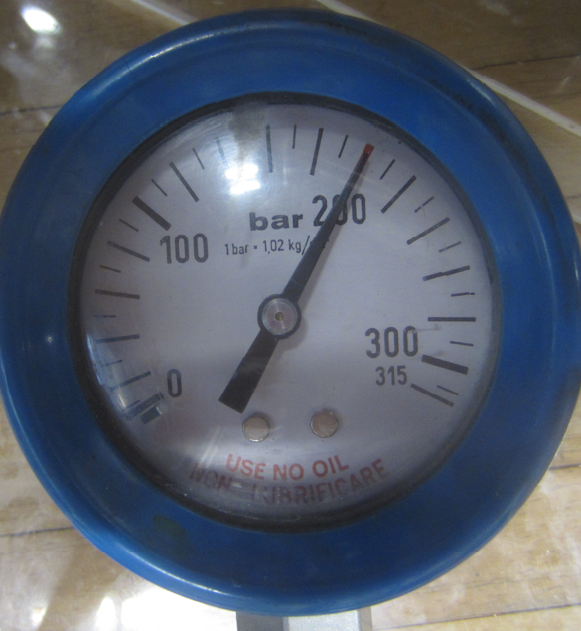
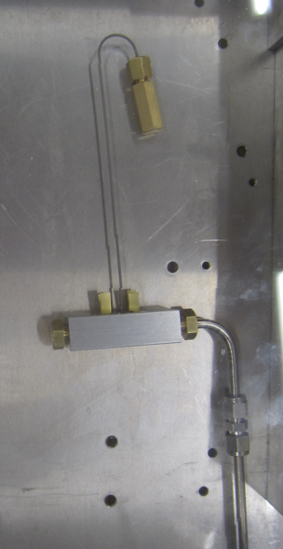
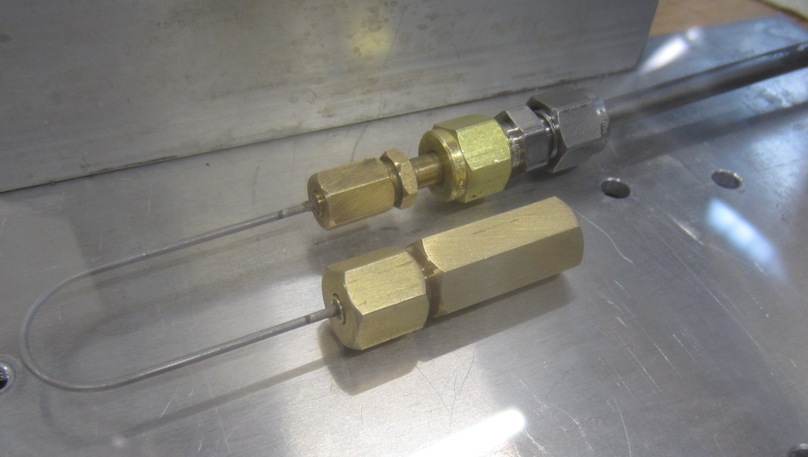
CAPILLARY HIGH VACUUM BRAZED PROTOTYPES
T + CAPILLARY + FITTING (Fred groove system for test)
sample
LAYER -2
LAYER -4
LAYER -3
PRESSURE TEST VERIFICATION: OK
WITH COMPRESSED AIR UP TO ~200bar

Slide 16
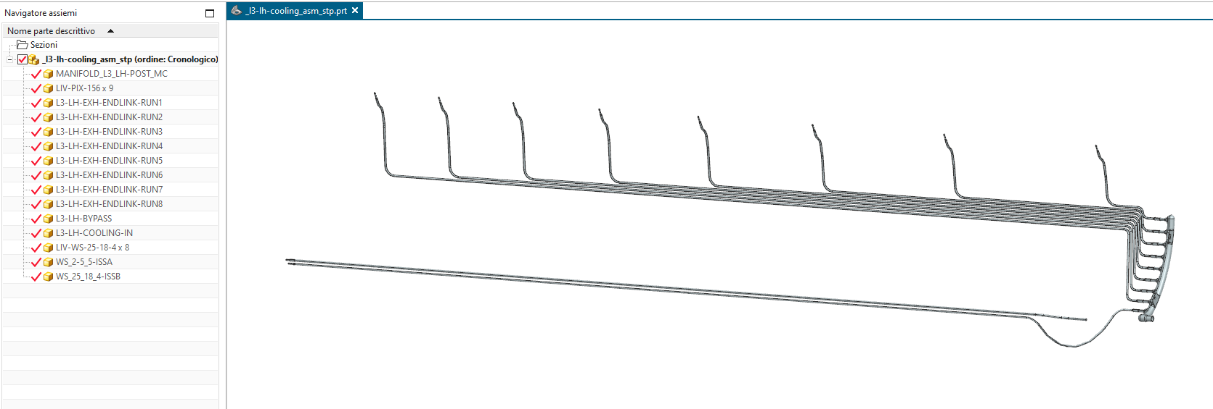
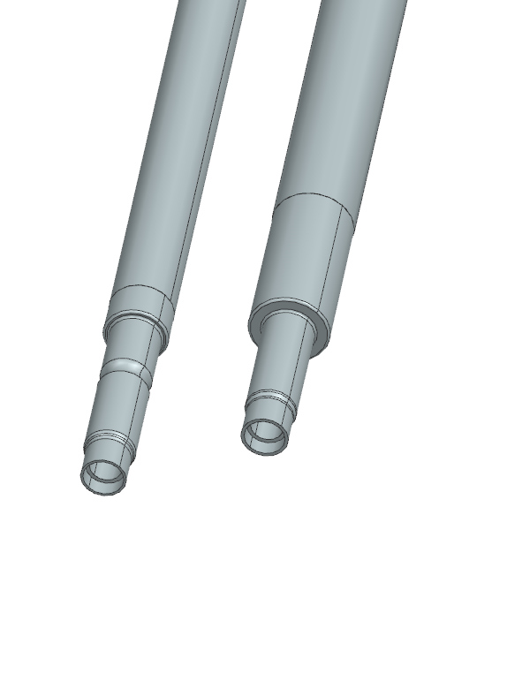
INLET LINE – BY-PASS LINE CAPILLARY CONNECTION
last concept model for a half shell LAYER 2
by Fred Gannaway June 2022
https://edms.cern.ch/document/2858201/1
INLET LINE
BY-PASS LINE

Slide 17
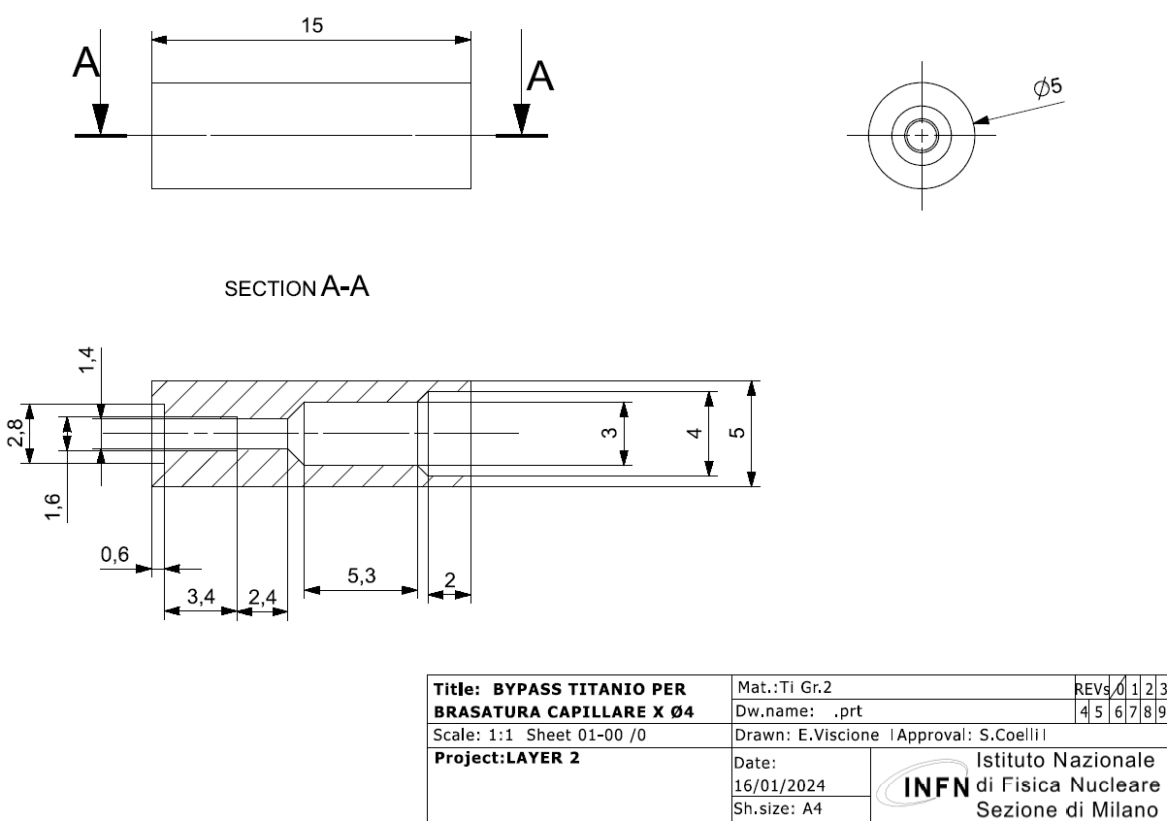
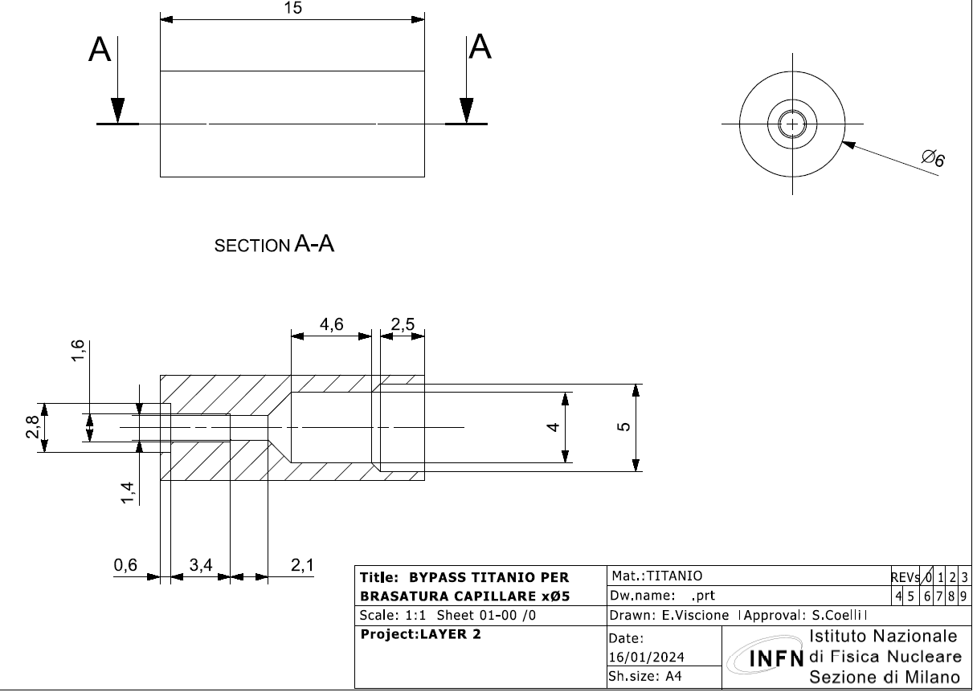
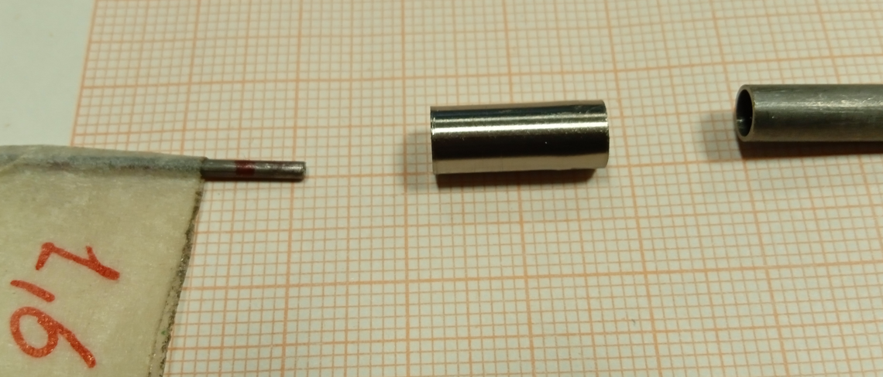
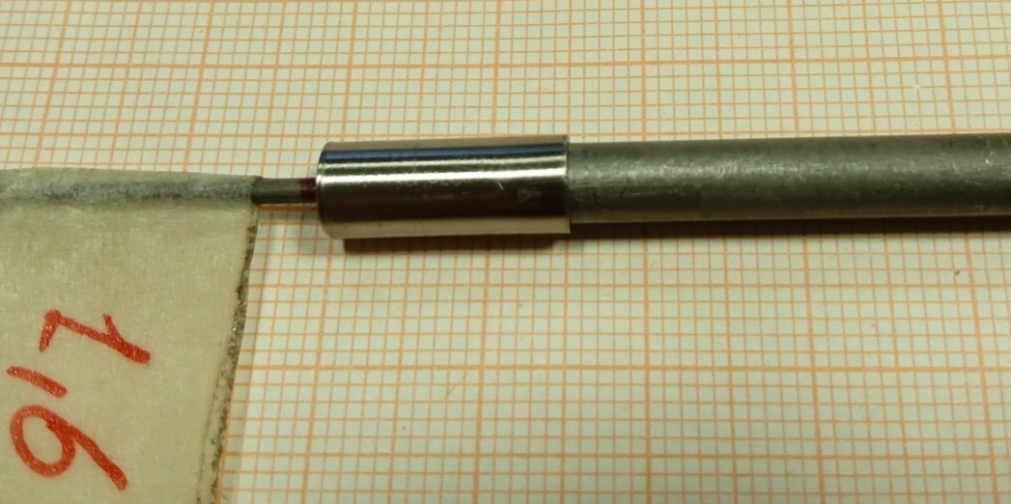
INLET LINE – BY-PASS LINE CAPILLARY CONNECTION
axial tube head proposal for capillary brazing
PROTOTYPES:
OD 5mm FOR INLET LINE and bypass layer 4
OD 4mm FOR bypass layer 2 and 3
READY TO BE BRAZED WITH CAPILLARIY

Slide 18
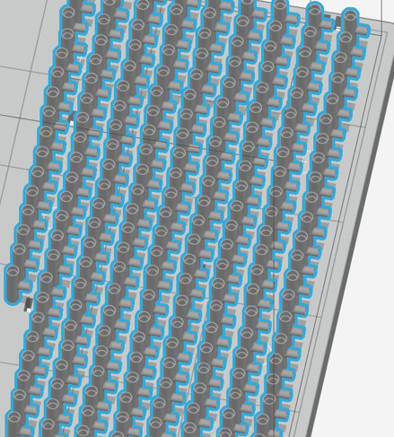
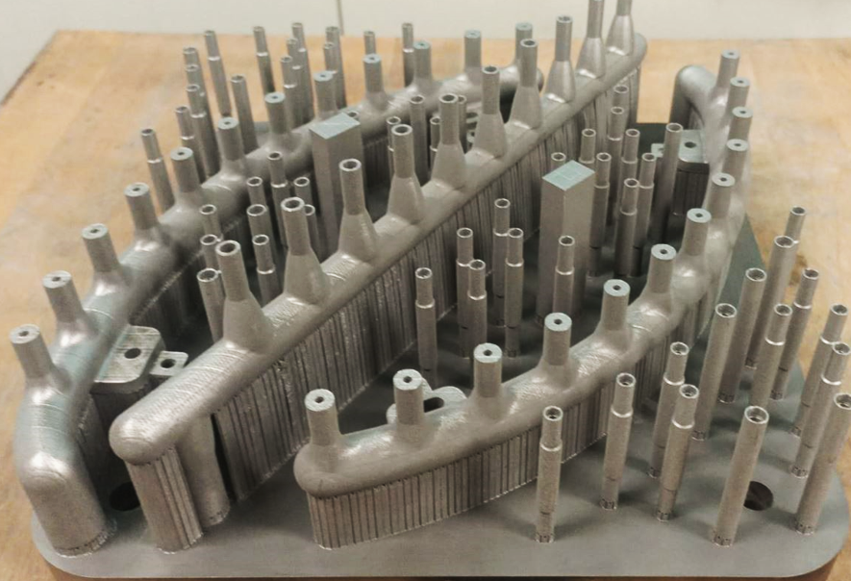
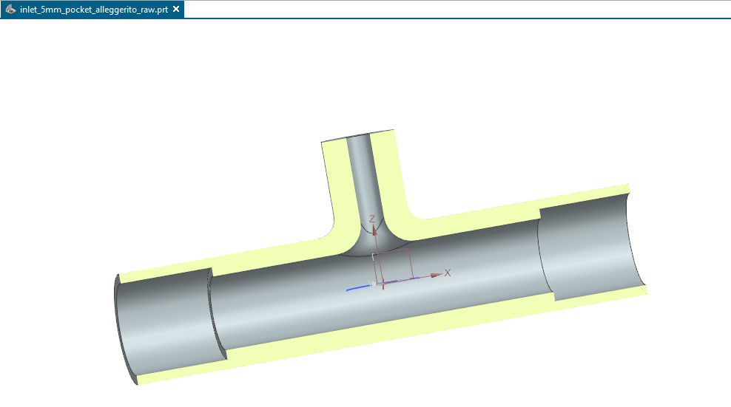
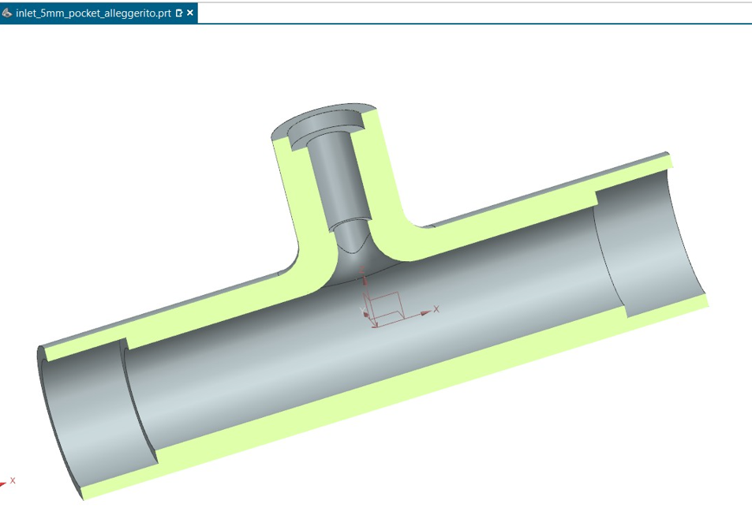
INLET LINE COMPONENTS FROM ADDITIVE MANUFACTURING
lighter and smarter
Design: less material in the detector!
A production solution has been investigated
Based on our previous, positive experience with components from the SLM printing process (from manifold to socket samples)
We can print everything in one shot (both T pieces and including axial heads) with a budget of 2k€, then working them (finishing) in house
Finished in house
Reaming for the 5mm welds
Finishing the brazing interface
Ready for brazing
Model to be 3D printed

Slide 19
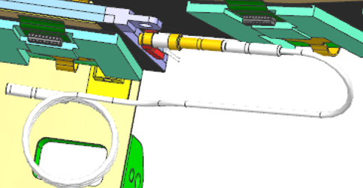
INLET LINE COMPONENTS
The fittings on the capillaryHR side:
have to be produced by a precision company
INTEGRATION SIDE: connection to the E-breacker

Slide 20
    WELDING EXPERIENCE:
    BUTT WELDING VS SOCKET WELDING
    QUALIFICATION OF THE COOLING SYSTEM:
    PRESSURE TEST
    DE-MOUNTABLE FITTINGS “NEW DESIGN”
    OD 4mm, OD 5mm, OD 12.7mm pipes
    PRODUCTION AND TEST

Slide 21
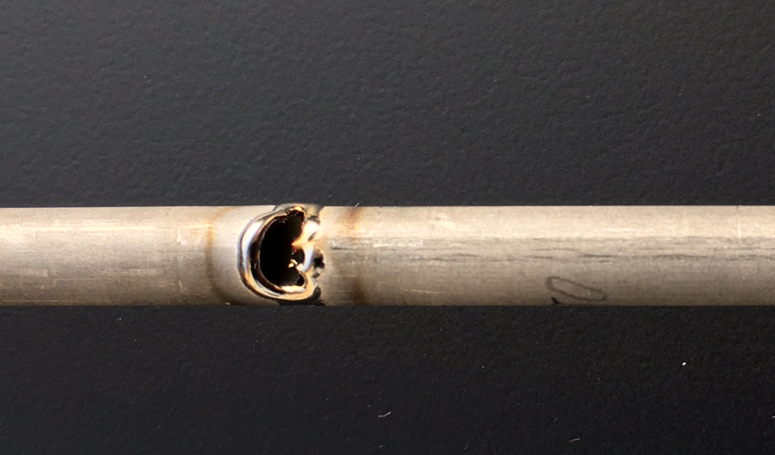
Pocket welding is more reliable than butt welding
Welding head setup procedure (butt welding case):
-lock in the first pipe centering its top in front of the tungsten electrode
-push the second pipe against the first one (already locked)
-close the welding head locking the second pipe
When you close the welding head to clamp the second pipe you CANNOT see if it moves from the first one
Possible effects:
-Welding is ok
-welding is ok but the pipes are misaligned resulting in a narrower inner diameter
-welding has a burn through due to the non-perfect contact between pipes

Slide 22
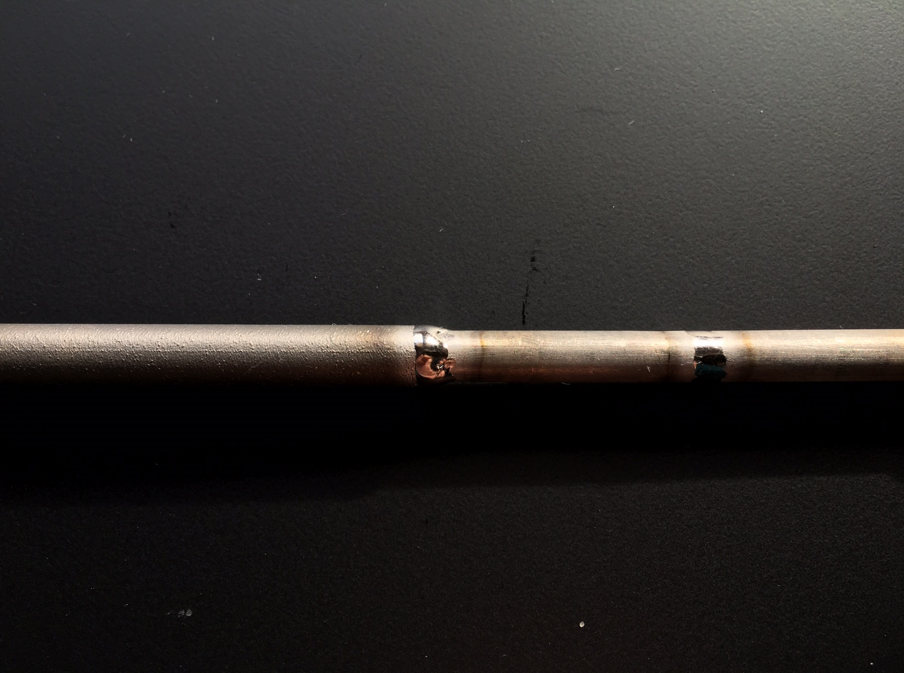
In pocket welding one pipe is inserted in the other one for few millimeters.
Thanks to the overlapping, the welding is sturdy even in presence of small misalignements.
You never burn through.
You are less sensitive to protection gas pressure variations.
Possible defects are the uncomplete welding between pocket and inner pipe.

Slide 23
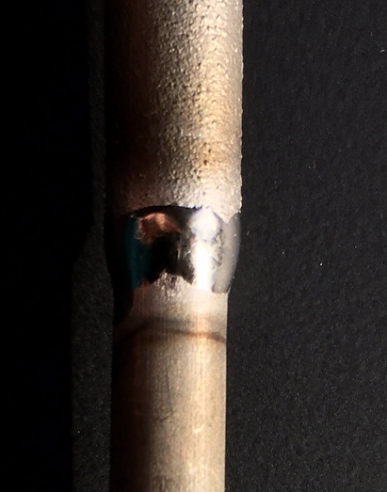
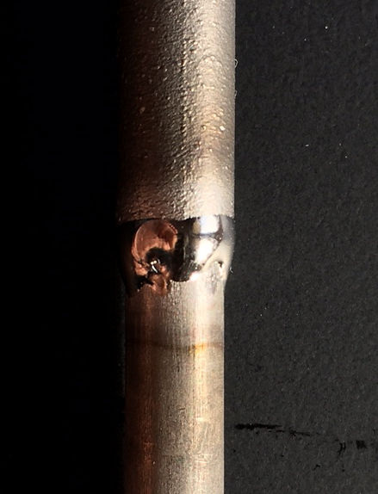
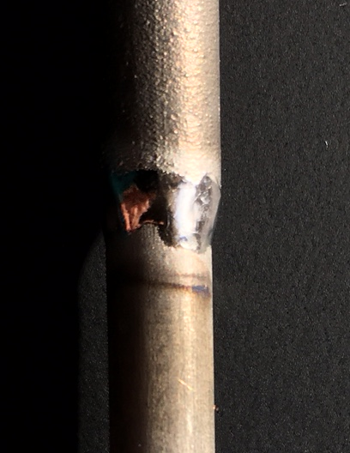
A bad welding is often caused by clearance between pipe and socket
In this case you can repeat the welding procedure possibly moving the head
Theese FAULTY and UGLY weldings are mechanically strong and leakproof: we vacuum tested them with helium and they have been pressured with dry air at 180Bar and oil at 500Bar:

Slide 24
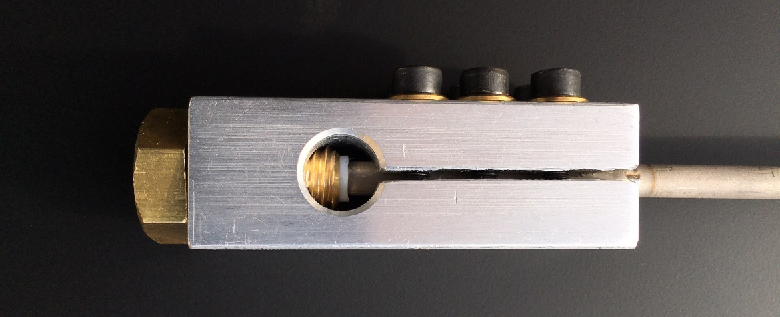
We developed a clamping system to pressurize «face-machined» pipes without any additional fit.
From right to left you find:
-clamp internally bored to the pipe’s nominal size
-central inspection&venting hole
-brass screw as stopper with PTFE gasket

Slide 25
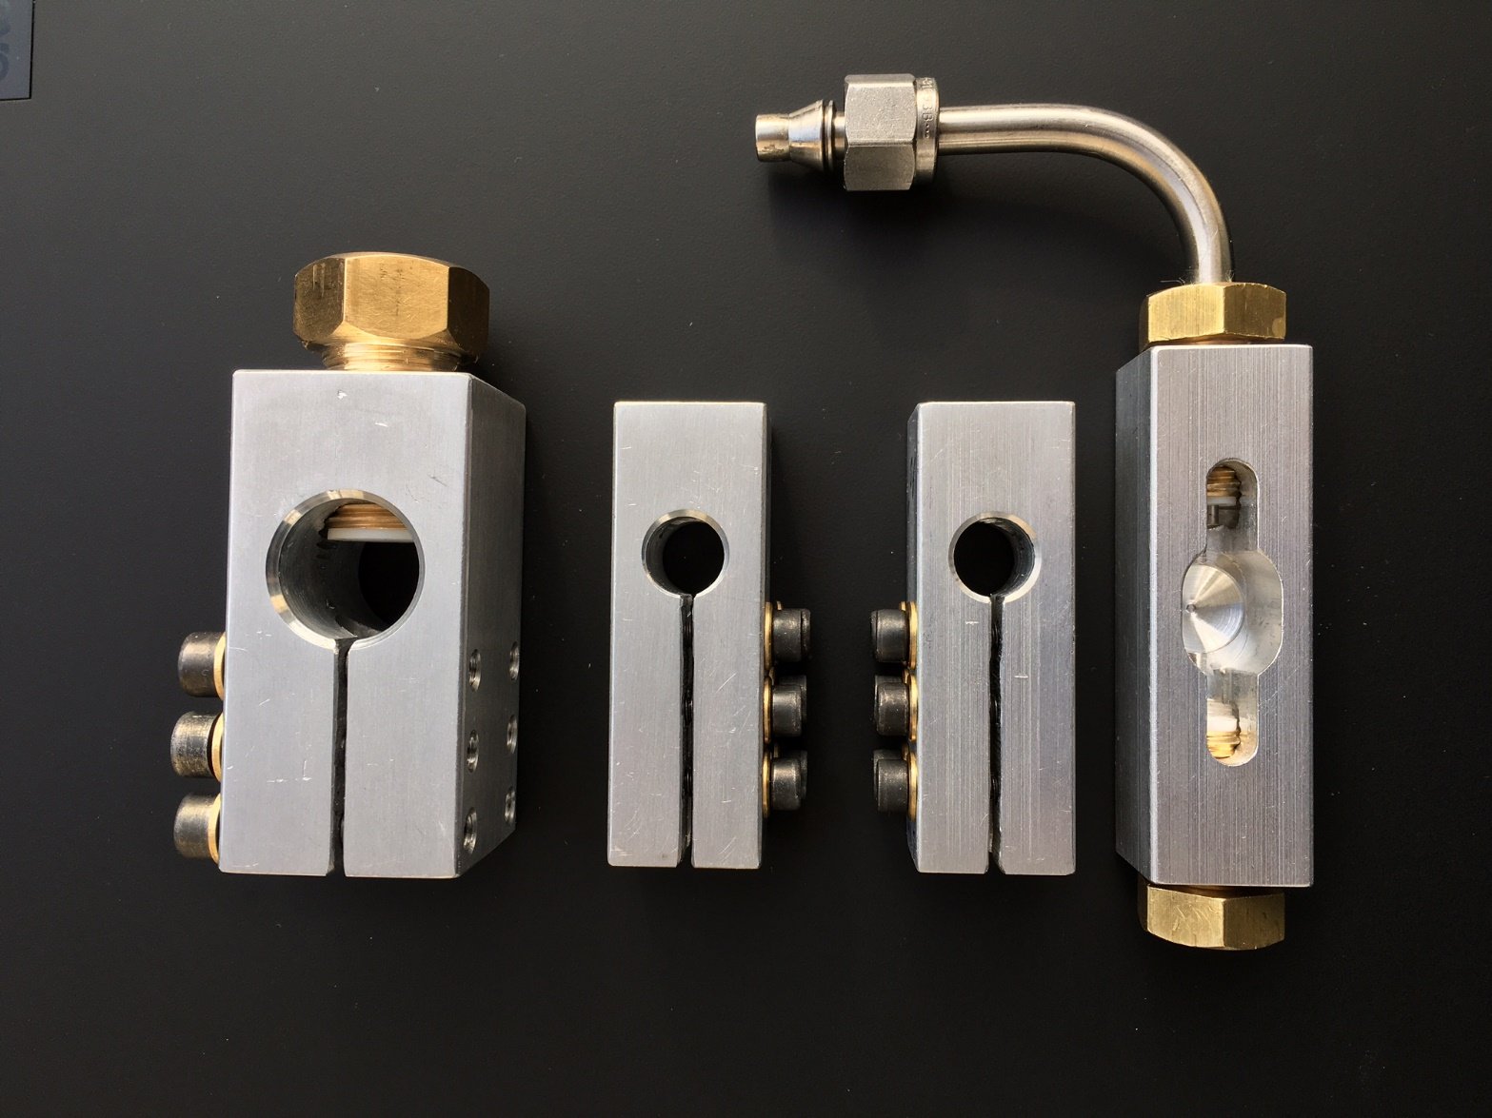
Depending on the working pressure and pipe diameter it’s necessary to adjust the clamping force and the brass screw.
4 and 5 mm pipes have 0.5mm wall and are easily deformed if clamped too much
12.7mm pipes are stronger and need a much higher force to seal them at the same pressure (higher surface area)
After some testing we choose to use 1Nm torque for 4mm and 5mm pipes (M4 screws) and 5Nm torque for 12.7mm pipe (M5 screws)

Slide 26
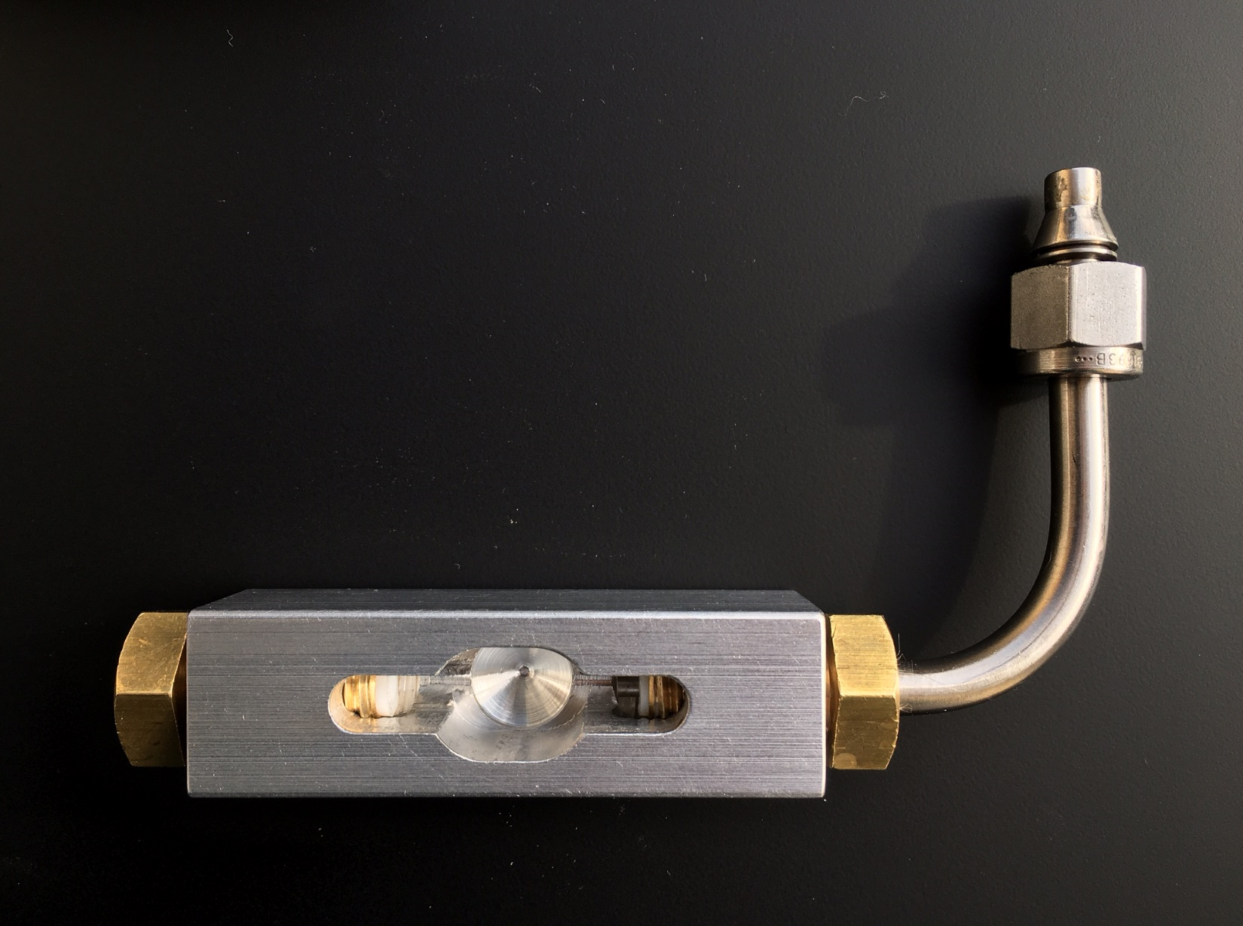
A double screw version is used to test the «T» with the capillary already brazed
a modified brass screw with swagelok plug and pierced PTFE gasket to pressurize the «T»

Slide 27
Back-up slides
simone.coelli@mi.infn.it

Slide 28
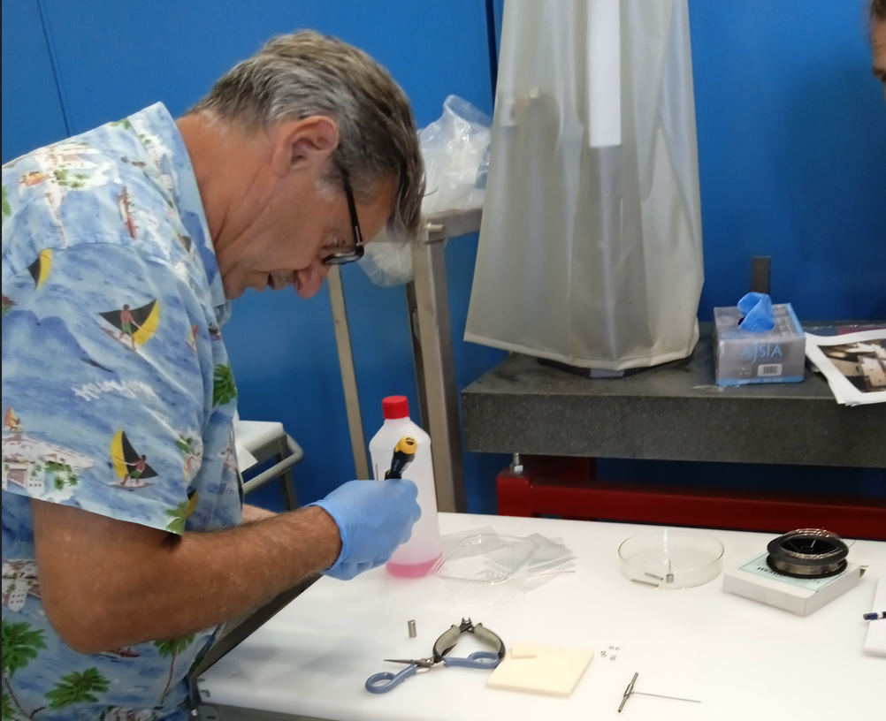
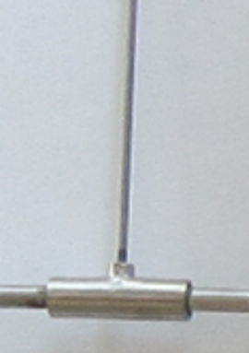


BRAZING FRASCATI LABORATORIES
TEST ASSEMBLIES USED TO SET UP THE PROCESS
Roberto Di Raddo (LNF) inserting the BFM
The Brazing Filler Material = PALCOSIL Al-Ag-Pd
Temperatures UP TO 860°C
The brazing furnace process details and parts positioning
Have been tested
It was a «new» experience with PURE TITANIUM (gr2) in LNF
Leak thightness is tested

Slide 29



PROTYPES FOR THE NEXT BRAZING CYCLE
WE HAVE PREPARED THE 3 ASSEMBLIES SIMULATING THE CAPILLARIES FOR THE 3 ENDCAP LAYERS
ESTIMATED LENGTHS
U BENDING ACCORDING TO FRED PRELIMINARY CONCEPT DESIGN AND ACCORDING TO BRAZING EXPERIENCE => DURING THE BRAZING PROCESS THE PARTS ARE PLACED VERTICALLY SO THAT BRAZING FILLER CAN FILL IN THE GAP EASILY (GRAVITY HELPS)
PRODUCED IN MILANO AND NOW AT LNF FOR BRAZING

Slide 30


PRESSURE DROP TEST ON THE BRAZED ASSEMBLY
«T» + CAPILLARY + FITTING
OUTLET FLOW USING
A REMOVABLE FITTING («FRED FITTING»)
(I.E. WITH A SWAGELOK FITTING ¼ INCH)
PROPOSED TEST SEQUENCE:
BRAZING PROCESS
THIGTHNESS TEST (HELIUM LEAK RATE MEASUREMENT)
PRESSURIZATION ACCEPTANCE TEST (>162 BAR)
COILING, NEEDED AT LEAST FOR LAYER 2 AND LAYER 3 (TO TAKE IN ACCOUNT ACCIDENTAL SQUASHING IN THE COILING PROCESS)
PRESSURE DROP MEASUREMENT AT THE CERN FACILITY USING CO2 WITH THE CORRECT PHYSICAL CONDITIONS
Then:
ORBITAL WELDING OF THE PIPES ON BOTH SIDES
THIGTHNESS TEST (HELIUM LEAK RATE MEASUREMENT)
PRESSURIZATION ACCEPTANCE TEST (>162 BAR)
GEOMETRY CONTROL
INLET FLOW WITH A CUSTOM TOOL
- TO CLOSE THE «T» COMPONENT ONE SIDE.
TO ALLOW A FLOW THROUGH THE CAPILLARY ON THE OTHER SIDE USING A CHANNEL IN A CAP (I.E. WITH A SWAGELOK FITTING ¼ INCH)
THIS IS A «CONCEPT»
TO BE DESIGNED,
AGREED WITH CERN FACILITY DESIGNERS AND USERS ,
THEN TO BE PRODUCED
AND TESTED!

