Slide 1
Services Cable Harness Loading
Owen Shea, Stephan Eisenhardt, Juan Pablo Moraga, Jon Webster
OEC Integration Workshop in Frascati
31/01/2024

Slide 2
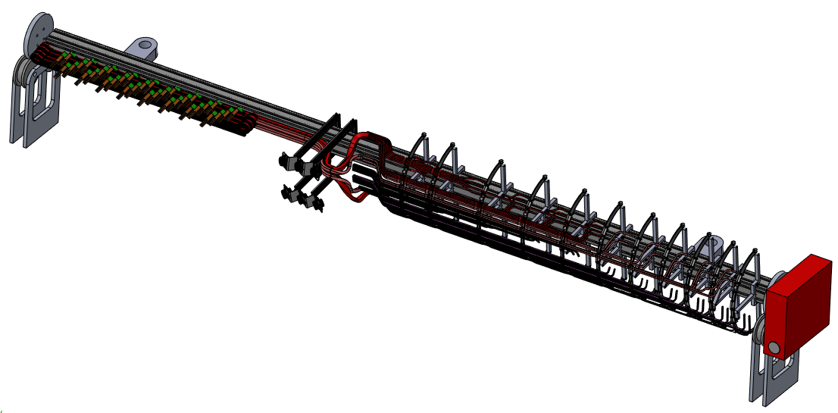
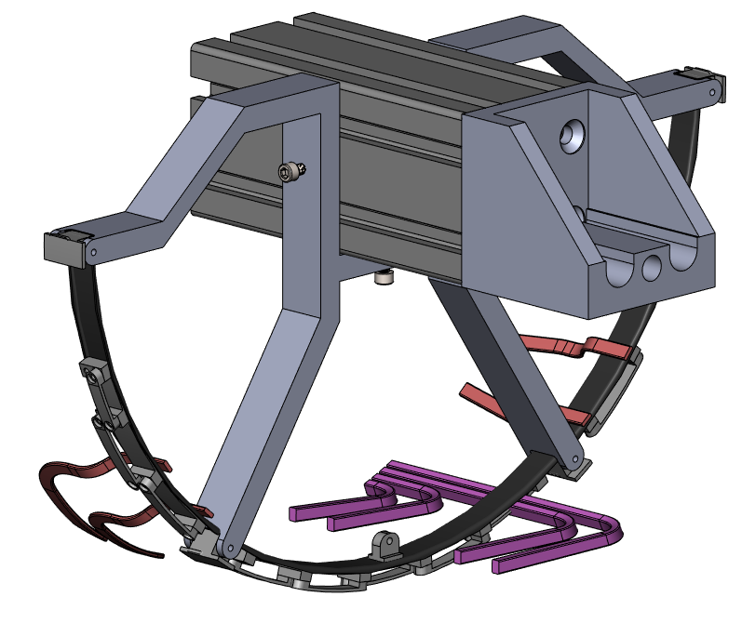
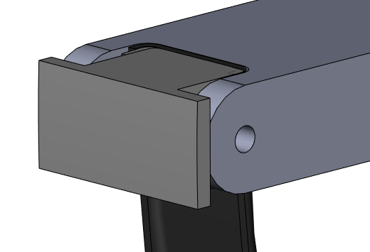
Cable Harness Assembly Tool
Cable harness assembly jig provides mounting positions for cable bundles. It can rotate so that each bundle can be placed in the most convenient position
Mounting positions are set by alignment features along the central beam (in progress thanks to Juan Pablo)
The detailed design of the temporary supports and their interface to the services support rings is in progress
Foresee the possibility of adding position adjustment in R in order to have good contact for gluing

Slide 3
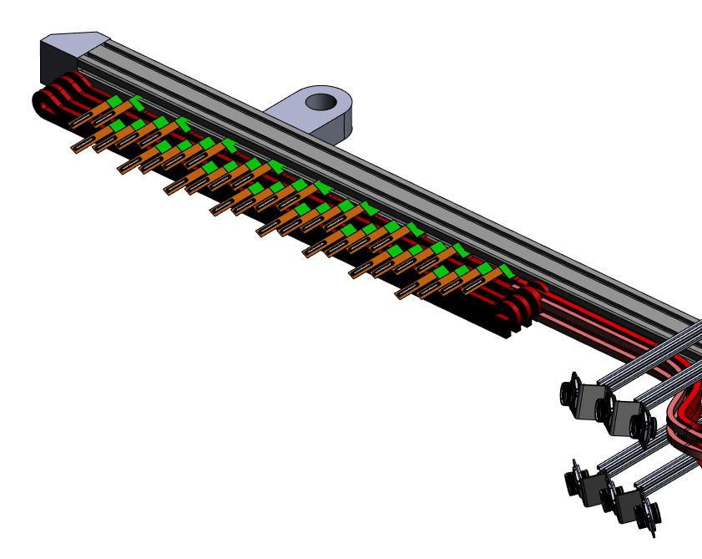
Cable Harness Assembly Tool
Folding of data cable bundles is designed in principle – needs design of actual support
Design for placement and support of termination boards is also needed
Design of PP1 connector support needs to be developed further – positions are agreed in principle
Also need to include additional PP1 connectors for environmental monitoring connections

Slide 4
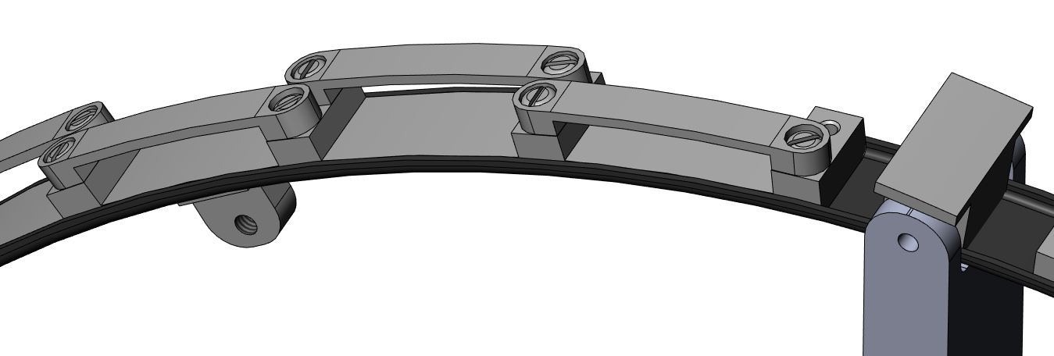
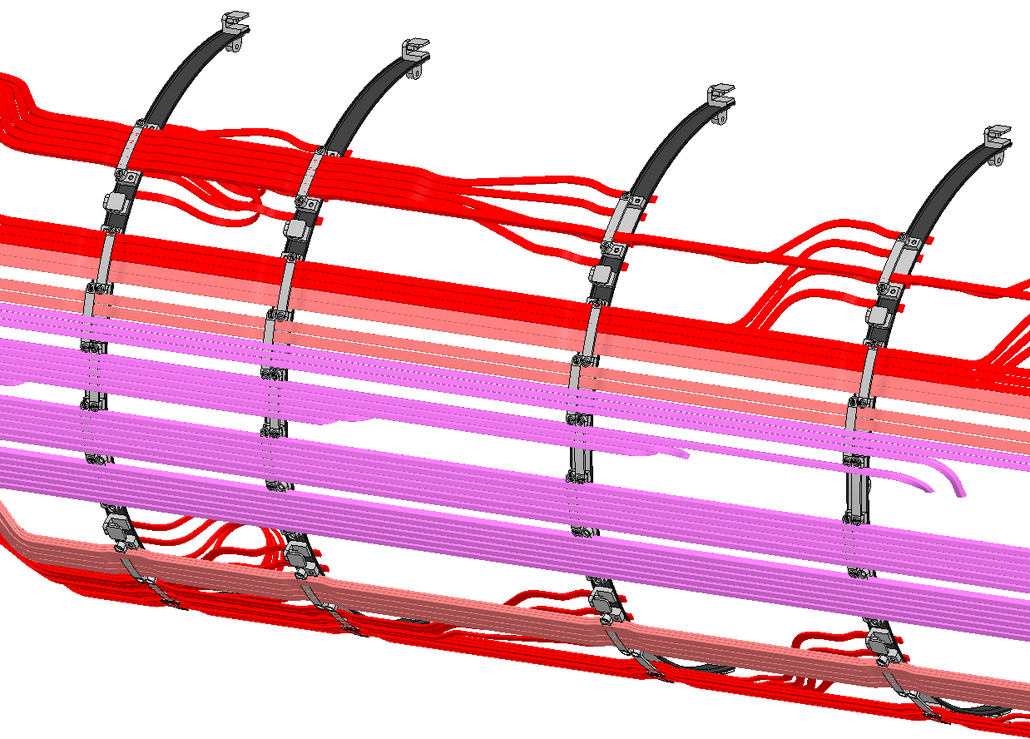
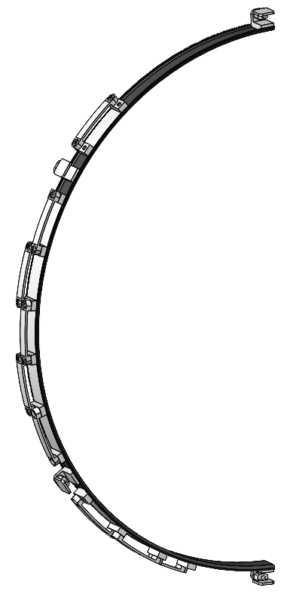
Services Support Ring
Support rings will be made from carbon fibre, with mounting/clamping hardware made from radiation-hard plastic
They are part of the harness assembly tool, but they are transferred into the half shell and will remain in the end cap
Baseline design has changed since what is shown here – cables will simply be guided by the support ring, not clamped. This requires a removable locking method to hold the cables in during harness production and transport
We need to understand the precision or adjustments required in order to get a good bond to the half shell

Slide 5
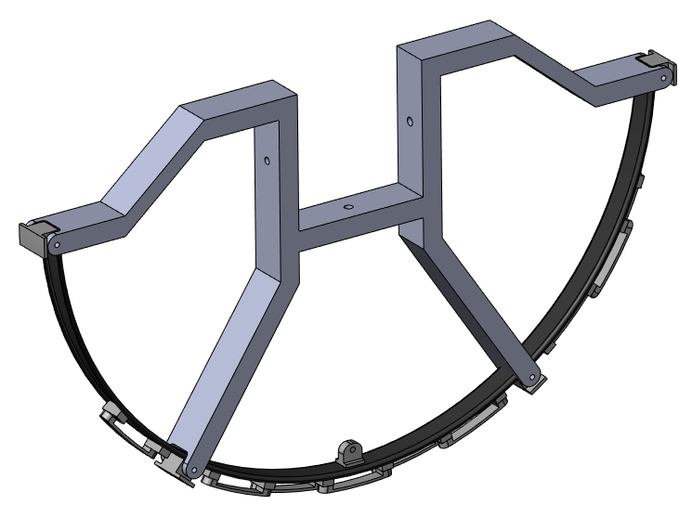
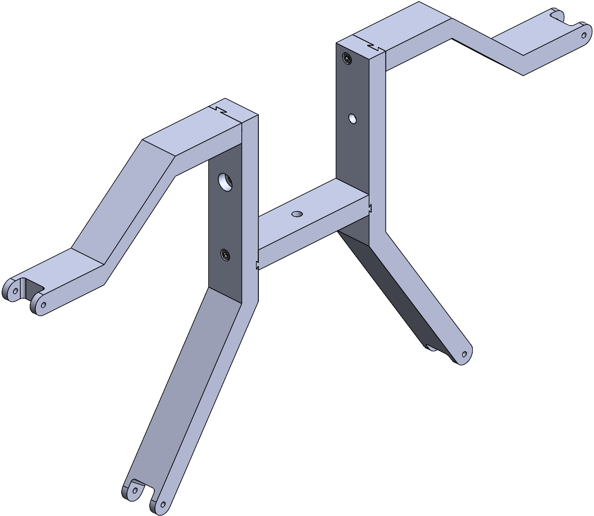
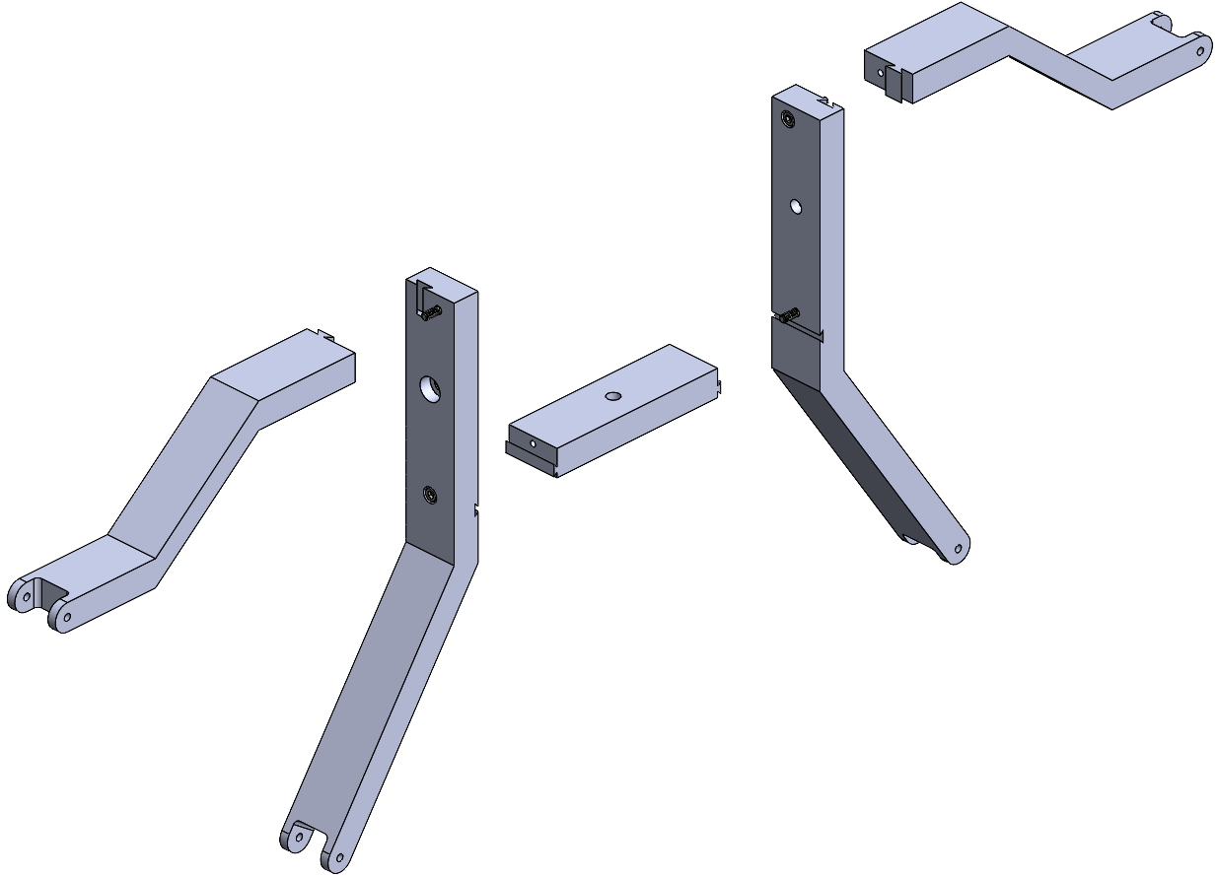
Temporary Mounting Support for the Services Support Ring
Actual design of clamps needs to be finished – will require variants to account for different thicknesses of bundles
Design of the support strut has progressed (thanks to Juan Pablo)
Still requires finalisation of design, and some rounds of testing
Support struts will also need features for parking power and data connectors during assembly

Slide 6
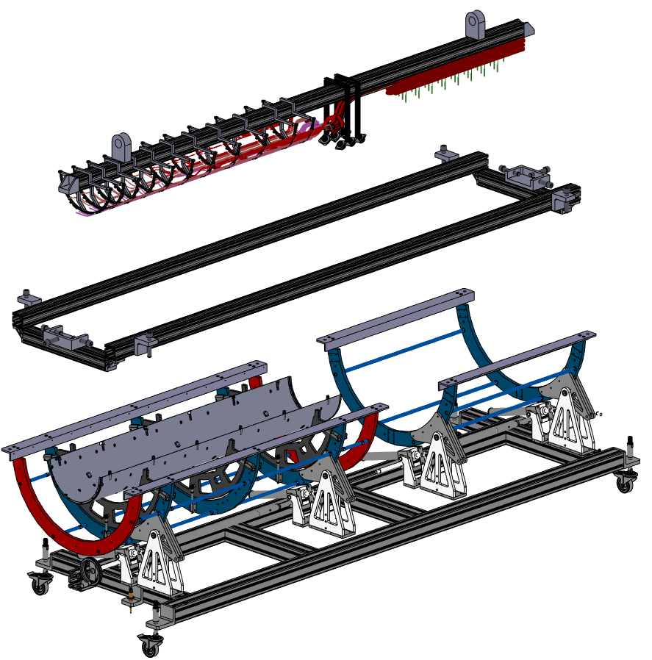
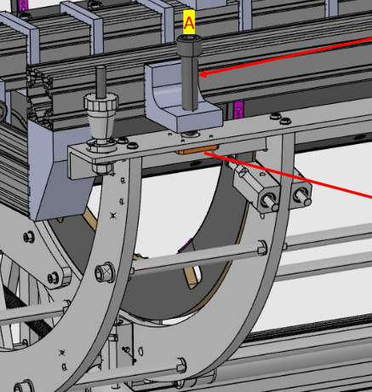
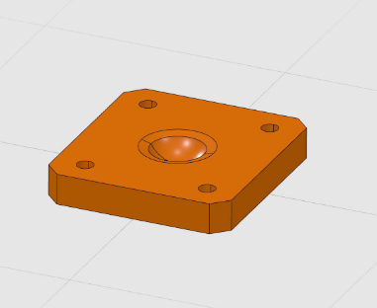
Cable Harness Integration
Cable harness – constructed and shipped from Edinburgh
Insertion Cradle – Stored at integration site, holds the cable harness during integration. Position of cable harness can be adjusted using screws
Rotating Assembly Tool – Insertion cradle + cables harness are placed on side rails. Cradle is lowered into position vertically by corner screws. The interface with the cradle has been agreed with Frascati
Cradle interface (A. Croce, S. Tomassini)

Slide 7
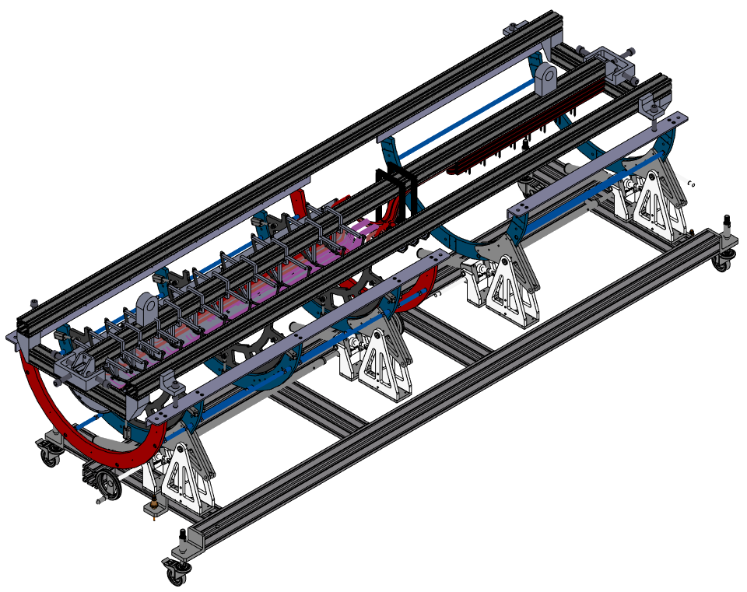
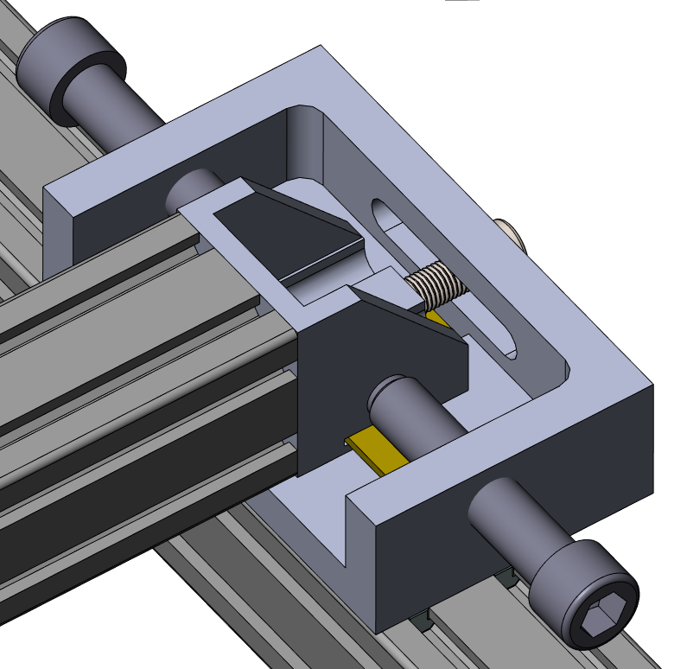
Cable Harness Integration
The position of the cable harness is adjustable on the cradle (designs from Jon Webster) – the plate at either end can slide on a low-friction interface
Horizontal position is adjusted by screws
Support of cables and transfer to integration tooling needs to be designed

Slide 8
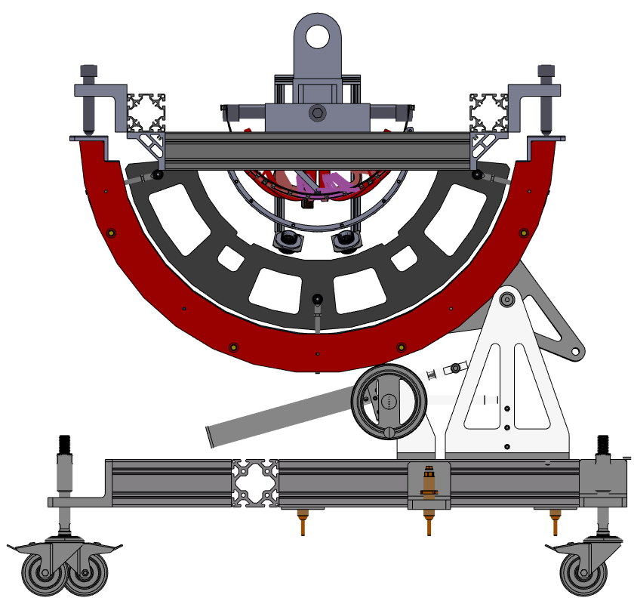
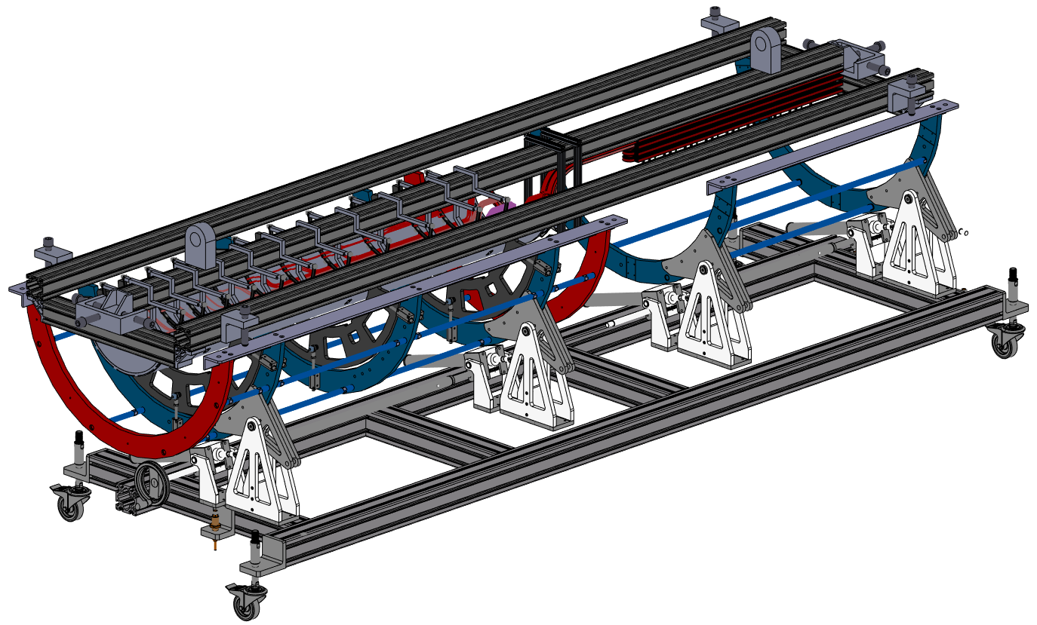
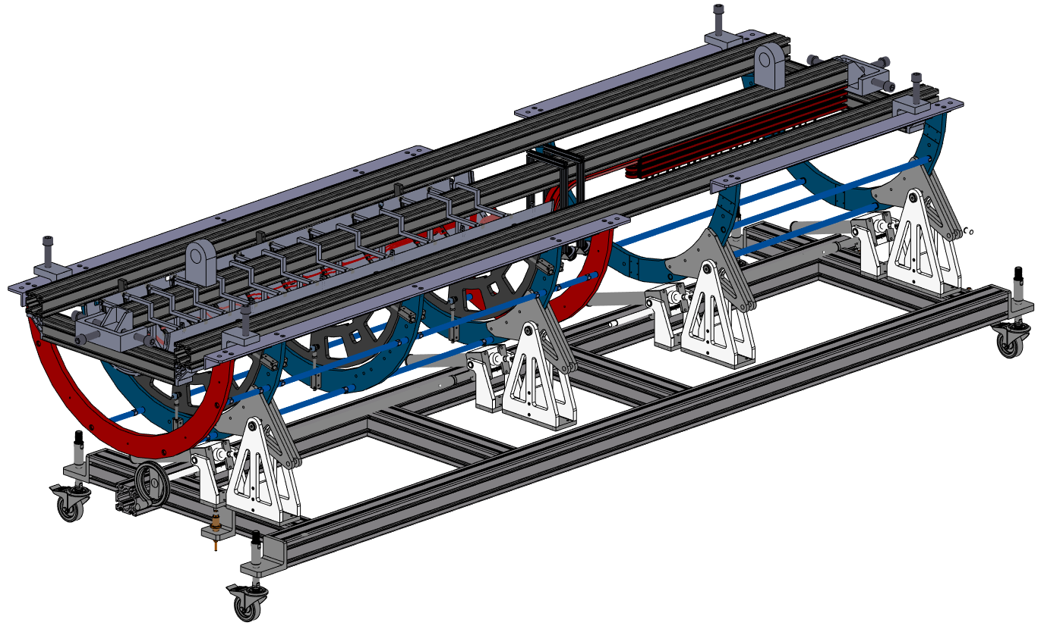
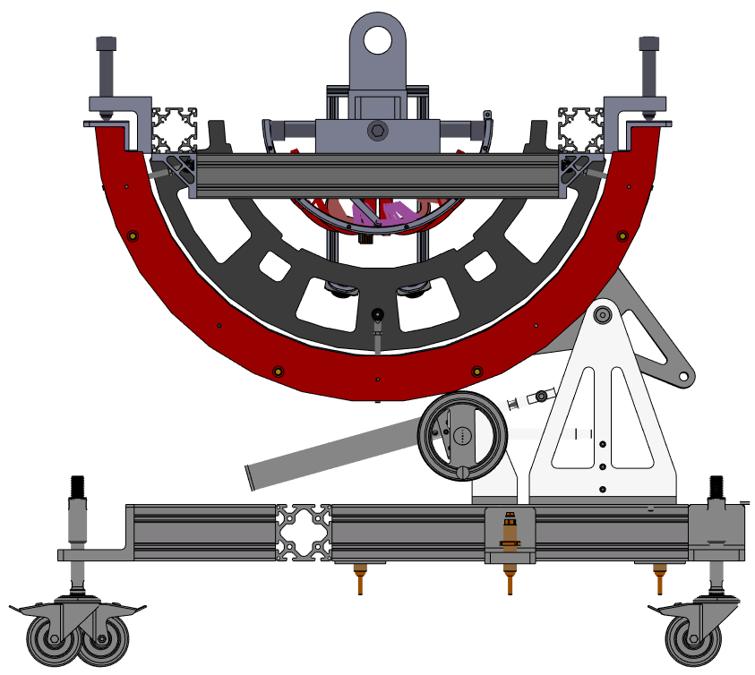
Cable Harness Integration Tool
Cradle mounted on rotating tool
Harness lowered into position and services support rings glued in place
Central beam can be lifted out while the support ring mounts remain to help position the connectors until the half rings are installed – need to ensure no collision with the half ring install tool
How to position/hold the connectors while the half-rings are integrated needs serious consideration, as does the procedure for making the electrical connections after installing HRs – this is done deep in the shell

Slide 9
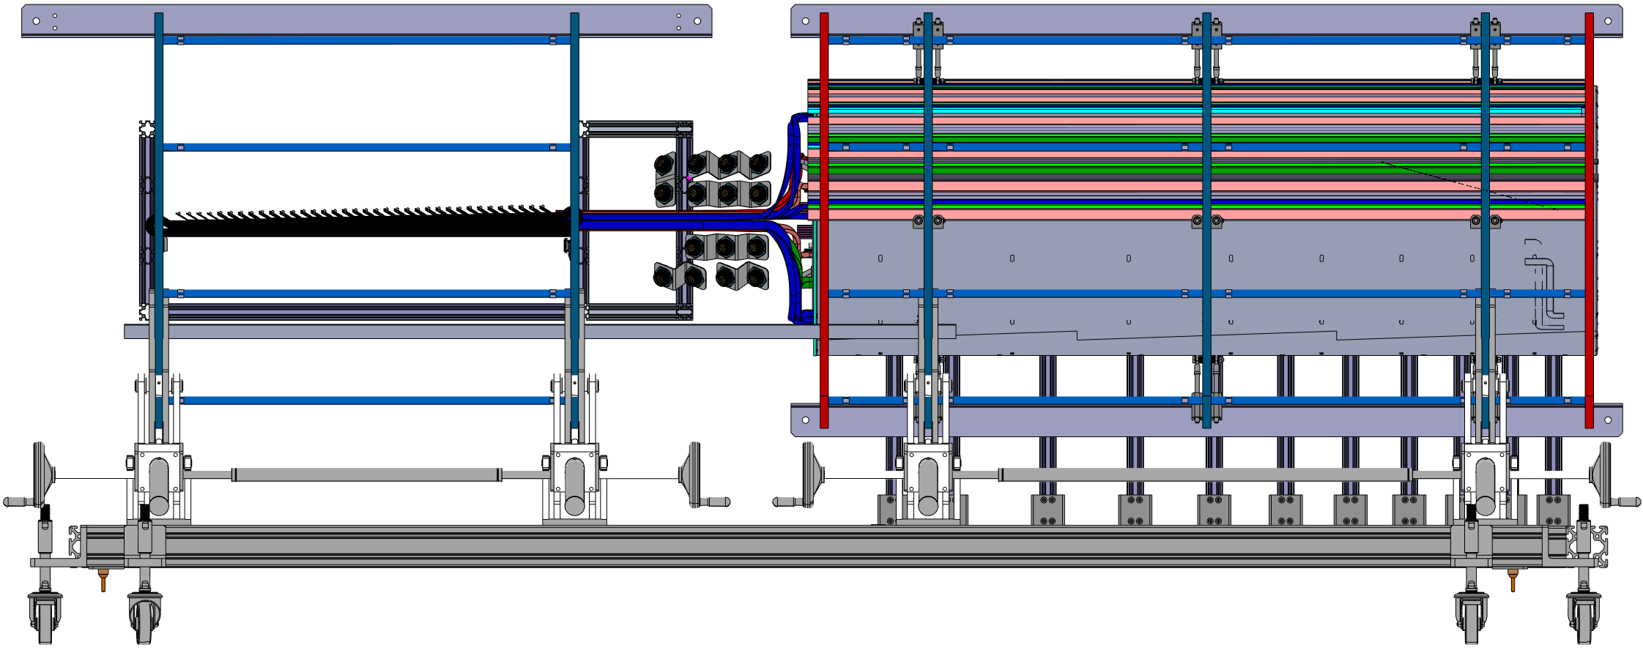
Services Trolley
Support trolley interfaces with integration tooling
Supports EC and OB services during integration – division of space agreed in principle. Routing and folding of OB services needs to be added to model
Need to confirm that connectors will be available for testing throughout integration
Need to test unfolding procedure
OB PP1
Connectors Envelope
OB Services Envelope
PST Rail Envelope
Services Trolley

Slide 10
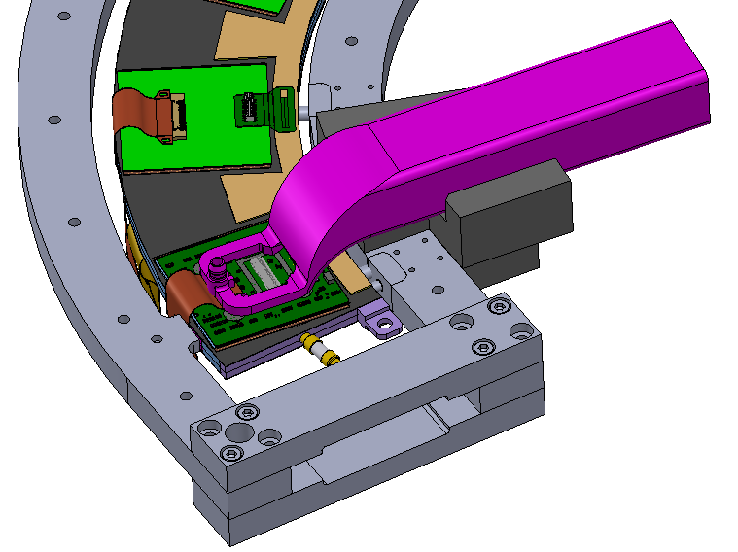
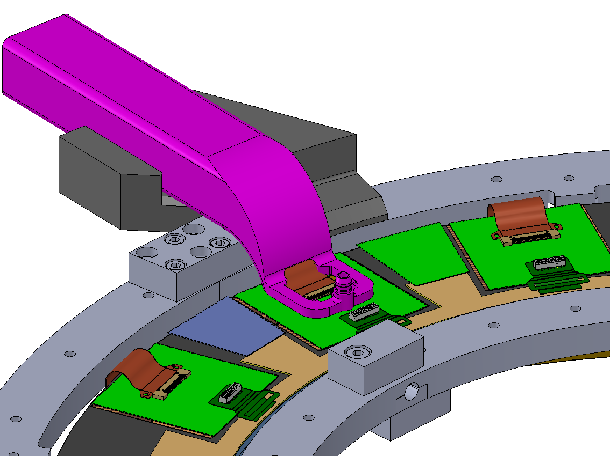
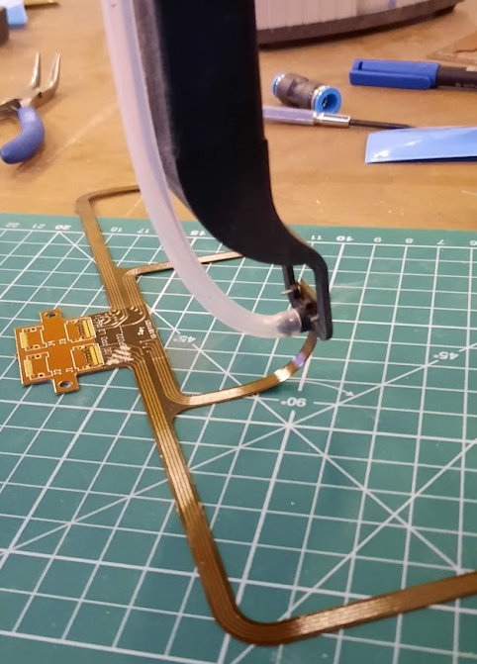
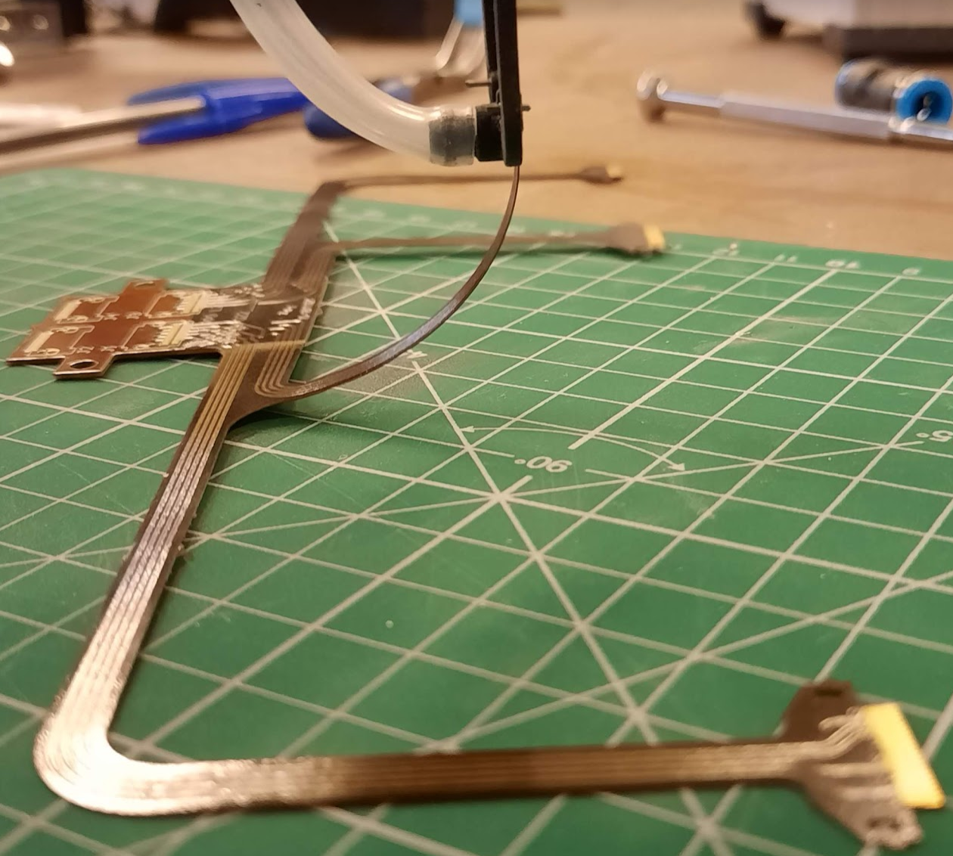
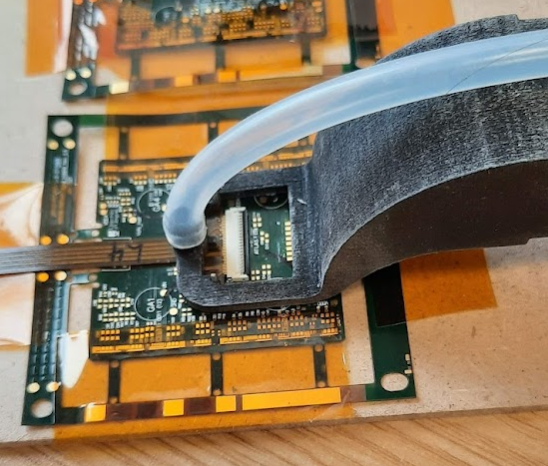
Data PP0 Connection-Module Connection
Vacuum pickup tool can be used with a guide to either push or pull the connector into the socket

