Slide 1
UK Welding Status –
Pixel Endcap Evaporators
Sam Edwards, Paul Kemp-Russell, Mitch Norfolk

Slide 2
Bare Ti Pipe Bent into shape
(Lancaster)
Electrical Breaks
(Ceramic Seals)
L2 + L3 + L4
2x EB welded to Pipe to make Evaporator
Leak check performed
(Sheffield)
L2 + L3
L2 + L3+ L4
Manchester
Pressure + leak check
Assembly
Genoa
Pressure + leak check
Assembly

Slide 3
Current Status
December 23 - Delivered 2x L4 and 2x L2 evaporators to Genoa
December 23 - Delivered 2x L3 and 3x L2 evaporators to Manchester
Full production stock of tube in hand @ Lancaster
Full production stock of Electrical Breaks in hand @ Sheffield
  Discussions on going RE what level of TiR we can accept
Set up and ready to make more Evaporators when bare ½ rings arrive from Lancaster

Slide 4
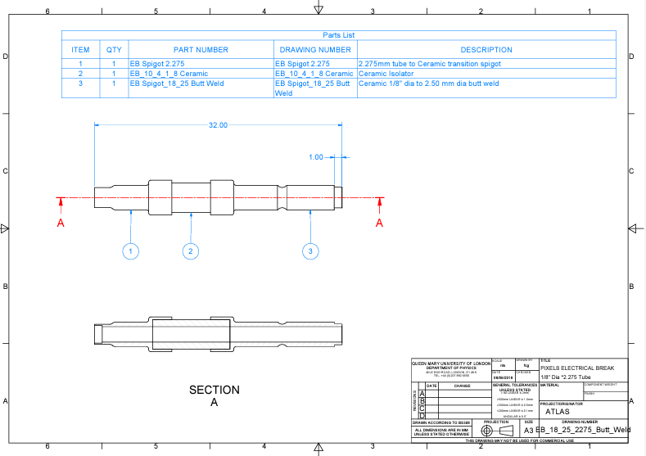
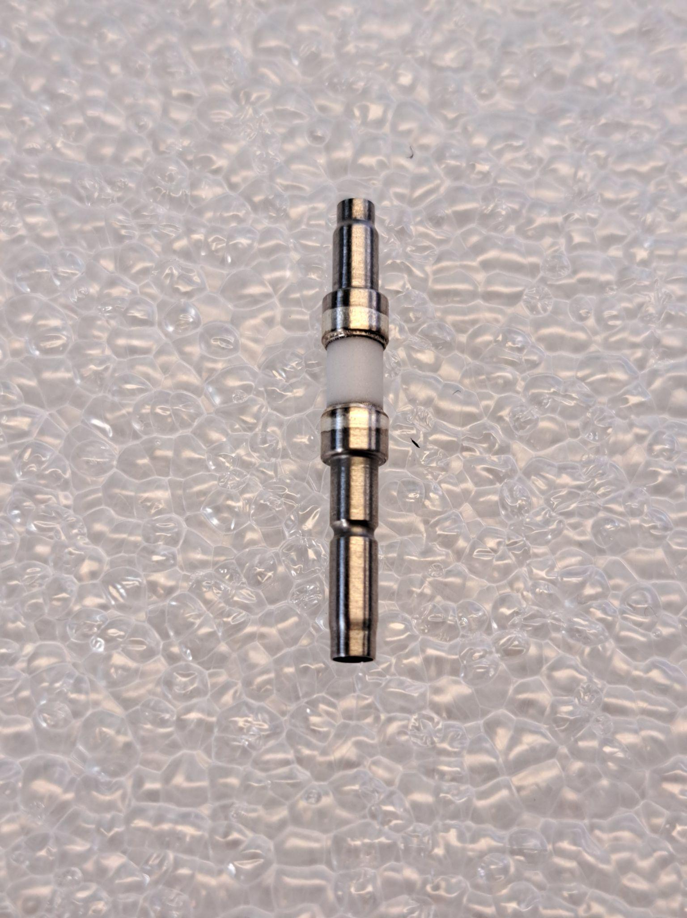
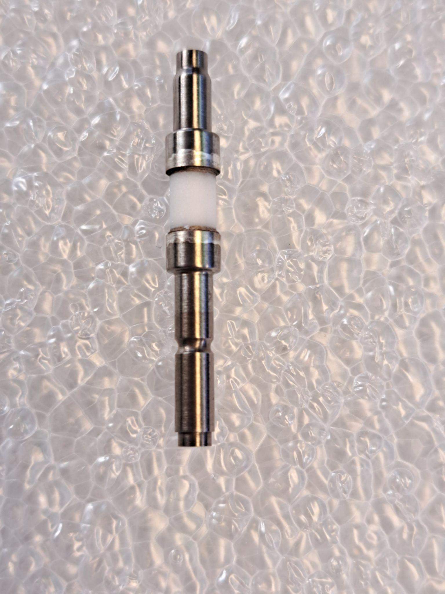
Integration
Aim is to make integration (Manchester + Frascatti) as reliable as possible
Two main this to help with this.
EB Design
Originally the EB to Exhaust / Inlet weld was to be a 2.5mm Sleeve joint.
Now changed to be a mating part
Better joint
Thicker wall
Better gas connection
This ‘male’ end now fits to ‘female’ fitting on either Capillary or exhaust
Old Design
New Design

Slide 5
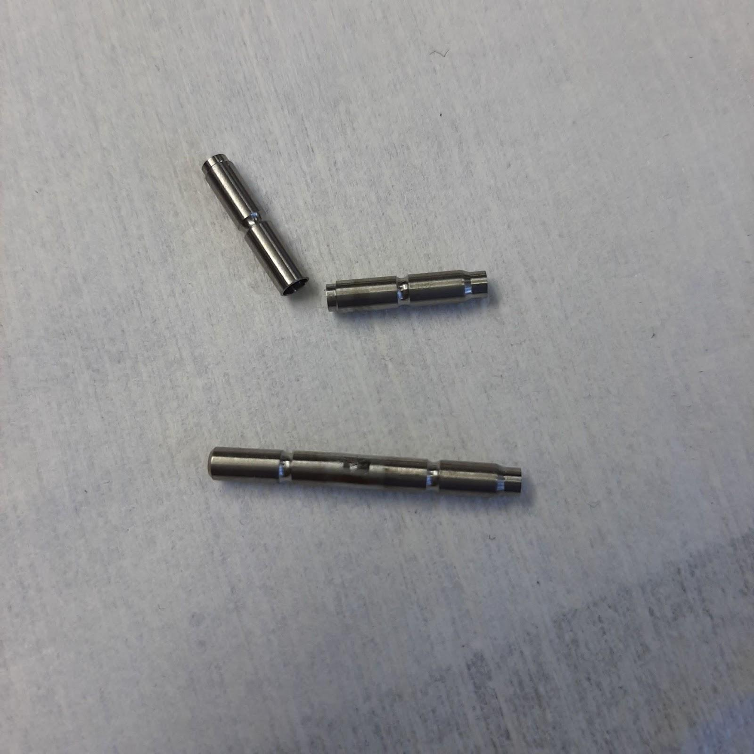
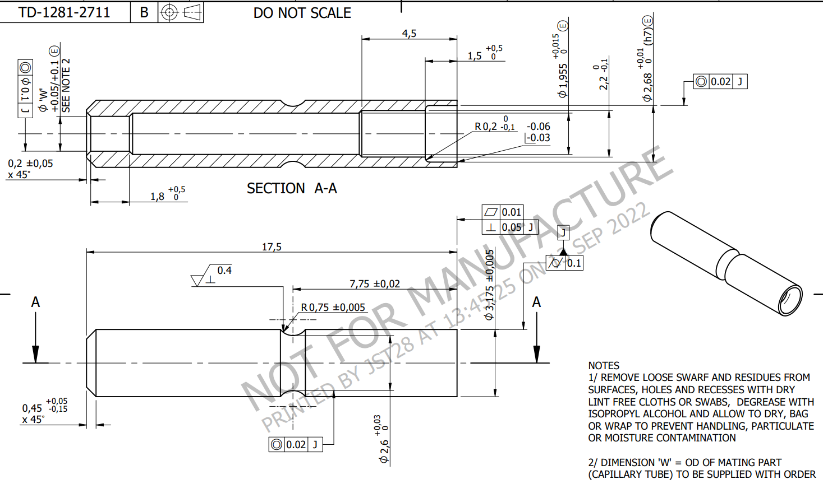
Integration
Weld trials with these fittings have gone well. This also give an opportunity to do a repair weld. By cutting at both o’ring grooves and placing a custom made fitting in the middle
Exact same joint being used in Stave.
Welds have been tested, WPS verified and CT scans completed.
A number of these joints are now in use on the Stave SR1 system test.
Capillary ‘female’ fitting

Slide 6
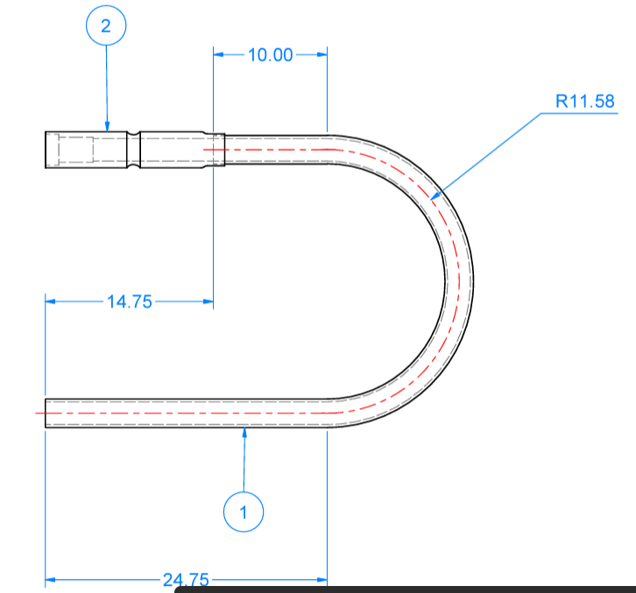
Integration
Plan is to have these u-bends made with the long leg (1) over size, that way it can be measured and trimmed on site
Plan to also have U-bends made with different radii (11.0, 11.5, 12.0)
These 2 features combined should cover a range of possible misalignments.
On site you would dry fit a bare U-Bend, cut then weld the fitting on before welding into the system
Some form of mock up needs to be made to test gas pressures for these welds. At the moment they are an unknown, and very critical.
Discussion also required on testing Leak + Pressure during integration. Who, what when.
Exhaust ‘female’ fitting

