Slide 1
HalfShell Clamping, Cycling and testing in Liverpool (all Layers)
Helen Hayward, Tim Jones

Slide 2
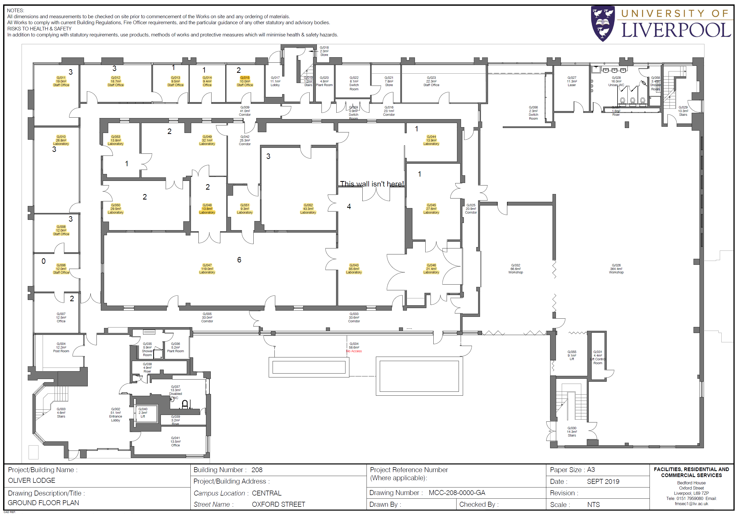
Liverpool LSDC
Lukasc Plant Room
Environmental Chamber
Liverpool LSDC has several rooms, which will be used for different activities.
We are limited on space, with no room to expand.
Half ring reception
Dispatch Area

Slide 3
Map of clean room
Lukasc
Tunnel for cables
Ring insertion area cradle
Climate Chamber
Space inside cleanroom is limited
Assume we have 4 cradles to maintain schedule
  i.e. if L2 rings are late we can proceed installing L3 services..
The ring insertion area is close to climate chamber for easy access.
Exact placement of the central integration support tool is needed to ensure space to transfer cradles from “service-area” to “ring-insertion area”
The full blue-base and central station can not move until its conversion into the transport box.
Rack space for DAQ, PS, PP2...
Possible storage of spare cradle
Services installation area
Dispatch area

Slide 4
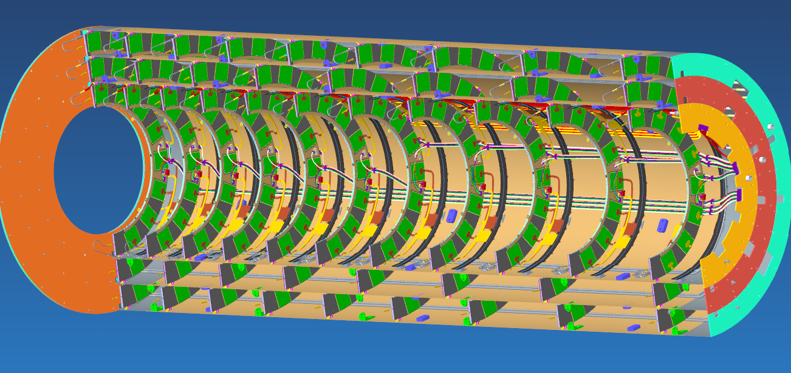
Clamping layers together
12 connectors per Layer
L2/L3 connectors on outside
L4 connectors on inside

Slide 5
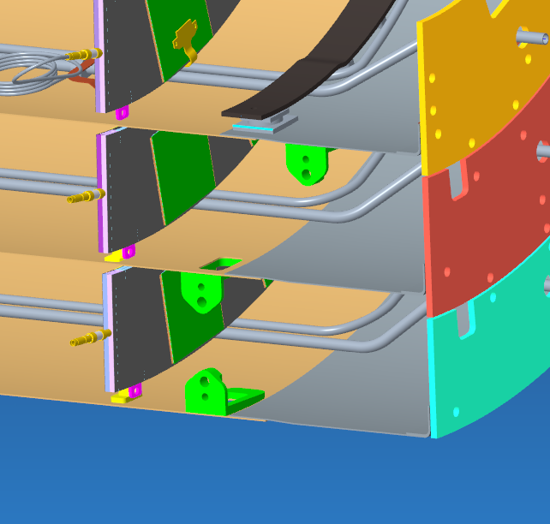
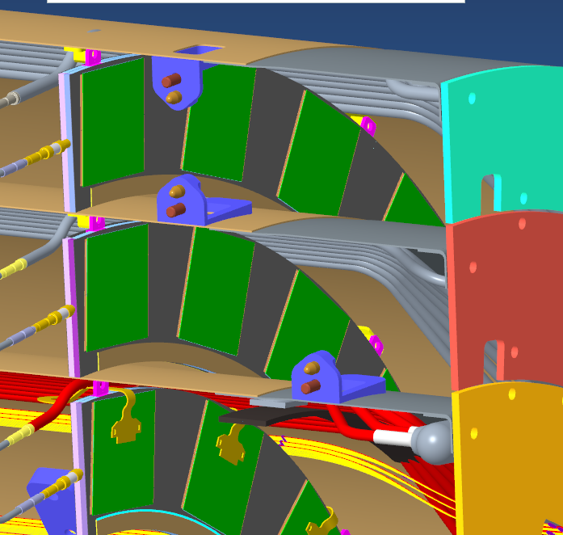
Zooming in….

Slide 6
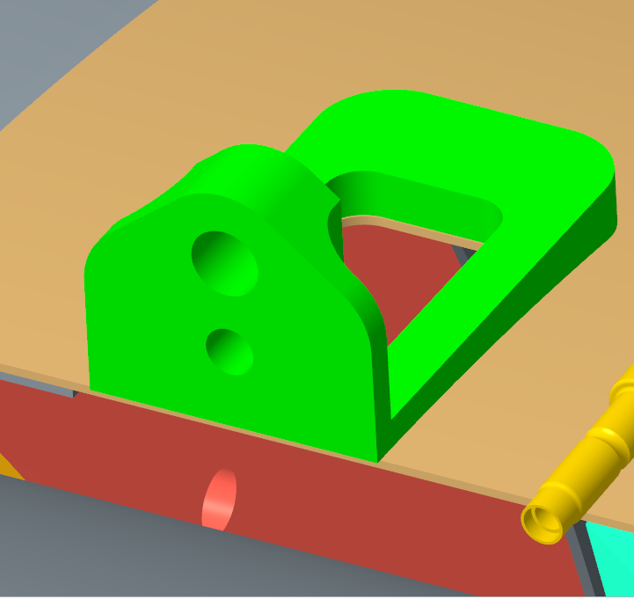
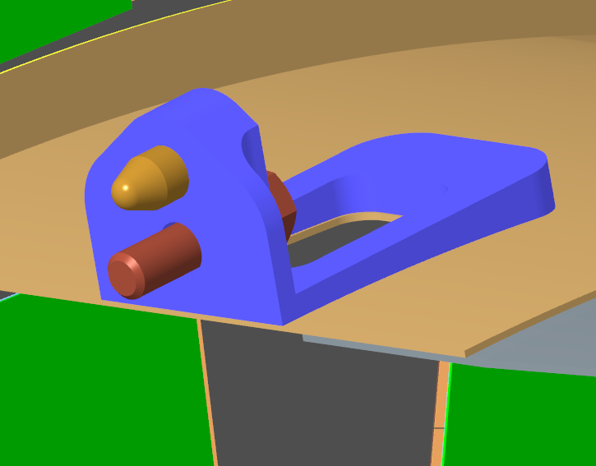
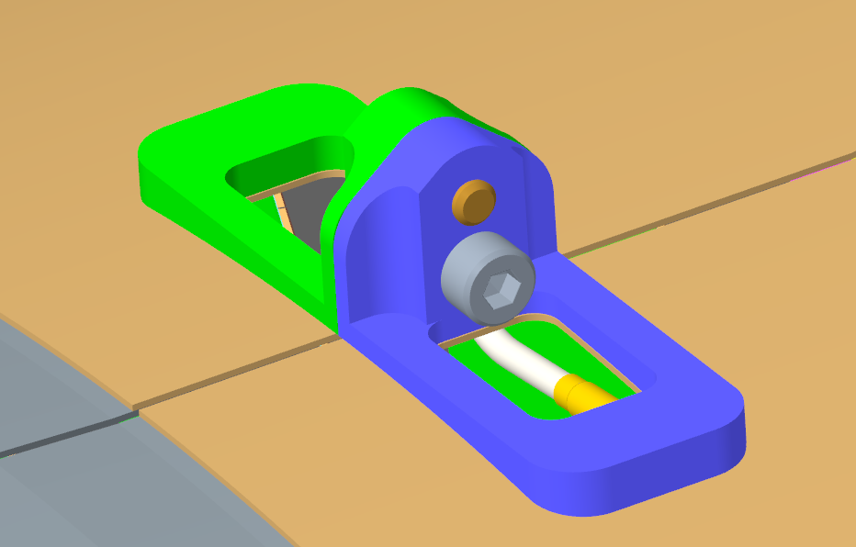
Detail….
Can cut-out in cylinder only required for L4
A bespoke tool is needed for L4 where connector is on the inside
Could cut-out be used with endoscope to help spot issues during alignment?

Slide 7
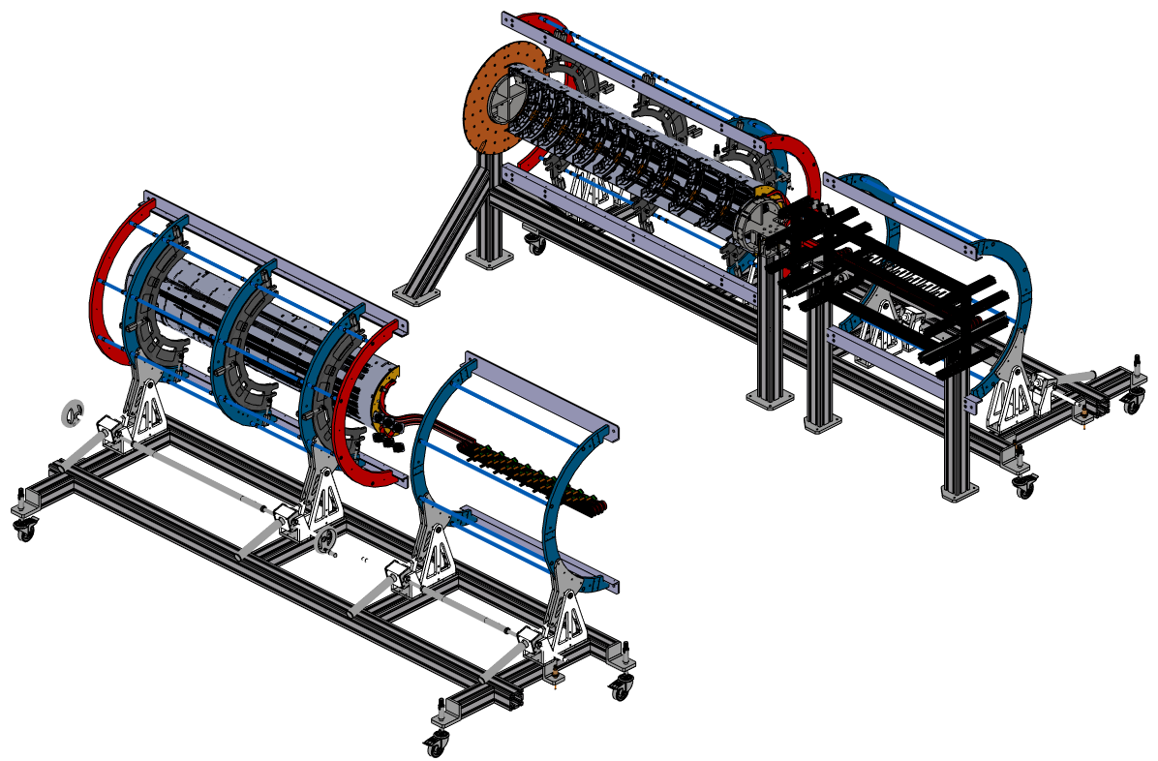
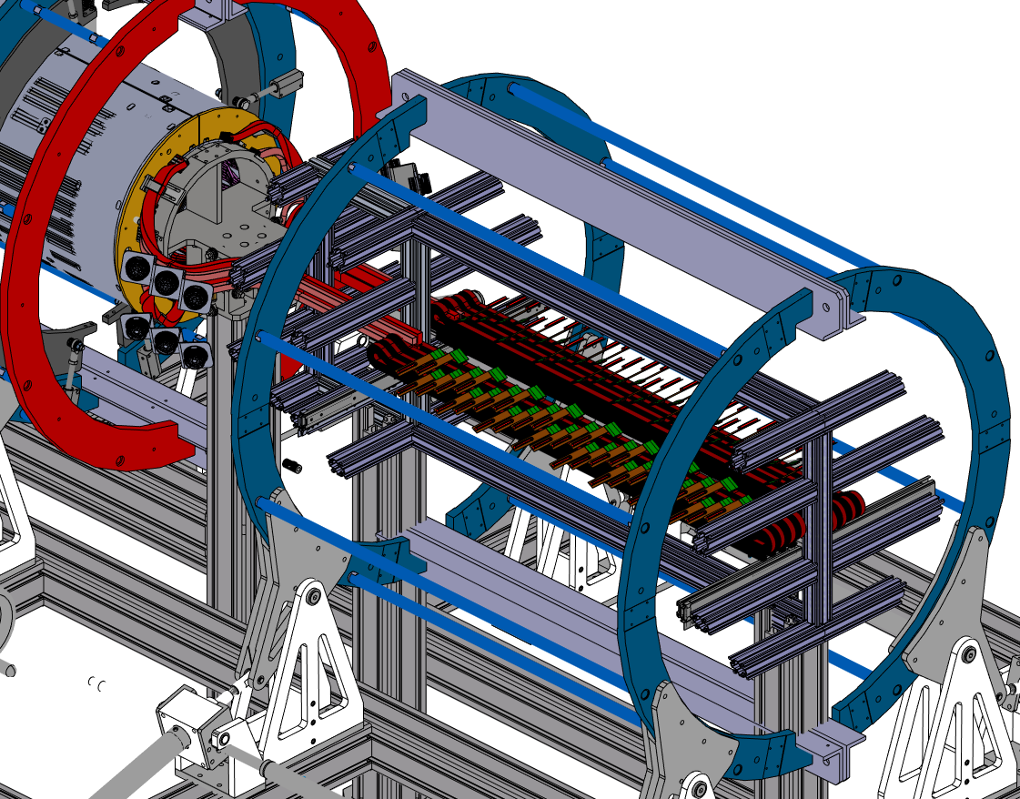
Mating of half-shells
Testing of mating of bare shells already occurred
Move both LH and RH trolleys to central assembly area
Check alignment with laser tracker.
Services transferred separately to services trolley
Connectivity warm-test with LP
  1 module per SP
  To be demonstrated LP + convective cooling works on closed layer
  Option: to test whilst layers are a few cm apart? (but after services transferred).
    Does this teach us anything?
  Does the service cradle move (rotate) independently to half cylinder cradle?

Slide 8
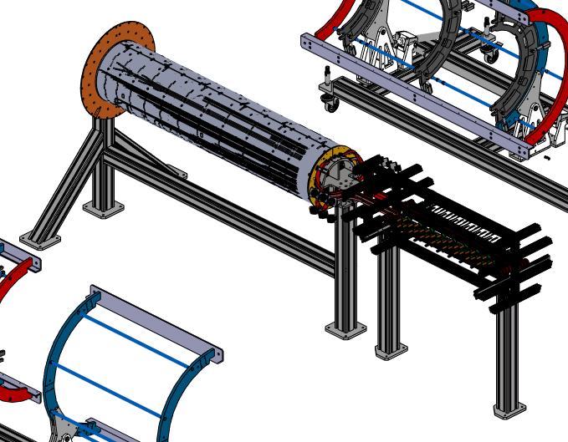
Can we cold test each mated layer?
If we wanted to cool with CO₂ at T_{ev}~+15C
  Check distance from Lukasc
    ~7m
  Or auxillary chiller?
    Only possible to chill environment inside enclosure
  Possibility of secondary “tent” enclosure with dry air.?
  The enclosure has to be within footprint of blue base
Need to incorporate time into schedule to construct enclosure per layer

Slide 9
Complete layer ready
Orbital welder: Swagelock M200
Q: how exactly to leak test?

Slide 10
Completed Endcap
Optoboxes
PP2, PP3, interlock, PS, DAQ

Slide 11
Dispatch
Transport box to be built around EC and blue-base (blue base is floor of transport box?)
  LxWxH=4250mmx 2200mmx 2000mm
  Dispatch doors 3000x3000
Slide transport box into LSDC via airskates
  Jack end cap up
  Design for blue base must incorporate recess and/or fixings and qualified for toe-jack lifting
Slide transport box base under EC
Blue base coupled to transport box via coupling springs
Construct shipping box around EC
Use air-skates to transport to loading bay
Forklift (from shipping company) loads into truck.
  Alternative workshop crane (check ceiling height).

Slide 12
Dispatch
Transport box to be built around EC and blue-base (blue base is floor of transport box?)
  LxWxH=4250mmx 2200mmx 2000mm
  Dispatch doors 3000x3000
Slide transport box into LSDC via airskates
  Jack end cap up
  Design for blue base must incorporate recess and/or fixings and qualified for toe-jack lifting
Slide transport box base under EC
Blue base coupled to transport box via coupling springs
Construct shipping box around EC
Use air-skates to transport to loading bay
Forklift (from shipping company) loads into truck.
  Alternative workshop crane (check ceiling height).

