Slide 1
Design cooling PP1 and cooling pipe integration in SR1
Emiliano Dané
LNF - 20240201

Slide 2
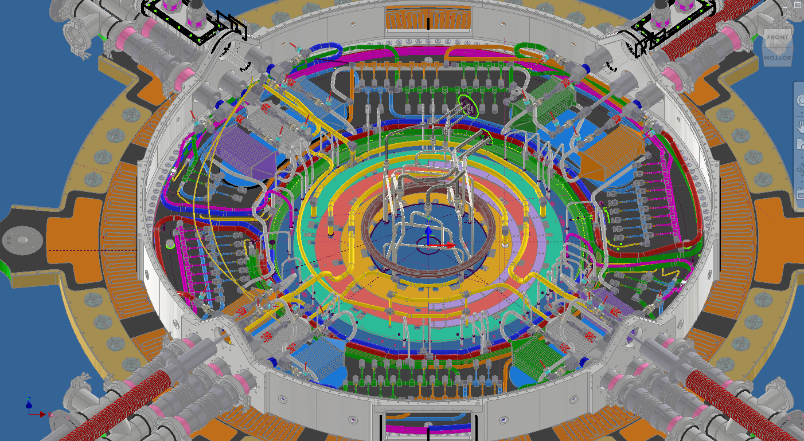
ITk PP1 PIPING A-side
Inner System
Warm Nose
Outer Barrel
ITk PP1 piping
16 IN/15 OUT cooling loops per side
Inner System: 3 loops
Outer System: 11 loops
  Outer Barrel: 8 loops
  Outer Endcap: 3 loops
Warm Nose: 2->1 loop
Outer Endcap

Slide 3
Update on piping in PP1
Flex Lines
  New design of the Flex Lines, overall regarding the connection to the Outer PP1 wall
Temp 4w
  No more Temperature sensors in contact with the fluid, but only on the surface
Foot prints
  Aluminum plates are positioned to the BH in order to fix structure for handling the Electrical breakers
Bulkheads bolts inside the envelope
Electrical Breakers
  Big problem in obtainng the quotation
Prototytpe
  Also for the prototype, the company is getting a lot of time to deliver the bent pipes

Slide 4
Detector's manifolding preparation for the SR1 Assembly

Slide 5
Inner System

Slide 6
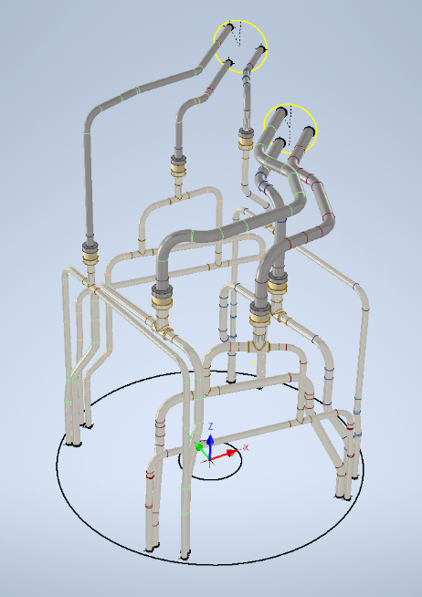
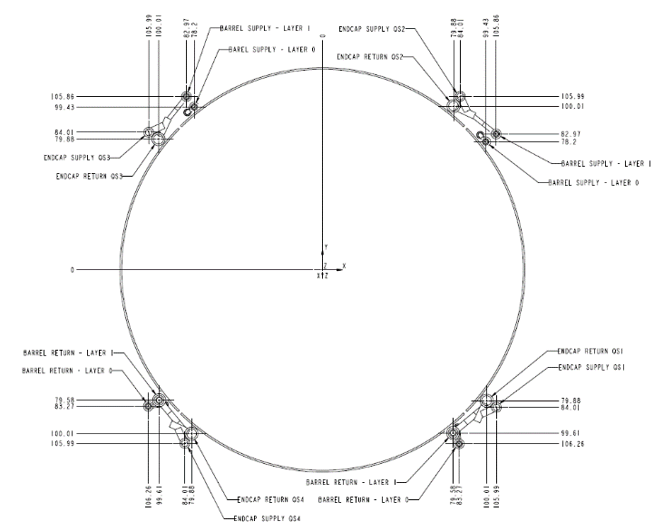
IS MANIFOLD (side A)
4/6
8/10
4/6
4/6
4/6
4/6
4/6
6/8
6/8
4/6

Slide 7
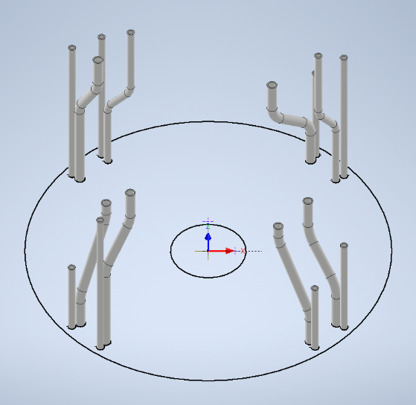
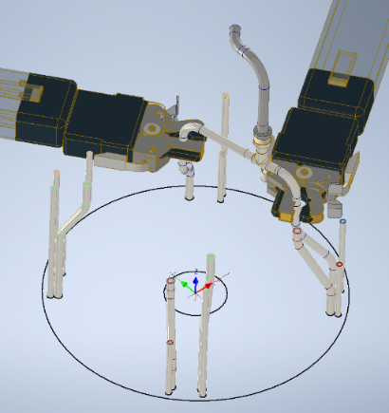
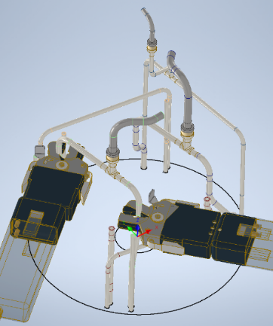
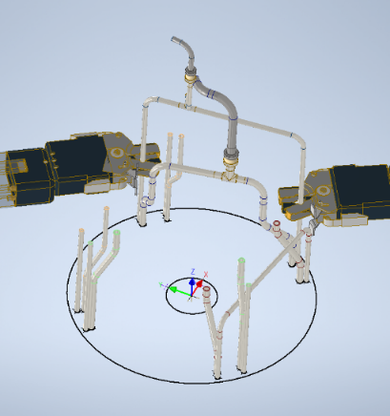
PP1 Manifold Assembly Procedure
Pipes from the detector
Not clear to me if will be assembled in SR1 or in USA
Step 0

Slide 8
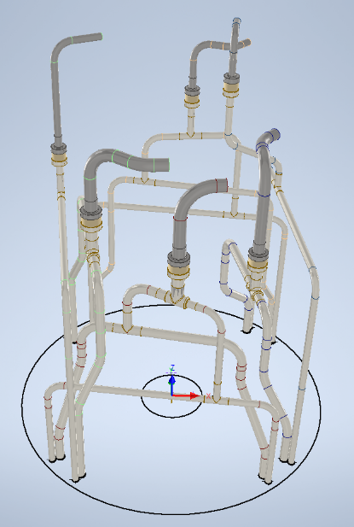
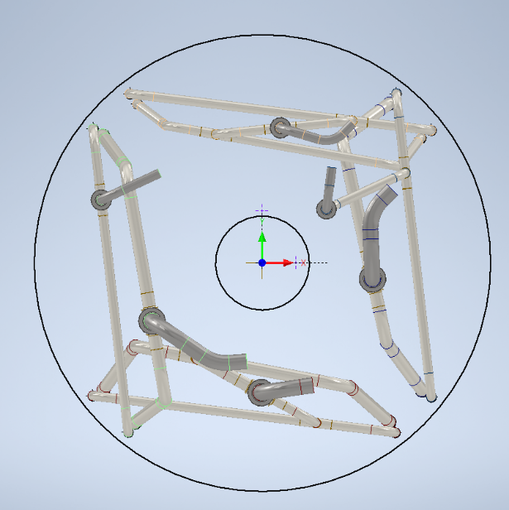
Final View
Top View
Closed by fittings+caps in order to perform the pressure tests in SR1, then
romoved.
The use of sleeves is foreseen in order to have 3 shots in case of problems during the assembly in the PIT

Slide 9
EC Piping Assembly in Production Sites

Slide 10
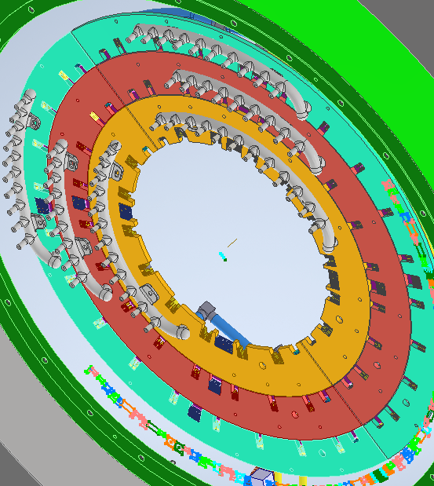
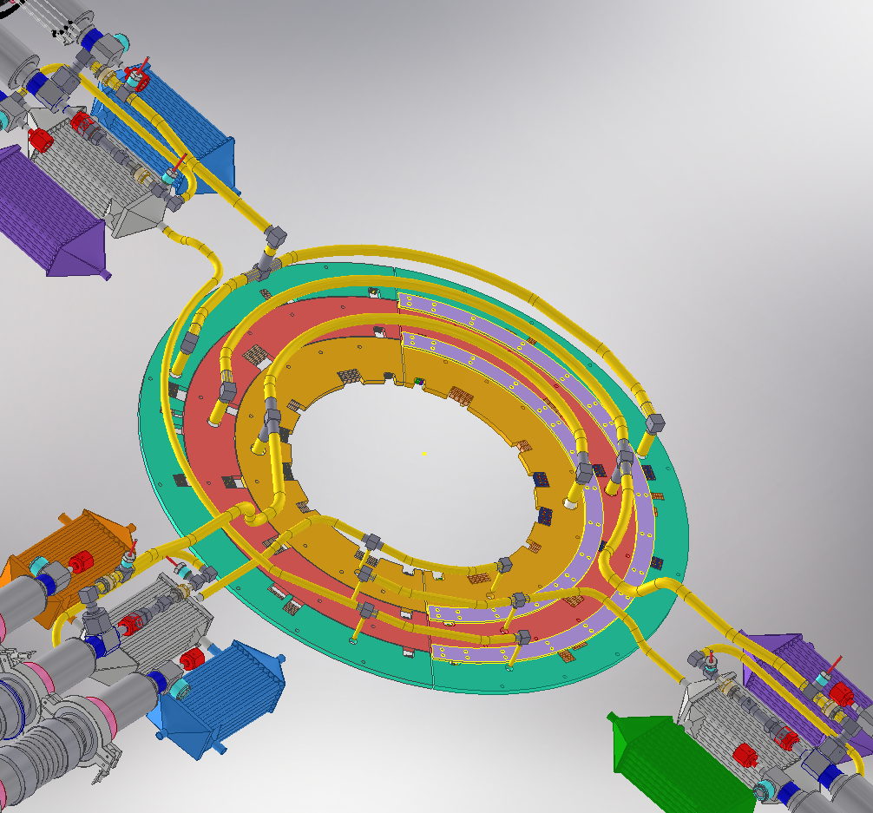
EC PP1 MANIFOLD
DETECTOR SIDE
PP1 SIDE
Exhaust Manifolds
3D printed

Slide 11
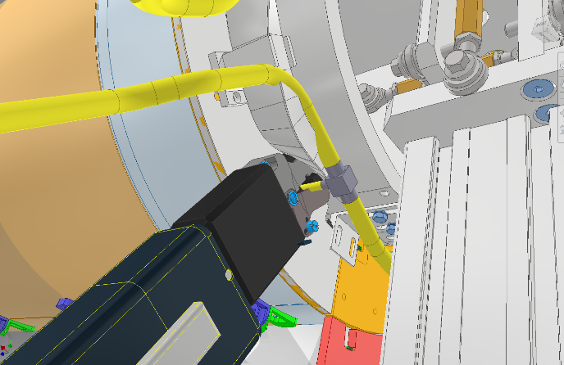
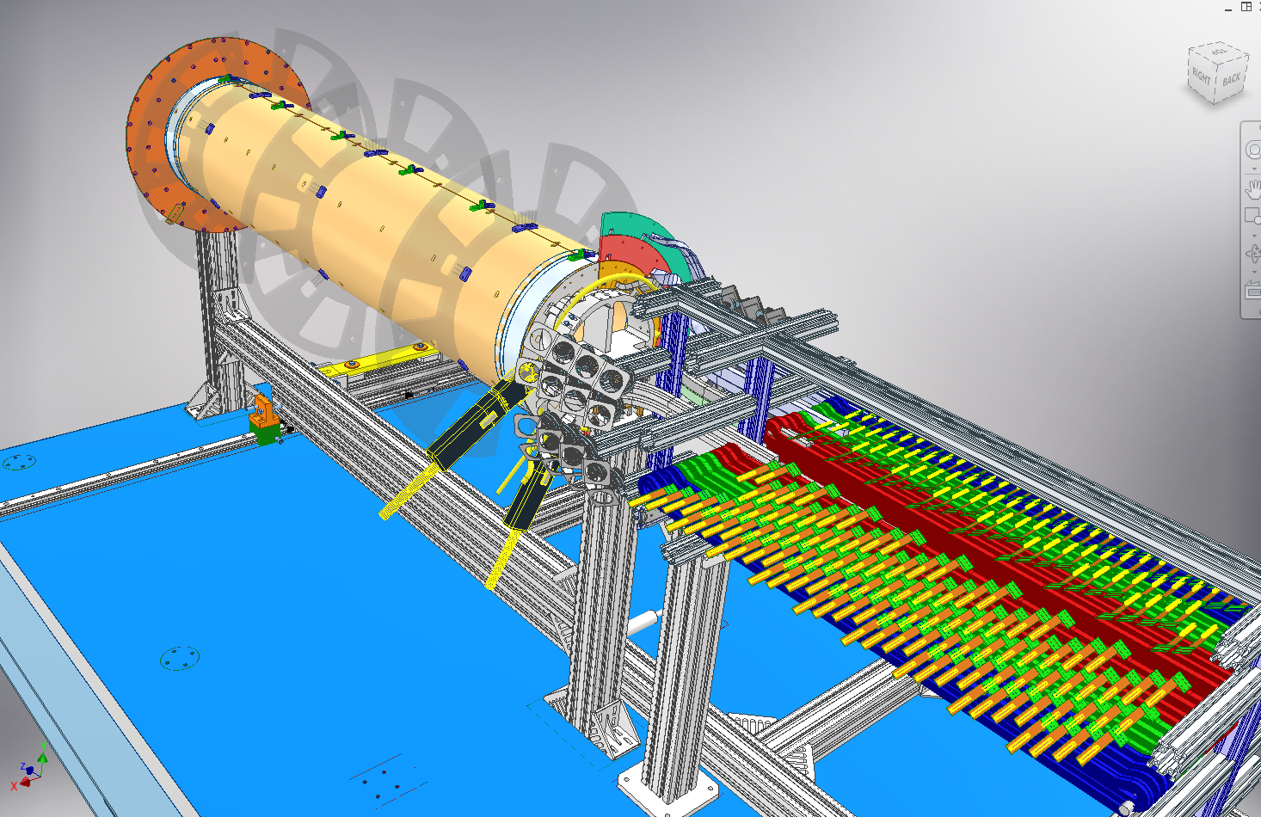
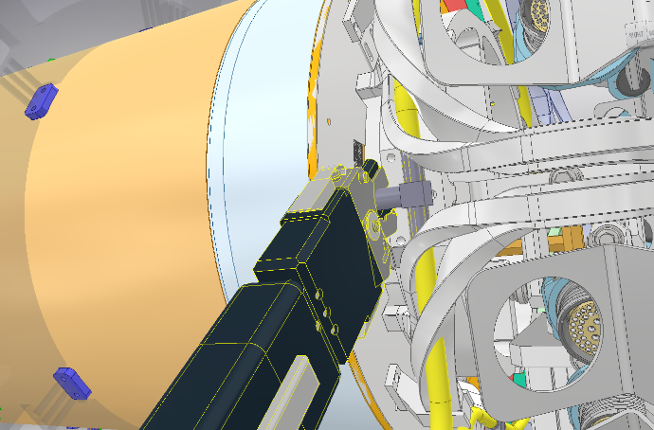
The plan is to weld the Inlets and Exhausts manifold just after mating each layer in order to perform the test by CO2 cooling plant and also because would be impossible to weld it after having comlpeted the detector.
In the 3D model I used the Swagelok Orbital Welding. Not yet defined the Welding Machine will be used in Frascati.
Layer 2 EC Inlet manifold welding
Layer 2 EC Exhaust manifold welding
Layer 2
S. Tomassini and D. Orecchini

Slide 12
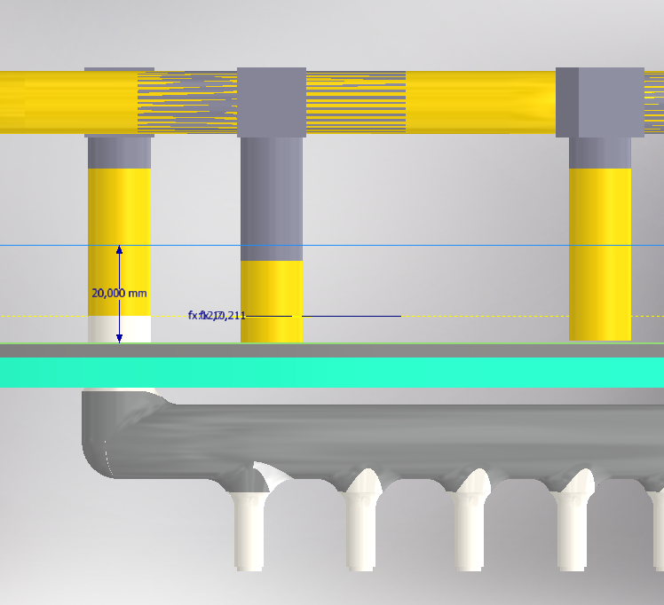
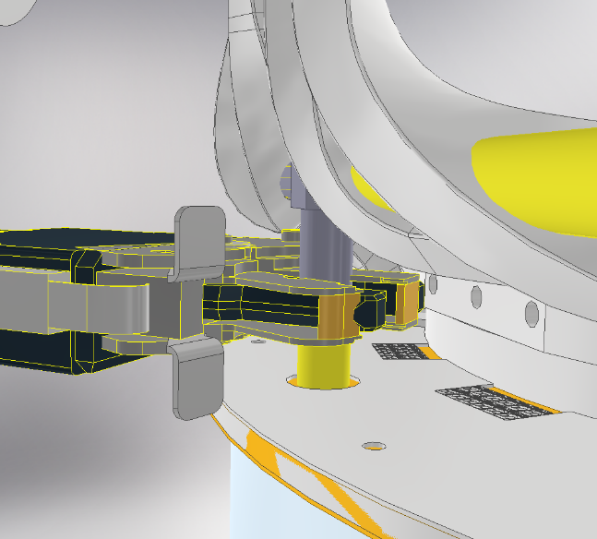
EC elbow
Possible clash between the EC flange and the Swagelok Orbital Head
EC PP1 Manifold
welding plane
40mm
EC centina
EC flange
For the Polysude is better having the welding plane @20mm while for the Swagelok due to the "wings" should be better a little bit higher
EC Detector Manifold
What about welding back solution: pocket welding is a possibility?

Slide 13
Outer PP1 piping Barrel Status

Slide 14
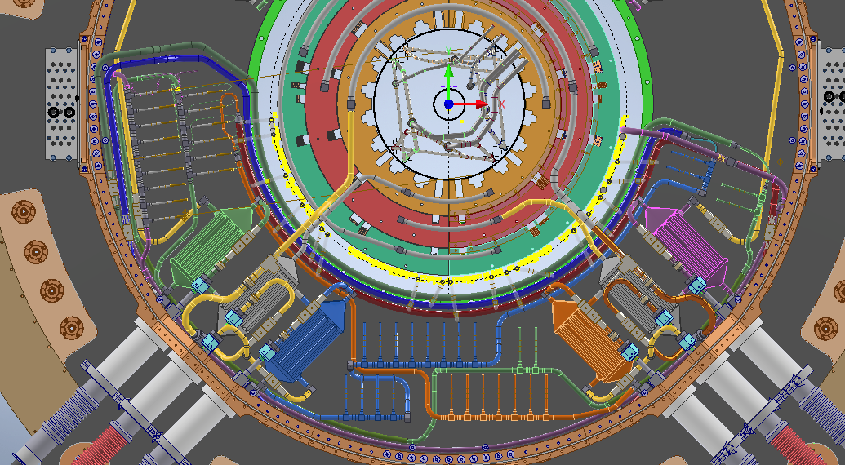
OB MANIFOLD
Heat Exchanger
Exhaust Manifold
Manifold for capillaries
Cooling Groups defined by colors
Inlet Manifold

Slide 15
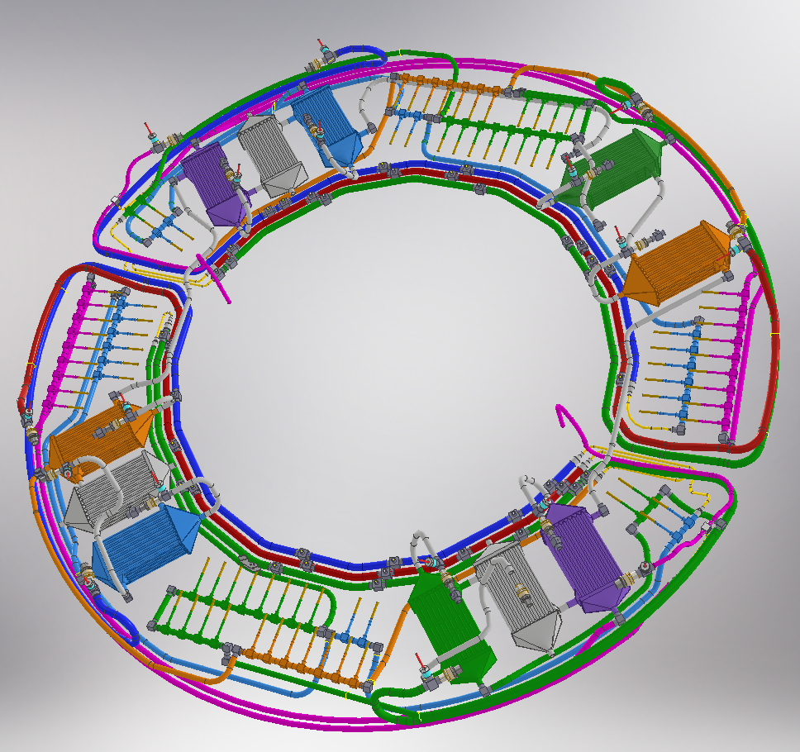
Warm Nose in place and welded
In order to get the minimum number of weldings in SR1, the target is build all the pipes in the workshop, including some parts of the warm nose line.
Red circles are the warm nose joints connecting the two halves (A1 and A2 OB parts). We are thinking to put the whole manifoldings.
All capillaries will be closed by caps (removable without cutting)
A1 part
A2 part

Slide 16
PP1 Assembly in SR1

Slide 17
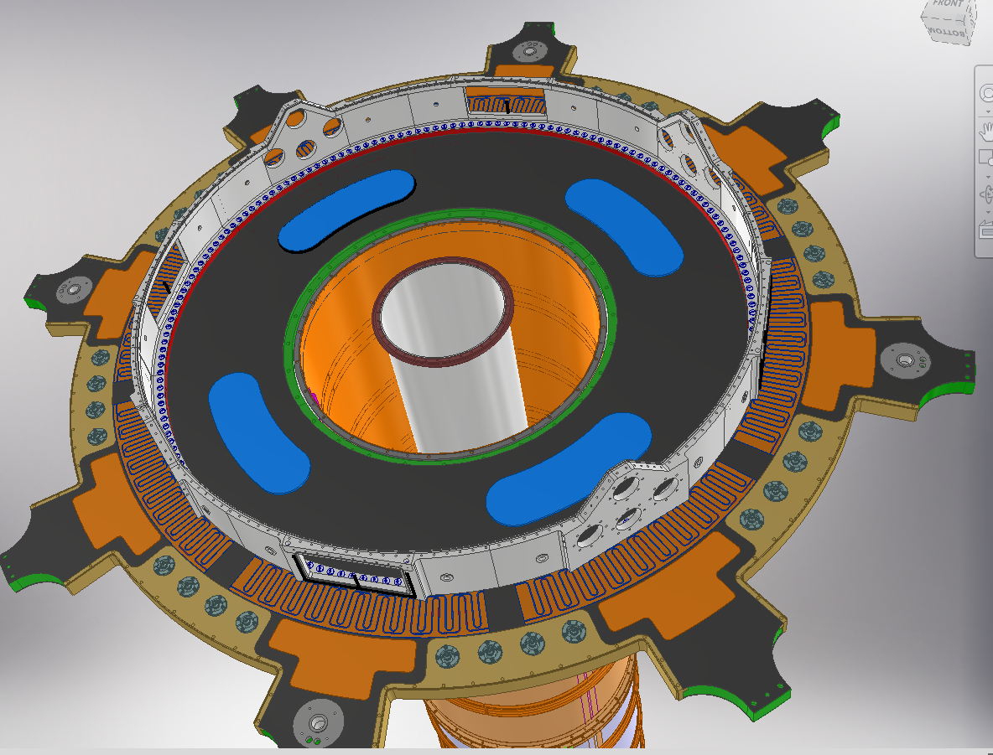
Step 0: Aluminum plates in order to support EB holders

Slide 18
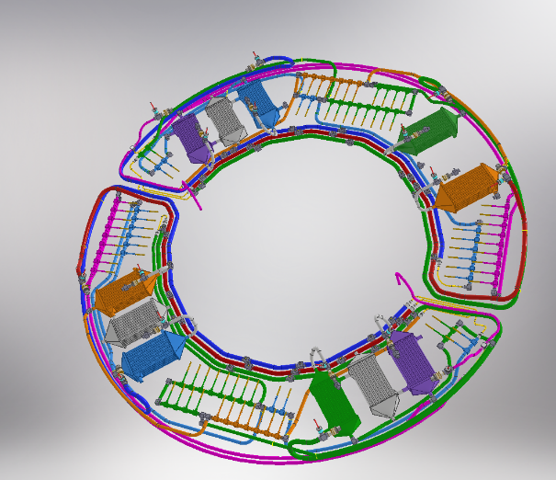
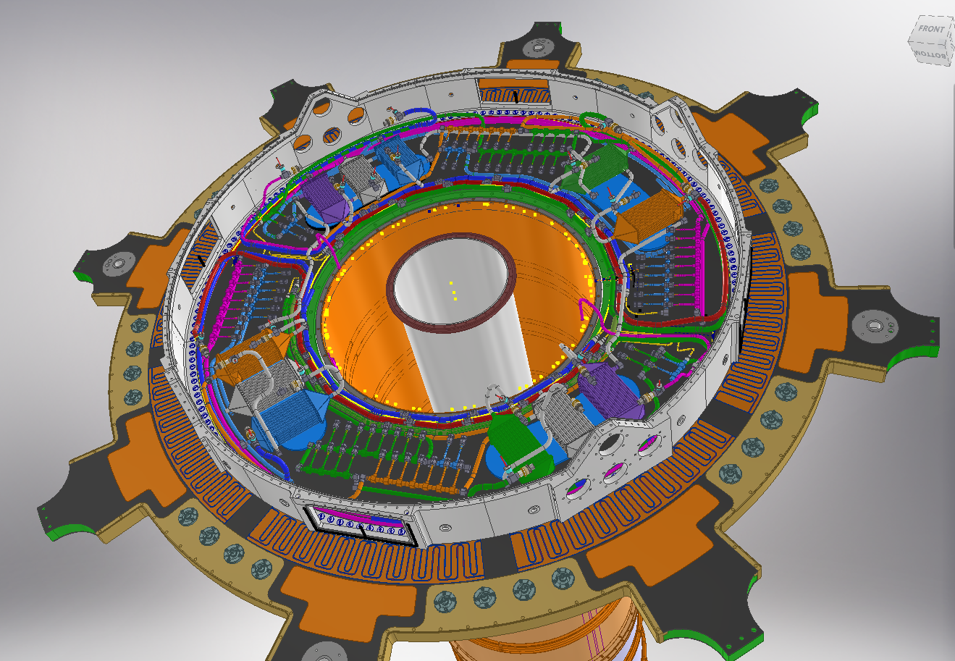
Step 1: OB piping and manifolds insertion
Step 1.1 Insertion of the Upper part
Step 1.2 Insertion of the bottom part
Step 1.3 Weld the 4 joints of the Warm nose line (slide ...)
OR Insertion of the whole OB+WN piping and also parts of the endcap.

Slide 19
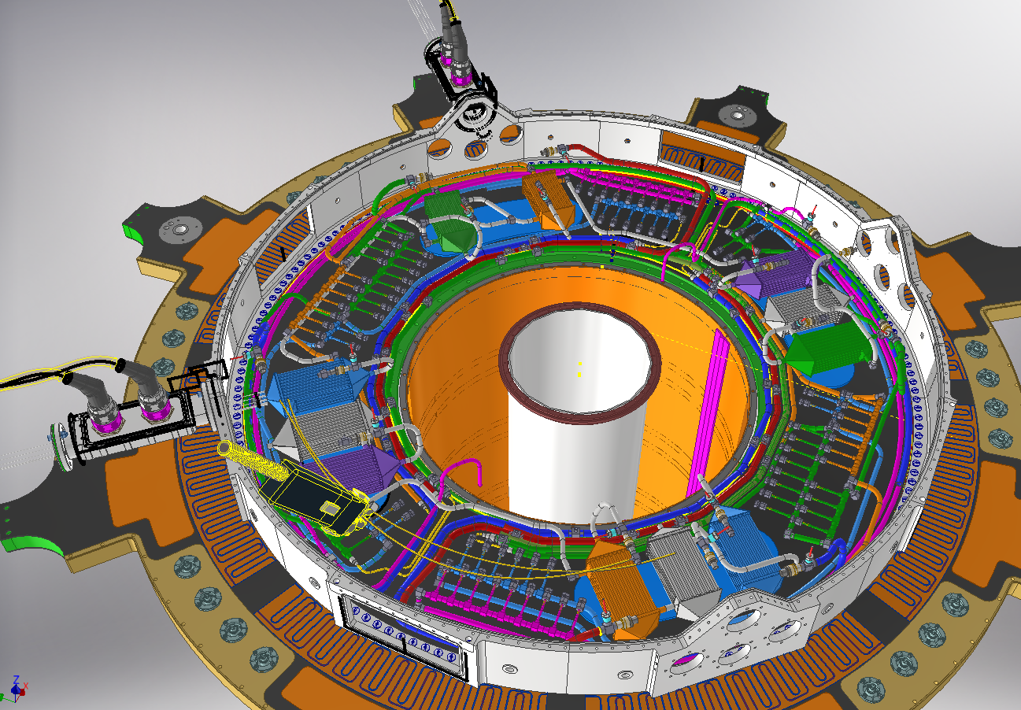
Step 2: Insertion of the DP boxes and DP capillaries welding

Slide 20
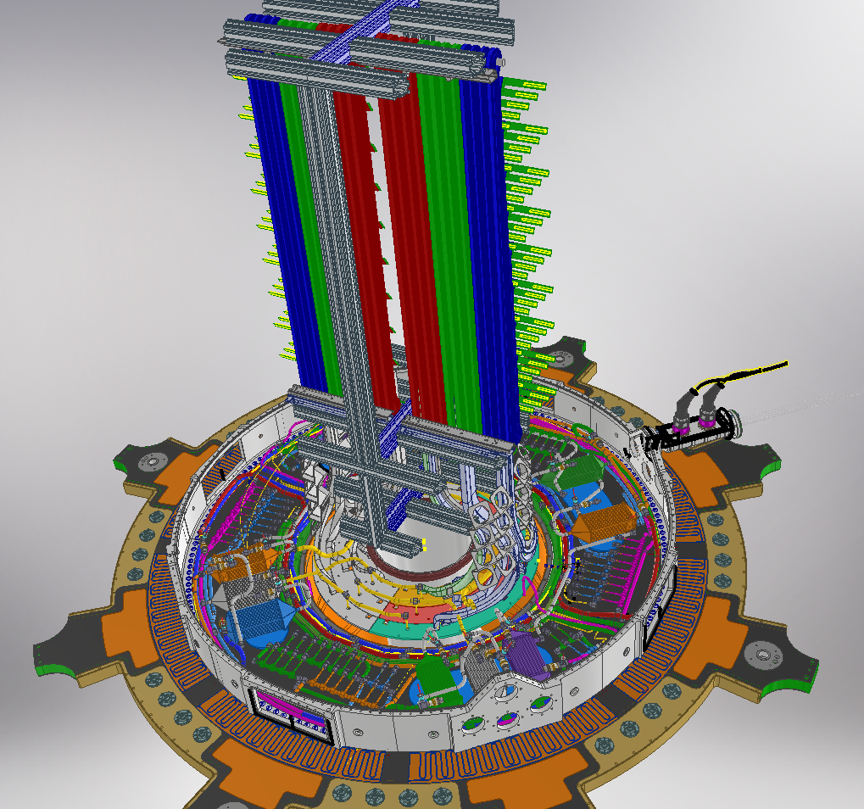
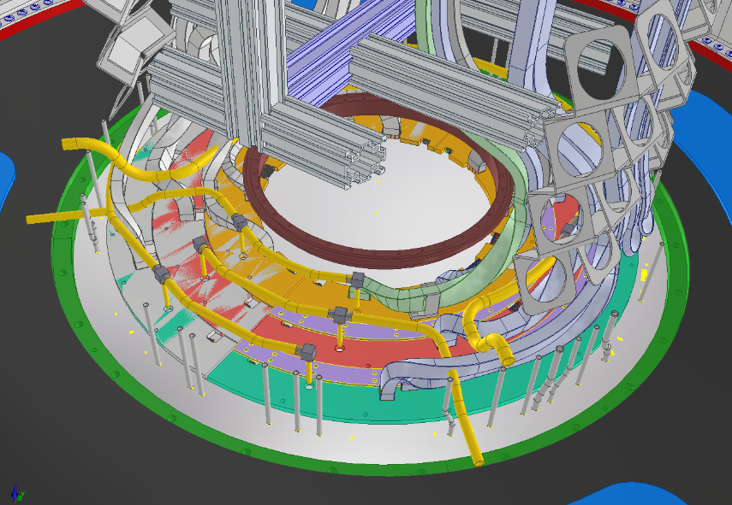
Step 3: OE and OB detectors insertion. Services on the trolley.
Outer Barrel exhaust pipes
Endcap cooling pipes
All these pipes arrive closed in order to perform the pressure test

Slide 21
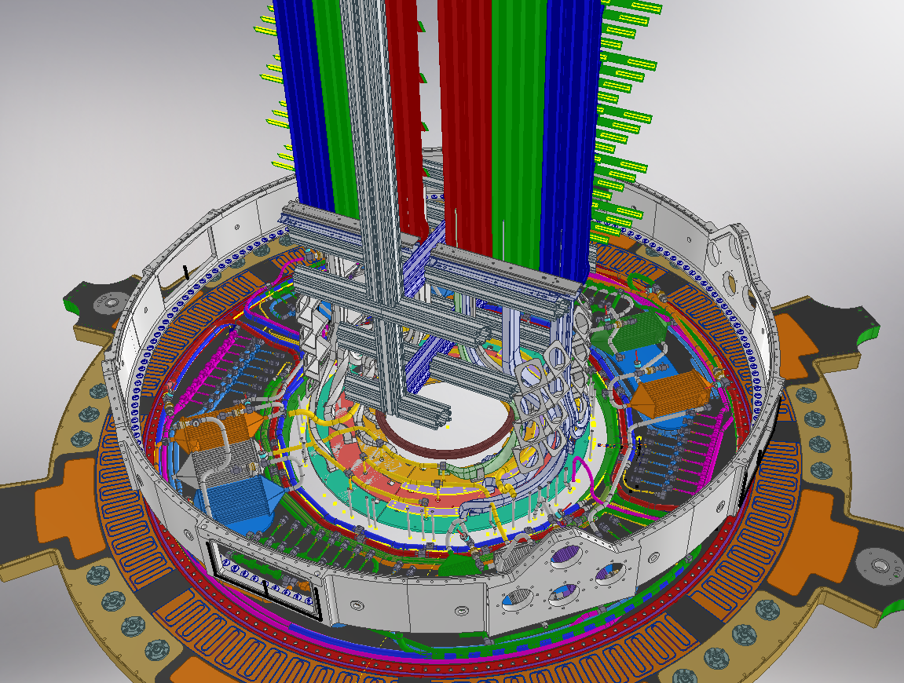
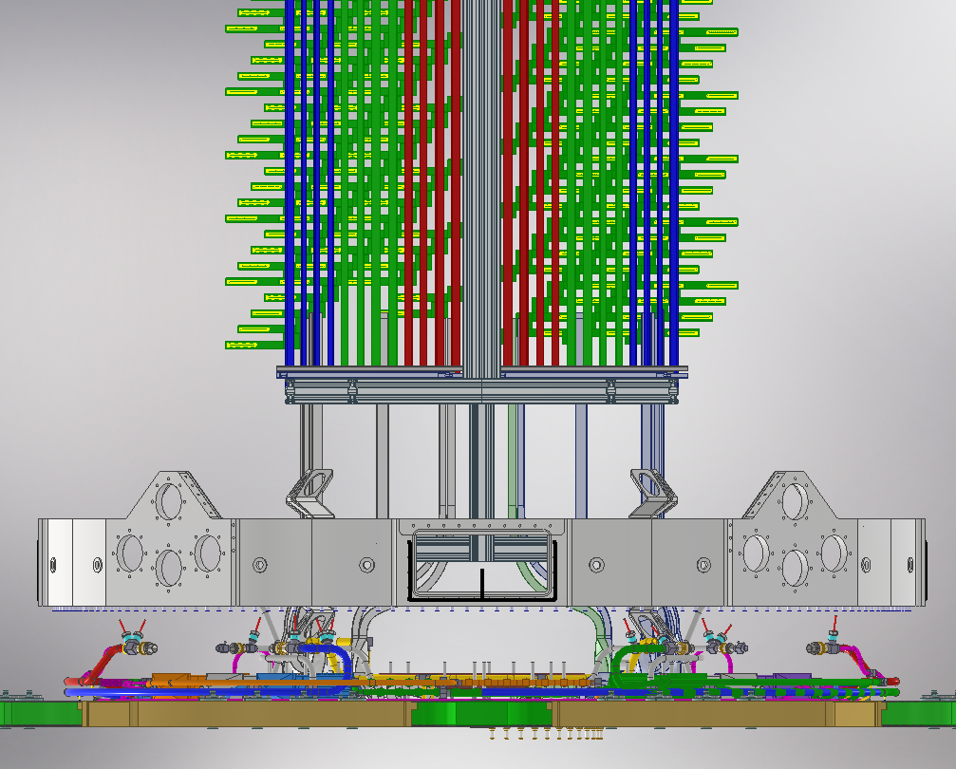
Step 4: PP1 Outer Wall shifting of 150mm in order to weld the OB U-pipes

Slide 22
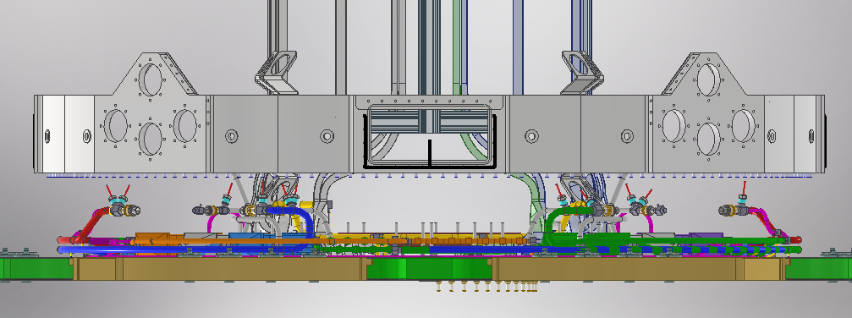
Step 4: OB U pipe Welding and Pressure Testing by using temporary pressure lines, with sacrificial VCR

Slide 23
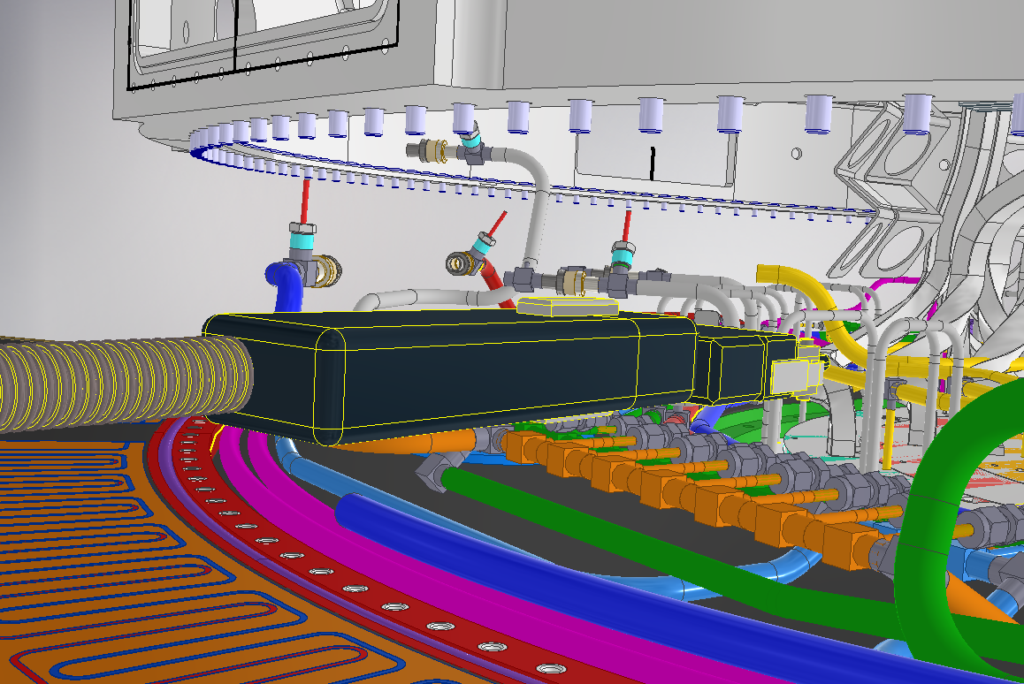
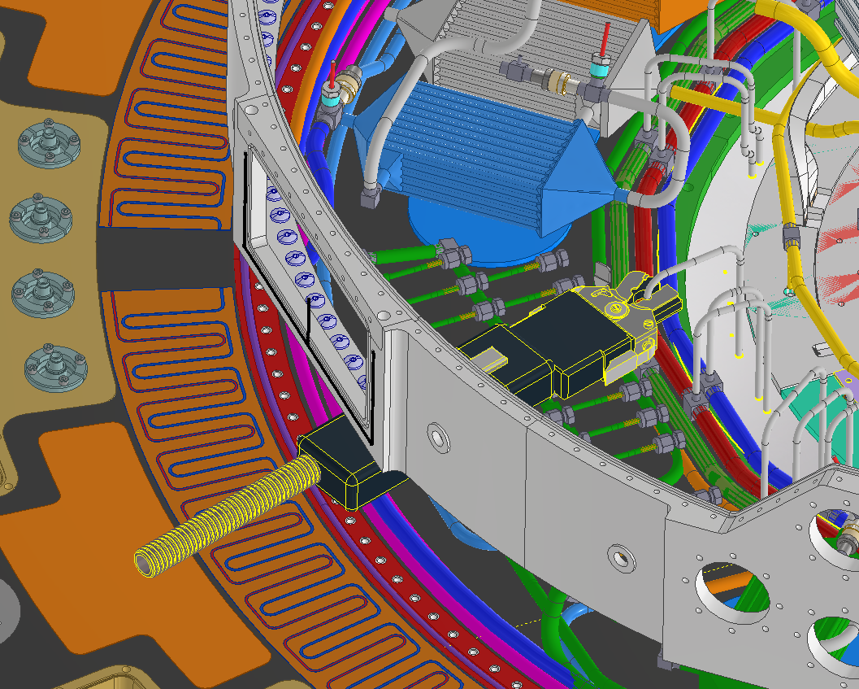
Step 5: OB U pipe Welding and Testing
The back solution is foreseen done by using the sleeves

Slide 24
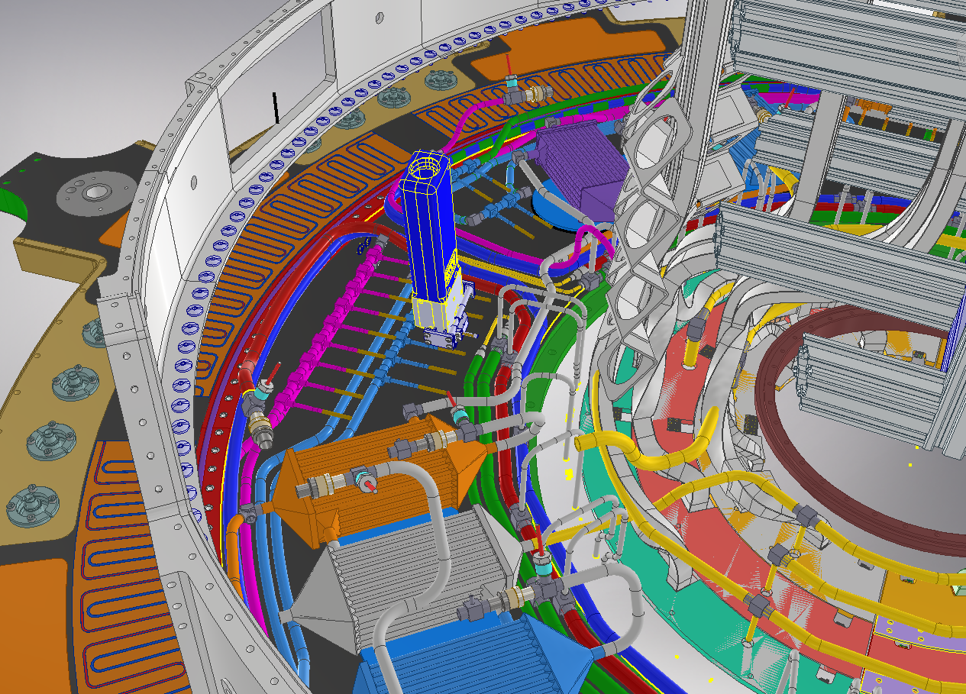
Step 5: OB Welding of the capillaries
AMI Welding Head
Capillary weldings:
79 in total per side
39 A1 part (upper)
40 A2 part (bottom)
Pressure Tests performed by temporary pressure lines

Slide 25
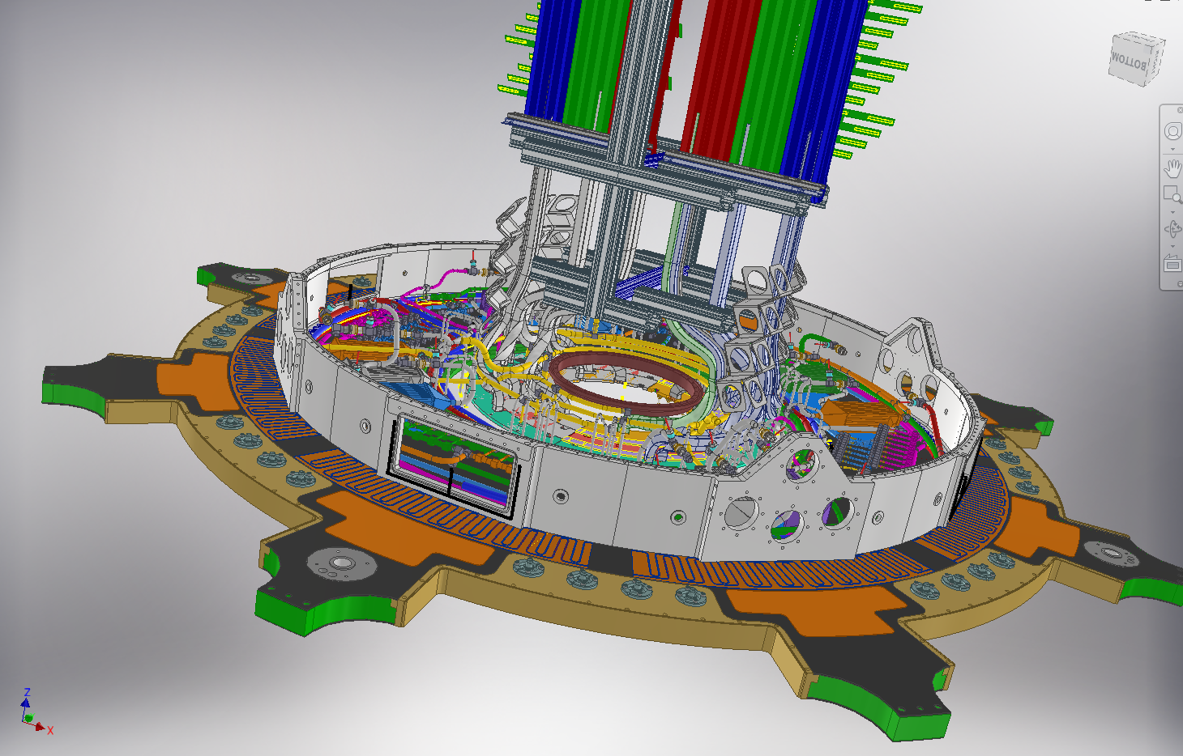
Step 6: Outer Wall flange back in position

Slide 26
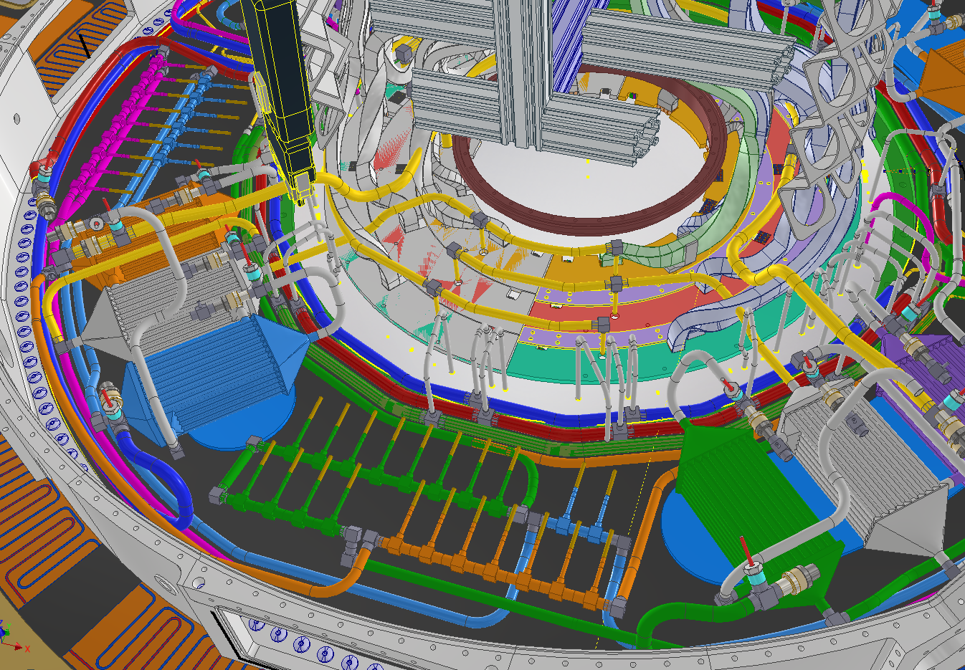
Step 6: EC pipe welding and test
6 weldings (2 per layer) in order to connect the EC to the VCR

Slide 27
BACKUP

