Slide 1



OEC Integration Workshop
Design of the PP1 Cabling and dress-up in SR1
INFN-LNF
F. Rosatelli
2024-02-01

Slide 2

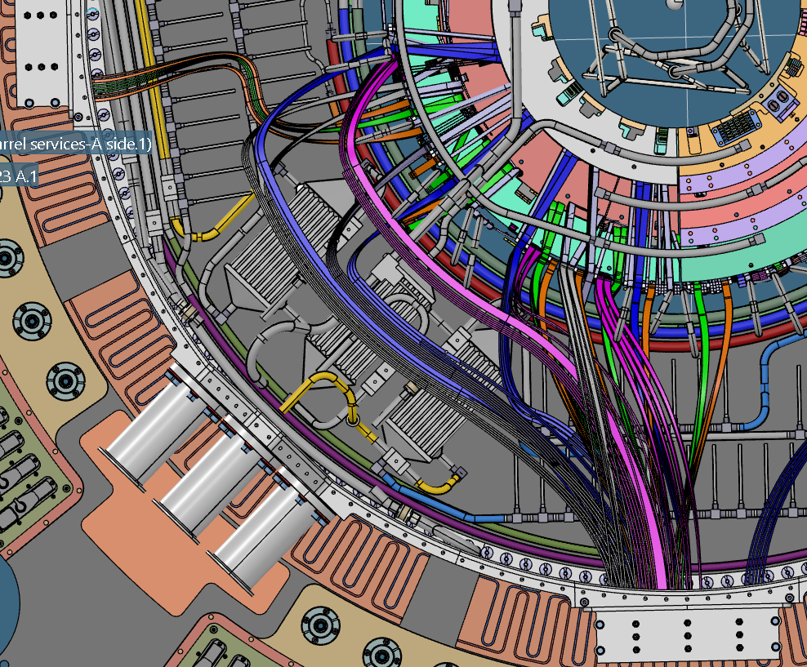
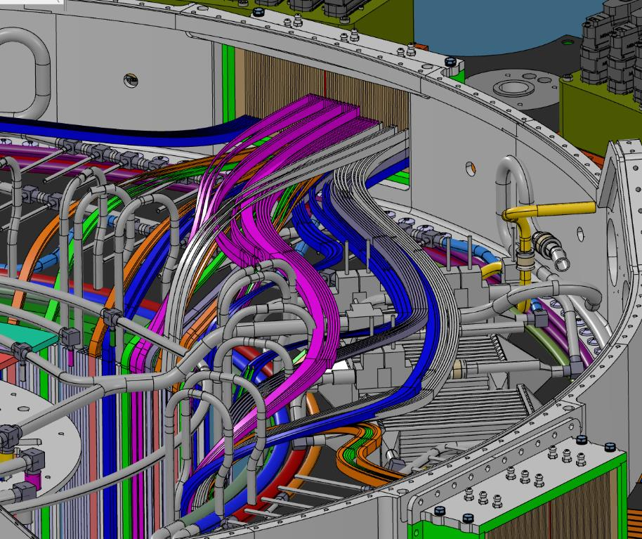
OB DATA CABLES ROUTING DESIGN
DFT 6-7
Filling direction
Z
ϕ
DFT 4-5
DFT 6-7
All Q3 OB data cables modeled.
They are dressed after installation of cooling pipes.

Slide 3

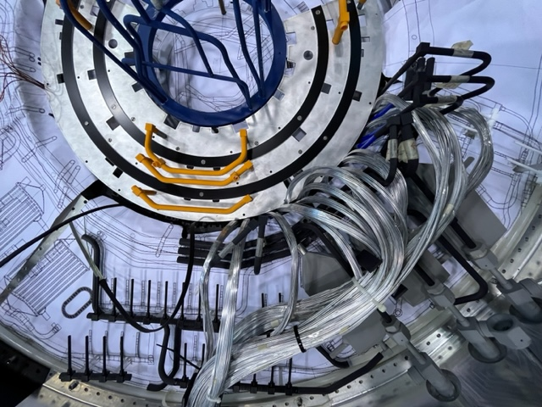
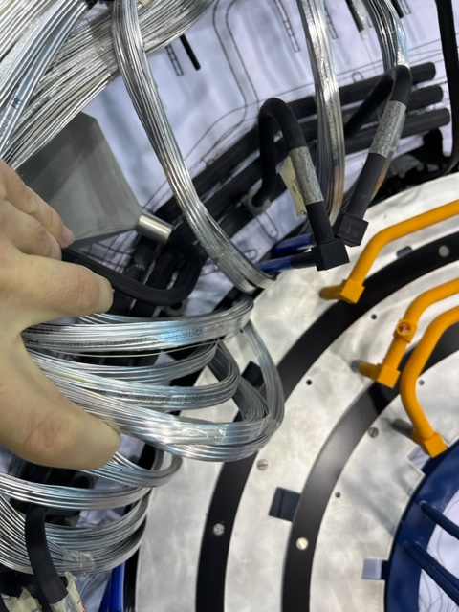
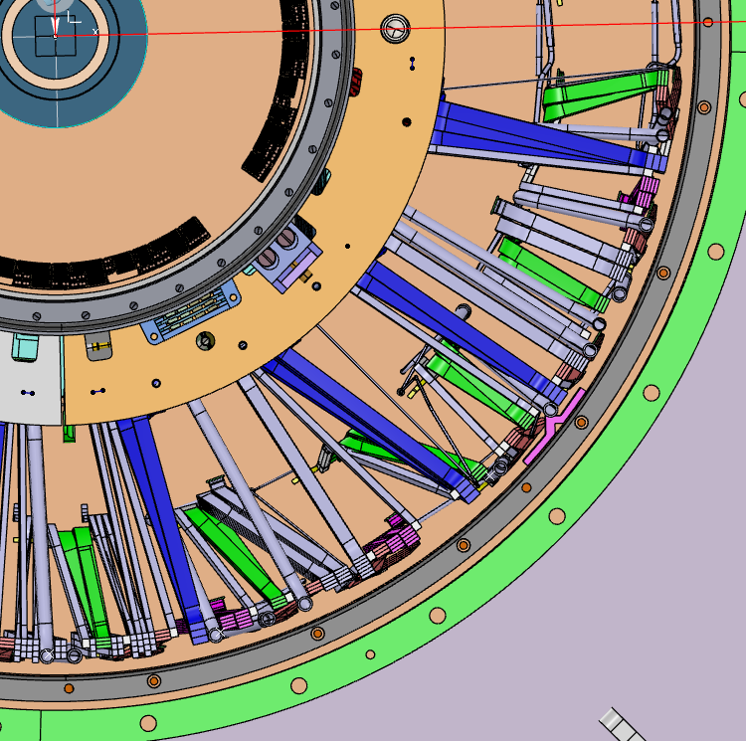
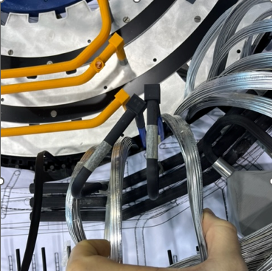
OB DATA CABLES ROUTING DESIGN-Mockup
Y
X
S1
S2
S3
DFT 6-7
S4
For other quadrant, routing and data cables lengths are taken from PP1 Mockup
Order bundles in groups.

Slide 4
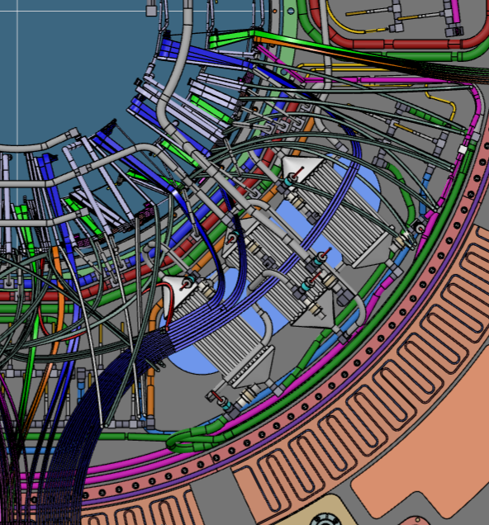
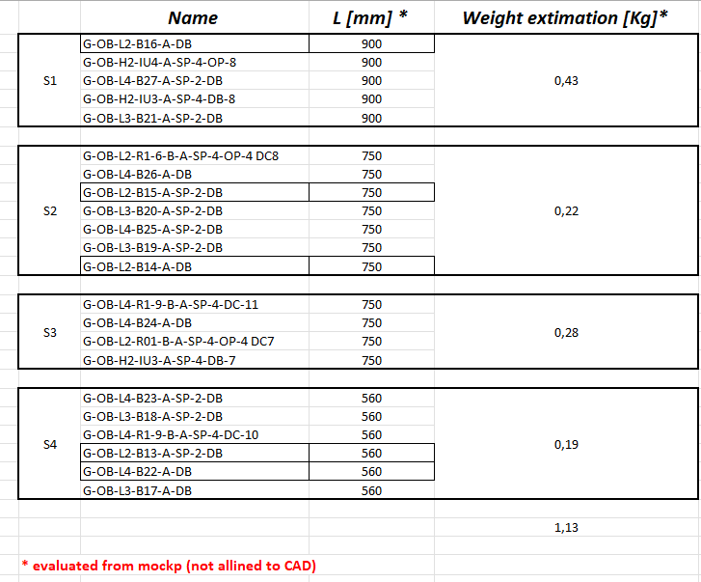
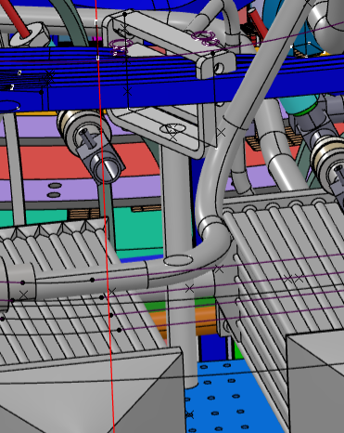
OB DATA CABLES ROUTING DESIGN-Mockup
CABLES SUPPORTS
PRELIMINARY
S1
S2
S3
Interface flange
(glued on bulkhead)
S4
Divide a quarter of OB in four sectors to define the length.
Assign possible position for fixation of cable holders (preliminary).
Evaluate bundles lengths.
Evaluate weight. 1,13 Kg.
Preliminary lengths. Mockup will be allined on CAD, after the piping is mounted (work in progress)

Slide 5
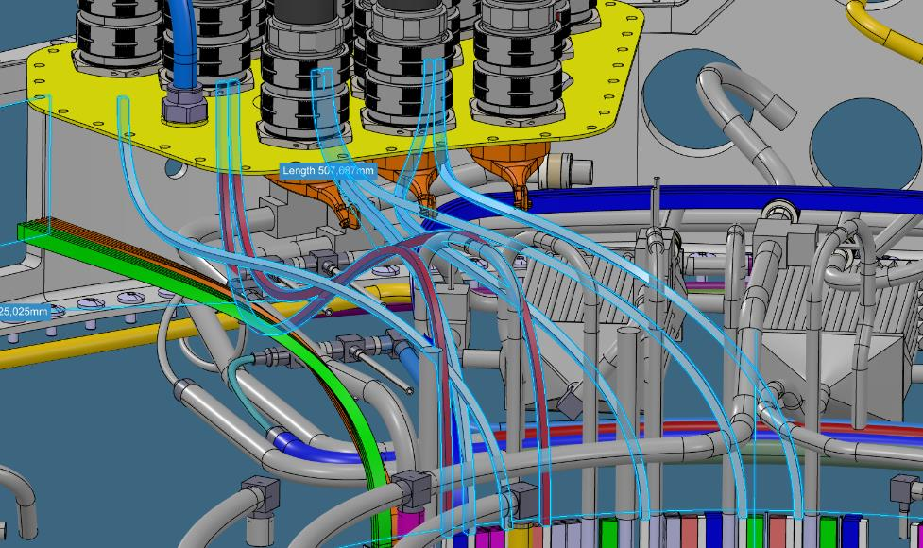
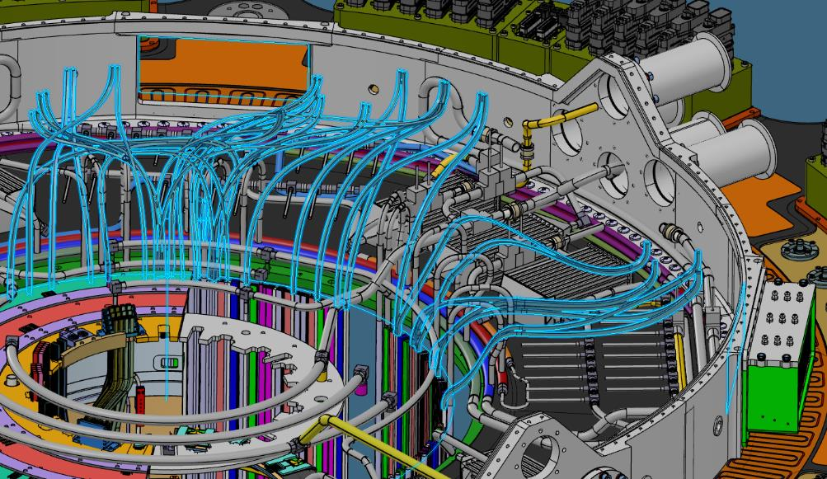
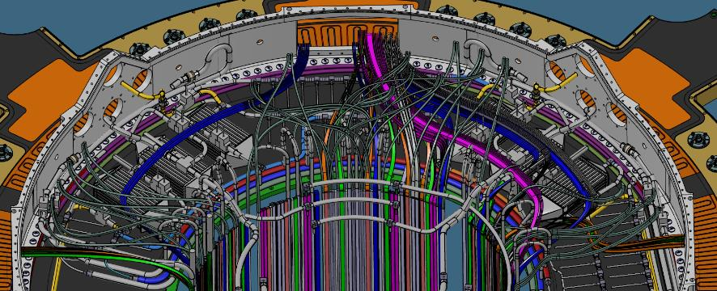
OB HV/LV ROUTING DESIGN
POWER CABLES ROUTING:
They will be placed after the data cables routing.
They will pass between the cooling pipes.

Slide 6
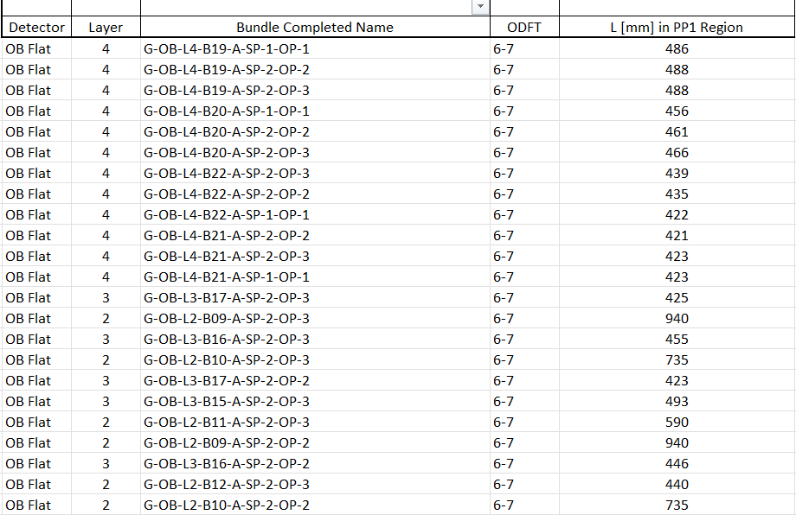
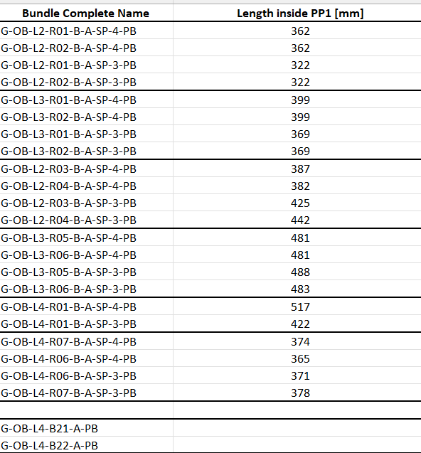
OB DATA CABLES ROUTING DESIGN-CAD
DATA
POWER
spreadsheets with data and power cable lengths modelled on a quarter of OB H2. https://edms.cern.ch/document/2976763/1
SF (safety factor) not included.
Safety factor for data (extra length)= +20 mm
Safety factor for power (extra length)= +20 mm

Slide 7
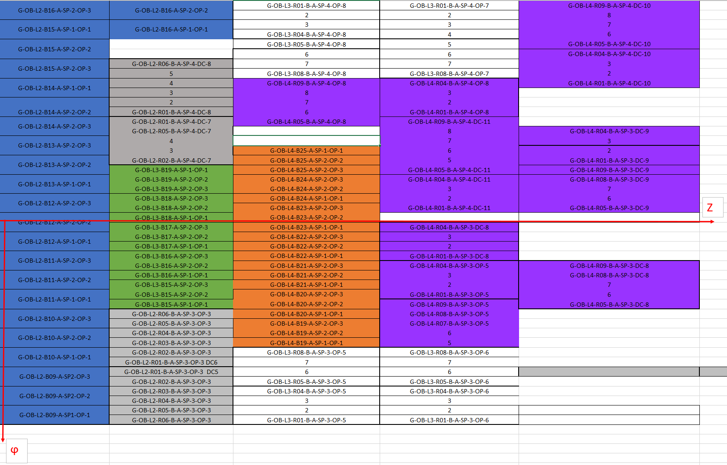
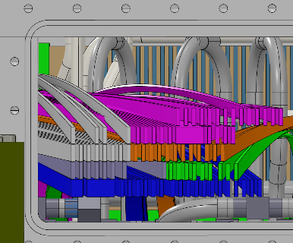
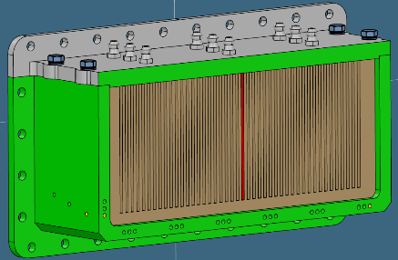
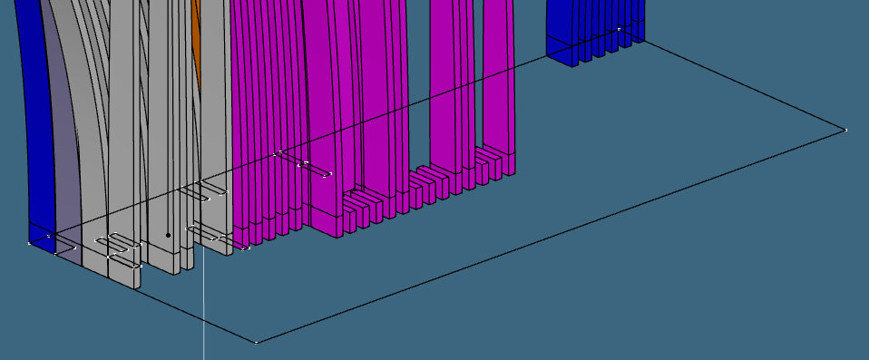
DFT 6-7 A SIDE
Frozen. According with Martin Janda
Z
ϕ
Mapping DFT 6-7
Filling direction

Slide 8
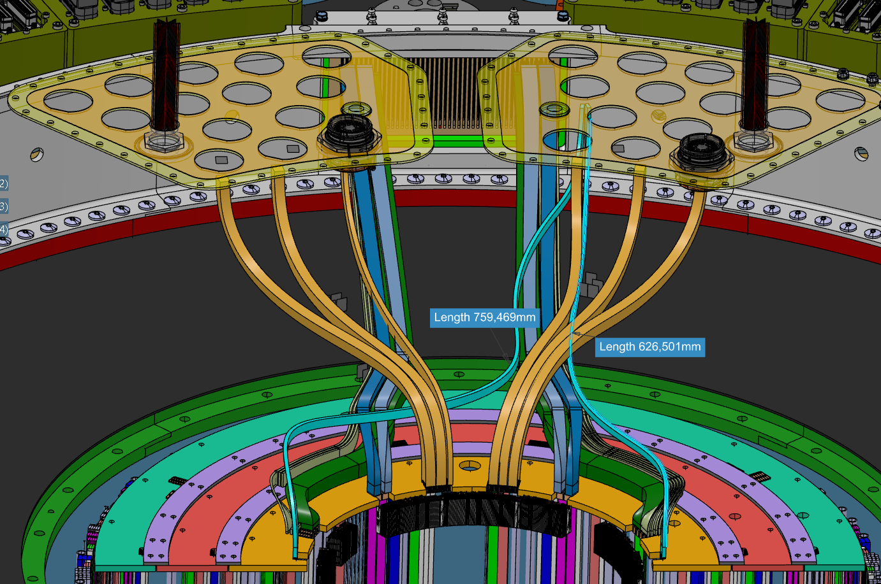
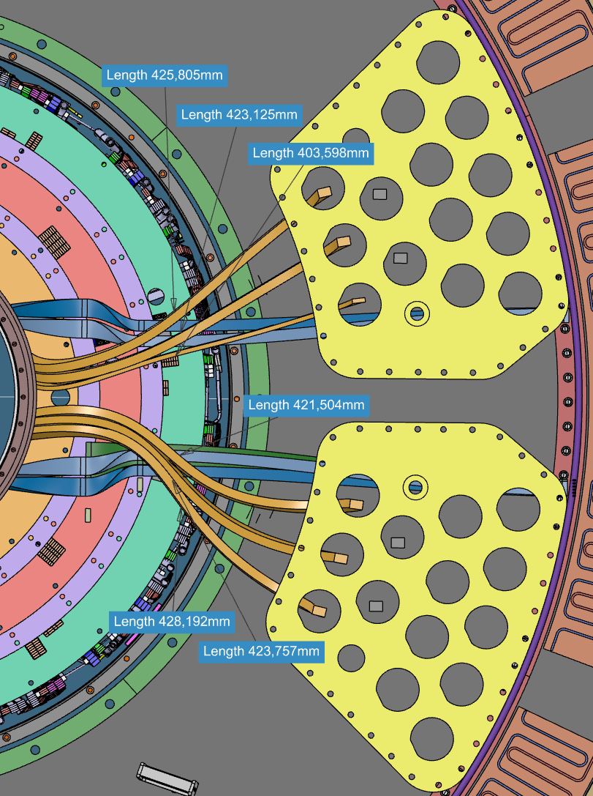
EC L2 CABLING
DFT 1-8
HV/LV
T-sensors
DATA
Layout of EC L2. Routing will change in function of the other layers and the mapping of DFT 1-8.
They will be placed after the data cables routing.
They will pass between the cooling pipes

Slide 9
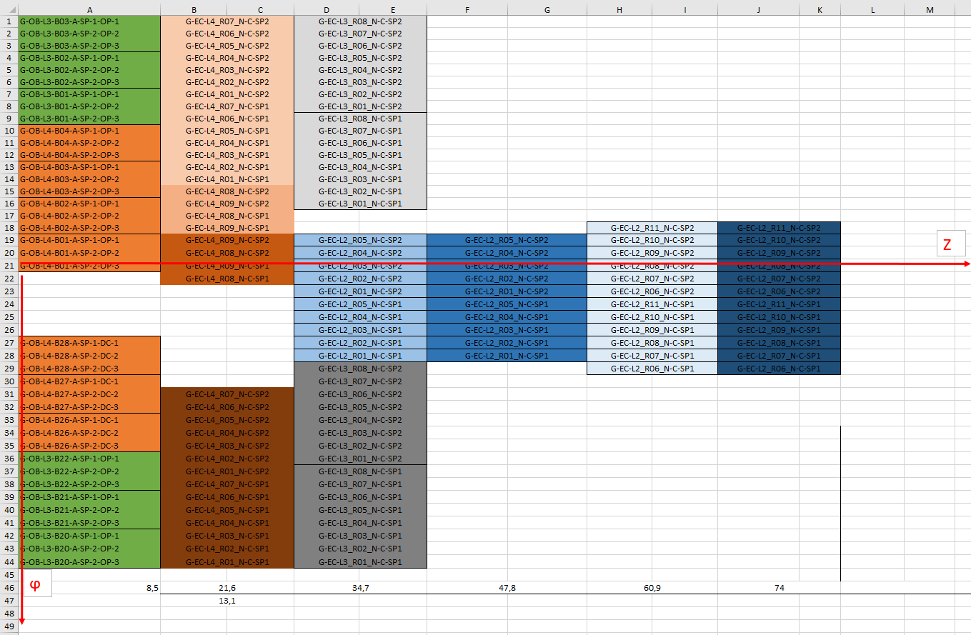
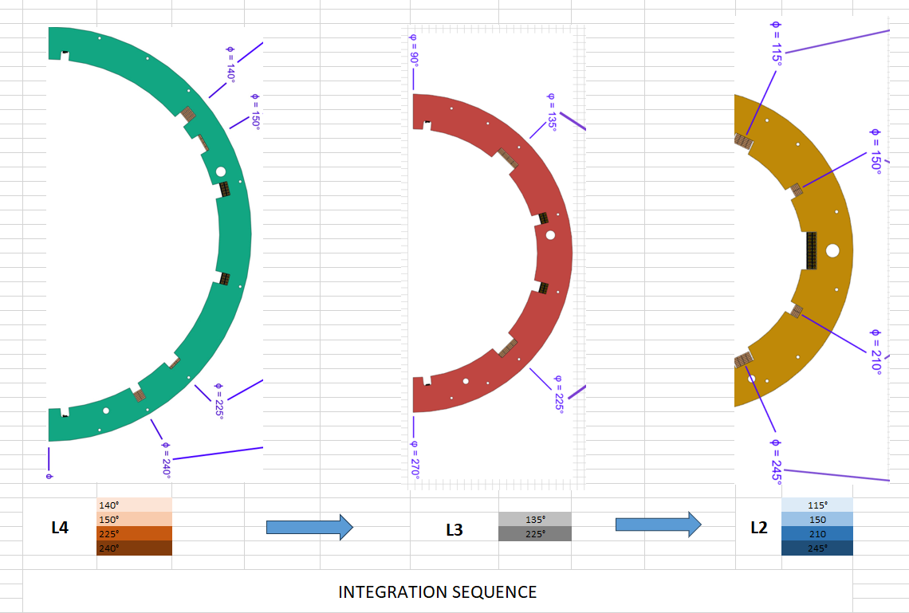
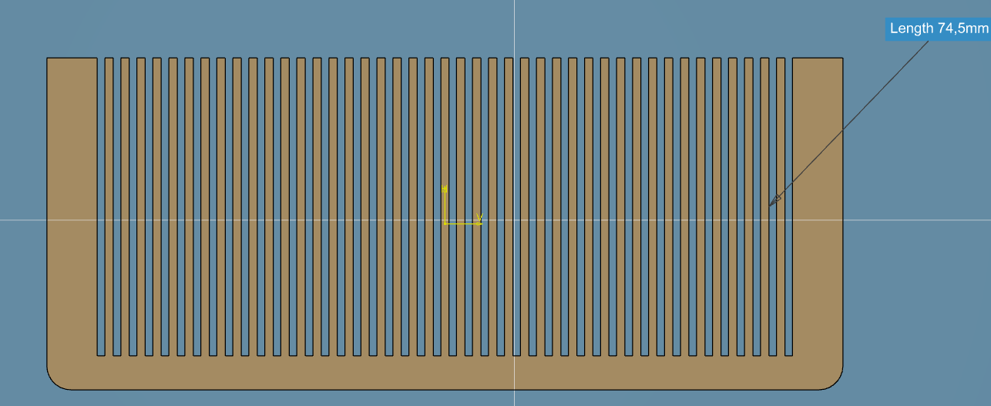
DFT 1-8 A SIDE
Z (internal view)
DFT 1-8:
OB cables first and after EC cables.
Complete mapping of DFT. Preliminary and not optimized.
ϕ

Slide 10
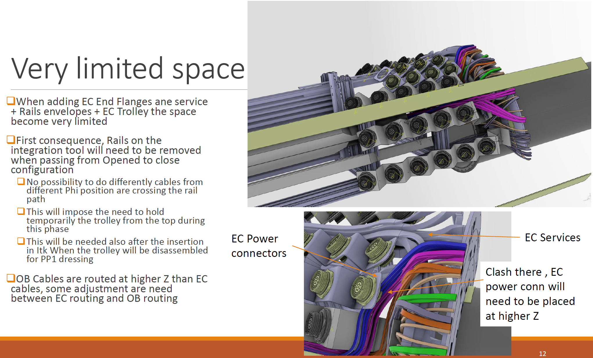
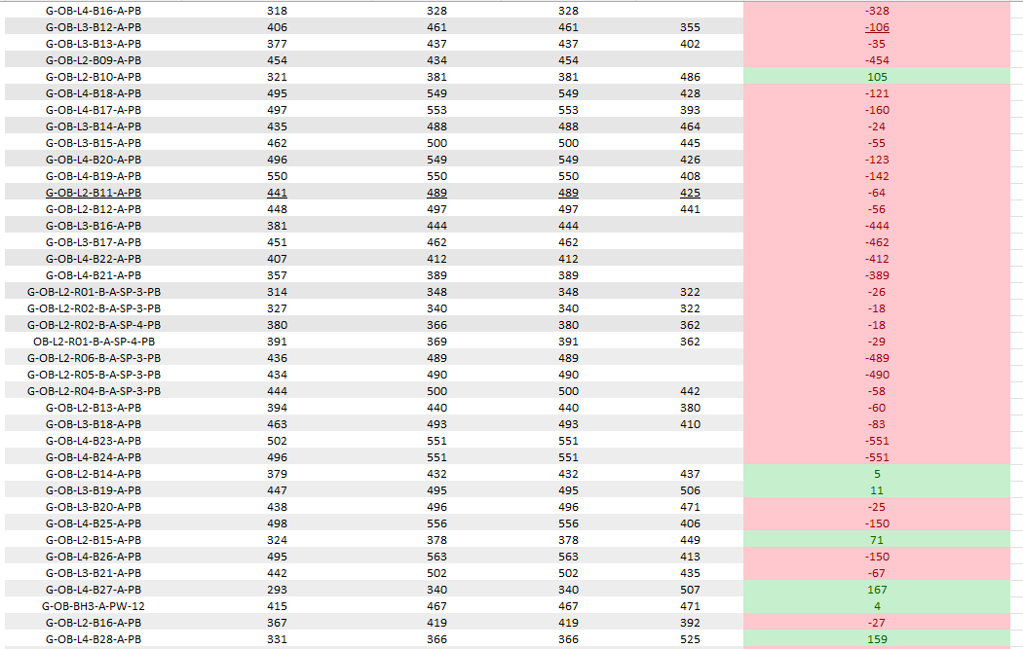
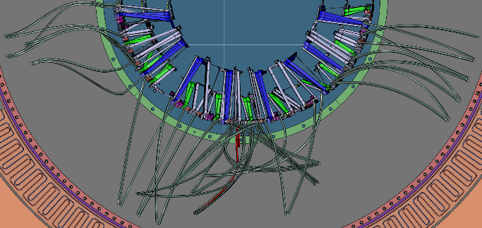
OB HV/LV ROUTING DESIGN
FROM ERIC VIGEOLAS
POWER CABLES ROUTING (WIP):
New cross check with open/close configuration. Maximum delta: – 160 mm (red)
Red: increase length inside PP1. Green: extra length managed on trolley

Slide 11
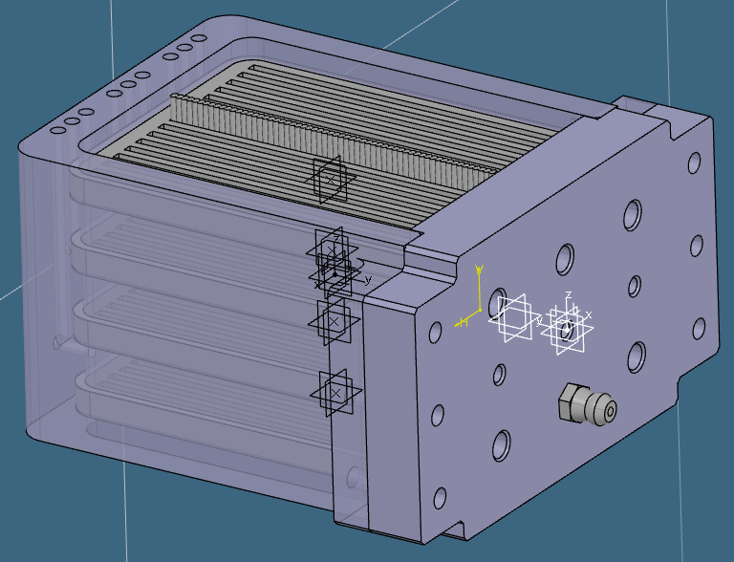
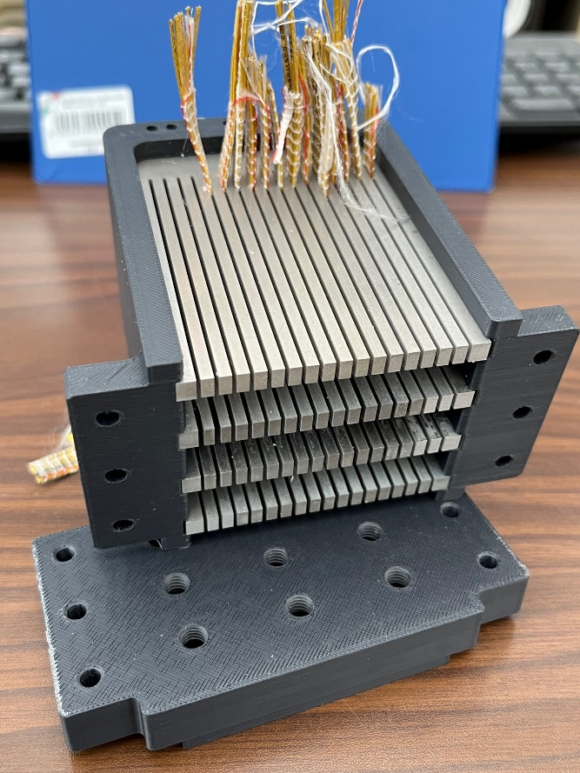
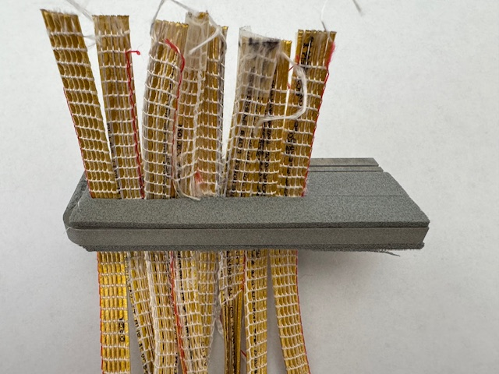
Data Feedthrought Prototype
COMB
76
EPDM ADHESIVE
60
103
CLOSING FLANGE
We improved the prototype of 1/3 of Outer Feedthrough:
The combs were made of Aluminum using electro-erosion.
Adjust the slots dimensions to grant the best fit possible with the data bundles (Work In Progress).
Reduce the leakage of filler using an adhesive EPDM mousse
Process and design will be applied to the full scale prototype.

Slide 12
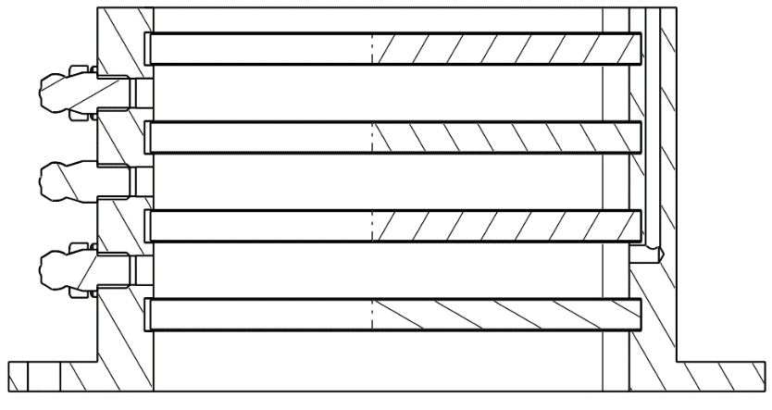
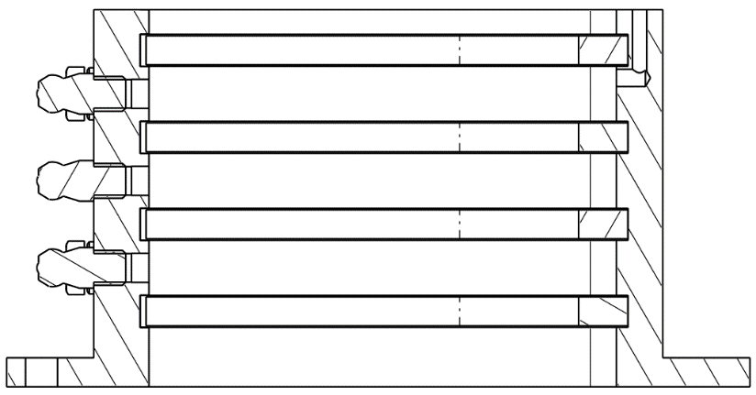
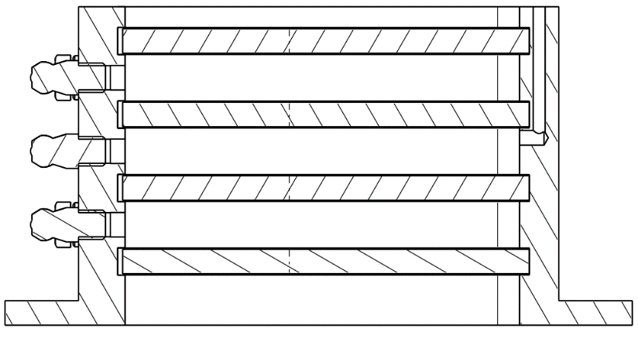
FILLING PROCESS
STEP 1
STEP 2
STEP 3
SC
B
ARALDITE 2011
B
SC
C
A
A
A
AIR VENT HOLE
The filling process follows this step by step procedure:
Filling the chamber A with silicon compound (SC). It has high viscosity and low curing time compared to Araldite 2011.This properties are necessary to ensure a containment function.
The air exits from vent hole, in opposite direction of filling. When the SC leaks out from hole, we proceed to the next injection hole.
Filling the chamber B with SC.
Now the chamber C is ready for Araldite 2011 injection. It’s contained between the two full volumes (A & B) and ensure a tightness in the operative conditions of the detector, due its radiation resistance.

Slide 13
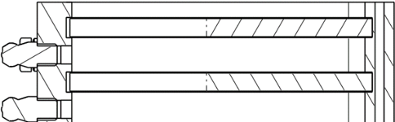
FILLING PROCESS-backup
PROPOSAL
STEP 4-backup
STEP 5-backup
SC
ARALDITE 2011
D
D
E
B
B
C
C
A
A
The backup of filling process is done with two extra chamber:
4. Filling the chamber D with silicon compound.
5. Filling chamber E with araldite 2011.
This new design increase the height of DFT. This solution is a proposal.

Slide 14
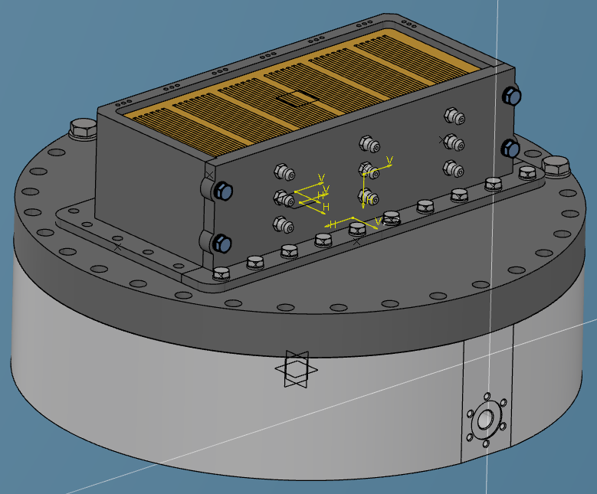
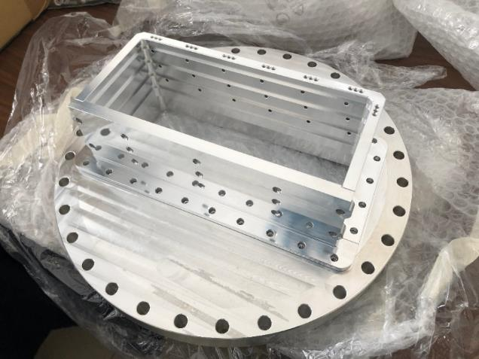
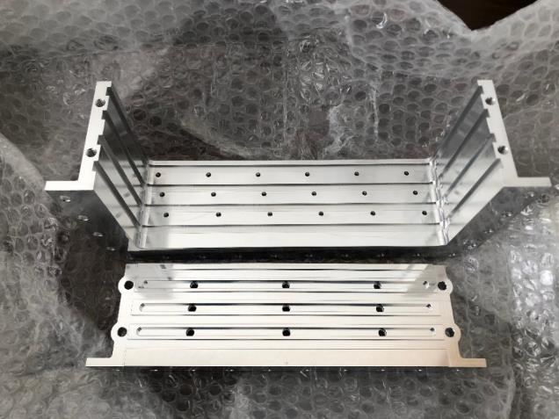
Data Feedthrought Prototype
1:1 SCALE FEEDTHROUGH
VESSEL
FLANGE
Leak Test OS data feedthrought:
Flush air using fluximeter up to an assigned ∆p. Read absolute pressure with manometer.
Increase the flux and build a chart X=flow Y=pressure. The leak is the slope of the curve.
Normalize curve to Standard helium leak rate.

