Slide 1
PP1 Requirements, integration approach, testing and organization plan
D. Giugni

Slide 2
General
PP1 is a real beast. It is far from a generic Patch Panel concept.
As for records, the functionalities it has to provide are numerous ( hereafter following the integration sequence):
  [1] Cooling
    Manifolds the OB inlet and return cooling lines. It handles the L2 and L3 Barrel-Inclined section flow split and it routes the lines to the Flex lines
    It routes the OEC lines to the flex lines
    It hosts the OS Warm Noses, monitors pressure and T
    It electrically decouples the cooling from the flex lines and it handles the transition between Ti and Stainless Steel piping
    It clears the PST bore for the OS insertion and allows secure failure-proof welding between on the on-detector pipes
  [2] Cabling
    It allows to route and dress-up the data cables. Populate the DFT’s to the correct mapping to match the destination optoboards.
    It routes the LV cables to the PP1 connectors and handles the take-up (mostly coming from the services trolley)

Slide 3
General (Cont.ed)
  [3] Detector volume tightness an its testing
    There are several seals in PP1. Each one needs to be verified during the integration process since it would be impossible to track leak over hundreds of seals once everything has been dressed up. Here some of them:
      Flex lines against the external PP1 cylindrical diameter. There the seal is both gas and electrical
      DATA cables seals across the feedthrough
      Connector tightness
  [4] PP1 must ensure a temperature of its external surface above the Dew Point in the OSV (Outer Services Volume)
    An heater systems is required as active insulation to prevent condensation. The DP in the OSV is guaranteed only @ -30℃ while the pipes inside PP1 can reach -55℃ in case of a major cooling failure.

Slide 4
Let’s talk about the overall PP1 integration sequence

Slide 5
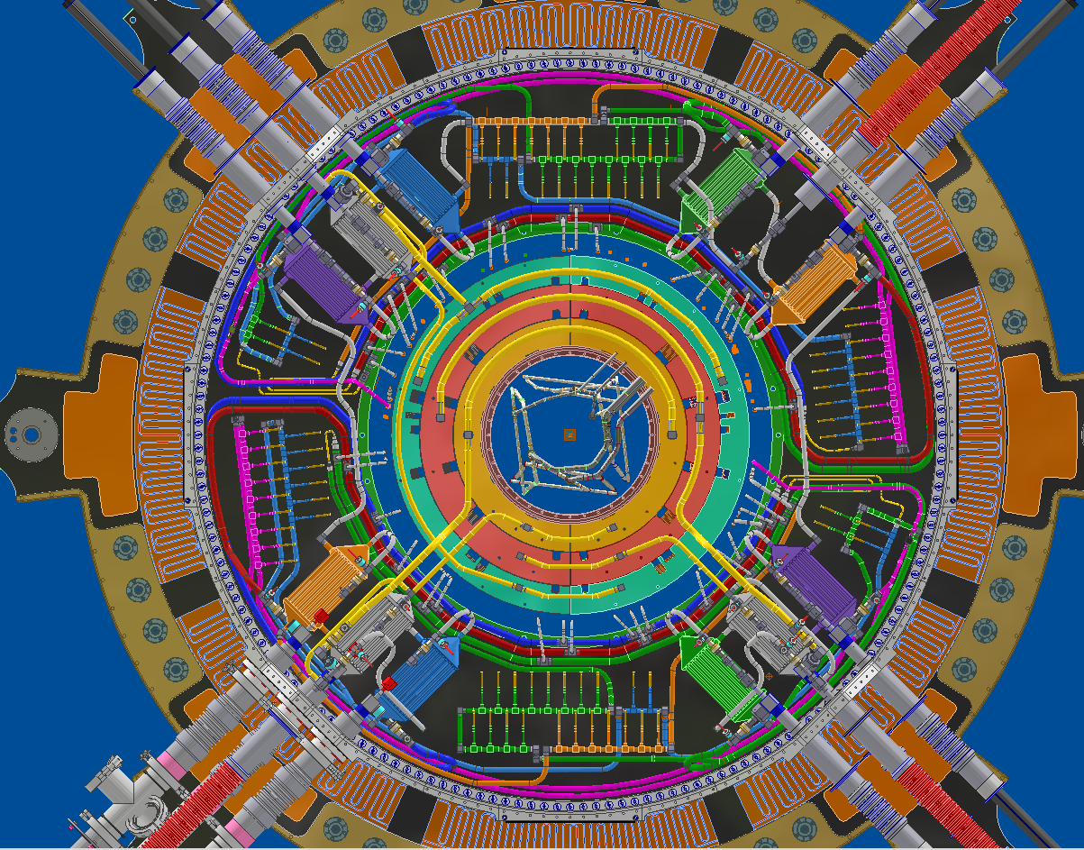
In Pit Pre-Insertion activities
At the time of the full ITK lowering in the pit, the Type-II services will be already installed and commissioned.
In particular, the flex lines comes in first and they will be pulled from PP1 outward.
  The correct starting position is provided by a
  mockup on the cryostat flange that provides
  the correct radial and clocking position to the
  flex lines.
  Type-II cables will follow. In the same way, the mockup provides the starting point @ low radii.
  Finally, all the services are folded back and the PP1 mockup removed to clear up the cryostat bore.
All the services are expected to be pulled so that the starting point at PP1 matches the connectors and flanges in the detector what finally installed.

Slide 6
[1] From stretch to Cooling pipe integration
In SR1 we will be facing an empty ITK flange showing the PST bore and an interface for the external part of the PP1 Faraday cage
First step is to add to the surface the anchoring plates for the Pixel services. These are four composite multipurpose anchoring interfaces that can support the piping and the cables weight
Then, in sequence the following assembly come in:
  PP1 Outer Wall
  OS cooling piping including the Warm Nose Heat exchangers
  Warm Nose services penetration (at flex line ports)
  Pressure sensing lines routing
  Warm Noses sensors for CO2 Control
After the piping is installed and tested, the detector can be inserted with the electrical services temporarily arranged in the services trolley. Next steps are:
  OB pipes welding and testing –leak/pressure/leak test-
  OEC pipes welding to the WN (leak/pressure/leak test)

Slide 7
[2] Cables dressing
The cable dressing is presented in detail in the next talks. However, hereafter a brief overall description of the approach:
  DATA links are populated in the DFT’s. Here it is essential to meet the proper mapping and the length left to the termination board. Exact lengths have not been defined yet. However, we are in the process to get there specifying the nominal lengths and the safety factor to apply to it.
  Tests and verification are on the DFT mapping and to the protruding DATA cable lengths.
  Next step is the DATA link sealing. We have not decided yet whether to seal them right away or wait until the LV lines are dressed up. I would say it is still an option.
    Sealing operation has one backup in case the first attempt fails or it is insufficient thigh (see Filippo’s talk). The DFT has, in fact, a second chamber for a backup adhesive casting.
    Testing the DST tightness is now a fundamental step. Plan is to embed the external part pf the DATA links into a sealed box. The box is flushed with air while the flow is measured. The ΔP build up vs. flow gives the leak rate.

Slide 8
[2] Cables dressing (cont.ed)
After the DATA links are routed and DFT’s potentially sealed, the LV lines can be dressed up and the PP1 panels can be populated with the connectors.
  The step require unfolding the cables from the services trolley and store them temporarily at higher radii.
  This allows to install the front PP1 frame
The connectors can now populate on the octant panels in one go postponing the electrical testing later.
  However, the OS PP1 gas volume is still uncomplete at this point since the PP1 cone interface is still missing.
  Needs first to bond the IST end-flange and then install the PP1 cone.
Electrical tests can start over two closing off two connector panels at the time
With the PP1 volume closed, leak test on the connector panels already tested can be performed measuring the pressure build up vs. the air flow injection in the PP1 volume.
  The rest of the panels are blinded off by caps (see later) . Those are caps mount on the PP1 panels bolts interface

Slide 9
[2] Humidity sensors for OEC
It’s worth to mention the integration sequence for the Humidity sensors.
The fibers assembly enters the PP1 volume through standard connector holes in the panel.
We provide the hole and the gasket. However, the assembly with the casted and sealed fibers should com from the DCS group
Note that inside PP1 the fibers MUST have an opto-connector mapping to the singe HalfShell
  We will mate those with the ones on the feedthrough at the time of closing off the panel.
It’s unclear to me whether the Type-II fibers will be spliced in the Pit or the full cable will be
MT Opto
connector
PP1
Volume
installed in SR1. Better if it is so. However, I believe we can handle a 10-15m of fibesr cable as we do for the DATA links.
.

Slide 10
[2] Humidity sensors for OEC (cont.ed)
Anyhow, humidity sensor connection is one of the last operation on the panel.
MT Opto
connector
PP1
Volume

Slide 11
[4] Heater System
The heater system will be described in a dedicated talk (See Gianmario’s talk).
Here is worth to note that the heaters itself come with the PP1 mechanical parts and they are laminated to the alluminum parts of the cage at a very early stage.
At the end of the PP1 integration sequence, the cables servicing the heater system are routed to the dedicated connectors mounted outside the PP1 structure.

Slide 12
Open issues
Post FDR planning and work sharing
  The activity on the PP1 continues at Frascati until the GM FDR.
  After that the pre-production is partially taken over by Marseille for what concerns the OB manifolding and piping.
  The PP1 mockup (actually in construction at Frascati) will be moved to CERN.
  However, I would like to point out that we still do not have a solution for Post-FDR. Certainly, there will some work still to be done for what concerns the mock-up, the integration procedures and the production.
Time is passing but there are not progresses on the IST flange bonding. This is not part of PP1 but it is deeply related to the PP1 integration and testing
Humidity sensors design at PP1 does not seem to be ready yet.

