Slide 1
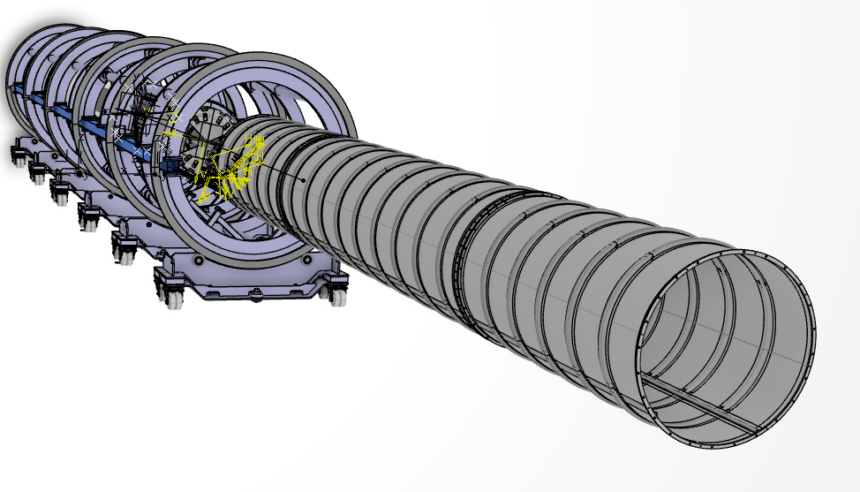
OS Detector Insertion
Eric Vigeolas OEC Integration WS Frascati January Feb the 1st 2024

Slide 2
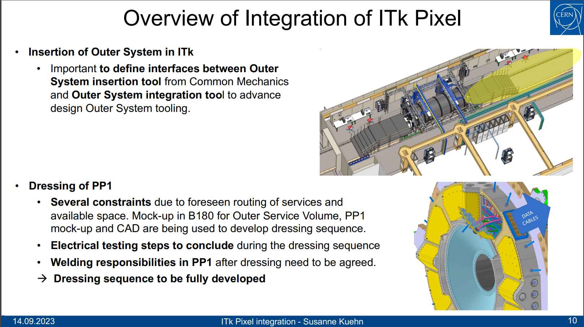
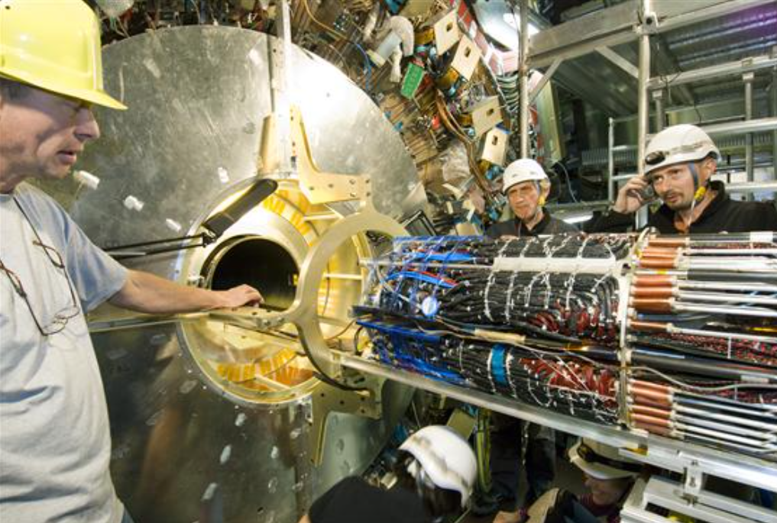
OS insertion
A lot remain do be done, this work package belong to ITK Global mechanics
The rail extension between the PST and the OS Integration tool have been discussed with Eric Anderssen but interfaces remain to be clearly defined

Slide 3
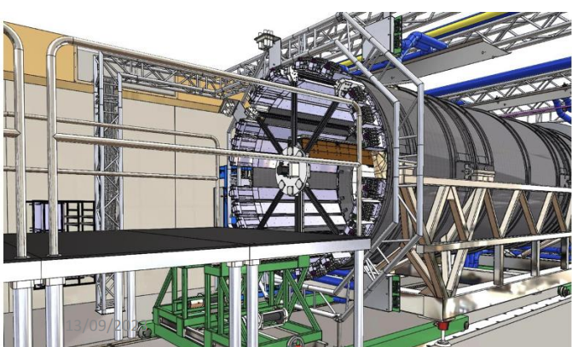
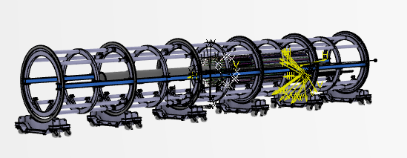
Lifting System
The OS integration tool will need to be lifted and aligned to the PST → We need more clarifications on tool and process of this action → impact on OS integration tool

Slide 4
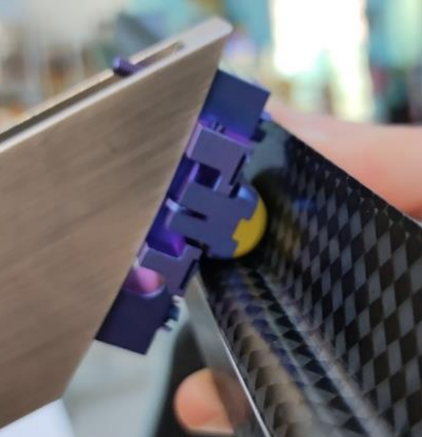
Pulling system
The Pixel OS will be inserted using a wire pulling system similarly to the current pixel detector process
Cables will need to be attached to ECA support points → OB can not work in compression mode
Need to decide if we place One or two cables and if the two cable will be joined to have a unique pulling wire
PST
Trolley A
ECA
OB
ECC
Trolley C
Two options for the wire fixation
On EC

Slide 5
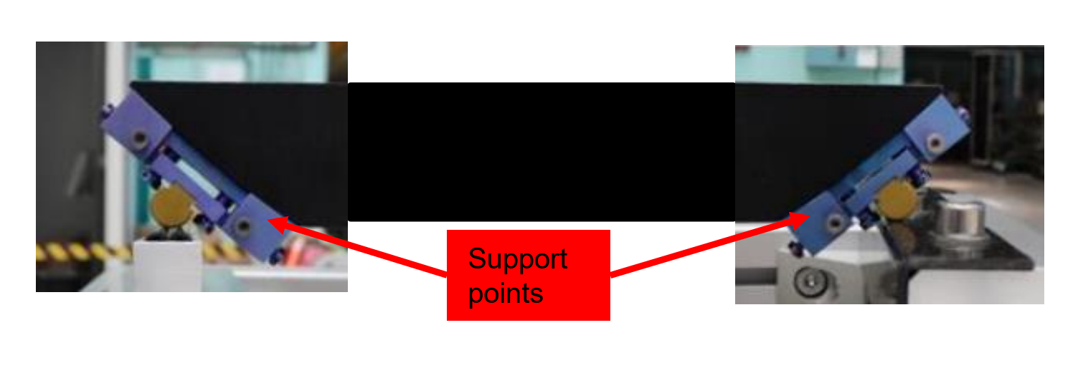
Wire path
As we decided to attached the cable on the sliders the cables have to pass though the sliders, the space is limited due to OB services on top of EC
Depending on the attachment option on EC, we may need to pass through the supports points

Slide 6
Symmetric pulling force
We need to decide if one cable (asymmetric load) or two cable (one per side, symmetric load) will be used
In case of two cables we will need to join them for the use of a unique pulling cable

Slide 7
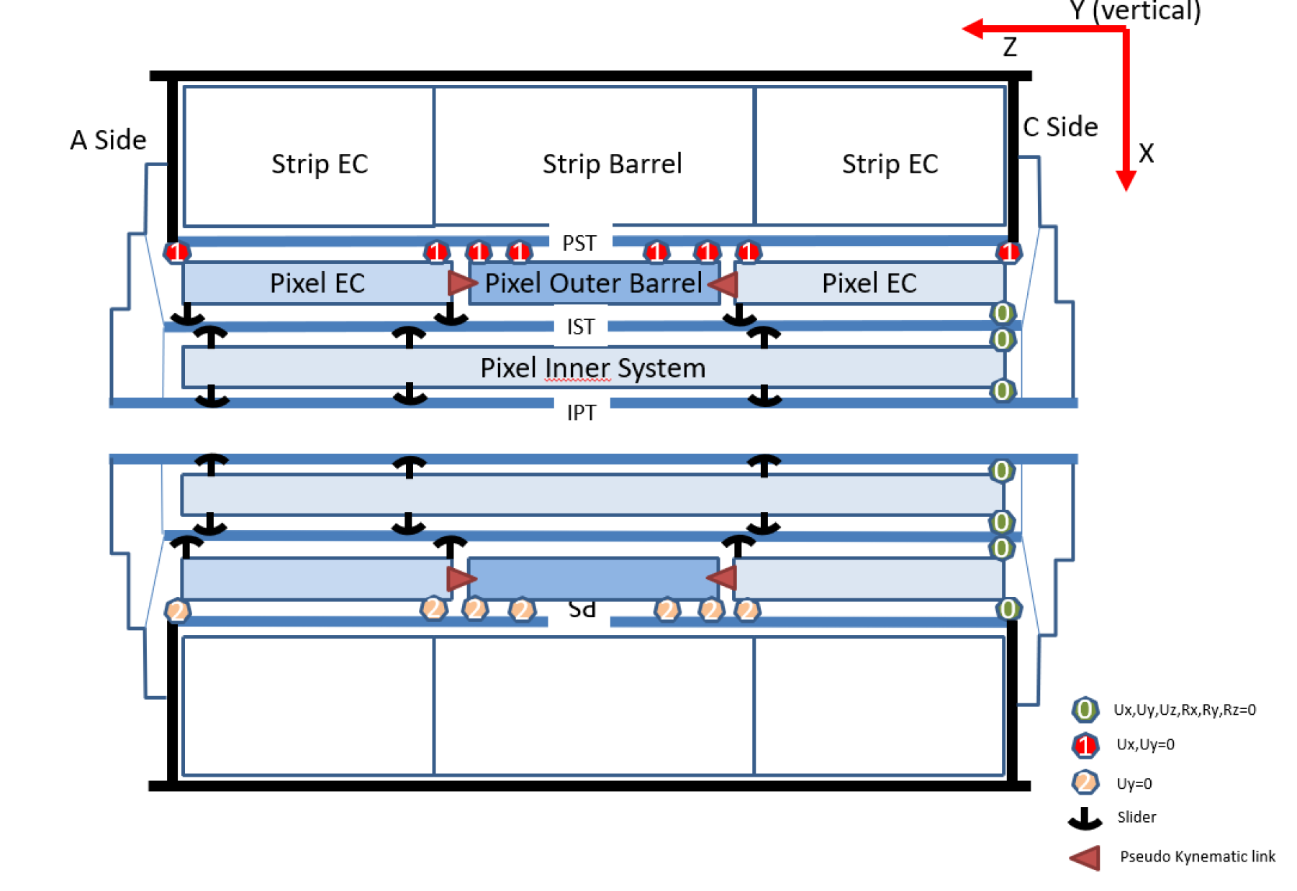
Z stopper
We did not defined yet how the detector will be referenced in Z direction
For the OS this is foreseen on C side on the E level
We need to define also the IS positioning in Z direction

Slide 8
Conclusion
This part of the Detector construction have not been worked out so much a lot remain to be done
For the ITK Pixel GM&I FDR, slider design should be completed and implemented in our design, this include wire system for the insertion
Z stopper remain to be clearly described and add in our design → this may affect the IST flange design
As the OS insertion is a share work between ITK GM mechanics and OS subsystem a lot of interfaces need to be described → We need more interaction there

