Slide 1



OEC Integration Workshop
Cable dress up and PP1 finalization
INFN-LNF
F. Rosatelli
2024-02-01

Slide 2

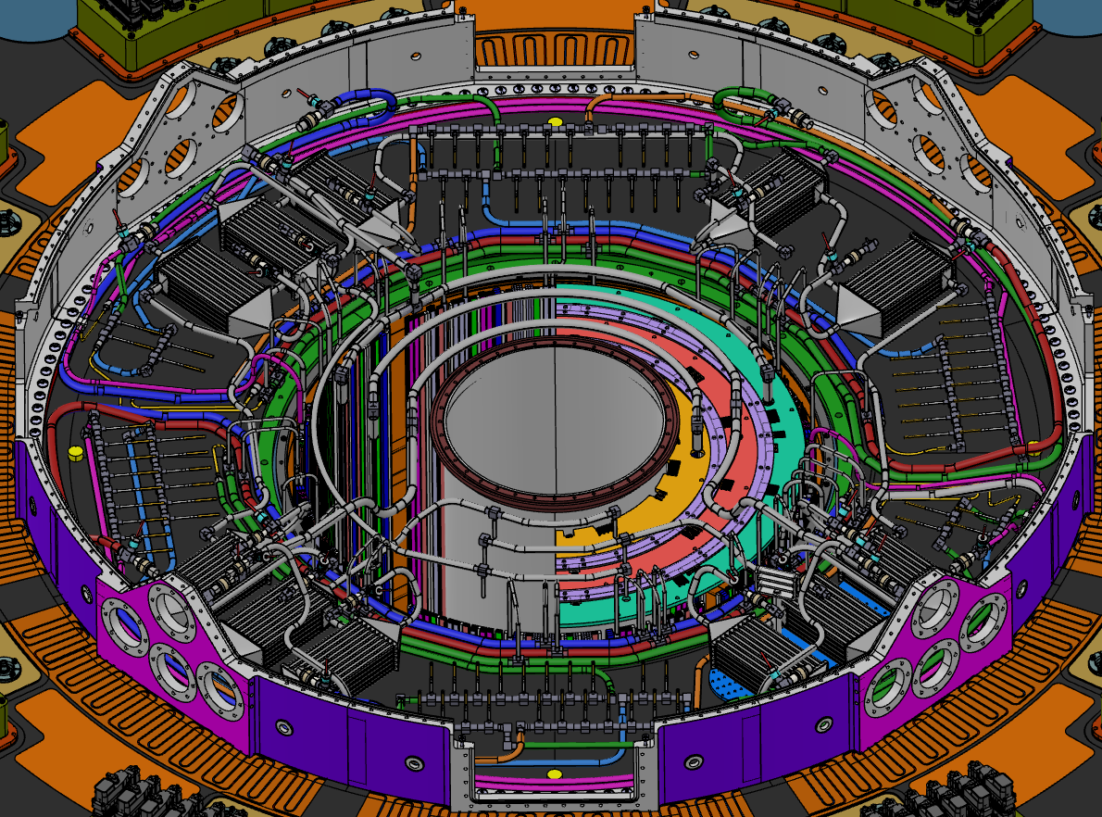
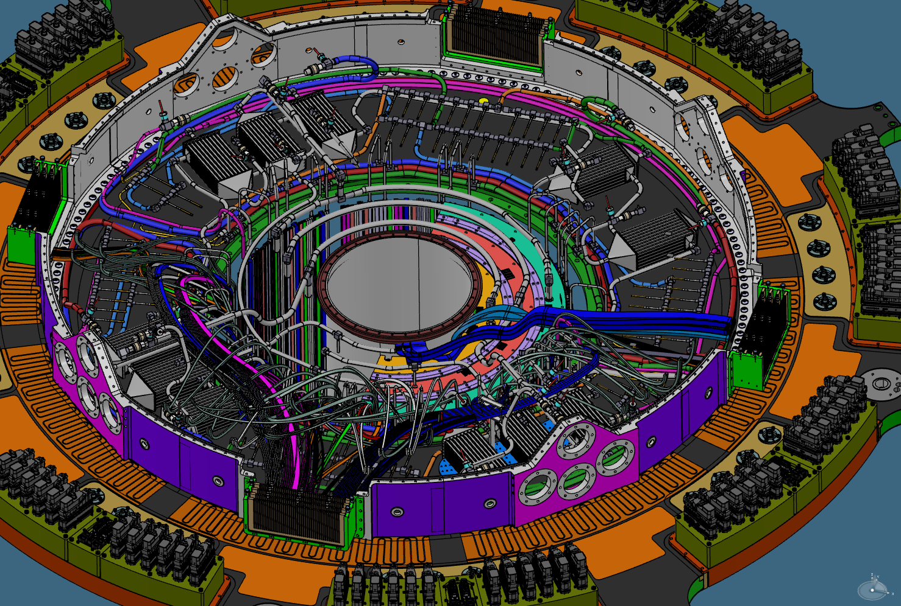
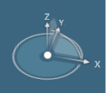
Integration sequence
Manifold installed, welded and tested. IST present.
Dressing OB and EC data cables from trolley to PP1 data feedthrought.
Power cables stored on services trolley.

Slide 3
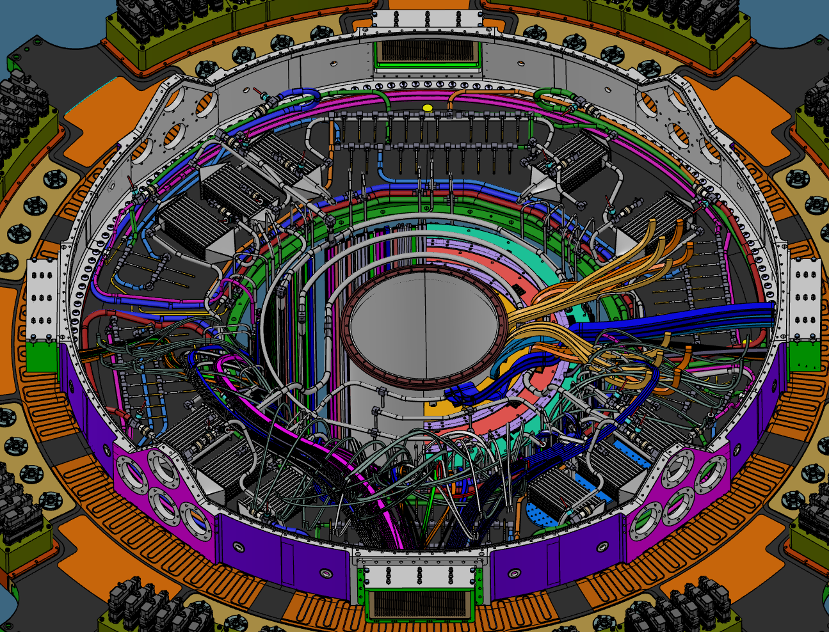
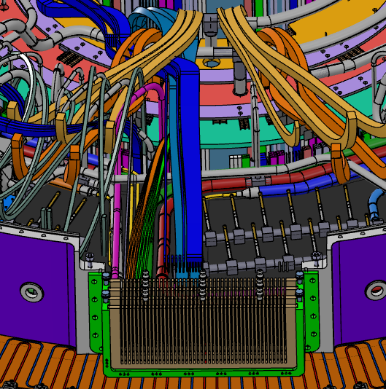
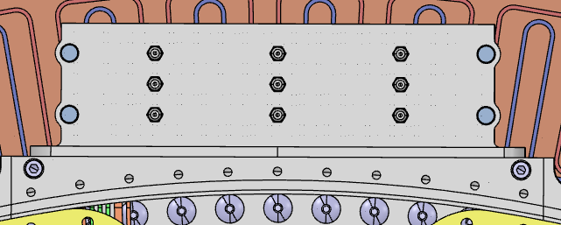
Integration sequence
Chamber
Filling DFTs with Araldite 2011 and silicon compound.
Leak test of DFTs using a chamber (TBD). If needed, a rework it’s possible.
Dressing OB and EC power and environmental cables. They placed temporarily inside PP1 volume.

Slide 4
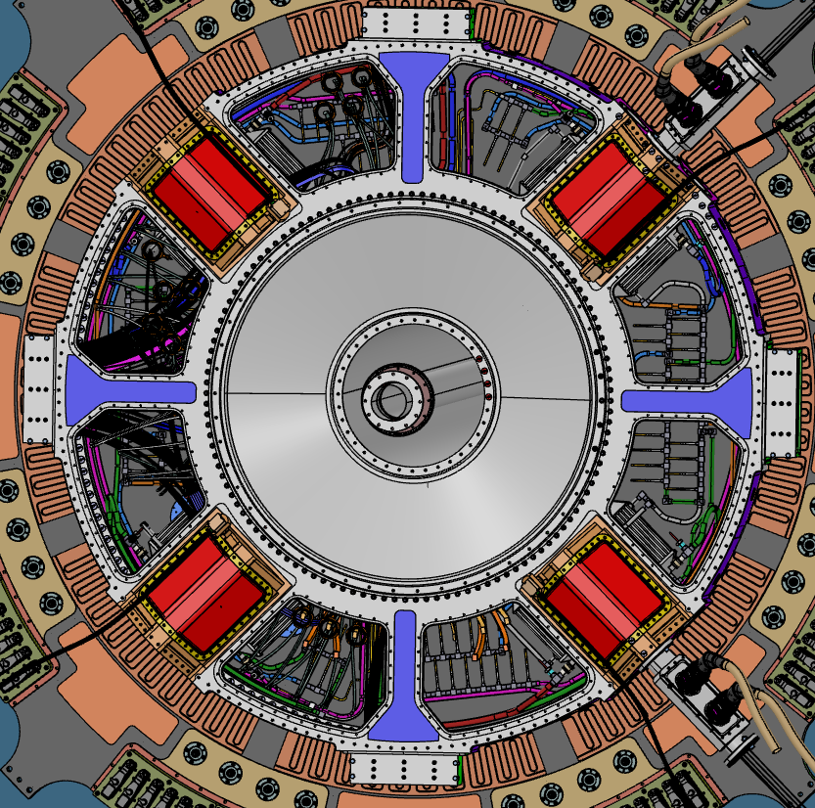
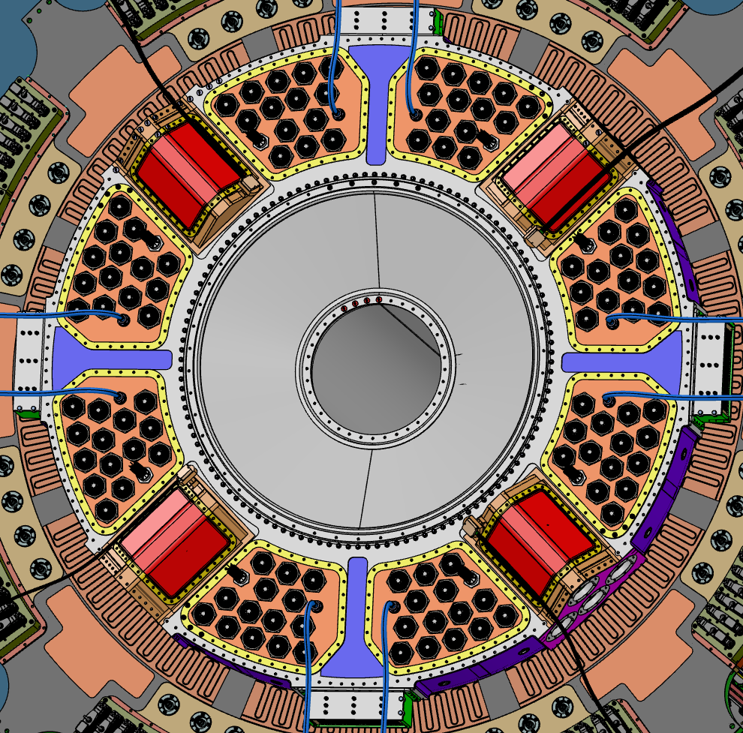
Integration sequence
Glue interface flange on IST
Install outer flange.
Install conical flange on interface flange.
Blank flanges for leak test
Panel connectorization
Leak test on two octant panel after electrical test

Slide 5

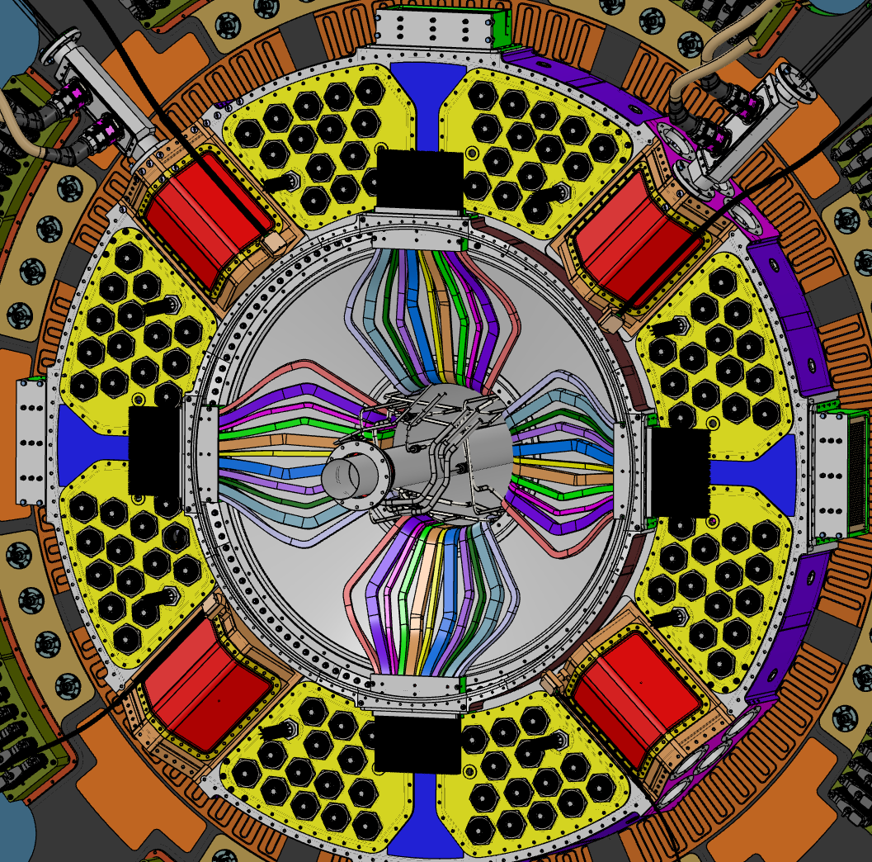
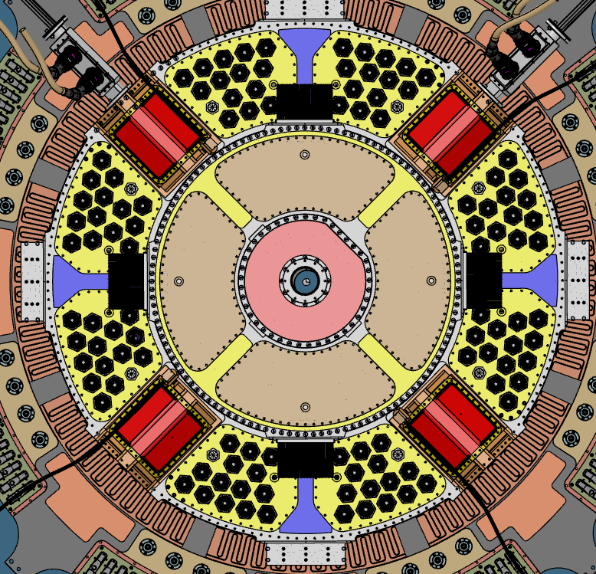
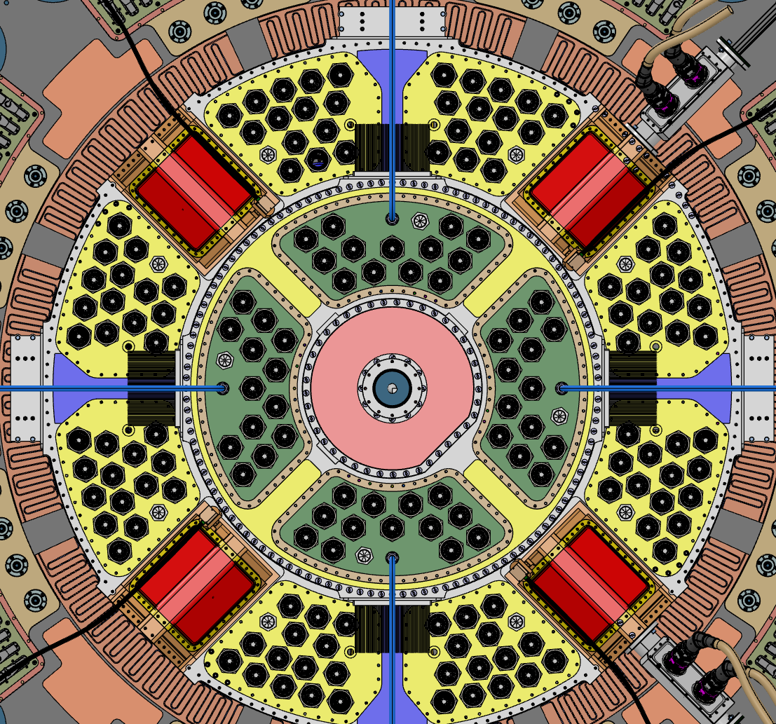
OB DATA CABLES ROUTING DESIGN
IS piping installed
Dressing data to DFT
Power dressed and clamped temporanly inside PP1 IS volume.
Filling IS DFTs with Araldite and silicon compound.
Leak test DFT using a chamber . If needed, a rework it’s possible.
Instal IS flanges and blank flanges for leak test IS
Panel connectorization and electrical test.

