Slide 1
ENDCAP RADIAL CLEARANCES
Tim Jones
December 19th 2023

Slide 2
Introduction
The purpose of this slide-pack is to investigate the build-up of manufacturing and assembly tolerances for Pixel Endcap Half-cylinders.
This work is motivated by the urgent need to decide whether half-rings need the extra stiffening offered by the inner rim to limit their thermal deformation to ensure they can never come into contact with neighbouring parts of the endcap or violate the envelopes to other sub-systems.
  FEA results indicate that the in-plane deformations could be as much as 1.6mm if the temperature is reduced to -55°C (exhaust cooling line rupture).
  Primarily, this issue relates to the deformation of L3 half-rings clashing with the L2 half cylinder or, L4 half rings clashing with the L3 half-cylinder.
Here’s the final paragraph …
  In conclusion, my best estimate of the margin for allowable deformation of half-rings at -55°C is 1.73mm PROVIDED the services gaps between the outer rim of half-rings and their supporting half-shell can be reduced by 0.22mm. If this reduction in the services radial envelope is achievable I would be cautiously optimistic that half-rings do not need the inner stiffening rim to prevent any clashes or envelope violations as the beneficial stiffening effect of the services support rings on the rigidity of the half-shell has not been modelled in FEA. If the services gap cannot be reduced, and the benefits of the services support rings are not sufficient, then half-rings may still need to be stiffened.
NB
  If you’ve read the previous bullet then I’m sorry but you’re now morally obliged to read every page of the intervening slides!
  Basically you’ve taken the equivalent of The Kings Shilling (see https://en.wikipedia.org/wiki/King’s_shilling)
    There are recurring tales of sailors being pressed after a shilling was slipped into their drink,^{[5]} leading to glass-bottomed tankards. However, this is likely to be a myth, for the Navy could press by force, rendering deception unnecessary.^{[4]}
We start from Peter Sutcliffe’s ‘envelope drawing’ from 2019

Slide 3
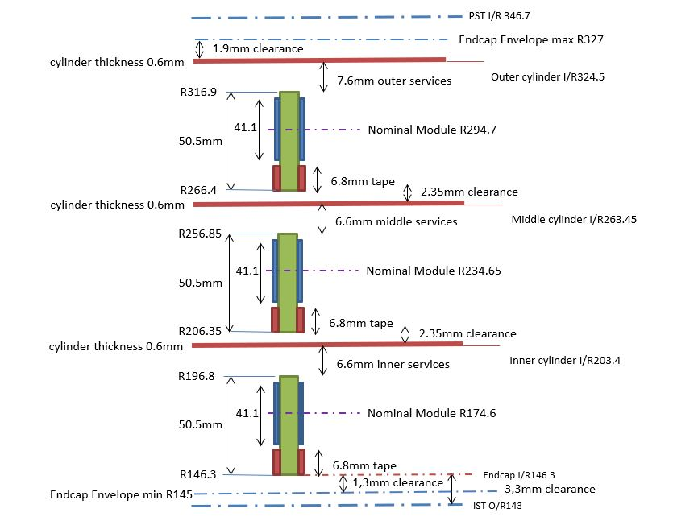
Historic Envelope ‘drawing’ - 2019

Slide 4
Evolution of the Envelope Drawing
Results from L4 prototype half-shell indicated deviations from ideal shape of +/- 0.25mm and difficulty in achieving desired radius.
  Sometime in 2020/21 we agreed to reduce half-shell integration ‘clearance’ from 2.35mm to 1.85mm to accommodate likely non-uniformities in half shell laminate.
    Concerns integration of L3 round L2 and integration of L4 around L3
    Clearance to IST remained as previously
  This means the nominal clearance between the inner radius of L2 (or L3) to the outside of the L2 (or L4) half-cylinder is 1.85mm
Work done towards the Bare Local Support PRR – led to a revised tolerance on half-ring inner rim
  As machined inner rim radius = Nominal inner rim radius +0 / -0.1mm
    Relative to centre of circle passing through the centres of all D3.25mm holes in half-ring mounting lugs.
  HR mounting lug to HR mounting block
    HRs are fixed to the half-shell via a D3.2 shoulder screw with an M3 thread passing through the D3.25 hole in the HR mounting lug and into the D3.2 recess in the HR mounting block.
    Allows a perfect HR to be mounted in a set of perfectly aligned HR mounting blocks to be mis-placed by +/- 0.025mm
In the following I look at the likely build-up of tolerances on the relative positioning of half-rings and half-cylinders due to the half-cylinder assembly process and endcap integration.

Slide 5
Commentary
Improvements in the manufacture of L2 Half-shell end-flanges indicates a reduction in the overall envelope for half-shells (from 0.6 + 0.5 = 1.1mm) to (0.6 + 0.3 = 0.9mm) is possible.
  However, this extra leeway has been taken by assembly tolerances from the manufacture of the half-cylinder assembly tooling.
Services Gap
  With the assembly tolerances taken into account, there is a potential violation of the services gap of 0.22mm. We need to check that this is not an issue with the revised services definition and routing.
Effects of CTE ?
  All tooling is Aluminium (CTE = 23ppm) – Deviations for 1°C temperature change …
  There should be no differential height change between the nominal Centre-line height between the End Towers and the HR Mounting Block placement jig regardless of the change in temperature
  A change in radius of the centres of the 10mm HS Location Pins does not change the height of the centre-line of the half cylinder but WILL change the transverse position.
    The 10mm pins are on a radial line at 55° to horizontal (so not too far from 45°).
Dimension | Value (mm) | Error for 1°C ΔT (mm)
Nominal Centre Line height | 423.00 | 0.010
Radius of 10mm HS Location Pin centres from CL | 330.10 | 0.008
Radius of 3.2mm HR Block pin centres from CL | 320.40 | 0.007
End Tower separation | 1879.00 | 0.043

Slide 6
Commentary …
Assuming the half-shell and half-ring radial envelopes are respected, and the positioning tolerances coming from the assembly tooling are correct, the margin for half-ring geometric deformation due to a temperature excursion to -55°C is
  L4 and L3: 1.73mm (inner rim of half-ring to outer surface of half-shell)
  L2 : 1.01mm (inner rim of L2 half-ring to inner envelope of OE sub-system)
During OS Integration we need to adhere to the OE global envelopes as the endcaps have to slide over the IST. However, once the IST is installed we are probably allowed to violate the OE inner envelope provided we do not come close to the outer envelope of the IST which is at 144.00.
  The effective clearance for deformation of L2 half-rings is 146.08 – 0.037 (HC-FS) - 0.03 (Grav. Defl.) - 144.00 = 2.01mm
  We should declare the operational violation of the OE inner envelope to GM
The static gravitational FEA shown at the GM&I PDR shows that half-rings deflect vertically by up to 0.06mm but that the differential movement between half-rings in neighbouring layers is less than 0.03mm. Given that the effects of gravity seem minor compared to the 1.76mm clearance, it is unlikely that any future GM FEA would indicate serious issues.
  Perhaps the only thing to worry about would be vertical oscillations occurring due to an excitation caused during transport of the completed endcaps to CERN
In conclusion, my best estimate of the margin for allowable deformation of half-rings at -55°C is 1.73mm PROVIDED the services gaps between the outer rim of half-rings and their supporting half-shell can be reduced by 0.22mm. If this reduction in the services radial envelope is achievable I would be cautiously optimistic that half-rings do not need the inner stiffening rim to prevent any clashes or envelope violations as the beneficial stiffening effect of the services support rings on the rigidity of the half-shell has not been modelled in FEA. If the services gap cannot be reduced, and the benefits of the services support rings are not sufficient, then half-rings may still need to be stiffened.

Slide 7
Back-up
Slides from Tuesday 9th

Slide 8
Contents
Envelope of half-cylinders coming from experience gained manufacturing L2 prototypes
Half-cylinder location in Assembly Tooling
Half-ring mounting block installation
Assembly Tooling tolerance build-up
Endcap Integration
Final Calculation of Clearances

Slide 9
Section 1
Envelope of half-cylinders coming from experience gained manufacturing L2 prototypes

Slide 10
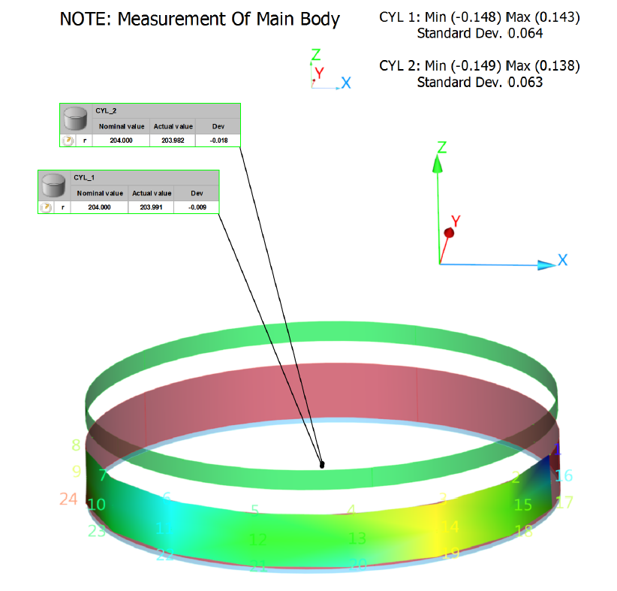
L2 Half-cylinder Prototyping –End-flanges
Nominal OR = 204.00mm
Two end-flanges manufactured
  #1 OR = 203.98
  #2 OR = 204.05
Typical deviations of surface points from ideal form are <0.15mm
  In all the following work I’ve taken the deviations as being +/-0.15mm. The image (left) shows the largest deviations are at the extremities of the end-flange section
Remember typical half-shell OR is 0.1 to 0.15mm larger due to thickness of bond-line between end-flanges and central section.
  Expect L2 envelope (between 2nd and last HR) to be ..
    Inner surface = 204.0 - 0.15 (non-uniformity) - 0.6 (laminate thickness) + 0.1 (glue line thickness) = 203.35 (0.05mm less than nominal from PS envelope dwg)
    Outer Surface = 204.0 + 0.15 (non-uniformity) + 0.1 (glue line thickness) = 204.25
Our L4 prototype has deviations of up to +/-0.25mm giving rise to a full half-shell envelope of 0.6 + 0.5 = 1.1mm. If the full L2 half-shell geometry follows that of the end-flanges the L2 envelope would be 204.25-203.35 = 0.9mm.

Slide 11
Section 2
Half-cylinder location in Assembly Tooling

Slide 12
Half-cylinder placement in Assembly Tooling
In this section we look at the placement tolerance for a perfect) half-shell in the half-cylinder assembly tooling.
Half-shell (HS) laminates are positioned on the tooling by a touching contact to 4 dowel pins (2 per side)
  Dowel pins are 10mm nominal but have a portion turned to the appropriate diameter for the measured as-manufactured HS end-flanges
  The rotational freedom of the HS end-flange is controlled with a vertical ‘ruler’ mounted on the end-towers
Image on next two slides shows general features of half-cylinder assembly tooling and a close-up of one End Tower showing how the position of a L4 HS is referenced

Slide 13
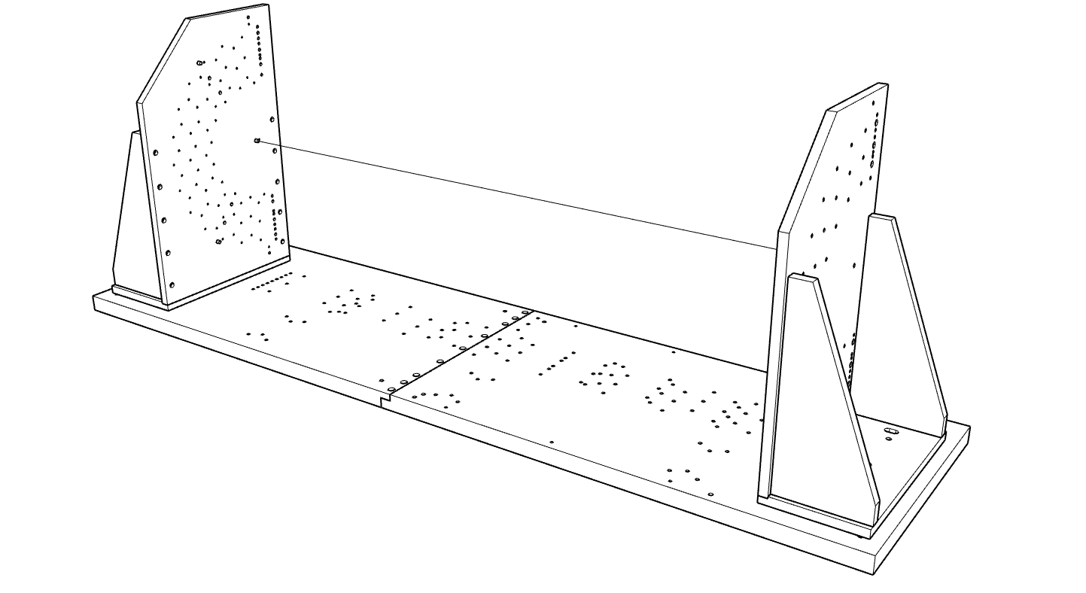
End Tower 1
End Tower 2
Nominal Centre-line
Base (2 parts)
General view of Half-cylinder assembly tooling showing base and two end tower assemblies

Slide 14
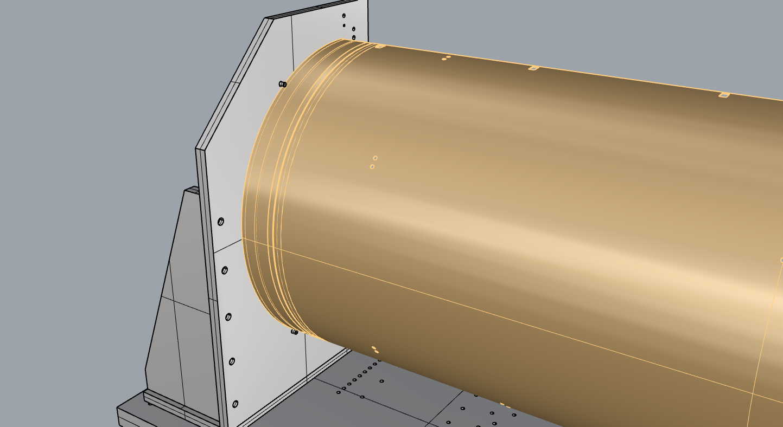
Half-Shell
End Tower
10mm location dowels

Slide 15
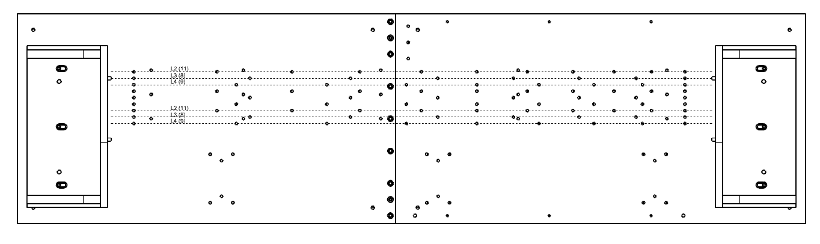
D12 Tooling Axis
The D12 Tooling Axis (nominally 210mm from the long side of the base) defines a virtual line to which all jigs and fixture that are mounted to the base are referenced to. It is formed by the line that passes through the centres of the two 12mm diameter dowel-pin holes that define the position of the End Towers.

Slide 16
End Towers
The two End Tower sub-assemblies consist of 4 plates.
  Three form the base and side supports
  The ‘front plate’ contains all the precision holes
The assembly of the towers is a complex process and requires repeated metrology / shimming / re-assembly
  Assemble as manufactured
  Measure perpendicularity of front plate and shim to make vertical
  Measure 10mm HS reference holes and adjust front plate to achieve nominal centre height of 423.00
  Measure array of holes for ruler and adjust front plate to set in-plane rotation over L4 HS diameter.
  Need to repeat metrology / shim / adjust several times to optimise everything

Slide 17
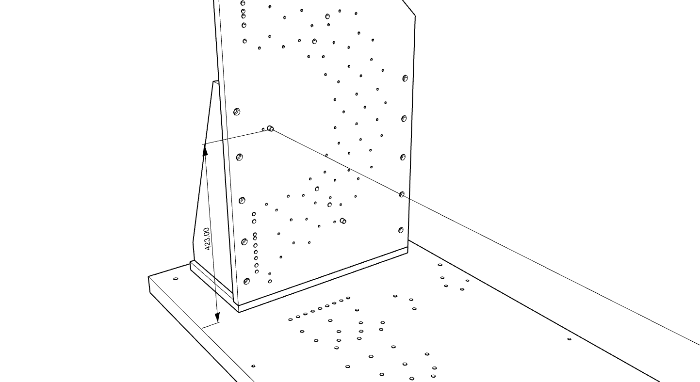
End Tower 1
Measure in-plane rotation of front-plate using (some of) these holes
Nominal Centre-line
Add shims at bolted interfaces to achieve nominal centre-line height of 423.00mm and ensure perpendicularity

Slide 18
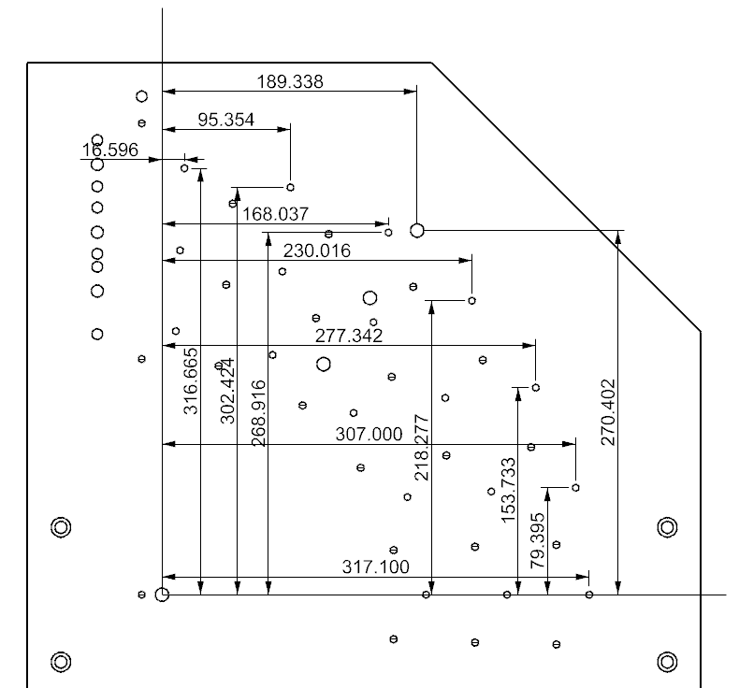
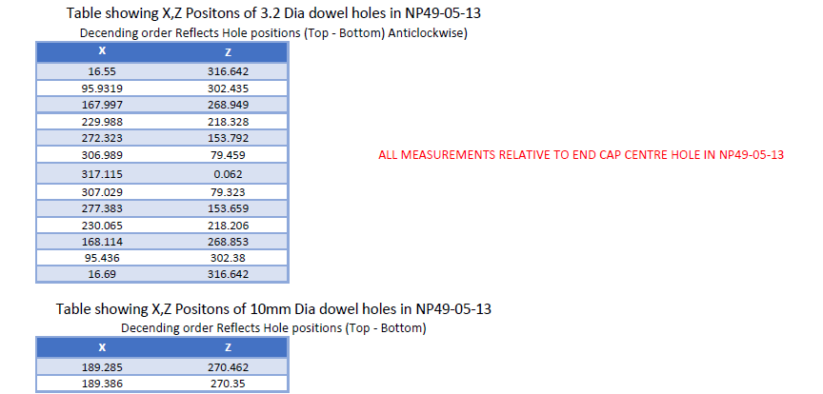
End Tower Metrology
8mm ?
8mm (H7)
NB – these measurements were done on a CMM with an accuracy of (2+L(mm)/450)µ. I don’t know what probing QC checks were made (eg how many points to measure a circle, did any measurements show large non-uniformities that might indicate problems (eg mis-probing / dirt) &c)
CAD Nominals – bottom half identical

Slide 19
End Tower Metrology
L4 10mm HS locator Centres | Nominals |  | As Measured |  | Deltas
 | x | y | x | y | x | y
Upper | 189.338 | 270.402 | 189.285 | 270.462 | -0.053 | 0.06
Lower | 189.338 | -270.402 | 189.386 | 270.35 | 0.048 | -0.052
3.2mm Dowel Pins | x | y | x | y | x | y
1 | 16.596 | 316.665 | 16.550 | 316.642 | -0.046 | -0.023
2 | 95.354 | 302.424 | 95.332 | 302.435 | -0.022 | 0.011
3 | 168.037 | 268.916 | 167.997 | 268.949 | -0.04 | 0.033
4 | 230.016 | 218.277 | 229.988 | 218.328 | -0.028 | 0.051
5 | 277.342 | 153.733 | 277.323 | 153.792 | -0.019 | 0.059
6 | 307.000 | 79.395 | 306.989 | 79.495 | -0.011 | 0.1
7 | 317.1 | 0 | 317.115 | 0.062 | 0.015 | 0.062
8 | 307.000 | -79.395 | 307.029 | -79.323 | 0.029 | 0.072
9 | 277.342 | -153.733 | 277.383 | -153.659 | 0.041 | 0.074
10 | 230.016 | -218.277 | 230.065 | -218.206 | 0.049 | 0.071
11 | 168.037 | -268.916 | 168.114 | -268.853 | 0.077 | 0.063
12 | 95.354 | -302.424 | 95.436 | -302.380 | 0.082 | 0.044
13 | 16.596 | -316.665 | 16.690 | -316.642 | 0.094 | 0.023
STDEV |  |  |  |  | 0.049 | 0.032

Slide 20
End Tower Metrology (Raw data)
NB point 2 (X) looks a bit suspicious so I’ve left it out of the fit to determine the rotation

Slide 21
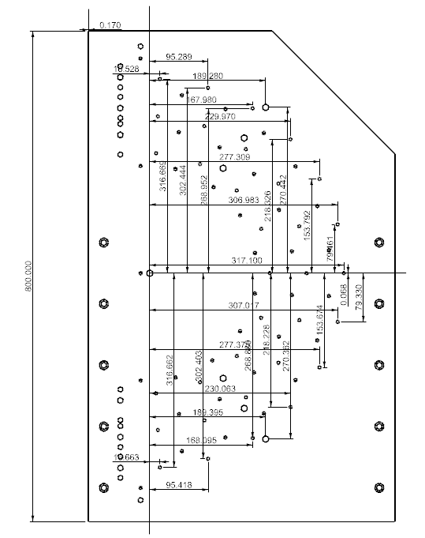
End Tower Metrology
Predicted X-Y coordinates with 0.0121°rotation
Rotation reduces range (X) from 0.14 to 0.03 and range (Y) from 0.123 to 0.06.
Suggest a reasonable goal might be +/- 0.02mm for the general tolerance of HS location pins relative to the Centre-line hole

Slide 22
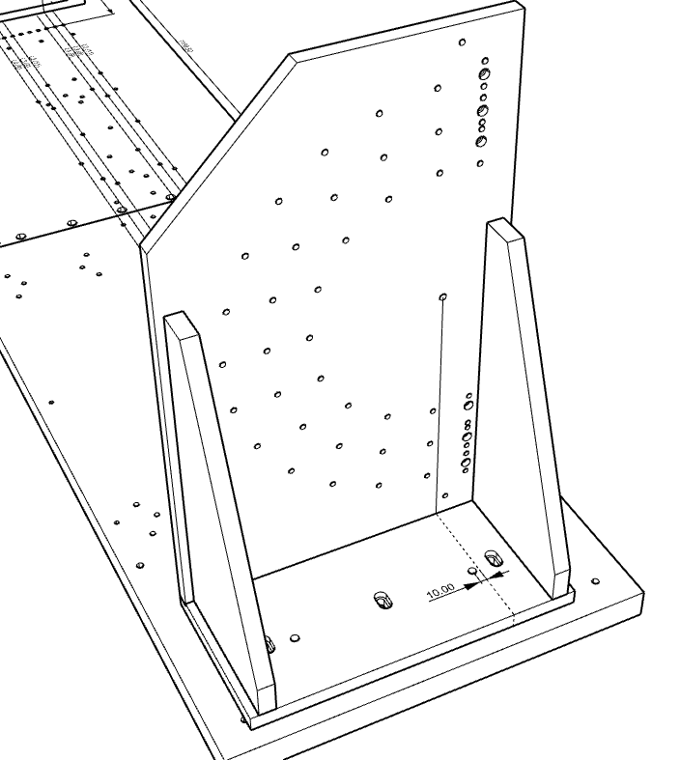
Transverse Position of 10mm HS reference Pins
The End Tower is referenced to the Base via the two D12 dowels engaging in the base. The front-plate is dowelled and bolted to the base and the triangular stiffeners.
I suggest a tolerance of +/-0.02mm for the positioning of the D10 ‘centre-line’ hole relative to the D12 hole in the base.

Slide 23
Section 3
Half-ring mounting block installation

Slide 24
HR Mounting Block Positioning Jig
HR Mounting Blocks are located using a positioning tool referenced to the tooling system base
  One tool for each layer
  Locates on the tooling system base with two D8 dowel pins
The assembly of the HR Mounting Block Jig is a complex process
  Assemble as manufactured
  Measure perpendicularity of front plate and shim joints
  Measure D3.2 HR Mounting Block location holes and adjust front plate to achieve nominal centre height (423.00mm) and rotation
  Need to repeat metrology / shim / adjust several times to optimise everything

Slide 25
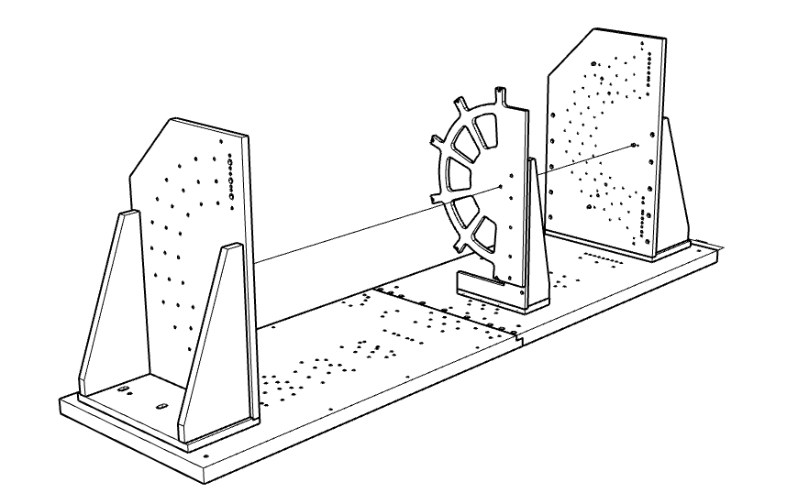
HR Mounting Block Placement Jig
End Tower 2
End Tower 1
General view showing HR Mounting Block Jig positioned on Base

Slide 26
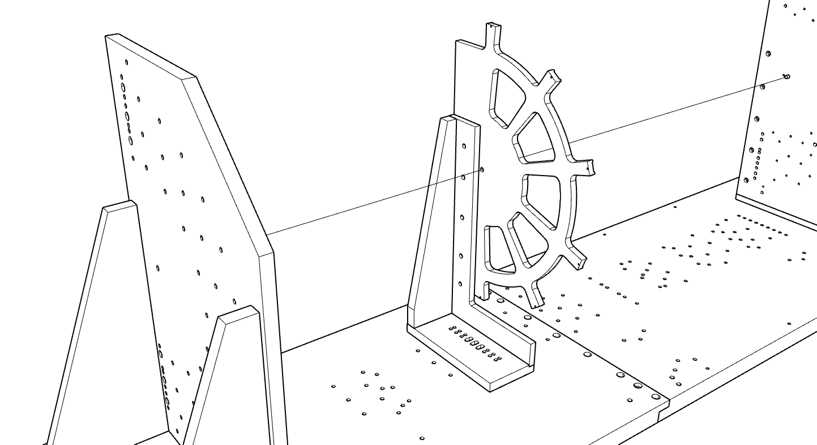
HR Mounting Block Placement Jig
Measure in-plane rotation of front-plate using D3.2 holes in fingers
Add shims at bolted interfaces to achieve nominal centre-line height of 423.00mm and non-perpendicularity over face

Slide 27
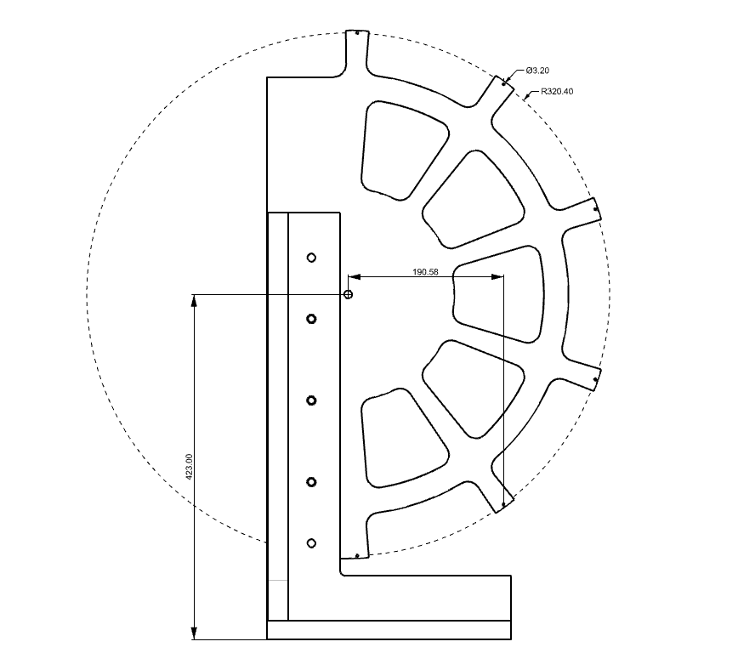
Check PCD of D3.2 holes
Check PCD centre relative to D10 hole on nominal axis.
Set D10 hole height to 423.00
Check lateral positions of D3.2 holes to control in-plane rotation

Slide 28
Transverse Positioning
The position of the HR Mounting Block Placement jig for each HR is defined by two 8mm dowels at each HR location.
Any variation in the transverse position of the 8mm dowel-holes relative to the D12 Tooling Axis will cause a transverse shift of a HR when mounted in the HS.

Slide 29
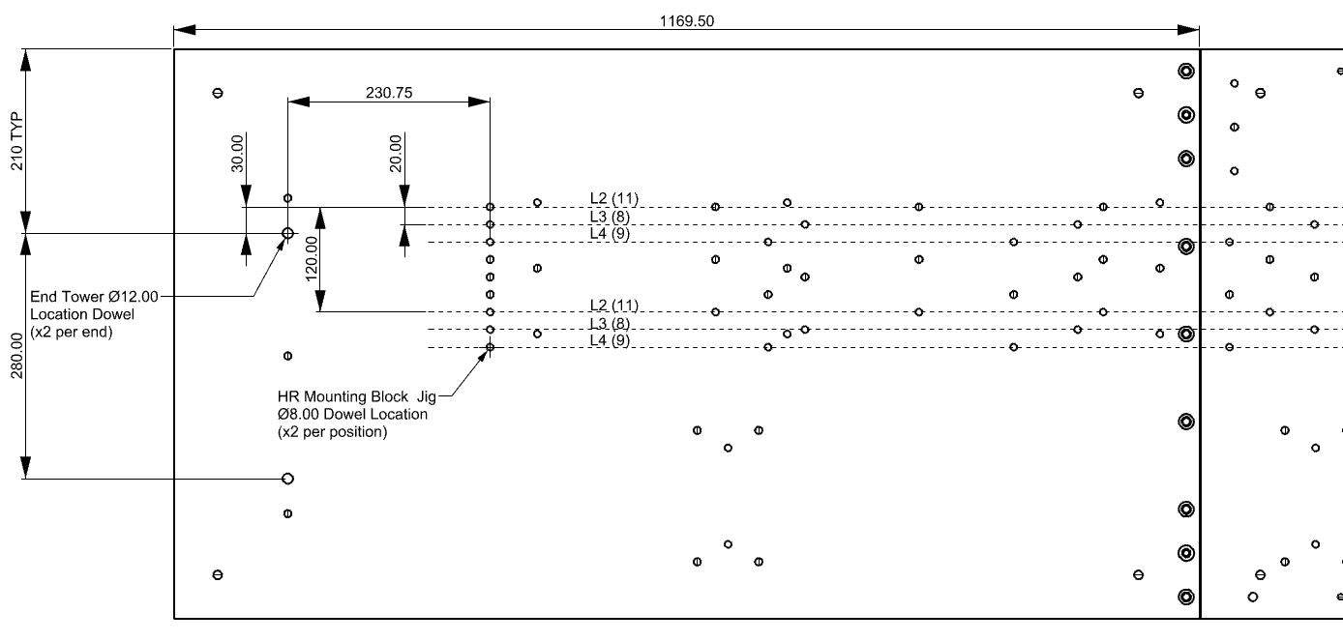
Transverse Positioning (Dimensional Detail)

Slide 30
Transverse Positioning Error
I believe measurements of the bases do exist but I do not have (on 19th December) access to the data – something to check in the new year.
  Taking analysis of End Tower at face value we should assume a general positional tolerance of +/- 0.02mm over a 1m scale.
The base is made in two parts for manufacturing reasons
  I suggest we assume that within each base (1m in length) the hole patterns are correct to +/-0.02mm AND
  Between the two base sections there is a potential (transverse) mis-alignment of the two parts relative to each other of +/- 0.02mm
Therefore, overall, relative to the D12 Tooling Axis that define the positions of the end towers I estimate the hole pattern to be good to +/- 0.04mm over the full length.

Slide 31
Section 4
Assembly Tooling Tolerance Build-up

Slide 32
Half-Shell Assembly Tolerance Build-up
Positioning of Half-cylinder
  The half-cylinder end-flanges are located with the two D10 (nominal) dowel pins in the End Towers. These are custom turned to suit the measured as-manufactured outer radial dimension of the end-flanges.
  The transverse position of the centres of the pair of D10 half-cylinder end-flange dowels can vary by +/- 0.04mm with respect to the D12 Tooling Axis.
  If the vertical separation of the two D10 dowels is incorrect then this will also lead to a transverse shift in the nominal centre-line of the half-cylinder. The measured separation of the two dowel pin holes in one end tower is 540.812 compared to the nominal value of 540.804 (0.008mm error). I assume a tolerance of +/- 0.01 so the overall transverse positioning tolerance increases from +/- 0.04 to +/- 0.05
  The height of the centres of the pair of D10 half-cylinder end-flange dowels can vary by +/- 0.07mm which puts a tolerance on the vertical height of the axis of the half-shell. However, 0.03mm of this comes from an assumed non-flatness of the base. Provided the shape of the base is stable, all half-shells will be mounted in the same manner and will be influenced by the same non-flatness.
Taking everything together we set a general tolerance on placing the outer surface of the end-flanges to +/- 0.05mm relative to the D12 Tooling Axis
See table below for a summary

Slide 33
Half-Shell Assembly Tolerance Build-up
Positioning of 4 half-shell end-flange location dowels (D10 nominal) to axis through pair of D12 End-tower Location Dowels
 | Variation | Tol. (mm) | Cause
Transverse | End-tower Centre-line hole to D12 Dowel | 0.02 | Positioning of Front-Plate relative to tower base
 | End-tower HS reference pin to Centre-line hole | 0.02 | Rotation of font-plate and general machining tolerance
 | Transverse offset from Vertical separation of HS Reference pins | 0.01
 | Linear Sum | 0.05
Vertical | Flatness of Base | 0.03 (est) | General machining tolerance of base / material relaxation. Same for all half-shells.
 | End-tower Centre-line hole to base | 0.02 (est) | Height of lip, positioning of hole pattern relative to edge
 | End-tower HS reference pin to Centre-line hole | 0.02 | Rotation of font-plate and general machining tolerance
 | Linear Sum | 0.07

Slide 34
Estimated L2 Half-cylinder envelope
From measurements of prototype L2 half-cylinder end-flanges we currently conclude that the likely radial envelope is
  Inner surface = 203.35 (violation of services space by 0.05mm)
  Outer surface = 204.25
The placement precision of the Half-cylinder in the assembly tooling is about 0.05mm in X & Y
  The envelope of the outer surface of L2 could increase to 204.25 + 0.05 = 204.30mm.
  The envelope of the inner surface of L2 could reduce to 203.35 – 0.05 = 203.30 potentially increasing the violation of the services space to 0.05mm (from half-cylinder geometrical form) + 0.05 (HC placement) = 0.10mm.

Slide 35
Half-ring Mounting Block Placement
The error on the placement of HR Mounting Blocks onto a half-shell comes from two sources
  Assuming we only use ONE HR Mounting Block Placement jig, the errors relating to the assembly of the HR Mounting Block placement jig will affect the relative position of each set of HR mounting blocks in the same way.
  The errors in the base are position-dependent and therefore will affect the placement of different sets of HR Mounting Blocks differently.
The error on the placement of the nominal centre of a half ring, as defined by the circle passing through the centres of all of the 3.2mm diameter recesses in the mounting blocks, is estimated to be +/- 0.08mm relative to the “D12 Tooling Axis”.
See table below for a summary

Slide 36
Half-ring Mounting Block Placement
Positioning of HR mounting block placement jig relative to axis through pair of D12 End-tower location dowels
 | Variation | Tolerance | Cause
Transverse | HR Mounting Block positioning jig dowel hole to D12 Tooling Axis | 0.04 | Deviation of HR Mounting Block positioning jig holes in base / mis-alignment of 2 base-parts (Z position dependent)
 | HR Mounting Block positioning jig Centre-line hole to jig dowel hole | 0.02 | Positioning of Front-Plate relative to tower base
 | HR Mounting Block positions to Centre-line hole | 0.02 | Rotation of front-plate of HR Mounting Block jig and general machining tolerance
 | Linear Sum | 0.08
Vertical | Flatness of Base | 0.03 | General machining tolerance of base / material relaxation (Z position dependent)
 | HR Mounting Block positioning jig Centre-line hole to base | 0.02 | Height of lip, positioning of hole pattern relative to edge
 | HR Mounting Block positions to Centre-line hole | 0.02 | Rotation of front-plate of HR Mounting Block positioning jig and general machining tolerance
 | Linear Sum | 0.07

Slide 37
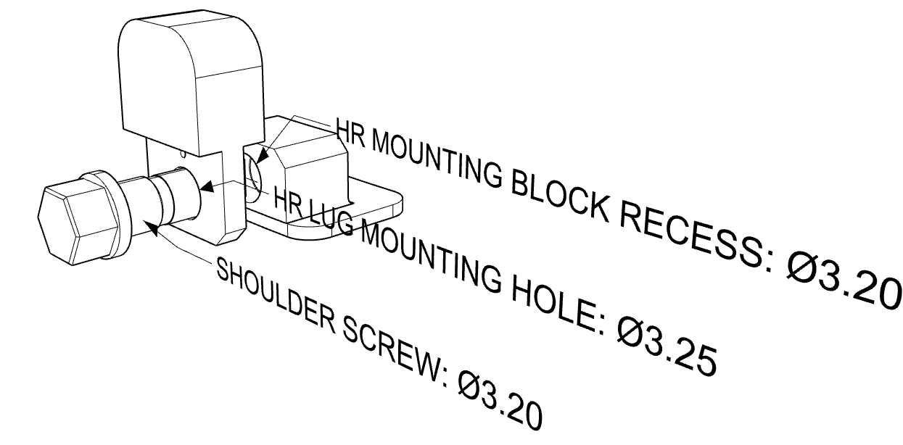
Half-ring to Half-ring Mounting Block Placement
Half-rings are fastened to the HR mounting blocks via a 3.2mm diameter shoulder screw passing through the 3.25mm diameter hole in the HR mounting lug and engaging into a 3.2mm diameter recess in the HR mounting block
  We haven’t decided how many lugs will have 3D2 shoulder screws for each half-ring – or which positions these will be in.
  We need to review & agree the tolerances on the three parts (shoulder screw, 3.25mm hole in HR lug, 3.2mm recess in HR mounting block. Here I assume 0.005mm for all three
Half-rings can shift by +/- (0.025+0.005 + 0.005 + 0.005) = +/- 0.04mm relative to the centre of the circle passing through the centres of the HR mounting block holes.

Slide 38
Section 5
Endcap Integration

Slide 39
Endcap Integration
Half-cylinders fully populated with services and half-rings are assembled to the front and rear supports to form the complete endcap
The relative position of the 6 half-cylinders is defined by pairs of 4mm dowel-screws passing through precision holes in the end-supports and into precision holes in the end-flanges of the half-cylinders
The placement accuracy of the six half-cylinders is determined by the positions of the precision holes and their diametric tolerances and by the diameter of the dowel that passes through them.
For the FS the intention is to place the six reference blocks (with the precision 4mm hole) accurately using a FS assembly jig of dimensions 0.7 x 0.7m
  Based on the metrology of an end tower one imagines that this can be done to better than +/- 0.02mm.
    What might be really neat is to use the same jig to place the corresponding blocks onto the half-shell end-flanges thereby removing a similar placement tolerance. The slight issue is then we’d have to remember which end-flange is for the left side and which for the right – but that shouldn’t be too hard.
Assuming H7 hole diametric tolerance (0/+0.012) in both precision holes the maximum positioning error of one half-cylinder relative to the FS is 0.02 + 2 x 0.006 + 0.005 (pin) = 0.037mm. For pairs of half-cylinders the relative positional accuracy will be better than 0.074mm

Slide 40
Section 6
Final Calculation of Clearances

Slide 41
Final Calculation….based on L2
Half-shells are positioned to an accuracy of +/- 0.05mm in the tooling system thereby increasing the HS envelope. Eg for L2:
  Inner envelope = 203.30
  Outer envelope = 204.30.
Half-ring mounting blocks are positioned to an accuracy of +/- 0.08 in the tooling system and half-rings can float by +/- 0.040mm relative to the HR mounting blocks so HRs are positioned to an accuracy of +/- 0.12mm.
  Outer HR radial envelope = 196.8 + 0.12 = 196.92
  Inner HR radial envelope = 146.3 – 0.1 – 0.12 = 146.08
Minium L2 services gap = 203.30 – 196.92 = 6.38 (0.22mm violation)

Slide 42
Final Calculation – Extrapolation to L3 & L4
Half-Shell Envelope
  L3: Inner surface = 264.05 -0.05 - 0.15 - 0.6 + 0.1 = 263.35
  L3: Outer Surface = 264.05 +0.05 + 0.15 + 0.1 = 264.35
  L4: Inner surface = 325.10 -0.05 - 0.15 - 0.6 + 0.1 = 324.40
  L4: Outer surface = 325.10 +0.05 + 0.15 + 0.1 = 325.40
HR Envelopes
  L3: Inner Radius = 206.35 – 0.1 – 0.12 = 206.13
  L3: Outer Radius = 256.85 + 0.12 = 256.97
  L4: Inner Radius = 266.40 – 0.1 – 0.12 = 266.18
  L4: Outer Radius = 316.9 + 0.12 = 317.02

Slide 43
Clearances
Services Gaps
  L2: 203.30 - 196.92 = 6.38 (historically 6.60)
  L3: 263.35 - 256.97 = 6.38 (historically 6.60)
  L4: 324.40 - 317.02 = 7.38 (historically 7.60)
Half-ring to inner Half Shell
  L3 to L2: 206.13 (HR-IR) - 204.30 (HC-OR) – 0.074 (HC-HC) = 1.76 (historically 2.35)
  L4 to L3: 266.18 (HR-IR) - 264.35 (HC-OR) – 0.074 (HC-HC) = 1.76 (historically 2.35)
Clearance to Global EC Envelopes
  Outer: 327.00 - 325.40 - 0.037 (HC-FS)= 1.56 (historically 1.9)
  Inner: 146.08 - 145.00 – 0.037 (HC-FS)= 1.04 (historically 1.3 but total clearance to IST envelope = 3.3)

Slide 44
Gravitational Deformation
In preparation for the GM&I PDR I carried out an FEA of the global structures using a simplified CAD model and idealised interfaces between the mating components.
The following load-cases were considered….
For Load Case 6, figure 39 of the report (AT2-IP-EN-0024) showed the vertical displacement of the half-rings due to the effect of gravity
  The maximum displacement (L4 R6) is 0.06mm and near-by half-rings in layers 3 and 2 deflect by about 0.035mm.
Load Case | Component Mass in model (kg) |  |  |  |  |  |  | F Calc (N) | Slider Reaction Forces (N) |  |  |  | F Sum (N)
 | Struct. | Type1 Electrical | Type1 Cooling | Half-rings | OB Services | Inner Pixels | Mass |  | Front Vee | Front Flat | Rear Vee | Rear Flat
1 | 12.8 |  |  |  |  |  | 12.8 | 126 | 28 | 27 | 36 | 35 | 126
2 | 12.8 | 24.3 |  |  |  |  | 37.1 | 364 | 71 | 71 | 112 | 109 | 364
3 | 12.8 | 24.3 | 4.7 |  |  |  | 41.8 | 410 | 80 | 80 | 127 | 123 | 410
4 | 12.8 | 24.3 | 4.7 | 13.8 |  |  | 55.6 | 545 | 122 | 118 | 152 | 152 | 545
5 | 12.8 | 24.3 | 4.7 | 13.8 | 53.6 |  | 109.2 | 1070 | 259 | 244 | 281 | 287 | 1071
6 | 12.8 | 24.3 | 4.7 | 13.8 | 53.6 | 76.8 | 186.0 | 1823 | 455 | 425 | 465 | 479 | 1824

Slide 45
Gravitational Deformation

Slide 46
Gravitational Deformation
Caveats
  The FEA was not done by an expert
  The CAD model is heavily-abstracted from the real 3D geometry to simplify modelling and constrain the number of elements.
  The material properties and loads may be out-dated.
On face value
  The differential gravitational deformation between half-rings of neighbouring layers is less than 0.03mm
  This reduces the clearance between the inner rim of L4/R6 and the outer surface of L3 from 1.76mm to 1.76-0.03 = 1.73 mm at the top
  The deformation of L2 is about 0.03mm so the clearance to the nominal OE inner envelope reduces to 1.04 – 0.03 = 1.01mm

