Slide 1
Outer System Integration and Testing
Endcap Integration workshop
1.2.2023
Diego Alvarez Feito CERN, Susanne Kuehn CERN, Sebastien Michal Uni Geneva

Slide 2

Introduction OS Integration
OB, ECs & IST assembled together in SR1 on the OS Integration Tool
Temporary IST supports
OB Service Trolleys
OB Service Trolleys
OB Service Trolleys
EC-C
Outer Barrel
EC-A
OB Service Trolleys
EC Service Trolleys
IST
EC Service Trolleys
IST
OB Service Trolleys
OB Service Trolleys
OB Service Trolleys
OB Service Trolleys
Service Support Shells
Material from Diego’s slides: https://indico.cern.ch/event/1315511/

Slide 3
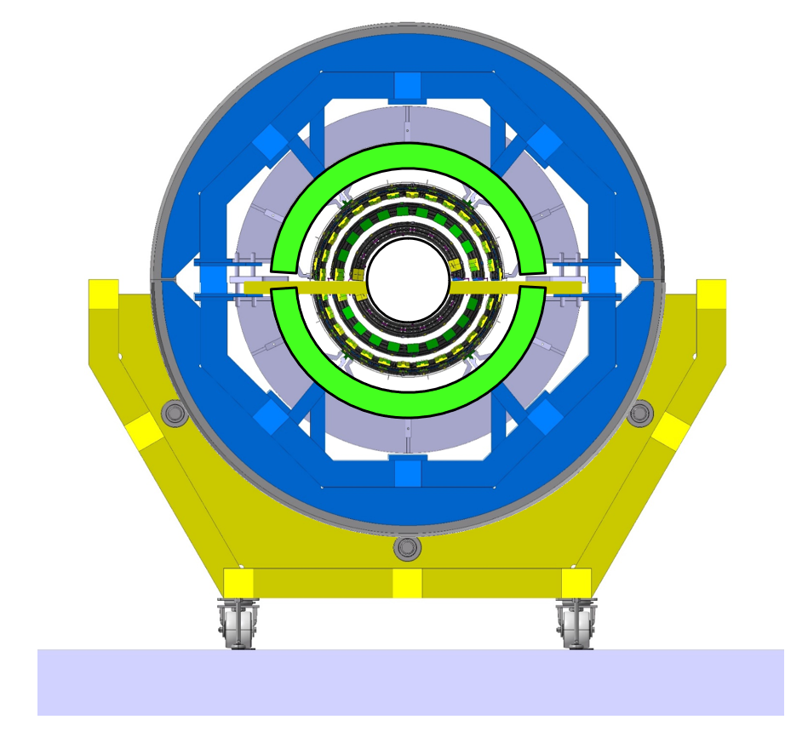
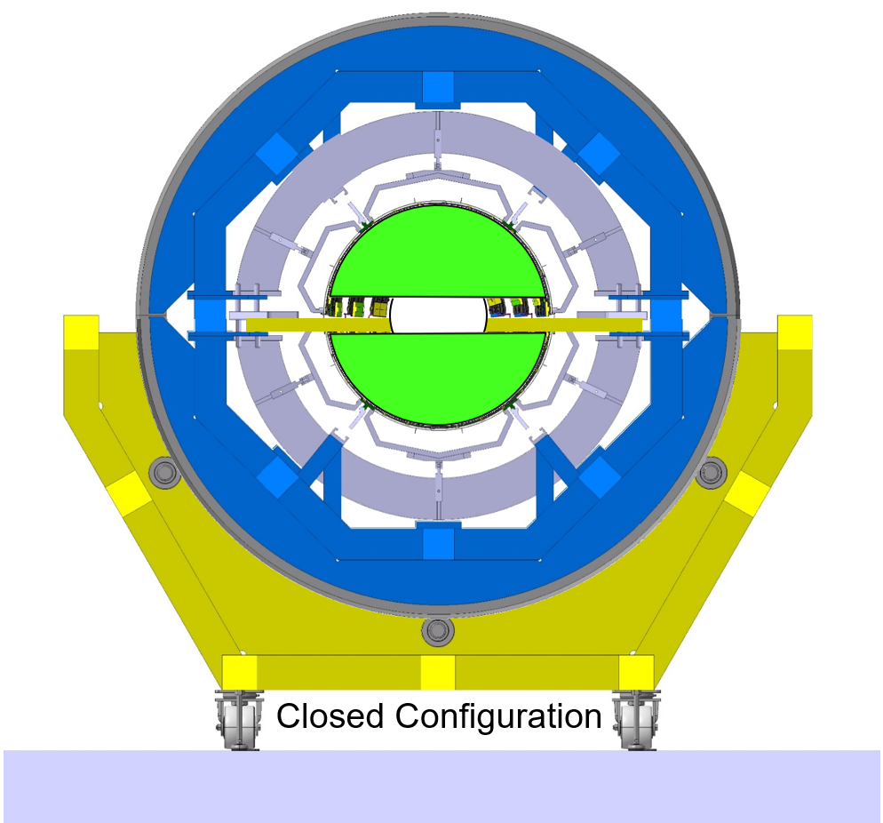
Outer Barrel Preparation for OS Integration
Outer Barrel already installed in the Outer System tool
Service support shells in open configuration (3-4mm radial gap)
OB service trolley in open configuration to clear the way for ECs
“Open” OB Service Trolleys
Open Configuration

Slide 4
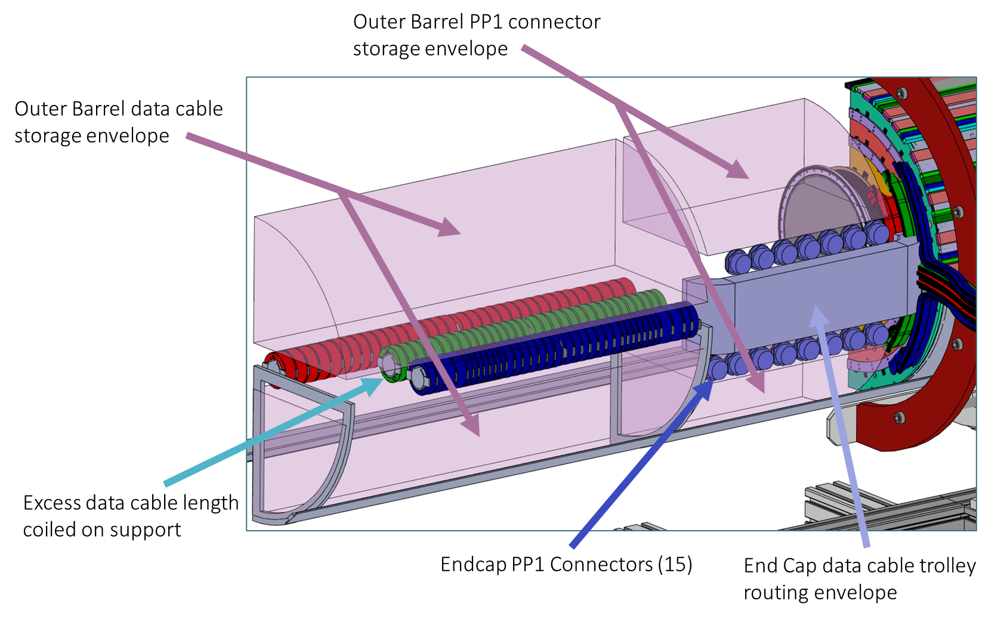
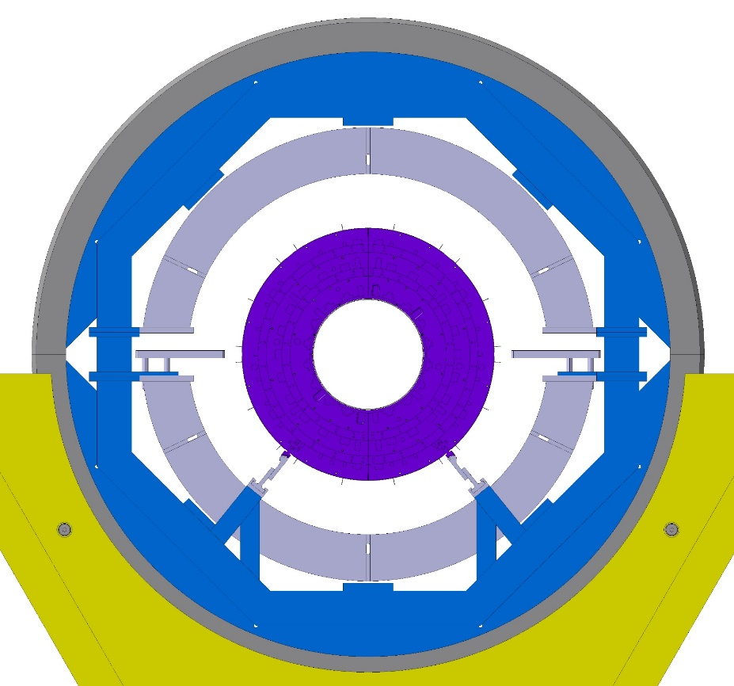
Endcap Preparation for OS Integration
Reception test after transport to SR1
Disconnection of off-detector services and trolley with type-1 services in configuration for insertion
Compact trolley configuration for insertion into OS Integration tool
EC Trolley

Slide 5
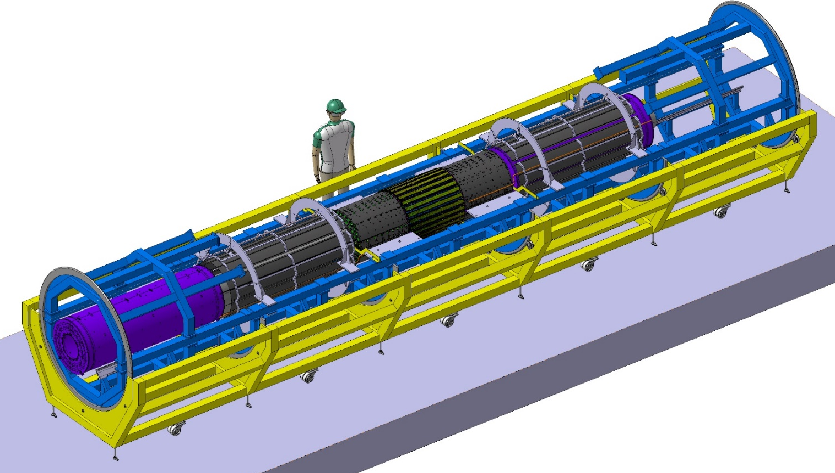
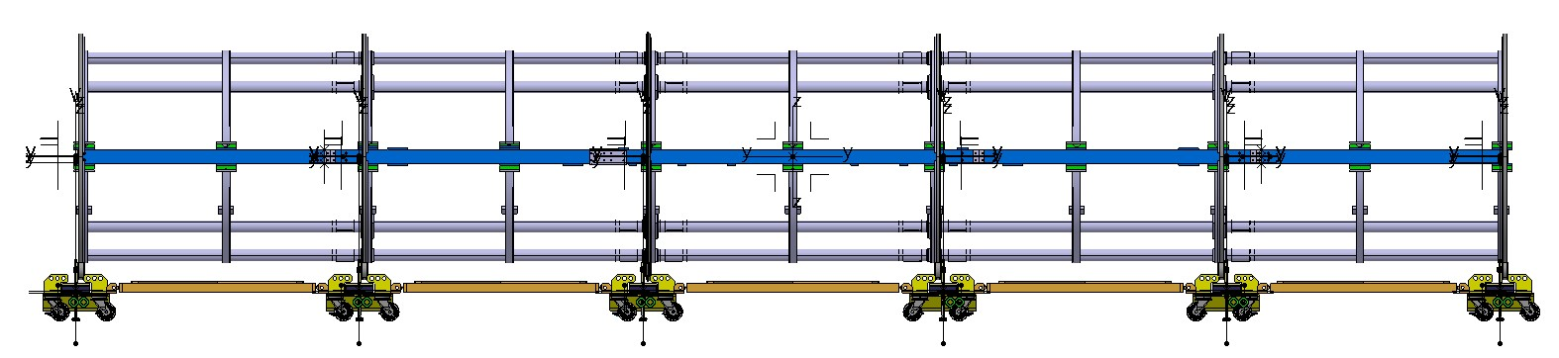
Endcap insertion
Alignment of EC and OB tools; Install rail extensions
EC-A inserted first; EC-C after
Transfer IST from temporary brackets to final supports on EC flanges
Connection to OB via OB-EC interlinks (2 interlinks with ball joints for z-coupling)
EC-A
EC-C
Trolleys not shown
~1066mm
O. JAMET

Slide 6
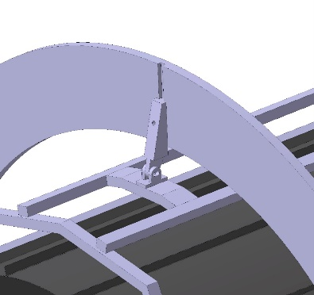
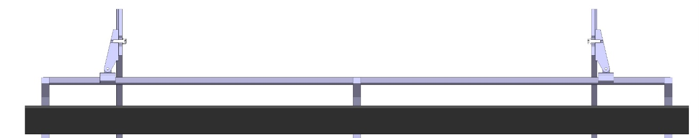
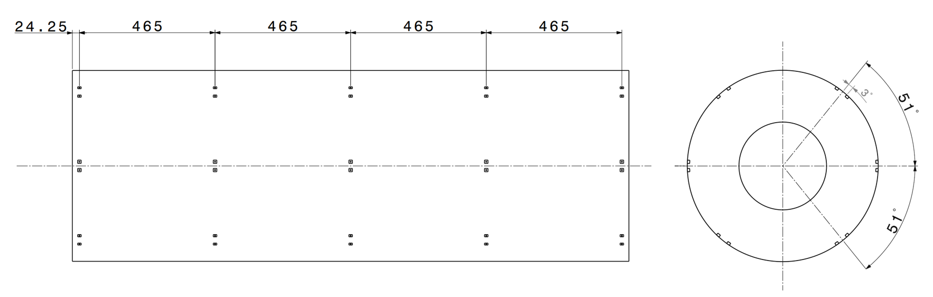
Outer Barrel closure after Endcap insertion
Closure of OB Service support shells and weight transfer to ECs
  Closing system with guiding slots for handling frames
  Service support shells bolted to ECs via threaded inserts bonded to the EC shells
Closure of OB trolleys around EC trolleys and weight transfer to rails
Fine adjustment of OB & EC support points if needed (pre-alignment & load distribution)
OBH1 Trolley
EC Trolley
OBH2 Trolley
Threaded inserts bonded to the EC to fix the service support shells

Slide 7
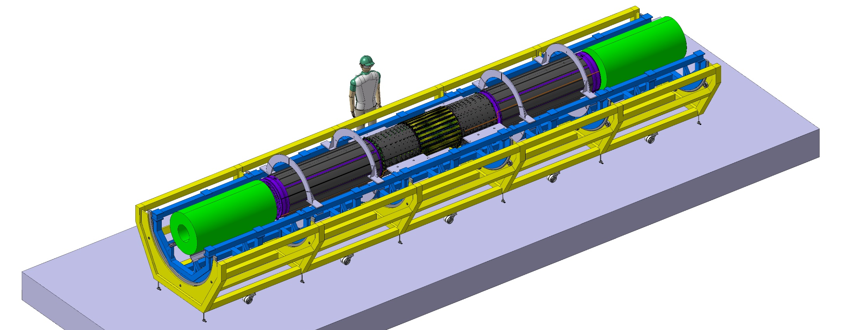
Outer Barrel Closure after Endcap Insertion
Closure of OB Service support shells and weight transfer to ECs
  Closing system with guiding slots for handling frames
  Service support shells bolted to ECs via threaded inserts bonded to the EC shells
Closure of OB trolleys around EC trolleys and weight transfer to rails
Fine adjustment of OB & EC support points if needed (pre-alignment & load distribution)
2.2m
10m

Slide 8
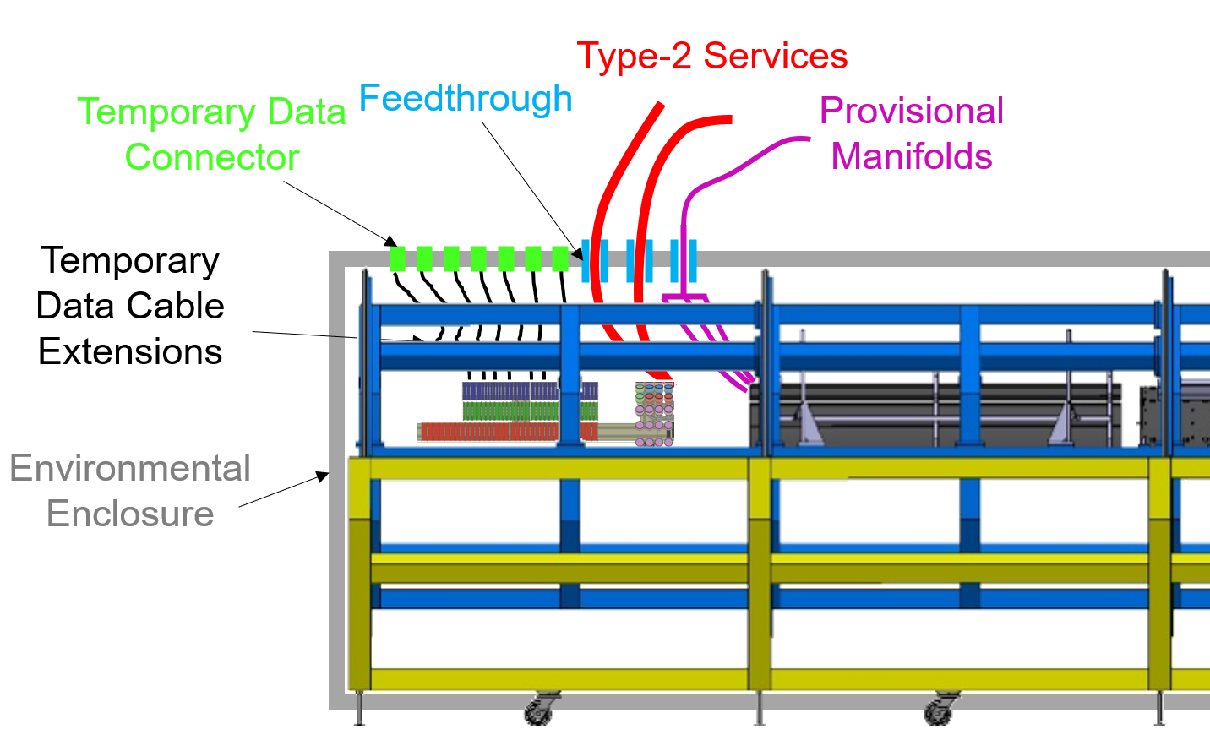
Testing of Outer System
Envelope check to verify that the 5 wagons are within R343.7mm for PST insertion
Electrical tests to verify installation of EC and OB in OS didn't degrade the units
Tests inside of temporary environmental enclosure for the electrical tests of the OB/EC/OS
  Removable panels for the integration/work on the detector
  Light, modular structure with seals for light and gas-tightness (Very large dry volume, ~20-30m³)
Patch panels at the extremities for temporary cooling and electrical connections
  Constraints from the temporary services (e.g. length of data extensions)
  Constraints in the position of the opto-panels
Design effort needed

Slide 9
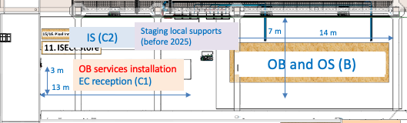
Electrical Test of Outer System
Electrical tests to verify connectivity inside of environmental enclosure
  Same testing steps as before during integration, re-use of connectivity files
  Connectivity test: min health test, IV, SP-LV
  OB: 504 LINKS, 56 SP-chains, EC: 528 LINKS, 16 SP-chains
  Warm temperature of modules (around 20°C)
Cooling racks for OS: piping for EC outlet to setup to be provided by EC team
Same 2 blue racks and piping, cables now to route to OS
2 Cooling FT on A- and 2 FT on C-side with power and flow equivalent to 1 PP1 CFT (1 loop for OB and 1 for EC (in OS))
In rack room: using same racks as before
staging
Hand-over to ITk Common Mechanics for insertion into ITk

Slide 10
SPARE

Slide 11
Test sequence
Final set of electrical tests to verify connectivity: SP-chain powering and configuration of FEs
Same sequence as ran during OB and EC integration individually → Usage of same connectivity files
Test Step | Endcaps |  |  | Outer Barrel
 | Detector Tested Section | # SP Chains | #Data (up/down) Links | Detector Tested Section | # SP Chains | #Data (up/down) Links
1 | 6xHRs (A&C) L2 left | 24 | 768/192 | OBH2-IU2-A & OBH2-IU2-C | 24 | 384/192
2 | 6xHR (A&C) L2 right | 24 | 768/192 | OBH1-IU2-A & OBH1-IU2-C | 24 | 384/192
3 | 5xHR L2 (A&C) left | 20 | 320/160 | OBH2-BH2 | 32 | 576/288
4 | 5xHR L2 (A&C) right | 20 | 320/160 | OBH1-BH2 | 32 | 576/288
5 | 8xHR L3 (A&C) left | 32 | 704/352 | OBH2-IU3-A & OBH2-IU3-C | 32 | 352/352
6 | 8xHR L3(A&C) right | 32 | 704/352 | OBH1-IU3-A & OBH1-IU3-C | 32 | 352/352
7 | 5xHR L4 (A&C) left | 20 | 260/260 | OBH2-BH3 | 44 | 396/396
8 | 5xHR L4 (A&C) right | 20 | 260/260 | OBH1-BH3 | 44 | 396/396
9 | 4xHR L4 (A&C) left | 16 | 312/208 | OBH2-IU4-A & OBH2-IU4-C | 36 | 504/504
10 | 4xHR L4 (A&C) right | 16 | 312/208 | OBH1-IU4-A & OBH1-IU4-C | 36 | 504/504
11 |  |  |  | OBH2-BH4 | 56 | 504/504
12 |  |  |  | OBH1-BH4 | 56 | 504/504

Slide 12
Information to store in the PDB
• Results of the reception tests for each component
• Results of the metrology survey
• Results of the module calibration test
• Results of the leak and pressure tests
• Results of the electrical tests
  Comparison to electrical (readout, IV) results and configs from previous assembly steps for comparison
  Mass

