Slide 1
Fibre Optic Sensors (FOS) for ITk humidity monitoring – Update
Simon Connell¹, L Truong¹, Lerothodi Leeuw², Doomnull Unwuchola², Xola Mapekula¹, Matt Connell¹,
1. University of Johannesburg (UJ),
2. University of the Western Cape (UWC),

Slide 2
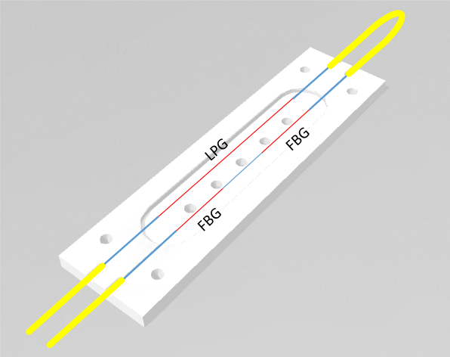
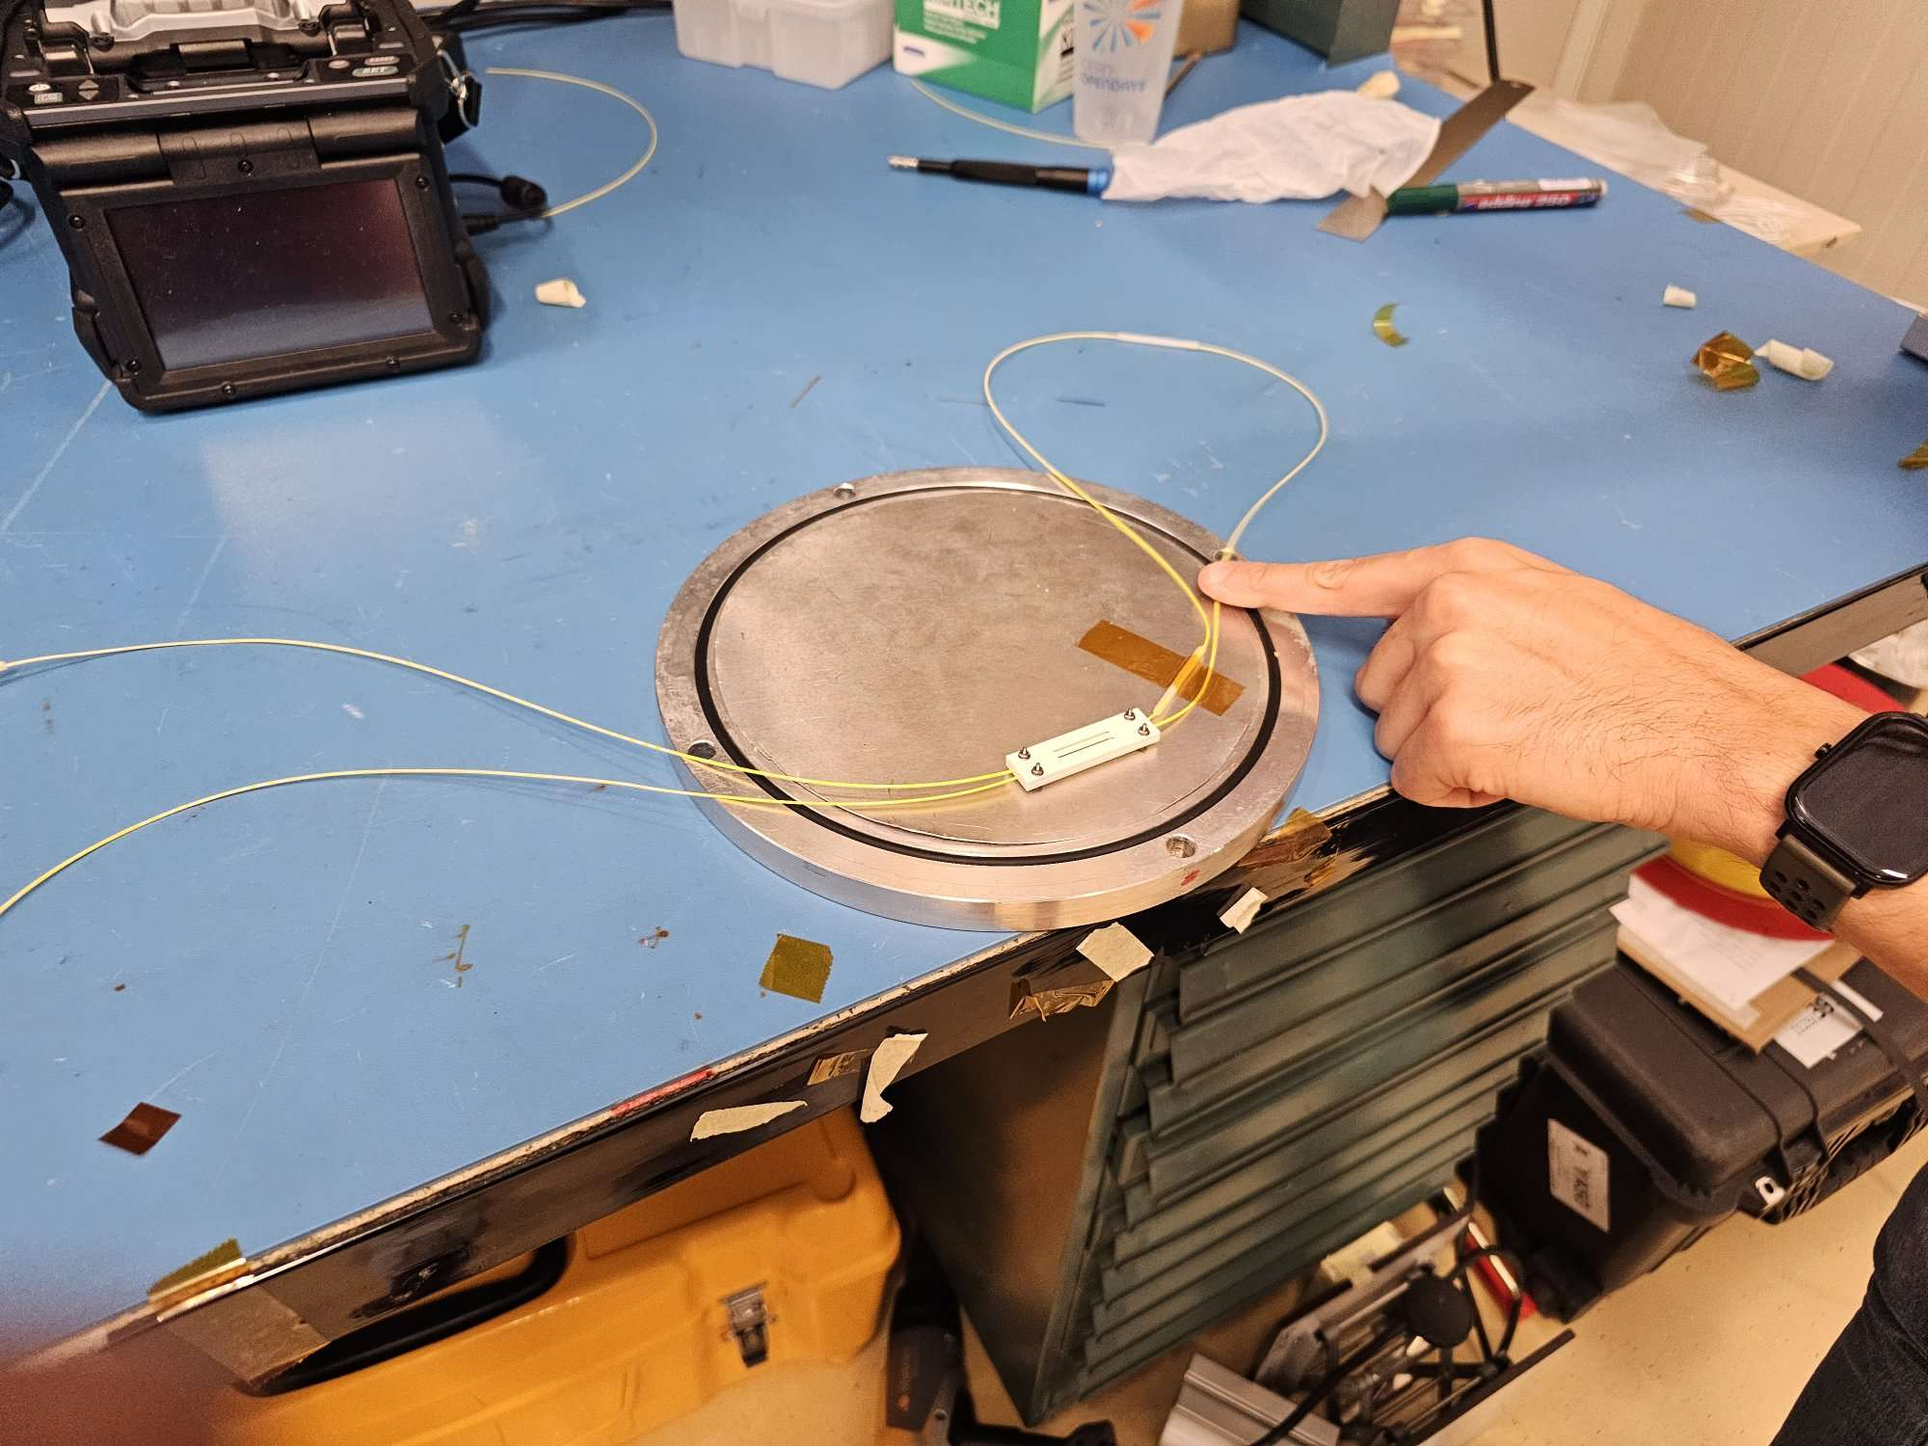
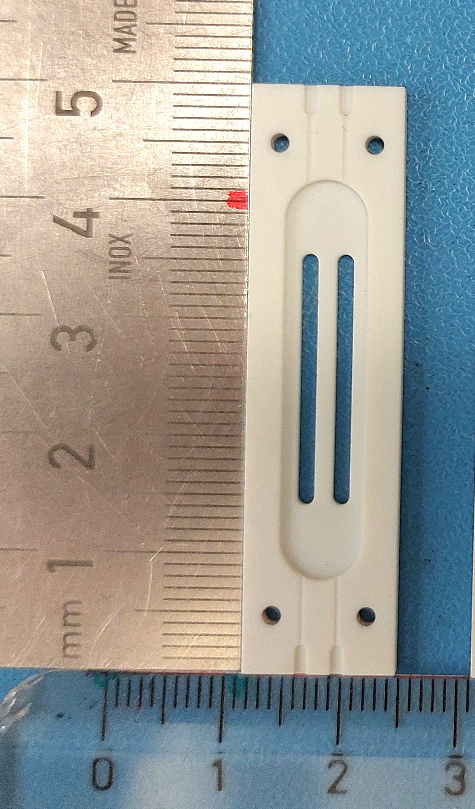
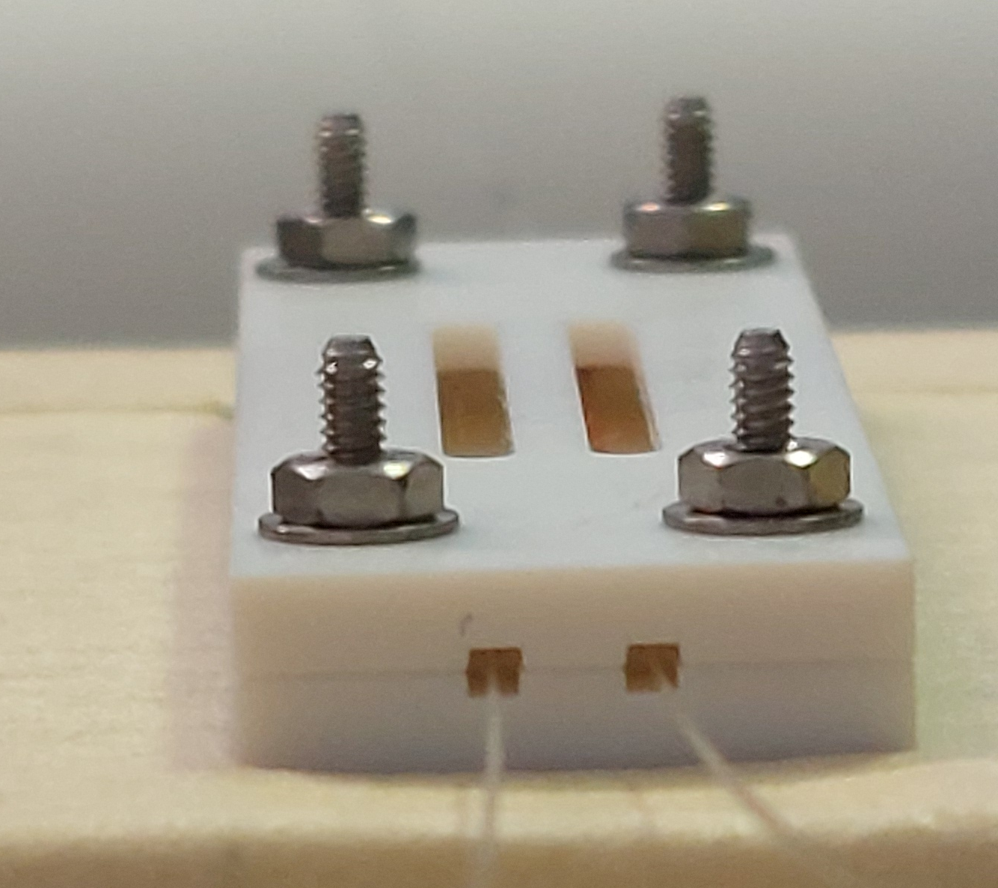
The FOS Package
The FOS package:
1x Pt10k – conventional temperature sensor
1x Honeywell HIH400 – conventional humidity sensor
1x LPG (long period grating) – FOS to measure humidity
2x FBG (Fibre Bragg Grating) – 1 Radiation-soft (to measure dose), 1 Radiation-hard (to measure temperature)
2x Neoceram plates (50x18x4mm), tightened with titanium screws
NOTE: fibre minimum bend radius 15mm
*Discussed further at end of talk
Fibre length AB: 250-300mm*
50mm
A
B
to MTP connector
18mm
4mm
Package dimensions

Slide 3
Procurement Status
.
All ingredients are ordered up to 25%
Final FDR concerns need to be addressed before 75% order
Item | Source | # | 25% | Status | 75% | Status | Lead time (weeks)
MTP Connector | Via CERN | 12 | - | - | - | Arrived | 3
LPG | University of Sannio | 64 | 16 | Ordered: 21 Dec 2023 | 48 | To order | 7 – 14
FBG Radiation soft | FiberCore, FBG UV from Fibercore B/Ge 1250/1500 fiber, Laser Components | 64 | 16 | Ordered: 23 Jan 2024 | 48 | To order | 6-8
FBG Radiation hard | FBG FEMTO written on Fujikura rad-hard fiber RRSMFB from Engionic Femto Gratings | 64 | 16 | Ordered: 23 Jan 2024 | 48 | To order | 6-8
NeoCeram Plates | TOP SEIKO CO., LTD | 70 | - | - | - | Ordered: 13 December 2023 | 10
PEEK Wire, type 0 | Polyflour | - | - | - | 1km twisted double 1km twisted triple | Ordered: 08 August 2023 | 18
HIH4000 | RS-Online | 64 | 16 | Arrived | 48 | To order | 1
Pt10k | IST-AG P10K.520.2K.Y.1400.D.S | 64 | 16 | Arrived | 48 | To order | -

Slide 4
Production Status
25% FOS production to begin as soon as FBG and LPGs are delivered.
Production process
Package assembly: 2-3 hours
Calibration tests: 3 days
Packaging: 1 hour
Currently done in batches of 2 sensors – looking to move to 4
Personnel at CERN
FOS packages are assembled at the EP-DT lab, Meyrin Bdg. 168, R-G14
Xola: Present – July 16th
Doomnull: Feb. 5th – May
Matt: Feb. 2nd – April 30th
2 more students will be trained in FOS assembly.
Code package
Automates full process of raw data
Goal is for it to be easily downloaded and used by non-experts.

Slide 5
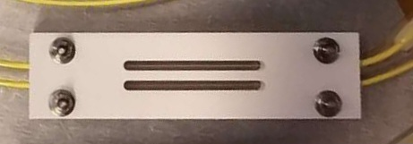
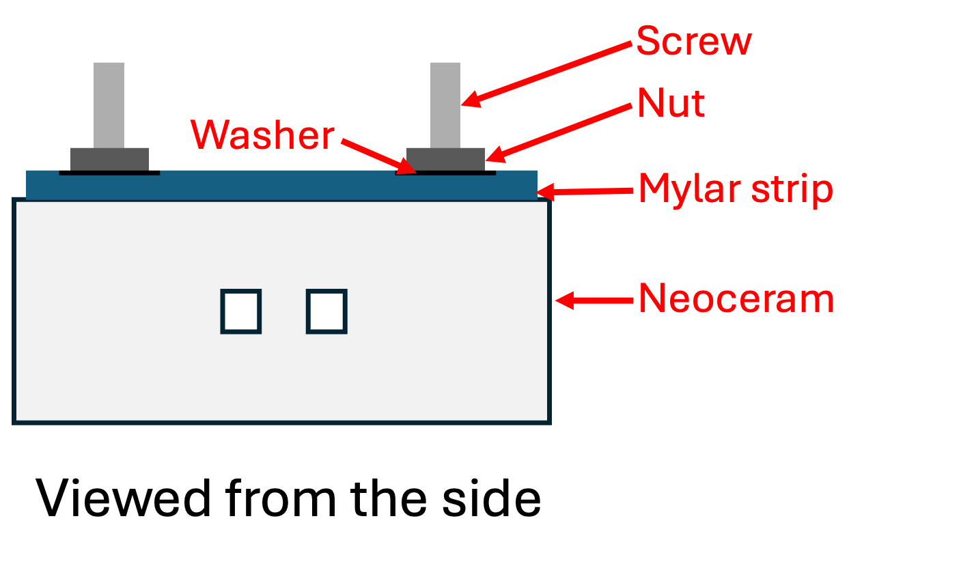
Grounding Discussion
Issue raised recently by Strips
Titanium screws may become charged under radiation.
Must be grounded to avoid this.
Proposed solution: use an aluminised Mylar strip and wire to ground the screws to the carbon fibre (CF) structure.
Strip can be secured by the nuts
Can be incorporated into the assembly process.
Aluminised mylar strip
Grounding wire to carbon fibre (CF)
Designs not finalized – the holes around the screws are exaggerated to make screws visible (LEFT) and thickness is exaggerated (RIGHT)

Slide 6
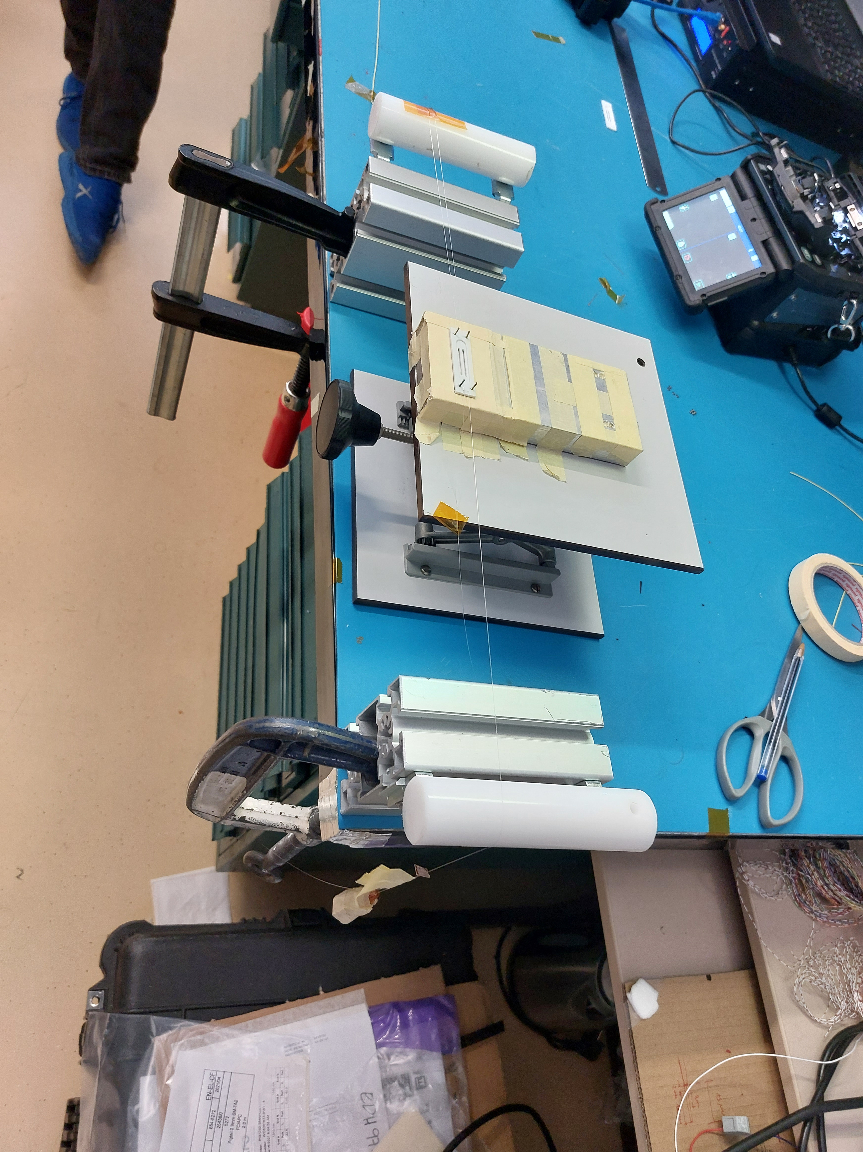
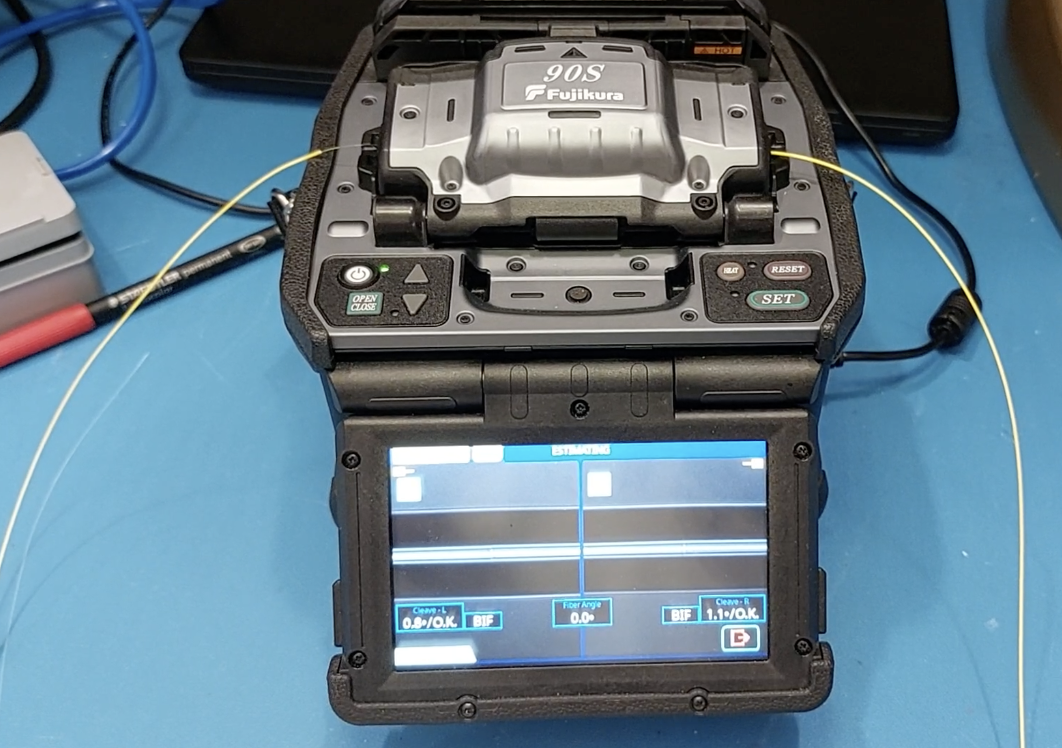
Notes on assembly process
Minimum bend radius 15mm
Securing sensors in the package:
LPGs ordered with extra fibre spliced to the sensor (hence splice 1).
LPG is on a separate fibre to FBGs – this is because it requires a pre-strain.
Sensors are secured in the Neoceram.
Finally, the two fibres are joined: (hence splice 2) – to fit in the splicer you need a decent length of fibre (bottom left image)
Fibre length AB: 250-300mm
2
A
1
B
Bottom right: FOS assembly, pre-strain applied with a weight (3).
LPG fibre
3
FBGs fibre

Slide 7
Shortening the length AB
Minimum bend radius 15mm
Simple changes
AB length easily reduced to 200mm
Splices easily reduced to 30mm, potentially 20mm.
Possible further changes
1. Different assembly process – splice fibres before applying pre-strain to LPG
Would require a lot of testing
Likely very tricky
2. Fold AB over the Neoceram
Must keep in mind min. bend radius
Request LPG splice further from the sensor itself
Fibre length AB: 250-300mm*
2
A
1
B
C
1
<15mm

Slide 8
Backup
ITk FOS brief info – Matt Connell

Slide 9
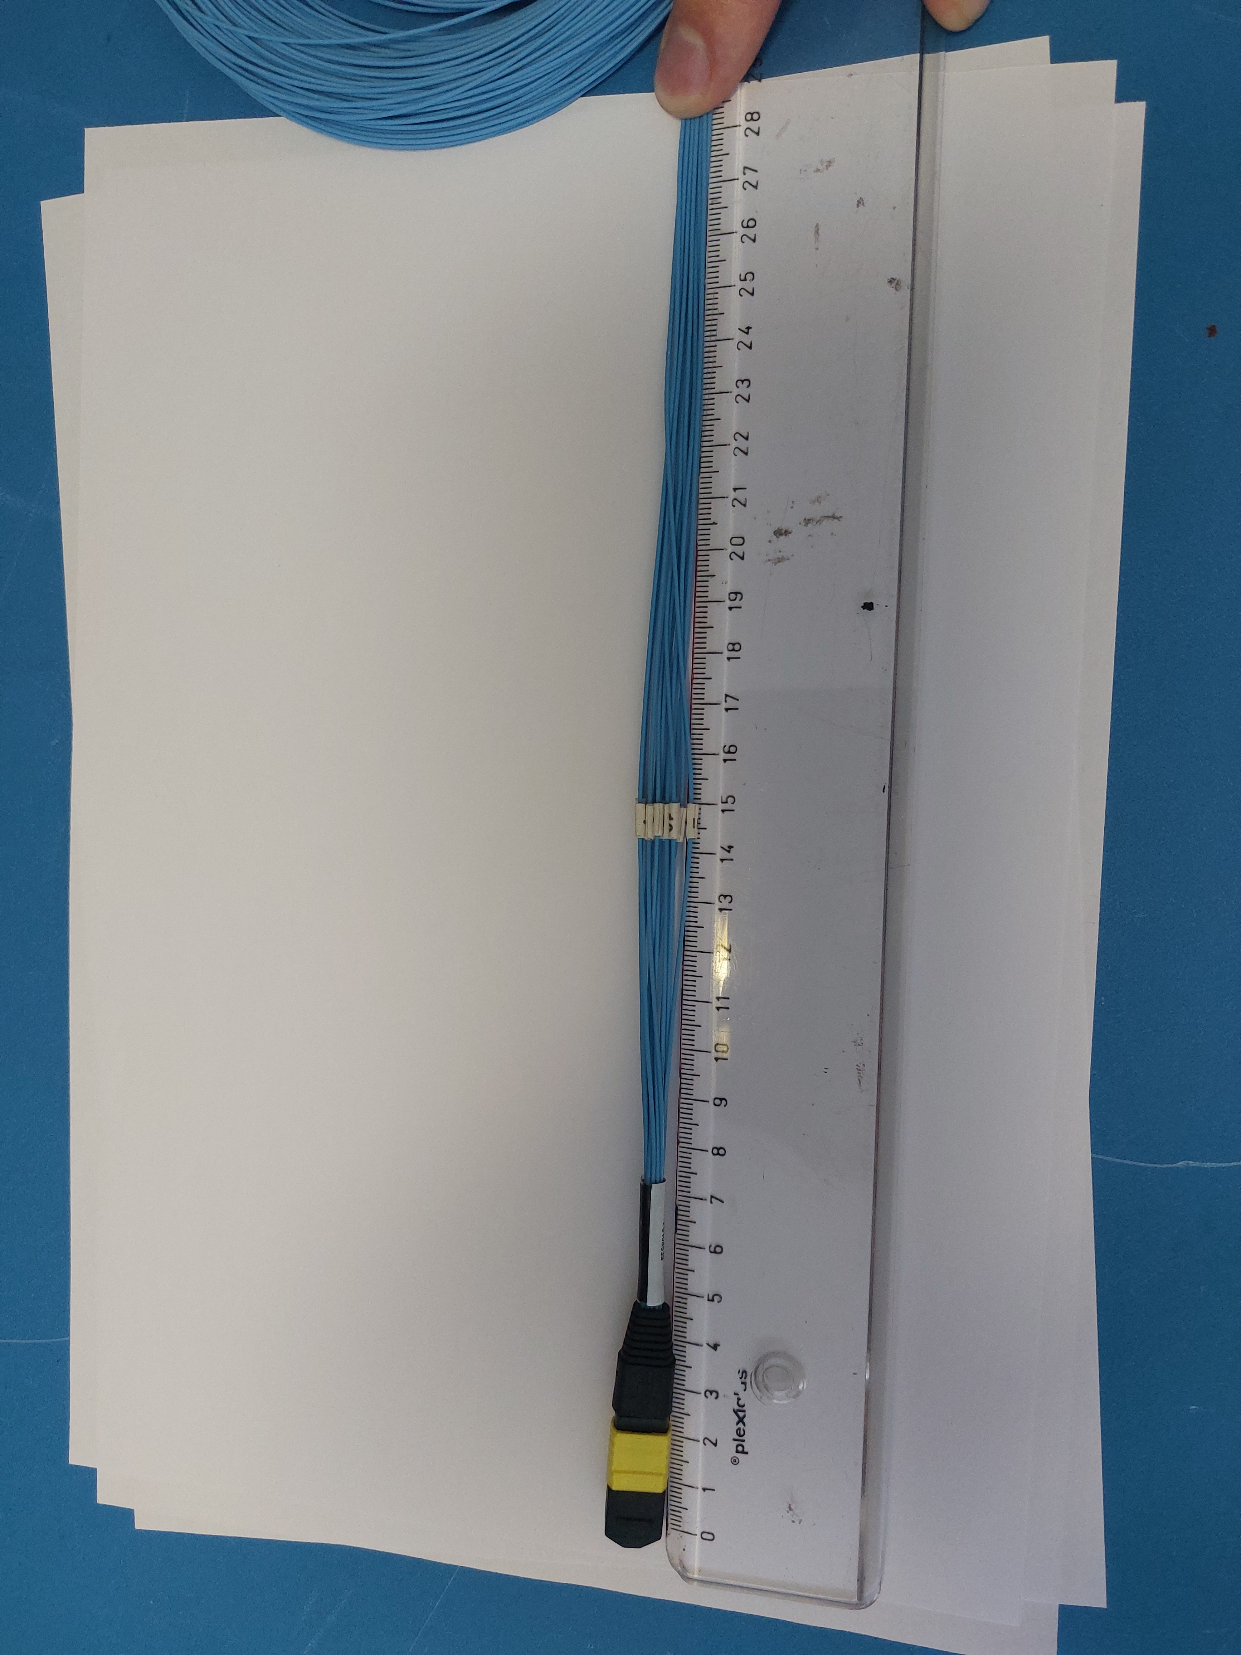
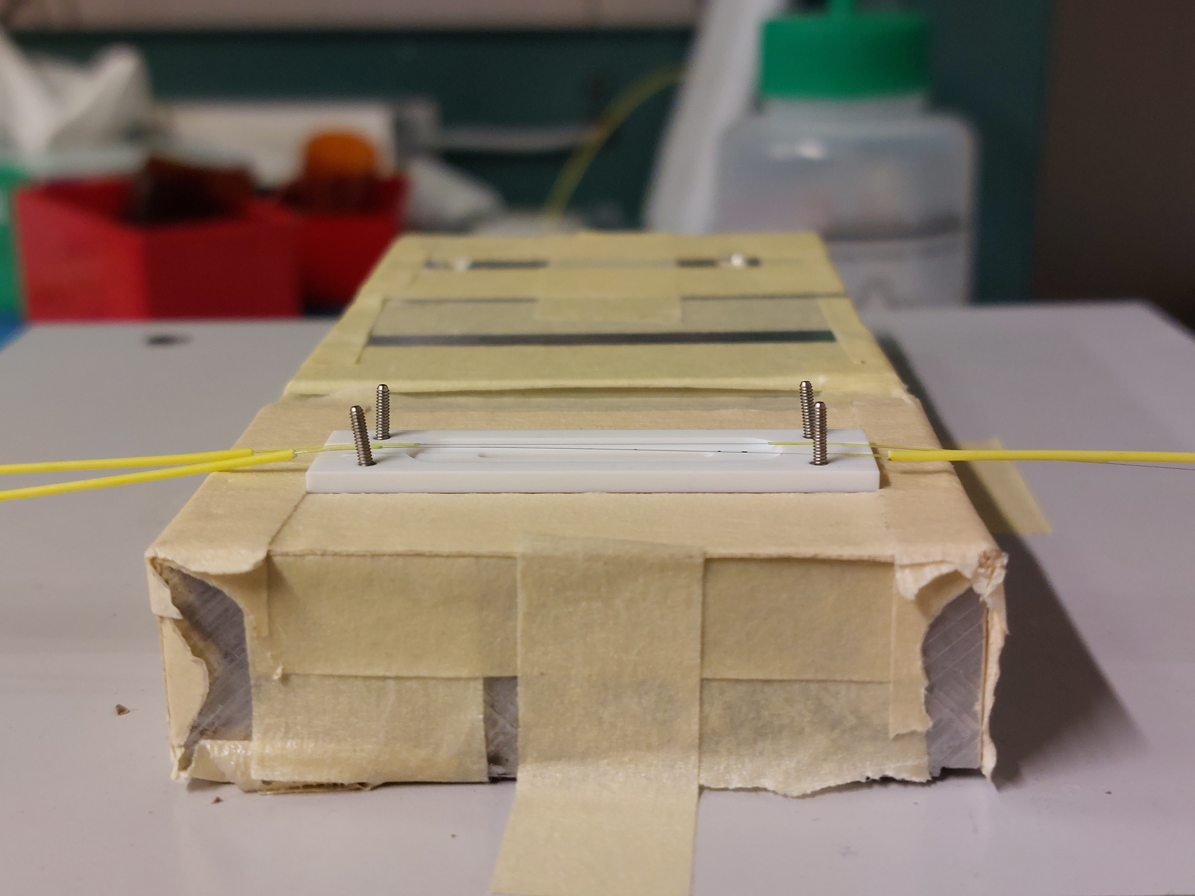
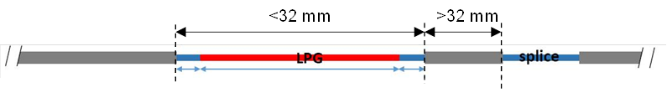
Operation
.
FOS are affected by temperature, dose and relative humidity.
Knowing initial values of these variables, the combination of LPG and both FBGs can be used to extract variations in all three variables.

Slide 10
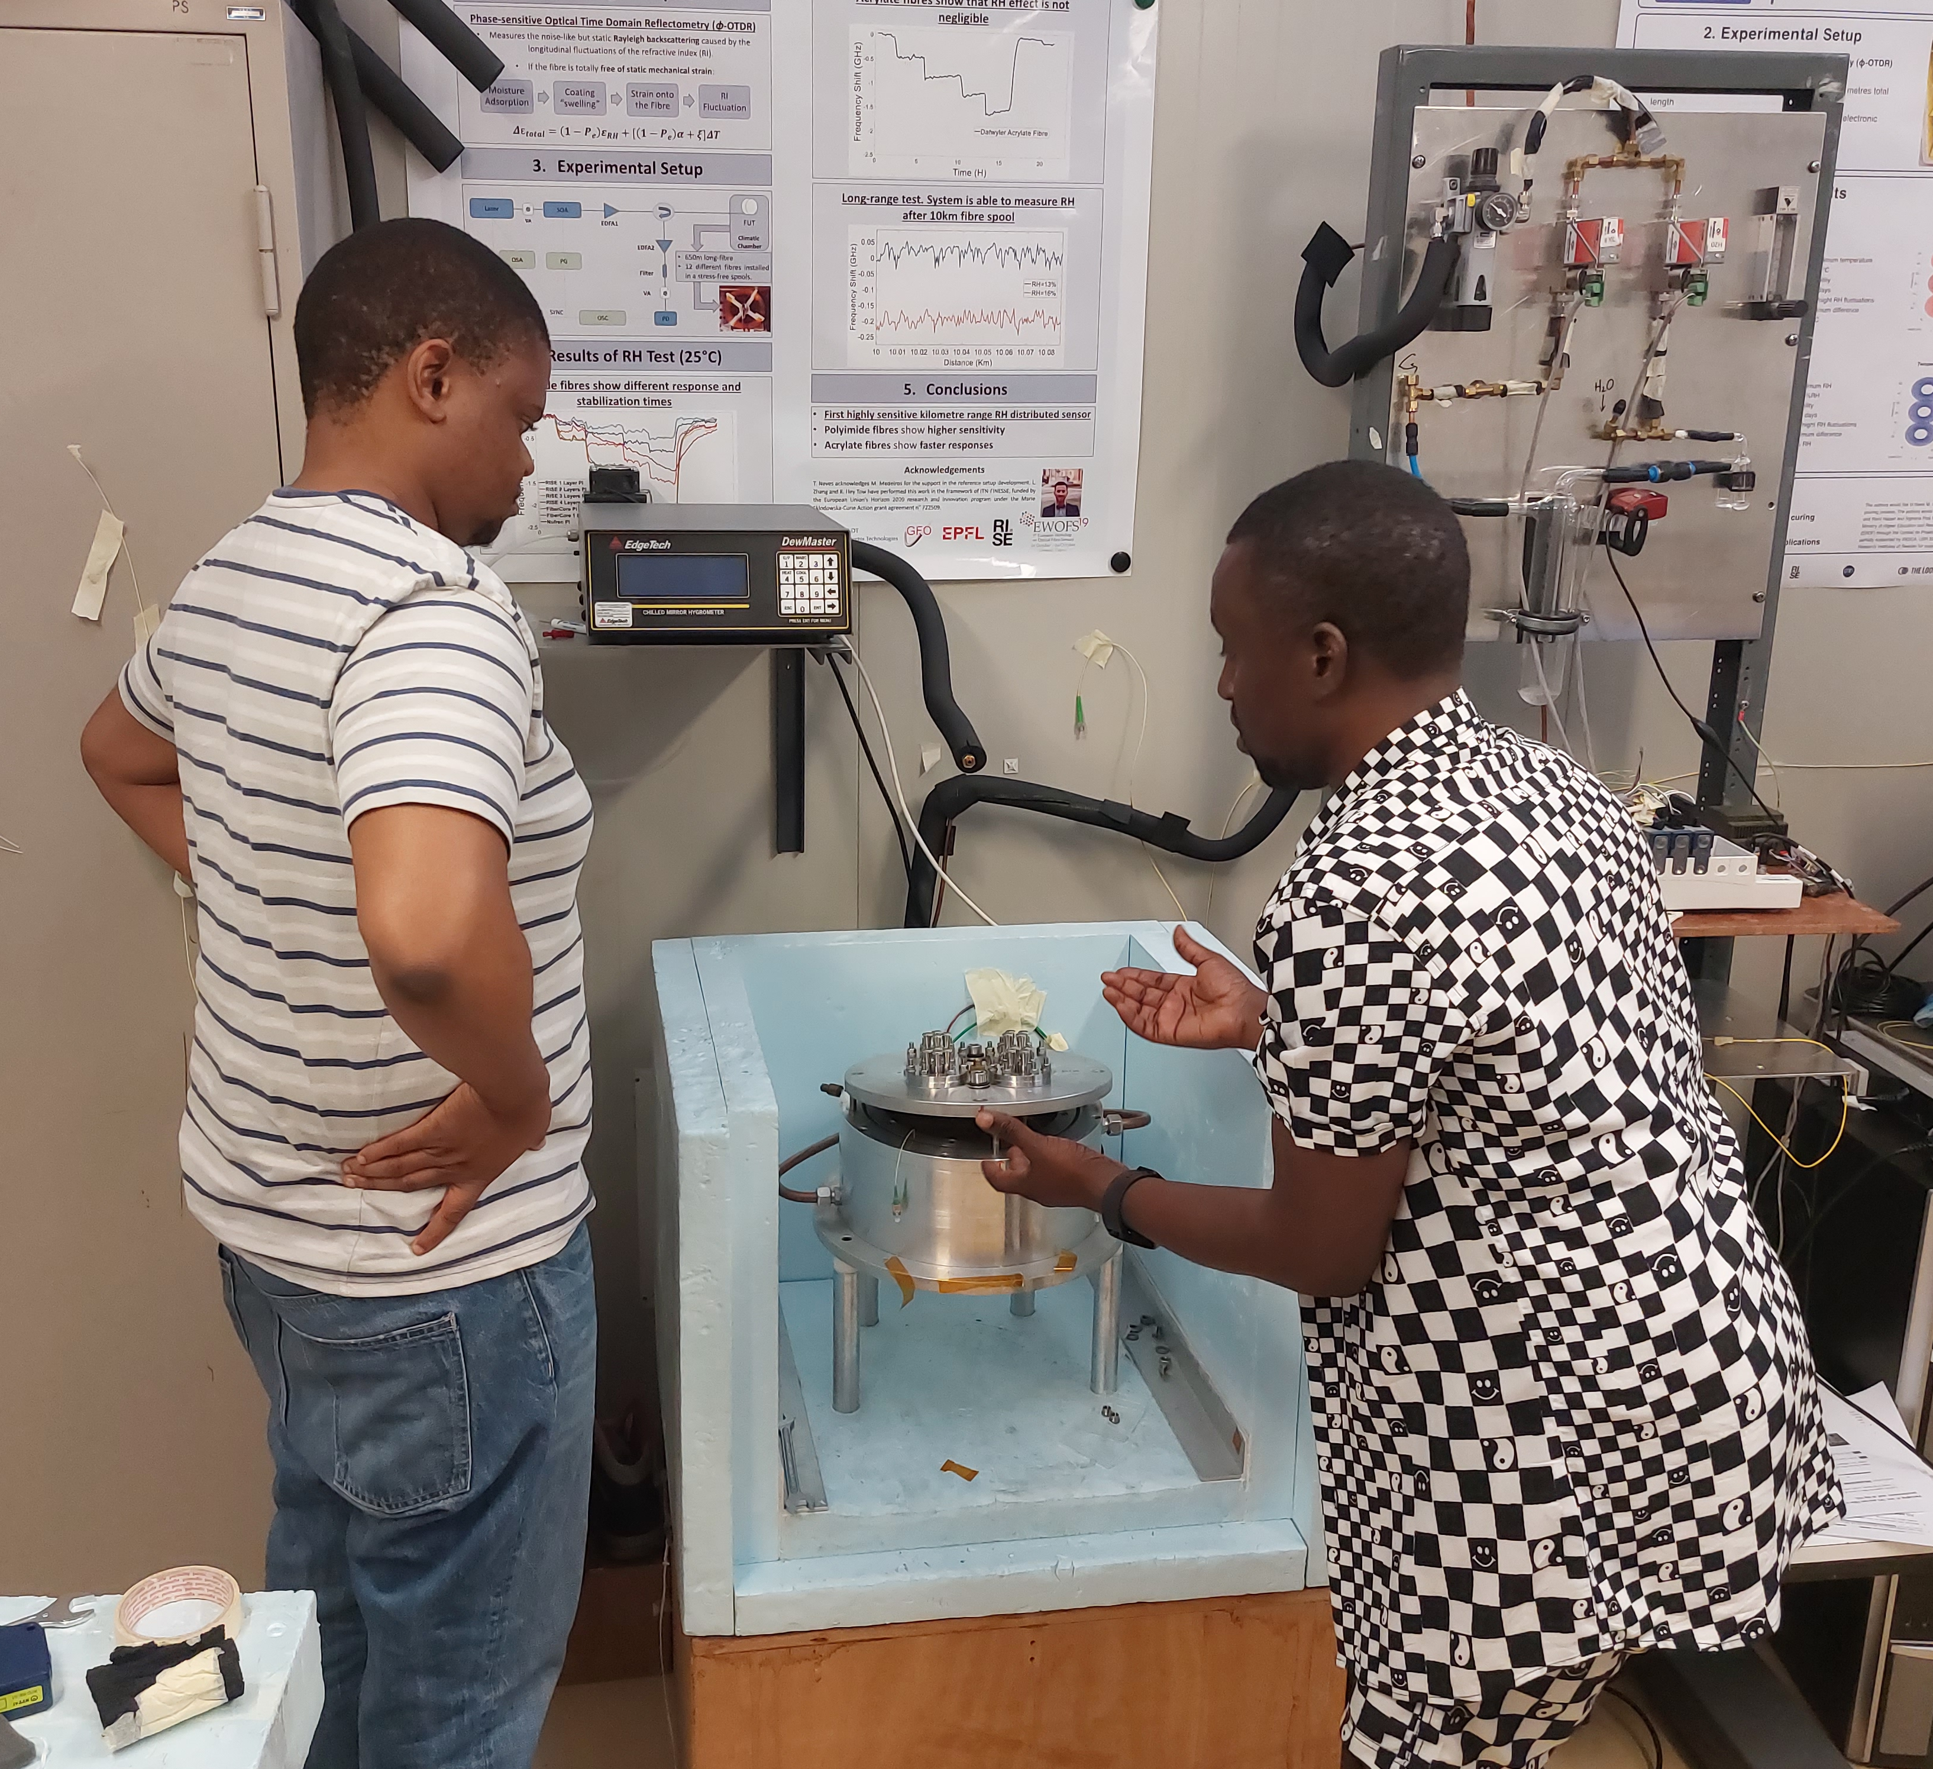
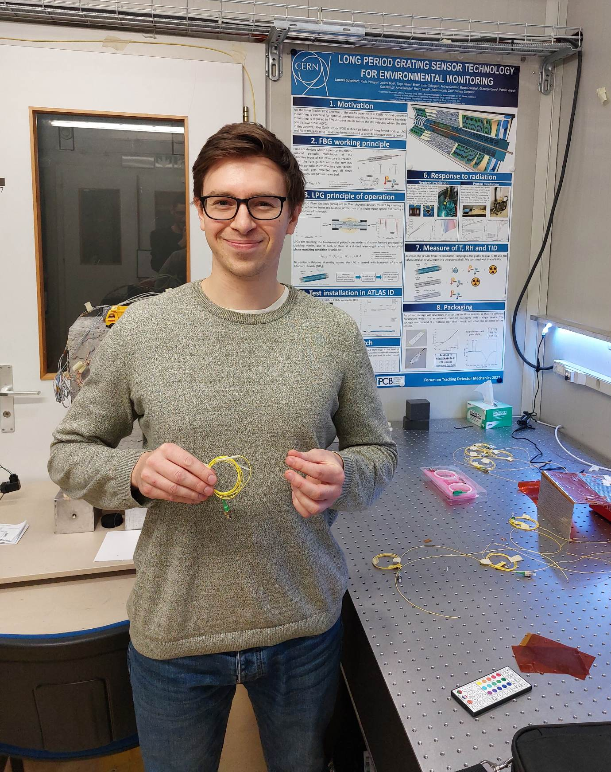
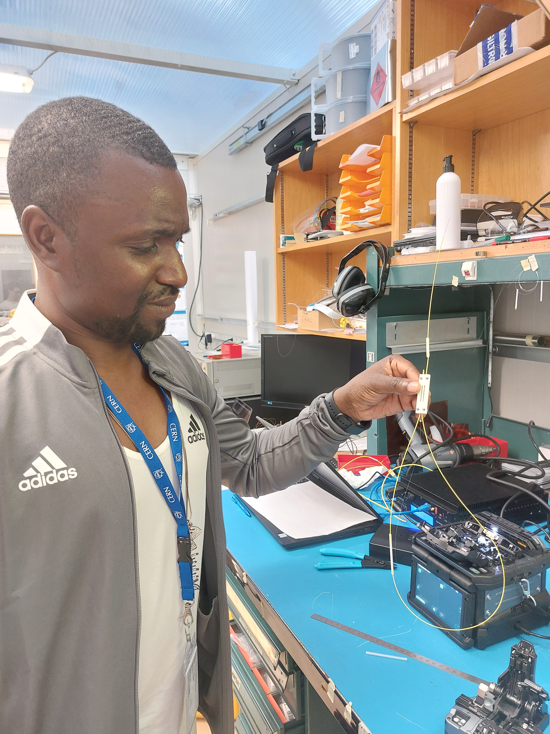
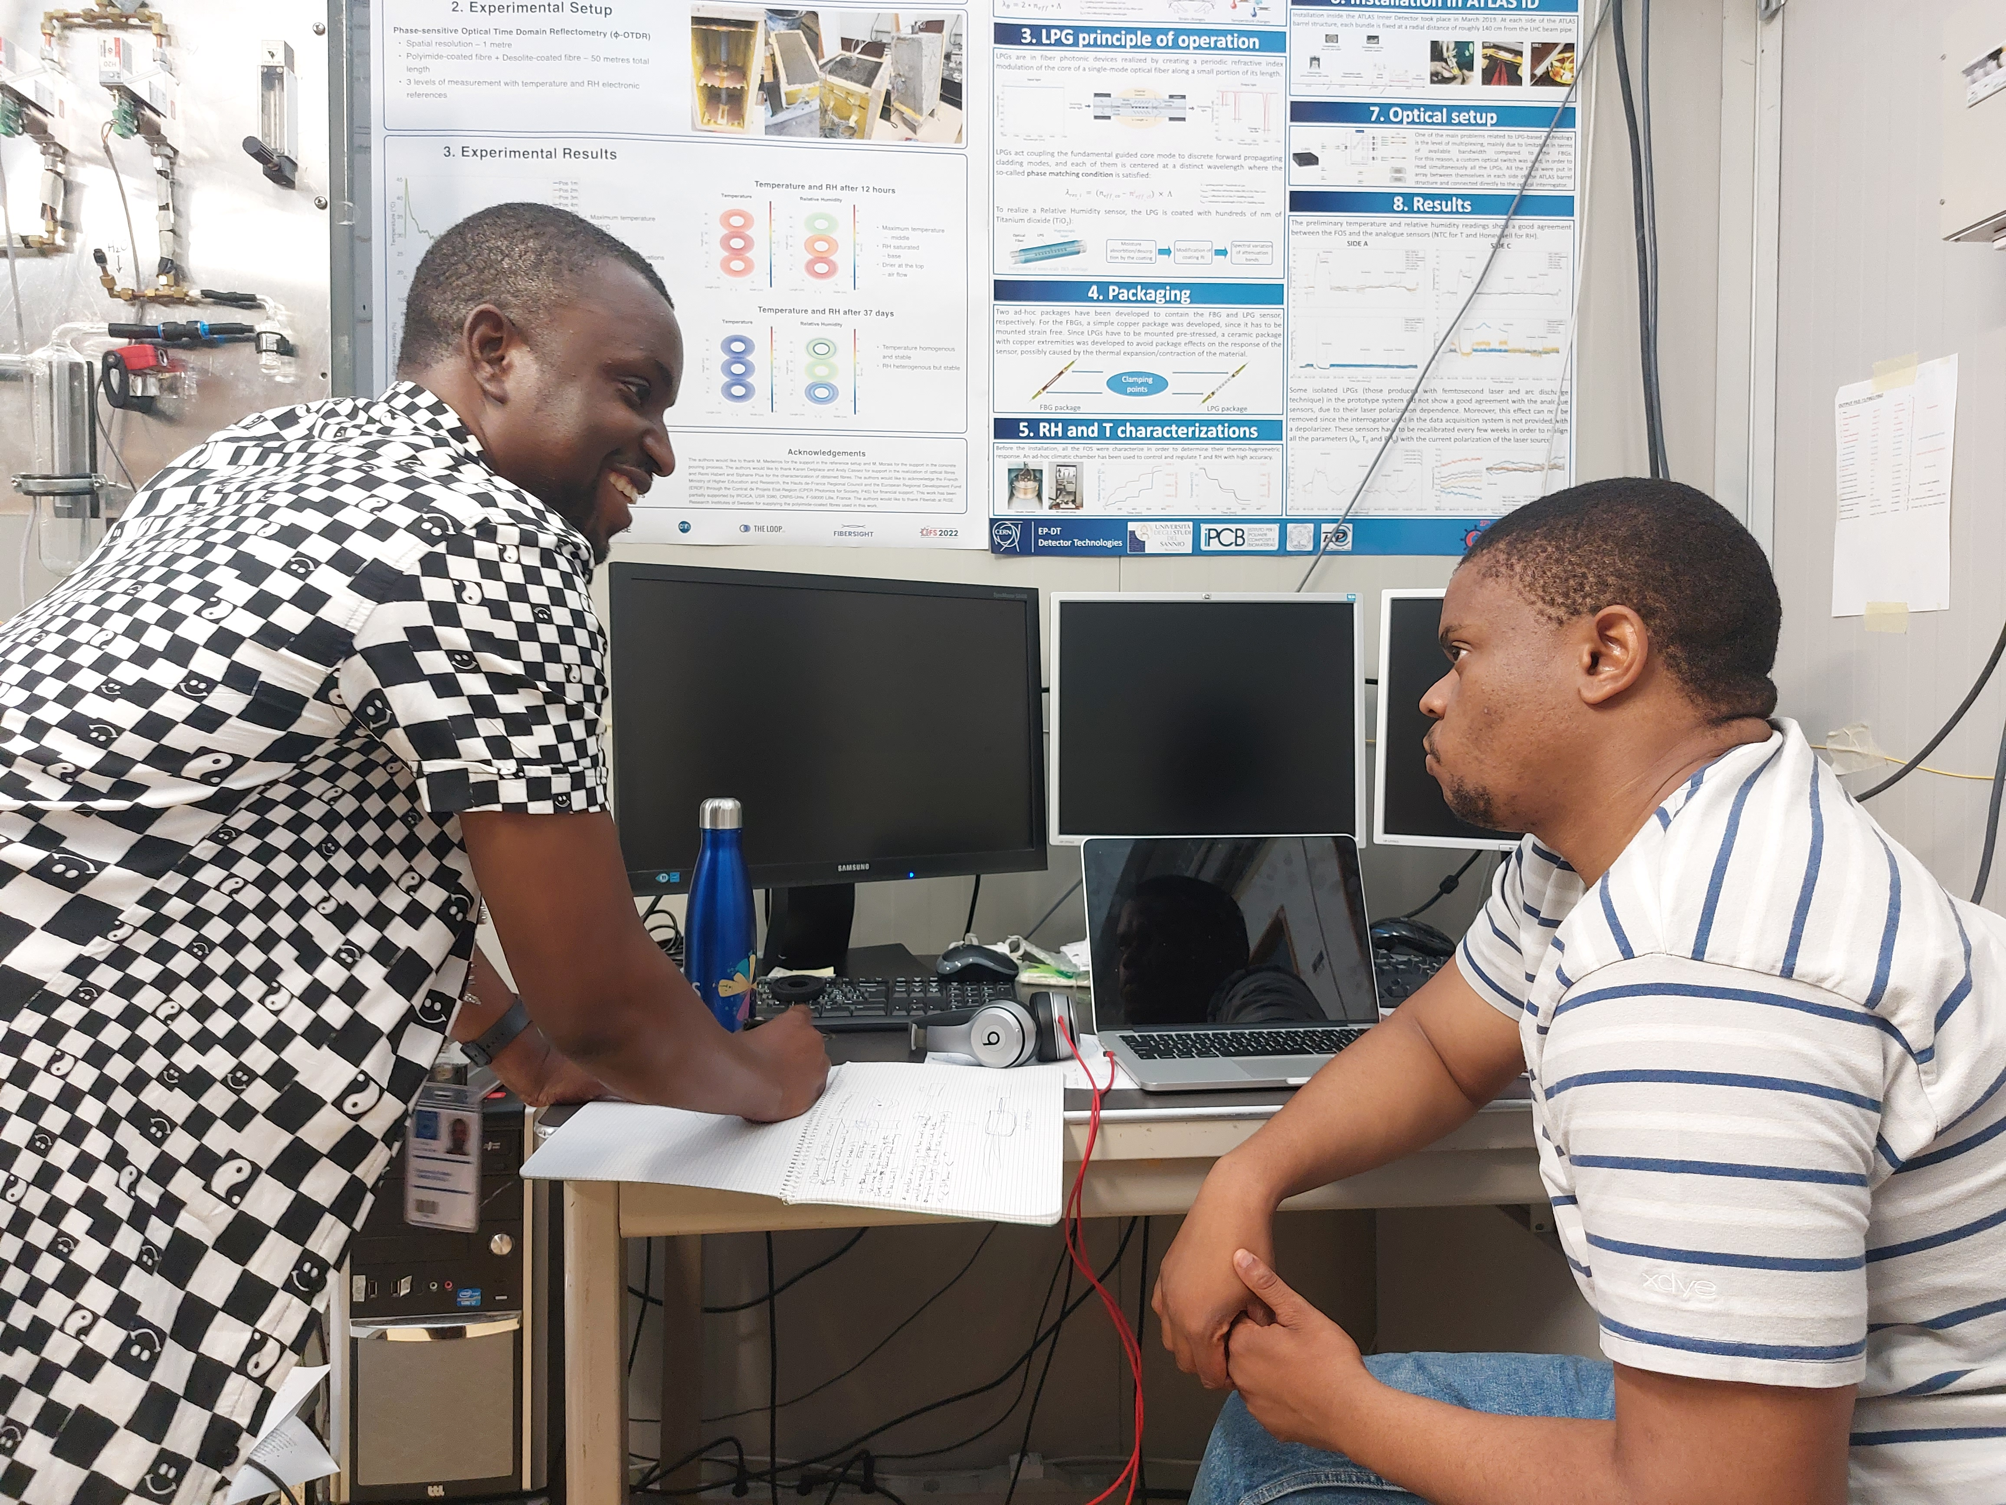
Thank you!

Slide 11
Code Status
Code package
Takes in raw spectra (LabVIEW, enLIGHT)
Develops calibration plots
Extracts Relative Humidity, Temperature and Dose from FOS
Compare to reference sensors
Returns all the above as series of plots
Aims
Make it easy to use by non-experts
Automated spectra analysis for peak acceptance.

