Slide 1
report on kek activities
Peter Kicsiny, D. Zhou, X. Buffat
FCC-ee Optics Meeting
25/01/2024

Slide 2
Outline
Outline
Introduction
SuperKEKB studies
  Microwave instability
  Tune scan with wakefields & beam-beam
  Attempt for analytical description
Summary

Slide 3

Introduction
Introduction
Goals:
  Review of experimental and simulated beam-beam effects at SuperKEKB
  Xsuite simulation benchmarks with the SuperKEKB machine
  Investigation of beam-beam driven synchro-betatron resonances and instability analysis to explain this phenomenon observed at SuperKEKB via experiments and simulations.

Slide 4
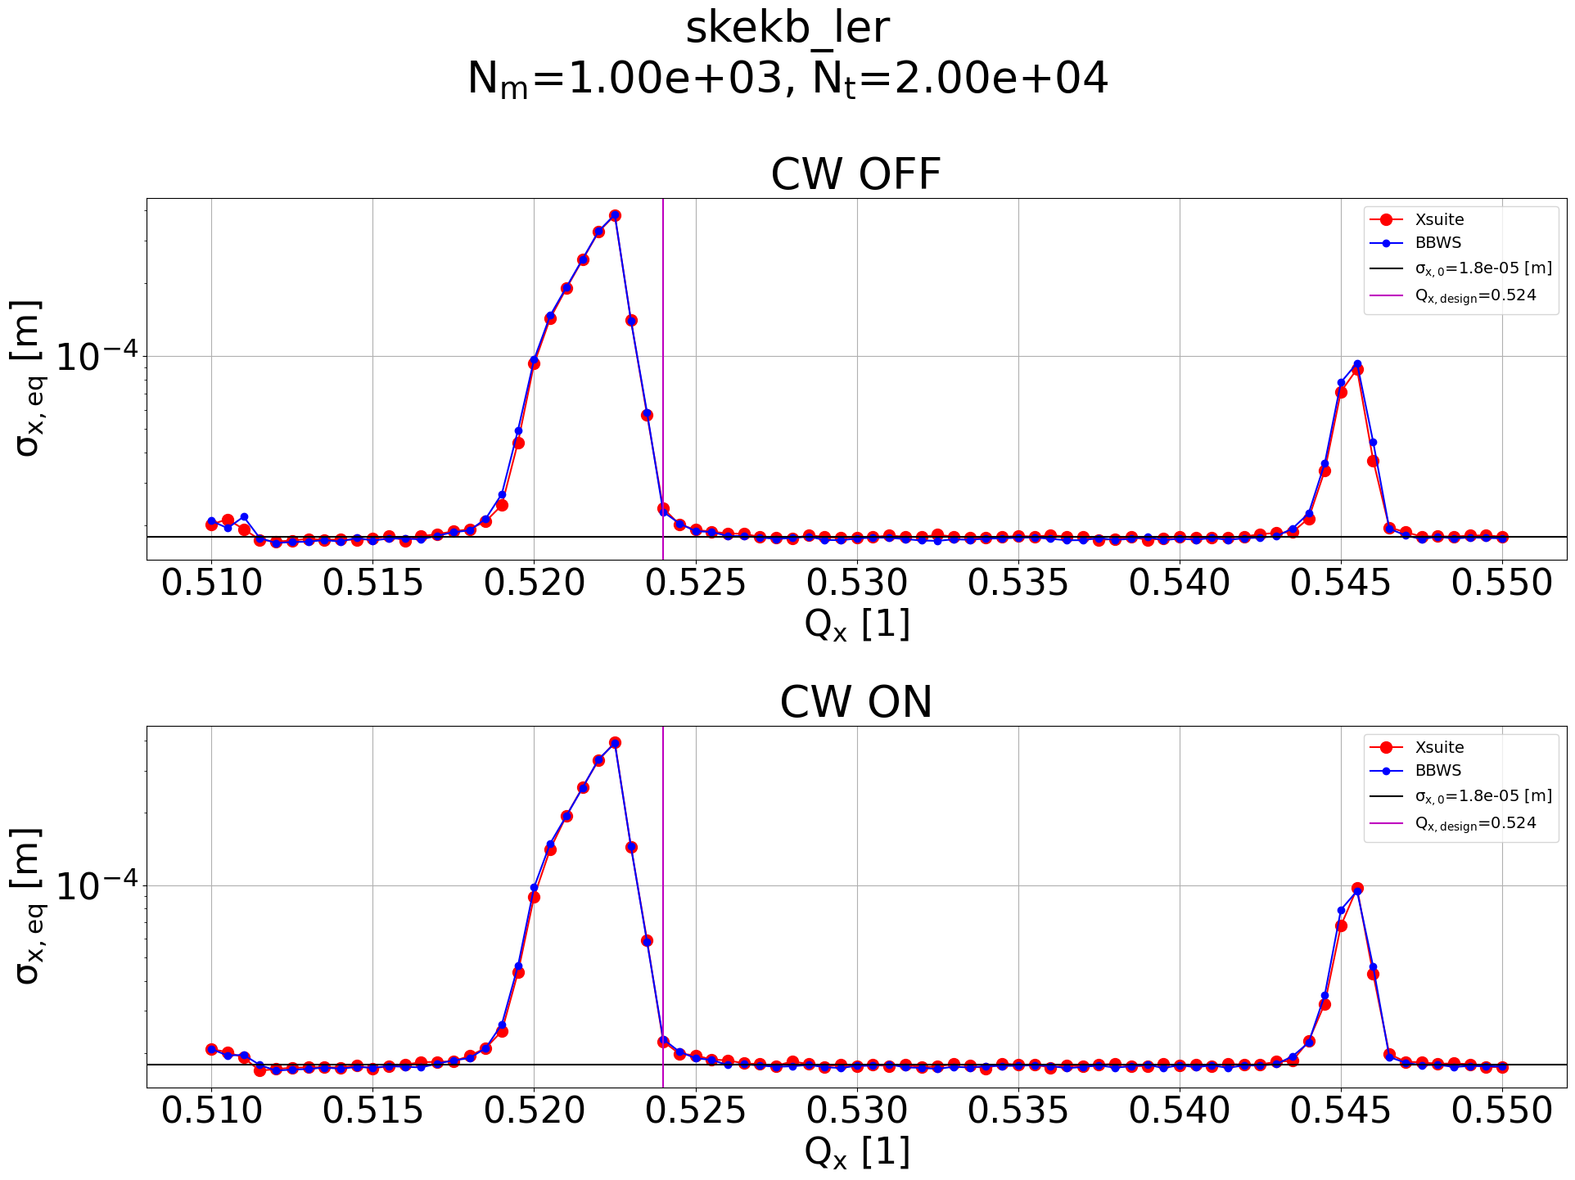
Introduction
Introduction
Collaboration with D. Zhou @ KEK
Starting point: Xsuite simulation benchmarks with the SuperKEKB machine
Linear lattice
synrad + BB (no BS)
Scan Qx with LER parameters
Compare eq. beam sizes Xsuite WS vs BBWS
Good agreement between the 2 codes

Slide 5
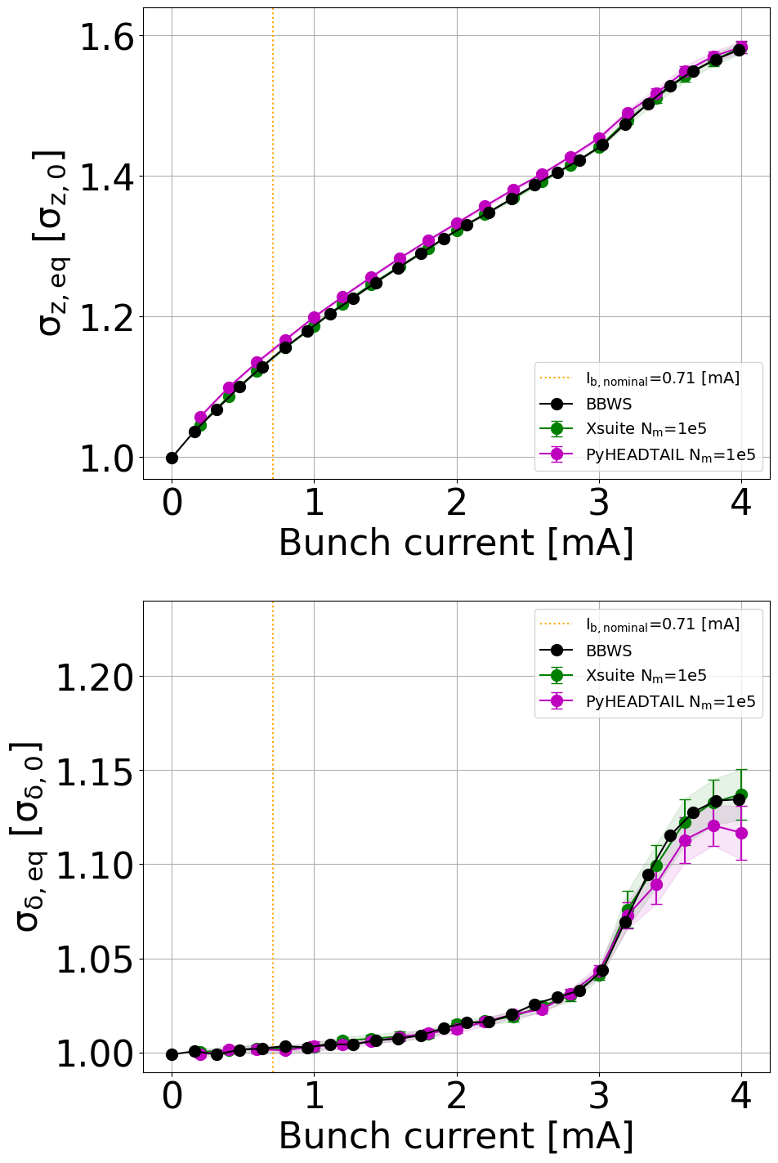
Microwave instability
SuperKEKB studies
Microwave instability: blowup in σ_{δ} above a current threshold
  Single bunch collective effect caused by the longitudinal wakefield
First test of tracking with wakefields
Scan bunch current & observe beam profile [arc, wake, obs]
Xsuite (WS), BBWS and PyHEADTAIL give the same physics
Longitudinal wakes ON
Beam-beam OFF
Linear tracking + synchrotron radiation

Slide 6
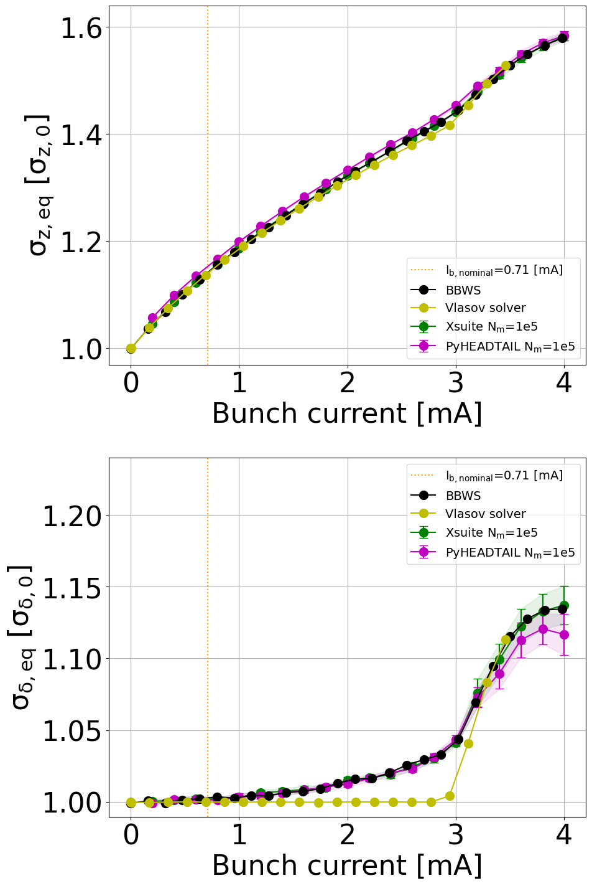
SuperKEKB studies
Microwave instability
Vlasov solver: energy spread shows a different dependence
Longitudinal wakes ON
Beam-beam OFF
Linear tracking + synchrotron radiation
Notes:
It’s called microwave bc the wavelength of the wakefield which drives this instab is much shorter than the bunch length. The frequency of impedance is very high.

Slide 7
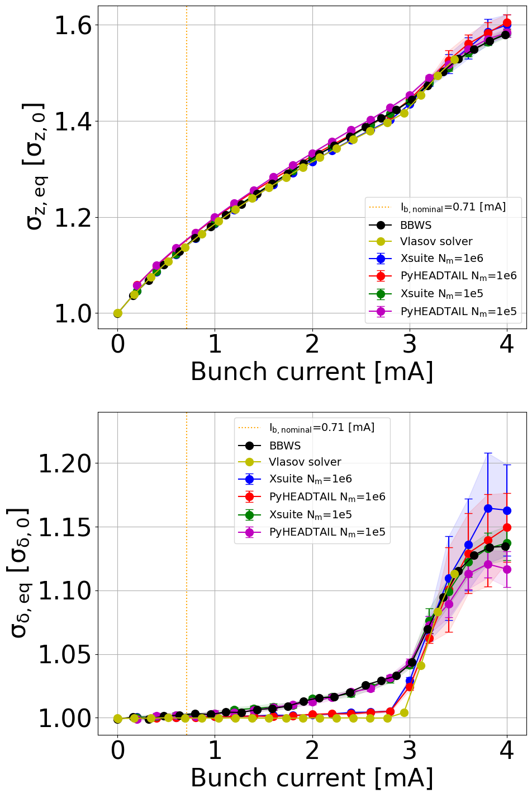
SuperKEKB studies
Microwave instability
With 10⁶ macroparticles Xsuite and PyHEADTAIL show better agreement with the Vlasov solver
At the nominal bunch current (vertical orange line) 10⁵ macroparticles are sufficient
Longitudinal wakes ON
Beam-beam OFF
Linear tracking + synchrotron radiation

Slide 8
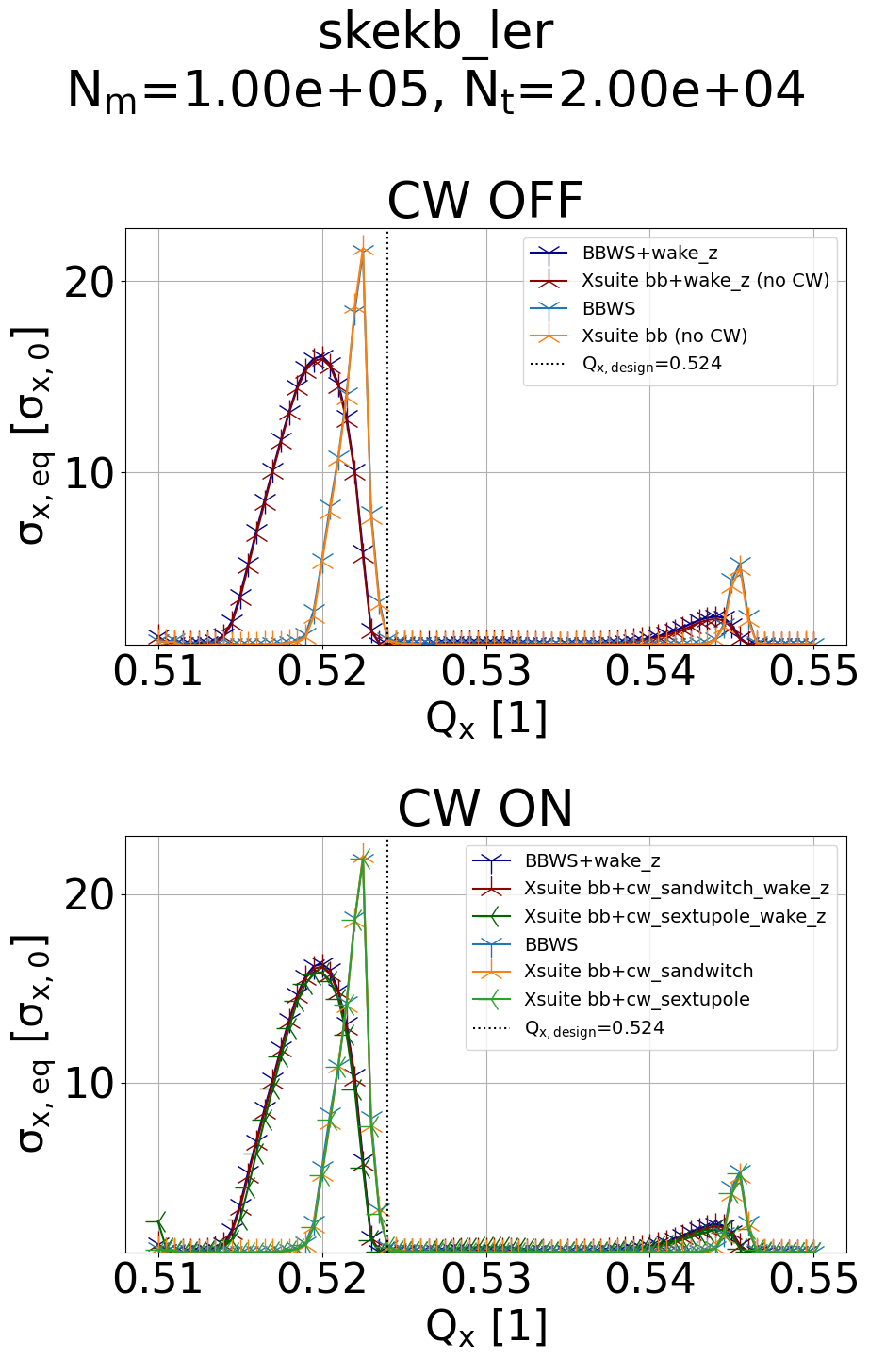
Tune scan with wakefields & beam-beam
SuperKEKB studies
Beam-beam with crossing angle introduces x-z coupling
Longitudinal wakefield perturbs longitudinal motion
Interplay of beam-beam + wakefield leads to synchro-betatron resonance
Has been observed at SuperKEKB
Pure x-z coupling, can ignore y motion
Successfully reproduced using Xsuite & benchmarked against BBWS
10⁵ macroparticles, 2*10⁴ turns
  order of elements in tracking: [wake, bb, arc, obs]

Slide 9
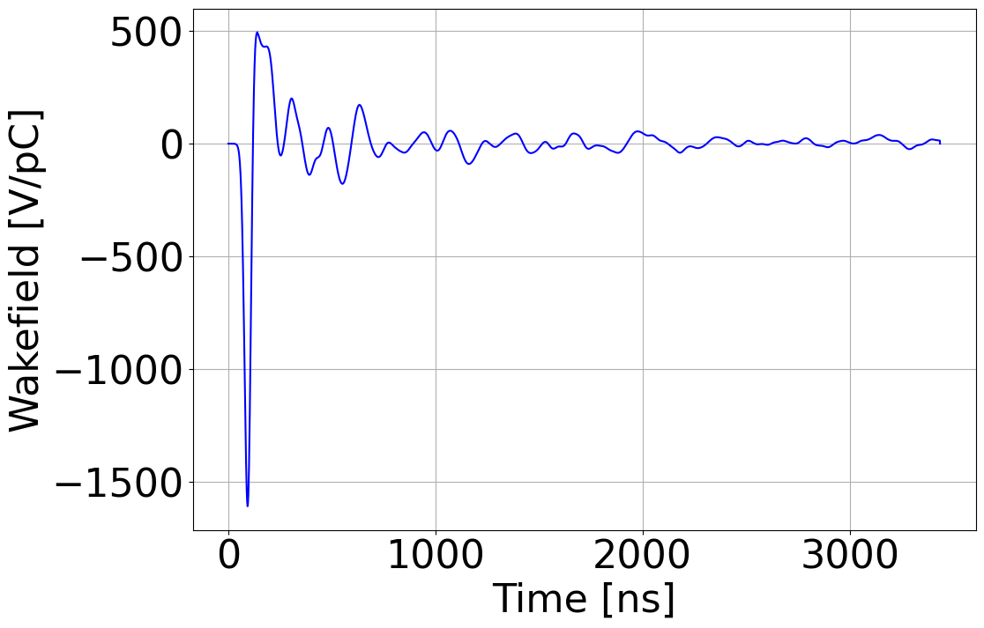
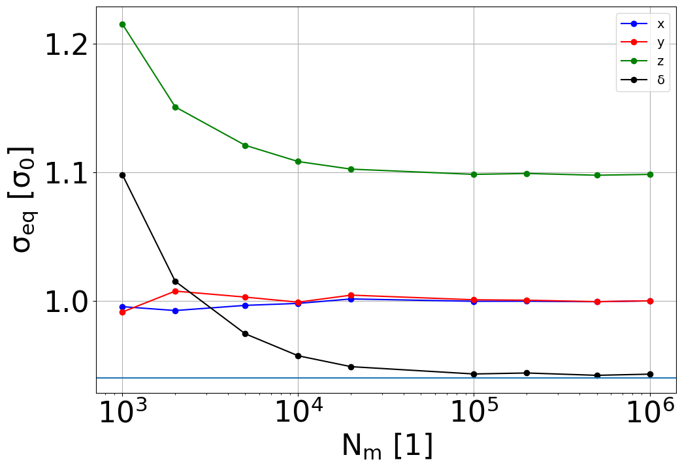
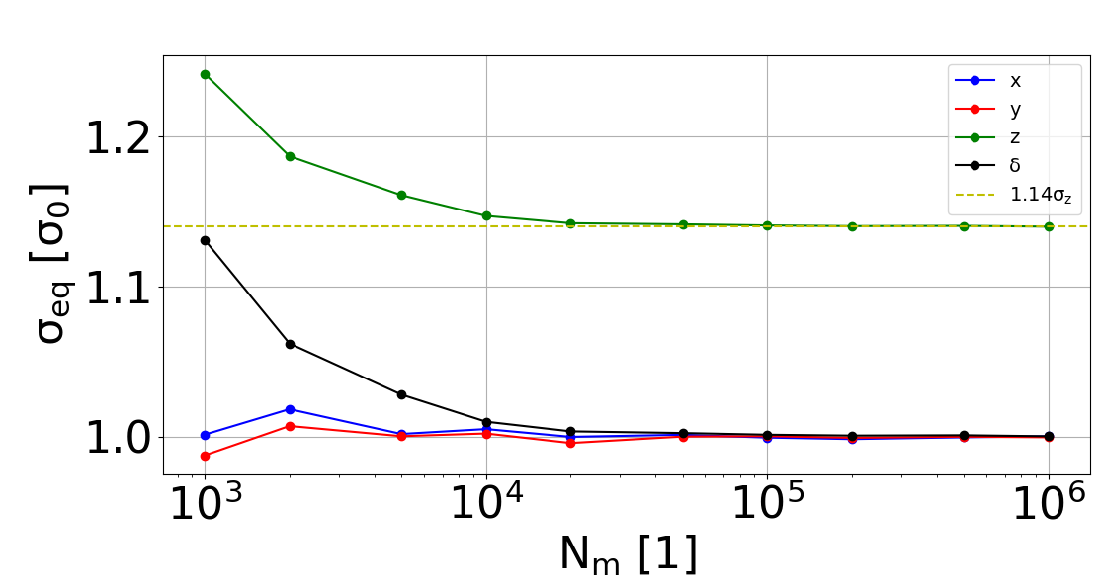
Main findings from benchmarks
SuperKEKB studies
In effective synrad model apply damping and noise only to δ instead of δ and z
  Does not matter for pure beam-beam studies
  Only matters when wakefields are included
Macroparticle scan, track 10⁴ turns, order of elements: [wake, arc, obs]
  (1) gives wrong longitudinal equilibrium RMS
(1) update z & δ
(2) update only δ
Notes:
Equilibrium RMS is verified by the bunch current scan

Slide 10
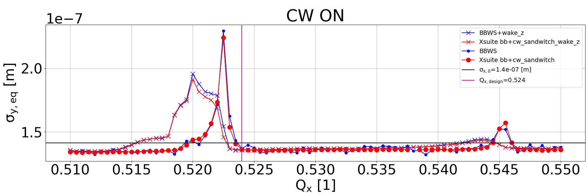
Main findings from benchmarks
SuperKEKB studies
2 ways of implementing crab-waist:
  crab sextupoles in arc
  transformation at IP (implemented in Xsuite during the visit)
Difference regarding vertical blowup suppression
No difference in horizontal & longitudinal planes

Slide 11
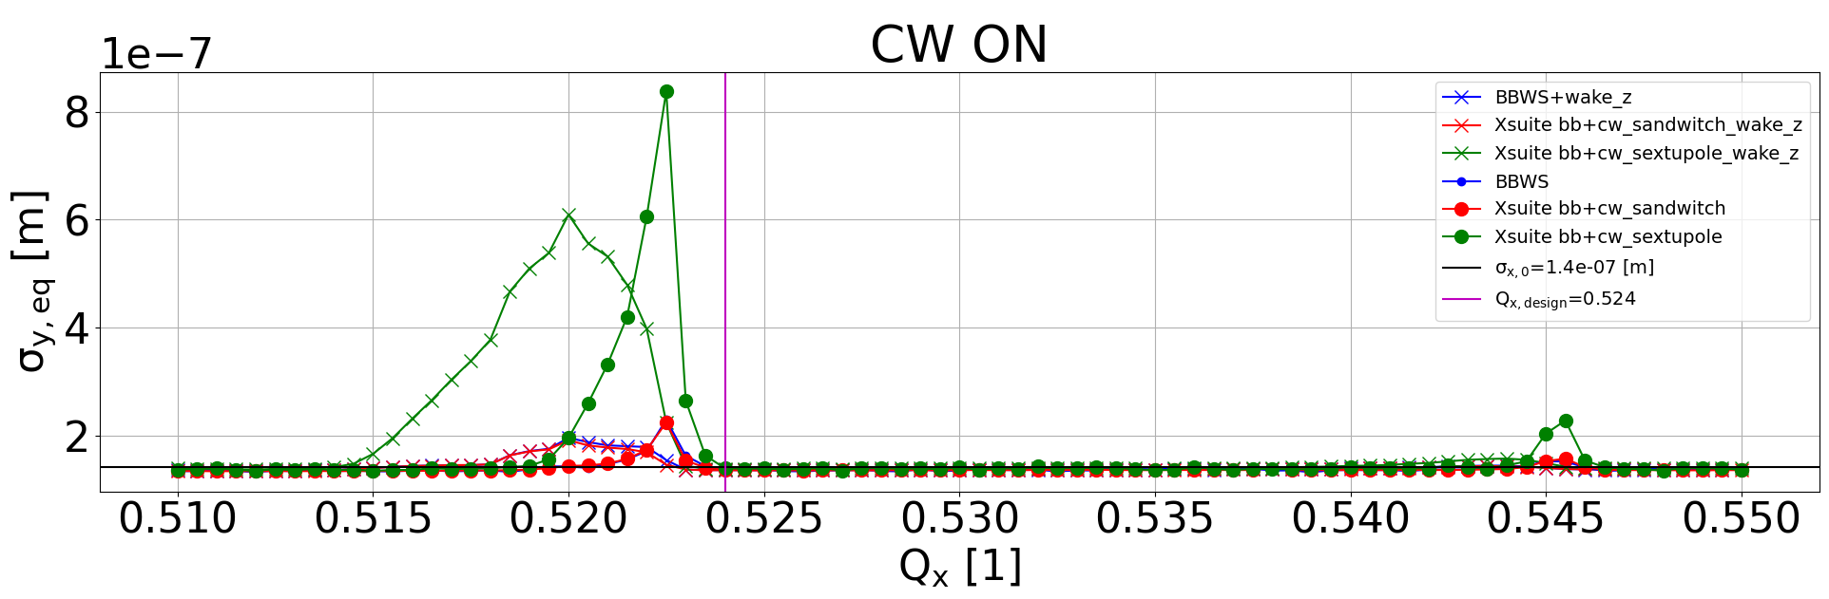
Main findings from benchmarks
SuperKEKB studies
2 ways of implementing crab-waist:
  crab sextupoles in arc
  transformation at IP (implemented in Xsuite during the visit)
Difference regarding vertical blowup suppression
No difference in horizontal & longitudinal planes
In conclusion, the benchmarks were successful and Xsuite is able to simulate the interplay of beam-beam and wakefields

Slide 12
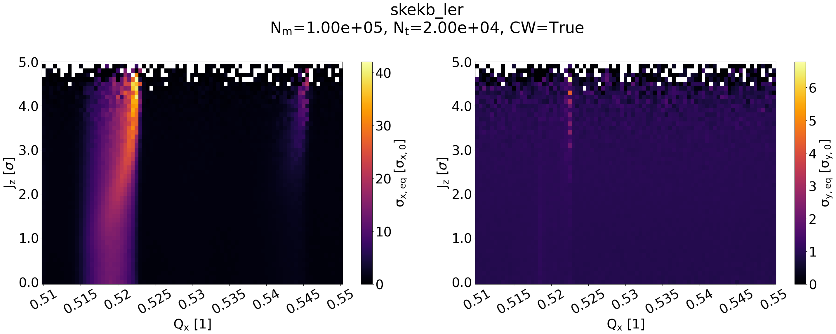
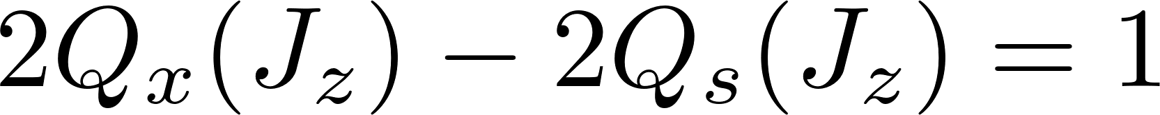
Tune scan with wakefields & beam-beam
SuperKEKB studies
Tune shift depends on amplitude (max. shift for low amplitude particles)
Strength of resonance is different for each particle:
Resonance condition will be met at different Q_{x} for particles with different J_{z}

Slide 13

Analytical description of resonance
SuperKEKB studies
Ongoing work, outline presented here (“smooth approximation”)
Hamiltonian with beam-beam potential V_{bb} in action angle coordinates:
Fourier expansion of V_{bb}:
V_{mx,my,mz,n} is the resonance driving term corresponding to the resonance m_{x}Q_{x}+m_{y}Q_{y}+m_{z}Q_{s}=n
We need V₀₀₀₀ (beam-beam tune shift) and V_{202n} (tune shift due to x-z coupling)
Get amplitude dependent tune shift away from resonances:
Ongoing work with D. Zhou

Slide 14
Summary
Summary
Xsuite successfully tested in the context of the SuperKEKB machine
Successful simulation and benchmark of x-z resonance caused by wakefield + beam-beam interplay
Work on analytical description ongoing
Thank you!

